Slide 1
Deep Learning for Vision & Language
Machine Learning II: SGD, Generalization, Regularization

Slide 2
About the class
COMP 646: Deep Learning for Vision and Language
Instructor: Vicente Ordóñez (Vicente Ordóñez Román)
Website: https://www.cs.rice.edu/~vo9/deep-vislang
Location: Herzstein Hall 210
Times: Tuesdays and Thursdays
from 4pm to 5:15pm
Office Hours: Tuesdays 10am to 11am (DH3098)
Teaching Assistants: Arnold, Jefferson, Sangwon, Gaotian
Discussion Forum: Piazza (Sign-up Link on Rice Canvas and Class Website)

Slide 3



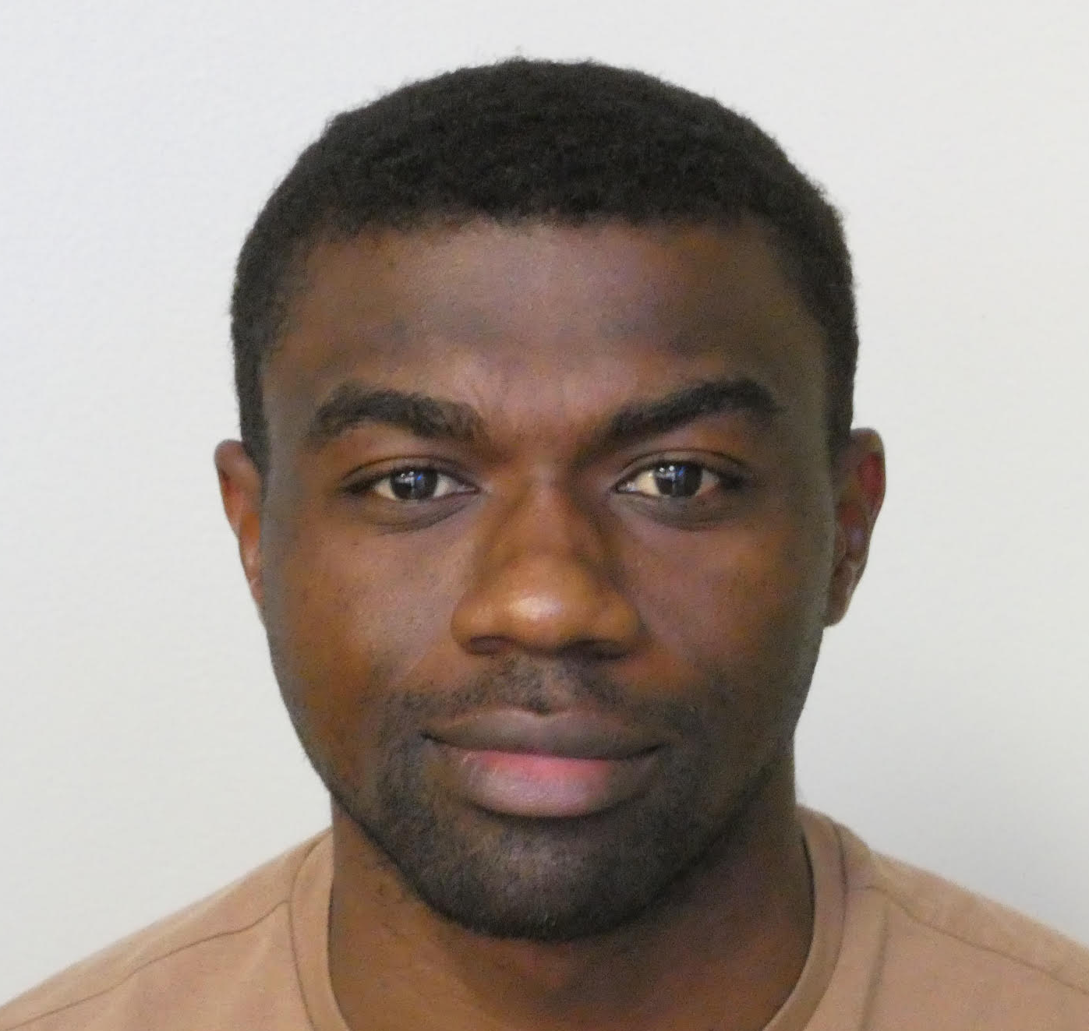
Teaching Assistants (TAs)
Jefferson
Hernandez
Sangwon Seo
Gaotian Wang
Arnold Kazadi
Mondays 2:30pm
DH 3036
Wednesdays 10am
DH 3002
Wednesdays 3pm
DH 3036
Thursdays 11am
DH 3036

Slide 4
Assignment 1
Assignment 1 is released and is available on the class website.

Slide 5
Grading for this class: COMP 646
Assignments: 30pts (3 assignments: 10pts + 10pts + 10pts)
Class Project: 60pts
Quiz: 10pts
Total: 100pts
Grade cutoffs: no stricter than the following:
A [between 90% and 100%], B [between 80% and 90%),
C [between 70% and 80%), D [between 55% and 70%),
F [less than 55%)

Slide 6
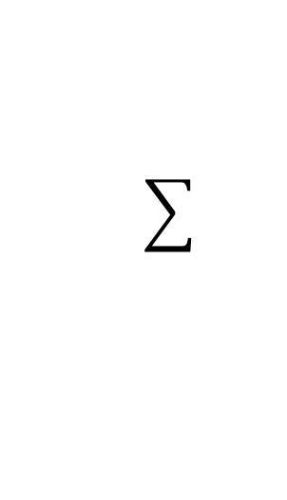
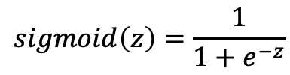





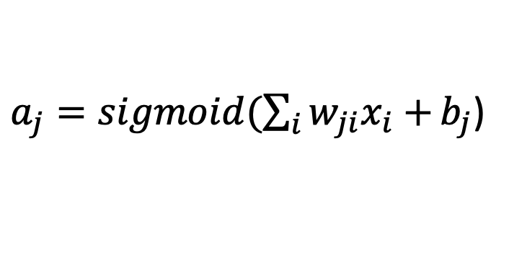



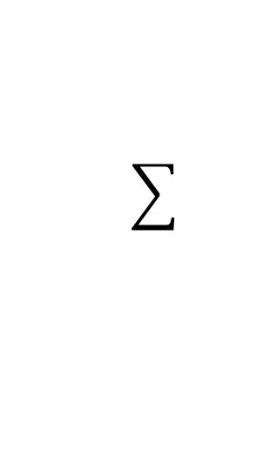
Neural Network with One Layer
$$sigmoid\left(z\right)=\frac{1}{1+e^{−z}}$$
$$x_{1}$$
$${W=[w}_{ji}]$$
$$a_{1}$$
$$x_{2}$$
$$x_{3}$$
$$a_{2}$$
$$x_{4}$$
$$x_{5}$$
$a_{j}=sigmoid(\sum_{i}{w_{ji}x_{i}+}b_{j}$)

Slide 7



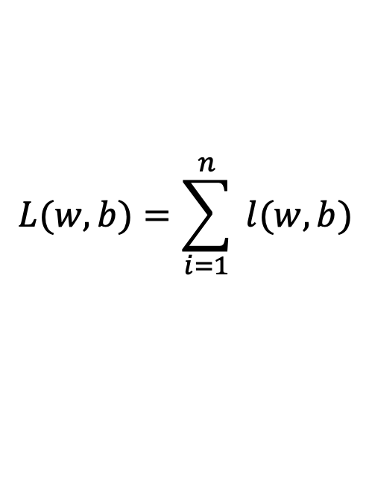



Gradient Descent
expensive
$$λ=0.01$$
$$L(w,b)=\sum_{i=1}^{n}{ l(w,b)}$$
Initialize w and b randomly
for e = 0, num_epochs do
Compute:
$$dL(w,b)/dw$$
and
$$dL(w,b)/db$$
Update w:
$$w=w −λ dL(w,b)/dw$$
Update b:
$$b=b −λ dL(w,b)/db$$
Print:
$$L(w,b)$$
// Useful to see if this is becoming smaller or not.
end

Slide 8
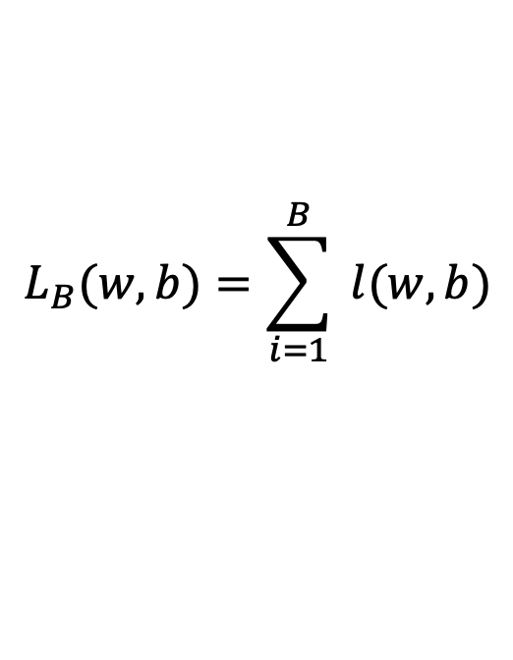





Stochastic Gradient Descent (mini-batch)
$$λ=0.01$$
$$L_{B}(w,b)=\sum_{i=1}^{B}{ l(w,b)}$$
Initialize w and b randomly
for e = 0, num_epochs do
for b = 0, num_batches do
Compute:
$$dL_{B}(w,b)/dw$$
and
$$dL_{B}(w,b)/db$$
Update w:
$$w=w −λ dl(w,b)/dw$$
Update b:
$$b=b −λ dl(w,b)/db$$
Print:
$$L_{B}(w,b)$$
// Useful to see if this is becoming smaller or not.
end
end

Slide 9
Stochastic Gradient Descent
How to choose the right batch size B?
How to choose the right learning rate lambda?
How to choose the right loss function, e.g. is least squares good enough?
How to choose the right function/classifier, e.g. linear, quadratic, neural network with 1 layer, 2 layers, etc?

Slide 10
Training, Validation (Dev), Test Sets
Training Set
Validation Set
Testing Set

Slide 11
Training, Validation (Dev), Test Sets
Training Set
Validation Set
Testing Set
Used during development

Slide 12
Training, Validation (Dev), Test Sets
Training Set
Validation Set
Testing Set
Only to be used for evaluating the model at the very end of development and any changes to the model after running it on the test set, could be influenced by what you saw happened on the test set, which would invalidate any future evaluation.

Slide 13


Gradient Descent
$$L\left(w\right)$$
2. Compute the gradient
(derivative) of L(w) at point
w = 12. (e.g. dL/dw = 6)
3. Recompute w as:
w = w – lambda * (dL / dw)
w=8
$$w$$

Slide 14
Source: Andrew Ng

Slide 15
In this class we will mostly rely on…
K-nearest neighbors
Linear classifiers
Naïve Bayes classifiers
Decision Trees
Random Forests
Boosted Decision Trees
Neural Networks

Slide 16
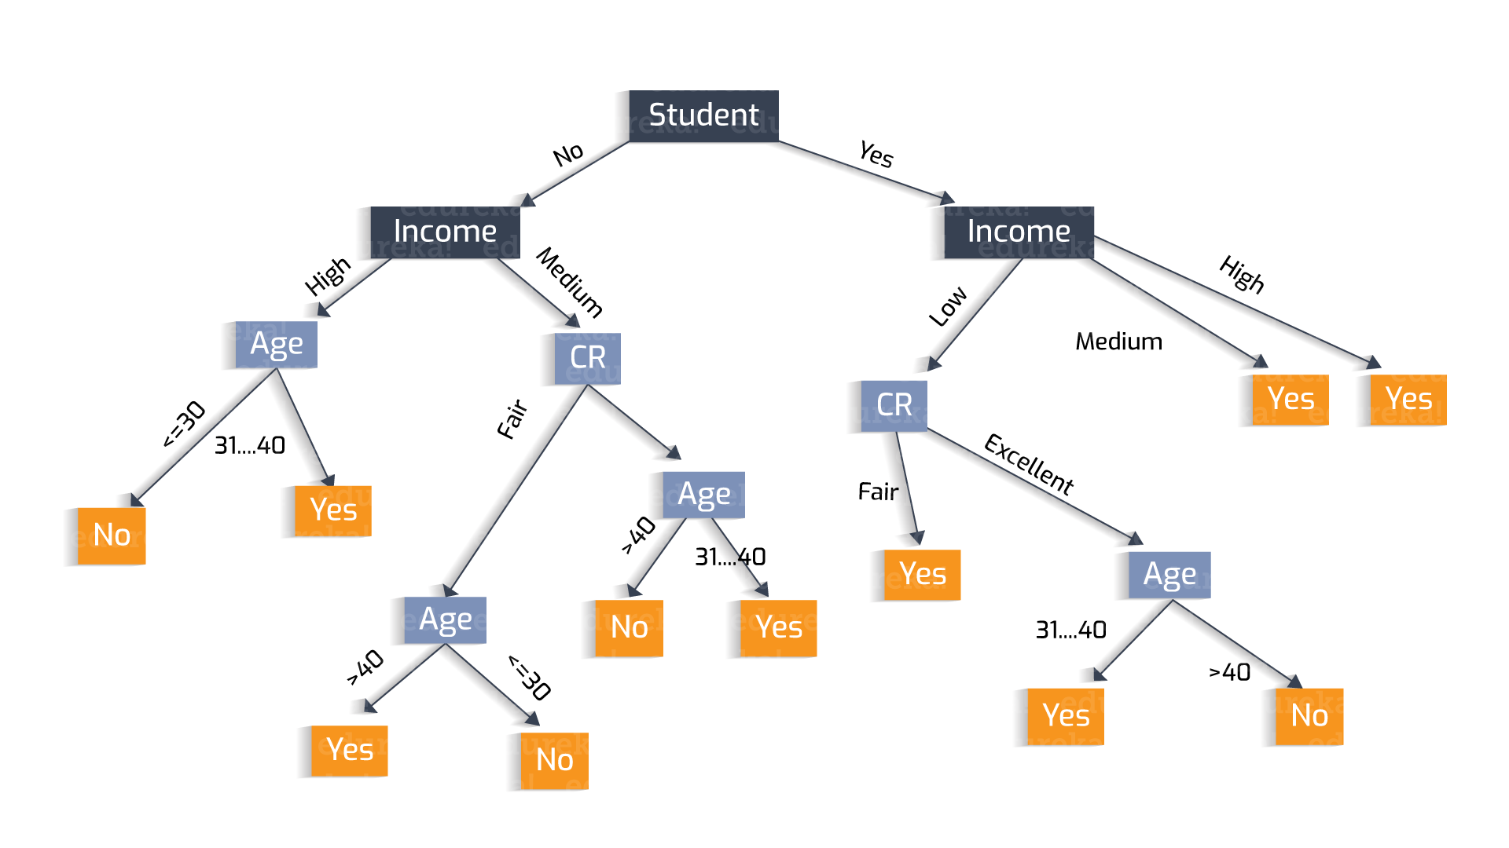
Why?
Decisions Trees
https://heartbeat.fritz.ai/understanding-the-mathematics-behind-decision-trees-22d86d55906 by Nikita Sharma

Slide 17
Why?
Decisions Trees are great because they are often interpretable.
However, they usually deal better with categorical data – not input pixel data.
https://heartbeat.fritz.ai/understanding-the-mathematics-behind-decision-trees-22d86d55906 by Nikita Sharma

Slide 18
How to pick the right model?

Slide 19










Linear Regression – 1 output, 1 input
$$y$$
$$(x_{8},y_{8})$$
$$(x_{6},y_{6})$$
$$(x_{7},y_{7})$$
$$(x_{4},y_{4})$$
$$(x_{5},y_{5})$$
$$(x_{2},y_{2})$$
$$(x_{3},y_{3})$$
$$(x_{1},y_{1})$$
$$x$$

Slide 20

Linear Regression – 1 output, 1 input
$$y$$
$$(x_{8},y_{8})$$
$$(x_{6},y_{6})$$
$$(x_{7},y_{7})$$
$$(x_{4},y_{4})$$
$$(x_{5},y_{5})$$
$$(x_{2},y_{2})$$
$$(x_{3},y_{3})$$
$$(x_{1},y_{1})$$
$$x$$
Model:
$$\hat{y}=wx+b$$

Slide 21
Linear Regression – 1 output, 1 input
$$y$$
$$(x_{8},y_{8})$$
$$(x_{6},y_{6})$$
$$(x_{7},y_{7})$$
$$(x_{4},y_{4})$$
$$(x_{5},y_{5})$$
$$(x_{2},y_{2})$$
$$(x_{3},y_{3})$$
$$(x_{1},y_{1})$$
$$x$$
Model:
$$\hat{y}=wx+b$$

Slide 22
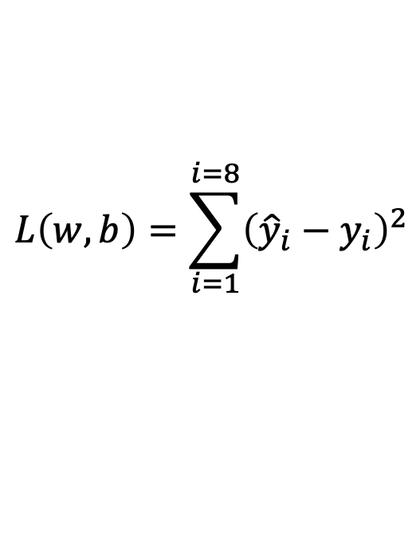
Linear Regression – 1 output, 1 input
$$y$$
$$(x_{8},y_{8})$$
$$(x_{6},y_{6})$$
$$(x_{7},y_{7})$$
$$(x_{4},y_{4})$$
$$(x_{5},y_{5})$$
$$(x_{2},y_{2})$$
$$(x_{3},y_{3})$$
$$(x_{1},y_{1})$$
$$x$$
$$L\left(w,b\right)=\sum_{i=1}^{i=8}{{\left({\hat{y}}_{i}−y_{i}\right)}^{2}}$$
Model:
$$\hat{y}=wx+b$$
Loss:

Slide 23

Quadratic Regression
$$y$$
$$(x_{8},y_{8})$$
$$(x_{6},y_{6})$$
$$(x_{7},y_{7})$$
$$(x_{4},y_{4})$$
$$(x_{5},y_{5})$$
$$(x_{2},y_{2})$$
$$(x_{3},y_{3})$$
$$(x_{1},y_{1})$$
$$x$$
$$L\left(w,b\right)=\sum_{i=1}^{i=8}{{\left({\hat{y}}_{i}−y_{i}\right)}^{2}}$$
Model:
$$\hat{y}=w_{1}x^{2}+w_{2}x+b$$
Loss:

Slide 24

n-polynomial Regression
$$y$$
$$(x_{8},y_{8})$$
$$(x_{6},y_{6})$$
$$(x_{7},y_{7})$$
$$(x_{4},y_{4})$$
$$(x_{5},y_{5})$$
$$(x_{2},y_{2})$$
$$(x_{3},y_{3})$$
$$(x_{1},y_{1})$$
$$x$$
$$L\left(w,b\right)=\sum_{i=1}^{i=8}{{\left({\hat{y}}_{i}−y_{i}\right)}^{2}}$$
Model:
$$\hat{y}=w_{n}x^{n}+…+w_{1}x+b$$
Loss:

Slide 25
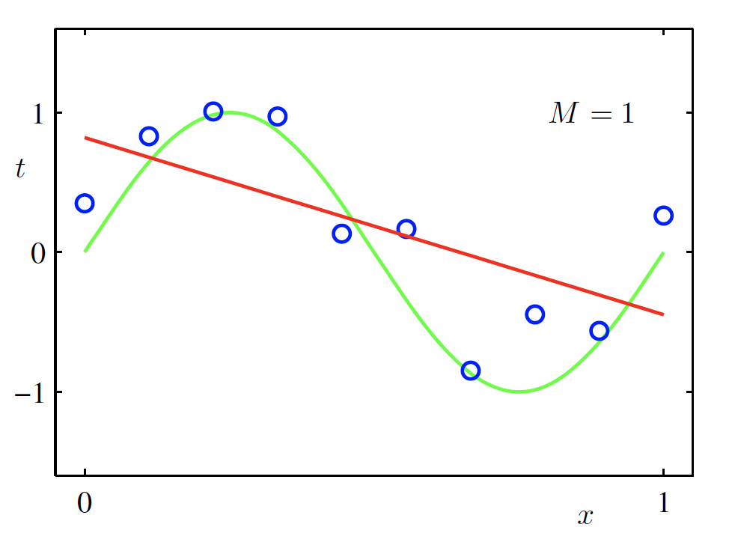
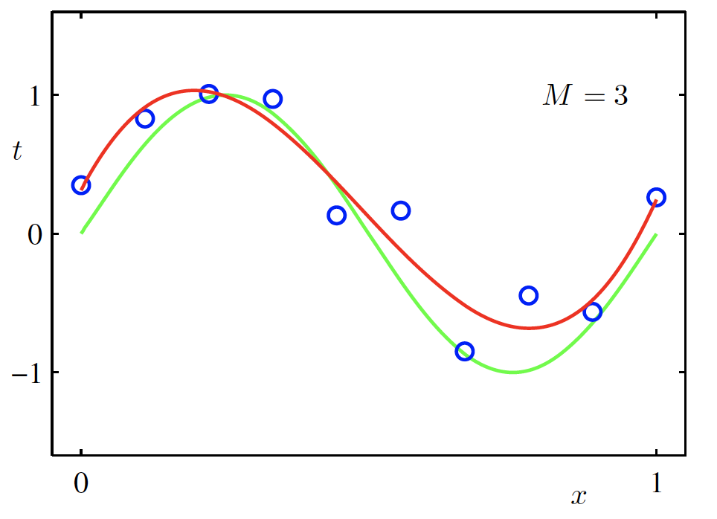
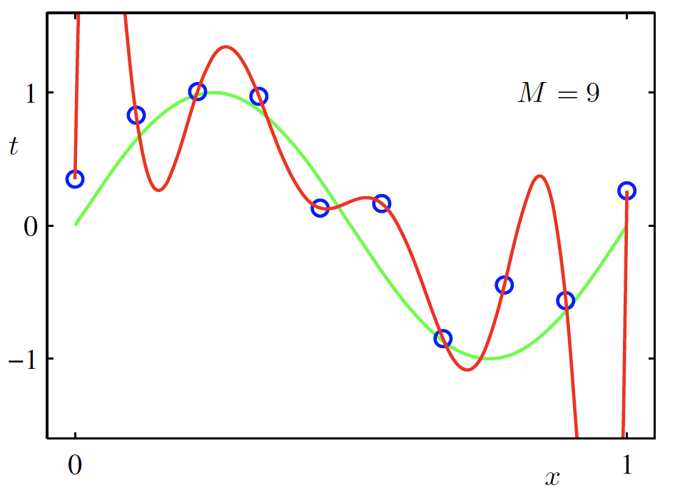

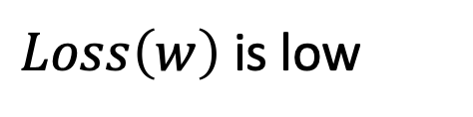
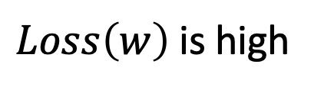
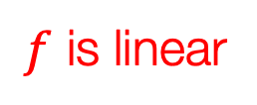
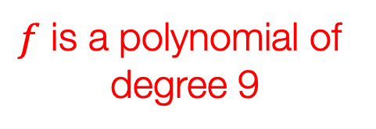
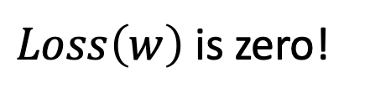
Overfitting
$f$ is a polynomial of
degree 9
$f$ is linear
$f$ is cubic
$Loss\left(w\right)$ is high
$Loss\left(w\right)$ is low
$Loss\left(w\right)$ is zero!
Underfitting
Overfitting
High Bias
High Variance
Christopher M. Bishop – Pattern Recognition and Machine Learning
Credit: C. Bishop. Pattern Recognition and Mach. Learning.

Slide 26



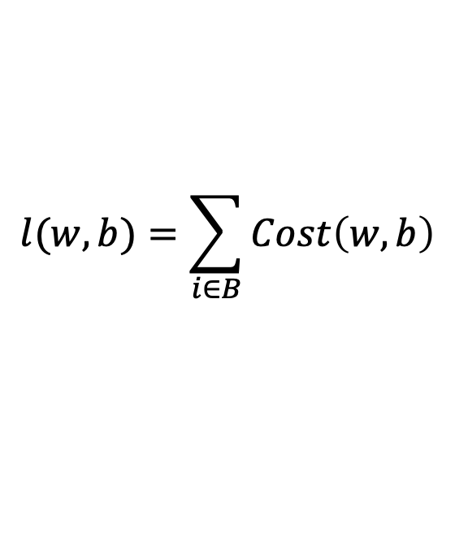



(mini-batch) Stochastic Gradient Descent (SGD)
$$λ=0.01$$
$$l(w,b)=\sum_{i∈B}{Cost\left(w,b\right)}$$
Initialize w and b randomly
for e = 0, num_epochs do
for b = 0, num_batches do
Compute:
$$dl(w,b)/dw$$
and
$$dl(w,b)/db$$
Update w:
$$w=w −λ dl(w,b)/dw$$
Update b:
$$b=b −λ dl(w,b)/db$$
Print:
$$l(w,b)$$
// Useful to see if this is becoming smaller or not.
end
end

Slide 27
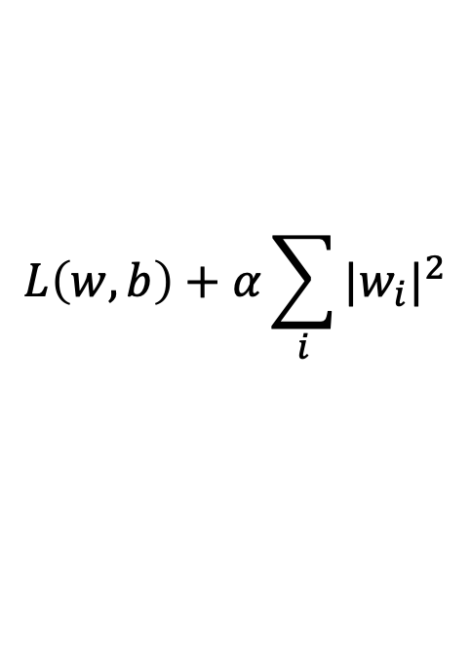
Regularization
Large weights lead to large variance. i.e. model fits to the training data too strongly.
Solution: Minimize the loss but also try to keep the weight values small by doing the following:
$$L\left(w,b\right)+α\sum_{i}{{|w_{i}|}^{2}}$$
minimize
Credit: C. Bishop. Pattern Recognition and Mach. Learning.

Slide 28
Regularization
Large weights lead to large variance. i.e. model fits to the training data too strongly.
Solution: Minimize the loss but also try to keep the weight values small by doing the following:
$$L\left(w,b\right)+α\sum_{i}{{|w_{i}|}^{2}}$$
minimize
Regularizer term
e.g. L2- regularizer
Credit: C. Bishop. Pattern Recognition and Mach. Learning.

Slide 29

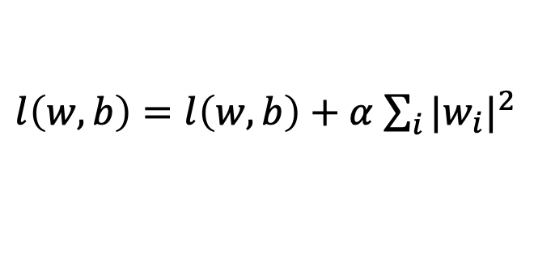

SGD with Regularization (L-2)
$$λ=0.01$$
$l\left(w,b\right)=l\left(w,b\right)+α$ $\sum_{i}{{|w_{i}|}^{2}}$
Initialize w and b randomly
for e = 0, num_epochs do
for b = 0, num_batches do
Compute:
$$dl(w,b)/dw$$
and
$$dl(w,b)/db$$
Update w:
$$w=w −λ dl(w,b)/dw−λαw$$
Update b:
$$b=b −λ dl(w,b)/db−λαw$$
Print:
$$l(w,b)$$
// Useful to see if this is becoming smaller or not.
end
end

Slide 30
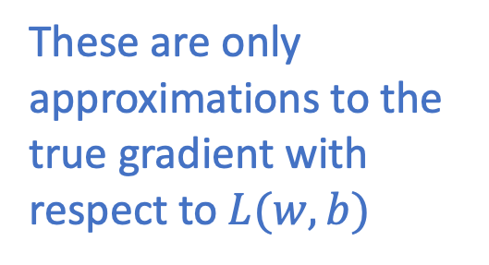
Revisiting Another Problem with SGD
$$λ=0.01$$
$l\left(w,b\right)=l\left(w,b\right)+α$ $\sum_{i}{{|w_{i}|}^{2}}$
Initialize w and b randomly
for e = 0, num_epochs do
These are only approximations to the true gradient with respect to $L(w,b)$
for b = 0, num_batches do
Compute:
$$dl(w,b)/dw$$
and
$$dl(w,b)/db$$
Update w:
$$w=w −λ dl(w,b)/dw−λαw$$
Update b:
$$b=b −λ dl(w,b)/db−λαw$$
Print:
$$l(w,b)$$
// Useful to see if this is becoming smaller or not.
end
end

Slide 31
Revisiting Another Problem with SGD
$$λ=0.01$$
$l\left(w,b\right)=l\left(w,b\right)+α$ $\sum_{i}{{|w_{i}|}^{2}}$
Initialize w and b randomly
for e = 0, num_epochs do
This could lead to “un-learning” what has been learned in some previous steps of training.
for b = 0, num_batches do
Compute:
$$dl(w,b)/dw$$
and
$$dl(w,b)/db$$
Update w:
$$w=w −λ dl(w,b)/dw−λαw$$
Update b:
$$b=b −λ dl(w,b)/db−λαw$$
Print:
$$l(w,b)$$
// Useful to see if this is becoming smaller or not.
end
end

Slide 32
Solution: Momentum Updates
$$λ=0.01$$
$l\left(w,b\right)=l\left(w,b\right)+α$ $\sum_{i}{{|w_{i}|}^{2}}$
Initialize w and b randomly
for e = 0, num_epochs do
Keep track of previous gradients in an accumulator variable! and use a weighted average with current gradient.
for b = 0, num_batches do
Compute:
$$dl(w,b)/dw$$
and
$$dl(w,b)/db$$
Update w:
$$w=w −λ dl(w,b)/dw−λαw$$
Update b:
$$b=b −λ dl(w,b)/db−λαw$$
Print:
$$l(w,b)$$
// Useful to see if this is becoming smaller or not.
end
end

Slide 33







Solution: Momentum Updates
$$λ=0.01$$
$$τ=0.9$$
Initialize w and b randomly
$l\left(w,b\right)=l\left(w,b\right)+α$ $\sum_{i}{{|w_{i}|}^{2}}$
global $v$
for e = 0, num_epochs do
for b = 0, num_batches do
Keep track of previous gradients in an accumulator variable! and use a weighted average with current gradient.
Compute:
$$dl(w,b)/dw$$
Compute:
$$v=τv+dl(w,b)/dw+αw$$
Update w:
$$w=w −λ v$$
Print:
$$l(w,b)$$
// Useful to see if this is becoming smaller or not.
end
end

Slide 34
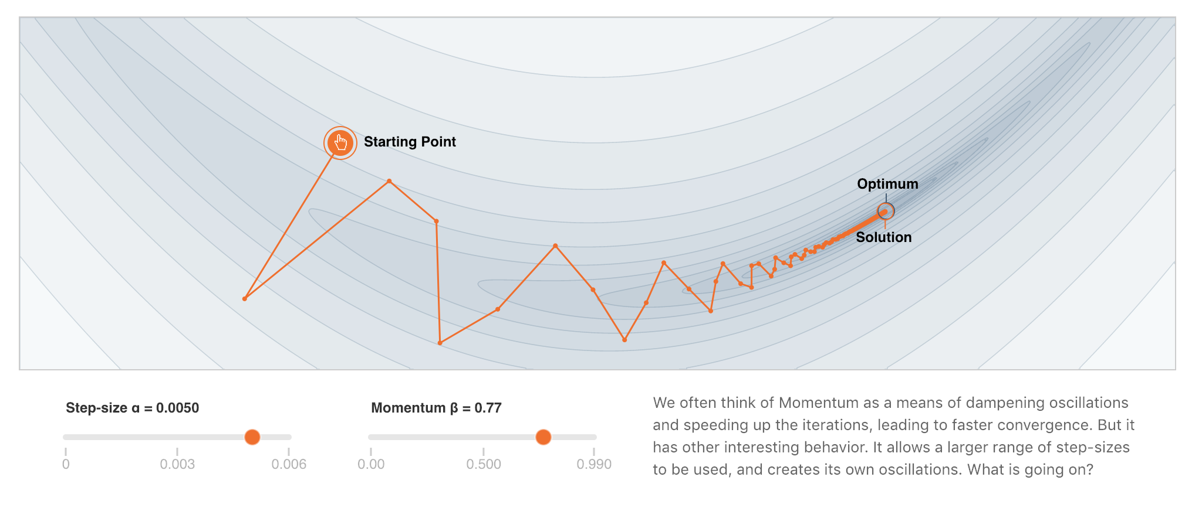
More on Momentum
https://distill.pub/2017/momentum/

Slide 35
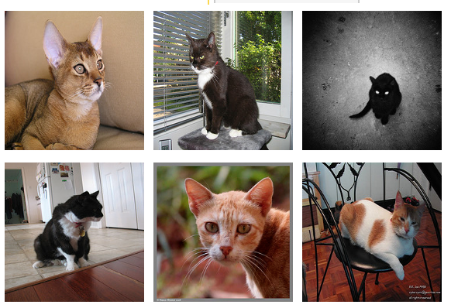
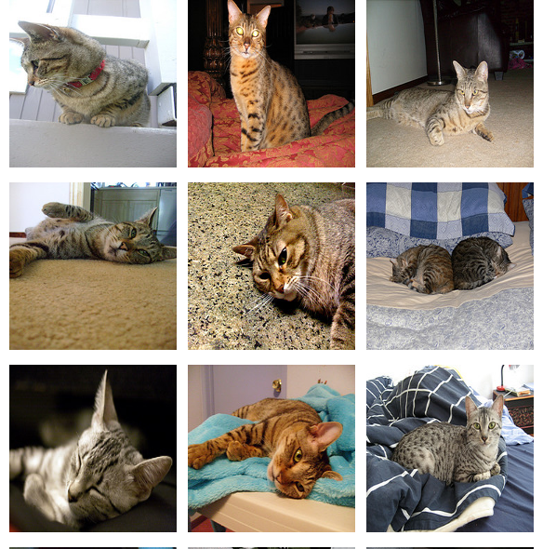
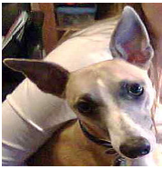
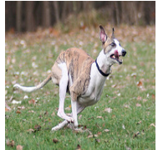
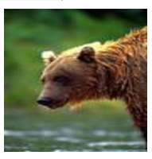
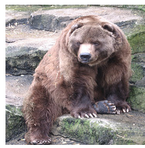
Supervised Learning - Classification
Training Data
Test Data
cat
dog
cat
.
.
.
.
.
.
bear

Slide 36








Supervised Learning - Classification
Training Data
cat
$$x_{1}=[ ]$$
$$y_{1}=[ ]$$
dog
$$x_{2}=[ ]$$
$$y_{2}=[ ]$$
cat
$$x_{3}=[ ]$$
$$y_{3}=[ ]$$
.
.
.
bear
$$x_{n}=[ ]$$
$$y_{n}=[ ]$$

Slide 37







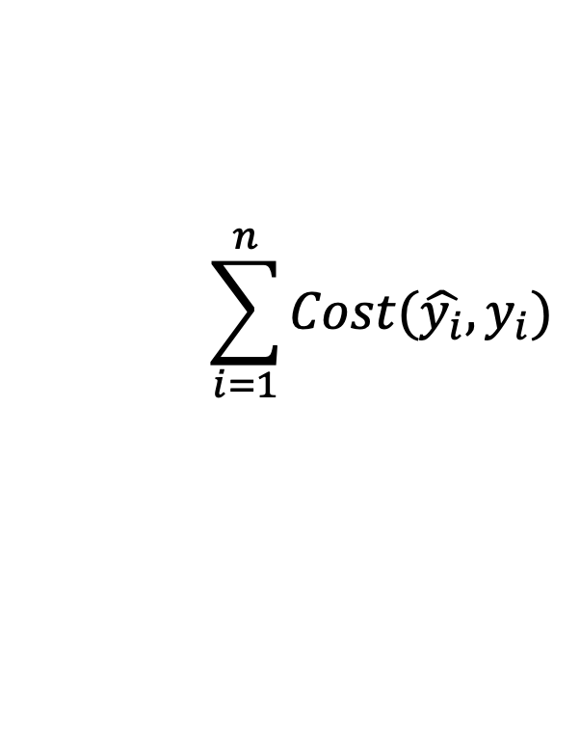


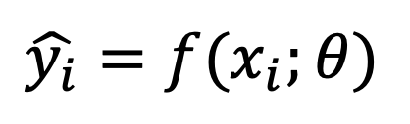



Supervised Learning - Classification
Training Data
targets /
labels /
ground truth
We need to find a function that
maps x and y for any of them.
inputs
predictions
$$x_{1}=[x_{11} { x}_{12} x_{13} { x}_{14}]$$
$$y_{1}=$$
1
$${\hat{y}}_{1}=$$
1
$$\hat{y_{i}}=f(x_{i};θ)$$
$$x_{2}=[x_{21} { x}_{22} x_{23} { x}_{24}]$$
$$y_{2}=$$
2
$${\hat{y}}_{2}=$$
2
$$x_{3}=[x_{31} { x}_{32} x_{33} { x}_{34}]$$
$$y_{3}=$$
1
$${\hat{y}}_{3}=$$
2
How do we ”learn” the parameters
of this function?
.
.
.
We choose ones that makes the
following quantity small:
$$\sum_{i=1}^{n}{Cost(\hat{y_{i}}, y_{i})}$$
$$x_{n}=[x_{n1} { x}_{n2} x_{n3} { x}_{n4}]$$
$$y_{n}=$$
3
$${\hat{y}}_{n}=$$
1

Slide 38
Questions?

