Slide 1
Deep Learning for Vision & Language
Computer Vision II: Convolutional Neural Network Architectures

Slide 2
Assignment 1
Due Monday at midnight (No extension for any reason but especially not due to errors/outages in Google Colab) – Everyone should have a version submitted on canvas by now. Maybe you should have one or two questions left to complete.
If that’s not the case – then accept right now that you probably will not be able to complete the assignment and that’s fine. You can make sure you finish the following assignments.

Slide 3
Most important operation for Computer Vision
The Convolution Operation
https://www.cs.rice.edu/~vo9/recognition/animation.gif

Slide 4
Most important operation for Computer Vision
The Convolution Operation
Convolutional filter
Convolutional kernel
Filter
Kernel

Slide 5
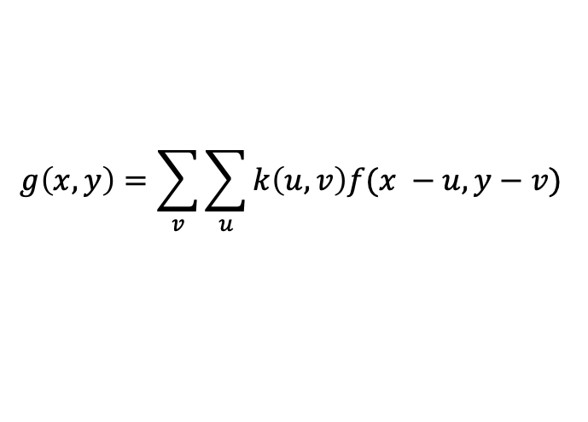



Most important operation for Computer Vision
The Convolution Operation
$$k(x,y)$$
$$f(x,y)$$
g$(x,y)$
$$g\left(x, y\right)=\sum_{v}{\sum_{u}{k\left(u,v\right)f(x −u, y−v) }}$$

Slide 6


Image filtering: Convolution operator e.g. mean filter
1/9 | 1/9 | 1/9
1/9 | 1/9 | 1/9
1/9 | 1/9 | 1/9
$k(x, y)$ =
$k(x, y)$
Image Credit: http://what-when-how.com/introduction-to-video-and-image-processing/neighborhood-processing-introduction-to-video-and-image-processing-part-1/

Slide 7
Image filtering: Convolution operator e.g. mean filter
1/9 | 1/9 | 1/9
1/9 | 1/9 | 1/9
1/9 | 1/9 | 1/9
$k(x, y)$ =
$k(x, y)$
Image Credit: http://what-when-how.com/introduction-to-video-and-image-processing/neighborhood-processing-introduction-to-video-and-image-processing-part-1/

Slide 8

Example: box filter
1
1
1
1
1
1
1
1
1
Slide credit: David Lowe (UBC)

Slide 9
Image filtering
1
1
1
1
1
1
1
1
1
0 | 0 | 0 | 0 | 0 | 0 | 0 | 0 | 0 | 0
0 | 0 | 0 | 0 | 0 | 0 | 0 | 0 | 0 | 0
0 | 0 | 0 | 90 | 90 | 90 | 90 | 90 | 0 | 0
0 | 0 | 0 | 90 | 90 | 90 | 90 | 90 | 0 | 0
0 | 0 | 0 | 90 | 90 | 90 | 90 | 90 | 0 | 0
0 | 0 | 0 | 90 | 0 | 90 | 90 | 90 | 0 | 0
0 | 0 | 0 | 90 | 90 | 90 | 90 | 90 | 0 | 0
0 | 0 | 0 | 0 | 0 | 0 | 0 | 0 | 0 | 0
0 | 0 | 90 | 0 | 0 | 0 | 0 | 0 | 0 | 0
0 | 0 | 0 | 0 | 0 | 0 | 0 | 0 | 0 | 0
 | 0
0 | 0 | 0 | 0 | 0 | 0 | 0 | 0 | 0 | 0
0 | 0 | 0 | 0 | 0 | 0 | 0 | 0 | 0 | 0
0 | 0 | 0 | 90 | 90 | 90 | 90 | 90 | 0 | 0
0 | 0 | 0 | 90 | 90 | 90 | 90 | 90 | 0 | 0
0 | 0 | 0 | 90 | 90 | 90 | 90 | 90 | 0 | 0
0 | 0 | 0 | 90 | 0 | 90 | 90 | 90 | 0 | 0
0 | 0 | 0 | 90 | 90 | 90 | 90 | 90 | 0 | 0
0 | 0 | 0 | 0 | 0 | 0 | 0 | 0 | 0 | 0
0 | 0 | 90 | 0 | 0 | 0 | 0 | 0 | 0 | 0
0 | 0 | 0 | 0 | 0 | 0 | 0 | 0 | 0 | 0
Credit: S. Seitz
Notes:
ones, divide by 9

Slide 10
Image filtering
1
1
1
1
1
1
1
1
1
0 | 0 | 0 | 0 | 0 | 0 | 0 | 0 | 0 | 0
0 | 0 | 0 | 0 | 0 | 0 | 0 | 0 | 0 | 0
0 | 0 | 0 | 90 | 90 | 90 | 90 | 90 | 0 | 0
0 | 0 | 0 | 90 | 90 | 90 | 90 | 90 | 0 | 0
0 | 0 | 0 | 90 | 90 | 90 | 90 | 90 | 0 | 0
0 | 0 | 0 | 90 | 0 | 90 | 90 | 90 | 0 | 0
0 | 0 | 0 | 90 | 90 | 90 | 90 | 90 | 0 | 0
0 | 0 | 0 | 0 | 0 | 0 | 0 | 0 | 0 | 0
0 | 0 | 90 | 0 | 0 | 0 | 0 | 0 | 0 | 0
0 | 0 | 0 | 0 | 0 | 0 | 0 | 0 | 0 | 0
 | 0 | 10
0 | 0 | 0 | 0 | 0 | 0 | 0 | 0 | 0 | 0
0 | 0 | 0 | 0 | 0 | 0 | 0 | 0 | 0 | 0
0 | 0 | 0 | 90 | 90 | 90 | 90 | 90 | 0 | 0
0 | 0 | 0 | 90 | 90 | 90 | 90 | 90 | 0 | 0
0 | 0 | 0 | 90 | 90 | 90 | 90 | 90 | 0 | 0
0 | 0 | 0 | 90 | 0 | 90 | 90 | 90 | 0 | 0
0 | 0 | 0 | 90 | 90 | 90 | 90 | 90 | 0 | 0
0 | 0 | 0 | 0 | 0 | 0 | 0 | 0 | 0 | 0
0 | 0 | 90 | 0 | 0 | 0 | 0 | 0 | 0 | 0
0 | 0 | 0 | 0 | 0 | 0 | 0 | 0 | 0 | 0
Credit: S. Seitz
Notes:
ones, divide by 9

Slide 11
Image filtering
1
1
1
1
1
1
1
1
1
0 | 0 | 0 | 0 | 0 | 0 | 0 | 0 | 0 | 0
0 | 0 | 0 | 0 | 0 | 0 | 0 | 0 | 0 | 0
0 | 0 | 0 | 90 | 90 | 90 | 90 | 90 | 0 | 0
0 | 0 | 0 | 90 | 90 | 90 | 90 | 90 | 0 | 0
0 | 0 | 0 | 90 | 90 | 90 | 90 | 90 | 0 | 0
0 | 0 | 0 | 90 | 0 | 90 | 90 | 90 | 0 | 0
0 | 0 | 0 | 90 | 90 | 90 | 90 | 90 | 0 | 0
0 | 0 | 0 | 0 | 0 | 0 | 0 | 0 | 0 | 0
0 | 0 | 90 | 0 | 0 | 0 | 0 | 0 | 0 | 0
0 | 0 | 0 | 0 | 0 | 0 | 0 | 0 | 0 | 0
 | 0 | 10 | 20
0 | 0 | 0 | 0 | 0 | 0 | 0 | 0 | 0 | 0
0 | 0 | 0 | 0 | 0 | 0 | 0 | 0 | 0 | 0
0 | 0 | 0 | 90 | 90 | 90 | 90 | 90 | 0 | 0
0 | 0 | 0 | 90 | 90 | 90 | 90 | 90 | 0 | 0
0 | 0 | 0 | 90 | 90 | 90 | 90 | 90 | 0 | 0
0 | 0 | 0 | 90 | 0 | 90 | 90 | 90 | 0 | 0
0 | 0 | 0 | 90 | 90 | 90 | 90 | 90 | 0 | 0
0 | 0 | 0 | 0 | 0 | 0 | 0 | 0 | 0 | 0
0 | 0 | 90 | 0 | 0 | 0 | 0 | 0 | 0 | 0
0 | 0 | 0 | 0 | 0 | 0 | 0 | 0 | 0 | 0
Credit: S. Seitz
Notes:
ones, divide by 9

Slide 12
Image filtering
1
1
1
1
1
1
1
1
1
0 | 0 | 0 | 0 | 0 | 0 | 0 | 0 | 0 | 0
0 | 0 | 0 | 0 | 0 | 0 | 0 | 0 | 0 | 0
0 | 0 | 0 | 90 | 90 | 90 | 90 | 90 | 0 | 0
0 | 0 | 0 | 90 | 90 | 90 | 90 | 90 | 0 | 0
0 | 0 | 0 | 90 | 90 | 90 | 90 | 90 | 0 | 0
0 | 0 | 0 | 90 | 0 | 90 | 90 | 90 | 0 | 0
0 | 0 | 0 | 90 | 90 | 90 | 90 | 90 | 0 | 0
0 | 0 | 0 | 0 | 0 | 0 | 0 | 0 | 0 | 0
0 | 0 | 90 | 0 | 0 | 0 | 0 | 0 | 0 | 0
0 | 0 | 0 | 0 | 0 | 0 | 0 | 0 | 0 | 0
 | 0 | 10 | 20 | 30
0 | 0 | 0 | 0 | 0 | 0 | 0 | 0 | 0 | 0
0 | 0 | 0 | 0 | 0 | 0 | 0 | 0 | 0 | 0
0 | 0 | 0 | 90 | 90 | 90 | 90 | 90 | 0 | 0
0 | 0 | 0 | 90 | 90 | 90 | 90 | 90 | 0 | 0
0 | 0 | 0 | 90 | 90 | 90 | 90 | 90 | 0 | 0
0 | 0 | 0 | 90 | 0 | 90 | 90 | 90 | 0 | 0
0 | 0 | 0 | 90 | 90 | 90 | 90 | 90 | 0 | 0
0 | 0 | 0 | 0 | 0 | 0 | 0 | 0 | 0 | 0
0 | 0 | 90 | 0 | 0 | 0 | 0 | 0 | 0 | 0
0 | 0 | 0 | 0 | 0 | 0 | 0 | 0 | 0 | 0
Credit: S. Seitz
Notes:
ones, divide by 9

Slide 13
Image filtering
1
1
1
1
1
1
1
1
1
0 | 0 | 0 | 0 | 0 | 0 | 0 | 0 | 0 | 0
0 | 0 | 0 | 0 | 0 | 0 | 0 | 0 | 0 | 0
0 | 0 | 0 | 90 | 90 | 90 | 90 | 90 | 0 | 0
0 | 0 | 0 | 90 | 90 | 90 | 90 | 90 | 0 | 0
0 | 0 | 0 | 90 | 90 | 90 | 90 | 90 | 0 | 0
0 | 0 | 0 | 90 | 0 | 90 | 90 | 90 | 0 | 0
0 | 0 | 0 | 90 | 90 | 90 | 90 | 90 | 0 | 0
0 | 0 | 0 | 0 | 0 | 0 | 0 | 0 | 0 | 0
0 | 0 | 90 | 0 | 0 | 0 | 0 | 0 | 0 | 0
0 | 0 | 0 | 0 | 0 | 0 | 0 | 0 | 0 | 0
 | 0 | 10 | 20 | 30 | 30
Credit: S. Seitz
Notes:
ones, divide by 9

Slide 14
Image filtering
1
1
1
1
1
1
1
1
1
0 | 0 | 0 | 0 | 0 | 0 | 0 | 0 | 0 | 0
0 | 0 | 0 | 0 | 0 | 0 | 0 | 0 | 0 | 0
0 | 0 | 0 | 90 | 90 | 90 | 90 | 90 | 0 | 0
0 | 0 | 0 | 90 | 90 | 90 | 90 | 90 | 0 | 0
0 | 0 | 0 | 90 | 90 | 90 | 90 | 90 | 0 | 0
0 | 0 | 0 | 90 | 0 | 90 | 90 | 90 | 0 | 0
0 | 0 | 0 | 90 | 90 | 90 | 90 | 90 | 0 | 0
0 | 0 | 0 | 0 | 0 | 0 | 0 | 0 | 0 | 0
0 | 0 | 90 | 0 | 0 | 0 | 0 | 0 | 0 | 0
0 | 0 | 0 | 0 | 0 | 0 | 0 | 0 | 0 | 0
 | 0 | 10 | 20 | 30 | 30
?
Credit: S. Seitz
Notes:
ones, divide by 9

Slide 15
Image filtering
1
1
1
1
1
1
1
1
1
0 | 0 | 0 | 0 | 0 | 0 | 0 | 0 | 0 | 0
0 | 0 | 0 | 0 | 0 | 0 | 0 | 0 | 0 | 0
0 | 0 | 0 | 90 | 90 | 90 | 90 | 90 | 0 | 0
0 | 0 | 0 | 90 | 90 | 90 | 90 | 90 | 0 | 0
0 | 0 | 0 | 90 | 90 | 90 | 90 | 90 | 0 | 0
0 | 0 | 0 | 90 | 0 | 90 | 90 | 90 | 0 | 0
0 | 0 | 0 | 90 | 90 | 90 | 90 | 90 | 0 | 0
0 | 0 | 0 | 0 | 0 | 0 | 0 | 0 | 0 | 0
0 | 0 | 90 | 0 | 0 | 0 | 0 | 0 | 0 | 0
0 | 0 | 0 | 0 | 0 | 0 | 0 | 0 | 0 | 0
 | 0 | 10 | 20 | 30 | 30
 |  |  |  | 50
?
Credit: S. Seitz
Notes:
ones, divide by 9

Slide 16
Image filtering
1
1
1
1
1
1
1
1
1
0 | 0 | 0 | 0 | 0 | 0 | 0 | 0 | 0 | 0
0 | 0 | 0 | 0 | 0 | 0 | 0 | 0 | 0 | 0
0 | 0 | 0 | 90 | 90 | 90 | 90 | 90 | 0 | 0
0 | 0 | 0 | 90 | 90 | 90 | 90 | 90 | 0 | 0
0 | 0 | 0 | 90 | 90 | 90 | 90 | 90 | 0 | 0
0 | 0 | 0 | 90 | 0 | 90 | 90 | 90 | 0 | 0
0 | 0 | 0 | 90 | 90 | 90 | 90 | 90 | 0 | 0
0 | 0 | 0 | 0 | 0 | 0 | 0 | 0 | 0 | 0
0 | 0 | 90 | 0 | 0 | 0 | 0 | 0 | 0 | 0
0 | 0 | 0 | 0 | 0 | 0 | 0 | 0 | 0 | 0
 | 0 | 10 | 20 | 30 | 30 | 30 | 20 | 10
 | 0 | 20 | 40 | 60 | 60 | 60 | 40 | 20
 | 0 | 30 | 60 | 90 | 90 | 90 | 60 | 30
 | 0 | 30 | 50 | 80 | 80 | 90 | 60 | 30
 | 0 | 30 | 50 | 80 | 80 | 90 | 60 | 30
 | 0 | 20 | 30 | 50 | 50 | 60 | 40 | 20
 | 10 | 20 | 30 | 30 | 30 | 30 | 20 | 10
 | 10 | 10 | 10 | 0 | 0 | 0 | 0 | 0
Credit: S. Seitz

Slide 17
Box Filter
What does it do?
Replaces each pixel with an average of its neighborhood
Achieve smoothing effect (remove sharp features)
1
1
1
1
1
1
1
1
1
Slide credit: David Lowe (UBC)

Slide 18
Image filtering: e.g. Mean Filter

Slide 19
Image filtering: Convolution operator Important filter: gaussian filter (gaussian blur)
1/16 | 1/8 | 1/16
1/8 | 1/4 | 1/8
1/16 | 1/8 | 1/16
$k(x, y)$ =
$k(x, y)$
Image Credit: http://what-when-how.com/introduction-to-video-and-image-processing/neighborhood-processing-introduction-to-video-and-image-processing-part-1/

Slide 20
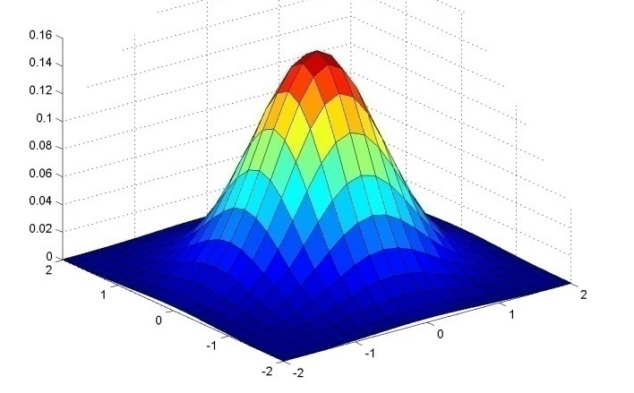
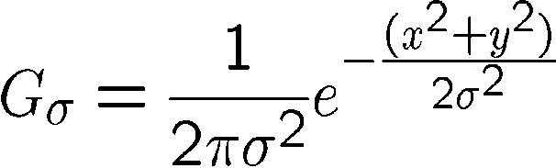
Important filter: Gaussian
Weight contributions of neighboring pixels by nearness
0.003 0.013 0.022 0.013 0.003
0.013 0.059 0.097 0.059 0.013
0.022 0.097 0.159 0.097 0.022
0.013 0.059 0.097 0.059 0.013
0.003 0.013 0.022 0.013 0.003
5 x 5, σ = 1
Slide credit: Christopher Rasmussen
Notes:
e^0 = 1, e^-1 = .37, e^-2 = .14, etc.

Slide 21
Image filtering: Convolution operator e.g. gaussian filter (gaussian blur)
Image Credit: http://what-when-how.com/introduction-to-video-and-image-processing/neighborhood-processing-introduction-to-video-and-image-processing-part-1/

Slide 22
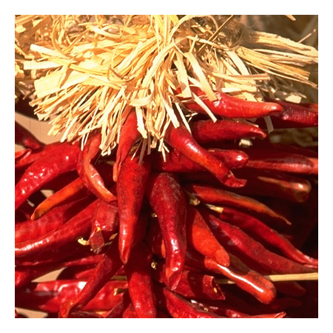
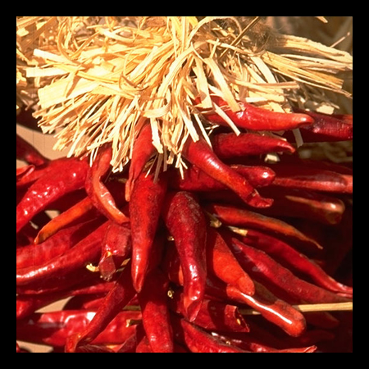

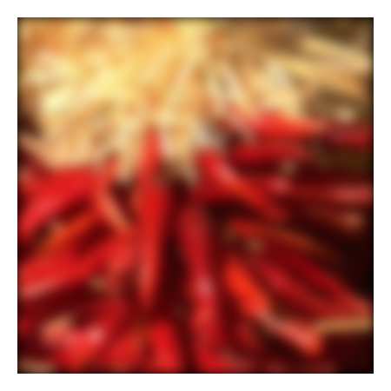
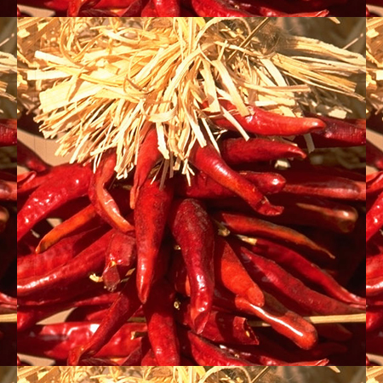

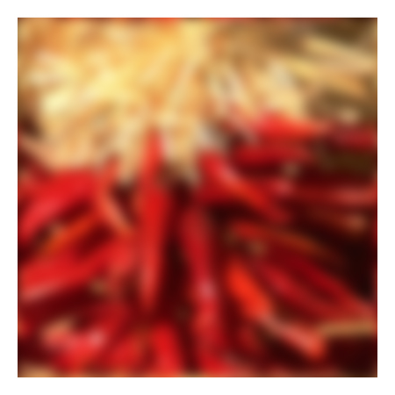
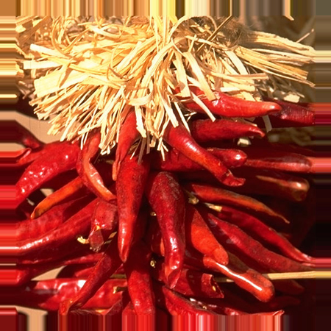


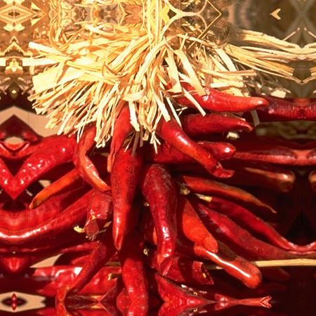


Practical matters
What about near the edge?
the filter window falls off the edge of the image
need to extrapolate
methods:
clip filter (black)
wrap around
copy edge
reflect across edge
Source: S. Marschner

Slide 23
Convolution: Useful Operator for Image Processing
Not all image filtering – region neighborhood operators can be expressed as convolutions.
They also can be used to extract information about edges and shapes .e.g. for image recognition
Convolutional operations are at the basis of convolutional neural networks.

Slide 24
Image filtering: Convolution operator Important Filter: Sobel operator
1 | 0 | -1
2 | 0 | -2
1 | 0 | -1
$k(x, y)$ =
$k(x, y)$
Image Credit: http://what-when-how.com/introduction-to-video-and-image-processing/neighborhood-processing-introduction-to-video-and-image-processing-part-1/

Slide 25
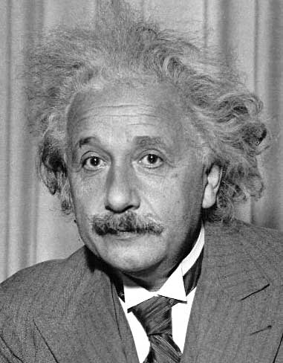
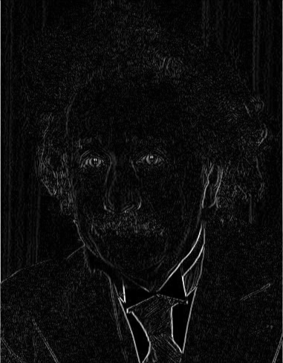
Other filters
1
0
-1
2
0
-2
1
0
-1
Sobel
Vertical Edge
(absolute value)
Slide by James Hays

Slide 26
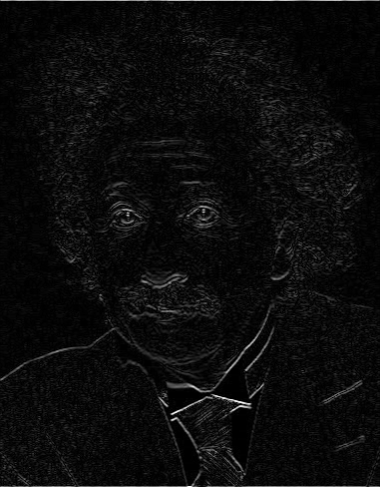
Other filters
1
2
1
0
0
0
-1
-2
-1
Sobel
Horizontal Edge
(absolute value)
Slide by James Hays
Notes:
Questions at this point?

Slide 27
Sobel operators are equivalent to 2D partial derivatives of the image
Vertical sobel operator – Partial derivative in X (width)
Horizontal sobel operator – Partial derivative in Y (height)
Can compute magnitude and phase at each location.
Useful for detecting edges

Slide 28
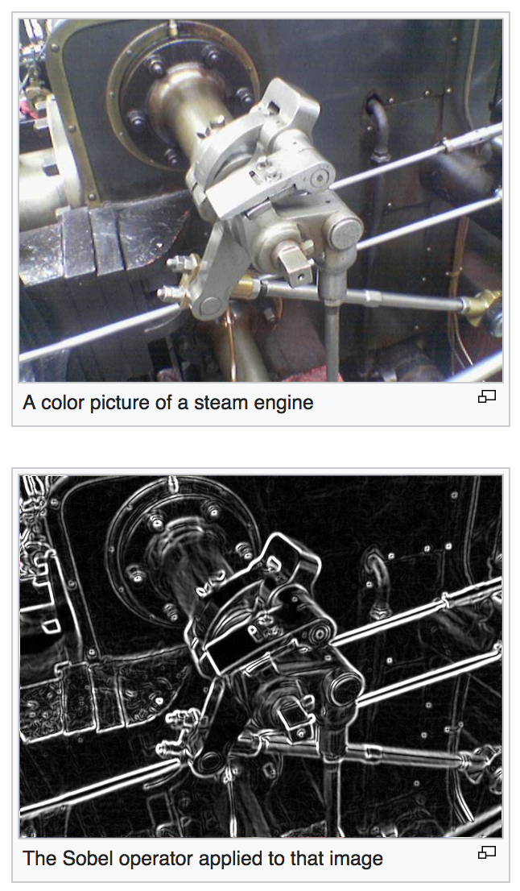
https://en.wikipedia.org/wiki/Sobel_operator

Slide 29

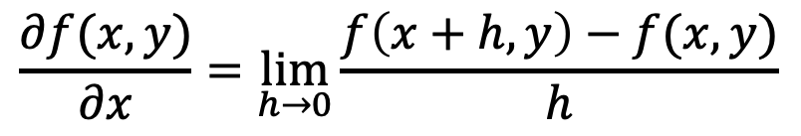
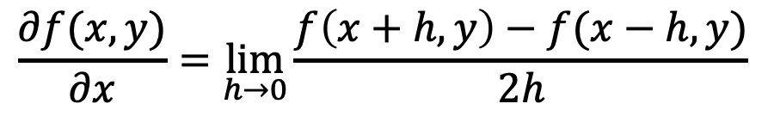
Sobel filters are (approximate) partial derivatives of the image
Let
$$f(x,y)$$
be your input image, then the partial derivative is:
$$\frac{∂f(x,y)}{∂x}=\lim_{h→0}{\frac{f\left(x+h, y\right)−f(x,y)}{h}}$$
Also:
$$\frac{∂f(x,y)}{∂x}=\lim_{h→0}{\frac{f\left(x+h,y\right)−f(x−h,y)}{2h}}$$

Slide 30



But digital images are not continuous, they are discrete
Let
$$f[x,y]$$
be your input image, then the partial derivative is:
$$Δ_{x}f[x,y]=f[x+1,y]−f[x,y]$$
Also:
$$Δ_{x}f[x,y]=f[x+1,y]−f[x−1,y]$$

Slide 31
But digital images are not continuous, they are discrete
Let
$$f[x,y]$$
be your input image, then the partial derivative is:
k(x, y) =
-1 | 1
$$Δ_{x}f[x,y]=f[x+1,y]−f[x,y]$$
Also:
-1 | 0 | 1
$$Δ_{x}f[x,y]=f[x+1,y]−f[x−1,y]$$
k(x, y) =

Slide 32
Sobel Operators Smooth in Y and then Differentiate in X
1
2
1
1 | 0 | -1
2 | 0 | -2
1 | 0 | -1
1 | 0 | -1
k(x, y) =
*
=
Similarly to differentiate in Y

Slide 33
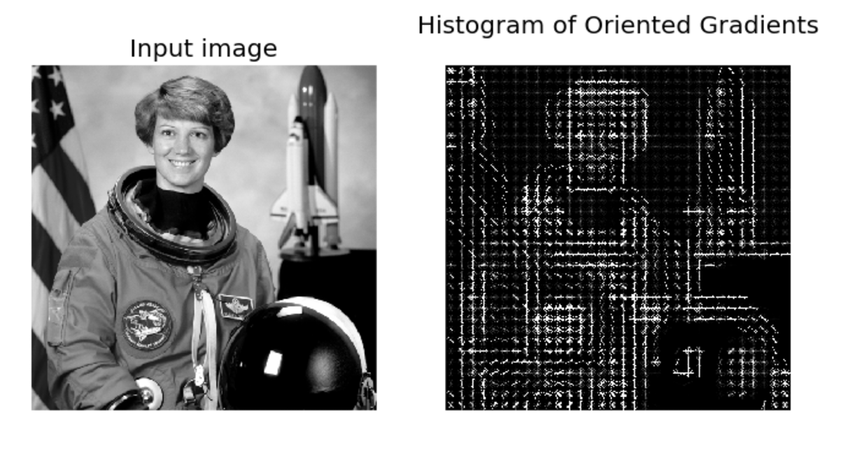
Image Features: HoG
Paper by Navneet Dalal & Bill Triggs presented at CVPR 2005 for detecting people.
Scikit-image implementation

Slide 34
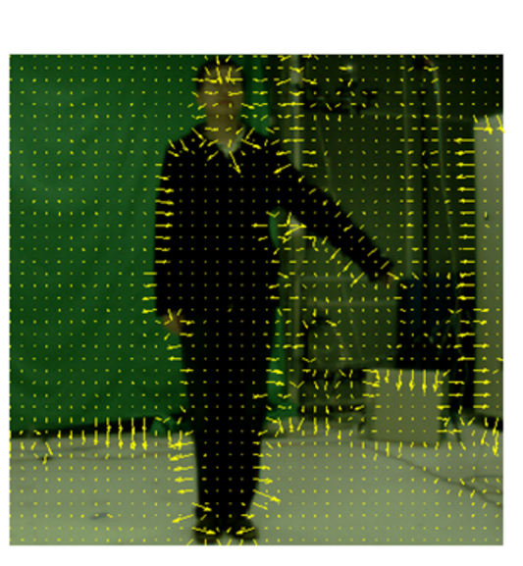
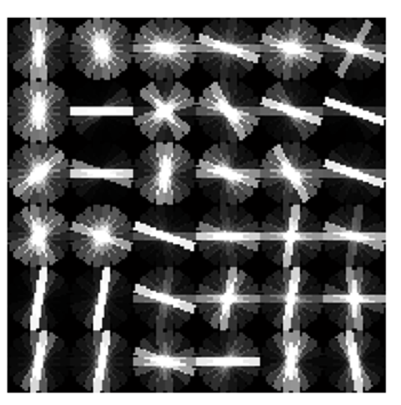
Image Features: HoG
+ Block Normalization
Paper by Navneet Dalal & Bill Triggs presented at CVPR 2005 for detecting people. Figure from Zhuolin Jiang, Zhe Lin, Larry S. Davis, ICCV 2009 for human action recognition.

Slide 35
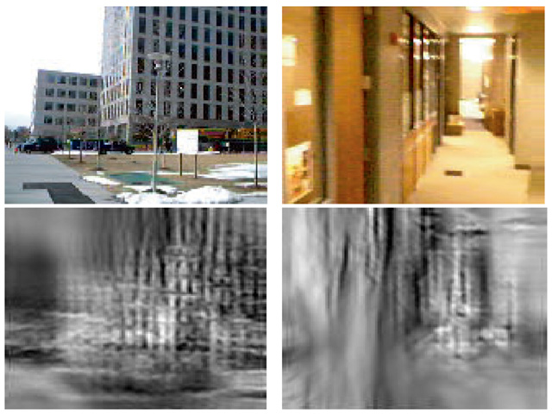
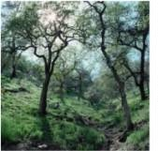
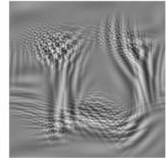
Image Features: GIST
The “gist” of a scene: Oliva & Torralba, 2001

Slide 36
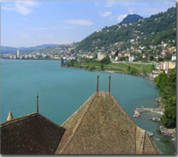
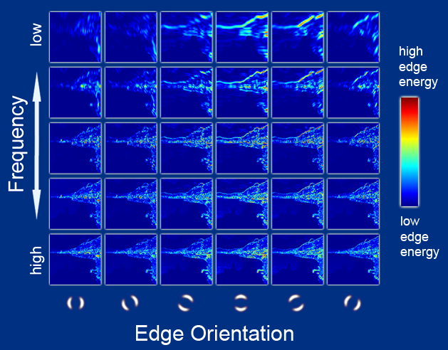
Image Features: GIST
Oriented edge response at multiple scales (5 spatial scales, 6 edge orientations)
Hays and Efros, SIGGRAPH 2007

Slide 37
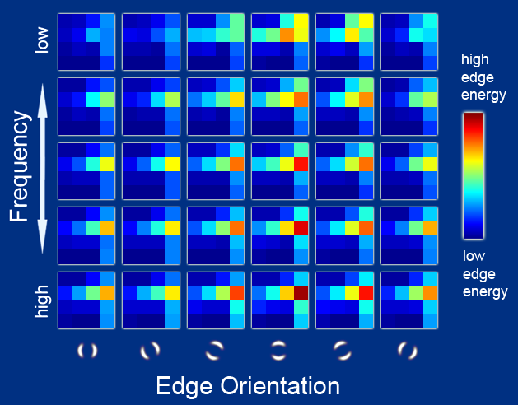
Image Features: GIST
Aggregated edge responses over 4x4 windows
Hays and Efros, SIGGRAPH 2007

Slide 38
The 2D Convolutional Layer in a Neural Network

Slide 39
The 2D Convolutional Layer in a Neural Network

Slide 40
The 2D Convolutional Layer in a Neural Network
Weights

Slide 41
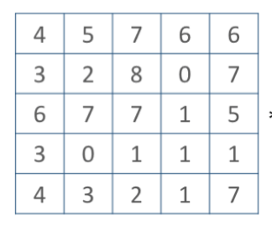
The 2D Convolutional Layer in a Neural Network
Weights
4

Slide 42
The 2D Convolutional Layer in a Neural Network
Weights
4
1

Slide 43
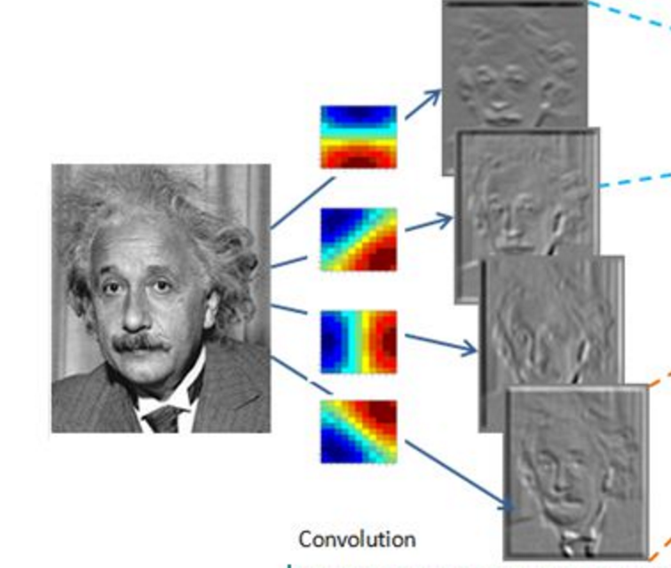
Convolutional Layer (with 4 filters)
weights: 4x1x9x9
Input: 1x224x224
Output: 4x224x224
if zero padding,
and stride = 1

Slide 44
Convolutional Layer (with 4 filters)
weights: 4x1x9x9
Input: 1x224x224
Output: 4x112x112
if zero padding,
but stride = 2

Slide 45
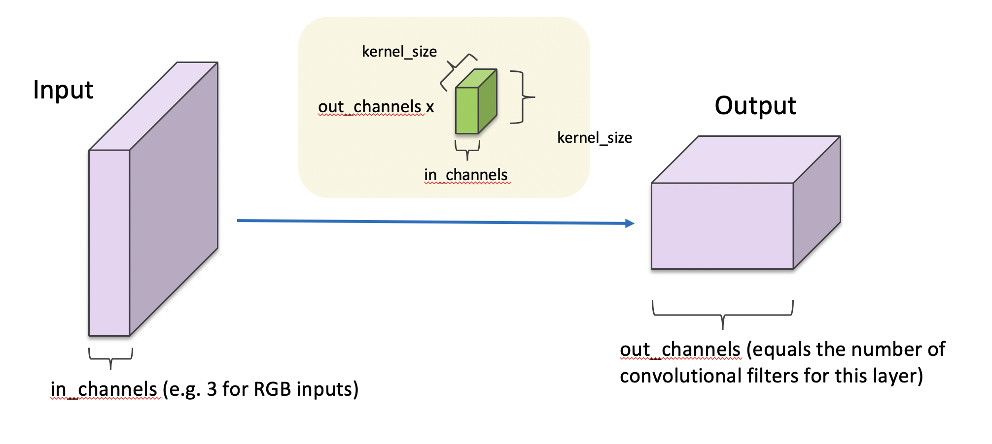
Convolutional Layer in pytorch

Slide 46
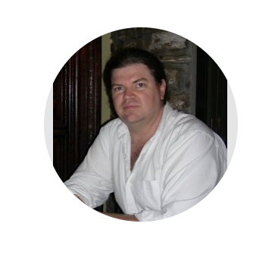
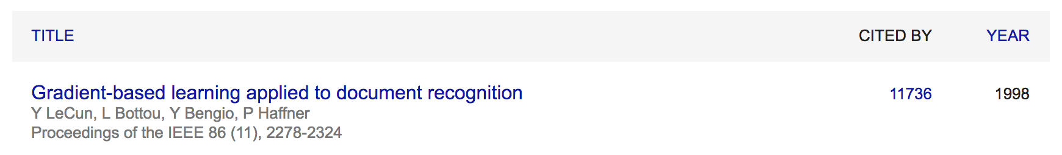
Convolutional Network: LeNet
Yann LeCun

Slide 47
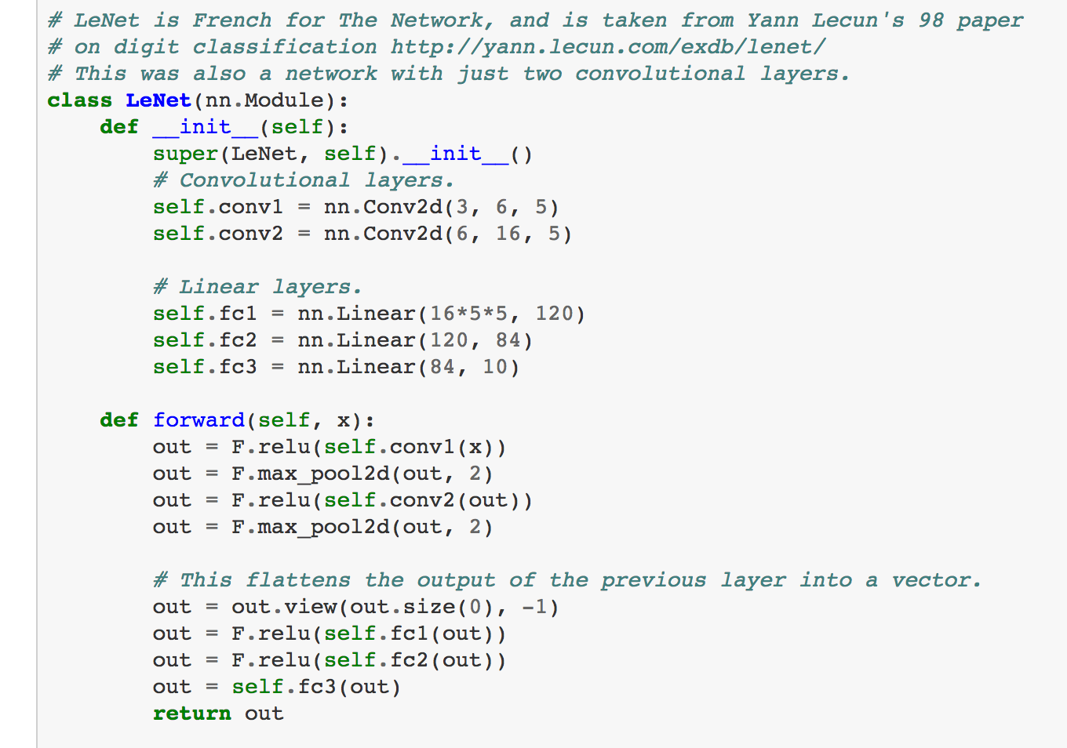
LeNet in Pytorch

Slide 48
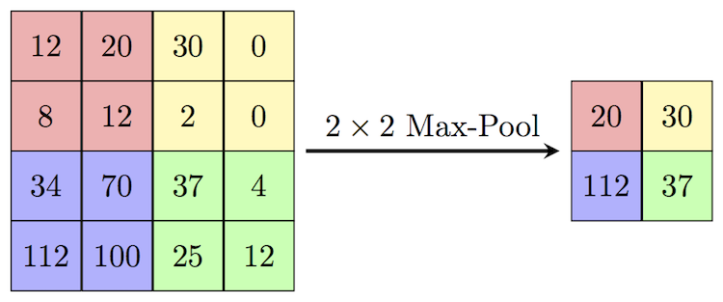
SpatialMaxPooling Layer
https://paperswithcode.com/method/max-pooling

Slide 49
LeNet Summary
2 Convolutional Layers + 3 Linear Layers
+ Non-linear functions: ReLUs or Sigmoids + Max-pooling operations

Slide 50
New Architectures Proposed
Alexnet (Kriszhevsky et al NIPS 2012) [Required Reading]
VGG (Simonyan and Zisserman 2014)
GoogLeNet (Szegedy et al CVPR 2015)
ResNet (He et al CVPR 2016)
DenseNet (Huang et al CVPR 2017)

Slide 51
Convolutional Layers as Matrix Multiplication
https://petewarden.com/2015/04/20/why-gemm-is-at-the-heart-of-deep-learning/

Slide 52
Convolutional Layers as Matrix Multiplication
https://petewarden.com/2015/04/20/why-gemm-is-at-the-heart-of-deep-learning/

Slide 53
Convolutional Layers as Matrix Multiplication
Pros?
Cons?
https://petewarden.com/2015/04/20/why-gemm-is-at-the-heart-of-deep-learning/

Slide 54
CNN Computations are Computationally Expensive
However highly parallelizable
GPU Computing is used in practice
CPU Computing in fact is prohibitive for training these models

Slide 55
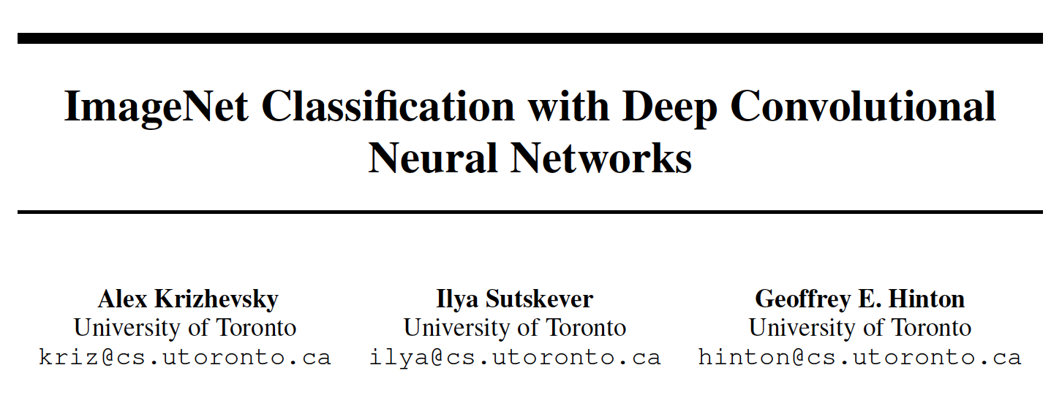
The Alexnet network (Krizhevsky et al NIPS 2012)

Slide 56
The Problem: Classification
Classify an image into 1000 possible classes: e.g. Abyssinian cat, Bulldog, French Terrier, Cormorant, Chickadee,
red fox, banjo, barbell, hourglass, knot, maze, viaduct, etc.
cat, tabby cat (0.71) Egyptian cat (0.22)
red fox (0.11)
…..

Slide 57
The Data: ILSVRC
Imagenet Large Scale Visual Recognition Challenge (ILSVRC): Annual Competition
1000 Categories
~1000 training images per Category
~1 million images in total for training
~50k images for validation
Only images released for the test set but no annotations, evaluation is performed centrally by the organizers (max 2 per week)

Slide 58
The Evaluation Metric: Top K-error
Top-1 error: 1.0
Top-1 accuracy: 0.0
Top-2 error: 1.0
Top-2 accuracy: 0.0
True label: Abyssinian cat
Top-3 error: 1.0
Top-3 accuracy: 0.0
Top-4 error: 0.0
Top-4 accuracy: 1.0
Top-5 error: 0.0
Top-5 accuracy: 1.0
cat, tabby cat (0.61) Egyptian cat (0.22)
red fox (0.11)
Abyssinian cat (0.10)
French terrier (0.03)
…..

Slide 59
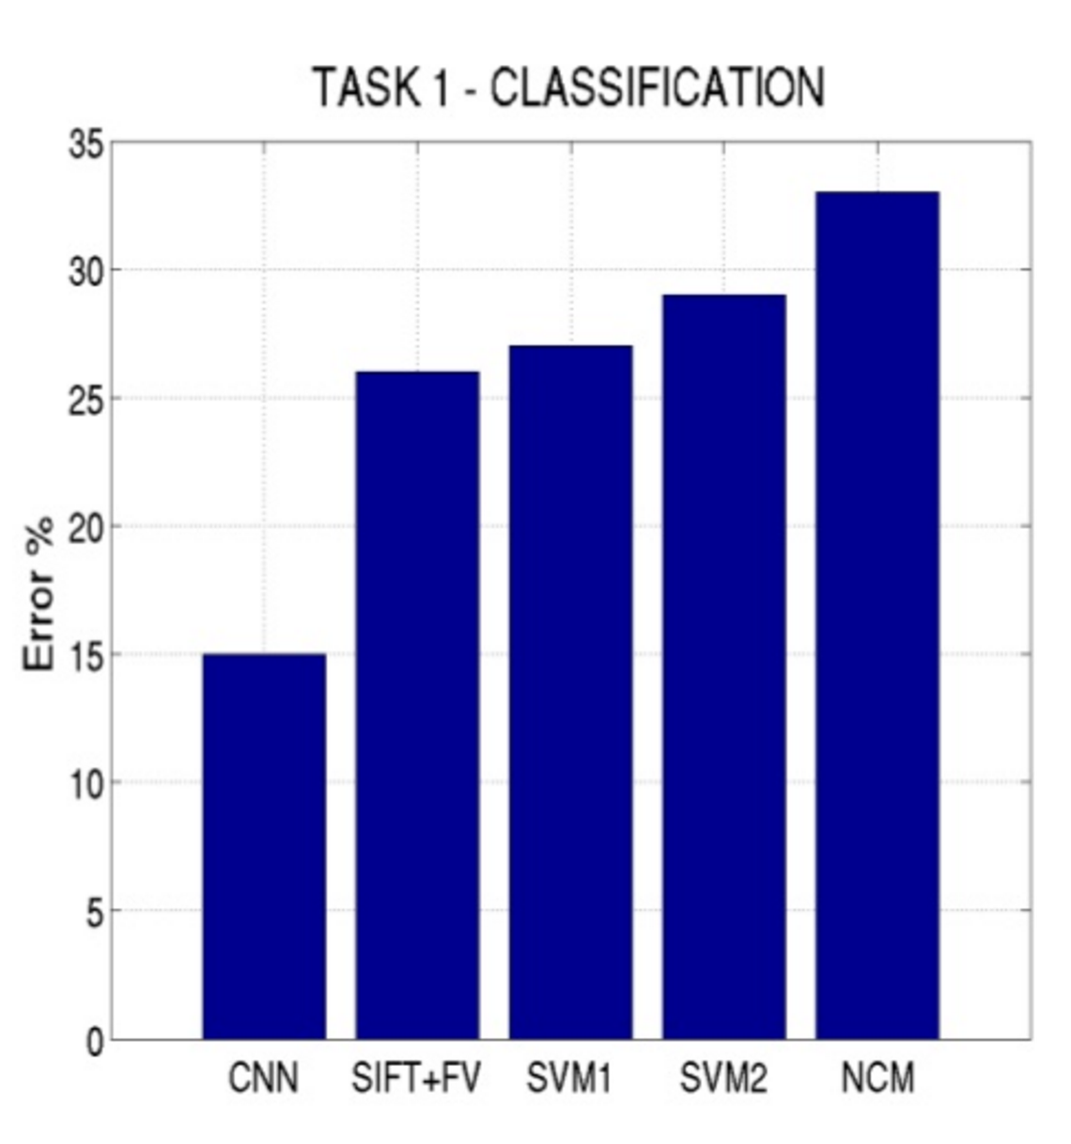
Top-5 error on this competition (2012)

Slide 60
Alexnet
https://www.saagie.com/fr/blog/object-detection-part1

Slide 61
Pytorch Code for Alexnet
In-class analysis https://github.com/pytorch/vision/blob/master/torchvision/models/alexnet.py

Slide 62
Dropout Layer
Srivastava et al 2014

Slide 63
What is happening?
https://www.saagie.com/fr/blog/object-detection-part1

Slide 64
SIFT + FV + SVM (or softmax)
Feature extraction (SIFT)
Feature encoding (Bag of words)
Classification (SVM or softmax)
Deep Learning
Convolutional Network
(includes both feature extraction and classifier)

Slide 65
Preprocessing and Data Augmentation

Slide 66
Preprocessing and Data Augmentation
256
256

Slide 67
Preprocessing and Data Augmentation
224x224

Slide 68
Preprocessing and Data Augmentation
224x224

Slide 69
True label: Abyssinian cat

Slide 70
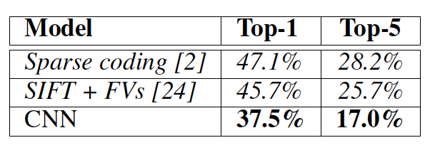
Other Important Aspects
Using ReLUs instead of Sigmoid or Tanh
Momentum + Weight Decay
Dropout (Randomly sets Unit outputs to zero during training)
GPU Computation!

Slide 71
VGG Network
Top-5:
https://github.com/pytorch/vision/blob/master/torchvision/models/vgg.py
Simonyan and Zisserman, 2014.
https://arxiv.org/pdf/1409.1556.pdf

Slide 72
GoogLeNet
https://github.com/kuangliu/pytorch-cifar/blob/master/models/googlenet.py
Szegedy et al. 2014
https://www.cs.unc.edu/~wliu/papers/GoogLeNet.pdf

Slide 73
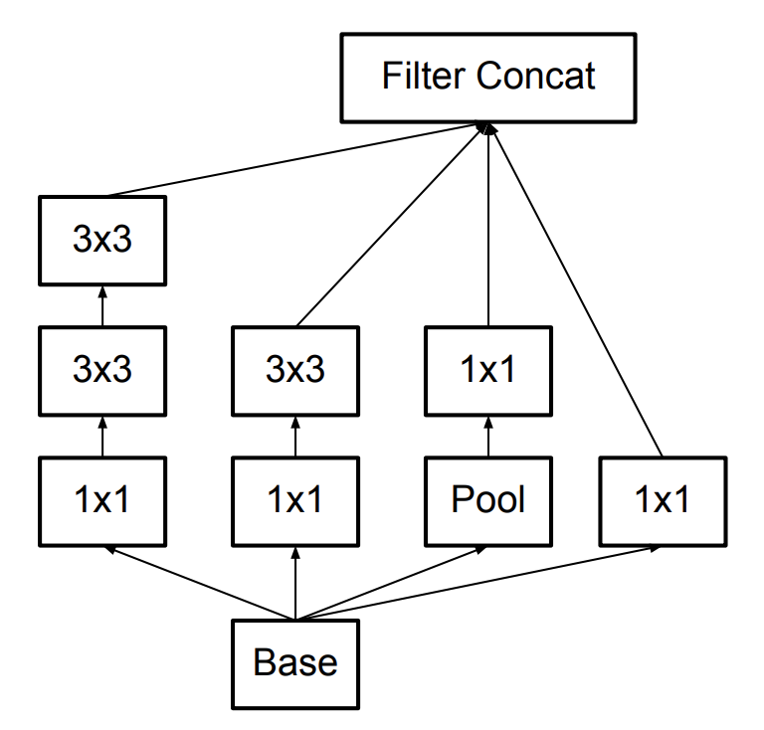
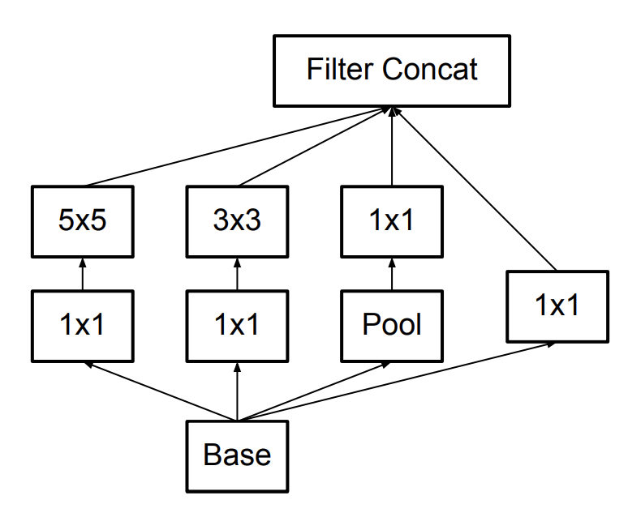
Further Refinements – Inception v3, e.g.
GoogLeNet (Inceptionv1)
Inception v3

Slide 74
BatchNormalization Layer
https://arxiv.org/abs/1502.03167

Slide 75
ResNet (He et al CVPR 2016)
Sorry, does not fit in slide.
http://felixlaumon.github.io/assets/kaggle-right-whale/resnet.png
https://github.com/pytorch/vision/blob/master/torchvision/models/resnet.py

Slide 76
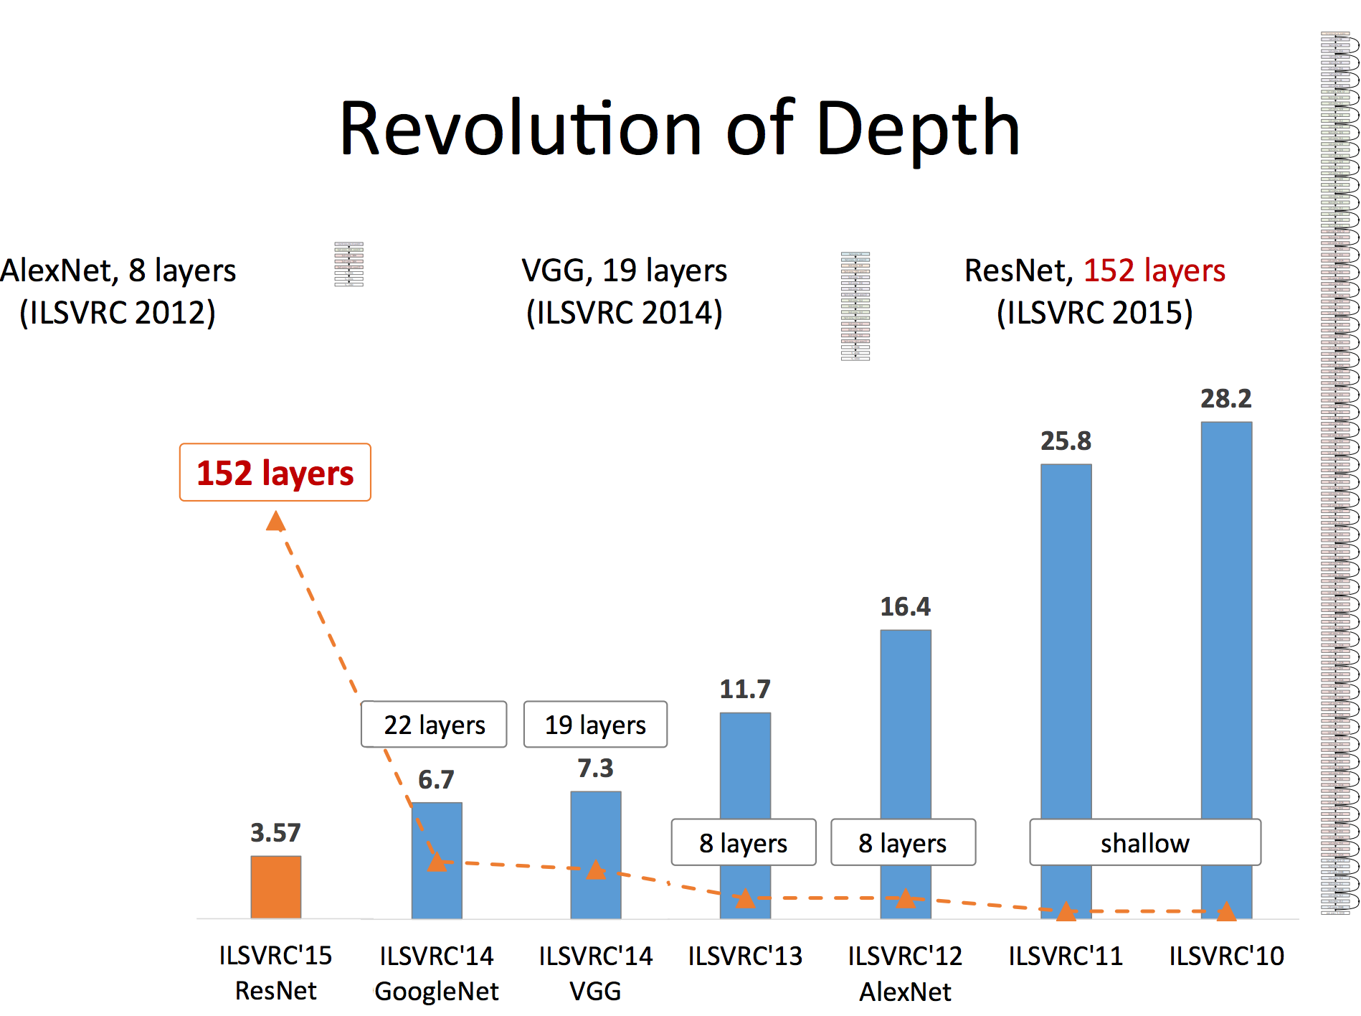
Slide by Mohammad Rastegari

Slide 77
Questions

