Slide 1
Deep Learning for Vision & Language
Transformers I: Introduction

Slide 2
Today
Sequence-to-sequence (RNNs) for Machine Translation
Learning to Align and Translate with Soft Attention
Image Captioning (CNNs + RNNs): Show and Tell
Image Captioning (CNNs + RNNs + Attention): Show Attend and Tell
Attention is All you Need!
Encoder Transformers: BERT
Decoder Transformers: GPT-2 – maybe next class

Slide 3
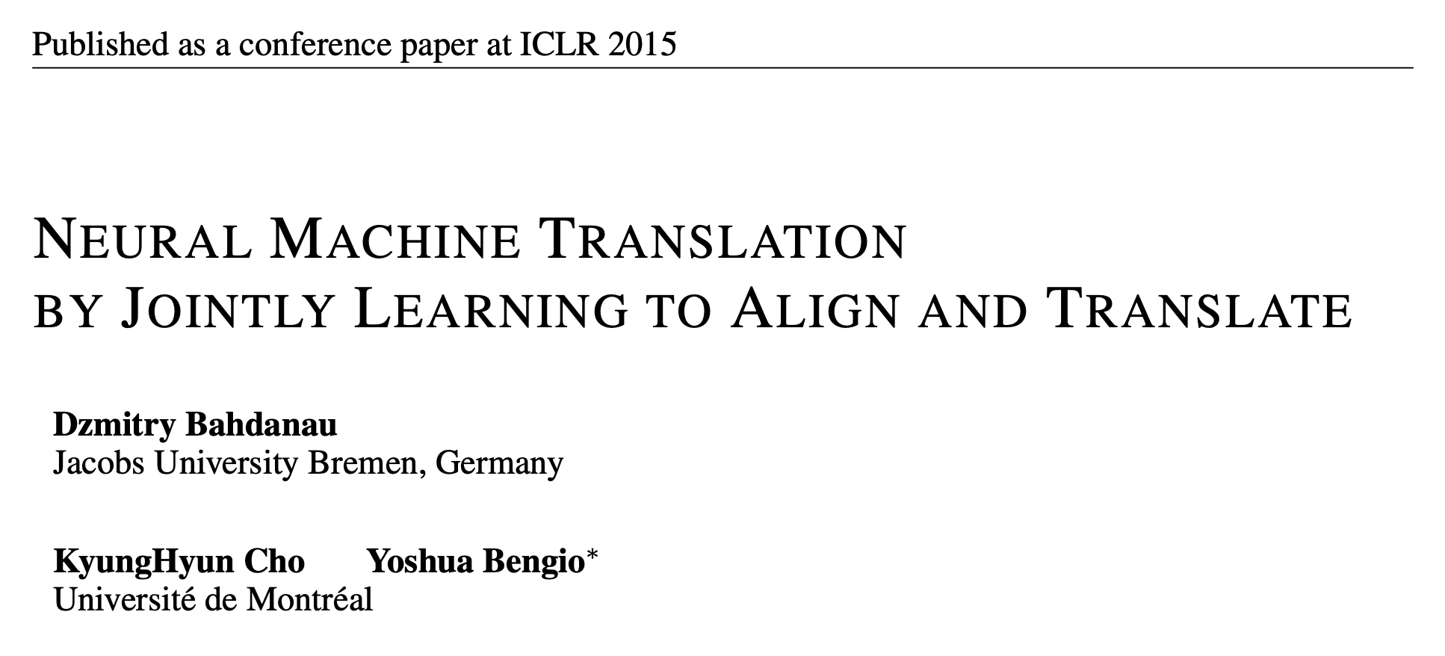
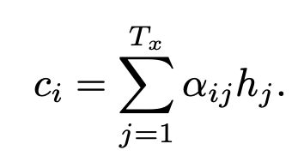
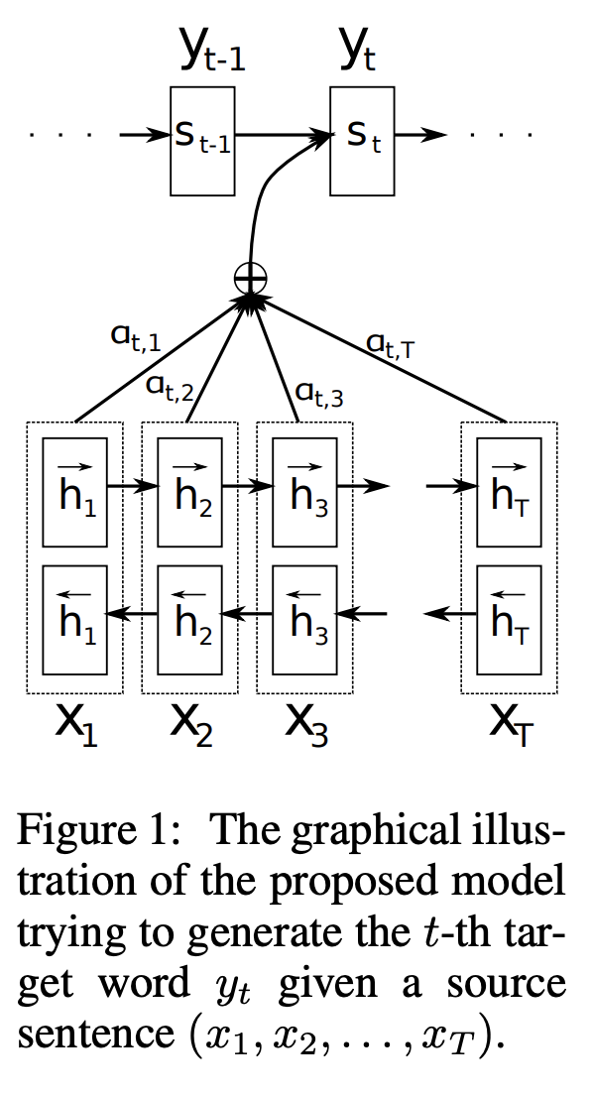
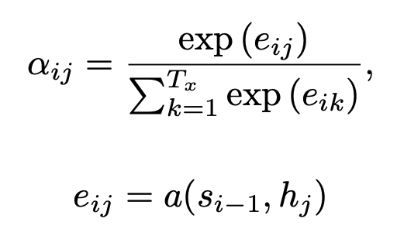
Let’s take a look at one of the first papers introducing this idea.

Slide 4
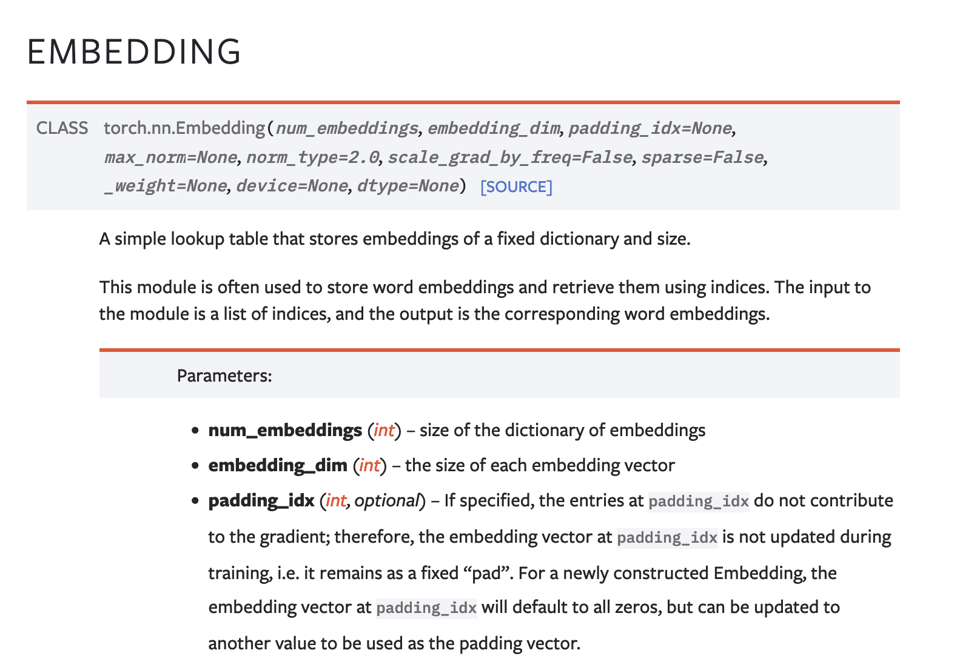
The Embedding Layer nn.Embedding

Slide 5
The Embedding Layer nn.Embedding
d
dog
cat
apple
work#
the
nn.Embedding(n, d)
n
…
under
wizard
zealot

Slide 6
Let’s take a look at one of the first papers introducing this idea.

Slide 7
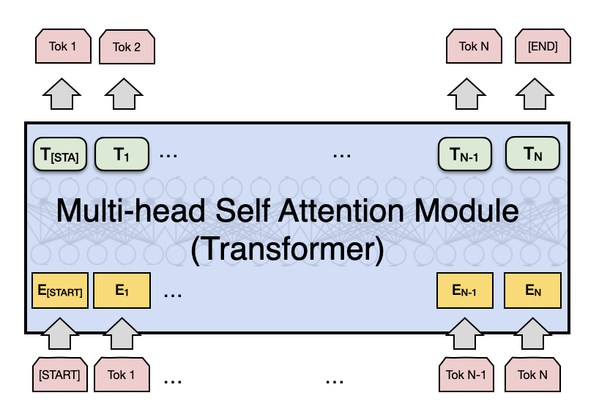
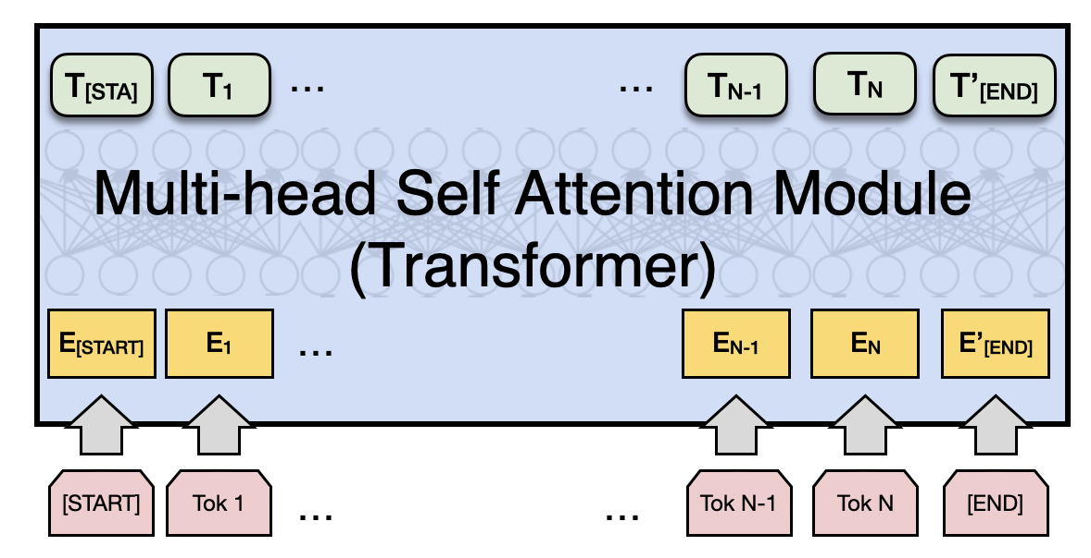
Attention is All you Need (no RNNs)
Vaswani et al. Attention is all you need
https://arxiv.org/abs/1706.03762
Decoder
Encoder
Fixed number of input tokens
[but hey! we can always define a large enough length and add mask tokens]

Slide 8
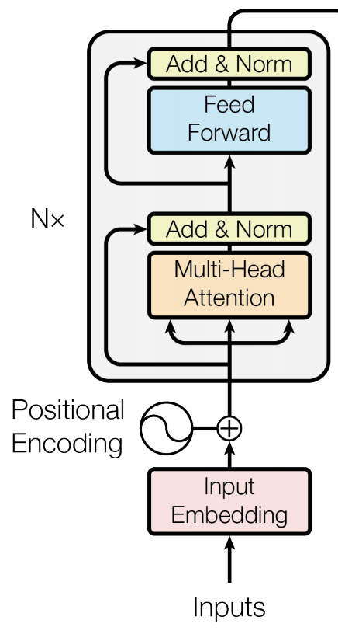
Attention is All you Need (no RNNs)
Vaswani et al. Attention is all you need
https://arxiv.org/abs/1706.03762
Decoder
Encoder
Fixed number of input tokens
[but hey! we can always define a large enough length and add mask tokens]

Slide 9
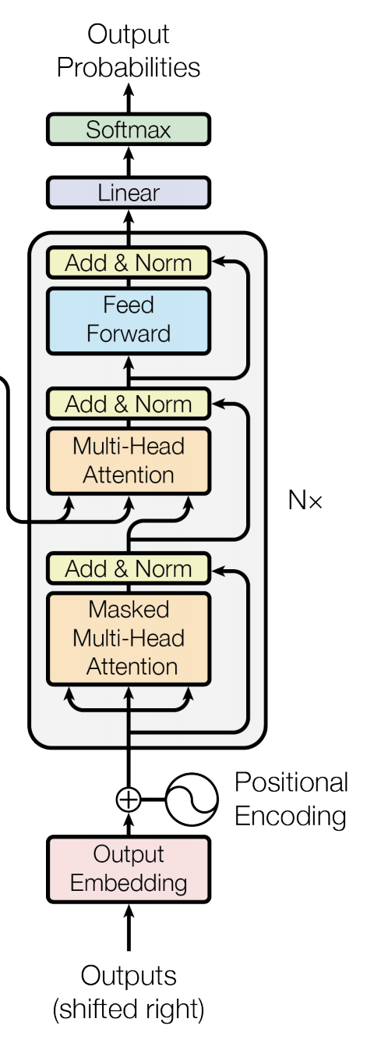
Attention is All you Need (no RNNs)
Vaswani et al. Attention is all you need
https://arxiv.org/abs/1706.03762
Decoder
Encoder
Fixed number of input tokens
[but hey! we can always define a large enough length and add mask tokens]

Slide 10
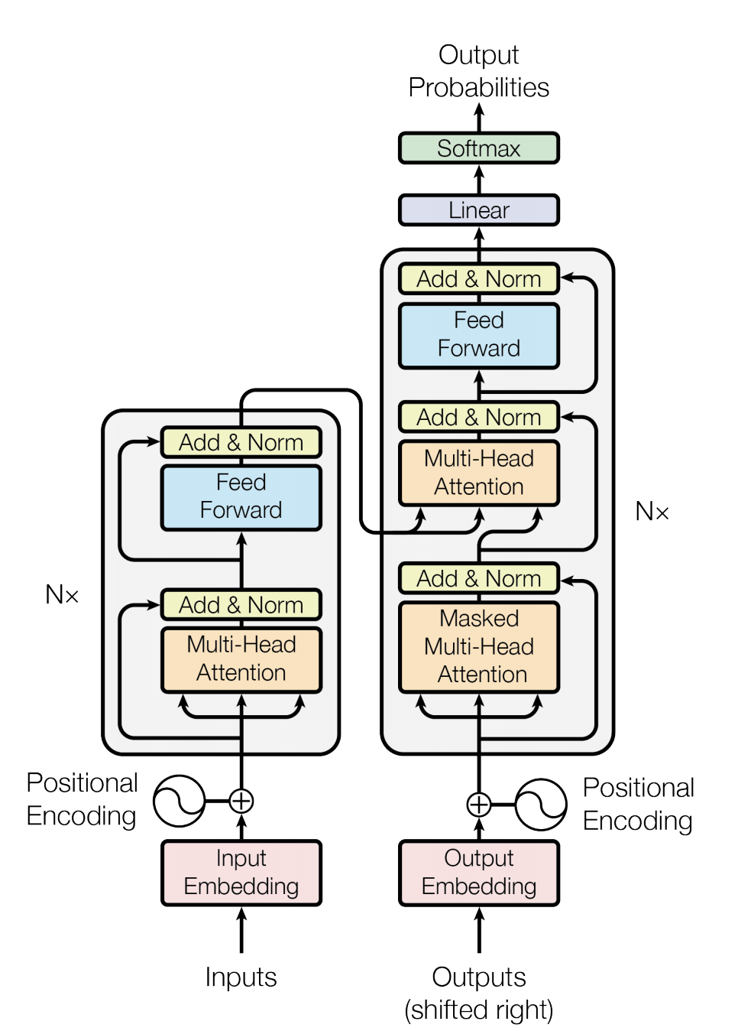
We can also draw this as in the paper:
Vaswani et al. Attention is all you need
https://arxiv.org/abs/1706.03762

Slide 11
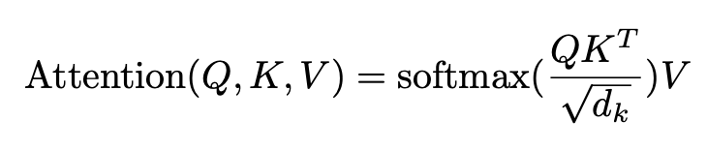
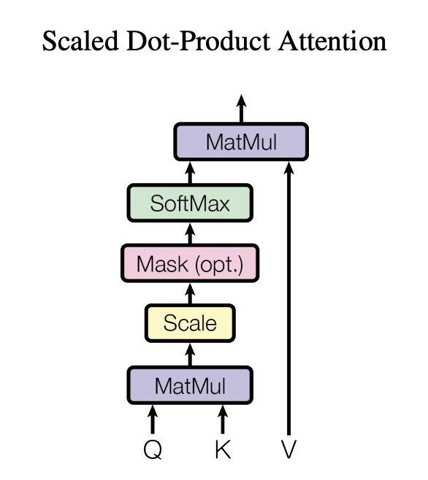
Regular Attention: + Scaling factor
Vaswani et al. Attention is all you need
https://arxiv.org/abs/1706.03762

Slide 12







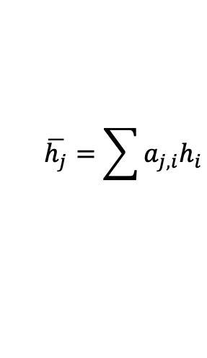









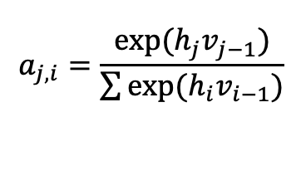

This is not unlike what we already used before
Only showing the third time step encoder-decoder connection
The
world
is
not
enough
<END>
Q: those are v’s here
V: those are h’s here
K: those are h’s here
$$y_{1}$$
$$y_{2}$$
$$y_{3}$$
$$y_{4}$$
$$y_{5}$$
$$y_{6}$$
$$h_{1}$$
$$h_{2}$$
$$h_{3}$$
$$h_{4}$$
$$h_{5}$$
$$h_{6}$$
$$v_{0}$$
RNN
$$v_{1}$$
RNN
$$v_{2}$$
RNN
$$v_{3}$$
RNN
$$v_{4}$$
RNN
$$v_{5}$$
RNN
$$x_{1}$$
$$x_{2}$$
$$x_{3}$$
$$x_{4}$$
$$x_{5}$$
$$x_{6}$$
The
world
is
not
enough
$$\overline{h}$$
$$h_{1}$$
$$h_{2}$$
$$h_{3}$$
$$h_{4}$$
$$h_{5}$$
$$h_{6}$$
$$\overline{h_{j}}=\sum{a_{j,i}h_{i}}$$
RNN
RNN
RNN
RNN
RNN
RNN
such that:
$$h_{0}$$
$$h_{1}$$
$$h_{2}$$
$$h_{3}$$
$$h_{4}$$
$$h_{5}$$
$$a_{j,i}=\frac{exp⁡(h_{j}v_{j−1})}{\sum{exp⁡(h_{i}v_{i−1})}}$$
$$x_{1}$$
$$x_{2}$$
$$x_{3}$$
$$x_{4}$$
$$x_{5}$$
$$x_{6}$$
<START>
El
mundo
no
es
suficiente

Slide 13
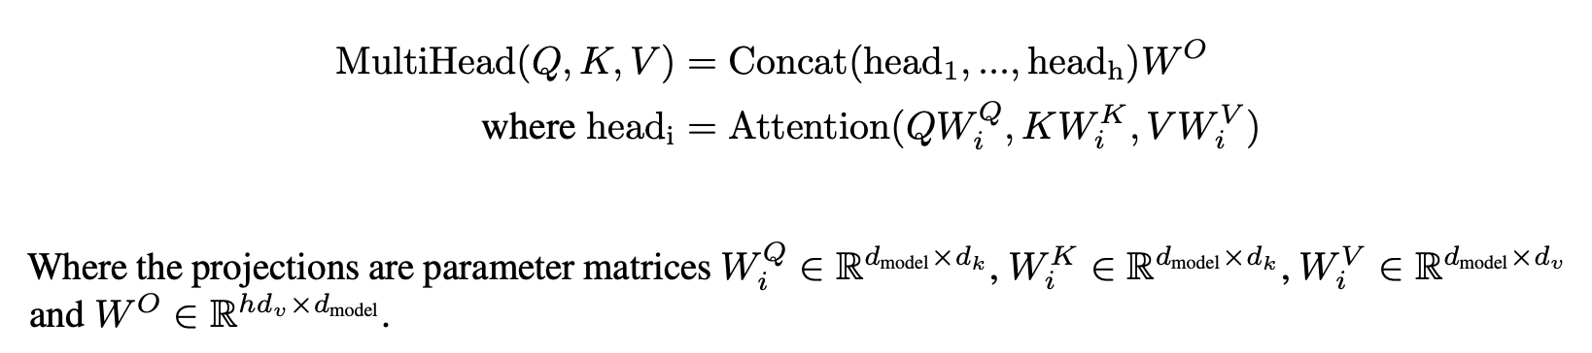
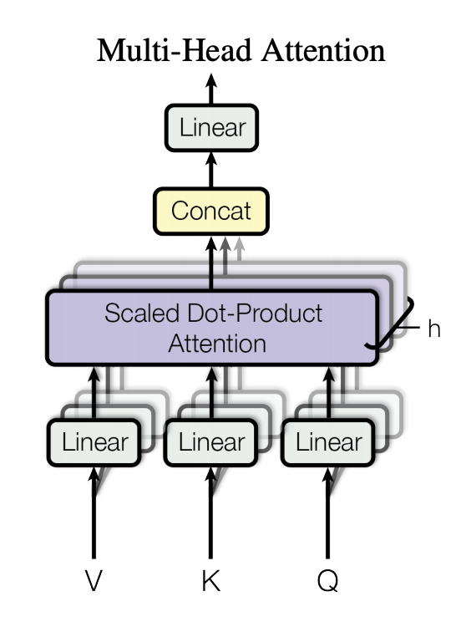
Multi-head Attention: Do not settle for just one set of attention weights.
Vaswani et al. Attention is all you need
https://arxiv.org/abs/1706.03762

Slide 14
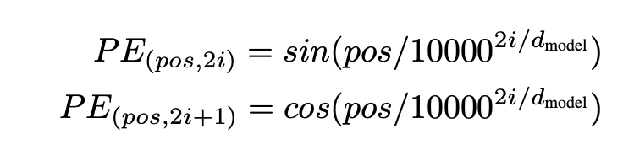
We can lose track of position since we are aggregating across all locations
Vaswani et al. Attention is all you need
https://arxiv.org/abs/1706.03762

Slide 15
Attention is All you Need (no RNNs)
Vaswani et al. Attention is all you need
https://arxiv.org/abs/1706.03762
Decoder
Encoder
Fixed number of input tokens
[but hey! we can always define a large enough length and add mask tokens]

Slide 16
Attention is All you Need (no RNNs)
Vaswani et al. Attention is all you need
https://arxiv.org/abs/1706.03762
Decoder
Encoder
Fixed number of input tokens
[but hey! we can always define a large enough length and add mask tokens]

Slide 17
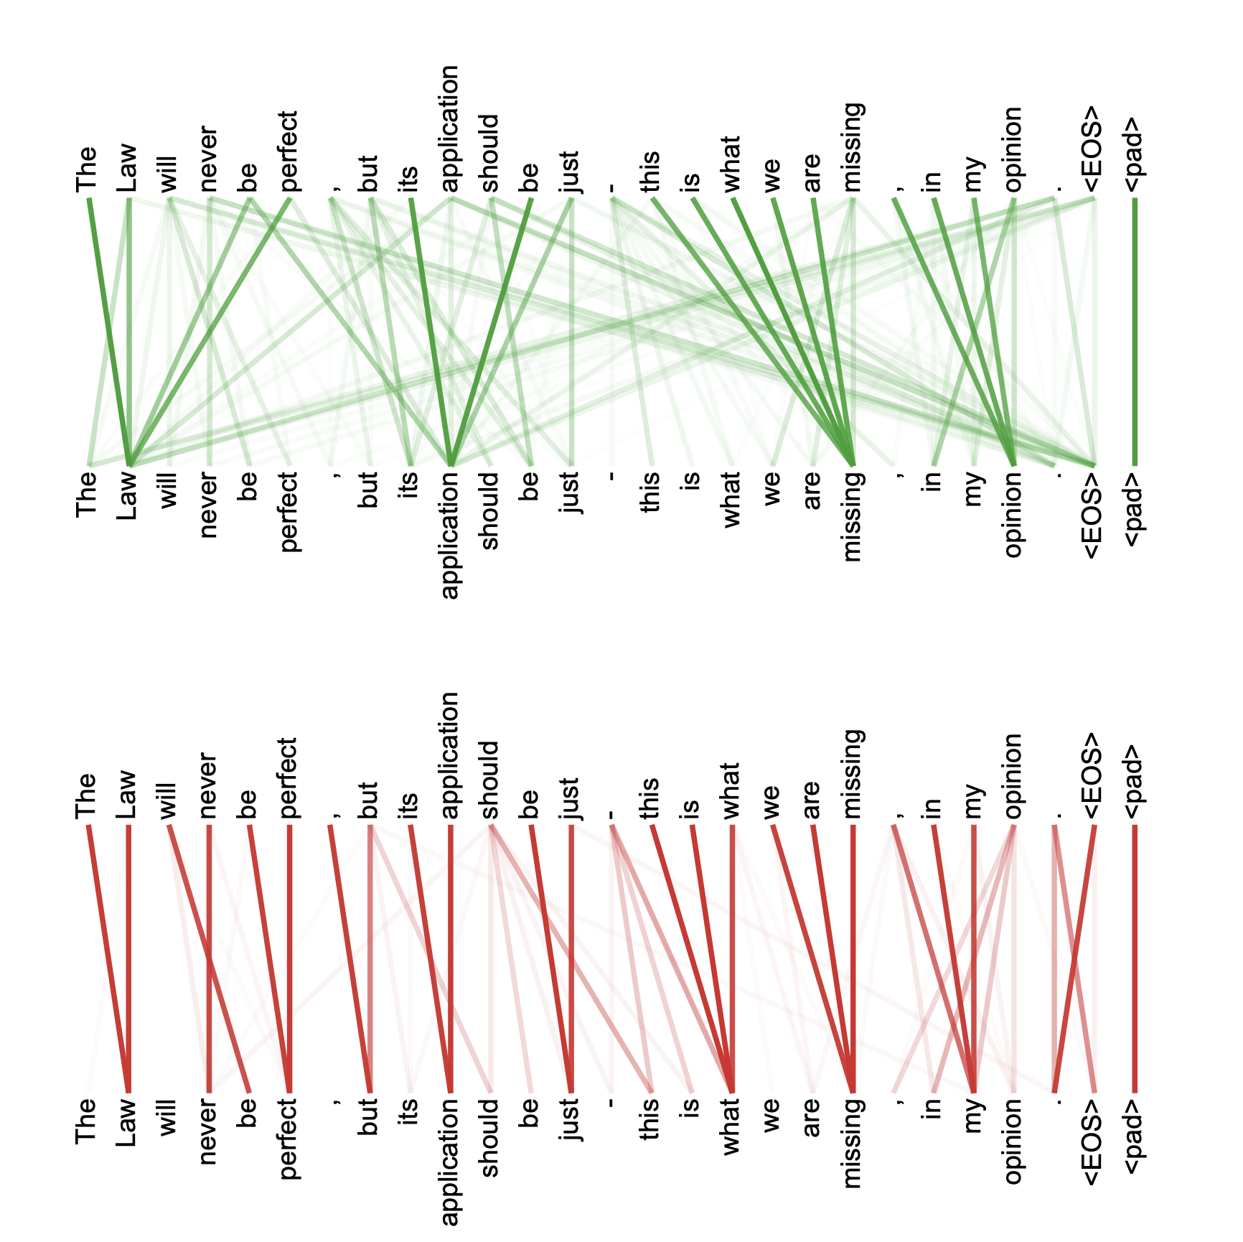
Multi-headed attention weights are harder to interpret obviously

Slide 18
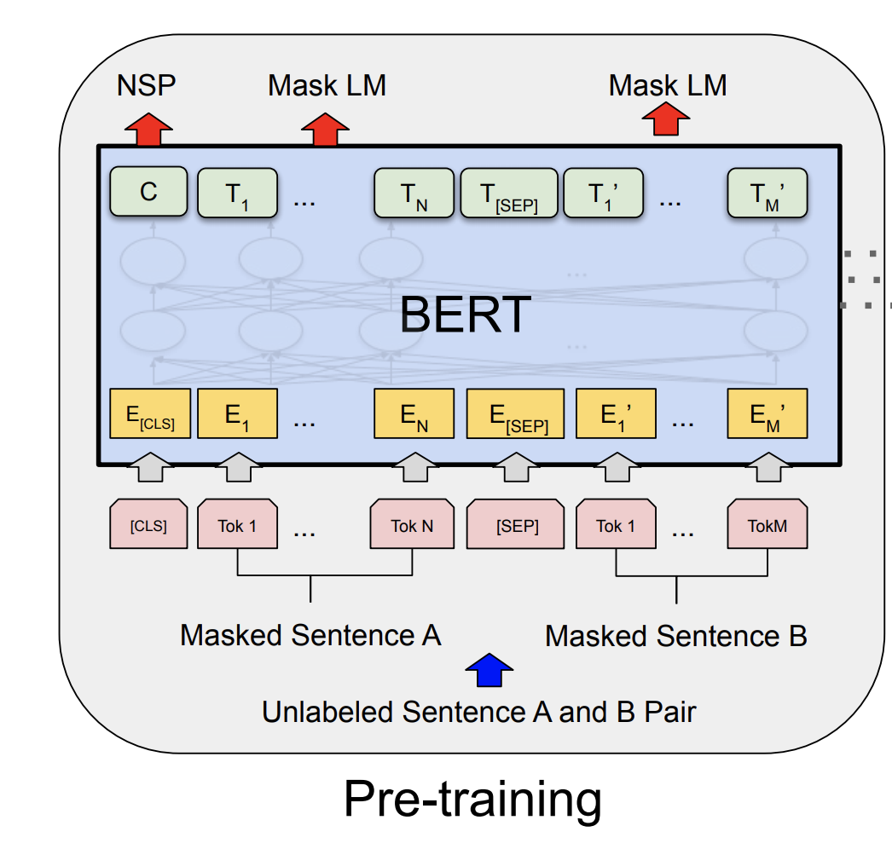
The BERT Encoder Model
Devlin et al. BERT: Pre-training of Deep Bidirectional Transformers for Language Understanding . https://arxiv.org/abs/1810.04805
Important things to know
No decoder
Train the model to fill-in-the-blank by masking some of the input tokens and trying to recover the full sentence.
The input is not one sentence but two sentences separated by a [SEP] token.
Also try to predict whether these two input sentences are consecutive or not.

Slide 19
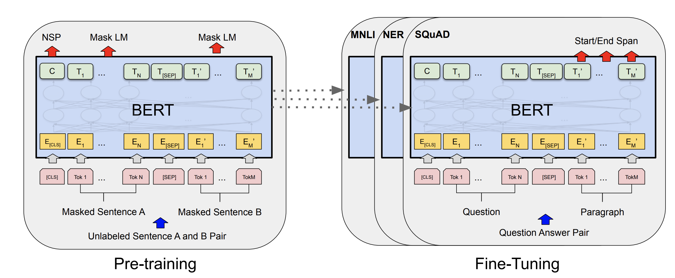
The BERT Encoder Model
Devlin et al. BERT: Pre-training of Deep Bidirectional Transformers for Language Understanding . https://arxiv.org/abs/1810.04805

Slide 20
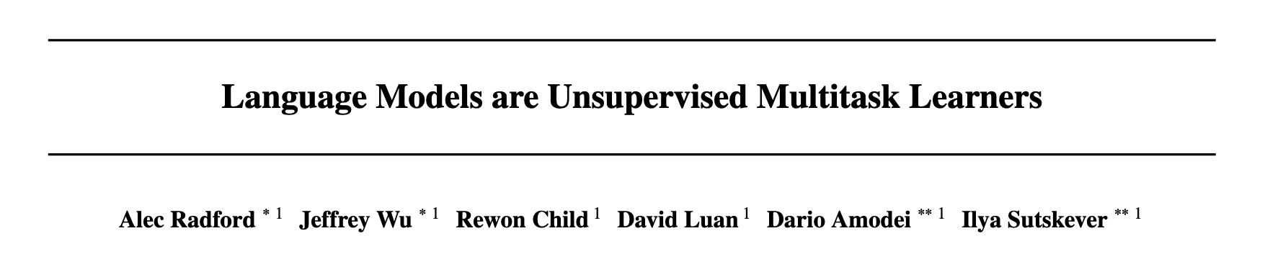
The GPT-2 Model
https://openai.com/blog/better-language-models/

Slide 21
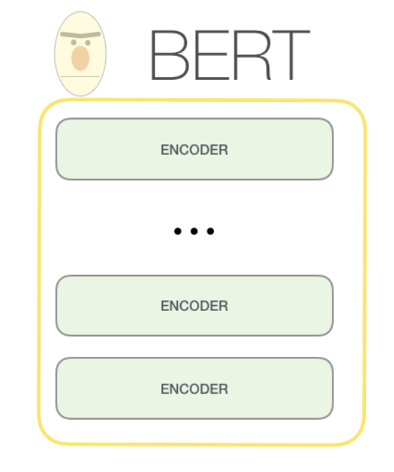
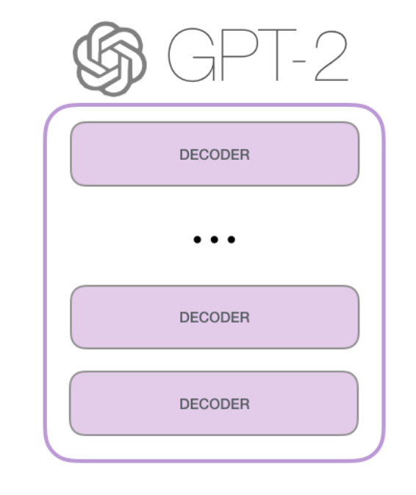
The GPT-2 Model
https://jalammar.github.io/illustrated-gpt2/

Slide 22
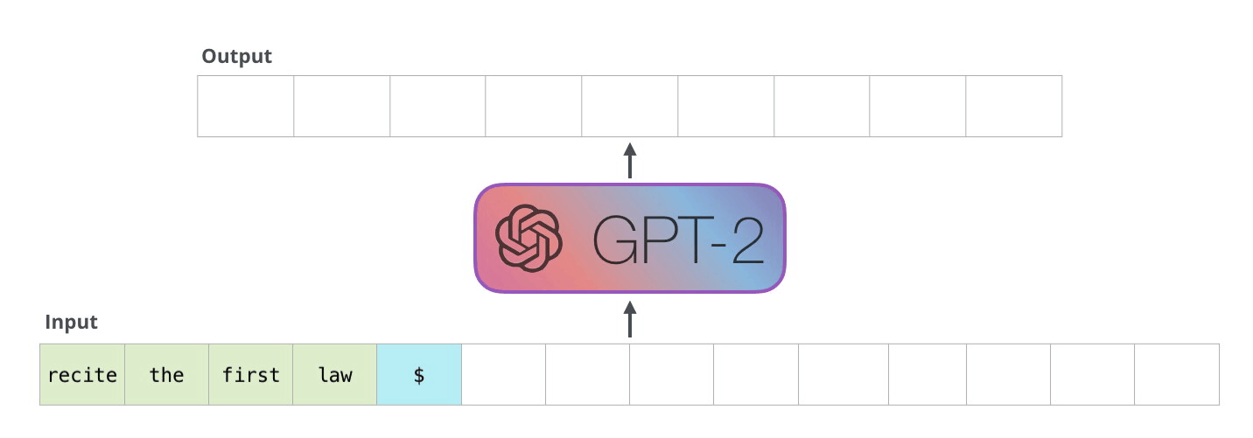
The GPT-2 Model
https://jalammar.github.io/illustrated-gpt2/

Slide 23
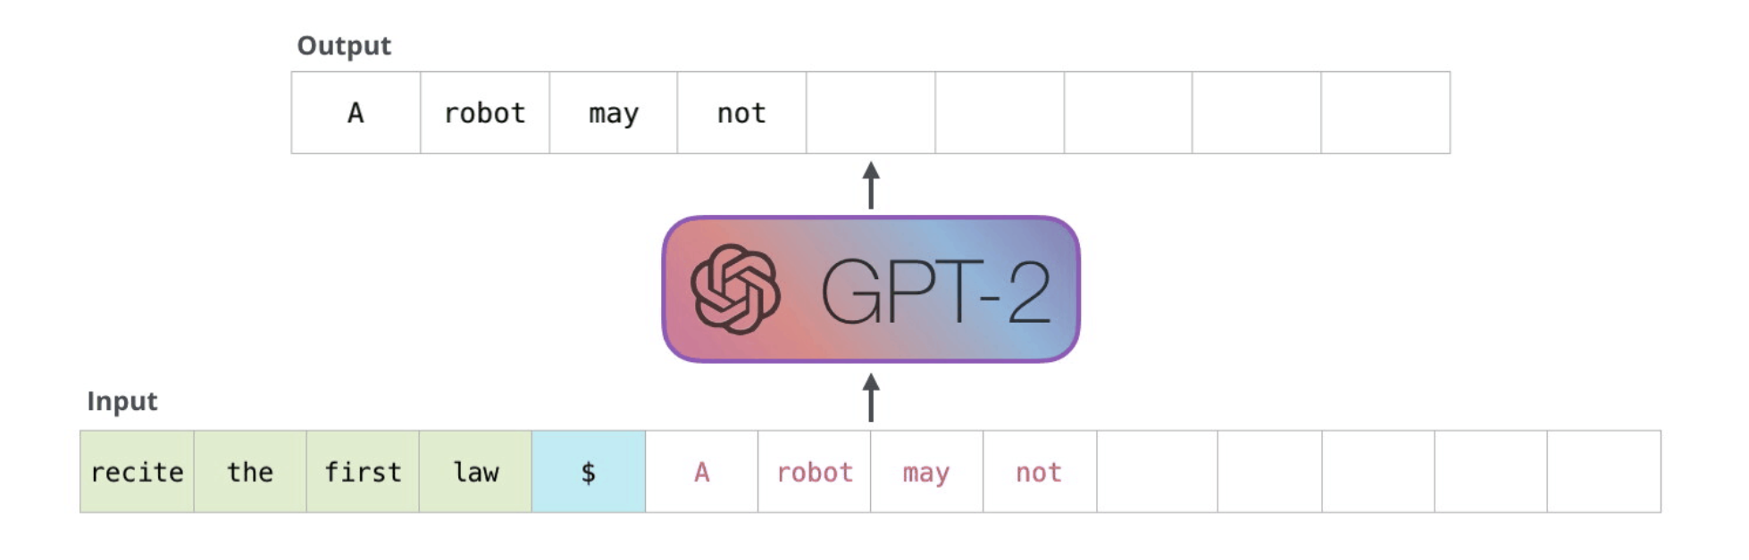
The GPT-2 Model
https://jalammar.github.io/illustrated-gpt2/

Slide 24
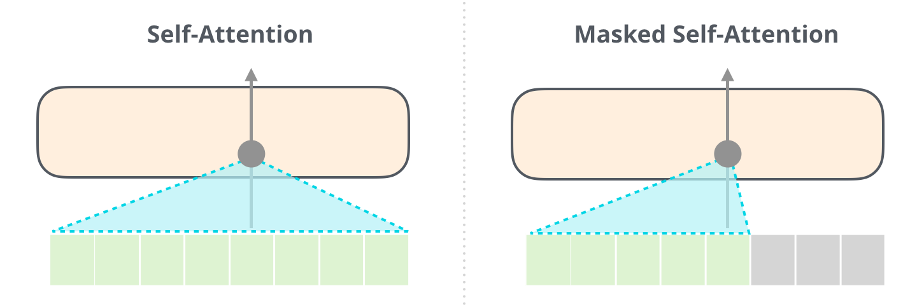
The GPT-2 Model
BERT
GPT
https://jalammar.github.io/illustrated-gpt2/

Slide 25
GPT-1 vs GPT-2 vs GPT-3
 | GPT-1 | GPT-2 | GPT-3
Parameters | 117 Million | 1.5 Billion | 175 Billion
Decoder Layers | 12 | 48 | 96
Context Token Size | 512 | 1024 | 2048
Hidden Layer | 768 | 1600 | 12288
Batch Size | 64 | 512 | 3.2M
https://360digitmg.com/blog/types-of-gpt-in-artificial-intelligence

Slide 26
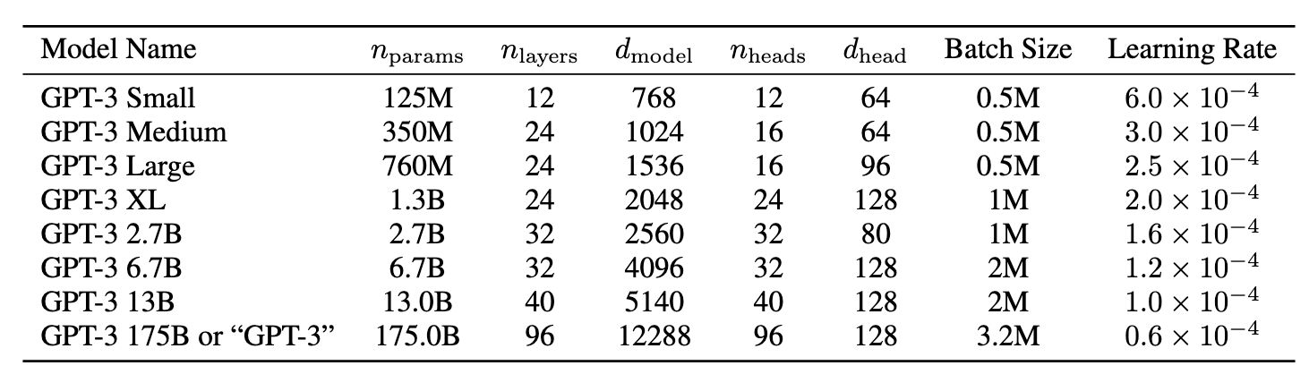
GPT-3
https://arxiv.org/abs/2005.14165

Slide 27
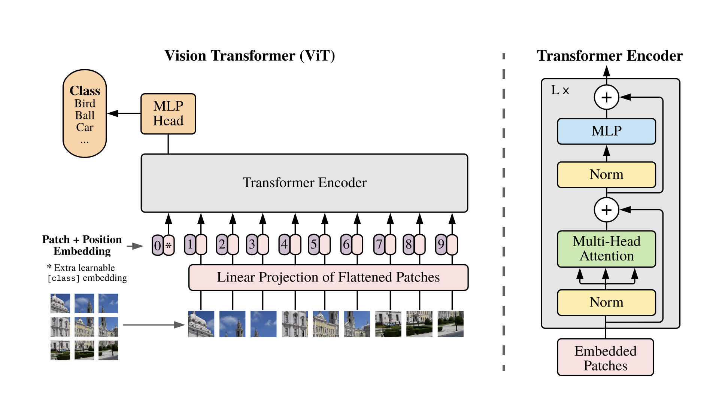
Vision Transformers
https://arxiv.org/abs/2010.11929
An Image is Worth 16x16 Words: Transformers for Image Recognition at Scale
Alexey Dosovitskiy, Lucas Beyer, Alexander Kolesnikov, Dirk Weissenborn, Xiaohua Zhai, Thomas Unterthiner, Mostafa Dehghani, Matthias Minderer, Georg Heigold, Sylvain Gelly, Jakob Uszkoreit, Neil Houlsby

Slide 28
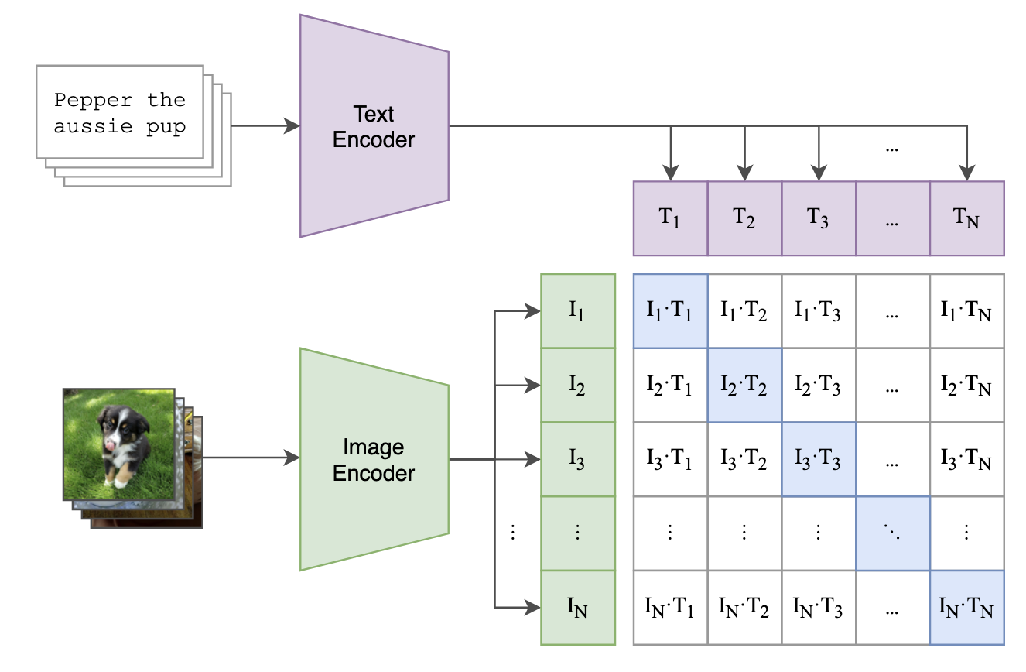
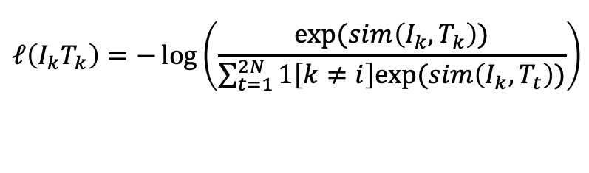
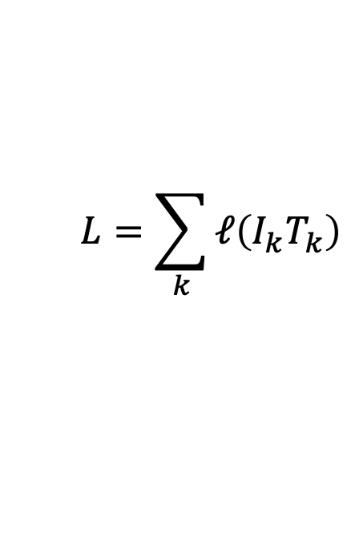
The CLIP Model
$$L=\sum_{k}{ℓ\left(I_{k}T_{k}\right)}$$
$$ℓ\left(I_{k}T_{k}\right)=−\log\left(\frac{exp⁡(sim\left(I_{k}, T_{k}\right))}{\sum_{t=1}^{2N}{1\left[k≠i\right]exp⁡(sim\left(I_{k}, T_{t}\right))}}\right)$$
https://arxiv.org/abs/2103.00020
Learning Transferable Visual Models From Natural Language Supervision
Alec Radford, Jong Wook Kim, Chris Hallacy, Aditya Ramesh, Gabriel Goh, Sandhini Agarwal, Girish Sastry, Amanda Askell, Pamela Mishkin, Jack Clark, Gretchen Krueger, Ilya Sutskever

Slide 29
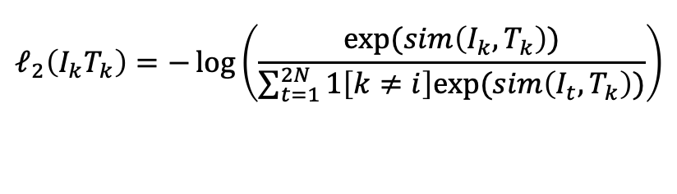
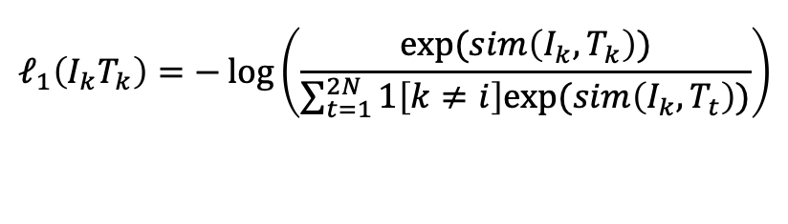
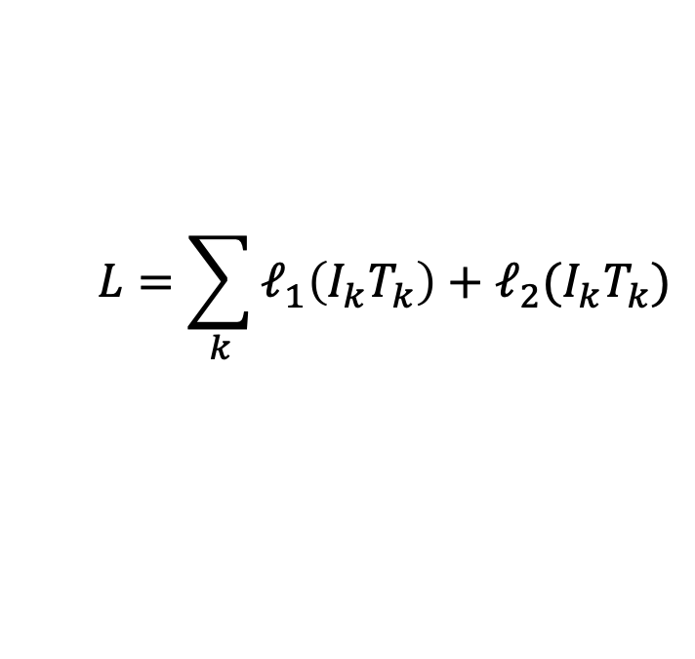
The CLIP Model
$$L=\sum_{k}{ℓ_{1}\left(I_{k}T_{k}\right)+ℓ_{2}(I_{k}T_{k})}$$
$$ℓ_{1}\left(I_{k}T_{k}\right)=−\log\left(\frac{exp⁡(sim\left(I_{k}, T_{k}\right))}{\sum_{t=1}^{2N}{1\left[k≠i\right]exp⁡(sim\left(I_{k}, T_{t}\right))}}\right)$$
$$ℓ_{2}\left(I_{k}T_{k}\right)=−\log\left(\frac{exp⁡(sim\left(I_{k}, T_{k}\right))}{\sum_{t=1}^{2N}{1\left[k≠i\right]exp⁡(sim\left(I_{t}, T_{k}\right))}}\right)$$
https://arxiv.org/abs/2103.00020
Learning Transferable Visual Models From Natural Language Supervision
Alec Radford, Jong Wook Kim, Chris Hallacy, Aditya Ramesh, Gabriel Goh, Sandhini Agarwal, Girish Sastry, Amanda Askell, Pamela Mishkin, Jack Clark, Gretchen Krueger, Ilya Sutskever

Slide 30
Questions?

