Slide 1
Deep Learning for Vision & Language
Convolutional Neural Networks for Segmentation

Slide 2
Final Project
PDF Project report (4 pages)
Template: https://www.overleaf.com/read/fyjndmqhghjg
Link to source code / github or google drive or dropbox links to code.
5 slides presenting your work -- ideally a video of you walking me through your project in case I have trouble running it or understanding your report [Motivation] [Problem Setup] [Model] [Experiments] [Results]

Slide 3
Semantic Segmentation / Image Parsing
deer
cat
trees
grass

Slide 4
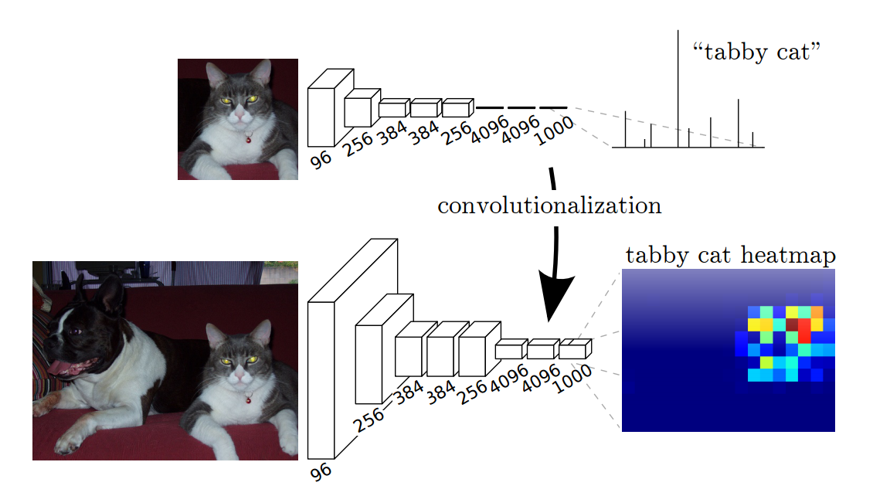
Idea 1: Convolutionalization
However resolution of the segmentation map is low.
https://people.eecs.berkeley.edu/~jonlong/long_shelhamer_fcn.pdf

Slide 5
Alexnet
https://www.saagie.com/fr/blog/object-detection-part1

Slide 6

Idea 1: Convolutionalization
$$≡$$

Slide 7
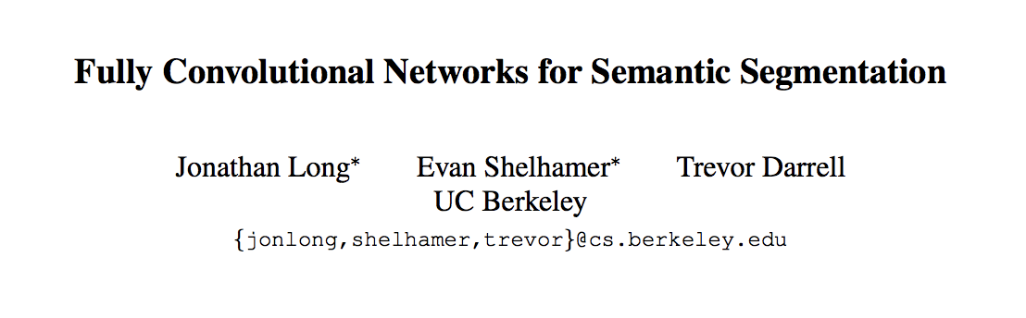
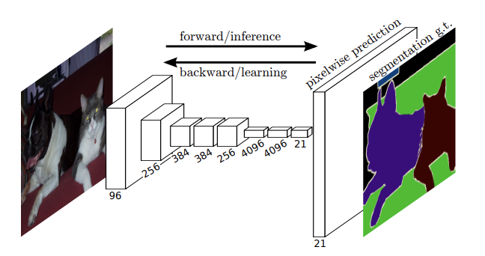
Fully Convolutional Networks (CVPR 2015)

Slide 8
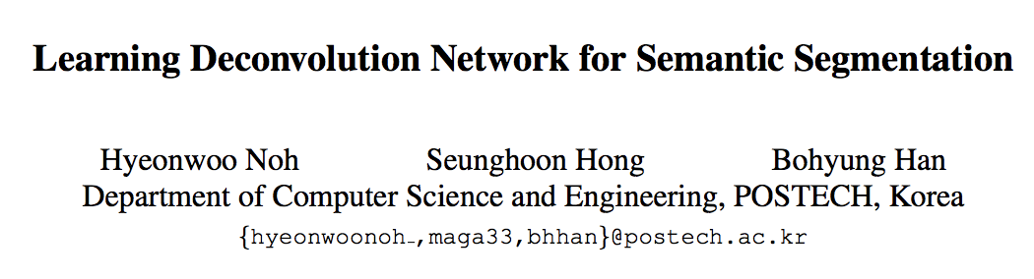
Idea 2: Up-sampling Convolutions or ”Deconvolutions”
http://cvlab.postech.ac.kr/research/deconvnet/

Slide 9
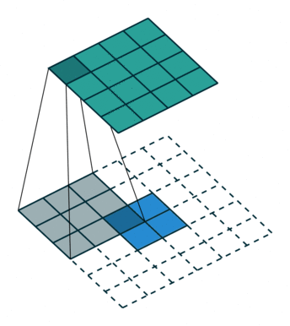
Idea 2: Up-sampling Convolutions or ”Deconvolutions”
https://github.com/vdumoulin/conv_arithmetic

Slide 10
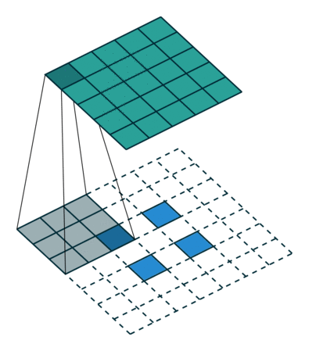
Idea 2: Up-sampling Convolutions or ”Deconvolutions”
https://github.com/vdumoulin/conv_arithmetic

Slide 11
Idea 2: Up-sampling Convolutions or ”Deconvolutions”
Deconvolutional Layers
Upconvolutional Layers
Backwards Strided Convolutional Layers
Fractionally Strided Convolutional Layers
Transposed Convolutional Layers
Spatial Full Convolutional Layers

Slide 12
Convolutional Layer in pytorch
kernel_size
Input
out_channels x
Output
kernel_size
in_channels
out_channels (equals the number of convolutional filters for this layer)
in_channels (e.g. 3 for RGB inputs)

Slide 13
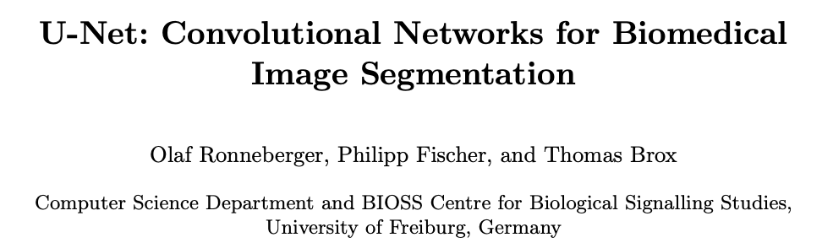
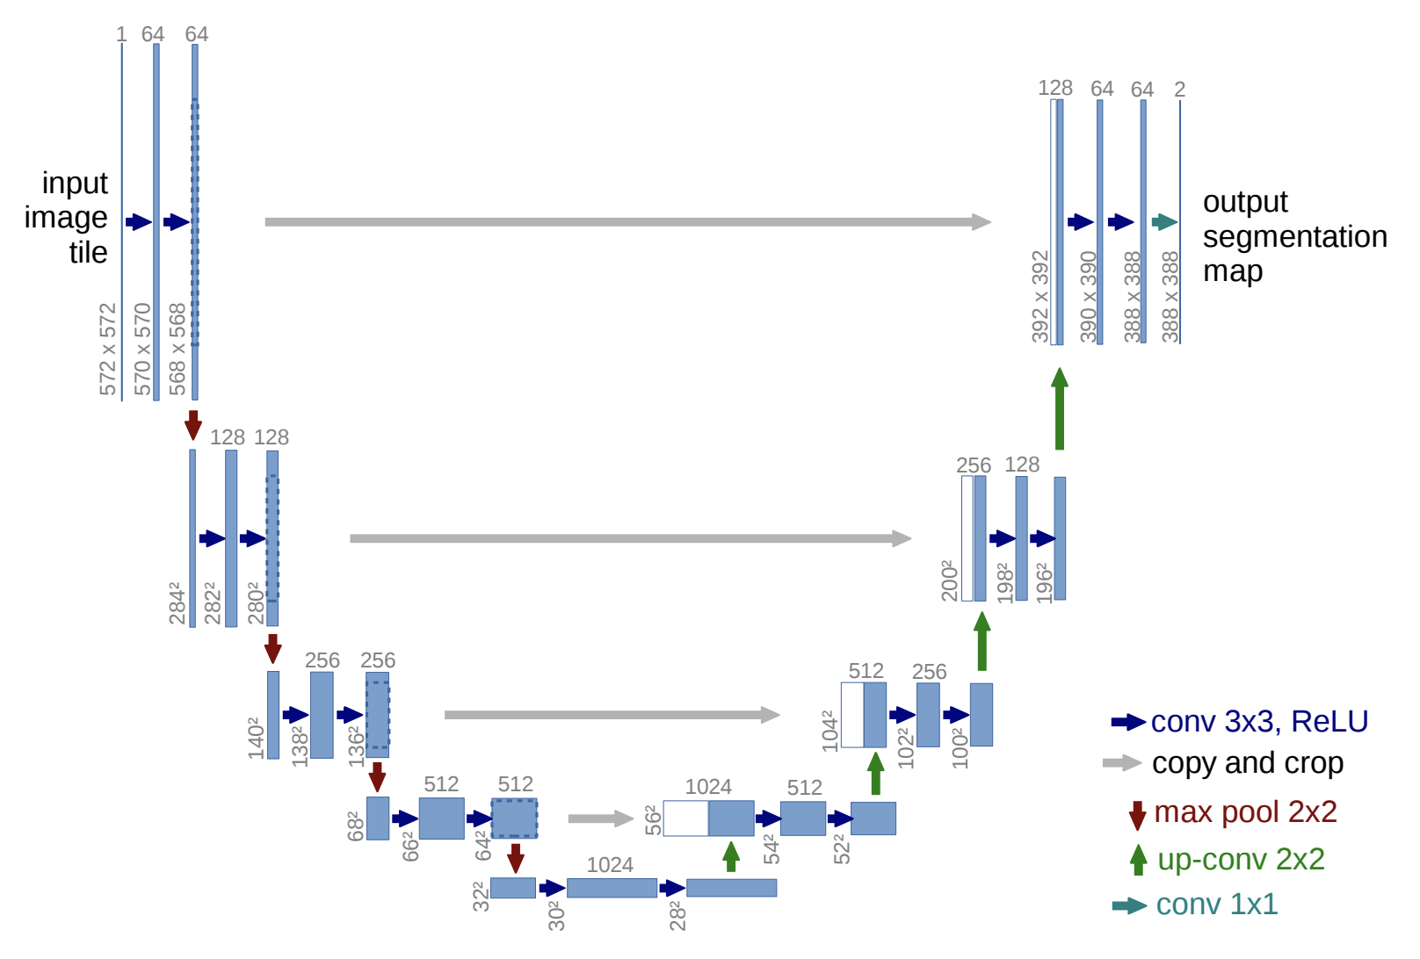
https://arxiv.org/abs/1505.04597
https://github.com/milesial/Pytorch-UNet
https://github.com/usuyama/pytorch-unet

Slide 14
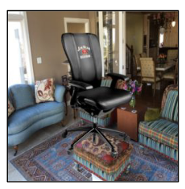

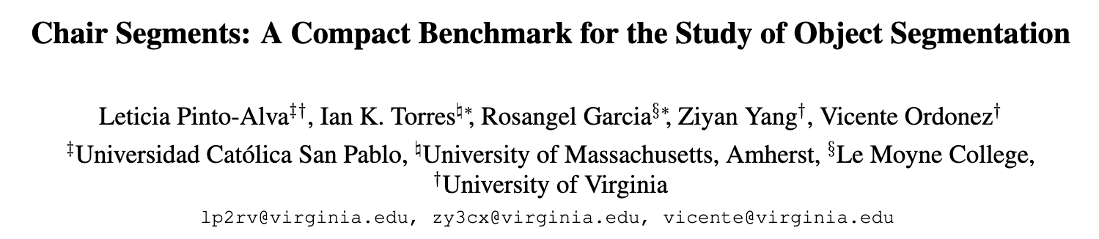
Chair segmentation - Training

Slide 15
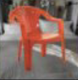

Chair segmentation - Prediction

Slide 16
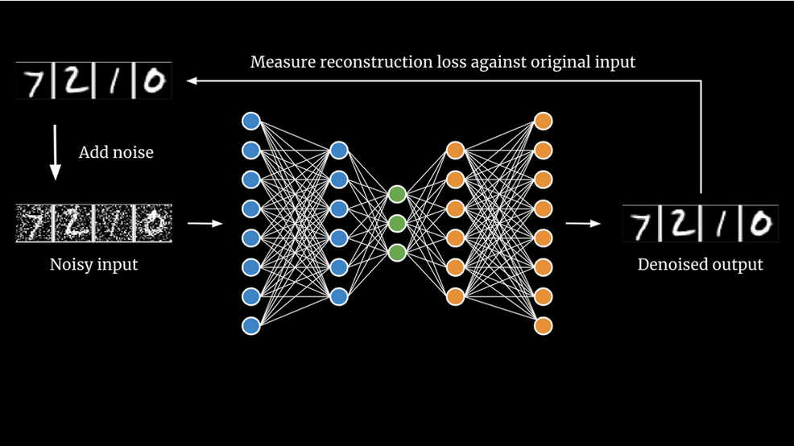
AutoEncoders
https://www.saberhq.com/blog/autoencoders

Slide 17
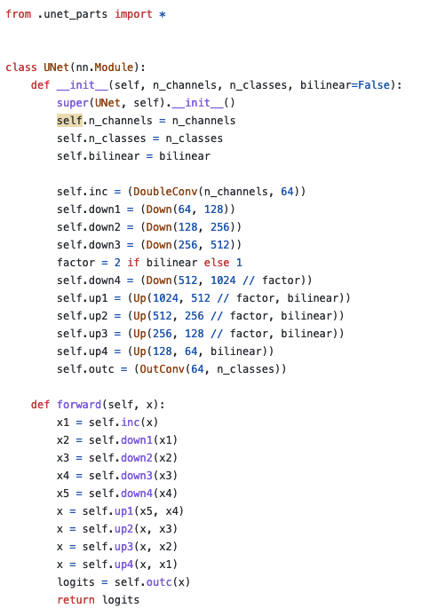
UNet in Pytorch

Slide 18
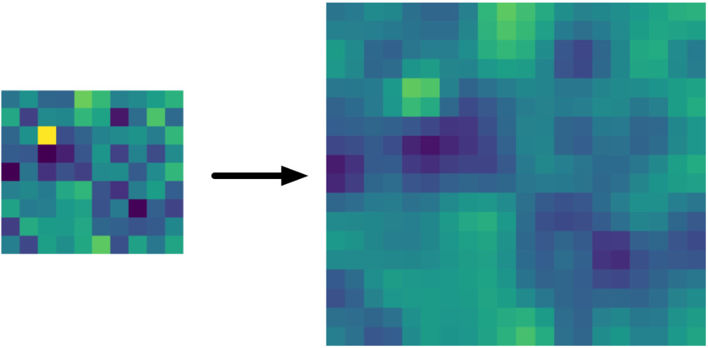
Bilinear Upsampling Layer
https://machinethink.net/blog/coreml-upsampling/

Slide 19
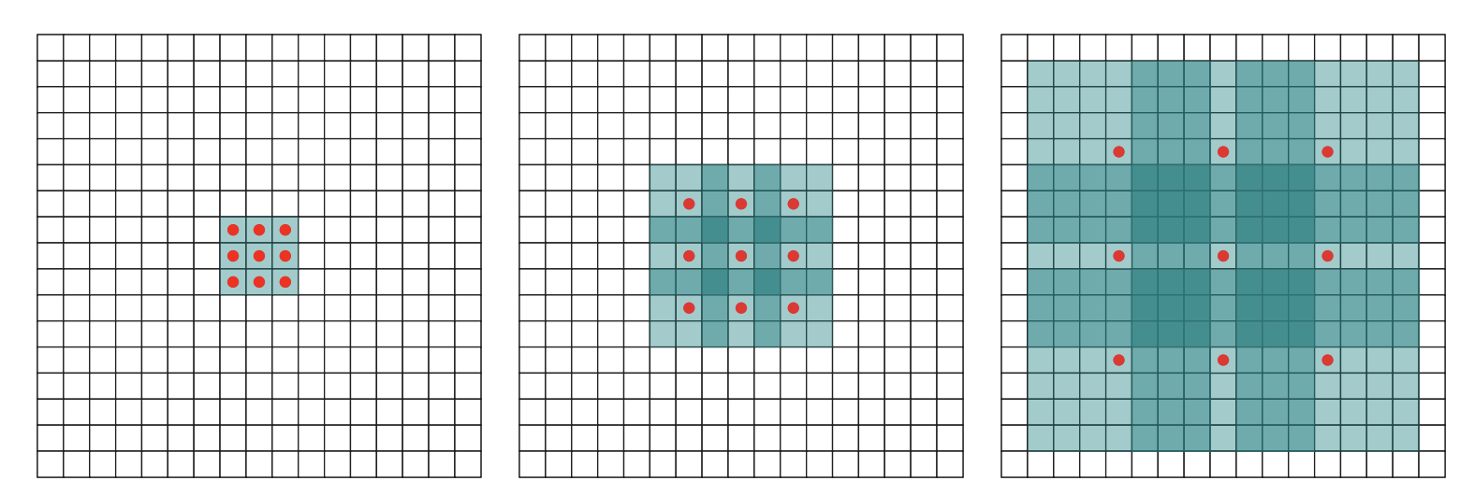
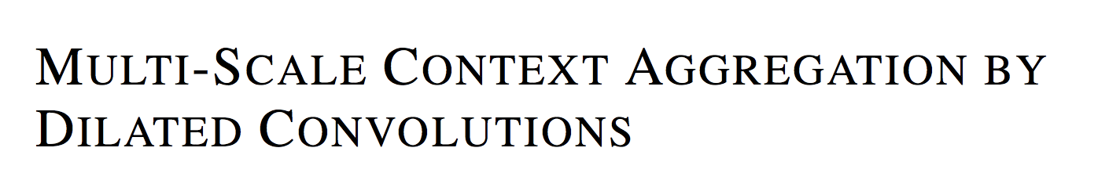
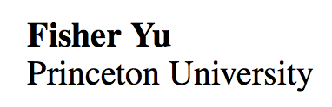
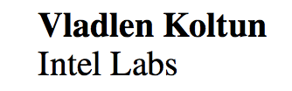
Idea 3: Dilated Convolutions
ICLR 2016

Slide 20
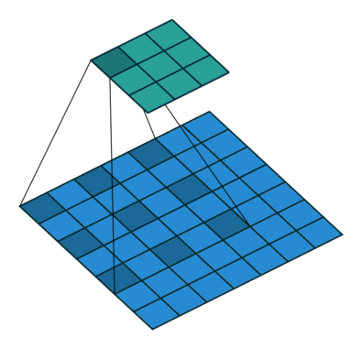
Idea 3: Dilated Convolutions
ICLR 2016

Slide 21

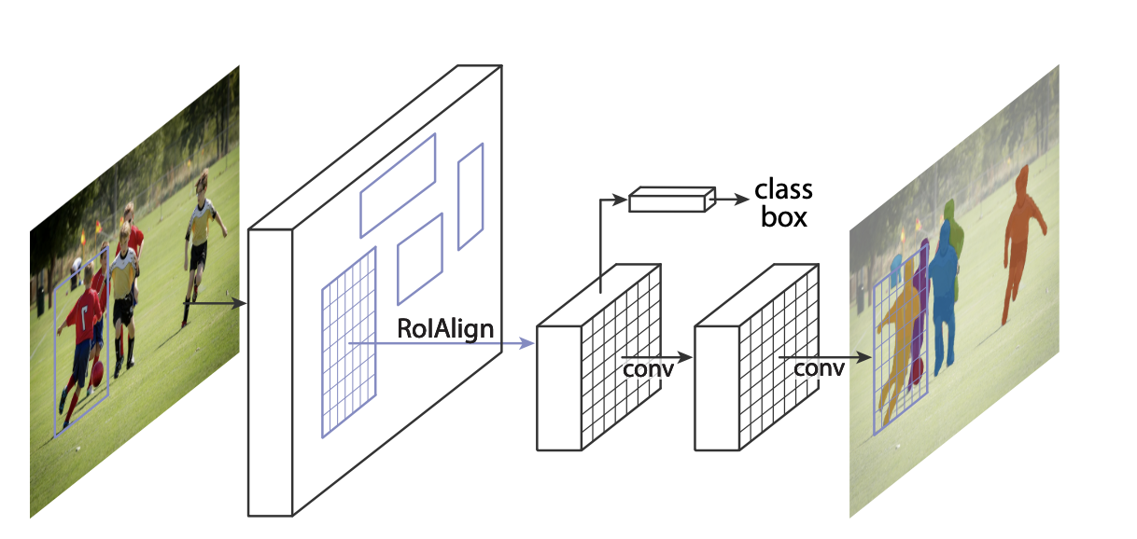
https://github.com/facebookresearch/detectron2
https://arxiv.org/abs/1703.06870

Slide 22
Questions

