Slide 1
Deep Learning for Vision & Language
Generative Adversarial Networks, Text-to-Scene Introduction

Slide 2





Recap RNNs for your Assignment
$$h_{1}=tanh⁡(W_{hh}h_{0}+W_{hx}x_{1})$$
$$h_{0}$$
$$RNN$$
$$h_{1}$$
$$x_{1}$$

Slide 3
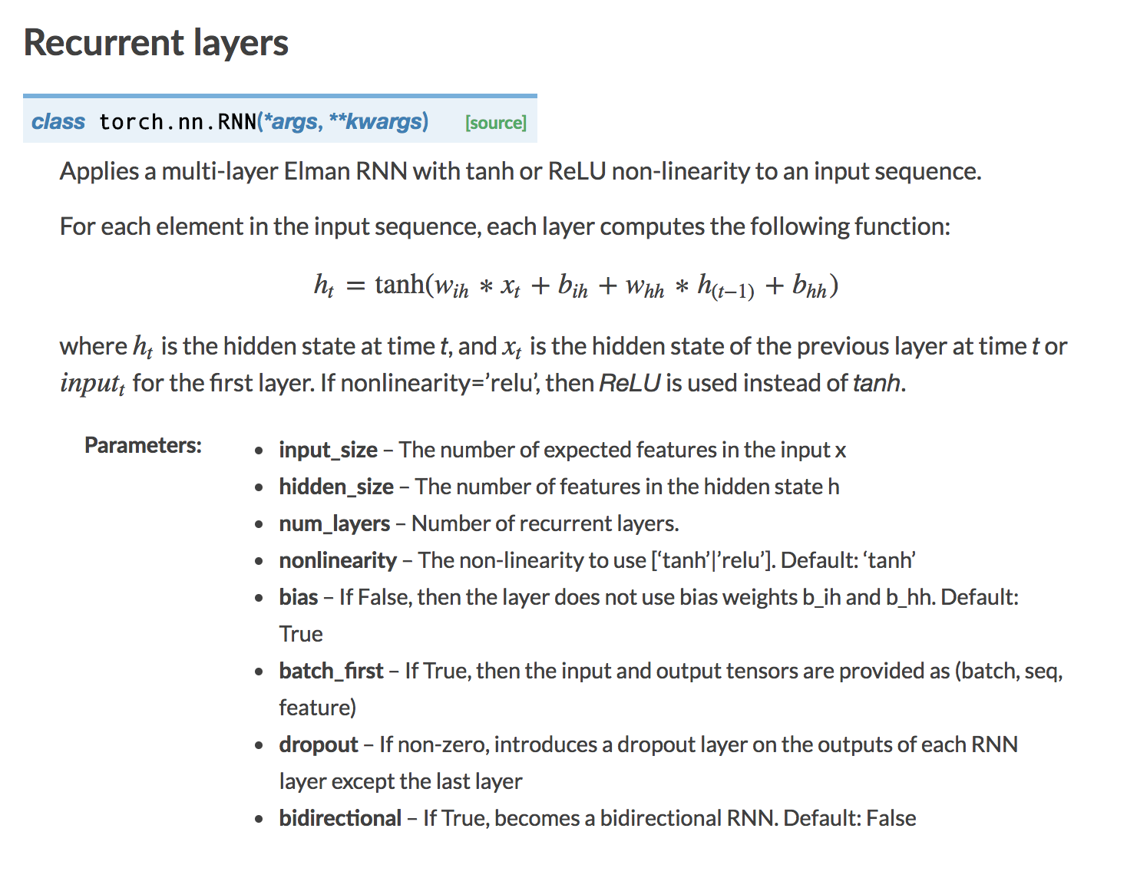
RNN in Pytorch

Slide 4





LSTM Cell (Long Short-Term Memory)
$$h_{0}$$
$$h_{1}$$
$$LSTM$$
$$c_{0}$$
$$c_{1}$$
$$x_{1}$$
https://ieeexplore.ieee.org/abstract/document/6795963

Slide 5
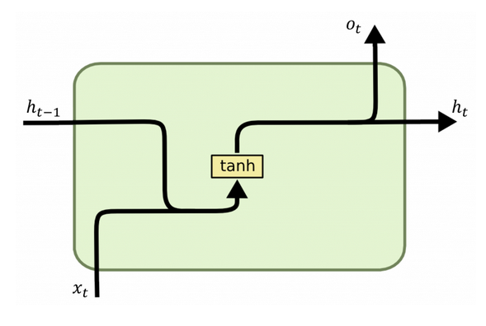
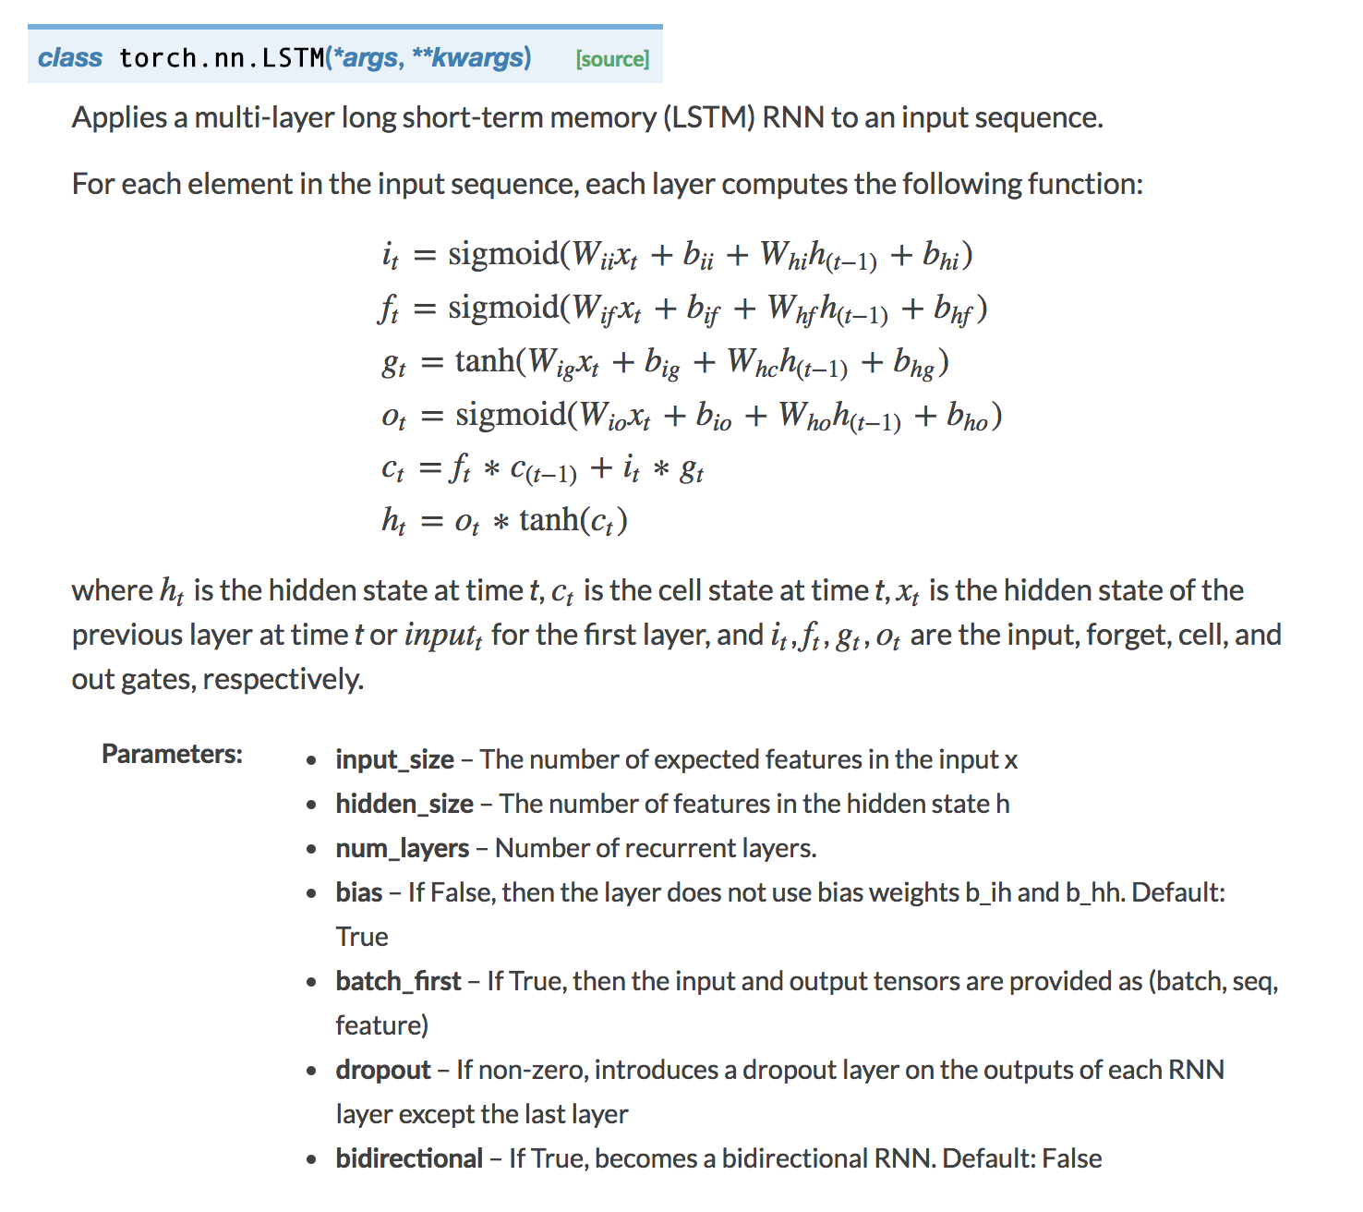
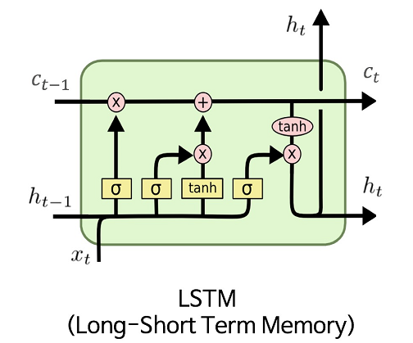
LSTM in Pytorch
RNN
https://colah.github.io/posts/2015-08-Understanding-LSTMs/

Slide 6
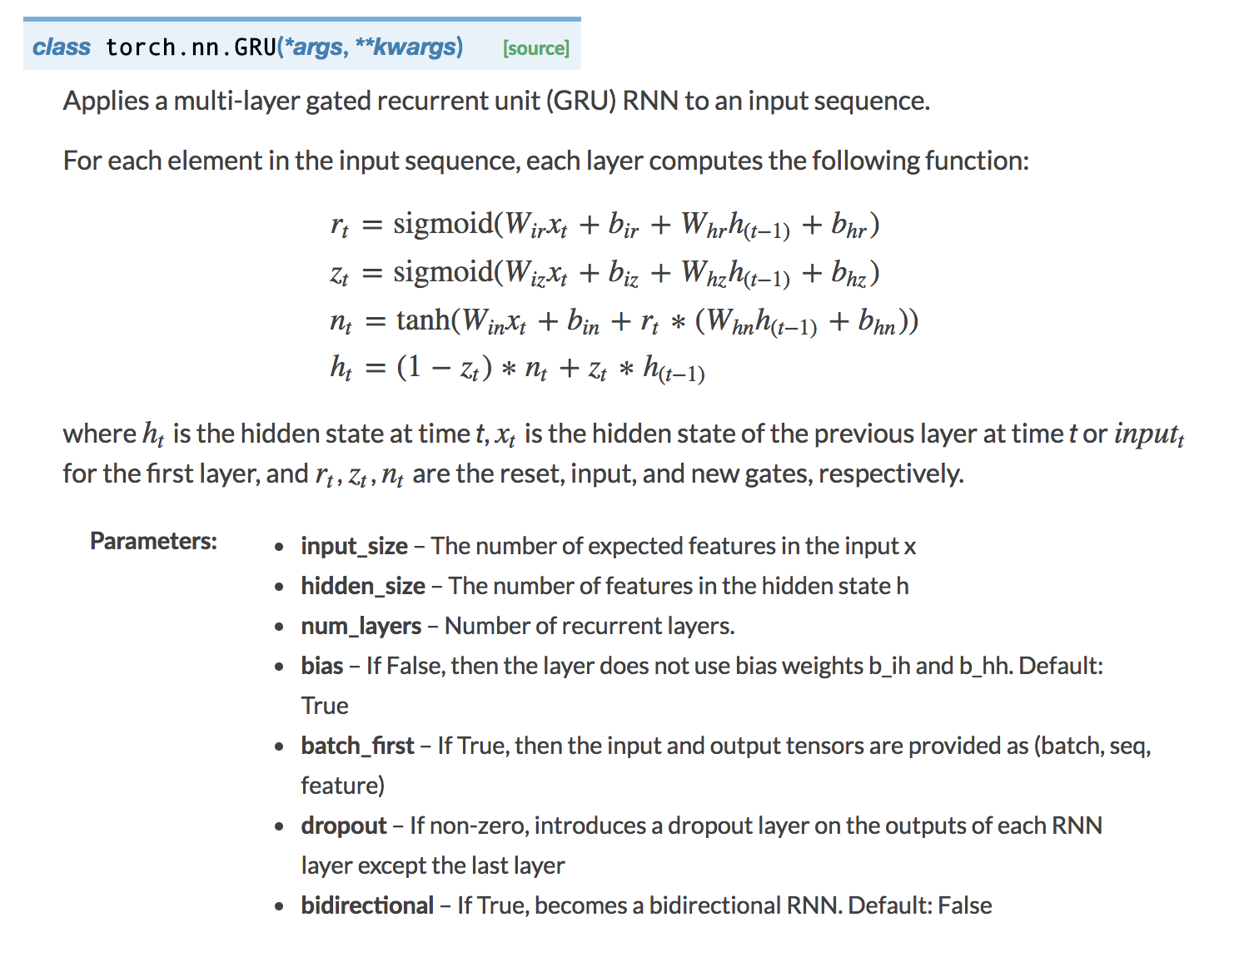
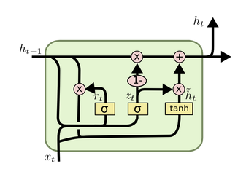
GRU in Pytorch
RNN
https://colah.github.io/posts/2015-08-Understanding-LSTMs/

Slide 7
Today’s Class
Adversarial Examples – Input Optimization
Generative Adversarial Networks (GANs)
Conditional GANs

Slide 8
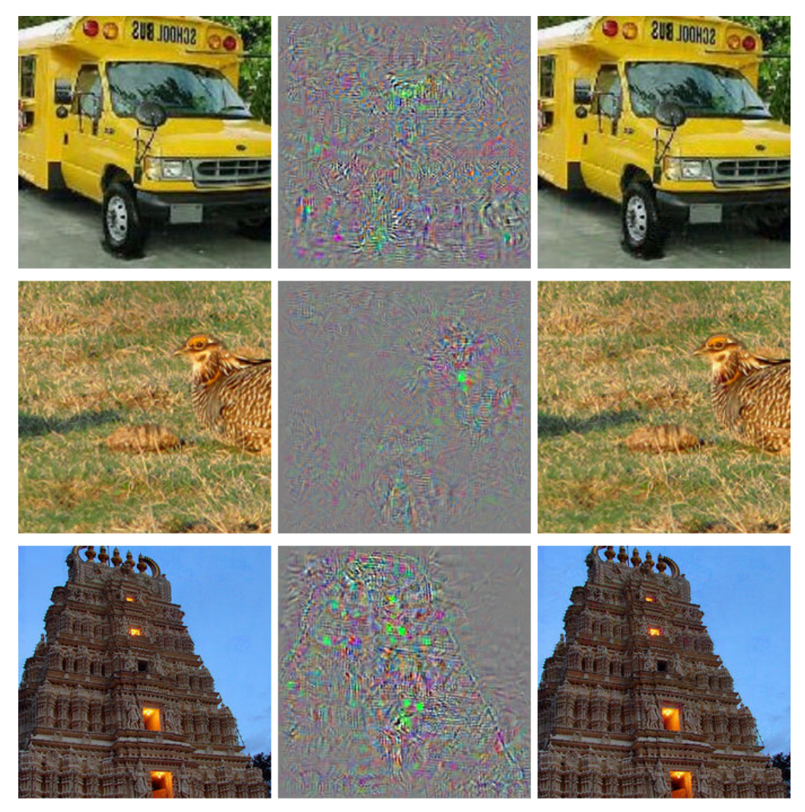



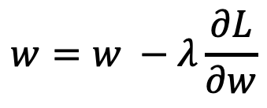
What we have been doing: Optimize weights in the network to predict bus (correct class).
$$I$$
$$y=f(I;w)$$
$$L(y, bus)$$
bus
$$w=w −λ\frac{∂L}{∂w}$$

Slide 9

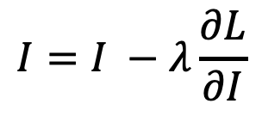
New Idea: Create Adversarial Inputs by optimizing the input image to predict ostrich (wrong class).
$$I$$
$$y=f(I;w)$$
$$L(y, ostrich)$$
ostrich
$$I=I −λ\frac{∂L}{∂I}$$
Work on Adversarial examples by Goodfellow et al. , Szegedy et. al., etc.

Slide 10
Convnets (optimize input to predict ostrich)
ostrich
Work on Adversarial examples by Goodfellow et al. , Szegedy et. al., etc.

Slide 12
All get predicted as ostrich

Slide 13
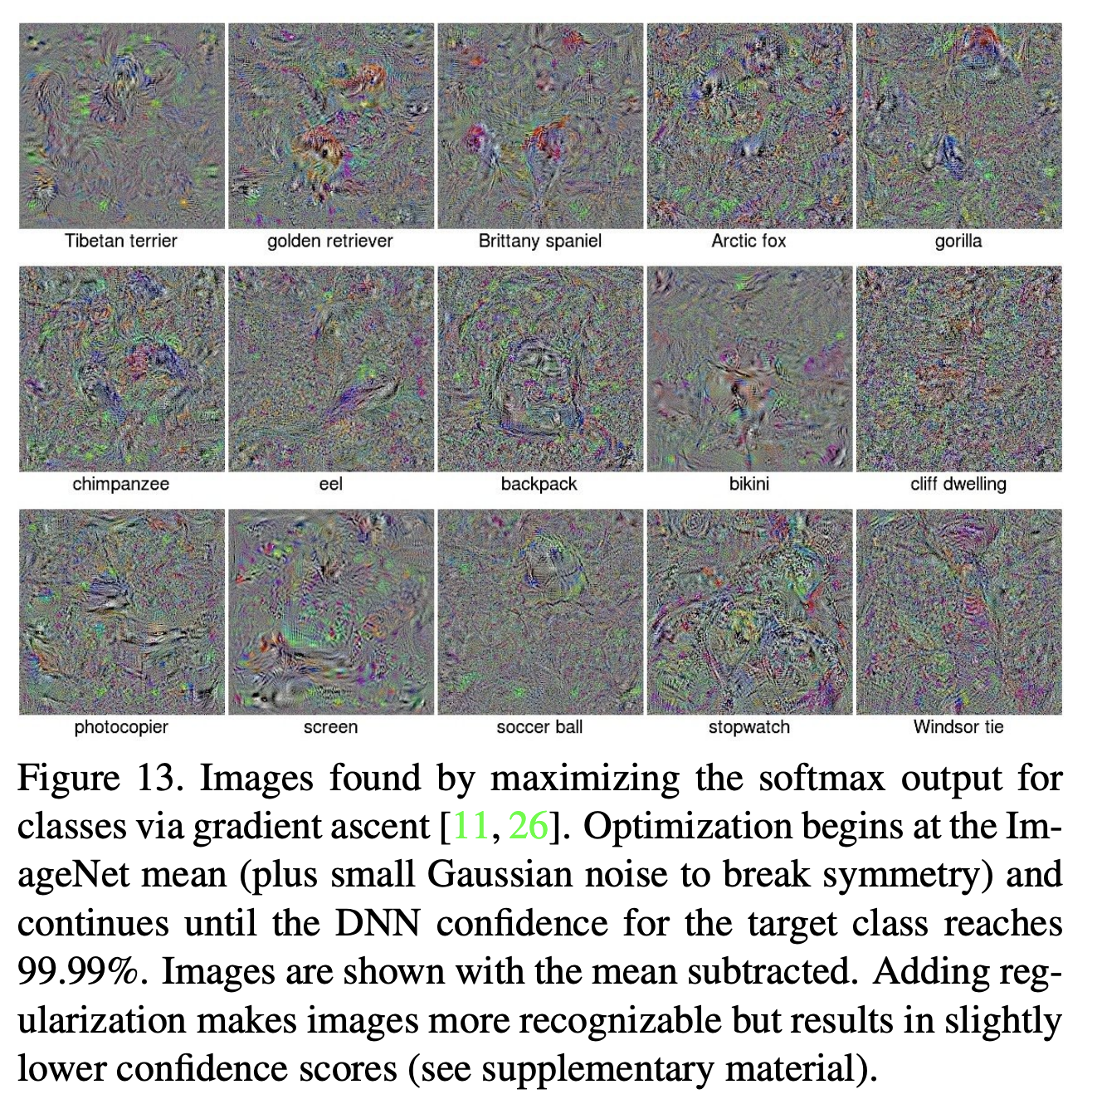
Deep Neural Networks are Easily Fooled: High Confidence Predictions for Unrecognizable Images
Anh Nguyen, Jason Yosinski, Jeff Clune, 2014

Slide 14

New Idea: Create Adversarial Inputs by optimizing the input image to predict ostrich (wrong class).
$$I$$
$$y=f(I;w)$$
$$L(y, parking meter)$$
parking meter
$$I=I −λ\frac{∂L}{∂I}$$
Work on Adversarial examples by Goodfellow et al. , Szegedy et. al., etc.

Slide 15
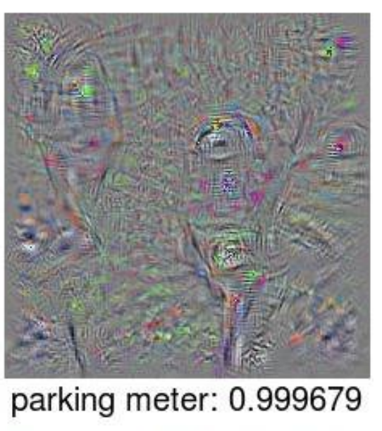

Slide 16
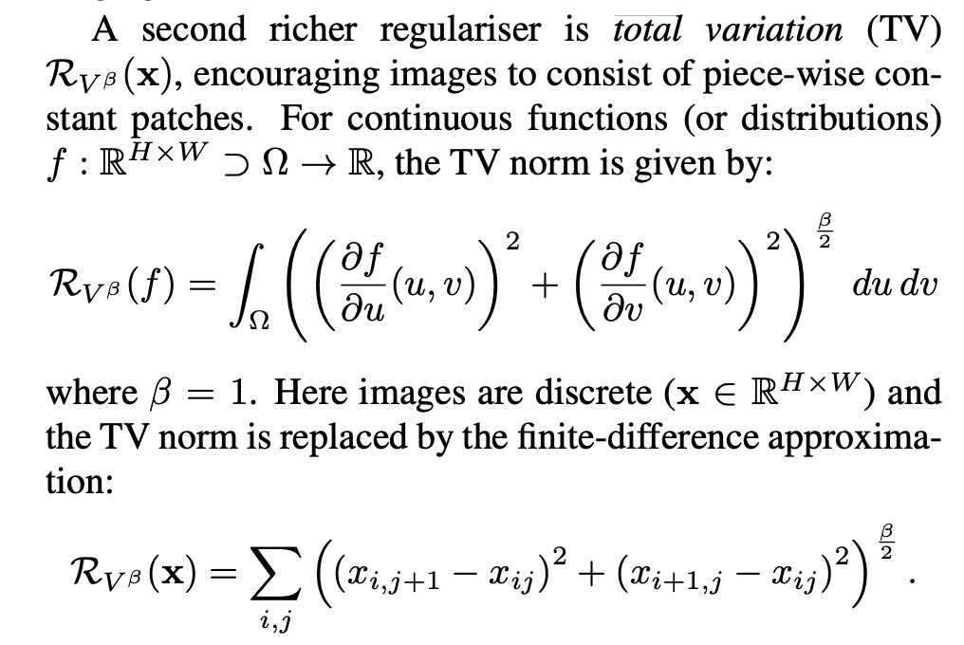
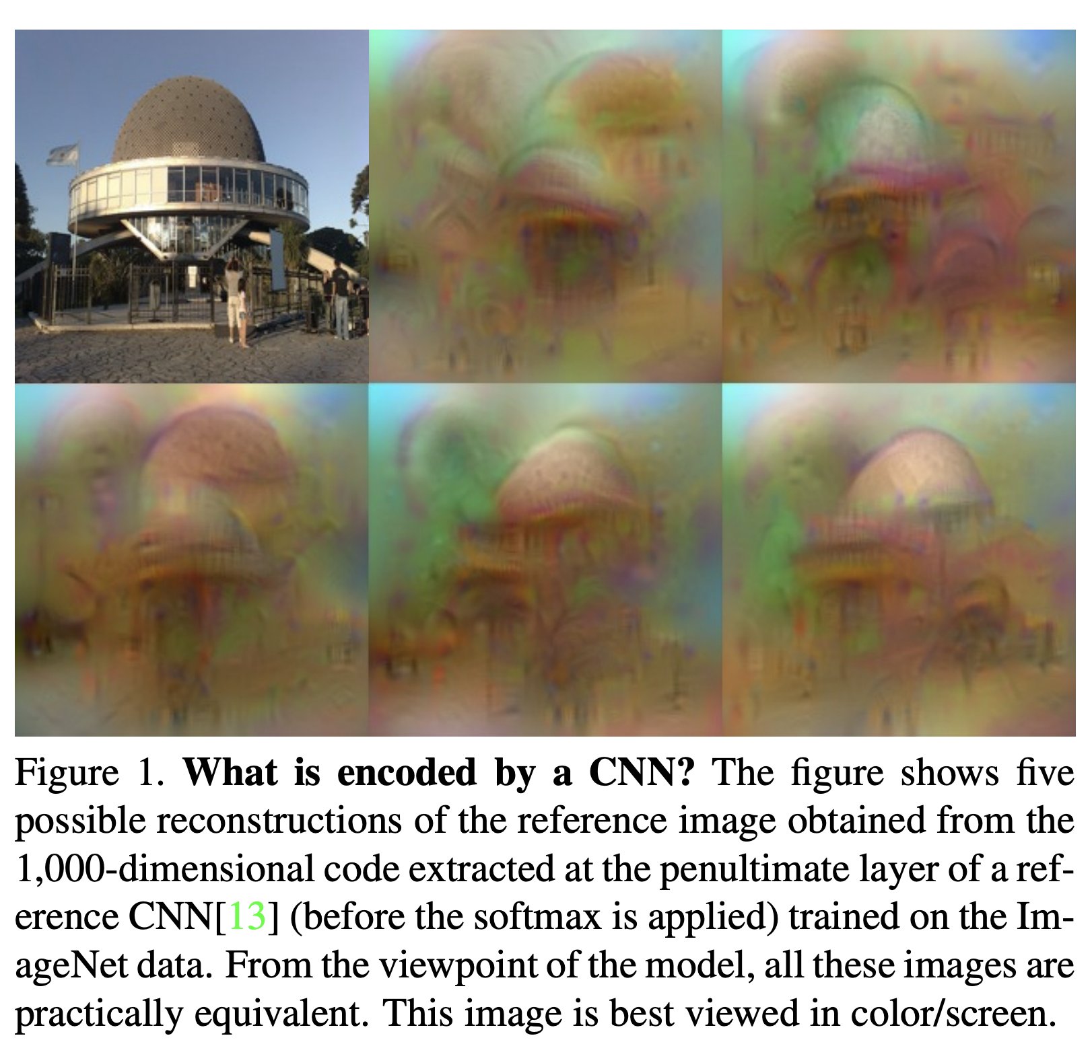
Total Variation Regularization
Mahendran and Vedaldi, Understanding Deep Image Representations by Inverting Them, 2014

Slide 17
Taking the idea to the extreme: Google’s DeepDream
https://research.googleblog.com/2015/06/inceptionism-going-deeper-into-neural.html
Generate your own in Pytorch:
https://github.com/XavierLinNow/deepdream_pytorch

Slide 18
Generative Adversarial Networks (GAN) [Goodfellow et al 2014]
https://deeplearning4j.org/generative-adversarial-network

Slide 19
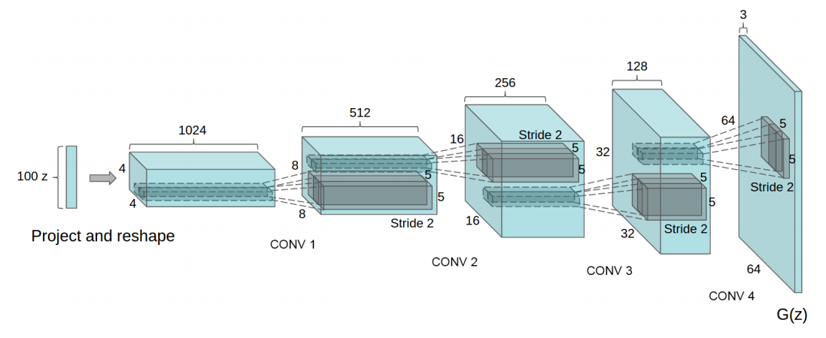
Generative Network (closer look)
Radford et. al. Unsupervised Representation Learning with Deep Convolutional Generative Adversarial Networks. ICLR 2016

Slide 20
Generative Network (closer look)
Deconvolutional Layers
Upconvolutional Layers
Backwards Strided Convolutional Layers
Fractionally Strided Convolutional Layers
Transposed Convolutional Layers
Spatial Full Convolutional Layers
Radford et. al. Unsupervised Representation Learning with Deep Convolutional Generative Adversarial Networks. ICLR 2016

Slide 21
Generative Adversarial Networks (GAN) [Goodfellow et al.]
https://deeplearning4j.org/generative-adversarial-network

Slide 22
Generative Adversarial Networks (GAN) [Goodfellow et al.]
https://deeplearning4j.org/generative-adversarial-network

Slide 23
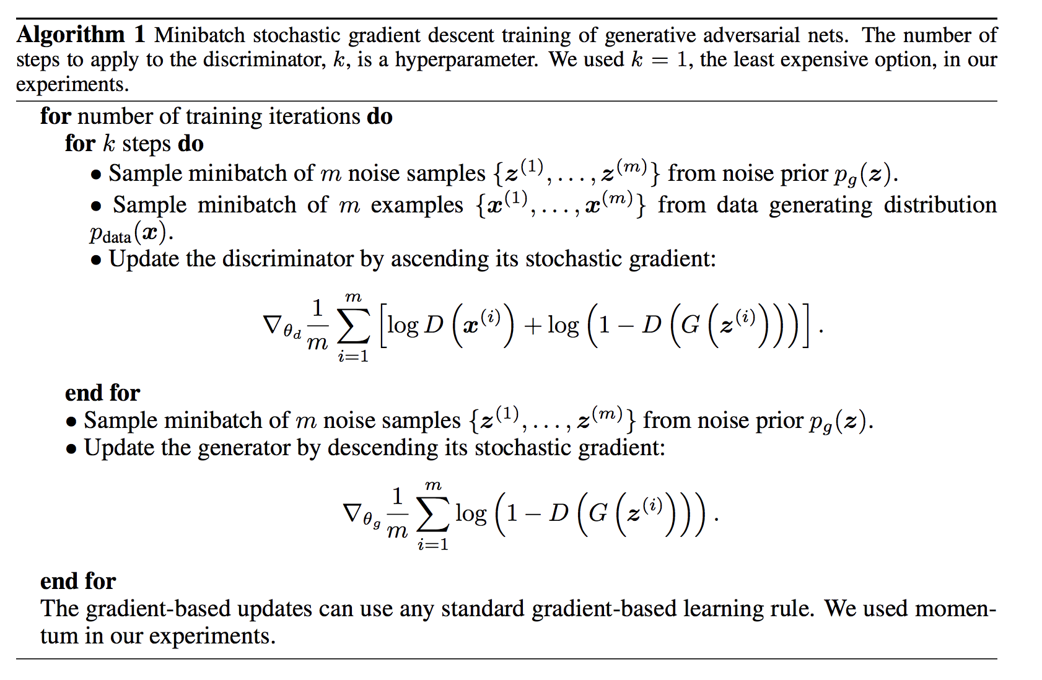
Goodfellow et al. NeurIPS 2014

Slide 24
Update Discriminator D
Goodfellow et al. NeurIPS 2014

Slide 25
Update Generator
G
Goodfellow et al. NeurIPS 2014

Slide 26
Until Desirable Results are Achieved?
Goodfellow et al. NeurIPS 2014

Slide 27
Generative Adversarial Networks (GAN) [Goodfellow et al.]
https://deeplearning4j.org/generative-adversarial-network

Slide 28
Generative Adversarial Networks (GAN) [Goodfellow et al.]
GANs are hard to train, loss for the discriminator and generator might fluctuate.
There are many choices for loss, and other auxiliary signals.
Training of these models is even less well understood than for other deep models.
https://deeplearning4j.org/generative-adversarial-network

Slide 29
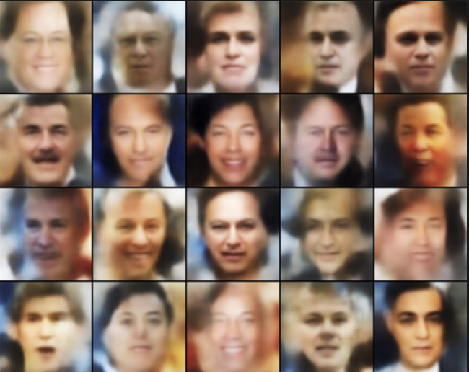
Basic GAN Results (Example implementation is provided in Pytorch’s examples)
http://torch.ch/blog/2015/11/13/gan.html

Slide 30
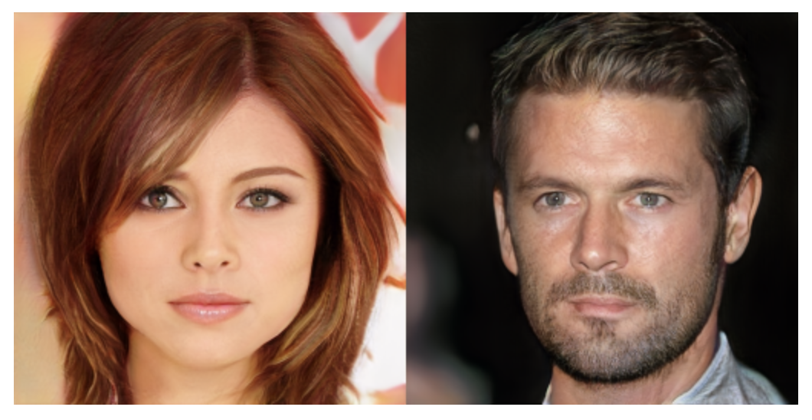
NVidia’s progressive GANs ICLR 2018

Slide 31
Google’s BigGAN

Slide 32
Google’s BigGAN
Teddy Bear
Microphone
http://aiweirdness.com/post/179626595787/the-creepiest-images-generated-by-biggan

Slide 33
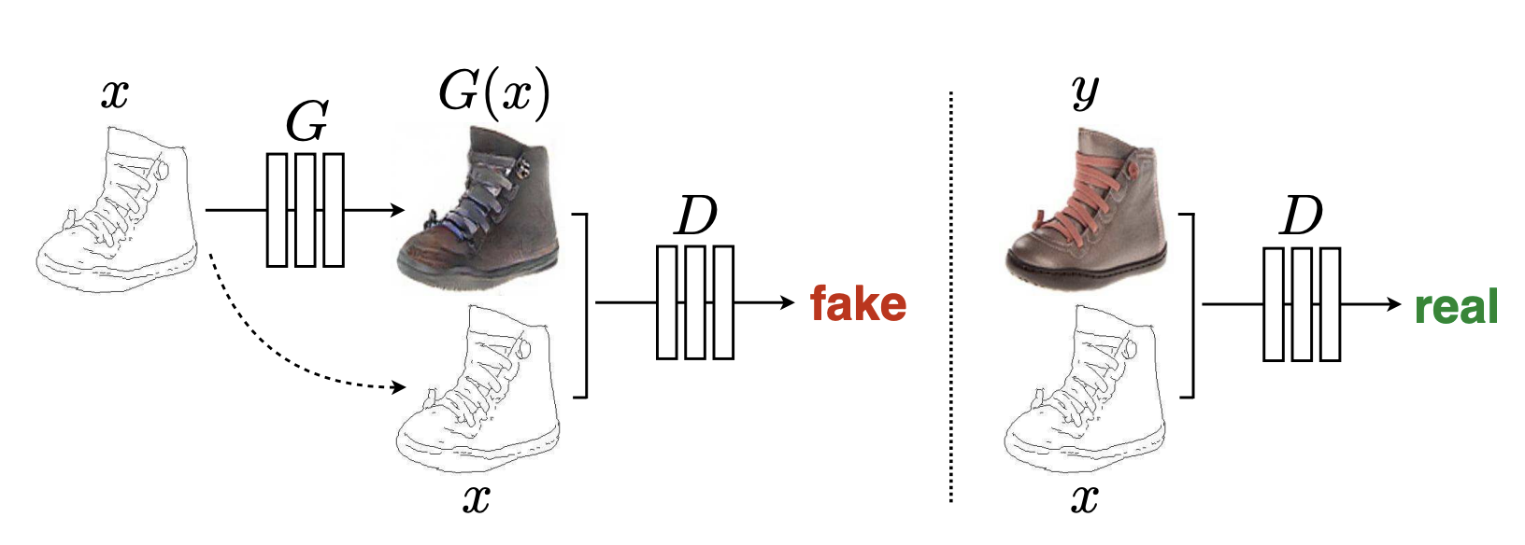
Conditional GANs: Input is not just Noise
Isola et al. CVPR 2017: Image-to-Image Translation with Conditional Adversarial Networks

Slide 34
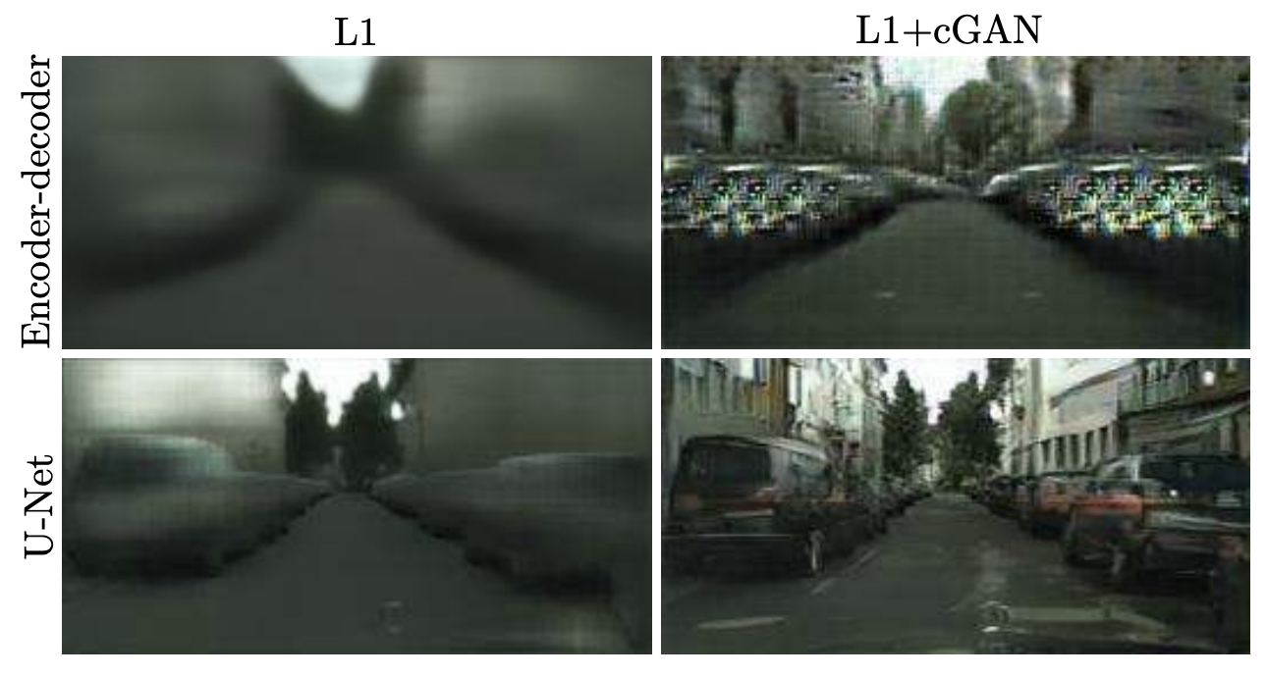
Conditional GANs: Also Hard to Train
Result they obtained with a regular Fully Convolutional Network
Result they obtained with a U-Net network (with skip-connections)
Isola et al. CVPR 2017: Image-to-Image Translation with Conditional Adversarial Networks

Slide 35
Conditional GANs: Also Hard to Train
Ronneberger et al. MICCAI 2015. U-Net: Convolutional Networks for Biomedical Image Segmentation

Slide 36
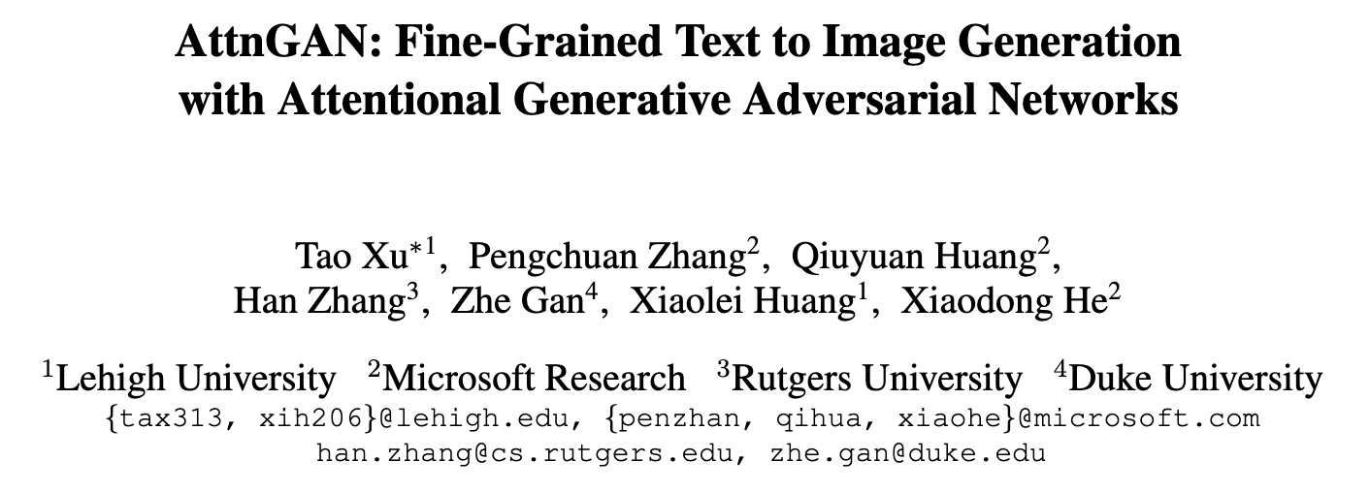
Conditional GANs / Text-conditioned

Slide 37
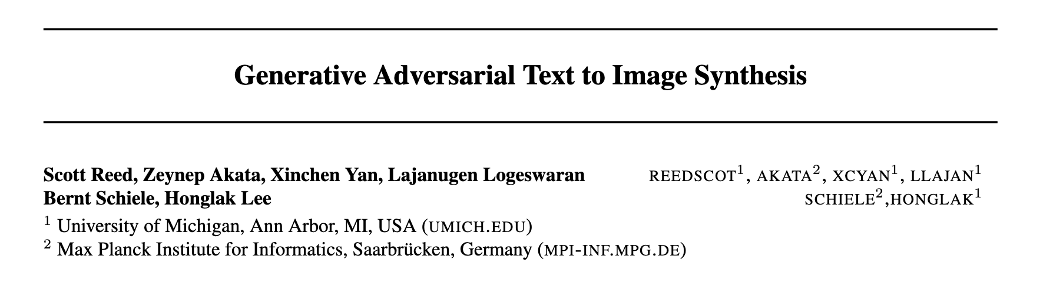
Conditional GANs / Text-conditioned

Slide 38
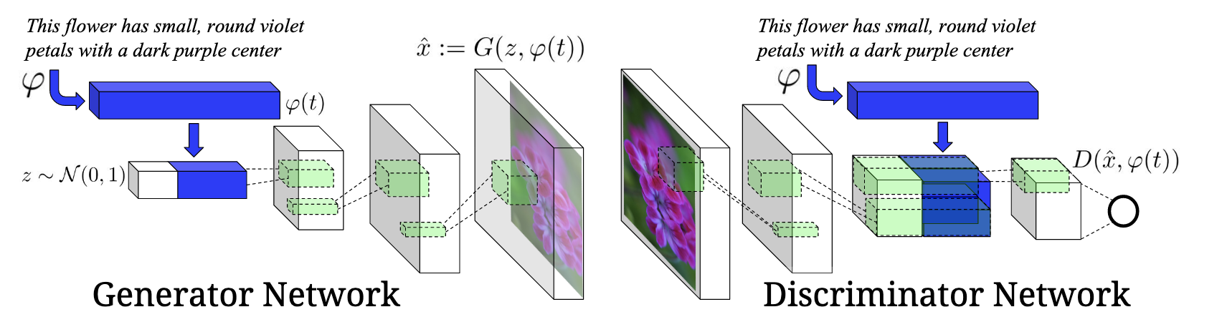
Conditional GANs / Text-conditioned

Slide 39
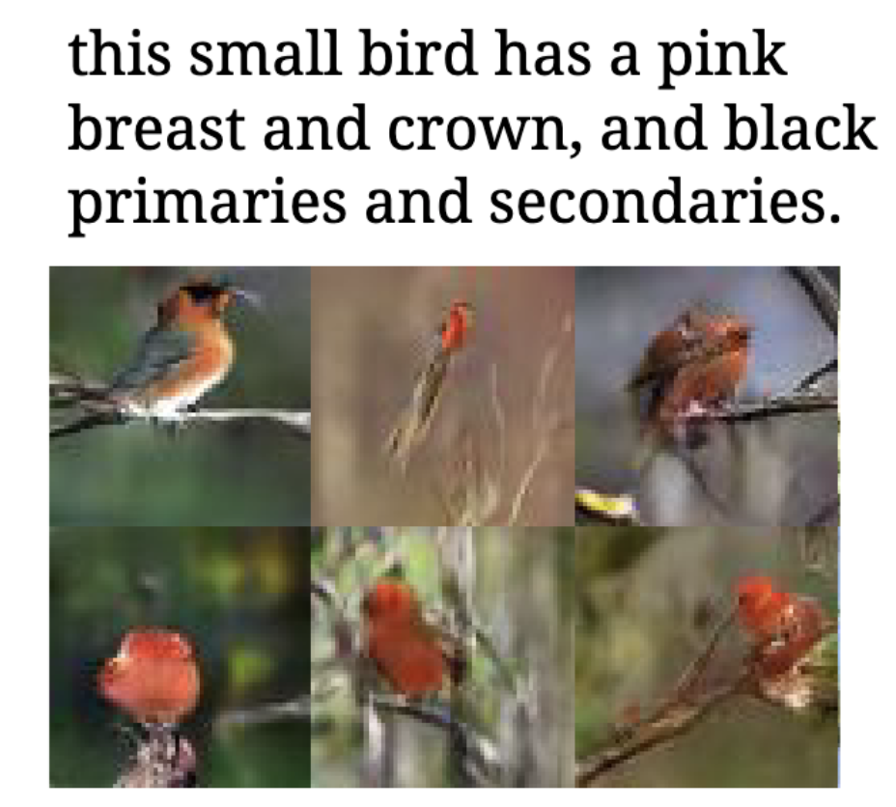
Conditional GANs / Text-conditioned

Slide 40
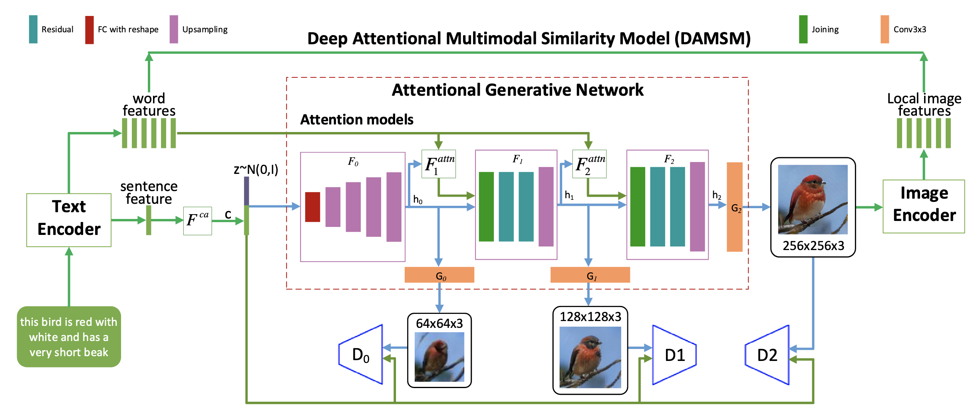
Conditional GANs / Text-conditioned

Slide 41
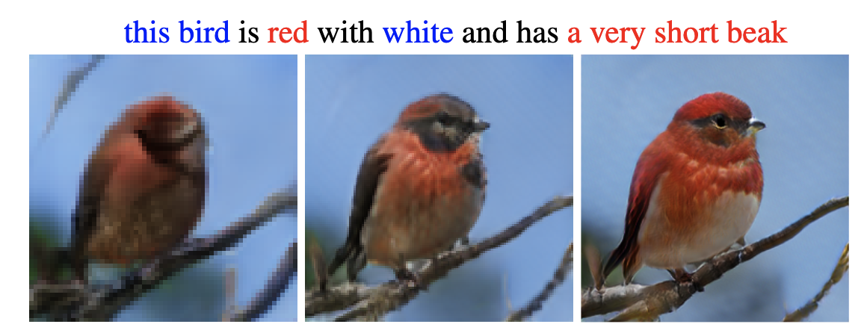
Conditional GANs / Text-conditioned

Slide 42
Questions

