Slide 1
Deep Learning for Vision & Language
Text-to-Scene Models

Slide 2
Last Class
Conditional GANs
AutoEncoder Models (AEs, VAEs)
Today:
Text to image Models
Sequence-to-sequence based text-to-image models
Detour: Style Transfer – Input Feature Optimization.
Reverse Diffusion Models

Slide 3
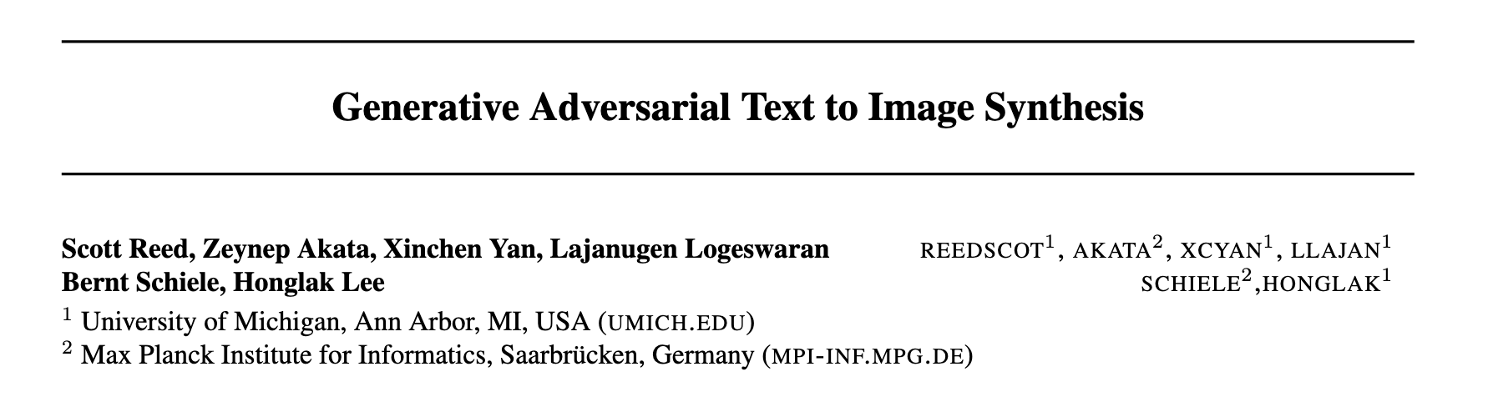
Conditional GANs / Text-conditioned

Slide 4
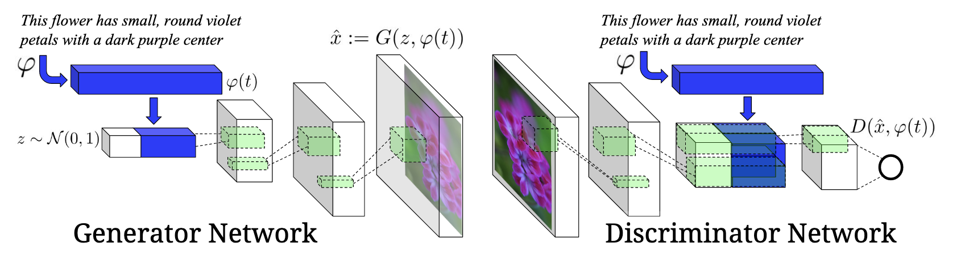
Conditional GANs / Text-conditioned

Slide 5
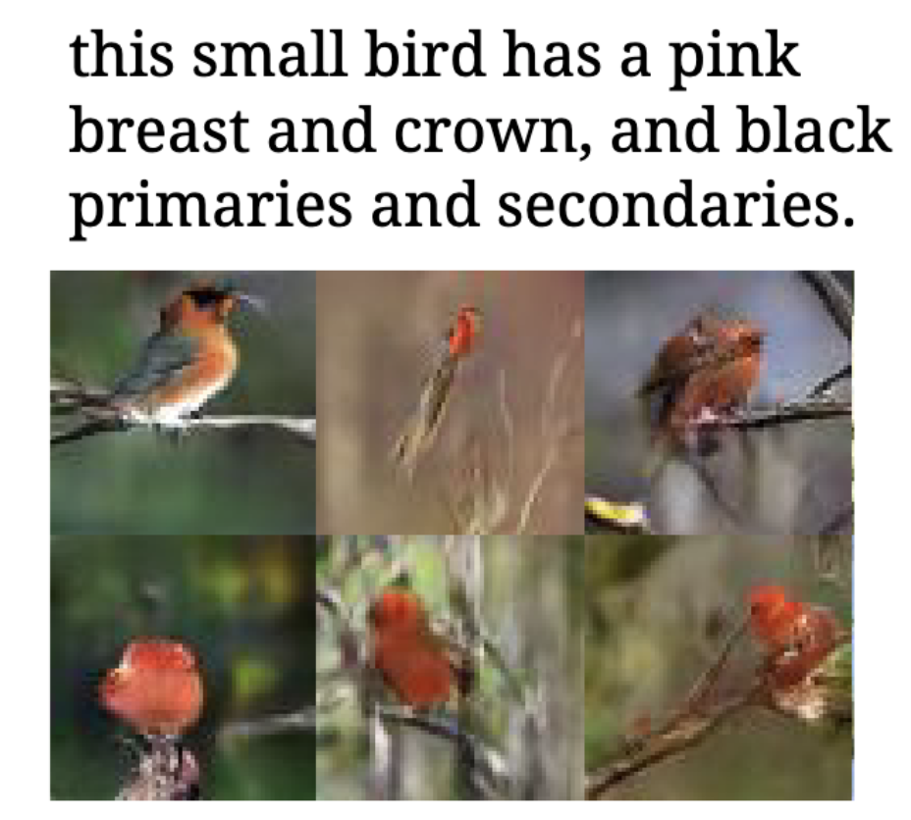
Conditional GANs / Text-conditioned

Slide 6
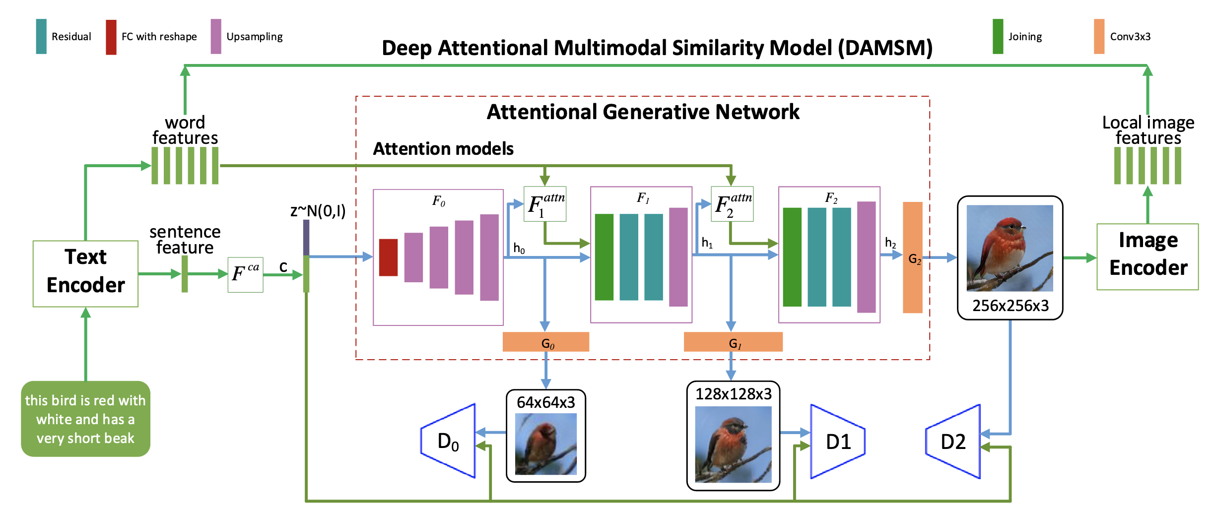
Conditional GANs / Text-conditioned

Slide 7
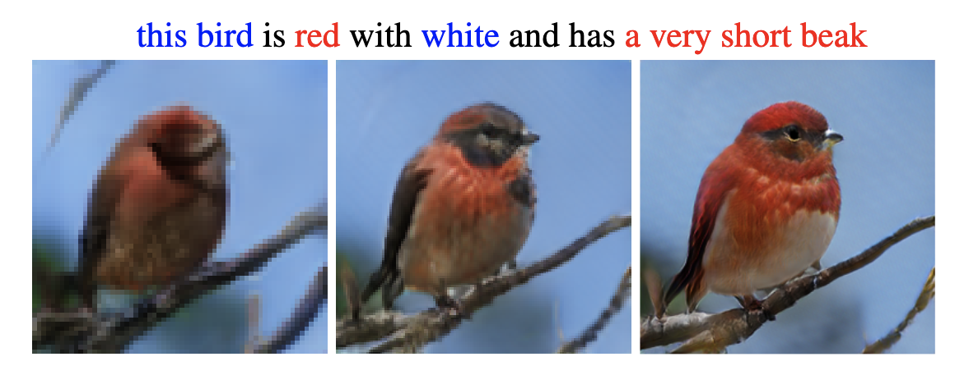
Conditional GANs / Text-conditioned

Slide 8
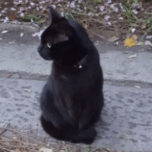
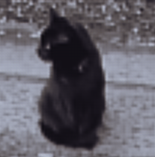
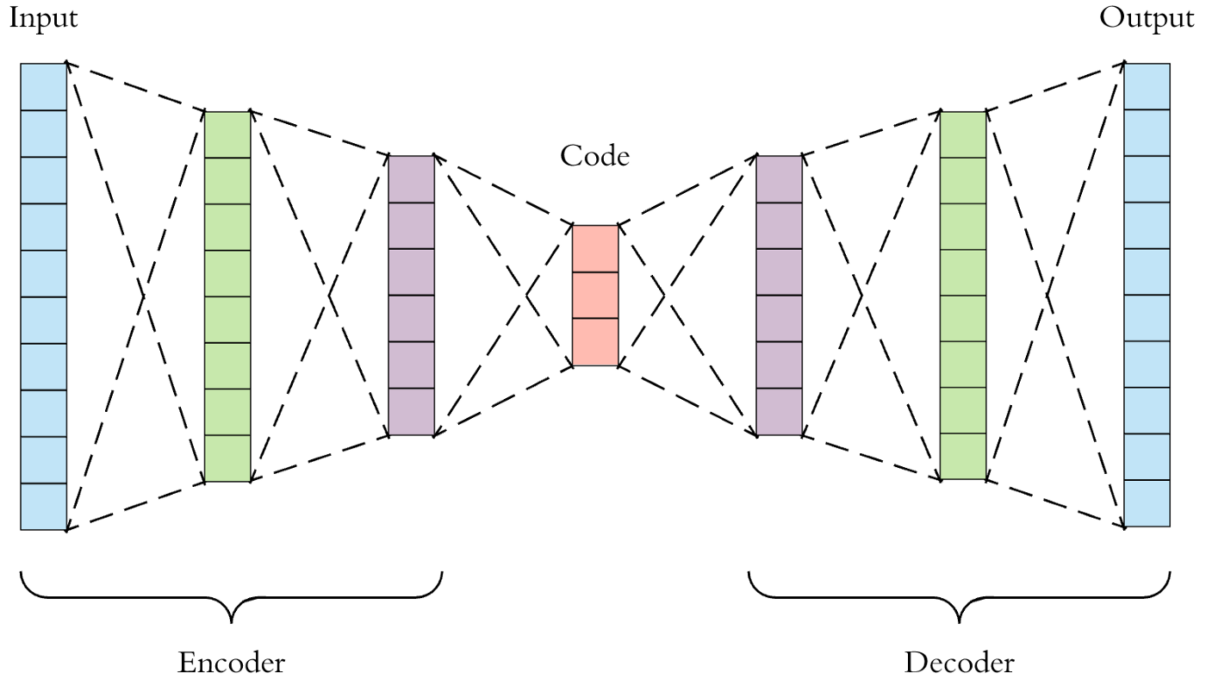
AutoEncoder Models

Slide 9
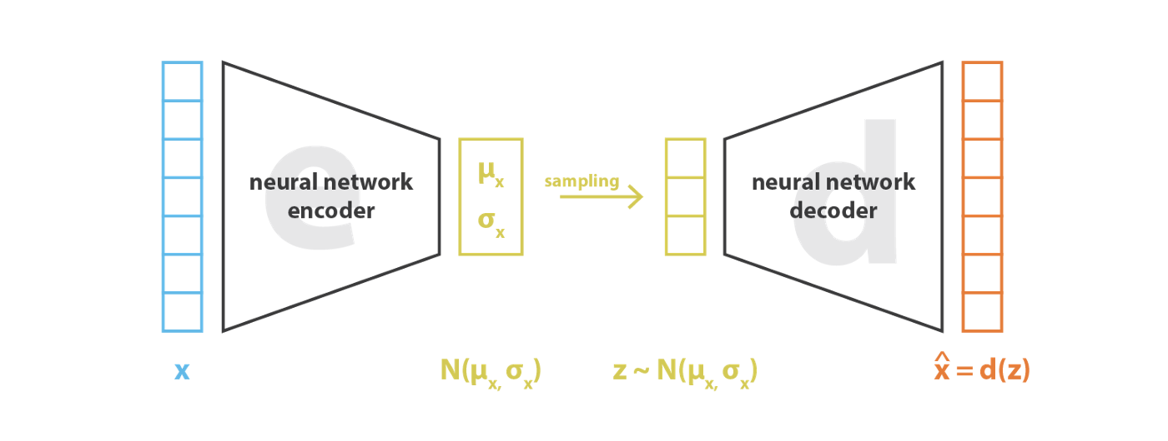

Variational AutoEncoder (VAE)
https://pytorch.org/docs/stable/generated/torch.normal.html
https://ai.stackexchange.com/questions/30176/are-mean-and-standard-deviation-in-variational-autoencoders-unique

Slide 10
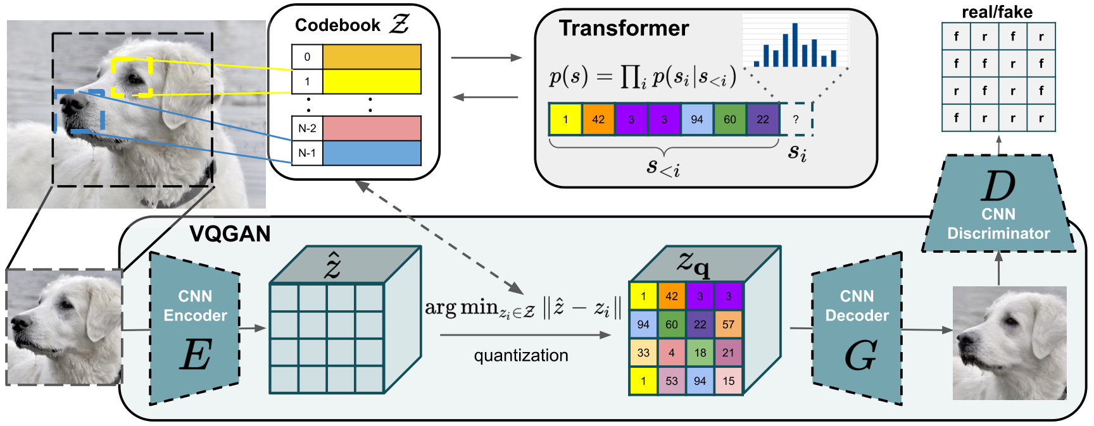
Vector Quantized - GAN
https://arxiv.org/abs/2012.09841
https://arxiv.org/pdf/2110.04627.pdf

Slide 11
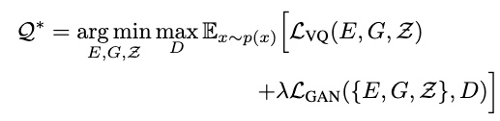

Vector Quantized GAN (VQGAN)
https://arxiv.org/abs/2012.09841
https://arxiv.org/pdf/2110.04627.pdf

Slide 12
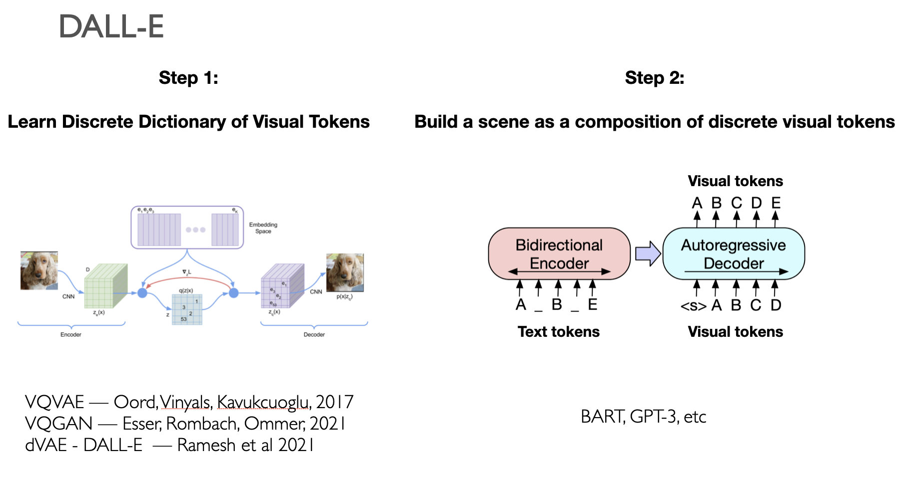
DALL-E (v1)

Slide 13
DALL-E (v1)

Slide 14
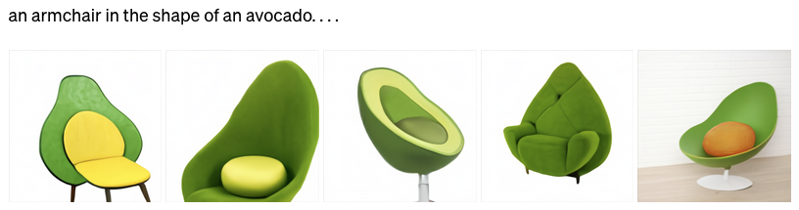

Slide 17
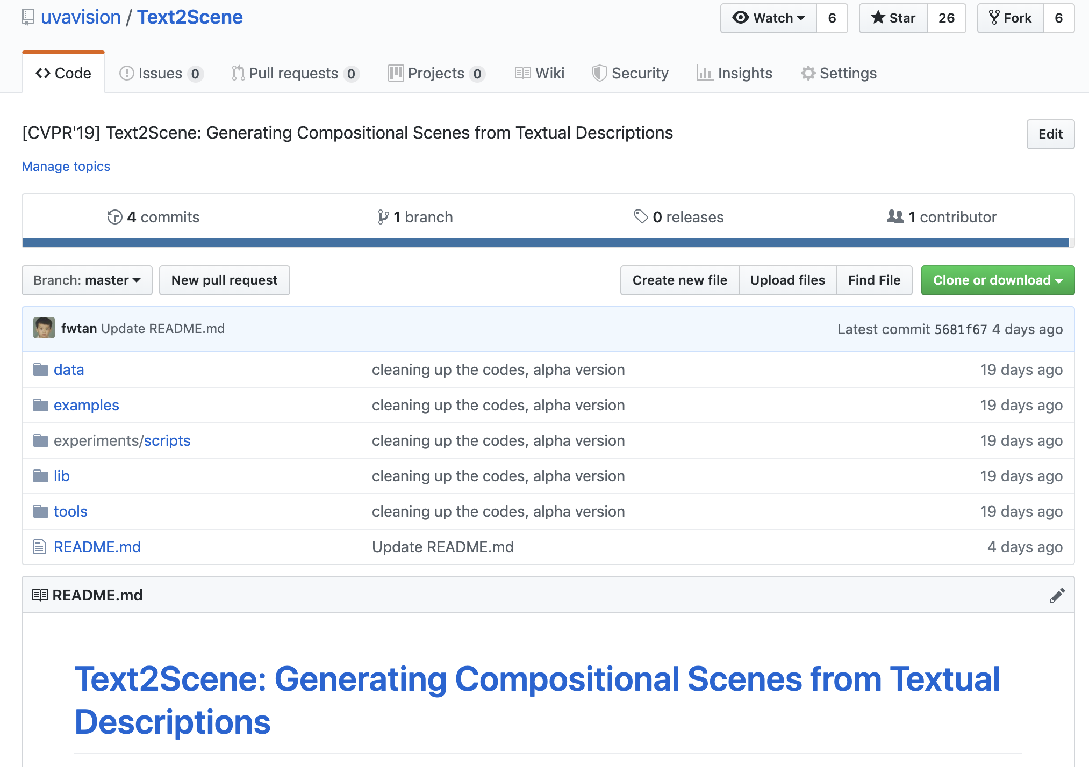
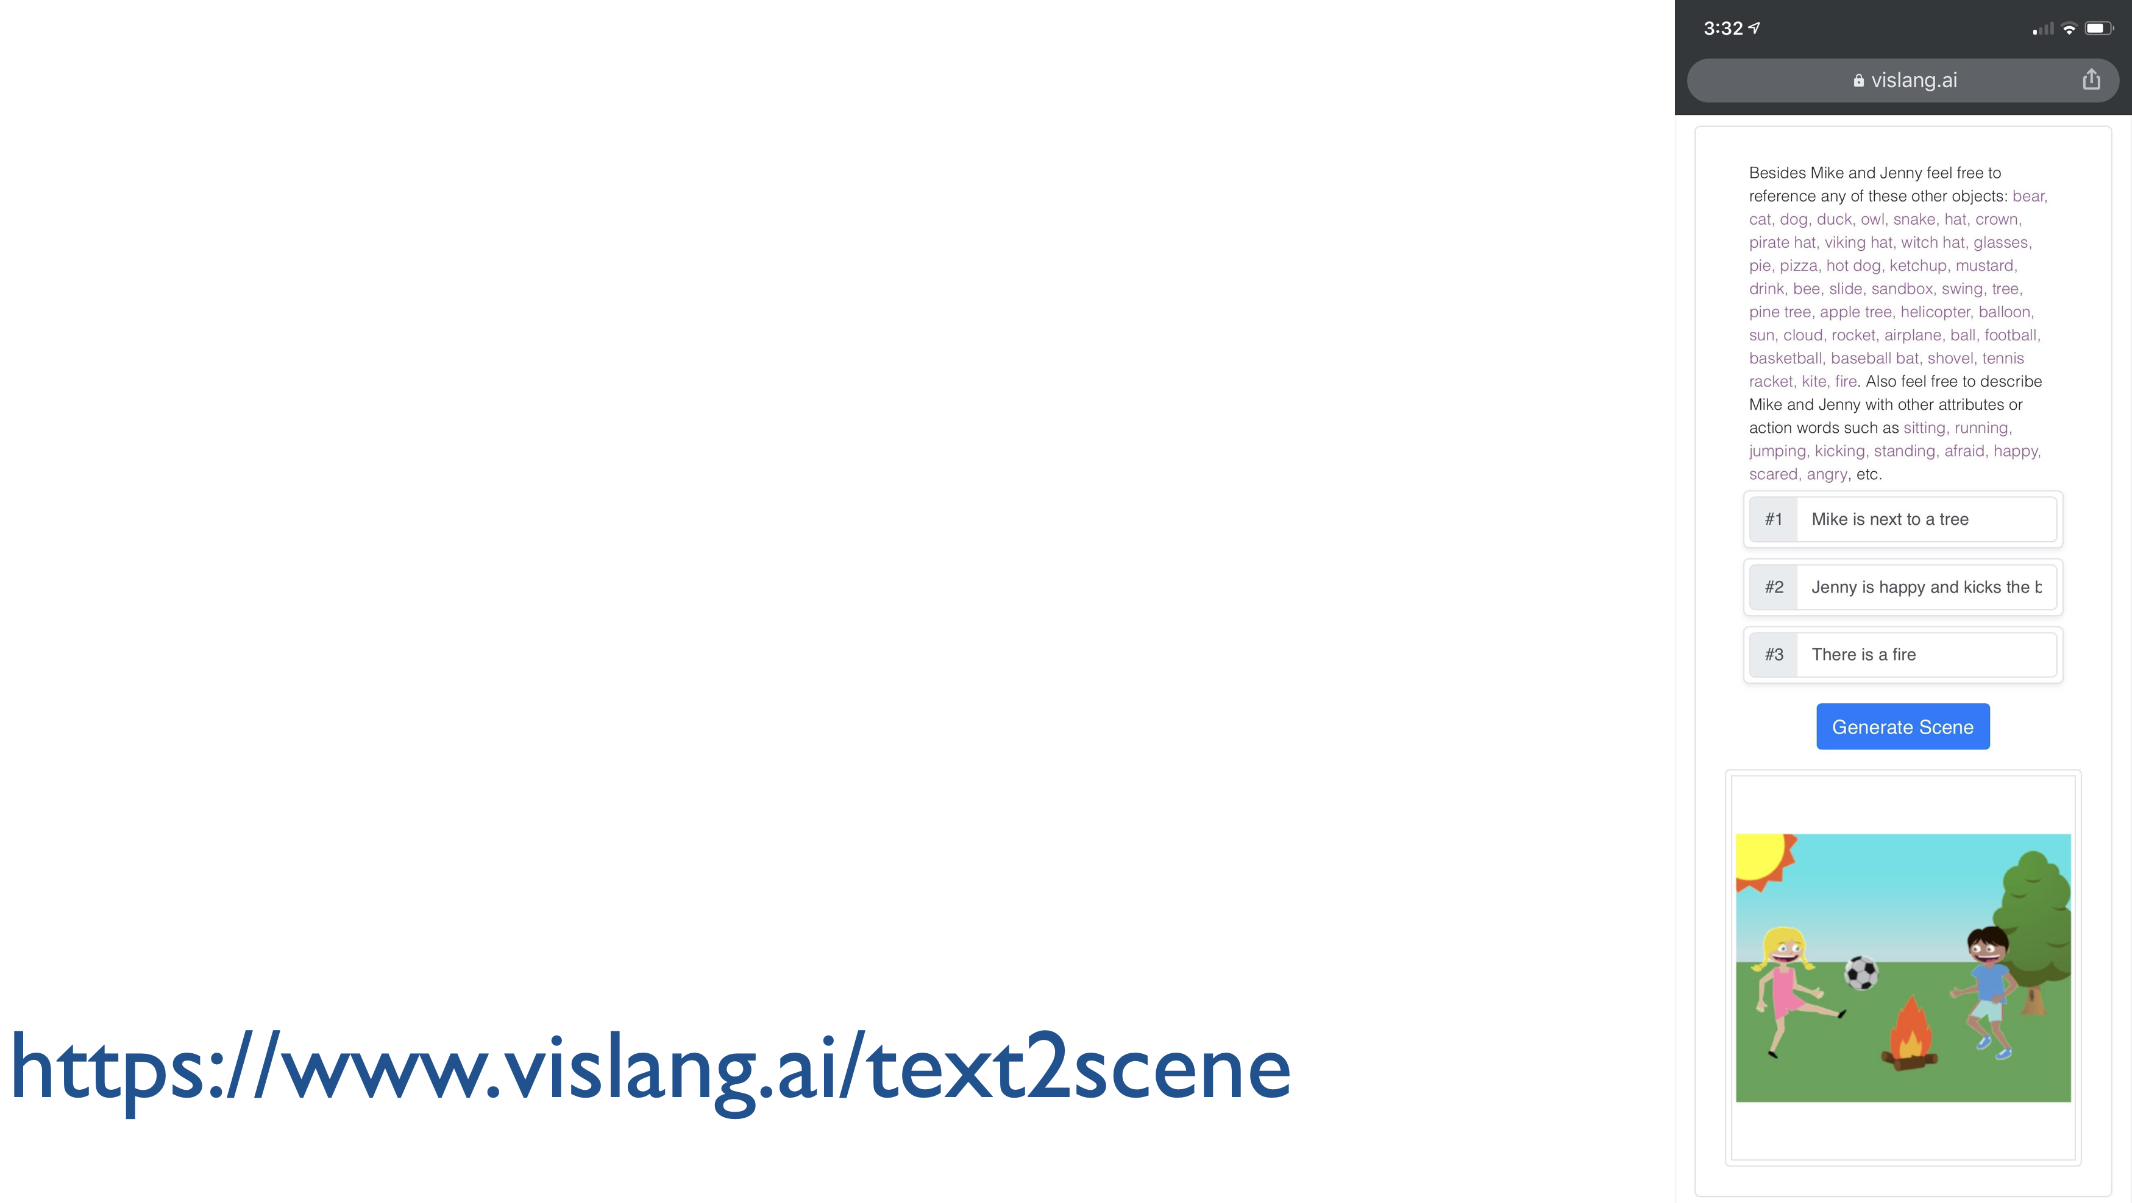

Slide 20
More on the Idea of Feature Space Optimization
Gatys et. al. Image Style Transfer Using Convolutional Neural Networks. CVPR 2016

Slide 21
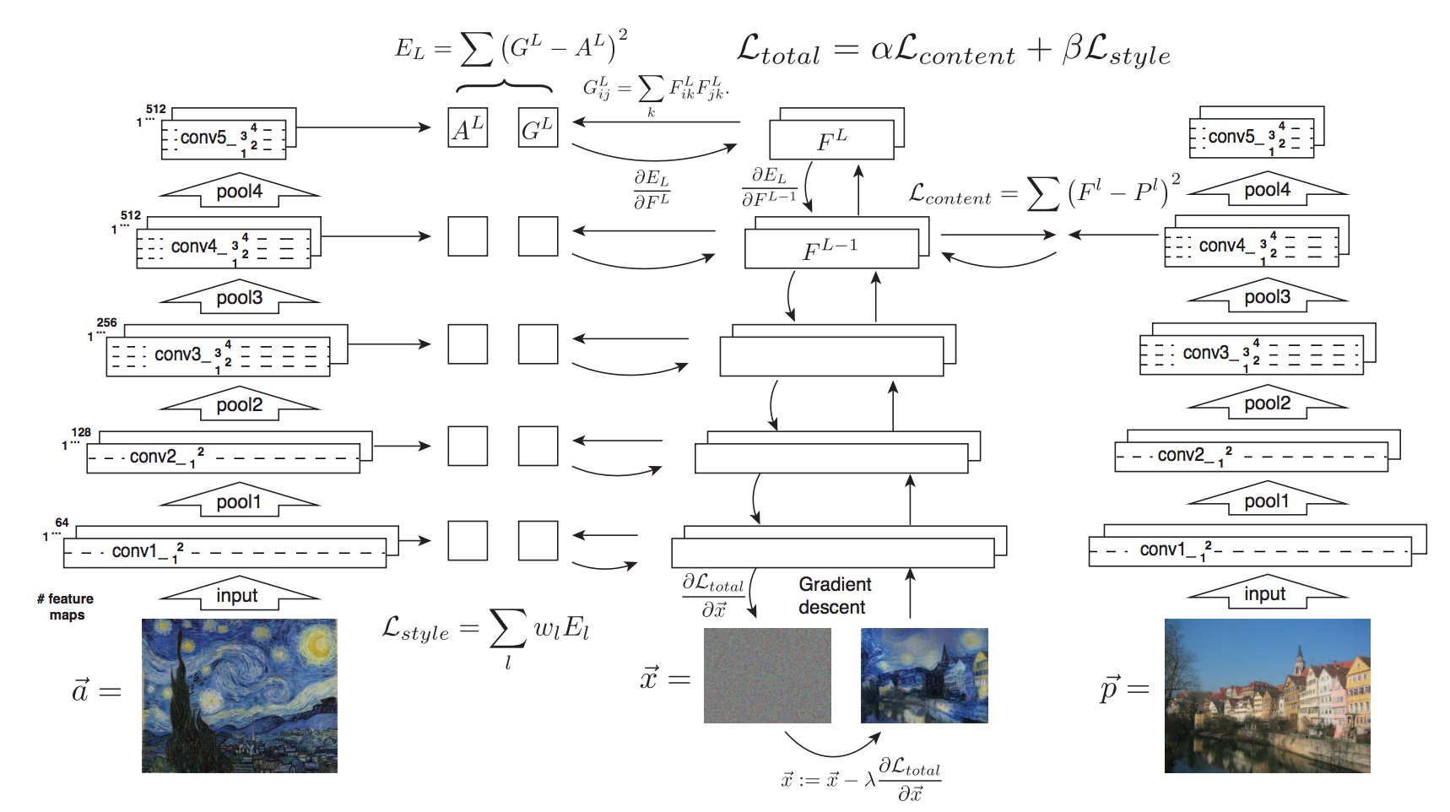

Slide 22
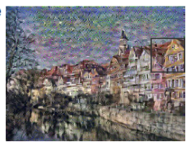
Gatys et. al. Image Style Transfer Using Convolutional Neural Networks. CVPR 2016
Idea 1: Image Reconstruction from Features

Slide 23

Gatys et. al. Image Style Transfer Using Convolutional Neural Networks. CVPR 2016
Idea 1: Image Reconstruction from Features

Slide 24
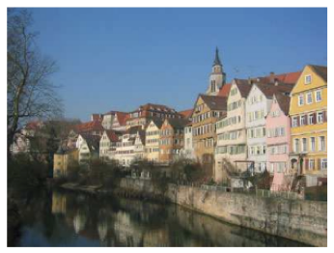
Gatys et. al. Image Style Transfer Using Convolutional Neural Networks. CVPR 2016
Idea 1: Image Reconstruction from Features

Slide 25
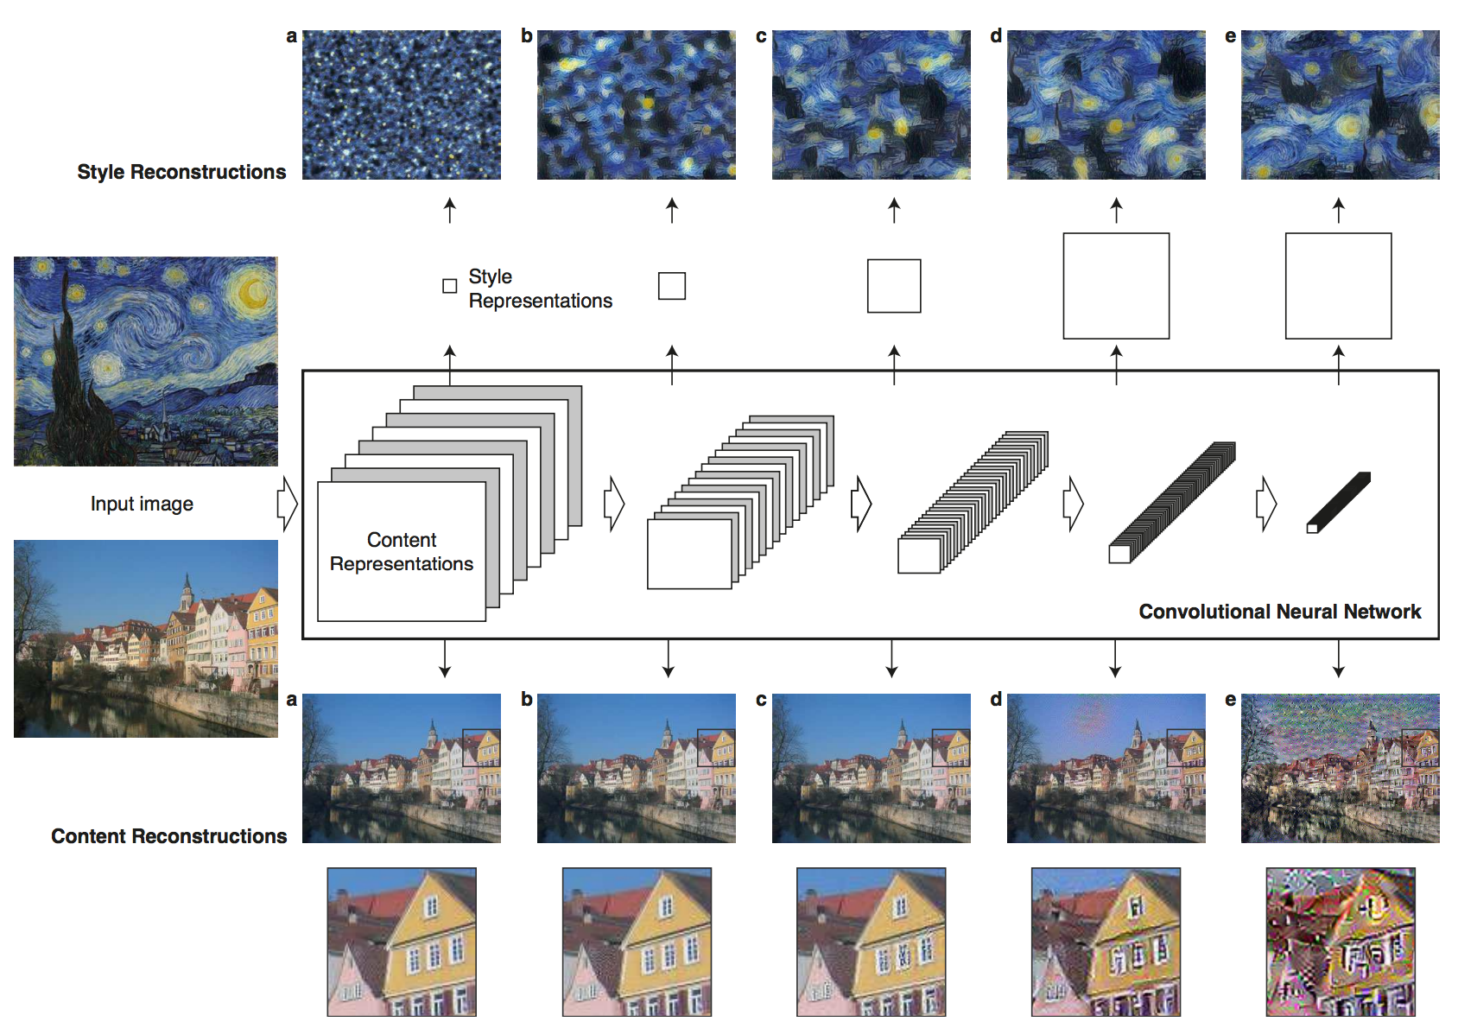
Gatys et. al. Image Style Transfer Using Convolutional Neural Networks. CVPR 2016

Slide 26

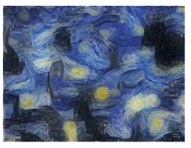
Gatys et. al. Image Style Transfer Using Convolutional Neural Networks. CVPR 2016
Idea 2: Backpropagation of Style

Slide 27

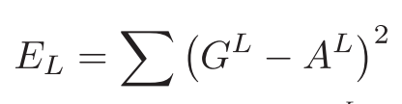
Gatys et. al. Image Style Transfer Using Convolutional Neural Networks. CVPR 2016
Idea 2: Backpropagation of Style

Slide 28
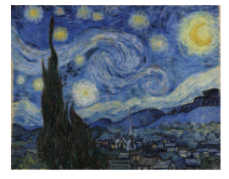
Gatys et. al. Image Style Transfer Using Convolutional Neural Networks. CVPR 2016
Idea 2: Backpropagation of Style

Slide 29
Gatys et. al. Image Style Transfer Using Convolutional Neural Networks. CVPR 2016

Slide 30
Gatys et. al. Image Style Transfer Using Convolutional Neural Networks. CVPR 2016

Slide 31
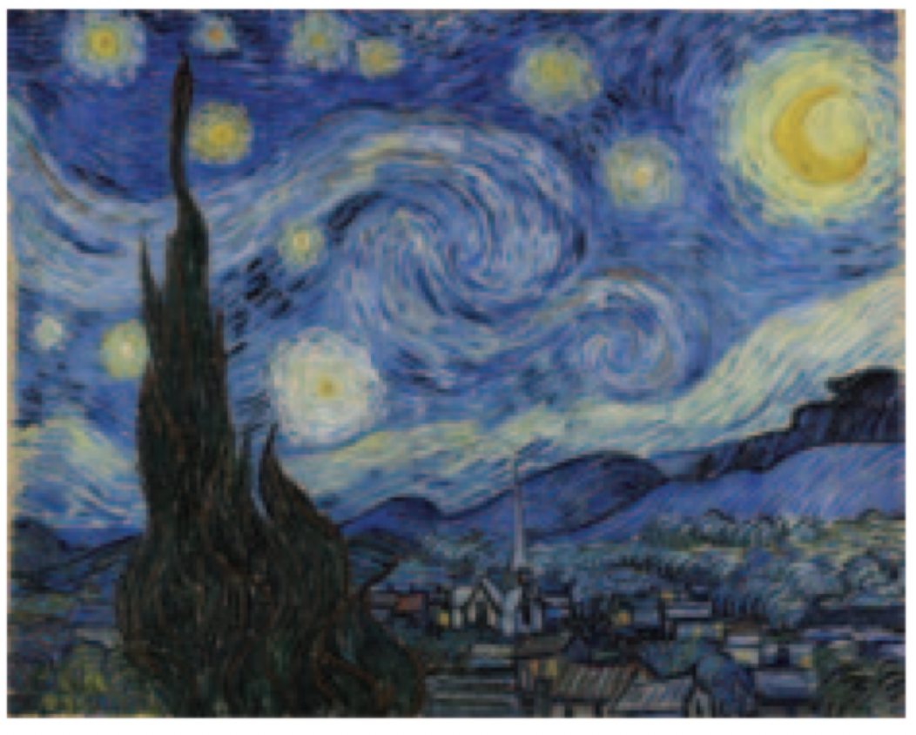
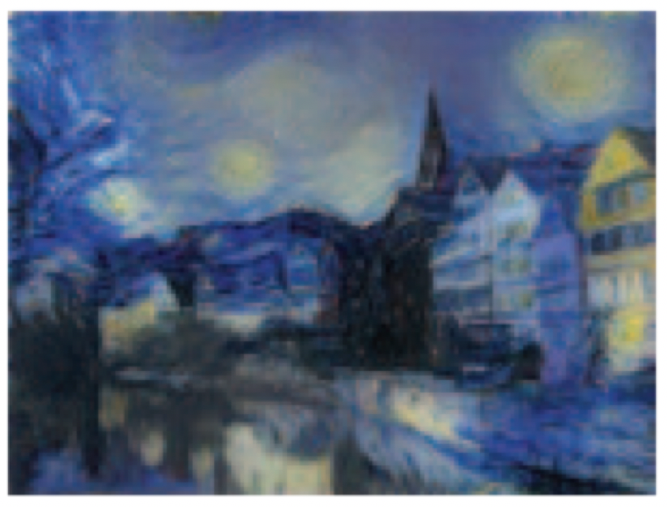
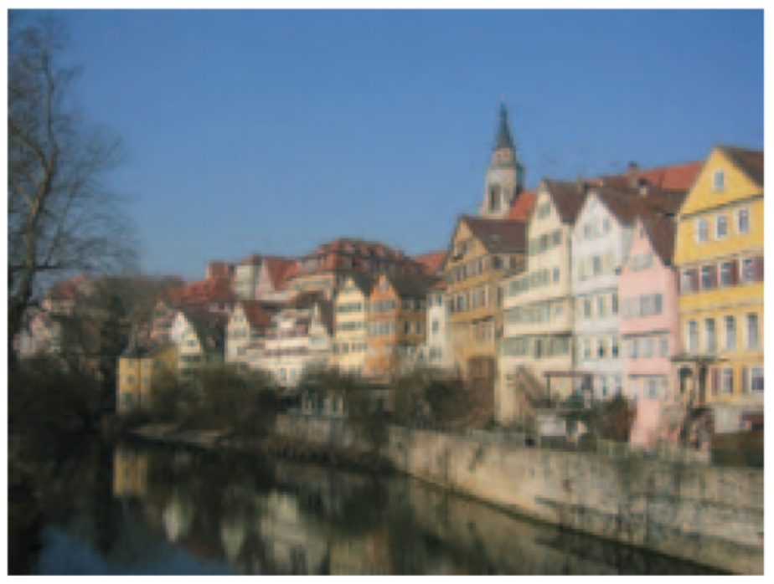
Gatys et. al. Image Style Transfer Using Convolutional Neural Networks. CVPR 2016

Slide 32
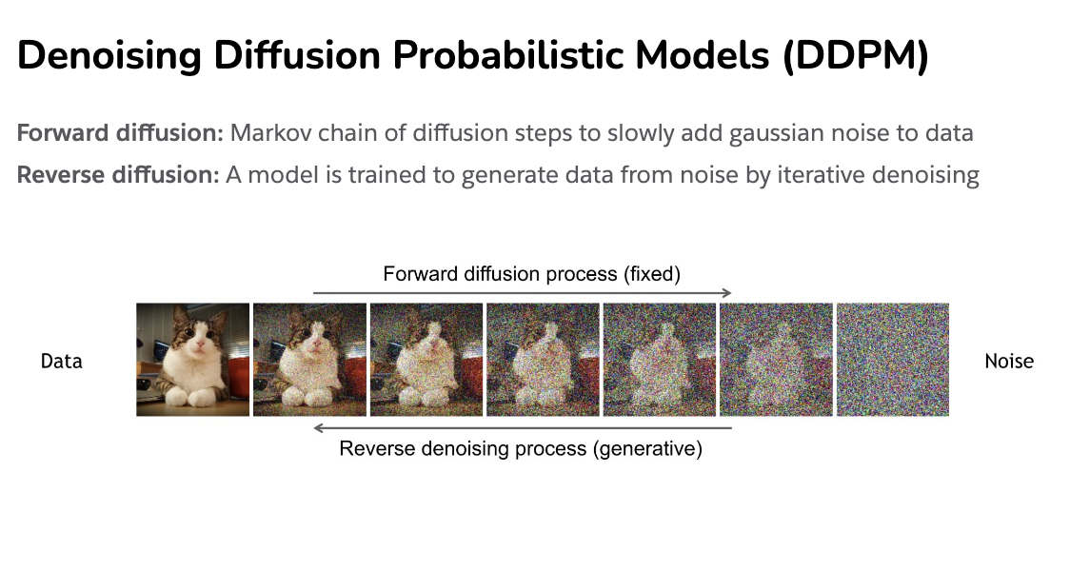
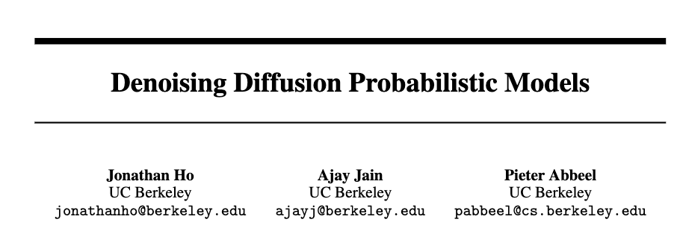
Diffusion Process
Slides compiled by my student Aman Shrivastava

Slide 33
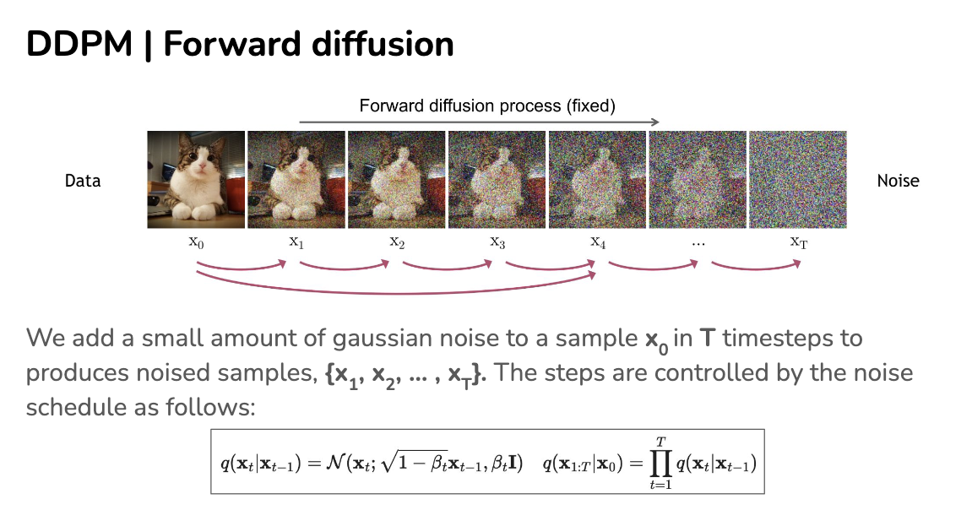

Slide 34
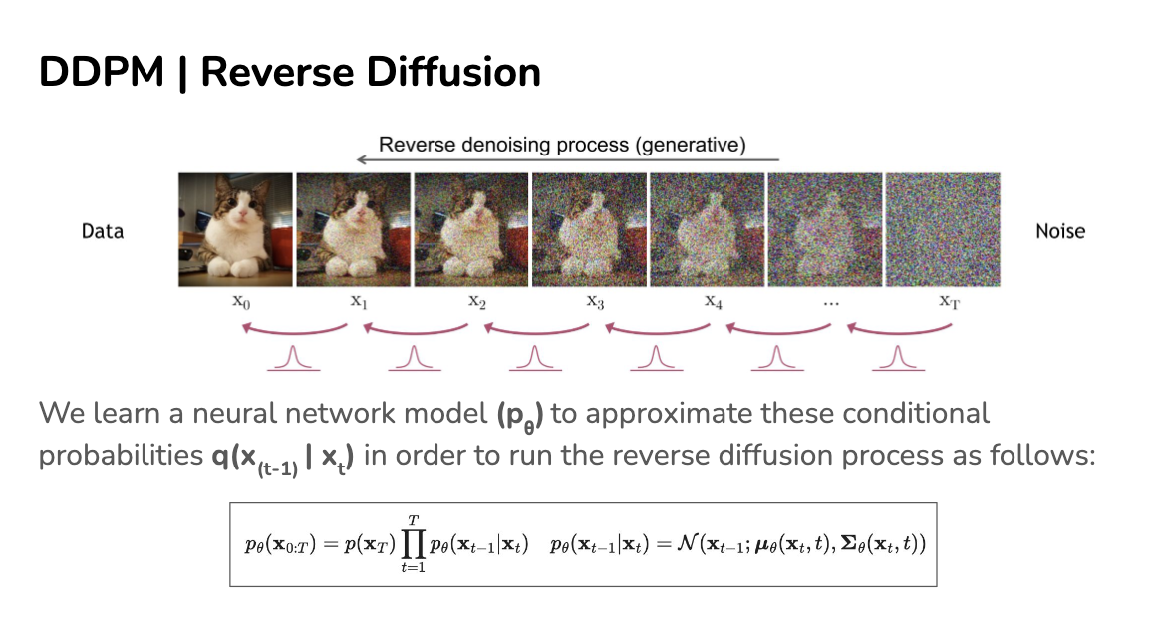
Slides compiled by my student Aman Shrivastava

Slide 35
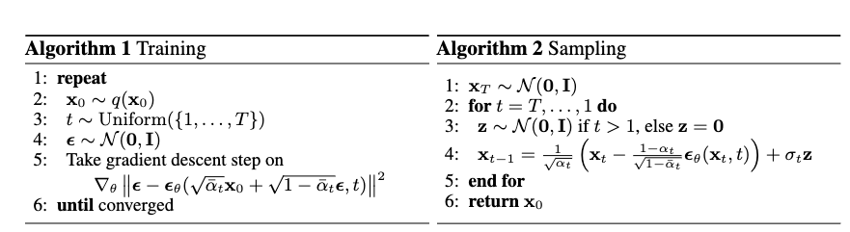
How do we train?
Slides compiled by my student Aman Shrivastava

Slide 36
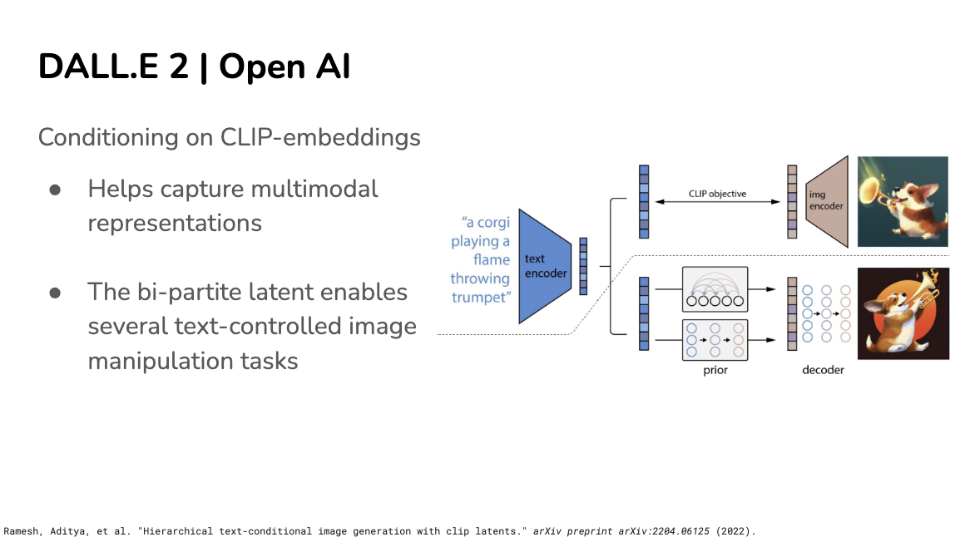

Slide 37
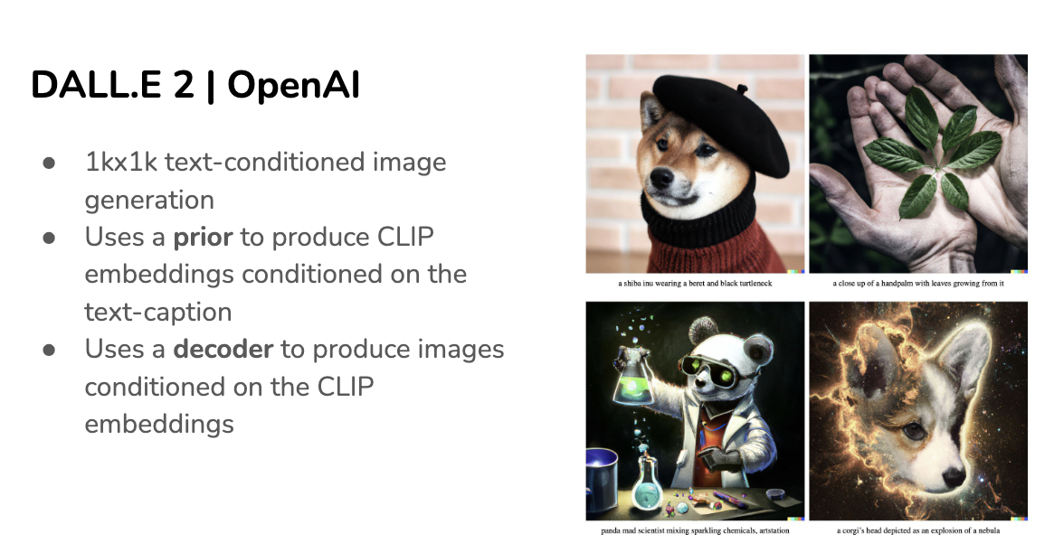
Slides compiled by my student Aman Shrivastava

Slide 38
Questions

