Slide 1
Deep Learning for Vision & Language
Text-to-Scene Models

Slide 2
Last Class
Text to image Models
Sequence-to-sequence based text-to-image models
Detour: Style Transfer – Input Feature Optimization.
Today:
Reverse Diffusion Models
Other Topics

Slide 3
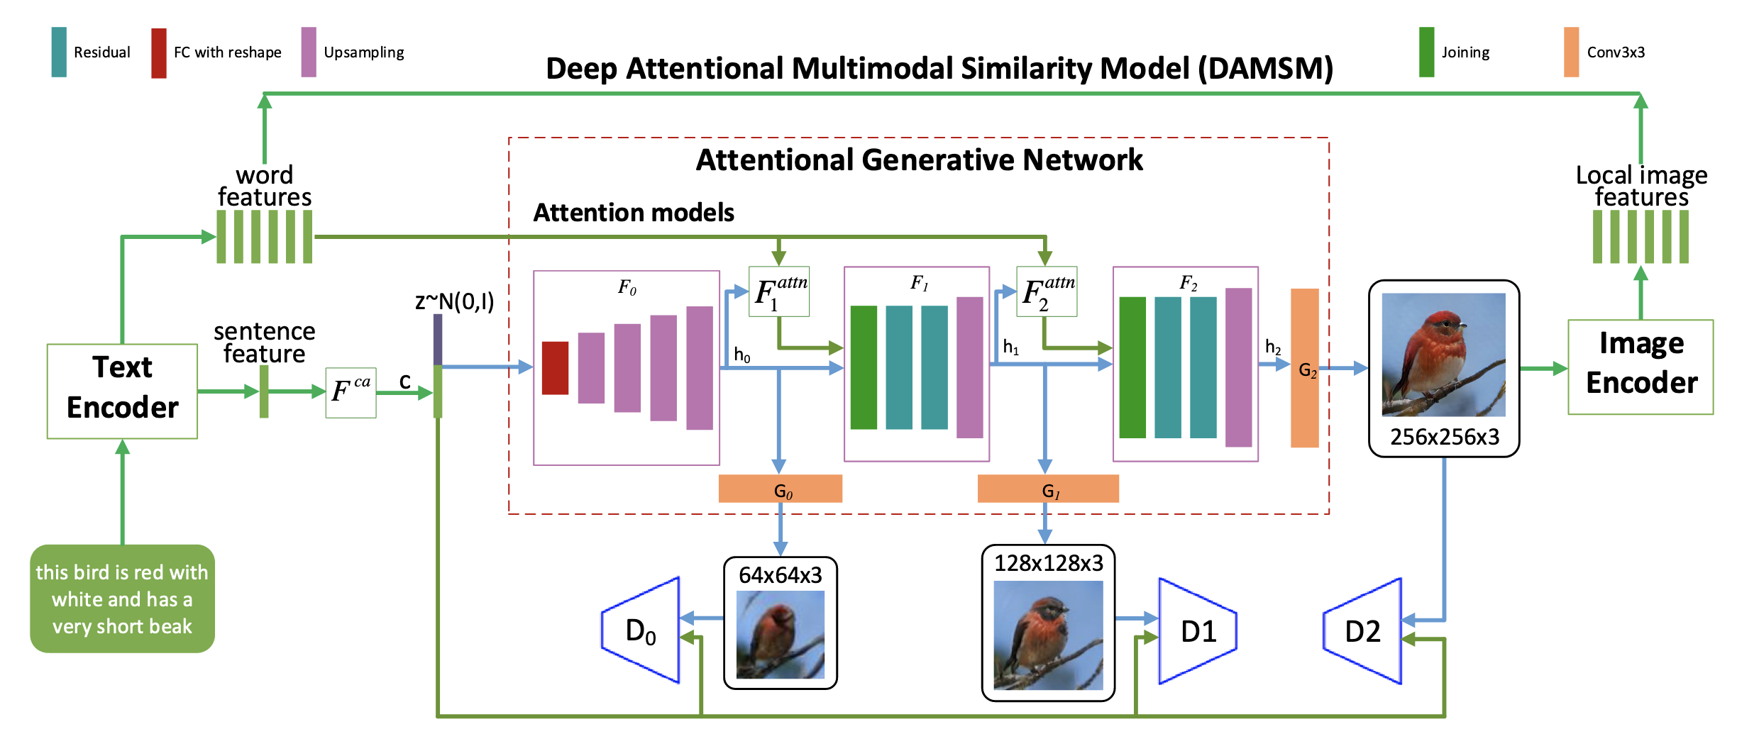
(1) Hierarchical Conditional GANs / Text-conditioned (AttnGAN)

Slide 4
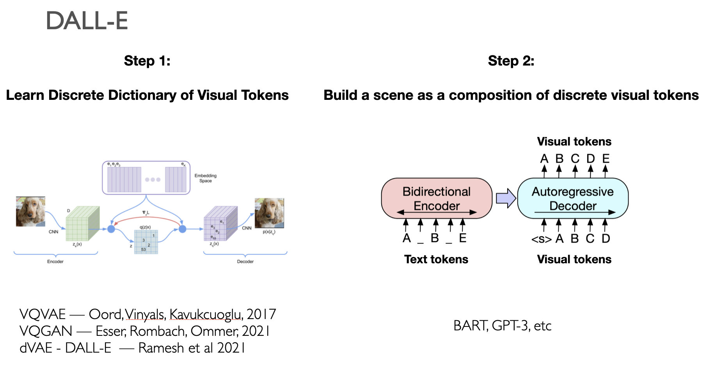
(2) Visual Token Learning (VQGAN) + Seq2Seq Machine Translation (e.g. BART)

Slide 5
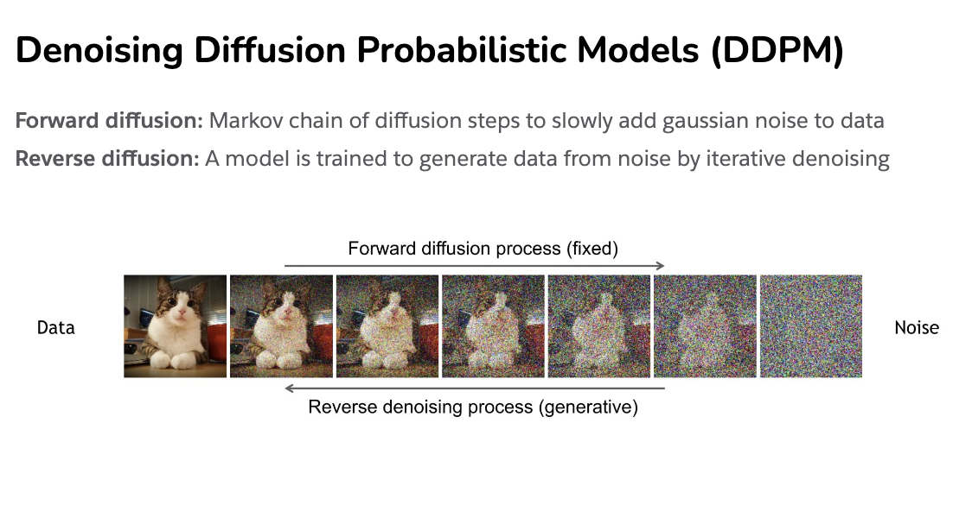
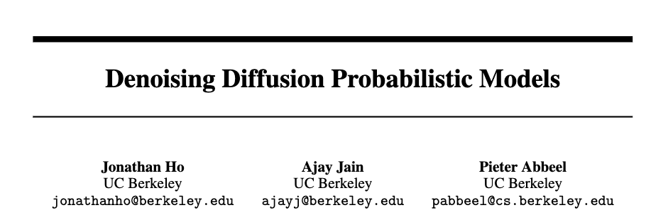
Diffusion Process
https://cvpr2022-tutorial-diffusion-models.github.io/
Slides compiled by my student Aman Shrivastava

Slide 6
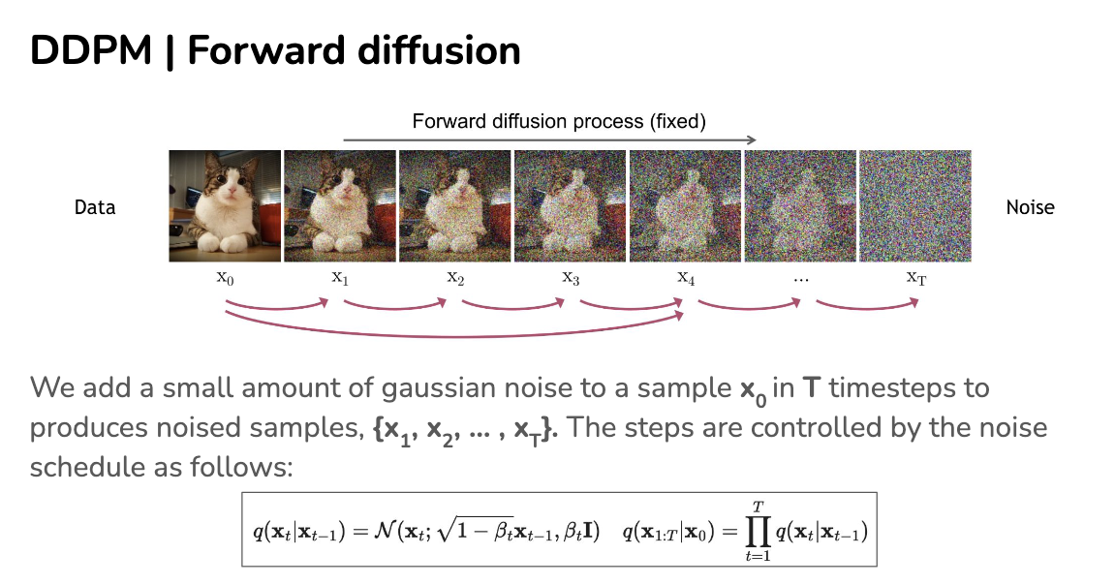
https://cvpr2022-tutorial-diffusion-models.github.io/

Slide 7
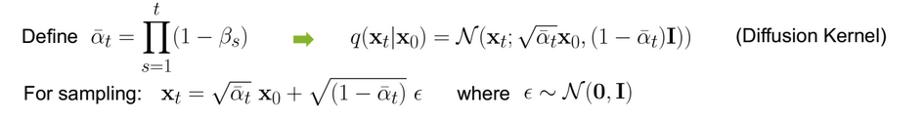

Slide 8
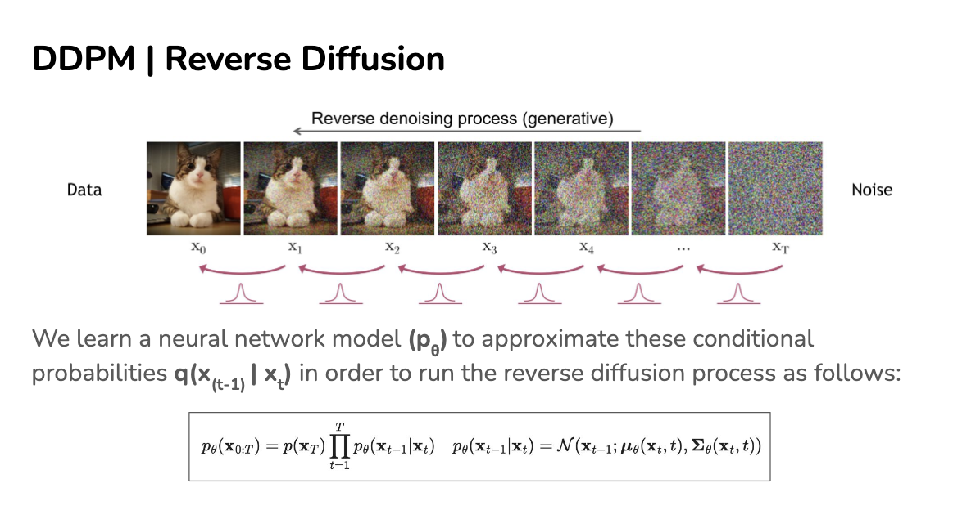
https://cvpr2022-tutorial-diffusion-models.github.io/

Slide 9
https://cvpr2022-tutorial-diffusion-models.github.io/

Slide 10





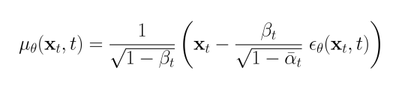
U-Net
Objective:
Given that:

Slide 11
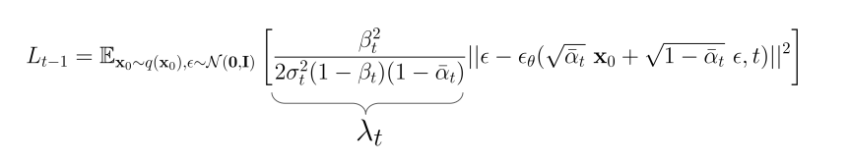
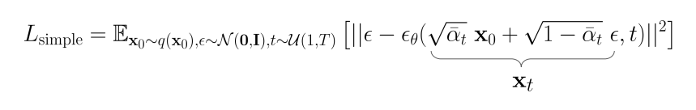
Replacing on the equation
Used in practice:

Slide 12
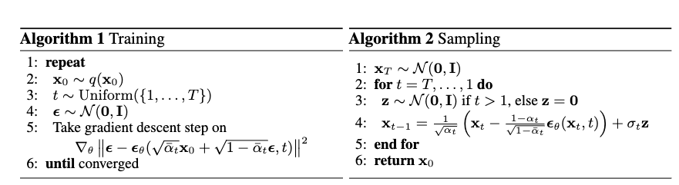
How do we train?
https://cvpr2022-tutorial-diffusion-models.github.io/

Slide 13
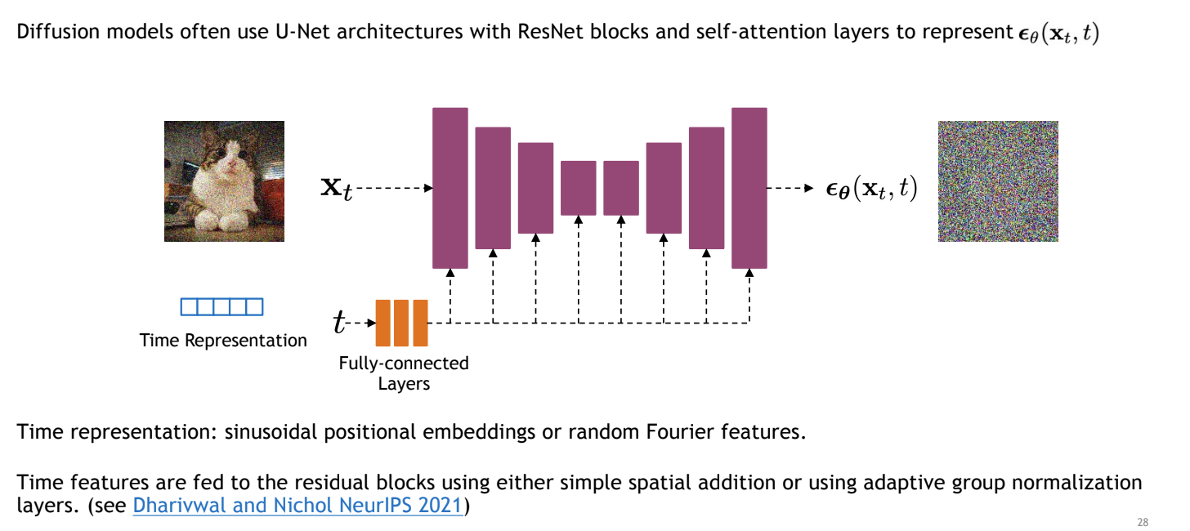
Unet to model transition
https://cvpr2022-tutorial-diffusion-models.github.io/

Slide 14
How do we train?
https://cvpr2022-tutorial-diffusion-models.github.io/

Slide 15
How do we train?
https://cvpr2022-tutorial-diffusion-models.github.io/

Slide 16
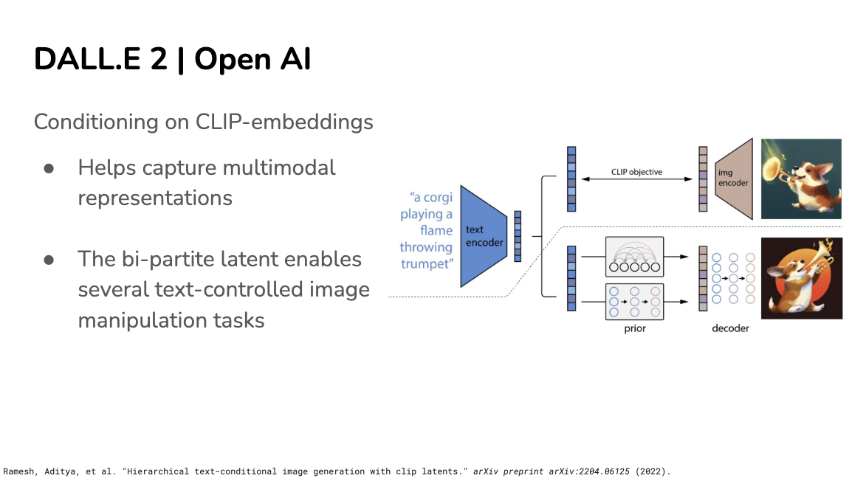

Slide 17
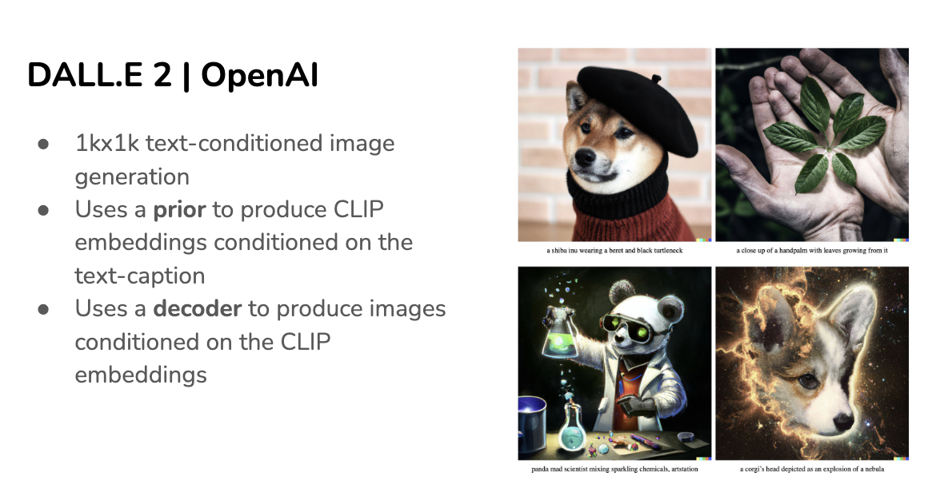
Slides compiled by my student Aman Shrivastava
https://cvpr2022-tutorial-diffusion-models.github.io/

Slide 18
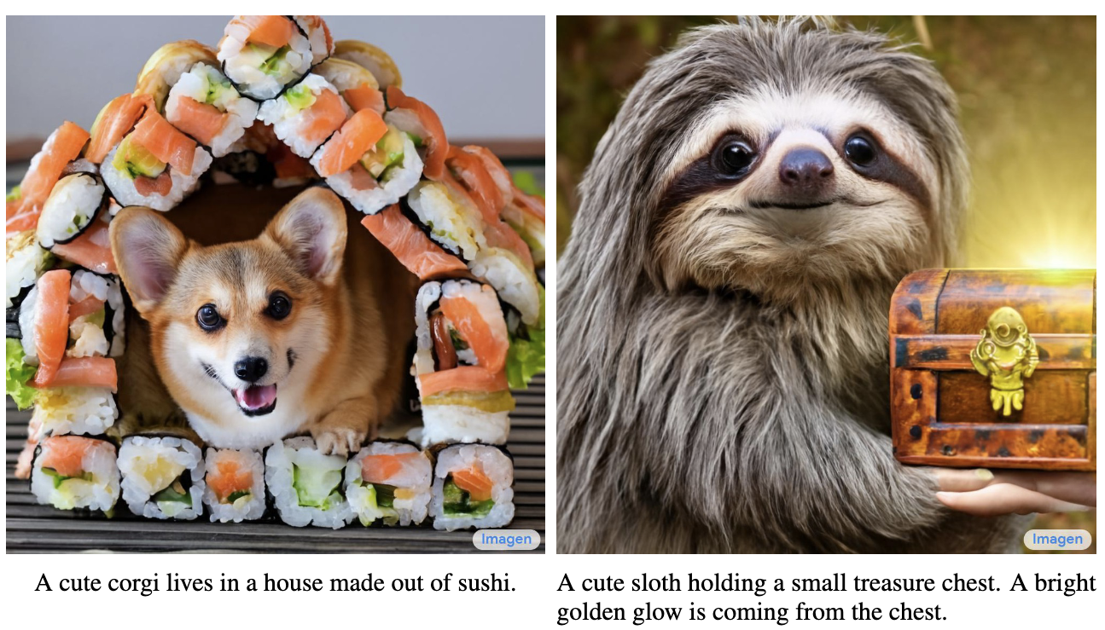
Imagen by Google

Slide 19
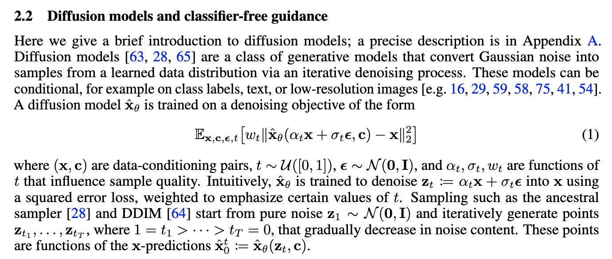
Imagen by Google
https://arxiv.org/pdf/2205.11487.pdf

Slide 20
Questions

