Slide 1
Deep Learning for Vision & Language
Back to Language Models: FLAN-T5, ChatGPT and others

Slide 2
Last Few Classes
Conditional GANs
Sequence-to-sequence based text-to-image models (DALLE-1)
Style Transfer – Input Feature Optimization.
AutoEncoders (AEs)
Variational AutoEncoders (VAEs)
Vector Quantized Autoencoders (VQVAEs, VQGANs, dVAE)
Diffusion Models (e.g. DALLE-2, Imagen, Stable Diffusion)
Today:
Back to Language Models
Language Models + Images

Slide 3
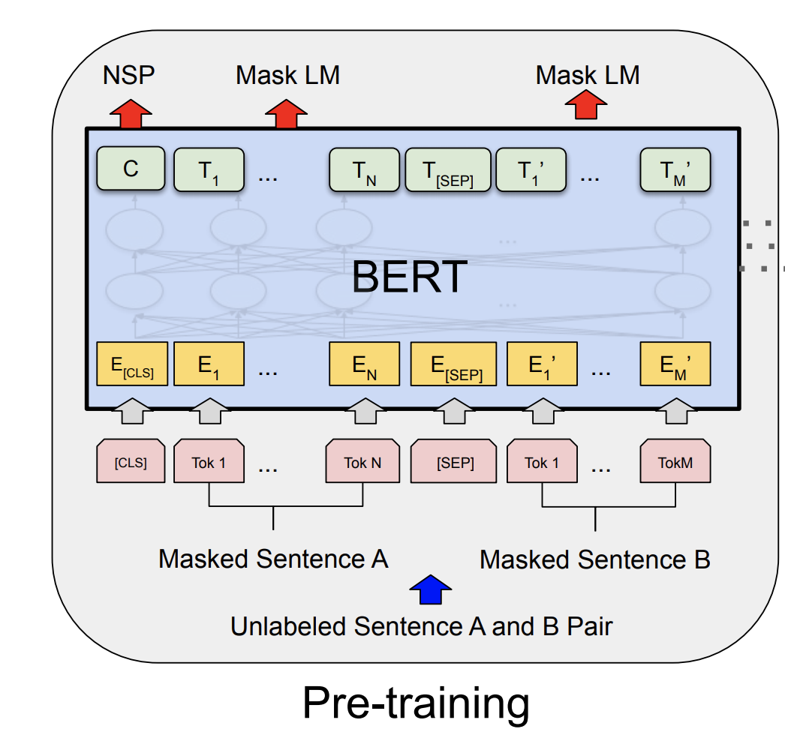
The BERT Encoder Model
Devlin et al. BERT: Pre-training of Deep Bidirectional Transformers for Language Understanding . https://arxiv.org/abs/1810.04805
Important things to know
No decoder
Train the model to fill-in-the-blank by masking some of the input tokens and trying to recover the full sentence.
The input is not one sentence but two sentences separated by a [SEP] token.
Also try to predict whether these two input sentences are consecutive or not.

Slide 4
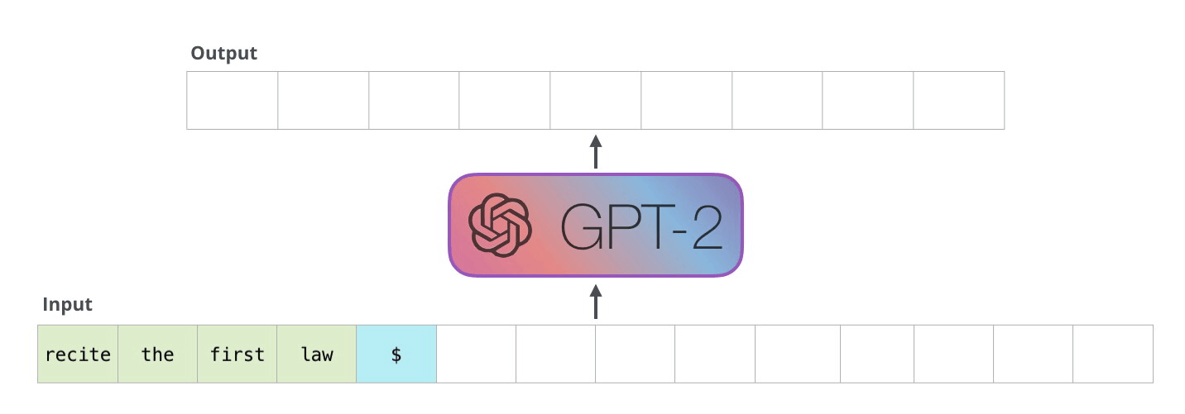
The GPT-2 Model
https://jalammar.github.io/illustrated-gpt2/

Slide 5
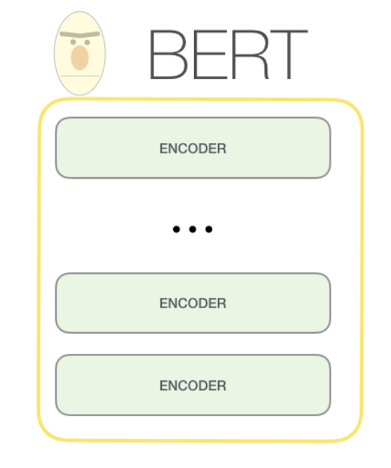
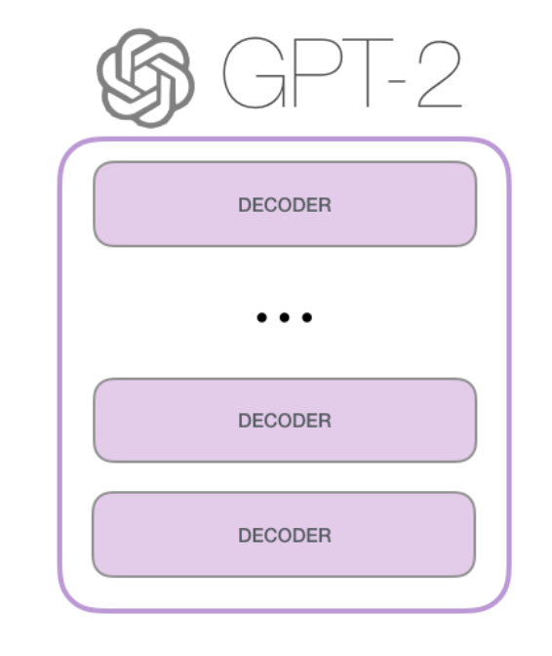
The GPT-2 Model
https://jalammar.github.io/illustrated-gpt2/

Slide 6
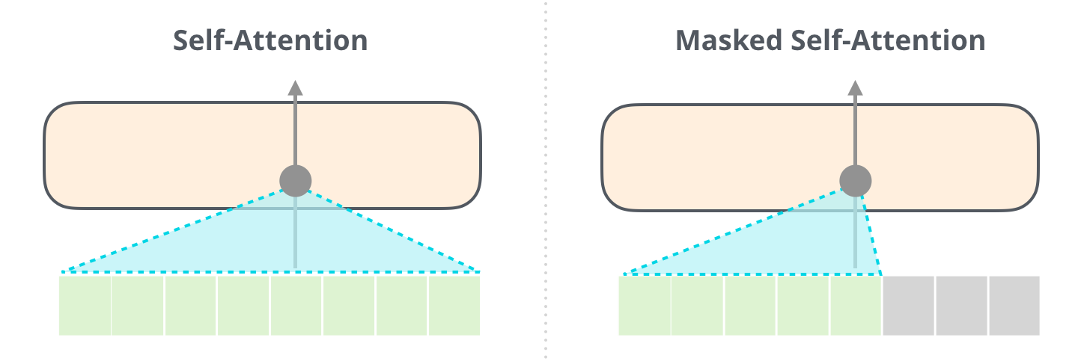
The GPT-2 Model
BERT
GPT
https://jalammar.github.io/illustrated-gpt2/

Slide 7
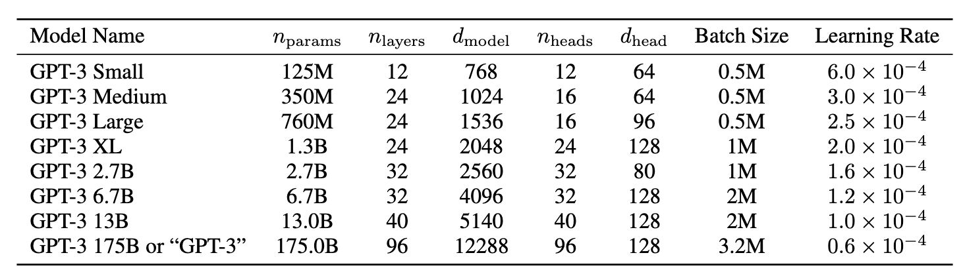
The GPT-3 Model: Explosion of Size

Slide 8
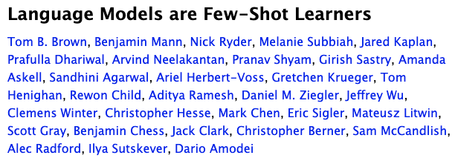
https://arxiv.org/abs/2005.14165

Slide 9
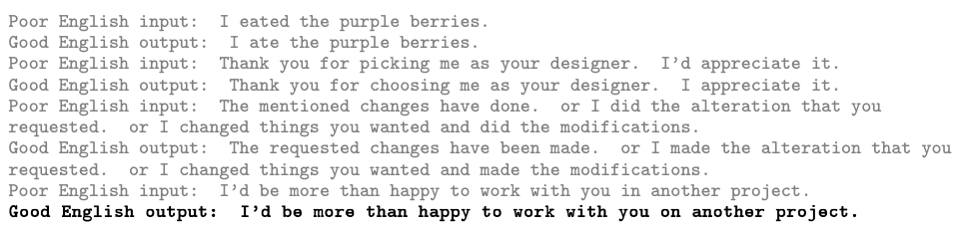
Prompt Engineering
https://arxiv.org/abs/2005.14165

Slide 10
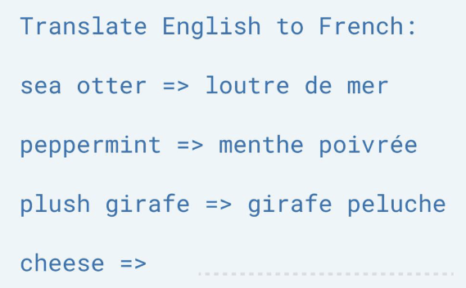
Prompt Engineering
https://arxiv.org/abs/2005.14165

Slide 11
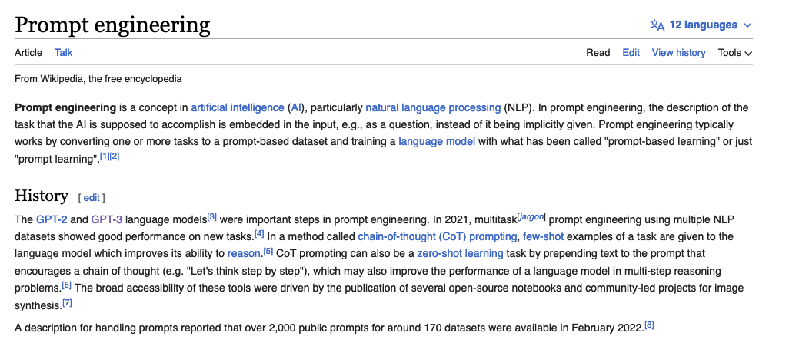
Prompt Engineer

Slide 12
How would you come up with a solution for this problem?
The kid is throwing rocks at the window
The <subject>kid</subject> is throwing <object>rocks</object> at the <destination>window</destination>

Slide 13
Prompt Engineering
Input: The cat is throwing the ball into the ground
Output: The <subject>cat</subject> is throwing the <object>ball</object> into the <destination>ground</ground>
Input: The snake is being attacked by the wolf
Output: The <object>snake</object> is being attacked by the <actor>wolf</actor>
Input: The kid is throwing rocks at the window
Output:

Slide 14
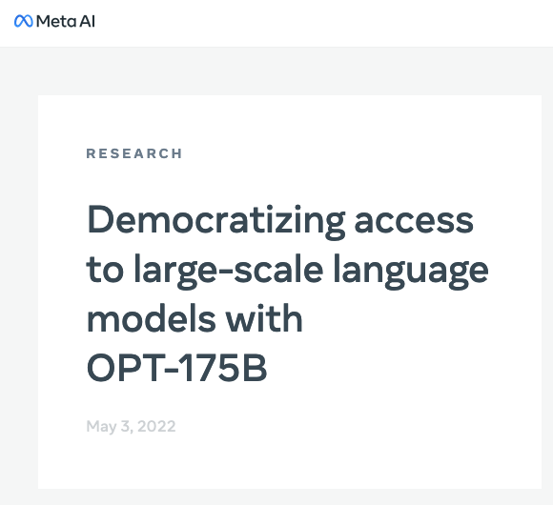

Prompt Engineering
Any Large Language Model (LLM) such as GPT-3 can be turned into a general purpose problem solver in this way.
Obviously, it is not going to work well for every use case.
Other Large Language Models trained at the scale of GPT-3 that are actually publicly available:
BLOOM-176B and OPT-175B:

Slide 15
However these are still limited
Predicting the next word can lead to intelligent behavior such as the one exemplified earlier however this still limited
What makes some of the new LLMs special? ChatGPT, FLAN-T5, OPT-IML

Slide 16
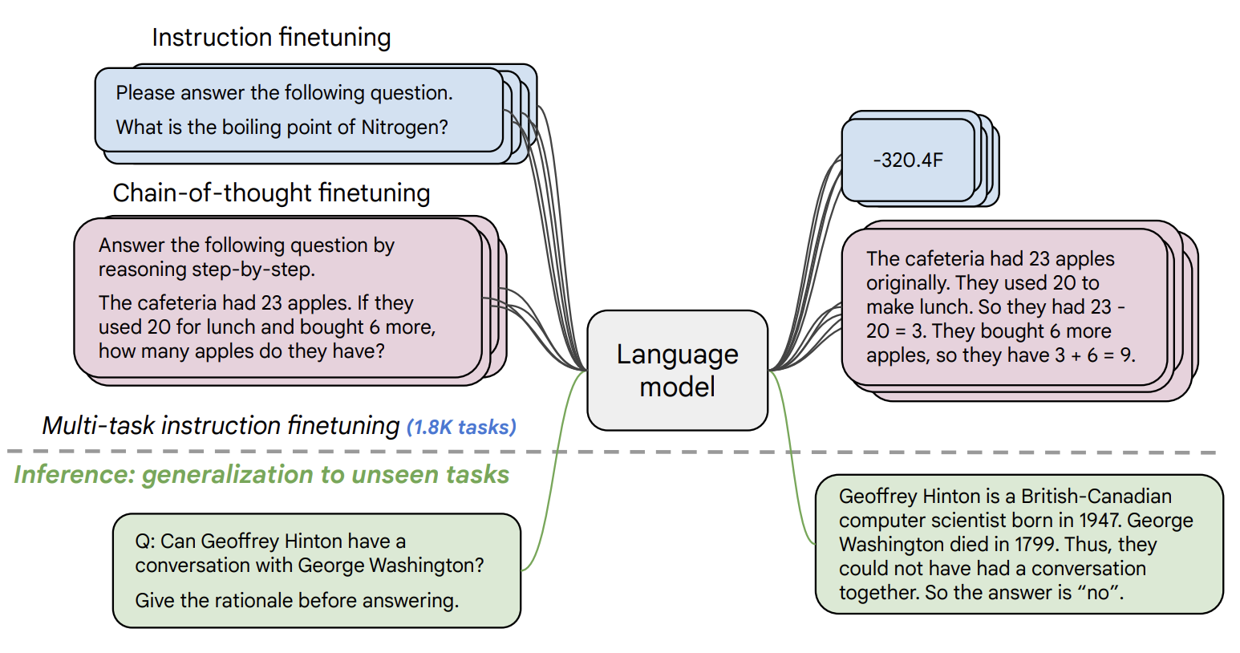
Instruction Tuning (e.g. FLAN-T5 by Google)
https://arxiv.org/pdf/2210.11416.pdf

Slide 17
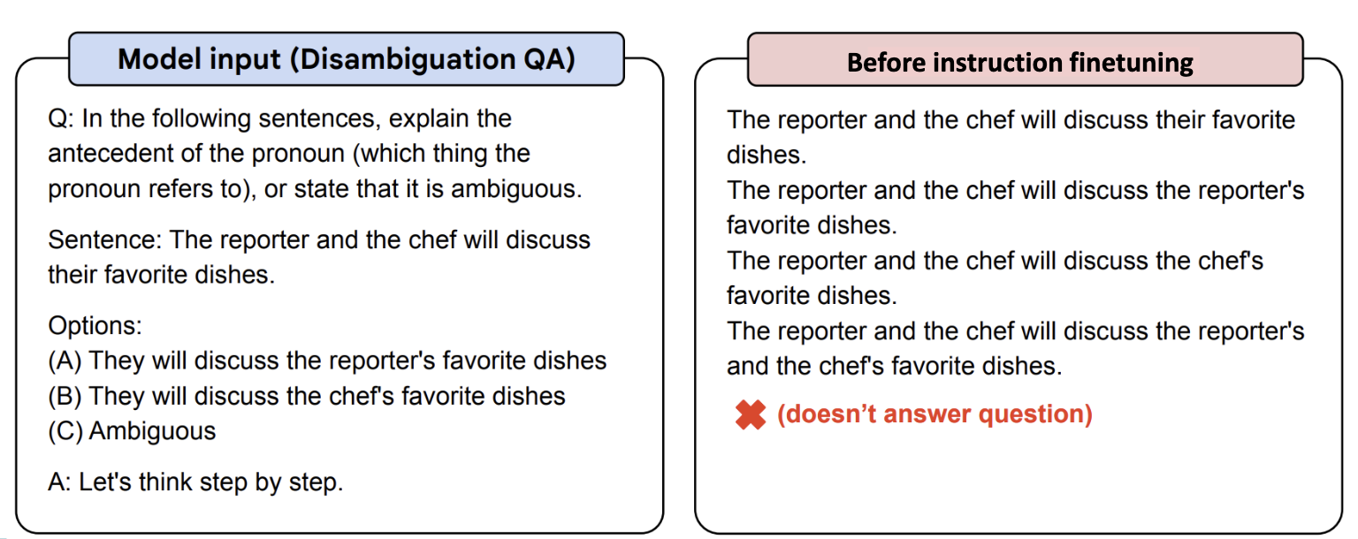
FLAN-T5

Slide 18
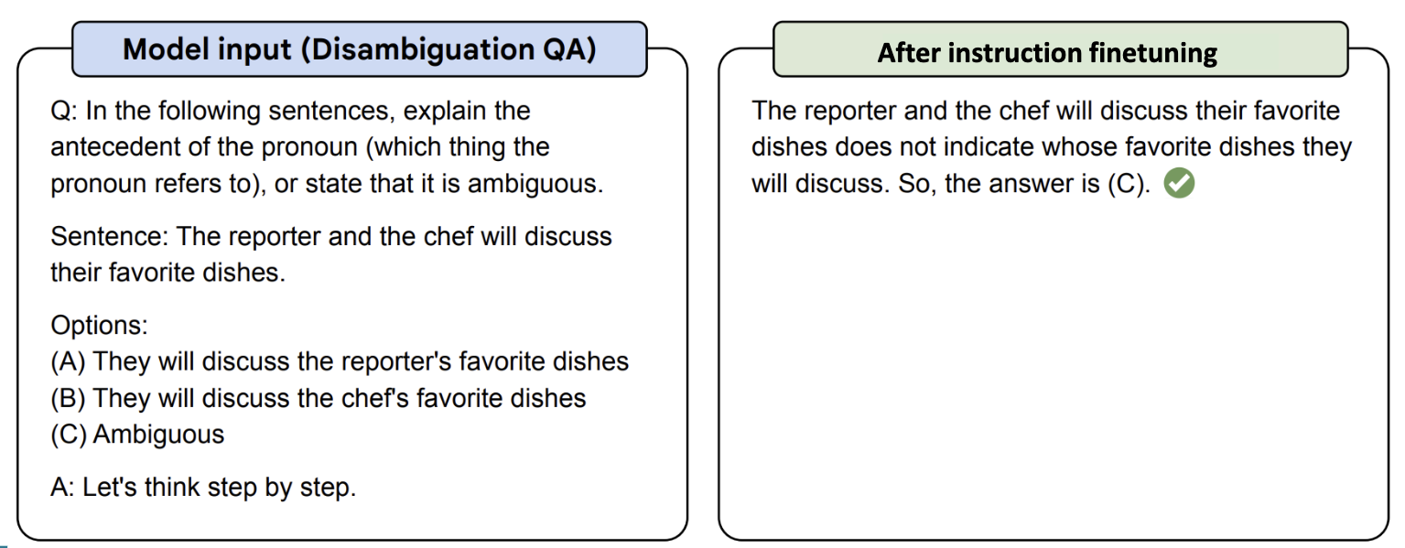
FLAN-T5

Slide 19
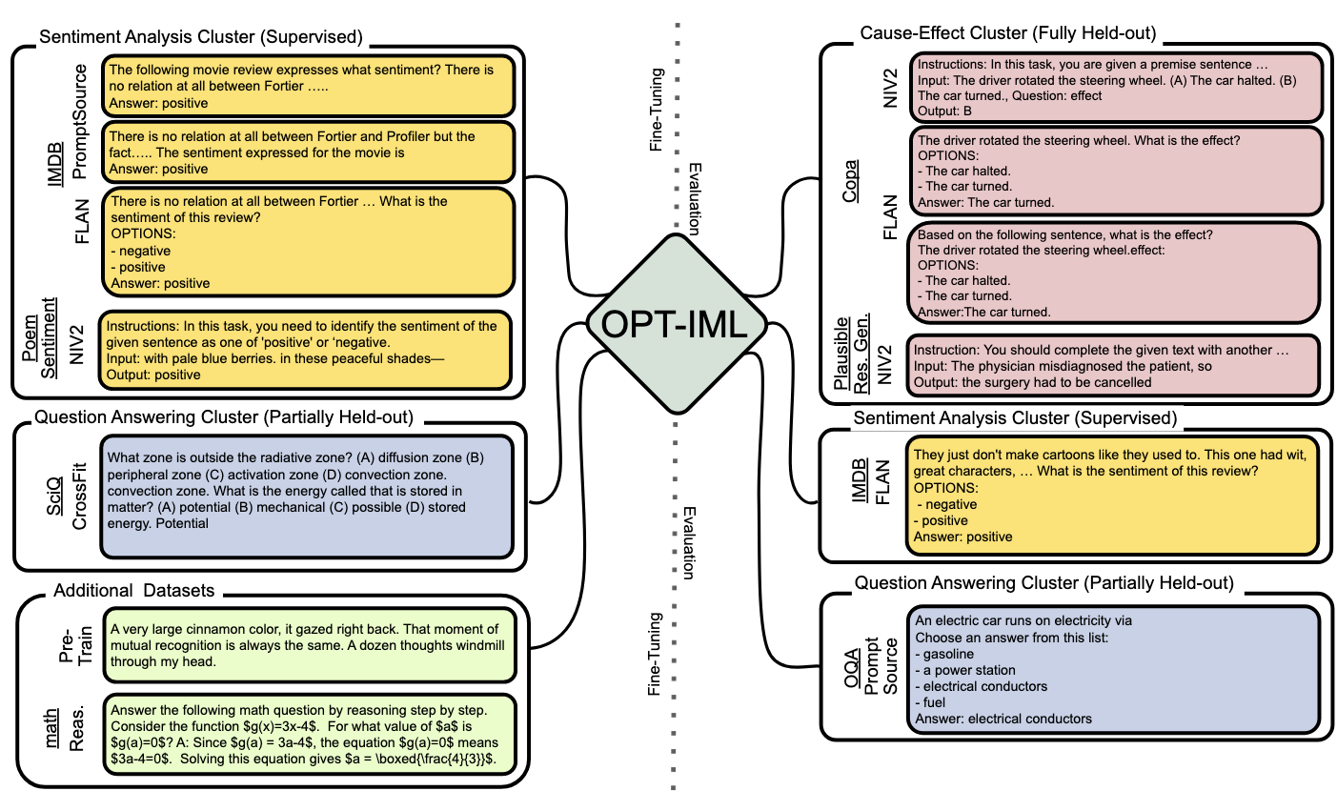
Instruction Tuning (e.g. OPT-IML by Facebook)
https://arxiv.org/pdf/2212.12017.pdf

Slide 20
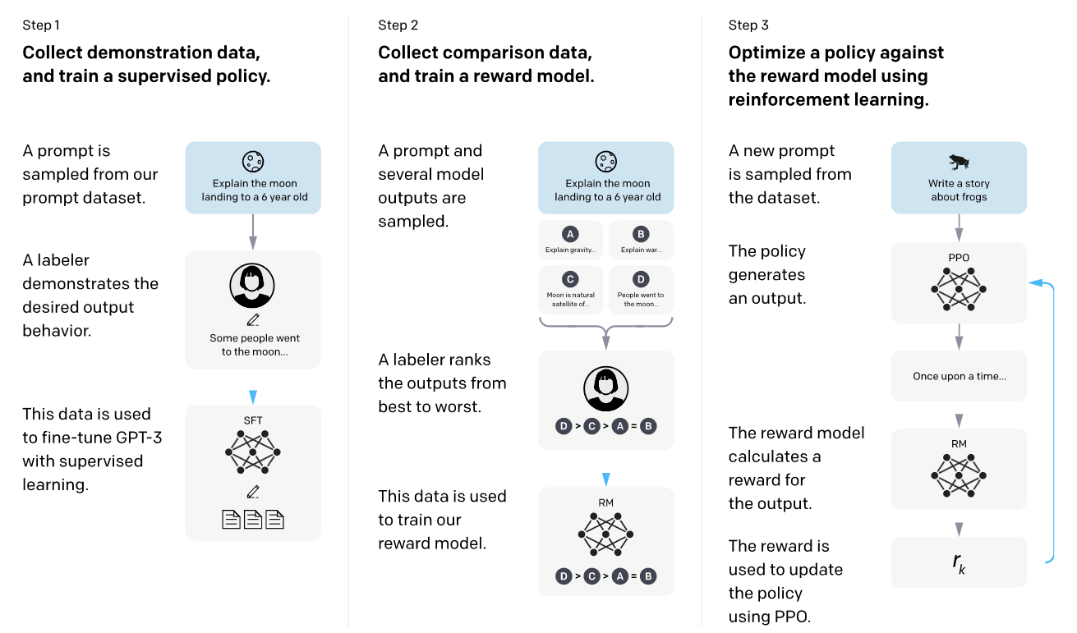
InstructGPT (ChatGPT)
https://arxiv.org/abs/2203.02155

Slide 21
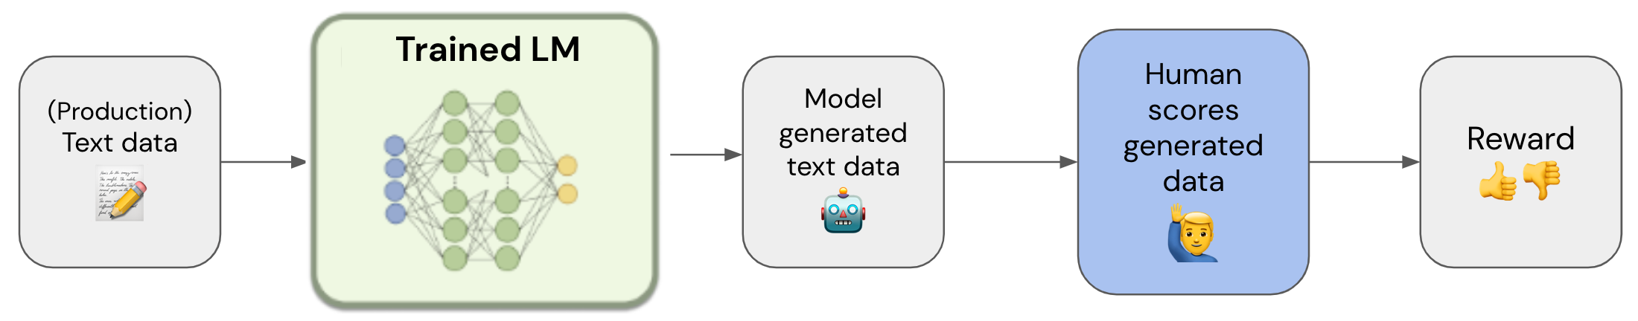
Step by Step: Train a Reward Model that learns from Human Ratings e.g. from 1 to 5
https://gist.github.com/JoaoLages/c6f2dfd13d2484aa8bb0b2d567fbf093

Slide 22
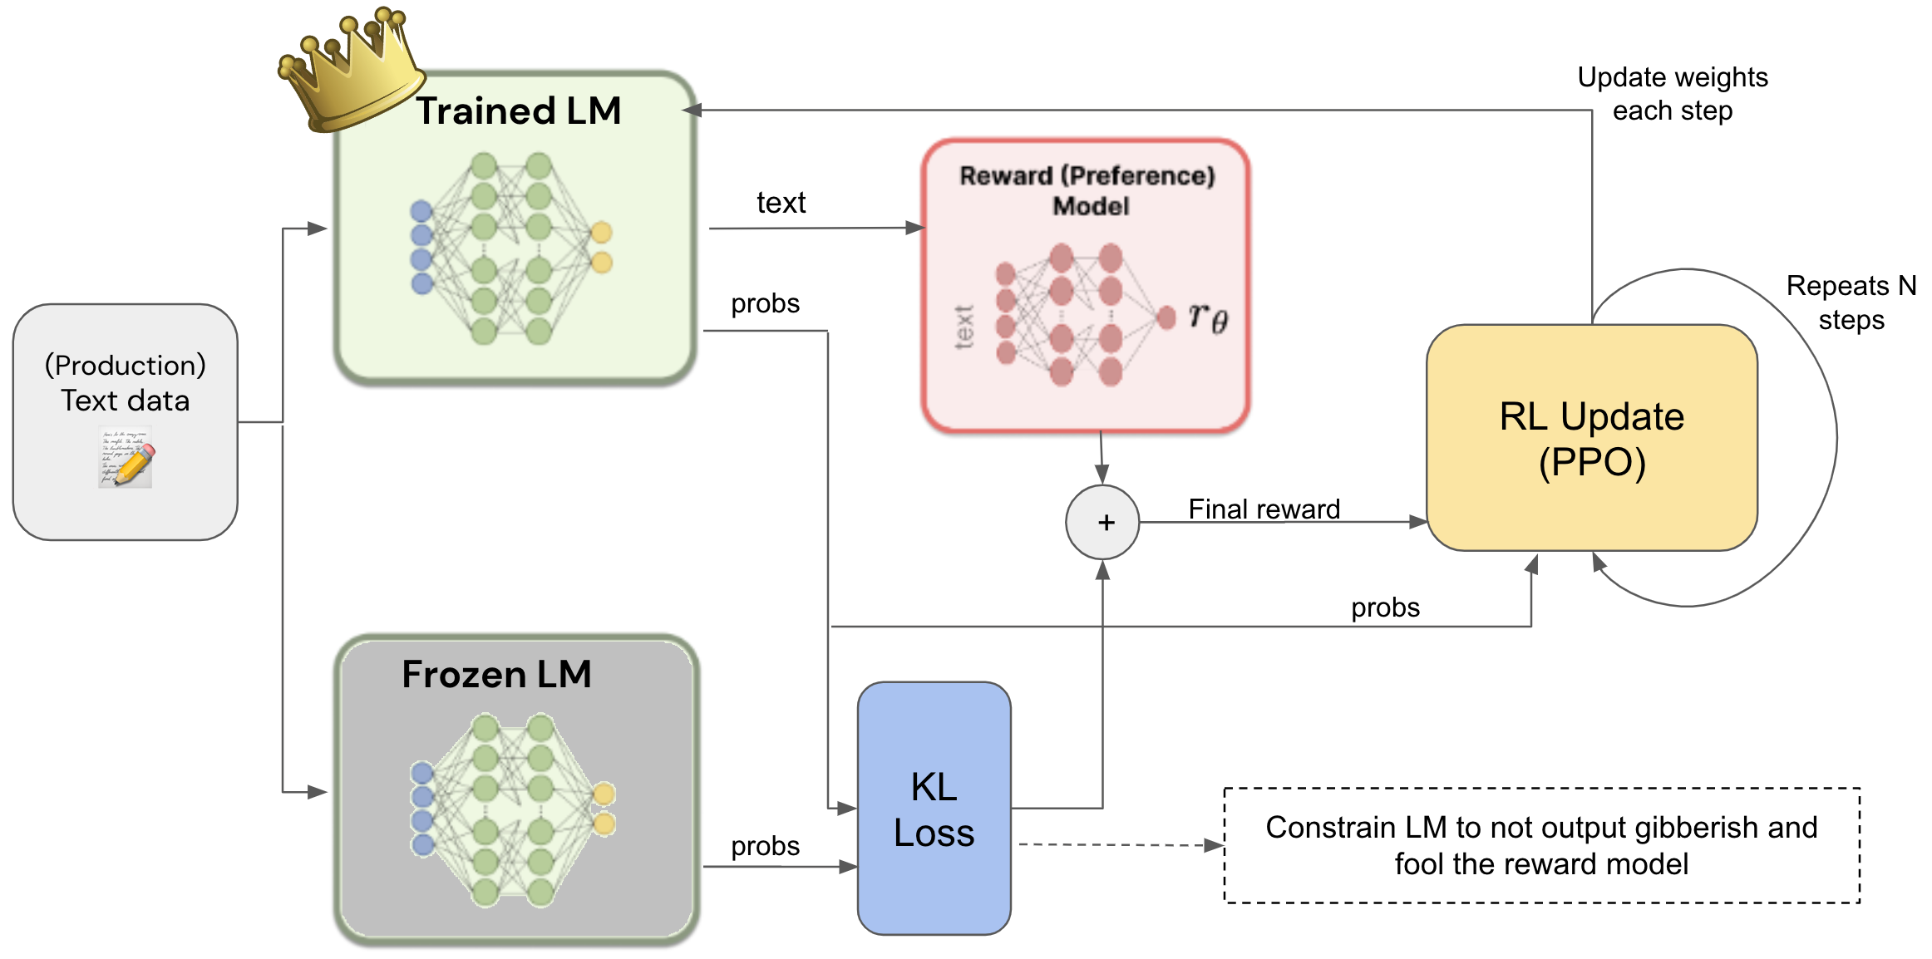
Step by Step: Train the LM to generate text that gets high reward but still produces stuff that makes sense
https://gist.github.com/JoaoLages/c6f2dfd13d2484aa8bb0b2d567fbf093

Slide 23
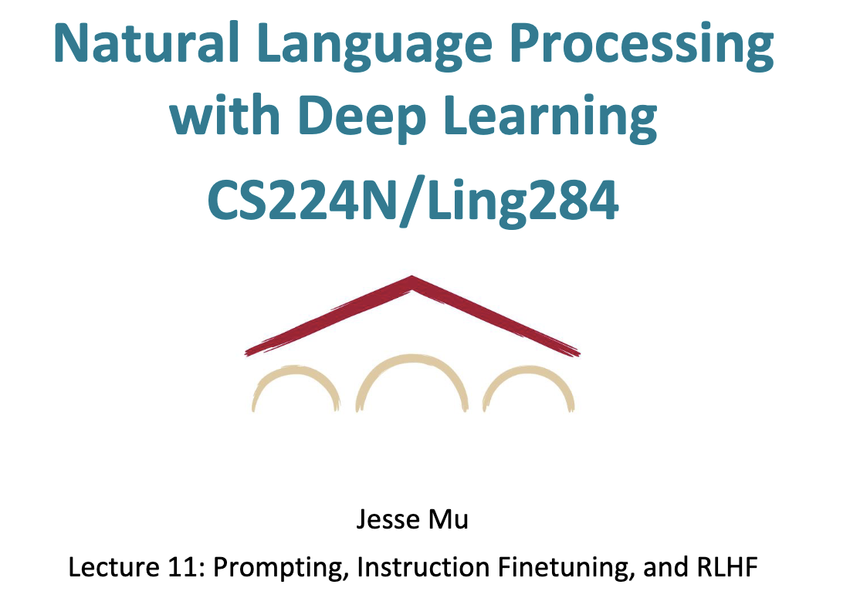
Recommended Slide Deck
http://web.stanford.edu/class/cs224n/slides/cs224n-2023-lecture11-prompting-rlhf.pdf

Slide 24
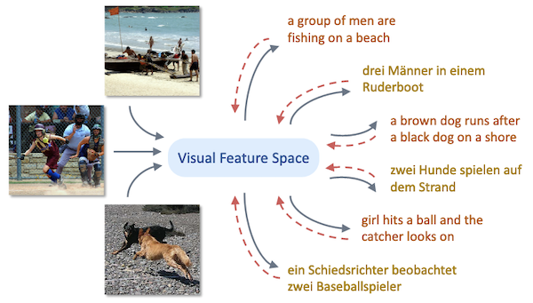
Next Step: Multimodality

Slide 25
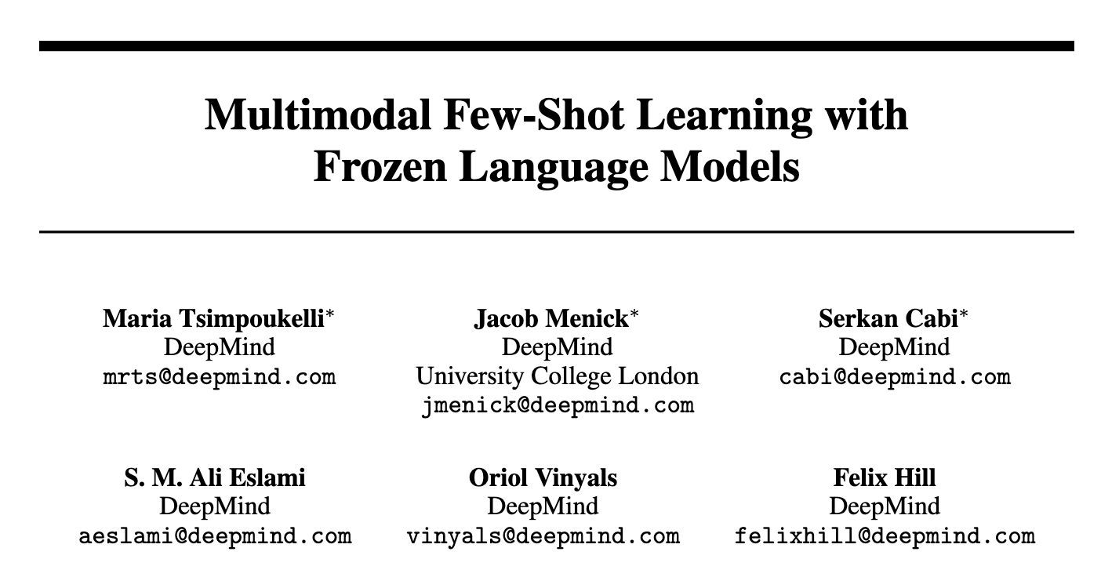
NeurIPS 2021

Slide 26
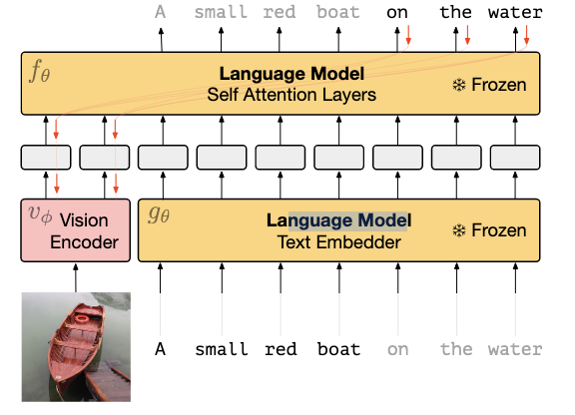
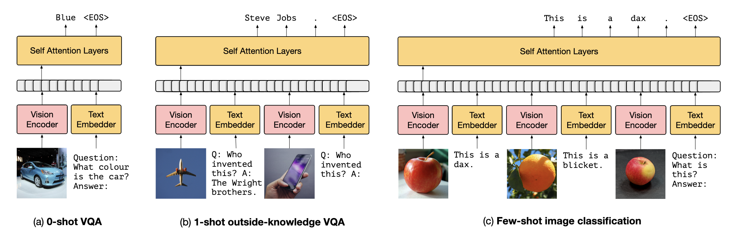
Training:

Slide 27
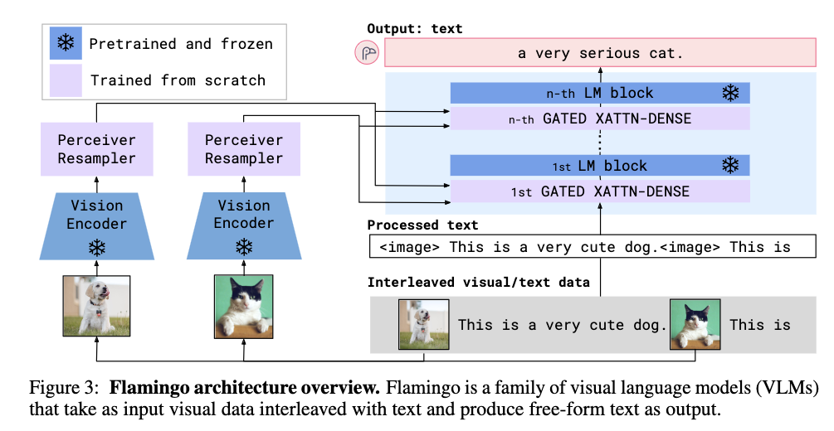
Flamingo
https://arxiv.org/pdf/2204.14198.pdf

Slide 28
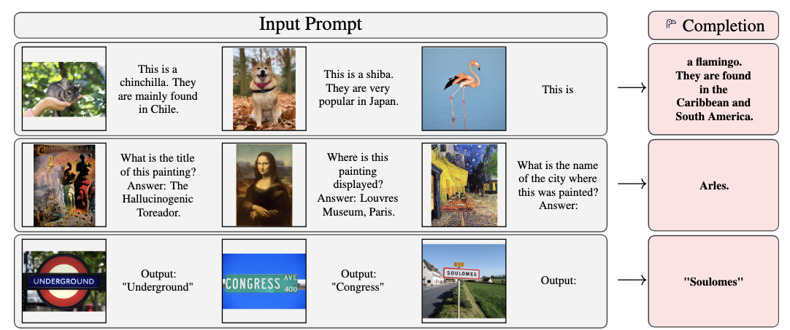
Flamingo
https://arxiv.org/pdf/2204.14198.pdf

Slide 29
Questions

