Slide 1
Deep Learning for Vision & Language
Referring Expression Comprehension (Visual Grounding),
Visual Question Answering, Explainable Heatmaps

Slide 2
Today
Referring Expressions
Referring Expressions vs Image Captions
Generating Referring Expressions
Referring Expression Comprehension

Slide 3
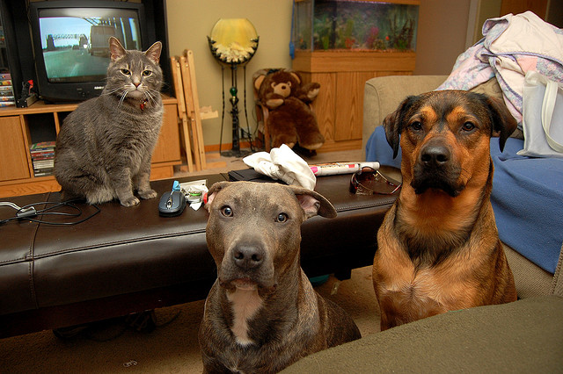
Computer Vision
feline
tv set
teddy bear
pitbull
bullmastiff
cat
tv stand
group of dogs
fish tank
room
indoor
man-made
footstool
Image tagging / Image classification
furniture

Slide 4
Computer Vision
tv set
fish tank
feline
cat, feline
tv set
teddy bear
sofa
bullmastiff, animal
teddy bear
tv stand
pitbull
bullmastiff
footstool
pitbull
cat
tv stand
group of dogs
fish tank
room
indoor
man-made
footstool
Object Detection
furniture

Slide 5
Computer Vision
feline
tv set
teddy bear
pitbull
dog
cat
tv stand
group of dogs
fish tank
room
indoor
man-made
footstool
Image Parsing / Image Segmentation
furniture

Slide 6
How do we describe images?
Object Importance
Attribute
Importance
Action
Importance
World knowledge
A cat and two big dogs staring at the camera

Slide 7
Referring to objects
The dog in the middle
The gray dog in the middle
The gray dog
Notes:
Less variation in the things people choose to mention
There is a way to verify them that is objective
People tend to overspecify
People tend to call objects with certain names.

Slide 8
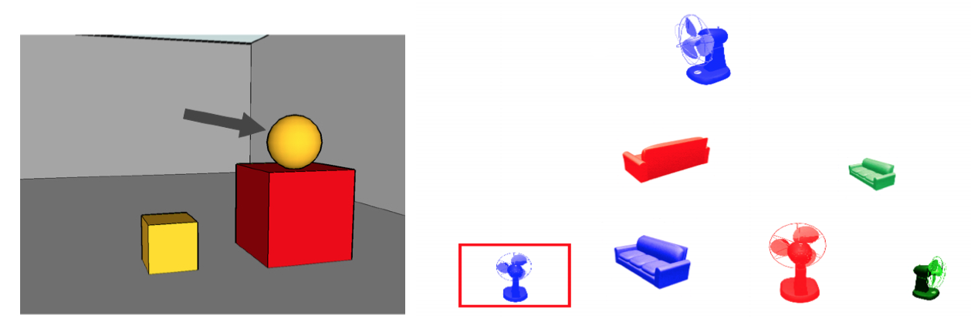
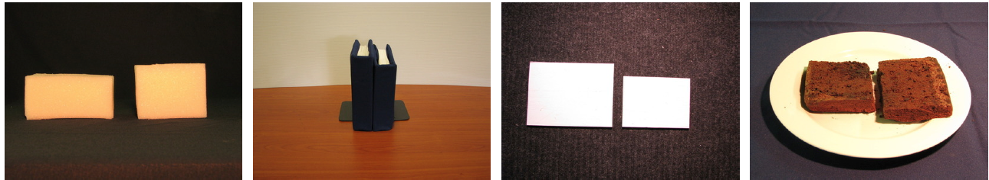
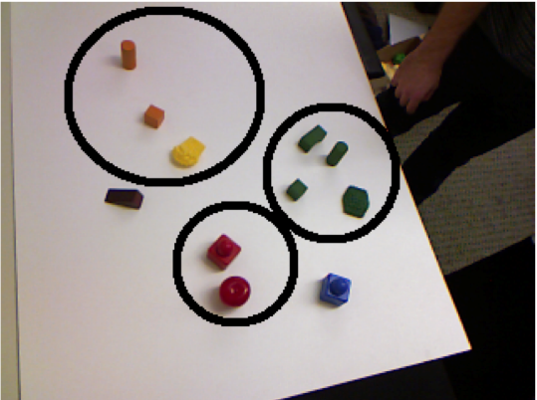
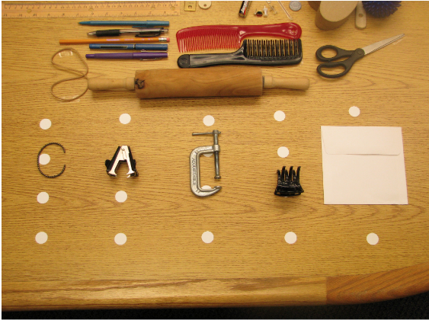
Work on Referring Expression
TUNA Corpus
van Deemter et al 2006
GRE3D3 Corpus
Viethen and Dale 2008
[20 scenes]
Size Corpus
Mitchell et al 2011
[96 scenes]
GenX Corpus
FitzGerald et al 2013
[269 scenes]
Typicality Corpus
Mitchell et al 2013
[35 scenes]
Notes:
Referring expressions have been studied in the past since the 70’s from different perspectives.
From the use of color, orientation, location, relative locations to size modifiers and from single objects to multiple objects.
As you can see some of the earlier work analyzed simpler synthetic computer generated images and some more recent work has moved toward more realistic scenarios.
Our goal was to take this one step futher and collect referring expressions for real world natural scenes.
In order to study this problem we decided to collect a new dataset.

Slide 9

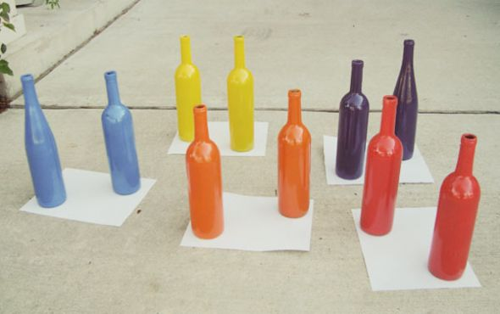

Referit Game
Player 1
Orange bottle on the right
Player 2
Orange bottle on the right
Notes:
So we designed and implemented this new game for collecting referring expressions. This is a two player cooperative game where one player sees an image and an objected outlined in the image and then he writes a expression referring to the object. The other player (Player 2) just sees the image and the expression and has to click in the correct object. If Player 2 successfully finds the object that was outlined for Player 1, then both win points and keep playing reversing their roles on each iteration.
This allows us to both collect and verify descriptions inside of the game.

Slide 10
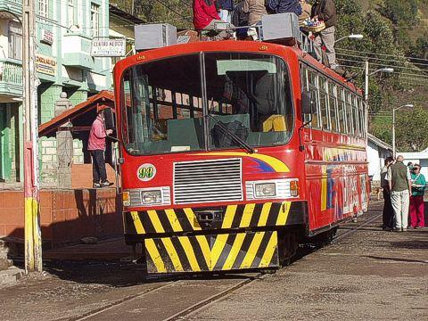
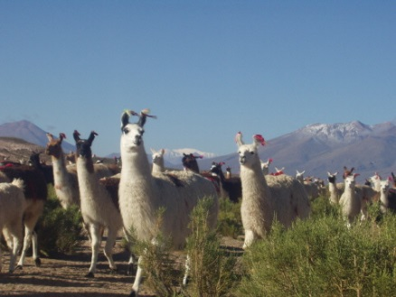
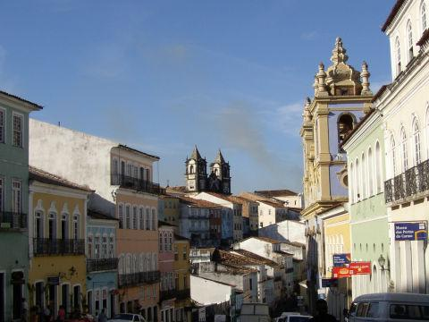
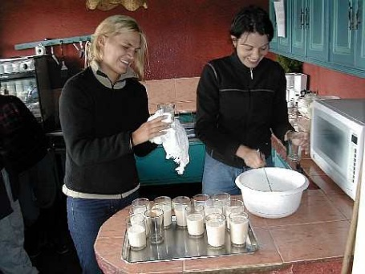
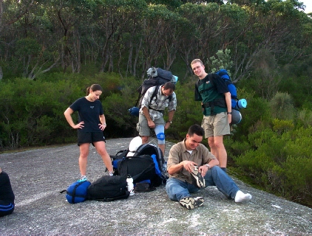
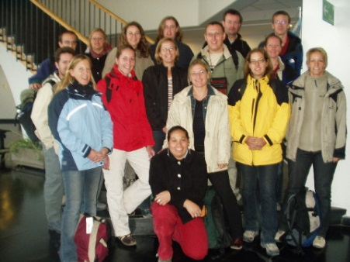
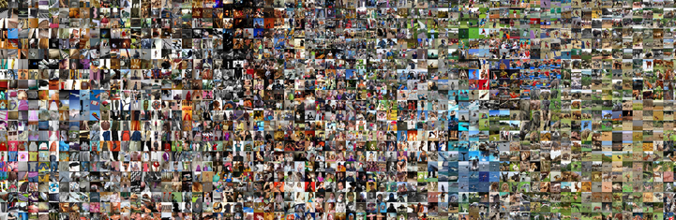
Referring Expressions for Natural Scenes
Diverse Many real world objects
Complex
Many object instances
Big
20k images
IAPR TC-12 Segmented and Annotated Dataset. Escalante et. al. 2009
Notes:
The real world has a lot of variation and sparsity so …
- We want referring expressions for a diverse set of objects. We want to have some coverage of different object classes.
- We want complex natural scenes where often there is more than object of the same type in the image.
And we want our data to be big. One such image dataset is the IAPR TC-12 Segmented and Annotated Dataset by Escalante and collaborators. It contains 20,000 images with many object instances per image and it already has the objets nicely segmented. So we only need to collect referring expressions.
How did we collect this many referring expressions? Sahar is going to talk to you about that.

Slide 11
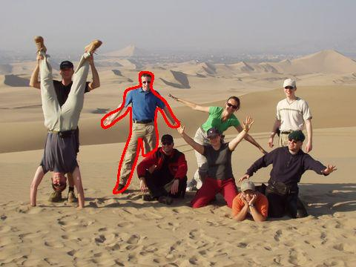
Referit Game Dataset
Blue shirt man
Blue guy
Second guy from left
ReferItGame Dataset
130k Referring expressions for 90k Objects in 19k images
ReferItGame: Referring to Objects in Photographs of Natural Scenes Sahar Kazemzadeh, Vicente Ordonez, Mark Matten, Tamara L. Berg. Empirical Methods on Natural Language Processing. EMNLP 2014.
Notes:
We endup with a large dataset with 130k Referring expressions for 90k objects in 19k images. We use the IAPR – TC dataset that contains manual segmentations for most objects in all the images.

Slide 12
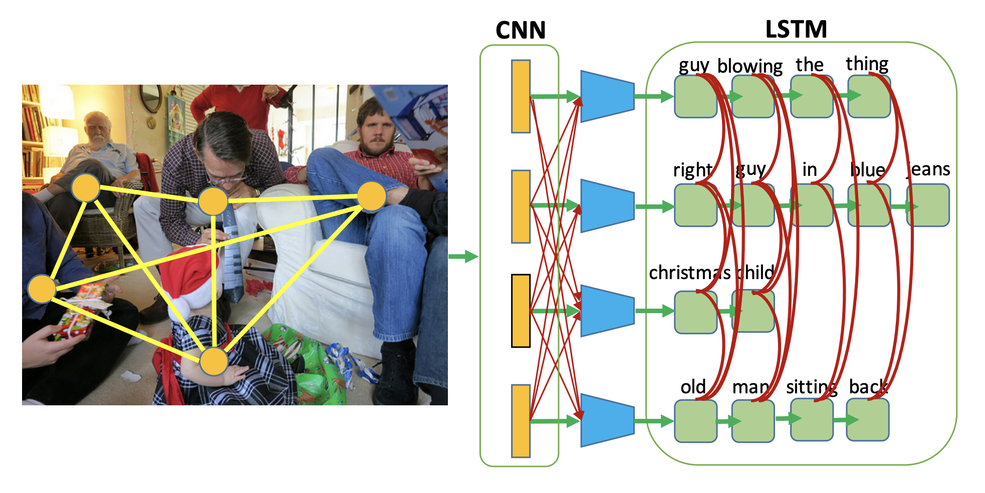
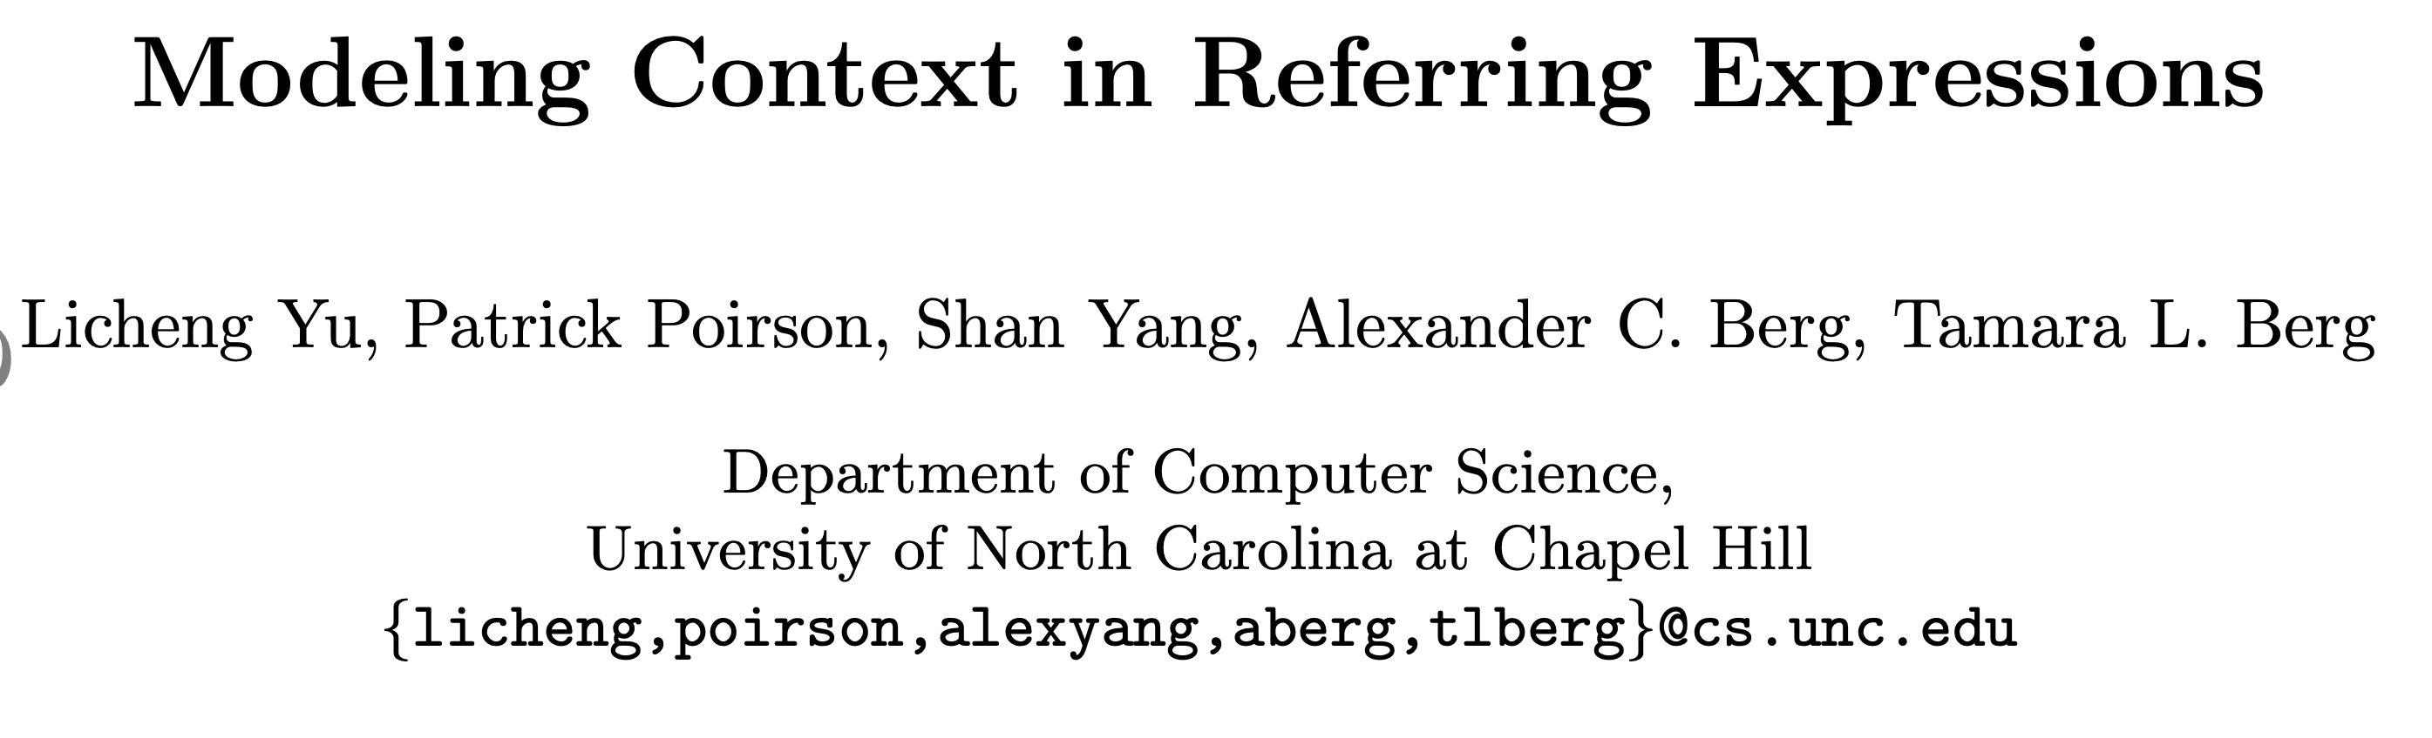
Deep Generation of Referring Expressions
2016

Slide 13
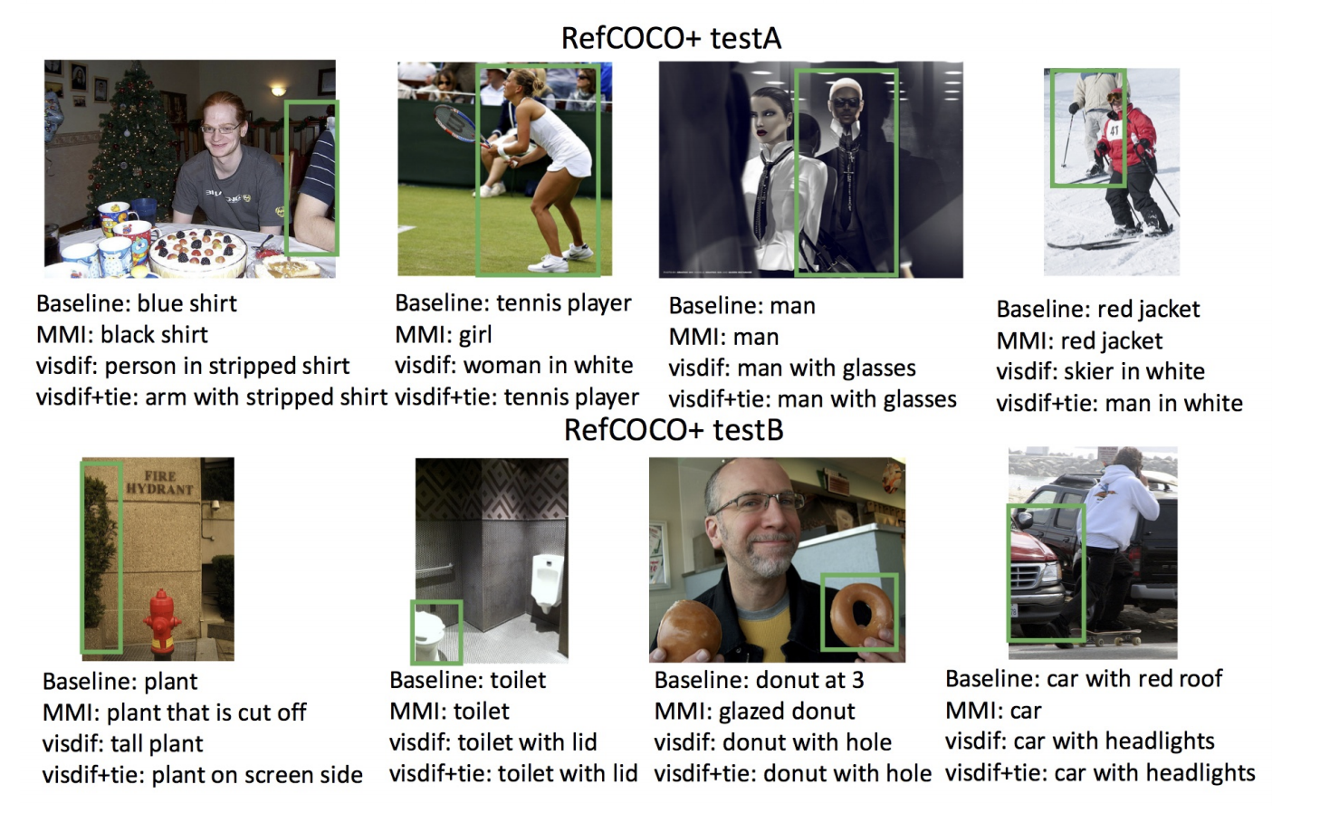

Slide 14
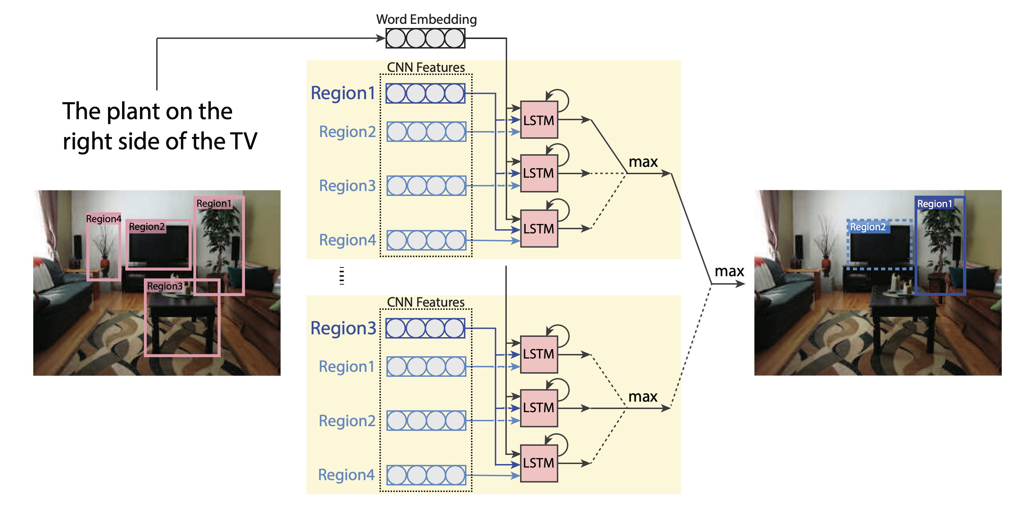
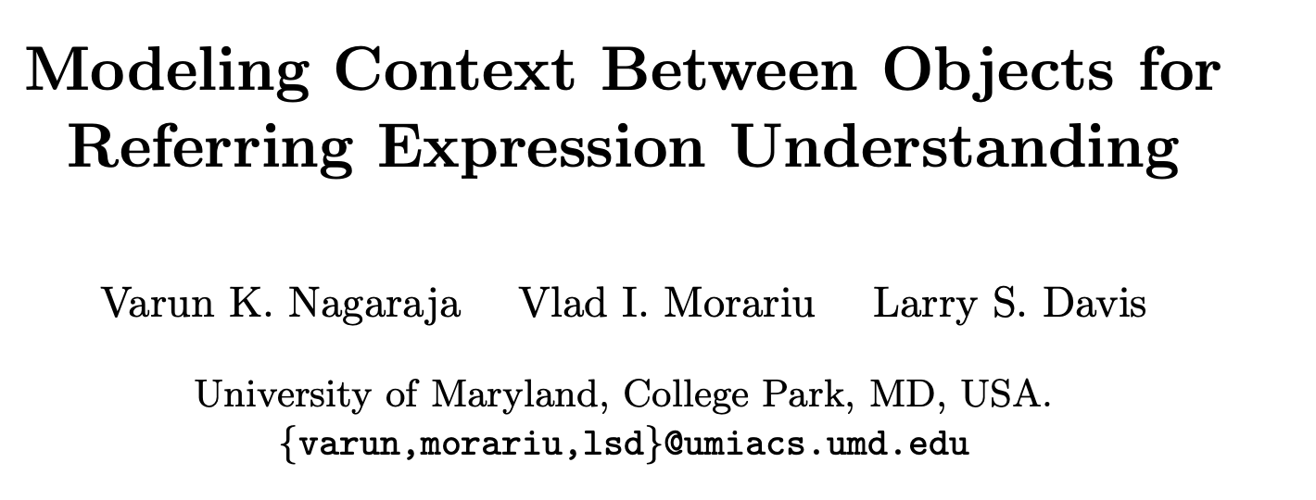
Referring Expression Comprehension

Slide 15
Referring Expression Comprehension

Slide 16
Referring Expression Comprehension

Slide 17
Referring Expression Comprehension
2016

Slide 18
Other important work
MattNet: Yu et al. https://arxiv.org/abs/1801.08186
Mao et al. https://arxiv.org/abs/1511.02283
Rohrbach et al. https://arxiv.org/abs/1511.03745

Slide 19
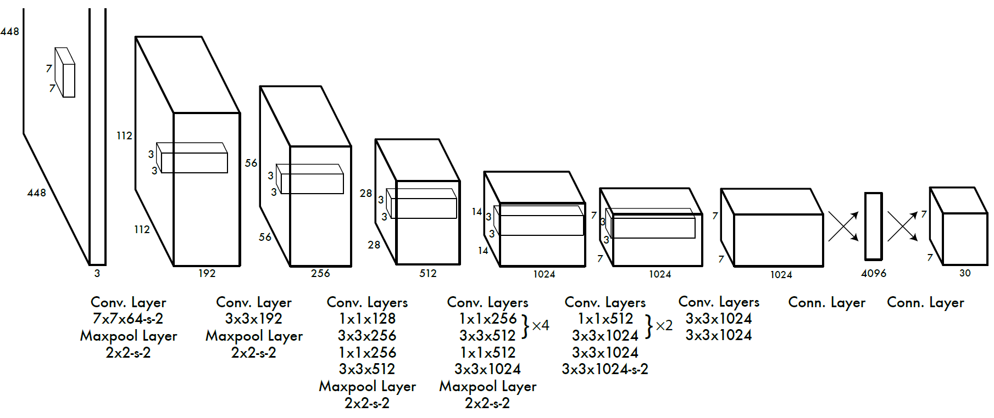
Detour: Recap on Object Detection
Two-stage: Faster-RCNN, Mask-RCNN
Single-stage: YOLO (You Only Look Once), SSD (Single Shot Detector)

Slide 20
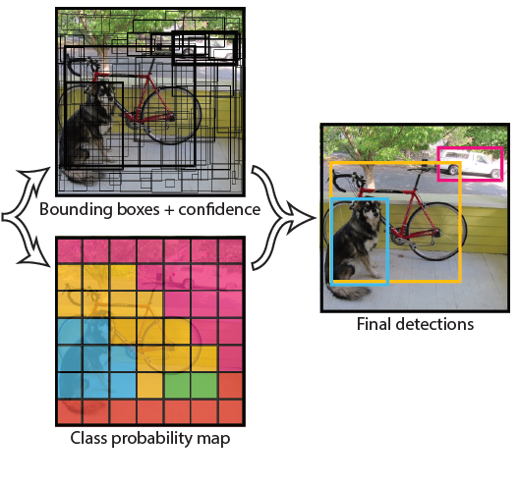
Post-processing: Non-Max Suppression

Slide 21
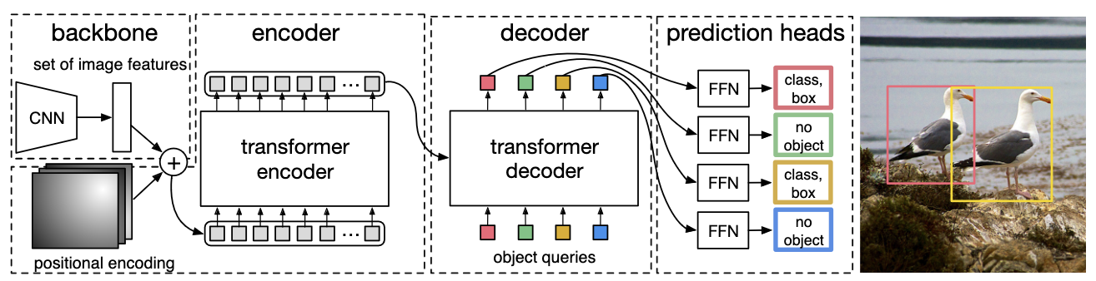
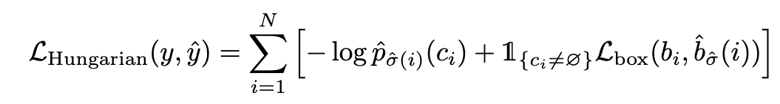
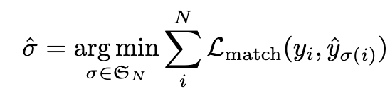
End-to-end Object Detection with Transfromers (DETR) (2020)
where
https://arxiv.org/abs/2005.12872
https://github.com/facebookresearch/detr

Slide 22
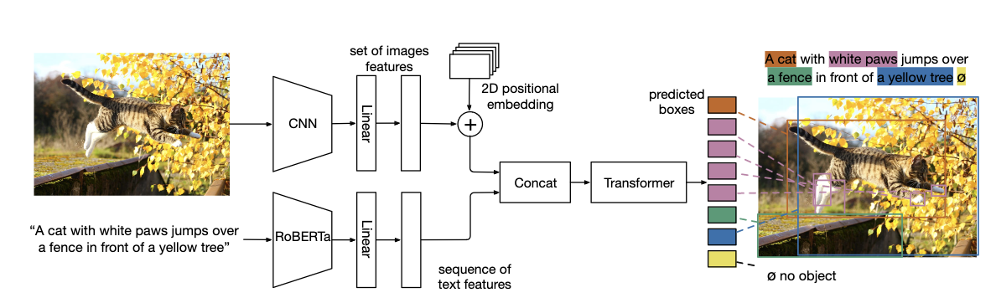
MDETR: Modulated Detection for Multimodal Understanding (2021)
https://arxiv.org/pdf/2104.12763.pdf
https://github.com/facebookresearch/detr

Slide 23
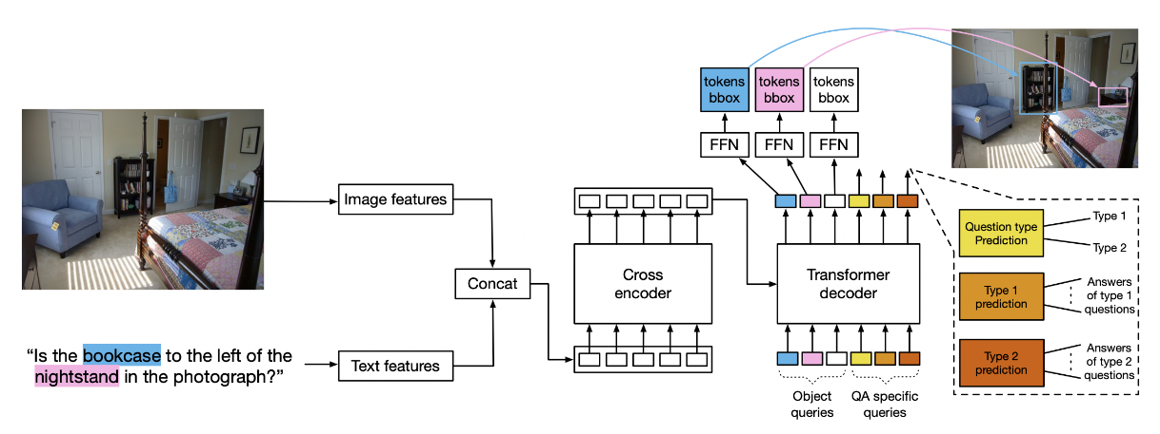
MDETR: For Question Answering

Slide 24
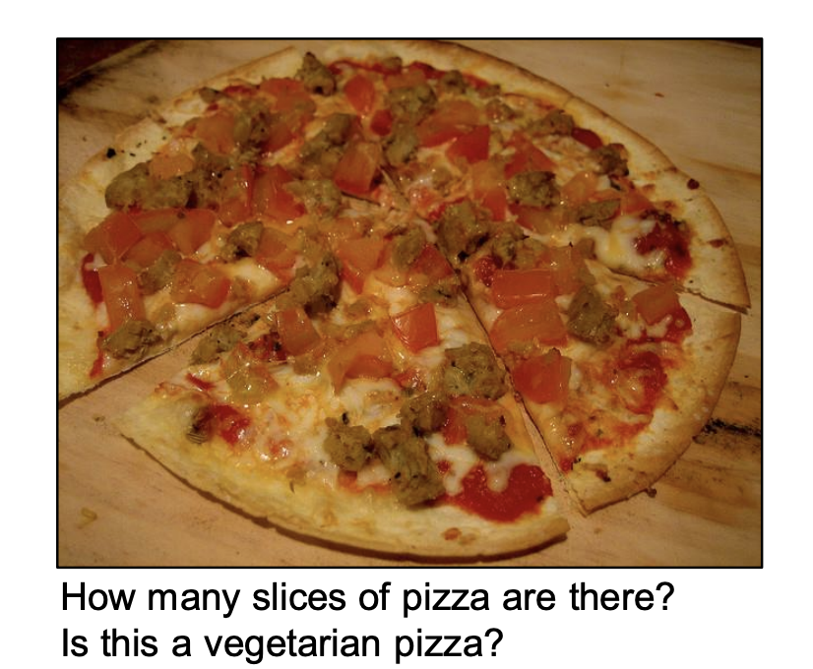
Visually Grounded Question Answering
https://arxiv.org/pdf/1505.00468.pdf

Slide 25
Visually Grounded Question Answering
https://arxiv.org/pdf/1505.00468.pdf

Slide 26

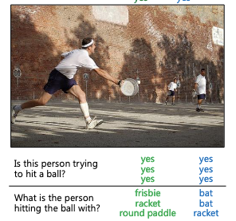
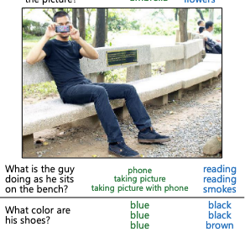

Slide 27
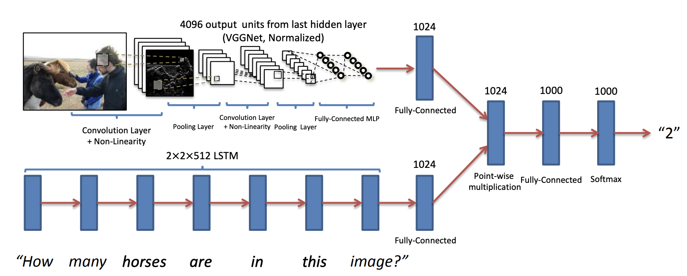
Visually Grounded Question Answering
https://arxiv.org/pdf/1505.00468.pdf

Slide 28
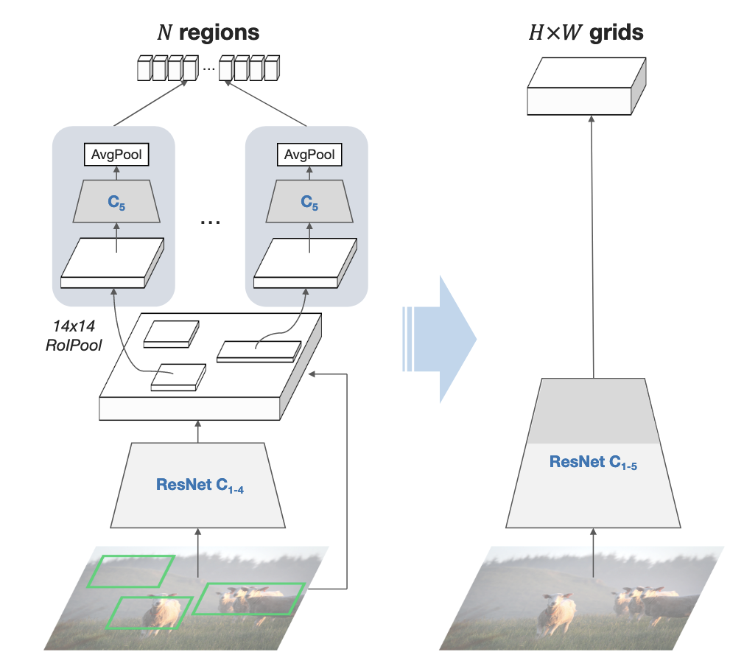
What Features to use as input visual features?

Slide 29

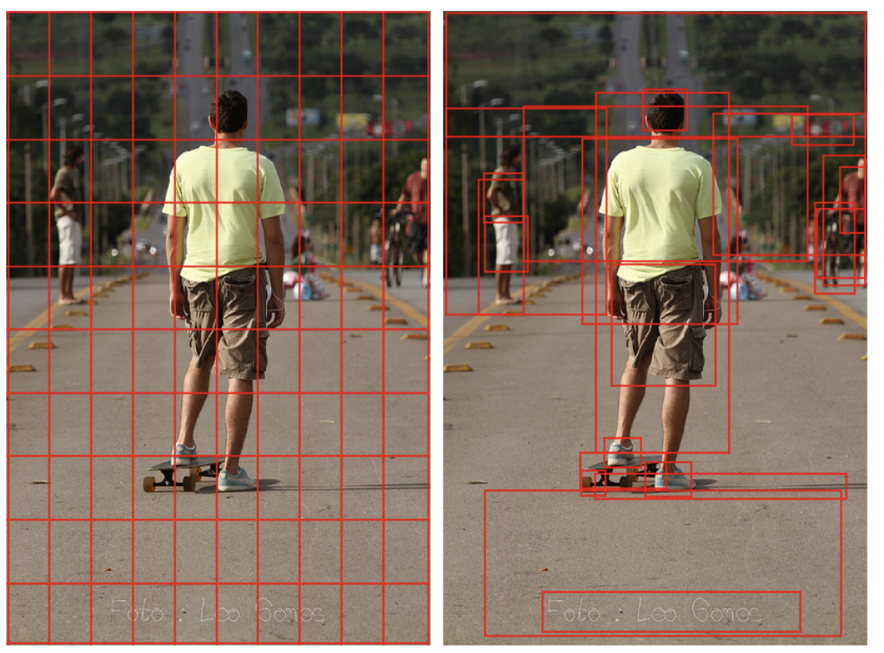
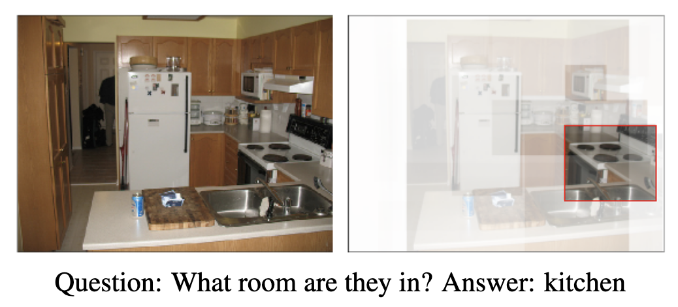
CVPR 2017

Slide 30
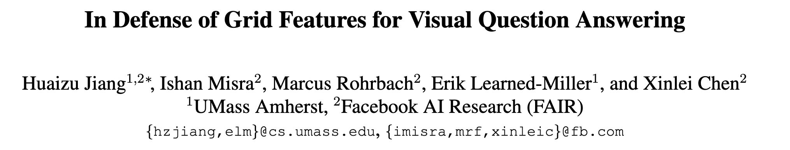
CVPR 2020

Slide 31
VQA Solution today?
?
?
Cross Entroy Loss
Across 5000 possible answers
?
What is the color of the jacket of the man on this picture?

Slide 32
VQA Solution today?
Cross Entroy Loss
Across 5000 possible answers
?
What is the color of the jacket of the man on this picture?

Slide 33
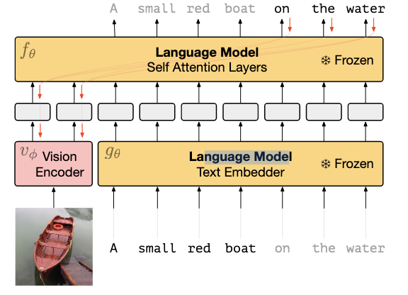
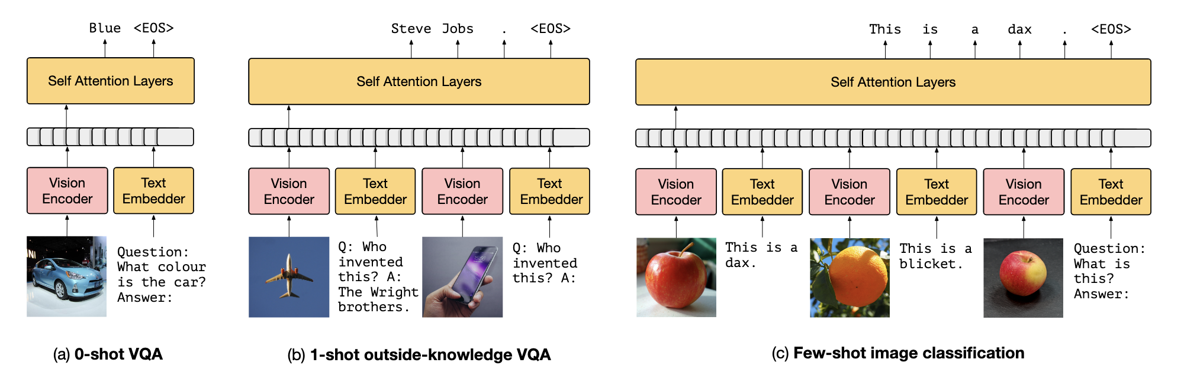
Training:

Slide 34
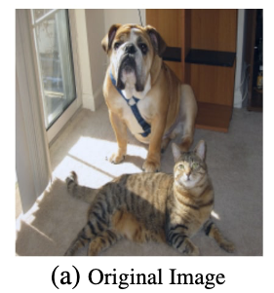
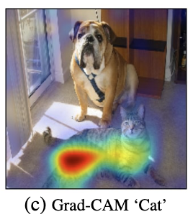
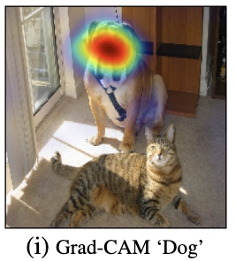
Explainability: GradCAM
https://arxiv.org/abs/1610.02391

Slide 35
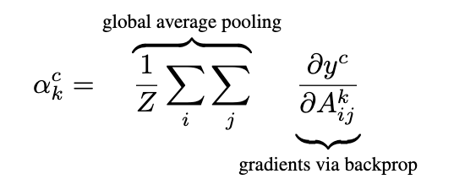
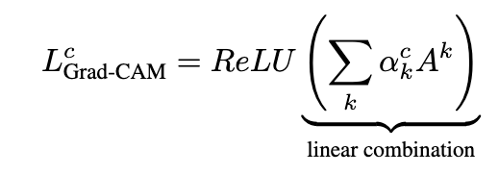
Explainability: GradCAM
https://arxiv.org/abs/1610.02391

Slide 36
Questions?

