Slide 1
Deep Learning for Vision & Language
Explainability, Self-Supervision, and Video

Slide 2
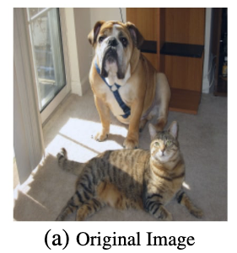
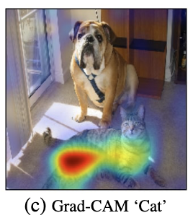
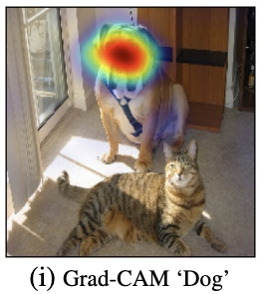
Explainability: GradCAM
https://arxiv.org/abs/1610.02391

Slide 3
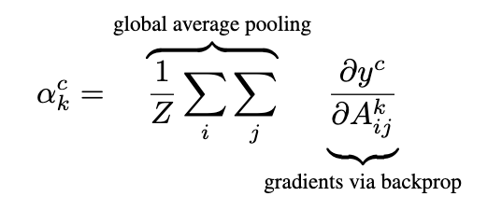
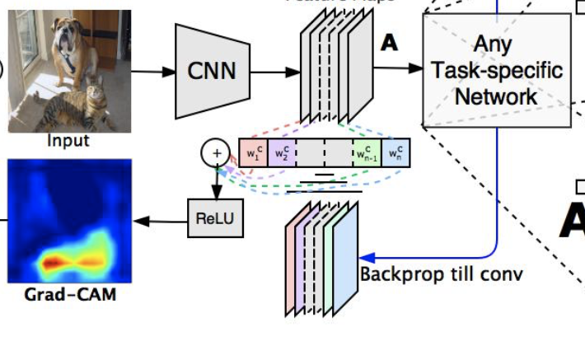
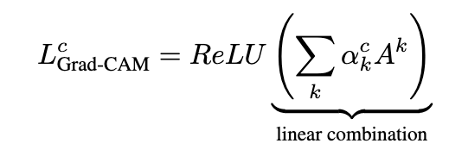
Explainability: GradCAM
https://arxiv.org/abs/1610.02391

Slide 4
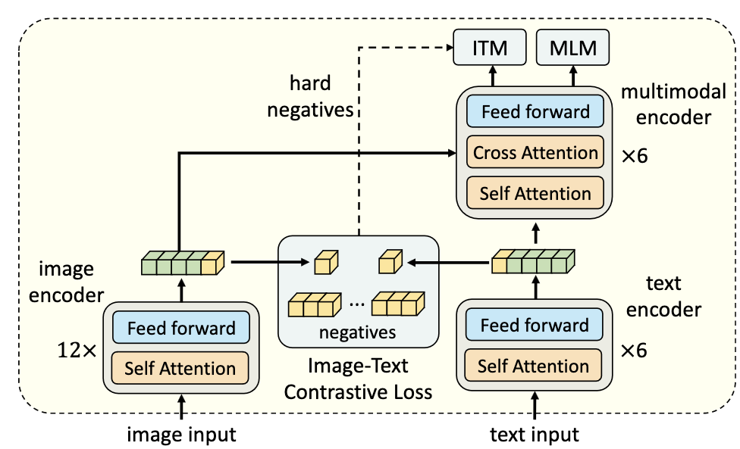
Explainability with Vision-Language Models
Case Study: The ALBEF model
https://arxiv.org/pdf/2107.07651.pdf

Slide 5
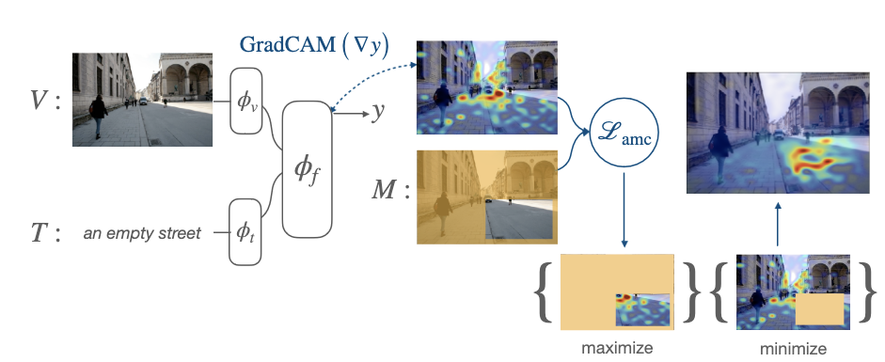
Attention Mask Consistency (AMC)
https://arxiv.org/abs/2206.15462

Slide 6
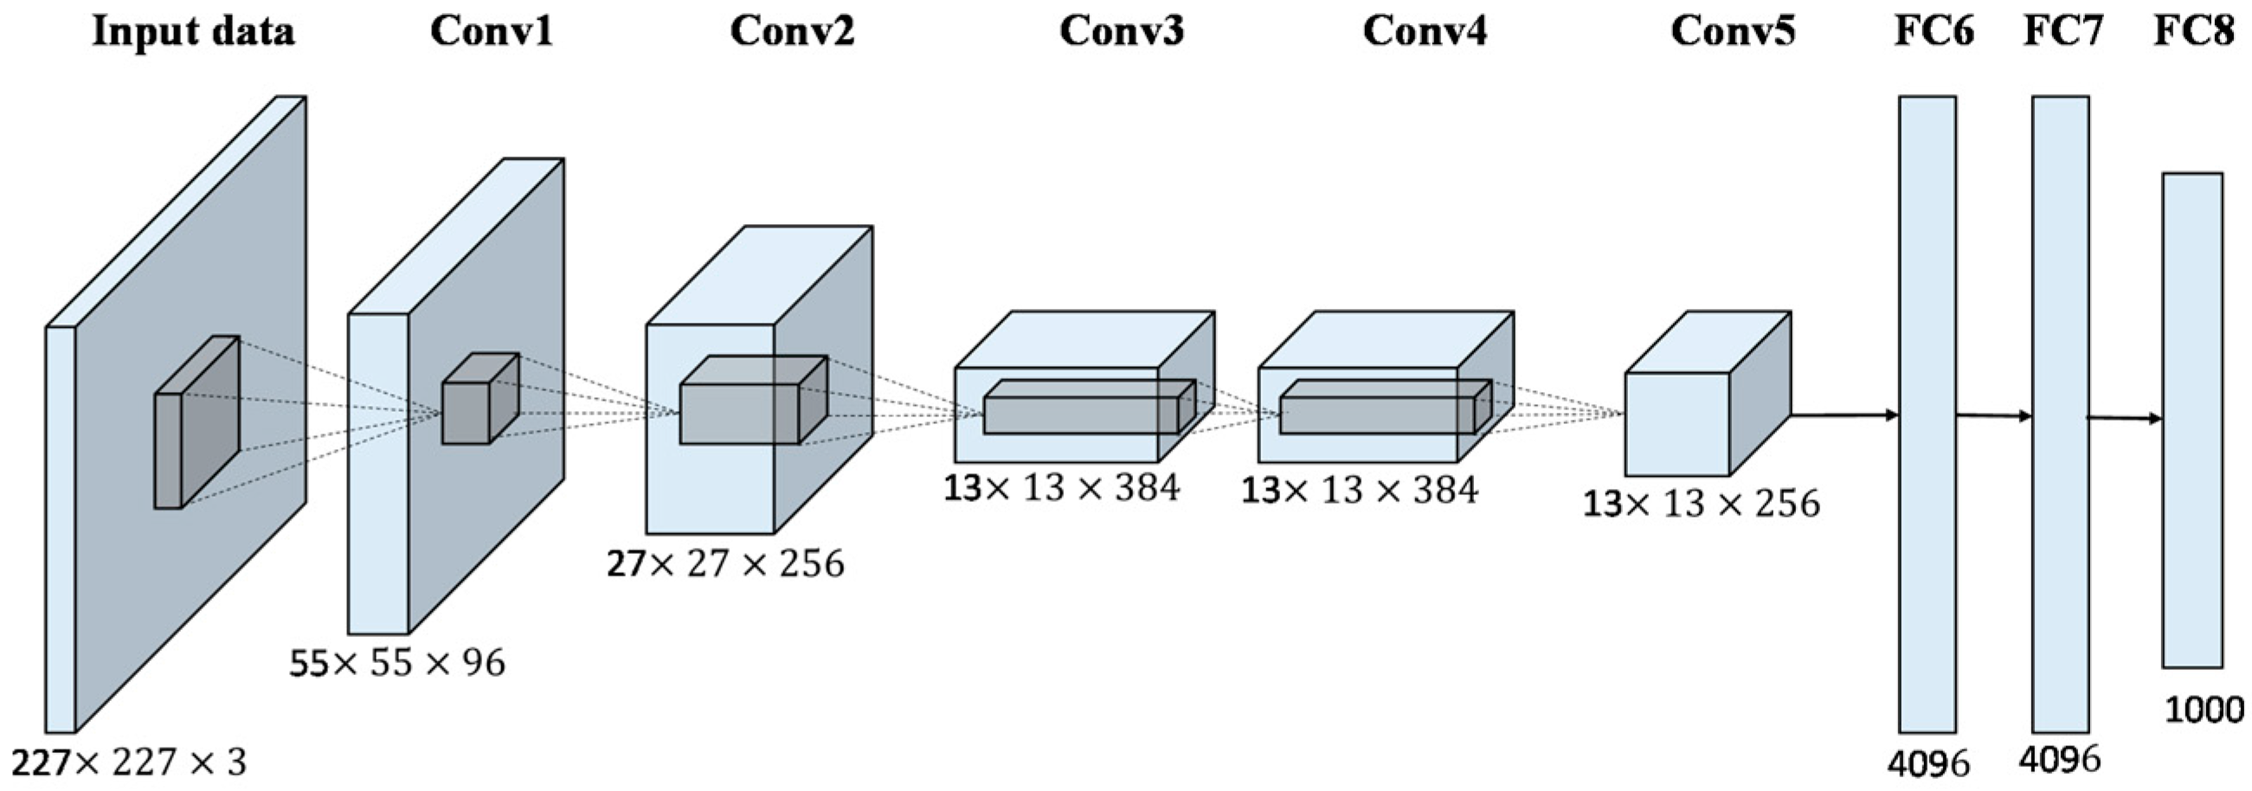
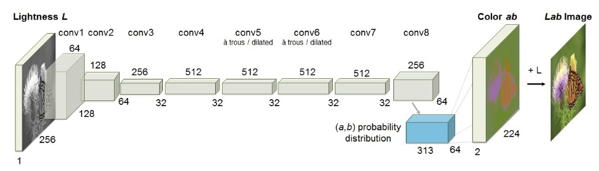
Self-Supervised Learning vs Supervised Learning
Labels

Slide 7
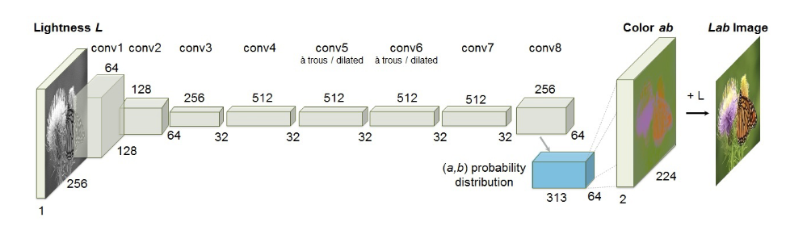
Colorization
https://arxiv.org/pdf/1603.08511.pdf

Slide 8
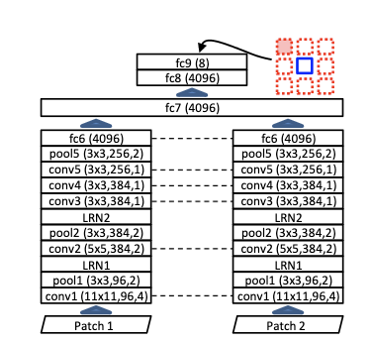
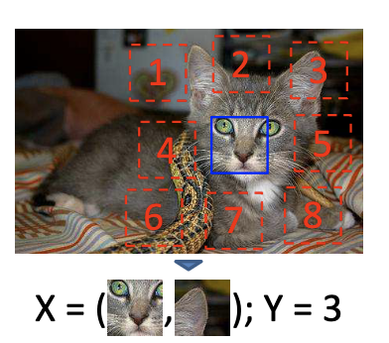
Context Prediction

Slide 9
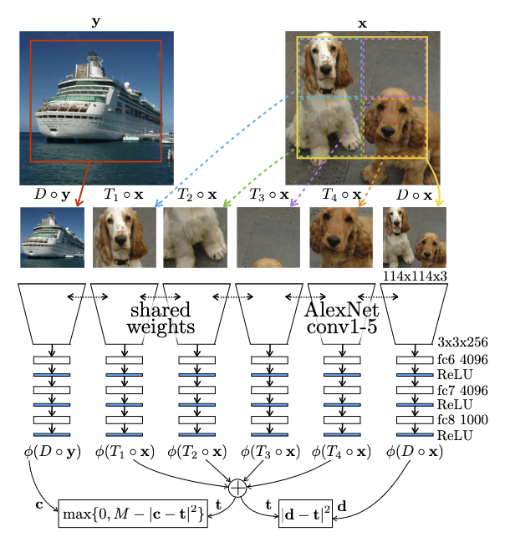
Consistency Counting
https://openaccess.thecvf.com/content_ICCV_2017/papers/Noroozi_Representation_Learning_by_ICCV_2017_paper.pdf

Slide 10

Training Vision models with Self-supervision
Case: SimCLR
https://arxiv.org/abs/2002.05709

Slide 11
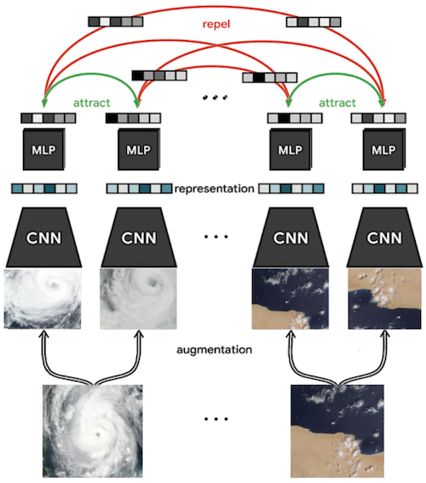
Training Vision models with Self-supervision
Case: SimCLR
https://arxiv.org/abs/2002.05709

Slide 12

Training Vision models with Self-supervision
Case: SimCLR
https://www.earthdata.nasa.gov/learn/articles/ssl-impact-blog
https://arxiv.org/abs/2002.05709

Slide 13
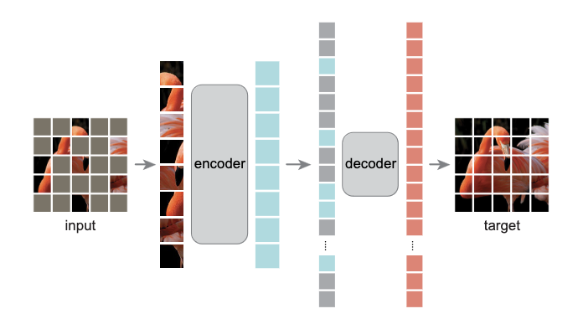
Masked AutoEncoders
https://arxiv.org/pdf/2111.06377.pdf

Slide 14
Video
  Optical flow
  Two-Stream Networks
  CNN + LSTM
  CNN + Temporal Pooling
  3D CNNs

Slide 15
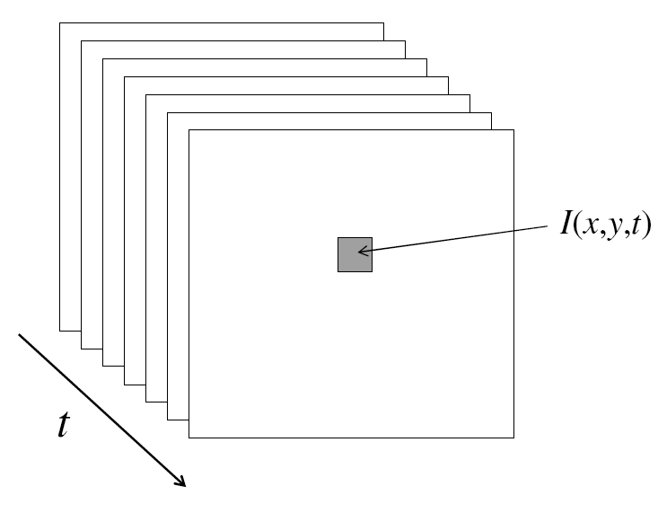
From images to videos
A video is a sequence of frames captured over time
Now our image data is a function of space (x, y) and time (t)

Slide 16
Why is motion useful?

Slide 17
Why is motion useful?

Slide 18
Optical flow
Definition: optical flow is the apparent motion of brightness patterns in the image
Note: apparent motion can be caused by lighting changes without any actual motion
  Think of a uniform rotating sphere under fixed lighting vs. a stationary sphere under moving illumination
  GOAL: Recover image motion at each pixel from optical flow
Source: Silvio Savarese

Slide 19
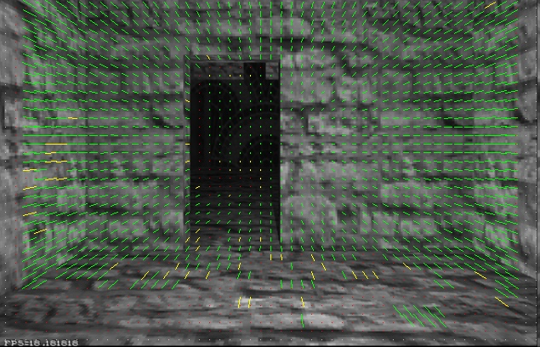
Optical flow
Vector field function of the spatio-temporal image brightness variations
Picture courtesy of Selim Temizer - Learning and Intelligent Systems (LIS) Group, MIT

Slide 20
Estimating optical flow
I(x,y,t–1)
I(x,y,t)
Given two subsequent frames, estimate the apparent motion field u(x,y), v(x,y) between them
Key assumptions
  Brightness constancy: projection of the same point looks the same in every frame
  Small motion: points do not move very far
  Spatial coherence: points move like their neighbors
Source: Silvio Savarese

Slide 21
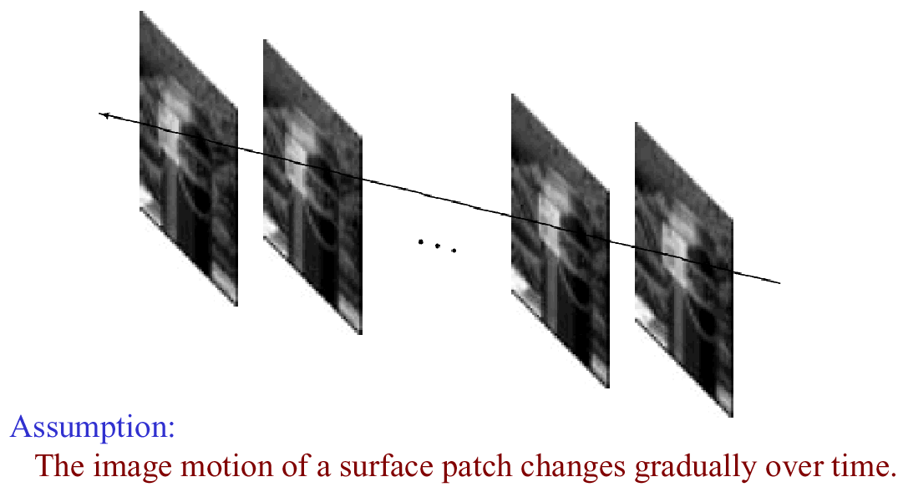
Key Assumptions: small motions

Slide 22
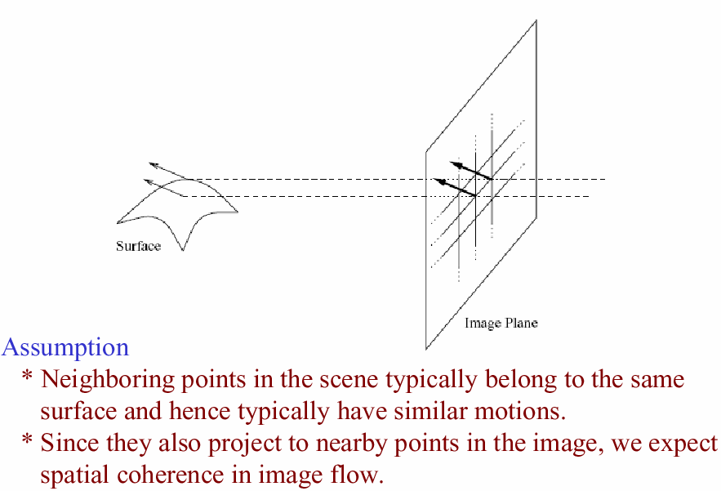
Key Assumptions: spatial coherence
* Slide from Michael Black, CS143 2003

Slide 23
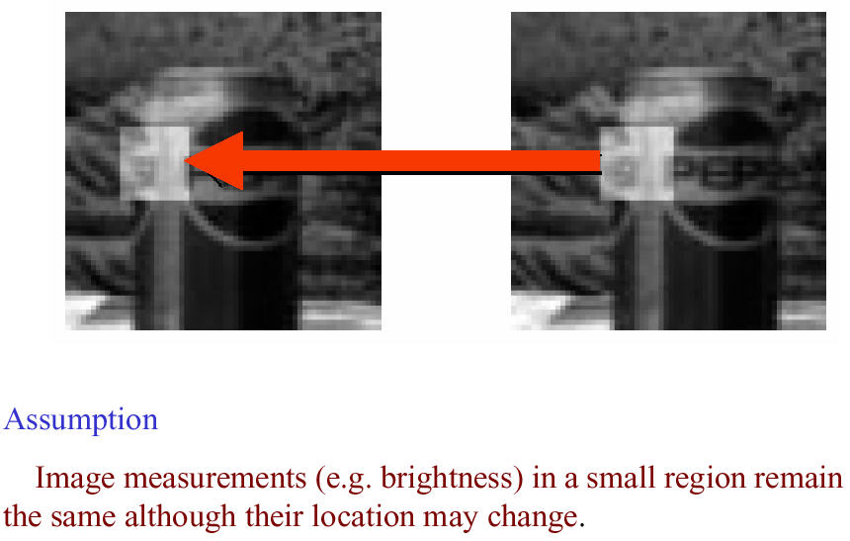
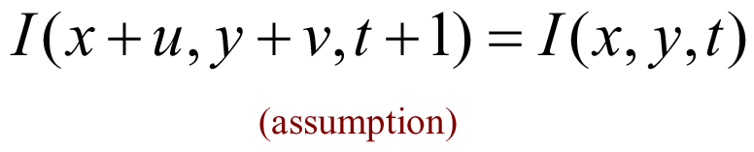
Key Assumptions: brightness Constancy
* Slide from Michael Black, CS143 2003

Slide 24


The brightness constancy constraint
I(x,y,t–1)
I(x,y,t)
Brightness Constancy Equation:
Linearizing the right side using Taylor expansion:
Image derivative along x
Source: Silvio Savarese
Hence,

Slide 25
The brightness constancy constraint
B. Lucas and T. Kanade. An iterative image registration technique with an application to stereo vision. In Proceedings of the International Joint Conference on Artificial Intelligence, pp. 674–679, 1981.
I(x,y,t–1)
I(x,y,t)
Brightness Constancy Equation:
Linearizing the right side using Taylor expansion:
Image derivative along x
Source: Silvio Savarese
Hence,

Slide 26
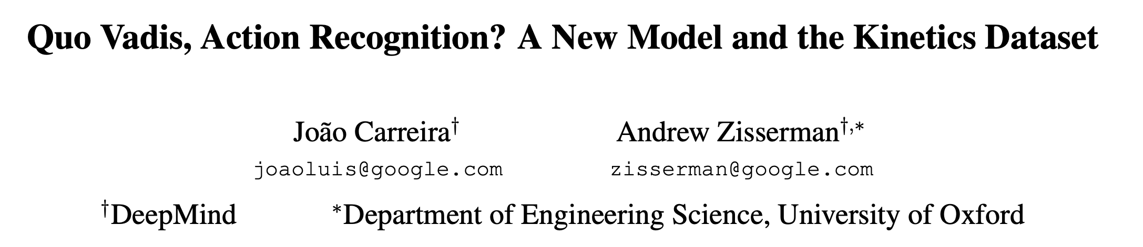
Action Classification from Video
Recommended Paper to Read:

Slide 27
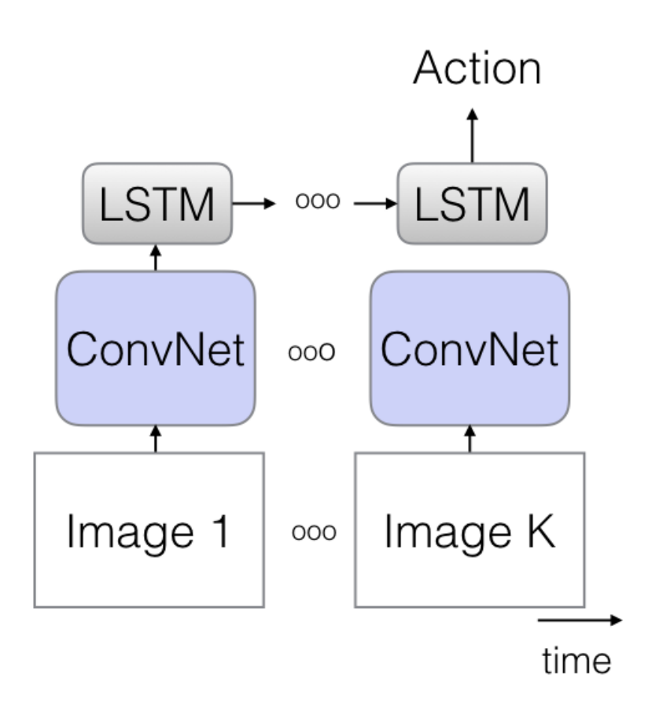
Action Classification from Video
CNN + LSTM over sequence of frames
Figure from Carreira & Zisserman, 2018

Slide 28
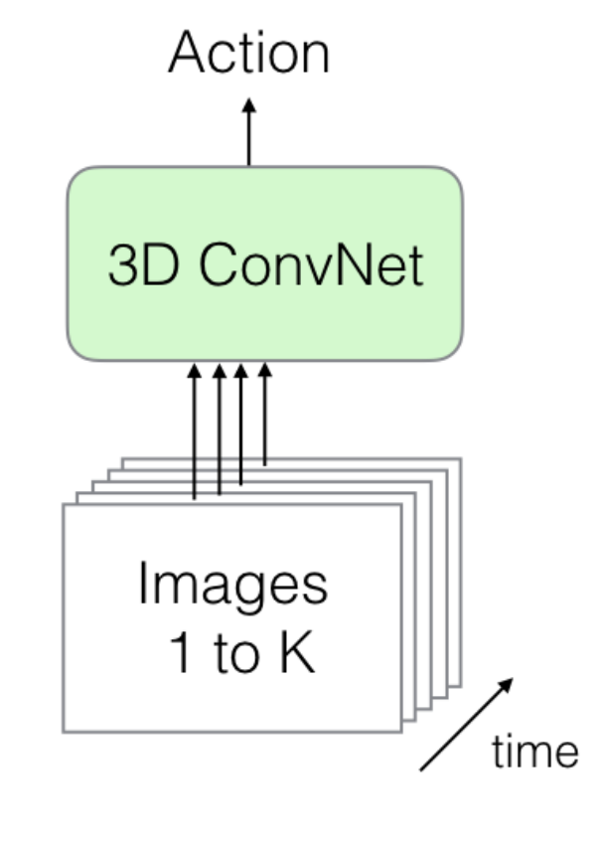
Action Classification from Video
3D CNN of consecutive frames across time
Figure from Carreira & Zisserman, 2018

Slide 29
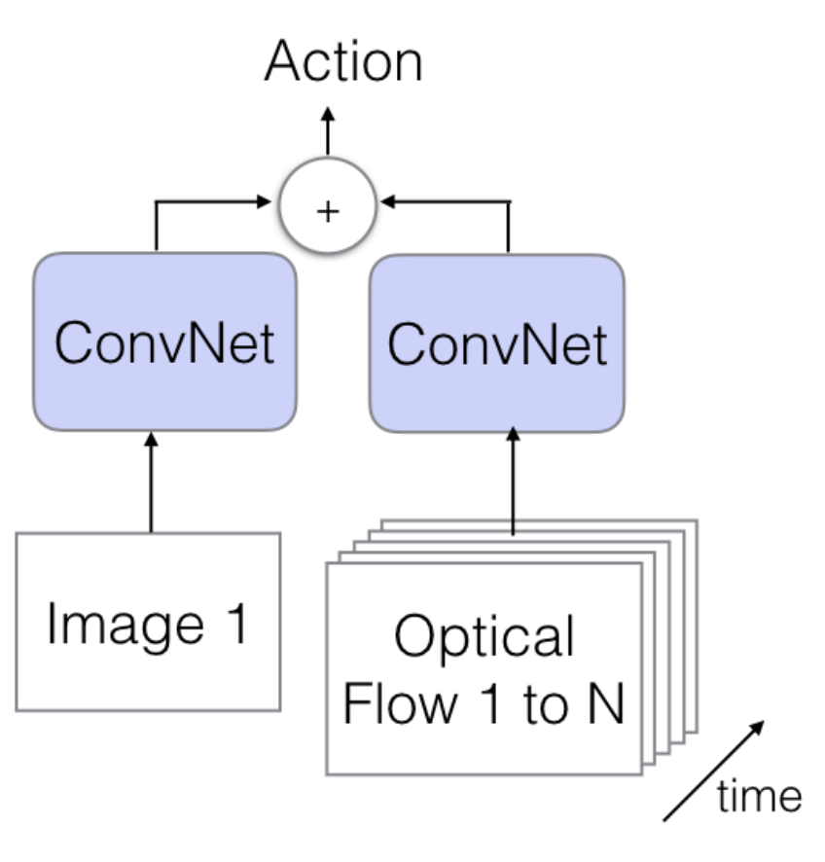
Action Classification from Video
Two Stream CNN: Images + Flow Map
Figure from Carreira & Zisserman, 2018

Slide 30
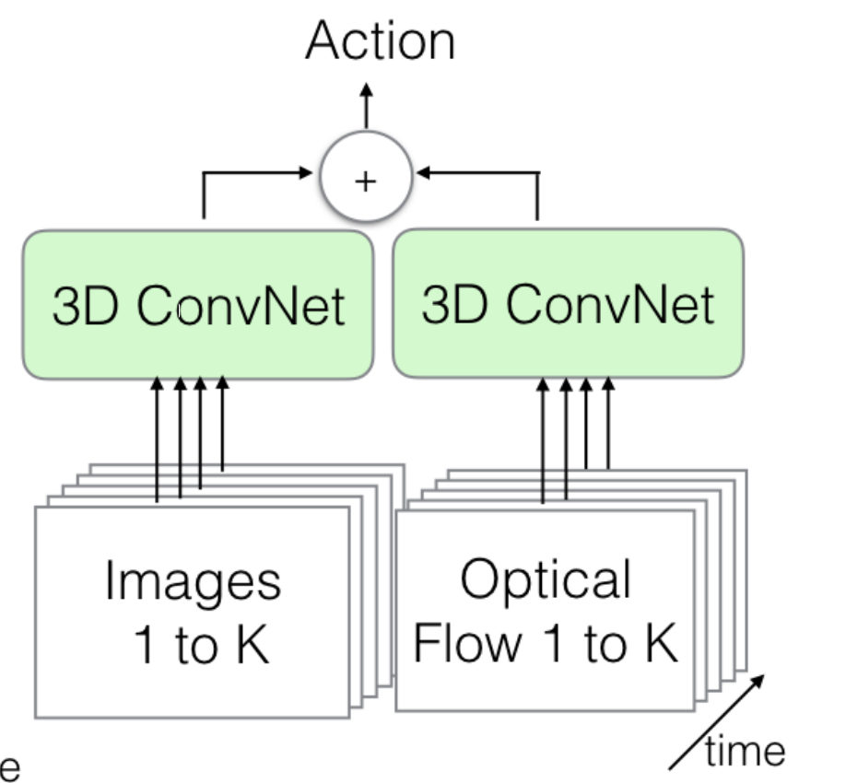
Action Classification from Video
Two Stream 3D CNN: Images + Flow Map
Figure from Carreira & Zisserman, 2018

Slide 31
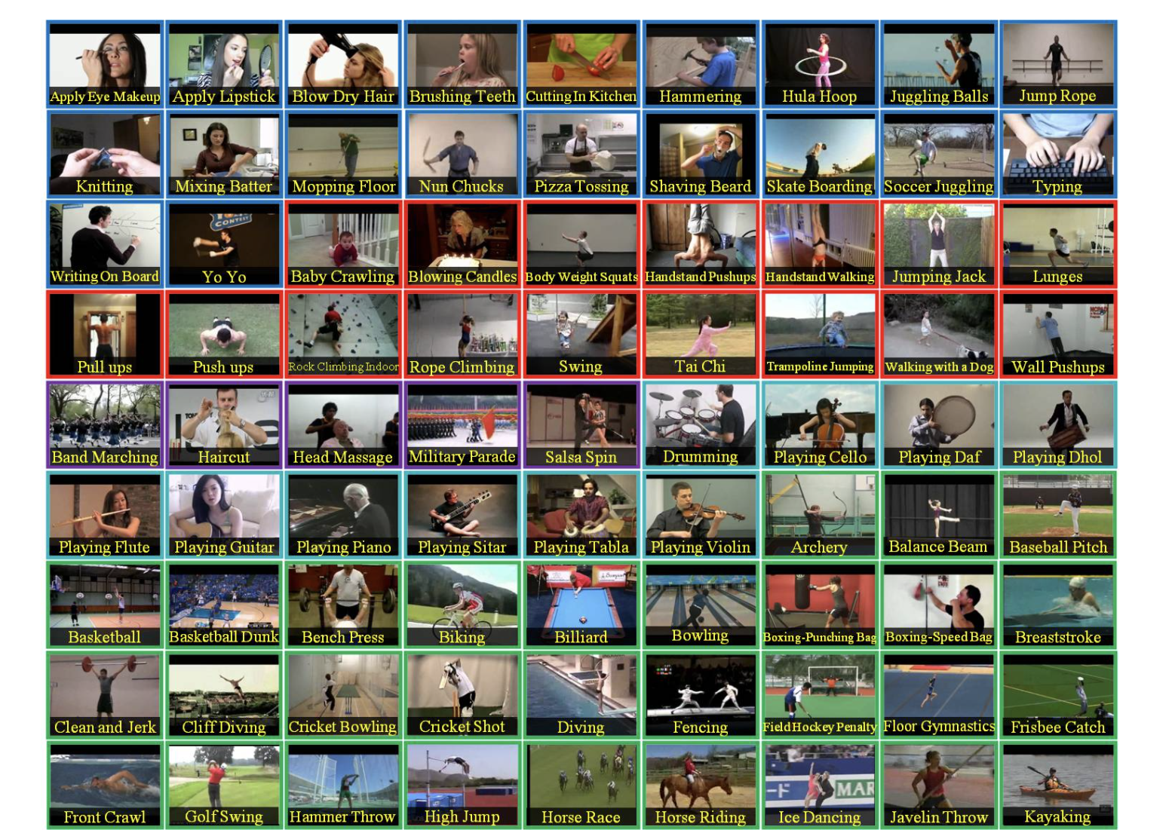
UCF-101 Action Dataset
https://www.crcv.ucf.edu/data/UCF101.php

Slide 32
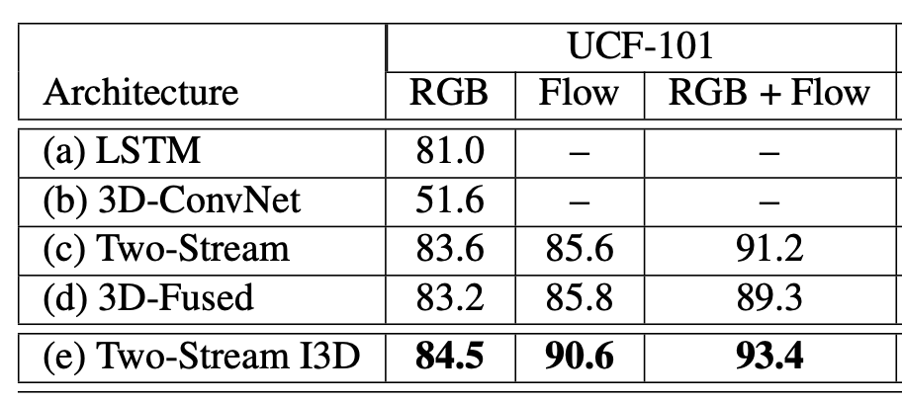
Action Classification from Video
Results on UCF101 actions
Figure from Carreira & Zisserman, 2018

Slide 33
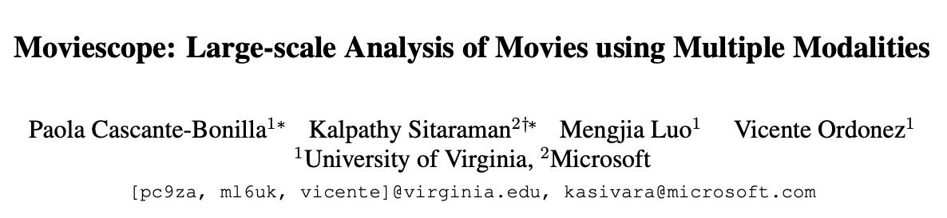
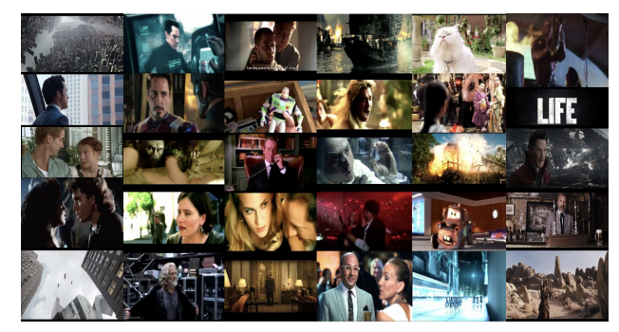
Movie Trailers
https://arxiv.org/abs/1908.03180

Slide 34
Movie Trailers
Movie Trailers
Movie Plots
Movie Posters
Movie Metadata
https://arxiv.org/abs/1908.03180

Slide 35
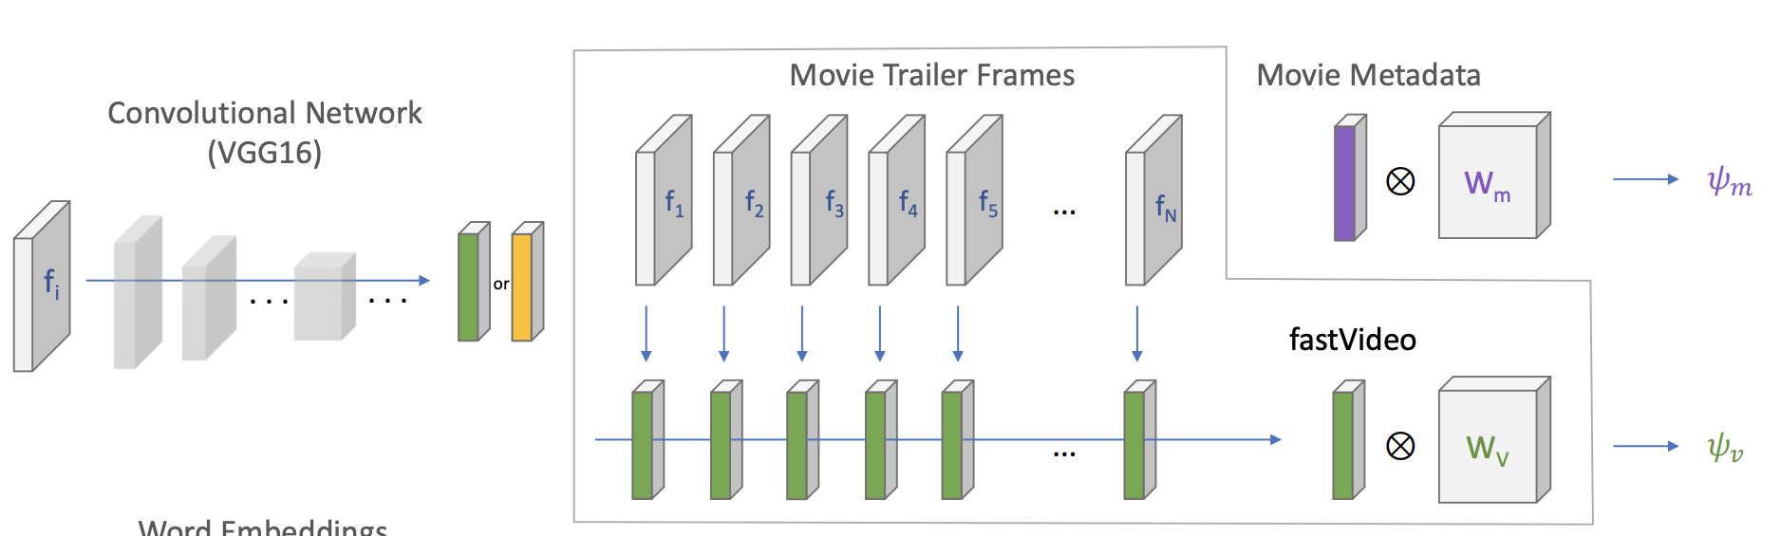
CNN + Temporal Pooling

Slide 36
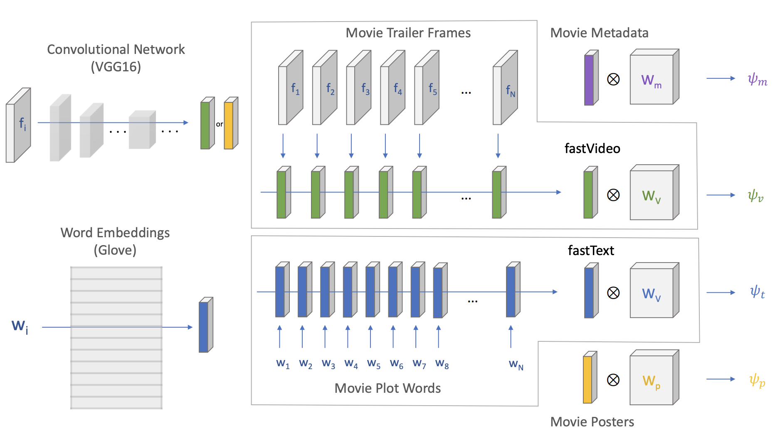
CNN + Temporal Pooling

Slide 37
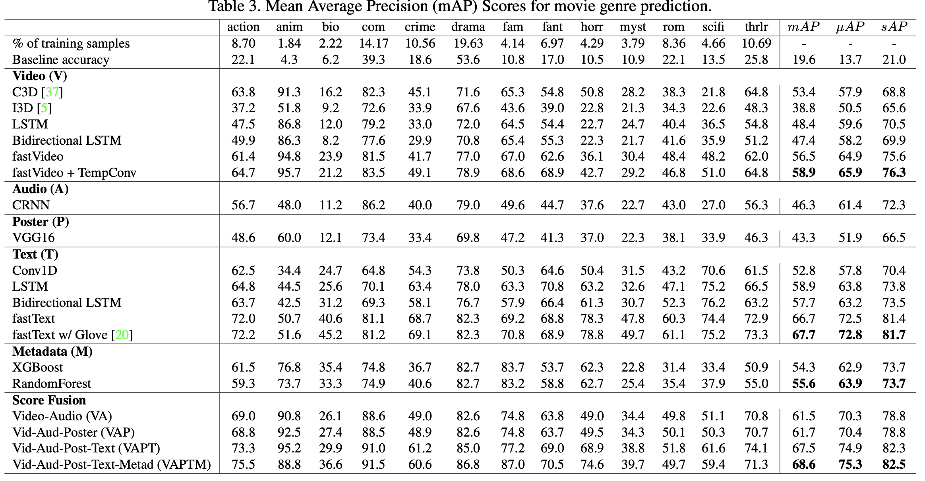
Results

Slide 38
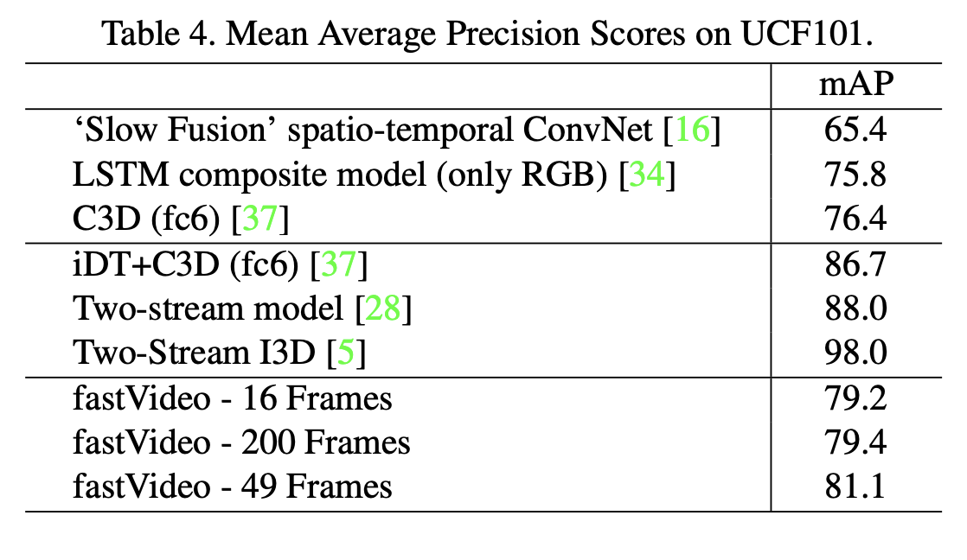
Results

Slide 39
Other Video and Language
Youtube videos with titles
  http://aliensunmin.github.io/project/video-language/index.html#VTW
YouCook2 Dataset
  http://youcook2.eecs.umich.edu/
MSRVTT: Microsoft Video and Text Dataset
  https://www.microsoft.com/en-us/research/publication/msr-vtt-a-large-video-description-dataset-for-bridging-video-and-language/

Slide 40
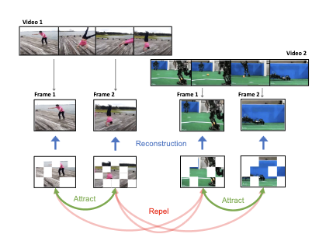
ViC-MAE (Video Contrastive Masked Autoencoders)
https://arxiv.org/abs/2303.12001

Slide 41
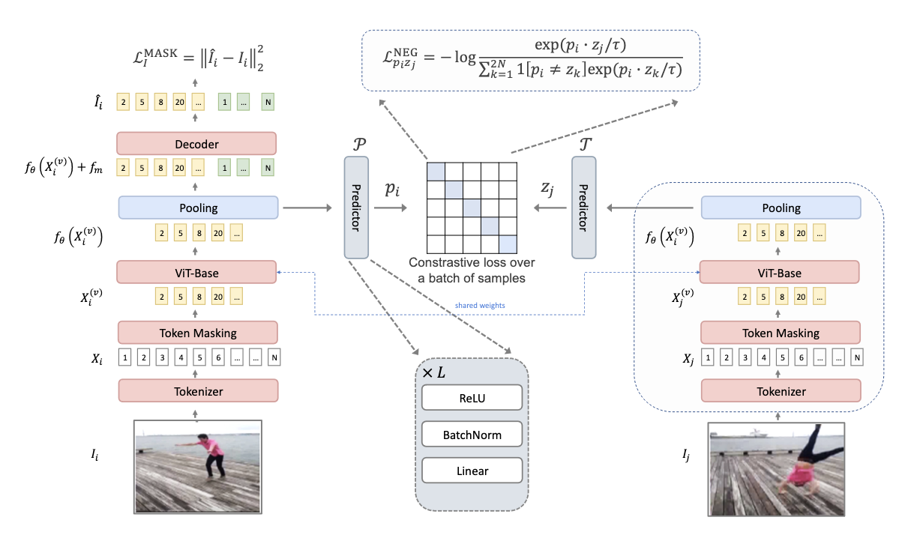
ViC-MAE (Video Contrastive Masked Autoencoders)
https://arxiv.org/abs/2303.12001

Slide 42
Questions?

