Slide 1
Deep Learning for Vision & Language
Course Recap

Slide 2
Final Project
PDF Project report (4 pages).
Link to source code / github or google drive or dropbox links to code.
5 slides presenting your work -- ideally a video (optional) of you walking me through your project in case I have trouble running it or understanding your report
[Motivation] [Problem Setup] [Model] [Experiments] [Results] / you can also submit a link for this part.
Due: April 27th

Slide 3
Grading Criteria
Originality: Either in the idea itself, the application itself, or the experiments you present in your final report. Are you teaching me something new that is not obvious? The more clear this answer is yes, the more likely you get full points on this part.
Technical soundness: Are you describing how your solution and the components that you used in your solution with good amount of details and correct technical accuracy? You should provide enough details to understand just by reading your report what you did. If I have to look at your code to understand what you did then technical soundness will not receive as high a score. If you re-used a component e.g. CLIP or something else, but from reading your report it seems obvious you're not understanding what this model does. Then, this can also lead to points deducted.
Results: Does your report present results in a way that is easy to understand -- e.g. example of input outputs of your model -- and does your project provide quantitative empirical and/or statistical evidence of your solution -- e.g. plots/figures/tables/etc. Ideally most projects should have both types of "results".
Presentation: Is your project report of top quality, (e.g. as shown in the template), or did you include figures that are just screenshots of some experiment you run on a notebook, e.g. your plots do not have clear labeling for what is being shown in the x-axis or what are the units, your images look too low resolution. Anything of those issues will get you points deducted automatically. Your presentation in your project report has to be scientific manuscript quality.

Slide 4
Today
Course Recap
Future Directions

Slide 5
What you learned in this class?
Machine Learning Basics (SGD, Losses, Evaluation)
Computer Vision (CNNs, Detection, Segmentation, Vision Transform.)
Natural Language Processing (RNNs, Transformers, GPTs, InstructGPT)
Vision and Language (RefExp, VQA, CLIP, cGANs, Diffusion)
Practical Implementation Aspects / Technical Skills

Slide 6
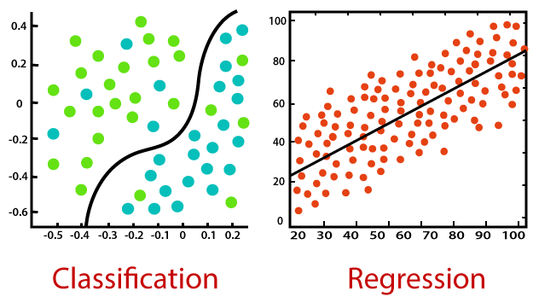
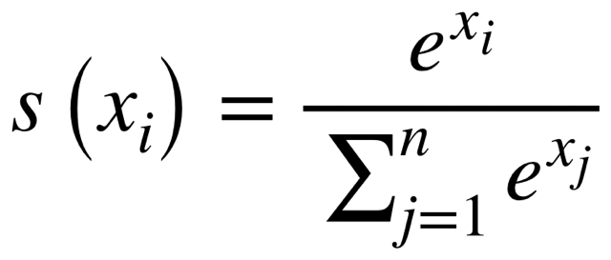
Machine Learning : Introduction
Supervised Learning vs Unsupervised Learning (+Self-supervised)
Classification vs Regression
Least Squares Regression (Mean Squared Error MSE Loss – L1Loss)
Simple Linear Classifiers e.g. Softmax Classifiers
https://static.javatpoint.com/tutorial/machine-learning/images/regression-vs-classification-in-machine-learning.png

Slide 7
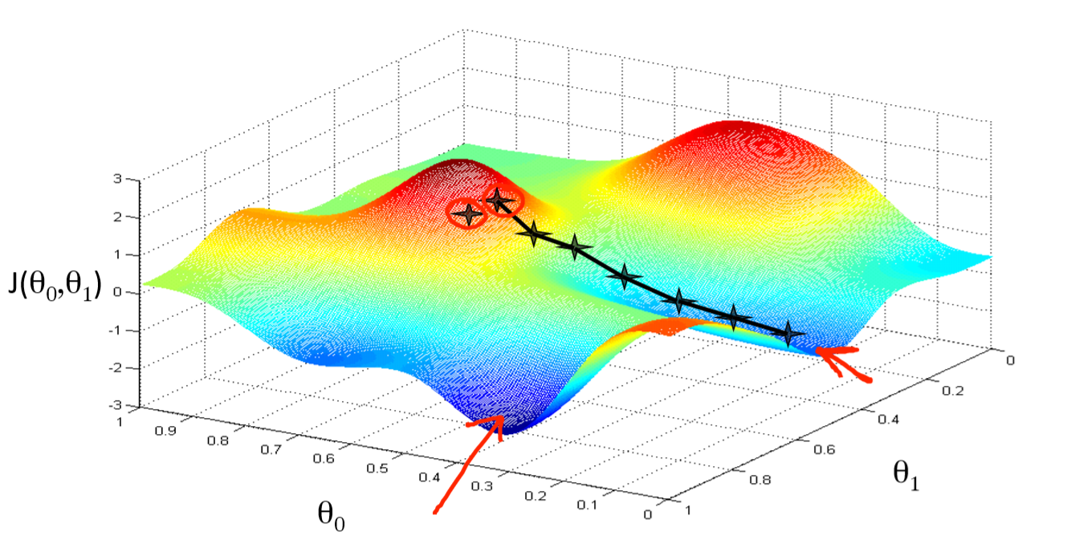
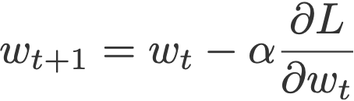
Machine Learning: Optimization
Gradient Descent (GD)
(mini-batch) Stochastic Gradient Descent (SGD)
Regularization, Momentum, Overfitting vs Underfitting
Data Preprocessing and Data Augmentation
Training / Validation / Testing
https://miro.medium.com/proxy/1*f9a162GhpMbiTVTAua_lLQ.png

Slide 8
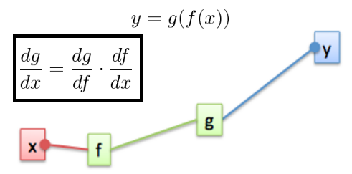
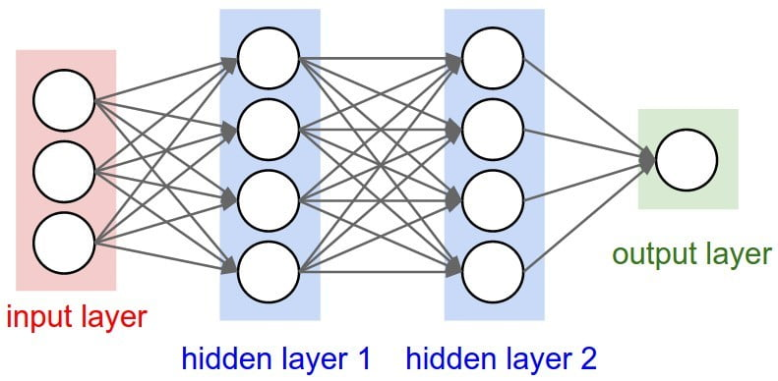
Neural Networks: Backpropagation
The Perceptron Model
Multi-layer Perceptrons (Neural Networks of Linear Layers)
Linear Layers and Non-linear Activations (ReLU, Sigmoid, Tanh)
The backpropagation algorithm (Chain-rule) and SGD
Pytorch’s automatic differentiation (loss.backward() and param.grad)
https://s7280.pcdn.co/wp-content/uploads/2020/07/Two-or-more-hidden-layers-comprise-a-Deep-Neural-Network.png
https://www.oreilly.com/library/view/hands-on-convolutional-neural/9781789130331/assets/85cb6c18-9cbc-44ff-9db6-c7d90d3c7cf0.png

Slide 9
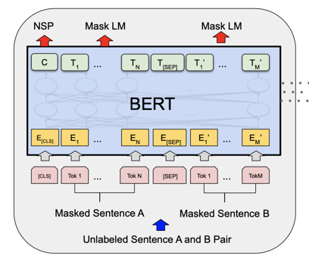
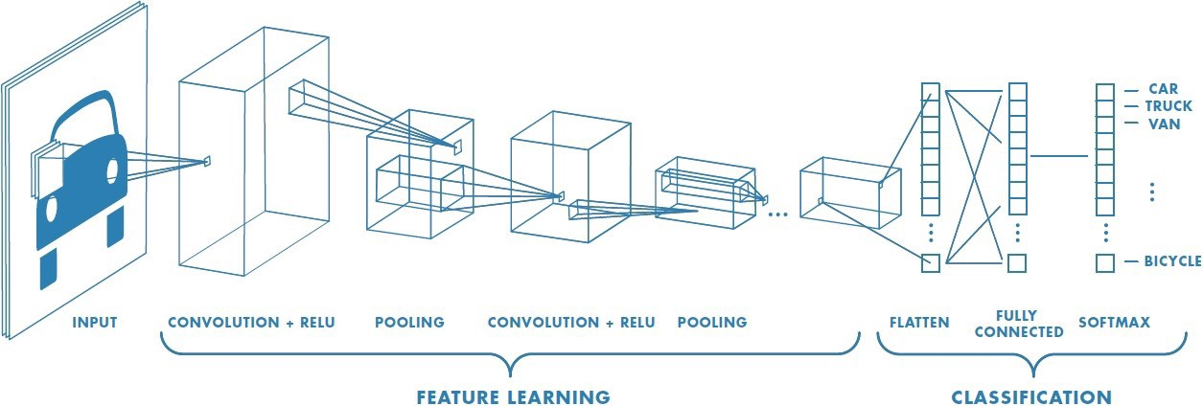
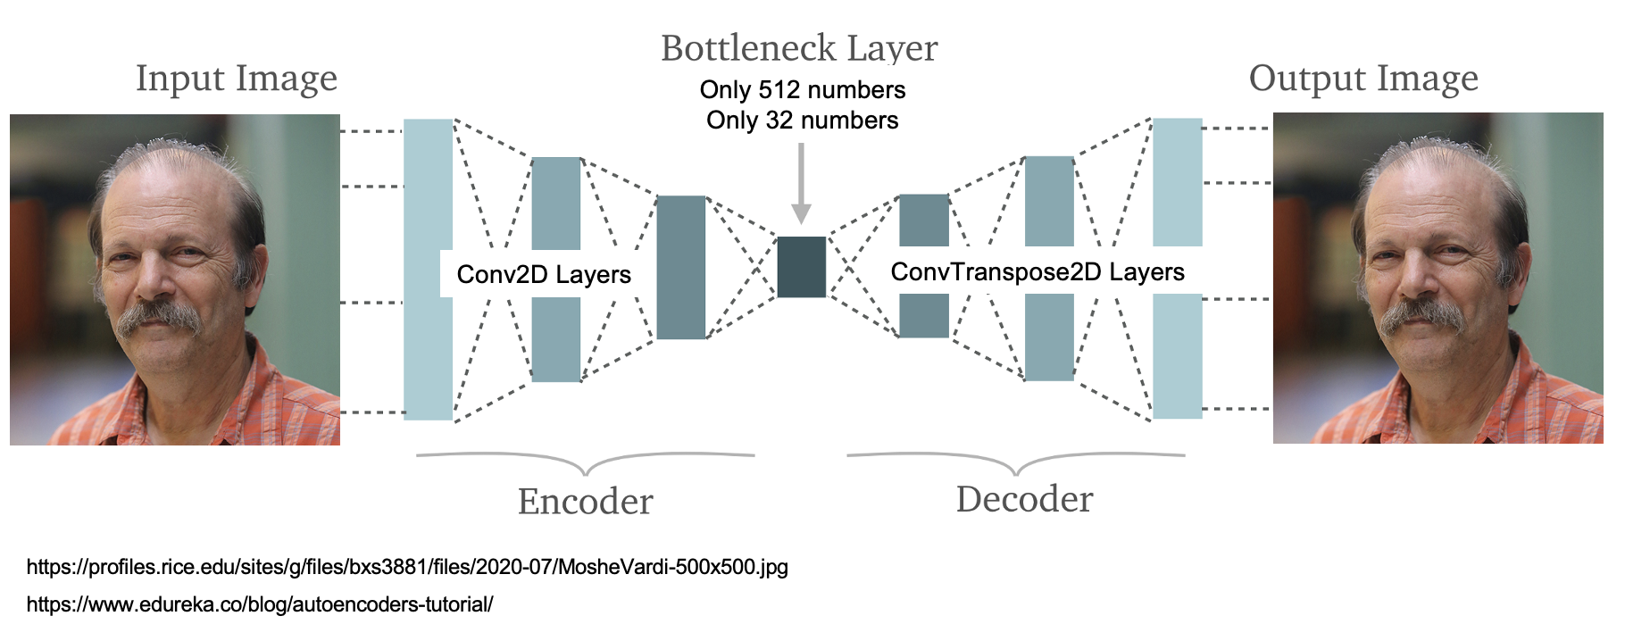
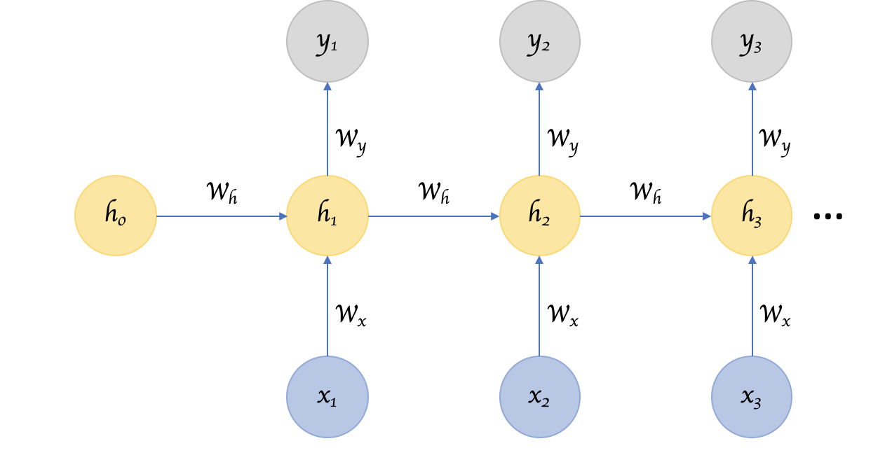
Neural Networks: Models
Transformer Networks
Autoencoder Networks
Convolutional Neural Networks
Recurrent Neural Networks

Slide 10
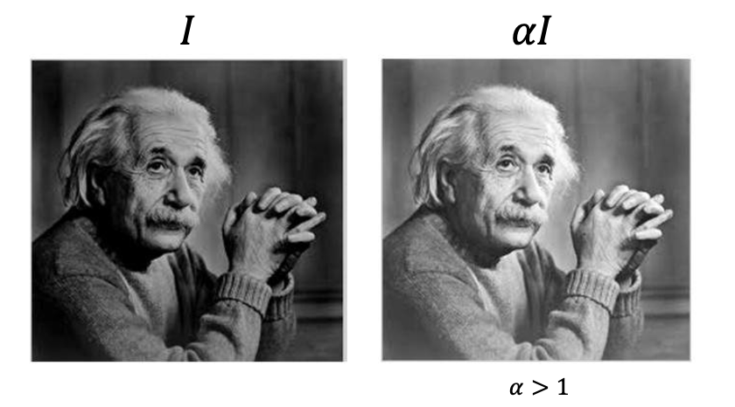
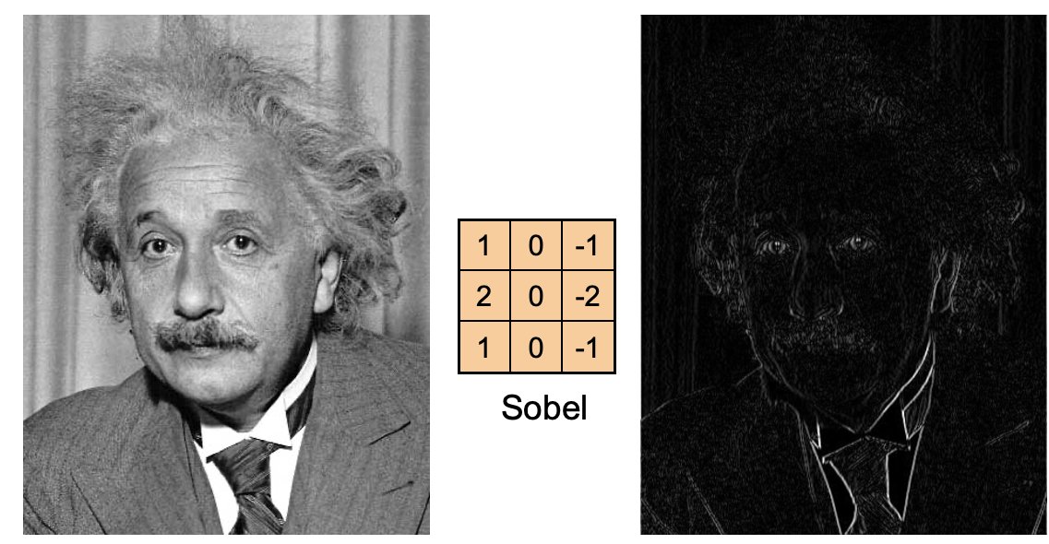
Intro to Computer Vision: Image Manipulations
Image Processing and Manipulation
(Brightness, Cropping, Normalizing, Resizing)
Image Filtering and the Convolutional Operator
(Box/Mean Filter, Gaussian Blur, Sobel Filtering)

Slide 11
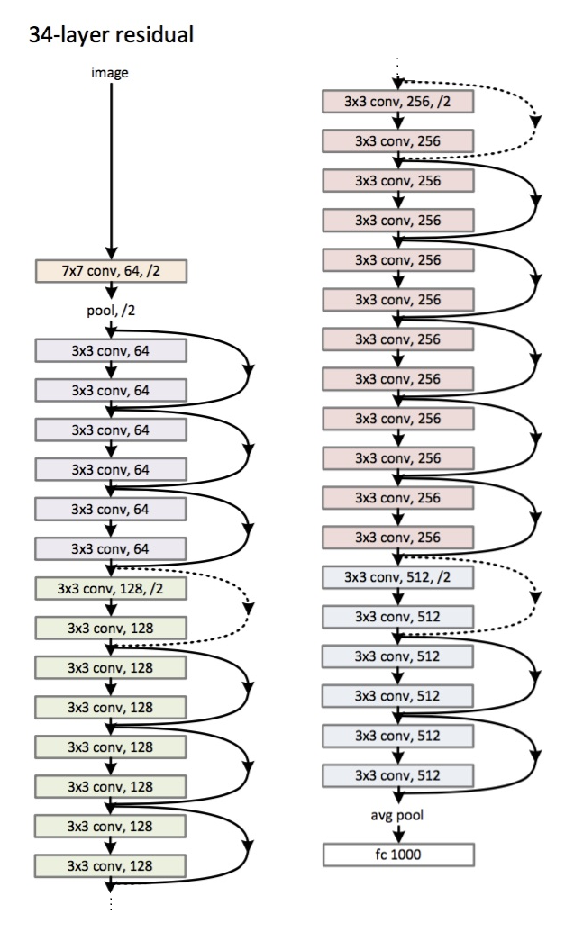
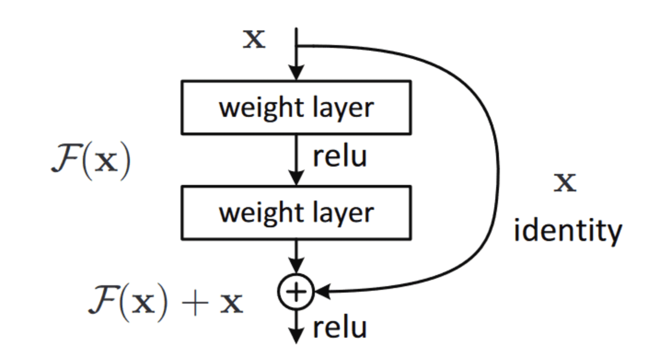
Computer Vision: CNN Architectures
Datasets: Imagenet (objects), SUN (scenes)
Convolutional Neural Network Architectures for Images
  AlexNet, VGGNet, GoogLeNet, ResNets, Densenet
Layers: Dropout, Batch Normalization, Max Pooling

Slide 12
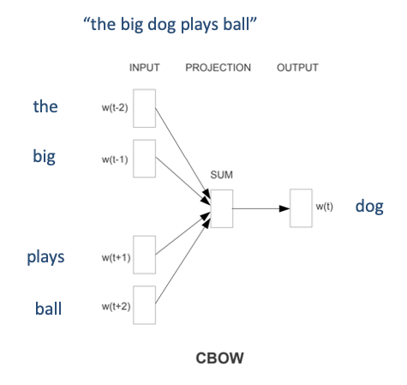
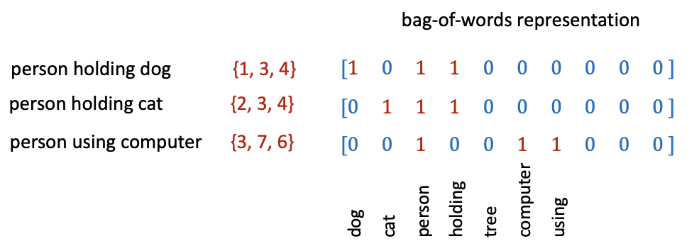
Intro to Natural Language Processing
Representing text as Bag of Words
Continuous Bag of Words (CBOW) -- i.e. Learned Word Embeddings
Part-of-speech tagging, Text parsing, Entailment Resolution
Tokenizers (including BytePairEncoding BPE)

Slide 13
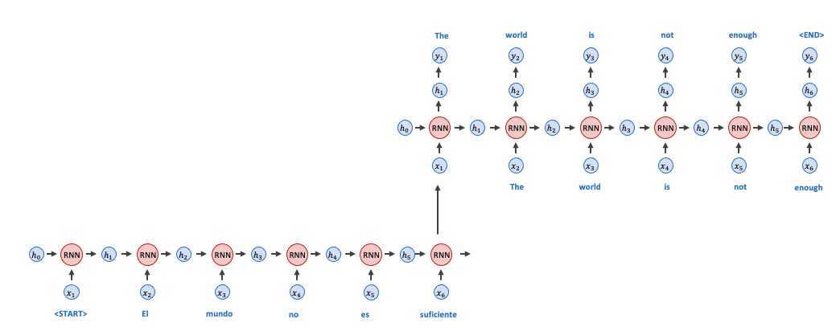

Natural Language Processing: RNNs
Recurrent Neural Networks (RNNs)
  Gated Recurrent Units (GRUs), Long-short Term Memory Networks (LSTMs)
  Auto-regressive Models

Slide 14
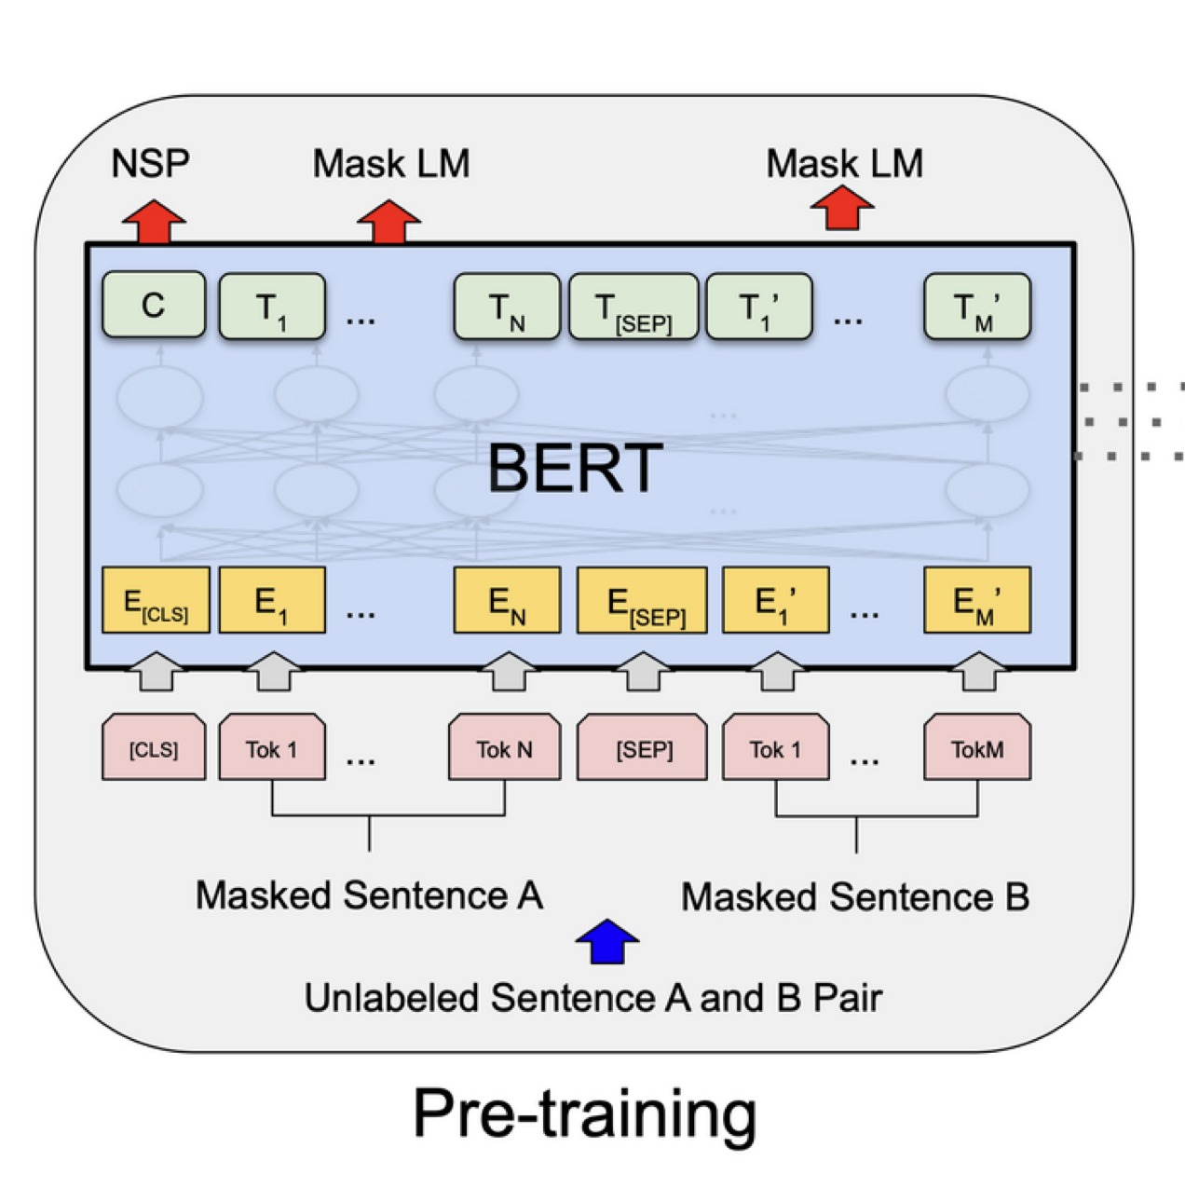
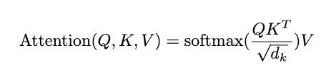

Natural Language Processing: Transformers
Transformer Models
(Attention is all you need)
  Single Head vs Multi-head Attention
  Self-Attention and Masked Self-Attention
  Positional Encodings
  Masked Language Modeling (MLM)
  The BERT Transformer Model
  Other transformer models: GPT-2, GPT-3, T5, BLOOM, OPT, LLAMA, BART

Slide 15
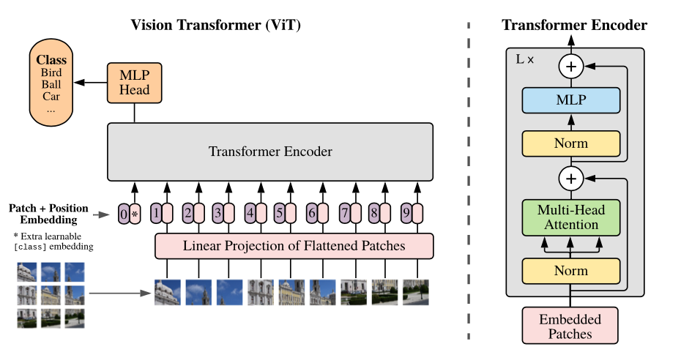
Computer Vision: Transformers
Transformers for Images
  The ViT Transformer

Slide 16
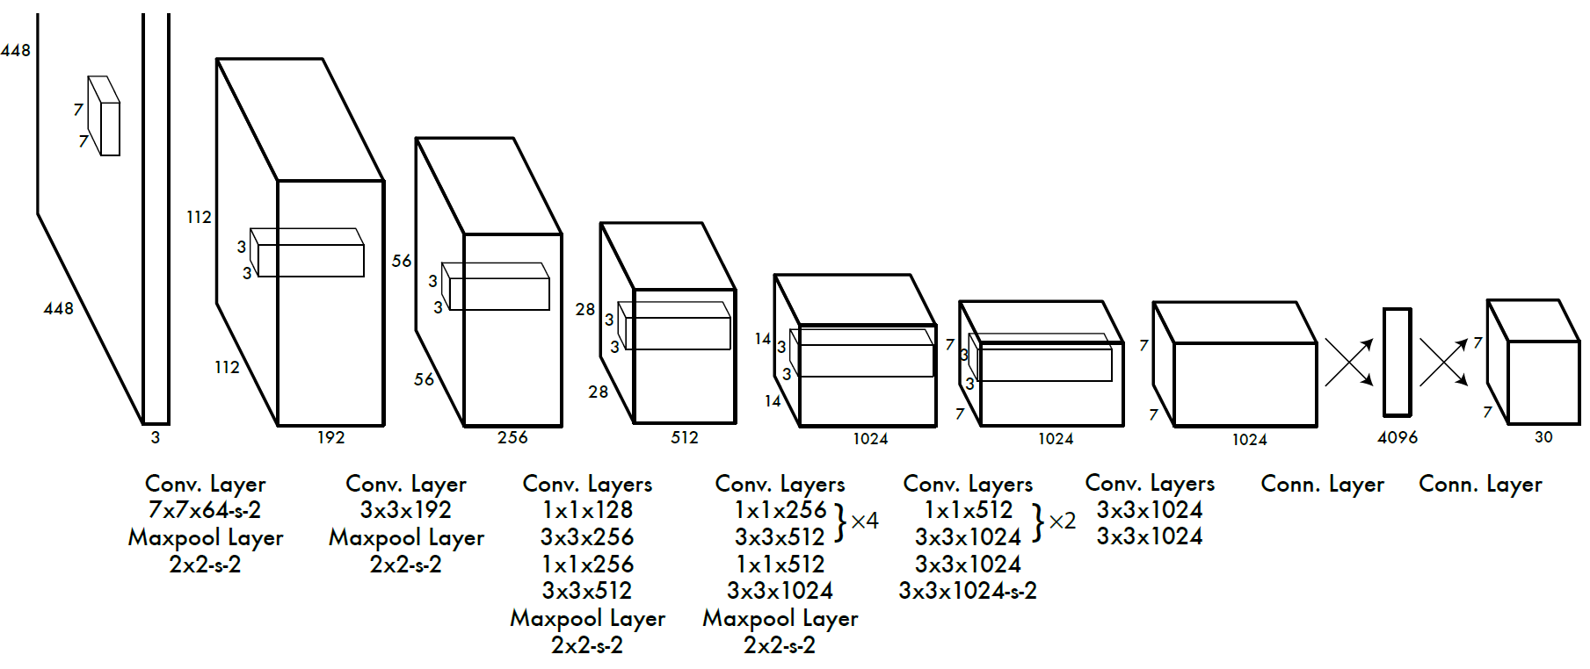
Computer Vision: Object Detection
Convolutional Neural Networks for Object Detection
  Two-Stage: RCNN, Fast-RCNN, Faster-RCNN
  Single-Stage: You Only Look Once (YOLO), Single-Shot Detector (SSD)
Faster-RCNN: Two-stage detector
YOLO: Single-stage detector

Slide 17
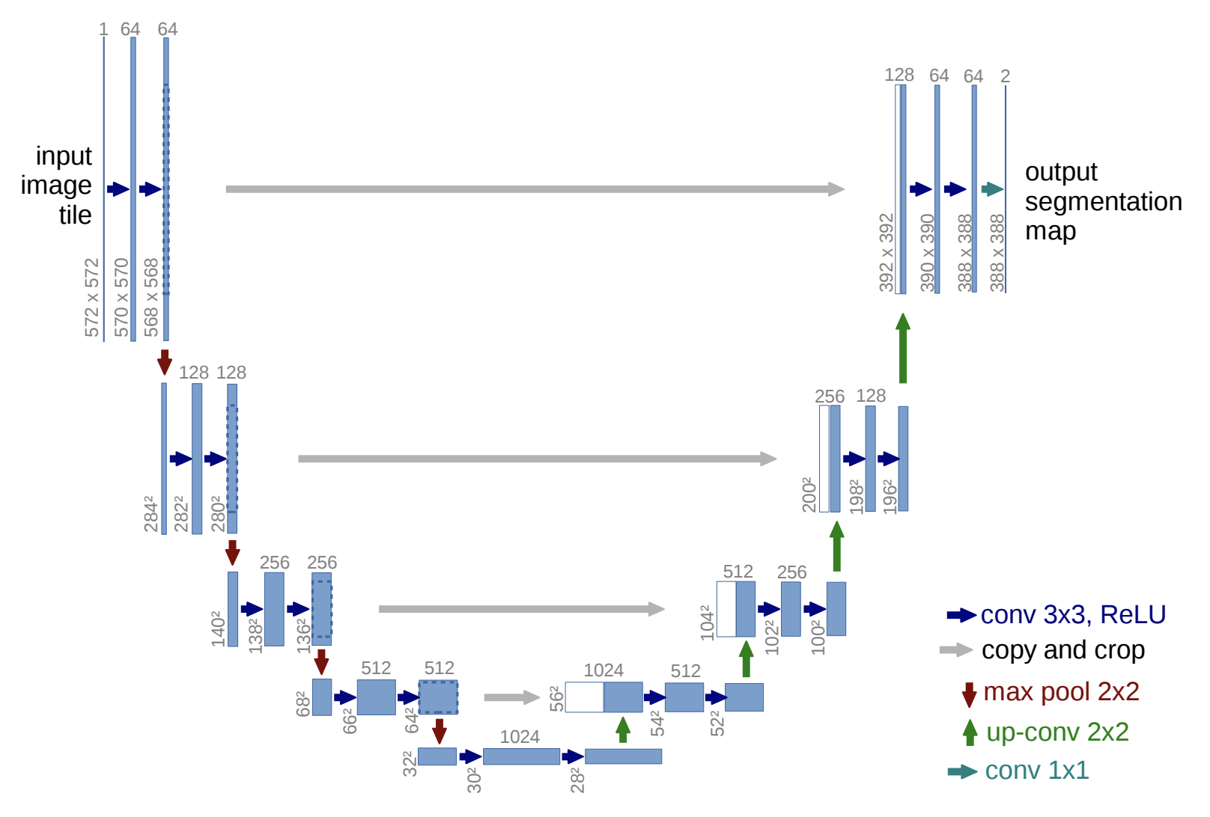
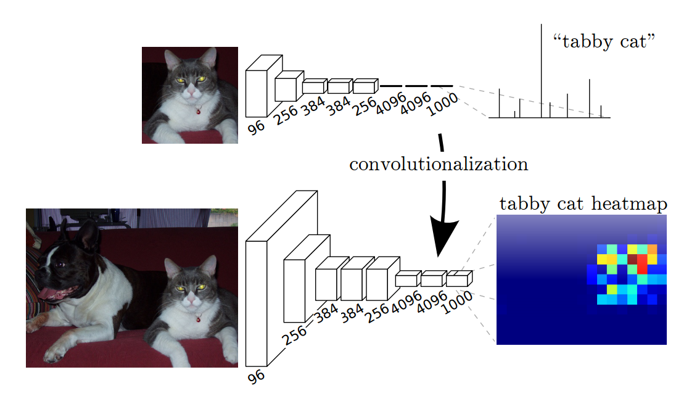
Computer Vision: Segmentation
Convolutional Neural Networks for Segmentation
  Upsampling Convolutions, and Dilated Convolutions
  U-Nets, Fully Convolutional Nets, and Mask-RCNN
Fully Convolutional Networks
U-Net: Upsampling convolutions and skip connections

Slide 18
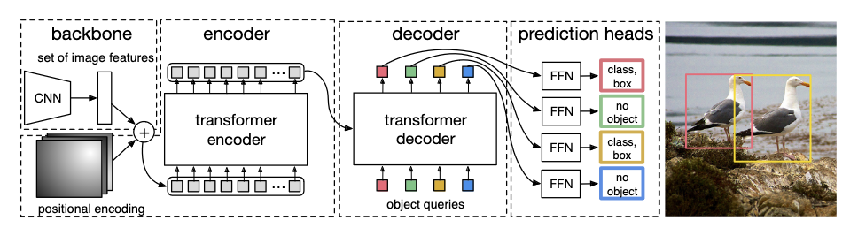
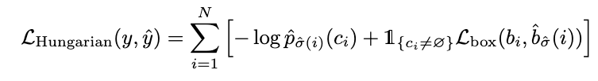

Computer Vision: Object Detection with Transformers
Vision Transformers for Object Detection (DETR)
  Hungarian Loss through Bipartite Matching

Slide 19
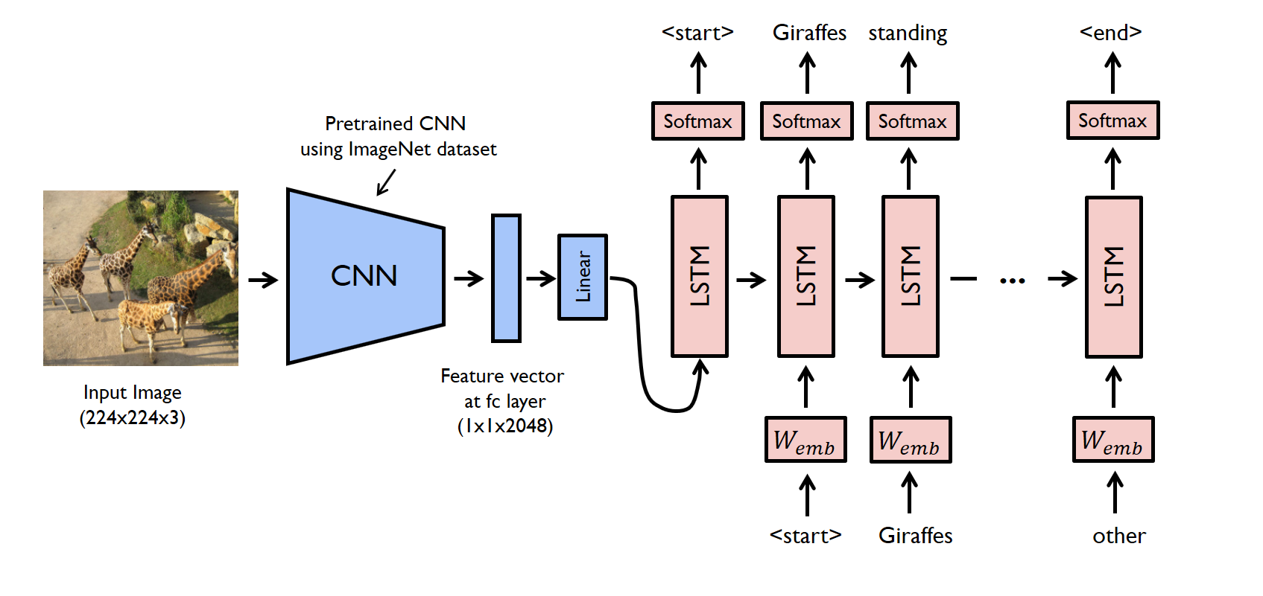
Vision and Language
Image Captioning (CNNs + RNNs): Autoregressive + Greedy decoding
https://raw.githubusercontent.com/yunjey/pytorch-tutorial/master/tutorials/03-advanced/image_captioning/png/model.png

Slide 20
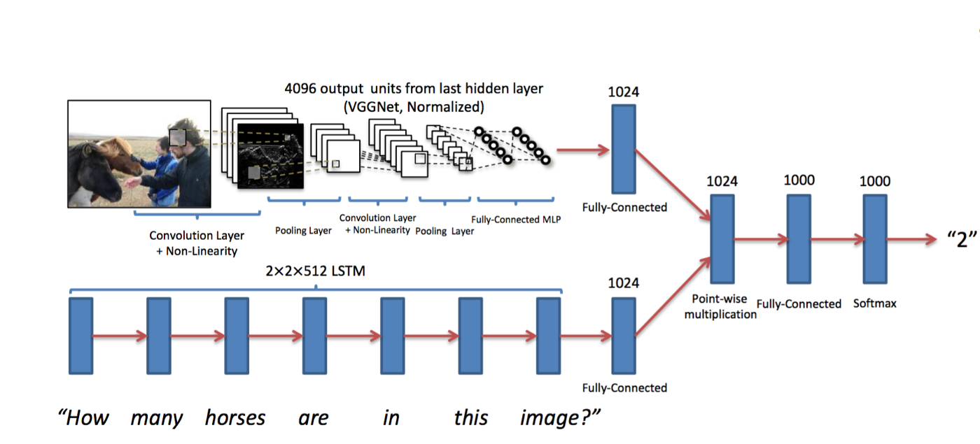
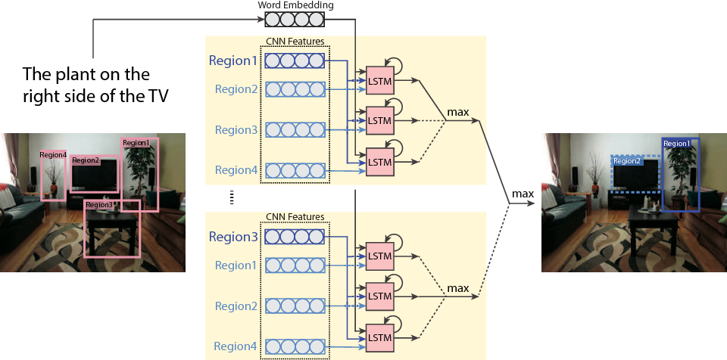
Vision and Language: VQA, RefExps
Visual Question Answering (CNNs + RNNs + MLPs)
Referring Expression Generation (Faster-RCNN + RNNs)
Referring Expression Comprehension (Faster-RCNN + RNNs + MLPs)
https://miro.medium.com/max/1400/1*QbWaFSNaO3GTgjQZOxhdDg.png
https://d3i71xaburhd42.cloudfront.net/f25b9aed37614aae007fc876f31eed0595ab9cd0/5-Figure2-1.png

Slide 21
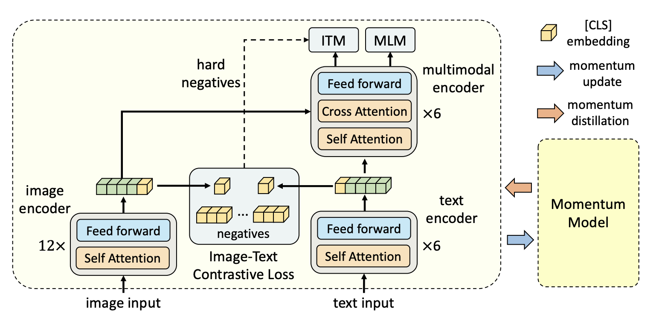
Vision and Language: Transformers
Vision-Language Transformers (e.g. ALBEF)
Align before Fuse: Vision and Language Representation Learning with Momentum Distillation

Slide 22
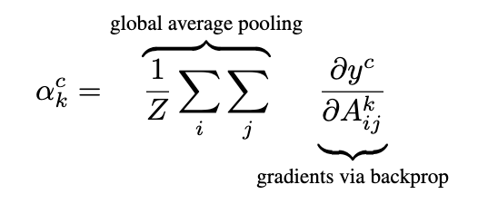
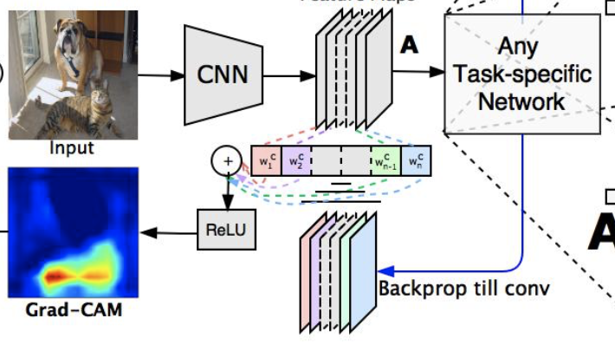
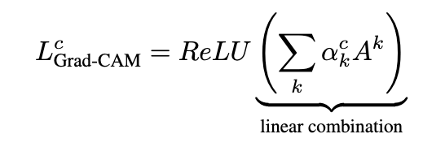
Vision and Language: Explanations

Slide 23
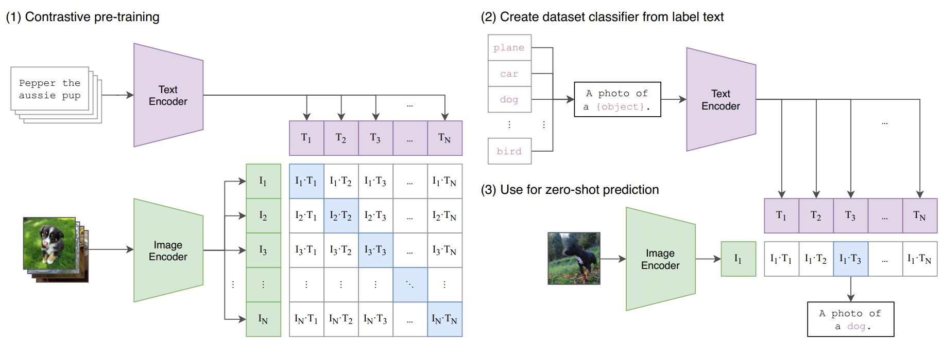
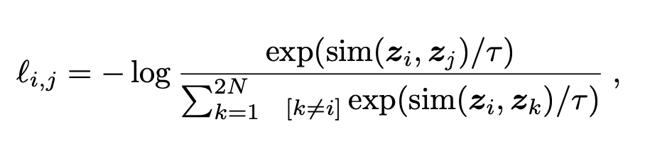
Vision and Language: Contrastive Learning
Vision-Language Contrastive Learning (CLIP)
  Zero-shot visual recognition through CLIP visual prompt engineering

Slide 24
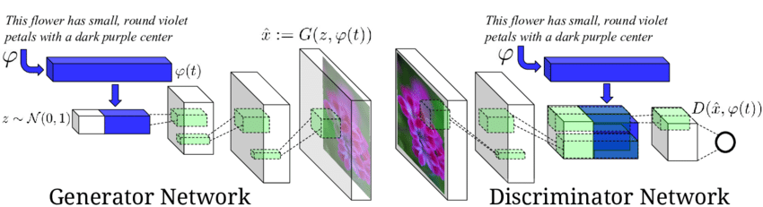
Vision and Language: Text-to-Image
Conditional GANs (Text-to-image synthesis)
AutoEncoders + Transformers (DALL-E and DALL-E mini)
Reed, Scott & Akata, Zeynep & Yan, Xinchen & Logeswaran, Lajanugen & Schiele, Bernt & Lee, Honglak. (2016). Generative Adversarial Text to Image Synthesis.

Slide 25
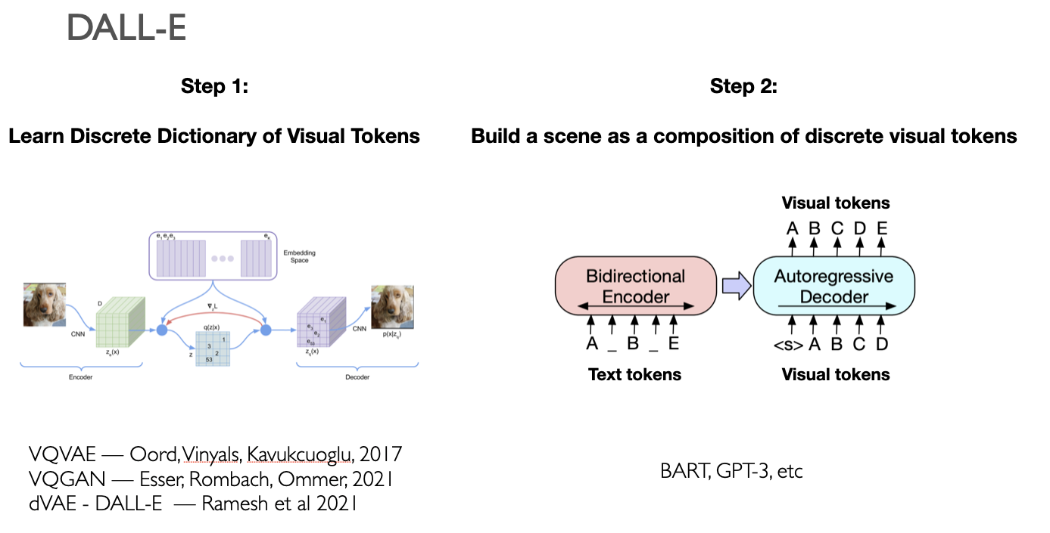
Vision and Language: Text-to-Image
Conditional GANs (Text-to-image synthesis)
AutoEncoders + Transformers (DALL-E and DALL-E mini)

Slide 26
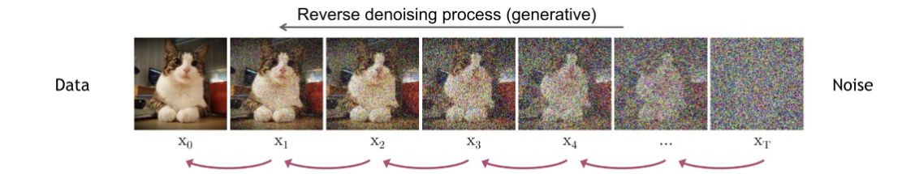
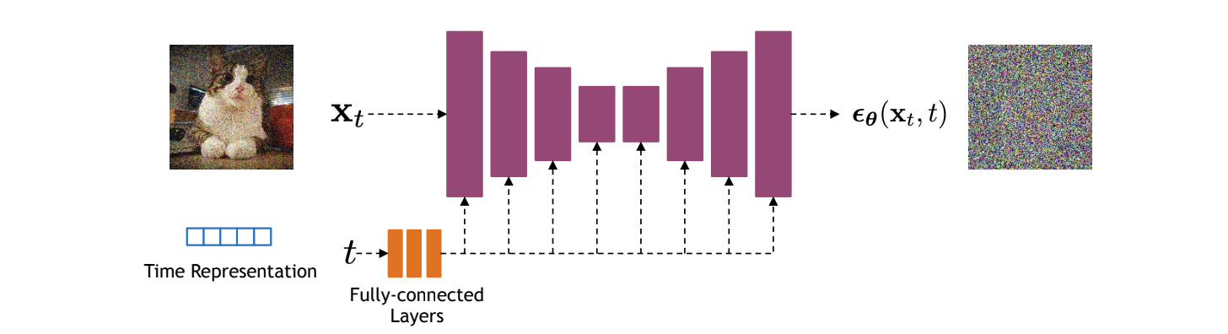

Vision and Language: Text to Image
Reverse Diffusion Models (e.g. DALLE-2, StableDiffusion, Imagen)

Slide 27
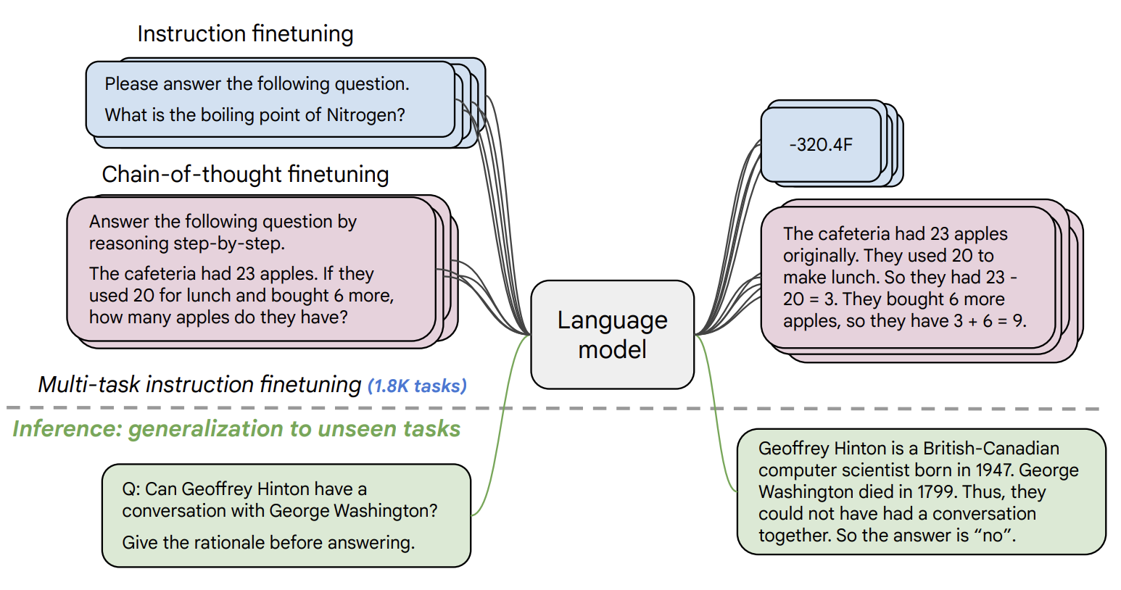
Natural Language Processing: Instruction Following LLMs and Chatbot LLMs
Finetuned on Instructions: FLAN-T5, OPT-IML
Tuned with Reinforcement Learning with Human Feedback: InstructGPT, ChatGPT
https://arxiv.org/pdf/2210.11416.pdf

Slide 28
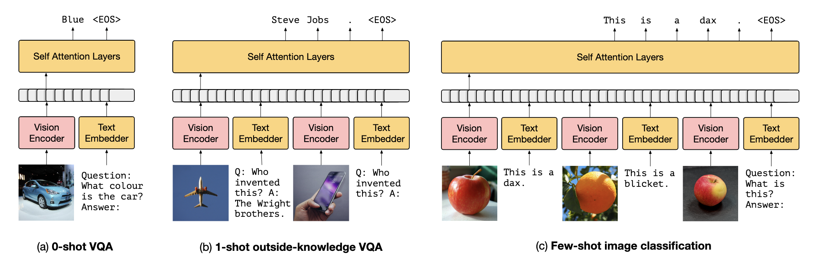
Vision and Language: Advanced Multimodal Models
Tuned LLMs with Image data:
Frozen, Flamingo, GPT-4, among others…

Slide 29
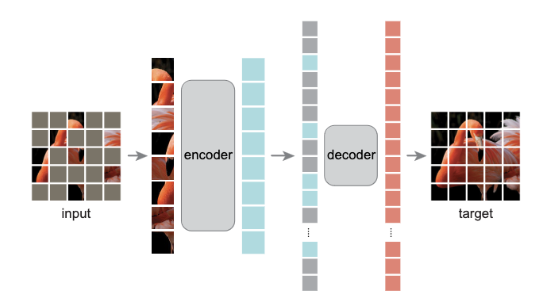
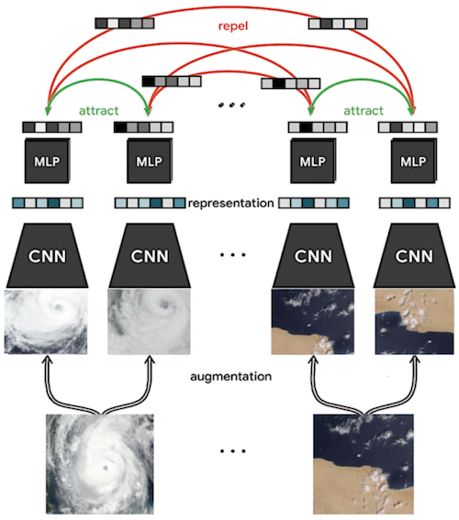
Computer Vision: Self-supervision
Basic Pretext tasks: Colorization, context prediction, counting
Contrastive Learning through Augmented Views: e.g. SimCLR
Masked AutoEncoders (MAEs)

Slide 30
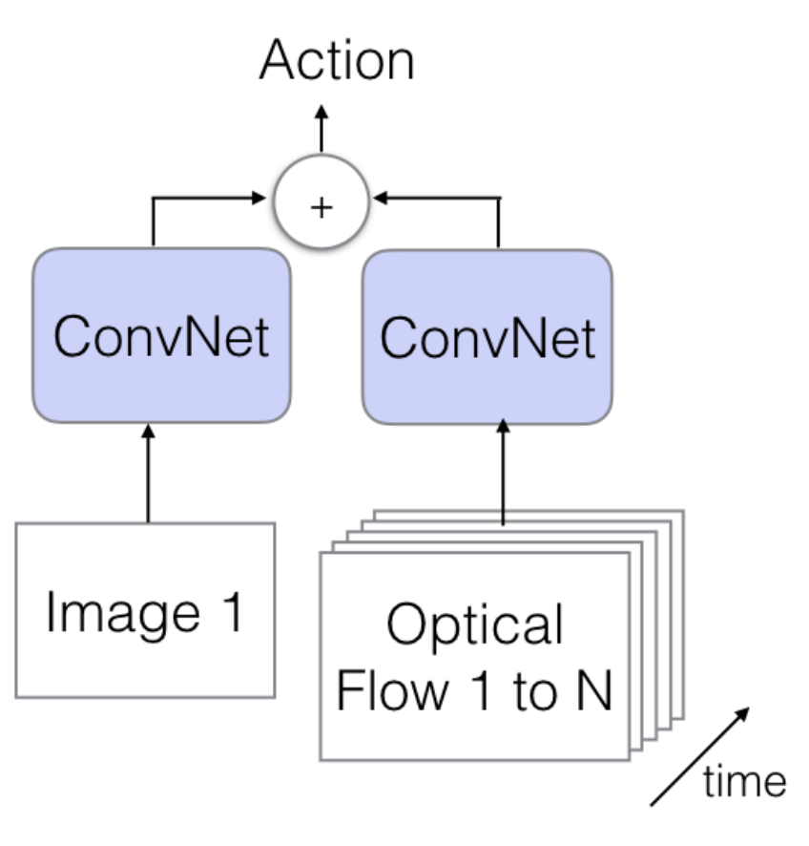
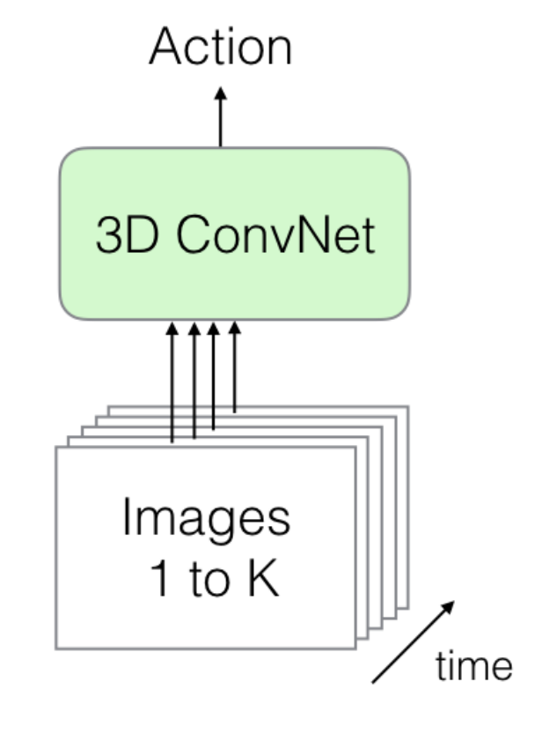
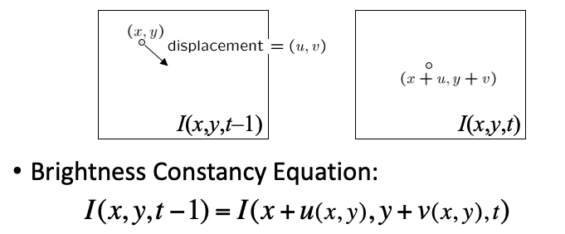
Computer Vision: Video
Convolutional Neural Networks for Video
  Optical Flow: Lucas-Kanade formulation
  Two-stream Networks (RGB and optical flow inputs)
  3D Convolutional Networks

Slide 31






Practical Aspects
Python + Pytorch + Automatic Differentiation + GPU
Liveloss / Weights and Biases: For experiment Monitoring
Matplotlib, LiveLossPlot, Torchvision, PIL (Python Imaging Library)
Huggingface Transformers/Tokenizers Library

Slide 32



Practical Aspects
Interactive Coding Tools
  Google Colab Notebooks and Amazon SageMaker Lab
  Powered by Project Jupyter

Slide 33



Practical Aspects
Containers: Docker and Singularity
Batch processing: SLURM and the Rice NOTS Cluster
+ Whatever you ended up needing for your course project

Slide 34
Practical Aspects: What else I recommend?
Pytorch’s advanced features:
  Distributed training across multiple GPUs, and across multiple nodes with multiple GPUs. Torch.
Cloud: AWS, Google Cloud, Microsoft Azure, Oracle Cloud
  On Demand vs Spot Instances
  Submitting batch processing jobs through containers
  Weights & Biases, Tensorboard, Comet
Other frameworks:
  Tensorflow, Apache MXNet, JAX (low level support for some optimized operations)
  ONNX: Cross-platform compatible model checkpoint file.

Slide 35






Practical Aspects: User Interfaces/Demos Recommended
Flask (or Django): For dynamic python-based server-side deployments
  Jinja2 for templating your output HTML (if needed)
JQuery, Bootstrap, React, ReactNative, Vue.js: For App Development

Slide 36
Things we didn’t cover in the class
Vision and Language Navigation
  (e.g. see https://arxiv.org/abs/1711.07280)
Visual Commonsense Reasoning
  (e.g. see https://visualcommonsense.com/)
Other topics:
  Reinforcement Learning (Prof Vaibhav Unhelkar)
  Graph Neural Networks and Graphical Models (Prof. Arlei Silva)
  Information Retrieval (Prof Xia Ben Hu)
  Neural Radiance Fields (NERFs) (Prof Guha Balakrishnan)
  3D Computer Vision and Imaging (Prof. Ashok Veeraraghavan)
  Robotics (Kaiyu Hang and Lydia Kavraki)

Slide 37


Rice University - Resources
https://entrepreneurship.rice.edu/
https://riceventures.org/

Slide 38
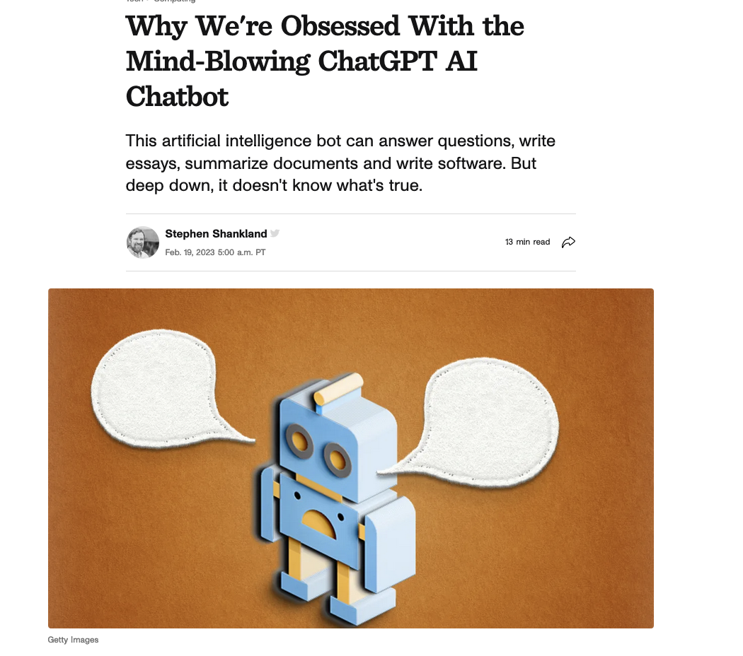
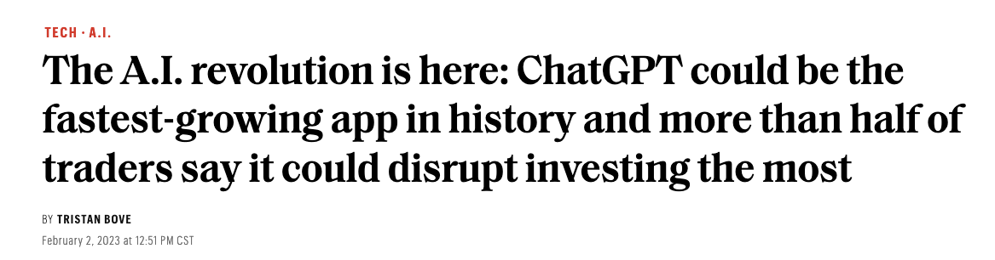
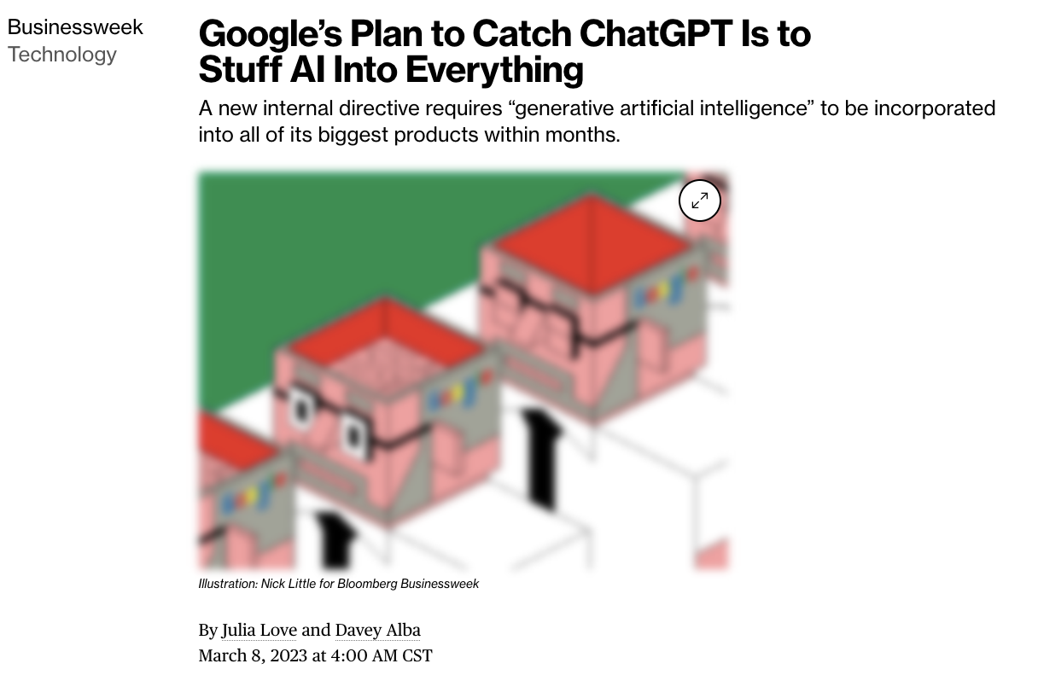
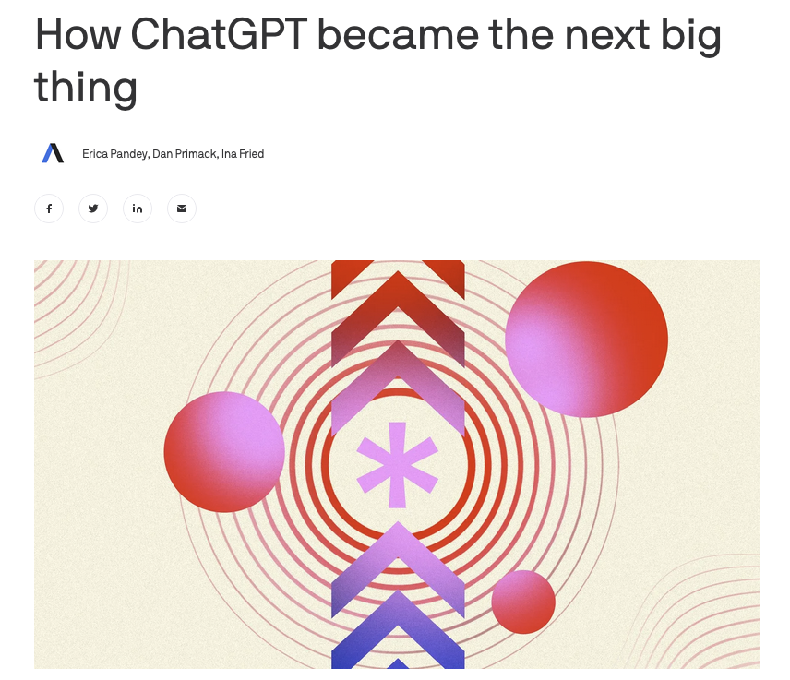
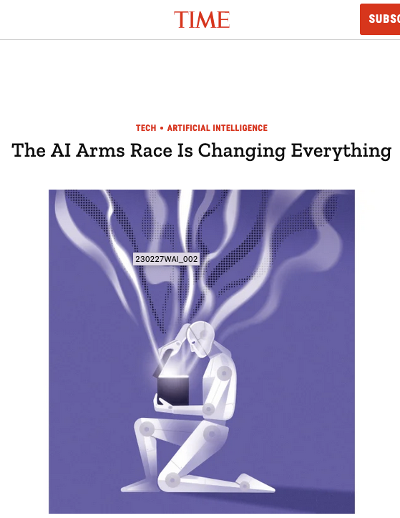

Other things to be aware about…

Slide 39





Other things to be aware about…

Slide 40




Other things to be aware about…

Slide 41




Other things to be aware about…

Slide 42









Other things to be aware about…

Slide 43
Thanks Everyone
Finish your course projects – I will be providing feedback to your progress report in the meantime for those that are left without feedback. I’m done 80% now.
Keep in touch – especially if you go on to do something great using computer vision / vision-language – always happy to hear back from students

