Slide 1
Deep Learning for Vision & Language
Machine Learning II: SGD, Generalization, Regularization, Softmax, MLPs

Slide 2
About the class
COMP 646: Deep Learning for Vision and Language
Instructor: Vicente Ordóñez (Vicente Ordóñez Román)
Website: https://www.cs.rice.edu/~vo9/deep-vislang
Location: Keck Hall 100
Times: Tuesdays and Thursdays
from 4pm to 5:15pm
Office Hours: Wednesdays 10am to noon (DH2080)
Teaching Assistants: Ayush, Jefferson, Jaywon, Zilin
Discussion Forum: Piazza (Sign-up Link on Rice Canvas and Class Website)

Slide 3
Assignment 1
Assignment 1 is released and is available on the class website and to be submitted via Canvas.
Due: Monday January 29th, midnight (you can and should submit early but not late – do not wait until finishing the whole assignment to have a version uploaded on canvas)

Slide 4
Grading for this class: COMP 646
Assignments: 30pts (3 assignments: 10pts + 10pts + 10pts)
Class Project: 60pts
Quiz: 10pts
Total: 100pts
Grade cutoffs: no stricter than the following:
A [between 90% and 100%], B [between 80% and 90%),
C [between 70% and 80%), D [between 55% and 70%),
F [less than 55%)

Slide 5
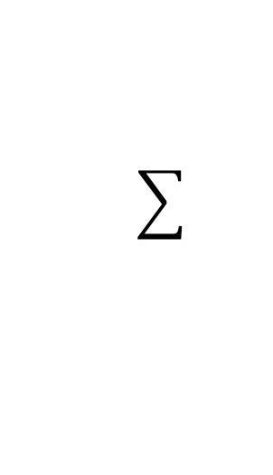
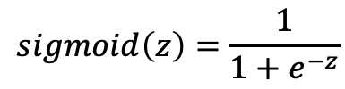





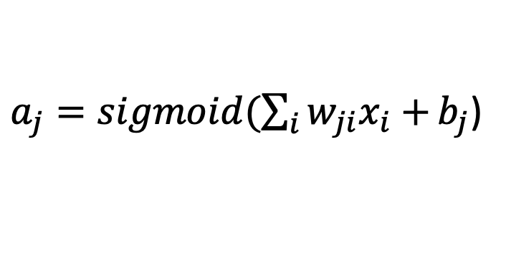



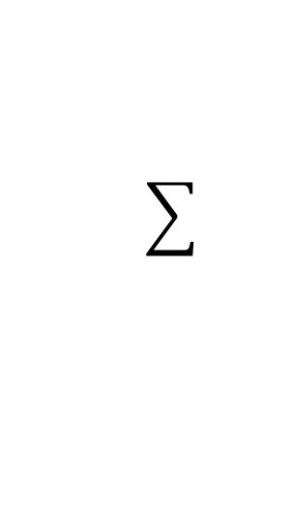
Neural Network with One Layer
$$sigmoid\left(z\right)=\frac{1}{1+e^{−z}}$$
$$x_{1}$$
$${W=[w}_{ji}]$$
$$a_{1}$$
$$x_{2}$$
$$x_{3}$$
$$a_{2}$$
$$x_{4}$$
$$x_{5}$$
$a_{j}=sigmoid(\sum_{i}{w_{ji}x_{i}+}b_{j}$)

Slide 6



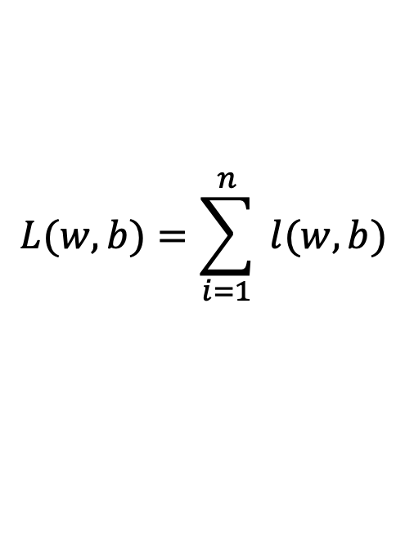



Gradient Descent
expensive
$$λ=0.01$$
$$L(w,b)=\sum_{i=1}^{n}{ l(w,b)}$$
Initialize w and b randomly
for e = 0, num_epochs do
Compute:
$$dL(w,b)/dw$$
and
$$dL(w,b)/db$$
Update w:
$$w=w −λ dL(w,b)/dw$$
Update b:
$$b=b −λ dL(w,b)/db$$
Print:
$$L(w,b)$$
// Useful to see if this is becoming smaller or not.
end

Slide 7
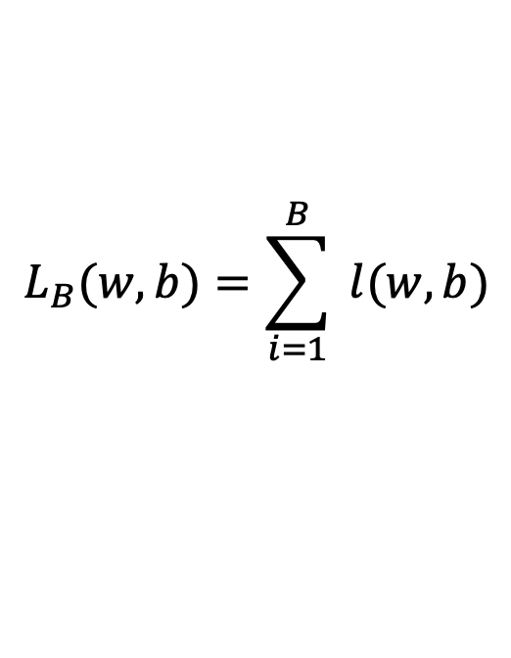





Stochastic Gradient Descent (mini-batch)
$$λ=0.01$$
$$L_{B}(w,b)=\sum_{i=1}^{B}{ l(w,b)}$$
Initialize w and b randomly
for e = 0, num_epochs do
for b = 0, num_batches do
Compute:
$$dL_{B}(w,b)/dw$$
and
$$dL_{B}(w,b)/db$$
Update w:
$$w=w −λ dl(w,b)/dw$$
Update b:
$$b=b −λ dl(w,b)/db$$
Print:
$$L_{B}(w,b)$$
// Useful to see if this is becoming smaller or not.
end
end

Slide 8
Stochastic Gradient Descent
How to choose the right batch size B?
How to choose the right learning rate lambda?
How to choose the right loss function, e.g. is least squares good enough?
How to choose the right function/classifier, e.g. linear, quadratic, neural network with 1 layer, 2 layers, etc?

Slide 9
Training, Validation (Dev), Test Sets
Training Set
Validation Set
Testing Set

Slide 10
Training, Validation (Dev), Test Sets
Training Set
Validation Set
Testing Set
Used during development

Slide 11
Training, Validation (Dev), Test Sets
Training Set
Validation Set
Testing Set
Only to be used for evaluating the model at the very end of development and any changes to the model after running it on the test set, could be influenced by what you saw happened on the test set, which would invalidate any future evaluation.

Slide 12


Gradient Descent
$$L\left(w\right)$$
2. Compute the gradient
(derivative) of L(w) at point
w = 12. (e.g. dL/dw = 6)
3. Recompute w as:
w = w – lambda * (dL / dw)
w=8
$$w$$

Slide 13
Source: Andrew Ng

Slide 14
In this class we will mostly rely on…
K-nearest neighbors
Linear classifiers
Naïve Bayes classifiers
Decision Trees
Random Forests
Boosted Decision Trees
Neural Networks

Slide 15
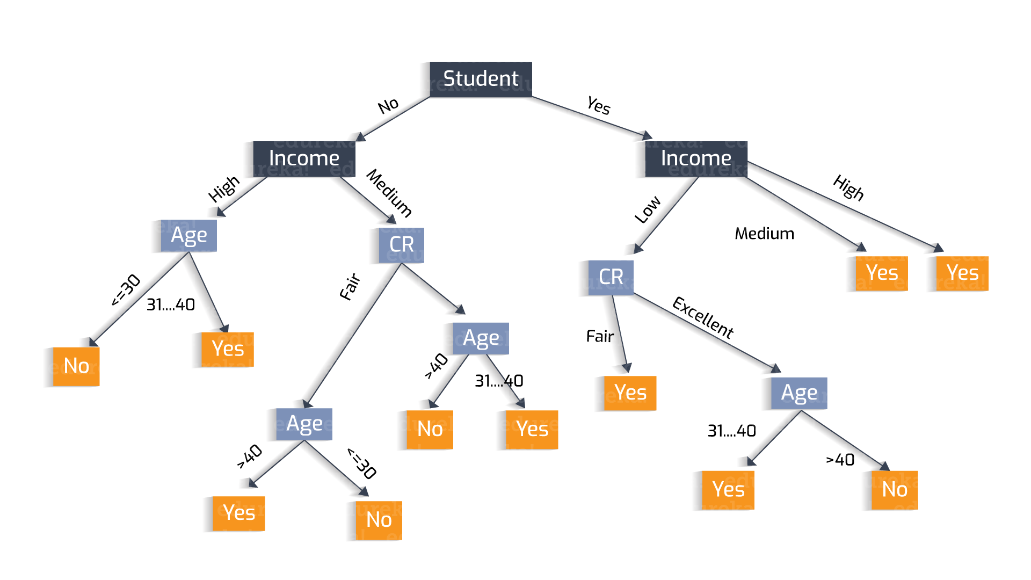
Why?
Decisions Trees
https://heartbeat.fritz.ai/understanding-the-mathematics-behind-decision-trees-22d86d55906 by Nikita Sharma

Slide 16
Why?
Decisions Trees are great because they are often interpretable.
However, they usually deal better with categorical data – not input pixel data.
https://heartbeat.fritz.ai/understanding-the-mathematics-behind-decision-trees-22d86d55906 by Nikita Sharma

Slide 17
How to pick the right model?

Slide 18










Linear Regression – 1 output, 1 input
$$y$$
$$(x_{8},y_{8})$$
$$(x_{6},y_{6})$$
$$(x_{7},y_{7})$$
$$(x_{4},y_{4})$$
$$(x_{5},y_{5})$$
$$(x_{2},y_{2})$$
$$(x_{3},y_{3})$$
$$(x_{1},y_{1})$$
$$x$$

Slide 19

Linear Regression – 1 output, 1 input
$$y$$
$$(x_{8},y_{8})$$
$$(x_{6},y_{6})$$
$$(x_{7},y_{7})$$
$$(x_{4},y_{4})$$
$$(x_{5},y_{5})$$
$$(x_{2},y_{2})$$
$$(x_{3},y_{3})$$
$$(x_{1},y_{1})$$
$$x$$
Model:
$$\hat{y}=wx+b$$

Slide 20
Linear Regression – 1 output, 1 input
$$y$$
$$(x_{8},y_{8})$$
$$(x_{6},y_{6})$$
$$(x_{7},y_{7})$$
$$(x_{4},y_{4})$$
$$(x_{5},y_{5})$$
$$(x_{2},y_{2})$$
$$(x_{3},y_{3})$$
$$(x_{1},y_{1})$$
$$x$$
Model:
$$\hat{y}=wx+b$$

Slide 21
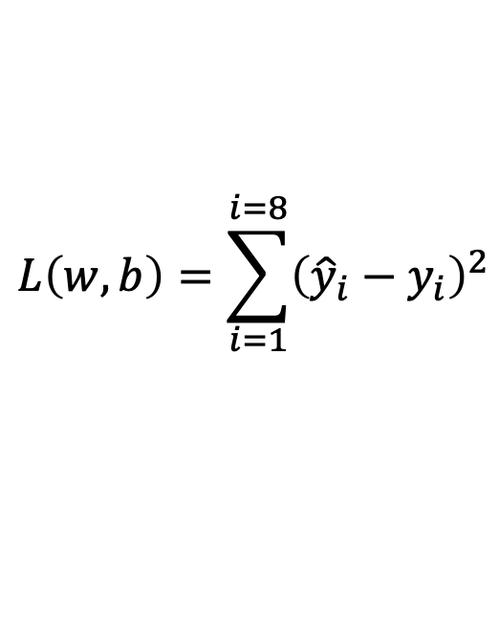
Linear Regression – 1 output, 1 input
$$y$$
$$(x_{8},y_{8})$$
$$(x_{6},y_{6})$$
$$(x_{7},y_{7})$$
$$(x_{4},y_{4})$$
$$(x_{5},y_{5})$$
$$(x_{2},y_{2})$$
$$(x_{3},y_{3})$$
$$(x_{1},y_{1})$$
$$x$$
$$L\left(w,b\right)=\sum_{i=1}^{i=8}{{\left({\hat{y}}_{i}−y_{i}\right)}^{2}}$$
Model:
$$\hat{y}=wx+b$$
Loss:

Slide 22

Quadratic Regression
$$y$$
$$(x_{8},y_{8})$$
$$(x_{6},y_{6})$$
$$(x_{7},y_{7})$$
$$(x_{4},y_{4})$$
$$(x_{5},y_{5})$$
$$(x_{2},y_{2})$$
$$(x_{3},y_{3})$$
$$(x_{1},y_{1})$$
$$x$$
$$L\left(w,b\right)=\sum_{i=1}^{i=8}{{\left({\hat{y}}_{i}−y_{i}\right)}^{2}}$$
Model:
$$\hat{y}=w_{1}x^{2}+w_{2}x+b$$
Loss:

Slide 23

n-polynomial Regression
$$y$$
$$(x_{8},y_{8})$$
$$(x_{6},y_{6})$$
$$(x_{7},y_{7})$$
$$(x_{4},y_{4})$$
$$(x_{5},y_{5})$$
$$(x_{2},y_{2})$$
$$(x_{3},y_{3})$$
$$(x_{1},y_{1})$$
$$x$$
$$L\left(w,b\right)=\sum_{i=1}^{i=8}{{\left({\hat{y}}_{i}−y_{i}\right)}^{2}}$$
Model:
$$\hat{y}=w_{n}x^{n}+…+w_{1}x+b$$
Loss:

Slide 24
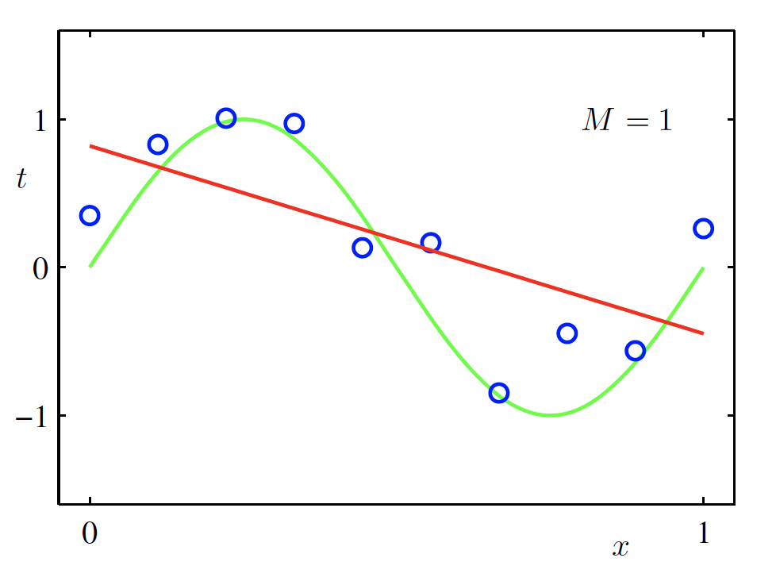
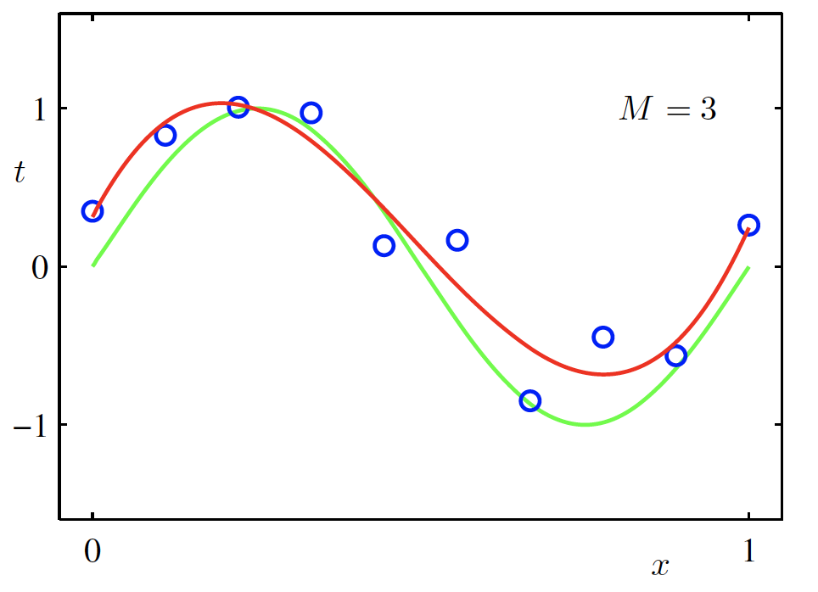
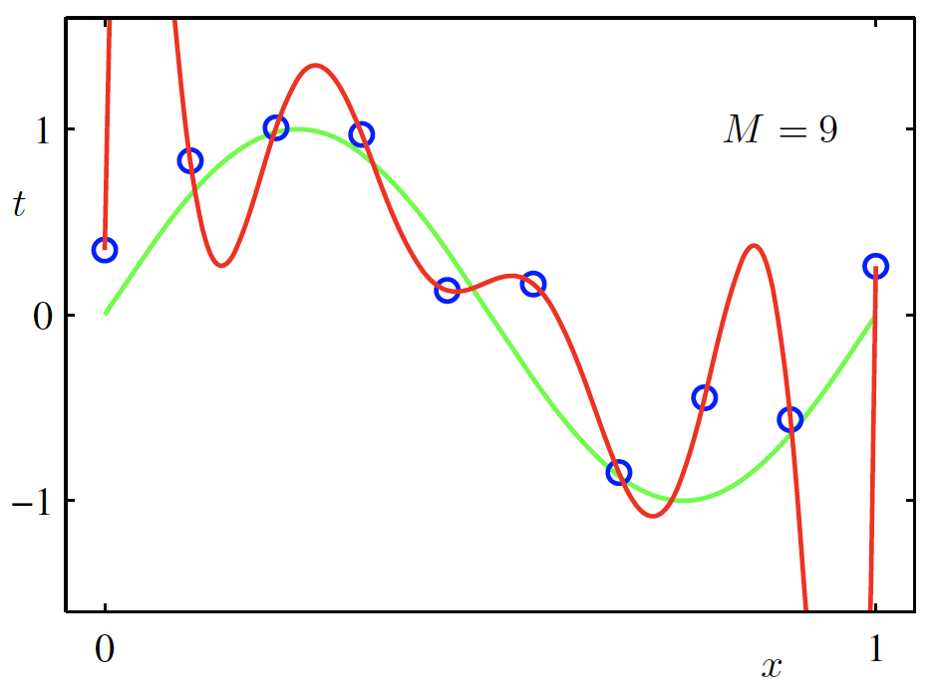

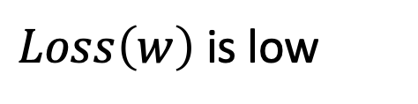
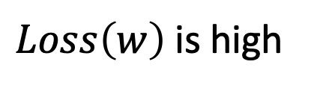
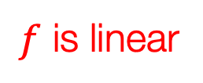
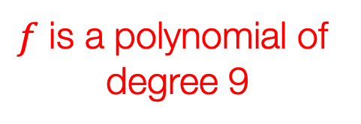
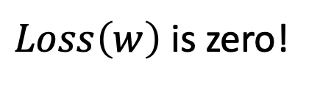
Overfitting
$f$ is a polynomial of
degree 9
$f$ is linear
$f$ is cubic
$Loss\left(w\right)$ is high
$Loss\left(w\right)$ is low
$Loss\left(w\right)$ is zero!
Underfitting
Overfitting
High Bias
High Variance
Christopher M. Bishop – Pattern Recognition and Machine Learning
Credit: C. Bishop. Pattern Recognition and Mach. Learning.

Slide 25



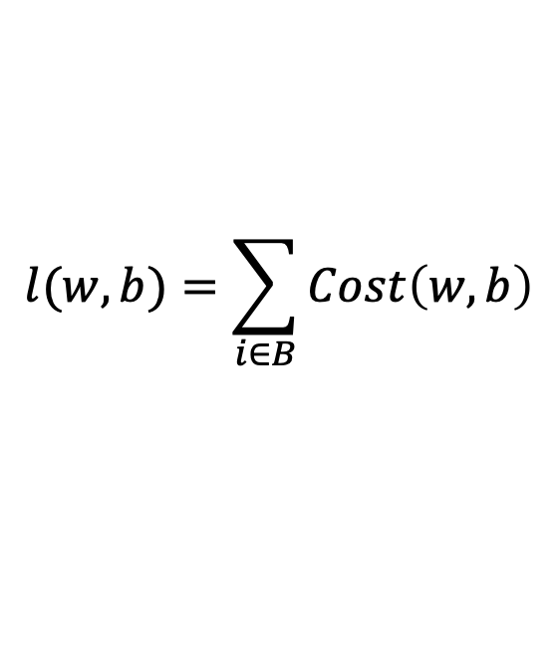



(mini-batch) Stochastic Gradient Descent (SGD)
$$λ=0.01$$
$$l(w,b)=\sum_{i∈B}{Cost\left(w,b\right)}$$
Initialize w and b randomly
for e = 0, num_epochs do
for b = 0, num_batches do
Compute:
$$dl(w,b)/dw$$
and
$$dl(w,b)/db$$
Update w:
$$w=w −λ dl(w,b)/dw$$
Update b:
$$b=b −λ dl(w,b)/db$$
Print:
$$l(w,b)$$
// Useful to see if this is becoming smaller or not.
end
end

Slide 26
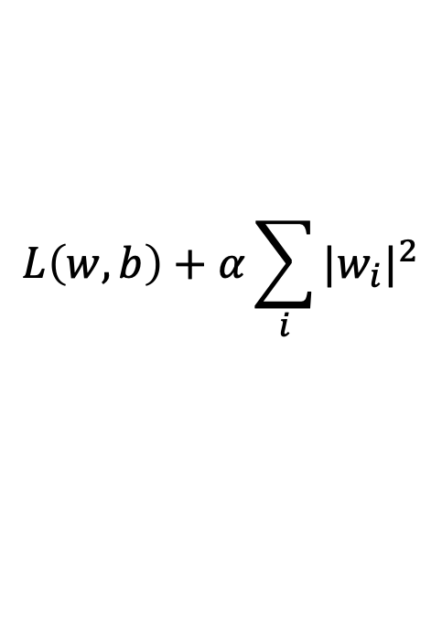
Regularization
Large weights lead to large variance. i.e. model fits to the training data too strongly.
Solution: Minimize the loss but also try to keep the weight values small by doing the following:
$$L\left(w,b\right)+α\sum_{i}{{|w_{i}|}^{2}}$$
minimize
Credit: C. Bishop. Pattern Recognition and Mach. Learning.

Slide 27
Regularization
Large weights lead to large variance. i.e. model fits to the training data too strongly.
Solution: Minimize the loss but also try to keep the weight values small by doing the following:
$$L\left(w,b\right)+α\sum_{i}{{|w_{i}|}^{2}}$$
minimize
Regularizer term
e.g. L2- regularizer
Credit: C. Bishop. Pattern Recognition and Mach. Learning.

Slide 28

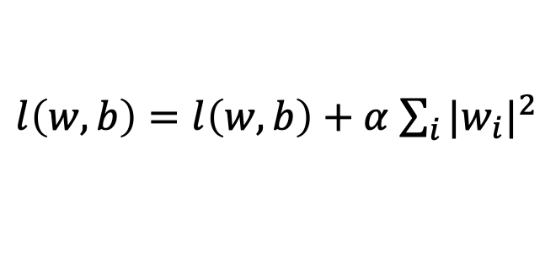

SGD with Regularization (L-2)
$$λ=0.01$$
$l\left(w,b\right)=l\left(w,b\right)+α$ $\sum_{i}{{|w_{i}|}^{2}}$
Initialize w and b randomly
for e = 0, num_epochs do
for b = 0, num_batches do
Compute:
$$dl(w,b)/dw$$
and
$$dl(w,b)/db$$
Update w:
$$w=w −λ dl(w,b)/dw−λαw$$
Update b:
$$b=b −λ dl(w,b)/db−λαw$$
Print:
$$l(w,b)$$
// Useful to see if this is becoming smaller or not.
end
end

Slide 29
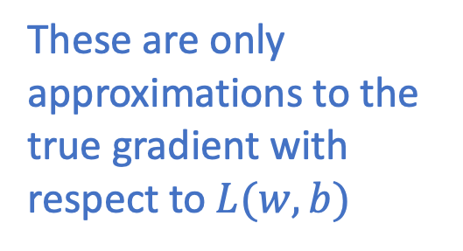
Revisiting Another Problem with SGD
$$λ=0.01$$
$l\left(w,b\right)=l\left(w,b\right)+α$ $\sum_{i}{{|w_{i}|}^{2}}$
Initialize w and b randomly
for e = 0, num_epochs do
These are only approximations to the true gradient with respect to $L(w,b)$
for b = 0, num_batches do
Compute:
$$dl(w,b)/dw$$
and
$$dl(w,b)/db$$
Update w:
$$w=w −λ dl(w,b)/dw−λαw$$
Update b:
$$b=b −λ dl(w,b)/db−λαw$$
Print:
$$l(w,b)$$
// Useful to see if this is becoming smaller or not.
end
end

Slide 30
Revisiting Another Problem with SGD
$$λ=0.01$$
$l\left(w,b\right)=l\left(w,b\right)+α$ $\sum_{i}{{|w_{i}|}^{2}}$
Initialize w and b randomly
for e = 0, num_epochs do
This could lead to “un-learning” what has been learned in some previous steps of training.
for b = 0, num_batches do
Compute:
$$dl(w,b)/dw$$
and
$$dl(w,b)/db$$
Update w:
$$w=w −λ dl(w,b)/dw−λαw$$
Update b:
$$b=b −λ dl(w,b)/db−λαw$$
Print:
$$l(w,b)$$
// Useful to see if this is becoming smaller or not.
end
end

Slide 31
Solution: Momentum Updates
$$λ=0.01$$
$l\left(w,b\right)=l\left(w,b\right)+α$ $\sum_{i}{{|w_{i}|}^{2}}$
Initialize w and b randomly
for e = 0, num_epochs do
Keep track of previous gradients in an accumulator variable! and use a weighted average with current gradient.
for b = 0, num_batches do
Compute:
$$dl(w,b)/dw$$
and
$$dl(w,b)/db$$
Update w:
$$w=w −λ dl(w,b)/dw−λαw$$
Update b:
$$b=b −λ dl(w,b)/db−λαw$$
Print:
$$l(w,b)$$
// Useful to see if this is becoming smaller or not.
end
end

Slide 32







Solution: Momentum Updates
$$λ=0.01$$
$$τ=0.9$$
Initialize w and b randomly
$l\left(w,b\right)=l\left(w,b\right)+α$ $\sum_{i}{{|w_{i}|}^{2}}$
global $v$
for e = 0, num_epochs do
for b = 0, num_batches do
Keep track of previous gradients in an accumulator variable! and use a weighted average with current gradient.
Compute:
$$dl(w,b)/dw$$
Compute:
$$v=τv+dl(w,b)/dw+αw$$
Update w:
$$w=w −λ v$$
Print:
$$l(w,b)$$
// Useful to see if this is becoming smaller or not.
end
end

Slide 33
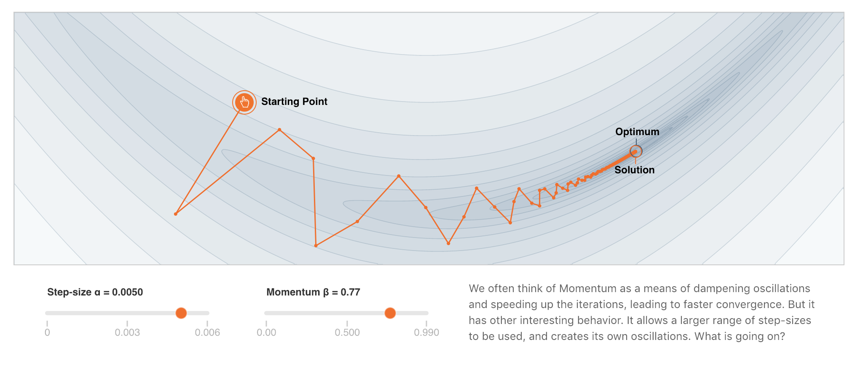
More on Momentum
https://distill.pub/2017/momentum/

Slide 34
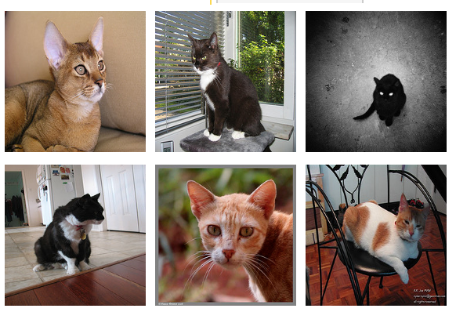
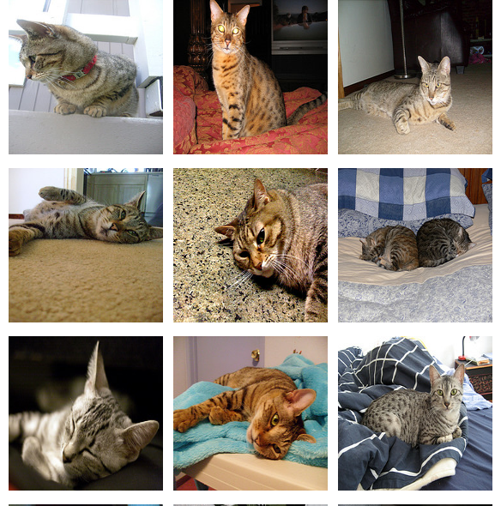
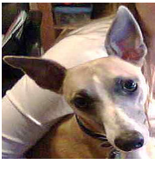
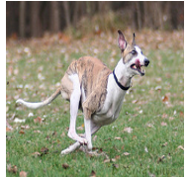
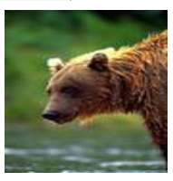
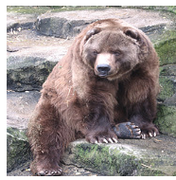
Supervised Learning - Classification
Training Data
Test Data
cat
dog
cat
.
.
.
.
.
.
bear

Slide 35








Supervised Learning - Classification
Training Data
cat
$$x_{1}=[ ]$$
$$y_{1}=[ ]$$
dog
$$x_{2}=[ ]$$
$$y_{2}=[ ]$$
cat
$$x_{3}=[ ]$$
$$y_{3}=[ ]$$
.
.
.
bear
$$x_{n}=[ ]$$
$$y_{n}=[ ]$$

Slide 36







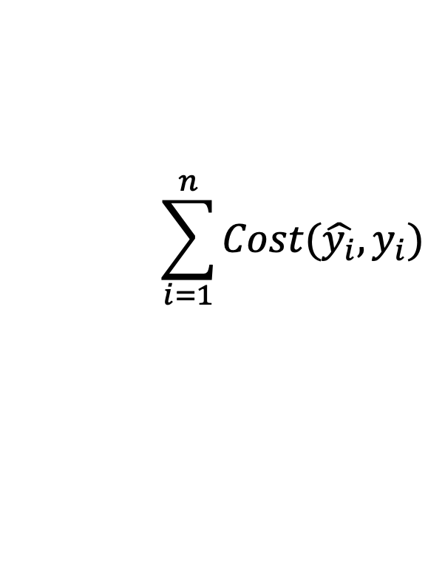


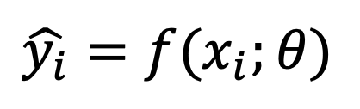



Supervised Learning - Classification
Training Data
targets /
labels /
ground truth
We need to find a function that
maps x and y for any of them.
inputs
predictions
$$x_{1}=[x_{11} { x}_{12} x_{13} { x}_{14}]$$
$$y_{1}=$$
1
$${\hat{y}}_{1}=$$
1
$$\hat{y_{i}}=f(x_{i};θ)$$
$$x_{2}=[x_{21} { x}_{22} x_{23} { x}_{24}]$$
$$y_{2}=$$
2
$${\hat{y}}_{2}=$$
2
$$x_{3}=[x_{31} { x}_{32} x_{33} { x}_{34}]$$
$$y_{3}=$$
1
$${\hat{y}}_{3}=$$
2
How do we ”learn” the parameters
of this function?
.
.
.
We choose ones that makes the
following quantity small:
$$\sum_{i=1}^{n}{Cost(\hat{y_{i}}, y_{i})}$$
$$x_{n}=[x_{n1} { x}_{n2} x_{n3} { x}_{n4}]$$
$$y_{n}=$$
3
$${\hat{y}}_{n}=$$
1

Slide 37
Supervised Learning - Classification
Training Data
Test Data
cat
dog
cat
.
.
.
.
.
.
bear

Slide 38
Supervised Learning - Classification
Training Data
cat
$$x_{1}=[ ]$$
$$y_{1}=[ ]$$
dog
$$x_{2}=[ ]$$
$$y_{2}=[ ]$$
cat
$$x_{3}=[ ]$$
$$y_{3}=[ ]$$
.
.
.
bear
$$x_{n}=[ ]$$
$$y_{n}=[ ]$$

Slide 39
Supervised Learning - Classification
Training Data
targets /
labels /
ground truth
We need to find a function that
maps x and y for any of them.
inputs
predictions
$$x_{1}=[x_{11} { x}_{12} x_{13} { x}_{14}]$$
$$y_{1}=$$
1
$${\hat{y}}_{1}=$$
1
$$\hat{y_{i}}=f(x_{i};θ)$$
$$x_{2}=[x_{21} { x}_{22} x_{23} { x}_{24}]$$
$$y_{2}=$$
2
$${\hat{y}}_{2}=$$
2
$$x_{3}=[x_{31} { x}_{32} x_{33} { x}_{34}]$$
$$y_{3}=$$
1
$${\hat{y}}_{3}=$$
2
How do we ”learn” the parameters
of this function?
.
.
.
We choose ones that makes the
following quantity small:
$$\sum_{i=1}^{n}{Cost(\hat{y_{i}}, y_{i})}$$
$$x_{n}=[x_{n1} { x}_{n2} x_{n3} { x}_{n4}]$$
$$y_{n}=$$
3
$${\hat{y}}_{n}=$$
1

Slide 40
Supervised Learning – Linear Softmax
Training Data
targets /
labels /
ground truth
inputs
$$x_{1}=[x_{11} { x}_{12} x_{13} { x}_{14}]$$
$$y_{1}=$$
1
$$x_{2}=[x_{21} { x}_{22} x_{23} { x}_{24}]$$
$$y_{2}=$$
2
$$x_{3}=[x_{31} { x}_{32} x_{33} { x}_{34}]$$
$$y_{3}=$$
1
.
.
.
$$x_{n}=[x_{n1} { x}_{n2} x_{n3} { x}_{n4}]$$
$$y_{n}=$$
3

Slide 41




Supervised Learning – Linear Softmax
Training Data
targets /
labels /
ground truth
inputs
predictions
$$x_{1}=[x_{11} { x}_{12} x_{13} { x}_{14}]$$
$$y_{1}=$$
[1 0 0]
$${\hat{y}}_{1}=$$
[0.85 0.10 0.05]
$$x_{2}=[x_{21} { x}_{22} x_{23} { x}_{24}]$$
$$y_{2}=$$
[0 1 0]
$${\hat{y}}_{2}=$$
[0.20 0.70 0.10]
$$x_{3}=[x_{31} { x}_{32} x_{33} { x}_{34}]$$
$$y_{3}=$$
[1 0 0]
$${\hat{y}}_{3}=$$
[0.40 0.45 0.15]
.
.
.
$$x_{n}=[x_{n1} { x}_{n2} x_{n3} { x}_{n4}]$$
$$y_{n}=$$
[0 0 1]
$${\hat{y}}_{n}=$$
[0.40 0.25 0.35]

Slide 42






Supervised Learning – Linear Softmax
$$x_{i}=[x_{i1} { x}_{i2} x_{i3} { x}_{i4}]$$
$$y_{i}=$$
[1 0 0]
$${\hat{y}}_{i}= [f_{1} f_{2} f_{3}]$$
$$a_{1}=w_{11}x_{i1}+w_{12}x_{i2}+w_{13}x_{i3}+w_{14}x_{i4}+b_{c}$$
$$a_{2}=w_{21}x_{i1}+w_{22}x_{i2}+w_{23}x_{i3}+w_{24}x_{i4}+b_{d}$$
$$a_{3}=w_{31}x_{i1}+w_{32}x_{i2}+w_{33}x_{i3}+w_{34}x_{i4}+b_{b}$$
$$f_{1}=e^{a_{1}}/{(e}^{a_{1}}+e^{a_{2}}+e^{a_{3}})$$
$$f_{2}=e^{a_{2}}/{(e}^{a_{1}}+e^{a_{2}}+e^{a_{3}})$$
$$f_{3}=e^{a_{3}}/{(e}^{a_{1}}+e^{a_{2}}+e^{a_{3}})$$

Slide 43
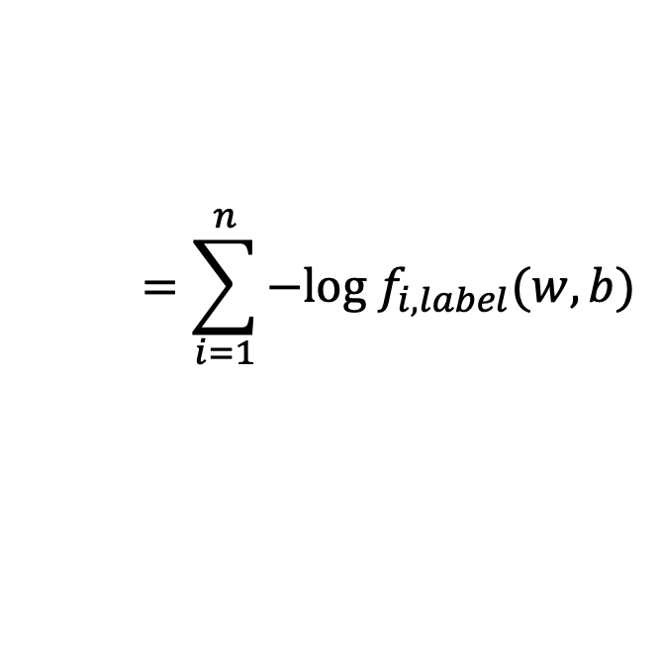
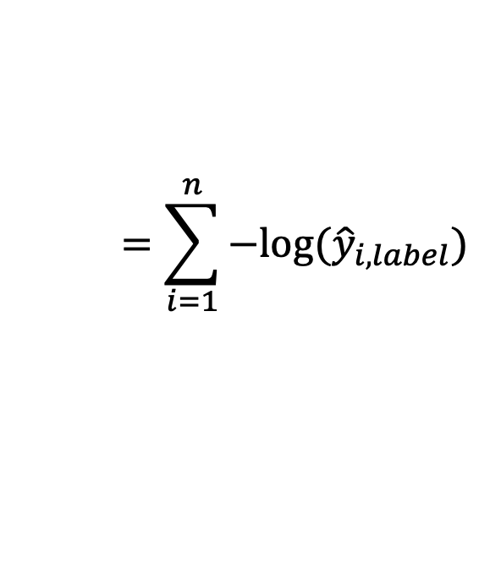
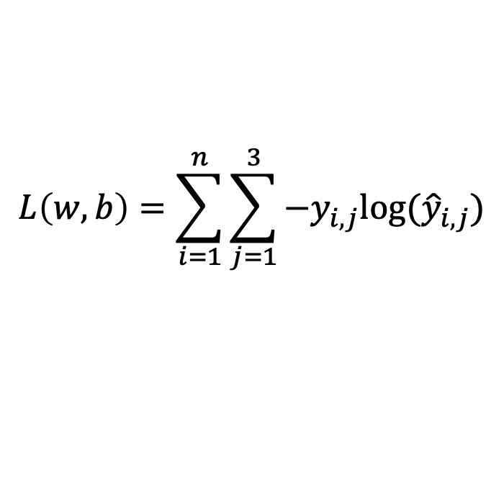

How do we find a good w and b?
$$x_{i}=[x_{i1} { x}_{i2} x_{i3} { x}_{i4}]$$
$$y_{i}=$$
[1 0 0]
$${\hat{y}}_{i}= [f_{1}(w,b) f_{2}(w,b) f_{3}(w,b)]$$
We need to find w, and b that minimize the following:
$$L\left(w,b\right)=\sum_{i=1}^{n}{\sum_{j=1}^{3}{−y_{i,j}log⁡({\hat{y}}_{i,j})}}$$
$$=\sum_{i=1}^{n}{−log⁡({\hat{y}}_{i,label})}$$
$$=\sum_{i=1}^{n}{−log f_{i,label}(w,b)}$$
Why?

Slide 44
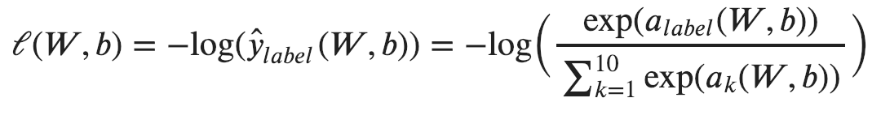
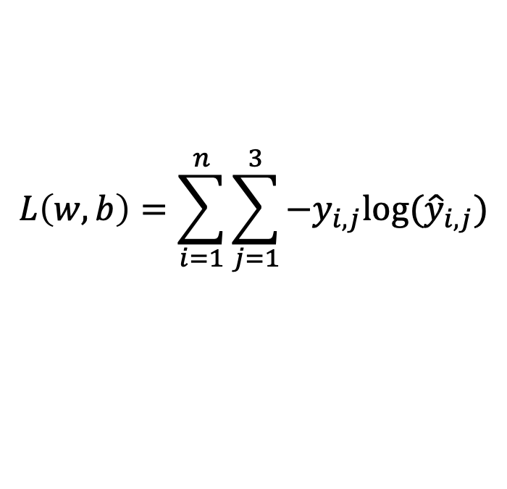
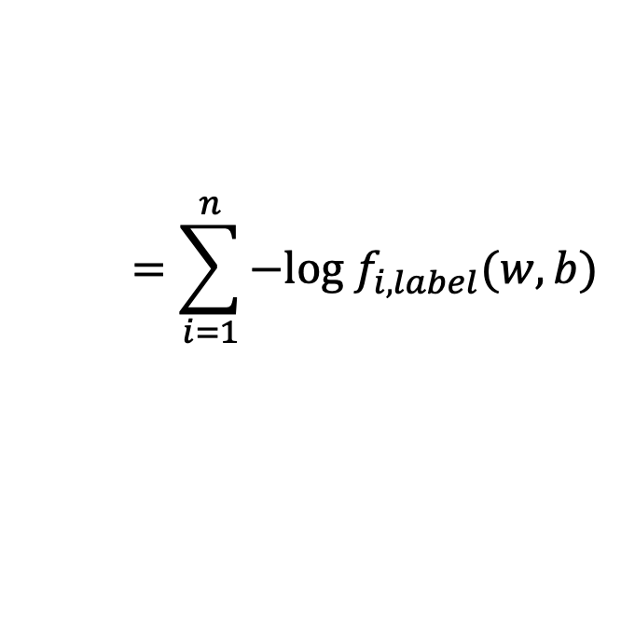
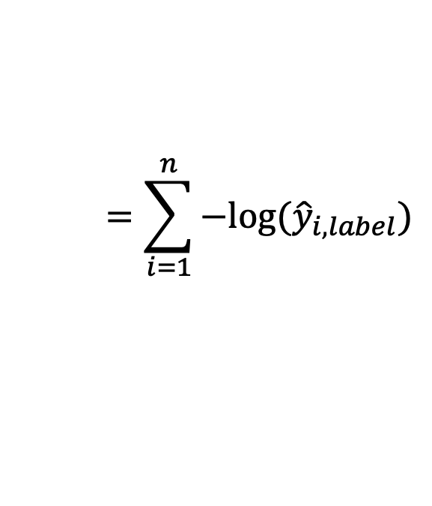
Computing Analytic Gradients
This is what we have:
$$L\left(w,b\right)=\sum_{i=1}^{n}{\sum_{j=1}^{3}{−y_{i,j}log⁡({\hat{y}}_{i,j})}}$$
$$=\sum_{i=1}^{n}{−log⁡({\hat{y}}_{i,label})}$$
$$=\sum_{i=1}^{n}{−log f_{i,label}(w,b)}$$
To simplify let’s assume n = 1
3

Slide 45



Supervised Learning – Linear Softmax
$$x=[x_{1} { x}_{2} x_{3} { x}_{4}]$$
$$y=$$
[1 0 0]
$$\hat{y}= [f_{1} f_{2} f_{3}]$$
$$a_{1}=w_{11}x_{1}+w_{12}x_{2}+w_{13}x_{3}+w_{14}x_{4}+b_{c}$$
$$a_{2}=w_{21}x_{1}+w_{22}x_{2}+w_{23}x_{3}+w_{24}x_{4}+b_{d}$$
$$a_{3}=w_{31}x_{1}+w_{32}x_{2}+w_{33}x_{3}+w_{34}x_{4}+b_{b}$$
$$f_{1}=e^{a_{1}}/{(e}^{a_{1}}+e^{a_{2}}+e^{a_{3}})$$
$$f_{2}=e^{a_{2}}/{(e}^{a_{1}}+e^{a_{2}}+e^{a_{3}})$$
$$f_{3}=e^{a_{3}}/{(e}^{a_{1}}+e^{a_{2}}+e^{a_{3}})$$

Slide 46
Computing Analytic Gradients
This is what we have:
3

Slide 47
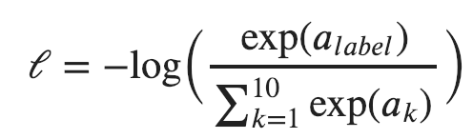
Computing Analytic Gradients
This is what we have:
3
3
Reminder:
$$a_{i}=(w_{i,1}x_{1}+w_{i,2}x_{2}+w_{i,3}x_{3}+w_{i,4}x_{4})+b_{i}$$

Slide 48
Computing Analytic Gradients
This is what we have:
3

Slide 49
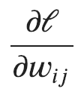

Computing Analytic Gradients
This is what we have:
3
This is what we need:
for each
for each

Slide 50
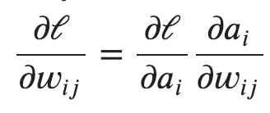
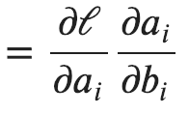
Computing Analytic Gradients
This is what we have:
3
Step 1: Chain Rule of Calculus

Slide 51
Computing Analytic Gradients
This is what we have:
3
Step 1: Chain Rule of Calculus
Let’s do these first

Slide 52
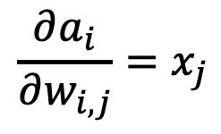
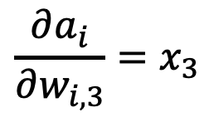
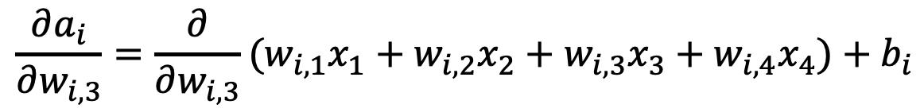
Computing Analytic Gradients
$$a_{i}=(w_{i,1}x_{1}+w_{i,2}x_{2}+w_{i,3}x_{3}+w_{i,4}x_{4})+b_{i}$$
$$\frac{∂a_{i}}{∂w_{i, 3}}=\frac{∂}{∂w_{i, 3}}(w_{i,1}x_{1}+w_{i,2}x_{2}+w_{i,3}x_{3}+w_{i,4}x_{4})+b_{i}$$
$$\frac{∂a_{i}}{∂w_{i, 3}}=x_{3}$$
$$\frac{∂a_{i}}{∂w_{i, j}}=x_{j}$$

Slide 53
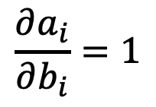
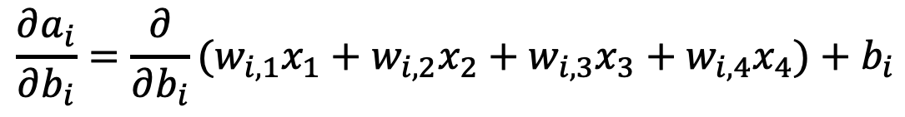
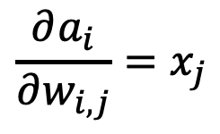
Computing Analytic Gradients
$$\frac{∂a_{i}}{∂w_{i, j}}=x_{j}$$
$$a_{i}=(w_{i,1}x_{1}+w_{i,2}x_{2}+w_{i,3}x_{3}+w_{i,4}x_{4})+b_{i}$$
$$\frac{∂a_{i}}{∂b_{i}}=\frac{∂}{∂b_{i}}(w_{i,1}x_{1}+w_{i,2}x_{2}+w_{i,3}x_{3}+w_{i,4}x_{4})+b_{i}$$
$$\frac{∂a_{i}}{∂b_{i}}=1$$

Slide 54

Computing Analytic Gradients
$$\frac{∂a_{i}}{∂w_{i, j}}=x_{j}$$
$$\frac{∂a_{i}}{∂b_{i}}=1$$

Slide 55
Computing Analytic Gradients
This is what we have:
3
Step 1: Chain Rule of Calculus
Now let’s do this one (same for both!)

Slide 56
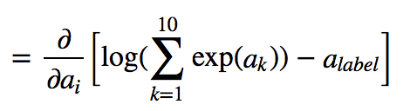
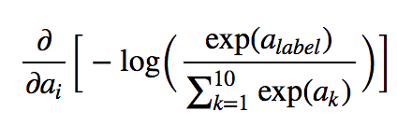
Computing Analytic Gradients
3
3
In our cat, dog, bear classification example: i = {1, 2, 3}

Slide 57
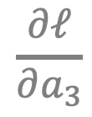


Computing Analytic Gradients
3
3
In our cat, dog, bear classification example: i = {1, 2, 3}
$$\frac{∂ℓ}{∂a_{1}}$$
$$\frac{∂ℓ}{∂a_{2}}$$
$$\frac{∂ℓ}{∂a_{3}}$$
Let’s say: label = 2
We need:

Slide 58





Computing Analytic Gradients
3
$$\frac{∂ℓ}{∂a_{1}}$$
$$\frac{∂ℓ}{∂a_{3}}$$
3
3
3
3
$$={\hat{y}}_{i}$$
$$={\hat{y}}_{i}$$
3

Slide 59
Supervised Learning – Linear Softmax
$$x_{i}=[x_{i1} { x}_{i2} x_{i3} { x}_{i4}]$$
$$y_{i}=$$
[1 0 0]
$${\hat{y}}_{i}= [f_{1} f_{2} f_{3}]$$
$$a_{1}=w_{11}x_{i1}+w_{12}x_{i2}+w_{13}x_{i3}+w_{14}x_{i4}+b_{c}$$
$$a_{2}=w_{21}x_{i1}+w_{22}x_{i2}+w_{23}x_{i3}+w_{24}x_{i4}+b_{d}$$
$$a_{3}=w_{31}x_{i1}+w_{32}x_{i2}+w_{33}x_{i3}+w_{34}x_{i4}+b_{b}$$
$$f_{1}=e^{a_{1}}/{(e}^{a_{1}}+e^{a_{2}}+e^{a_{3}})$$
$$f_{2}=e^{a_{2}}/{(e}^{a_{1}}+e^{a_{2}}+e^{a_{3}})$$
$$f_{3}=e^{a_{3}}/{(e}^{a_{1}}+e^{a_{2}}+e^{a_{3}})$$

Slide 60

Computing Analytic Gradients
3
$$\frac{∂ℓ}{∂a_{1}}$$
$$\frac{∂ℓ}{∂a_{3}}$$
3
3
3
3
$$={\hat{y}}_{i}$$
$$={\hat{y}}_{i}$$
3

Slide 61



Computing Analytic Gradients
3
$$\frac{∂ℓ}{∂a_{2}}$$
3
3
3
3
$$={\hat{y}}_{i}−1$$
3

Slide 62





Computing Analytic Gradients
label = 2
$$\frac{∂ℓ}{∂a_{1}}={\hat{y}}_{1}$$
$$\frac{∂ℓ}{∂a_{2}}={\hat{y}}_{2}−1$$
$$\frac{∂ℓ}{∂a_{3}}={\hat{y}}_{3}$$
$\frac{∂ℓ}{∂a}=\left[\begin{aligned}\frac{∂ℓ}{∂a_{1}} \\ \frac{∂ℓ}{∂a_{2}} \\ \frac{∂ℓ}{∂a_{3}}\end{aligned}\right]$= $\left[\begin{aligned}{\hat{y}}_{1} \\ {\hat{y}}_{2}−1 \\ {\hat{y}}_{3}\end{aligned}\right]=\left[\begin{aligned}{\hat{y}}_{1} \\ {\hat{y}}_{2} \\ {\hat{y}}_{3}\end{aligned}\right]−\left[\begin{aligned}0 \\ 1 \\ 0\end{aligned}\right]=\hat{y}−y$
$$\frac{∂ℓ}{∂a_{i}}={\hat{y}}_{i}−y_{i}$$

Slide 63





Computing Analytic Gradients
$$\frac{∂a_{i}}{∂w_{i, j}}=x_{j}$$
$$\frac{∂a_{i}}{∂b_{i}}=1$$
$$\frac{∂ℓ}{∂a_{i}}={\hat{y}}_{i}−y_{i}$$
$$\frac{∂ℓ}{∂w_{i, j}}=\left({\hat{y}}_{i}−y_{i}\right)x_{j}$$
$$\frac{∂ℓ}{∂b_{i}}=\left({\hat{y}}_{i}−y_{i}\right)$$

Slide 64











Perceptron Model
Frank Rosenblatt (1957) - Cornell University
Activation
function
$$x_{1}$$
$$w_{1}$$
$$f\left(x\right)=\left\{\begin{aligned}1, if \sum_{i=0}^{n}{w_{i}x_{i}}+b>0 \\ &0, otherwise \end{aligned}\right.$$
$$x_{2}$$
$$w_{2}$$
$$w_{3}$$
$$x_{3}$$
$$w_{4}$$
$$x_{4}$$
More: https://en.wikipedia.org/wiki/Perceptron

Slide 65
Perceptron Model
Frank Rosenblatt (1957) - Cornell University
!?
$$x_{1}$$
$$w_{1}$$
$$f\left(x\right)=\left\{\begin{aligned}1, if \sum_{i=0}^{n}{w_{i}x_{i}}+b>0 \\ &0, otherwise \end{aligned}\right.$$
$$x_{2}$$
$$w_{2}$$
$$w_{3}$$
$$x_{3}$$
$$w_{4}$$
$$x_{4}$$
More: https://en.wikipedia.org/wiki/Perceptron

Slide 66
Perceptron Model
Frank Rosenblatt (1957) - Cornell University
Activation
function
$$x_{1}$$
$$w_{1}$$
$$f\left(x\right)=\left\{\begin{aligned}1, if \sum_{i=0}^{n}{w_{i}x_{i}}+b>0 \\ &0, otherwise \end{aligned}\right.$$
$$x_{2}$$
$$w_{2}$$
$$w_{3}$$
$$x_{3}$$
$$w_{4}$$
$$x_{4}$$
More: https://en.wikipedia.org/wiki/Perceptron

Slide 67




Activation Functions
Step(x)
Sigmoid(x)
Tanh(x)
ReLU(x) = max(0, x)

Slide 68










Two-layer Multi-layer Perceptron (MLP)
”hidden" layer
Loss / Criterion
$$x_{1}$$
$$a_{1}$$
$$x_{2}$$
$$a_{2}$$
$${\hat{y}}_{1}$$
$$y_{1}$$
$$x_{3}$$
$$a_{3}$$
$$x_{4}$$
$$a_{4}$$

Slide 69






Linear Softmax
$$x_{i}=[x_{i1} { x}_{i2} x_{i3} { x}_{i4}]$$
$$y_{i}=$$
[1 0 0]
$${\hat{y}}_{i}= [f_{c} f_{d} f_{b}]$$
$$g_{c}=w_{c1}x_{i1}+w_{c2}x_{i2}+w_{c3}x_{i3}+w_{c4}x_{i4}+b_{c}$$
$$g_{d}=w_{d1}x_{i1}+w_{d2}x_{i2}+w_{d3}x_{i3}+w_{d4}x_{i4}+b_{d}$$
$$g_{b}=w_{b1}x_{i1}+w_{b2}x_{i2}+w_{b3}x_{i3}+w_{b4}x_{i4}+b_{b}$$
$$f_{c}=e^{g_{c}}/{(e}^{g_{c}}+e^{g_{d}}+e^{g_{b}})$$
$$f_{d}=e^{g_{d}}/{(e}^{g_{c}}+e^{g_{d}}+e^{g_{b}})$$
$$f_{b}=e^{g_{b}}/{(e}^{g_{c}}+e^{g_{d}}+e^{g_{b}})$$

Slide 70


Linear Softmax
$$x_{i}=[x_{i1} { x}_{i2} x_{i3} { x}_{i4}]$$
$$y_{i}=$$
[1 0 0]
$${\hat{y}}_{i}= [f_{c} f_{d} f_{b}]$$
$$g_{c}=w_{c1}x_{i1}+w_{c2}x_{i2}+w_{c3}x_{i3}+w_{c4}x_{i4}+b_{c}$$
$$w=\left[\begin{matrix}w_{c1} & w_{c2} & w_{c3} & w_{c4} \\ w_{d1} & w_{d2} & w_{d3} & w_{d4} \\ w_{b1} & w_{b2} & w_{b3} & w_{b4}\end{matrix}\right]$$
$$g_{d}=w_{d1}x_{i1}+w_{d2}x_{i2}+w_{d3}x_{i3}+w_{d4}x_{i4}+b_{d}$$
$$g_{b}=w_{b1}x_{i1}+w_{b2}x_{i2}+w_{b3}x_{i3}+w_{b4}x_{i4}+b_{b}$$
$$b=\left[\begin{matrix}b_{c} & b_{d} & b_{b}\end{matrix}\right]$$
$$f_{c}=e^{g_{c}}/{(e}^{g_{c}}+e^{g_{d}}+e^{g_{b}})$$
$$f_{d}=e^{g_{d}}/{(e}^{g_{c}}+e^{g_{d}}+e^{g_{b}})$$
$$f_{b}=e^{g_{b}}/{(e}^{g_{c}}+e^{g_{d}}+e^{g_{b}})$$

Slide 71

Linear Softmax
$$x_{i}=[x_{i1} { x}_{i2} x_{i3} { x}_{i4}]$$
$$y_{i}=$$
[1 0 0]
$${\hat{y}}_{i}= [f_{c} f_{d} f_{b}]$$
$$w=\left[\begin{matrix}w_{c1} & w_{c2} & w_{c3} & w_{c4} \\ w_{d1} & w_{d2} & w_{d3} & w_{d4} \\ w_{b1} & w_{b2} & w_{b3} & w_{b4}\end{matrix}\right]$$
$$g=wx^{T}+b^{T}$$
$$b=\left[\begin{matrix}b_{c} & b_{d} & b_{b}\end{matrix}\right]$$
$$f_{c}=e^{g_{c}}/{(e}^{g_{c}}+e^{g_{d}}+e^{g_{b}})$$
$$f_{d}=e^{g_{d}}/{(e}^{g_{c}}+e^{g_{d}}+e^{g_{b}})$$
$$f_{b}=e^{g_{b}}/{(e}^{g_{c}}+e^{g_{d}}+e^{g_{b}})$$

Slide 72

Linear Softmax
$$x_{i}=[x_{i1} { x}_{i2} x_{i3} { x}_{i4}]$$
$$y_{i}=$$
[1 0 0]
$${\hat{y}}_{i}= [f_{c} f_{d} f_{b}]$$
$$w=\left[\begin{matrix}w_{c1} & w_{c2} & w_{c3} & w_{c4} \\ w_{d1} & w_{d2} & w_{d3} & w_{d4} \\ w_{b1} & w_{b2} & w_{b3} & w_{b4}\end{matrix}\right]$$
$$g=wx^{T}+b^{T}$$
$$b=\left[\begin{matrix}b_{c} & b_{d} & b_{b}\end{matrix}\right]$$
$$f=softmax(g)$$

Slide 73

Linear Softmax
$$x_{i}=[x_{i1} { x}_{i2} x_{i3} { x}_{i4}]$$
$$y_{i}=$$
[1 0 0]
$${\hat{y}}_{i}= [f_{c} f_{d} f_{b}]$$
$$f=softmax(wx^{T}+b^{T})$$

Slide 74


Two-layer MLP + Softmax
$$x_{i}=[x_{i1} { x}_{i2} x_{i3} { x}_{i4}]$$
$$y_{i}=$$
[1 0 0]
$${\hat{y}}_{i}= [f_{c} f_{d} f_{b}]$$
$$a_{1}=sigmoid(w_{[1]}x^{T}+b_{[1]}^{T})$$
$$f=softmax(w_{[2]}{a_{1}}^{T}+b_{[2]}^{T})$$

Slide 75





N-layer MLP + Softmax
$$x_{i}=[x_{i1} { x}_{i2} x_{i3} { x}_{i4}]$$
$$y_{i}=$$
[1 0 0]
$${\hat{y}}_{i}= [f_{c} f_{d} f_{b}]$$
$$a_{1}=sigmoid(w_{[1]}x^{T}+b_{[1]}^{T})$$
$$a_{2}=sigmoid(w_{[2]}a_{1}^{T}+b_{[2]}^{T})$$
$$…$$
$$a_{k}=sigmoid(w_{[k]}a_{k−1}^{T}+b_{[k]}^{T})$$
$$…$$
$$f=softmax(w_{[n]}a_{n−1}^{T}+b_{[n]}^{T})$$

Slide 76





How to train the parameters?
$$x_{i}=[x_{i1} { x}_{i2} x_{i3} { x}_{i4}]$$
$$y_{i}=$$
[1 0 0]
$${\hat{y}}_{i}= [f_{c} f_{d} f_{b}]$$
$$a_{1}=sigmoid(w_{[1]}x^{T}+b_{[1]}^{T})$$
$$a_{2}=sigmoid(w_{[2]}a_{1}^{T}+b_{[2]}^{T})$$
$$…$$
$$a_{k}=sigmoid(w_{[k]}a_{k−1}^{T}+b_{[k]}^{T})$$
$$…$$
$$f=softmax(w_{[n]}a_{n−1}^{T}+b_{[n]}^{T})$$

Slide 77



Forward pass (Forward-propagation)
$${\hat{y}}_{1}$$
$$x_{1}$$
$$a_{1}$$
$$x_{2}$$
$$a_{2}$$
$${\hat{y}}_{2}$$
$$y_{1}$$
$$x_{3}$$
$$a_{3}$$
$$x_{4}$$
$$a_{4}$$

Slide 78





Forward pass (Forward-propagation)
$$z_{i}=\sum_{i=0}^{n}{w_{1ij}x_{i}}+b_{1}$$
$$a_{i}= Sigmoid(z_{i})$$
$$p_{1}=\sum_{i=0}^{n}{w_{2i}a_{i}}+b_{2}$$
$$y_{1}= Sigmoid(p_{i})$$
$$x_{1}$$
$$a_{1}$$
$$x_{2}$$
$$a_{2}$$
$${\hat{y}}_{1}$$
$$y_{1}$$
$$x_{3}$$
$$a_{3}$$
$$x_{4}$$
$$a_{4}$$
$Loss=L(y_{1},$ ${\hat{y}}_{1})$

Slide 79



How to train the parameters?
$$x_{i}=[x_{i1} { x}_{i2} x_{i3} { x}_{i4}]$$
$$y_{i}=$$
[1 0 0]
$${\hat{y}}_{i}= [f_{c} f_{d} f_{b}]$$
$$a_{1}=sigmoid(w_{[1]}x^{T}+b_{[1]}^{T})$$
$$a_{2}=sigmoid(w_{[2]}a_{1}^{T}+b_{[2]}^{T})$$
$$…$$
We can still use SGD
$$a_{k}=sigmoid(w_{[k]}a_{k−1}^{T}+b_{[i]}^{T})$$
$$…$$
We need!
$$\frac{∂l}{∂w_{[k]ij}}$$
$$\frac{∂l}{∂b_{\left[k\right]i}}$$
$$f=softmax(w_{[n]}a_{n−1}^{T}+b_{[n]}^{T})$$

Slide 80




How to train the parameters?
$$x_{i}=[x_{i1} { x}_{i2} x_{i3} { x}_{i4}]$$
$$y_{i}=$$
[1 0 0]
$${\hat{y}}_{i}= [f_{c} f_{d} f_{b}]$$
$$a_{1}=sigmoid(w_{[1]}x^{T}+b_{[1]}^{T})$$
$$a_{2}=sigmoid(w_{[2]}a_{1}^{T}+b_{[2]}^{T})$$
$$…$$
We can still use SGD
$$a_{i}=sigmoid(w_{[k]}a_{k−1}^{T}+b_{[k]}^{T})$$
$$…$$
We need!
$$f=softmax(w_{[n]}a_{n−1}^{T}+b_{[n]}^{T})$$
$$\frac{∂l}{∂w_{[k]ij}}$$
$$\frac{∂l}{∂b_{\left[k\right]i}}$$
$$l=loss(f, y)$$

Slide 81
How to train the parameters?
$$x_{i}=[x_{i1} { x}_{i2} x_{i3} { x}_{i4}]$$
$$y_{i}=$$
[1 0 0]
$${\hat{y}}_{i}= [f_{c} f_{d} f_{b}]$$
$$a_{1}=sigmoid(w_{[1]}x^{T}+b_{[1]}^{T})$$
$$a_{2}=sigmoid(w_{[2]}a_{1}^{T}+b_{[2]}^{T})$$
$$…$$
We can still use SGD
$$a_{i}=sigmoid(w_{[k]}a_{k−1}^{T}+b_{[k]}^{T})$$
$$…$$
We need!
$$f=softmax(w_{[n]}a_{n−1}^{T}+b_{[n]}^{T})$$
$$\frac{∂l}{∂w_{[k]ij}}$$
$$\frac{∂l}{∂b_{\left[k\right]i}}$$
$$l=loss(f, y)$$

Slide 82

How to train the parameters?
$$x_{i}=[x_{i1} { x}_{i2} x_{i3} { x}_{i4}]$$
$$y_{i}=$$
[1 0 0]
$${\hat{y}}_{i}= [f_{c} f_{d} f_{b}]$$
$$a_{1}=sigmoid(w_{[1]}x^{T}+b_{[1]}^{T})$$
$$a_{2}=sigmoid(w_{[2]}a_{1}^{T}+b_{[2]}^{T})$$
$$…$$
$$\frac{∂l}{∂w_{[k]ij}}=\frac{∂l}{∂a_{n−1}} \frac{∂a_{n−1}}{∂a_{n−2}}…\frac{∂a_{k−2}}{∂a_{k−1}}\frac{∂a_{k−1}}{∂w_{\left[k\right]ij}}$$
$$a_{i}=sigmoid(w_{[k]}a_{k−1}^{T}+b_{[k]}^{T})$$
$$…$$
$$f=softmax(w_{[n]}a_{n−1}^{T}+b_{[n]}^{T})$$
$$l=loss(f, y)$$

Slide 83







Backward pass (Back-propagation)
$${\frac{∂L}{∂x_{k}}}_{}=(\frac{∂}{∂x_{k}}\sum_{i=0}^{n}{w_{1ij}x_{i}}+b_{1})\frac{∂L}{∂z_{i}}$$
$${\frac{∂L}{∂z_{i}}}_{}=\frac{∂}{∂z_{i}}Sigmoid(z_{i})\frac{∂L}{∂a_{k}}$$
$${\frac{∂L}{∂a_{k}}}_{}=(\frac{∂}{∂a_{k}}\sum_{i=0}^{n}{w_{2i}a_{i}}+b_{2})\frac{∂L}{∂p_{1}}$$
${\frac{∂L}{∂p_{1}}}_{}=\frac{∂}{∂p_{1}}Sigmoid(p_{i})$ $\frac{∂L}{∂{\hat{y}}_{1}}$
$$x_{1}$$
$$a_{1}$$
$$x_{2}$$
$$a_{2}$$
$${\hat{y}}_{1}$$
$$y_{1}$$
$$x_{3}$$
$$a_{3}$$
$$x_{4}$$
$$a_{4}$$
$${\frac{∂L}{∂w_{2i}}=\frac{∂p_{1}}{∂w_{2i}}\frac{∂L}{∂p}}_{1}$$
$\frac{∂L}{∂{\hat{y}}_{1}}=\frac{∂}{∂{\hat{y}}_{1}}L(y_{1},$ ${\hat{y}}_{1})$
$${\frac{∂L}{∂w_{1ij}}=\frac{∂z_{i}}{∂w_{1ij}}\frac{∂L}{∂z}}_{i}$$

Slide 84
Questions?

