Slide 1
Deep Learning for Vision & Language
Computer Vision II: Convolutional Neural Network Architectures

Slide 2
Assignment 2: Vision and Language
Assignment 2 is released and is available on the class website and to be submitted via Canvas.
Due: Monday February 12th.

Slide 3
The 2D Convolutional Layer in a Neural Network

Slide 4
The 2D Convolutional Layer in a Neural Network

Slide 5
The 2D Convolutional Layer in a Neural Network
Weights

Slide 6
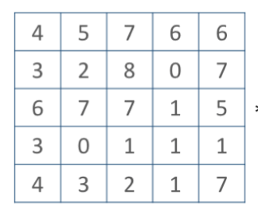
The 2D Convolutional Layer in a Neural Network
Weights
4

Slide 7
The 2D Convolutional Layer in a Neural Network
Weights
4
1

Slide 8
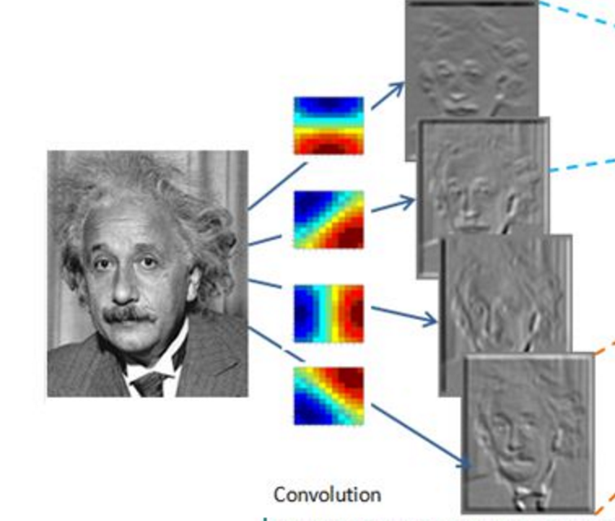
Convolutional Layer (with 4 filters)
weights: 4x1x9x9
Input: 1x224x224
Output: 4x224x224
if zero padding,
and stride = 1

Slide 9
Convolutional Layer (with 4 filters)
weights: 4x1x9x9
Input: 1x224x224
Output: 4x112x112
if zero padding,
but stride = 2

Slide 10
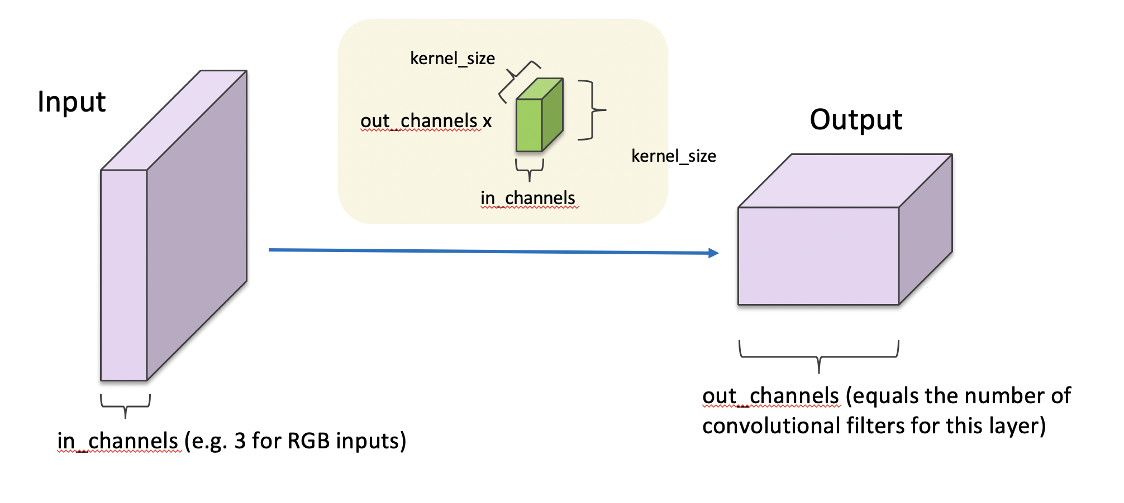
Convolutional Layer in pytorch

Slide 11
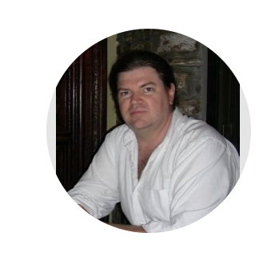
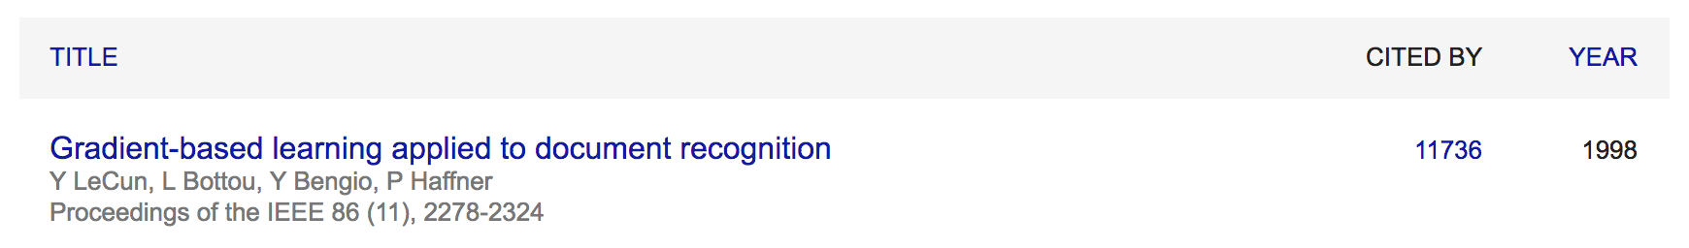
Convolutional Network: LeNet
Yann LeCun

Slide 12
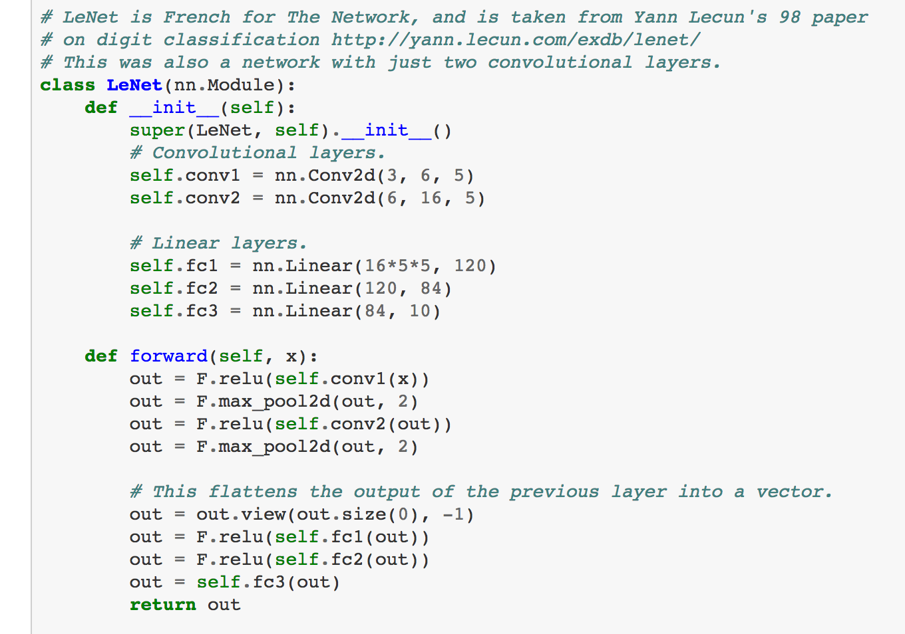
LeNet in Pytorch

Slide 13
SpatialMaxPooling Layer
take the max in this neighborhood
8
8
8
8
8

Slide 14
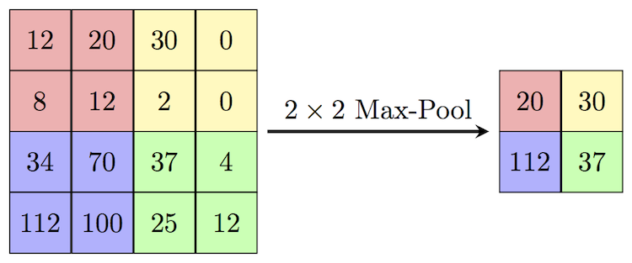
SpatialMaxPooling Layer
https://paperswithcode.com/method/max-pooling

Slide 15
LeNet Summary
2 Convolutional Layers + 3 Linear Layers
+ Non-linear functions: ReLUs or Sigmoids + Max-pooling operations

Slide 16
New Architectures Proposed
Alexnet (Kriszhevsky et al NIPS 2012) [Required Reading]
VGG (Simonyan and Zisserman 2014)
GoogLeNet (Szegedy et al CVPR 2015)
ResNet (He et al CVPR 2016)
DenseNet (Huang et al CVPR 2017)

Slide 17
Convolutional Layers as Matrix Multiplication
https://petewarden.com/2015/04/20/why-gemm-is-at-the-heart-of-deep-learning/

Slide 18
Convolutional Layers as Matrix Multiplication
https://petewarden.com/2015/04/20/why-gemm-is-at-the-heart-of-deep-learning/

Slide 19
Convolutional Layers as Matrix Multiplication
Pros?
Cons?
https://petewarden.com/2015/04/20/why-gemm-is-at-the-heart-of-deep-learning/

Slide 20
CNN Computations are Computationally Expensive
However highly parallelizable
GPU Computing is used in practice
CPU Computing in fact is prohibitive for training these models

Slide 21
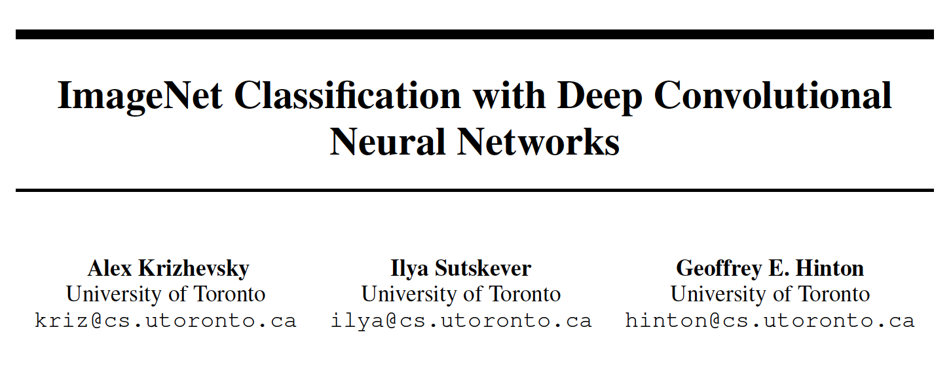
The Alexnet network (Krizhevsky et al NIPS 2012)

Slide 22
The Problem: Classification
Classify an image into 1000 possible classes: e.g. Abyssinian cat, Bulldog, French Terrier, Cormorant, Chickadee,
red fox, banjo, barbell, hourglass, knot, maze, viaduct, etc.
cat, tabby cat (0.71) Egyptian cat (0.22)
red fox (0.11)
…..

Slide 23
The Data: ILSVRC
Imagenet Large Scale Visual Recognition Challenge (ILSVRC): Annual Competition
1000 Categories
~1000 training images per Category
~1 million images in total for training
~50k images for validation
Only images released for the test set but no annotations, evaluation is performed centrally by the organizers (max 2 per week)

Slide 24
The Evaluation Metric: Top K-error
Top-1 error: 1.0
Top-1 accuracy: 0.0
Top-2 error: 1.0
Top-2 accuracy: 0.0
True label: Abyssinian cat
Top-3 error: 1.0
Top-3 accuracy: 0.0
Top-4 error: 0.0
Top-4 accuracy: 1.0
Top-5 error: 0.0
Top-5 accuracy: 1.0
cat, tabby cat (0.61) Egyptian cat (0.22)
red fox (0.11)
Abyssinian cat (0.10)
French terrier (0.03)
…..

Slide 25
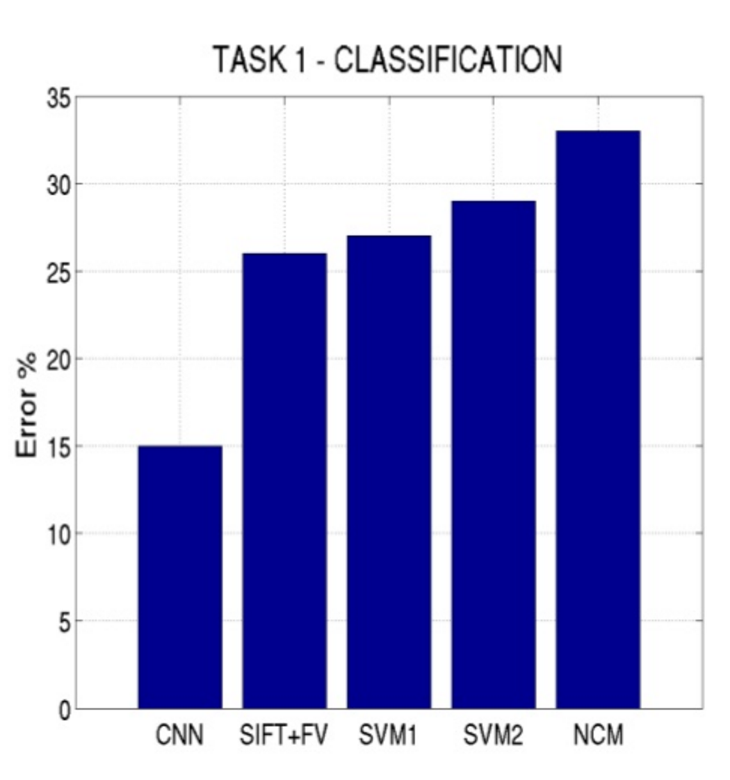
Top-5 error on this competition (2012)

Slide 26
Alexnet
https://www.saagie.com/fr/blog/object-detection-part1

Slide 27
Pytorch Code for Alexnet
In-class analysis https://github.com/pytorch/vision/blob/master/torchvision/models/alexnet.py

Slide 28
Dropout Layer
Srivastava et al 2014

Slide 29
What is happening?
https://www.saagie.com/fr/blog/object-detection-part1

Slide 30
SIFT + FV + SVM (or softmax)
Feature extraction (SIFT)
Feature encoding (Bag of words)
Classification (SVM or softmax)
Deep Learning
Convolutional Neural Network
Classifier (SVM or softmax)

Slide 31
Pre-training
1000 categories 1 million images
Convolutional Neural Network
Classifier
Fine-tuning
20 categories 400 images
Convolutional Neural Network
My Classifier

Slide 32
Preprocessing and Data Augmentation

Slide 33
Preprocessing and Data Augmentation
256
256

Slide 34
Preprocessing and Data Augmentation
224x224

Slide 35
Preprocessing and Data Augmentation
224x224

Slide 36
True label: Abyssinian cat

Slide 37
Other Data Augmentation options
Pytorch: https://pytorch.org/vision/stable/transforms.html
Basic: RandomCrop, RandomResize, RandomHorizontalFlip
Geometric: RandomRotation, RandomPerspective, RandomAffine, etc.
Color: RandomAutoContrast, RandomEqualize, RandomPosterize, etc.
Other: RandomErasing (https://arxiv.org/abs/1708.04896)

Slide 38
Advanced Data Augmentation
MixUp – 2017 (https://arxiv.org/abs/1710.09412)
AutoAugment - 2018 (https://arxiv.org/abs/1805.09501)
RandAugment - 2019 (https://arxiv.org/abs/1909.13719)
CutMix – 2019 (https://arxiv.org/abs/1905.04899)
AugMix – 2019 (https://arxiv.org/abs/1912.02781)
TrivialAugment - 2021 (https://arxiv.org/abs/2103.10158)

Slide 39
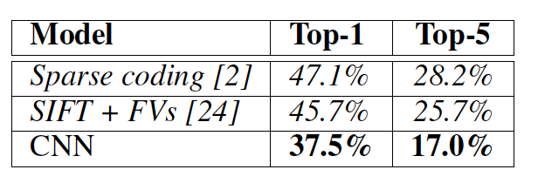
Other Important Aspects
Using ReLUs instead of Sigmoid or Tanh
Momentum + Weight Decay
Dropout (Randomly sets Unit outputs to zero during training)
GPU Computation!

Slide 40
VGG Network
Top-5:
https://github.com/pytorch/vision/blob/master/torchvision/models/vgg.py
Simonyan and Zisserman, 2014.
https://arxiv.org/pdf/1409.1556.pdf

Slide 41
GoogLeNet
https://github.com/kuangliu/pytorch-cifar/blob/master/models/googlenet.py
Szegedy et al. 2014
https://www.cs.unc.edu/~wliu/papers/GoogLeNet.pdf

Slide 42
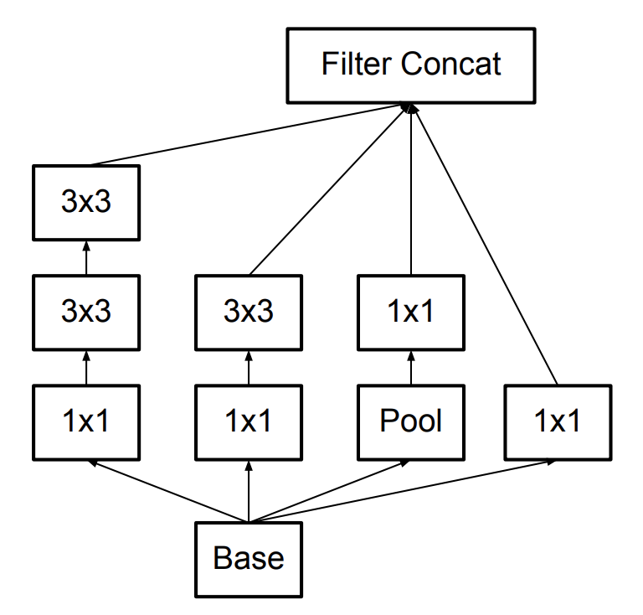
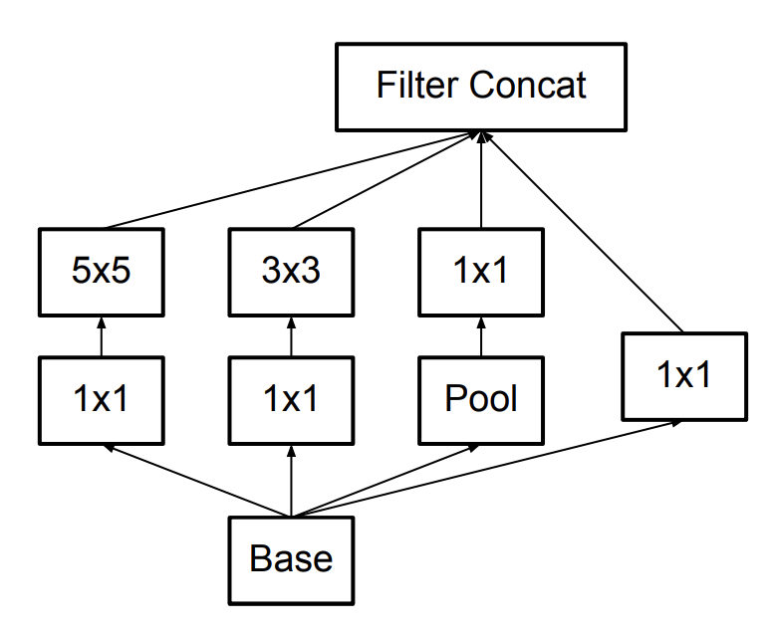
Further Refinements – Inception v3, e.g.
GoogLeNet (Inceptionv1)
Inception v3

Slide 43
BatchNormalization Layer
https://arxiv.org/abs/1502.03167

Slide 44
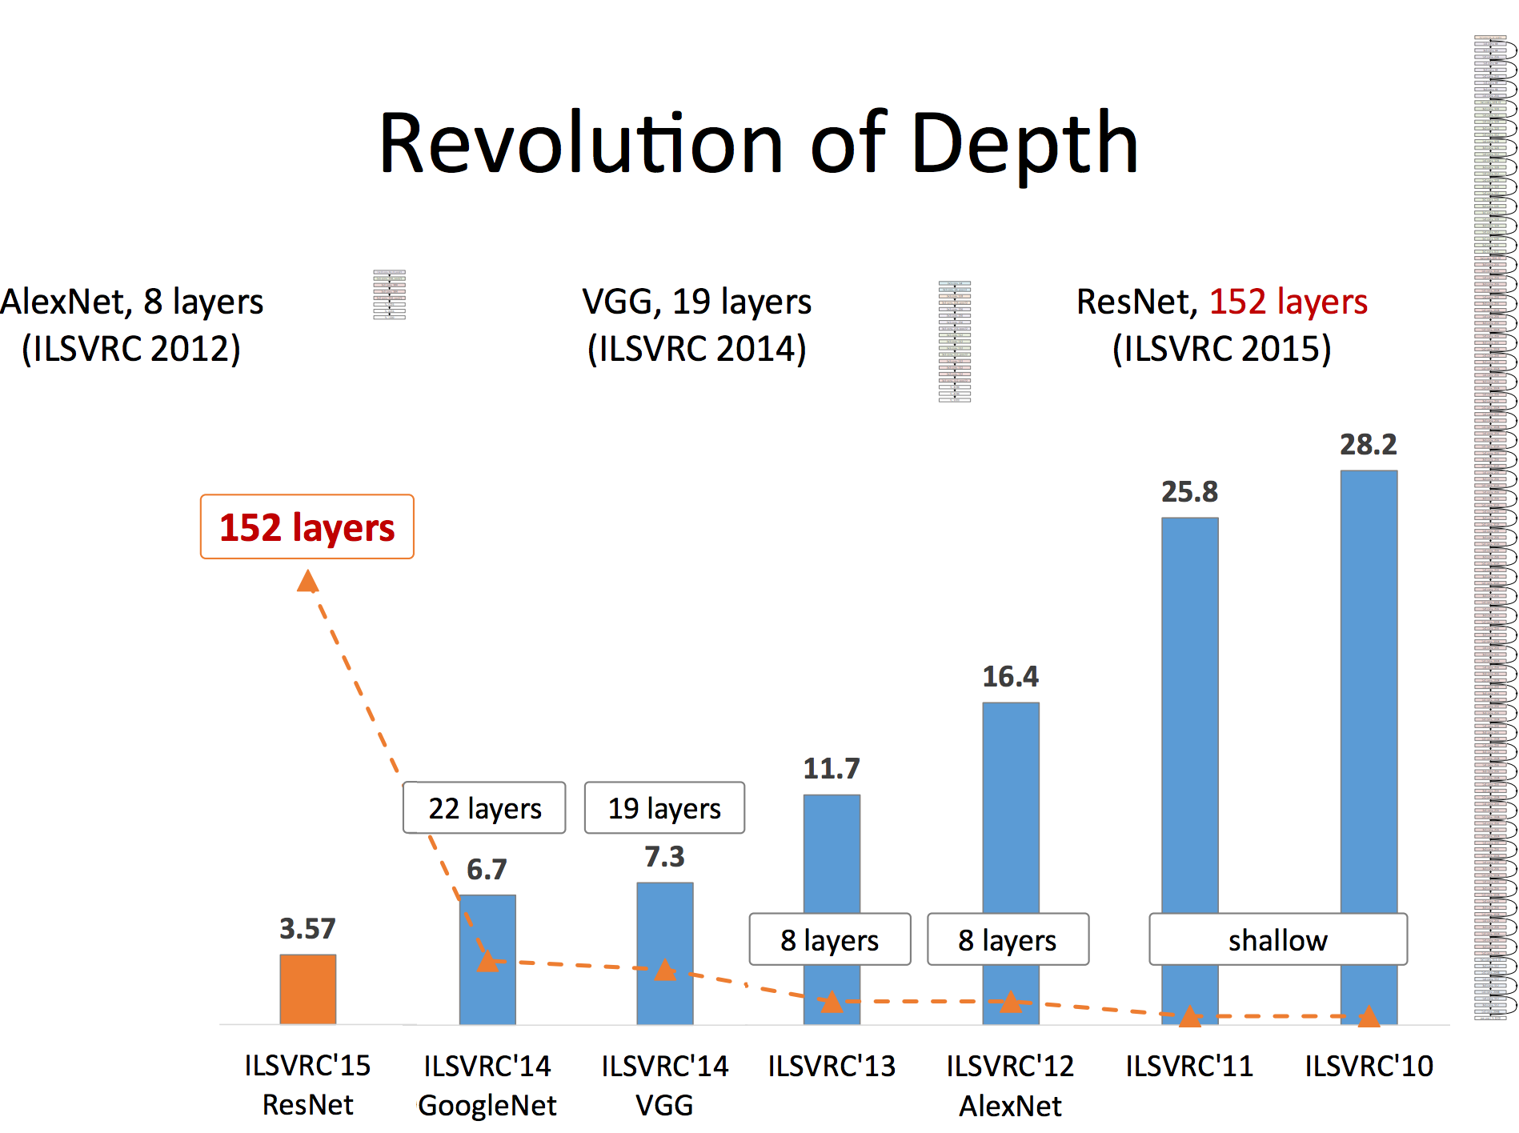
Slide by Mohammad Rastegari

Slide 45
ResNet (He et al CVPR 2016)
Sorry, does not fit in slide.
http://felixlaumon.github.io/assets/kaggle-right-whale/resnet.png
https://github.com/pytorch/vision/blob/master/torchvision/models/resnet.py

Slide 46
More Recent CNNs you can learn
DenseNet - 2016 (Similar to ResNet but all layers connect to all next and previous layers) https://arxiv.org/abs/1608.06993
ResNext – 2016 (Combines ideas from ResNet and InceptionNets https://arxiv.org/abs/1611.05431v2)
NASNet – 2017 (Search the space of possible architectures) https://arxiv.org/abs/1707.07012
EfficientNet – 2019 (Scales up both width and depth of CNNs using a more principled approach) https://arxiv.org/abs/1905.11946
RegNet – 2020 (Paper has a more principled formula to decide on widths and depths) https://arxiv.org/abs/2003.13678
ConvNext – 2022 (Combines many tricks both at the architecture and optimization level) https://arxiv.org/abs/2201.03545

Slide 47
Questions?

