Slide 1
Deep Learning for Vision & Language
Continuation of Segmentation, AutoEncoders, Variational AutoEncoders, Introduction to Diffusion Models

Slide 2
Semantic Segmentation / Image Parsing
deer
cat
trees
grass

Slide 3
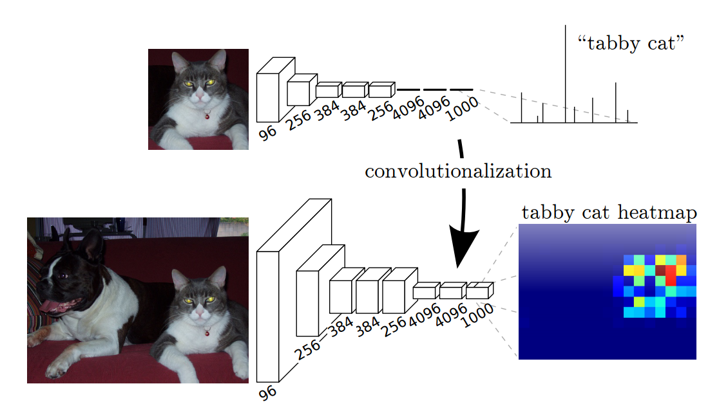
Idea 1: Convolutionalization
However resolution of the segmentation map is low.
https://people.eecs.berkeley.edu/~jonlong/long_shelhamer_fcn.pdf

Slide 4
Alexnet
https://www.saagie.com/fr/blog/object-detection-part1

Slide 5

Idea 1: Convolutionalization
nn.Linear(4096, 1000) == nn.Conv2D(4096, 1000, kernel_size = 1, stride = 1)
$$≡$$

Slide 6
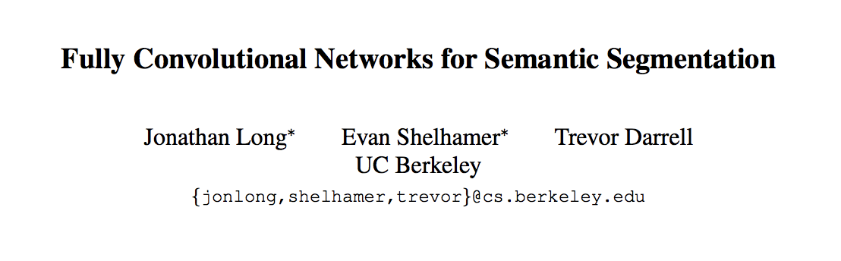
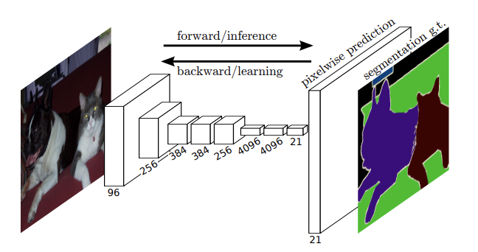
Fully Convolutional Networks (CVPR 2015)

Slide 7
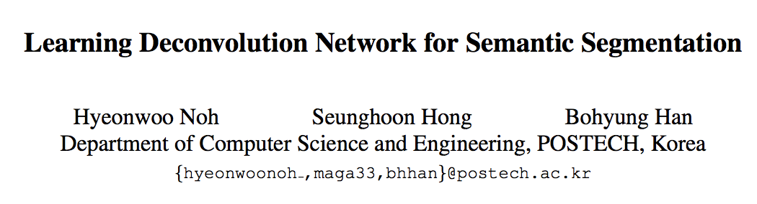
Idea 2: Up-sampling Convolutions or ”Deconvolutions”
http://cvlab.postech.ac.kr/research/deconvnet/

Slide 8
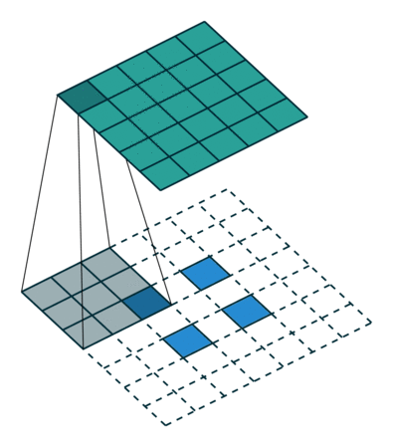
Idea 2: Up-sampling Convolutions or ”Deconvolutions”
https://github.com/vdumoulin/conv_arithmetic

Slide 9
Idea 2: Up-sampling Convolutions or ”Deconvolutions”
Deconvolutional Layers
Upconvolutional Layers
Backwards Strided Convolutional Layers
Fractionally Strided Convolutional Layers
Transposed Convolutional Layers
Spatial Full Convolutional Layers

Slide 10
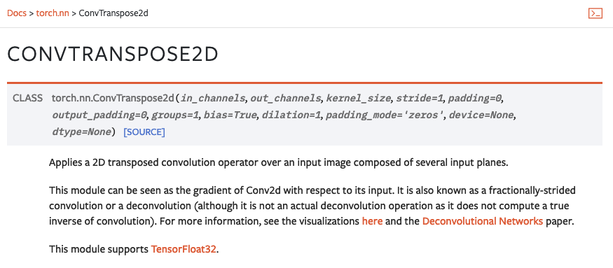
Pytorch

Slide 11
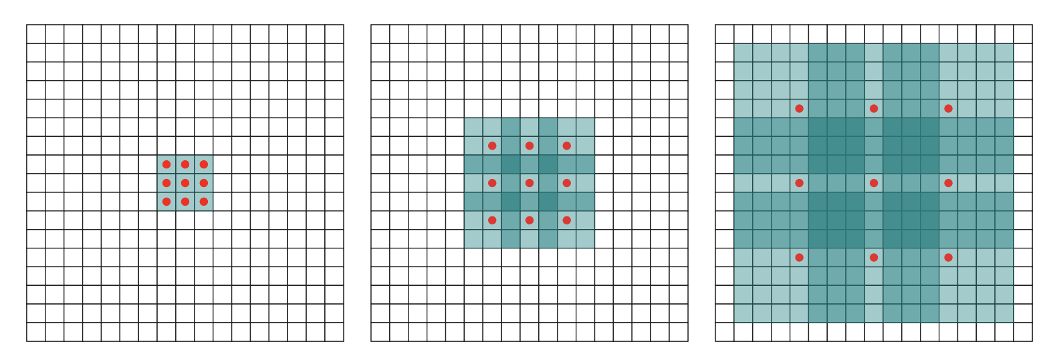
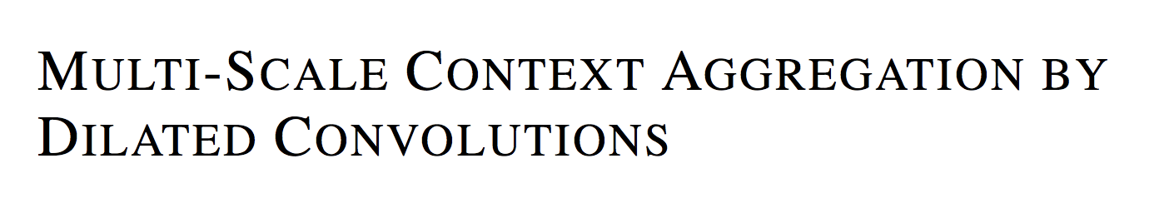
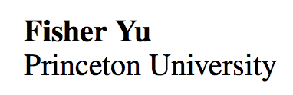
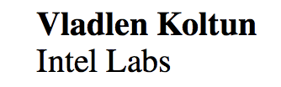
Idea 3: Dilated Convolutions
ICLR 2016

Slide 12
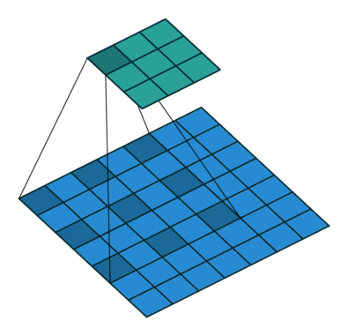
Idea 3: Dilated Convolutions
ICLR 2016

Slide 13
Convolutional Layer in pytorch
kernel_size
Input
out_channels x
Output
kernel_size
in_channels
out_channels (equals the number of convolutional filters for this layer)
in_channels (e.g. 3 for RGB inputs)

Slide 14
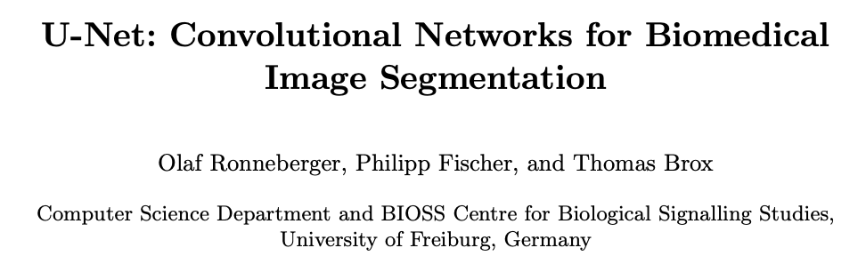
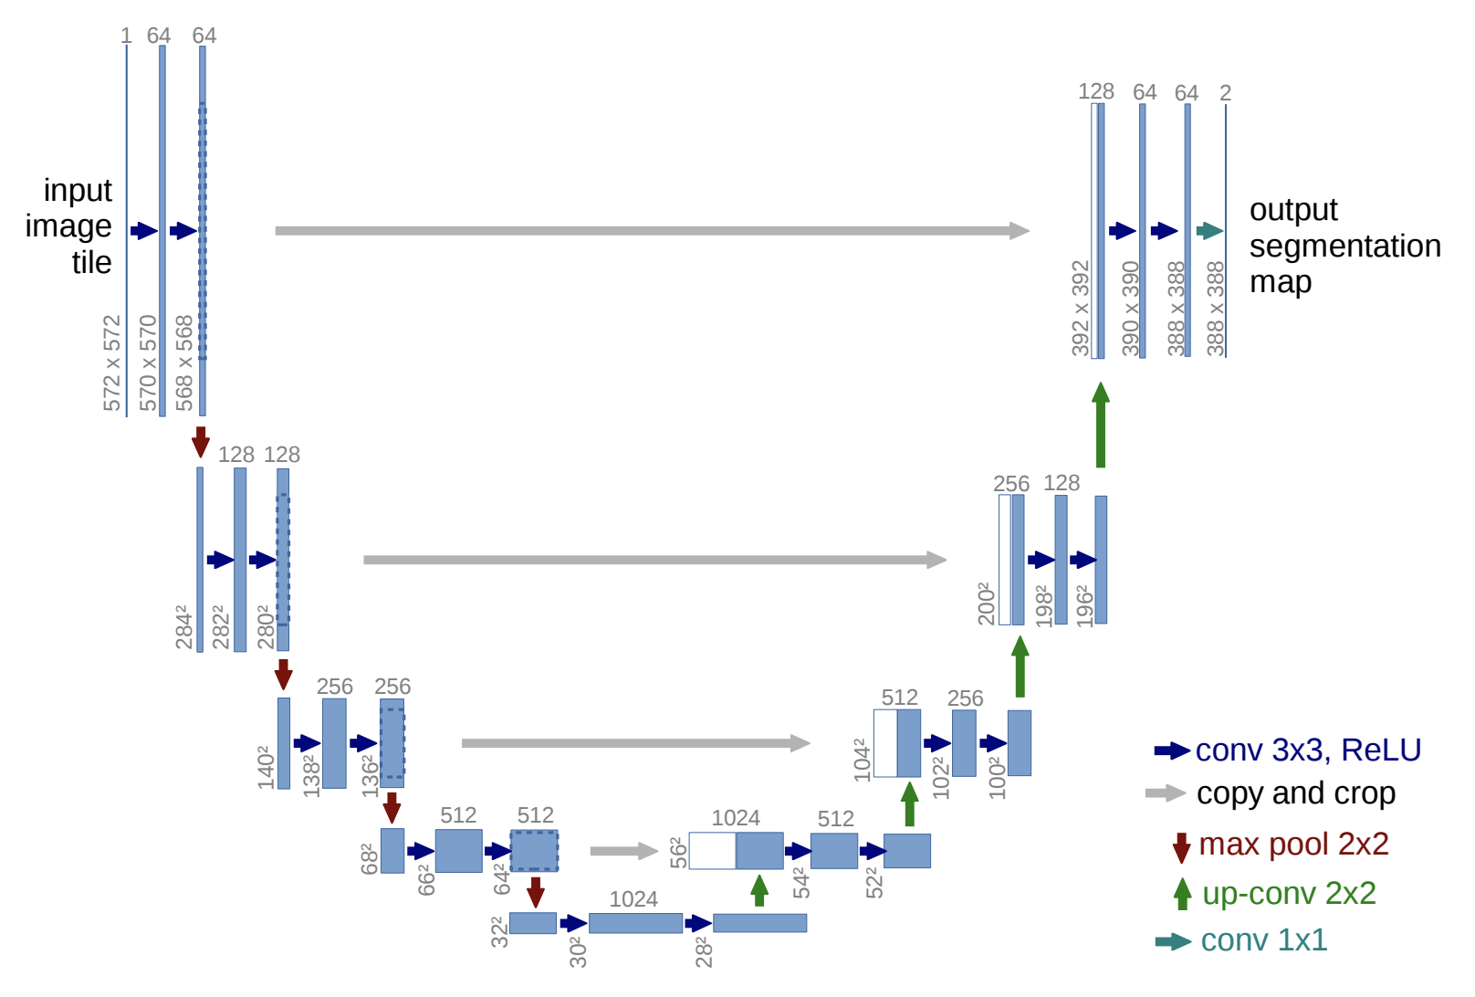
https://arxiv.org/abs/1505.04597
https://github.com/milesial/Pytorch-UNet
https://github.com/usuyama/pytorch-unet

Slide 15
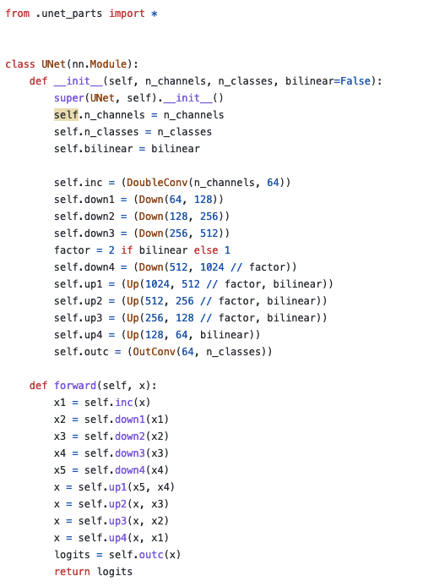
UNet in Pytorch
https://github.com/milesial/Pytorch-UNet/blob/master/unet/unet_model.py

Slide 16
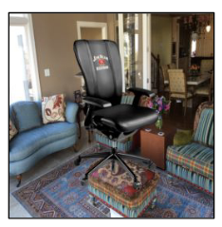

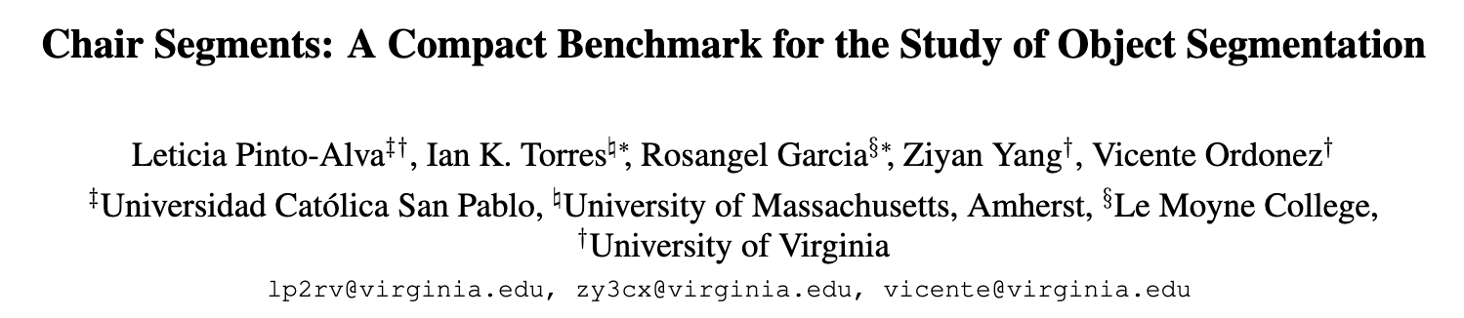
Chair segmentation - Training

Slide 17
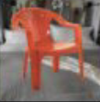
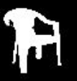
Chair segmentation - Prediction

Slide 18
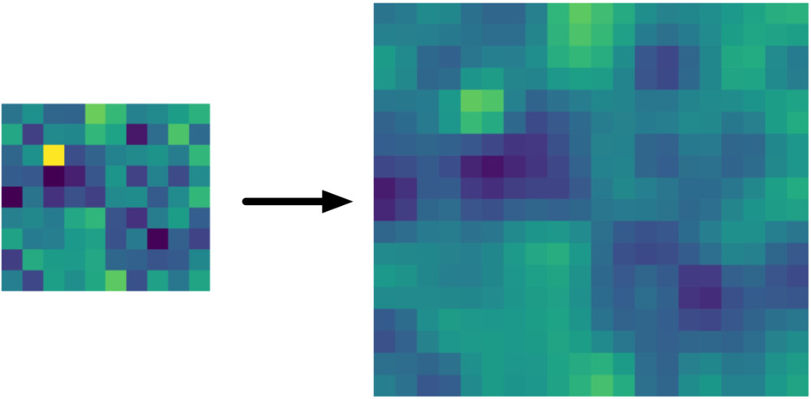
Bilinear Upsampling Layer
https://machinethink.net/blog/coreml-upsampling/

Slide 19
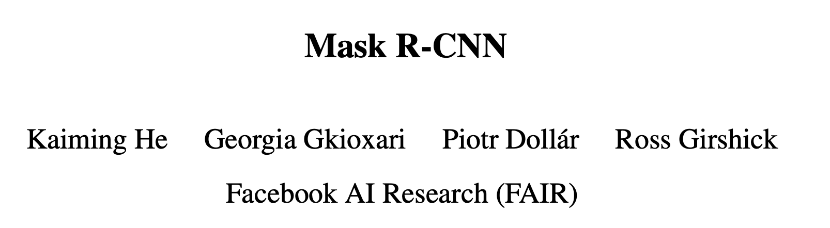
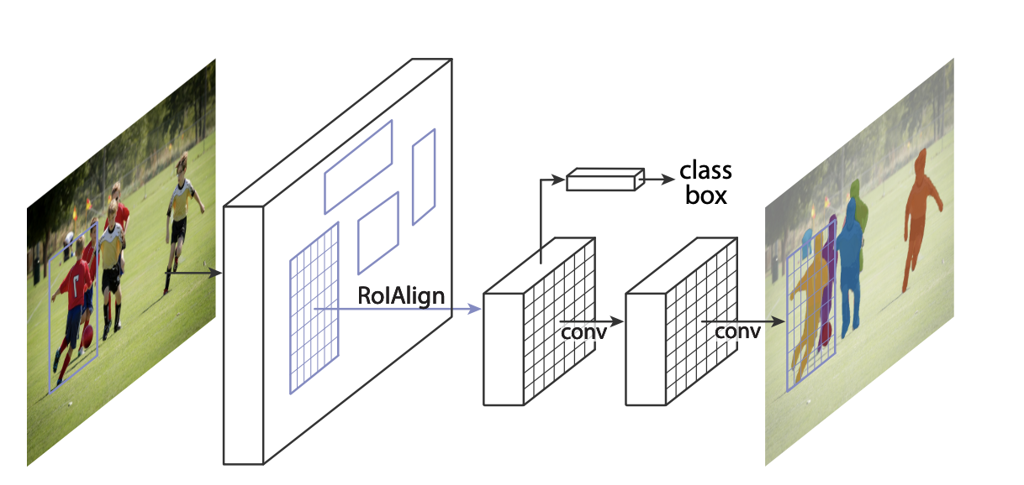
https://github.com/facebookresearch/detectron2
https://arxiv.org/abs/1703.06870

Slide 20
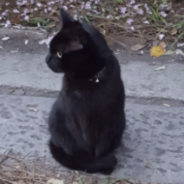
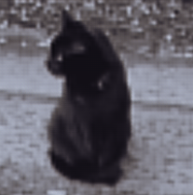
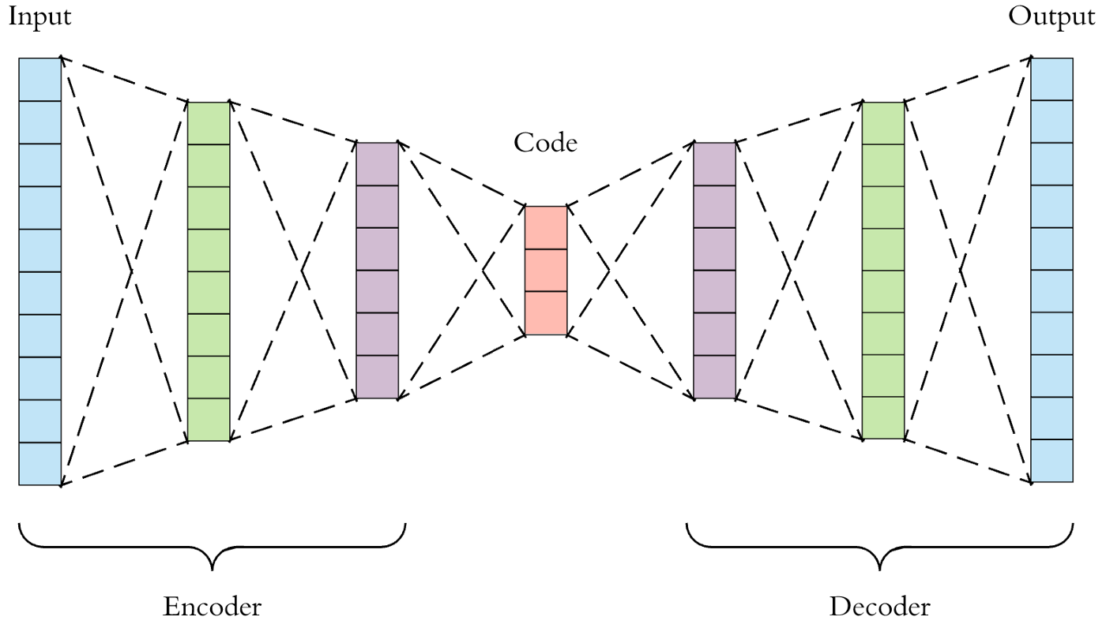
AutoEncoder Models (Downsample, Upsample)

Slide 21
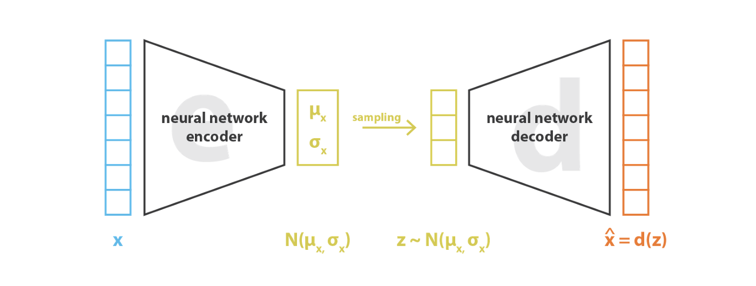

Variational AutoEncoders (VAE)
https://pytorch.org/docs/stable/generated/torch.normal.html
https://ai.stackexchange.com/questions/30176/are-mean-and-standard-deviation-in-variational-autoencoders-unique

Slide 22

Reparameterization “trick”
https://pytorch.org/docs/stable/generated/torch.normal.html
https://ai.stackexchange.com/questions/30176/are-mean-and-standard-deviation-in-variational-autoencoders-unique

Slide 23
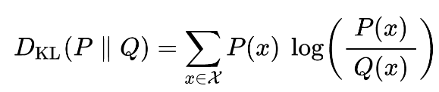
Kullback-Leibler Divergence

Slide 24
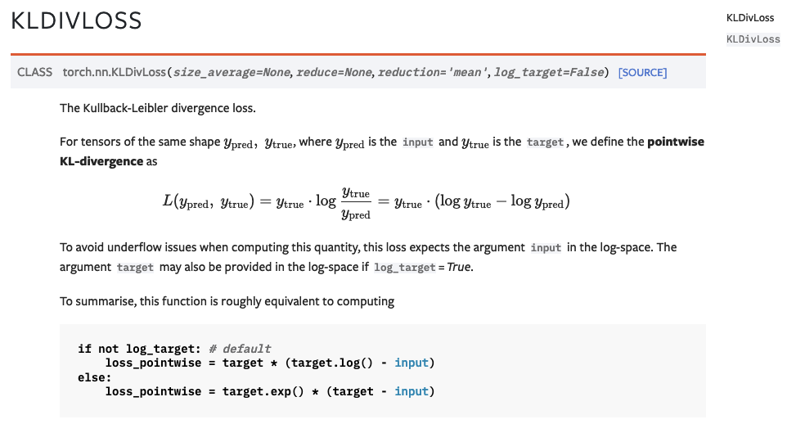

Slide 25
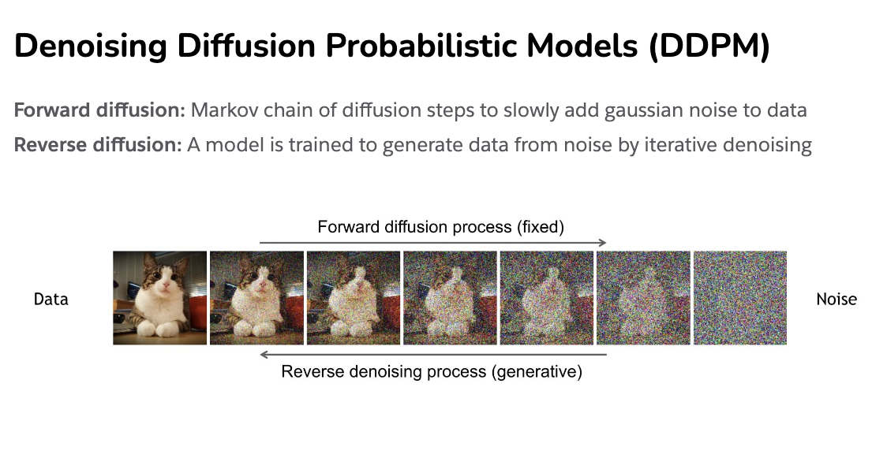
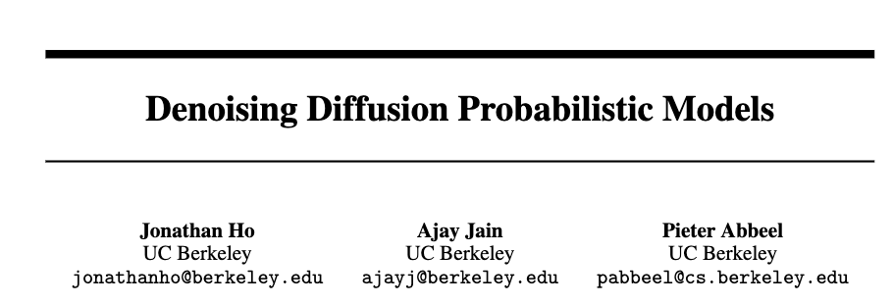
Diffusion Process
https://cvpr2022-tutorial-diffusion-models.github.io/
Slides compiled by my student Aman Shrivastava

Slide 26
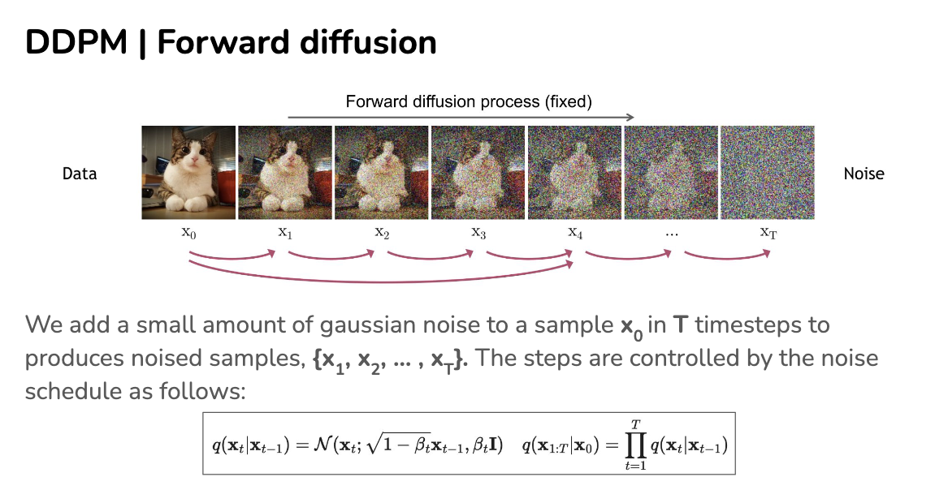
https://cvpr2022-tutorial-diffusion-models.github.io/

Slide 27
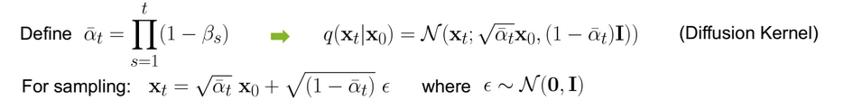

Slide 28
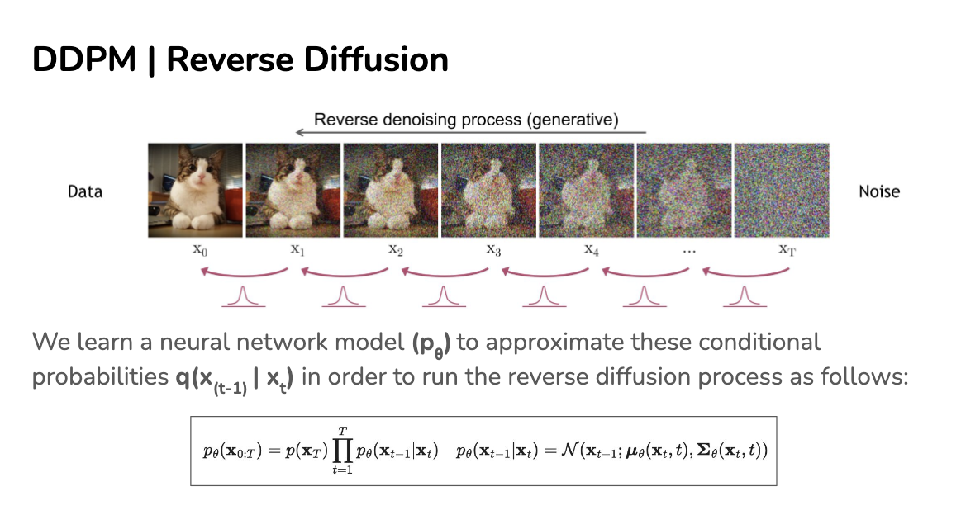
https://cvpr2022-tutorial-diffusion-models.github.io/

Slide 29
https://cvpr2022-tutorial-diffusion-models.github.io/

Slide 30
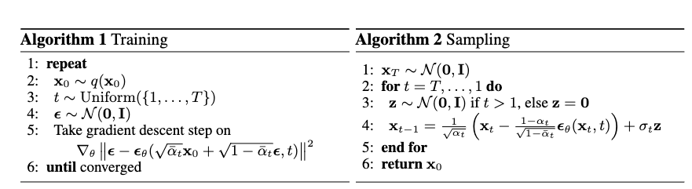
How do we train?
https://cvpr2022-tutorial-diffusion-models.github.io/

Slide 31
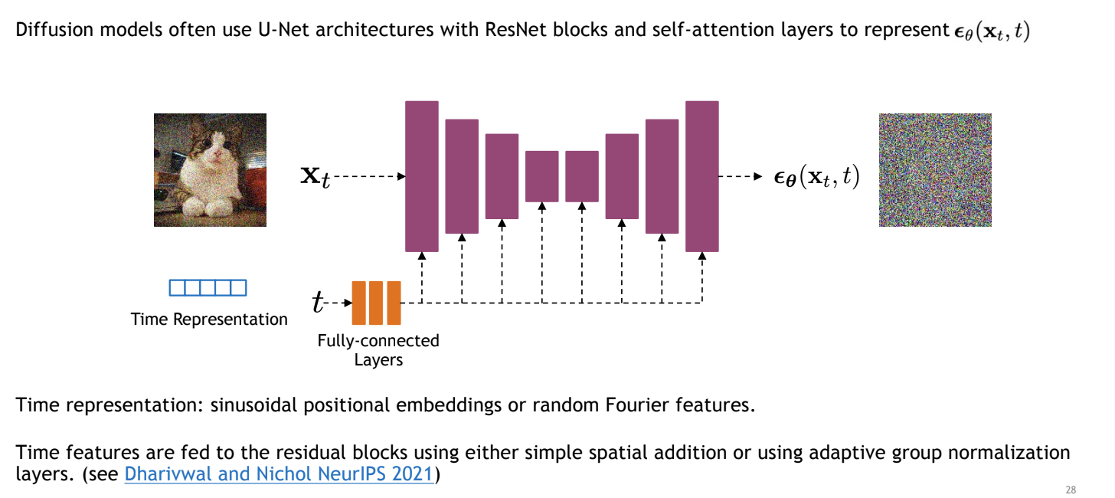
Unet to model transition
https://cvpr2022-tutorial-diffusion-models.github.io/

Slide 32
How do we train?
https://cvpr2022-tutorial-diffusion-models.github.io/

Slide 33
How do we train?
https://cvpr2022-tutorial-diffusion-models.github.io/

Slide 34
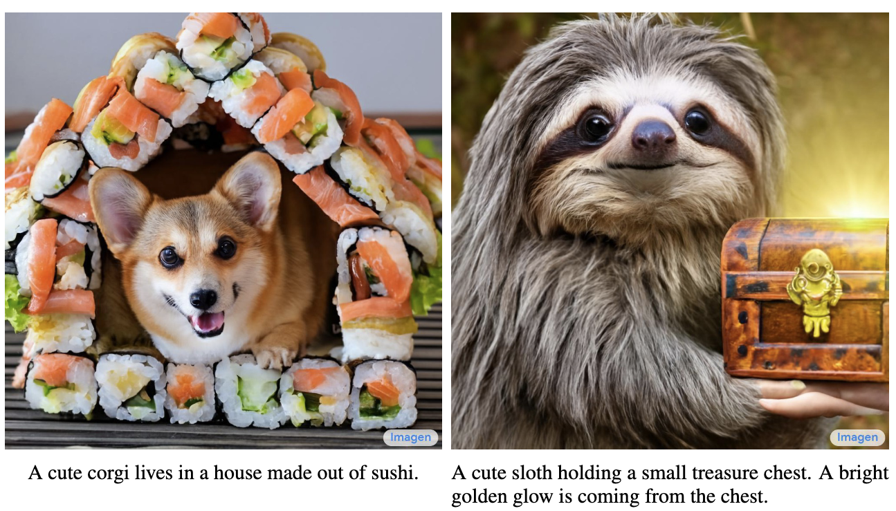
Imagen by Google

Slide 35
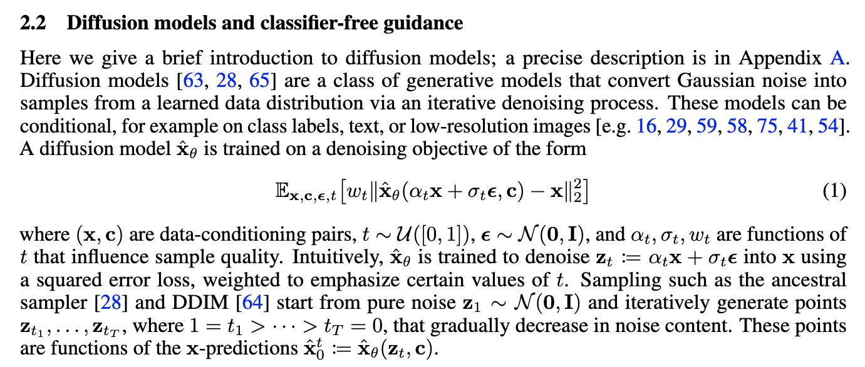
Imagen by Google
https://arxiv.org/pdf/2205.11487.pdf

Slide 37
Questions

