Slide 1
Deep Learning for Vision & Language
Diffusion Models II

Slide 2
Last Class
Text to image Models
Sequence-to-sequence based text-to-image models
Detour: Style Transfer – Input Feature Optimization.
Today:
Reverse Diffusion Models
Other Topics

Slide 3
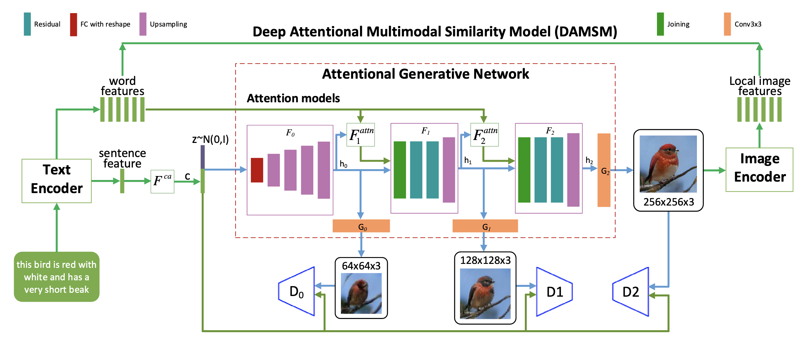
(1) Hierarchical Conditional GANs / Text-conditioned (AttnGAN)

Slide 4
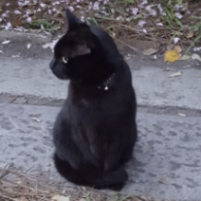
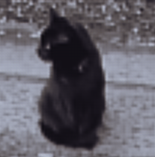
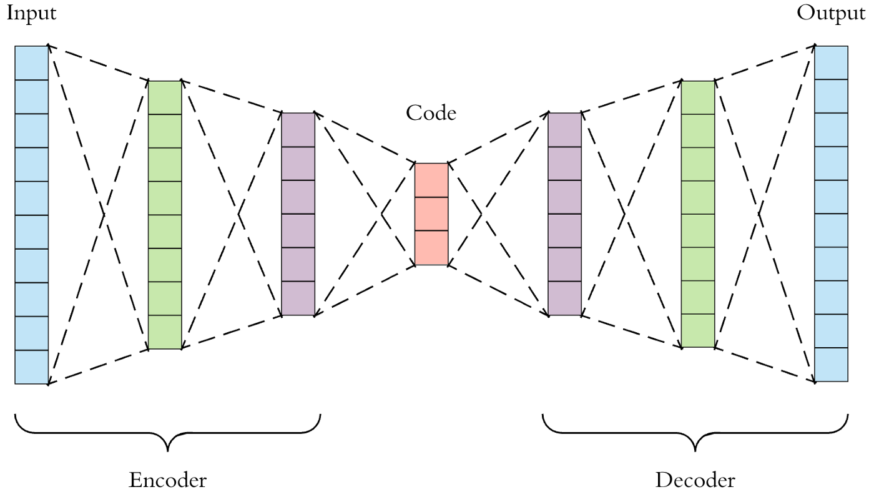
AutoEncoder Models

Slide 5
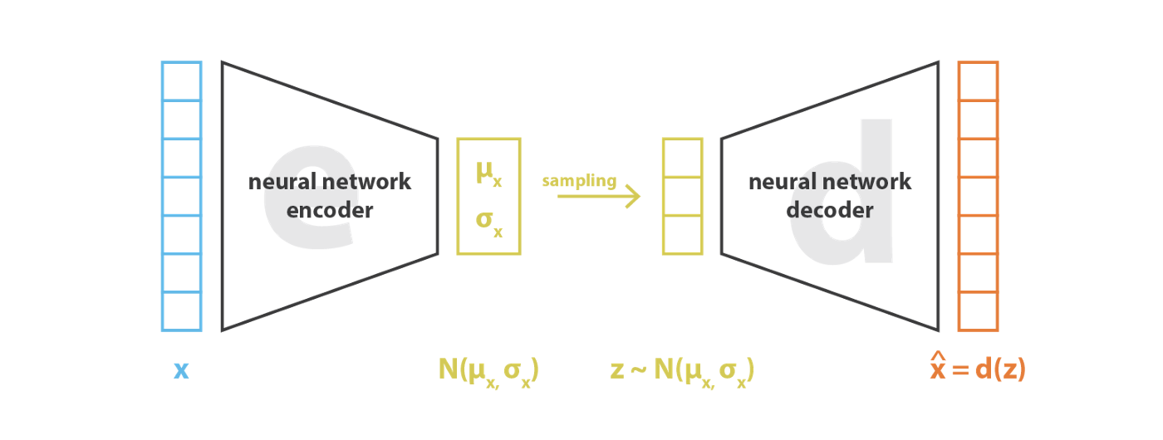

Variational AutoEncoder (VAE)
https://pytorch.org/docs/stable/generated/torch.normal.html
https://ai.stackexchange.com/questions/30176/are-mean-and-standard-deviation-in-variational-autoencoders-unique

Slide 6
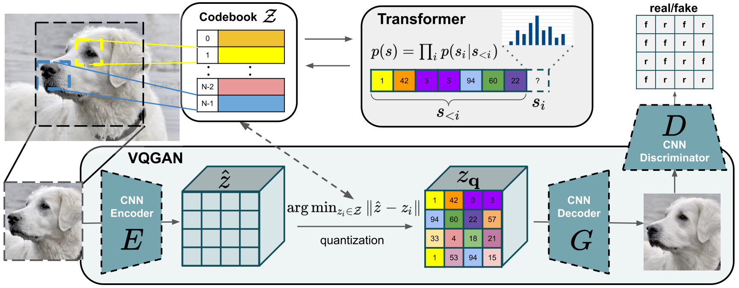
Vector Quantized - GAN
https://arxiv.org/abs/2012.09841
https://arxiv.org/pdf/2110.04627.pdf

Slide 7
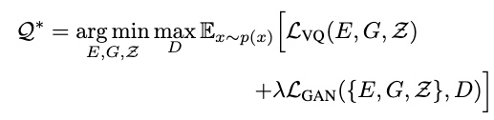

Vector Quantized GAN (VQGAN)
https://arxiv.org/abs/2012.09841
https://arxiv.org/pdf/2110.04627.pdf

Slide 8
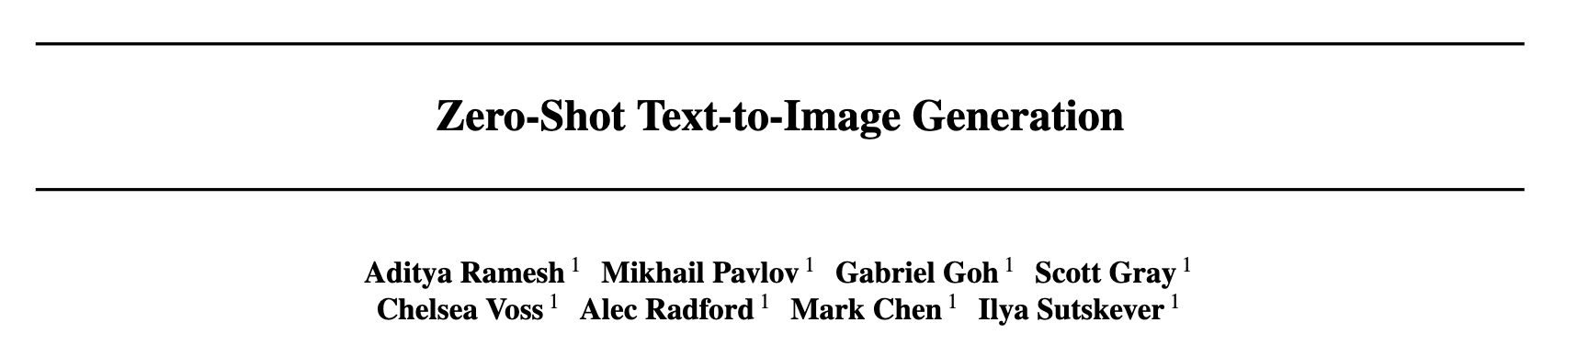
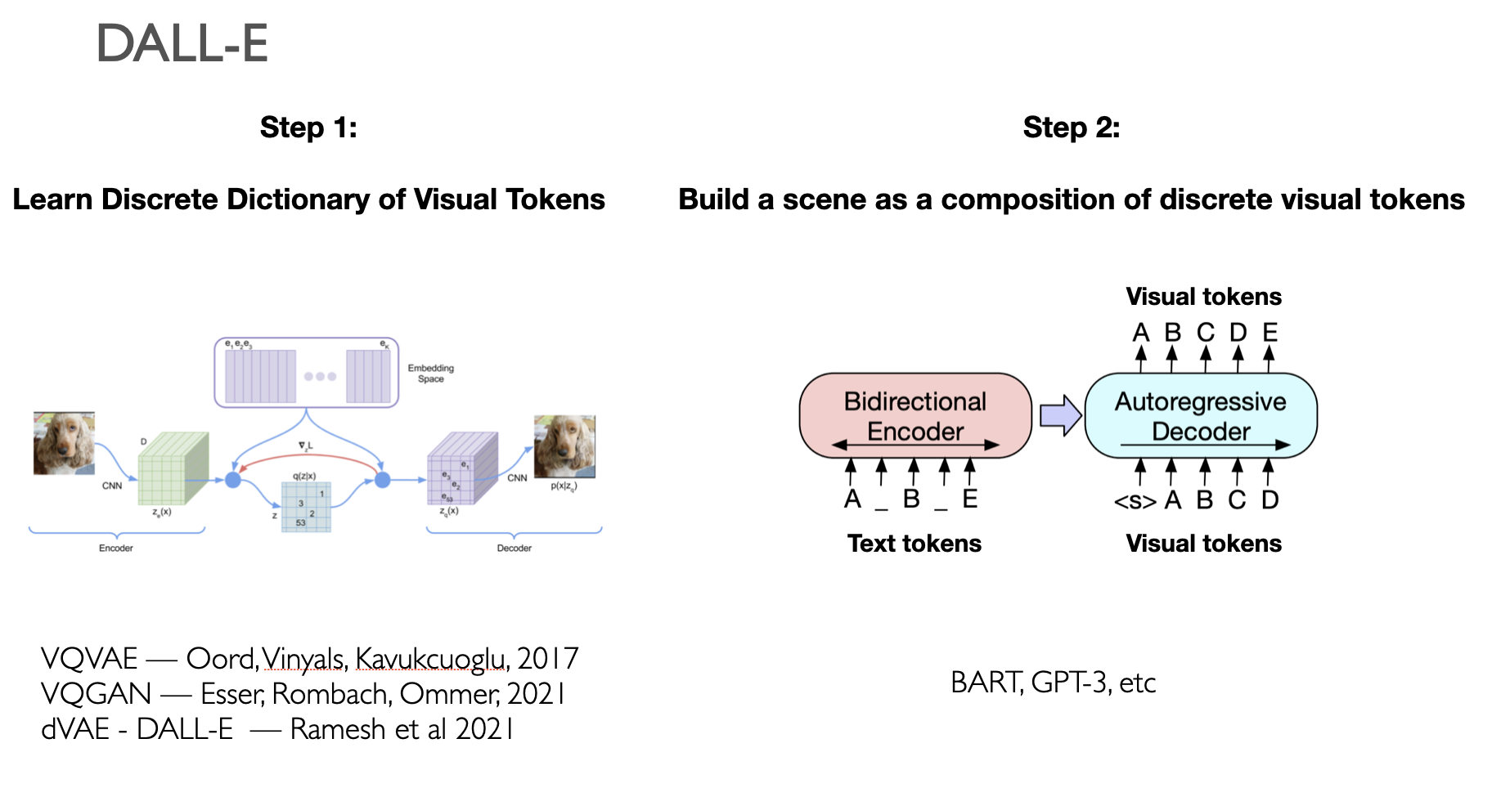
DALL-E (v1)
OpenAI Feb 2021

Slide 9
DALL-E (v1)

Slide 10
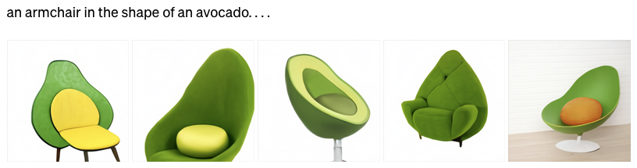

Slide 13
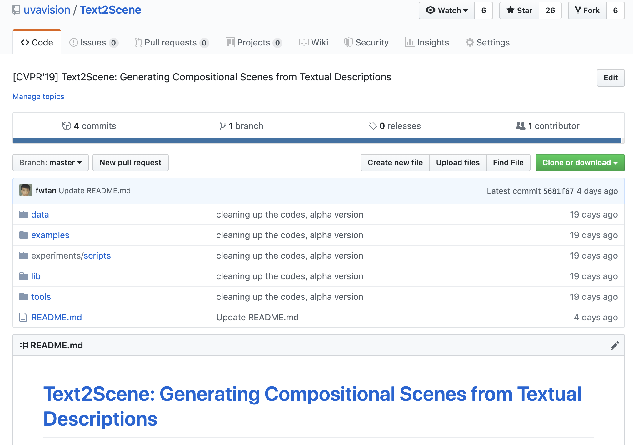
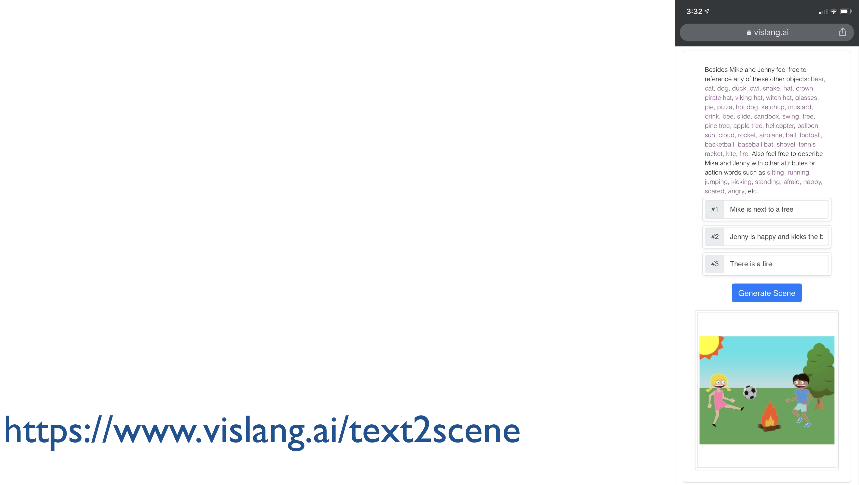

Slide 16
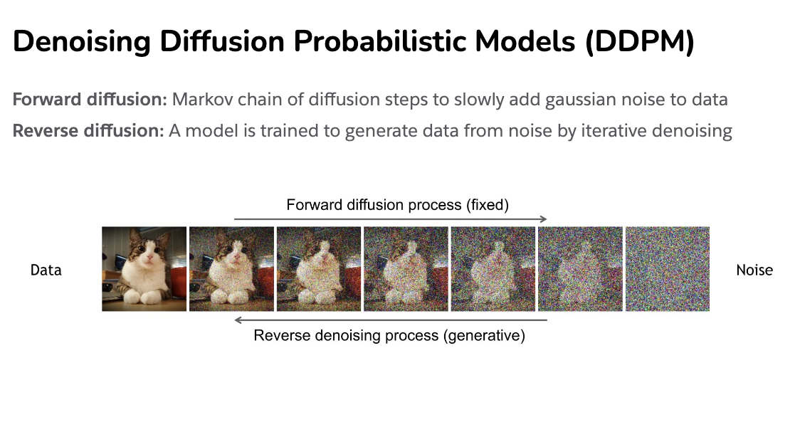
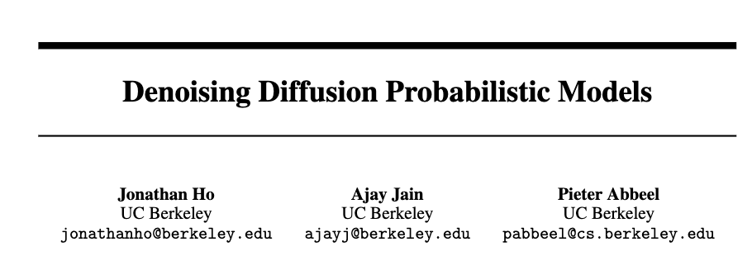
Diffusion Process
https://cvpr2022-tutorial-diffusion-models.github.io/
Slides compiled by my student Aman Shrivastava

Slide 17
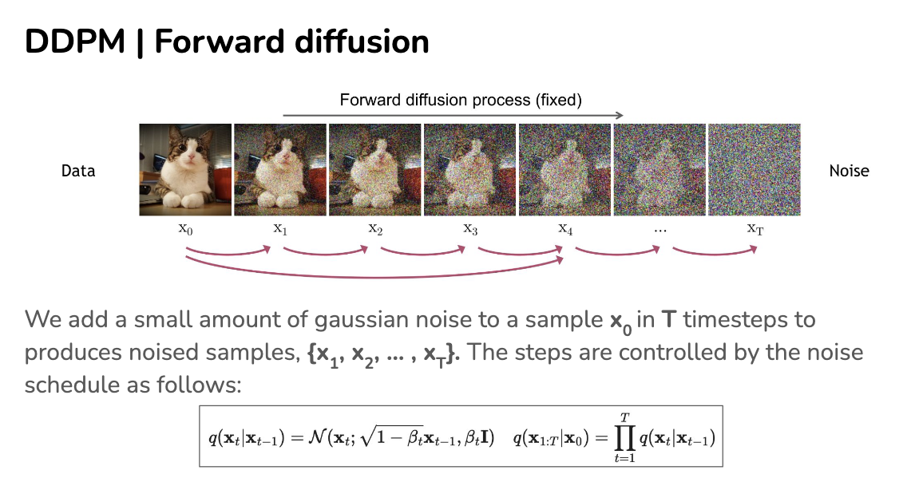
https://cvpr2022-tutorial-diffusion-models.github.io/

Slide 18
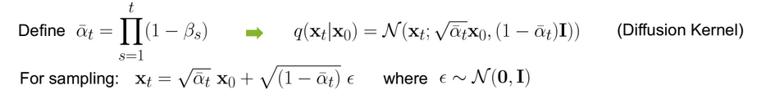

Slide 19
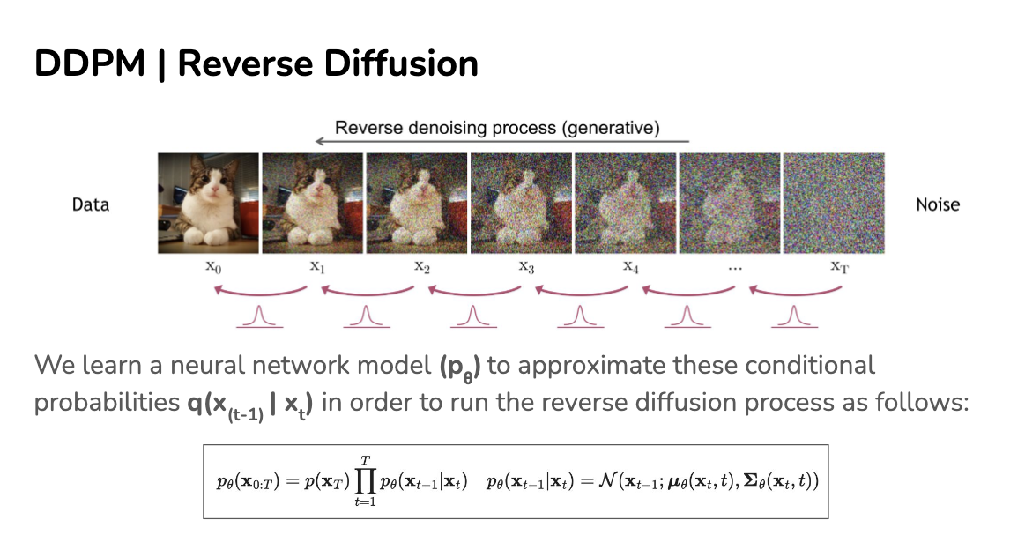
https://cvpr2022-tutorial-diffusion-models.github.io/

Slide 20
https://cvpr2022-tutorial-diffusion-models.github.io/

Slide 21





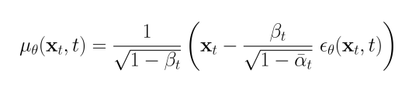
U-Net
Objective:
Given that:

Slide 22
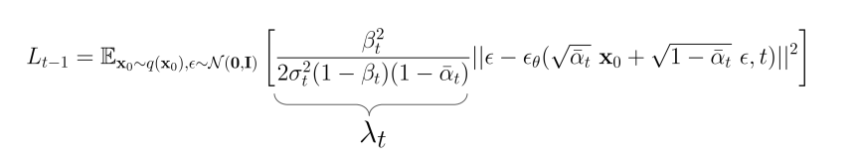
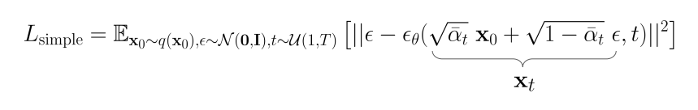
Replacing on the equation
Used in practice:

Slide 23
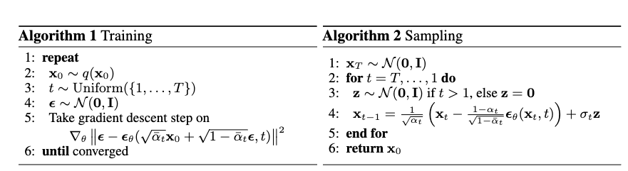
How do we train?
https://cvpr2022-tutorial-diffusion-models.github.io/

Slide 24
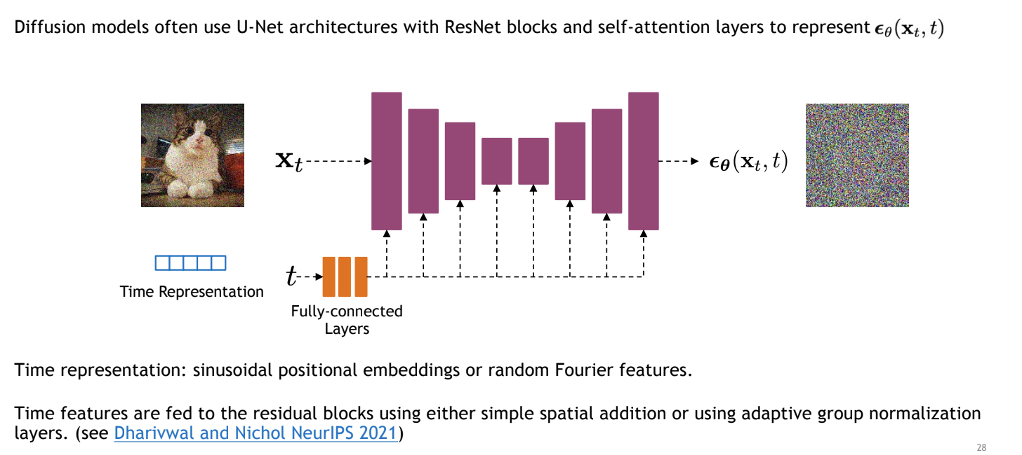
Unet to model transition
https://cvpr2022-tutorial-diffusion-models.github.io/

Slide 25
How do we train?
https://cvpr2022-tutorial-diffusion-models.github.io/

Slide 26
How do we train?
https://cvpr2022-tutorial-diffusion-models.github.io/

Slide 27
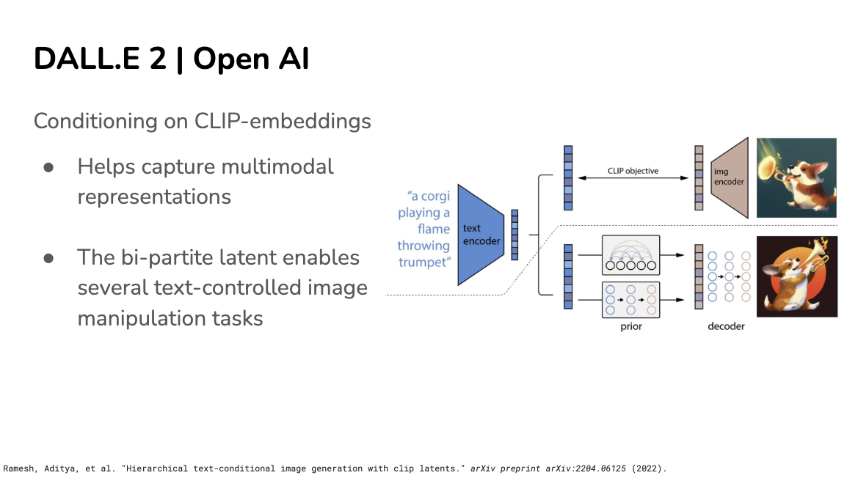

Slide 28
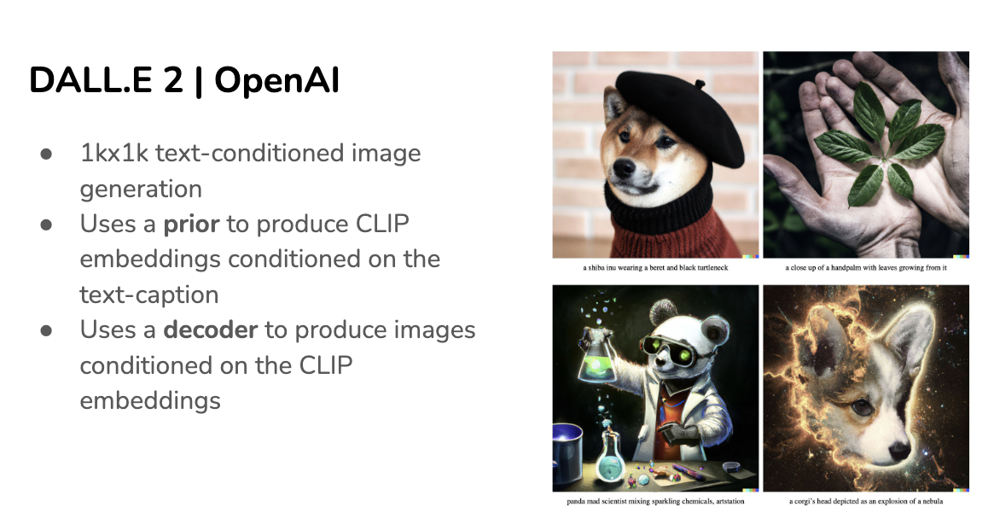
Slides compiled by my student Aman Shrivastava
https://cvpr2022-tutorial-diffusion-models.github.io/

Slide 29
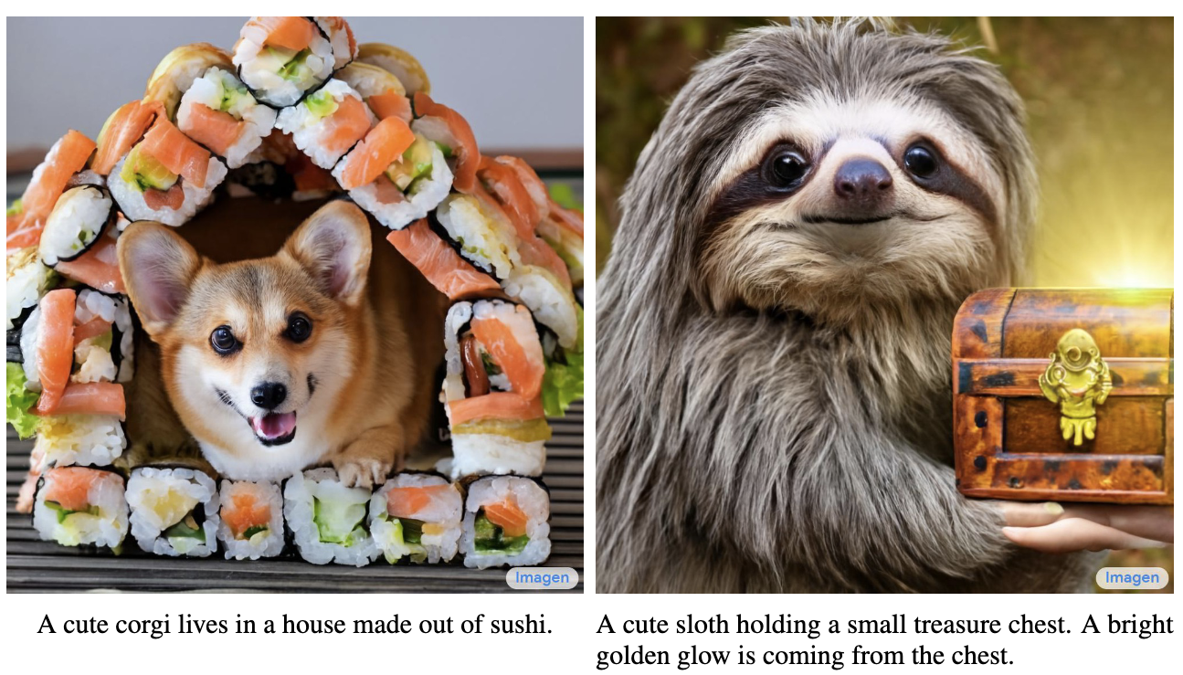
Imagen by Google

Slide 30
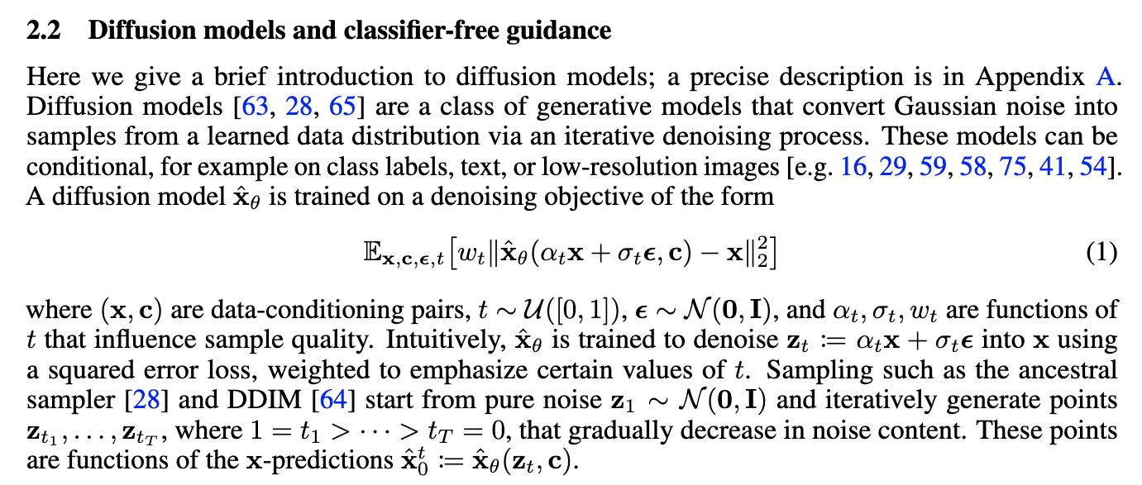
Imagen by Google
https://arxiv.org/pdf/2205.11487.pdf

Slide 31
Now
Stable Diffusion: Diffusion in the Latent Space
DALLE-3: Larger Model, Larger Resolution, Recaptioned Data
SORA: Text-to-Video Generation
Stable Diffusion Video
Other modalities: Audio, Audio+Video

Slide 32
Questions

