Slide 1
Deep Learning for Vision & Language
Other Topics

Slide 2
Today
GradCAM: Explaining Predictions
ALBEF
ALBEF + AMC
Two-step Optimization for Object Detection
Visual Question Answering: General Framework
Mobile UI Navigation: Spotlight

Slide 3
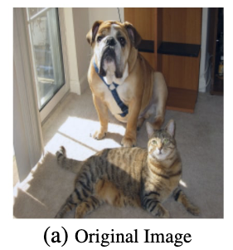
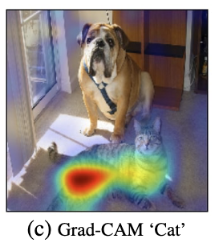
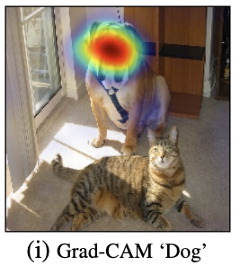
Explainability: GradCAM
https://arxiv.org/abs/1610.02391

Slide 4
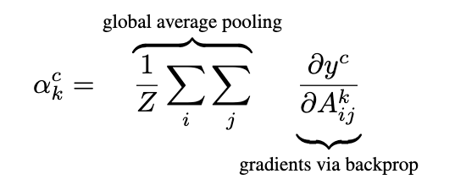
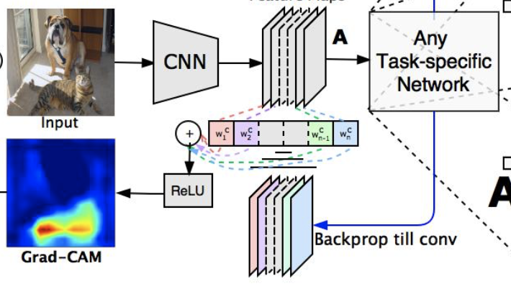
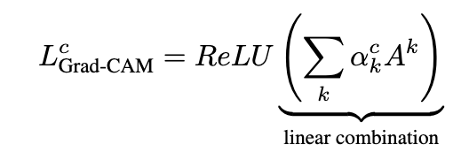
Explainability: GradCAM (2017)
https://arxiv.org/abs/1610.02391

Slide 5
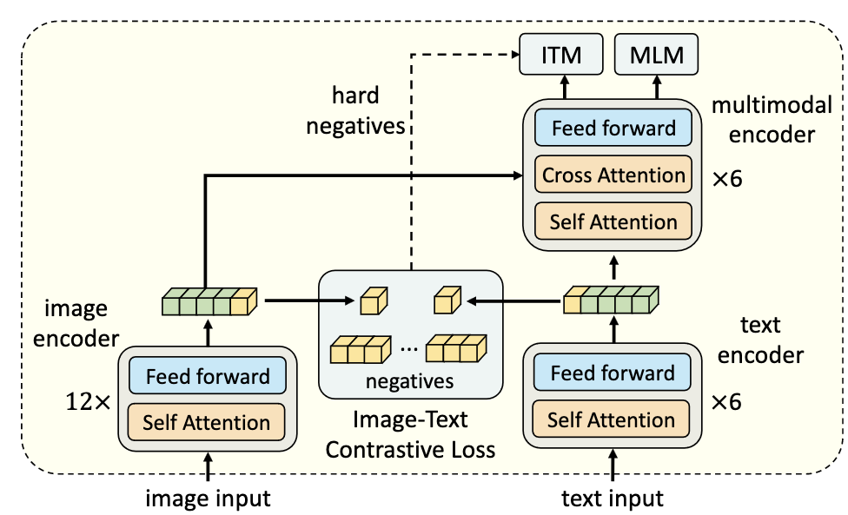
Explainability with Vision-Language Models Case Study: The ALBEF model
https://arxiv.org/pdf/2107.07651.pdf

Slide 6
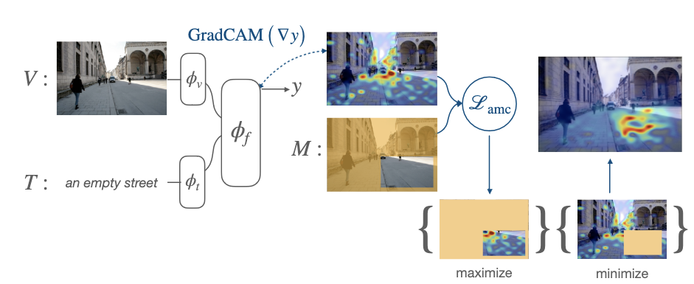
Attention Mask Consistency (AMC)
https://arxiv.org/abs/2206.15462

Slide 7
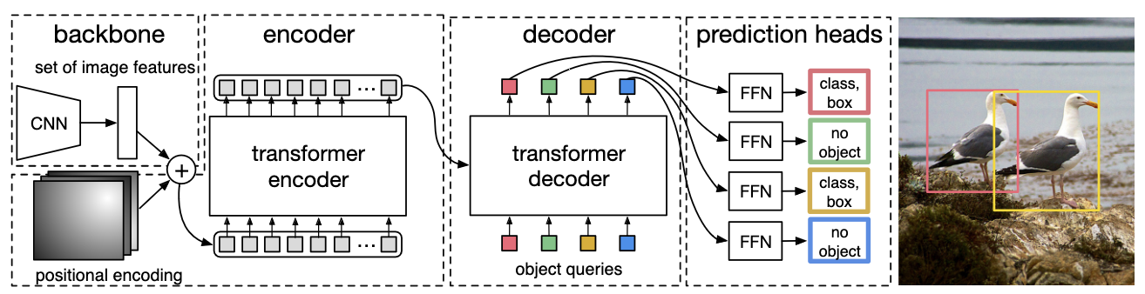
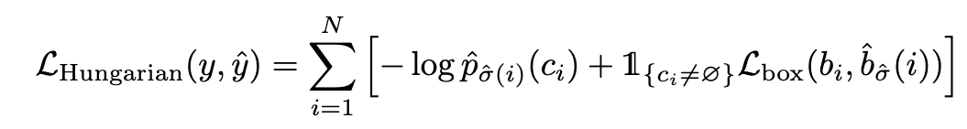
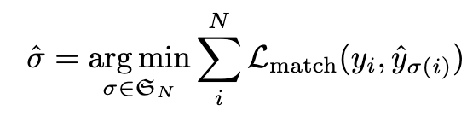
Object Detection with Transfromers (DETR) (2020)
where
https://arxiv.org/abs/2005.12872
https://github.com/facebookresearch/detr

Slide 8
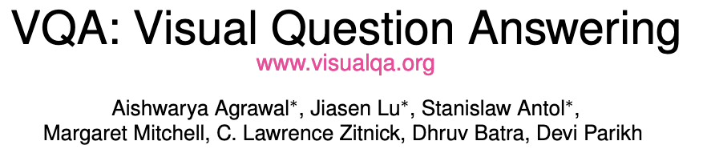
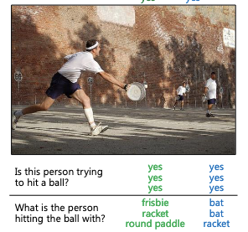
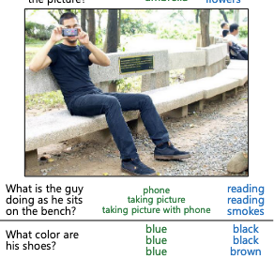

Slide 9
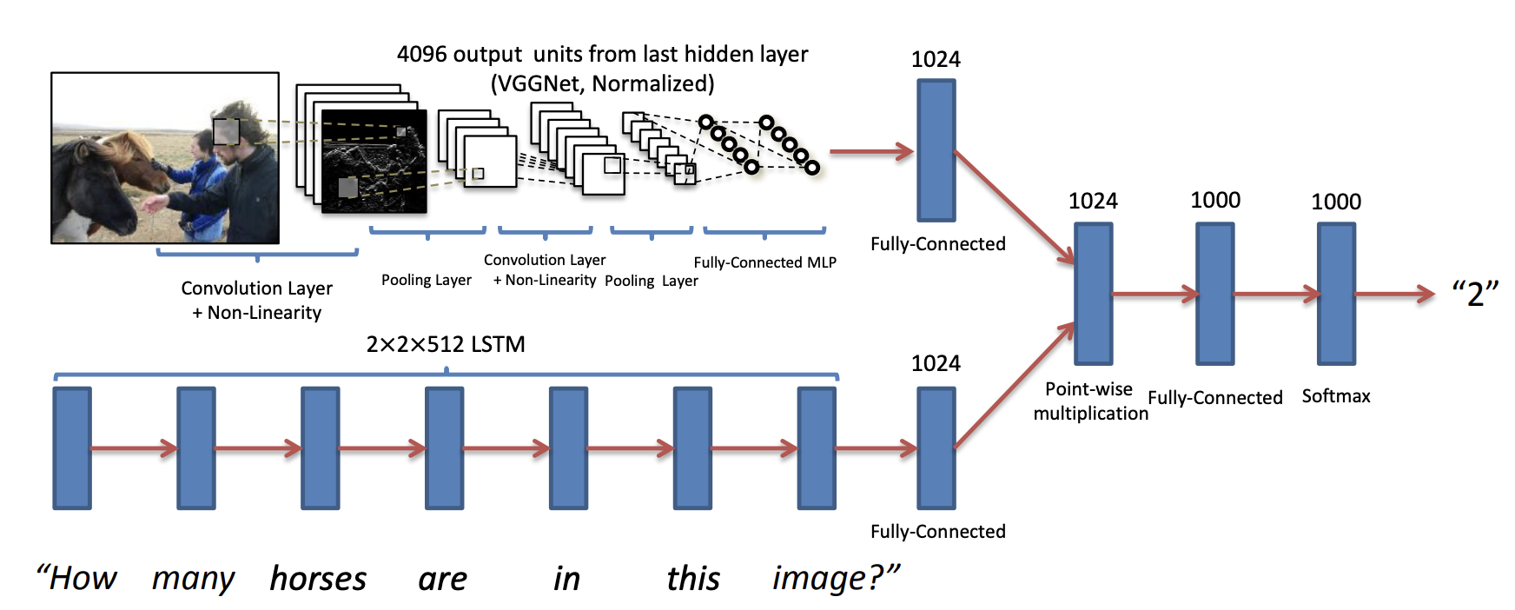
Visually Grounded Question Answering
https://arxiv.org/pdf/1505.00468.pdf

Slide 10
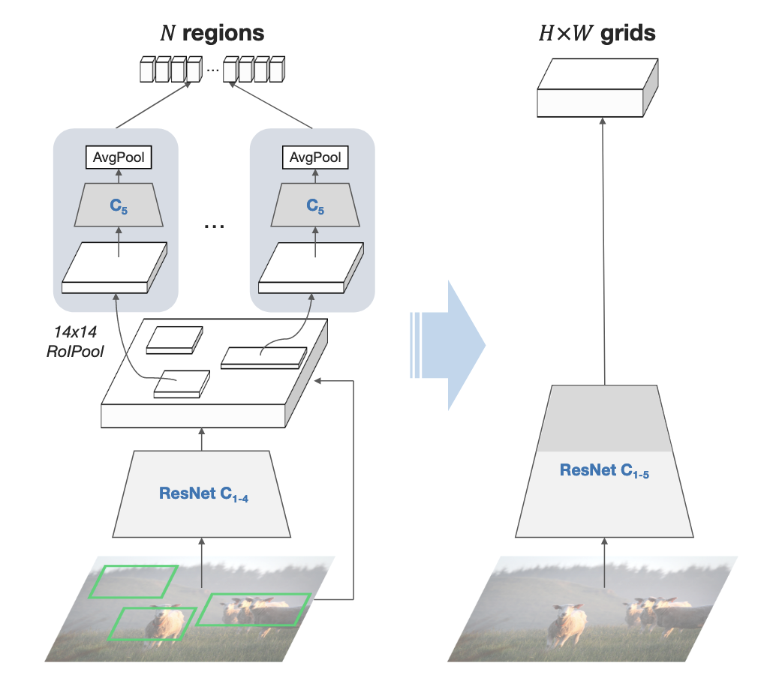
What Features to use as input visual features?

Slide 11

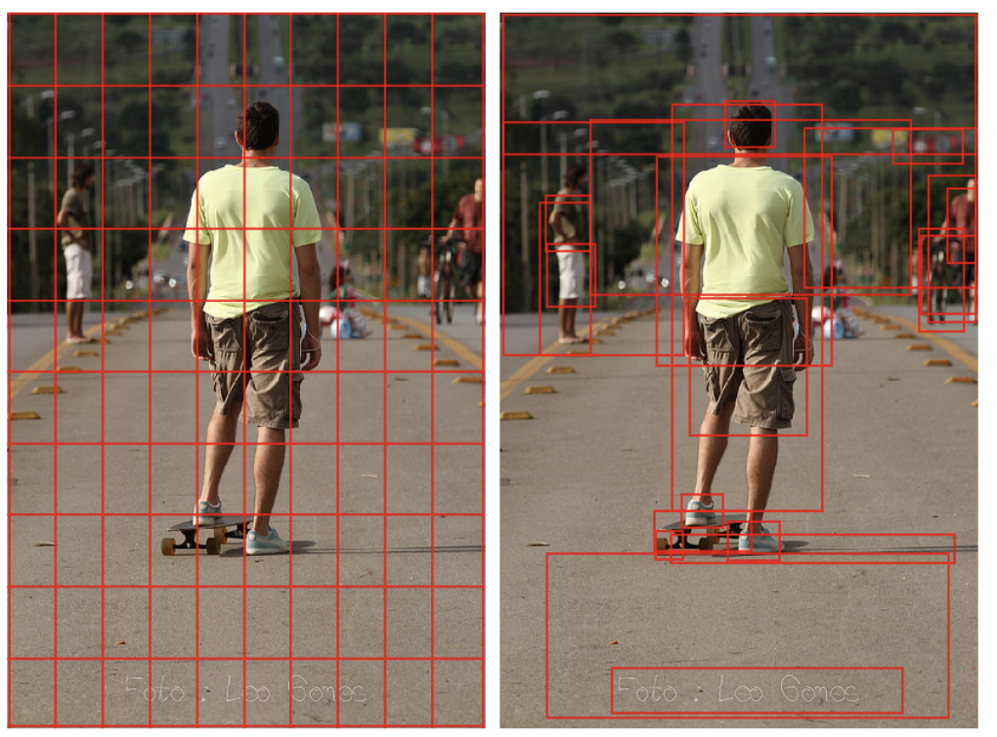
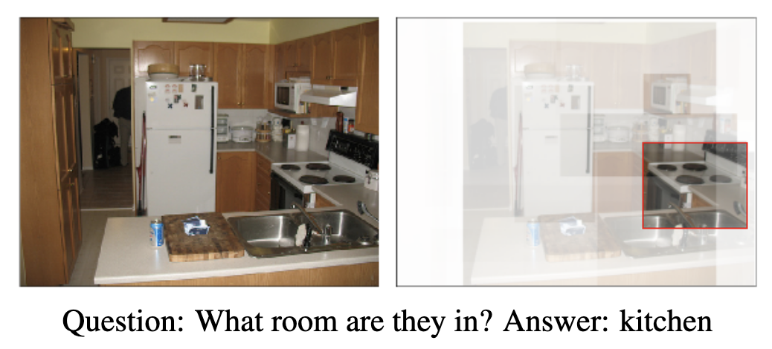
CVPR 2017

Slide 12
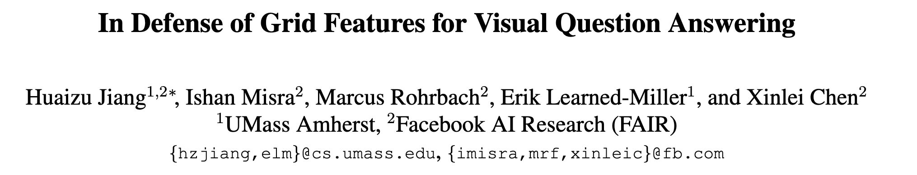
CVPR 2020

Slide 13
VQA Solution today?
?
?
Cross Entroy Loss
Across 5000 possible answers
?
What is the color of the jacket of the man on this picture?

Slide 14
VQA Solution today?
Cross Entroy Loss
Across 5000 possible answers
?
What is the color of the jacket of the man on this picture?

Slide 15
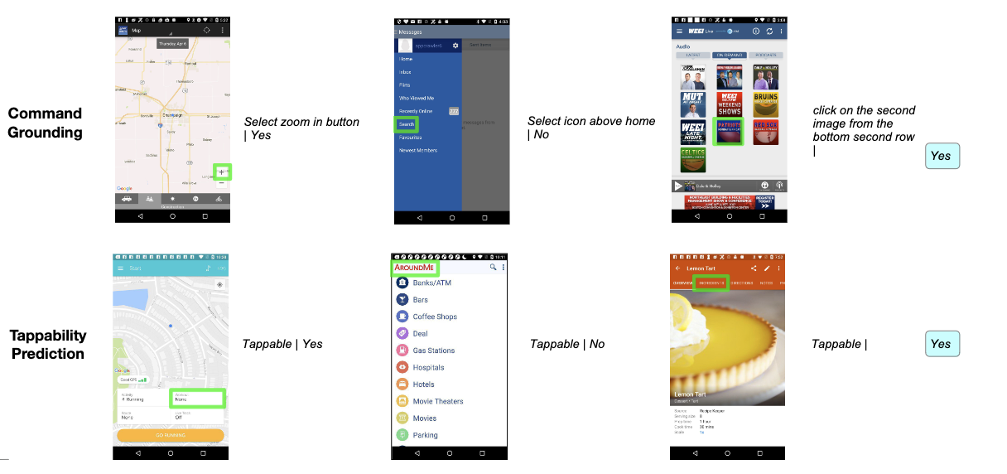
Spotlight: Visual Interface Navigation

Slide 16
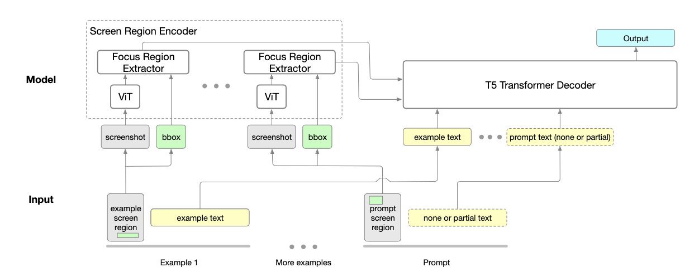
Spotlight: Visual Interface Navigation

Slide 17
Questions

