Slide 1
What could be the Next Generation of LLMs?
Zilin Xiao
Apr 16th, 2024
2024 Spring COMP 646 Guest Talk

Slide 2
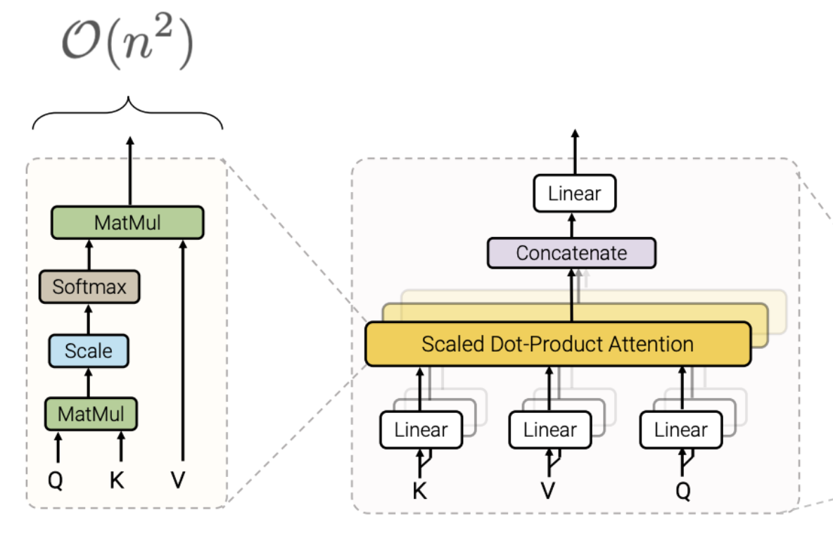
What’s wrong with current LLMs?
Transformer-based LLMs: suffers from quadratic complexity of self-attention w.r.t. sequence length.
  This makes it hard to scale native Transformer to long-context problems.
Ref: Yi et al. Efficient Transformers: A Survey

Slide 3
Why do we need long context language model?
Imagine you have to summarize a 4-page paper within 10mins.
  If you only have access to a GPT-2 with 512-token context window, you might have to select relevant content as your prompt.
  If you have a GPT-4-turbo with 128K context window, throwing the entire paper won’t be a problem.
Things become interesting when the context window scales…
  Chat with a PDF file, a webpage and even a book!
  Information Retrieval over a massive dataset.
  Anything else? Be creative!

Slide 4
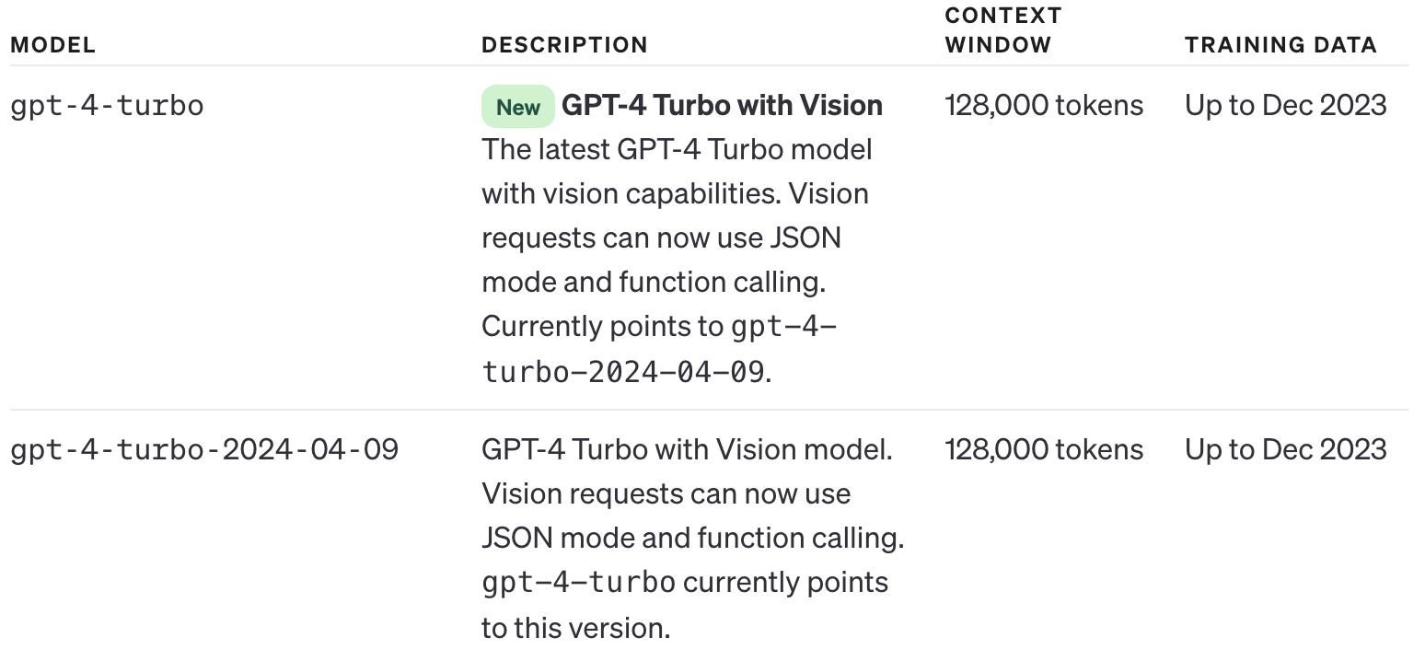
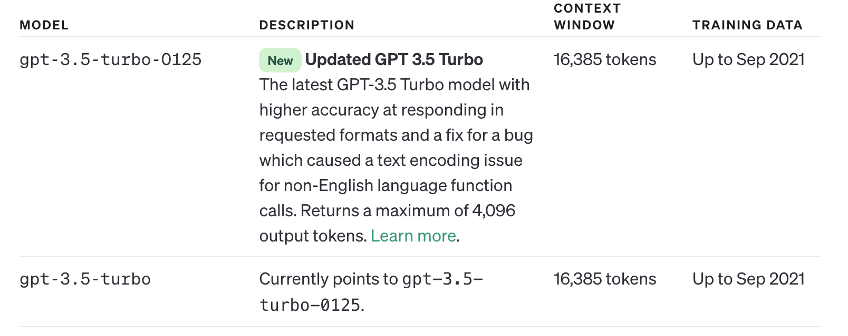
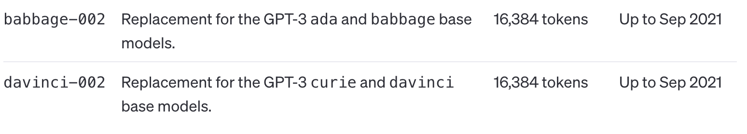
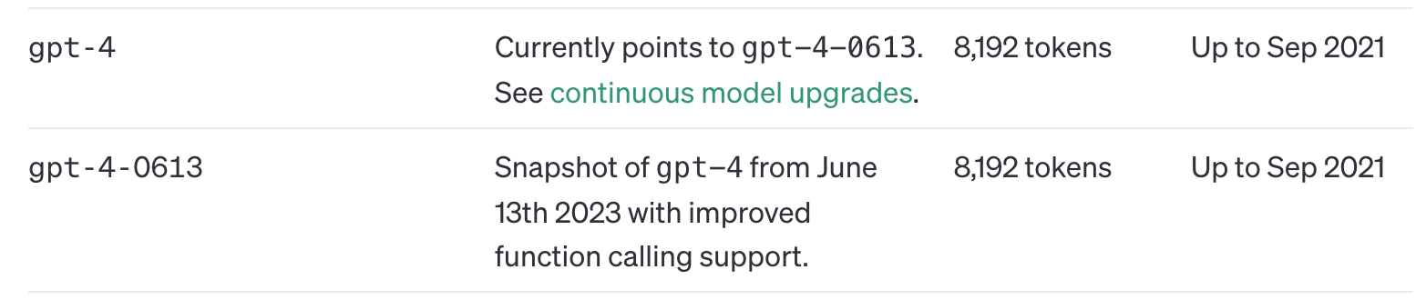
Why do we need long context language model?
From 8k to 128k, 16x increase in context window!
If still in stanard GPT architecture, that means 256x training compute (time and memory)!

Slide 5
Passkey Retrieval: the easiest needle-in-the-haystack experiment
Prompt: There is an important info hidden inside a lot of irrelevant text. Find it and memorize them. I will quiz you about the important information there.
Document:
  The grass is green. The sky is blue. The sun is yellow. Here we go. There and back again. The grass is green. The sky is blue. The sun is yellow. Here we go. There and back again… The pass key is joidYG+FD). Remember it. The grass is green. The sky is blue. The sun is yellow. Here we go. There and back again…
Query: What is the pass key? The pass key is

Slide 6
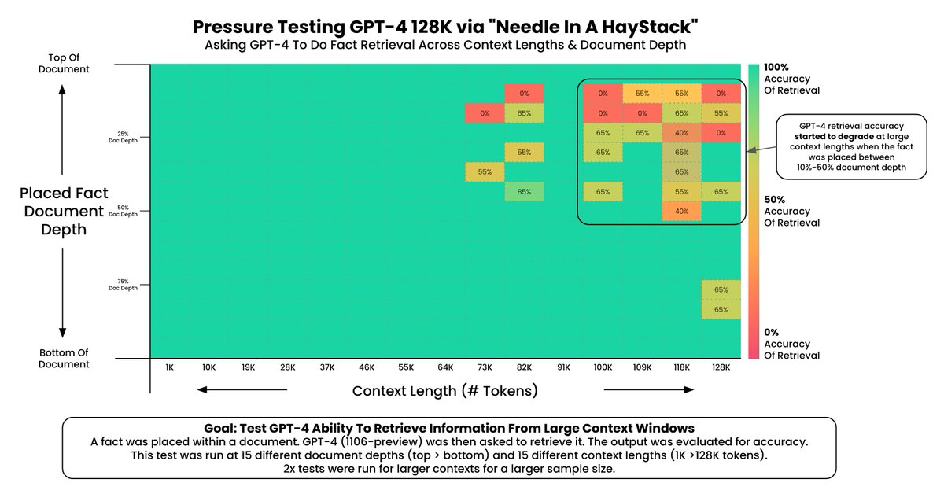
How do we evaluate long-context LMs?
Ref: https://x.com/GregKamradt/status/1722386725635580292

Slide 7
The Future of LLM
GPT models are growing, but still limited by context length.
  Training Speed - Cost is quadratic in length
  Generation Speed - Attention requires full lookback
Solutions Proposed:
  A) Approximation (e.g. Sparse, LoRA)
  B) RAG / Vector-DBs (ANN search, LSH)
  C) Brute-force compute (tiling, blockwise, e.g. RingAttention)
  D) Recurrent Model (What we will mainly discuss today!)
Ref: https://github.com/srush/do-we-need-attention/blob/main/DoWeNeedAttention.pdf
https://docs.google.com/presentation/d/180lS8XbeR1_bTMaldg21LKYQkjXftHuh9VnZ3xk27qQ/edit

Slide 8
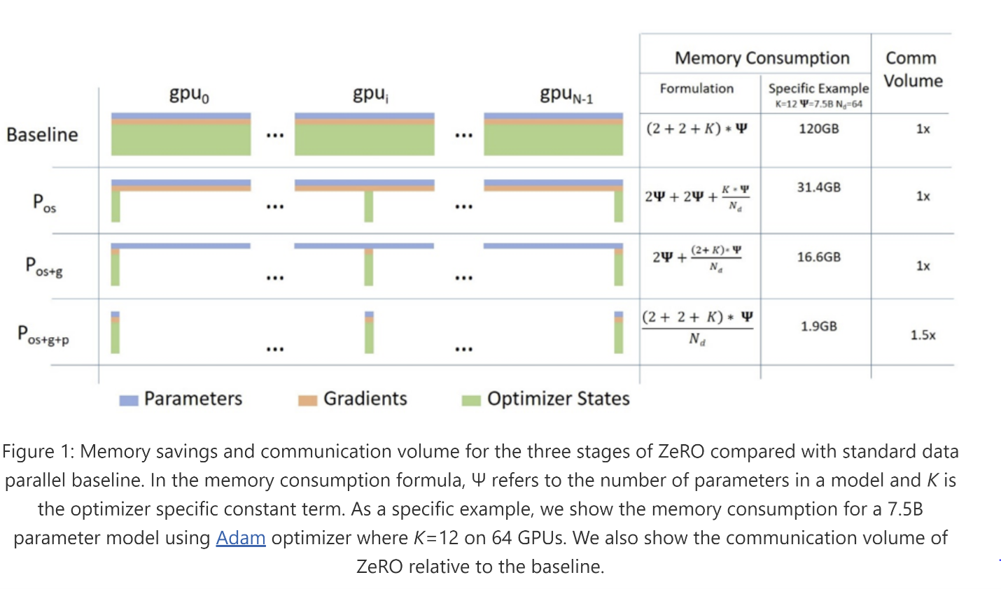
Prerequisite: Zero Redundancy Distributed Training
This does not solve long-context problem at all!
Because multi-head self-attention is still performed on single device, which is prohibitive for long-context input.
Ref: https://www.deepspeed.ai/2021/03/07/zero3-offload.html

Slide 9
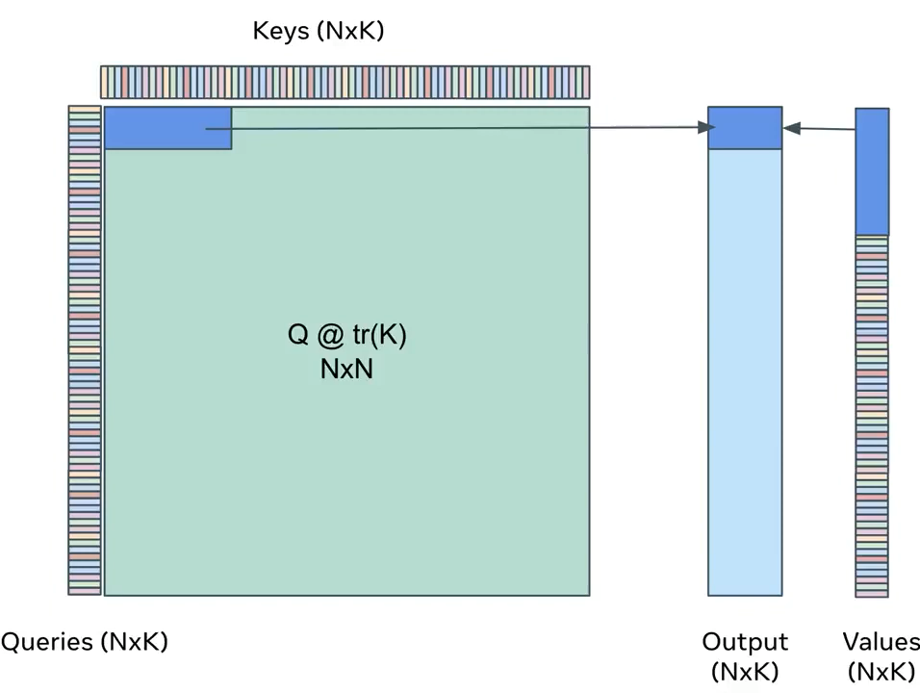
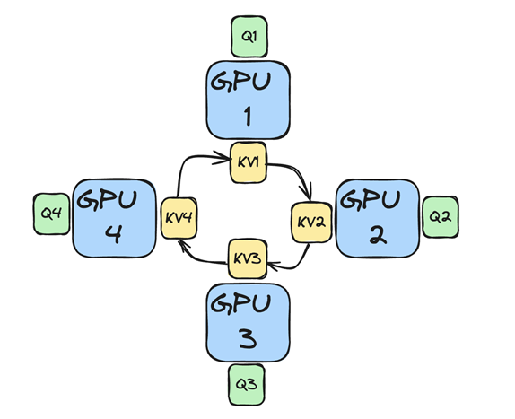
RingAttention: a type of Tensor Parallelism
Pro: it’s still self-attention without any sparse approximation. And it is widely adopted in modern LLM product.
Con: Still quadric complexity!
Ref: https://twitter.com/fvsmassa/status/1580229170629849089

Slide 10
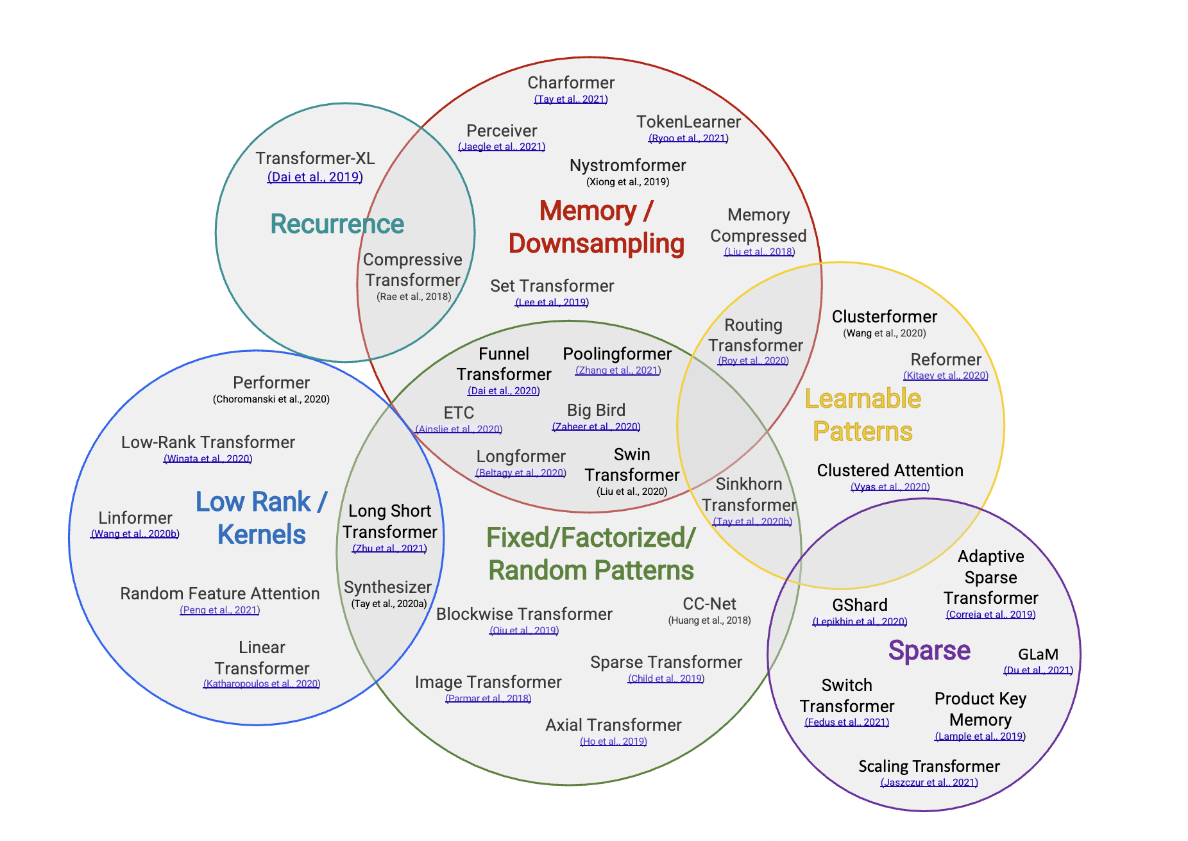
Alternatives towards Long-Context Problems
RWKV: I am here!
RWKV
Ref: Yi et al. Efficient Transformers: A Survey

Slide 11
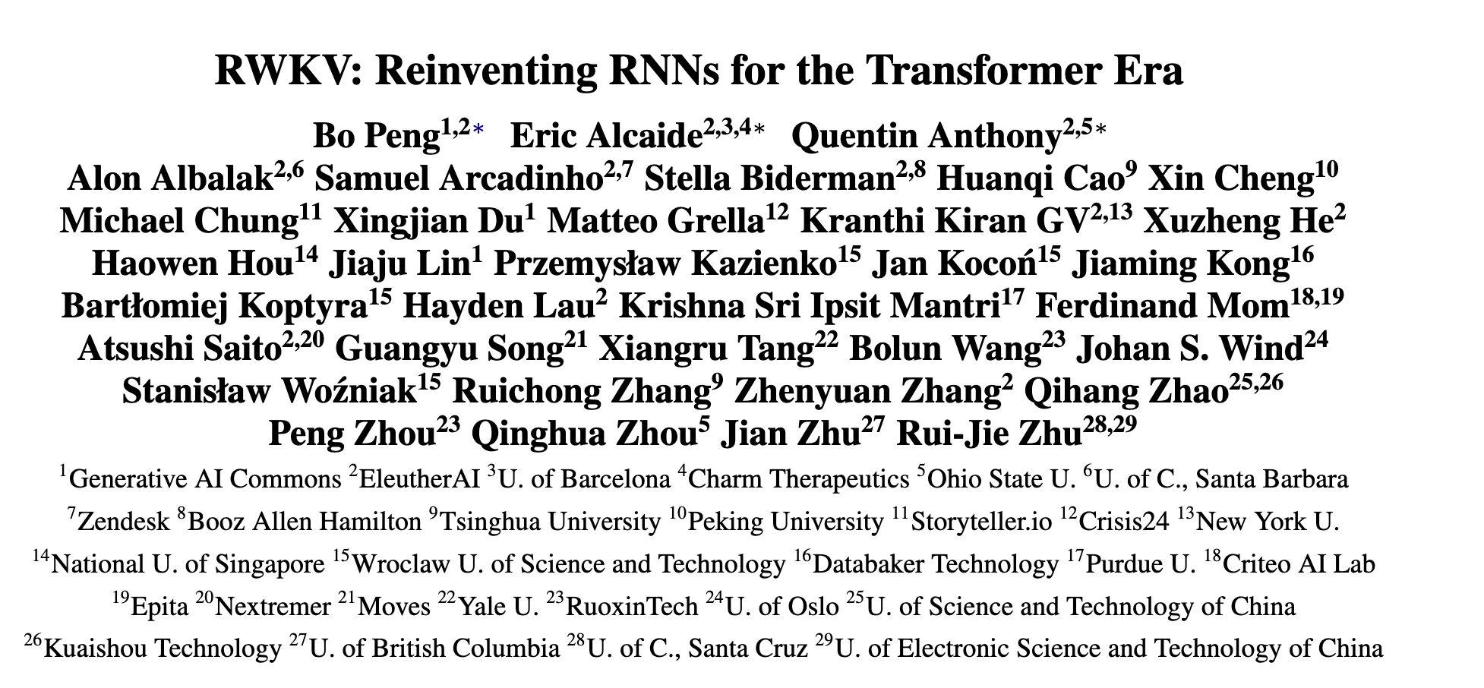
RWKV Explained

Slide 12
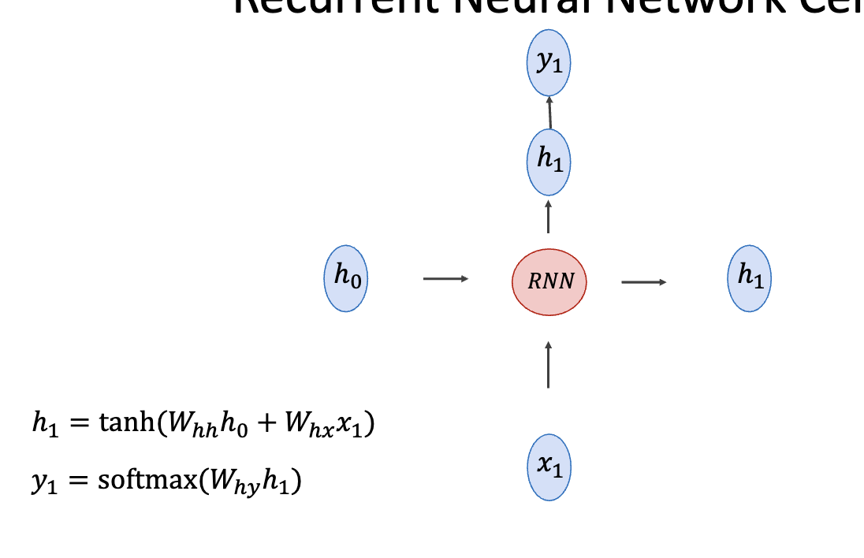
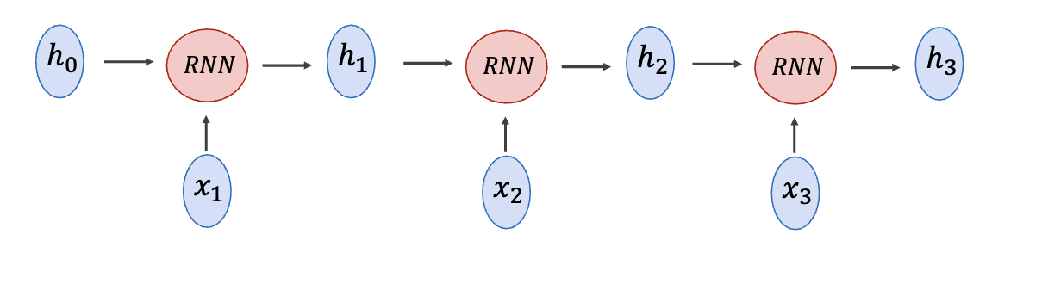
Prerequisite: Recurrent Neural Network Recall
Ref: https://www.cs.rice.edu/~vo9/deep-vislang/lectures/lecture08.pdf
Notes:
Let’s take a look at this first Pre/requisite, which I believe you’re already very familiar with. Because I took this from Vicente’s previous lecture.
In an RNN cell, it maintains a hidden state and at each time step, the input interacts with some projection layer and updates the hidden states, which contributes to the final output of current timestep. By performing this token by token, you are building a seq2seq model called RNN.

Slide 13
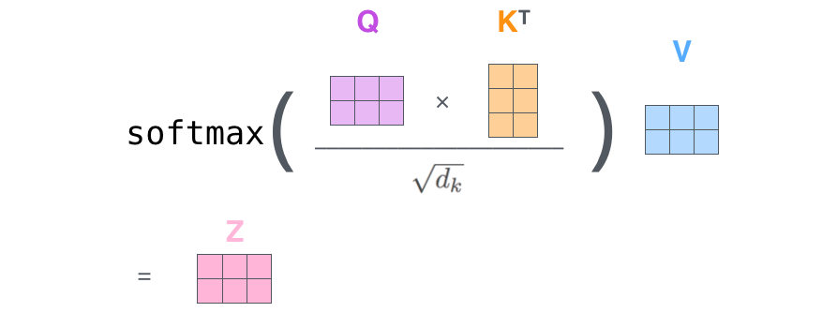
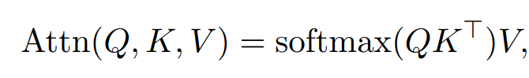
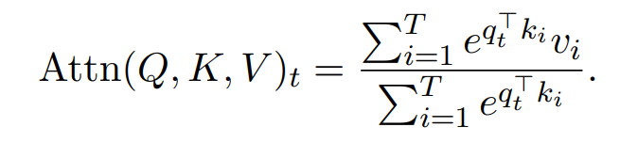
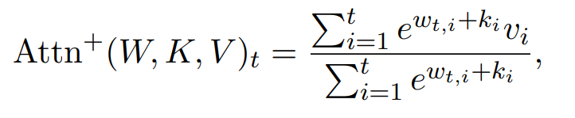
Prerequisite: AFT (Attention Free Transformer)
decomposed as
{ w_{t,i} } ∈ R^{T×T} is the learned pair-wise position biases, and each w_{t,i} is a scalar
Ref: [1] https://jalammar.github.io/illustrated-transformer/ [2] Peng, Bo, et al. "Rwkv: Reinventing rnns for the transformer era." arXiv preprint arXiv:2305.13048 (2023).

Slide 14
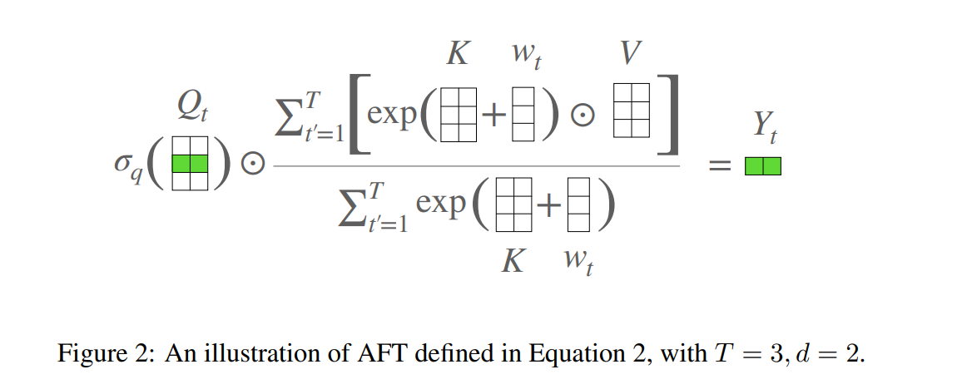
Prerequisite: AFT (Attention Free Transformer)
{ w_{t,i} } ∈ R^{T×T} is the learned pair-wise position biases,
and each w_{t,i} is a scalar
Ref: Zhai et al. An Attention Free Transformer

Slide 15

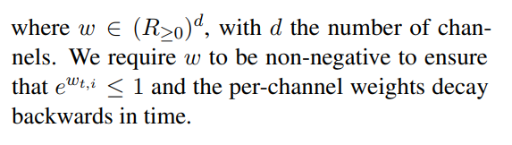
RWKV Explained
Each w_{t,i} in RWKV be a channel-wise time decay vector multiplied by the relative position. Not a standalone learnable position embedding any more!

Slide 16
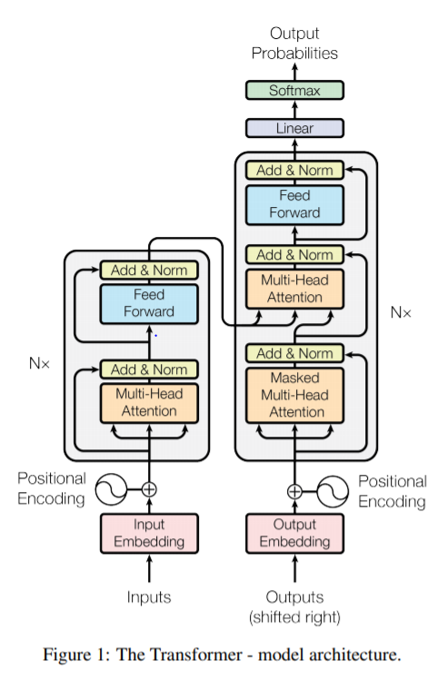
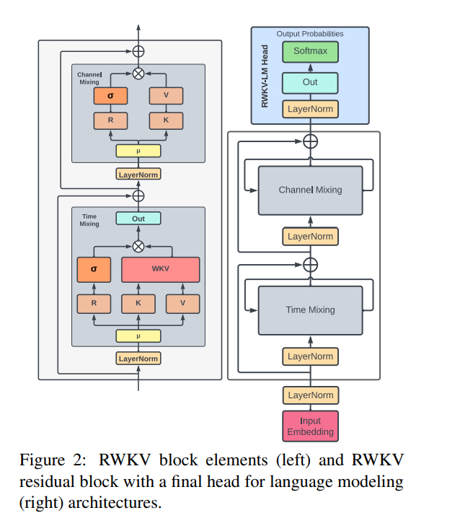
RWKV Block v.s. Transformer Block
Notes:
This is a brief side-by-side comparison of RWKV block and transformer block. They are nearly identical if we ignore technical details inside each module.
In RWKV, time-mixing block replaced the MHA, and channel mixing block replaced feed forward layer.

Slide 17
RWKV
time-mixing and channel-mixing blocks
R: Receptance vector acting as the acceptance of past information.
  Sounds like what? Forget Gate!
W: Weight is the positional weight decay vector. A trainable model parameter.
K: Key is a vector analogous to K in traditional attention.
V : Value is a vector analogous to V in traditional attention

Slide 18
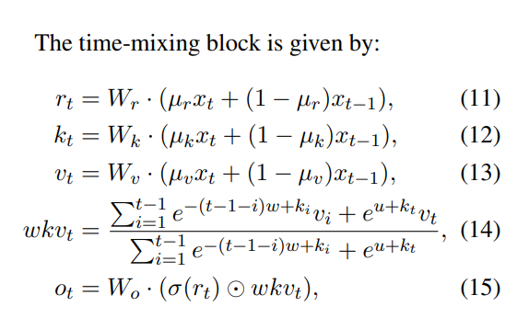
RWKV Time-mixing Block
Token shift: only see one step before!
AFT
addictive operation replacing multiplication

Slide 19
RWKV Parallel Training
Let’s think: which factor prevents RNN parallel training?
  At each timestep RNN has to conditioned on previous hidden states!
In RWKV, this is not a problem! RWKV does not explicitly rely on hidden states, but instead uses AFT to capture context.

Slide 20
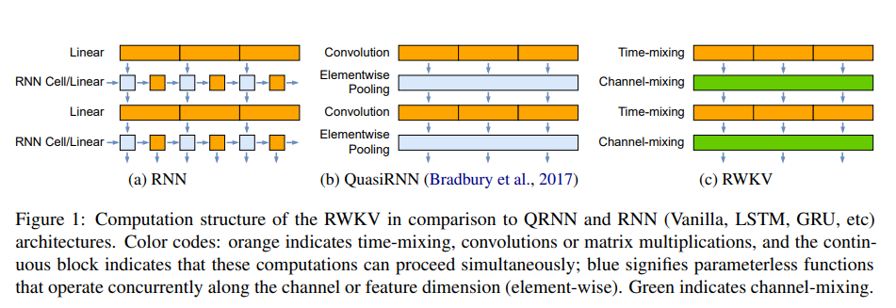
RWKV Parallel Training
hidden states propagation prevents efficicent training!

Slide 21
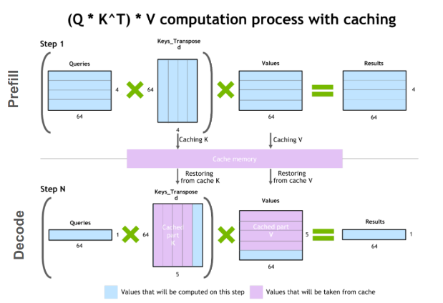
RWKV Sequential Decoding
Question First: what’s the time complexity for GPT to decode a sequence of length n?
  native: O(n²);
  with key-value caching: O(n); at each timestep, we only compute intermediate activations for current position and reuse all previous key-values.
Ref: https://developer.nvidia.com/blog/mastering-llm-techniques-inference-optimization/

Slide 22
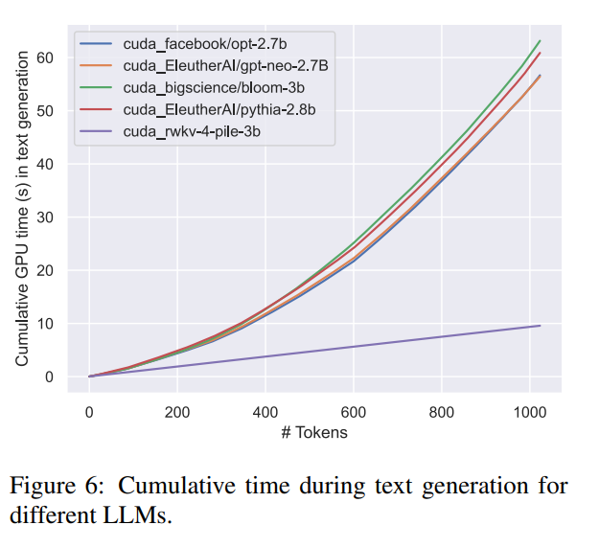
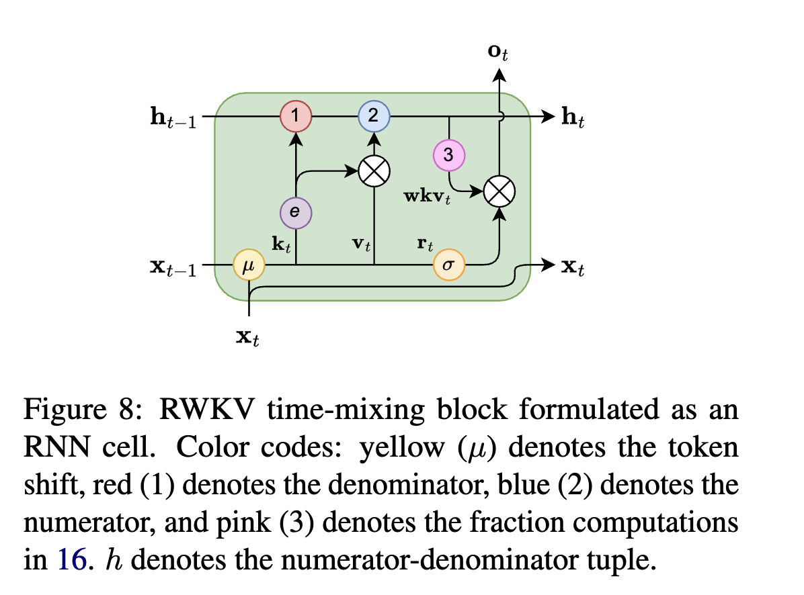
RWKV Sequential Decoding
RWKV Time-mixing Block can be seen as an RNN cell (Appendix D),
  which means a native O(n) decoder!
O(n²)
O(n)

Slide 23
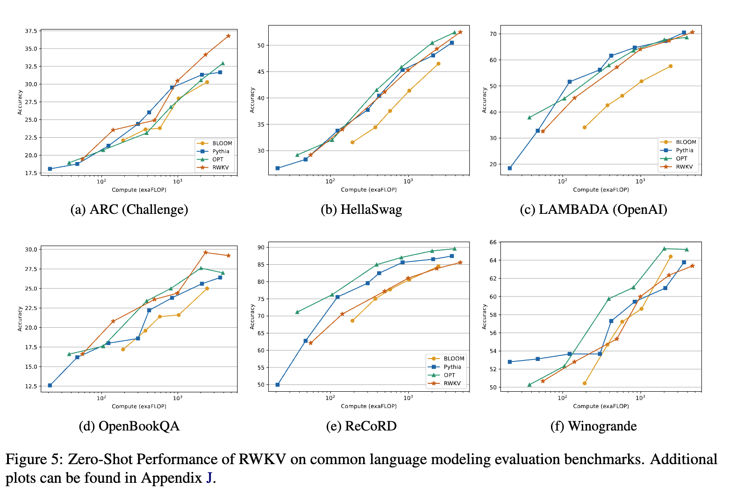
RWKV Results

Slide 24
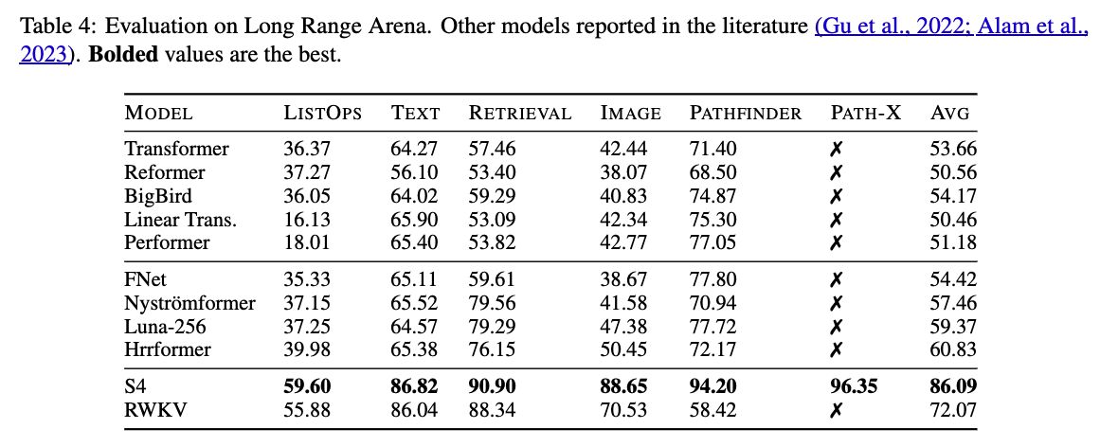
RWKV Long-range Arena Results

Slide 25
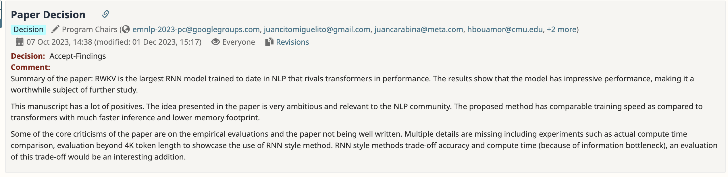
RWKV -> EMNLP’23 Findings

Slide 26
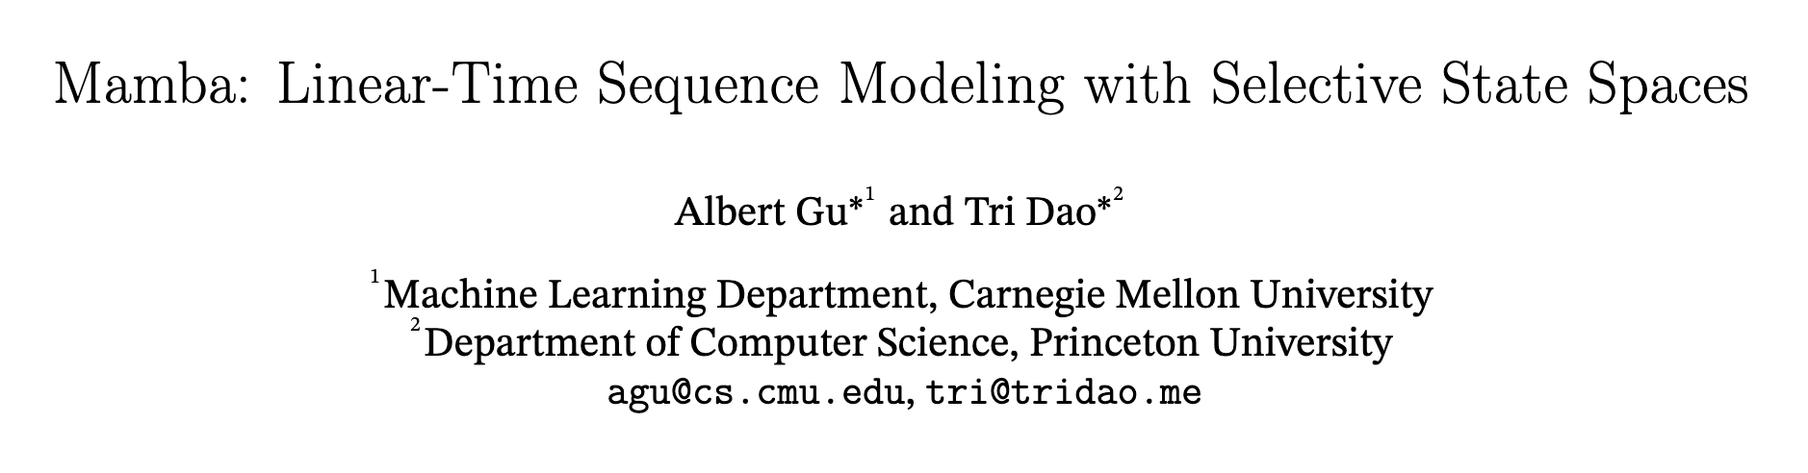
Another recurrent model: Mamba
Mamba is motivated by “Selective State Space Model” (S4), another RNN variant.
Encourage you to read it after class. We will introduce it at an intuitive level.

Slide 27
Structured State-Space Sequence (S4): Intuitive Understanding
State space
1
2
3
h
4
attention
prediction
prediction
Transformer Attention
S4 Model
Ref: https://www.youtube.com/watch?v=iskuX3Ak9Uk

Slide 28
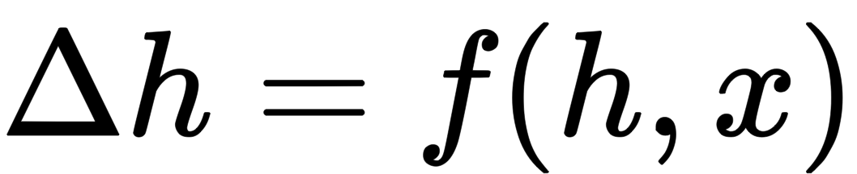
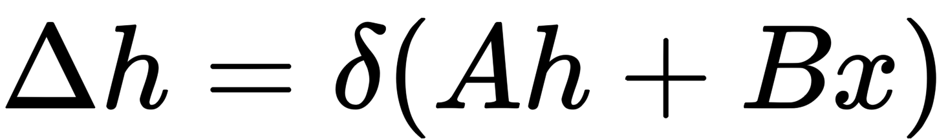
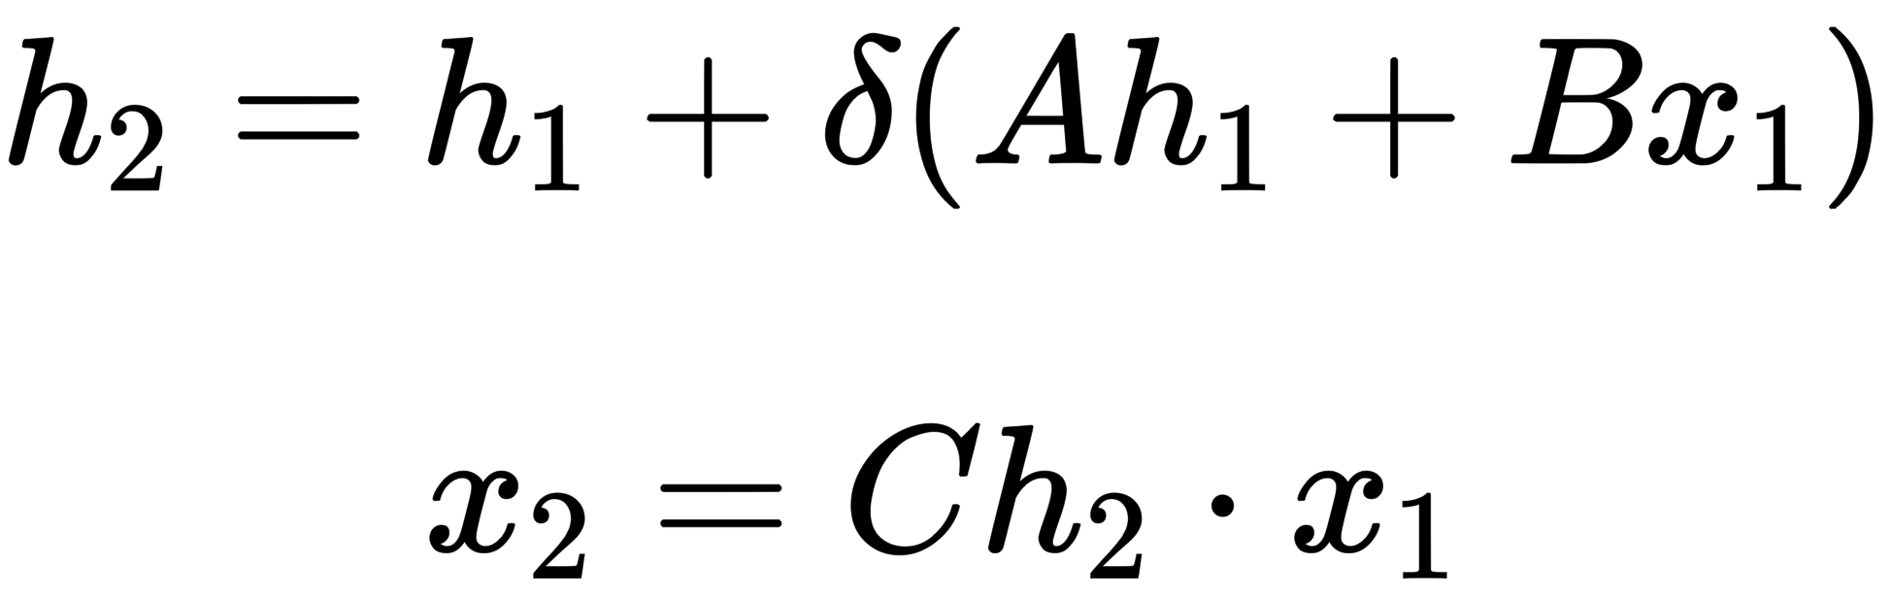
Structured State-Space Sequence (S4): Intuitive Understanding
State space
State space
1
h
2
h
prediction
prediction
State space
3
h
prediction

Slide 29
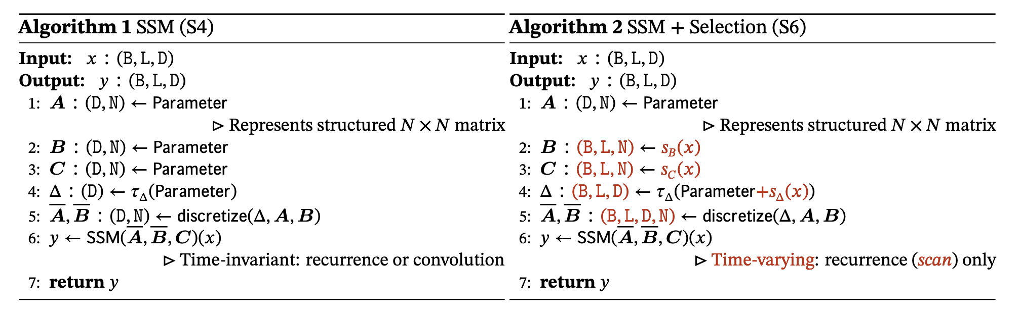
Mamba (S4 + Selective) Algorithms
State space
4
h
prediction
Mamba improves S4 by:
  Now B, C and delta is dependent on current time step input x.
  B -> B(x); C-> C(x); delta -> delta(x)
  During this process, the model selectively chooses which part of hidden states to use depending on current input.

Slide 30
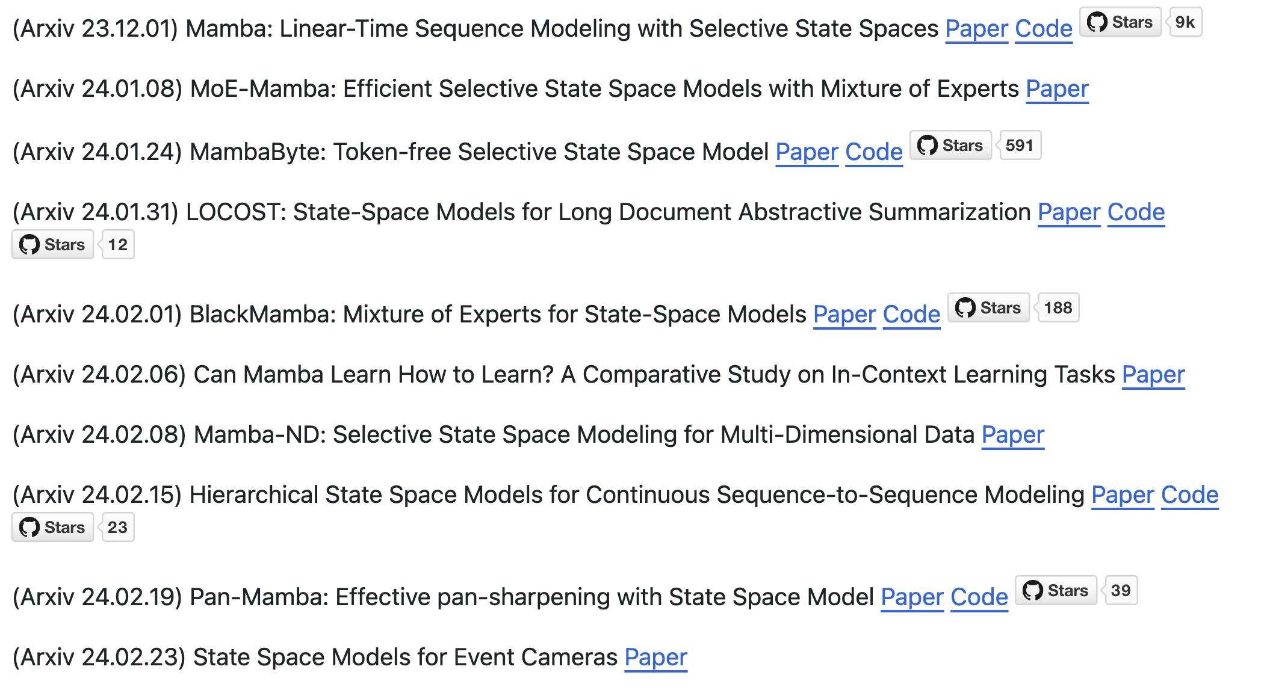
Mamba and its extension
Researchers have been migrating mamba into various domains.
Ref: https://github.com/yyyujintang/Awesome-Mamba-Papers

Slide 31
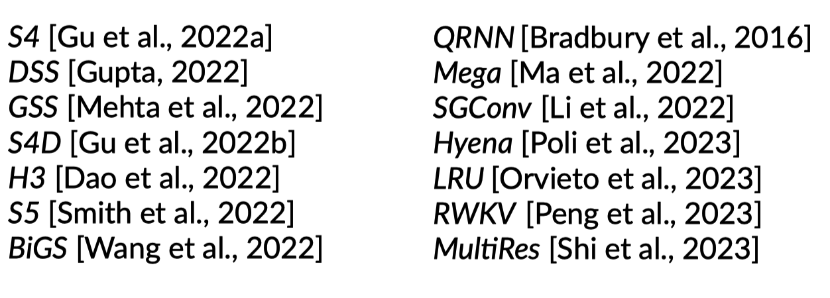
Is recurrent model the future arch of LLM?
Yes and No!
Yes: the community is continuously contributing works towards recurrent model, and some of them have amazing designs! Another GPT might hide in them.

Slide 32
Is recurrent model the future arch of LLM?
Yes and No!
No: in standard evaluation setting (no long-context ability needed), they are unable to match their transformer counterpart with similar size and FLOPs.

Slide 33
Lossless long-context is everything
If you had a context length of 1 billion tokens, none of the problems you see today would be problems.
  Zhiling Yang, Author of Transformer-XL, Founder of Moonshot AI. Raised $1B in Series B in Feb. 2024.
The next generation of LLM should have:
  scalability
  generalization ability
Is it still with Transformer-like block? Is it still trained with next token prediction loss?
  We don’t know.
Ref: https://foresightnews.pro/article/detail/53994

Slide 34
Questions?

