Slide 1
Missing Topics in
Multimodal AI
Vision and Language and Beyond

Slide 2

Vision-Language Models
Explainability: GradCAM
Anatomy of a “Multimodal LLM” also know as “Visual LLM” or “LMM” Large Multimodal Model: Frozen, Flamingo, LlaVA.
Recent VLMS: QwenVL, DeepSeekVL, Gemma-3

Slide 3
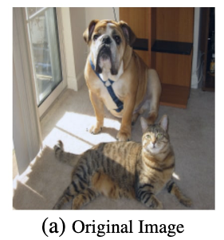
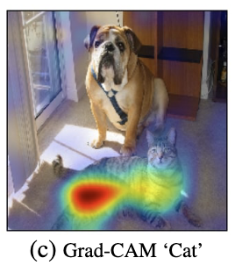
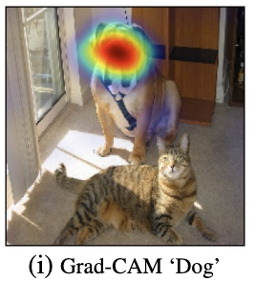
Explainability: GradCAM
https://arxiv.org/abs/1610.02391

Slide 4
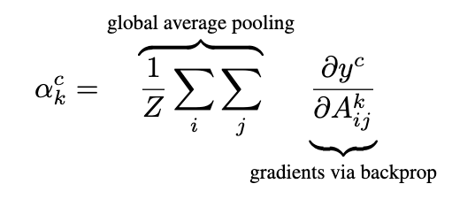
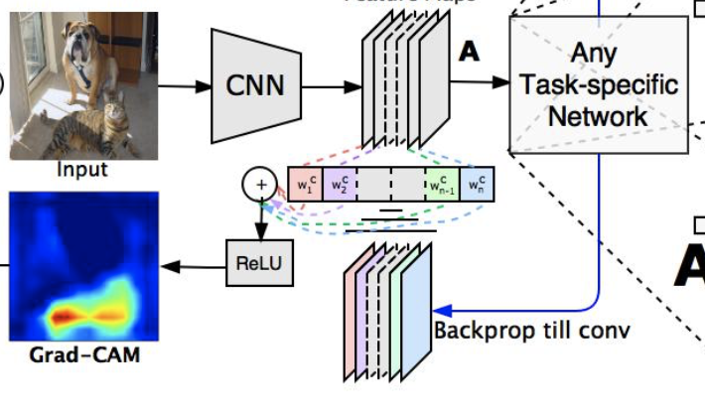
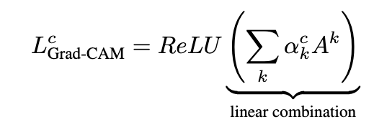
Explainability: GradCAM (2017)
https://arxiv.org/abs/1610.02391

Slide 5
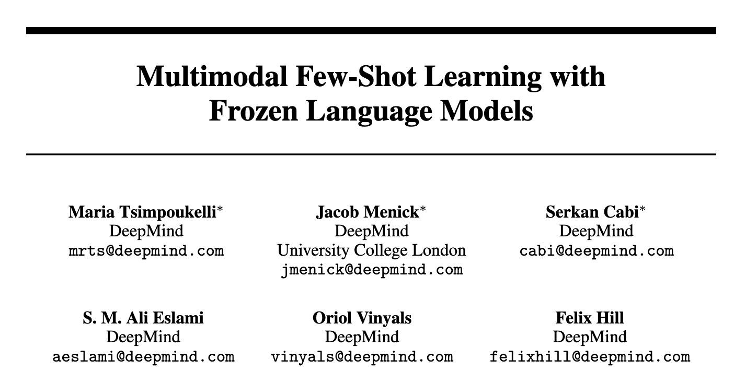
NeurIPS 2021

Slide 6
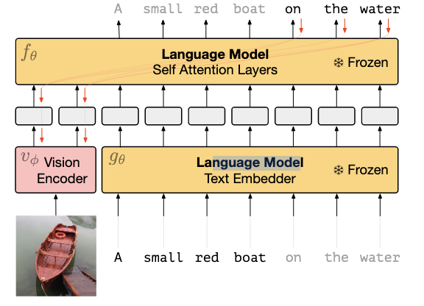
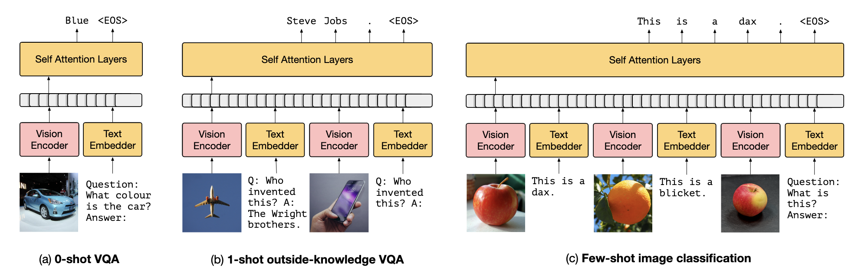
Training:

Slide 7
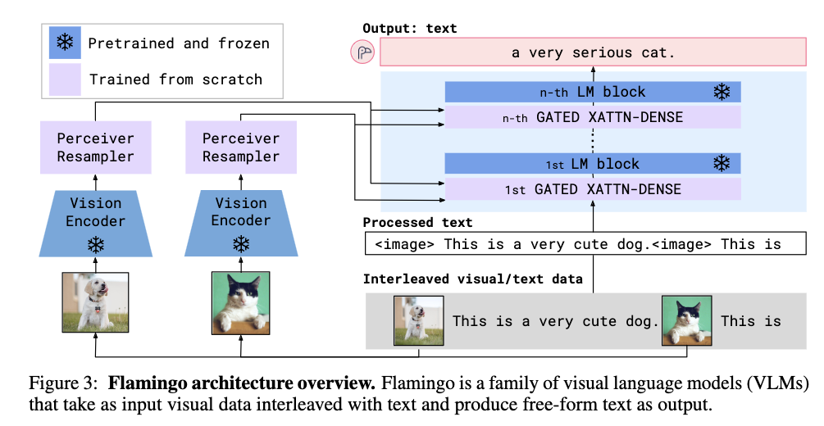
Flamingo
https://arxiv.org/pdf/2204.14198.pdf

Slide 8
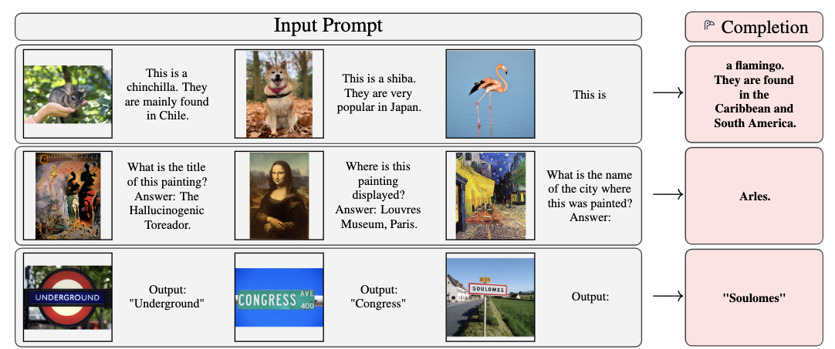
Flamingo
https://arxiv.org/pdf/2204.14198.pdf

Slide 9
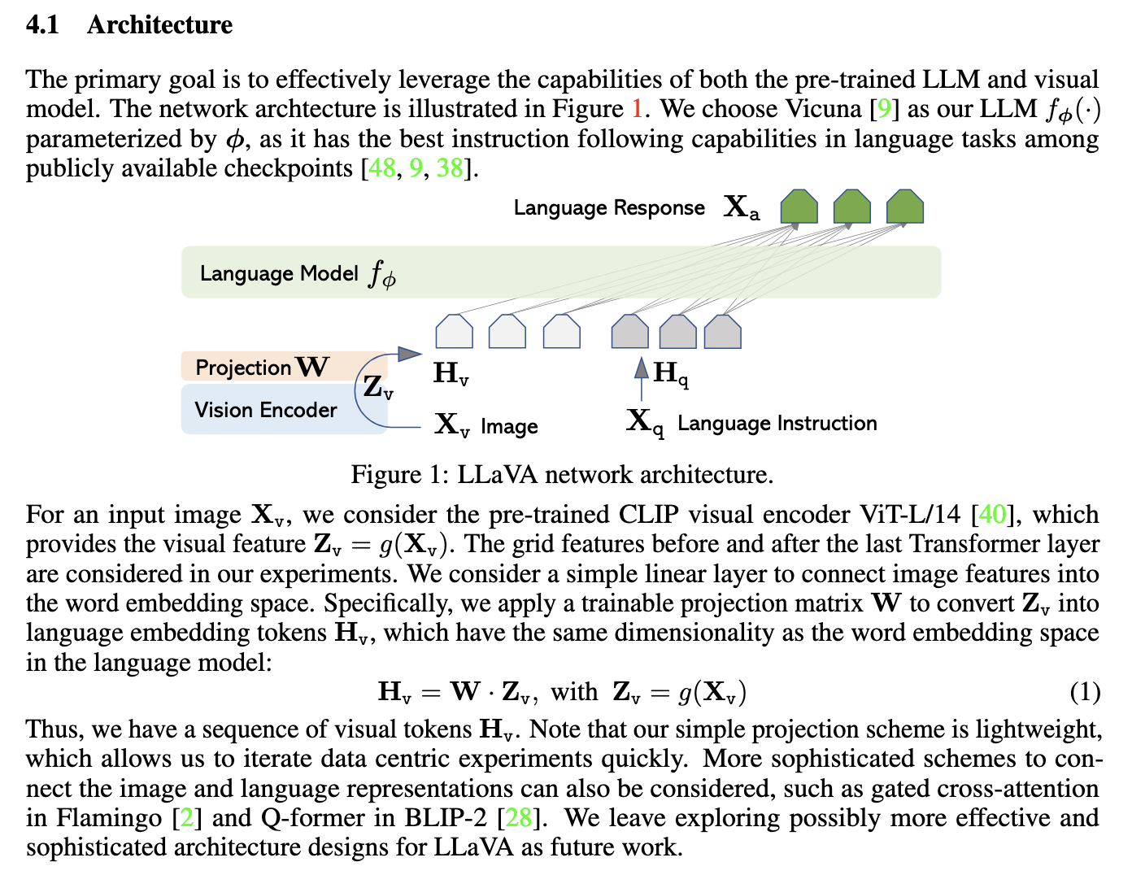
LLaVA
https://arxiv.org/pdf/2304.08485

Slide 10
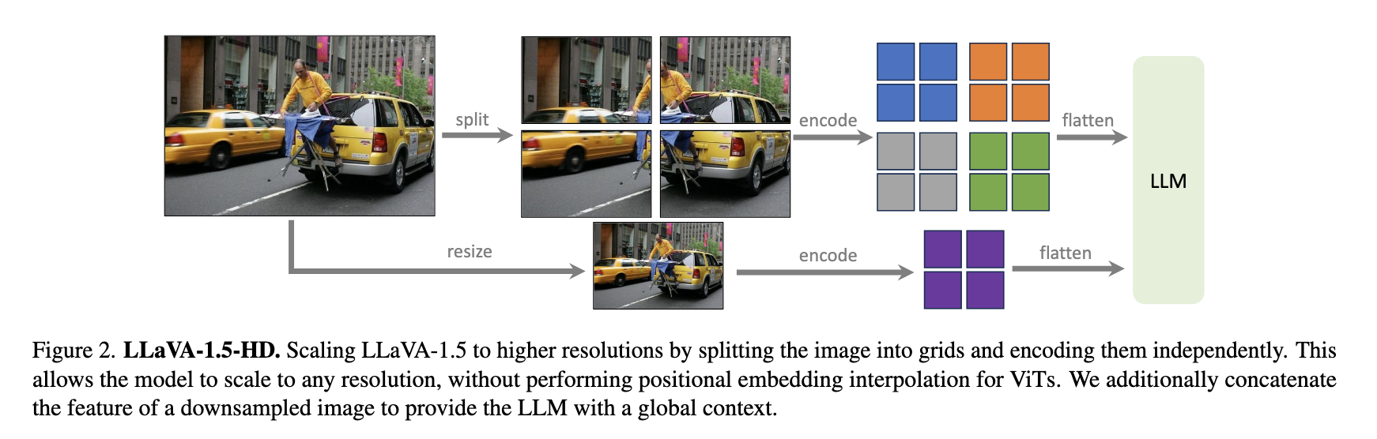
LLaVA-1.5
https://arxiv.org/pdf/2310.03744

Slide 11
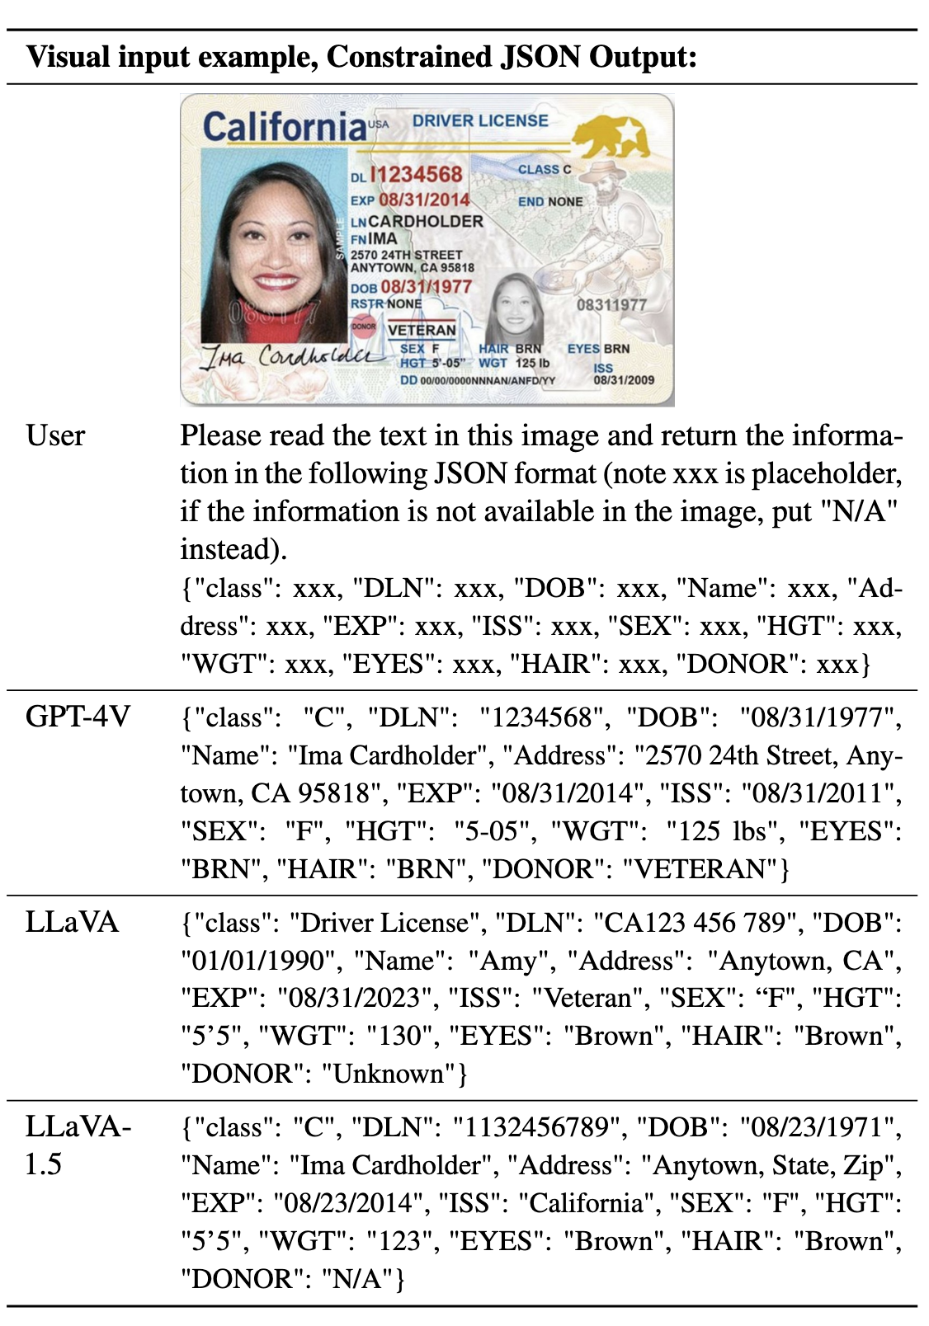
LLaVA-1.5
LLaVA-Next
https://arxiv.org/pdf/2310.03744
https://llava-vl.github.io/blog/2024-01-30-llava-next/

Slide 12
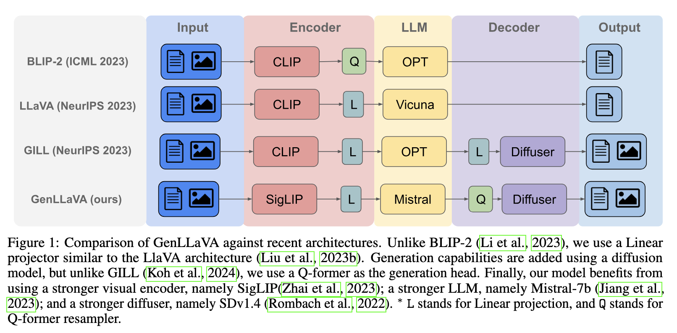
GenLLaVA
https://arxiv.org/abs/2406.11262

Slide 13
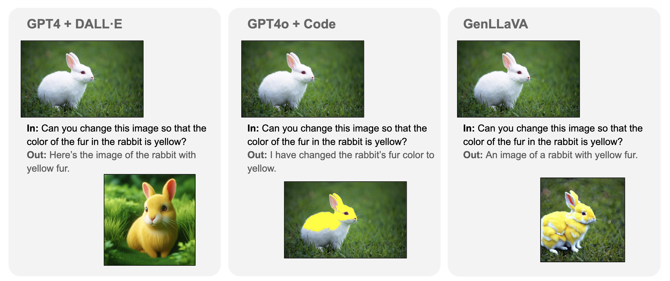

Slide 14
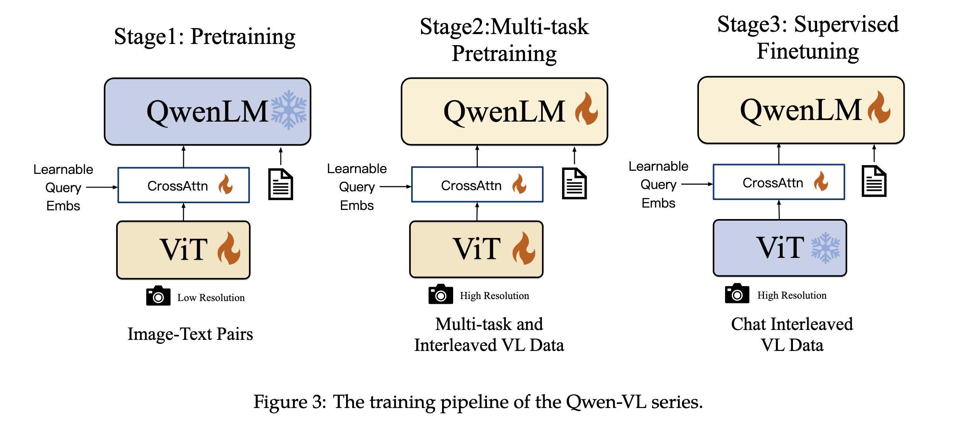
Qwen-VL
https://arxiv.org/pdf/2308.12966

Slide 15
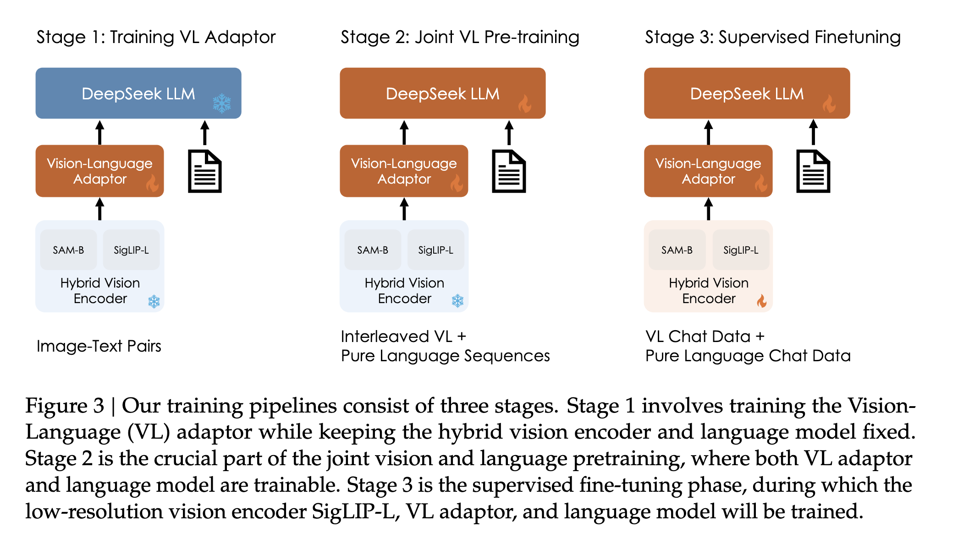
DeepSeek-VL
https://arxiv.org/pdf/2403.05525

Slide 16
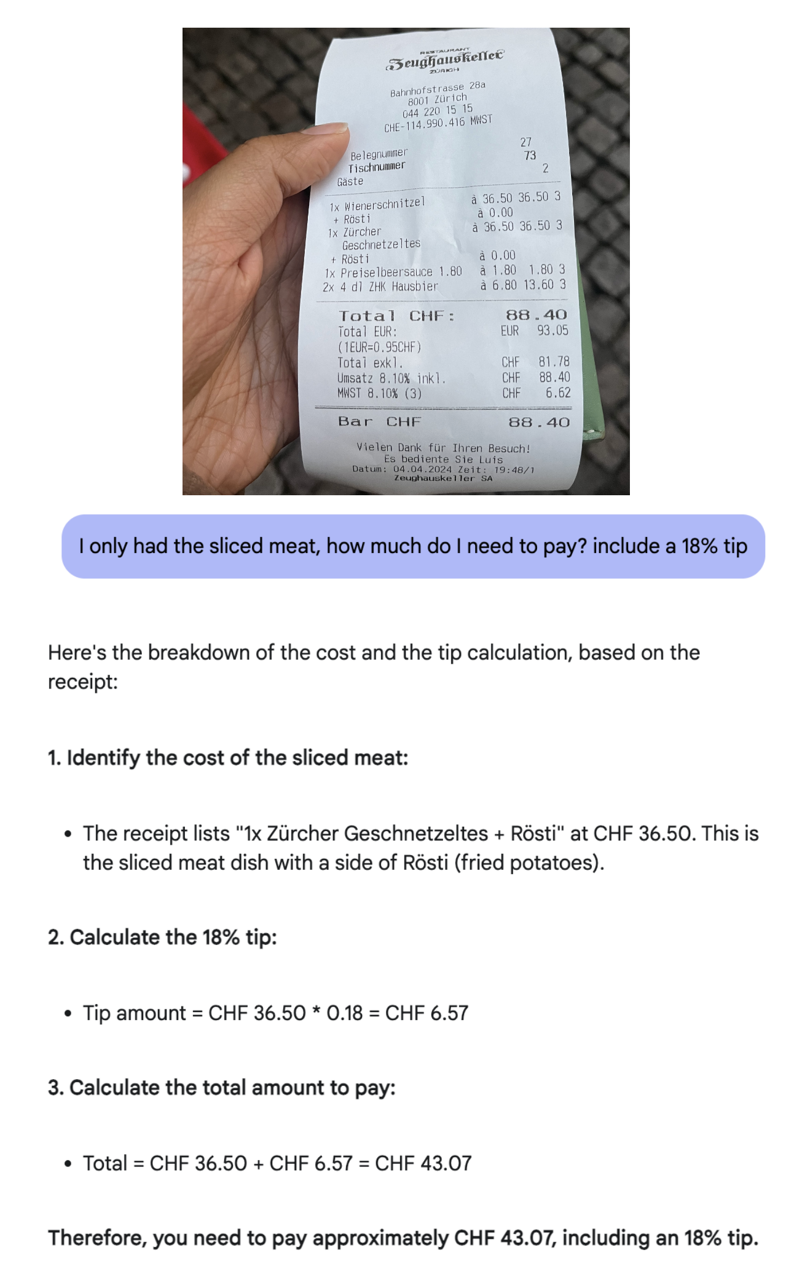
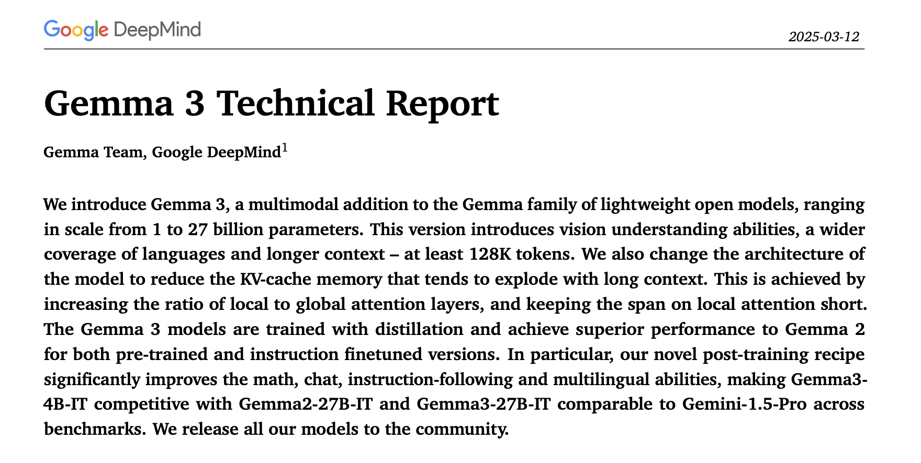
Gemma 3

Slide 17
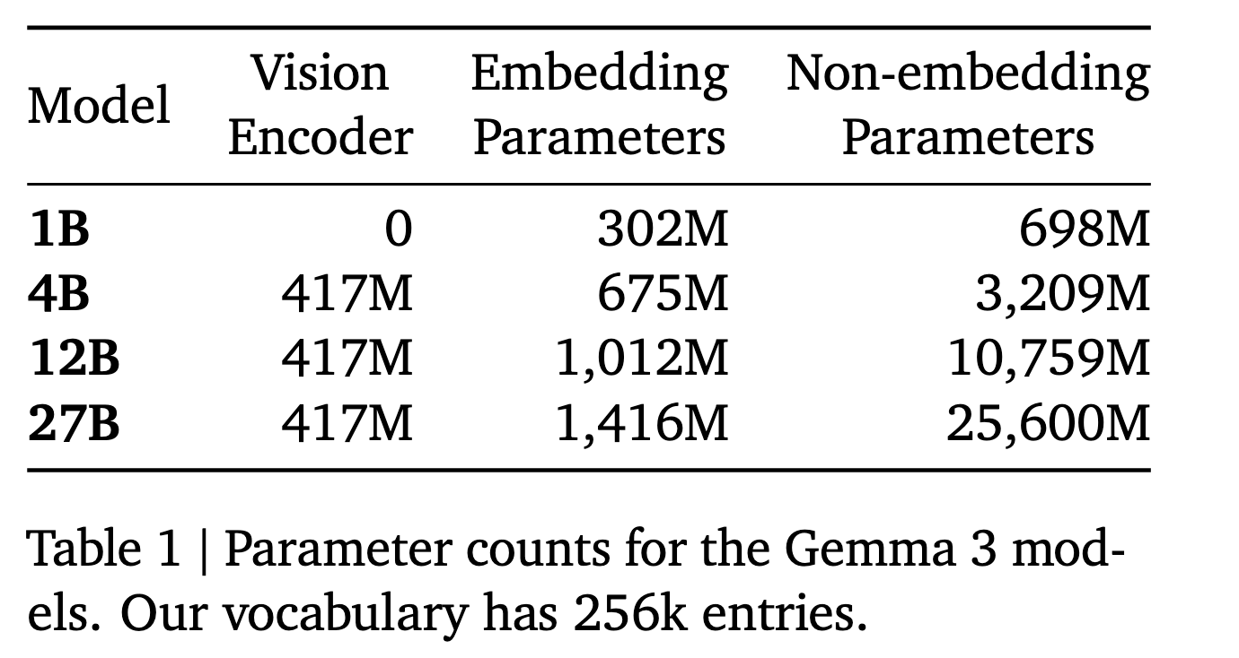
Gemma3

Slide 18
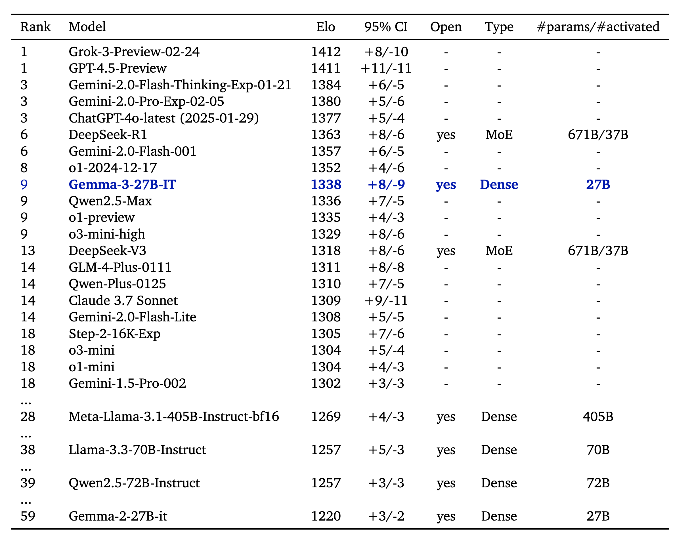

Slide 19
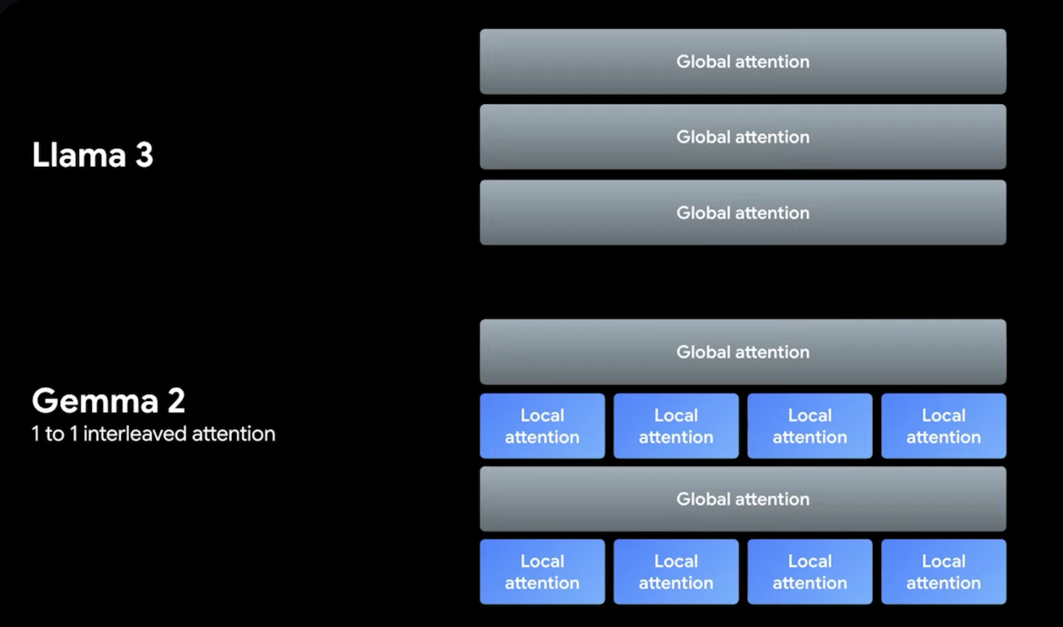

Slide 20
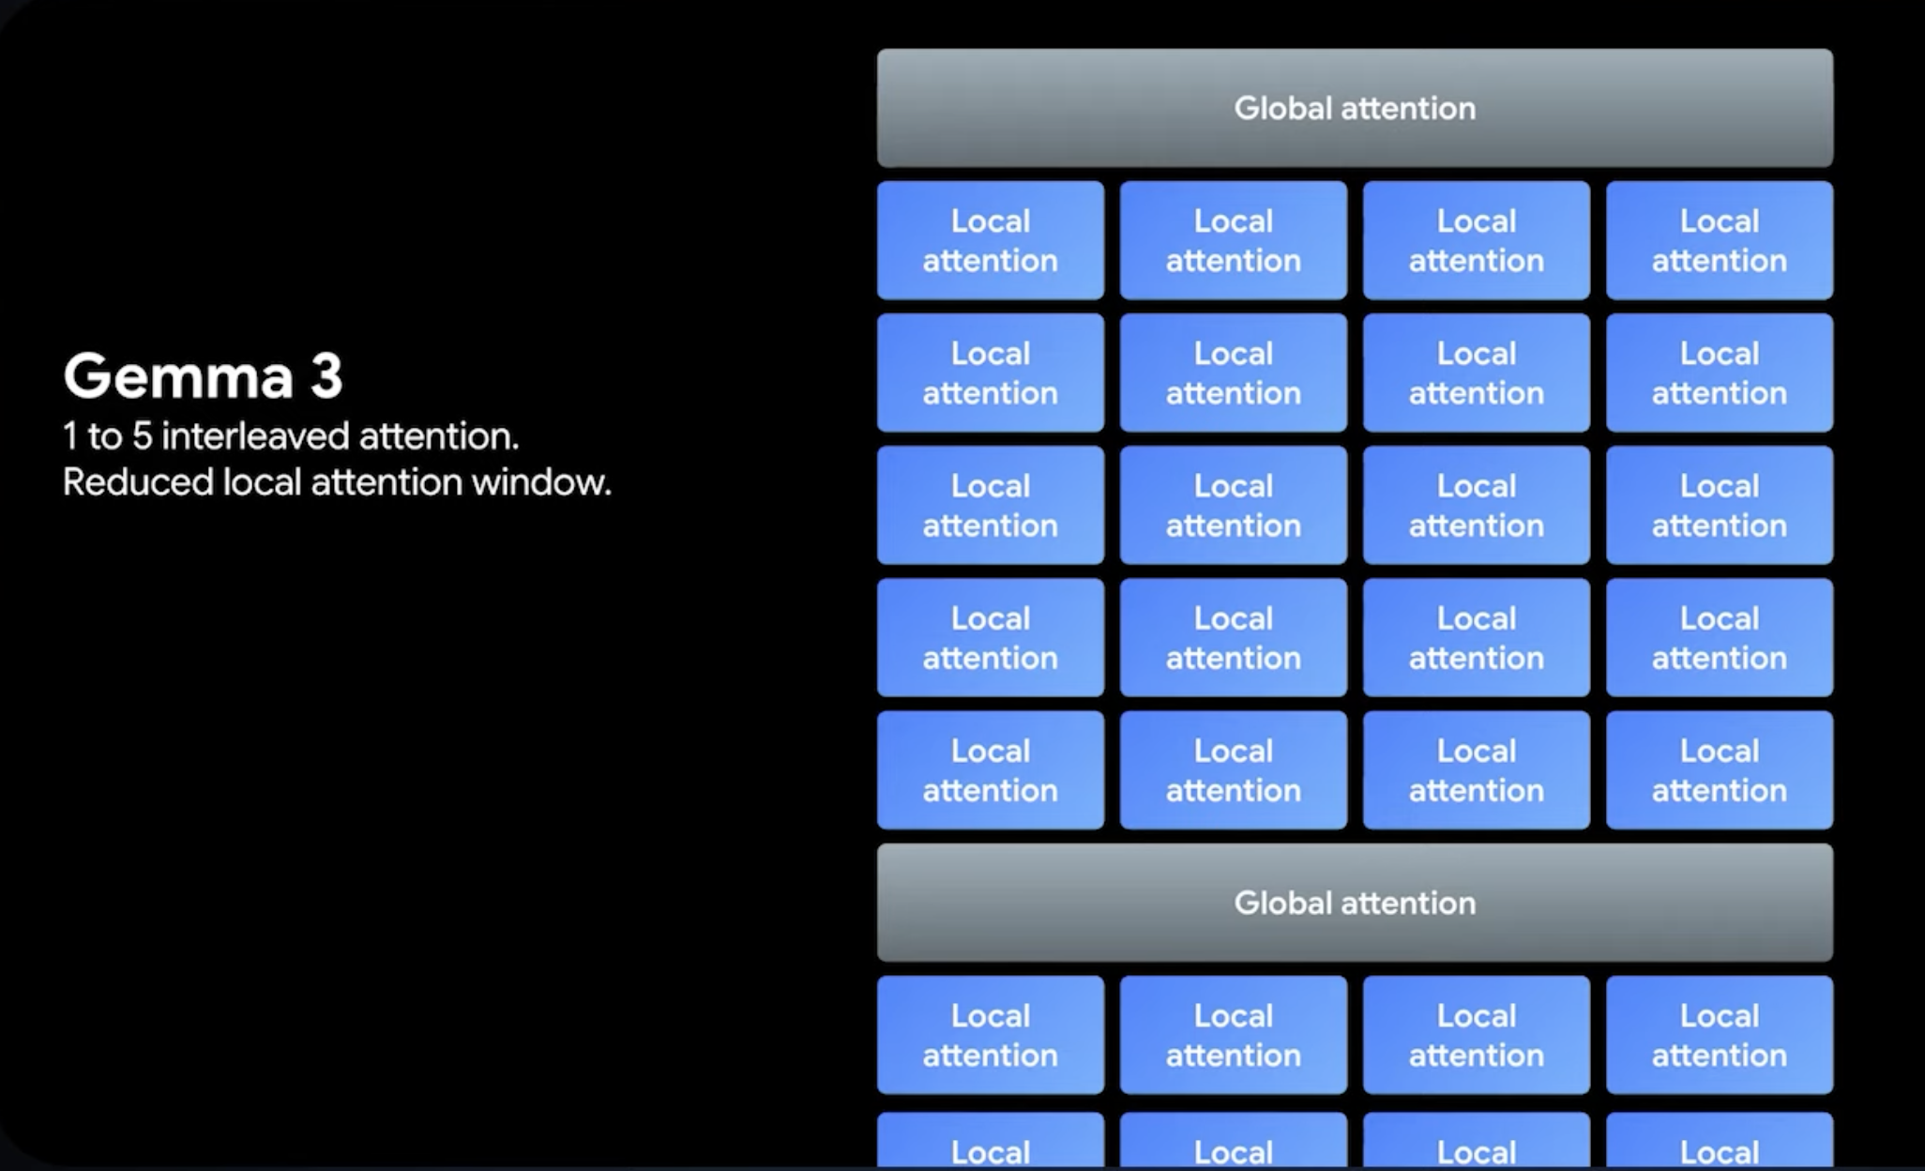

Slide 21
What’s next?
Vision-Language Models + Robotics?
Vision-Language Models + Video?
Vision-Language Models + Agents (Web Agents)
Vision-Language Models + Agents (Cooperative-tasks)
Vision-Language Models + Search?
Vision-Language Models + Reinforcement Learning more generally

