Slide 1
Deep Learning for Vision & Language
Finetuning Models Efficiently

Slide 2
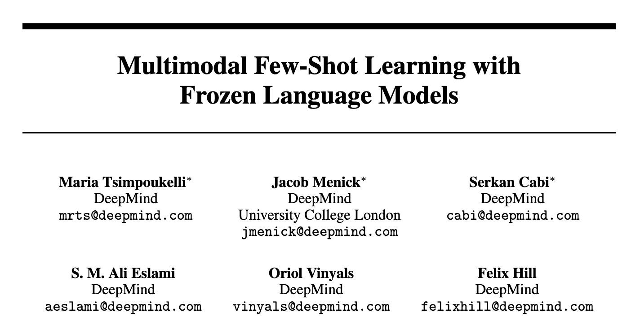
NeurIPS 2021

Slide 3
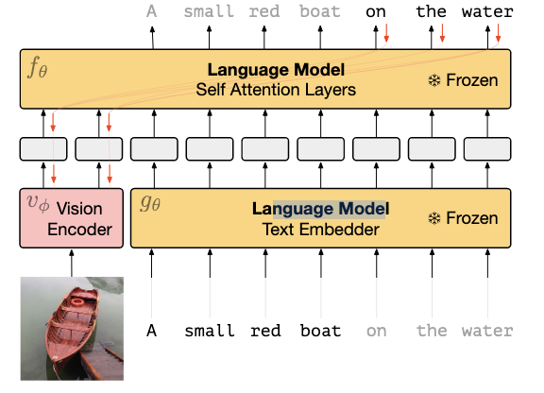
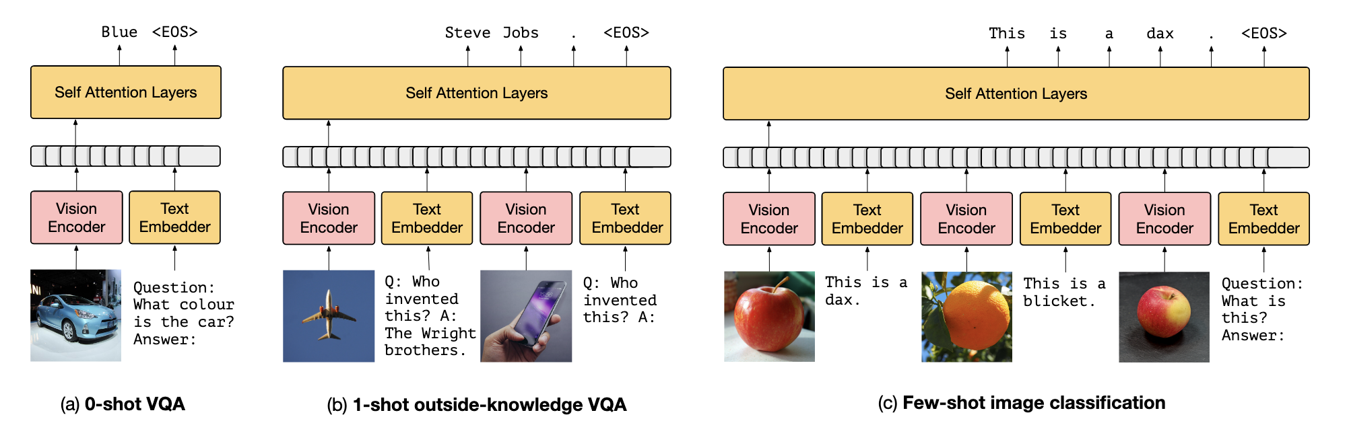
Training:

Slide 4
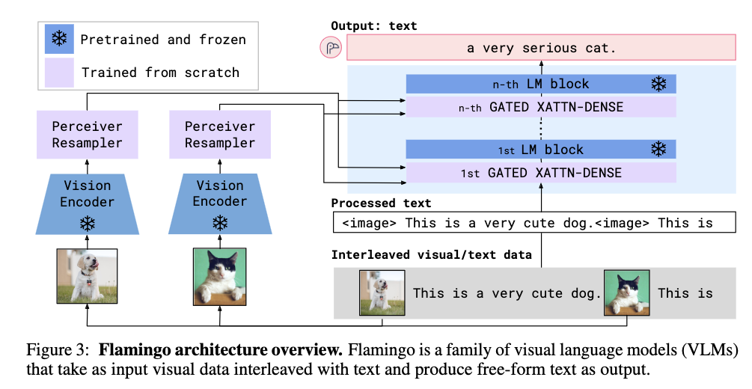
Flamingo
https://arxiv.org/pdf/2204.14198.pdf

Slide 5
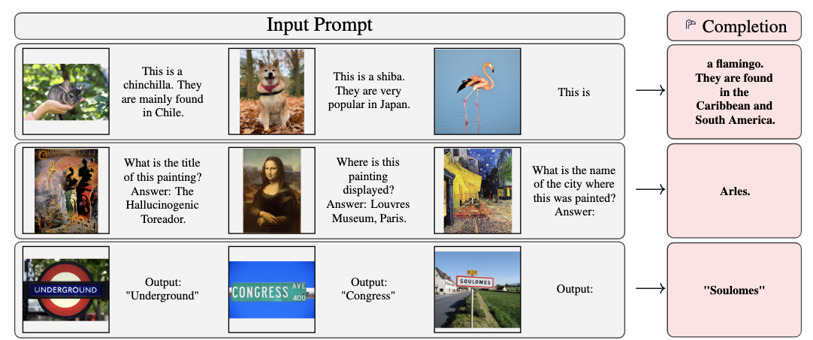
Flamingo
https://arxiv.org/pdf/2204.14198.pdf

Slide 6
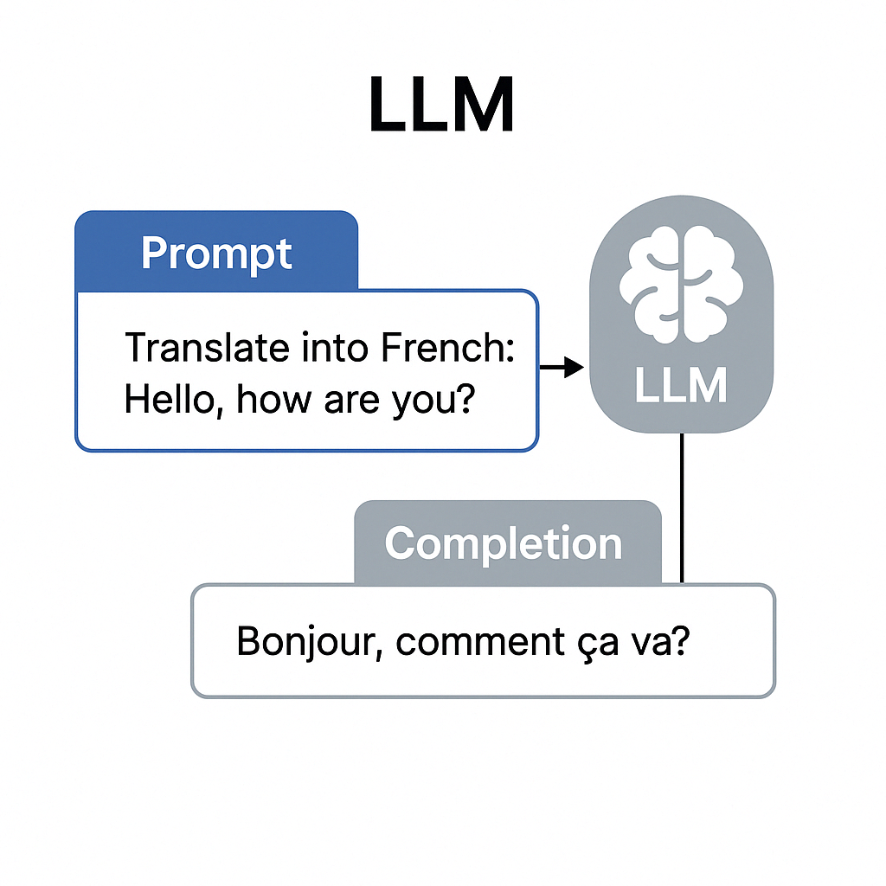
LLM Prompting

Slide 7
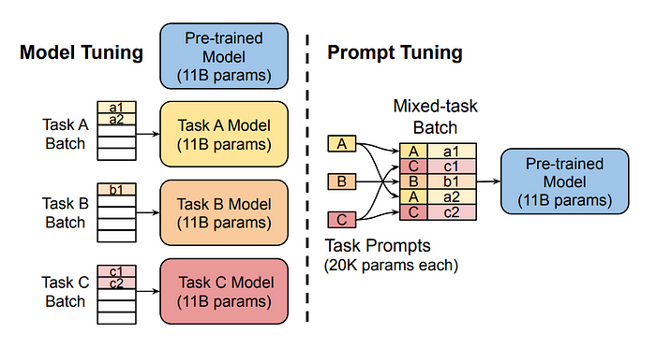
LLM Efficient Model Finetuning
Prompt Tuning
https://medium.com/@shahshreyansh20/prompt-tuning-a-powerful-technique-for-adapting-llms-to-new-tasks-6d6fd9b83557

Slide 8
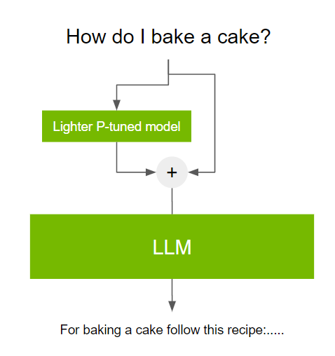
LLM Efficient Model Finetuning
Prompt Tuning
https://medium.com/@shahshreyansh20/prompt-tuning-a-powerful-technique-for-adapting-llms-to-new-tasks-6d6fd9b83557

Slide 9
LLM Efficient Model Finetuning
Prompt Tuning
https://medium.com/@shahshreyansh20/prompt-tuning-a-powerful-technique-for-adapting-llms-to-new-tasks-6d6fd9b83557

Slide 10
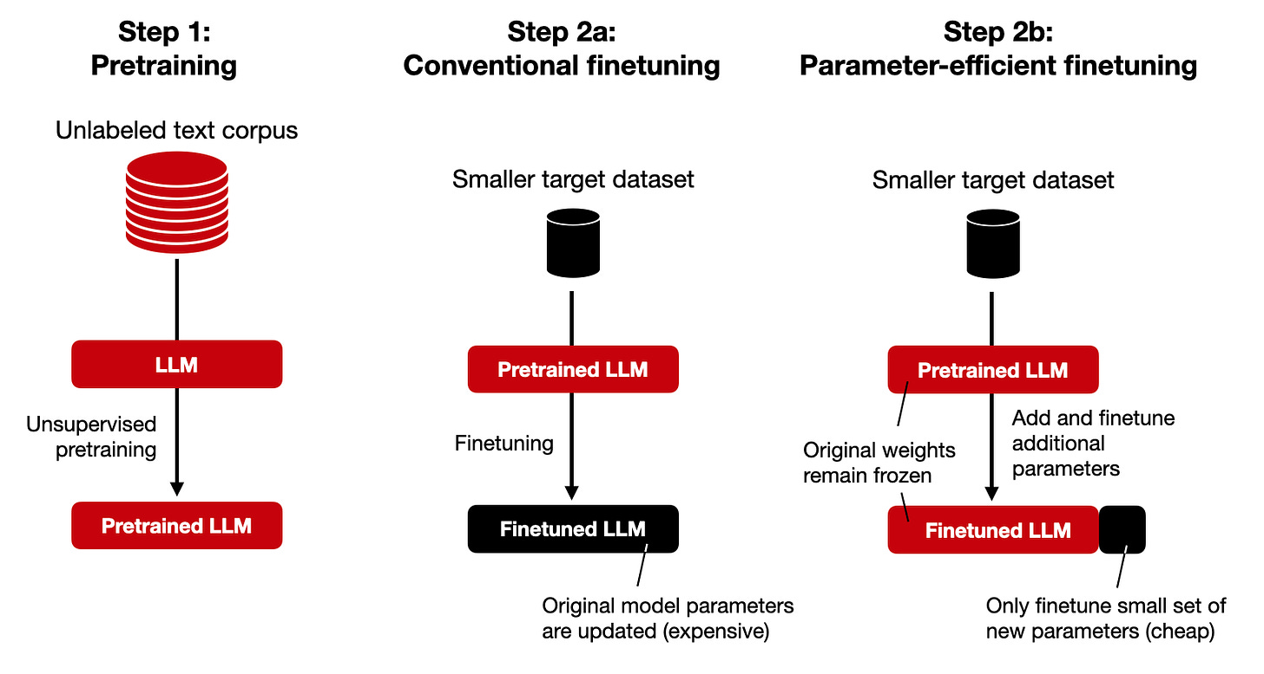
LLM Efficient Model Finetuning
Prompt Tuning
Parameter Efficient Finetuning (PEFT)
https://github.com/huggingface/peft
https://magazine.sebastianraschka.com/p/finetuning-llms-with-adapters

Slide 11
LLM Efficient Model Finetuning
Prompt Tuning
Parameter Efficient Finetuning (PEFT)
https://github.com/huggingface/peft
https://magazine.sebastianraschka.com/p/finetuning-llms-with-adapters

Slide 12
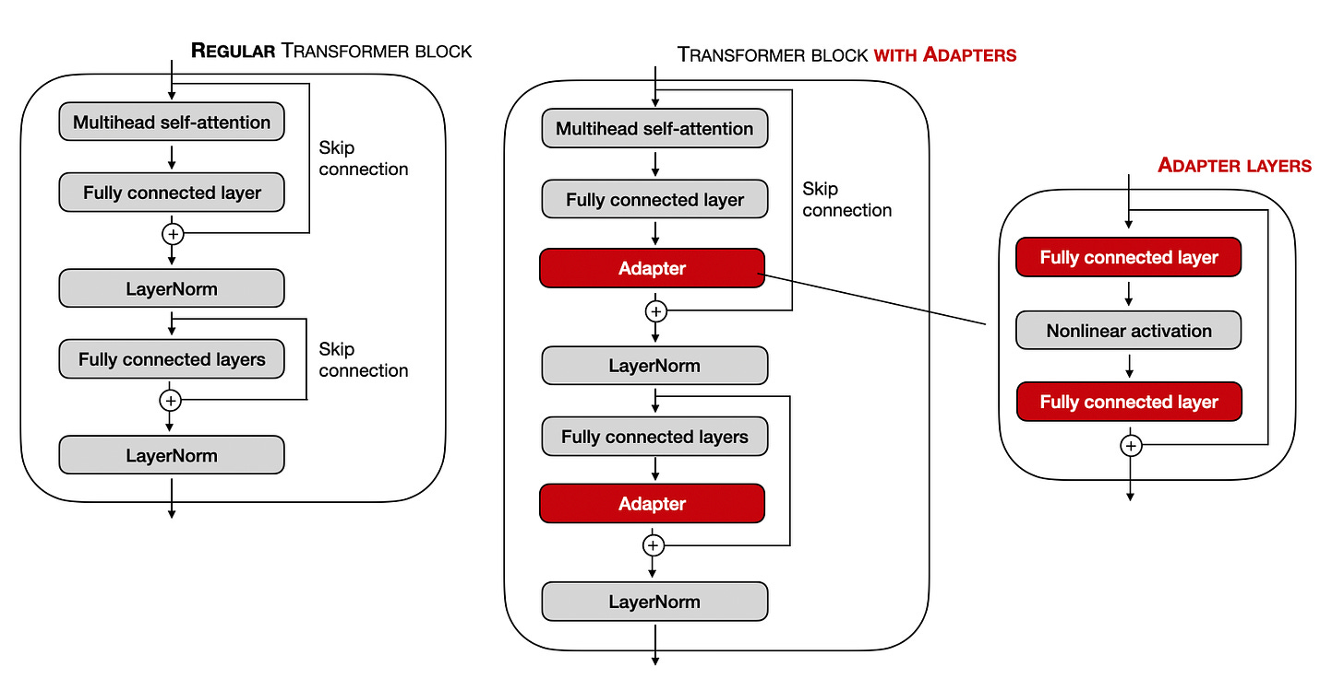
LLM Efficient Model Finetuning: Adapters
Prompt Tuning
Parameter Efficient Finetuning (PEFT)
https://github.com/huggingface/peft
https://magazine.sebastianraschka.com/p/finetuning-llms-with-adapters

Slide 13
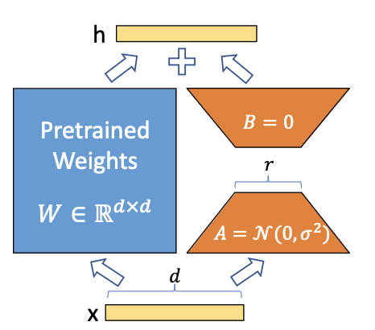

LLM Efficient Model Finetuning: LoRA
https://github.com/huggingface/peft
LoRA: Low Rank Adaptation

Slide 14
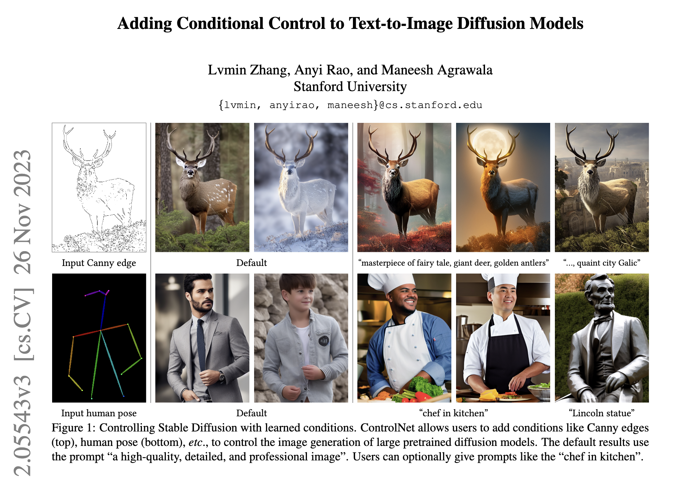
ControlNet

Slide 15
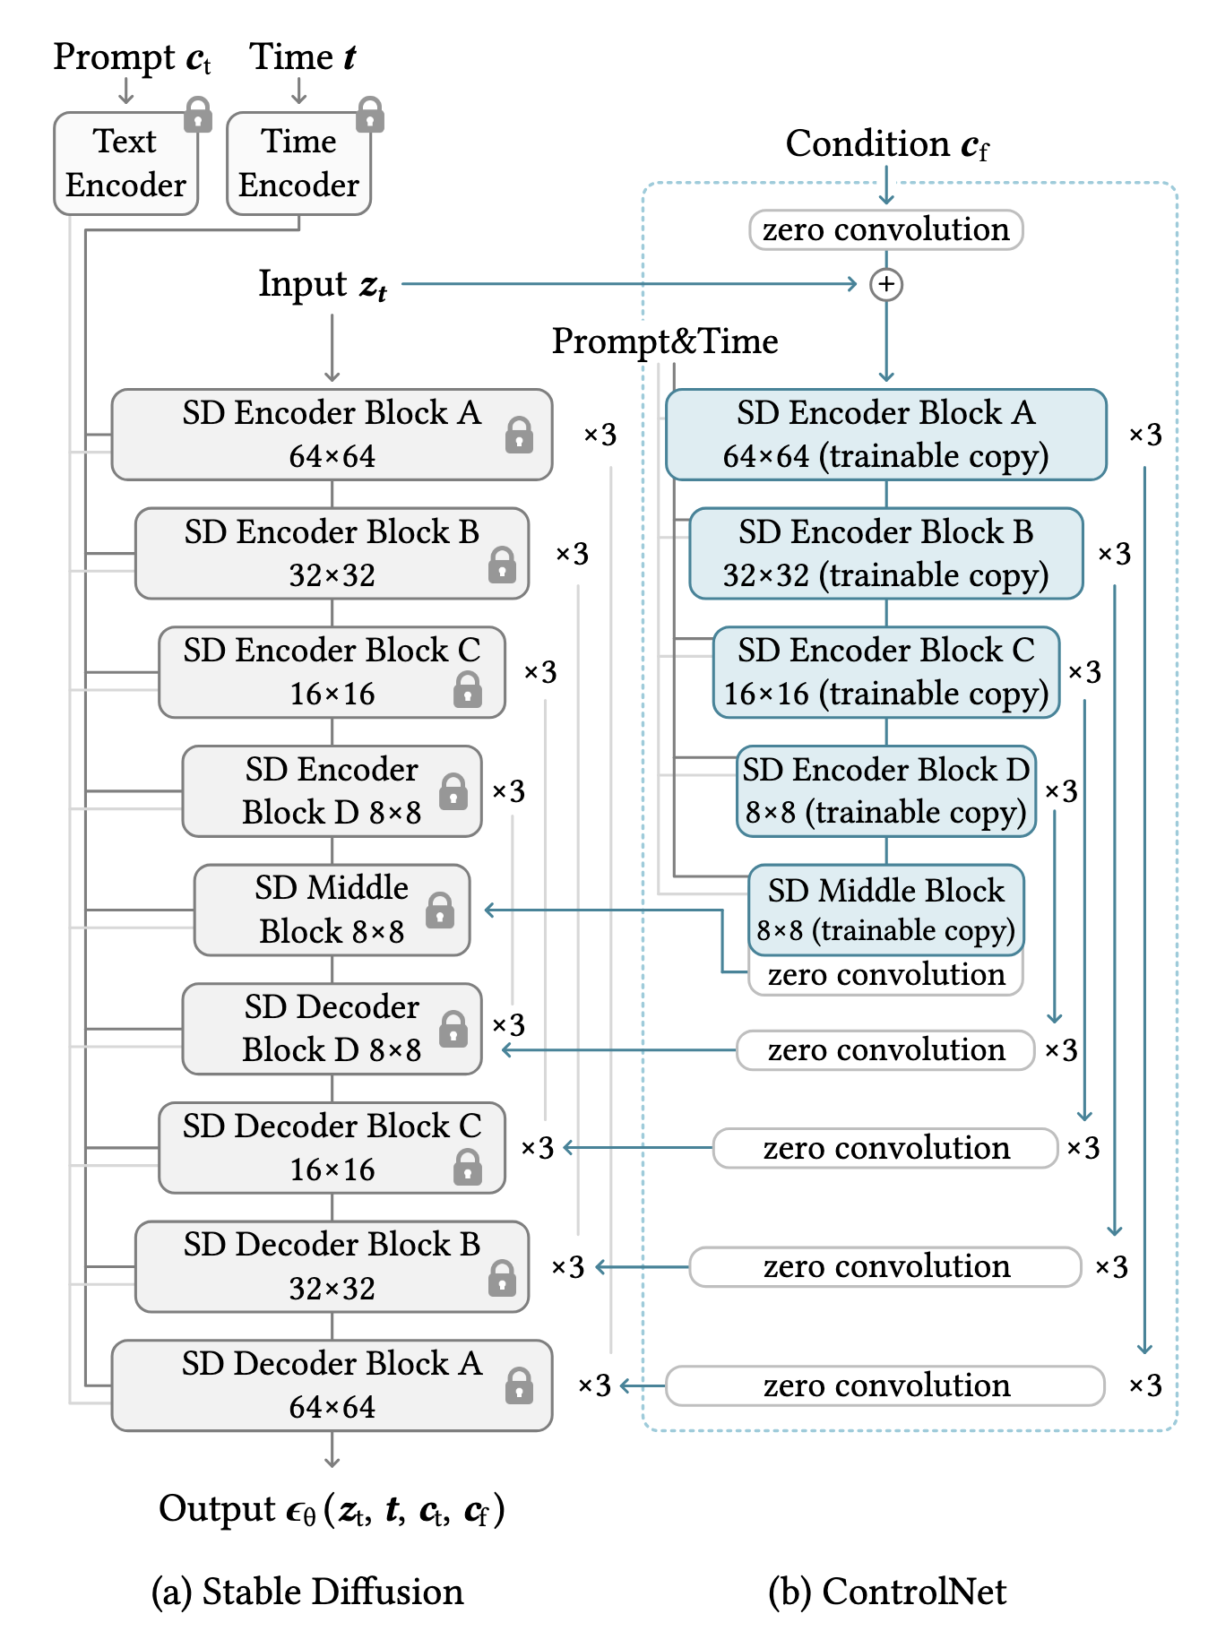
ControlNet

Slide 16
Questions?

