Slide 1
Deep Learning for Vision & Language
Text-to-3D models

Slide 2
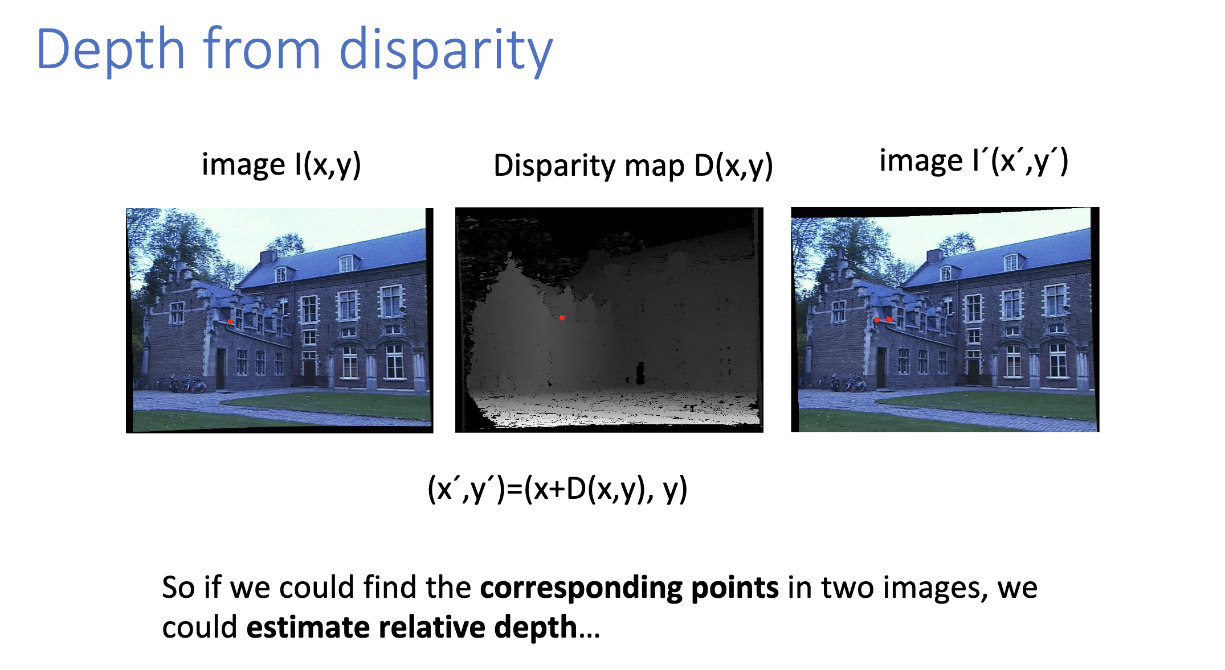
Preliminaries 1: 3D information from Multiple Image Views

Slide 3
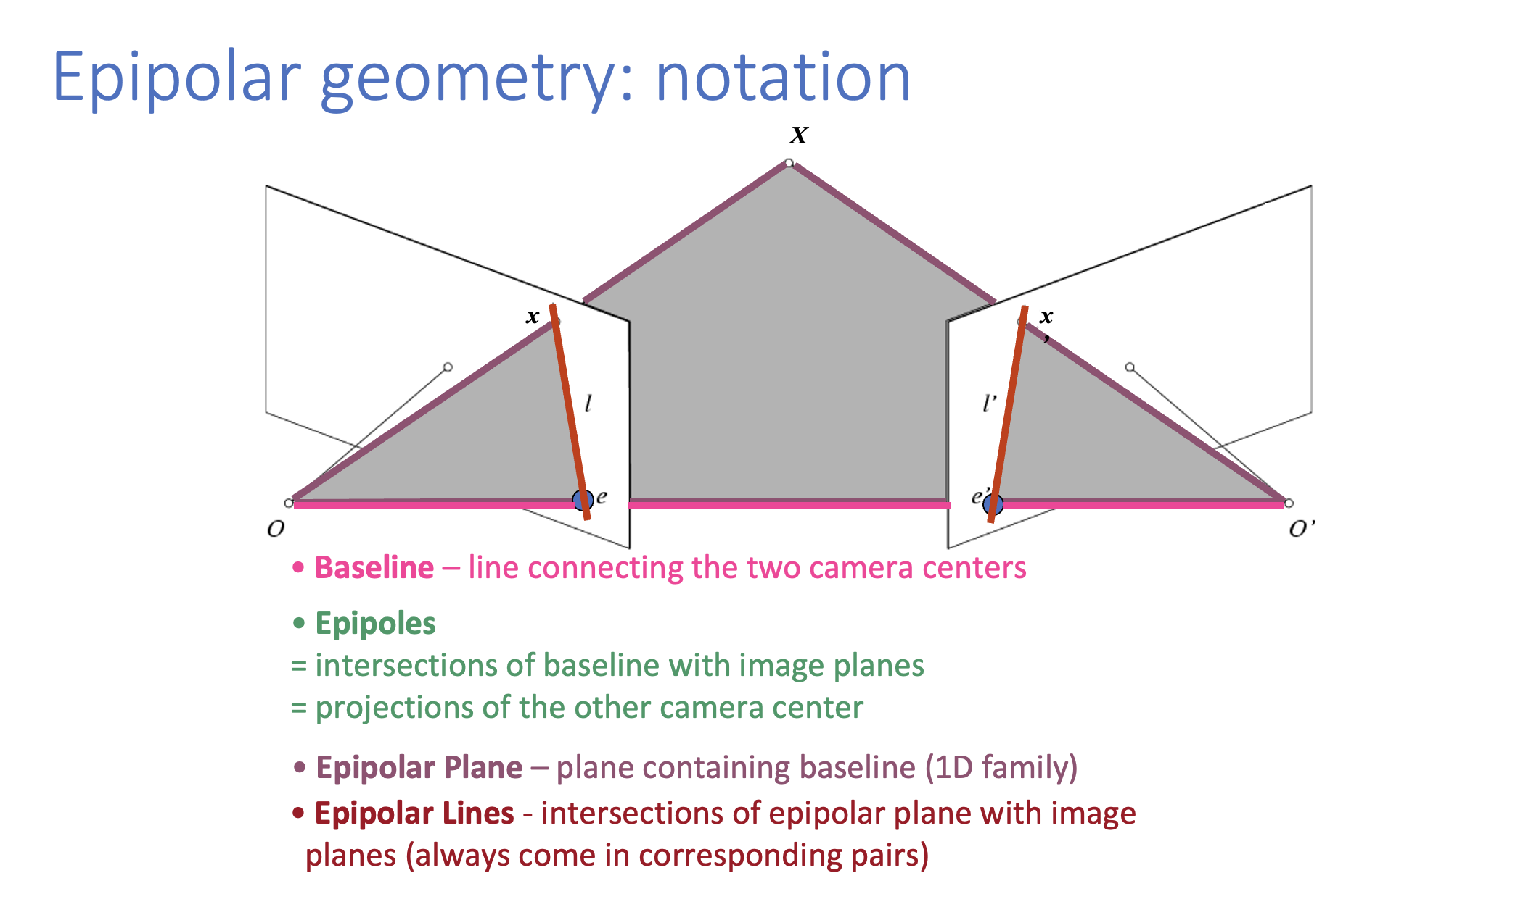
Preliminaries 1: 3D information from Multiple Image Views

Slide 4
Preliminaries 2: Explicit Representations vs Implicit Representations
(x1, y1)
(x2, y2)
Explicit: (x1, y1) (x2, y2)
Implicit: f(x, y) such that 1 if (x,y) inside the square 0 if (x,y) outside the square

Slide 5
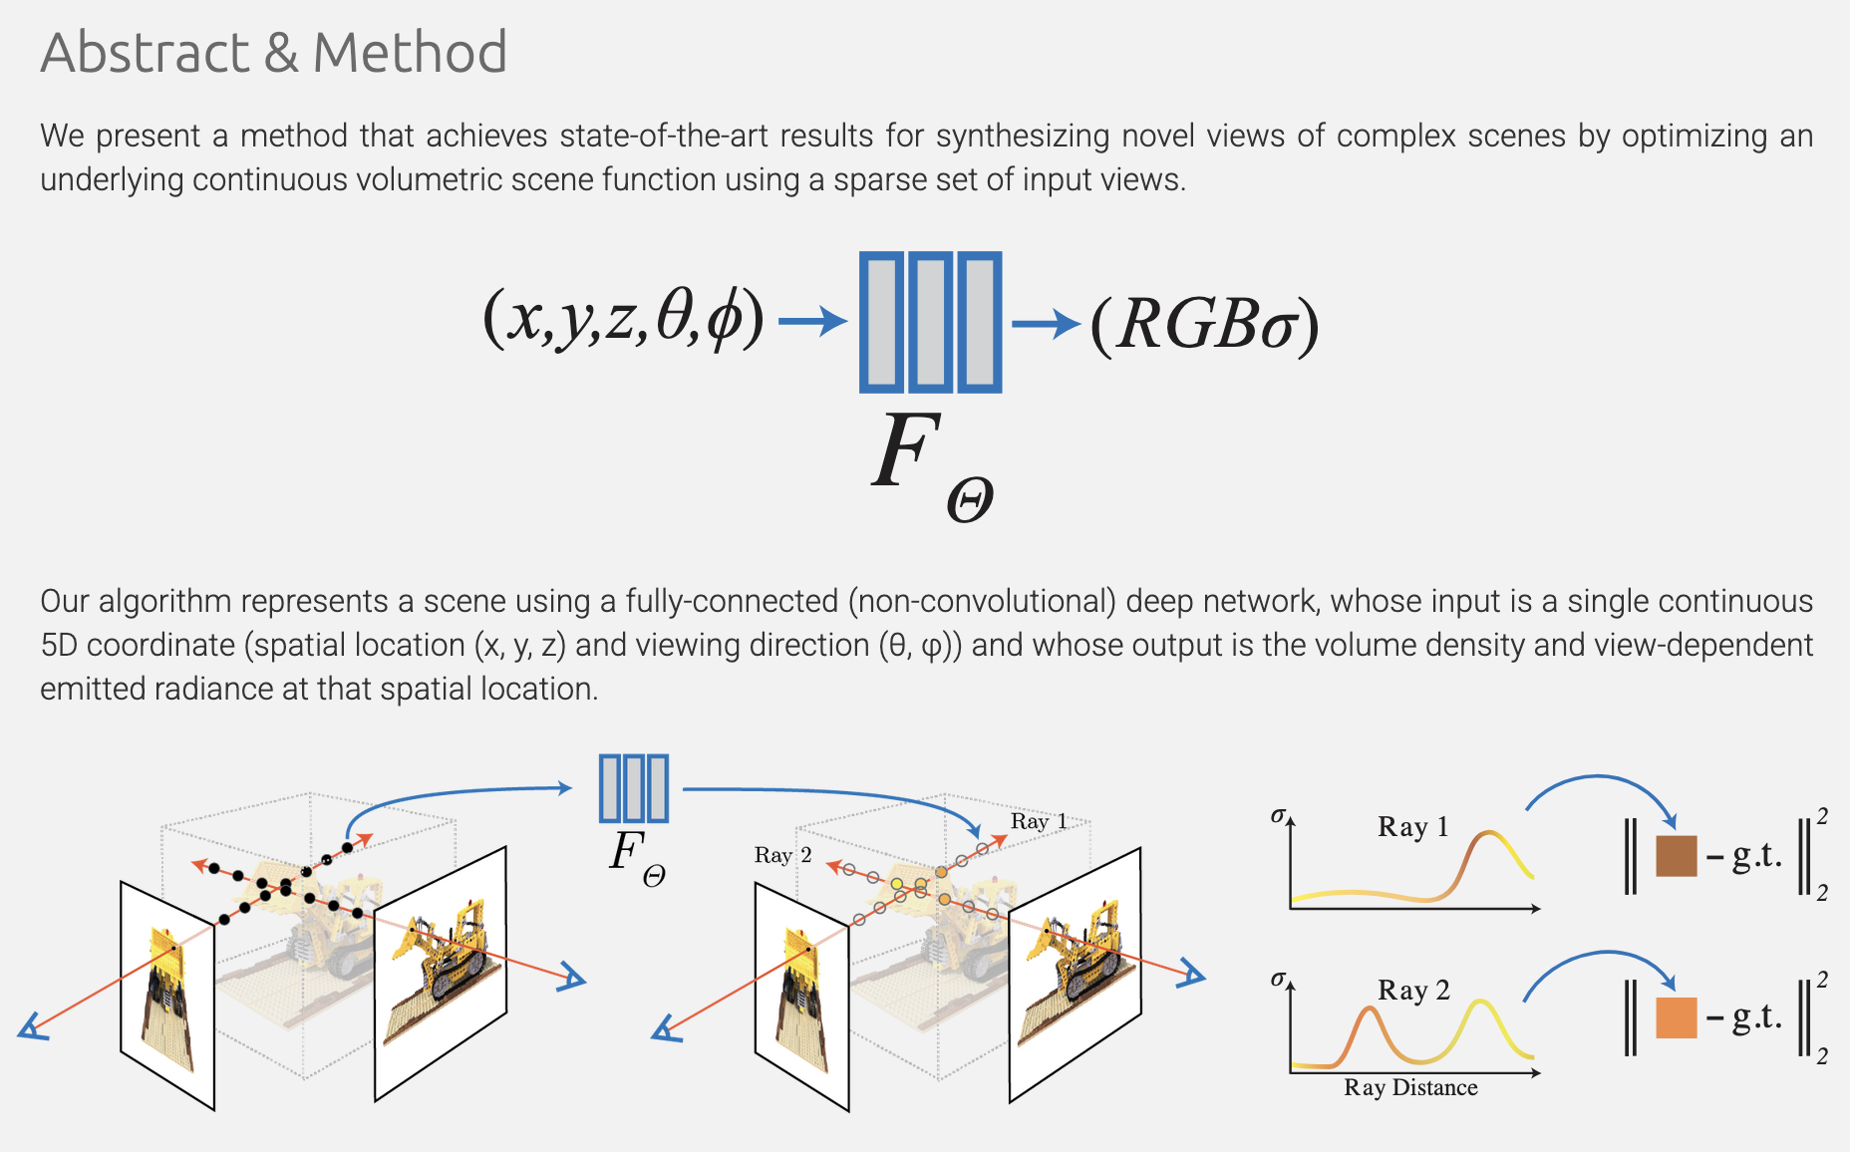
Neural Radiance Fields (NeRFs)
https://www.matthewtancik.com/nerf

Slide 6
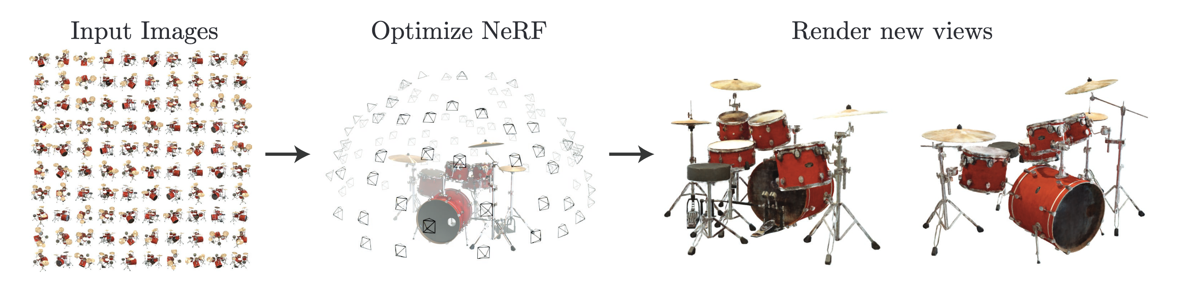
Neural Radiance Fields (NeRFs)
https://www.matthewtancik.com/nerf

Slide 7
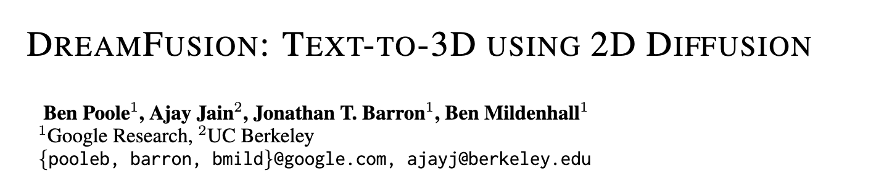
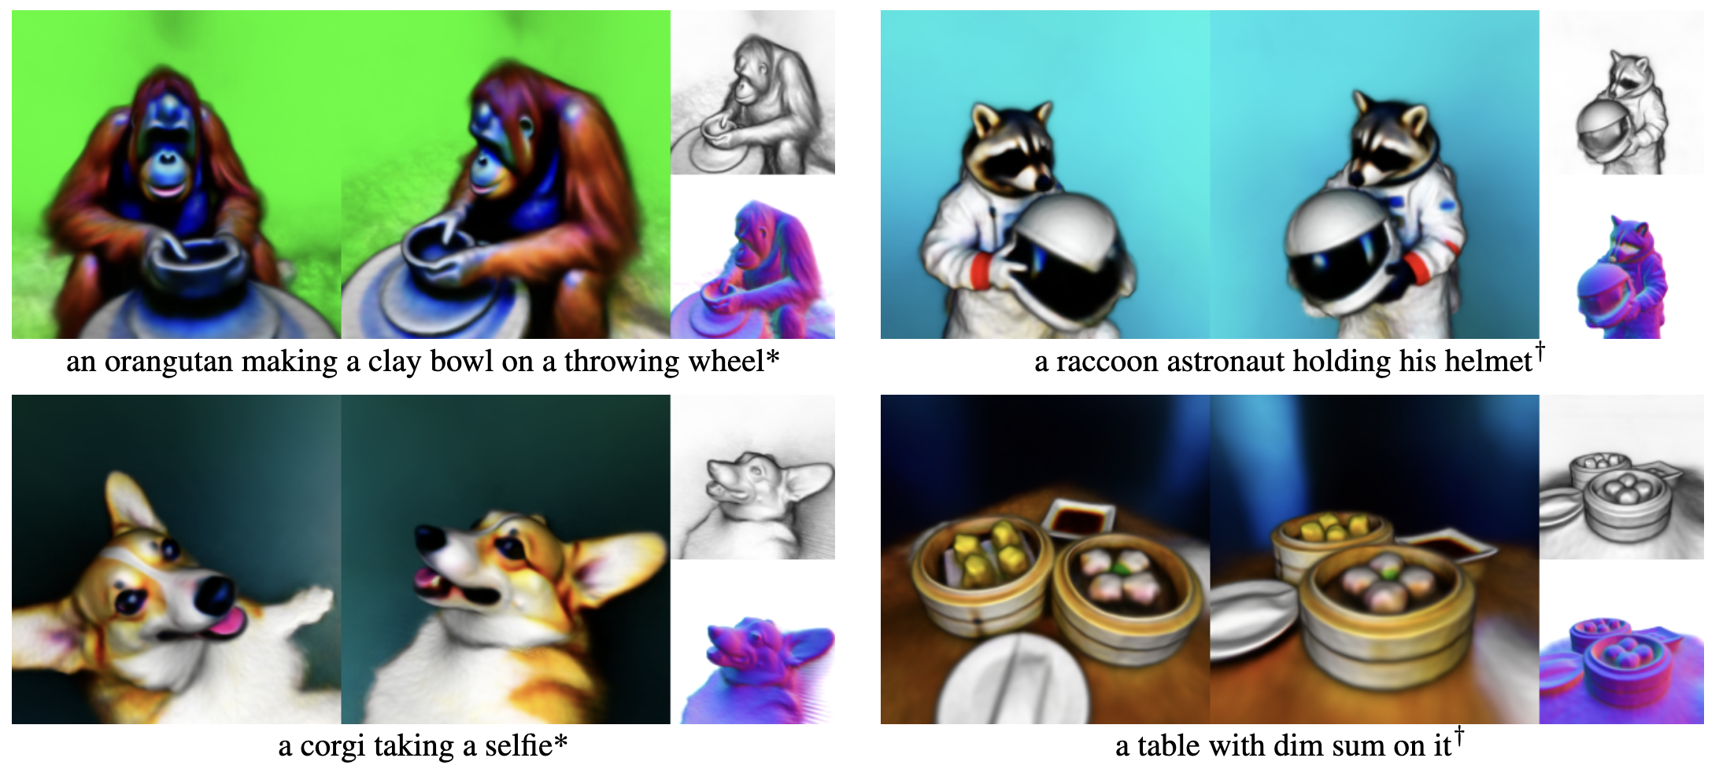
https://arxiv.org/abs/2209.14988 (September 2022)

Slide 8
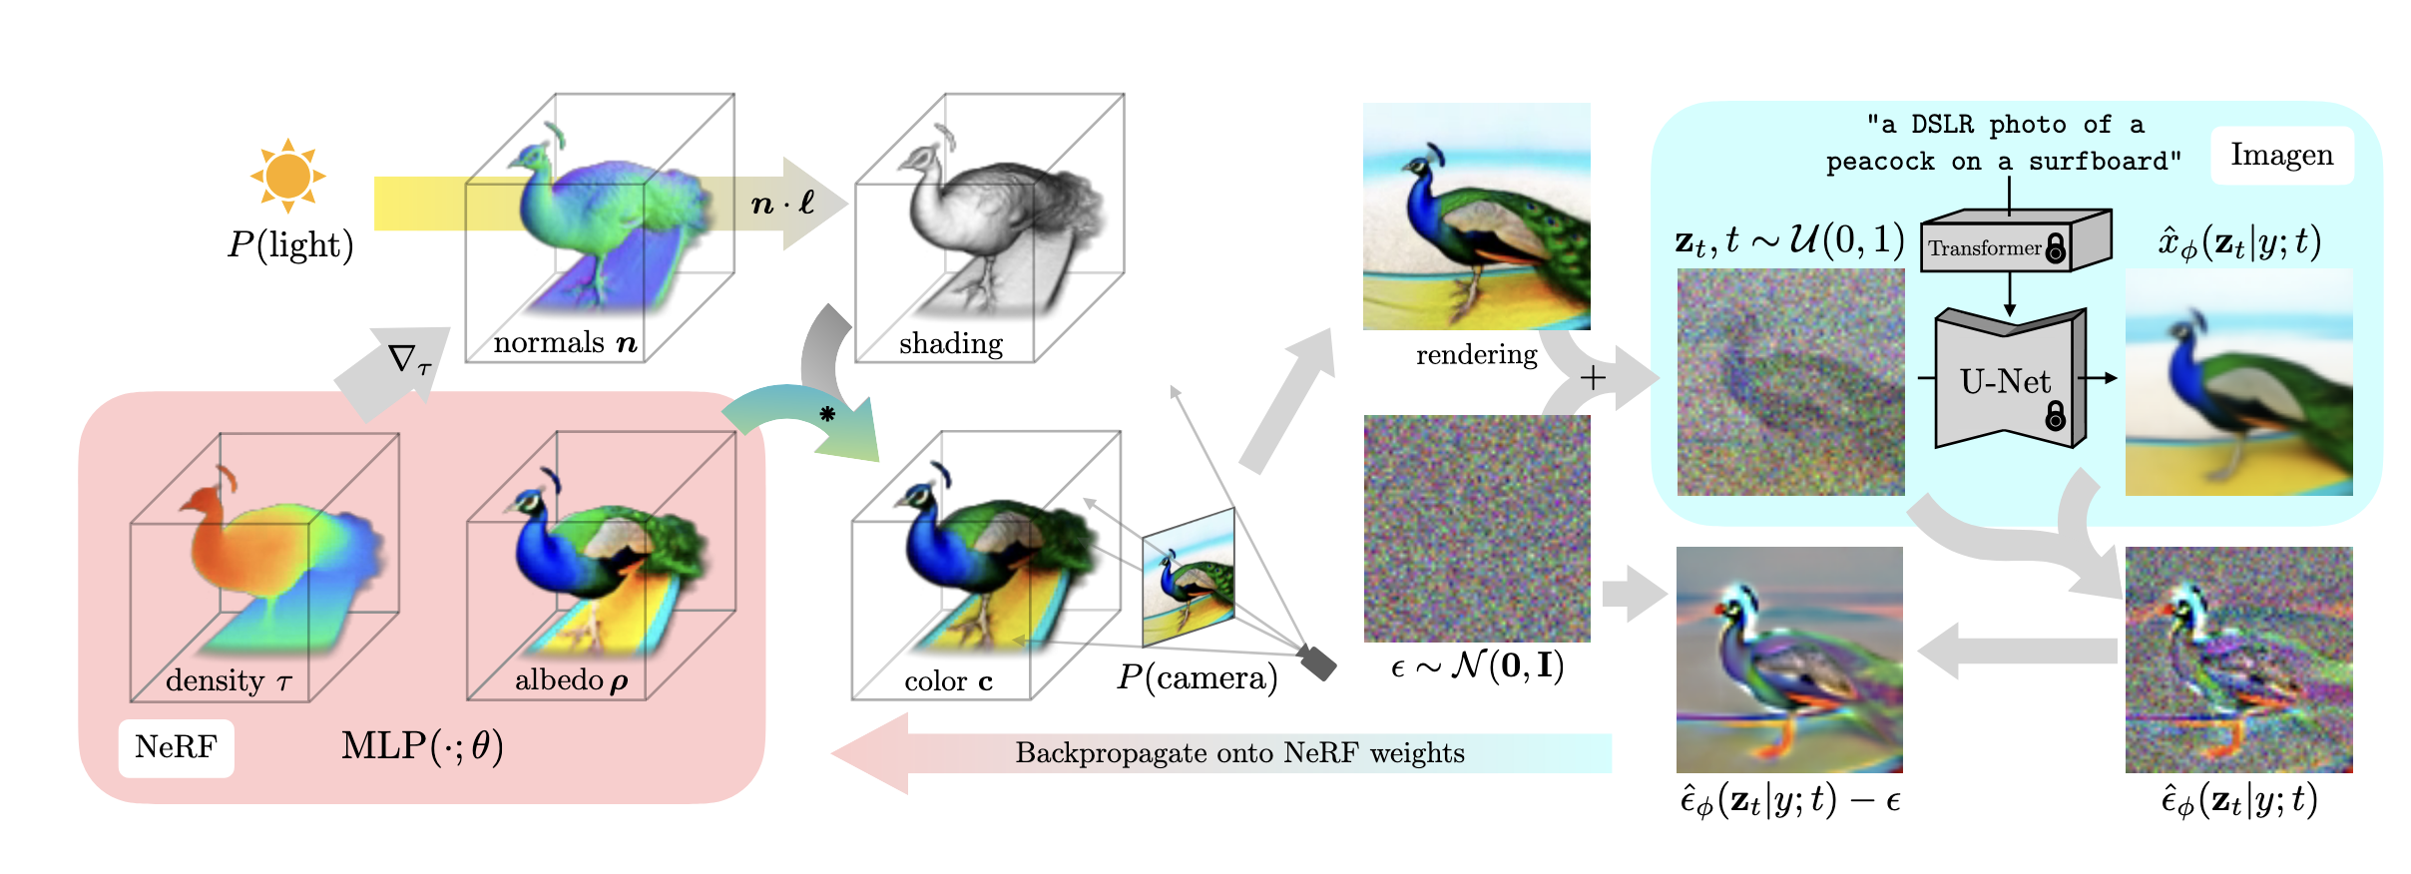

Slide 9
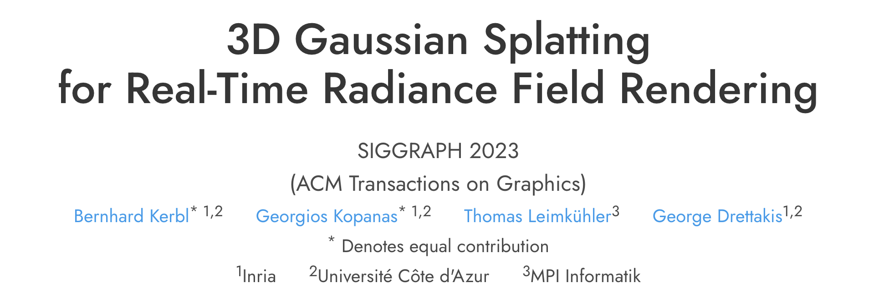
3D Gaussian Splatting
https://repo-sam.inria.fr/fungraph/3d-gaussian-splatting/

Slide 10
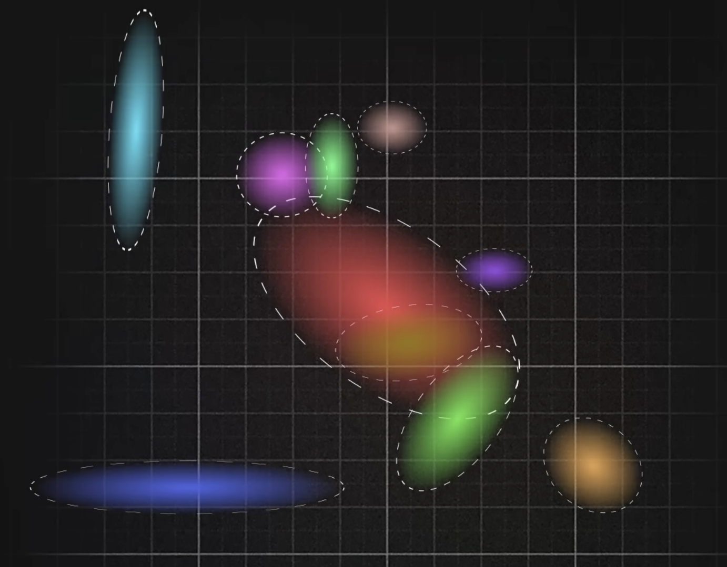
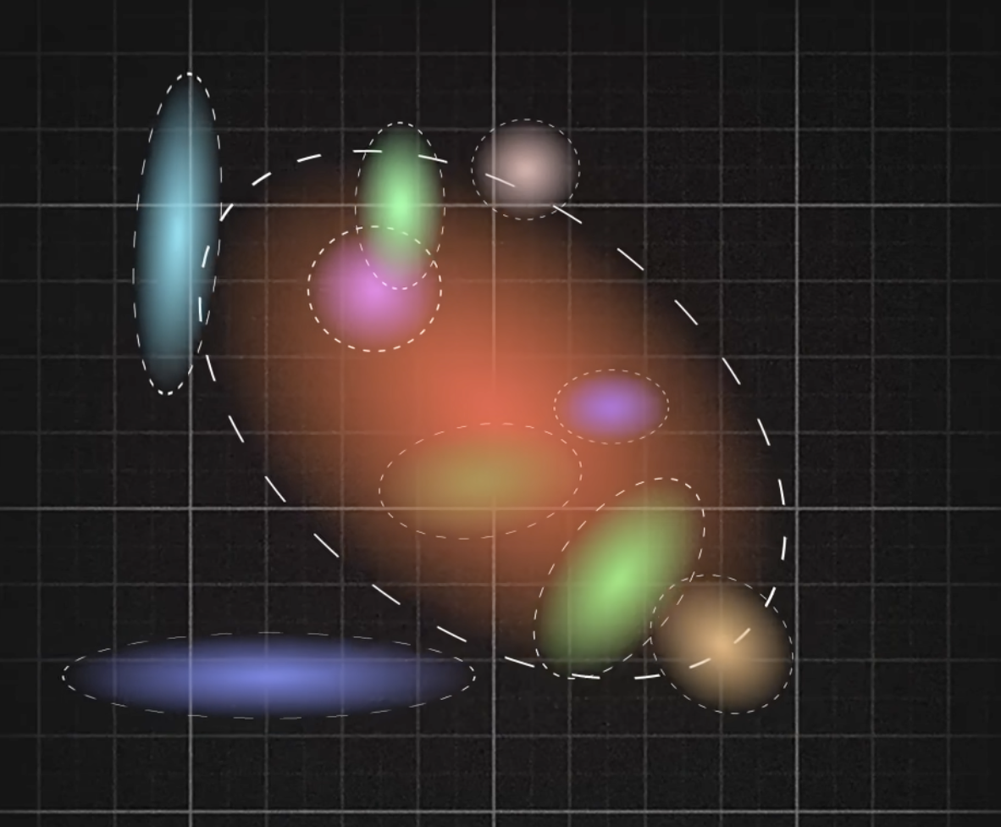
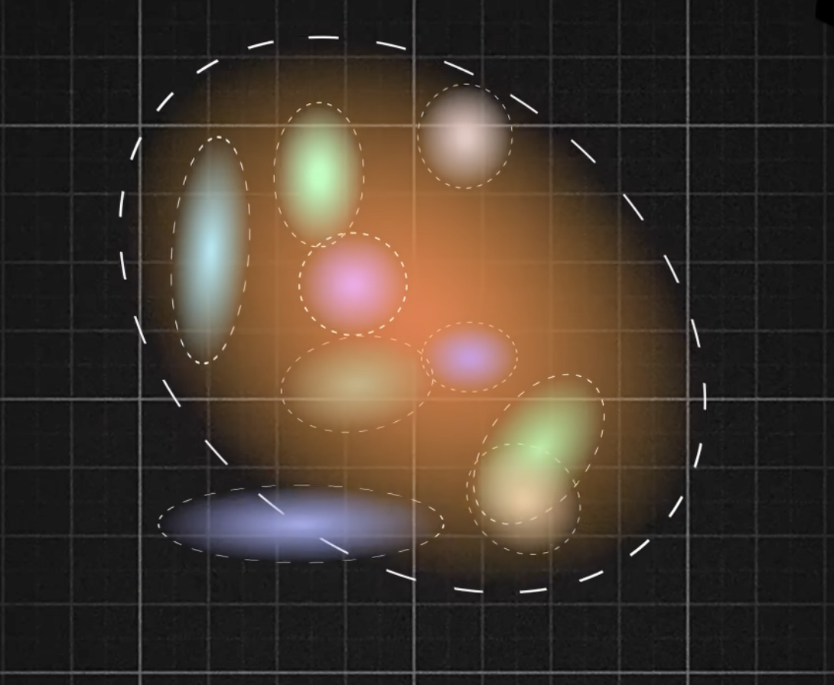
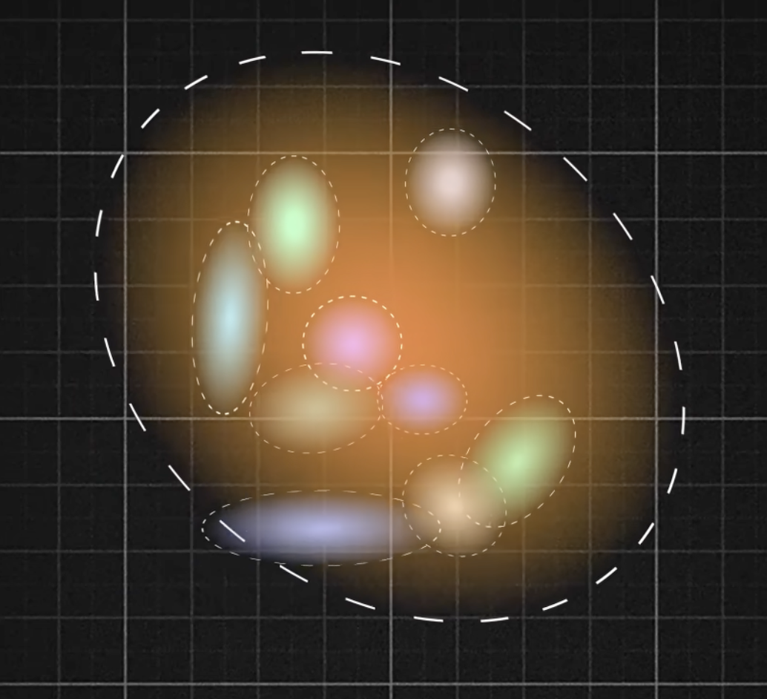
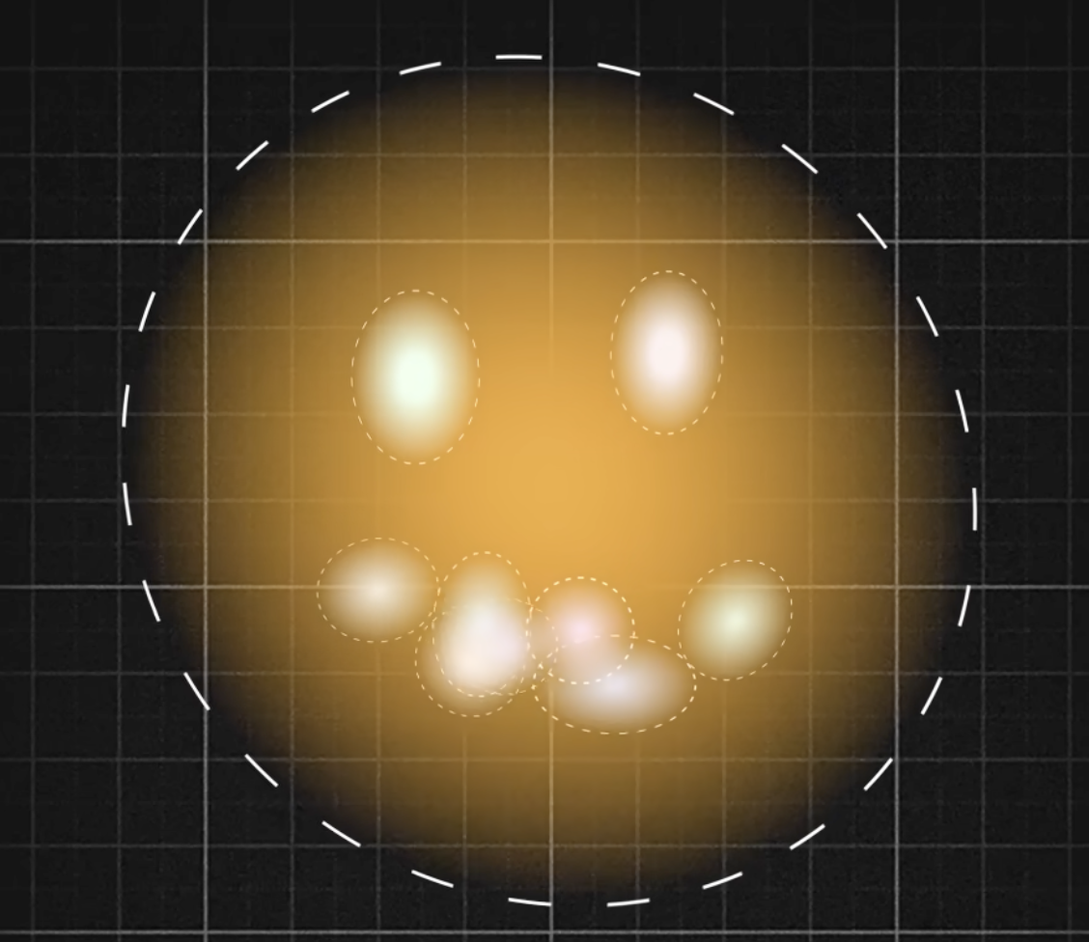
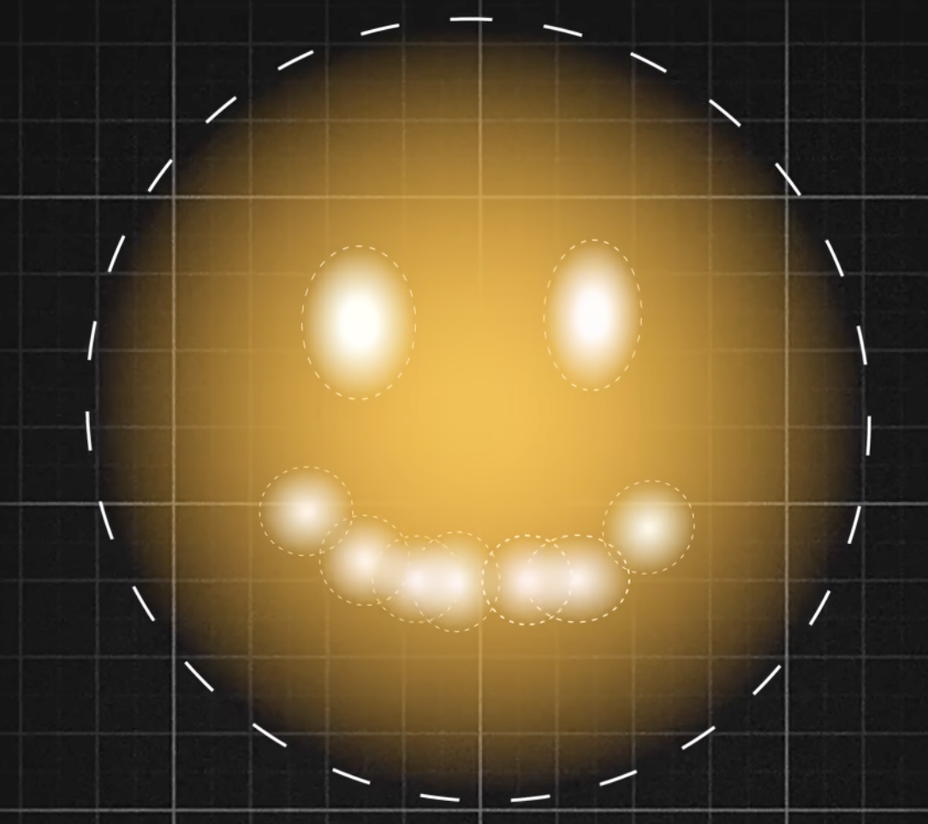
2D Gaussian Splatting
https://www.youtube.com/watch?v=_vPwiPuBDnU&t=817s

Slide 11
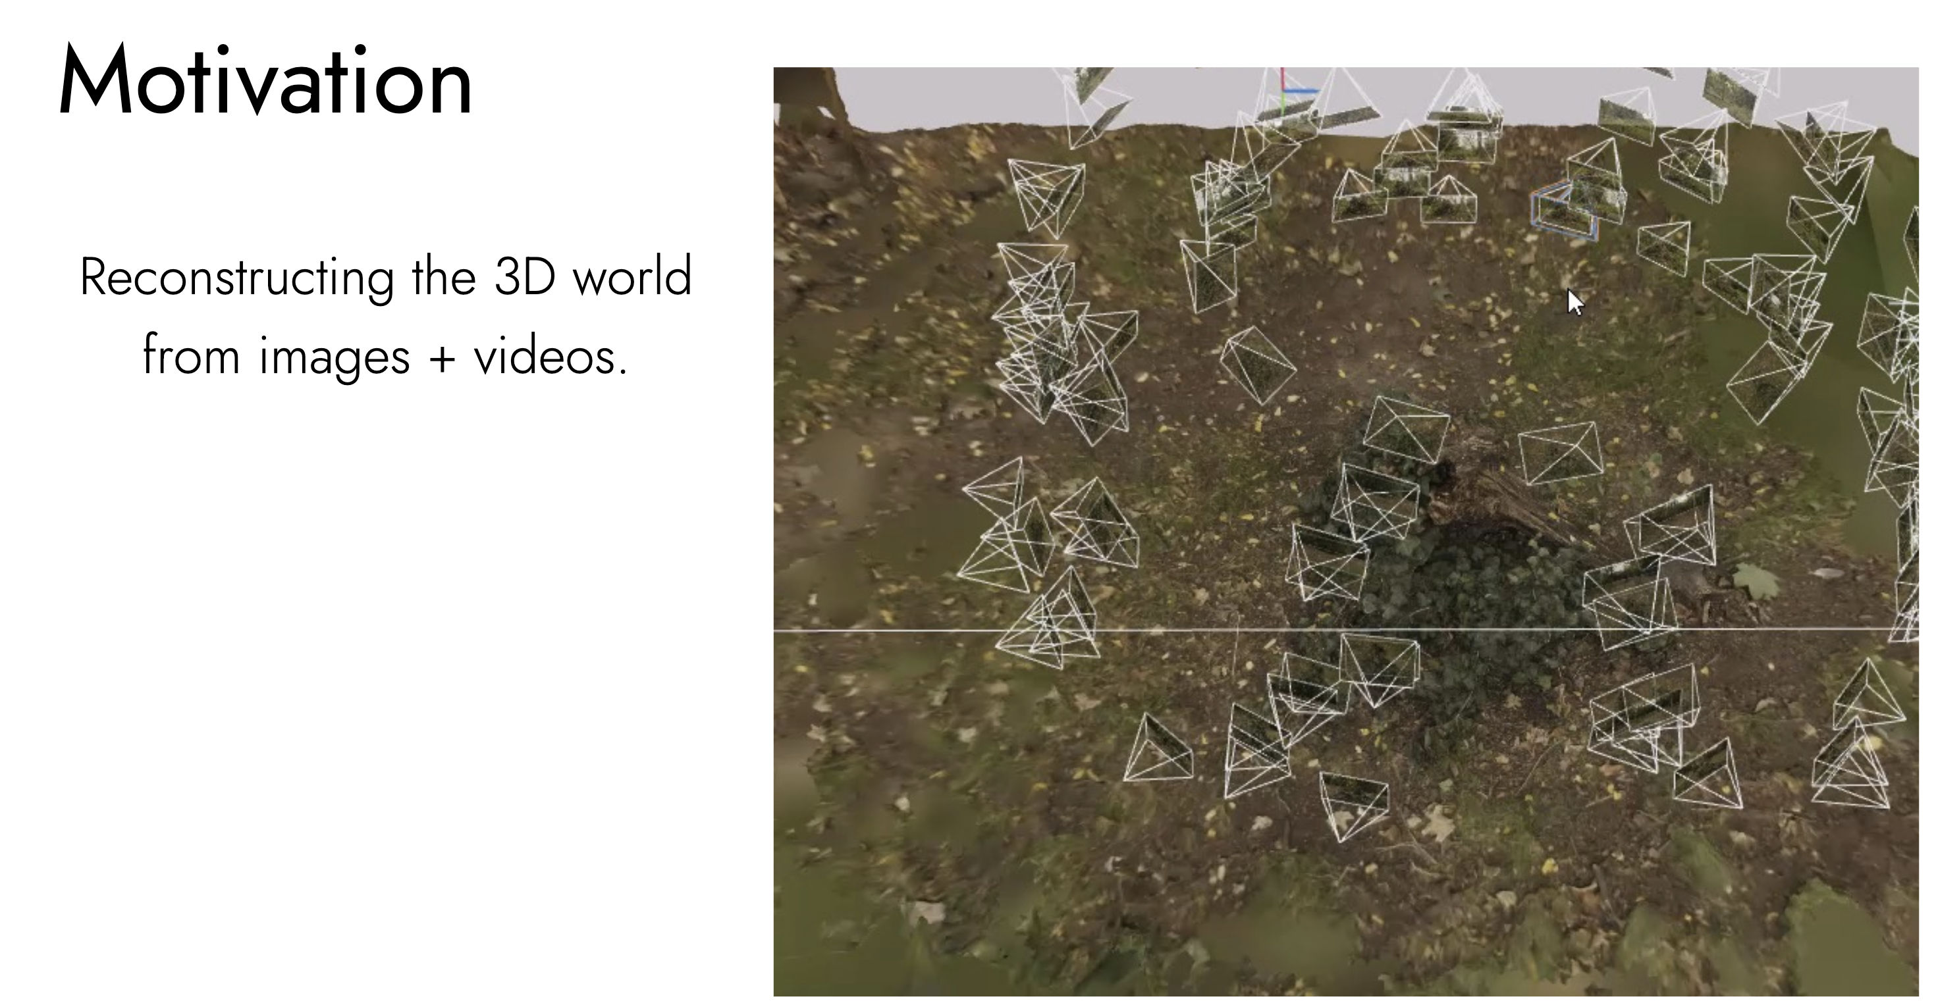
3D Gaussian Splatting
https://3dgstutorial.github.io/3dv_part1.pdf

Slide 12
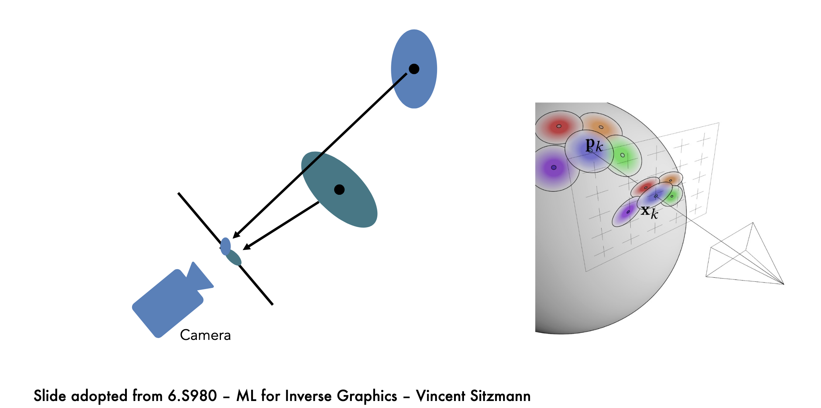
3d Gaussian Splatting

Slide 13
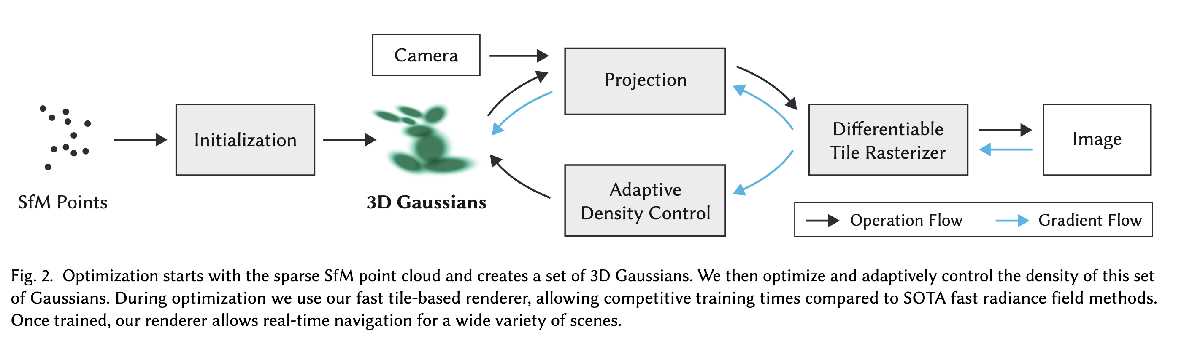
3D Gaussian Splatting
Example: https://youtu.be/_vPwiPuBDnU?si=sEzIEPlnam77AMi4&t=721

Slide 14
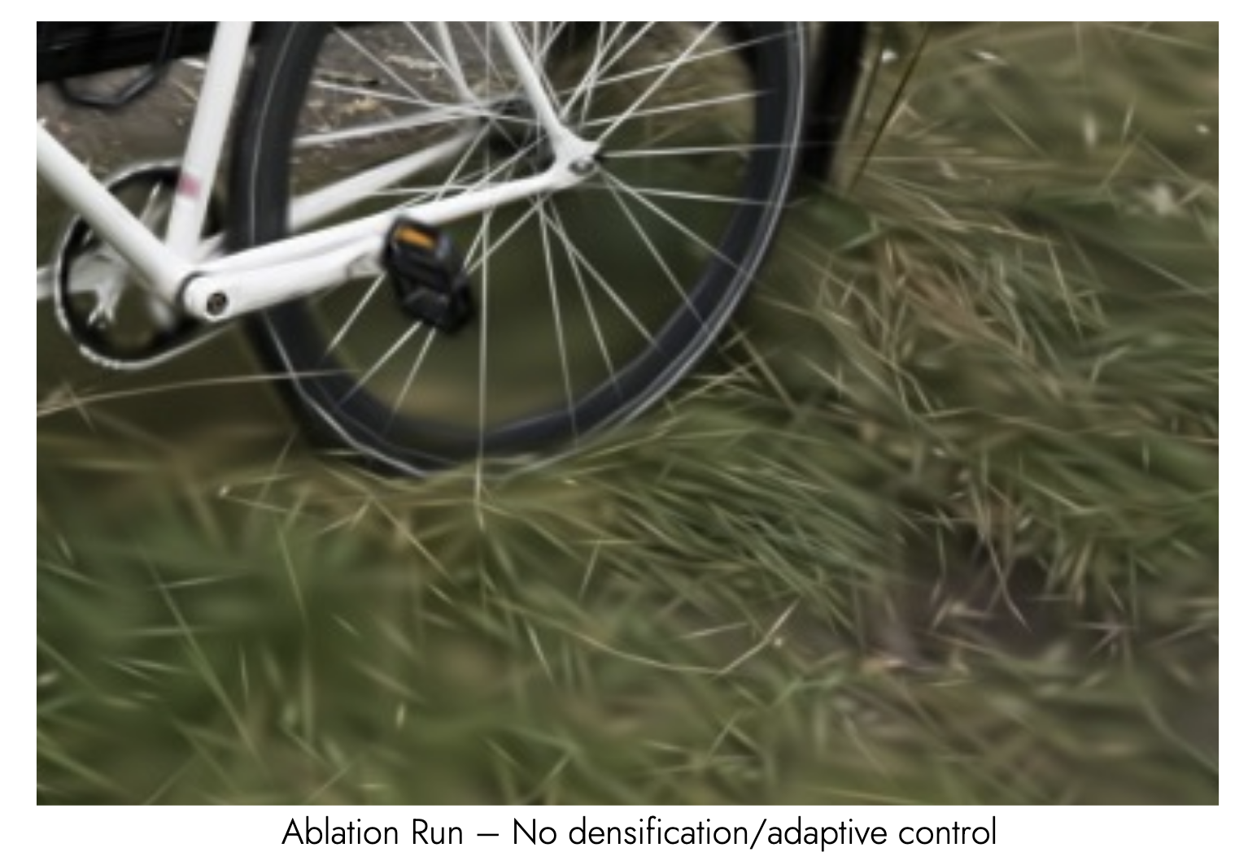
Other Details: Densification vs No Densification
https://3dgstutorial.github.io/3dv_part1.pdf

Slide 15
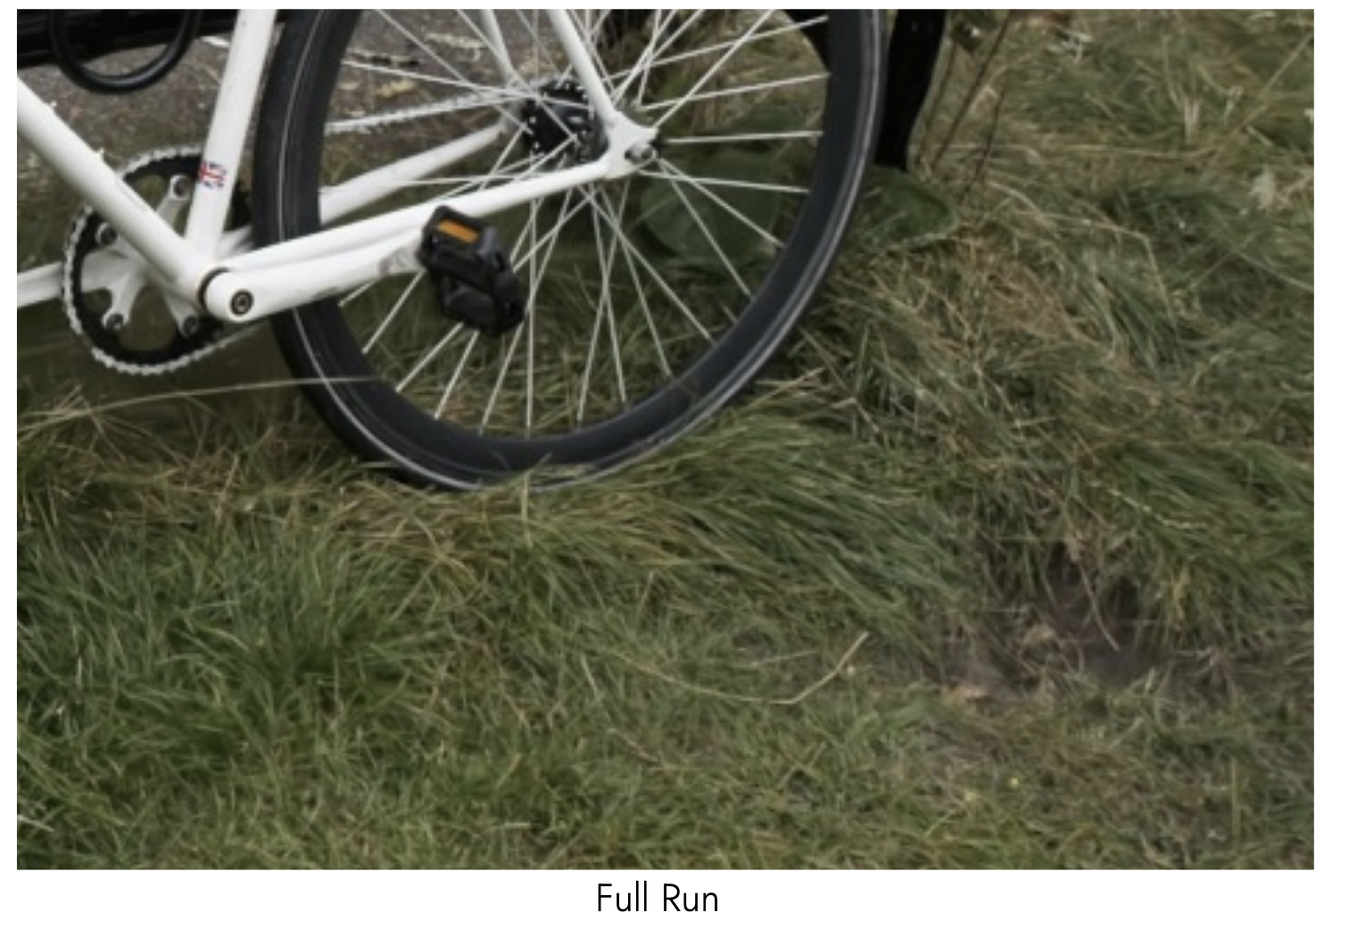
Other Details: Densification vs No Densification
https://3dgstutorial.github.io/3dv_part1.pdf

Slide 16
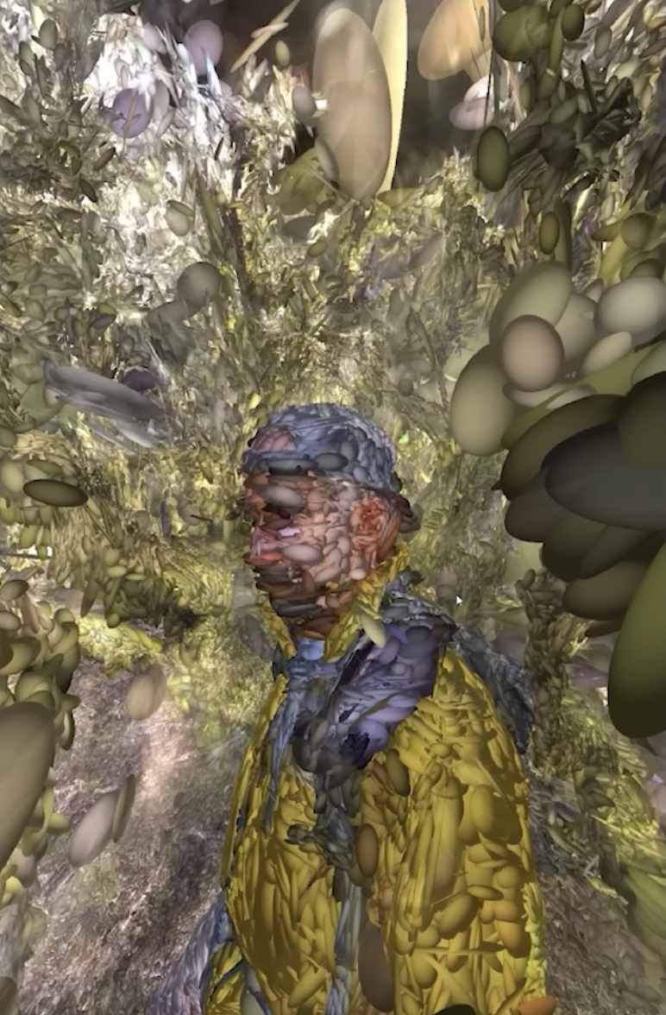
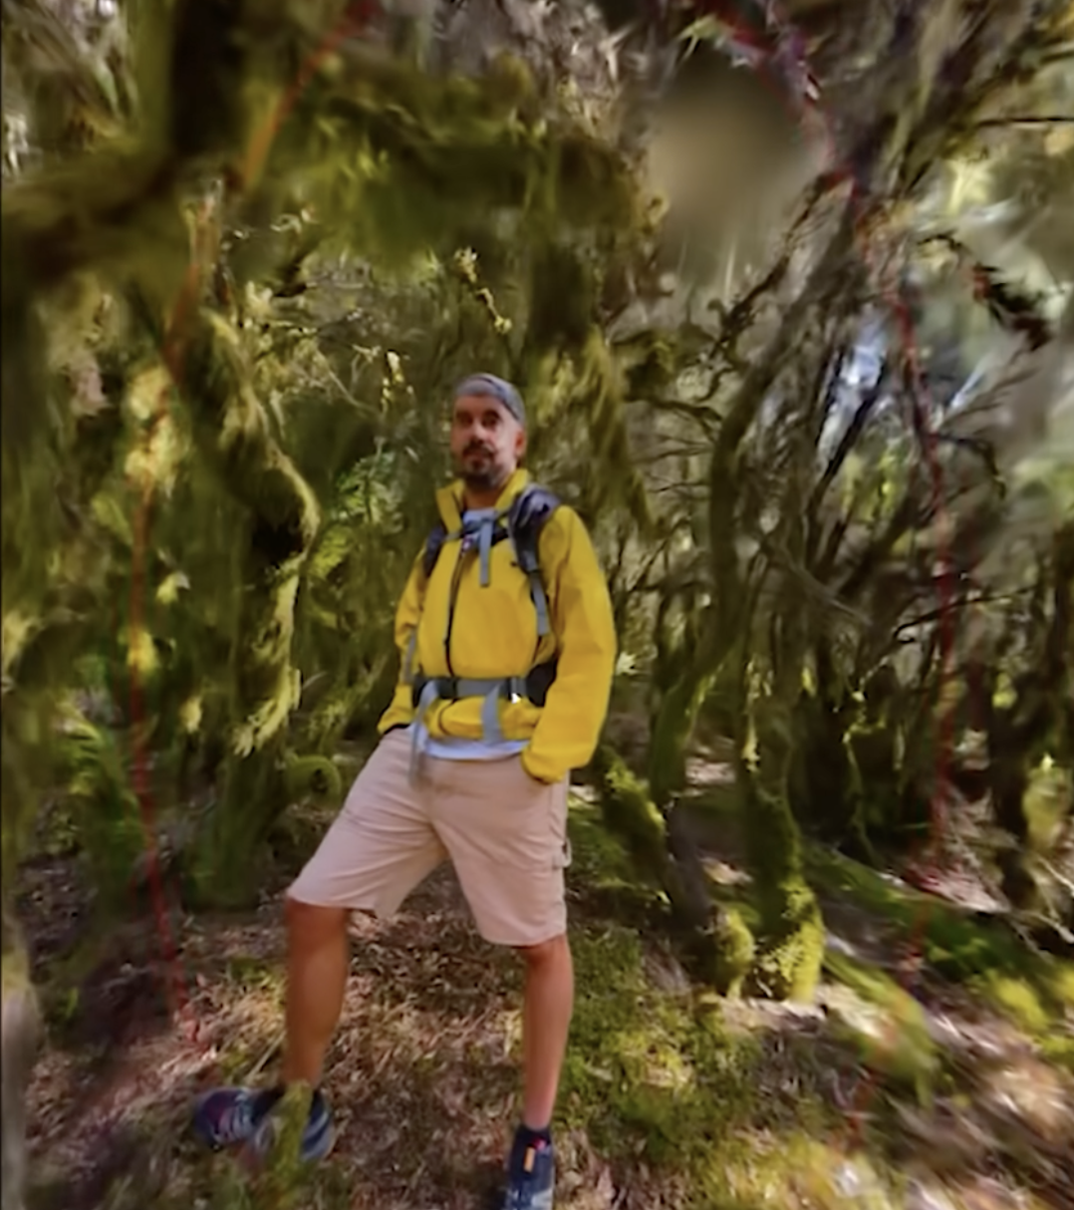
3D Gaussian Splatting
Example: https://youtu.be/_vPwiPuBDnU?si=sEzIEPlnam77AMi4&t=721

Slide 17
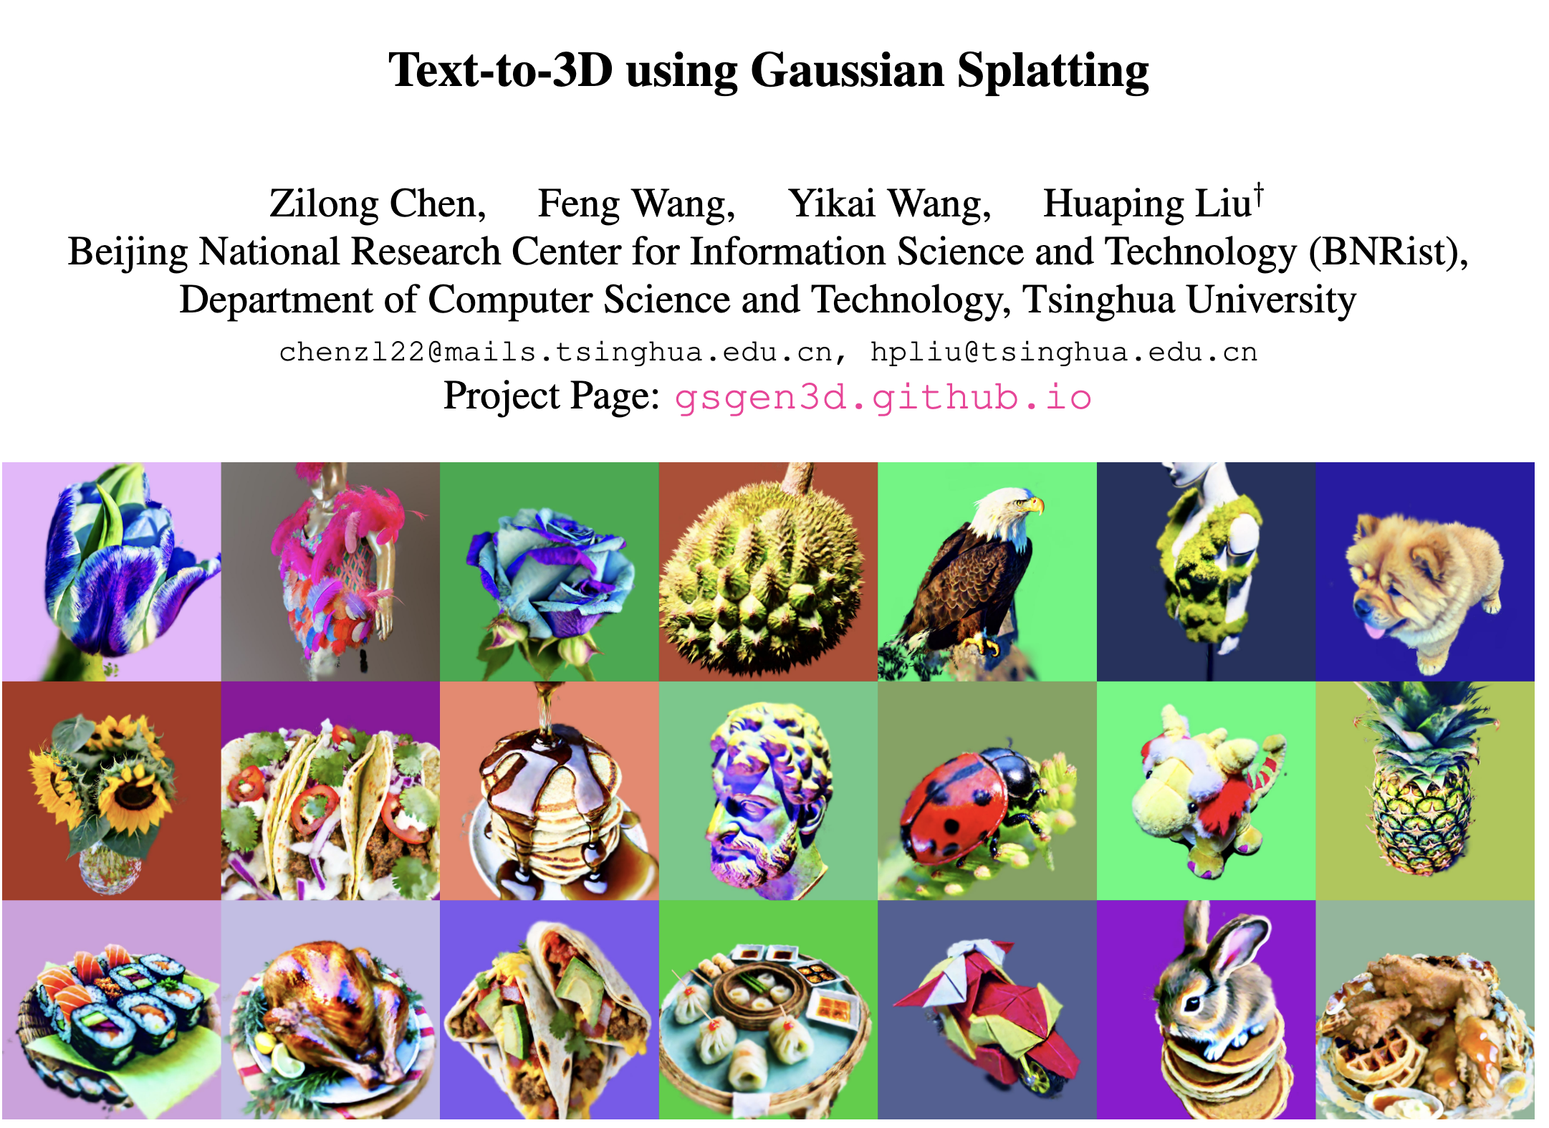
https://arxiv.org/abs/2309.16585 (April 2024)

Slide 18
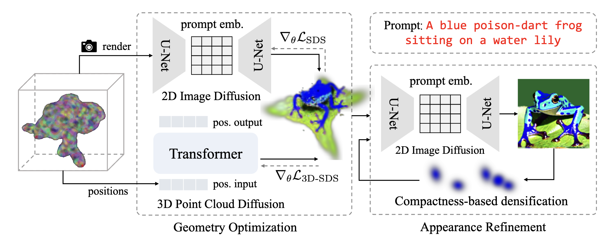

Slide 19
Questions?

