Slide 1
Deep Learning for
Vision and Language
Welcome and Introduction

Slide 2
About the class
COMP 646: Deep Learning for Vision and Language
Instructor: Vicente Ordóñez (Vicente Ordóñez Román)
Website: https://www.cs.rice.edu/~vo9/deep-vislang
Location: Keck Hall 100
Times: Tuesdays and Thursdays
from 4pm to 5:15pm
Office Hours: TBD (Duncan Hall 2080)
Teaching Assistants: Jaywon Koo, Catherine He, Ruidi Chang, Jason Uwaeze
Discussion Forum: TBD

Slide 3
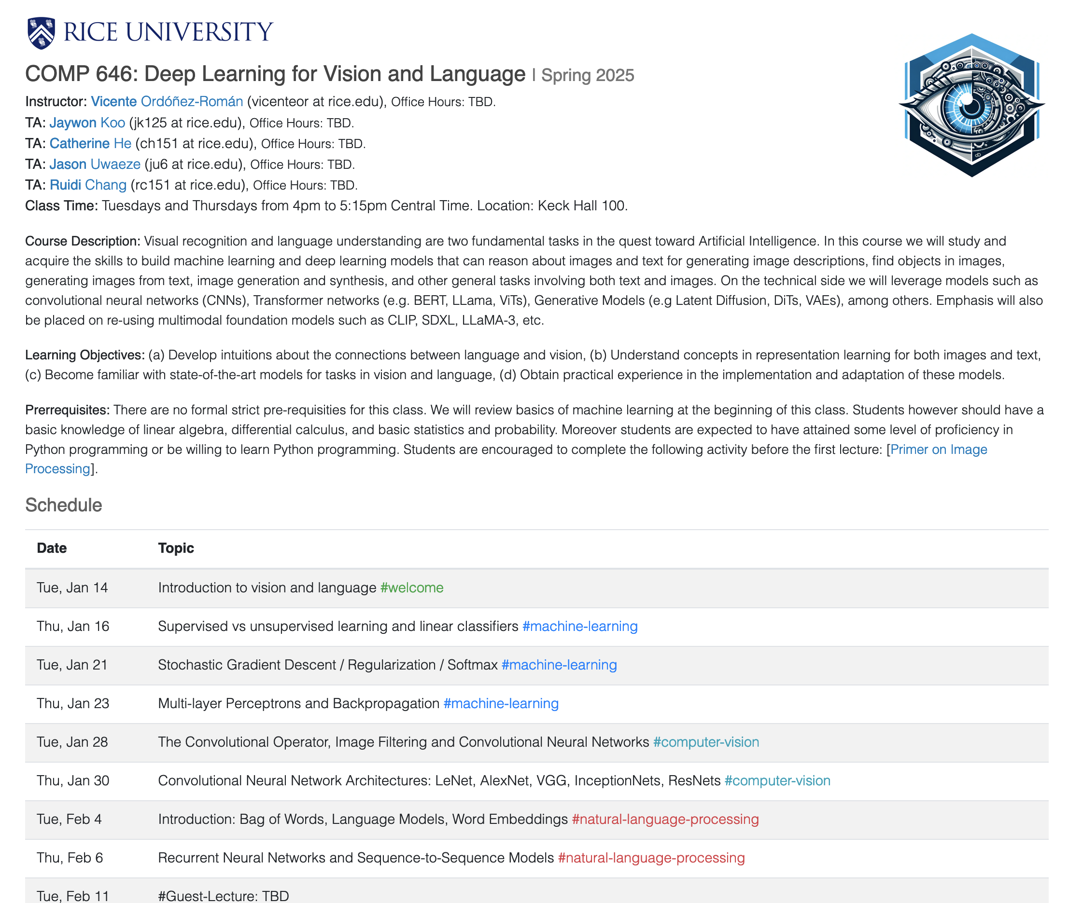
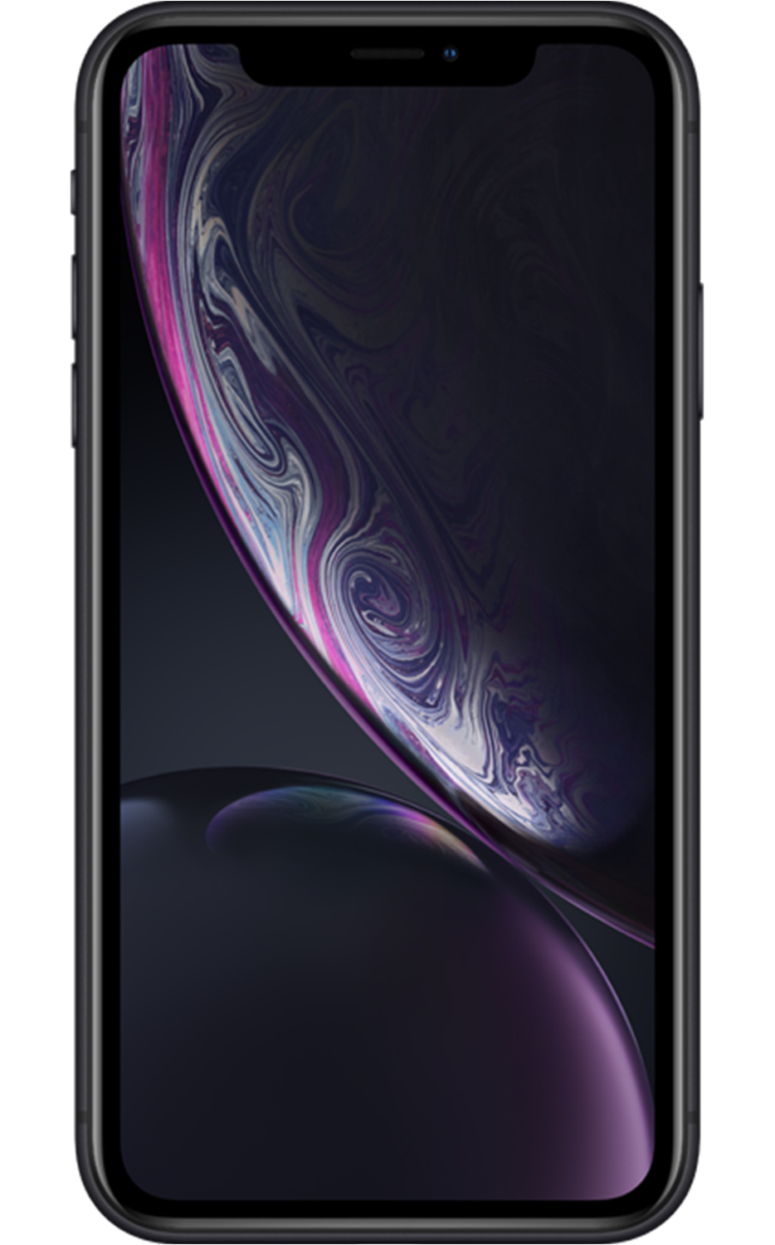
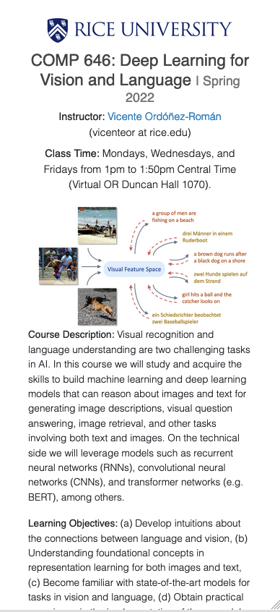
https://www.cs.rice.edu/~vo9/deep-vislang/

Slide 4









About me -- Vicente
Associate Professor,
2021 - Present
Visiting Academic
2021 - 2025
Assistant Professor,
2016 - 2021
Visiting Professor,
2019
Adobe Research
Visiting Researcher,
2015 - 2016
MS, PhD in CS,
2009-2015
… also spent time at:

Slide 5
What is Vision and Language?
Anything at the intersection of Computer Vision and Natural Language Processing. Systems and models that depend a little bit on both.
Computer Vision: How do we teach machines to process, represent and understand images? e.g. to recognize objects in images.
Natural Language Processing: How do we teach machines to process, represent and understand text? e.g. to classify or generate text.

Slide 6
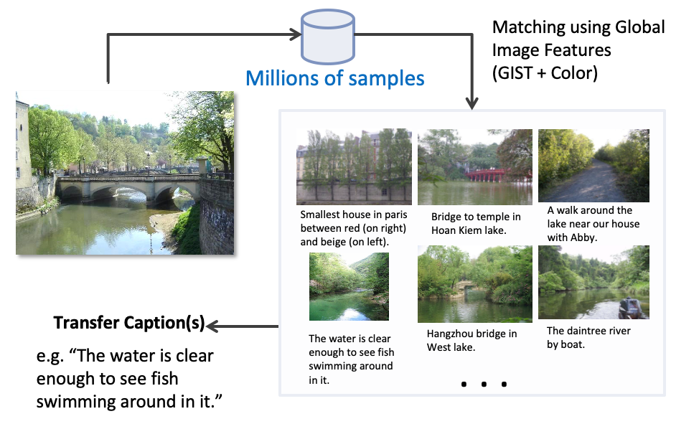
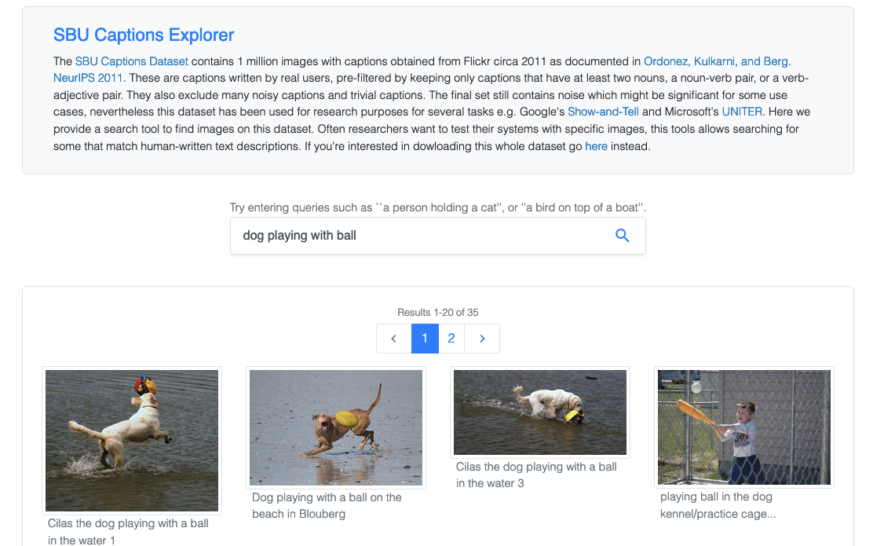
Some of our work includes…
Describing images with language
https://vislang.ai/sbu-explorer

Slide 7
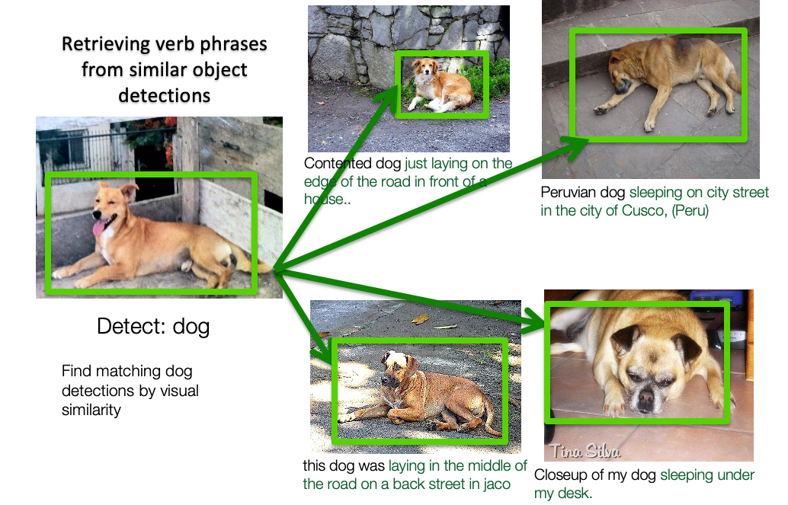
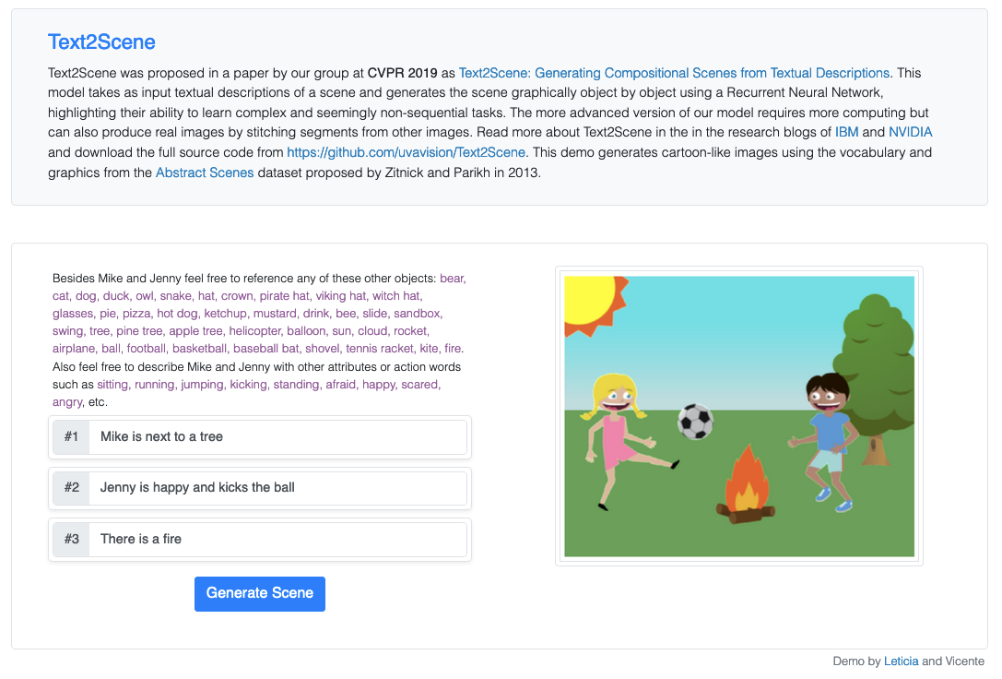
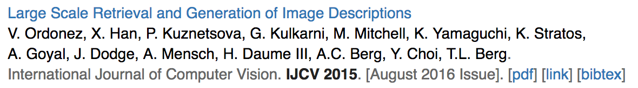
Some of our work includes…
Describing images with language
Describing language with images
https://vislang.ai/text2scene

Slide 8
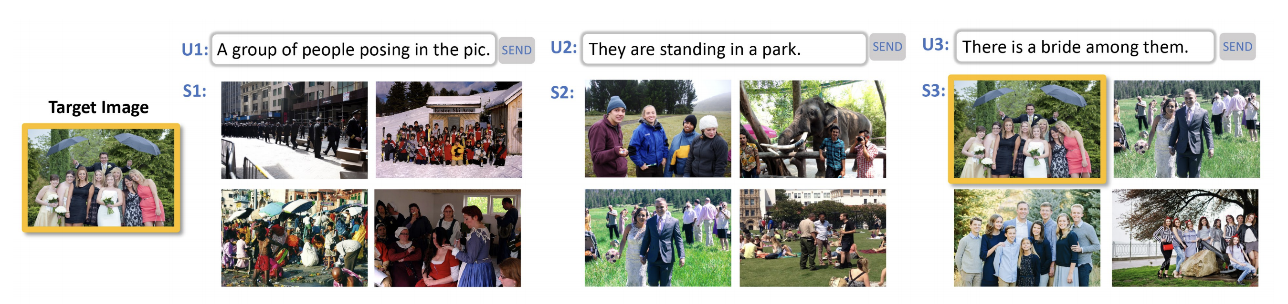
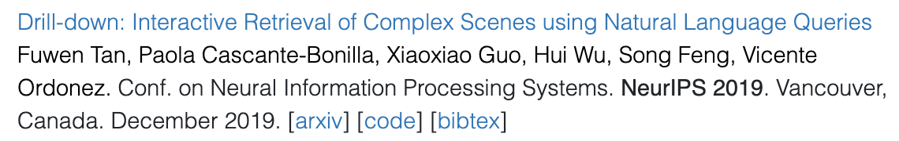
Some of our work includes…
Interactive Image Retrieval

Slide 9
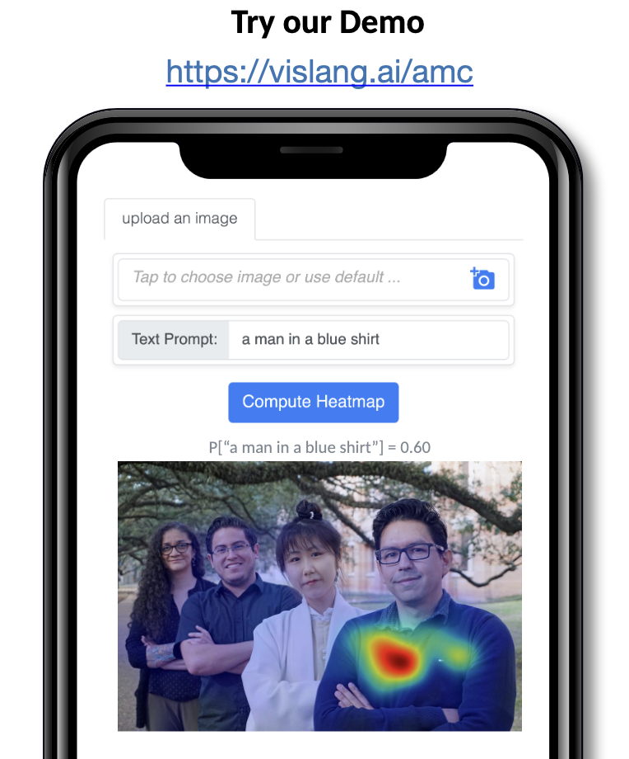
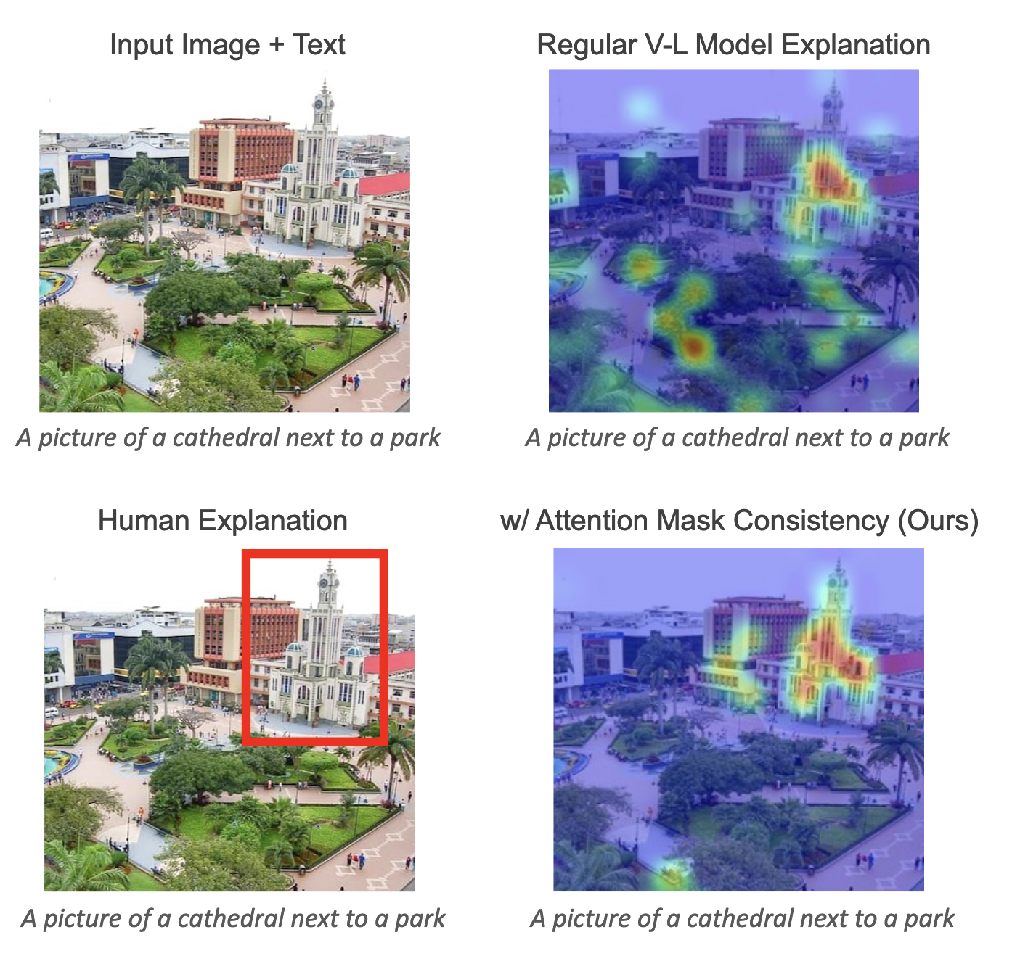
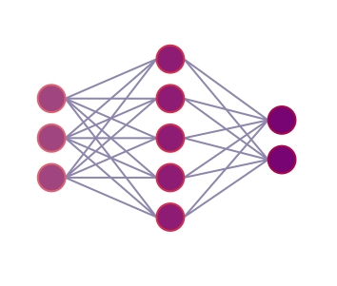
Visual Grounding: Identifying Any Object in Images
Improving Visual Grounding by Encouraging Consistent Gradient-based Explanations.
Ziyan Yang, Kushal Kafle, Franck Dernoncourt, Vicente Ordonez. Conf. on Computer Vision and Pattern Recognition. CVPR 2023. Vancouver, Canada.
Improved Visual Grounding through Self-Consistent Explanations
Ruozhen He, Paola Cascante-Bonilla, Ziyan Yang, Alexander C. Berg, Vicente Ordonez Conf. on Computer Vision and Pattern Recognition. CVPR 2024. Seattle, WA.

Slide 10
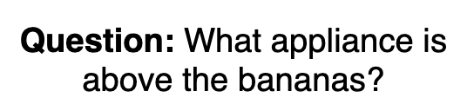
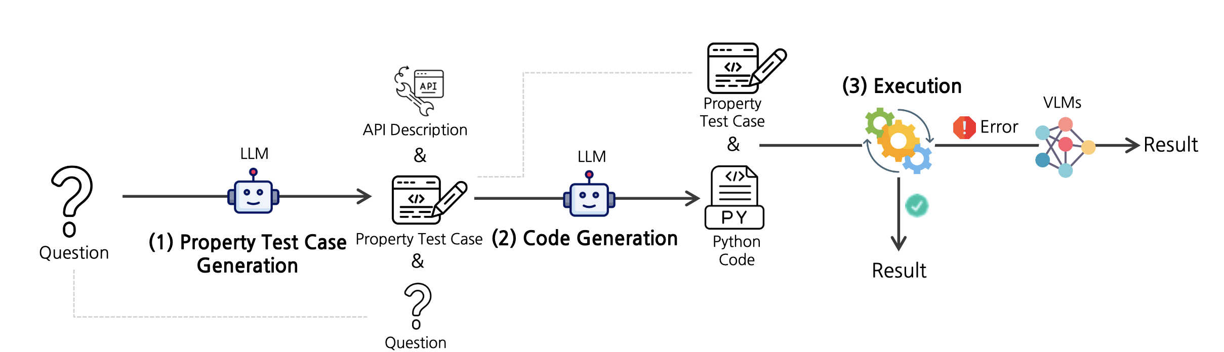
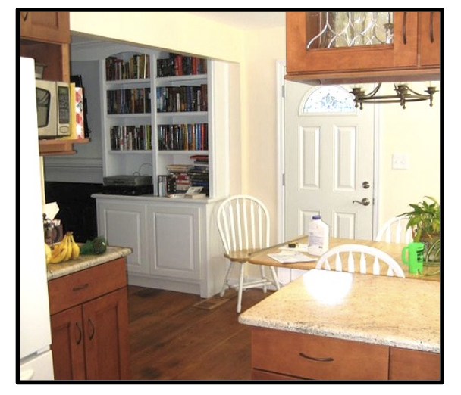

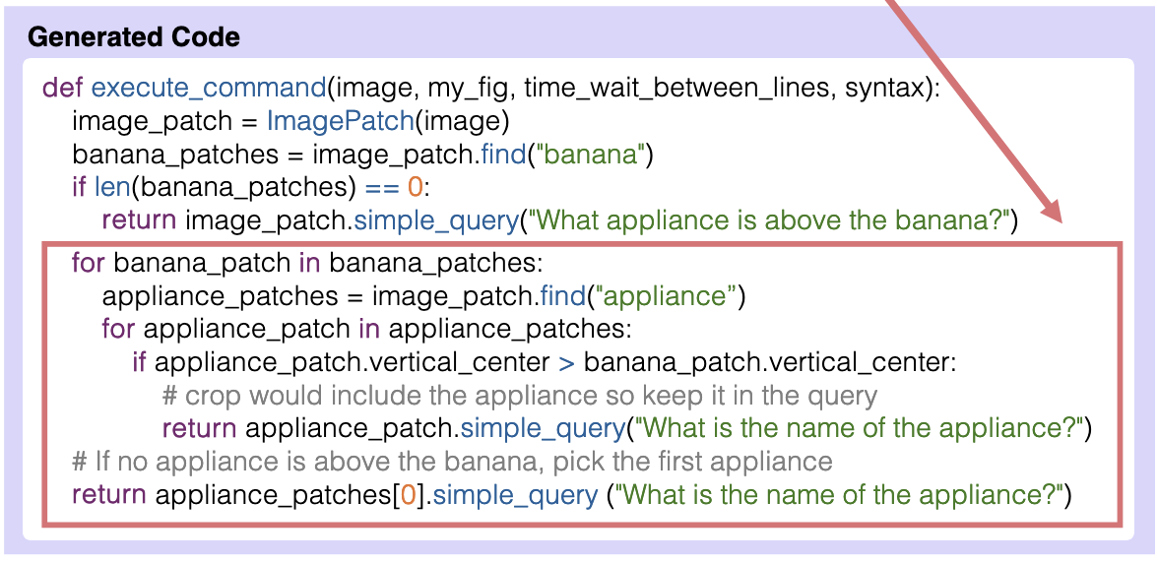
Probing LLMs for Visual Reasoning
PropTest: Automatic Property Testing for Improved Visual Programming
Jaywon Koo, Ziyan Yang, Paola Cascante-Bonilla, Baishakhi Ray, Vicente Ordonez. Conf. on Empirical Methods in Natural Language Processing. EMNLP 2024 (Findings).

Slide 11
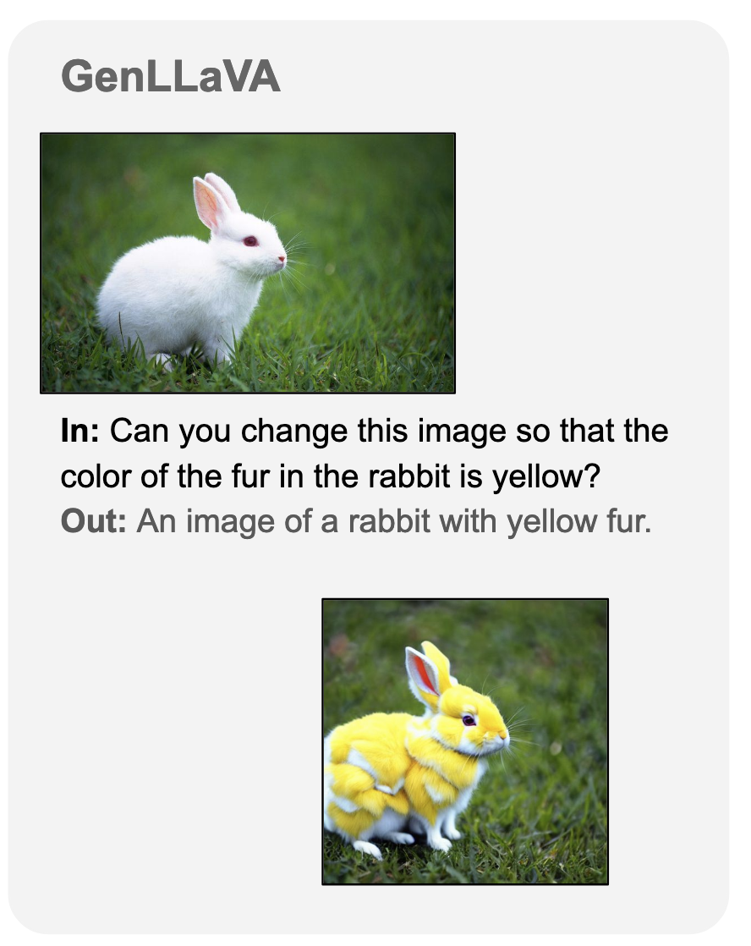
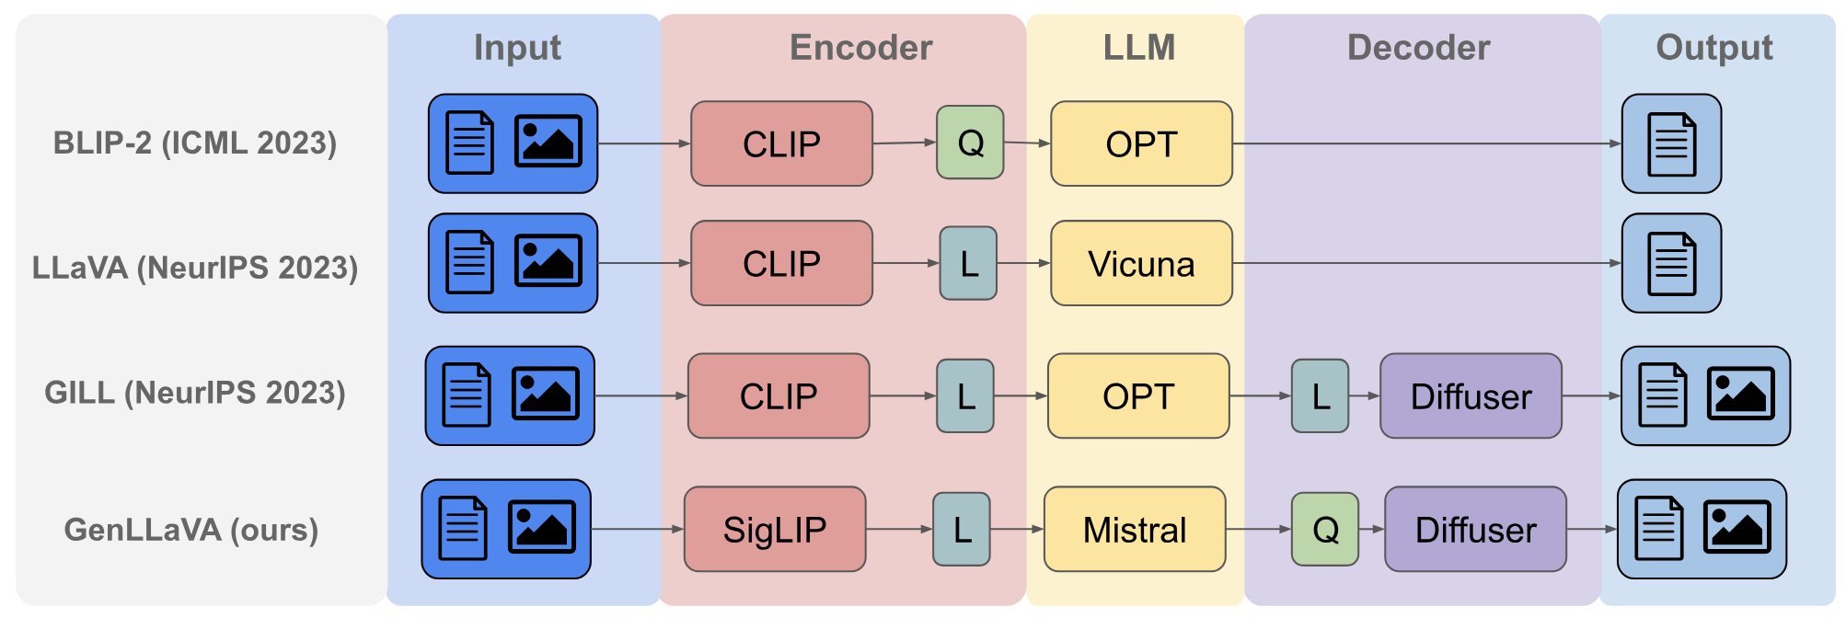
Combining LLMs with Vision Models: GenLLaVA
Generative Visual Instruction Tuning
Jefferson Hernandez, Ruben Villegas, Vicente Ordonez. arXiv:2406.11262 June 2024.

Slide 12
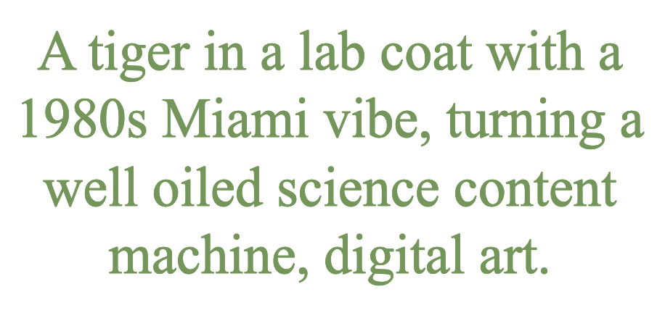

Generative AI: Text-to-Image and Text-to-Video
ElasticDiffusion: Training-free Arbitrary Size Image Generation through Global-Local Content Separation
Moayed Haji Ali, Guha Balakrishnan, Vicente Ordonez Conf. on Computer Vision and Pattern Recognition. CVPR 2024. Seattle, WA.
https://elasticdiffusion.github.io/

Slide 13
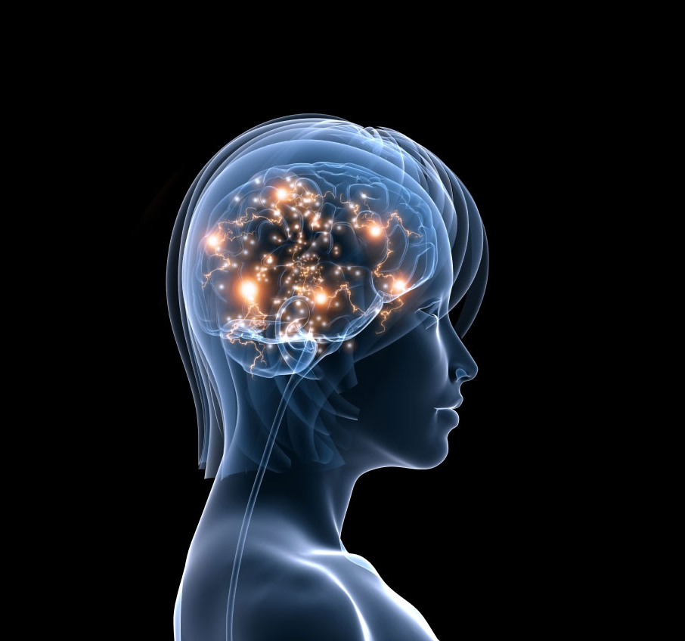
Why Vision and Language Together?
What makes us intelligent?

Slide 14
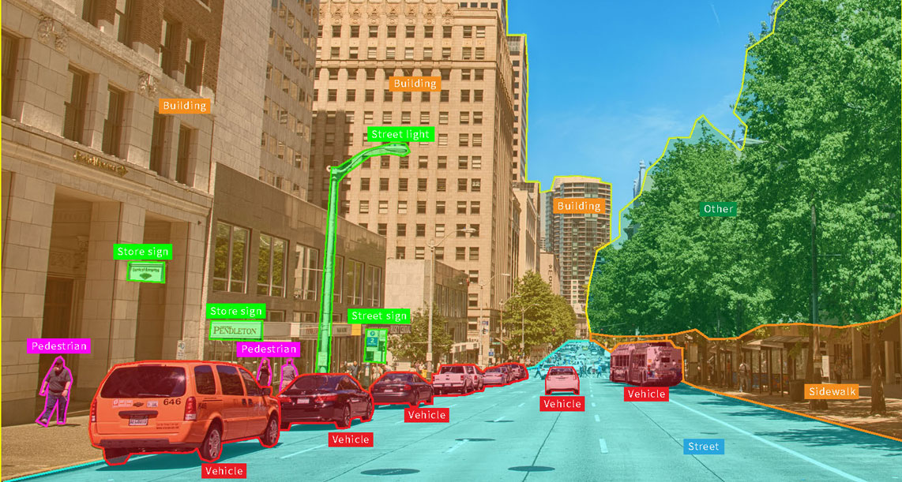
Why Vision and Language Together?
What makes us intelligent?
Vision is not just sensing – but interpreting what our eyes capture
https://appen.com/blog/computer-vision-vs-machine-vision/

Slide 15
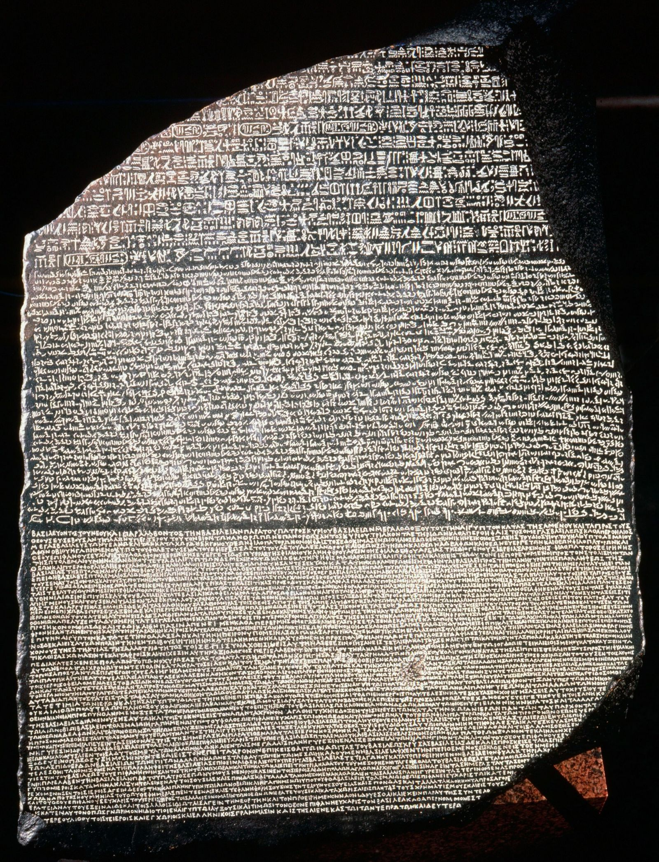
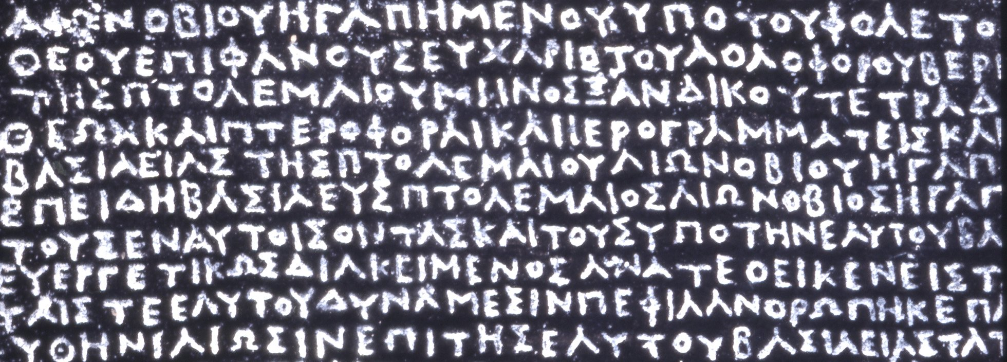
Why Vision and Language Together?
What makes us intelligent?
Vision is not just sensing – but interpreting what our eyes capture
Language is not just a sequence of symbols – but interpreting what do they mean – think of a foreign language to you

Slide 16

Can we learn language through pictures?
https://www.hameraypublishing.com/blogs/all/teaching-kids-about-the-structure-of-the-spanish-language

Slide 17
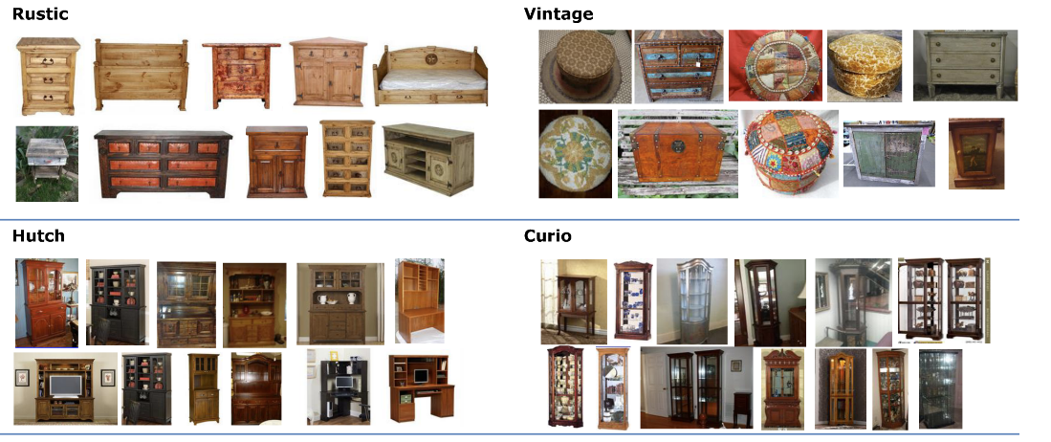
Vision and Language in Practice
Searching products using language can be hard – e.g. I want to find a “rustic vintage curio with dark cherry finishes”

Slide 18
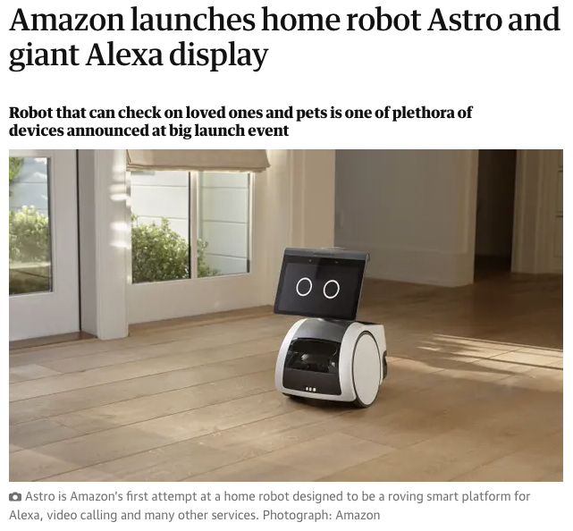
Vision and Language in Practice
Robotics: Instruction Following

Slide 19
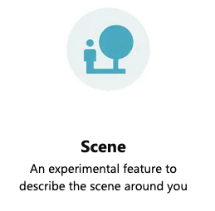
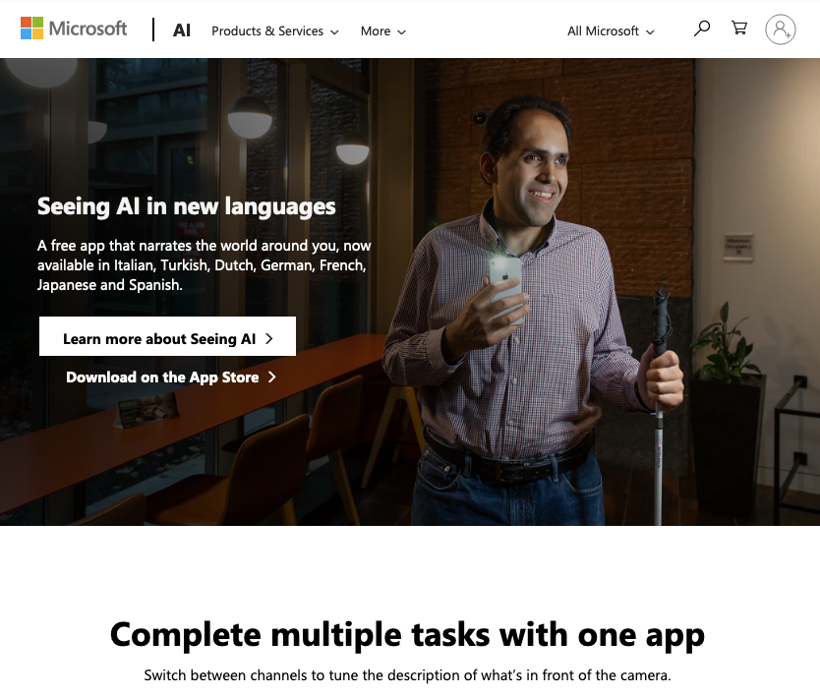
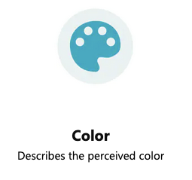
Vision and Language in Practice
Assistive Technologies

Slide 20
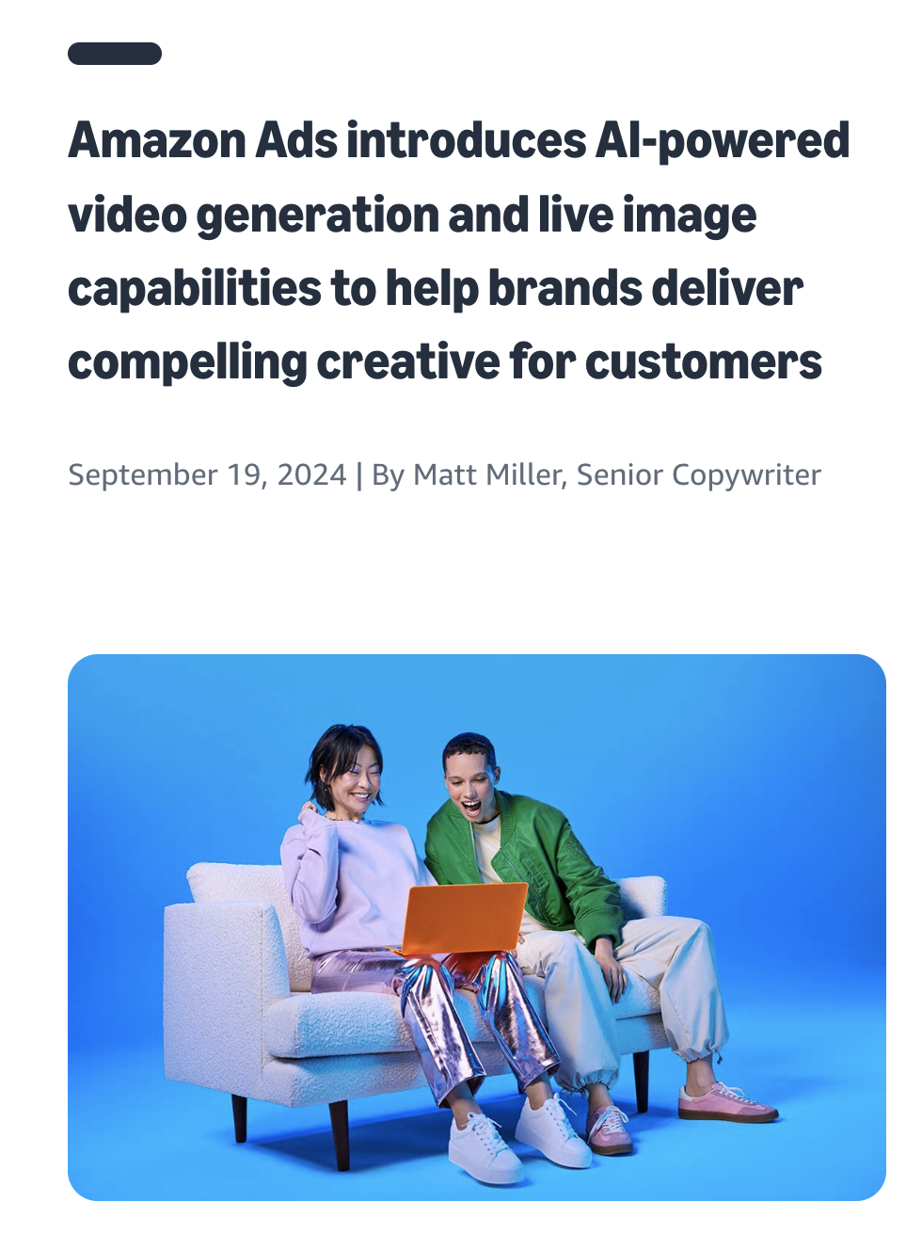
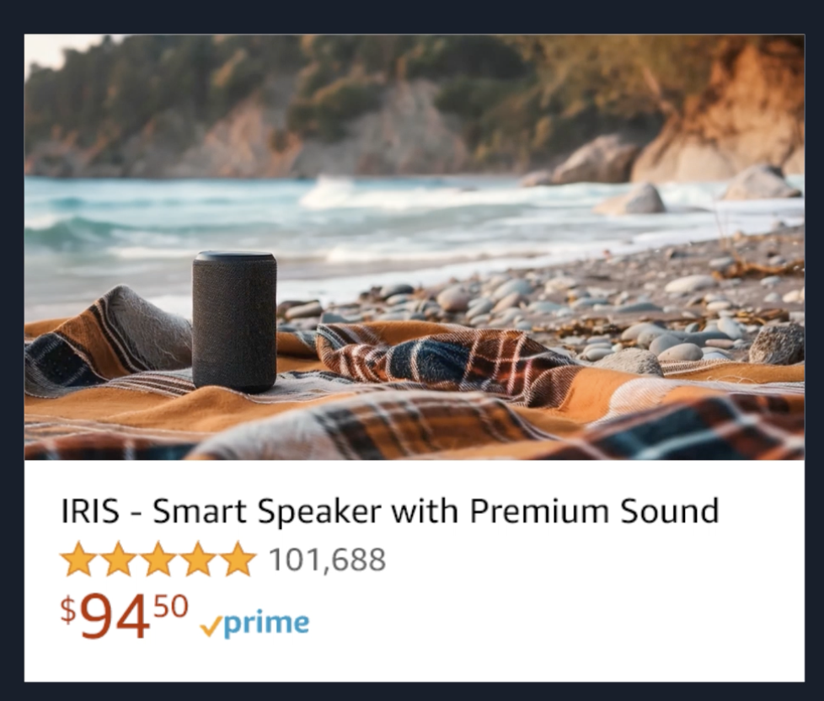
Generative for Advertising and Marketing

Slide 21
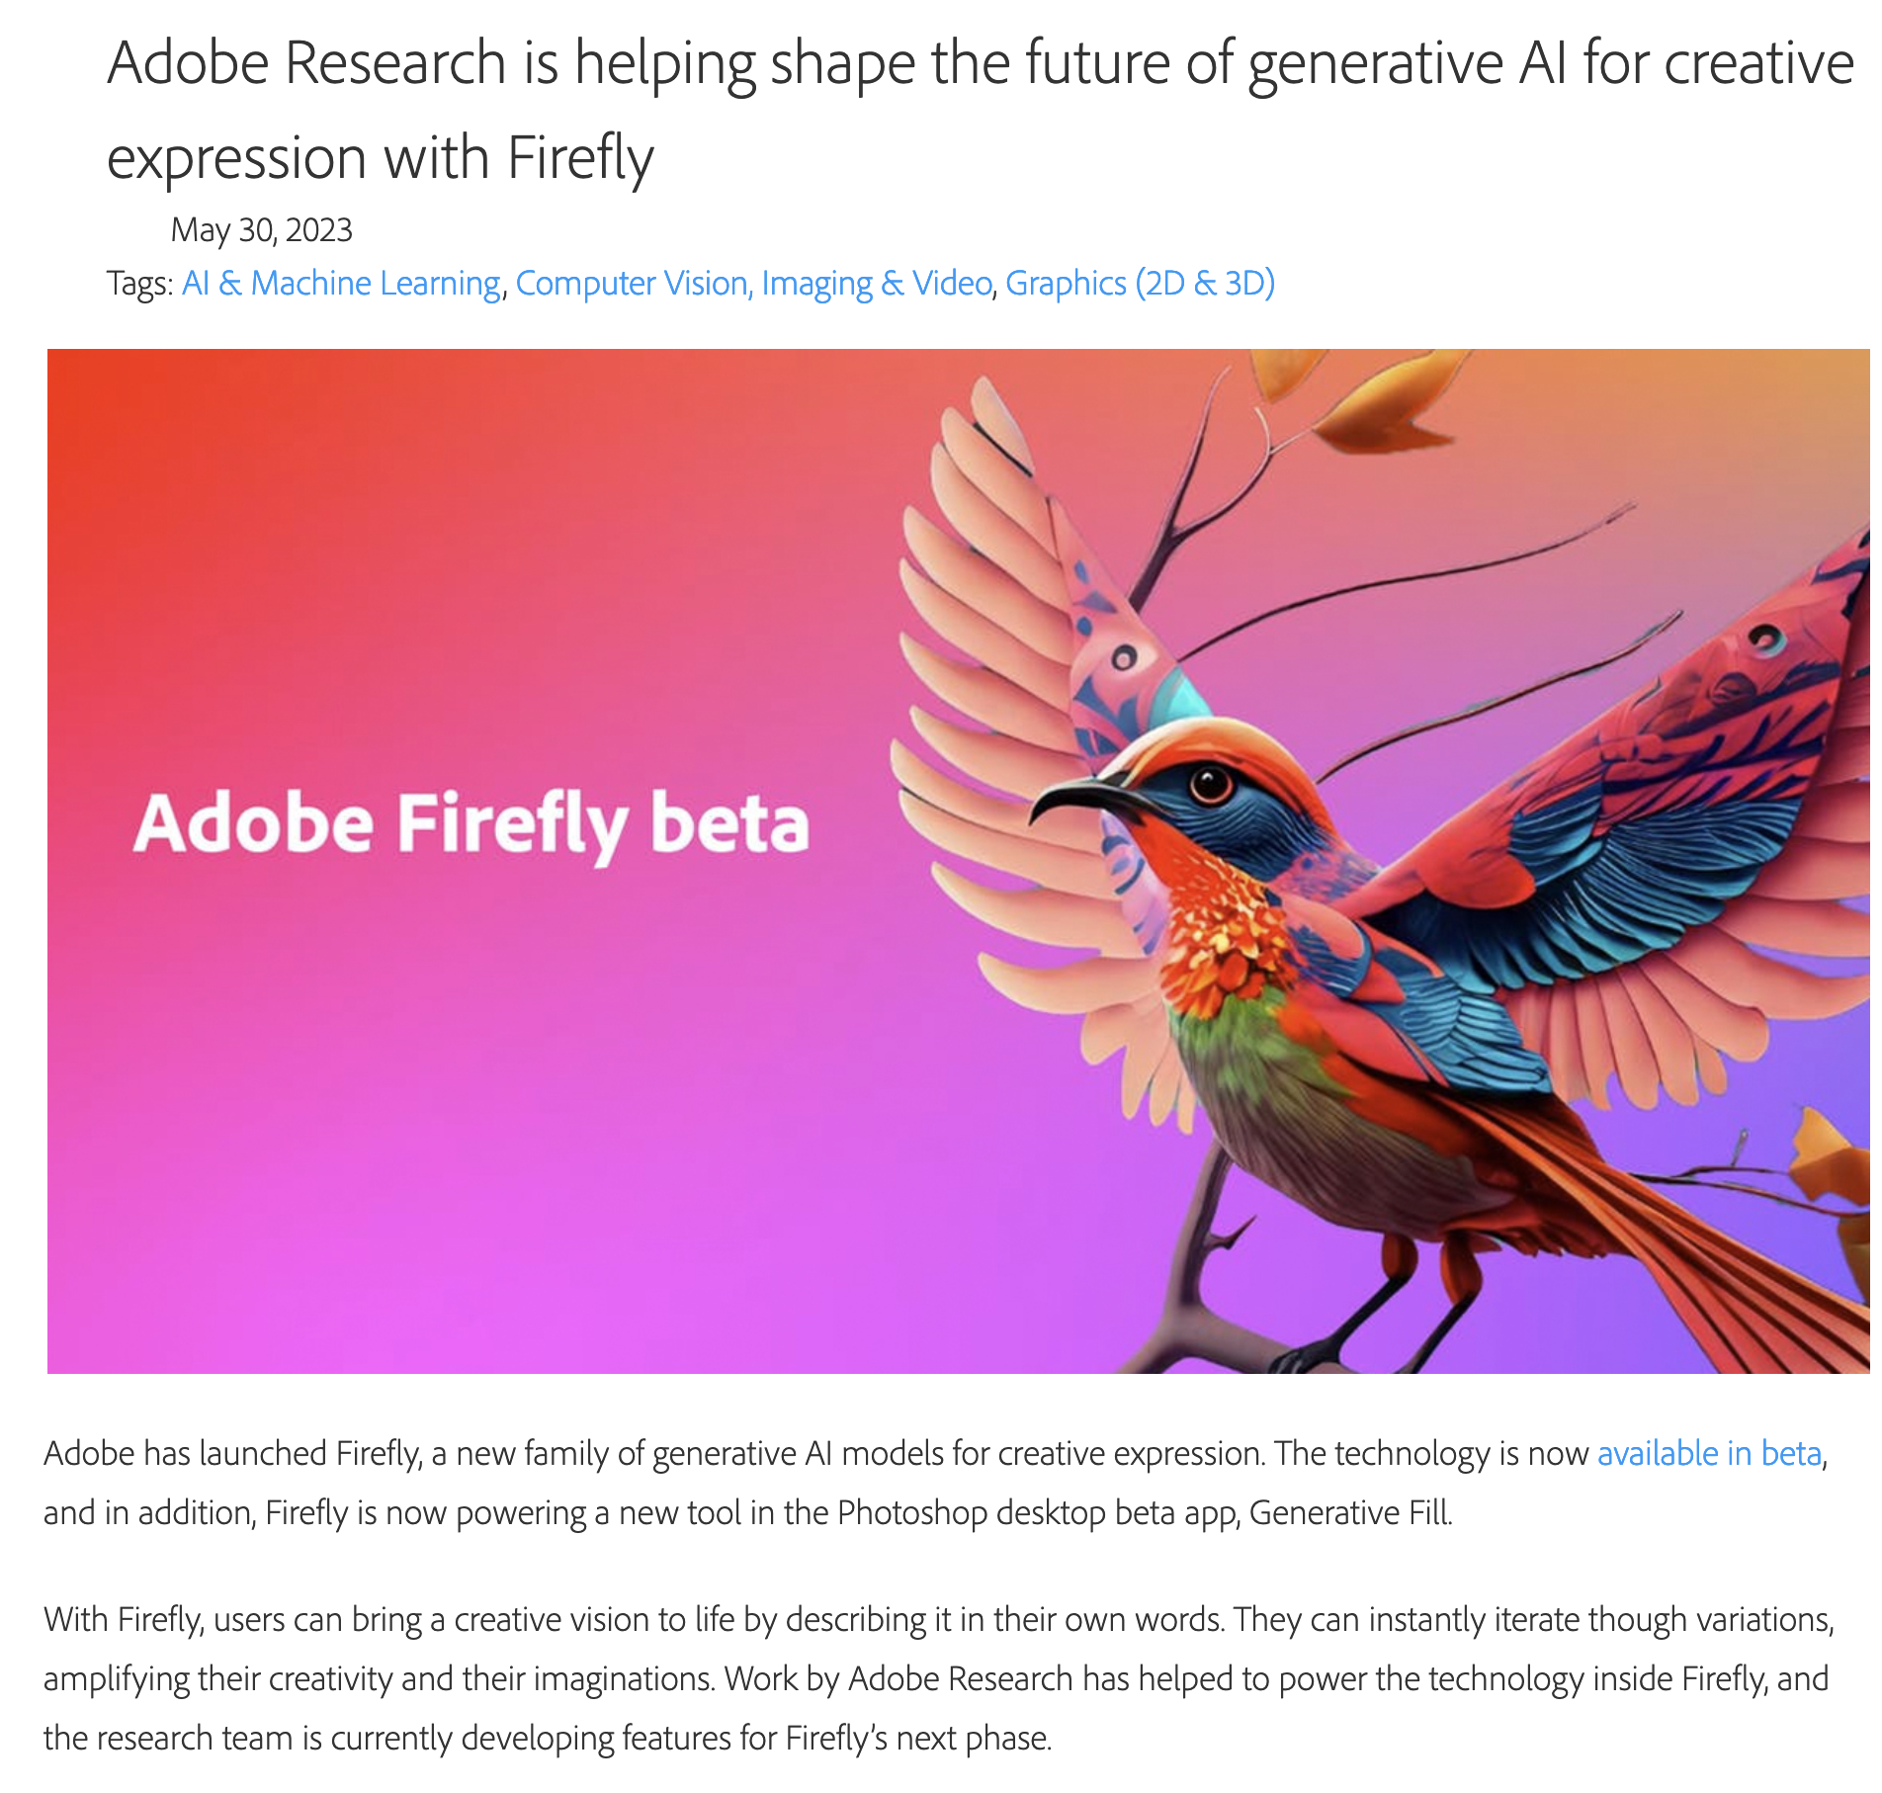
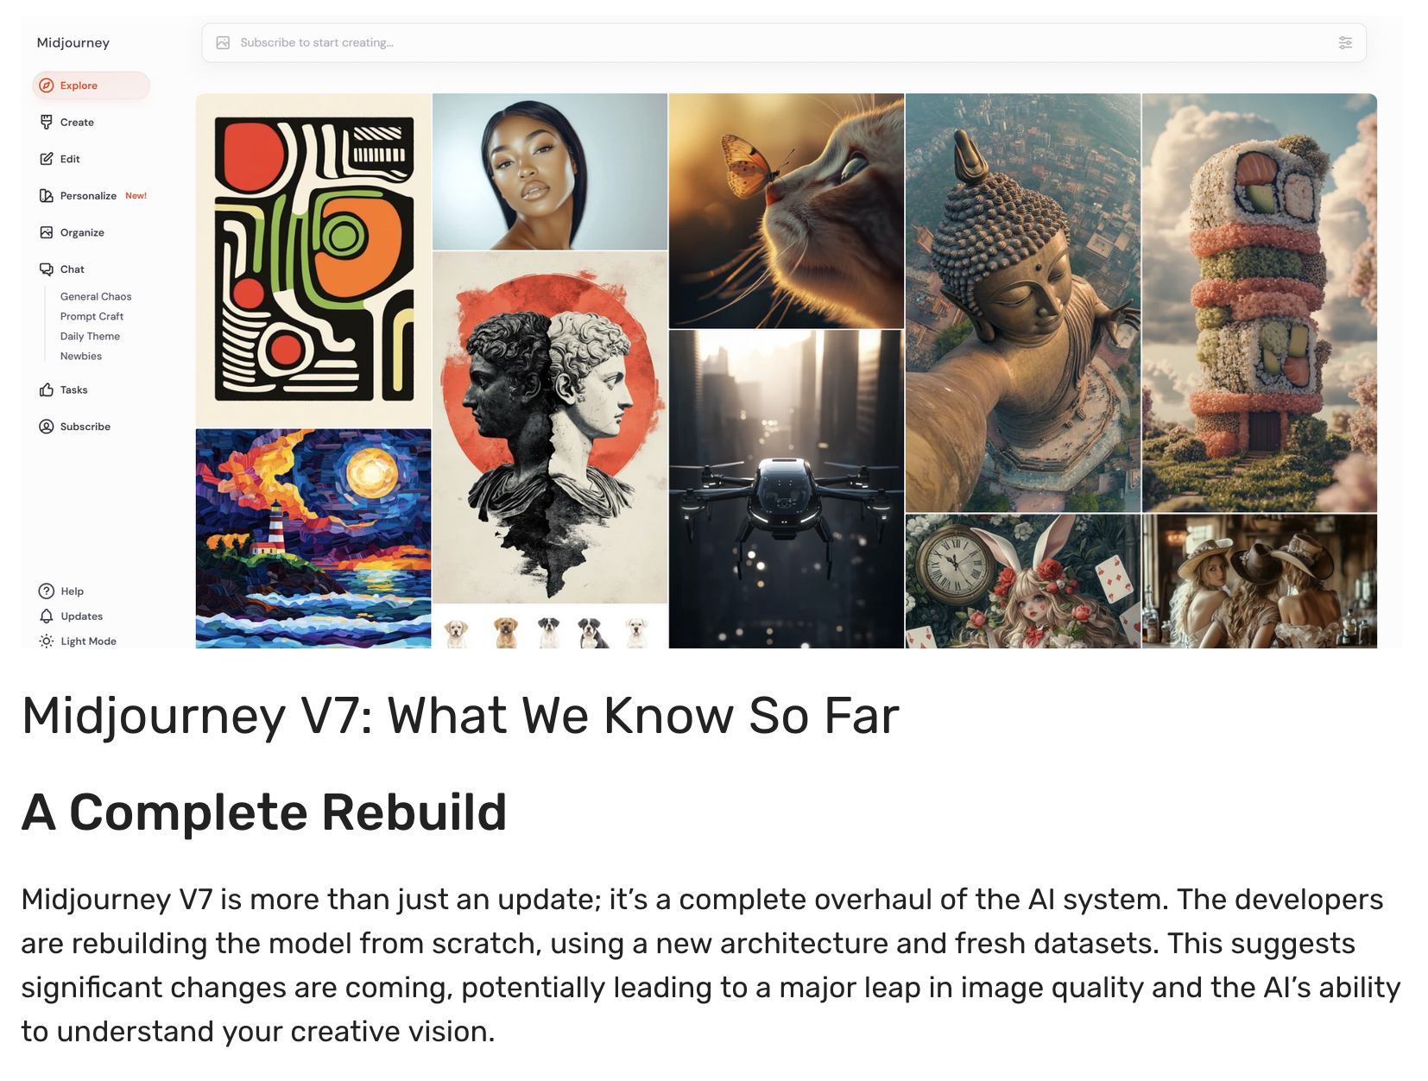
Image and Media Editing and Generation

Slide 22
What will we cover in this class?
In terms of tools
3 weeks
Introduction to ML / Vision / NLP
Neural Networks (NNs) / Deep Learning.
Convolutional Neural Networks (CNNs)
Recurrent Neural Networks (RNNs, LSTMs, GRUs)
Transformers (e.g. BERT, GPT, FLAN-T5, LLaMA, etc)
Diffusion Models (e.g. Stable Diffusion, ControlNet)
State-of-the-art and Recent Developments
2 weeks
2 weeks
8 weeks

Slide 23
What will we cover in this class?
In terms of topics
Image Captioning
Referring Expression Comprehension
Visually-grounded Question Answering
Learning from Text and Images
Retrieving Images from Natural Language Queries
Generating Images from Text
Multimodal Translation using both Images and Text
Vision-Language Navigation
Biases in Vision and Language Tasks
Possibly more topics…
https://www.cs.rice.edu/~vo9/deep-vislang/

Slide 24
Pre-requisites
No formal pre-requisites but…
You need to know how to program with Python or be VERY motivated to learn as you go. Definitely know how to program at a college graduate level.
You will benefit from knowing some Machine Learning or be VERY motivated to do some self-learning as you go.
You need to be proficient on basic calculus, linear algebra, and statistics. Nothing advanced but the right basic terminology and concepts are needed. (matrices, vectors, vector spaces, chain rule of calculus, derivatives, gradients, maximum likelihood estimation, least squares regression)

Slide 25
Grading for this class: COMP 646
Assignments: 30pts (3 assignments: 10pts + 10pts + 10pts)
Class Project: 60pts
Quiz: 10pts
Total: 100pts
Grade cutoffs: TBD but no harsher than those indicated in our syllabus.

Slide 26
Class Project Timeline
Class Project: 60pts
  You can form a group: 3 students maximum per group
  You can also work solo – 1 student groups.
In ~4 weeks: Submit as a group a project proposal (1 page PDF)
In ~6 weeks: Submit as a group a final project proposal (1 page PDF)
In ~10 weeks: Submit a project progress report (2 page PDF)
End of semester: Submit the following:
  Project report PDF (4 pages)
  Slides + Presentation (Video / Demo)
  Source code + ideally an online demo (if appropriate)

Slide 27
Project Requirements
The project has to be at least as challenging as the most challenging assignment on this class. Do not work on something too trivial or too demanding for a class project. I can provide guidance if you submit on time a high quality project proposal.
All projects need to involve both vision and language capabilities.
If you are interested in a project that only involves image classification, object detection, etc. This is not the right class. You should take:
  COMP 447: Computer Vision (Guha Balakrishnan, Spring 2025)
If you are interested in a project that only involves text, e.g. sentiment analysis, building a chatbot, etc. This is not the right class. You should take:
  COMP 652: Natural Language Processing (Hanjie Chen, Spring 2025)

Slide 28
You are encouraged to take advantage of recent open foundation models for your project.
CLIP by OpenAI or SigLIP or OpenCLIP or MetaCLIP (Images + Text)
InternVL (Images + Text) or InternVideo (Images + Video)
FLAN-T5 by Google (Text)
Llama-2 or Llama-3 by Meta or Mistral-7B by MistralAI (Text)
GLIP by Microsoft, or OwL-ViT (Images + Text)
Whisper by OpenAI (Speech to Text)
StableDiffusion v1.5 (or SDXL) models (Text to Images)
LLaVa v1.5 (Multimodal LLM)

Slide 29
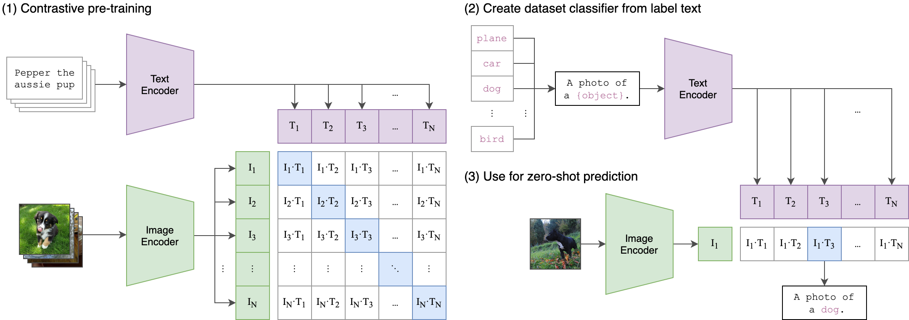
CLIP
https://github.com/openai/CLIP

Slide 30
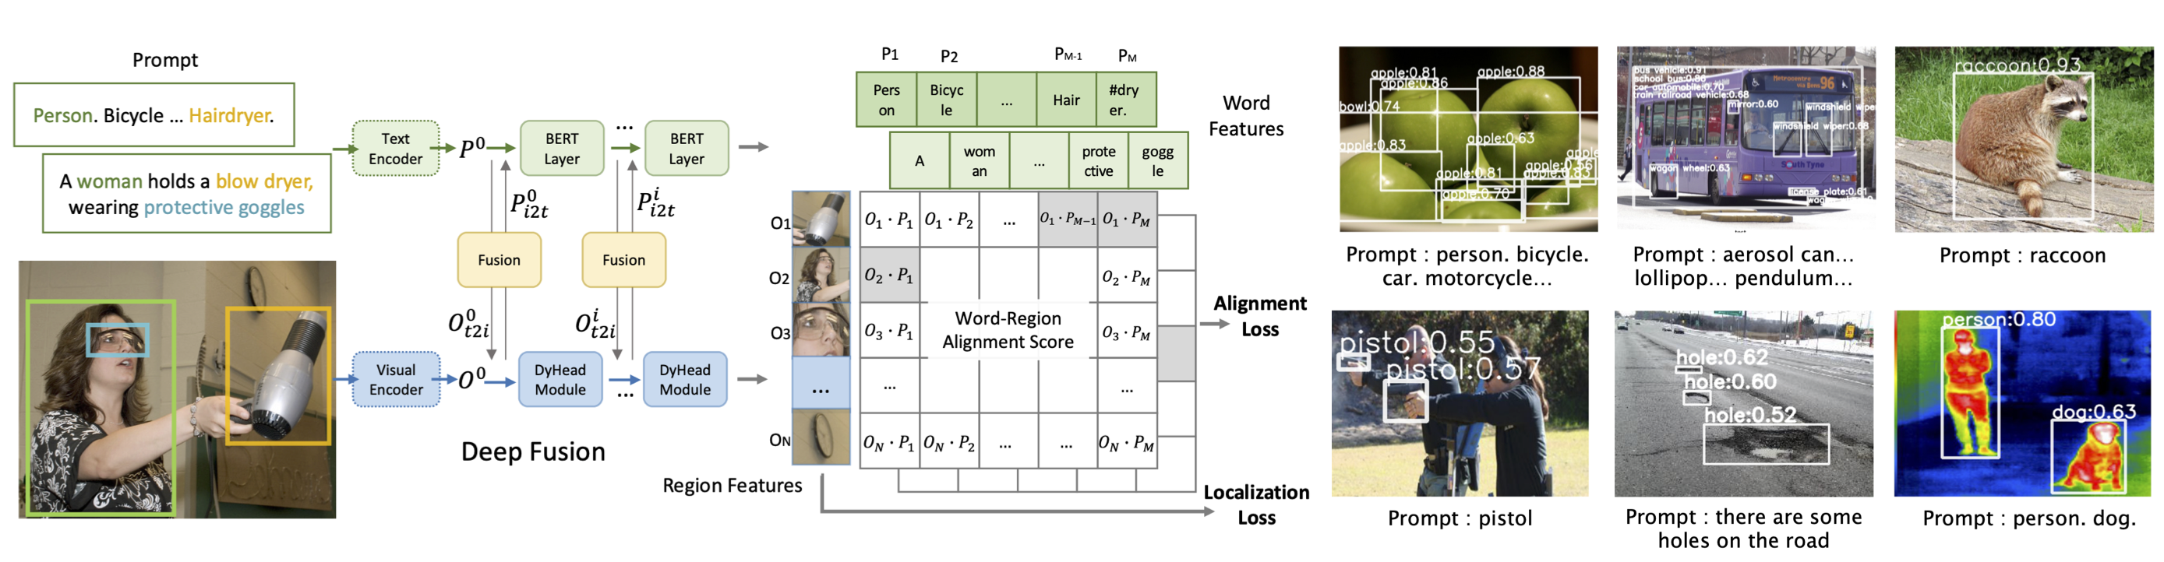
GLIP
https://github.com/microsoft/GLIP

Slide 31
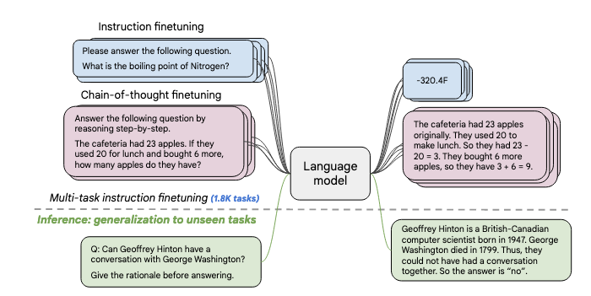
FLAN T5
https://huggingface.co/docs/transformers/model_doc/flan-t5

Slide 32
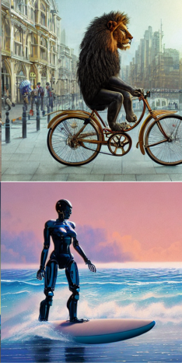
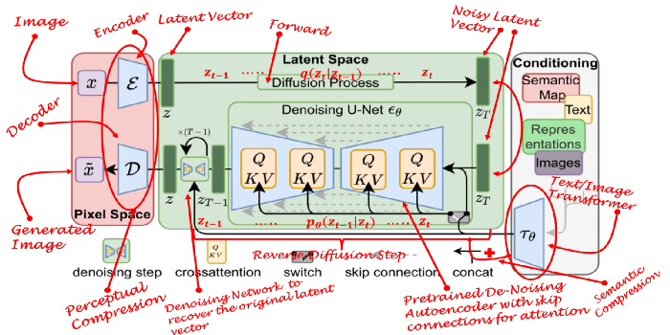
Stable Diffusion v2
https://towardsdatascience.com/what-are-stable-diffusion-models-and-why-are-they-a-step-forward-for-image-generation-aa1182801d46
https://huggingface.co/stabilityai/stable-diffusion-2

Slide 33
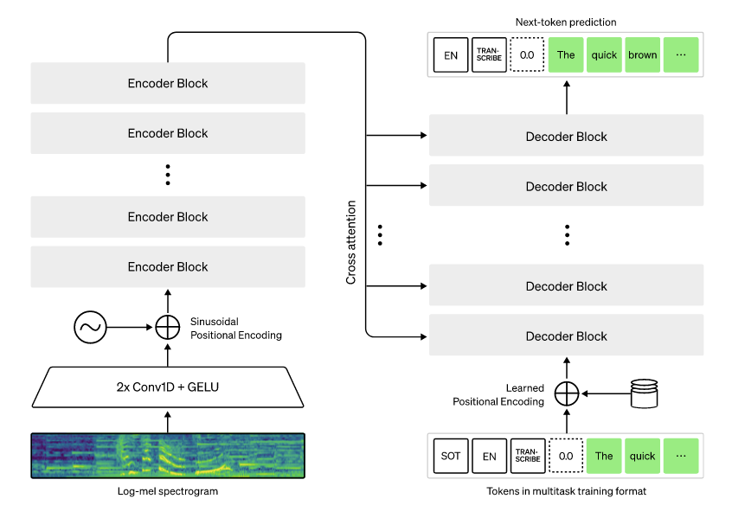
Whisper
https://github.com/openai/whisper

Slide 34


We will be using
https://pytorch.org/
https://huggingface.co/
But you’re free to use any other framework especially for your projects: e.g. Tensorflow, Apache MXNet, JAX

Slide 35

We will also be using…
https://colab.research.google.com/

Slide 36
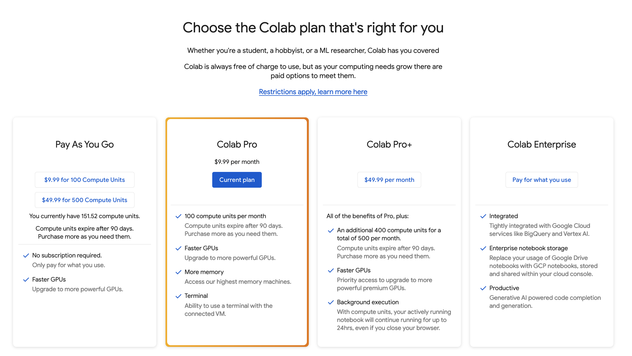

Slide 37
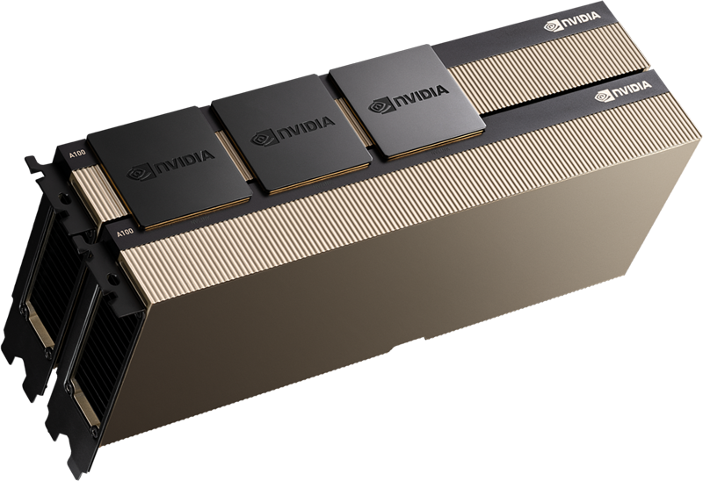
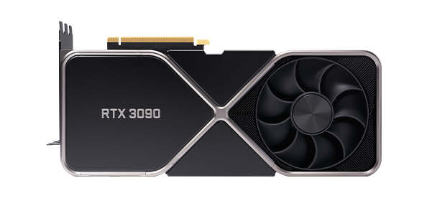
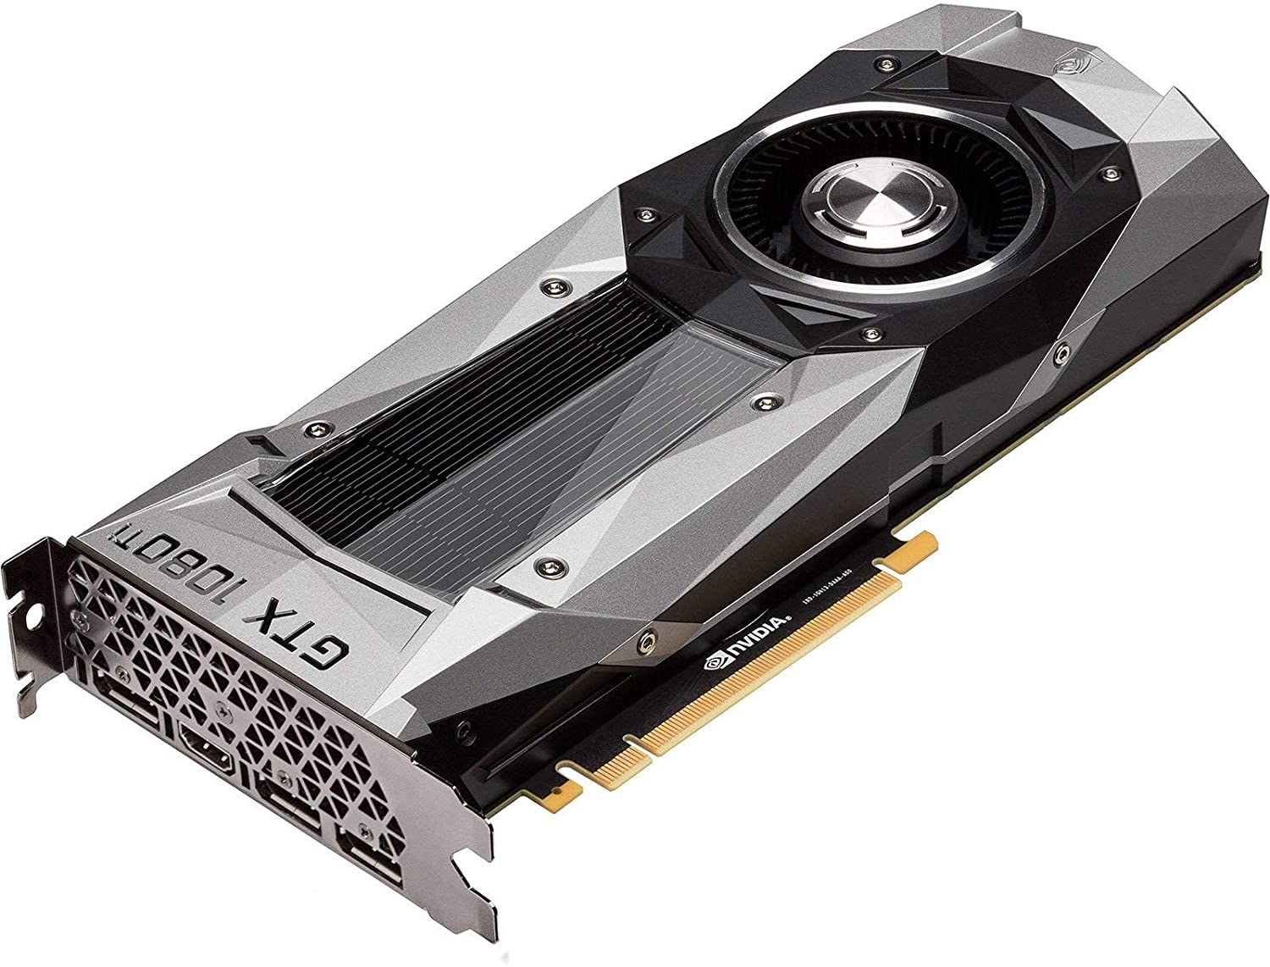
You will benefit if you have / but not required
NVIDIA Ampere A100 $17,000
NVIDIA Tesla v100 $7,000
NVIDIA RTX 4090 $1600
NVIDIA GTX 1080 Ti $700

Slide 38

Also try using:
https://aws.amazon.com/sagemaker/studio-lab/

Slide 39
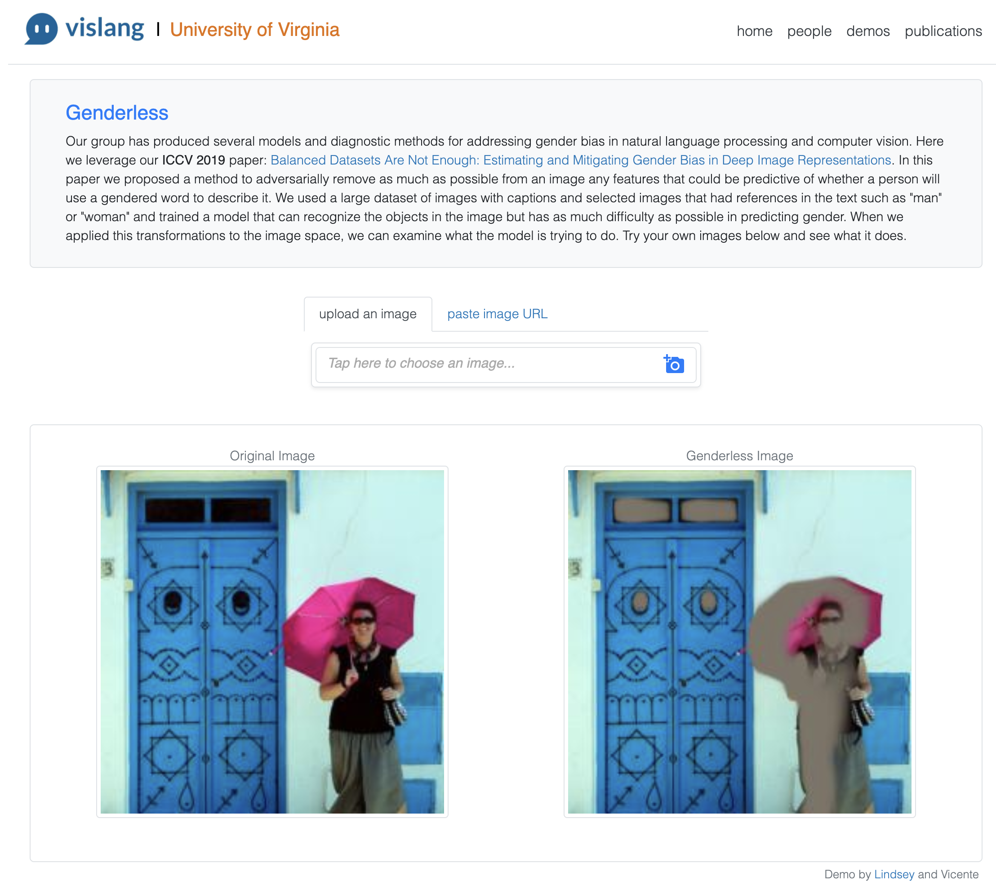
Demos
https://vislang.ai/genderless

Slide 40
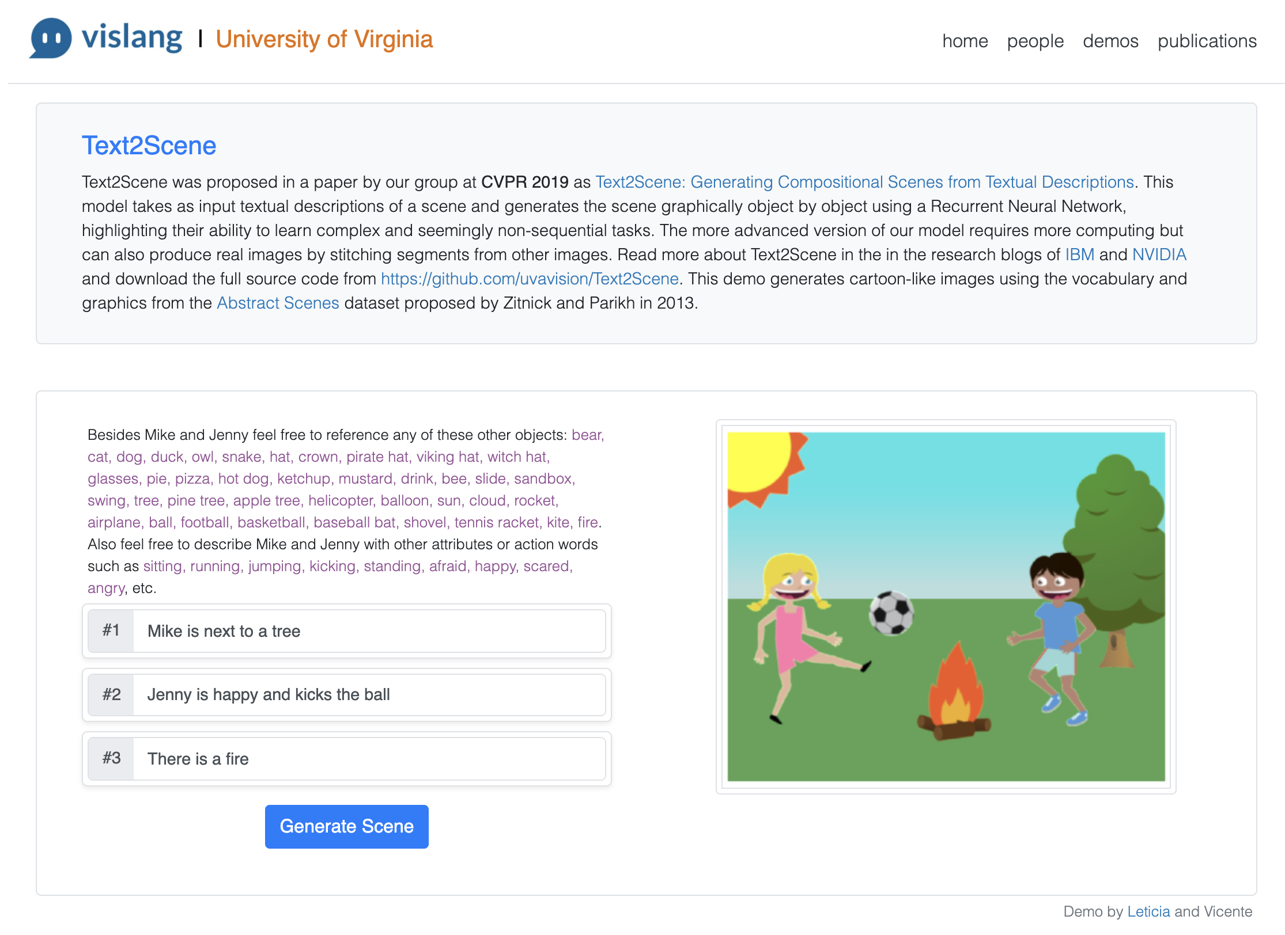
Demos
https://vislang.ai/text2scene

Slide 41
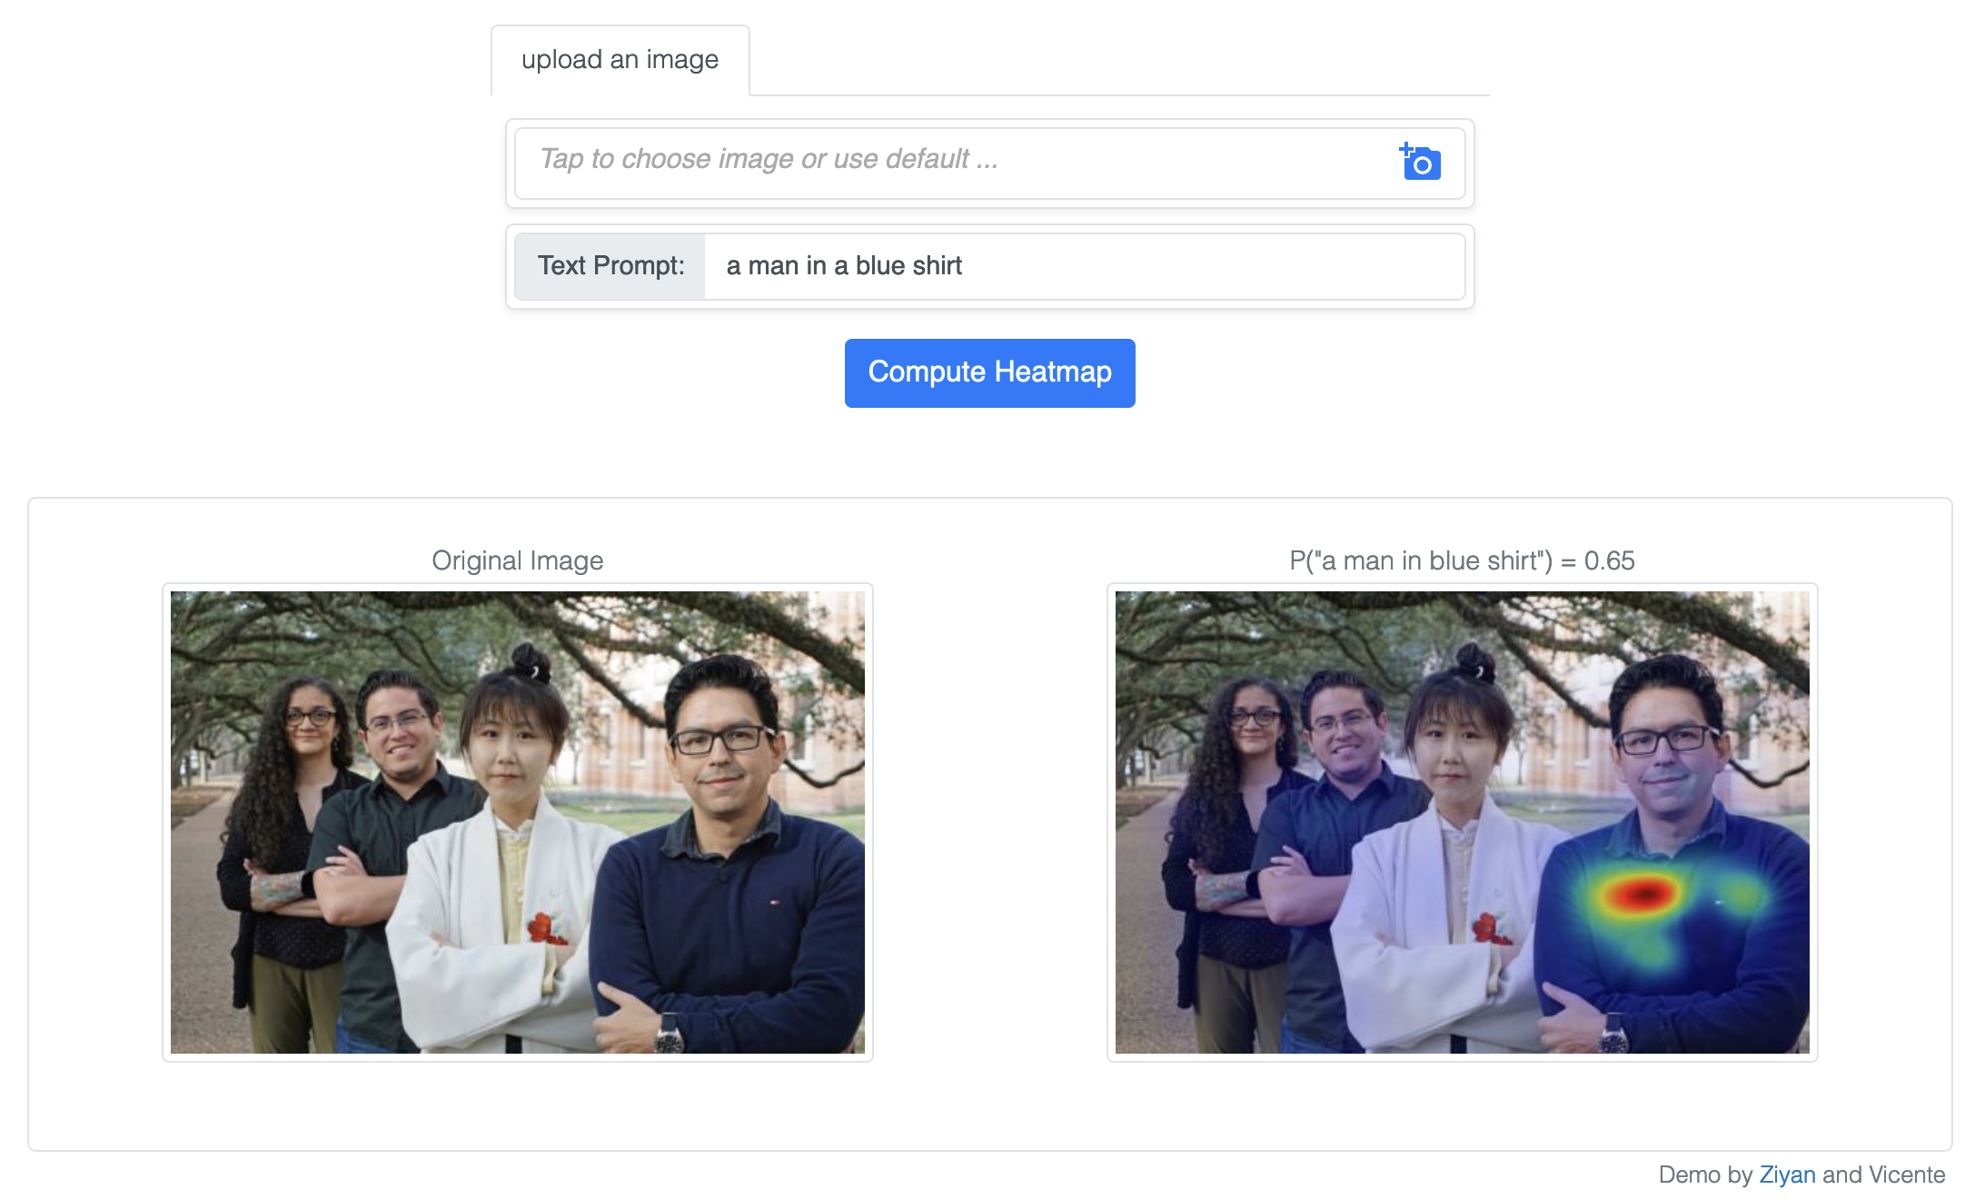
AMC Visual Grounding
https://vislang.ai/amc

Slide 42
For Next Class…
Intro to Machine Learning
You need to complete the following two activities:
Completing this [Primer on Image Processing], and optionally, the tutorial and assignment on [Image Classification] from my old Deep Learning for Visual Recognition class.

Slide 43
Questions?

