Slide 1
Deep Learning for Vision & Language
Stochastic Gradient Descent / Generalization / Overfitting / Underfitting

Slide 2



































Linear Regression
Example: Hollywood movie data
input variables x
output variables y
production
costs
promotional costs
genre of
the movie
box office first week
total book
sales
total revenue USA
total revenue international
$$x_{1}^{(1)}$$
$$x_{2}^{(1)}$$
$$x_{3}^{(1)}$$
$$x_{4}^{(1)}$$
$$x_{5}^{(1)}$$
$$x_{6}^{(1)}$$
$$x_{7}^{(1)}$$
$$x_{1}^{(2)}$$
$$x_{2}^{(2)}$$
$$x_{3}^{(2)}$$
$$x_{4}^{(2)}$$
$$x_{5}^{(2)}$$
$$x_{6}^{(2)}$$
$$x_{7}^{(2)}$$
$$x_{1}^{(3)}$$
$$x_{2}^{(3)}$$
$$x_{3}^{(3)}$$
$$x_{4}^{(3)}$$
$$x_{5}^{(3)}$$
$$x_{6}^{(3)}$$
$$x_{7}^{(3)}$$
$$x_{1}^{(4)}$$
$$x_{2}^{(4)}$$
$$x_{3}^{(4)}$$
$$x_{4}^{(4)}$$
$$x_{5}^{(4)}$$
$$x_{6}^{(4)}$$
$$x_{7}^{(4)}$$
$$x_{1}^{(5)}$$
$$x_{2}^{(5)}$$
$$x_{3}^{(5)}$$
$$x_{4}^{(5)}$$
$$x_{5}^{(5)}$$
$$x_{6}^{(5)}$$
$$x_{7}^{(5)}$$

Slide 3










Linear Regression
Example: Hollywood movie data
input variables x
output variables y
production
costs
promotional costs
genre of
the movie
box office first week
total book
sales
total revenue USA
total revenue international
$$x_{1}^{(1)}$$
$$x_{2}^{(1)}$$
$$x_{3}^{(1)}$$
$$x_{4}^{(1)}$$
$$x_{5}^{(1)}$$
$$y_{1}^{(1)}$$
$$y_{2}^{(1)}$$
$$x_{1}^{(2)}$$
$$x_{2}^{(2)}$$
$$x_{3}^{(2)}$$
$$x_{4}^{(2)}$$
$$x_{5}^{(2)}$$
$$y_{1}^{(2)}$$
$$y_{2}^{(2)}$$
$$x_{1}^{(3)}$$
$$x_{2}^{(3)}$$
$$x_{3}^{(3)}$$
$$x_{4}^{(3)}$$
$$x_{5}^{(3)}$$
$$y_{1}^{(3)}$$
$$y_{2}^{(3)}$$
$$x_{1}^{(4)}$$
$$x_{2}^{(4)}$$
$$x_{3}^{(4)}$$
$$x_{4}^{(4)}$$
$$x_{5}^{(4)}$$
$$y_{1}^{(4)}$$
$$y_{2}^{(4)}$$
$$x_{1}^{(5)}$$
$$x_{2}^{(5)}$$
$$x_{3}^{(5)}$$
$$x_{4}^{(5)}$$
$$x_{5}^{(5)}$$
$$y_{1}^{(5)}$$
$$y_{2}^{(5)}$$

Slide 4
Linear Regression
Example: Hollywood movie data
input variables x
output variables y
production
costs
promotional costs
genre of
the movie
box office first week
total book
sales
total revenue USA
total revenue international
$$x_{1}^{(1)}$$
$$x_{2}^{(1)}$$
$$x_{3}^{(1)}$$
$$x_{4}^{(1)}$$
$$x_{5}^{(1)}$$
$$y_{1}^{(1)}$$
$$y_{2}^{(1)}$$
training
data
$$x_{1}^{(2)}$$
$$x_{2}^{(2)}$$
$$x_{3}^{(2)}$$
$$x_{4}^{(2)}$$
$$x_{5}^{(2)}$$
$$y_{1}^{(2)}$$
$$y_{2}^{(2)}$$
$$x_{1}^{(3)}$$
$$x_{2}^{(3)}$$
$$x_{3}^{(3)}$$
$$x_{4}^{(3)}$$
$$x_{5}^{(3)}$$
$$y_{1}^{(3)}$$
$$y_{2}^{(3)}$$
$$x_{1}^{(4)}$$
$$x_{2}^{(4)}$$
$$x_{3}^{(4)}$$
$$x_{4}^{(4)}$$
$$x_{5}^{(4)}$$
$$y_{1}^{(4)}$$
$$y_{2}^{(4)}$$
test
data
$$x_{1}^{(5)}$$
$$x_{2}^{(5)}$$
$$x_{3}^{(5)}$$
$$x_{4}^{(5)}$$
$$x_{5}^{(5)}$$
$$y_{1}^{(5)}$$
$$y_{2}^{(5)}$$

Slide 5
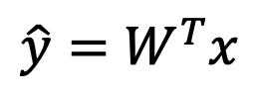
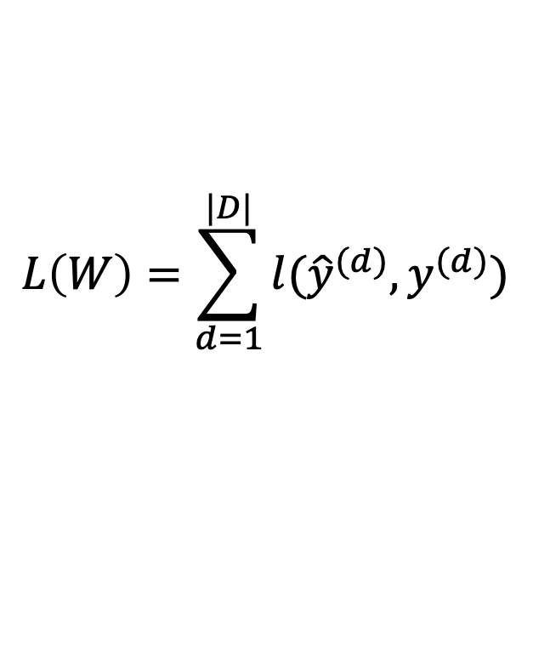


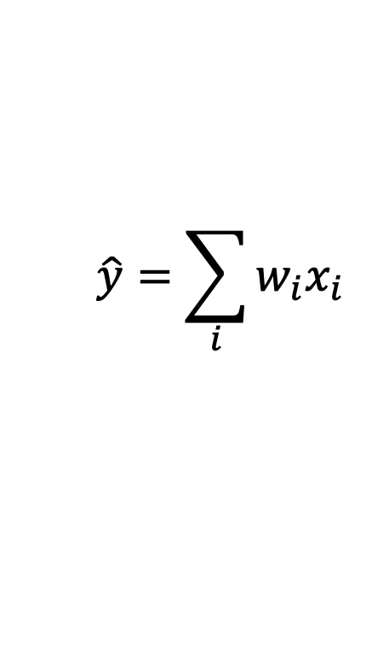
Linear Regression
$$\hat{y}=\sum_{i}{w_{i}x_{i}}$$
Prediction,
Inference,
Testing
$$\hat{y}=W^{T}x$$
$$L\left(W\right)=\sum_{d=1}^{|D|}{l({\hat{y}}^{(d)}, y^{(d)})}$$
Training,
Learning, Parameter estimation
Objective minimization
$$D=\{(x^{\left(d\right)},y^{\left(d\right)})\}$$
$$W^{∗}=argmin L(W)$$

Slide 6
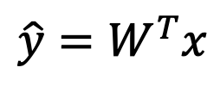
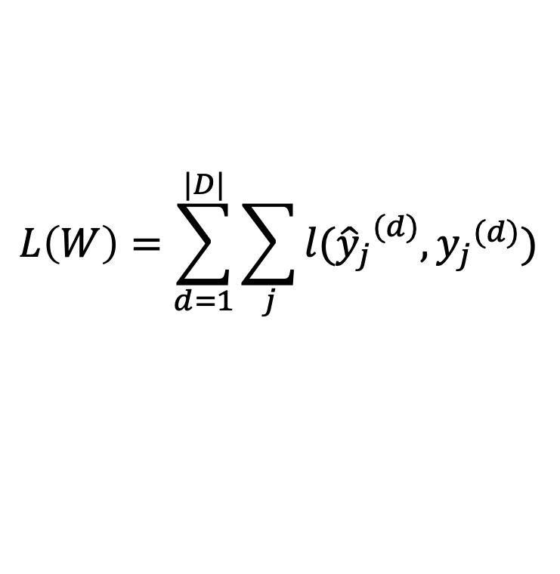
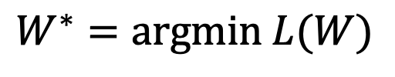

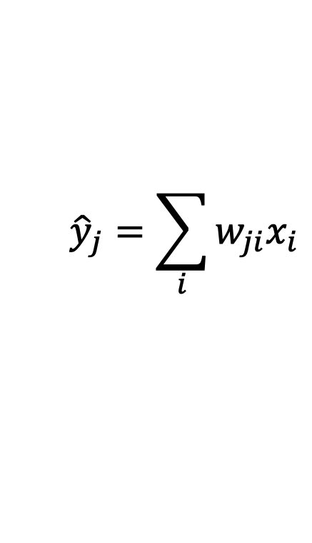
Linear Regression
$${\hat{y}}_{j}=\sum_{i}{w_{ji}x_{i}}$$
Prediction,
Inference,
Testing
$$\hat{y}=W^{T}x$$
$$L\left(W\right)=\sum_{d=1}^{|D|}{\sum_{j}{l({{\hat{y}}_{j}}^{(d)}, {y_{j}}^{(d)})}}$$
Training,
Learning, Parameter estimation
Objective minimization
$$D=\{(x^{\left(d\right)},y^{\left(d\right)})\}$$
$$W^{∗}=argmin L(W)$$

Slide 7
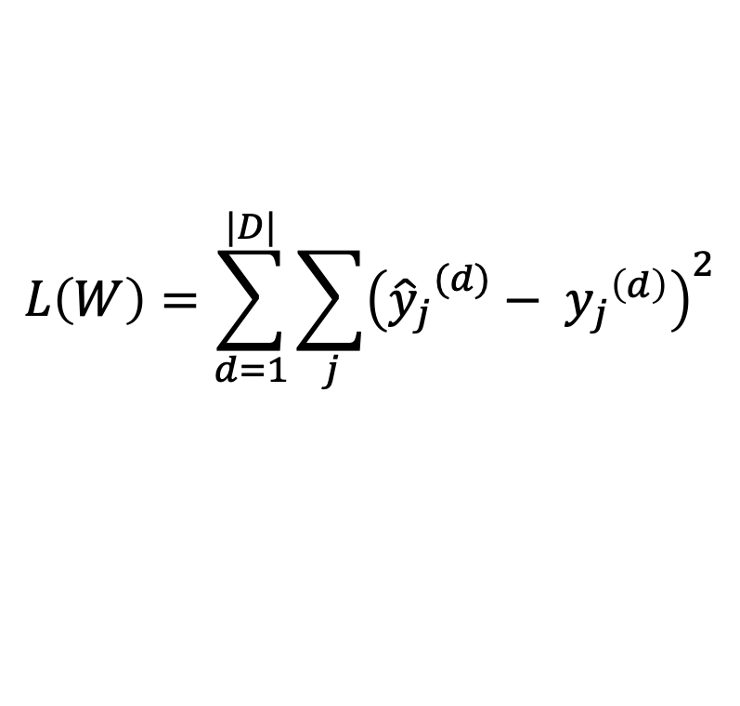
Linear Regression – Least Squares
$${\hat{y}}_{j}=\sum_{i}{w_{ji}x_{i}}$$
$$\hat{y}=W^{T}x$$
$$L\left(W\right)=\sum_{d=1}^{|D|}{\sum_{j}{{\left({{\hat{y}}_{j}}^{(d)}− {y_{j}}^{\left(d\right)}\right)}^{2}}}$$
Training,
Learning, Parameter estimation
Objective minimization
$$D=\{(x^{\left(d\right)},y^{\left(d\right)})\}$$
$$W^{∗}=argmin L(W)$$

Slide 8
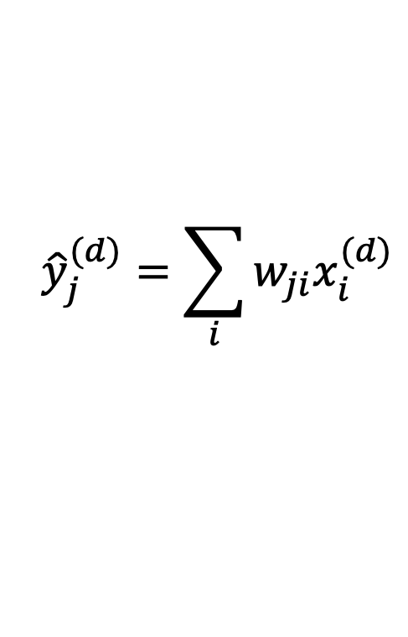
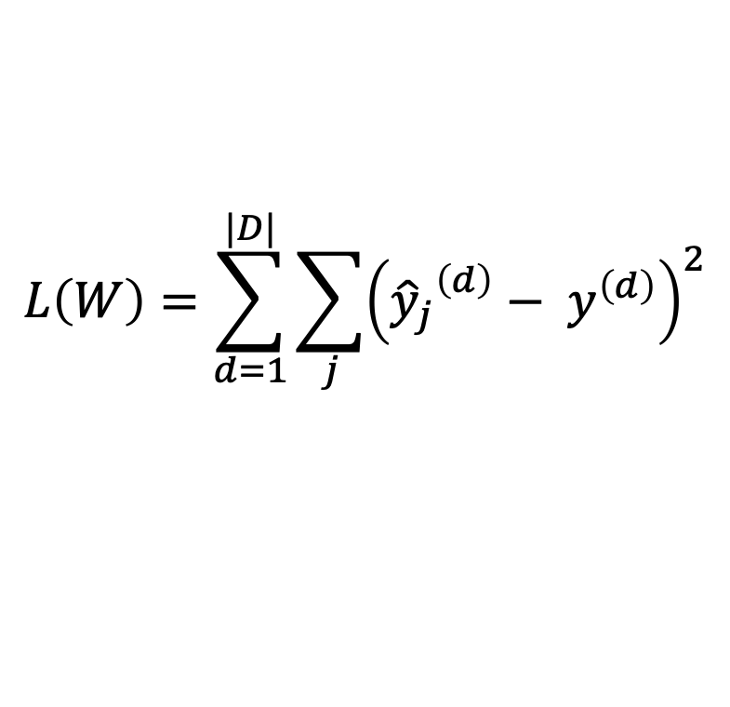
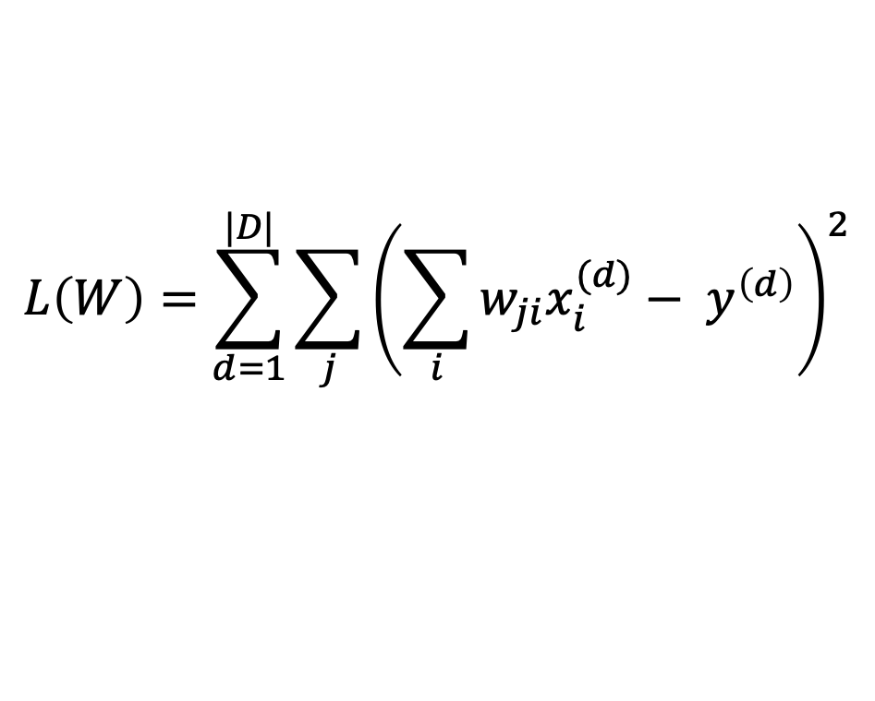
Linear Regression – Least Squares
$$L\left(W\right)=\sum_{d=1}^{|D|}{\sum_{j}{{\left({{\hat{y}}_{j}}^{\left(d\right)}− y^{\left(d\right)}\right)}^{2}}}$$
$${\hat{y}}_{j}^{(d)}=\sum_{i}{w_{ji}x_{i}^{(d)}}$$
$$L\left(W\right)=\sum_{d=1}^{|D|}{\sum_{j}{{\left(\sum_{i}{w_{ji}x_{i}^{(d)}}− y^{\left(d\right)}\right)}^{2}}}$$

Slide 9
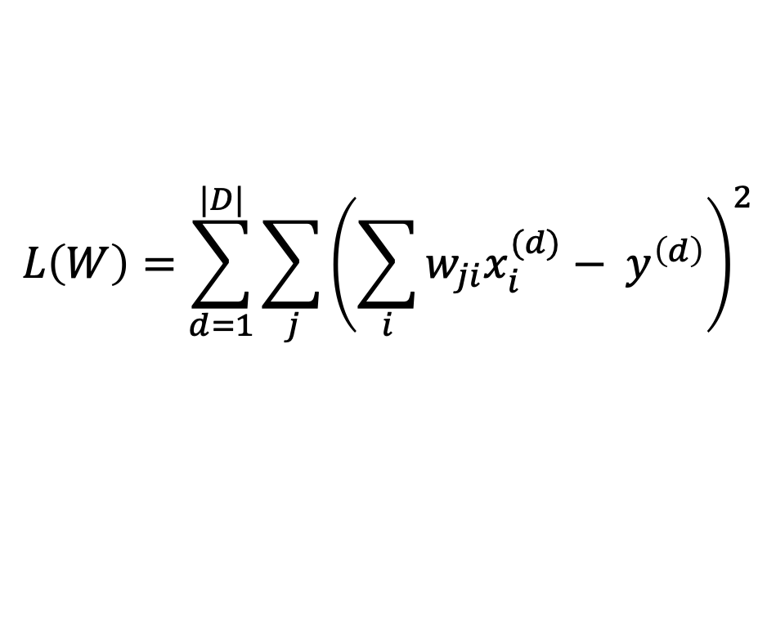
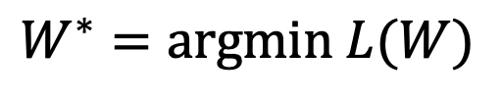
Linear Regression – Least Squares
$$L\left(W\right)=\sum_{d=1}^{|D|}{\sum_{j}{{\left(\sum_{i}{w_{ji}x_{i}^{(d)}}− y^{\left(d\right)}\right)}^{2}}}$$
$$W^{∗}=argmin L(W)$$

Slide 10


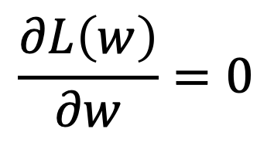
How to find the minimum of a function L(W)?
$$L\left(w\right)$$
$$\frac{∂L\left(w\right)}{∂w}=0$$
$$w$$

Slide 11
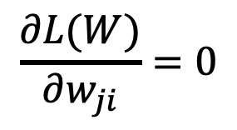
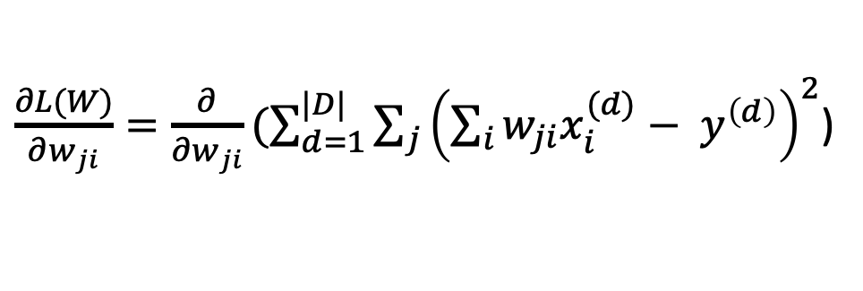

Linear Regression – Least Squares
$\frac{∂L(W)}{∂w_{ji}}=\frac{∂}{∂w_{ji}}(\sum_{d=1}^{|D|}{\sum_{j}{{\left(\sum_{i}{w_{ji}x_{i}^{(d)}}− y^{\left(d\right)}\right)}^{2}}}$)
$$\frac{∂L(W)}{∂w_{ji}}=0$$
…
$$W={(X}^{T}{X)}^{−1}X^{T}Y$$

Slide 12
ML Classifier / Regression models
K-nearest neighbors
Linear classifier / Linear regression
Naïve Bayes classifiers
Decision Trees
Random Forests
Boosted Decision Trees
Neural Networks

Slide 13
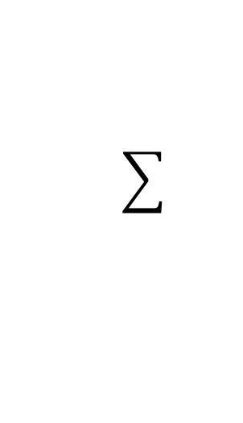
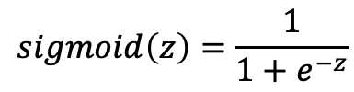





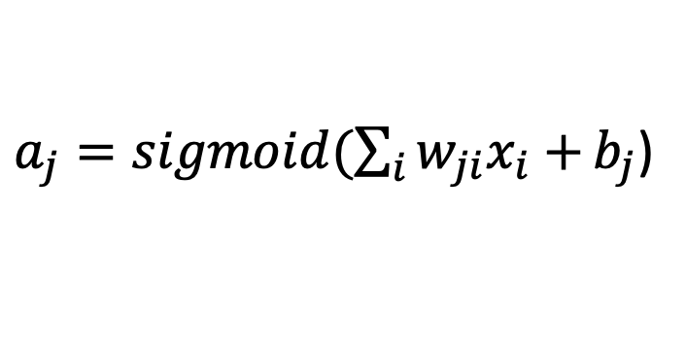



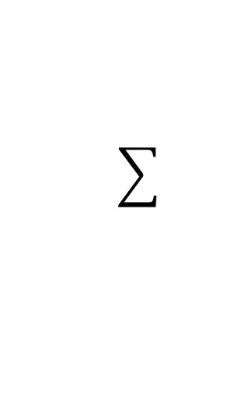
Neural Network with One Layer
$$sigmoid\left(z\right)=\frac{1}{1+e^{−z}}$$
$$x_{1}$$
$${W=[w}_{ji}]$$
$$a_{1}$$
$$x_{2}$$
$$x_{3}$$
$$a_{2}$$
$$x_{4}$$
$$x_{5}$$
$a_{j}=sigmoid(\sum_{i}{w_{ji}x_{i}+}b_{j}$)

Slide 14
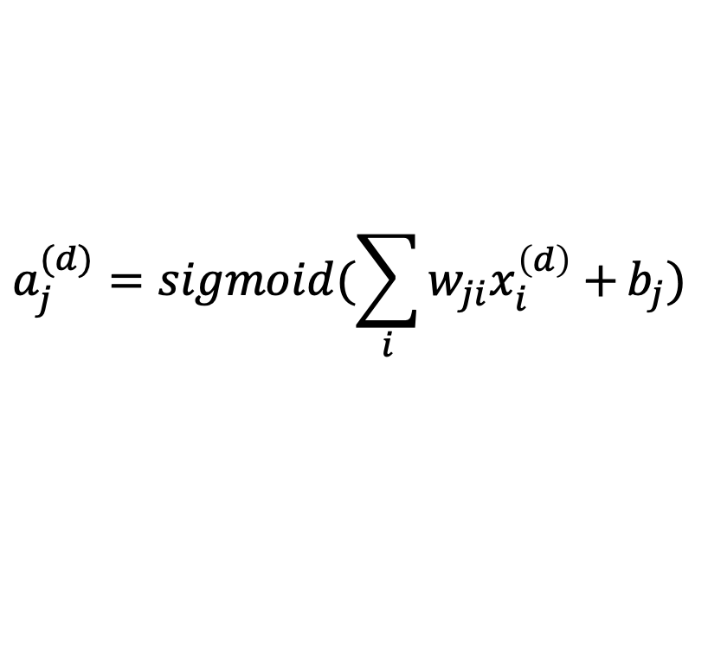
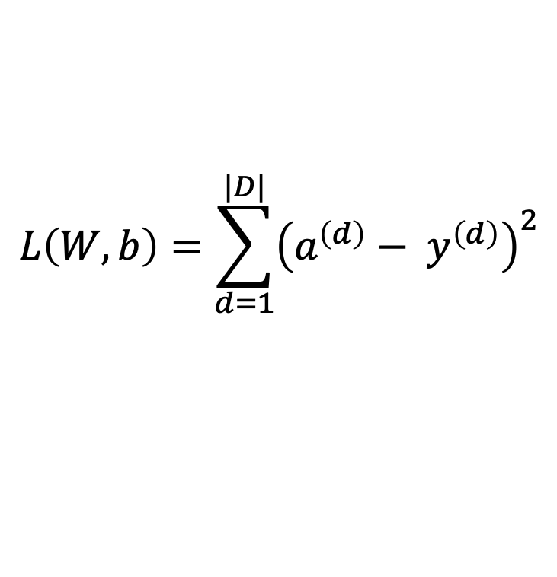
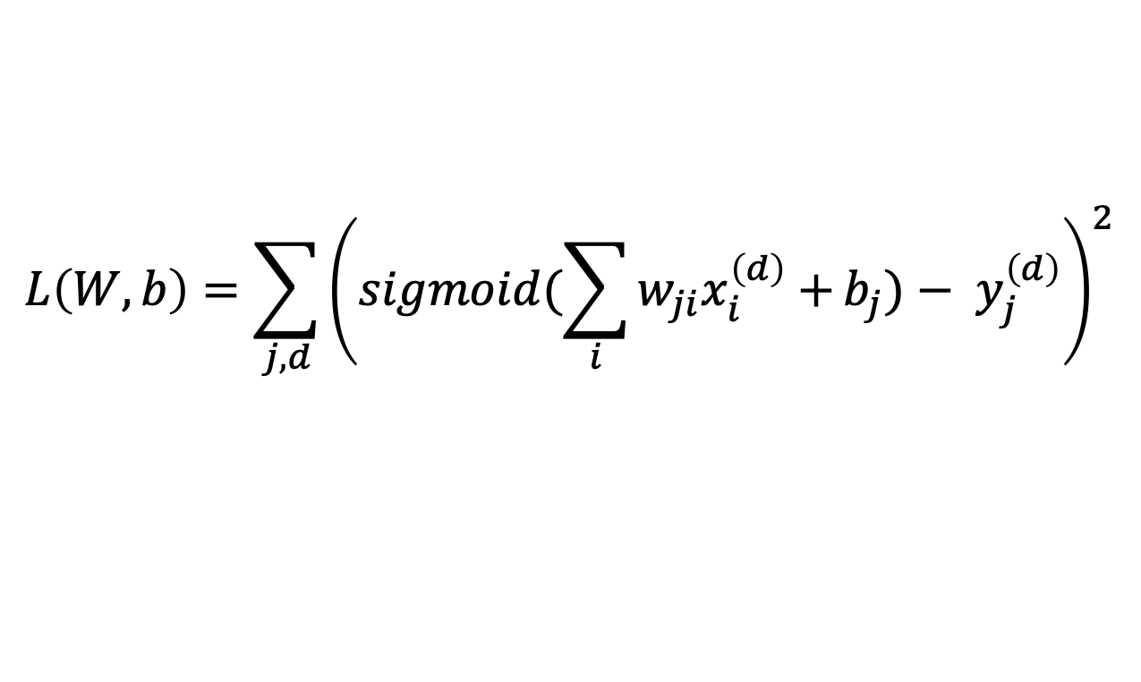
Neural Network with One Layer
$$L\left(W, b\right)=\sum_{d=1}^{|D|}{{\left(a^{\left(d\right)}− y^{\left(d\right)}\right)}^{2}}$$
$$a_{j}^{(d)}=sigmoid(\sum_{i}{w_{ji}x_{i}^{\left(d\right)}+}b_{j})$$
Bias parameters
$$L\left(W, b\right)=\sum_{j,d}{{\left(sigmoid(\sum_{i}{w_{ji}x_{i}^{\left(d\right)}+}b_{j})− y_{j}^{\left(d\right)}\right)}^{2}}$$

Slide 15
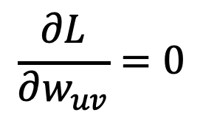
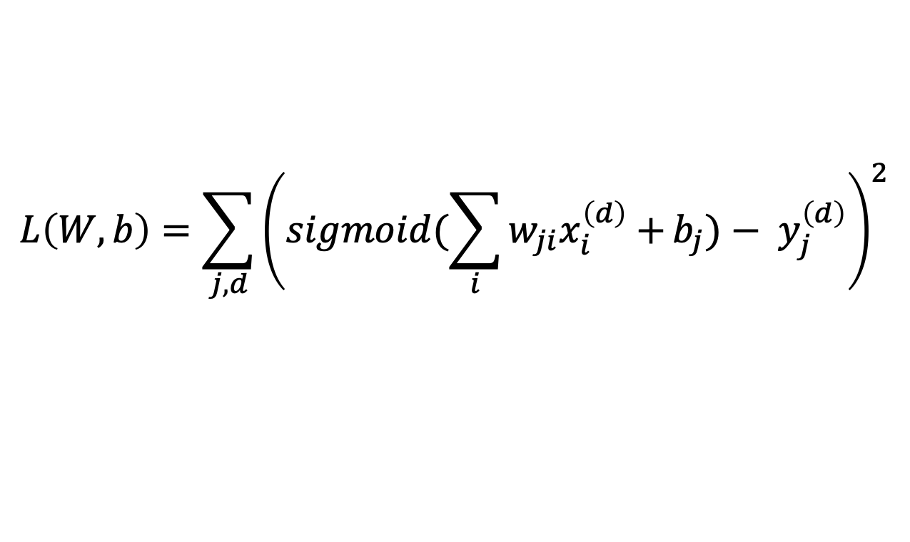
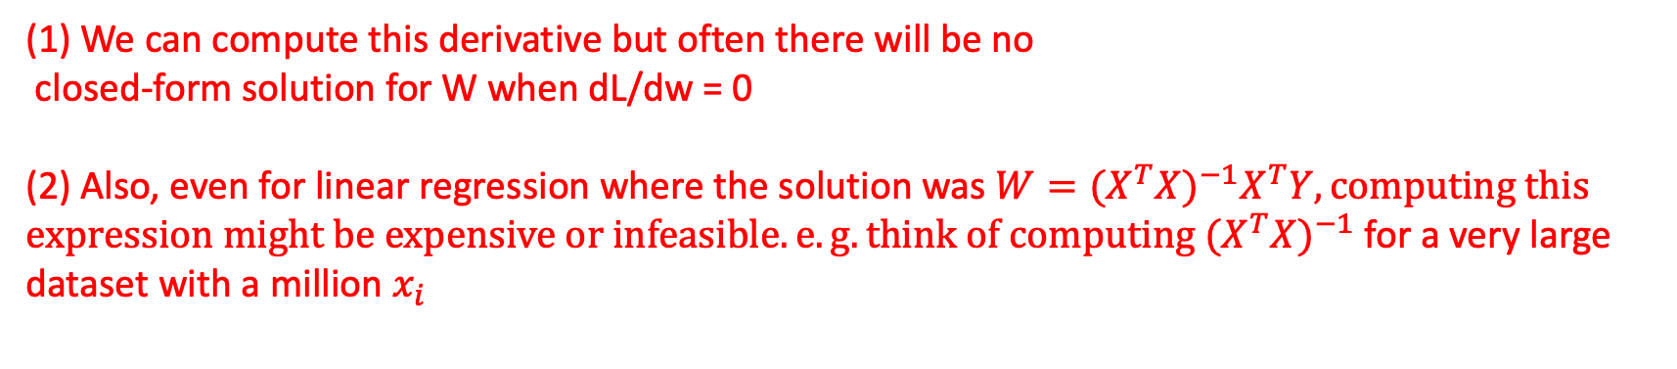
Neural Network with One Layer
$$L\left(W, b\right)=\sum_{j,d}{{\left(sigmoid(\sum_{i}{w_{ji}x_{i}^{\left(d\right)}+}b_{j})− y_{j}^{\left(d\right)}\right)}^{2}}$$
$$\frac{∂L}{∂w_{uv}}=0$$
(1) We can compute this derivative but often there will be no
closed-form solution for W when dL/dw = 0
(2) Also, even for linear regression where the solution was $W={(X}^{T}{X)}^{−1}X^{T}Y, computing this expression might be expensive or infeasible. e.g. think of computing {(X}^{T}{X)}^{−1}$ for a very large
dataset with a million $x_{i}$

Slide 16


Gradient Descent
1. Start with a random value of w (e.g. w = 12)
$$L\left(w\right)$$
2. Compute the gradient (derivative) of L(w) at point w = 12. (e.g. dL/dw = 6)
3. Recompute w as:
w = w – lambda * (dL / dw)
w=12
$$w$$

Slide 17
Gradient Descent
$$L\left(w\right)$$
2. Compute the gradient (derivative) of L(w) at point w = 10. (e.g. dL/dw = 6)
3. Recompute w as:
w = w – lambda * (dL / dw)
w=10
$$w$$

Slide 18
Gradient Descent
$$L\left(w\right)$$
2. Compute the gradient (derivative) of L(w) at point w = 12. (e.g. dL/dw = 6)
3. Recompute w as:
w = w – lambda * (dL / dw)
w=8
$$w$$

Slide 19



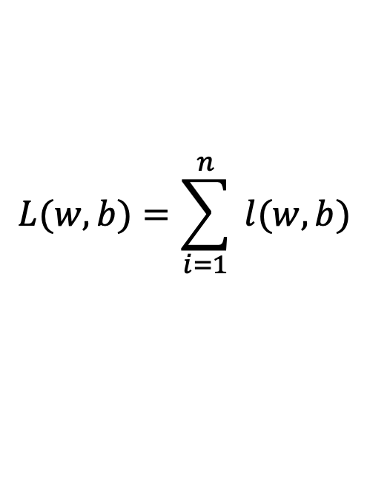



Gradient Descent
expensive
$$λ=0.01$$
$$L(w,b)=\sum_{i=1}^{n}{ l(w,b)}$$
Initialize w and b randomly
for e = 0, num_epochs do
Compute:
$$dL(w,b)/dw$$
and
$$dL(w,b)/db$$
Update w:
$$w=w −λ dL(w,b)/dw$$
Update b:
$$b=b −λ dL(w,b)/db$$
Print:
$$L(w,b)$$
// Useful to see if this is becoming smaller or not.
end

Slide 20
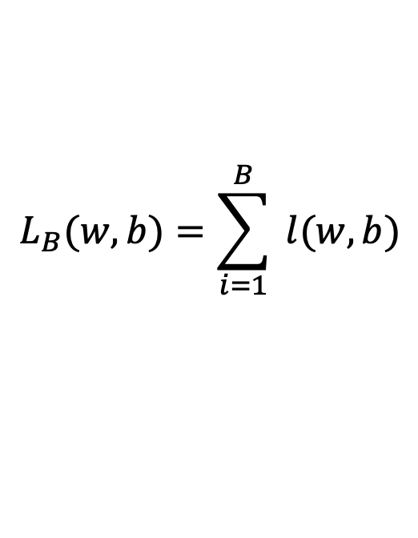





Stochastic Gradient Descent (mini-batch)
$$λ=0.01$$
$$L_{B}(w,b)=\sum_{i=1}^{B}{ l(w,b)}$$
Initialize w and b randomly
for e = 0, num_epochs do
for b = 0, num_batches do
Compute:
$$dL_{B}(w,b)/dw$$
and
$$dL_{B}(w,b)/db$$
Update w:
$$w=w −λ dl(w,b)/dw$$
Update b:
$$b=b −λ dl(w,b)/db$$
Print:
$$L_{B}(w,b)$$
// Useful to see if this is becoming smaller or not.
end
end

Slide 21
In this class we will mostly rely on…
K-nearest neighbors
Linear classifiers
Naïve Bayes classifiers
Decision Trees
Random Forests
Boosted Decision Trees
Neural Networks

Slide 22
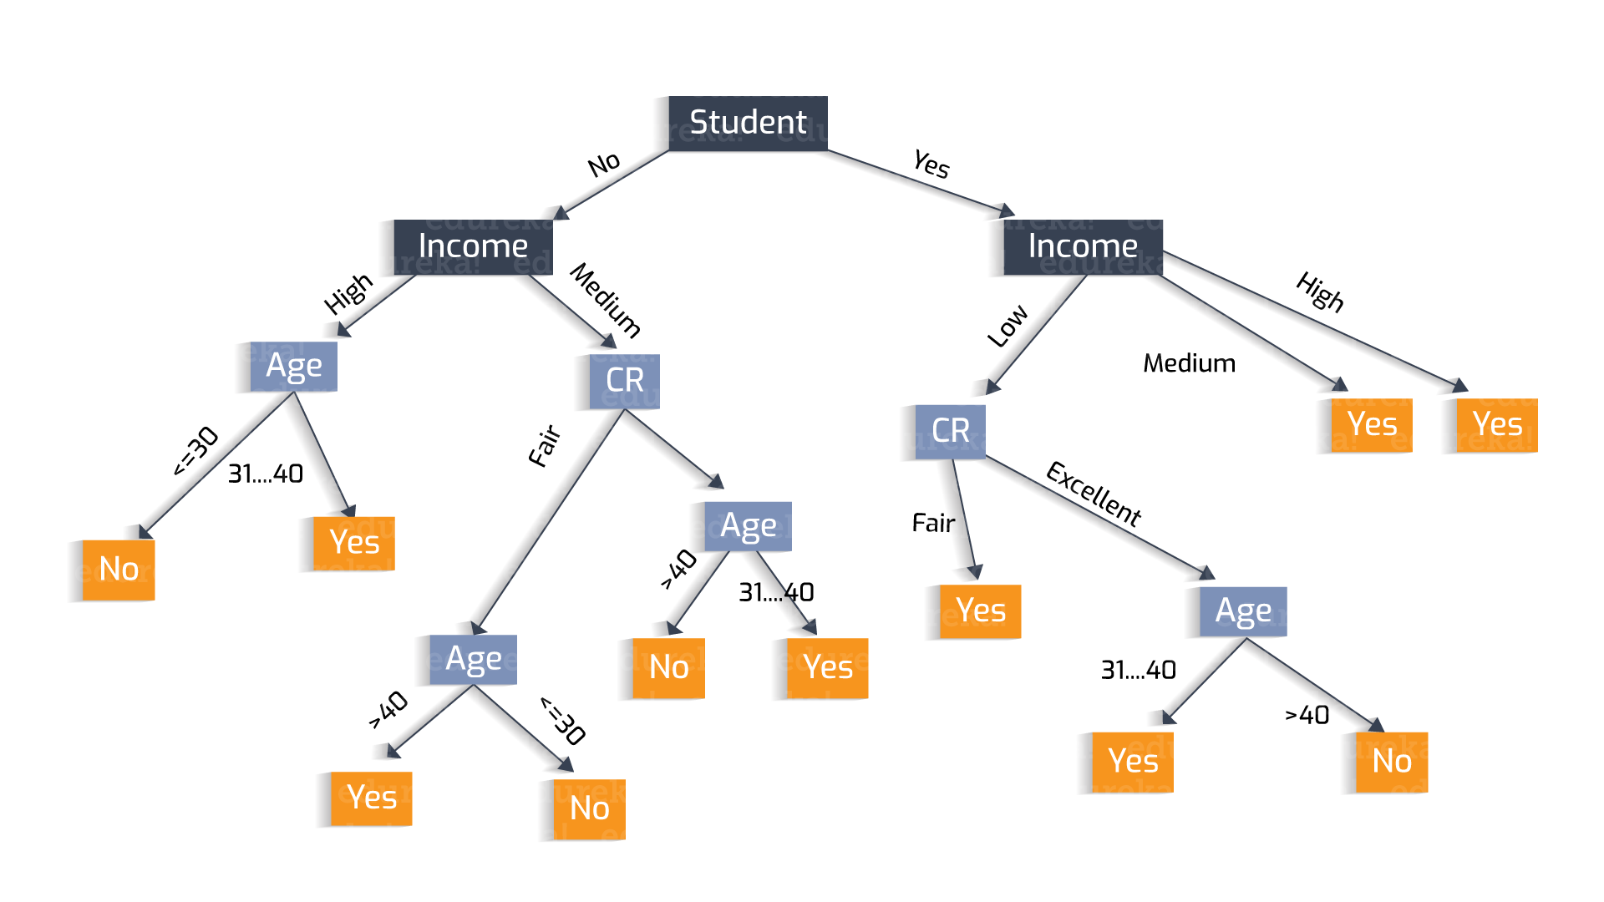
Why?
Decisions Trees
https://heartbeat.fritz.ai/understanding-the-mathematics-behind-decision-trees-22d86d55906 by Nikita Sharma

Slide 23
Why?
Decisions Trees are great because they are often interpretable.
However, they usually deal better with categorical data – not input pixel data.
https://heartbeat.fritz.ai/understanding-the-mathematics-behind-decision-trees-22d86d55906 by Nikita Sharma

Slide 24
Regression vs Classification
Regression
Labels are continuous variables – e.g. distance.
Losses: Distance-based losses, e.g. sum of distances to true values.
Evaluation: Mean distances, correlation coefficients, etc.
Classification
Labels are discrete variables (1 out of K categories)
Losses: Cross-entropy loss, margin losses, logistic regression (binary cross entropy)
Evaluation: Classification accuracy, etc.

Slide 25
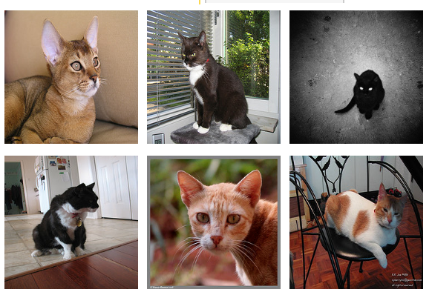
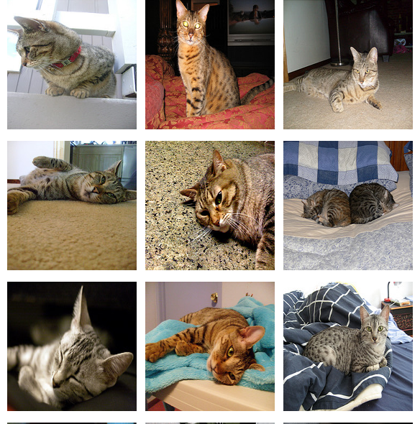
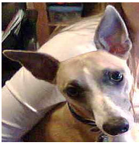
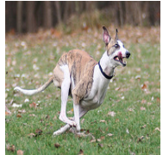
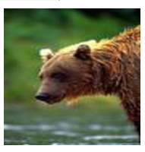
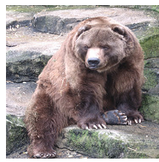
Supervised Learning - Classification
Training Data
Test Data
cat
dog
cat
.
.
.
.
.
.
bear

Slide 26








Supervised Learning - Classification
Training Data
cat
$$x_{1}=[ ]$$
$$y_{1}=[ ]$$
dog
$$x_{2}=[ ]$$
$$y_{2}=[ ]$$
cat
$$x_{3}=[ ]$$
$$y_{3}=[ ]$$
.
.
.
bear
$$x_{n}=[ ]$$
$$y_{n}=[ ]$$

Slide 27







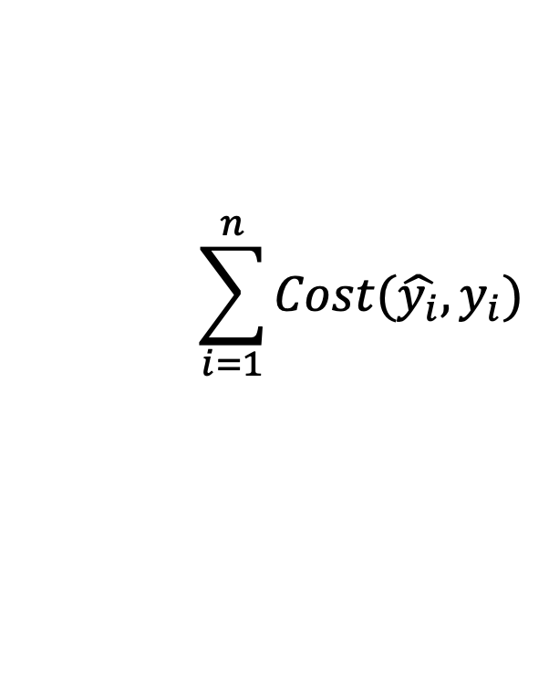


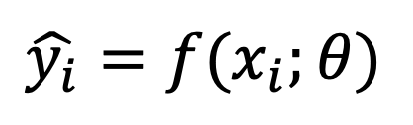



Supervised Learning - Classification
Training Data
targets /
labels /
ground truth
We need to find a function that
maps x and y for any of them.
inputs
predictions
$$x_{1}=[x_{11} { x}_{12} x_{13} { x}_{14}]$$
$$y_{1}=$$
1
$${\hat{y}}_{1}=$$
1
$$\hat{y_{i}}=f(x_{i};θ)$$
$$x_{2}=[x_{21} { x}_{22} x_{23} { x}_{24}]$$
$$y_{2}=$$
2
$${\hat{y}}_{2}=$$
2
$$x_{3}=[x_{31} { x}_{32} x_{33} { x}_{34}]$$
$$y_{3}=$$
1
$${\hat{y}}_{3}=$$
2
How do we ”learn” the parameters
of this function?
.
.
.
We choose ones that makes the
following quantity small:
$$\sum_{i=1}^{n}{Cost(\hat{y_{i}}, y_{i})}$$
$$x_{n}=[x_{n1} { x}_{n2} x_{n3} { x}_{n4}]$$
$$y_{n}=$$
3
$${\hat{y}}_{n}=$$
1

Slide 28
Stochastic Gradient Descent
How to choose the right batch size B?
How to choose the right learning rate lambda?
How to choose the right loss function, e.g. is least squares good enough?
How to choose the right function/classifier, e.g. linear, quadratic, neural network with 1 layer, 2 layers, etc?

Slide 29
Linear Regression
Example: Hollywood movie data
input variables x
output variables y
production
costs
promotional costs
genre of
the movie
box office first week
total book
sales
total revenue USA
total revenue international
$$x_{1}^{(1)}$$
$$x_{2}^{(1)}$$
$$x_{3}^{(1)}$$
$$x_{4}^{(1)}$$
$$x_{5}^{(1)}$$
$$y_{1}^{(1)}$$
$$y_{2}^{(1)}$$
training
data
$$x_{1}^{(2)}$$
$$x_{2}^{(2)}$$
$$x_{3}^{(2)}$$
$$x_{4}^{(2)}$$
$$x_{5}^{(2)}$$
$$y_{1}^{(2)}$$
$$y_{2}^{(2)}$$
$$x_{1}^{(3)}$$
$$x_{2}^{(3)}$$
$$x_{3}^{(3)}$$
$$x_{4}^{(3)}$$
$$x_{5}^{(3)}$$
$$y_{1}^{(3)}$$
$$y_{2}^{(3)}$$
$$x_{1}^{(4)}$$
$$x_{2}^{(4)}$$
$$x_{3}^{(4)}$$
$$x_{4}^{(4)}$$
$$x_{5}^{(4)}$$
$$y_{1}^{(4)}$$
$$y_{2}^{(4)}$$
test
data
$$x_{1}^{(5)}$$
$$x_{2}^{(5)}$$
$$x_{3}^{(5)}$$
$$x_{4}^{(5)}$$
$$x_{5}^{(5)}$$
$$y_{1}^{(5)}$$
$$y_{2}^{(5)}$$

Slide 30
Training, Validation (Dev), Test Sets
Training Set
Validation Set
Testing Set

Slide 31
Training, Validation (Dev), Test Sets
Training Set
Validation Set
Testing Set
Used during development

Slide 32
Training, Validation (Dev), Test Sets
Training Set
Validation Set
Testing Set
Only to be used for evaluating the model at the very end of development and any changes to the model after running it on the test set, could be influenced by what you saw happened on the test set, which would invalidate any future evaluation.

Slide 33
How to pick the right model?

Slide 34










Linear Regression – 1 output, 1 input
$$y$$
$$(x_{8},y_{8})$$
$$(x_{6},y_{6})$$
$$(x_{7},y_{7})$$
$$(x_{4},y_{4})$$
$$(x_{5},y_{5})$$
$$(x_{2},y_{2})$$
$$(x_{3},y_{3})$$
$$(x_{1},y_{1})$$
$$x$$

Slide 35

Linear Regression – 1 output, 1 input
$$y$$
$$(x_{8},y_{8})$$
$$(x_{6},y_{6})$$
$$(x_{7},y_{7})$$
$$(x_{4},y_{4})$$
$$(x_{5},y_{5})$$
$$(x_{2},y_{2})$$
$$(x_{3},y_{3})$$
$$(x_{1},y_{1})$$
$$x$$
Model:
$$\hat{y}=wx+b$$

Slide 36
Linear Regression – 1 output, 1 input
$$y$$
$$(x_{8},y_{8})$$
$$(x_{6},y_{6})$$
$$(x_{7},y_{7})$$
$$(x_{4},y_{4})$$
$$(x_{5},y_{5})$$
$$(x_{2},y_{2})$$
$$(x_{3},y_{3})$$
$$(x_{1},y_{1})$$
$$x$$
Model:
$$\hat{y}=wx+b$$

Slide 37
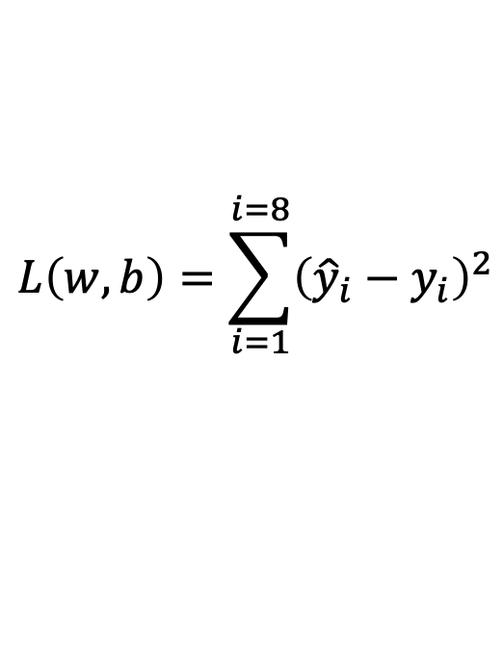
Linear Regression – 1 output, 1 input
$$y$$
$$(x_{8},y_{8})$$
$$(x_{6},y_{6})$$
$$(x_{7},y_{7})$$
$$(x_{4},y_{4})$$
$$(x_{5},y_{5})$$
$$(x_{2},y_{2})$$
$$(x_{3},y_{3})$$
$$(x_{1},y_{1})$$
$$x$$
$$L\left(w,b\right)=\sum_{i=1}^{i=8}{{\left({\hat{y}}_{i}−y_{i}\right)}^{2}}$$
Model:
$$\hat{y}=wx+b$$
Loss:

Slide 38

Quadratic Regression
$$y$$
$$(x_{8},y_{8})$$
$$(x_{6},y_{6})$$
$$(x_{7},y_{7})$$
$$(x_{4},y_{4})$$
$$(x_{5},y_{5})$$
$$(x_{2},y_{2})$$
$$(x_{3},y_{3})$$
$$(x_{1},y_{1})$$
$$x$$
$$L\left(w,b\right)=\sum_{i=1}^{i=8}{{\left({\hat{y}}_{i}−y_{i}\right)}^{2}}$$
Model:
$$\hat{y}=w_{1}x^{2}+w_{2}x+b$$
Loss:

Slide 39

n-polynomial Regression
$$y$$
$$(x_{8},y_{8})$$
$$(x_{6},y_{6})$$
$$(x_{7},y_{7})$$
$$(x_{4},y_{4})$$
$$(x_{5},y_{5})$$
$$(x_{2},y_{2})$$
$$(x_{3},y_{3})$$
$$(x_{1},y_{1})$$
$$x$$
$$L\left(w,b\right)=\sum_{i=1}^{i=8}{{\left({\hat{y}}_{i}−y_{i}\right)}^{2}}$$
Model:
$$\hat{y}=w_{n}x^{n}+…+w_{1}x+b$$
Loss:

Slide 40
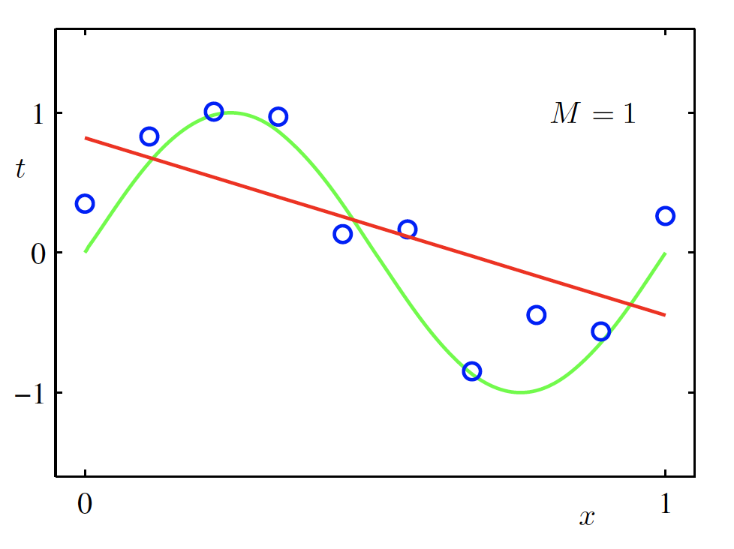
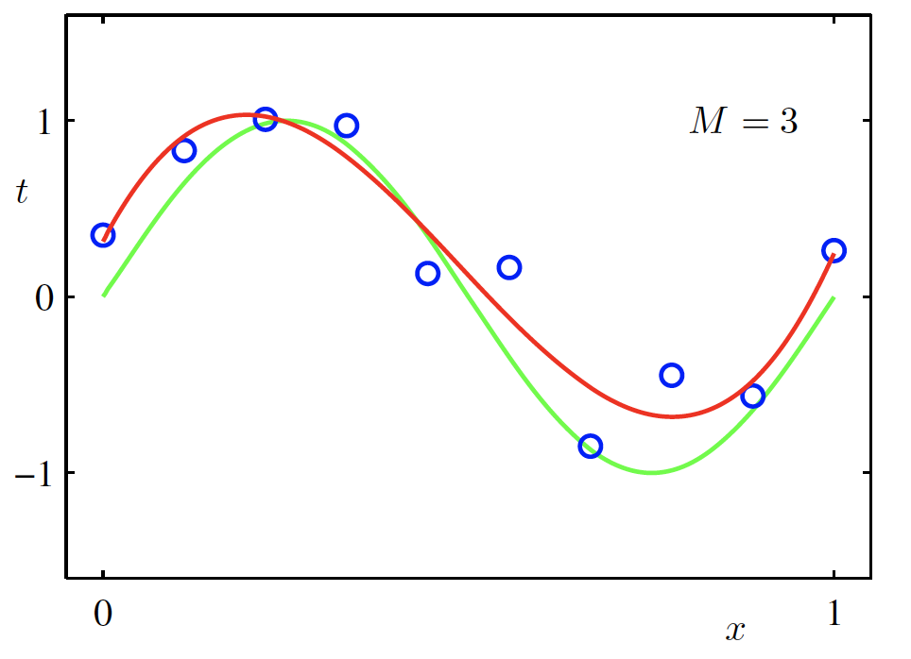
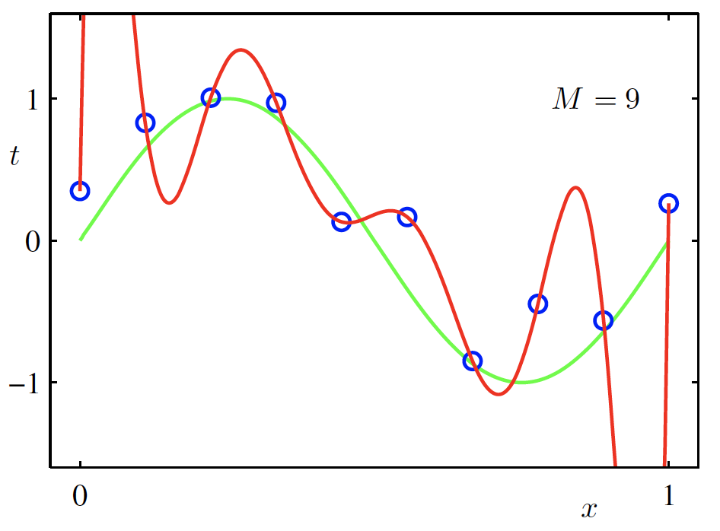

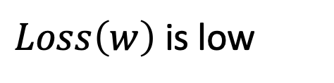
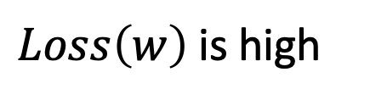
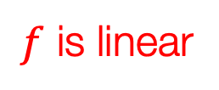
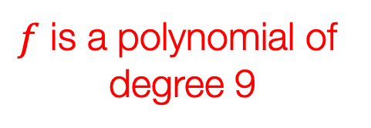
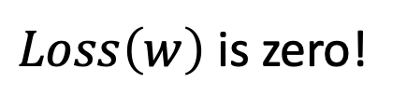
Overfitting
$f$ is a polynomial of degree 9
$f$ is linear
$f$ is cubic
$Loss\left(w\right)$ is high
$Loss\left(w\right)$ is low
$Loss\left(w\right)$ is zero!
Underfitting
Overfitting
Christopher M. Bishop – Pattern Recognition and Machine Learning
Credit: C. Bishop. Pattern Recognition and Mach. Learning.

Slide 41
Questions?

