Slide 1
Deep Learning for Vision & Language
SGD and Regularization, Softmax, MLPs

Slide 2
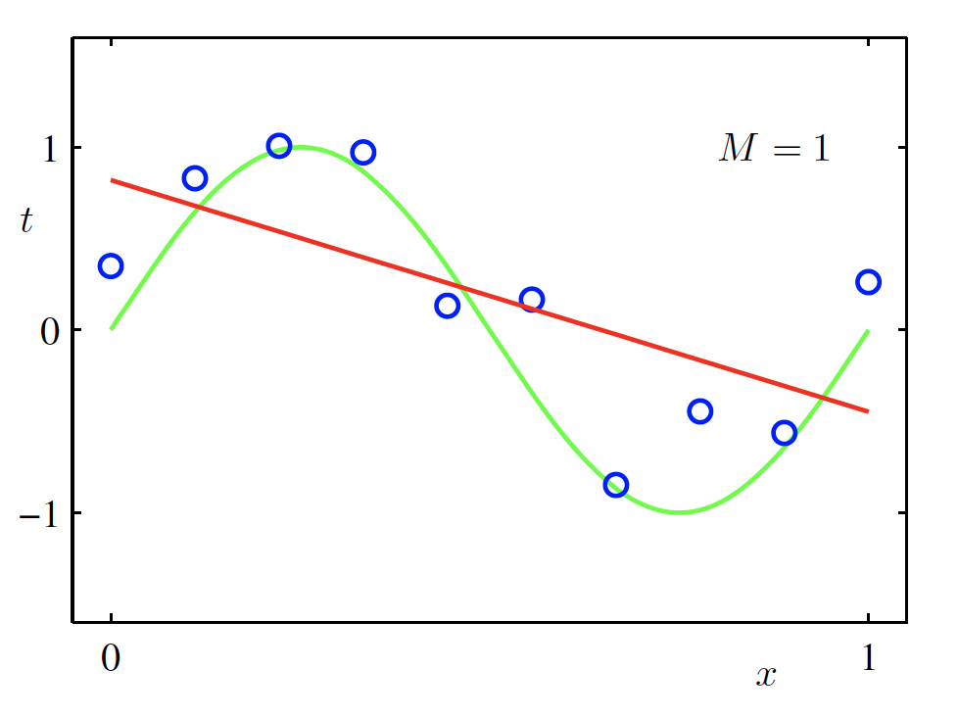
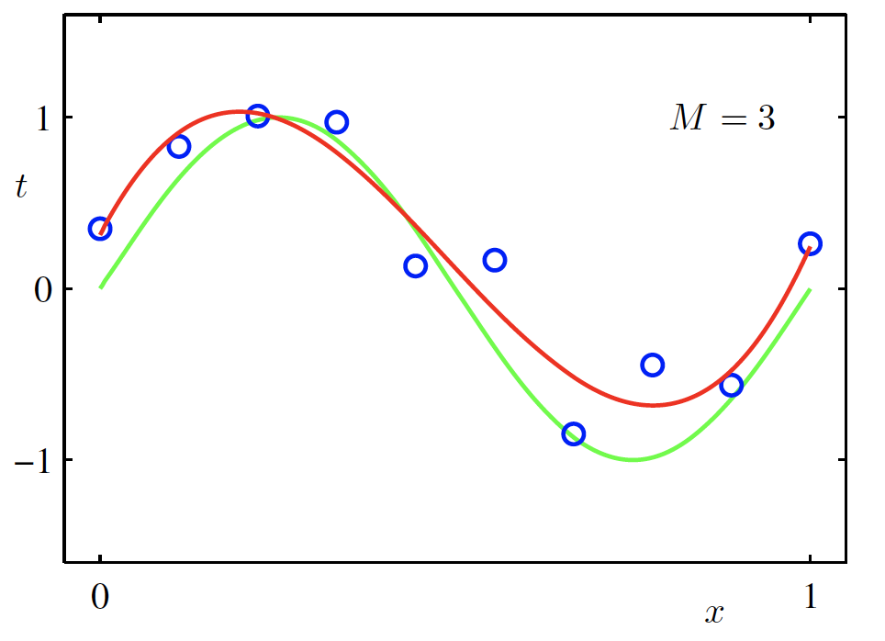
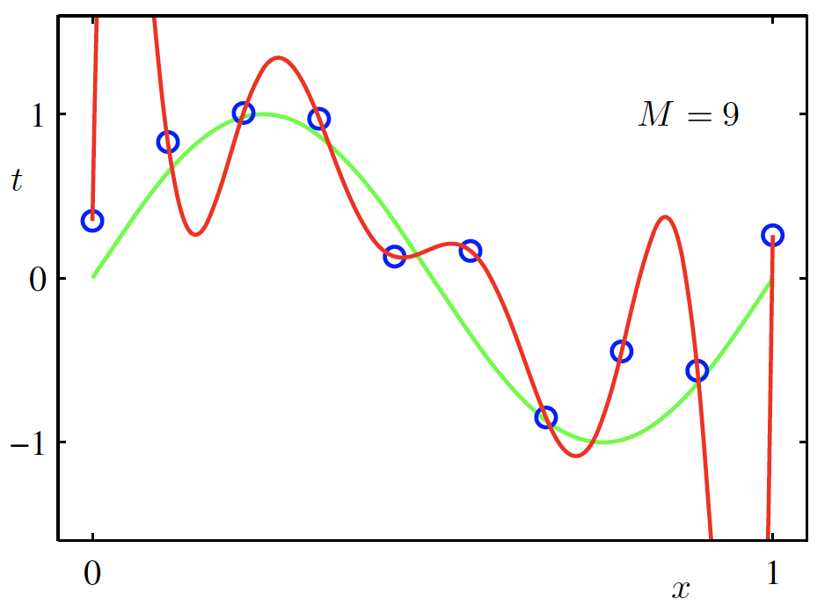

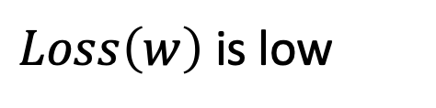
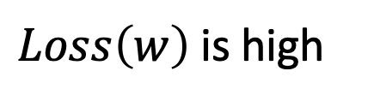
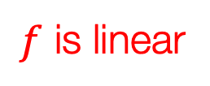
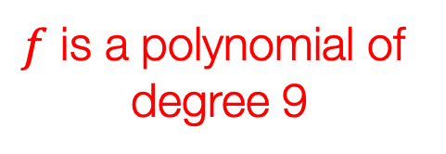
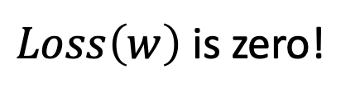
Overfitting
$f$ is a polynomial of
degree 9
$f$ is linear
$f$ is cubic
$Loss\left(w\right)$ is high
$Loss\left(w\right)$ is low
$Loss\left(w\right)$ is zero!
Underfitting
Overfitting
Christopher M. Bishop – Pattern Recognition and Machine Learning
Credit: C. Bishop. Pattern Recognition and Mach. Learning.

Slide 3



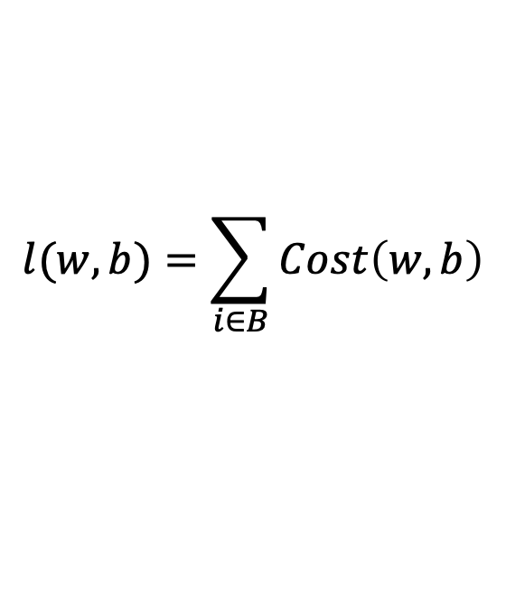



(mini-batch) Stochastic Gradient Descent (SGD)
$$λ=0.01$$
$$l(w,b)=\sum_{i∈B}{Cost\left(w,b\right)}$$
Initialize w and b randomly
for e = 0, num_epochs do
for b = 0, num_batches do
Compute:
$$dl(w,b)/dw$$
and
$$dl(w,b)/db$$
Update w:
$$w=w −λ dl(w,b)/dw$$
Update b:
$$b=b −λ dl(w,b)/db$$
Print:
$$l(w,b)$$
// Useful to see if this is becoming smaller or not.
end
end

Slide 4
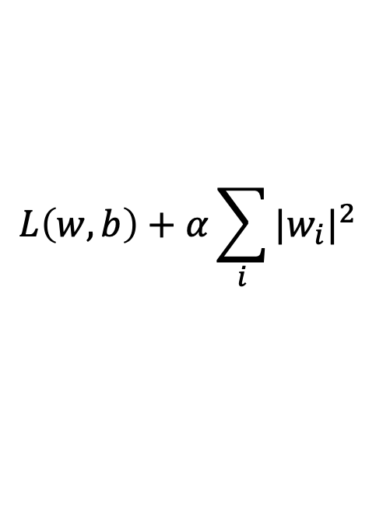
Regularization
Large weights lead to large variance. i.e. model fits to the training data too strongly.
Solution: Minimize the loss but also try to keep the weight values small by doing the following:
$$L\left(w,b\right)+α\sum_{i}{{|w_{i}|}^{2}}$$
minimize
Credit: C. Bishop. Pattern Recognition and Mach. Learning.

Slide 5
Regularization
Large weights lead to large variance. i.e. model fits to the training data too strongly.
Solution: Minimize the loss but also try to keep the weight values small by doing the following:
$$L\left(w,b\right)+α\sum_{i}{{|w_{i}|}^{2}}$$
minimize
Regularizer term
e.g. L2- regularizer
Credit: C. Bishop. Pattern Recognition and Mach. Learning.

Slide 6

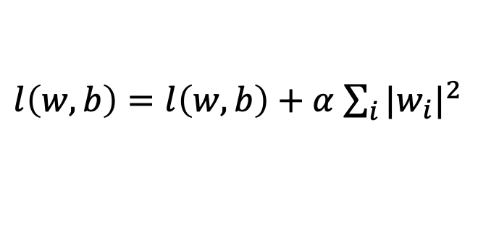

SGD with Regularization (L-2)
$$λ=0.01$$
$l\left(w,b\right)=l\left(w,b\right)+α$ $\sum_{i}{{|w_{i}|}^{2}}$
Initialize w and b randomly
for e = 0, num_epochs do
for b = 0, num_batches do
Compute:
$$dl(w,b)/dw$$
and
$$dl(w,b)/db$$
Update w:
$$w=w −λ dl(w,b)/dw−λαw$$
Update b:
$$b=b −λ dl(w,b)/db−λαw$$
Print:
$$l(w,b)$$
// Useful to see if this is becoming smaller or not.
end
end

Slide 7
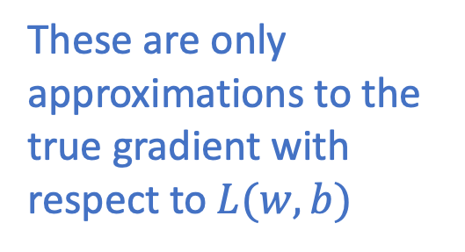
Revisiting Another Problem with SGD
$$λ=0.01$$
$l\left(w,b\right)=l\left(w,b\right)+α$ $\sum_{i}{{|w_{i}|}^{2}}$
Initialize w and b randomly
for e = 0, num_epochs do
These are only approximations to the true gradient with respect to $L(w,b)$
for b = 0, num_batches do
Compute:
$$dl(w,b)/dw$$
and
$$dl(w,b)/db$$
Update w:
$$w=w −λ dl(w,b)/dw−λαw$$
Update b:
$$b=b −λ dl(w,b)/db−λαw$$
Print:
$$l(w,b)$$
// Useful to see if this is becoming smaller or not.
end
end

Slide 8
Revisiting Another Problem with SGD
$$λ=0.01$$
$l\left(w,b\right)=l\left(w,b\right)+α$ $\sum_{i}{{|w_{i}|}^{2}}$
Initialize w and b randomly
for e = 0, num_epochs do
This could lead to “un-learning” what has been learned in some previous steps of training.
for b = 0, num_batches do
Compute:
$$dl(w,b)/dw$$
and
$$dl(w,b)/db$$
Update w:
$$w=w −λ dl(w,b)/dw−λαw$$
Update b:
$$b=b −λ dl(w,b)/db−λαw$$
Print:
$$l(w,b)$$
// Useful to see if this is becoming smaller or not.
end
end

Slide 9
Solution: Momentum Updates
$$λ=0.01$$
$l\left(w,b\right)=l\left(w,b\right)+α$ $\sum_{i}{{|w_{i}|}^{2}}$
Initialize w and b randomly
for e = 0, num_epochs do
Keep track of previous gradients in an accumulator variable! and use a weighted average with current gradient.
for b = 0, num_batches do
Compute:
$$dl(w,b)/dw$$
and
$$dl(w,b)/db$$
Update w:
$$w=w −λ dl(w,b)/dw−λαw$$
Update b:
$$b=b −λ dl(w,b)/db−λαw$$
Print:
$$l(w,b)$$
// Useful to see if this is becoming smaller or not.
end
end

Slide 10







Solution: Momentum Updates
$$λ=0.01$$
$$τ=0.9$$
Initialize w and b randomly
$l\left(w,b\right)=l\left(w,b\right)+α$ $\sum_{i}{{|w_{i}|}^{2}}$
global $v$
for e = 0, num_epochs do
for b = 0, num_batches do
Keep track of previous gradients in an accumulator variable! and use a weighted average with current gradient.
Compute:
$$dl(w,b)/dw$$
Compute:
$$v=τv+dl(w,b)/dw+αw$$
Update w:
$$w=w −λ v$$
Print:
$$l(w,b)$$
// Useful to see if this is becoming smaller or not.
end
end

Slide 11
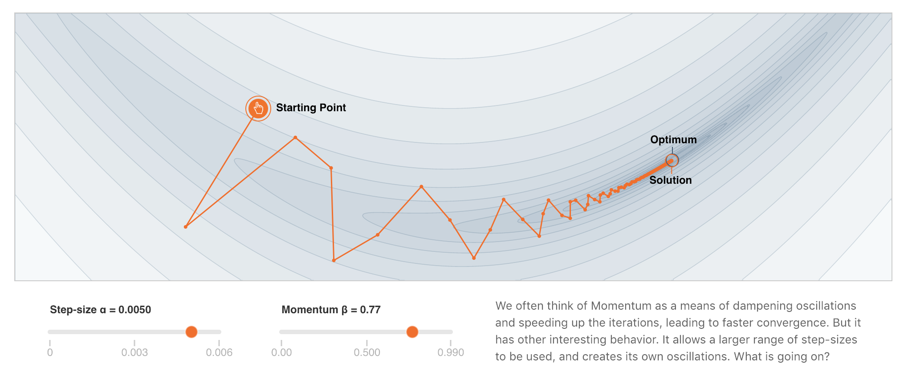
More on Momentum
https://distill.pub/2017/momentum/

Slide 12
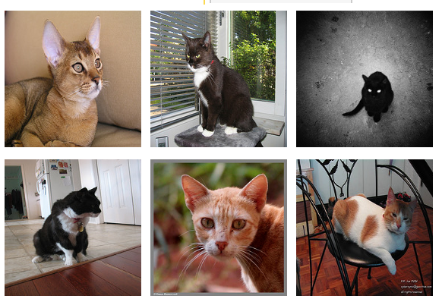
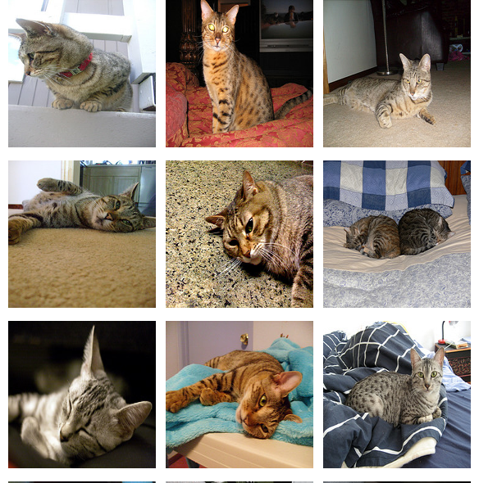
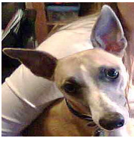
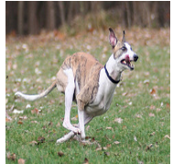
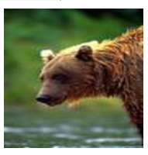
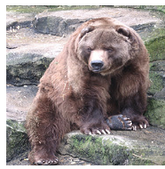
Supervised Learning - Classification
Training Data
Test Data
cat
dog
cat
.
.
.
.
.
.
bear

Slide 13








Supervised Learning - Classification
Training Data
cat
$$x_{1}=[ ]$$
$$y_{1}=[ ]$$
dog
$$x_{2}=[ ]$$
$$y_{2}=[ ]$$
cat
$$x_{3}=[ ]$$
$$y_{3}=[ ]$$
.
.
.
bear
$$x_{n}=[ ]$$
$$y_{n}=[ ]$$

Slide 14







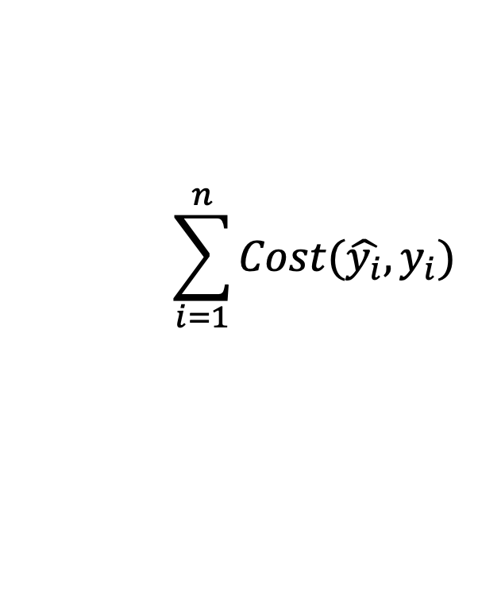


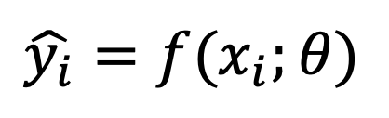



Supervised Learning - Classification
Training Data
targets /
labels /
ground truth
We need to find a function that
maps x and y for any of them.
inputs
predictions
$$x_{1}=[x_{11} { x}_{12} x_{13} { x}_{14}]$$
$$y_{1}=$$
1
$${\hat{y}}_{1}=$$
1
$$\hat{y_{i}}=f(x_{i};θ)$$
$$x_{2}=[x_{21} { x}_{22} x_{23} { x}_{24}]$$
$$y_{2}=$$
2
$${\hat{y}}_{2}=$$
2
$$x_{3}=[x_{31} { x}_{32} x_{33} { x}_{34}]$$
$$y_{3}=$$
1
$${\hat{y}}_{3}=$$
2
How do we ”learn” the parameters
of this function?
.
.
.
We choose ones that makes the
following quantity small:
$$\sum_{i=1}^{n}{Cost(\hat{y_{i}}, y_{i})}$$
$$x_{n}=[x_{n1} { x}_{n2} x_{n3} { x}_{n4}]$$
$$y_{n}=$$
3
$${\hat{y}}_{n}=$$
1

Slide 15
Supervised Learning - Classification
Training Data
Test Data
cat
dog
cat
.
.
.
.
.
.
bear

Slide 16
Supervised Learning - Classification
Training Data
cat
$$x_{1}=[ ]$$
$$y_{1}=[ ]$$
dog
$$x_{2}=[ ]$$
$$y_{2}=[ ]$$
cat
$$x_{3}=[ ]$$
$$y_{3}=[ ]$$
.
.
.
bear
$$x_{n}=[ ]$$
$$y_{n}=[ ]$$

Slide 17
Supervised Learning - Classification
Training Data
targets /
labels /
ground truth
We need to find a function that
maps x and y for any of them.
inputs
predictions
$$x_{1}=[x_{11} { x}_{12} x_{13} { x}_{14}]$$
$$y_{1}=$$
1
$${\hat{y}}_{1}=$$
1
$$\hat{y_{i}}=f(x_{i};θ)$$
$$x_{2}=[x_{21} { x}_{22} x_{23} { x}_{24}]$$
$$y_{2}=$$
2
$${\hat{y}}_{2}=$$
2
$$x_{3}=[x_{31} { x}_{32} x_{33} { x}_{34}]$$
$$y_{3}=$$
1
$${\hat{y}}_{3}=$$
2
How do we ”learn” the parameters
of this function?
.
.
.
We choose ones that makes the
following quantity small:
$$\sum_{i=1}^{n}{Cost(\hat{y_{i}}, y_{i})}$$
$$x_{n}=[x_{n1} { x}_{n2} x_{n3} { x}_{n4}]$$
$$y_{n}=$$
3
$${\hat{y}}_{n}=$$
1

Slide 18
Supervised Learning – Linear Softmax
Training Data
targets /
labels /
ground truth
inputs
$$x_{1}=[x_{11} { x}_{12} x_{13} { x}_{14}]$$
$$y_{1}=$$
1
$$x_{2}=[x_{21} { x}_{22} x_{23} { x}_{24}]$$
$$y_{2}=$$
2
$$x_{3}=[x_{31} { x}_{32} x_{33} { x}_{34}]$$
$$y_{3}=$$
1
.
.
.
$$x_{n}=[x_{n1} { x}_{n2} x_{n3} { x}_{n4}]$$
$$y_{n}=$$
3

Slide 19




Supervised Learning – Linear Softmax
Training Data
targets /
labels /
ground truth
inputs
predictions
$$x_{1}=[x_{11} { x}_{12} x_{13} { x}_{14}]$$
$$y_{1}=$$
[1 0 0]
$${\hat{y}}_{1}=$$
[0.85 0.10 0.05]
$$x_{2}=[x_{21} { x}_{22} x_{23} { x}_{24}]$$
$$y_{2}=$$
[0 1 0]
$${\hat{y}}_{2}=$$
[0.20 0.70 0.10]
$$x_{3}=[x_{31} { x}_{32} x_{33} { x}_{34}]$$
$$y_{3}=$$
[1 0 0]
$${\hat{y}}_{3}=$$
[0.40 0.45 0.15]
.
.
.
$$x_{n}=[x_{n1} { x}_{n2} x_{n3} { x}_{n4}]$$
$$y_{n}=$$
[0 0 1]
$${\hat{y}}_{n}=$$
[0.40 0.25 0.35]

Slide 20






Supervised Learning – Linear Softmax
$$x_{i}=[x_{i1} { x}_{i2} x_{i3} { x}_{i4}]$$
$$y_{i}=$$
[1 0 0]
$${\hat{y}}_{i}= [f_{1} f_{2} f_{3}]$$
$$a_{1}=w_{11}x_{i1}+w_{12}x_{i2}+w_{13}x_{i3}+w_{14}x_{i4}+b_{c}$$
$$a_{2}=w_{21}x_{i1}+w_{22}x_{i2}+w_{23}x_{i3}+w_{24}x_{i4}+b_{d}$$
$$a_{3}=w_{31}x_{i1}+w_{32}x_{i2}+w_{33}x_{i3}+w_{34}x_{i4}+b_{b}$$
$$f_{1}=e^{a_{1}}/{(e}^{a_{1}}+e^{a_{2}}+e^{a_{3}})$$
$$f_{2}=e^{a_{2}}/{(e}^{a_{1}}+e^{a_{2}}+e^{a_{3}})$$
$$f_{3}=e^{a_{3}}/{(e}^{a_{1}}+e^{a_{2}}+e^{a_{3}})$$

Slide 21
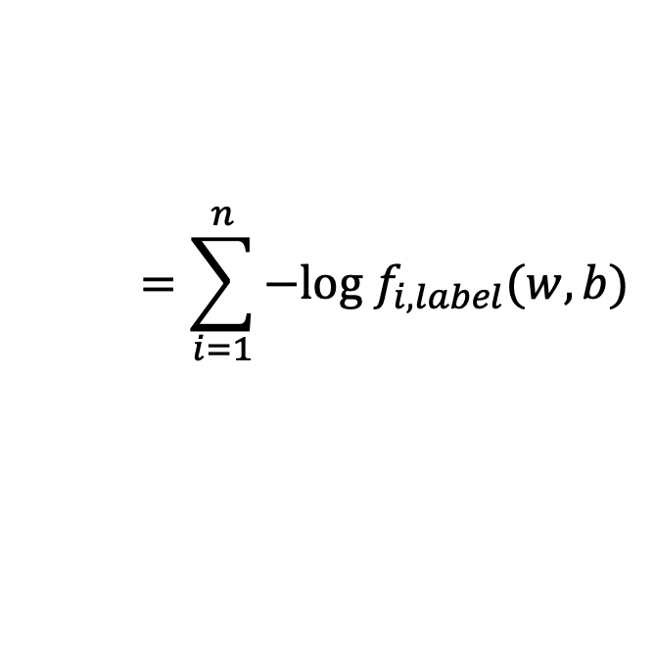
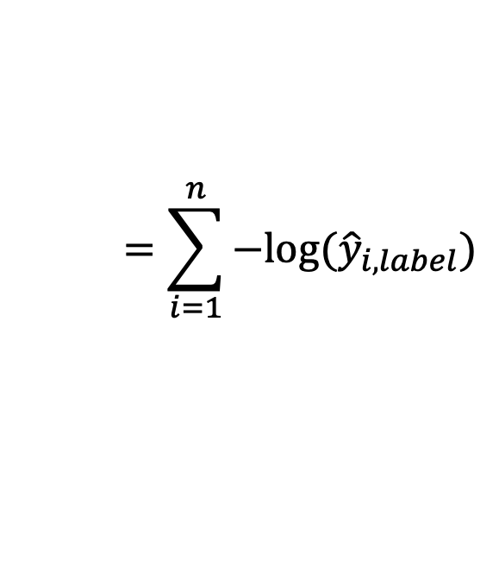
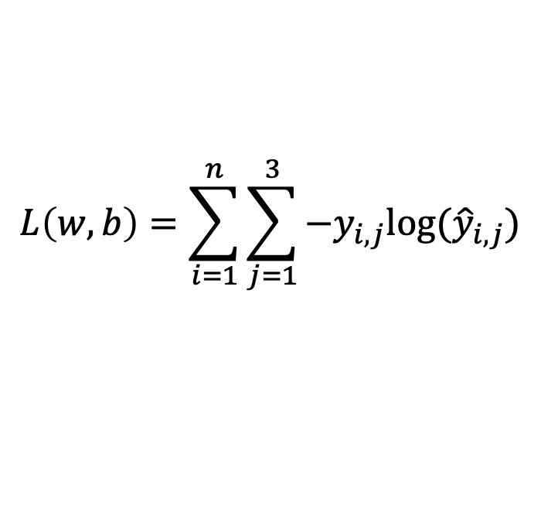

How do we find a good w and b?
$$x_{i}=[x_{i1} { x}_{i2} x_{i3} { x}_{i4}]$$
$$y_{i}=$$
[1 0 0]
$${\hat{y}}_{i}= [f_{1}(w,b) f_{2}(w,b) f_{3}(w,b)]$$
We need to find w, and b that minimize the following:
$$L\left(w,b\right)=\sum_{i=1}^{n}{\sum_{j=1}^{3}{−y_{i,j}log⁡({\hat{y}}_{i,j})}}$$
$$=\sum_{i=1}^{n}{−log⁡({\hat{y}}_{i,label})}$$
$$=\sum_{i=1}^{n}{−log f_{i,label}(w,b)}$$
Why?

Slide 22
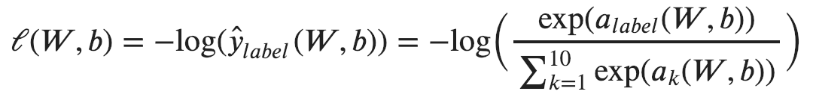
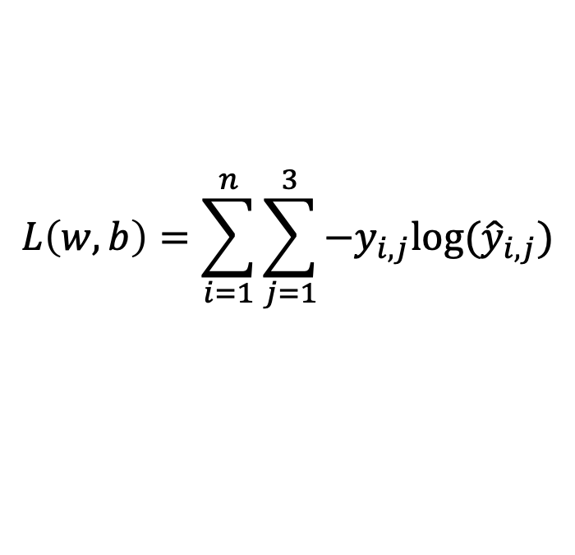
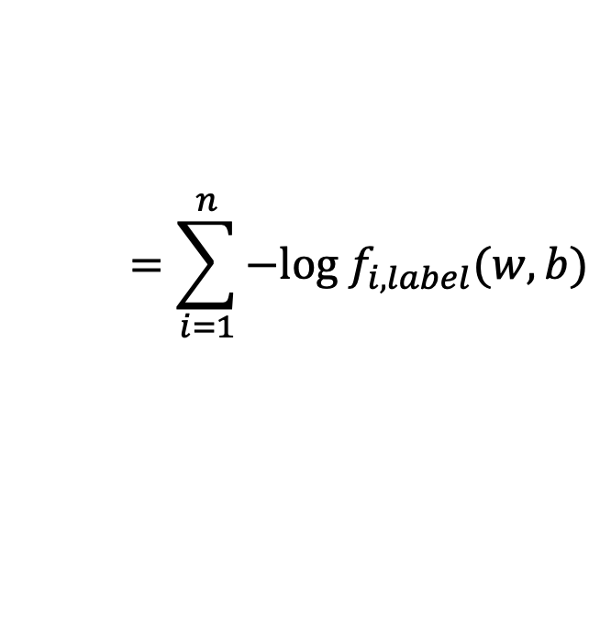
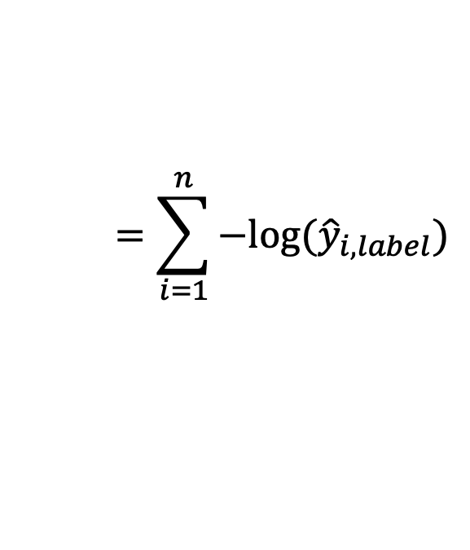
Computing Analytic Gradients
This is what we have:
$$L\left(w,b\right)=\sum_{i=1}^{n}{\sum_{j=1}^{3}{−y_{i,j}log⁡({\hat{y}}_{i,j})}}$$
$$=\sum_{i=1}^{n}{−log⁡({\hat{y}}_{i,label})}$$
$$=\sum_{i=1}^{n}{−log f_{i,label}(w,b)}$$
To simplify let’s assume n = 1
3

Slide 23



Supervised Learning – Linear Softmax
$$x=[x_{1} { x}_{2} x_{3} { x}_{4}]$$
$$y=$$
[1 0 0]
$$\hat{y}= [f_{1} f_{2} f_{3}]$$
$$a_{1}=w_{11}x_{1}+w_{12}x_{2}+w_{13}x_{3}+w_{14}x_{4}+b_{c}$$
$$a_{2}=w_{21}x_{1}+w_{22}x_{2}+w_{23}x_{3}+w_{24}x_{4}+b_{d}$$
$$a_{3}=w_{31}x_{1}+w_{32}x_{2}+w_{33}x_{3}+w_{34}x_{4}+b_{b}$$
$$f_{1}=e^{a_{1}}/{(e}^{a_{1}}+e^{a_{2}}+e^{a_{3}})$$
$$f_{2}=e^{a_{2}}/{(e}^{a_{1}}+e^{a_{2}}+e^{a_{3}})$$
$$f_{3}=e^{a_{3}}/{(e}^{a_{1}}+e^{a_{2}}+e^{a_{3}})$$

Slide 24
Computing Analytic Gradients
This is what we have:
3

Slide 25
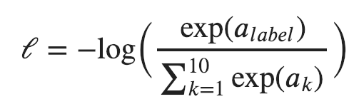
Computing Analytic Gradients
This is what we have:
3
3
Reminder:
$$a_{i}=(w_{i,1}x_{1}+w_{i,2}x_{2}+w_{i,3}x_{3}+w_{i,4}x_{4})+b_{i}$$

Slide 26
Computing Analytic Gradients
This is what we have:
3

Slide 27
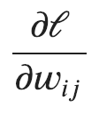

Computing Analytic Gradients
This is what we have:
3
This is what we need:
for each
for each

Slide 28
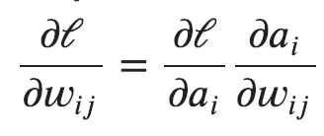
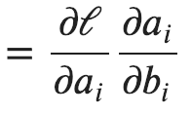
Computing Analytic Gradients
This is what we have:
3
Step 1: Chain Rule of Calculus

Slide 29
Computing Analytic Gradients
This is what we have:
3
Step 1: Chain Rule of Calculus
Let’s do these first

Slide 30
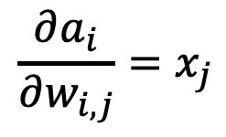
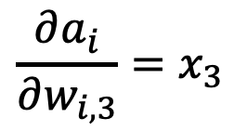
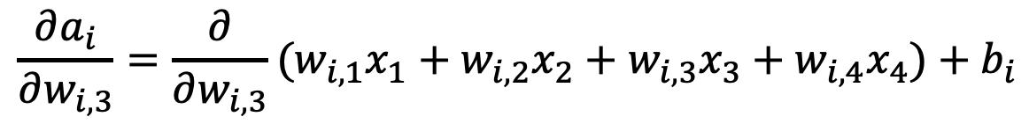
Computing Analytic Gradients
$$a_{i}=(w_{i,1}x_{1}+w_{i,2}x_{2}+w_{i,3}x_{3}+w_{i,4}x_{4})+b_{i}$$
$$\frac{∂a_{i}}{∂w_{i, 3}}=\frac{∂}{∂w_{i, 3}}(w_{i,1}x_{1}+w_{i,2}x_{2}+w_{i,3}x_{3}+w_{i,4}x_{4})+b_{i}$$
$$\frac{∂a_{i}}{∂w_{i, 3}}=x_{3}$$
$$\frac{∂a_{i}}{∂w_{i, j}}=x_{j}$$

Slide 31
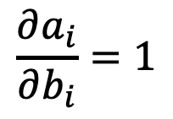
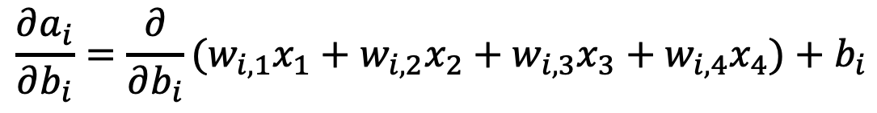
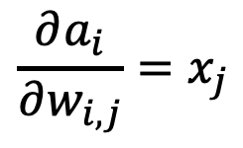
Computing Analytic Gradients
$$\frac{∂a_{i}}{∂w_{i, j}}=x_{j}$$
$$a_{i}=(w_{i,1}x_{1}+w_{i,2}x_{2}+w_{i,3}x_{3}+w_{i,4}x_{4})+b_{i}$$
$$\frac{∂a_{i}}{∂b_{i}}=\frac{∂}{∂b_{i}}(w_{i,1}x_{1}+w_{i,2}x_{2}+w_{i,3}x_{3}+w_{i,4}x_{4})+b_{i}$$
$$\frac{∂a_{i}}{∂b_{i}}=1$$

Slide 32

Computing Analytic Gradients
$$\frac{∂a_{i}}{∂w_{i, j}}=x_{j}$$
$$\frac{∂a_{i}}{∂b_{i}}=1$$

Slide 33
Computing Analytic Gradients
This is what we have:
3
Step 1: Chain Rule of Calculus
Now let’s do this one (same for both!)

Slide 34
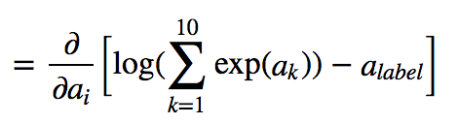
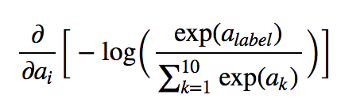
Computing Analytic Gradients
3
3
In our cat, dog, bear classification example: i = {1, 2, 3}

Slide 35
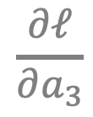
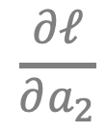
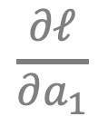
Computing Analytic Gradients
3
3
In our cat, dog, bear classification example: i = {1, 2, 3}
$$\frac{∂ℓ}{∂a_{1}}$$
$$\frac{∂ℓ}{∂a_{2}}$$
$$\frac{∂ℓ}{∂a_{3}}$$
Let’s say: label = 2
We need:

Slide 36
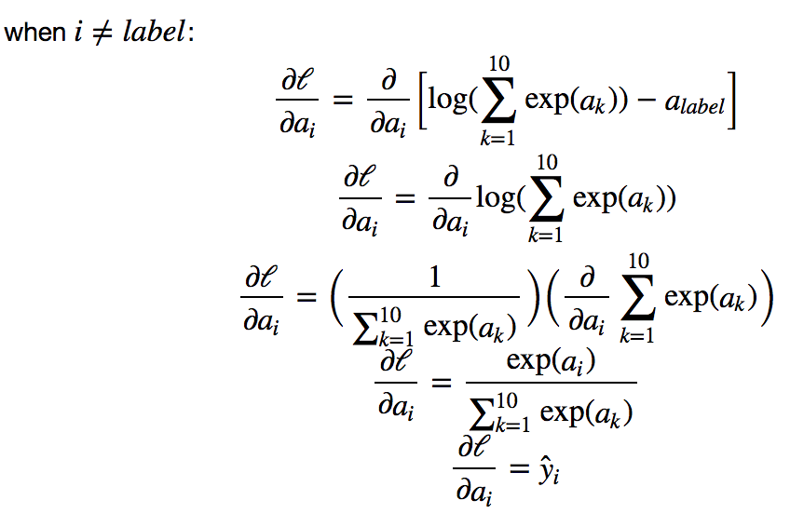

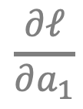

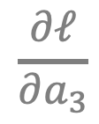
Computing Analytic Gradients
3
$$\frac{∂ℓ}{∂a_{1}}$$
$$\frac{∂ℓ}{∂a_{3}}$$
3
3
3
3
$$={\hat{y}}_{i}$$
$$={\hat{y}}_{i}$$
3

Slide 37
Supervised Learning – Linear Softmax
$$x_{i}=[x_{i1} { x}_{i2} x_{i3} { x}_{i4}]$$
$$y_{i}=$$
[1 0 0]
$${\hat{y}}_{i}= [f_{1} f_{2} f_{3}]$$
$$a_{1}=w_{11}x_{i1}+w_{12}x_{i2}+w_{13}x_{i3}+w_{14}x_{i4}+b_{c}$$
$$a_{2}=w_{21}x_{i1}+w_{22}x_{i2}+w_{23}x_{i3}+w_{24}x_{i4}+b_{d}$$
$$a_{3}=w_{31}x_{i1}+w_{32}x_{i2}+w_{33}x_{i3}+w_{34}x_{i4}+b_{b}$$
$$f_{1}=e^{a_{1}}/{(e}^{a_{1}}+e^{a_{2}}+e^{a_{3}})$$
$$f_{2}=e^{a_{2}}/{(e}^{a_{1}}+e^{a_{2}}+e^{a_{3}})$$
$$f_{3}=e^{a_{3}}/{(e}^{a_{1}}+e^{a_{2}}+e^{a_{3}})$$

Slide 38
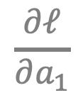
Computing Analytic Gradients
3
$$\frac{∂ℓ}{∂a_{1}}$$
$$\frac{∂ℓ}{∂a_{3}}$$
3
3
3
3
$$={\hat{y}}_{i}$$
$$={\hat{y}}_{i}$$
3

Slide 39
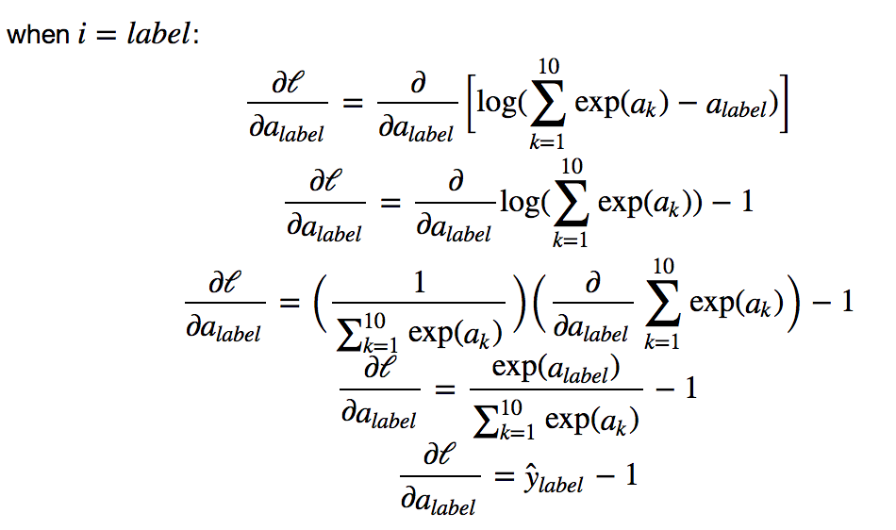
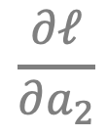

Computing Analytic Gradients
3
$$\frac{∂ℓ}{∂a_{2}}$$
3
3
3
3
$$={\hat{y}}_{i}−1$$
3

Slide 40





Computing Analytic Gradients
label = 2
$$\frac{∂ℓ}{∂a_{1}}={\hat{y}}_{1}$$
$$\frac{∂ℓ}{∂a_{2}}={\hat{y}}_{2}−1$$
$$\frac{∂ℓ}{∂a_{3}}={\hat{y}}_{3}$$
$\frac{∂ℓ}{∂a}=\left[\begin{aligned}\frac{∂ℓ}{∂a_{1}} \\ \frac{∂ℓ}{∂a_{2}} \\ \frac{∂ℓ}{∂a_{3}}\end{aligned}\right]$= $\left[\begin{aligned}{\hat{y}}_{1} \\ {\hat{y}}_{2}−1 \\ {\hat{y}}_{3}\end{aligned}\right]=\left[\begin{aligned}{\hat{y}}_{1} \\ {\hat{y}}_{2} \\ {\hat{y}}_{3}\end{aligned}\right]−\left[\begin{aligned}0 \\ 1 \\ 0\end{aligned}\right]=\hat{y}−y$
$$\frac{∂ℓ}{∂a_{i}}={\hat{y}}_{i}−y_{i}$$

Slide 41





Computing Analytic Gradients
$$\frac{∂a_{i}}{∂w_{i, j}}=x_{j}$$
$$\frac{∂a_{i}}{∂b_{i}}=1$$
$$\frac{∂ℓ}{∂a_{i}}={\hat{y}}_{i}−y_{i}$$
$$\frac{∂ℓ}{∂w_{i, j}}=\left({\hat{y}}_{i}−y_{i}\right)x_{j}$$
$$\frac{∂ℓ}{∂b_{i}}=\left({\hat{y}}_{i}−y_{i}\right)$$

Slide 42











Perceptron Model
Frank Rosenblatt (1957) - Cornell University
Activation
function
$$x_{1}$$
$$w_{1}$$
$$f\left(x\right)=\left\{\begin{aligned}1, if \sum_{i=0}^{n}{w_{i}x_{i}}+b>0 \\ &0, otherwise \end{aligned}\right.$$
$$x_{2}$$
$$w_{2}$$
$$w_{3}$$
$$x_{3}$$
$$w_{4}$$
$$x_{4}$$
More: https://en.wikipedia.org/wiki/Perceptron

Slide 43
Perceptron Model
Frank Rosenblatt (1957) - Cornell University
!?
$$x_{1}$$
$$w_{1}$$
$$f\left(x\right)=\left\{\begin{aligned}1, if \sum_{i=0}^{n}{w_{i}x_{i}}+b>0 \\ &0, otherwise \end{aligned}\right.$$
$$x_{2}$$
$$w_{2}$$
$$w_{3}$$
$$x_{3}$$
$$w_{4}$$
$$x_{4}$$
More: https://en.wikipedia.org/wiki/Perceptron

Slide 44
Perceptron Model
Frank Rosenblatt (1957) - Cornell University
Activation
function
$$x_{1}$$
$$w_{1}$$
$$f\left(x\right)=\left\{\begin{aligned}1, if \sum_{i=0}^{n}{w_{i}x_{i}}+b>0 \\ &0, otherwise \end{aligned}\right.$$
$$x_{2}$$
$$w_{2}$$
$$w_{3}$$
$$x_{3}$$
$$w_{4}$$
$$x_{4}$$
More: https://en.wikipedia.org/wiki/Perceptron

Slide 45




Activation Functions
Step(x)
Sigmoid(x)
Tanh(x)
ReLU(x) = max(0, x)

Slide 46










Two-layer Multi-layer Perceptron (MLP)
”hidden" layer
Loss / Criterion
$$x_{1}$$
$$a_{1}$$
$$x_{2}$$
$$a_{2}$$
$${\hat{y}}_{1}$$
$$y_{1}$$
$$x_{3}$$
$$a_{3}$$
$$x_{4}$$
$$a_{4}$$

Slide 47






Linear Softmax
$$x_{i}=[x_{i1} { x}_{i2} x_{i3} { x}_{i4}]$$
$$y_{i}=$$
[1 0 0]
$${\hat{y}}_{i}= [f_{c} f_{d} f_{b}]$$
$$g_{c}=w_{c1}x_{i1}+w_{c2}x_{i2}+w_{c3}x_{i3}+w_{c4}x_{i4}+b_{c}$$
$$g_{d}=w_{d1}x_{i1}+w_{d2}x_{i2}+w_{d3}x_{i3}+w_{d4}x_{i4}+b_{d}$$
$$g_{b}=w_{b1}x_{i1}+w_{b2}x_{i2}+w_{b3}x_{i3}+w_{b4}x_{i4}+b_{b}$$
$$f_{c}=e^{g_{c}}/{(e}^{g_{c}}+e^{g_{d}}+e^{g_{b}})$$
$$f_{d}=e^{g_{d}}/{(e}^{g_{c}}+e^{g_{d}}+e^{g_{b}})$$
$$f_{b}=e^{g_{b}}/{(e}^{g_{c}}+e^{g_{d}}+e^{g_{b}})$$

Slide 48


Linear Softmax
$$x_{i}=[x_{i1} { x}_{i2} x_{i3} { x}_{i4}]$$
$$y_{i}=$$
[1 0 0]
$${\hat{y}}_{i}= [f_{c} f_{d} f_{b}]$$
$$g_{c}=w_{c1}x_{i1}+w_{c2}x_{i2}+w_{c3}x_{i3}+w_{c4}x_{i4}+b_{c}$$
$$w=\left[\begin{matrix}w_{c1} & w_{c2} & w_{c3} & w_{c4} \\ w_{d1} & w_{d2} & w_{d3} & w_{d4} \\ w_{b1} & w_{b2} & w_{b3} & w_{b4}\end{matrix}\right]$$
$$g_{d}=w_{d1}x_{i1}+w_{d2}x_{i2}+w_{d3}x_{i3}+w_{d4}x_{i4}+b_{d}$$
$$g_{b}=w_{b1}x_{i1}+w_{b2}x_{i2}+w_{b3}x_{i3}+w_{b4}x_{i4}+b_{b}$$
$$b=\left[\begin{matrix}b_{c} & b_{d} & b_{b}\end{matrix}\right]$$
$$f_{c}=e^{g_{c}}/{(e}^{g_{c}}+e^{g_{d}}+e^{g_{b}})$$
$$f_{d}=e^{g_{d}}/{(e}^{g_{c}}+e^{g_{d}}+e^{g_{b}})$$
$$f_{b}=e^{g_{b}}/{(e}^{g_{c}}+e^{g_{d}}+e^{g_{b}})$$

Slide 49

Linear Softmax
$$x_{i}=[x_{i1} { x}_{i2} x_{i3} { x}_{i4}]$$
$$y_{i}=$$
[1 0 0]
$${\hat{y}}_{i}= [f_{c} f_{d} f_{b}]$$
$$w=\left[\begin{matrix}w_{c1} & w_{c2} & w_{c3} & w_{c4} \\ w_{d1} & w_{d2} & w_{d3} & w_{d4} \\ w_{b1} & w_{b2} & w_{b3} & w_{b4}\end{matrix}\right]$$
$$g=wx^{T}+b^{T}$$
$$b=\left[\begin{matrix}b_{c} & b_{d} & b_{b}\end{matrix}\right]$$
$$f_{c}=e^{g_{c}}/{(e}^{g_{c}}+e^{g_{d}}+e^{g_{b}})$$
$$f_{d}=e^{g_{d}}/{(e}^{g_{c}}+e^{g_{d}}+e^{g_{b}})$$
$$f_{b}=e^{g_{b}}/{(e}^{g_{c}}+e^{g_{d}}+e^{g_{b}})$$

Slide 50

Linear Softmax
$$x_{i}=[x_{i1} { x}_{i2} x_{i3} { x}_{i4}]$$
$$y_{i}=$$
[1 0 0]
$${\hat{y}}_{i}= [f_{c} f_{d} f_{b}]$$
$$w=\left[\begin{matrix}w_{c1} & w_{c2} & w_{c3} & w_{c4} \\ w_{d1} & w_{d2} & w_{d3} & w_{d4} \\ w_{b1} & w_{b2} & w_{b3} & w_{b4}\end{matrix}\right]$$
$$g=wx^{T}+b^{T}$$
$$b=\left[\begin{matrix}b_{c} & b_{d} & b_{b}\end{matrix}\right]$$
$$f=softmax(g)$$

Slide 51

Linear Softmax
$$x_{i}=[x_{i1} { x}_{i2} x_{i3} { x}_{i4}]$$
$$y_{i}=$$
[1 0 0]
$${\hat{y}}_{i}= [f_{c} f_{d} f_{b}]$$
$$f=softmax(wx^{T}+b^{T})$$

Slide 52


Two-layer MLP + Softmax
$$x_{i}=[x_{i1} { x}_{i2} x_{i3} { x}_{i4}]$$
$$y_{i}=$$
[1 0 0]
$${\hat{y}}_{i}= [f_{c} f_{d} f_{b}]$$
$$a_{1}=sigmoid(w_{[1]}x^{T}+b_{[1]}^{T})$$
$$f=softmax(w_{[2]}{a_{1}}^{T}+b_{[2]}^{T})$$

Slide 53





N-layer MLP + Softmax
$$x_{i}=[x_{i1} { x}_{i2} x_{i3} { x}_{i4}]$$
$$y_{i}=$$
[1 0 0]
$${\hat{y}}_{i}= [f_{c} f_{d} f_{b}]$$
$$a_{1}=sigmoid(w_{[1]}x^{T}+b_{[1]}^{T})$$
$$a_{2}=sigmoid(w_{[2]}a_{1}^{T}+b_{[2]}^{T})$$
$$…$$
$$a_{k}=sigmoid(w_{[k]}a_{k−1}^{T}+b_{[k]}^{T})$$
$$…$$
$$f=softmax(w_{[n]}a_{n−1}^{T}+b_{[n]}^{T})$$

Slide 54





How to train the parameters?
$$x_{i}=[x_{i1} { x}_{i2} x_{i3} { x}_{i4}]$$
$$y_{i}=$$
[1 0 0]
$${\hat{y}}_{i}= [f_{c} f_{d} f_{b}]$$
$$a_{1}=sigmoid(w_{[1]}x^{T}+b_{[1]}^{T})$$
$$a_{2}=sigmoid(w_{[2]}a_{1}^{T}+b_{[2]}^{T})$$
$$…$$
$$a_{k}=sigmoid(w_{[k]}a_{k−1}^{T}+b_{[k]}^{T})$$
$$…$$
$$f=softmax(w_{[n]}a_{n−1}^{T}+b_{[n]}^{T})$$

Slide 55



Forward pass (Forward-propagation)
$${\hat{y}}_{1}$$
$$x_{1}$$
$$a_{1}$$
$$x_{2}$$
$$a_{2}$$
$${\hat{y}}_{2}$$
$$y_{1}$$
$$x_{3}$$
$$a_{3}$$
$$x_{4}$$
$$a_{4}$$

Slide 56





Forward pass (Forward-propagation)
$$z_{i}=\sum_{i=0}^{n}{w_{1ij}x_{i}}+b_{1}$$
$$a_{i}= Sigmoid(z_{i})$$
$$p_{1}=\sum_{i=0}^{n}{w_{2i}a_{i}}+b_{2}$$
$$y_{1}= Sigmoid(p_{i})$$
$$x_{1}$$
$$a_{1}$$
$$x_{2}$$
$$a_{2}$$
$${\hat{y}}_{1}$$
$$y_{1}$$
$$x_{3}$$
$$a_{3}$$
$$x_{4}$$
$$a_{4}$$
$Loss=L(y_{1},$ ${\hat{y}}_{1})$

Slide 57



How to train the parameters?
$$x_{i}=[x_{i1} { x}_{i2} x_{i3} { x}_{i4}]$$
$$y_{i}=$$
[1 0 0]
$${\hat{y}}_{i}= [f_{c} f_{d} f_{b}]$$
$$a_{1}=sigmoid(w_{[1]}x^{T}+b_{[1]}^{T})$$
$$a_{2}=sigmoid(w_{[2]}a_{1}^{T}+b_{[2]}^{T})$$
$$…$$
We can still use SGD
$$a_{k}=sigmoid(w_{[k]}a_{k−1}^{T}+b_{[i]}^{T})$$
$$…$$
We need!
$$\frac{∂l}{∂w_{[k]ij}}$$
$$\frac{∂l}{∂b_{\left[k\right]i}}$$
$$f=softmax(w_{[n]}a_{n−1}^{T}+b_{[n]}^{T})$$

Slide 58




How to train the parameters?
$$x_{i}=[x_{i1} { x}_{i2} x_{i3} { x}_{i4}]$$
$$y_{i}=$$
[1 0 0]
$${\hat{y}}_{i}= [f_{c} f_{d} f_{b}]$$
$$a_{1}=sigmoid(w_{[1]}x^{T}+b_{[1]}^{T})$$
$$a_{2}=sigmoid(w_{[2]}a_{1}^{T}+b_{[2]}^{T})$$
$$…$$
We can still use SGD
$$a_{i}=sigmoid(w_{[k]}a_{k−1}^{T}+b_{[k]}^{T})$$
$$…$$
We need!
$$f=softmax(w_{[n]}a_{n−1}^{T}+b_{[n]}^{T})$$
$$\frac{∂l}{∂w_{[k]ij}}$$
$$\frac{∂l}{∂b_{\left[k\right]i}}$$
$$l=loss(f, y)$$

Slide 59
How to train the parameters?
$$x_{i}=[x_{i1} { x}_{i2} x_{i3} { x}_{i4}]$$
$$y_{i}=$$
[1 0 0]
$${\hat{y}}_{i}= [f_{c} f_{d} f_{b}]$$
$$a_{1}=sigmoid(w_{[1]}x^{T}+b_{[1]}^{T})$$
$$a_{2}=sigmoid(w_{[2]}a_{1}^{T}+b_{[2]}^{T})$$
$$…$$
We can still use SGD
$$a_{i}=sigmoid(w_{[k]}a_{k−1}^{T}+b_{[k]}^{T})$$
$$…$$
We need!
$$f=softmax(w_{[n]}a_{n−1}^{T}+b_{[n]}^{T})$$
$$\frac{∂l}{∂w_{[k]ij}}$$
$$\frac{∂l}{∂b_{\left[k\right]i}}$$
$$l=loss(f, y)$$

Slide 60

How to train the parameters?
$$x_{i}=[x_{i1} { x}_{i2} x_{i3} { x}_{i4}]$$
$$y_{i}=$$
[1 0 0]
$${\hat{y}}_{i}= [f_{c} f_{d} f_{b}]$$
$$a_{1}=sigmoid(w_{[1]}x^{T}+b_{[1]}^{T})$$
$$a_{2}=sigmoid(w_{[2]}a_{1}^{T}+b_{[2]}^{T})$$
$$…$$
$$\frac{∂l}{∂w_{[k]ij}}=\frac{∂l}{∂a_{n−1}} \frac{∂a_{n−1}}{∂a_{n−2}}…\frac{∂a_{k−2}}{∂a_{k−1}}\frac{∂a_{k−1}}{∂w_{\left[k\right]ij}}$$
$$a_{i}=sigmoid(w_{[k]}a_{k−1}^{T}+b_{[k]}^{T})$$
$$…$$
$$f=softmax(w_{[n]}a_{n−1}^{T}+b_{[n]}^{T})$$
$$l=loss(f, y)$$

Slide 61







Backward pass (Back-propagation)
$${\frac{∂L}{∂x_{k}}}_{}=(\frac{∂}{∂x_{k}}\sum_{i=0}^{n}{w_{1ij}x_{i}}+b_{1})\frac{∂L}{∂z_{i}}$$
$${\frac{∂L}{∂z_{i}}}_{}=\frac{∂}{∂z_{i}}Sigmoid(z_{i})\frac{∂L}{∂a_{k}}$$
$${\frac{∂L}{∂a_{k}}}_{}=(\frac{∂}{∂a_{k}}\sum_{i=0}^{n}{w_{2i}a_{i}}+b_{2})\frac{∂L}{∂p_{1}}$$
${\frac{∂L}{∂p_{1}}}_{}=\frac{∂}{∂p_{1}}Sigmoid(p_{i})$ $\frac{∂L}{∂{\hat{y}}_{1}}$
$$x_{1}$$
$$a_{1}$$
$$x_{2}$$
$$a_{2}$$
$${\hat{y}}_{1}$$
$$y_{1}$$
$$x_{3}$$
$$a_{3}$$
$$x_{4}$$
$$a_{4}$$
$${\frac{∂L}{∂w_{2i}}=\frac{∂p_{1}}{∂w_{2i}}\frac{∂L}{∂p}}_{1}$$
$\frac{∂L}{∂{\hat{y}}_{1}}=\frac{∂}{∂{\hat{y}}_{1}}L(y_{1},$ ${\hat{y}}_{1})$
$${\frac{∂L}{∂w_{1ij}}=\frac{∂z_{i}}{∂w_{1ij}}\frac{∂L}{∂z}}_{i}$$

Slide 62
Questions?

