Slide 1
Deep Learning for Vision & Language
Computer Vision: Introduction and CNNs

Slide 2
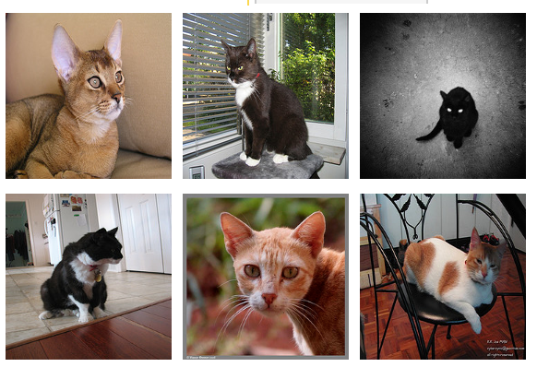
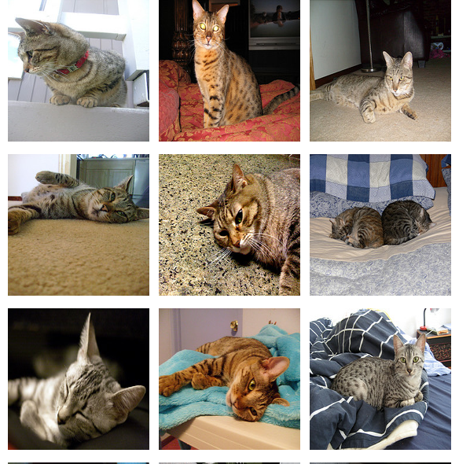
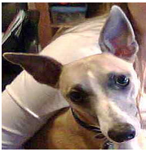
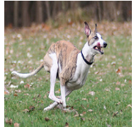
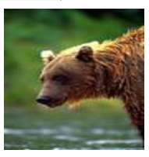
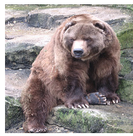
Supervised Learning - Classification
Training Data
Test Data
cat
dog
cat
.
.
.
.
.
.
bear

Slide 3








Supervised Learning - Classification
Training Data
cat
$$x_{1}=[ ]$$
$$y_{1}=[ ]$$
dog
$$x_{2}=[ ]$$
$$y_{2}=[ ]$$
cat
$$x_{3}=[ ]$$
$$y_{3}=[ ]$$
.
.
.
bear
$$x_{n}=[ ]$$
$$y_{n}=[ ]$$

Slide 4







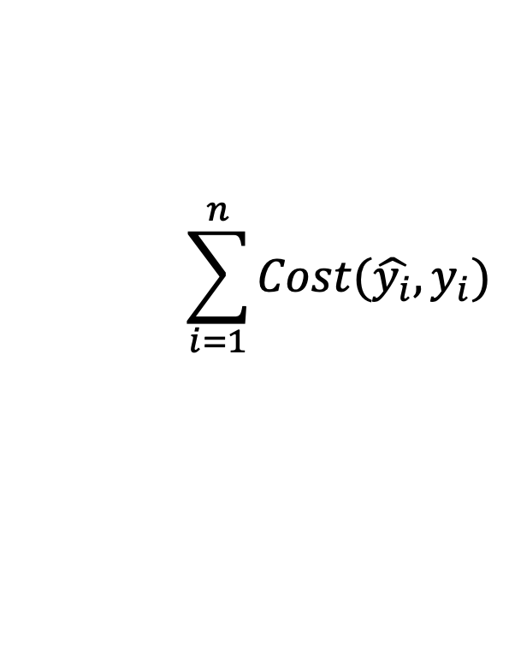


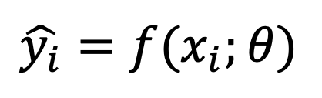



Supervised Learning - Classification
Training Data
targets /
labels /
ground truth
We need to find a function that
maps x and y for any of them.
inputs
predictions
$$x_{1}=[x_{11} { x}_{12} x_{13} { x}_{14}]$$
$$y_{1}=$$
1
$${\hat{y}}_{1}=$$
1
$$\hat{y_{i}}=f(x_{i};θ)$$
$$x_{2}=[x_{21} { x}_{22} x_{23} { x}_{24}]$$
$$y_{2}=$$
2
$${\hat{y}}_{2}=$$
2
$$x_{3}=[x_{31} { x}_{32} x_{33} { x}_{34}]$$
$$y_{3}=$$
1
$${\hat{y}}_{3}=$$
2
How do we ”learn” the parameters
of this function?
.
.
.
We choose ones that makes the
following quantity small:
$$\sum_{i=1}^{n}{Cost(\hat{y_{i}}, y_{i})}$$
$$x_{n}=[x_{n1} { x}_{n2} x_{n3} { x}_{n4}]$$
$$y_{n}=$$
3
$${\hat{y}}_{n}=$$
1

Slide 5
Supervised Learning - Classification
Training Data
Test Data
cat
dog
cat
.
.
.
.
.
.
bear

Slide 6
Supervised Learning - Classification
Training Data
cat
$$x_{1}=[ ]$$
$$y_{1}=[ ]$$
dog
$$x_{2}=[ ]$$
$$y_{2}=[ ]$$
cat
$$x_{3}=[ ]$$
$$y_{3}=[ ]$$
.
.
.
bear
$$x_{n}=[ ]$$
$$y_{n}=[ ]$$

Slide 7
Supervised Learning - Classification
Training Data
targets /
labels /
ground truth
We need to find a function that
maps x and y for any of them.
inputs
predictions
$$x_{1}=[x_{11} { x}_{12} x_{13} { x}_{14}]$$
$$y_{1}=$$
1
$${\hat{y}}_{1}=$$
1
$$\hat{y_{i}}=f(x_{i};θ)$$
$$x_{2}=[x_{21} { x}_{22} x_{23} { x}_{24}]$$
$$y_{2}=$$
2
$${\hat{y}}_{2}=$$
2
$$x_{3}=[x_{31} { x}_{32} x_{33} { x}_{34}]$$
$$y_{3}=$$
1
$${\hat{y}}_{3}=$$
2
How do we ”learn” the parameters
of this function?
.
.
.
We choose ones that makes the
following quantity small:
$$\sum_{i=1}^{n}{Cost(\hat{y_{i}}, y_{i})}$$
$$x_{n}=[x_{n1} { x}_{n2} x_{n3} { x}_{n4}]$$
$$y_{n}=$$
3
$${\hat{y}}_{n}=$$
1

Slide 8
Supervised Learning – Linear Softmax
Training Data
targets /
labels /
ground truth
inputs
$$x_{1}=[x_{11} { x}_{12} x_{13} { x}_{14}]$$
$$y_{1}=$$
1
$$x_{2}=[x_{21} { x}_{22} x_{23} { x}_{24}]$$
$$y_{2}=$$
2
$$x_{3}=[x_{31} { x}_{32} x_{33} { x}_{34}]$$
$$y_{3}=$$
1
.
.
.
$$x_{n}=[x_{n1} { x}_{n2} x_{n3} { x}_{n4}]$$
$$y_{n}=$$
3

Slide 9




Supervised Learning – Linear Softmax
Training Data
targets /
labels /
ground truth
inputs
predictions
$$x_{1}=[x_{11} { x}_{12} x_{13} { x}_{14}]$$
$$y_{1}=$$
[1 0 0]
$${\hat{y}}_{1}=$$
[0.85 0.10 0.05]
$$x_{2}=[x_{21} { x}_{22} x_{23} { x}_{24}]$$
$$y_{2}=$$
[0 1 0]
$${\hat{y}}_{2}=$$
[0.20 0.70 0.10]
$$x_{3}=[x_{31} { x}_{32} x_{33} { x}_{34}]$$
$$y_{3}=$$
[1 0 0]
$${\hat{y}}_{3}=$$
[0.40 0.45 0.15]
.
.
.
$$x_{n}=[x_{n1} { x}_{n2} x_{n3} { x}_{n4}]$$
$$y_{n}=$$
[0 0 1]
$${\hat{y}}_{n}=$$
[0.40 0.25 0.35]

Slide 10






Supervised Learning – Linear Softmax
$$x_{i}=[x_{i1} { x}_{i2} x_{i3} { x}_{i4}]$$
$$y_{i}=$$
[1 0 0]
$${\hat{y}}_{i}= [f_{1} f_{2} f_{3}]$$
$$a_{1}=w_{11}x_{i1}+w_{12}x_{i2}+w_{13}x_{i3}+w_{14}x_{i4}+b_{c}$$
$$a_{2}=w_{21}x_{i1}+w_{22}x_{i2}+w_{23}x_{i3}+w_{24}x_{i4}+b_{d}$$
$$a_{3}=w_{31}x_{i1}+w_{32}x_{i2}+w_{33}x_{i3}+w_{34}x_{i4}+b_{b}$$
$$f_{1}=e^{a_{1}}/{(e}^{a_{1}}+e^{a_{2}}+e^{a_{3}})$$
$$f_{2}=e^{a_{2}}/{(e}^{a_{1}}+e^{a_{2}}+e^{a_{3}})$$
$$f_{3}=e^{a_{3}}/{(e}^{a_{1}}+e^{a_{2}}+e^{a_{3}})$$

Slide 11
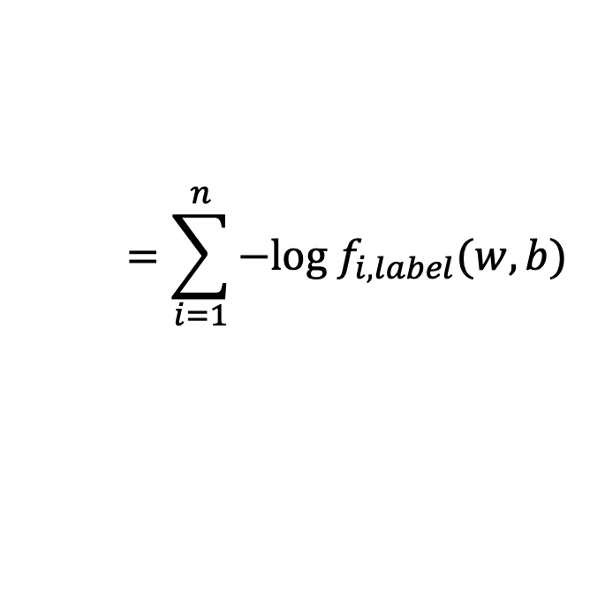
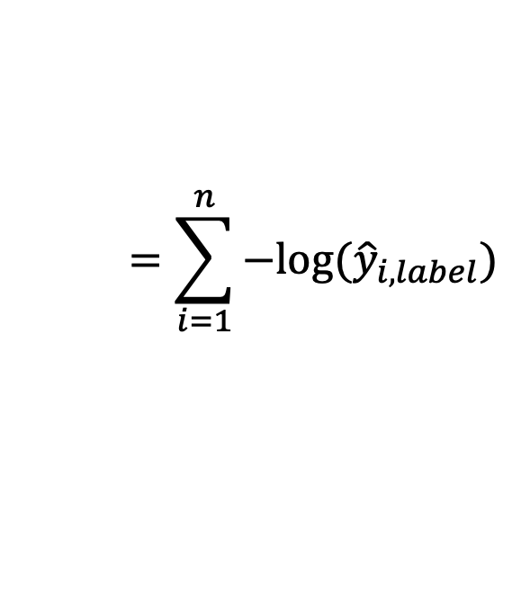
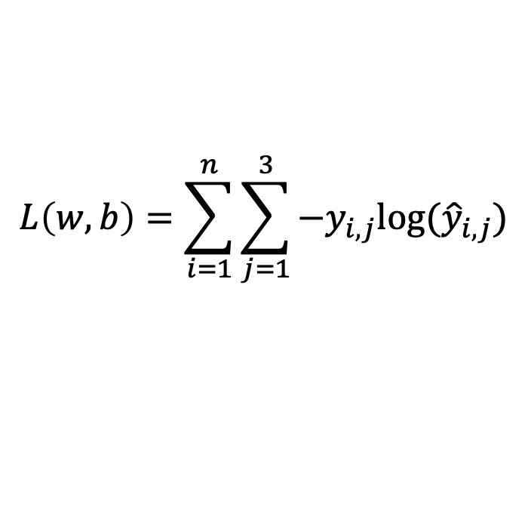

How do we find a good w and b?
$$x_{i}=[x_{i1} { x}_{i2} x_{i3} { x}_{i4}]$$
$$y_{i}=$$
[1 0 0]
$${\hat{y}}_{i}= [f_{1}(w,b) f_{2}(w,b) f_{3}(w,b)]$$
We need to find w, and b that minimize the following:
$$L\left(w,b\right)=\sum_{i=1}^{n}{\sum_{j=1}^{3}{−y_{i,j}log⁡({\hat{y}}_{i,j})}}$$
$$=\sum_{i=1}^{n}{−log⁡({\hat{y}}_{i,label})}$$
$$=\sum_{i=1}^{n}{−log f_{i,label}(w,b)}$$
Why?

Slide 12



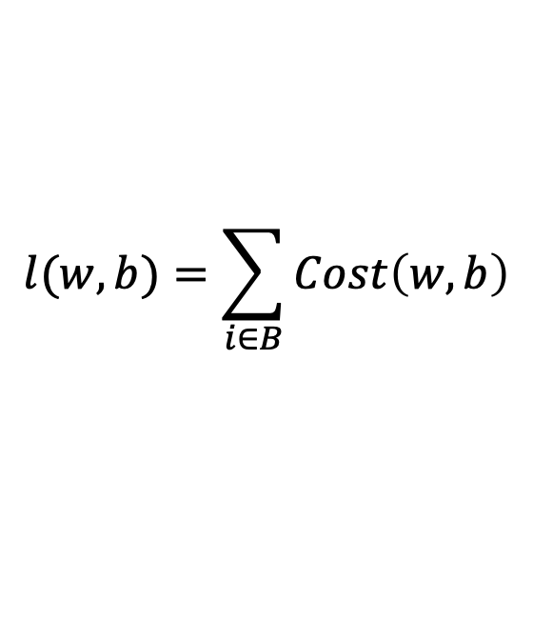



(mini-batch) Stochastic Gradient Descent (SGD)
$$λ=0.01$$
$$l(w,b)=\sum_{i∈B}{Cost\left(w,b\right)}$$
Initialize w and b randomly
for e = 0, num_epochs do
for b = 0, num_batches do
Compute:
$$dl(w,b)/dw$$
and
$$dl(w,b)/db$$
Update w:
$$w=w −λ dl(w,b)/dw$$
Update b:
$$b=b −λ dl(w,b)/db$$
Print:
$$l(w,b)$$
// Useful to see if this is becoming smaller or not.
end
end

Slide 13
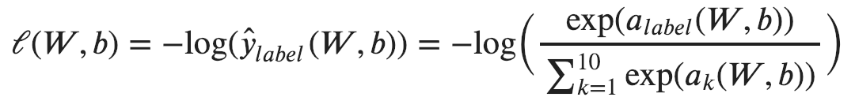
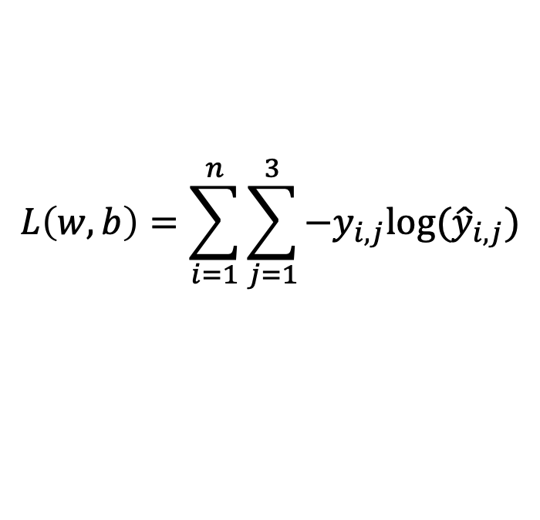
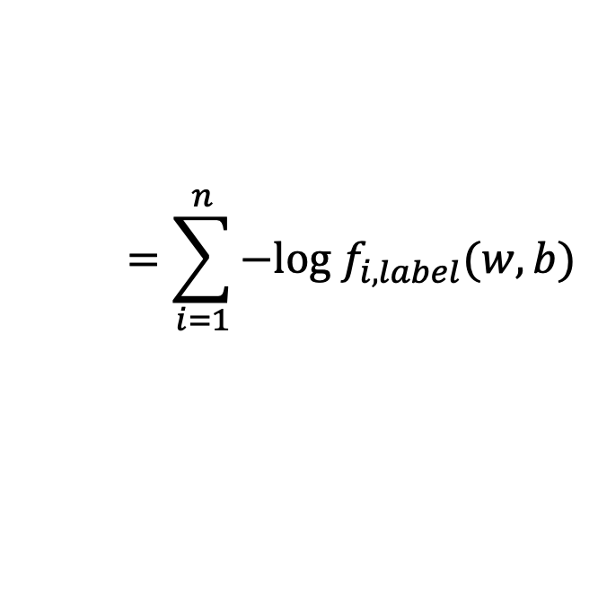
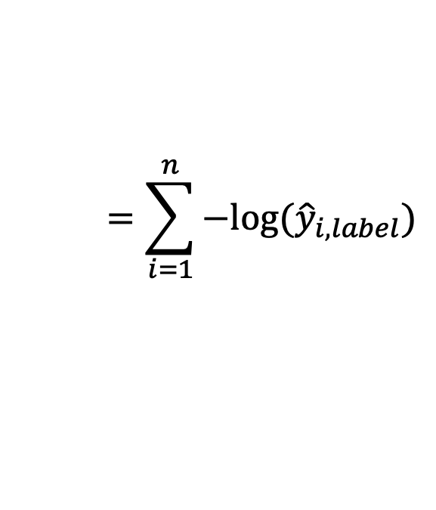
Computing Analytic Gradients
This is what we have:
$$L\left(w,b\right)=\sum_{i=1}^{n}{\sum_{j=1}^{3}{−y_{i,j}log⁡({\hat{y}}_{i,j})}}$$
$$=\sum_{i=1}^{n}{−log⁡({\hat{y}}_{i,label})}$$
$$=\sum_{i=1}^{n}{−log f_{i,label}(w,b)}$$
To simplify let’s assume n = 1
3

Slide 14



Supervised Learning – Linear Softmax
$$x=[x_{1} { x}_{2} x_{3} { x}_{4}]$$
$$y=$$
[1 0 0]
$$\hat{y}= [f_{1} f_{2} f_{3}]$$
$$a_{1}=w_{11}x_{1}+w_{12}x_{2}+w_{13}x_{3}+w_{14}x_{4}+b_{c}$$
$$a_{2}=w_{21}x_{1}+w_{22}x_{2}+w_{23}x_{3}+w_{24}x_{4}+b_{d}$$
$$a_{3}=w_{31}x_{1}+w_{32}x_{2}+w_{33}x_{3}+w_{34}x_{4}+b_{b}$$
$$f_{1}=e^{a_{1}}/{(e}^{a_{1}}+e^{a_{2}}+e^{a_{3}})$$
$$f_{2}=e^{a_{2}}/{(e}^{a_{1}}+e^{a_{2}}+e^{a_{3}})$$
$$f_{3}=e^{a_{3}}/{(e}^{a_{1}}+e^{a_{2}}+e^{a_{3}})$$

Slide 15
Computing Analytic Gradients
This is what we have:
3

Slide 16
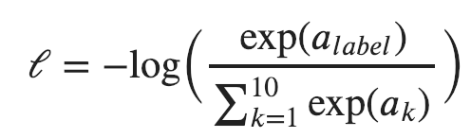
Computing Analytic Gradients
This is what we have:
3
3
Reminder:
$$a_{i}=(w_{i,1}x_{1}+w_{i,2}x_{2}+w_{i,3}x_{3}+w_{i,4}x_{4})+b_{i}$$

Slide 17
Computing Analytic Gradients
This is what we have:
3

Slide 18
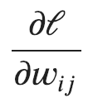

Computing Analytic Gradients
This is what we have:
3
This is what we need:
for each
for each

Slide 19
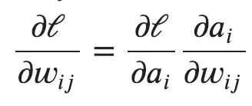
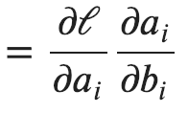
Computing Analytic Gradients
This is what we have:
3
Step 1: Chain Rule of Calculus

Slide 20
Computing Analytic Gradients
This is what we have:
3
Step 1: Chain Rule of Calculus
Let’s do these first

Slide 21
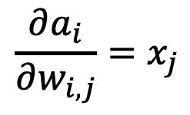
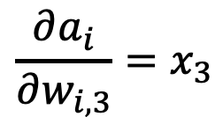
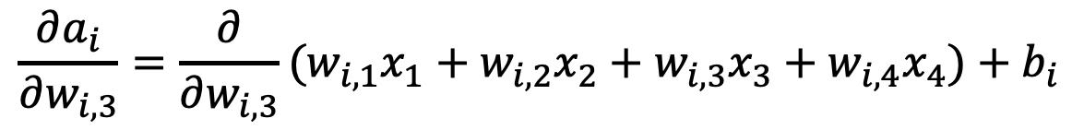
Computing Analytic Gradients
$$a_{i}=(w_{i,1}x_{1}+w_{i,2}x_{2}+w_{i,3}x_{3}+w_{i,4}x_{4})+b_{i}$$
$$\frac{∂a_{i}}{∂w_{i, 3}}=\frac{∂}{∂w_{i, 3}}(w_{i,1}x_{1}+w_{i,2}x_{2}+w_{i,3}x_{3}+w_{i,4}x_{4})+b_{i}$$
$$\frac{∂a_{i}}{∂w_{i, 3}}=x_{3}$$
$$\frac{∂a_{i}}{∂w_{i, j}}=x_{j}$$

Slide 22
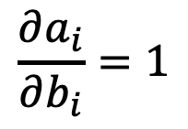
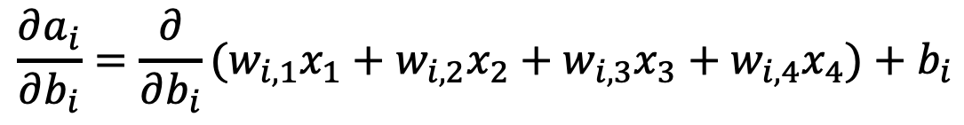
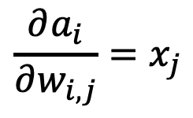
Computing Analytic Gradients
$$\frac{∂a_{i}}{∂w_{i, j}}=x_{j}$$
$$a_{i}=(w_{i,1}x_{1}+w_{i,2}x_{2}+w_{i,3}x_{3}+w_{i,4}x_{4})+b_{i}$$
$$\frac{∂a_{i}}{∂b_{i}}=\frac{∂}{∂b_{i}}(w_{i,1}x_{1}+w_{i,2}x_{2}+w_{i,3}x_{3}+w_{i,4}x_{4})+b_{i}$$
$$\frac{∂a_{i}}{∂b_{i}}=1$$

Slide 23

Computing Analytic Gradients
$$\frac{∂a_{i}}{∂w_{i, j}}=x_{j}$$
$$\frac{∂a_{i}}{∂b_{i}}=1$$

Slide 24
Computing Analytic Gradients
This is what we have:
3
Step 1: Chain Rule of Calculus
Now let’s do this one (same for both!)

Slide 25
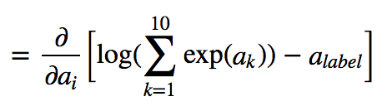
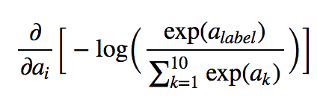
Computing Analytic Gradients
3
3
In our cat, dog, bear classification example: i = {1, 2, 3}

Slide 26
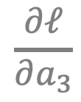
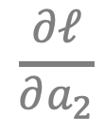
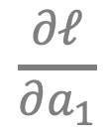
Computing Analytic Gradients
3
3
In our cat, dog, bear classification example: i = {1, 2, 3}
$$\frac{∂ℓ}{∂a_{1}}$$
$$\frac{∂ℓ}{∂a_{2}}$$
$$\frac{∂ℓ}{∂a_{3}}$$
Let’s say: label = 2
We need:

Slide 27
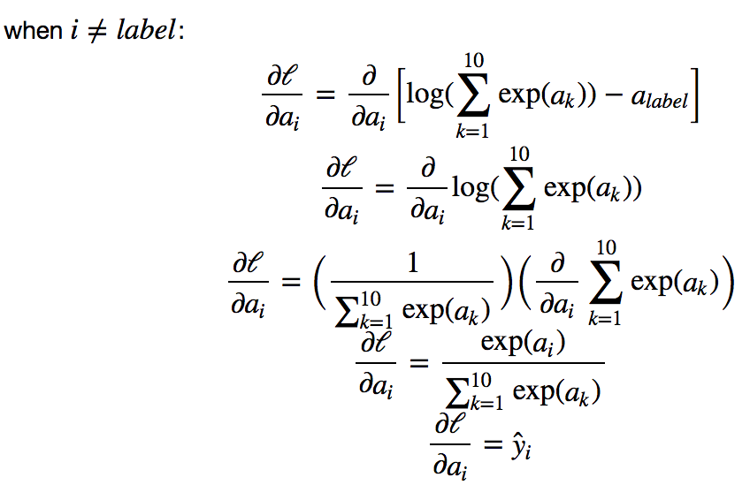

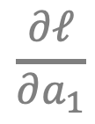

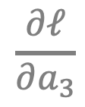
Computing Analytic Gradients
3
$$\frac{∂ℓ}{∂a_{1}}$$
$$\frac{∂ℓ}{∂a_{3}}$$
3
3
3
3
$$={\hat{y}}_{i}$$
$$={\hat{y}}_{i}$$
3

Slide 28
Supervised Learning – Linear Softmax
$$x_{i}=[x_{i1} { x}_{i2} x_{i3} { x}_{i4}]$$
$$y_{i}=$$
[1 0 0]
$${\hat{y}}_{i}= [f_{1} f_{2} f_{3}]$$
$$a_{1}=w_{11}x_{i1}+w_{12}x_{i2}+w_{13}x_{i3}+w_{14}x_{i4}+b_{c}$$
$$a_{2}=w_{21}x_{i1}+w_{22}x_{i2}+w_{23}x_{i3}+w_{24}x_{i4}+b_{d}$$
$$a_{3}=w_{31}x_{i1}+w_{32}x_{i2}+w_{33}x_{i3}+w_{34}x_{i4}+b_{b}$$
$$f_{1}=e^{a_{1}}/{(e}^{a_{1}}+e^{a_{2}}+e^{a_{3}})$$
$$f_{2}=e^{a_{2}}/{(e}^{a_{1}}+e^{a_{2}}+e^{a_{3}})$$
$$f_{3}=e^{a_{3}}/{(e}^{a_{1}}+e^{a_{2}}+e^{a_{3}})$$

Slide 29
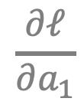
Computing Analytic Gradients
3
$$\frac{∂ℓ}{∂a_{1}}$$
$$\frac{∂ℓ}{∂a_{3}}$$
3
3
3
3
$$={\hat{y}}_{i}$$
$$={\hat{y}}_{i}$$
3

Slide 30
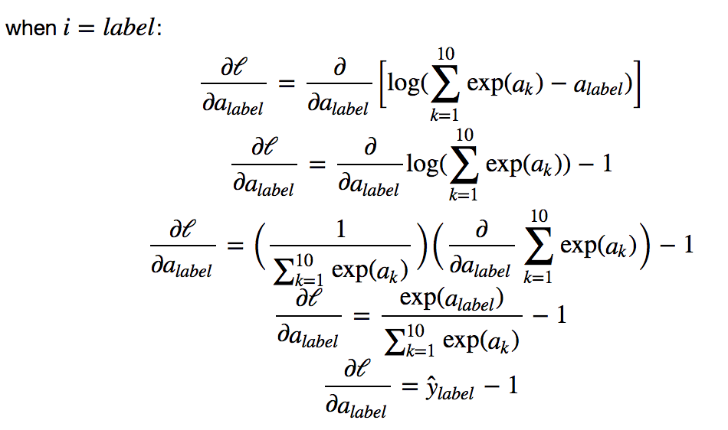
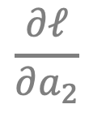

Computing Analytic Gradients
3
$$\frac{∂ℓ}{∂a_{2}}$$
3
3
3
3
$$={\hat{y}}_{i}−1$$
3

Slide 31
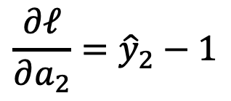
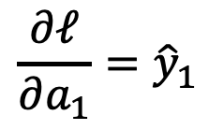
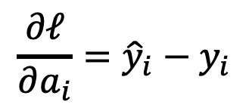
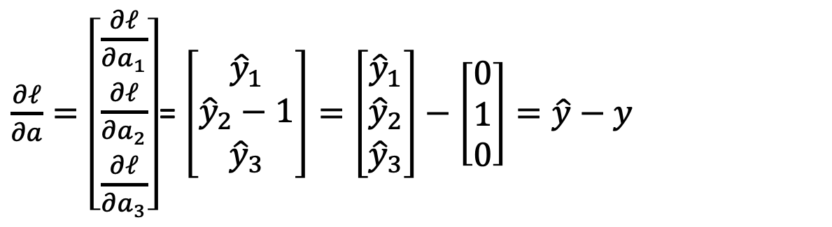
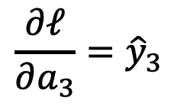
Computing Analytic Gradients
label = 2
$$\frac{∂ℓ}{∂a_{1}}={\hat{y}}_{1}$$
$$\frac{∂ℓ}{∂a_{2}}={\hat{y}}_{2}−1$$
$$\frac{∂ℓ}{∂a_{3}}={\hat{y}}_{3}$$
$\frac{∂ℓ}{∂a}=\left[\begin{aligned}\frac{∂ℓ}{∂a_{1}} \\ \frac{∂ℓ}{∂a_{2}} \\ \frac{∂ℓ}{∂a_{3}}\end{aligned}\right]$= $\left[\begin{aligned}{\hat{y}}_{1} \\ {\hat{y}}_{2}−1 \\ {\hat{y}}_{3}\end{aligned}\right]=\left[\begin{aligned}{\hat{y}}_{1} \\ {\hat{y}}_{2} \\ {\hat{y}}_{3}\end{aligned}\right]−\left[\begin{aligned}0 \\ 1 \\ 0\end{aligned}\right]=\hat{y}−y$
$$\frac{∂ℓ}{∂a_{i}}={\hat{y}}_{i}−y_{i}$$

Slide 32
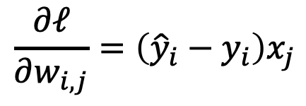
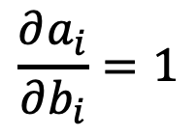
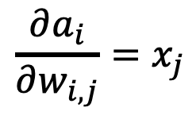
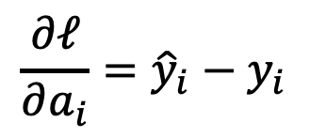
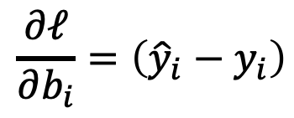
Computing Analytic Gradients
$$\frac{∂a_{i}}{∂w_{i, j}}=x_{j}$$
$$\frac{∂a_{i}}{∂b_{i}}=1$$
$$\frac{∂ℓ}{∂a_{i}}={\hat{y}}_{i}−y_{i}$$
$$\frac{∂ℓ}{∂w_{i, j}}=\left({\hat{y}}_{i}−y_{i}\right)x_{j}$$
$$\frac{∂ℓ}{∂b_{i}}=\left({\hat{y}}_{i}−y_{i}\right)$$

Slide 33
Automatic Differentiation
You only need to write code for the operations in the prediction step,
Gradient computation can be computed “automatically”.
Pytorch (Facebook -- mostly):
Tensorflow (Google -- mostly):
MXNet (Amazon -- mostly):
https://pytorch.org/
https://www.tensorflow.org/
https://mxnet.apache.org/versions/1.9.0/

Slide 34



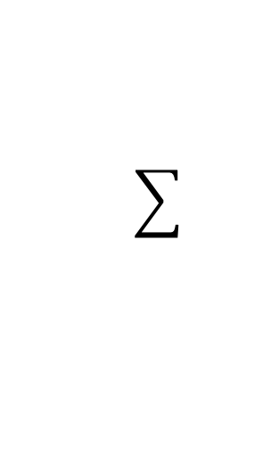
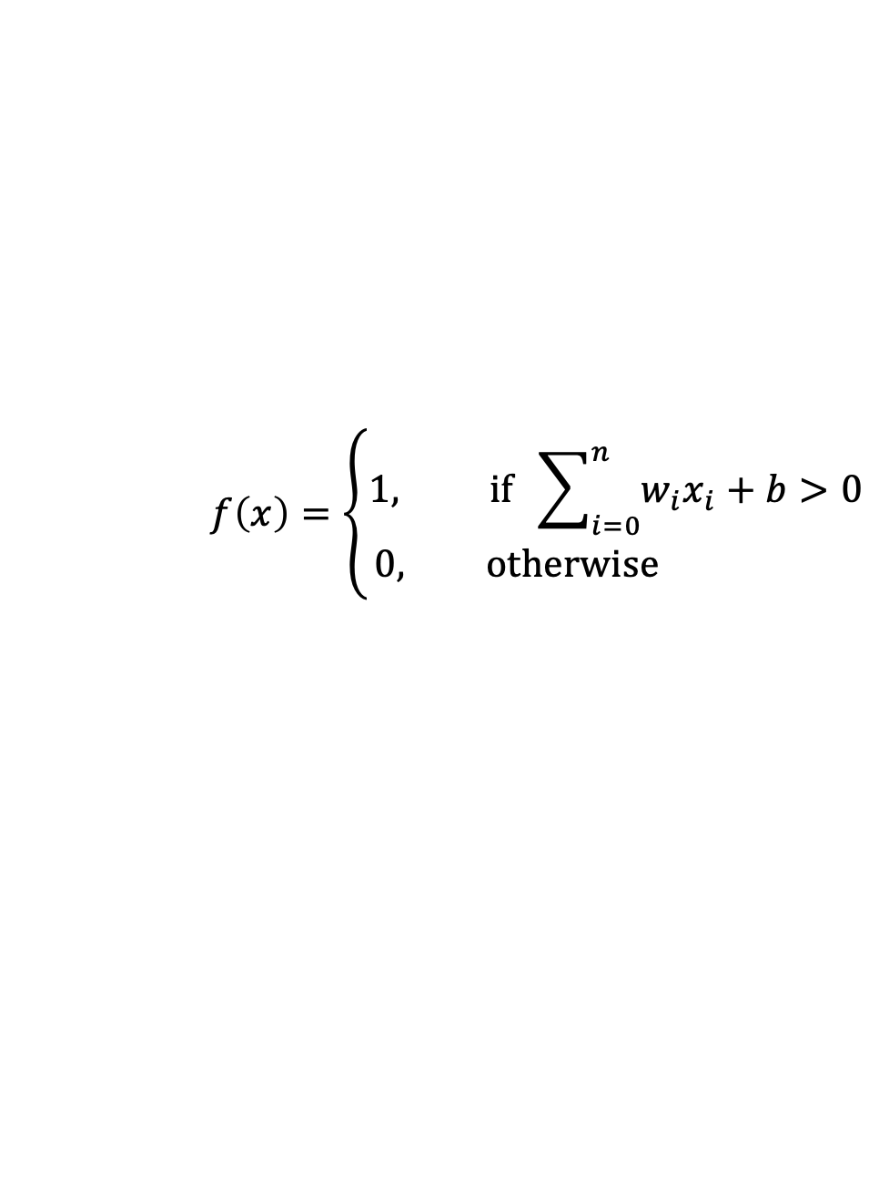






Perceptron Model
Frank Rosenblatt (1957) - Cornell University
Activation function
$$x_{1}$$
$$w_{1}$$
$$f\left(x\right)=\left\{\begin{aligned}1, if \sum_{i=0}^{n}{w_{i}x_{i}}+b>0 \\ &0, otherwise \end{aligned}\right.$$
$$x_{2}$$
$$w_{2}$$
$$w_{3}$$
$$x_{3}$$
$$w_{4}$$
$$x_{4}$$
More: https://en.wikipedia.org/wiki/Perceptron

Slide 35
Perceptron Model
Frank Rosenblatt (1957) - Cornell University
!?
$$x_{1}$$
$$w_{1}$$
$$f\left(x\right)=\left\{\begin{aligned}1, if \sum_{i=0}^{n}{w_{i}x_{i}}+b>0 \\ &0, otherwise \end{aligned}\right.$$
$$x_{2}$$
$$w_{2}$$
$$w_{3}$$
$$x_{3}$$
$$w_{4}$$
$$x_{4}$$
More: https://en.wikipedia.org/wiki/Perceptron

Slide 36
Perceptron Model
Frank Rosenblatt (1957) - Cornell University
Activation function
$$x_{1}$$
$$w_{1}$$
$$f\left(x\right)=\left\{\begin{aligned}1, if \sum_{i=0}^{n}{w_{i}x_{i}}+b>0 \\ &0, otherwise \end{aligned}\right.$$
$$x_{2}$$
$$w_{2}$$
$$w_{3}$$
$$x_{3}$$
$$w_{4}$$
$$x_{4}$$
More: https://en.wikipedia.org/wiki/Perceptron

Slide 37




Activation Functions
Step(x)
Sigmoid(x)
Tanh(x)
ReLU(x) = max(0, x)

Slide 38










Two-layer Multi-layer Perceptron (MLP)
”hidden" layer
Loss / Criterion
$$x_{1}$$
$$a_{1}$$
$$x_{2}$$
$$a_{2}$$
$${\hat{y}}_{1}$$
$$y_{1}$$
$$x_{3}$$
$$a_{3}$$
$$x_{4}$$
$$a_{4}$$

Slide 39






Linear Softmax
$$x_{i}=[x_{i1} { x}_{i2} x_{i3} { x}_{i4}]$$
$$y_{i}=$$
[1 0 0]
$${\hat{y}}_{i}= [f_{c} f_{d} f_{b}]$$
$$g_{c}=w_{c1}x_{i1}+w_{c2}x_{i2}+w_{c3}x_{i3}+w_{c4}x_{i4}+b_{c}$$
$$g_{d}=w_{d1}x_{i1}+w_{d2}x_{i2}+w_{d3}x_{i3}+w_{d4}x_{i4}+b_{d}$$
$$g_{b}=w_{b1}x_{i1}+w_{b2}x_{i2}+w_{b3}x_{i3}+w_{b4}x_{i4}+b_{b}$$
$$f_{c}=e^{g_{c}}/{(e}^{g_{c}}+e^{g_{d}}+e^{g_{b}})$$
$$f_{d}=e^{g_{d}}/{(e}^{g_{c}}+e^{g_{d}}+e^{g_{b}})$$
$$f_{b}=e^{g_{b}}/{(e}^{g_{c}}+e^{g_{d}}+e^{g_{b}})$$

Slide 40


Linear Softmax
$$x_{i}=[x_{i1} { x}_{i2} x_{i3} { x}_{i4}]$$
$$y_{i}=$$
[1 0 0]
$${\hat{y}}_{i}= [f_{c} f_{d} f_{b}]$$
$$g_{c}=w_{c1}x_{i1}+w_{c2}x_{i2}+w_{c3}x_{i3}+w_{c4}x_{i4}+b_{c}$$
$$w=\left[\begin{matrix}w_{c1} & w_{c2} & w_{c3} & w_{c4} \\ w_{d1} & w_{d2} & w_{d3} & w_{d4} \\ w_{b1} & w_{b2} & w_{b3} & w_{b4}\end{matrix}\right]$$
$$g_{d}=w_{d1}x_{i1}+w_{d2}x_{i2}+w_{d3}x_{i3}+w_{d4}x_{i4}+b_{d}$$
$$g_{b}=w_{b1}x_{i1}+w_{b2}x_{i2}+w_{b3}x_{i3}+w_{b4}x_{i4}+b_{b}$$
$$b=\left[\begin{matrix}b_{c} & b_{d} & b_{b}\end{matrix}\right]$$
$$f_{c}=e^{g_{c}}/{(e}^{g_{c}}+e^{g_{d}}+e^{g_{b}})$$
$$f_{d}=e^{g_{d}}/{(e}^{g_{c}}+e^{g_{d}}+e^{g_{b}})$$
$$f_{b}=e^{g_{b}}/{(e}^{g_{c}}+e^{g_{d}}+e^{g_{b}})$$

Slide 41

Linear Softmax
$$x_{i}=[x_{i1} { x}_{i2} x_{i3} { x}_{i4}]$$
$$y_{i}=$$
[1 0 0]
$${\hat{y}}_{i}= [f_{c} f_{d} f_{b}]$$
$$w=\left[\begin{matrix}w_{c1} & w_{c2} & w_{c3} & w_{c4} \\ w_{d1} & w_{d2} & w_{d3} & w_{d4} \\ w_{b1} & w_{b2} & w_{b3} & w_{b4}\end{matrix}\right]$$
$$g=wx^{T}+b^{T}$$
$$b=\left[\begin{matrix}b_{c} & b_{d} & b_{b}\end{matrix}\right]$$
$$f_{c}=e^{g_{c}}/{(e}^{g_{c}}+e^{g_{d}}+e^{g_{b}})$$
$$f_{d}=e^{g_{d}}/{(e}^{g_{c}}+e^{g_{d}}+e^{g_{b}})$$
$$f_{b}=e^{g_{b}}/{(e}^{g_{c}}+e^{g_{d}}+e^{g_{b}})$$

Slide 42

Linear Softmax
$$x_{i}=[x_{i1} { x}_{i2} x_{i3} { x}_{i4}]$$
$$y_{i}=$$
[1 0 0]
$${\hat{y}}_{i}= [f_{c} f_{d} f_{b}]$$
$$w=\left[\begin{matrix}w_{c1} & w_{c2} & w_{c3} & w_{c4} \\ w_{d1} & w_{d2} & w_{d3} & w_{d4} \\ w_{b1} & w_{b2} & w_{b3} & w_{b4}\end{matrix}\right]$$
$$g=wx^{T}+b^{T}$$
$$b=\left[\begin{matrix}b_{c} & b_{d} & b_{b}\end{matrix}\right]$$
$$f=softmax(g)$$

Slide 43

Linear Softmax
$$x_{i}=[x_{i1} { x}_{i2} x_{i3} { x}_{i4}]$$
$$y_{i}=$$
[1 0 0]
$${\hat{y}}_{i}= [f_{c} f_{d} f_{b}]$$
$$f=softmax(wx^{T}+b^{T})$$

Slide 44


Two-layer MLP + Softmax
$$x_{i}=[x_{i1} { x}_{i2} x_{i3} { x}_{i4}]$$
$$y_{i}=$$
[1 0 0]
$${\hat{y}}_{i}= [f_{c} f_{d} f_{b}]$$
$$a_{1}=sigmoid(w_{[1]}x^{T}+b_{[1]}^{T})$$
$$f=softmax(w_{[2]}{a_{1}}^{T}+b_{[2]}^{T})$$

Slide 45





N-layer MLP + Softmax
$$x_{i}=[x_{i1} { x}_{i2} x_{i3} { x}_{i4}]$$
$$y_{i}=$$
[1 0 0]
$${\hat{y}}_{i}= [f_{c} f_{d} f_{b}]$$
$$a_{1}=sigmoid(w_{[1]}x^{T}+b_{[1]}^{T})$$
$$a_{2}=sigmoid(w_{[2]}a_{1}^{T}+b_{[2]}^{T})$$
$$…$$
$$a_{k}=sigmoid(w_{[k]}a_{k−1}^{T}+b_{[k]}^{T})$$
$$…$$
$$f=softmax(w_{[n]}a_{n−1}^{T}+b_{[n]}^{T})$$

Slide 46





How to train the parameters?
$$x_{i}=[x_{i1} { x}_{i2} x_{i3} { x}_{i4}]$$
$$y_{i}=$$
[1 0 0]
$${\hat{y}}_{i}= [f_{c} f_{d} f_{b}]$$
$$a_{1}=sigmoid(w_{[1]}x^{T}+b_{[1]}^{T})$$
$$a_{2}=sigmoid(w_{[2]}a_{1}^{T}+b_{[2]}^{T})$$
$$…$$
$$a_{k}=sigmoid(w_{[k]}a_{k−1}^{T}+b_{[k]}^{T})$$
$$…$$
$$f=softmax(w_{[n]}a_{n−1}^{T}+b_{[n]}^{T})$$

Slide 47



Forward pass (Forward-propagation)
$${\hat{y}}_{1}$$
$$x_{1}$$
$$a_{1}$$
$$x_{2}$$
$$a_{2}$$
$${\hat{y}}_{2}$$
$$y_{1}$$
$$x_{3}$$
$$a_{3}$$
$$x_{4}$$
$$a_{4}$$

Slide 48





Forward pass (Forward-propagation)
$$z_{i}=\sum_{i=0}^{n}{w_{1ij}x_{i}}+b_{1}$$
$$a_{i}= Sigmoid(z_{i})$$
$$p_{1}=\sum_{i=0}^{n}{w_{2i}a_{i}}+b_{2}$$
$$y_{1}= Sigmoid(p_{i})$$
$$x_{1}$$
$$a_{1}$$
$$x_{2}$$
$$a_{2}$$
$${\hat{y}}_{1}$$
$$y_{1}$$
$$x_{3}$$
$$a_{3}$$
$$x_{4}$$
$$a_{4}$$
$Loss=L(y_{1},$ ${\hat{y}}_{1})$

Slide 49



How to train the parameters?
$$x_{i}=[x_{i1} { x}_{i2} x_{i3} { x}_{i4}]$$
$$y_{i}=$$
[1 0 0]
$${\hat{y}}_{i}= [f_{c} f_{d} f_{b}]$$
$$a_{1}=sigmoid(w_{[1]}x^{T}+b_{[1]}^{T})$$
$$a_{2}=sigmoid(w_{[2]}a_{1}^{T}+b_{[2]}^{T})$$
$$…$$
We can still use SGD
$$a_{k}=sigmoid(w_{[k]}a_{k−1}^{T}+b_{[i]}^{T})$$
$$…$$
We need!
$$\frac{∂l}{∂w_{[k]ij}}$$
$$\frac{∂l}{∂b_{\left[k\right]i}}$$
$$f=softmax(w_{[n]}a_{n−1}^{T}+b_{[n]}^{T})$$

Slide 50




How to train the parameters?
$$x_{i}=[x_{i1} { x}_{i2} x_{i3} { x}_{i4}]$$
$$y_{i}=$$
[1 0 0]
$${\hat{y}}_{i}= [f_{c} f_{d} f_{b}]$$
$$a_{1}=sigmoid(w_{[1]}x^{T}+b_{[1]}^{T})$$
$$a_{2}=sigmoid(w_{[2]}a_{1}^{T}+b_{[2]}^{T})$$
$$…$$
We can still use SGD
$$a_{i}=sigmoid(w_{[k]}a_{k−1}^{T}+b_{[k]}^{T})$$
$$…$$
We need!
$$f=softmax(w_{[n]}a_{n−1}^{T}+b_{[n]}^{T})$$
$$\frac{∂l}{∂w_{[k]ij}}$$
$$\frac{∂l}{∂b_{\left[k\right]i}}$$
$$l=loss(f, y)$$

Slide 51
How to train the parameters?
$$x_{i}=[x_{i1} { x}_{i2} x_{i3} { x}_{i4}]$$
$$y_{i}=$$
[1 0 0]
$${\hat{y}}_{i}= [f_{c} f_{d} f_{b}]$$
$$a_{1}=sigmoid(w_{[1]}x^{T}+b_{[1]}^{T})$$
$$a_{2}=sigmoid(w_{[2]}a_{1}^{T}+b_{[2]}^{T})$$
$$…$$
We can still use SGD
$$a_{i}=sigmoid(w_{[k]}a_{k−1}^{T}+b_{[k]}^{T})$$
$$…$$
We need!
$$f=softmax(w_{[n]}a_{n−1}^{T}+b_{[n]}^{T})$$
$$\frac{∂l}{∂w_{[k]ij}}$$
$$\frac{∂l}{∂b_{\left[k\right]i}}$$
$$l=loss(f, y)$$

Slide 52

How to train the parameters?
$$x_{i}=[x_{i1} { x}_{i2} x_{i3} { x}_{i4}]$$
$$y_{i}=$$
[1 0 0]
$${\hat{y}}_{i}= [f_{c} f_{d} f_{b}]$$
$$a_{1}=sigmoid(w_{[1]}x^{T}+b_{[1]}^{T})$$
$$a_{2}=sigmoid(w_{[2]}a_{1}^{T}+b_{[2]}^{T})$$
$$…$$
$$\frac{∂l}{∂w_{[k]ij}}=\frac{∂l}{∂a_{n−1}} \frac{∂a_{n−1}}{∂a_{n−2}}…\frac{∂a_{k−2}}{∂a_{k−1}}\frac{∂a_{k−1}}{∂w_{\left[k\right]ij}}$$
$$a_{i}=sigmoid(w_{[k]}a_{k−1}^{T}+b_{[k]}^{T})$$
$$…$$
$$f=softmax(w_{[n]}a_{n−1}^{T}+b_{[n]}^{T})$$
$$l=loss(f, y)$$

Slide 53







Backward pass (Back-propagation)
$${\frac{∂L}{∂x_{k}}}_{}=(\frac{∂}{∂x_{k}}\sum_{i=0}^{n}{w_{1ij}x_{i}}+b_{1})\frac{∂L}{∂z_{i}}$$
$${\frac{∂L}{∂z_{i}}}_{}=\frac{∂}{∂z_{i}}Sigmoid(z_{i})\frac{∂L}{∂a_{k}}$$
$${\frac{∂L}{∂a_{k}}}_{}=(\frac{∂}{∂a_{k}}\sum_{i=0}^{n}{w_{2i}a_{i}}+b_{2})\frac{∂L}{∂p_{1}}$$
${\frac{∂L}{∂p_{1}}}_{}=\frac{∂}{∂p_{1}}Sigmoid(p_{i})$ $\frac{∂L}{∂{\hat{y}}_{1}}$
$$x_{1}$$
$$a_{1}$$
$$x_{2}$$
$$a_{2}$$
$${\hat{y}}_{1}$$
$$y_{1}$$
$$x_{3}$$
$$a_{3}$$
$$x_{4}$$
$$a_{4}$$
$${\frac{∂L}{∂w_{2i}}=\frac{∂p_{1}}{∂w_{2i}}\frac{∂L}{∂p}}_{1}$$
$\frac{∂L}{∂{\hat{y}}_{1}}=\frac{∂}{∂{\hat{y}}_{1}}L(y_{1},$ ${\hat{y}}_{1})$
$${\frac{∂L}{∂w_{1ij}}=\frac{∂z_{i}}{∂w_{1ij}}\frac{∂L}{∂z}}_{i}$$

Slide 54
Automatic Differentiation
You only need to write code for the forward pass,
backward pass is computed automatically.
Pytorch (Facebook -- mostly):
Tensorflow (Google -- mostly):
MXNet (Amazon -- mostly):
https://pytorch.org/
https://www.tensorflow.org/
https://mxnet.apache.org/versions/1.9.0/

Slide 55

Defining a Model in Pytorch (Two Layer NN)

Slide 56


1. Creating Model, Loss, Optimizer

Slide 57

2. Running forward and backward on a batch

Slide 58









Birdsnap
Computer Vision
Face Detection in Cameras

Slide 59
Human Vision / Human Brain
Geometry
Machine Learning
Deep Learning
Computer Vision
Optics / Cameras
Robotics

Slide 60
Who is using Computer Vision?
Facebook – Oculus VR, Image Search, Image tagging, Content filtering, Instagram, etc.
Google/Alphabet – Waymo, DeepMind, Image Search, Google Earth/Maps, Street View, Google Photos, etc.
Adobe – Photoshop, Premiere, Lightroom, etc.
Snap Inc – Snapchat, Smart Goggles, Filters, Face Detection, Style Transfer, etc.
eBay Inc – Product Search, Product Matching, Content Filtering, Duplicate Removal, etc.
Amazon – Warehouse robotics, Smart Stores, Product Search.
IBM – Image Retrieval, Medical Applications, Product Quality.
Microsoft – Hololens, Optical Character Recognition (OCR), Face Detection, Cloud Services.
Apple – Face Verification, Enhanced cameras and chips for image processing.

Slide 61


https://bristles.ai/

Slide 62

https://bristles.ai/

Slide 63


https://www.mercuryalert.ai/

Slide 64


Phiar.ai (now part of Google)

Slide 65


Images
Can be viewed as a matrix with pixel values

Slide 66

Images
Or as a function in a 2D domain
$$z=f(x, y)$$

Slide 67
Color Images
Can be viewed as tensors (3-dimensional arrays)
T =
sizeof(T) = 3 x height x width
Channels are usually RGB: Red, Green, and Blue
Other color spaces: HSV, HSL, LUV, XYZ, Lab, CMYK, etc

Slide 68


Why is it hard?

Slide 69

This is just as hard for computers

Slide 70

Why is Computer Vision hard?
Ambiguities due to viewpoints

Slide 71

Why is Computer Vision hard?
Ambiguities due to viewpoints

Slide 72

Why is Computer Vision hard?
Issues with Illumination

Slide 73

Why is Computer Vision hard?
Background
clutter

Slide 74

Why is Computer Vision hard?
Intra-class
variation

Slide 75
Computer Vision vs Image Processing
Computer Vision: Image Knowledge
cat
deer

Slide 76

Computer Vision vs Image Processing
Image Processing: Image Image

Slide 77




Basic Image Processing
$$I$$
$$αI$$
$$α>1$$
Primer on Image Processing: https://bit.ly/3lGEdwv

Slide 78
Most important operation for Computer Vision (*)
The Convolution Operation
http://www.cs.virginia.edu/~vicente/recognition/animation.gif
(*) Maybe

Slide 79
Most important operation for Computer Vision (*)
The Convolution Operation
Convolutional filter
Convolutional kernel
Filter
Kernel
(*) Maybe

Slide 80




Most important operation for Computer Vision (*)
The Convolution Operation
$$k(x,y)$$
$$f(x,y)$$
g$(x,y)$
$$g\left(x, y\right)=\sum_{v}{\sum_{u}{k\left(u,v\right)f(x −u, y−v) }}$$
(*) Maybe

Slide 81


Image filtering: Convolution operator e.g. mean filter
1/9 | 1/9 | 1/9
1/9 | 1/9 | 1/9
1/9 | 1/9 | 1/9
$k(x, y)$ =
$k(x, y)$
Image Credit: http://what-when-how.com/introduction-to-video-and-image-processing/neighborhood-processing-introduction-to-video-and-image-processing-part-1/

Slide 82
Image filtering: Convolution operator e.g. mean filter
1/9 | 1/9 | 1/9
1/9 | 1/9 | 1/9
1/9 | 1/9 | 1/9
$k(x, y)$ =
$k(x, y)$
Image Credit: http://what-when-how.com/introduction-to-video-and-image-processing/neighborhood-processing-introduction-to-video-and-image-processing-part-1/

Slide 83

Example: box filter
1
1
1
1
1
1
1
1
1
Slide credit: David Lowe (UBC)

Slide 84
Image filtering
1
1
1
1
1
1
1
1
1
0 | 0 | 0 | 0 | 0 | 0 | 0 | 0 | 0 | 0
0 | 0 | 0 | 0 | 0 | 0 | 0 | 0 | 0 | 0
0 | 0 | 0 | 90 | 90 | 90 | 90 | 90 | 0 | 0
0 | 0 | 0 | 90 | 90 | 90 | 90 | 90 | 0 | 0
0 | 0 | 0 | 90 | 90 | 90 | 90 | 90 | 0 | 0
0 | 0 | 0 | 90 | 0 | 90 | 90 | 90 | 0 | 0
0 | 0 | 0 | 90 | 90 | 90 | 90 | 90 | 0 | 0
0 | 0 | 0 | 0 | 0 | 0 | 0 | 0 | 0 | 0
0 | 0 | 90 | 0 | 0 | 0 | 0 | 0 | 0 | 0
0 | 0 | 0 | 0 | 0 | 0 | 0 | 0 | 0 | 0
 | 0
0 | 0 | 0 | 0 | 0 | 0 | 0 | 0 | 0 | 0
0 | 0 | 0 | 0 | 0 | 0 | 0 | 0 | 0 | 0
0 | 0 | 0 | 90 | 90 | 90 | 90 | 90 | 0 | 0
0 | 0 | 0 | 90 | 90 | 90 | 90 | 90 | 0 | 0
0 | 0 | 0 | 90 | 90 | 90 | 90 | 90 | 0 | 0
0 | 0 | 0 | 90 | 0 | 90 | 90 | 90 | 0 | 0
0 | 0 | 0 | 90 | 90 | 90 | 90 | 90 | 0 | 0
0 | 0 | 0 | 0 | 0 | 0 | 0 | 0 | 0 | 0
0 | 0 | 90 | 0 | 0 | 0 | 0 | 0 | 0 | 0
0 | 0 | 0 | 0 | 0 | 0 | 0 | 0 | 0 | 0
Credit: S. Seitz
Notes:
ones, divide by 9

Slide 85
Image filtering
1
1
1
1
1
1
1
1
1
0 | 0 | 0 | 0 | 0 | 0 | 0 | 0 | 0 | 0
0 | 0 | 0 | 0 | 0 | 0 | 0 | 0 | 0 | 0
0 | 0 | 0 | 90 | 90 | 90 | 90 | 90 | 0 | 0
0 | 0 | 0 | 90 | 90 | 90 | 90 | 90 | 0 | 0
0 | 0 | 0 | 90 | 90 | 90 | 90 | 90 | 0 | 0
0 | 0 | 0 | 90 | 0 | 90 | 90 | 90 | 0 | 0
0 | 0 | 0 | 90 | 90 | 90 | 90 | 90 | 0 | 0
0 | 0 | 0 | 0 | 0 | 0 | 0 | 0 | 0 | 0
0 | 0 | 90 | 0 | 0 | 0 | 0 | 0 | 0 | 0
0 | 0 | 0 | 0 | 0 | 0 | 0 | 0 | 0 | 0
 | 0 | 10
0 | 0 | 0 | 0 | 0 | 0 | 0 | 0 | 0 | 0
0 | 0 | 0 | 0 | 0 | 0 | 0 | 0 | 0 | 0
0 | 0 | 0 | 90 | 90 | 90 | 90 | 90 | 0 | 0
0 | 0 | 0 | 90 | 90 | 90 | 90 | 90 | 0 | 0
0 | 0 | 0 | 90 | 90 | 90 | 90 | 90 | 0 | 0
0 | 0 | 0 | 90 | 0 | 90 | 90 | 90 | 0 | 0
0 | 0 | 0 | 90 | 90 | 90 | 90 | 90 | 0 | 0
0 | 0 | 0 | 0 | 0 | 0 | 0 | 0 | 0 | 0
0 | 0 | 90 | 0 | 0 | 0 | 0 | 0 | 0 | 0
0 | 0 | 0 | 0 | 0 | 0 | 0 | 0 | 0 | 0
Credit: S. Seitz
Notes:
ones, divide by 9

Slide 86
Image filtering
1
1
1
1
1
1
1
1
1
0 | 0 | 0 | 0 | 0 | 0 | 0 | 0 | 0 | 0
0 | 0 | 0 | 0 | 0 | 0 | 0 | 0 | 0 | 0
0 | 0 | 0 | 90 | 90 | 90 | 90 | 90 | 0 | 0
0 | 0 | 0 | 90 | 90 | 90 | 90 | 90 | 0 | 0
0 | 0 | 0 | 90 | 90 | 90 | 90 | 90 | 0 | 0
0 | 0 | 0 | 90 | 0 | 90 | 90 | 90 | 0 | 0
0 | 0 | 0 | 90 | 90 | 90 | 90 | 90 | 0 | 0
0 | 0 | 0 | 0 | 0 | 0 | 0 | 0 | 0 | 0
0 | 0 | 90 | 0 | 0 | 0 | 0 | 0 | 0 | 0
0 | 0 | 0 | 0 | 0 | 0 | 0 | 0 | 0 | 0
 | 0 | 10 | 20
0 | 0 | 0 | 0 | 0 | 0 | 0 | 0 | 0 | 0
0 | 0 | 0 | 0 | 0 | 0 | 0 | 0 | 0 | 0
0 | 0 | 0 | 90 | 90 | 90 | 90 | 90 | 0 | 0
0 | 0 | 0 | 90 | 90 | 90 | 90 | 90 | 0 | 0
0 | 0 | 0 | 90 | 90 | 90 | 90 | 90 | 0 | 0
0 | 0 | 0 | 90 | 0 | 90 | 90 | 90 | 0 | 0
0 | 0 | 0 | 90 | 90 | 90 | 90 | 90 | 0 | 0
0 | 0 | 0 | 0 | 0 | 0 | 0 | 0 | 0 | 0
0 | 0 | 90 | 0 | 0 | 0 | 0 | 0 | 0 | 0
0 | 0 | 0 | 0 | 0 | 0 | 0 | 0 | 0 | 0
Credit: S. Seitz
Notes:
ones, divide by 9

Slide 87
Image filtering
1
1
1
1
1
1
1
1
1
0 | 0 | 0 | 0 | 0 | 0 | 0 | 0 | 0 | 0
0 | 0 | 0 | 0 | 0 | 0 | 0 | 0 | 0 | 0
0 | 0 | 0 | 90 | 90 | 90 | 90 | 90 | 0 | 0
0 | 0 | 0 | 90 | 90 | 90 | 90 | 90 | 0 | 0
0 | 0 | 0 | 90 | 90 | 90 | 90 | 90 | 0 | 0
0 | 0 | 0 | 90 | 0 | 90 | 90 | 90 | 0 | 0
0 | 0 | 0 | 90 | 90 | 90 | 90 | 90 | 0 | 0
0 | 0 | 0 | 0 | 0 | 0 | 0 | 0 | 0 | 0
0 | 0 | 90 | 0 | 0 | 0 | 0 | 0 | 0 | 0
0 | 0 | 0 | 0 | 0 | 0 | 0 | 0 | 0 | 0
 | 0 | 10 | 20 | 30
0 | 0 | 0 | 0 | 0 | 0 | 0 | 0 | 0 | 0
0 | 0 | 0 | 0 | 0 | 0 | 0 | 0 | 0 | 0
0 | 0 | 0 | 90 | 90 | 90 | 90 | 90 | 0 | 0
0 | 0 | 0 | 90 | 90 | 90 | 90 | 90 | 0 | 0
0 | 0 | 0 | 90 | 90 | 90 | 90 | 90 | 0 | 0
0 | 0 | 0 | 90 | 0 | 90 | 90 | 90 | 0 | 0
0 | 0 | 0 | 90 | 90 | 90 | 90 | 90 | 0 | 0
0 | 0 | 0 | 0 | 0 | 0 | 0 | 0 | 0 | 0
0 | 0 | 90 | 0 | 0 | 0 | 0 | 0 | 0 | 0
0 | 0 | 0 | 0 | 0 | 0 | 0 | 0 | 0 | 0
Credit: S. Seitz
Notes:
ones, divide by 9

Slide 88
Image filtering
1
1
1
1
1
1
1
1
1
0 | 0 | 0 | 0 | 0 | 0 | 0 | 0 | 0 | 0
0 | 0 | 0 | 0 | 0 | 0 | 0 | 0 | 0 | 0
0 | 0 | 0 | 90 | 90 | 90 | 90 | 90 | 0 | 0
0 | 0 | 0 | 90 | 90 | 90 | 90 | 90 | 0 | 0
0 | 0 | 0 | 90 | 90 | 90 | 90 | 90 | 0 | 0
0 | 0 | 0 | 90 | 0 | 90 | 90 | 90 | 0 | 0
0 | 0 | 0 | 90 | 90 | 90 | 90 | 90 | 0 | 0
0 | 0 | 0 | 0 | 0 | 0 | 0 | 0 | 0 | 0
0 | 0 | 90 | 0 | 0 | 0 | 0 | 0 | 0 | 0
0 | 0 | 0 | 0 | 0 | 0 | 0 | 0 | 0 | 0
 | 0 | 10 | 20 | 30 | 30
Credit: S. Seitz
Notes:
ones, divide by 9

Slide 89
Image filtering
1
1
1
1
1
1
1
1
1
0 | 0 | 0 | 0 | 0 | 0 | 0 | 0 | 0 | 0
0 | 0 | 0 | 0 | 0 | 0 | 0 | 0 | 0 | 0
0 | 0 | 0 | 90 | 90 | 90 | 90 | 90 | 0 | 0
0 | 0 | 0 | 90 | 90 | 90 | 90 | 90 | 0 | 0
0 | 0 | 0 | 90 | 90 | 90 | 90 | 90 | 0 | 0
0 | 0 | 0 | 90 | 0 | 90 | 90 | 90 | 0 | 0
0 | 0 | 0 | 90 | 90 | 90 | 90 | 90 | 0 | 0
0 | 0 | 0 | 0 | 0 | 0 | 0 | 0 | 0 | 0
0 | 0 | 90 | 0 | 0 | 0 | 0 | 0 | 0 | 0
0 | 0 | 0 | 0 | 0 | 0 | 0 | 0 | 0 | 0
 | 0 | 10 | 20 | 30 | 30
?
Credit: S. Seitz
Notes:
ones, divide by 9

Slide 90
Image filtering
1
1
1
1
1
1
1
1
1
0 | 0 | 0 | 0 | 0 | 0 | 0 | 0 | 0 | 0
0 | 0 | 0 | 0 | 0 | 0 | 0 | 0 | 0 | 0
0 | 0 | 0 | 90 | 90 | 90 | 90 | 90 | 0 | 0
0 | 0 | 0 | 90 | 90 | 90 | 90 | 90 | 0 | 0
0 | 0 | 0 | 90 | 90 | 90 | 90 | 90 | 0 | 0
0 | 0 | 0 | 90 | 0 | 90 | 90 | 90 | 0 | 0
0 | 0 | 0 | 90 | 90 | 90 | 90 | 90 | 0 | 0
0 | 0 | 0 | 0 | 0 | 0 | 0 | 0 | 0 | 0
0 | 0 | 90 | 0 | 0 | 0 | 0 | 0 | 0 | 0
0 | 0 | 0 | 0 | 0 | 0 | 0 | 0 | 0 | 0
 | 0 | 10 | 20 | 30 | 30
 |  |  |  | 50
?
Credit: S. Seitz
Notes:
ones, divide by 9

Slide 91
Image filtering
1
1
1
1
1
1
1
1
1
0 | 0 | 0 | 0 | 0 | 0 | 0 | 0 | 0 | 0
0 | 0 | 0 | 0 | 0 | 0 | 0 | 0 | 0 | 0
0 | 0 | 0 | 90 | 90 | 90 | 90 | 90 | 0 | 0
0 | 0 | 0 | 90 | 90 | 90 | 90 | 90 | 0 | 0
0 | 0 | 0 | 90 | 90 | 90 | 90 | 90 | 0 | 0
0 | 0 | 0 | 90 | 0 | 90 | 90 | 90 | 0 | 0
0 | 0 | 0 | 90 | 90 | 90 | 90 | 90 | 0 | 0
0 | 0 | 0 | 0 | 0 | 0 | 0 | 0 | 0 | 0
0 | 0 | 90 | 0 | 0 | 0 | 0 | 0 | 0 | 0
0 | 0 | 0 | 0 | 0 | 0 | 0 | 0 | 0 | 0
 | 0 | 10 | 20 | 30 | 30 | 30 | 20 | 10
 | 0 | 20 | 40 | 60 | 60 | 60 | 40 | 20
 | 0 | 30 | 60 | 90 | 90 | 90 | 60 | 30
 | 0 | 30 | 50 | 80 | 80 | 90 | 60 | 30
 | 0 | 30 | 50 | 80 | 80 | 90 | 60 | 30
 | 0 | 20 | 30 | 50 | 50 | 60 | 40 | 20
 | 10 | 20 | 30 | 30 | 30 | 30 | 20 | 10
 | 10 | 10 | 10 | 0 | 0 | 0 | 0 | 0
Credit: S. Seitz

Slide 92
Box Filter
What does it do?
Replaces each pixel with an average of its neighborhood
Achieve smoothing effect (remove sharp features)
1
1
1
1
1
1
1
1
1
Slide credit: David Lowe (UBC)

Slide 93
Image filtering: e.g. Mean Filter

Slide 94
Image filtering: Convolution operator Important filter: gaussian filter (gaussian blur)
1/16 | 1/8 | 1/16
1/8 | 1/4 | 1/8
1/16 | 1/8 | 1/16
$k(x, y)$ =
$k(x, y)$
Image Credit: http://what-when-how.com/introduction-to-video-and-image-processing/neighborhood-processing-introduction-to-video-and-image-processing-part-1/

Slide 95


Important filter: Gaussian
Weight contributions of neighboring pixels by nearness
0.003 0.013 0.022 0.013 0.003
0.013 0.059 0.097 0.059 0.013
0.022 0.097 0.159 0.097 0.022
0.013 0.059 0.097 0.059 0.013
0.003 0.013 0.022 0.013 0.003
5 x 5, σ = 1
Slide credit: Christopher Rasmussen
Notes:
e^0 = 1, e^-1 = .37, e^-2 = .14, etc.

Slide 96
Image filtering: Convolution operator e.g. gaussian filter (gaussian blur)
Image Credit: http://what-when-how.com/introduction-to-video-and-image-processing/neighborhood-processing-introduction-to-video-and-image-processing-part-1/

Slide 97













Practical matters
What about near the edge?
the filter window falls off the edge of the image
need to extrapolate
methods:
clip filter (black)
wrap around
copy edge
reflect across edge
Source: S. Marschner

Slide 98
Questions?

