Slide 1
Deep Learning for Vision & Language
Computer Vision I: The Convolutional Operator, Image Filtering and Convolutional Neural Networks, and ConvNet Architectures

Slide 2
Most important operation for Computer Vision (*)
The Convolution Operation
http://www.cs.virginia.edu/~vicente/recognition/animation.gif
(*) Maybe

Slide 3
Most important operation for Computer Vision (*)
The Convolution Operation
Convolutional filter
Convolutional kernel
Filter
Kernel
(*) Maybe

Slide 4
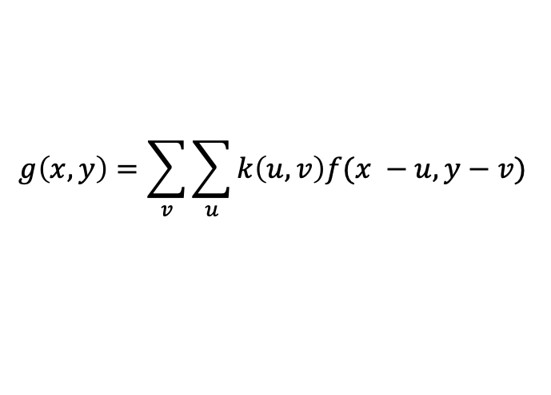



Most important operation for Computer Vision (*)
The Convolution Operation
$$k(x,y)$$
$$f(x,y)$$
g$(x,y)$
$$g\left(x, y\right)=\sum_{v}{\sum_{u}{k\left(u,v\right)f(x −u, y−v) }}$$
(*) Maybe

Slide 5


Image filtering: Convolution operator e.g. mean filter
1/9 | 1/9 | 1/9
1/9 | 1/9 | 1/9
1/9 | 1/9 | 1/9
$k(x, y)$ =
$k(x, y)$
Image Credit: http://what-when-how.com/introduction-to-video-and-image-processing/neighborhood-processing-introduction-to-video-and-image-processing-part-1/

Slide 6
Image filtering: Convolution operator e.g. mean filter
1/9 | 1/9 | 1/9
1/9 | 1/9 | 1/9
1/9 | 1/9 | 1/9
$k(x, y)$ =
$k(x, y)$
Image Credit: http://what-when-how.com/introduction-to-video-and-image-processing/neighborhood-processing-introduction-to-video-and-image-processing-part-1/

Slide 7

Example: box filter
1
1
1
1
1
1
1
1
1
Slide credit: David Lowe (UBC)

Slide 8
Image filtering
1
1
1
1
1
1
1
1
1
0 | 0 | 0 | 0 | 0 | 0 | 0 | 0 | 0 | 0
0 | 0 | 0 | 0 | 0 | 0 | 0 | 0 | 0 | 0
0 | 0 | 0 | 90 | 90 | 90 | 90 | 90 | 0 | 0
0 | 0 | 0 | 90 | 90 | 90 | 90 | 90 | 0 | 0
0 | 0 | 0 | 90 | 90 | 90 | 90 | 90 | 0 | 0
0 | 0 | 0 | 90 | 0 | 90 | 90 | 90 | 0 | 0
0 | 0 | 0 | 90 | 90 | 90 | 90 | 90 | 0 | 0
0 | 0 | 0 | 0 | 0 | 0 | 0 | 0 | 0 | 0
0 | 0 | 90 | 0 | 0 | 0 | 0 | 0 | 0 | 0
0 | 0 | 0 | 0 | 0 | 0 | 0 | 0 | 0 | 0
 | 0
0 | 0 | 0 | 0 | 0 | 0 | 0 | 0 | 0 | 0
0 | 0 | 0 | 0 | 0 | 0 | 0 | 0 | 0 | 0
0 | 0 | 0 | 90 | 90 | 90 | 90 | 90 | 0 | 0
0 | 0 | 0 | 90 | 90 | 90 | 90 | 90 | 0 | 0
0 | 0 | 0 | 90 | 90 | 90 | 90 | 90 | 0 | 0
0 | 0 | 0 | 90 | 0 | 90 | 90 | 90 | 0 | 0
0 | 0 | 0 | 90 | 90 | 90 | 90 | 90 | 0 | 0
0 | 0 | 0 | 0 | 0 | 0 | 0 | 0 | 0 | 0
0 | 0 | 90 | 0 | 0 | 0 | 0 | 0 | 0 | 0
0 | 0 | 0 | 0 | 0 | 0 | 0 | 0 | 0 | 0
Credit: S. Seitz
Notes:
ones, divide by 9

Slide 9
Image filtering
1
1
1
1
1
1
1
1
1
0 | 0 | 0 | 0 | 0 | 0 | 0 | 0 | 0 | 0
0 | 0 | 0 | 0 | 0 | 0 | 0 | 0 | 0 | 0
0 | 0 | 0 | 90 | 90 | 90 | 90 | 90 | 0 | 0
0 | 0 | 0 | 90 | 90 | 90 | 90 | 90 | 0 | 0
0 | 0 | 0 | 90 | 90 | 90 | 90 | 90 | 0 | 0
0 | 0 | 0 | 90 | 0 | 90 | 90 | 90 | 0 | 0
0 | 0 | 0 | 90 | 90 | 90 | 90 | 90 | 0 | 0
0 | 0 | 0 | 0 | 0 | 0 | 0 | 0 | 0 | 0
0 | 0 | 90 | 0 | 0 | 0 | 0 | 0 | 0 | 0
0 | 0 | 0 | 0 | 0 | 0 | 0 | 0 | 0 | 0
 | 0 | 10
0 | 0 | 0 | 0 | 0 | 0 | 0 | 0 | 0 | 0
0 | 0 | 0 | 0 | 0 | 0 | 0 | 0 | 0 | 0
0 | 0 | 0 | 90 | 90 | 90 | 90 | 90 | 0 | 0
0 | 0 | 0 | 90 | 90 | 90 | 90 | 90 | 0 | 0
0 | 0 | 0 | 90 | 90 | 90 | 90 | 90 | 0 | 0
0 | 0 | 0 | 90 | 0 | 90 | 90 | 90 | 0 | 0
0 | 0 | 0 | 90 | 90 | 90 | 90 | 90 | 0 | 0
0 | 0 | 0 | 0 | 0 | 0 | 0 | 0 | 0 | 0
0 | 0 | 90 | 0 | 0 | 0 | 0 | 0 | 0 | 0
0 | 0 | 0 | 0 | 0 | 0 | 0 | 0 | 0 | 0
Credit: S. Seitz
Notes:
ones, divide by 9

Slide 10
Image filtering
1
1
1
1
1
1
1
1
1
0 | 0 | 0 | 0 | 0 | 0 | 0 | 0 | 0 | 0
0 | 0 | 0 | 0 | 0 | 0 | 0 | 0 | 0 | 0
0 | 0 | 0 | 90 | 90 | 90 | 90 | 90 | 0 | 0
0 | 0 | 0 | 90 | 90 | 90 | 90 | 90 | 0 | 0
0 | 0 | 0 | 90 | 90 | 90 | 90 | 90 | 0 | 0
0 | 0 | 0 | 90 | 0 | 90 | 90 | 90 | 0 | 0
0 | 0 | 0 | 90 | 90 | 90 | 90 | 90 | 0 | 0
0 | 0 | 0 | 0 | 0 | 0 | 0 | 0 | 0 | 0
0 | 0 | 90 | 0 | 0 | 0 | 0 | 0 | 0 | 0
0 | 0 | 0 | 0 | 0 | 0 | 0 | 0 | 0 | 0
 | 0 | 10 | 20
0 | 0 | 0 | 0 | 0 | 0 | 0 | 0 | 0 | 0
0 | 0 | 0 | 0 | 0 | 0 | 0 | 0 | 0 | 0
0 | 0 | 0 | 90 | 90 | 90 | 90 | 90 | 0 | 0
0 | 0 | 0 | 90 | 90 | 90 | 90 | 90 | 0 | 0
0 | 0 | 0 | 90 | 90 | 90 | 90 | 90 | 0 | 0
0 | 0 | 0 | 90 | 0 | 90 | 90 | 90 | 0 | 0
0 | 0 | 0 | 90 | 90 | 90 | 90 | 90 | 0 | 0
0 | 0 | 0 | 0 | 0 | 0 | 0 | 0 | 0 | 0
0 | 0 | 90 | 0 | 0 | 0 | 0 | 0 | 0 | 0
0 | 0 | 0 | 0 | 0 | 0 | 0 | 0 | 0 | 0
Credit: S. Seitz
Notes:
ones, divide by 9

Slide 11
Image filtering
1
1
1
1
1
1
1
1
1
0 | 0 | 0 | 0 | 0 | 0 | 0 | 0 | 0 | 0
0 | 0 | 0 | 0 | 0 | 0 | 0 | 0 | 0 | 0
0 | 0 | 0 | 90 | 90 | 90 | 90 | 90 | 0 | 0
0 | 0 | 0 | 90 | 90 | 90 | 90 | 90 | 0 | 0
0 | 0 | 0 | 90 | 90 | 90 | 90 | 90 | 0 | 0
0 | 0 | 0 | 90 | 0 | 90 | 90 | 90 | 0 | 0
0 | 0 | 0 | 90 | 90 | 90 | 90 | 90 | 0 | 0
0 | 0 | 0 | 0 | 0 | 0 | 0 | 0 | 0 | 0
0 | 0 | 90 | 0 | 0 | 0 | 0 | 0 | 0 | 0
0 | 0 | 0 | 0 | 0 | 0 | 0 | 0 | 0 | 0
 | 0 | 10 | 20 | 30
0 | 0 | 0 | 0 | 0 | 0 | 0 | 0 | 0 | 0
0 | 0 | 0 | 0 | 0 | 0 | 0 | 0 | 0 | 0
0 | 0 | 0 | 90 | 90 | 90 | 90 | 90 | 0 | 0
0 | 0 | 0 | 90 | 90 | 90 | 90 | 90 | 0 | 0
0 | 0 | 0 | 90 | 90 | 90 | 90 | 90 | 0 | 0
0 | 0 | 0 | 90 | 0 | 90 | 90 | 90 | 0 | 0
0 | 0 | 0 | 90 | 90 | 90 | 90 | 90 | 0 | 0
0 | 0 | 0 | 0 | 0 | 0 | 0 | 0 | 0 | 0
0 | 0 | 90 | 0 | 0 | 0 | 0 | 0 | 0 | 0
0 | 0 | 0 | 0 | 0 | 0 | 0 | 0 | 0 | 0
Credit: S. Seitz
Notes:
ones, divide by 9

Slide 12
Image filtering
1
1
1
1
1
1
1
1
1
0 | 0 | 0 | 0 | 0 | 0 | 0 | 0 | 0 | 0
0 | 0 | 0 | 0 | 0 | 0 | 0 | 0 | 0 | 0
0 | 0 | 0 | 90 | 90 | 90 | 90 | 90 | 0 | 0
0 | 0 | 0 | 90 | 90 | 90 | 90 | 90 | 0 | 0
0 | 0 | 0 | 90 | 90 | 90 | 90 | 90 | 0 | 0
0 | 0 | 0 | 90 | 0 | 90 | 90 | 90 | 0 | 0
0 | 0 | 0 | 90 | 90 | 90 | 90 | 90 | 0 | 0
0 | 0 | 0 | 0 | 0 | 0 | 0 | 0 | 0 | 0
0 | 0 | 90 | 0 | 0 | 0 | 0 | 0 | 0 | 0
0 | 0 | 0 | 0 | 0 | 0 | 0 | 0 | 0 | 0
 | 0 | 10 | 20 | 30 | 30
Credit: S. Seitz
Notes:
ones, divide by 9

Slide 13
Image filtering
1
1
1
1
1
1
1
1
1
0 | 0 | 0 | 0 | 0 | 0 | 0 | 0 | 0 | 0
0 | 0 | 0 | 0 | 0 | 0 | 0 | 0 | 0 | 0
0 | 0 | 0 | 90 | 90 | 90 | 90 | 90 | 0 | 0
0 | 0 | 0 | 90 | 90 | 90 | 90 | 90 | 0 | 0
0 | 0 | 0 | 90 | 90 | 90 | 90 | 90 | 0 | 0
0 | 0 | 0 | 90 | 0 | 90 | 90 | 90 | 0 | 0
0 | 0 | 0 | 90 | 90 | 90 | 90 | 90 | 0 | 0
0 | 0 | 0 | 0 | 0 | 0 | 0 | 0 | 0 | 0
0 | 0 | 90 | 0 | 0 | 0 | 0 | 0 | 0 | 0
0 | 0 | 0 | 0 | 0 | 0 | 0 | 0 | 0 | 0
 | 0 | 10 | 20 | 30 | 30
?
Credit: S. Seitz
Notes:
ones, divide by 9

Slide 14
Image filtering
1
1
1
1
1
1
1
1
1
0 | 0 | 0 | 0 | 0 | 0 | 0 | 0 | 0 | 0
0 | 0 | 0 | 0 | 0 | 0 | 0 | 0 | 0 | 0
0 | 0 | 0 | 90 | 90 | 90 | 90 | 90 | 0 | 0
0 | 0 | 0 | 90 | 90 | 90 | 90 | 90 | 0 | 0
0 | 0 | 0 | 90 | 90 | 90 | 90 | 90 | 0 | 0
0 | 0 | 0 | 90 | 0 | 90 | 90 | 90 | 0 | 0
0 | 0 | 0 | 90 | 90 | 90 | 90 | 90 | 0 | 0
0 | 0 | 0 | 0 | 0 | 0 | 0 | 0 | 0 | 0
0 | 0 | 90 | 0 | 0 | 0 | 0 | 0 | 0 | 0
0 | 0 | 0 | 0 | 0 | 0 | 0 | 0 | 0 | 0
 | 0 | 10 | 20 | 30 | 30
 |  |  |  | 50
?
Credit: S. Seitz
Notes:
ones, divide by 9

Slide 15
Image filtering
1
1
1
1
1
1
1
1
1
0 | 0 | 0 | 0 | 0 | 0 | 0 | 0 | 0 | 0
0 | 0 | 0 | 0 | 0 | 0 | 0 | 0 | 0 | 0
0 | 0 | 0 | 90 | 90 | 90 | 90 | 90 | 0 | 0
0 | 0 | 0 | 90 | 90 | 90 | 90 | 90 | 0 | 0
0 | 0 | 0 | 90 | 90 | 90 | 90 | 90 | 0 | 0
0 | 0 | 0 | 90 | 0 | 90 | 90 | 90 | 0 | 0
0 | 0 | 0 | 90 | 90 | 90 | 90 | 90 | 0 | 0
0 | 0 | 0 | 0 | 0 | 0 | 0 | 0 | 0 | 0
0 | 0 | 90 | 0 | 0 | 0 | 0 | 0 | 0 | 0
0 | 0 | 0 | 0 | 0 | 0 | 0 | 0 | 0 | 0
 | 0 | 10 | 20 | 30 | 30 | 30 | 20 | 10
 | 0 | 20 | 40 | 60 | 60 | 60 | 40 | 20
 | 0 | 30 | 60 | 90 | 90 | 90 | 60 | 30
 | 0 | 30 | 50 | 80 | 80 | 90 | 60 | 30
 | 0 | 30 | 50 | 80 | 80 | 90 | 60 | 30
 | 0 | 20 | 30 | 50 | 50 | 60 | 40 | 20
 | 10 | 20 | 30 | 30 | 30 | 30 | 20 | 10
 | 10 | 10 | 10 | 0 | 0 | 0 | 0 | 0
Credit: S. Seitz

Slide 16
Box Filter
What does it do?
Replaces each pixel with an average of its neighborhood
Achieve smoothing effect (remove sharp features)
1
1
1
1
1
1
1
1
1
Slide credit: David Lowe (UBC)

Slide 17
Image filtering: e.g. Mean Filter

Slide 18
Image filtering: Convolution operator Important filter: gaussian filter (gaussian blur)
1/16 | 1/8 | 1/16
1/8 | 1/4 | 1/8
1/16 | 1/8 | 1/16
$k(x, y)$ =
$k(x, y)$
Image Credit: http://what-when-how.com/introduction-to-video-and-image-processing/neighborhood-processing-introduction-to-video-and-image-processing-part-1/

Slide 19
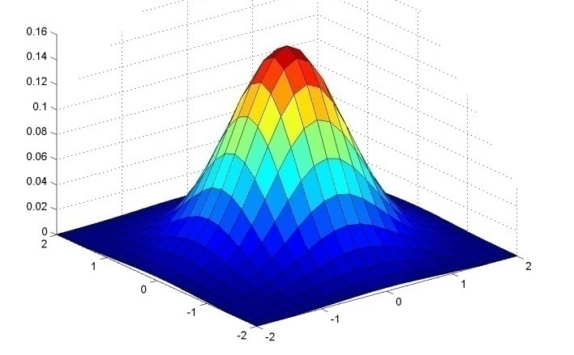
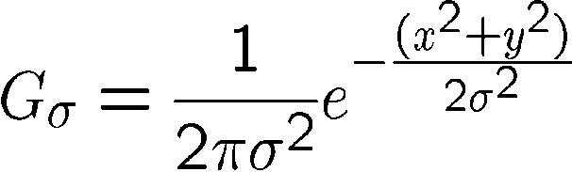
Important filter: Gaussian
Weight contributions of neighboring pixels by nearness
0.003 0.013 0.022 0.013 0.003
0.013 0.059 0.097 0.059 0.013
0.022 0.097 0.159 0.097 0.022
0.013 0.059 0.097 0.059 0.013
0.003 0.013 0.022 0.013 0.003
5 x 5, σ = 1
Slide credit: Christopher Rasmussen
Notes:
e^0 = 1, e^-1 = .37, e^-2 = .14, etc.

Slide 20
Image filtering: Convolution operator e.g. gaussian filter (gaussian blur)
Image Credit: http://what-when-how.com/introduction-to-video-and-image-processing/neighborhood-processing-introduction-to-video-and-image-processing-part-1/

Slide 21
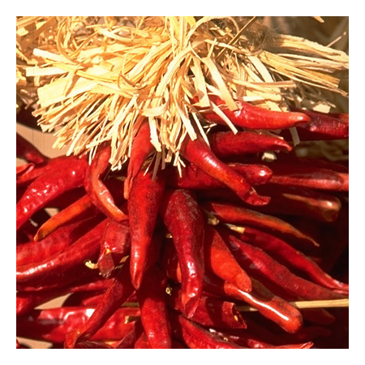
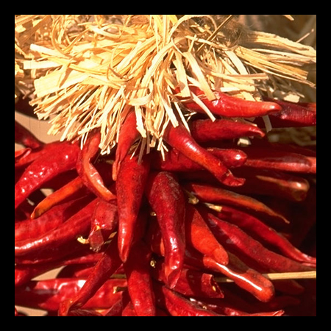

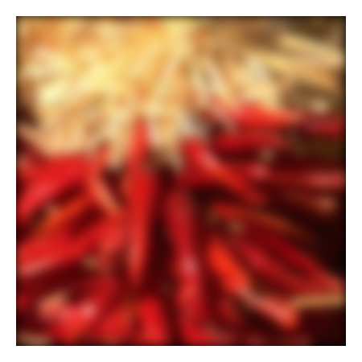
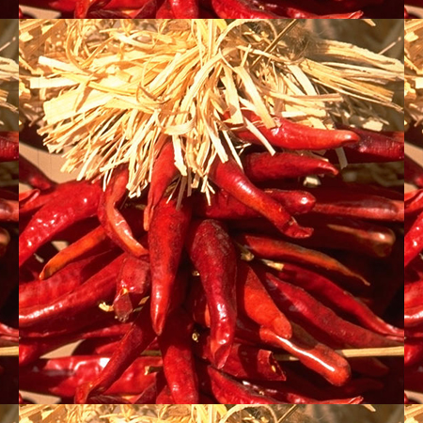

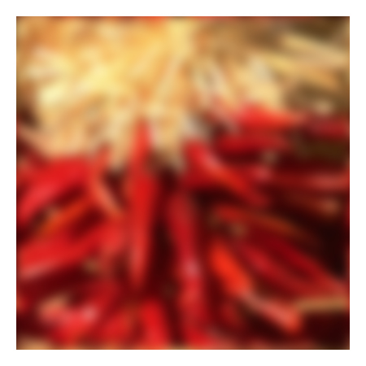
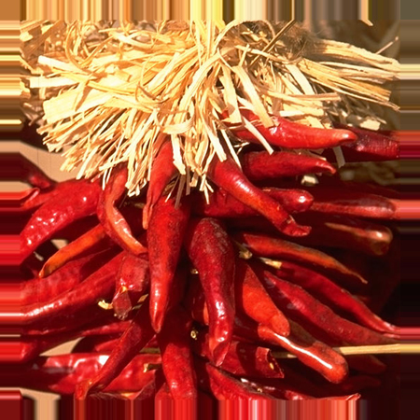


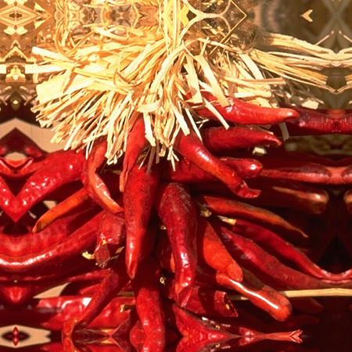


Practical matters
What about near the edge?
the filter window falls off the edge of the image
need to extrapolate
methods:
clip filter (black)
wrap around
copy edge
reflect across edge
Source: S. Marschner

Slide 22
Convolution: Useful Operator for Image Processing
Not all image filtering – region neighborhood operators can be expressed as convolutions.
They also can be used to extract information about edges and shapes .e.g. for image recognition
Convolutional operations are at the basis of convolutional neural networks.

Slide 23
Image filtering: Convolution operator Important Filter: Sobel operator
1 | 0 | -1
2 | 0 | -2
1 | 0 | -1
$k(x, y)$ =
$k(x, y)$
Image Credit: http://what-when-how.com/introduction-to-video-and-image-processing/neighborhood-processing-introduction-to-video-and-image-processing-part-1/

Slide 24
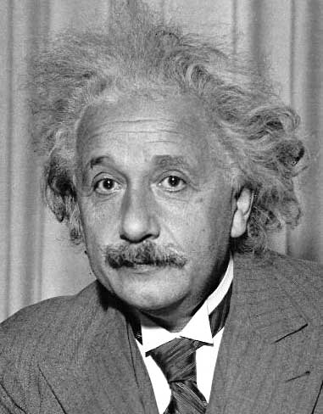
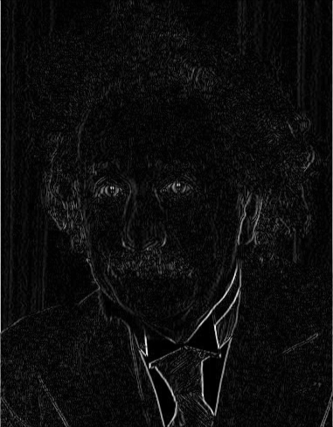
Other filters
1
0
-1
2
0
-2
1
0
-1
Sobel
Vertical Edge
(absolute value)
Slide by James Hays

Slide 25
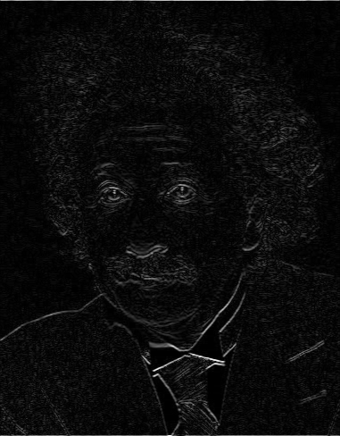
Other filters
1
2
1
0
0
0
-1
-2
-1
Sobel
Horizontal Edge
(absolute value)
Slide by James Hays
Notes:
Questions at this point?

Slide 26
Sobel operators are equivalent to 2D partial derivatives of the image
Vertical sobel operator – Partial derivative in X (width)
Horizontal sobel operator – Partial derivative in Y (height)
Can compute magnitude and phase at each location.
Useful for detecting edges

Slide 27
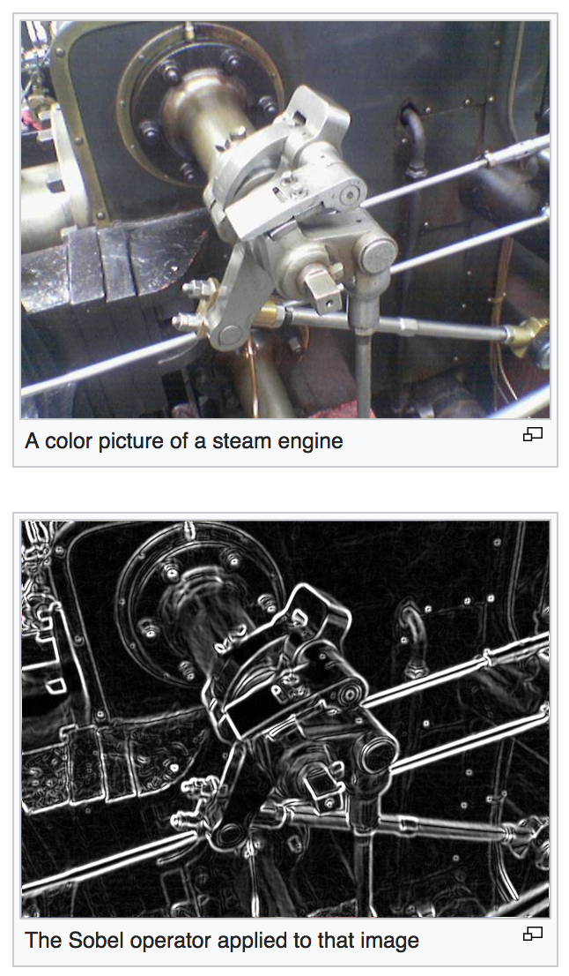
https://en.wikipedia.org/wiki/Sobel_operator

Slide 28

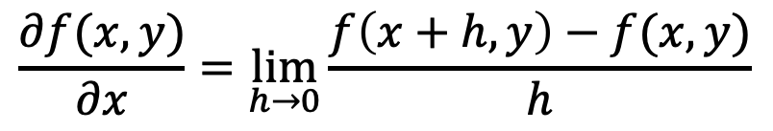
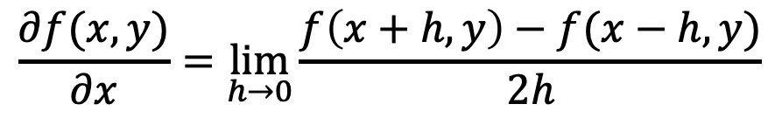
Sobel filters are (approximate) partial derivatives of the image
Let
$$f(x,y)$$
be your input image, then the partial derivative is:
$$\frac{∂f(x,y)}{∂x}=\lim_{h→0}{\frac{f\left(x+h, y\right)−f(x,y)}{h}}$$
Also:
$$\frac{∂f(x,y)}{∂x}=\lim_{h→0}{\frac{f\left(x+h,y\right)−f(x−h,y)}{2h}}$$

Slide 29



But digital images are not continuous, they are discrete
Let
$$f[x,y]$$
be your input image, then the partial derivative is:
$$Δ_{x}f[x,y]=f[x+1,y]−f[x,y]$$
Also:
$$Δ_{x}f[x,y]=f[x+1,y]−f[x−1,y]$$

Slide 30
But digital images are not continuous, they are discrete
Let
$$f[x,y]$$
be your input image, then the partial derivative is:
k(x, y) =
-1 | 1
$$Δ_{x}f[x,y]=f[x+1,y]−f[x,y]$$
Also:
-1 | 0 | 1
$$Δ_{x}f[x,y]=f[x+1,y]−f[x−1,y]$$
k(x, y) =

Slide 31
Sobel Operators Smooth in Y and then Differentiate in X
1
2
1
1 | 0 | -1
2 | 0 | -2
1 | 0 | -1
1 | 0 | -1
k(x, y) =
*
=
Similarly to differentiate in Y

Slide 32
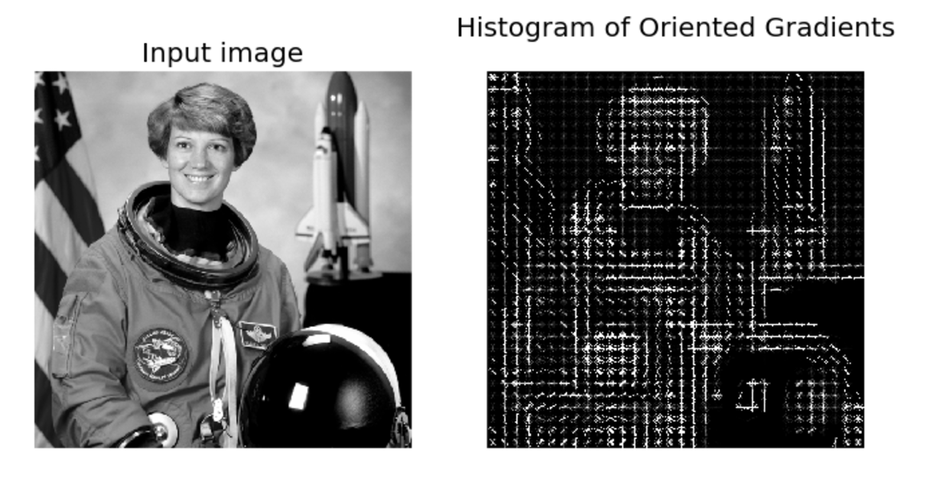
Image Features: HoG
Paper by Navneet Dalal & Bill Triggs presented at CVPR 2005 for detecting people.
Scikit-image implementation

Slide 33
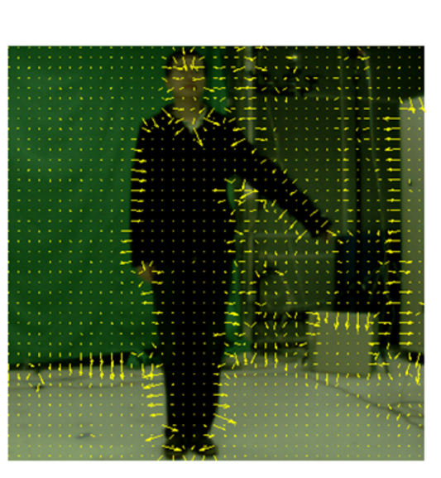
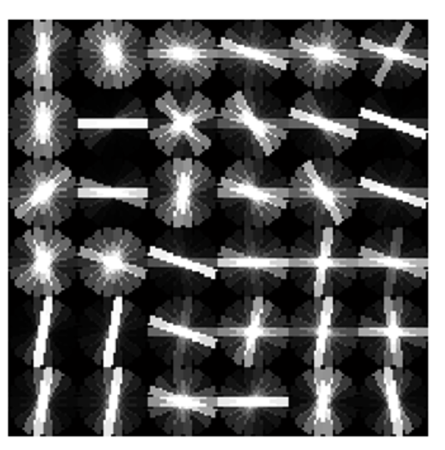
Image Features: HoG
+ Block Normalization
Paper by Navneet Dalal & Bill Triggs presented at CVPR 2005 for detecting people. Figure from Zhuolin Jiang, Zhe Lin, Larry S. Davis, ICCV 2009 for human action recognition.

Slide 34
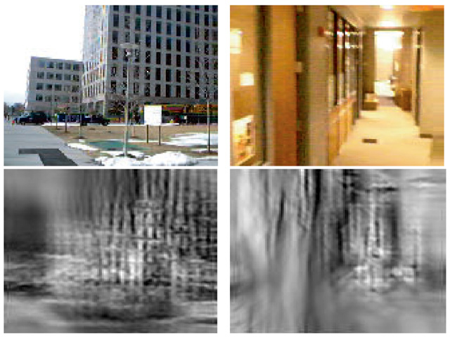
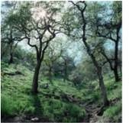
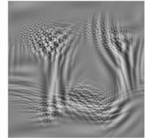
Image Features: GIST
The “gist” of a scene: Oliva & Torralba, 2001

Slide 35
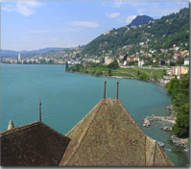
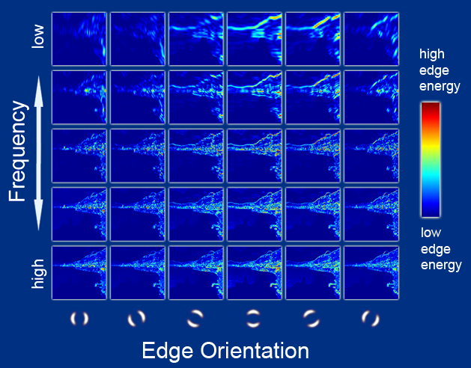
Image Features: GIST
Oriented edge response at multiple scales (5 spatial scales, 6 edge orientations)
Hays and Efros, SIGGRAPH 2007

Slide 36
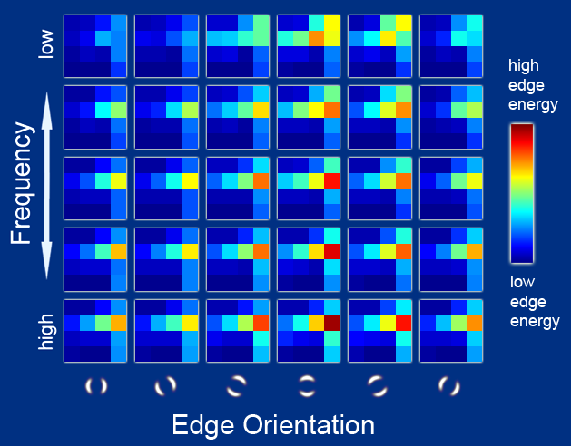
Image Features: GIST
Aggregated edge responses over 4x4 windows
Hays and Efros, SIGGRAPH 2007

Slide 37
The 2D Convolutional Layer in a Neural Network

Slide 38
The 2D Convolutional Layer in a Neural Network

Slide 39
The 2D Convolutional Layer in a Neural Network
Weights

Slide 40
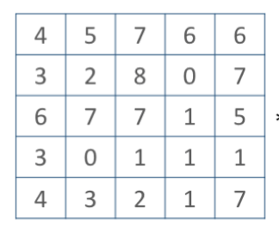
The 2D Convolutional Layer in a Neural Network
Weights
4

Slide 41
The 2D Convolutional Layer in a Neural Network
Weights
4
1

Slide 42
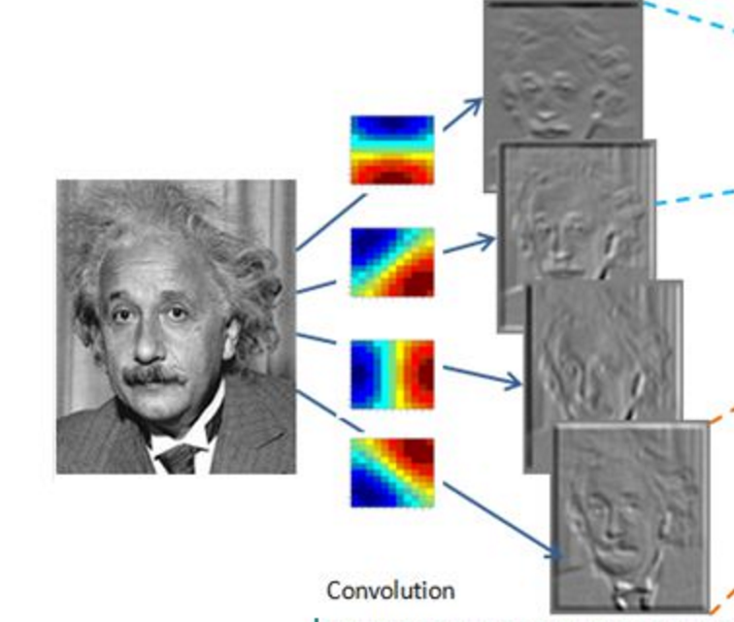
Convolutional Layer (with 4 filters)
weights: 4x1x9x9
Input: 1x224x224
Output: 4x224x224
if zero padding,
and stride = 1

Slide 43
Convolutional Layer (with 4 filters)
weights: 4x1x9x9
Input: 1x224x224
Output: 4x112x112
if zero padding,
but stride = 2

Slide 44
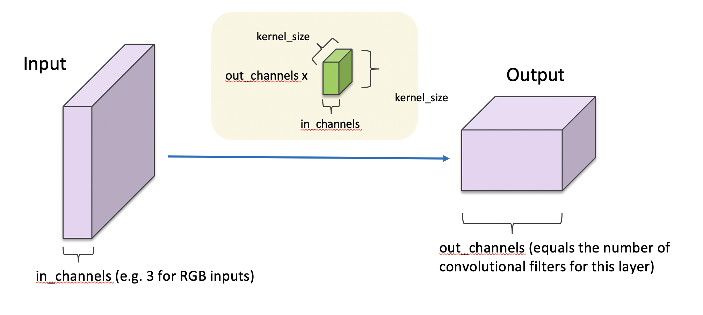
Convolutional Layer in pytorch

Slide 45
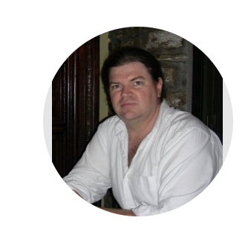
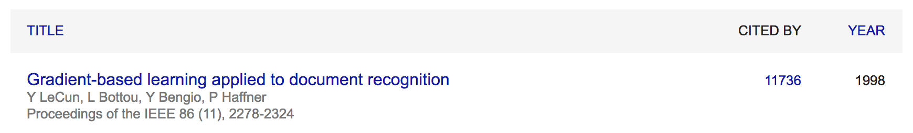
Convolutional Network: LeNet
Yann LeCun

Slide 46
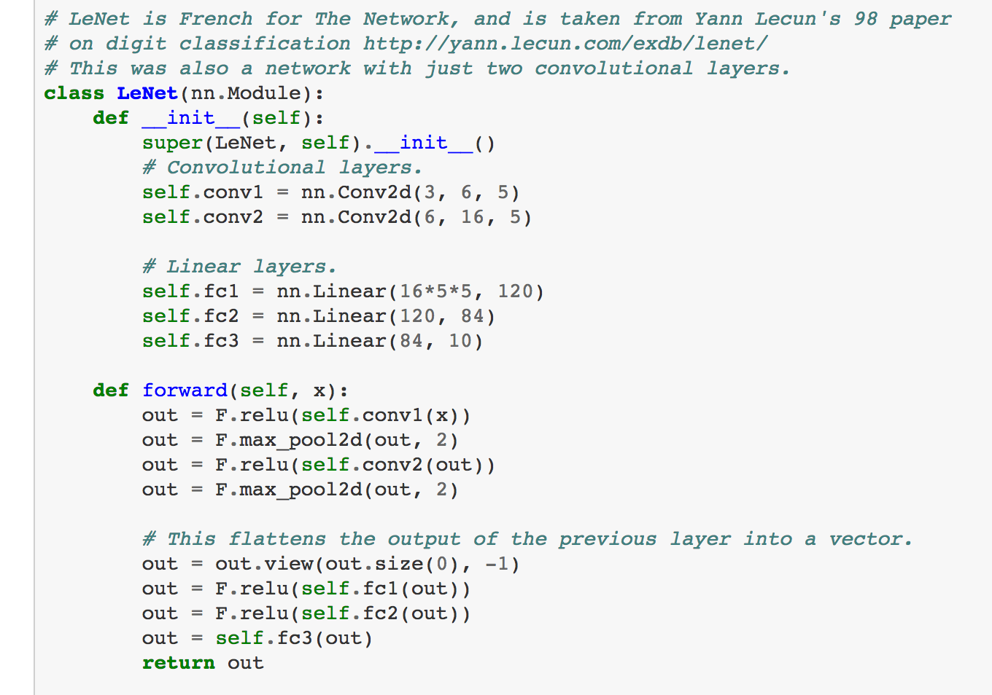
LeNet in Pytorch

Slide 47
SpatialMaxPooling Layer
take the max in this neighborhood
8
8
8
8
8

Slide 48
LeNet Summary
2 Convolutional Layers + 3 Linear Layers
+ Non-linear functions: ReLUs or Sigmoids + Max-pooling operations

Slide 49
New Architectures Proposed
Alexnet (Kriszhevsky et al NIPS 2012) [Required Reading]
VGG (Simonyan and Zisserman 2014)
GoogLeNet (Szegedy et al CVPR 2015)
ResNet (He et al CVPR 2016)
DenseNet (Huang et al CVPR 2017)

Slide 50
Convolutional Layers as Matrix Multiplication
https://petewarden.com/2015/04/20/why-gemm-is-at-the-heart-of-deep-learning/

Slide 51
Convolutional Layers as Matrix Multiplication
https://petewarden.com/2015/04/20/why-gemm-is-at-the-heart-of-deep-learning/

Slide 52
Convolutional Layers as Matrix Multiplication
Pros?
Cons?
https://petewarden.com/2015/04/20/why-gemm-is-at-the-heart-of-deep-learning/

Slide 53
CNN Computations are Computationally Expensive
However highly parallelizable
GPU Computing is used in practice
CPU Computing in fact is prohibitive for training these models

Slide 54
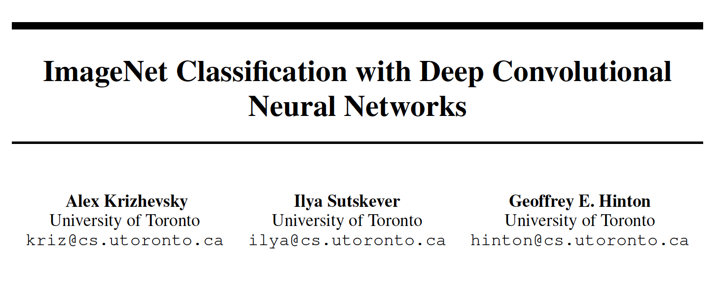
The Alexnet network (Krizhevsky et al NIPS 2012)

Slide 55
The Problem: Classification
Classify an image into 1000 possible classes: e.g. Abyssinian cat, Bulldog, French Terrier, Cormorant, Chickadee,
red fox, banjo, barbell, hourglass, knot, maze, viaduct, etc.
cat, tabby cat (0.71) Egyptian cat (0.22)
red fox (0.11)
…..

Slide 56
The Data: ILSVRC
Imagenet Large Scale Visual Recognition Challenge (ILSVRC): Annual Competition
1000 Categories
~1000 training images per Category
~1 million images in total for training
~50k images for validation
Only images released for the test set but no annotations, evaluation is performed centrally by the organizers (max 2 per week)

Slide 57
The Evaluation Metric: Top K-error
Top-1 error: 1.0
Top-1 accuracy: 0.0
Top-2 error: 1.0
Top-2 accuracy: 0.0
True label: Abyssinian cat
Top-3 error: 1.0
Top-3 accuracy: 0.0
Top-4 error: 0.0
Top-4 accuracy: 1.0
Top-5 error: 0.0
Top-5 accuracy: 1.0
cat, tabby cat (0.61) Egyptian cat (0.22)
red fox (0.11)
Abyssinian cat (0.10)
French terrier (0.03)
…..

Slide 58
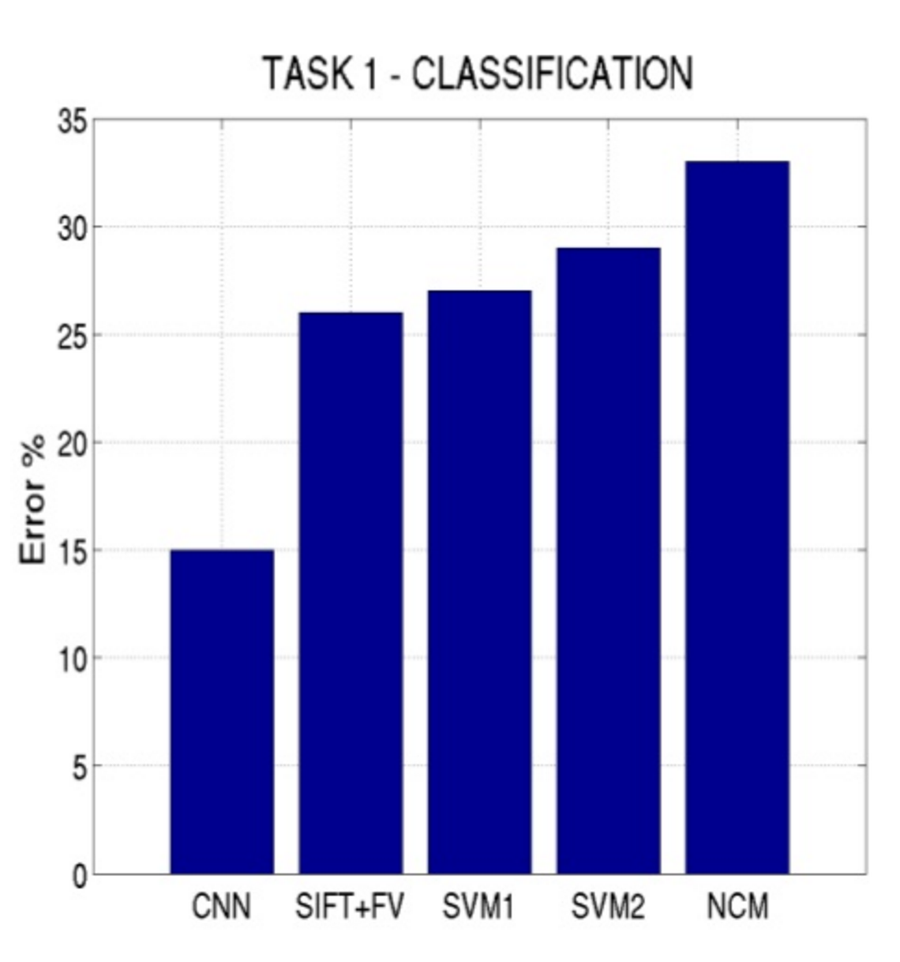
Top-5 error on this competition (2012)

Slide 59
Alexnet
https://www.saagie.com/fr/blog/object-detection-part1

Slide 60
Pytorch Code for Alexnet
In-class analysis https://github.com/pytorch/vision/blob/master/torchvision/models/alexnet.py

Slide 61
Dropout Layer
Srivastava et al 2014

Slide 62
What is happening?
https://www.saagie.com/fr/blog/object-detection-part1

Slide 63
SIFT + FV + SVM (or softmax)
Feature extraction (SIFT)
Feature encoding (Bag of words)
Classification (SVM or softmax)
Deep Learning
Convolutional Neural Network
Classifier (SVM or softmax)

Slide 64
Pre-training
1000 categories 1 million images
Convolutional Neural Network
Classifier
Fine-tuning
20 categories 400 images
Convolutional Neural Network
My Classifier

Slide 65
Preprocessing and Data Augmentation

Slide 66
Preprocessing and Data Augmentation
256
256

Slide 67
Preprocessing and Data Augmentation
224x224

Slide 68
Preprocessing and Data Augmentation
224x224

Slide 69
True label: Abyssinian cat

Slide 70
Other Data Augmentation options
Pytorch: https://pytorch.org/vision/stable/transforms.html
Basic: RandomCrop, RandomResize, RandomHorizontalFlip
Geometric: RandomRotation, RandomPerspective, RandomAffine, etc.
Color: RandomAutoContrast, RandomEqualize, RandomPosterize, etc.
Other: RandomErasing (https://arxiv.org/abs/1708.04896)

Slide 71
Advanced Data Augmentation
MixUp – 2017 (https://arxiv.org/abs/1710.09412)
AutoAugment - 2018 (https://arxiv.org/abs/1805.09501)
RandAugment - 2019 (https://arxiv.org/abs/1909.13719)
CutMix – 2019 (https://arxiv.org/abs/1905.04899)
AugMix – 2019 (https://arxiv.org/abs/1912.02781)
TrivialAugment - 2021 (https://arxiv.org/abs/2103.10158)

Slide 72
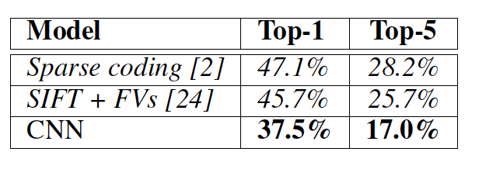
Other Important Aspects
Using ReLUs instead of Sigmoid or Tanh
Momentum + Weight Decay
Dropout (Randomly sets Unit outputs to zero during training)
GPU Computation!

Slide 73
VGG Network
Top-5:
https://github.com/pytorch/vision/blob/master/torchvision/models/vgg.py
Simonyan and Zisserman, 2014.
https://arxiv.org/pdf/1409.1556.pdf

Slide 74
GoogLeNet
https://github.com/kuangliu/pytorch-cifar/blob/master/models/googlenet.py
Szegedy et al. 2014
https://www.cs.unc.edu/~wliu/papers/GoogLeNet.pdf

Slide 75
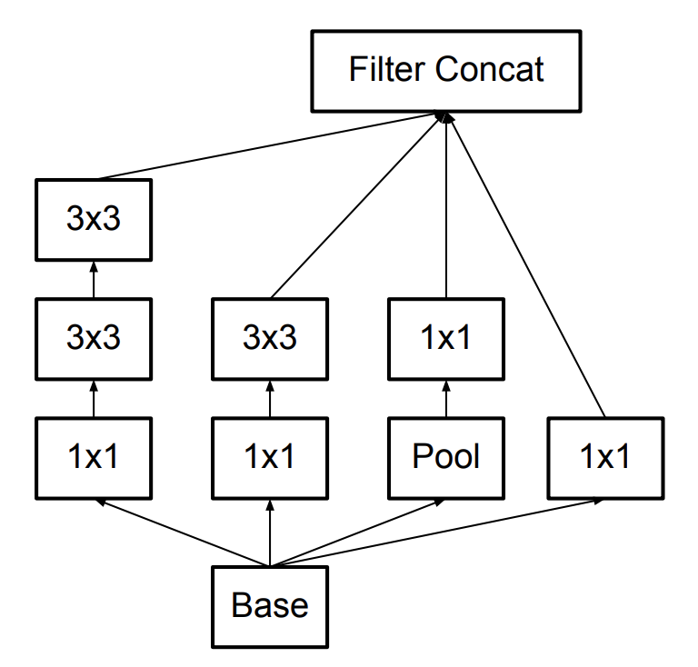
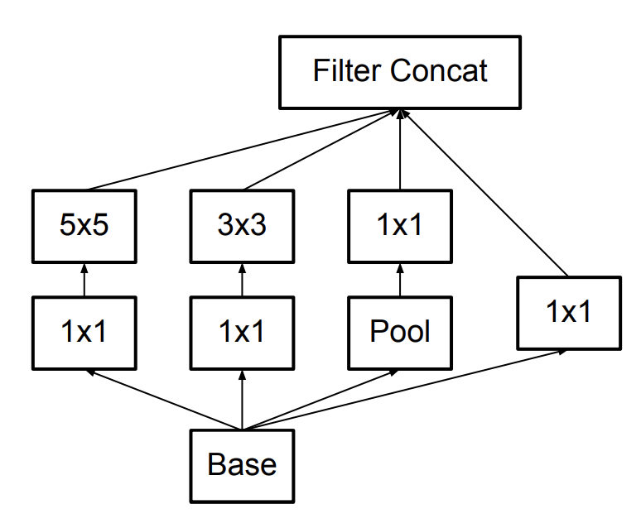
Further Refinements – Inception v3, e.g.
GoogLeNet (Inceptionv1)
Inception v3

Slide 76
BatchNormalization Layer
https://arxiv.org/abs/1502.03167

Slide 77
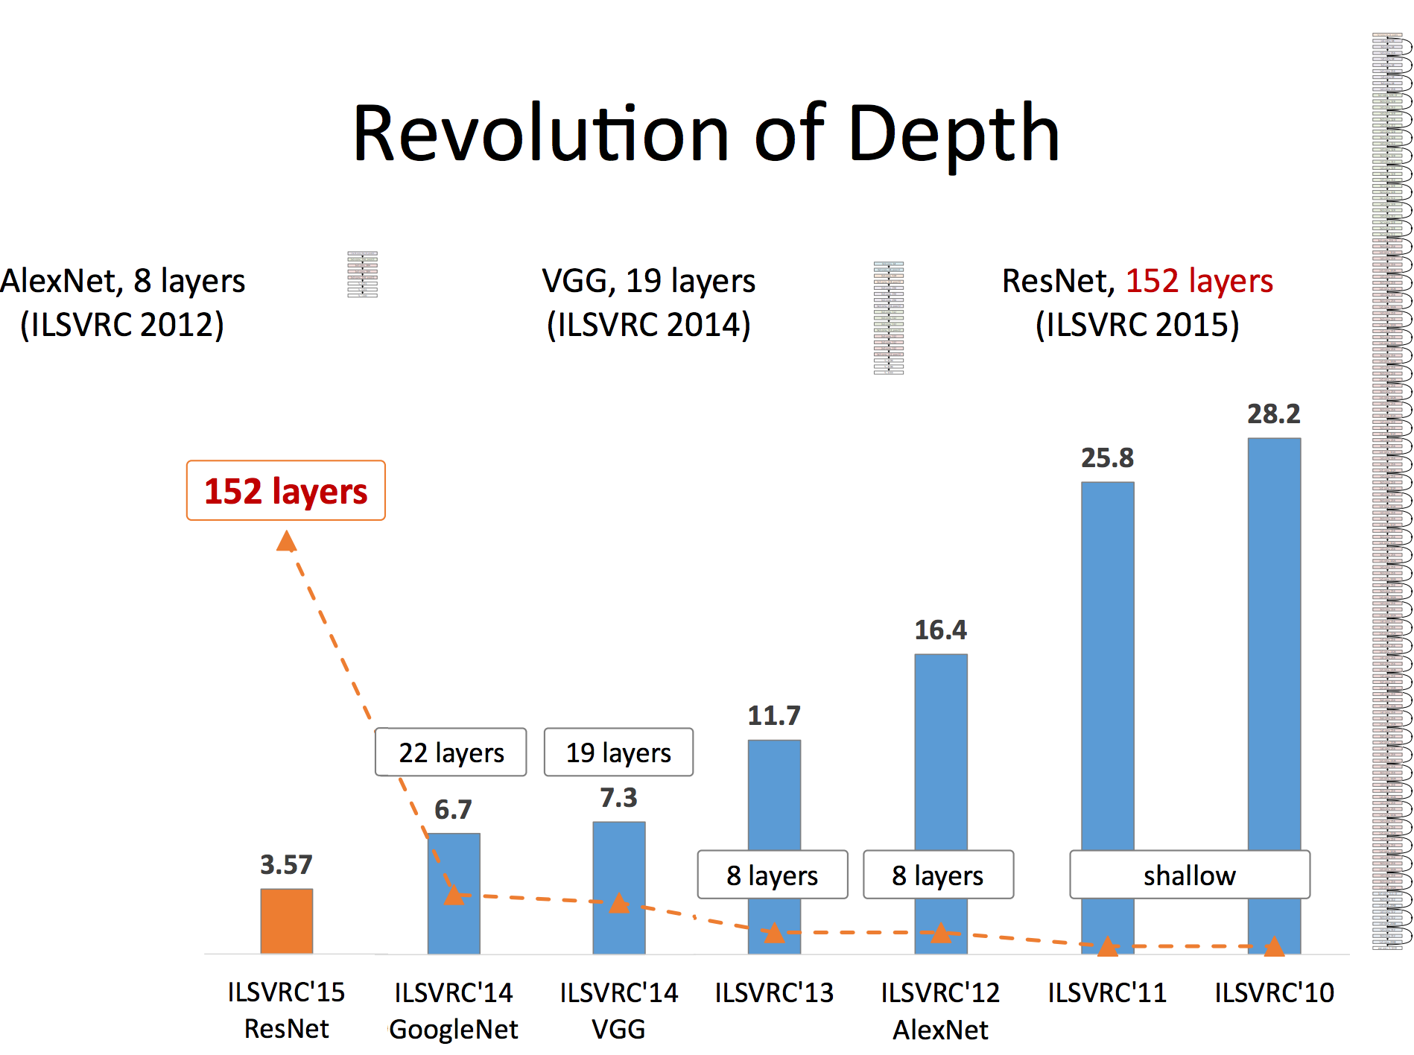
Slide by Mohammad Rastegari

Slide 78
ResNet (He et al CVPR 2016)
Sorry, does not fit in slide.
http://felixlaumon.github.io/assets/kaggle-right-whale/resnet.png
https://github.com/pytorch/vision/blob/master/torchvision/models/resnet.py

Slide 79
More Recent CNNs you can learn
DenseNet - 2016 (Similar to ResNet but all layers connect to all next and previous layers) https://arxiv.org/abs/1608.06993
ResNext – 2016 (Combines ideas from ResNet and InceptionNets https://arxiv.org/abs/1611.05431v2)
NASNet – 2017 (Search the space of possible architectures) https://arxiv.org/abs/1707.07012
EfficientNet – 2019 (Scales up both width and depth of CNNs using a more principled approach) https://arxiv.org/abs/1905.11946
RegNet – 2020 (Paper has a more principled formula to decide on widths and depths) https://arxiv.org/abs/2003.13678
ConvNext – 2022 (Combines many tricks both at the architecture and optimization level) https://arxiv.org/abs/2201.03545

Slide 80
Questions?

