Slide 1
Deep Learning for Vision & Language
Natural Language Processing I: Introduction

Slide 2
Natural Language Processing
The study of automatic reasoning over text / language

Slide 3
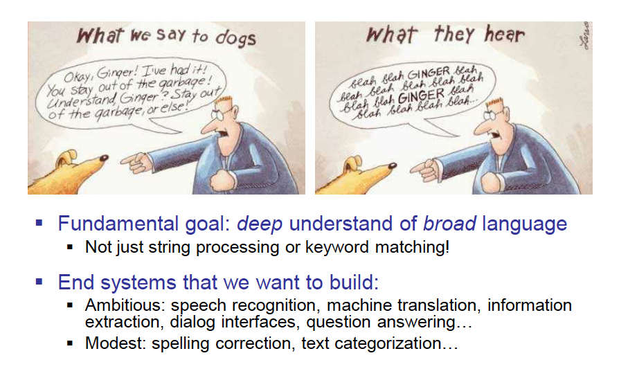
Slide by Dan Klein

Slide 4
Why is NLP Hard?
Human Language is Ambiguous
Task: Pronoun Resolution
  Jack drank the wine on the table. It was red and round.
  Jack saw Sam at the party. He went back to the bar to get another drink.
  Jack saw Sam at the party. He clearly had drunk too much.
    [Adapted from Wilks (1975)]
Slide by Yejin Choi

Slide 5
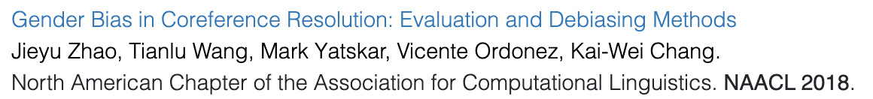
Why is NLP Hard?
Human Language Requires World Knowledge
Task: Co-Reference Resolution
  The doctor hired a secretary because she needed help with new patients.
  The physician hired the secretary because he was highly recommended.
    [From some of our group’s work]
Adapted from a slide by Yejin Choi

Slide 6
Why is NLP Hard?
Human Language is Ambiguous
Learning mother tongue (native language)
-- you might think it’s easy, but…
  compare 5 year old V.S. 10 year old V.S. 20 year old
Learning foreign languages
  – even harder
Slide by Yejin Choi

Slide 7
Word Segmentation
Slide from Ray Mooney
Breaking a string of characters into a sequence of words.
In some written languages (e.g. Japanese) words are not separated by spaces.
Even in English, characters other than white-space can be used to separate words [e.g. , ; . - : ( ) ]
Examples from English URLs:
  jumptheshark.com ⇒ jump the shark .com
  myspace.com/pluckerswingbar
  ⇒ myspace .com pluckers wing bar
  ⇒ myspace .com plucker swing bar

Slide 8
Morphological Analysis
Morphology is the field of linguistics that studies the internal structure of words. (Wikipedia)
A morpheme is the smallest linguistic unit that has semantic meaning (Wikipedia)
  e.g. “carry”, “pre”, “ed”, “ly”, “s”
Morphological analysis is the task of segmenting a word into its morphemes:
  carried ⇒ carry + ed (past tense)
  independently ⇒ in + (depend + ent) + ly
  Googlers ⇒ (Google + er) + s (plural)
  unlockable ⇒ un + (lock + able) ?
  ⇒ (un + lock) + able ?
Slide from Ray Mooney

Slide 9
German
555 --> fünf­hundert­fünf­und­fünfzig
7254 → Siebentausendzweihundertvierundfünfzig

Slide 10
Part Of Speech (POS) Tagging
Annotate each word in a sentence with a part-of-speech.
Useful for subsequent syntactic parsing and word sense disambiguation.
I ate the spaghetti with meatballs.
Pro V Det N Prep N
John saw the saw and decided to take it to the table.
PN V Det N Con V Part V Pro Prep Det N
Slide from Ray Mooney
Notes:
Word sense disambiguation, e.g. bank (can be noun or verb, e.g. bank the ball off the side vs I got some money from the bank)

Slide 11
Phrase Chunking
Slide from Ray Mooney
Find all noun phrases (NPs) and verb phrases (VPs) in a sentence.
  [NP I] [VP ate] [NP the spaghetti] [PP with] [NP meatballs].
  [NP He ] [VP reckons ] [NP the current account deficit ] [VP will narrow ] [PP to ] [NP only # 1.8 billion ] [PP in ] [NP September ]
Notes:
Break sentences down into phrasal units

Slide 12
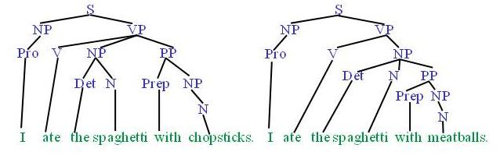
Syntactic Parsing
Slide from Ray Mooney
Produce the correct syntactic parse tree for a sentence.
Notes:
And at a higher level can automatically produce a complete syntactic parse tree for a sentence

Slide 13
Word Sense Disambiguation (WSD)
Words in natural language usually have a fair number of different possible meanings.
  Ellen has a strong interest in computational linguistics.
  Ellen pays a large amount of interest on her credit card.
For many tasks (question answering, translation), the proper sense of each ambiguous word in a sentence must be determined.
Slide from Ray Mooney

Slide 14
Other tasks more “advanced” tasks:
Text classification
  Simple: Is this text English or Spanish?
  Harder: Is this text about Toys or Weapons?
  Even harder: Is this text written by Shakespeare or not?
Text Generation
  Free form: Generate arbitrary human-like produced text
  Conditional: Generate text that has certain style
Entailment, can text statement A be deduced from text statement B?
Question Answering (QA), Given a question text, give a text answer.
Dialog – same as VQA but continuous back and forth

Slide 15







How to represent a word?
one-hot encodings
dog
cat
person
holding
tree
computer
using
1
2
3
4
5
6
7
$$[1 0 0 0 0 0 0 0 0 0 ]$$
$$[0 1 0 0 0 0 0 0 0 0 ]$$
$$[0 0 1 0 0 0 0 0 0 0 ]$$
$$[0 0 0 1 0 0 0 0 0 0 ]$$
$$[0 0 0 0 1 0 0 0 0 0 ]$$
$$[0 0 0 0 0 1 0 0 0 0 ]$$
$$[0 0 0 0 0 0 1 0 0 0 ]$$
What we see

Slide 16
How to represent a word?

Slide 17




How to represent a phrase/sentence?
bag-of-words representation
person holding dog
{1, 3, 4}
$$[1 0 1 1 0 0 0 0 0 0 ]$$
person holding cat
{2, 3, 4}
dog
cat
person
holding
tree
computer
using
$$[0 1 1 1 0 0 0 0 0 0 ]$$
person using computer
{3, 7, 6}
$$[0 0 1 0 0 1 1 0 0 0 ]$$
person using computer person holding cat
{3, 3, 7, 6, 2}
$$[0 1 2 1 0 1 1 0 0 0 ]$$
What we see
What if vocabulary is very large?

Slide 18
Sparse Representation
bag-of-words representation
person holding dog
{1, 3, 4}
indices = [1, 3, 4] values = [1, 1, 1]
person holding cat
{2, 3, 4}
indices = [2, 3, 4] values = [1, 1, 1]
person using computer
{3, 7, 6}
indices = [3, 7, 6] values = [1, 1, 1]
person using computer person holding cat
{3, 3, 7, 6, 2}
indices = [3, 7, 6, 2] values = [2, 1, 1, 1]
What we see

Slide 19
Recap
Bag-of-words encodings for text (e.g. sentences, paragraphs, captions, etc)
You can take a set of sentences/documents and classify them, cluster them, or compute distances between them using this representation.

Slide 20
Problem with this bag-of-words representation
my friend makes a nice meal
These would be the same using bag-of-words
my nice friend makes a meal

Slide 21
Bag of Bi-grams
indices = [10132, 21342, 43233, 53123, 64233] values = [1, 1, 1, 1, 1]
my friend makes a nice meal
{my friend, friend makes, makes a, a nice, nice meal}
indices = [10232, 43133, 21342, 43233, 54233] values = [1, 1, 1, 1, 1]
my nice friend makes a meal
{my nice, nice friend, friend makes, makes a, a meal}
A dense vector-representation would be very inefficient
Think about tri-grams and n-grams
What we see

Slide 22
Recommended reading: n-gram language models
Yejin Choi’s course on Natural Language Processing
http://www3.cs.stonybrook.edu/~ychoi/cse628/lecture/02-ngram.pdf

Slide 23
Questions?

