Slide 1
Deep Learning for Vision & Language
Natural Language Processing II: Introduction

Slide 2




How to represent a phrase/sentence?
bag-of-words representation
person holding dog
{1, 3, 4}
$$[1 0 1 1 0 0 0 0 0 0 ]$$
person holding cat
{2, 3, 4}
dog
cat
person
holding
tree
computer
using
$$[0 1 1 1 0 0 0 0 0 0 ]$$
person using computer
{3, 7, 6}
$$[0 0 1 0 0 1 1 0 0 0 ]$$
person using computer person holding cat
{3, 3, 7, 6, 2}
$$[0 1 2 1 0 1 1 0 0 0 ]$$
What we see
What if vocabulary is very large?

Slide 3
Sparse Representation
bag-of-words representation
person holding dog
{1, 3, 4}
indices = [1, 3, 4] values = [1, 1, 1]
person holding cat
{2, 3, 4}
indices = [2, 3, 4] values = [1, 1, 1]
person using computer
{3, 7, 6}
indices = [3, 7, 6] values = [1, 1, 1]
person using computer person holding cat
{3, 3, 7, 6, 2}
indices = [3, 7, 6, 2] values = [2, 1, 1, 1]
What we see

Slide 4
Recap
Bag-of-words encodings for text (e.g. sentences, paragraphs, captions, etc)
You can take a set of sentences/documents and classify them, cluster them, or compute distances between them using this representation.

Slide 5
Problem with this bag-of-words representation
my friend makes a nice meal
These would be the same using bag-of-words
my nice friend makes a meal

Slide 6
Bag of Bi-grams
indices = [10132, 21342, 43233, 53123, 64233] values = [1, 1, 1, 1, 1]
my friend makes a nice meal
{my friend, friend makes, makes a, a nice, nice meal}
indices = [10232, 43133, 21342, 43233, 54233] values = [1, 1, 1, 1, 1]
my nice friend makes a meal
{my nice, nice friend, friend makes, makes a, a meal}
A dense vector-representation would be very inefficient Think about tri-grams and n-grams
What we see

Slide 7
Recommended reading: n-gram language models
Yejin Choi’s course on Natural Language Processing
http://www3.cs.stonybrook.edu/~ychoi/cse628/lecture/02-ngram.pdf

Slide 8
Modern way of representing Phrases/Text
Pre-trained Neural Network
Continuous Bag of Words (CBOW) – Word embeddings
Sequence-based representations (RNNs, LSTMs)
Transformer-based representations (e.g. BERT, GPT-2, T5, etc)
my friend makes a nice meal

Slide 9



Back to how to represent a word?
Problem: distance between words using one-hot encodings always the same
dog
cat
person
1
2
3
$$[1 0 0 0 0 0 0 0 0 0 ]$$
$$[0 1 0 0 0 0 0 0 0 0 ]$$
$$[0 0 1 0 0 0 0 0 0 0 ]$$
Idea: Instead of one-hot-encoding use a histogram of commonly co-occurring words.
What we see

Slide 10
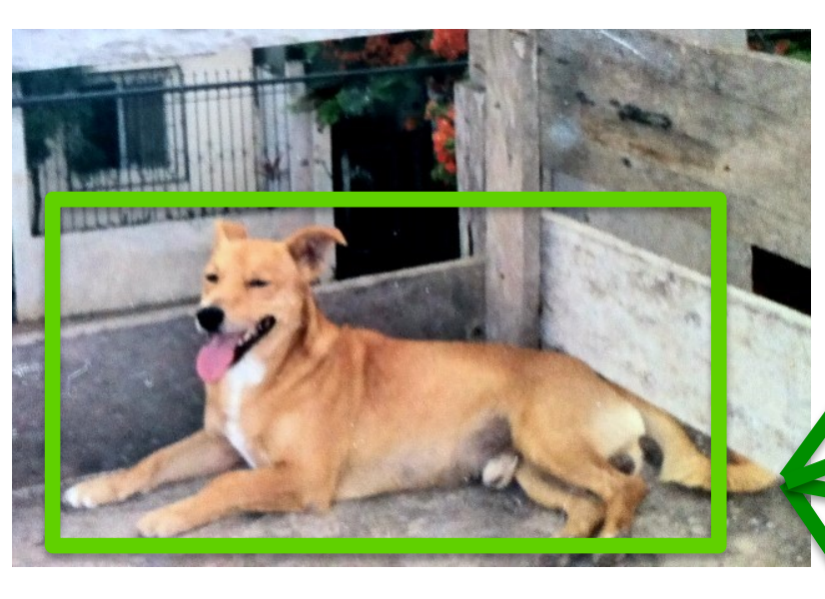
Distributional Semantics
Dogs are man’s best friend.
I saw a dog on a leash walking in the park.
friend
leash
park
walking
walks
food
legs
runs
sleeps
sits
…
His dog is his best companion.
He walks his dog in the late afternoon
…
dog
$$[3 2 3 4 2 4 3 5 6 7 …]$$
What we see

Slide 11
Distributional Semantics
food
walks
window
runs
mouse
invented
legs
sleeps
mirror
tail
…
dog
cat
person
$$[5 5 0 5 0 0 5 5 0 2 …]$$
$$[5 4 1 4 2 0 3 4 0 3 … ]$$
$$[5 5 1 5 0 2 5 5 0 0 …]$$
This vocabulary can be extremely large
What we see

Slide 12
Toward more Compact Representations
food
walks
window
runs
mouse
invented
legs
sleeps
mirror
tail
…
dog
cat
person
$$[5 5 0 5 0 0 5 5 0 2 …]$$
$$[5 4 1 4 2 0 3 4 0 3 … ]$$
$$[5 5 1 5 0 2 5 5 0 0 …]$$
This vocabulary can be extremely large
What we see

Slide 13
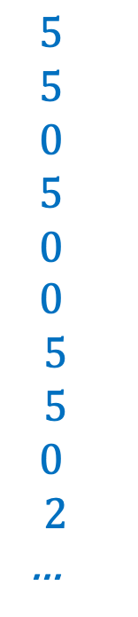
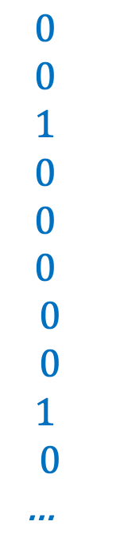
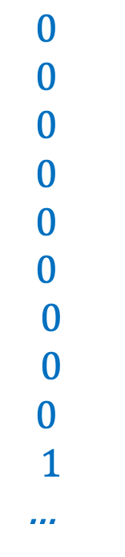
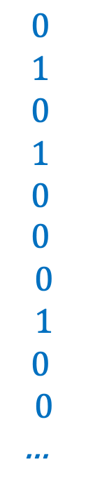
Toward more Compact Representations
$$5$$
$$5$$
$$0$$
$$5$$
$$0$$
$$0$$
$$5$$
$$5$$
$$0$$
$$2$$
…
$$0$$
$$1$$
$$0$$
$$1$$
$$0$$
$$0$$
$$0$$
$$1$$
$$0$$
$$0$$
…
$$0$$
$$0$$
$$0$$
$$0$$
$$0$$
$$0$$
$$0$$
$$0$$
$$0$$
$$1$$
…
$$0$$
$$0$$
$$1$$
$$0$$
$$0$$
$$0$$
$$0$$
$$0$$
$$1$$
$$0$$
…
dog =
=
w1
+ w2
+ w3
+ …
What we see
legs, running, walking
tail, fur,
ears
mirror, window, door

Slide 14
Toward more Compact Representations
dog =
w1
w2
w3
The basis vectors can be found using Principal Component Analysis (PCA)
This is known as Latent Semantic Analysis sometimes in NLP, maybe not anymore?
What we see

Slide 15
Toward more Compact Representations: Word Embeddings
dog =
w1
w2
w3
The weights w1, …, wn are found using a neural network
Word2Vec: https://arxiv.org/abs/1301.3781
What we see

Slide 16



Word2Vec – CBOW Version
First, create a huge matrix of word embeddings initialized with random values – where each row is a vector for a different word in the vocabulary.
d
$$w_{1}$$
$$w_{2}$$
n
…
$$w_{n}$$

Slide 17
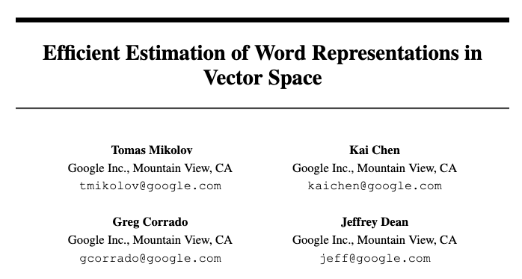

Slide 18
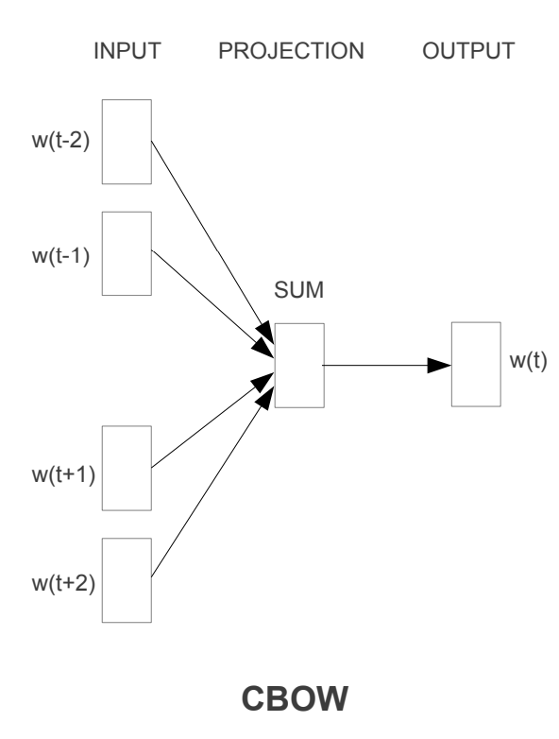



Word2Vec – CBOW Version
Then, collect a lot of text, and solve the following regression problem for a large corpus of text:
d
“the big dog drinks water”
$$w_{1}$$
the
$$w_{2}$$
big
n
…
dog
drinks
water
$$w_{n}$$

Slide 19
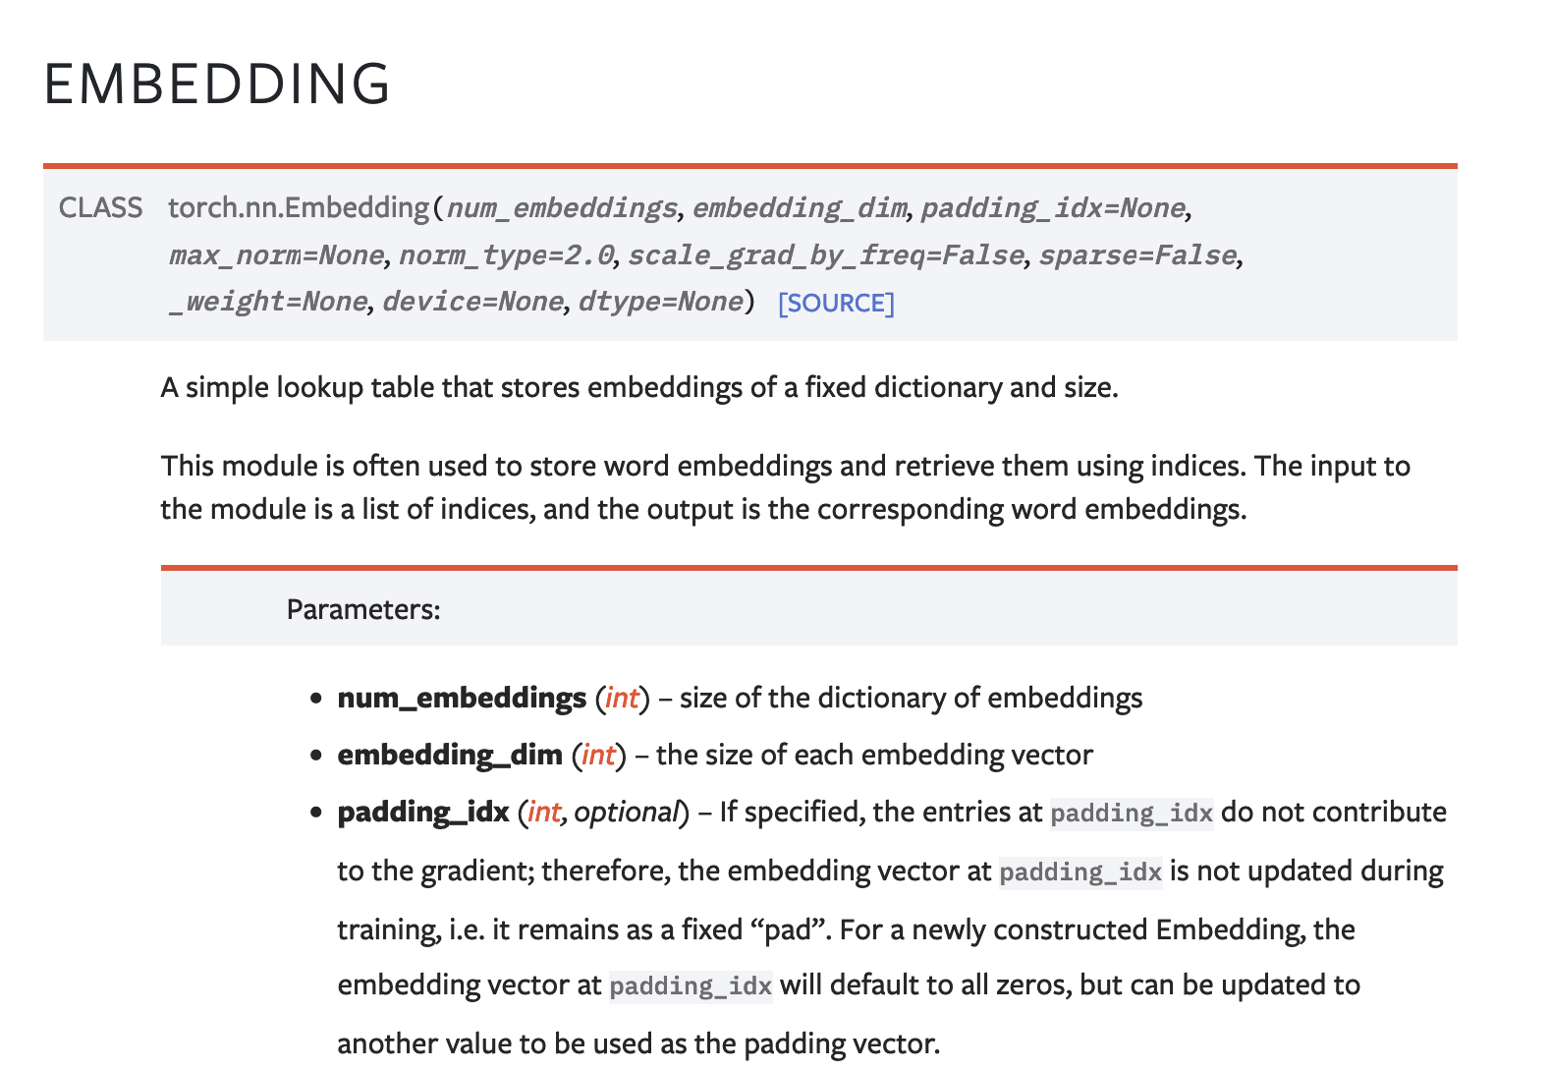
The Embedding Layer nn.Embedding

Slide 20
The Embedding Layer nn.Embedding
d
dog
cat
apple
work#
the
nn.Embedding(n, d)
n
…
under
wizard
zealot

Slide 21
Pre-trained Language Models
1-hot vectors
The
big
dog
plays
with
a
ball

Slide 22
Pre-trained Language Models
Transformer Model
1-hot vectors
The
big
dog
plays
with
a
ball

Slide 23
Pre-trained Language Models
y = dog
Softmax classifier
across n possible words
Transformer Model
1-hot vectors
The
big
plays
with
a
ball

Slide 24
Pre-trained Language Models
y = with
Softmax classifier
across n possible words
Transformer Model
1-hot vectors
The
big
dog
plays
a
ball

Slide 25
Pre-trained Language Models
y₁ = big
y₂ = with
Softmax classifier
across n possible words
Softmax classifier
across n possible words
Transformer Model
1-hot vectors
The
dog
plays
a
ball

Slide 26
Generative Language Models
y = ball
Softmax classifier
across n possible words
Transformer Model
1-hot vectors
The
big
dog
plays
with
a

Slide 27
Practical Issues - Tokenization
For each text representation we usually need to separate a sentence into tokens – we have assumed words in this lecture (or pairs of words) – but tokens could also be characters and anything in-between.
Word segmentation can be used as tokenization.
In the assignment I was lazy I just did “my sentence”.split(“ “) and called it a day.
However, even English is more difficult than that because of punctuation, double spaces, quotes, etc. For English I would recommend you too look up the great word tokenization tools in libraries such as Python’s NLTK and Spacy before you try to come up with your own word tokenizer.

Slide 28
Issues with Word based Tokenization
We already mentioned that tokenization can be hard even when word-based for other languages that don’t use spaces in-between words.
Word tokenization can also be bad for languages where the words can be “glued” together like German or Turkish.
Remember fünf­hundert­fünf­und­fünfzig? It wouldn’t be feasible to have a word embedding for every number in the German language.
It is problematic to handle words that are not in the vocabulary e.g. a common practice is to use a special <OOV> (out of vocabulary) token for those words that don’t show up in the vocabulary.

Slide 29
Tokenization can be complex
Think of Japanese
Three vocabularies/sets of symbols: Katakana and Hiragana symbols represent syllables / sounds く= ku, ぎ = gi, ナ = na, ア= a Kanji represent ideas / words (Chinese characters).
日 = day, sun, 大 = big, 凸= convex 凹 = concave
They can be combined – e.g. tomorrow = 明日
Each symbol also has some structure within the symbols. They are not independently created. e.g. bright= 明るい , rising sun = 旭
And of course there are no spaces in between the characters.

Slide 30
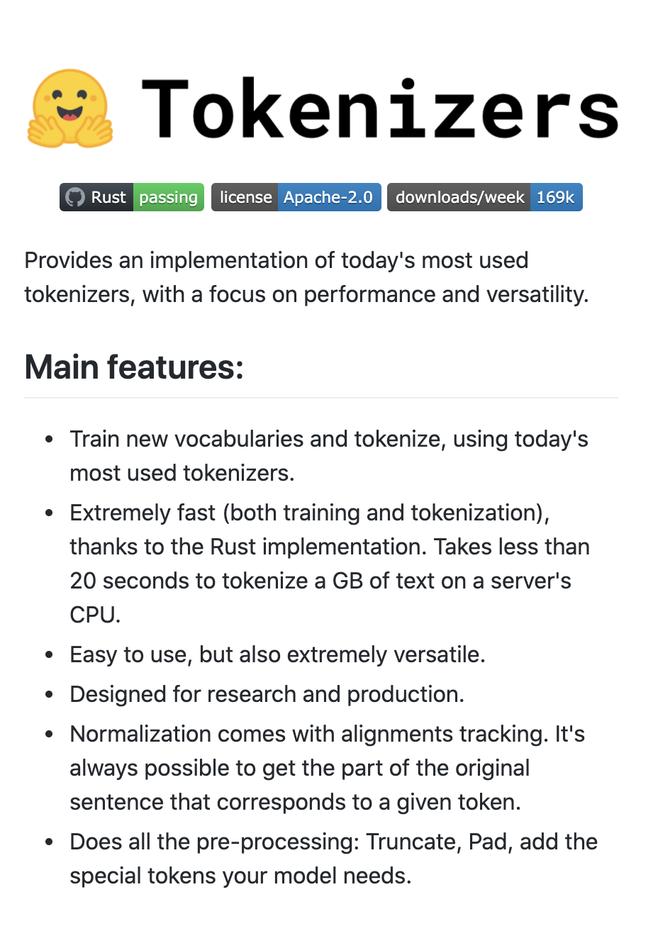
Solution: Sub-word Tokenization
Byte-pair Encoding Tokenization (BPE)
Start from small strings and based on substring counts iteratively use larger sequences until you define a vocabulary that maximizes informative subtokens. That way most will correspond to words at the end.
Byte-level BPE Tokenizer
Do the same but at the byte representation level not at the substring representation level.
huggingface/tokenizers

Slide 31
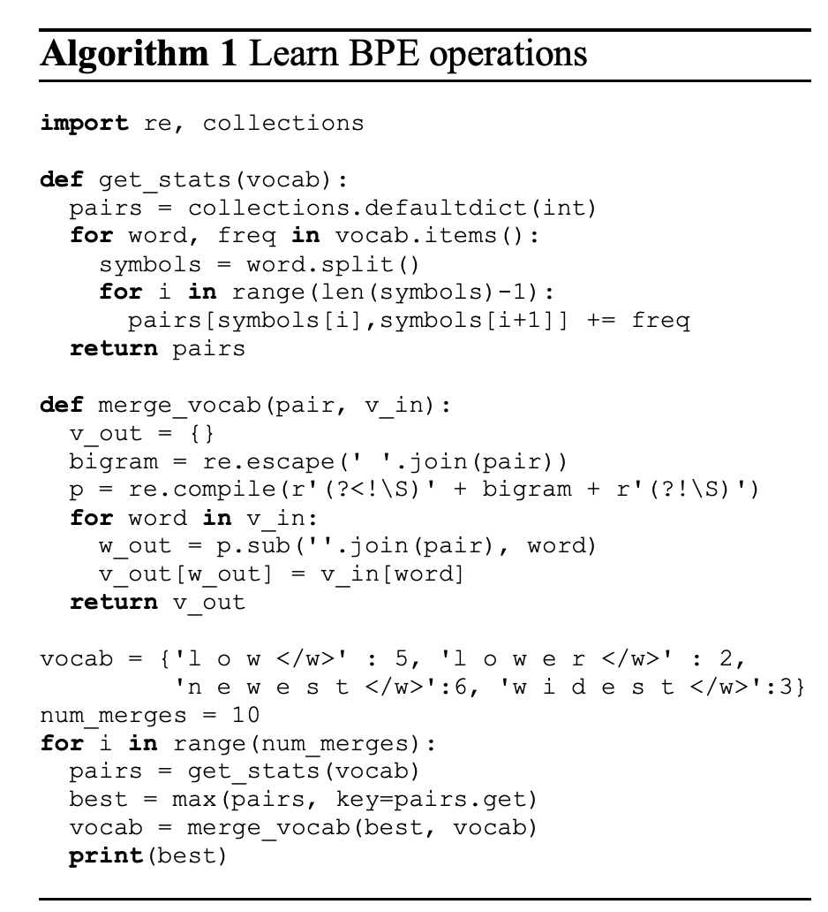

BPE Tokenization Overview
Learn BPE operations (python code on the right) – from the paper.
Use said operations to construct your sub-word vocabulary.
Treat each sub-word token as a “word” in any models we will discuss.
https://colab.research.google.com/drive/1gUjL_h2tXdTtPSfxbBP-6MkE_BMck6gm?usp=sharing

Slide 32
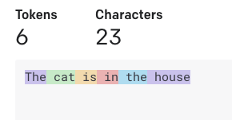
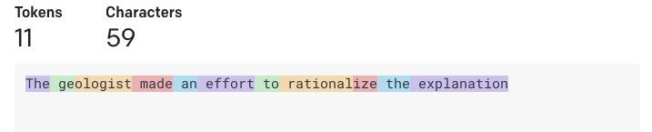

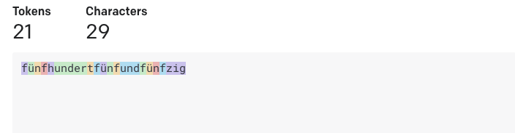
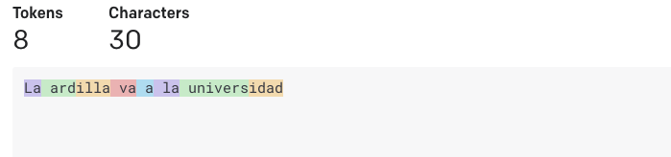


Tokenization used in GPT-3
https://platform.openai.com/tokenizer
The cat is in the house
The geologist made an effort to rationalize the explanation
fünf­hundert­fünf­und­fünfzig
La ardilla va a la universidad

Slide 33
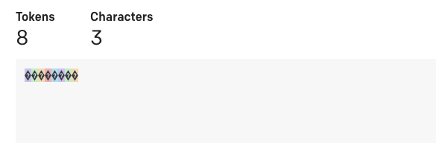

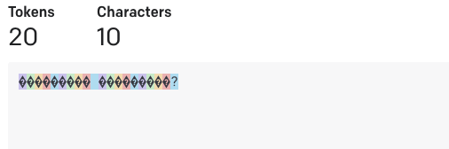
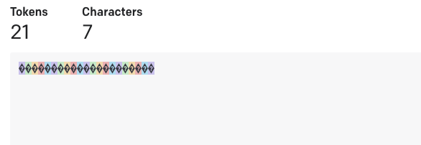

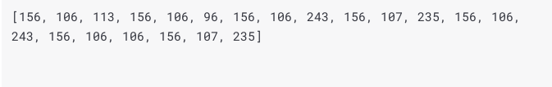
Tokenization used in GPT-3
https://platform.openai.com/tokenizer
深層学
কেমন আছেন?
வணக்கம்

Slide 34
Recurrent Neural Networks
These are models for handling sequences of things.
Each input is not a vector but a sequence of input vectors.
e.g. Each input can be a “word embedding” or any “word” representation – we will use in our first examples one-hot encoded tokens but in practice continuous dense word embeddings are used.

Slide 35





Recurrent Neural Network Cell
$$h_{1}=tanh⁡(W_{hh}h_{0}+W_{hx}x_{1})$$
$$h_{0}$$
$$RNN$$
$$h_{1}$$
$$x_{1}$$

Slide 36




Recurrent Neural Network Cell
$$y_{1}$$
$$h_{1}$$
$$h_{0}$$
$$RNN$$
$$h_{1}$$
$$h_{1}=tanh⁡(W_{hh}h_{0}+W_{hx}x_{1})$$
$$x_{1}$$
$$y_{1}=softmax⁡(W_{hy}h_{1})$$

Slide 37





Recurrent Neural Network Cell
$$y_{1}=[0.1, 0.05, 0.05, 0.1, 0.7]$$
$$h_{1}=[0.1 0.2 0 −0.3 −0.1 ]$$
$$h_{0}=[0 0 0 0 0 0 0 ]$$
$$RNN$$
$$h_{1}=[0.1 0.2 0 −0.3 −0.1 ]$$
$$h_{1}=tanh⁡(W_{hh}h_{0}+W_{hx}x_{1})$$
$$x_{1}= [0 0 1 0 0]$$
$$y_{1}=softmax⁡(W_{hy}h_{1})$$

Slide 38

Recurrent Neural Network Cell
$$y_{1}=[0.1, 0.05, 0.05, 0.1, 0.7]$$
e (0.7)
$$h_{1}=[0.1 0.2 0 −0.3 −0.1 ]$$
$$h_{0}=[0 0 0 0 0 0 0 ]$$
$$RNN$$
$$h_{1}=[0.1 0.2 0 −0.3 −0.1 ]$$
$$x_{1}= [0 0 1 0 0]$$
c
a b c d e

Slide 39
Recurrent Neural Network Cell
$$y_{1}$$
$$h_{1}$$
$$h_{0}$$
$$RNN$$
$$h_{1}$$
$$h_{1}=tanh⁡(W_{hh}h_{0}+W_{hx}x_{1})$$
$$x_{1}$$
$$y_{1}=softmax⁡(W_{hy}h_{1})$$

Slide 40
Recurrent Neural Network Cell
$$h_{1}$$
$$h_{0}$$
$$RNN$$
$$h_{1}$$
$$h_{1}=tanh⁡(W_{hh}h_{0}+W_{hx}x_{1})$$
$$x_{1}$$

Slide 41
Recurrent Neural Network Cell
$$h_{0}$$
$$RNN$$
$$h_{1}$$
$$h_{1}=tanh⁡(W_{hh}h_{0}+W_{hx}x_{1})$$
$$x_{1}$$

Slide 42
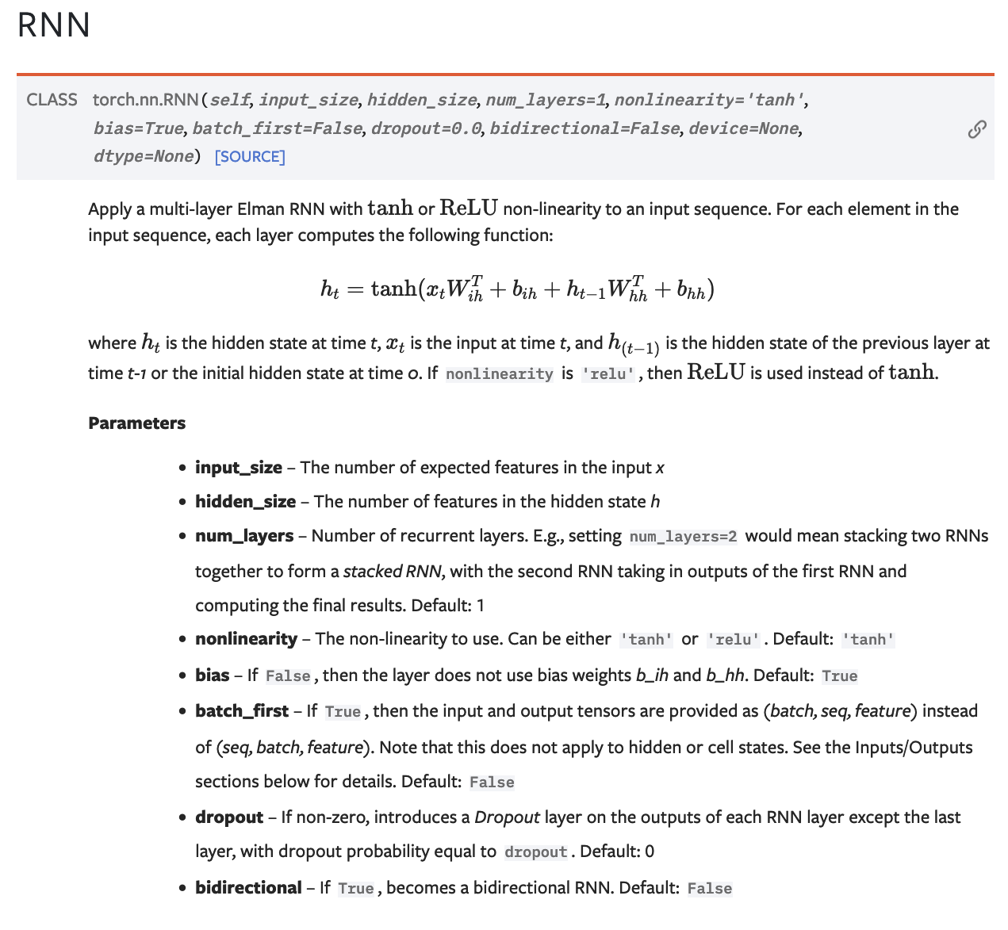
Pytorch RNN

Slide 43
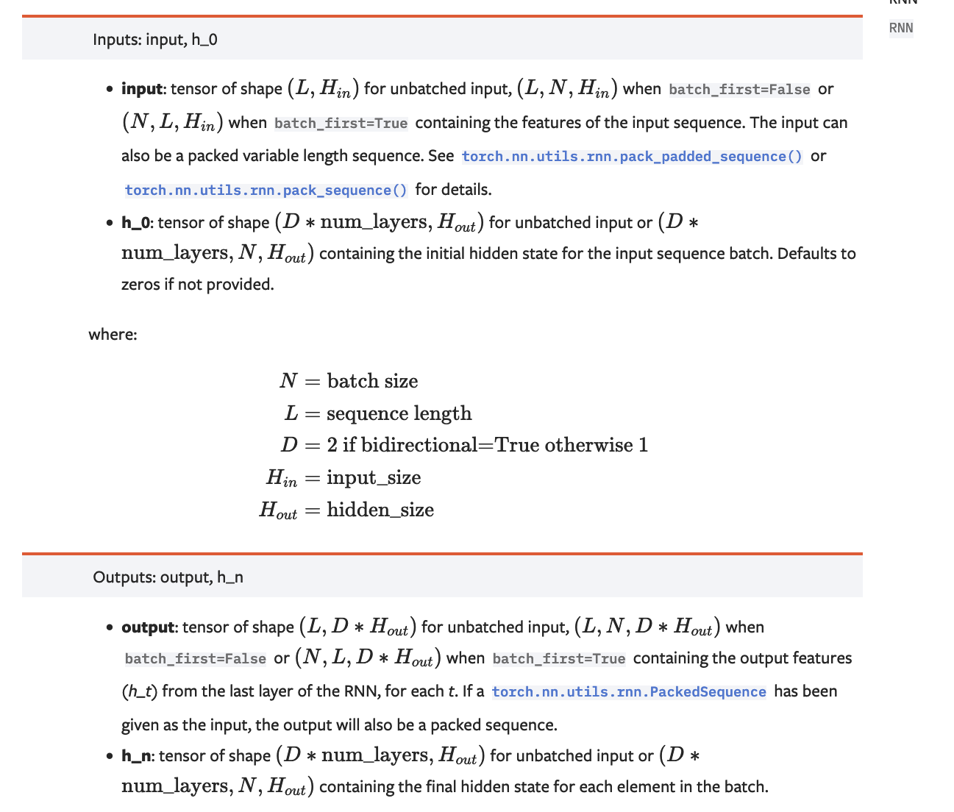

Slide 44










(Unrolled) Recurrent Neural Network
$$h_{0}$$
$$RNN$$
$$h_{1}$$
$$h_{2}$$
$$h_{3}$$
$$RNN$$
$$RNN$$
$$x_{1}$$
$$x_{2}$$
$$x_{3}$$

Slide 45






How can it be used? – e.g. Tagging a Text Sequence One-to-one Sequence Mapping Problems
<<possessive>>
<<noun>>
<<verb>>
$$y_{1}$$
$$y_{2}$$
$$y_{3}$$
$$h_{1}$$
$$h_{2}$$
$$h_{3}$$
$$h_{0}$$
$$RNN$$
$$h_{1}$$
$$h_{2}$$
$$h_{3}$$
$$RNN$$
$$RNN$$
$$x_{1}$$
$$x_{2}$$
$$x_{3}$$
my
car
works

Slide 46
How can it be used? – e.g. Tagging a Text Sequence One-to-one Sequence Mapping Problems
Training examples don’t need to be the same length!
input
output
my car works
<<possessive>> <<noun>> <<verb>>
my dog ate the assignment
<<possessive>> <<noun>> <<verb>> <<pronoun>> <<noun>>
my mother saved the day
<<possessive>> <<noun>> <<verb>> <<pronoun>> <<noun>>
the smart kid solved the problem
<<pronoun>> <<qualifier>> <<noun>> <<verb>> <<pronoun>> <<noun>>

Slide 47
How can it be used? – e.g. Tagging a Text Sequence One-to-one Sequence Mapping Problems
Training examples don’t need to be the same length!
input
output
L(my car works) = 3
L (<<possessive>> <<noun>> <<verb>>) = 3
L( my dog ate the assignment ) = 5
L (<<possessive>> <<noun>> <<verb>> <<pronoun>> <<noun>>) = 5
L( my mother saved the day ) = 5
L (<<possessive>> <<noun>> <<verb>> <<pronoun>> <<noun>>) = 5
L( the smart kid solved the problem ) = 6
L (<<pronoun>> <<qualifier>> <<noun>> <<verb>> <<pronoun>> <<noun>>) = 6

Slide 48
How can it be used? – e.g. Tagging a Text Sequence One-to-one Sequence Mapping Problems
Training examples don’t need to be the same length!
If we assume a vocabulary of a 1000 possible words and 20 possible output tags
input
output
T: 1000 x 3
T: 20 x 3
T: 1000 x 5
T: 20 x 5
T: 1000 x 5
T: 20 x 5
T: 1000 x 6
T: 20 x 6

Slide 49
How can it be used? – e.g. Tagging a Text Sequence One-to-one Sequence Mapping Problems
Training examples don’t need to be the same length!
If we assume a vocabulary of a 1000 possible words and 20 possible output tags
input
output
T: 1000 x 3
T: 20 x 3
T: 1000 x 5
T: 20 x 5
T: 1000 x 5
T: 20 x 5
T: 1000 x 6
T: 20 x 6
How do we create batches if inputs and outputs have different shapes?

Slide 50
How can it be used? – e.g. Tagging a Text Sequence One-to-one Sequence Mapping Problems
Training examples don’t need to be the same length!
If we assume a vocabulary of a 1000 possible words and 20 possible output tags
input
output
T: 1000 x 3
T: 20 x 3
T: 1000 x 5
T: 20 x 5
T: 1000 x 5
T: 20 x 5
T: 1000 x 6
T: 20 x 6
How do we create batches if inputs and outputs have different shapes?
Solution 1: Forget about batches, just process things one by one.

Slide 51
How can it be used? – e.g. Tagging a Text Sequence One-to-one Sequence Mapping Problems
Training examples don’t need to be the same length!
If we assume a vocabulary of a 1000 possible words and 20 possible output tags
input
output
T: 1000 x 3
T: 20 x 3
T: 1000 x 5
T: 20 x 5
T: 1000 x 5
T: 20 x 5
T: 1000 x 6
T: 20 x 6
How do we create batches if inputs and outputs have different shapes?
Solution 2: Zero padding.
We can put the above vectors in
T: 4 x 1000 x 6

Slide 52












How can it be used? – e.g. Scoring the Sentiment of a Text Sequence Many-to-one Sequence to score problems
positive / negative sentiment rating
$$y_{}$$
$$h_{n}$$
$$h_{0}$$
$$RNN$$
$$h_{1}$$
$$h_{2}$$
…
$$RNN$$
$$h_{n}$$
$$RNN$$
$$RNN$$
$$x_{1}$$
$$x_{2}$$
$$x_{3}$$
$$x_{n}$$
the
cat
likes
<<EOS>>

Slide 53
How can it be used? – e.g. Sentiment Scoring Many to one Mapping Problems
Input training examples don’t need to be the same length! In this case outputs can be.
input
output
this restaurant has good food
Positive
this restaurant is bad
Negative
this restaurant is the worst
Negative
this restaurant is well recommended
Positive

Slide 54
























How can it be used? – e.g. Text Generation Auto-regressive model – Sequence to Sequence during Training, Auto-regressive during test
DURING TRAINING
The
world
is
not
enough
<END>
$$y_{1}$$
$$y_{2}$$
$$y_{3}$$
$$y_{4}$$
$$y_{5}$$
$$y_{6}$$
$$h_{1}$$
$$h_{2}$$
$$h_{3}$$
$$h_{4}$$
$$h_{5}$$
$$h_{6}$$
$$h_{0}$$
RNN
$$h_{1}$$
RNN
$$h_{2}$$
RNN
$$h_{3}$$
RNN
$$h_{4}$$
RNN
$$h_{5}$$
RNN
$$x_{1}$$
$$x_{2}$$
$$x_{3}$$
$$x_{4}$$
$$x_{5}$$
$$x_{6}$$
<START>
The
world
is
not
enough

Slide 55
How can it be used? – e.g. Text Generation Auto-regressive Models
Input training examples don’t need to be the same length! In this case outputs can be.
input
output
<START> this restaurant has good food
this restaurant has good food <END>
<START> this restaurant is bad
this restaurant is bad <END>
<START> this restaurant is the worst
this restaurant is the worst <END>
<START> this restaurant is well recommended
this restaurant is well recommended <END>

Slide 56
How can it be used? – e.g. Text Generation Auto-regressive model – Sequence to Sequence during Training, Auto-regressive during test
DURING TESTING
$$h_{0}$$
RNN
$$x_{1}$$
<START>

Slide 57
How can it be used? – e.g. Text Generation Auto-regressive model – Sequence to Sequence during Training, Auto-regressive during test
DURING TESTING
The
$$y_{1}$$
$$h_{1}$$
$$h_{0}$$
RNN
$$h_{1}$$
$$x_{1}$$
<START>

Slide 58
How can it be used? – e.g. Text Generation Auto-regressive model – Sequence to Sequence during Training, Auto-regressive during test
DURING TESTING
The
$$y_{1}$$
$$h_{1}$$
$$h_{0}$$
RNN
$$h_{1}$$
RNN
$$x_{1}$$
$$x_{2}$$
<START>

Slide 59
How can it be used? – e.g. Text Generation Auto-regressive model – Sequence to Sequence during Training, Auto-regressive during test
DURING TESTING
The
world
$$y_{1}$$
$$y_{2}$$
$$h_{1}$$
$$h_{2}$$
$$h_{0}$$
RNN
$$h_{1}$$
RNN
$$h_{2}$$
$$x_{1}$$
$$x_{2}$$
<START>

Slide 60
How can it be used? – e.g. Text Generation Auto-regressive model – Sequence to Sequence during Training, Auto-regressive during test
DURING TESTING
The
world
is
not
enough
<END>
$$y_{1}$$
$$y_{2}$$
$$y_{3}$$
$$y_{4}$$
$$y_{5}$$
$$y_{6}$$
$$h_{1}$$
$$h_{2}$$
$$h_{3}$$
$$h_{4}$$
$$h_{5}$$
$$h_{6}$$
$$h_{0}$$
RNN
$$h_{1}$$
RNN
$$h_{2}$$
RNN
$$h_{3}$$
RNN
$$h_{4}$$
RNN
$$h_{5}$$
RNN
$$x_{1}$$
$$x_{2}$$
$$x_{3}$$
$$x_{4}$$
$$x_{5}$$
$$x_{6}$$
<START>

Slide 61











How can it be used? – e.g. Machine Translation Sequence to Sequence – Encoding – Decoding – Many to Many mapping
DURING TRAINING
The
world
is
not
enough
<END>
$$y_{1}$$
$$y_{2}$$
$$y_{3}$$
$$y_{4}$$
$$y_{5}$$
$$y_{6}$$
$$h_{1}$$
$$h_{2}$$
$$h_{3}$$
$$h_{4}$$
$$h_{5}$$
$$h_{6}$$
$$h_{0}$$
RNN
$$h_{1}$$
RNN
$$h_{2}$$
RNN
$$h_{3}$$
RNN
$$h_{4}$$
RNN
$$h_{5}$$
RNN
$$h_{0}$$
RNN
$$h_{1}$$
RNN
$$h_{2}$$
RNN
$$h_{3}$$
RNN
$$h_{4}$$
RNN
$$h_{5}$$
RNN
$$x_{1}$$
$$x_{2}$$
$$x_{3}$$
$$x_{4}$$
$$x_{5}$$
$$x_{6}$$
$$x_{1}$$
$$x_{2}$$
$$x_{3}$$
$$x_{4}$$
$$x_{5}$$
$$x_{6}$$
<START>
El
mundo
no
es
suficiente
<START>
The
world
is
not
enough

Slide 62
How can it be used? – e.g. Machine Translation
Sequence to Sequence Models
Input training examples don’t need to be the same length! In this case outputs can be.
input
output
<START> este restaurante tiene buena comida
this restaurant has good food <END>
<START> this restaurant has good food
<START> el mundo no es suficiente
the world is not enough <END>
<START> the world is not enough

Slide 63











How can it be used? – e.g. Machine Translation Sequence to Sequence – Encoding – Decoding – Many to Many mapping
DURING TRAINING – (Alternative)
The
world
is
not
enough
<END>
$$y_{1}$$
$$y_{2}$$
$$y_{3}$$
$$y_{4}$$
$$y_{5}$$
$$y_{6}$$
$$h_{1}$$
$$h_{2}$$
$$h_{3}$$
$$h_{4}$$
$$h_{5}$$
$$h_{6}$$
$$h_{0}$$
RNN
$$h_{1}$$
RNN
$$h_{2}$$
RNN
$$h_{3}$$
RNN
$$h_{4}$$
RNN
$$h_{5}$$
RNN
$$x_{1}$$
$$x_{2}$$
$$x_{3}$$
$$x_{4}$$
$$x_{5}$$
$$x_{6}$$
The
world
is
not
enough
$$h_{0}$$
RNN
$$h_{1}$$
RNN
$$h_{2}$$
RNN
$$h_{3}$$
RNN
$$h_{4}$$
RNN
$$h_{5}$$
RNN
$$x_{1}$$
$$x_{2}$$
$$x_{3}$$
$$x_{4}$$
$$x_{5}$$
$$x_{6}$$
<START>
El
mundo
no
es
suficiente

Slide 64
Problems
Long Sequences lead to vanishing
Hidden states can not carry information in a long sequence (Telephone Game problem)

Slide 65
Solutions Proposed
Use another hidden state variable and experiment with more complex transition functions than h = tanh(W₁h + W₂x).
Read about LSTMs, GRUs, etc

Slide 66





LSTM Cell (Long Short-Term Memory)
$$h_{0}$$
$$h_{1}$$
$$LSTM$$
$$c_{0}$$
$$c_{1}$$
$$x_{1}$$

Slide 67
Solutions Proposed
Use another hidden state variable and experiment with more complex transition functions than h = tanh(W₁h + W₂x).
Read about LSTMs, GRUs, etc
Encode the sentences both from left-to-right and right-to-left using two RNNs and combine the final hidden states from each direction.
Read about Bidirectional RNNs (BiRNNs), BiLSTMs, BiGRUs

Slide 68
















Bidirectional Recurrent Neural Network
<<pronoun>>
<<noun>>
<<verb>>
$$y_{1}$$
$$y_{2}$$
$$y_{3}$$
$$h_{1}$$
$$h_{2}$$
$$h_{3}$$
$$h_{0}$$
$$BRNN$$
$$h_{1}$$
$$BRNN$$
$$h_{2}$$
$$BRNN$$
$$h_{3}$$
$$x_{1}$$
$$x_{2}$$
$$x_{3}$$
the
cat
wants

Slide 69
Solutions Proposed
Use another hidden state variable and experiment with more complex transition functions than h = tanh(W₁h + W₂x).
Read about LSTMs, GRUs, etc
Encode the sentences both from left-to-right and right-to-left using two RNNs and combine the final hidden states from each direction.
Read about Bidirectional RNNs (BiRNNs), BiLSTMs, BiGRUs
Stack RNNs, use an RNN that feeds its output states to another RNN and this second RNN outputs the final output states.
Stacked RNNs, or Deep RNNs.

Slide 70


























Stacked Recurrent Neural Network
$$y_{1}$$
$$y_{2}$$
$$y_{3}$$
$$h_{1}$$
$$h_{2}$$
$$h_{3}$$
$$h_{0}$$
$$RNN$$
$$h_{1}$$
$$RNN$$
$$h_{2}$$
$$RNN$$
$$h_{3}$$
$${\check{h}}_{1}$$
$${\check{h}}_{2}$$
$${\check{h}}_{3}$$
$${\check{h}}_{0}$$
$$RNN$$
$${\check{h}}_{1}$$
$$RNN$$
$${\check{h}}_{2}$$
$$RNN$$
$${\check{h}}_{3}$$
$$x_{1}$$
$$x_{2}$$
$$x_{3}$$
c
a
t

Slide 71
Stacked Bidirectional Recurrent Neural Network
$$y_{1}$$
$$y_{2}$$
$$y_{3}$$
$$h_{1}$$
$$h_{2}$$
$$h_{3}$$
$$h_{0}$$
$$RNN$$
$$h_{1}$$
$$RNN$$
$$h_{2}$$
$$RNN$$
$$h_{3}$$
$${\check{h}}_{1}$$
$${\check{h}}_{2}$$
$${\check{h}}_{3}$$
$${\check{h}}_{0}$$
$$RNN$$
$${\check{h}}_{1}$$
$$RNN$$
$${\check{h}}_{2}$$
$$RNN$$
$${\check{h}}_{3}$$
$$x_{1}$$
$$x_{2}$$
$$x_{3}$$
c
a
t

Slide 72
Best Solution: Learning Attention Weights

Slide 73












RNNs – Sequence to score prediction
Classify
[English, German, Swiss German, Gaelic, Dutch, Afrikaans, Luxembourgish, Limburgish, other]
$$y_{6}$$
$$h_{6}$$
$$h_{0}$$
RNN
$$h_{1}$$
RNN
$$h_{2}$$
RNN
$$h_{3}$$
RNN
$$h_{4}$$
RNN
$$h_{5}$$
RNN
$$x_{1}$$
$$x_{2}$$
$$x_{3}$$
$$x_{4}$$
$$x_{5}$$
$$x_{6}$$
<START>
El
mundo
no
es
suficiente

Slide 74
RNNs for Text Generation (Auto-regressive)
The
world
is
not
enough
<END>
$$y_{1}$$
$$y_{2}$$
$$y_{3}$$
$$y_{4}$$
$$y_{5}$$
$$y_{6}$$
$$h_{1}$$
$$h_{2}$$
$$h_{3}$$
$$h_{4}$$
$$h_{5}$$
$$h_{6}$$
$$h_{0}$$
RNN
$$h_{1}$$
RNN
$$h_{2}$$
RNN
$$h_{3}$$
RNN
$$h_{4}$$
RNN
$$h_{5}$$
RNN
$$x_{1}$$
$$x_{2}$$
$$x_{3}$$
$$x_{4}$$
$$x_{5}$$
$$x_{6}$$
<START>
The
world
is
not
enough
+ Noise vector

Slide 75

RNNs for Machine Translation Seq-to-Seq
The
world
is
not
enough
<END>
$$y_{1}$$
$$y_{2}$$
$$y_{3}$$
$$y_{4}$$
$$y_{5}$$
$$y_{6}$$
$$h_{1}$$
$$h_{2}$$
$$h_{3}$$
$$h_{4}$$
$$h_{5}$$
$$h_{6}$$
$$h_{0}$$
RNN
$$h_{1}$$
RNN
$$h_{2}$$
RNN
$$h_{3}$$
RNN
$$h_{4}$$
RNN
$$h_{5}$$
RNN
$$x_{1}$$
$$x_{2}$$
$$x_{3}$$
$$x_{4}$$
$$x_{5}$$
$$x_{6}$$
The
world
is
not
enough
$$h_{6}$$
$$h_{0}$$
RNN
$$h_{1}$$
RNN
$$h_{2}$$
RNN
$$h_{3}$$
RNN
$$h_{4}$$
RNN
$$h_{5}$$
RNN
$$x_{1}$$
$$x_{2}$$
$$x_{3}$$
$$x_{4}$$
$$x_{5}$$
$$x_{6}$$
<START>
El
mundo
no
es
suficiente

Slide 76



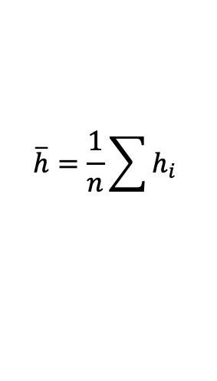




RNNs for Machine Translation Seq-to-Seq
The
world
is
not
enough
<END>
Perhaps a better idea is to
compute the average h vector across all steps
and pass this to the decoder
$$y_{1}$$
$$y_{2}$$
$$y_{3}$$
$$y_{4}$$
$$y_{5}$$
$$y_{6}$$
$$h_{1}$$
$$h_{2}$$
$$h_{3}$$
$$h_{4}$$
$$h_{5}$$
$$h_{6}$$
$$h_{0}$$
RNN
$$h_{1}$$
RNN
$$h_{2}$$
RNN
$$h_{3}$$
RNN
$$h_{4}$$
RNN
$$h_{5}$$
RNN
$$x_{1}$$
$$x_{2}$$
$$x_{3}$$
$$x_{4}$$
$$x_{5}$$
$$x_{6}$$
The
world
is
not
enough
$$\overline{h}$$
$$h_{1}$$
$$h_{2}$$
$$h_{3}$$
$$h_{4}$$
$$h_{5}$$
$$h_{6}$$
$$\overline{h}=\frac{1}{n}\sum{h_{i}}$$
$$h_{0}$$
RNN
$$h_{1}$$
RNN
$$h_{2}$$
RNN
$$h_{3}$$
RNN
$$h_{4}$$
RNN
$$h_{5}$$
RNN
$$x_{1}$$
$$x_{2}$$
$$x_{3}$$
$$x_{4}$$
$$x_{5}$$
$$x_{6}$$
<START>
El
mundo
no
es
suficiente

Slide 77
RNNs for Machine Translation Seq-to-Seq
The
world
is
not
enough
<END>
Perhaps an even better idea is to
compute the average h vector across all steps
and pass this to the decoder at each time
step in the decoder!
$$y_{1}$$
$$y_{2}$$
$$y_{3}$$
$$y_{4}$$
$$y_{5}$$
$$y_{6}$$
$$h_{1}$$
$$h_{2}$$
$$h_{3}$$
$$h_{4}$$
$$h_{5}$$
$$h_{6}$$
$$h_{0}$$
RNN
$$h_{1}$$
RNN
$$h_{2}$$
RNN
$$h_{3}$$
RNN
$$h_{4}$$
RNN
$$h_{5}$$
RNN
$$x_{1}$$
$$x_{2}$$
$$x_{3}$$
$$x_{4}$$
$$x_{5}$$
$$x_{6}$$
The
world
is
not
enough
$$\overline{h}$$
$$h_{1}$$
$$h_{2}$$
$$h_{3}$$
$$h_{4}$$
$$h_{5}$$
$$h_{6}$$
$$\overline{h}=\frac{1}{n}\sum{h_{i}}$$
$$h_{0}$$
RNN
$$h_{1}$$
RNN
$$h_{2}$$
RNN
$$h_{3}$$
RNN
$$h_{4}$$
RNN
$$h_{5}$$
RNN
$$x_{1}$$
$$x_{2}$$
$$x_{3}$$
$$x_{4}$$
$$x_{5}$$
$$x_{6}$$
<START>
El
mundo
no
es
suficiente

Slide 78
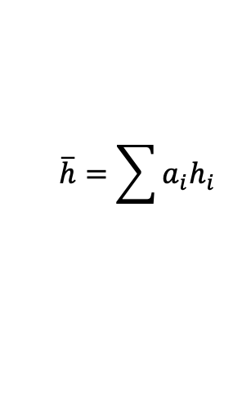
RNNs for Machine Translation Seq-to-Seq
The
world
is
not
enough
<END>
Perhaps an even better idea is to
compute the average h vector across all steps
and pass this to the decoder at each time
step in the decoder but using a weighted average
with learned weights!!
$$y_{1}$$
$$y_{2}$$
$$y_{3}$$
$$y_{4}$$
$$y_{5}$$
$$y_{6}$$
$$h_{1}$$
$$h_{2}$$
$$h_{3}$$
$$h_{4}$$
$$h_{5}$$
$$h_{6}$$
$$h_{0}$$
RNN
$$h_{1}$$
RNN
$$h_{2}$$
RNN
$$h_{3}$$
RNN
$$h_{4}$$
RNN
$$h_{5}$$
RNN
$$x_{1}$$
$$x_{2}$$
$$x_{3}$$
$$x_{4}$$
$$x_{5}$$
$$x_{6}$$
The
world
is
not
enough
$$\overline{h}$$
$$h_{1}$$
$$h_{2}$$
$$h_{3}$$
$$h_{4}$$
$$h_{5}$$
$$h_{6}$$
$$\overline{h}=\sum{a_{i}h_{i}}$$
$$h_{0}$$
RNN
$$h_{1}$$
RNN
$$h_{2}$$
RNN
$$h_{3}$$
RNN
$$h_{4}$$
RNN
$$h_{5}$$
RNN
$$x_{1}$$
$$x_{2}$$
$$x_{3}$$
$$x_{4}$$
$$x_{5}$$
$$x_{6}$$
<START>
El
mundo
no
es
suficiente

Slide 79




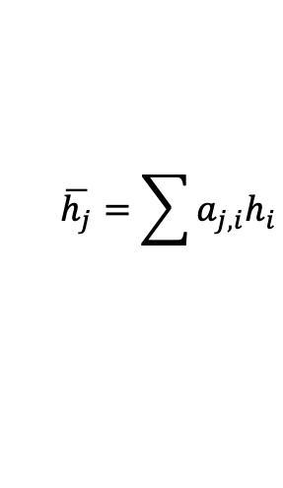






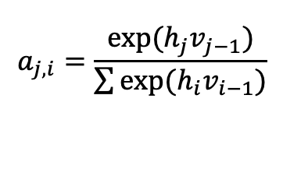
RNNs for Machine Translation Seq-to-Seq
Only showing the third time step encoder-decoder connection
The
world
is
not
enough
<END>
Perhaps an even better idea is to
compute the average h vector across all steps
and pass this to the decoder at each time
step in the decoder but using a weighted average
with learned weights, and the weights are specific
for each time step!!!
$$y_{1}$$
$$y_{2}$$
$$y_{3}$$
$$y_{4}$$
$$y_{5}$$
$$y_{6}$$
$$h_{1}$$
$$h_{2}$$
$$h_{3}$$
$$h_{4}$$
$$h_{5}$$
$$h_{6}$$
$$v_{0}$$
RNN
$$v_{1}$$
RNN
$$v_{2}$$
RNN
$$v_{3}$$
RNN
$$v_{4}$$
RNN
$$v_{5}$$
RNN
$$x_{1}$$
$$x_{2}$$
$$x_{3}$$
$$x_{4}$$
$$x_{5}$$
$$x_{6}$$
The
world
is
not
enough
$$\overline{h}$$
$$h_{1}$$
$$h_{2}$$
$$h_{3}$$
$$h_{4}$$
$$h_{5}$$
$$h_{6}$$
$$\overline{h_{j}}=\sum{a_{j,i}h_{i}}$$
RNN
RNN
RNN
RNN
RNN
RNN
such that:
$$h_{0}$$
$$h_{1}$$
$$h_{2}$$
$$h_{3}$$
$$h_{4}$$
$$h_{5}$$
$$a_{j,i}=\frac{exp⁡(h_{j}v_{j−1})}{\sum{exp⁡(h_{i}v_{i−1})}}$$
$$x_{1}$$
$$x_{2}$$
$$x_{3}$$
$$x_{4}$$
$$x_{5}$$
$$x_{6}$$
<START>
El
mundo
no
es
suficiente

Slide 80

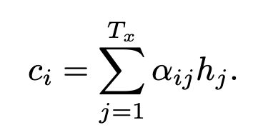
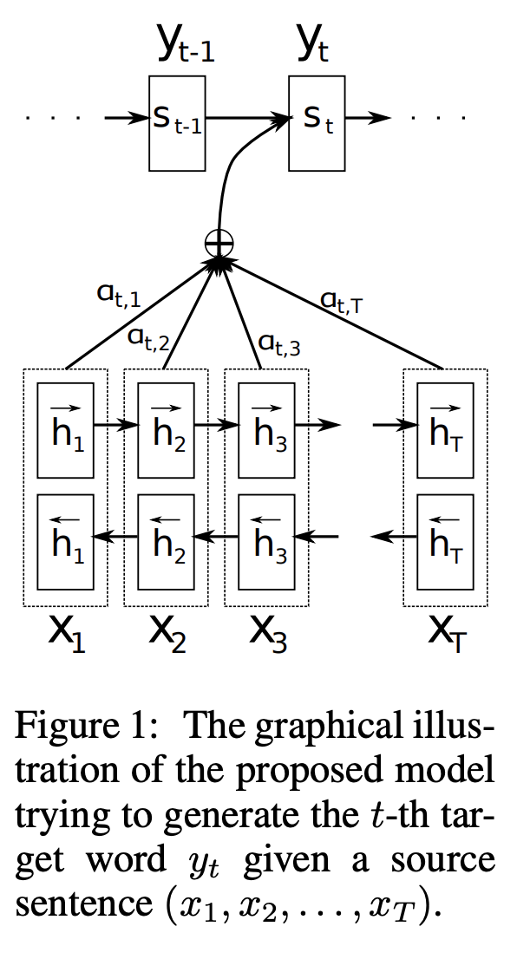
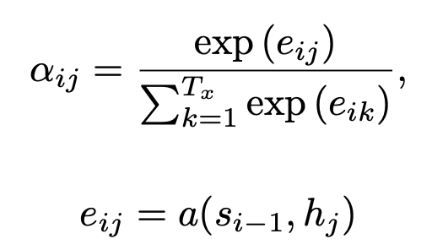
Let’s take a look at one of the first papers introducing this idea.

Slide 81
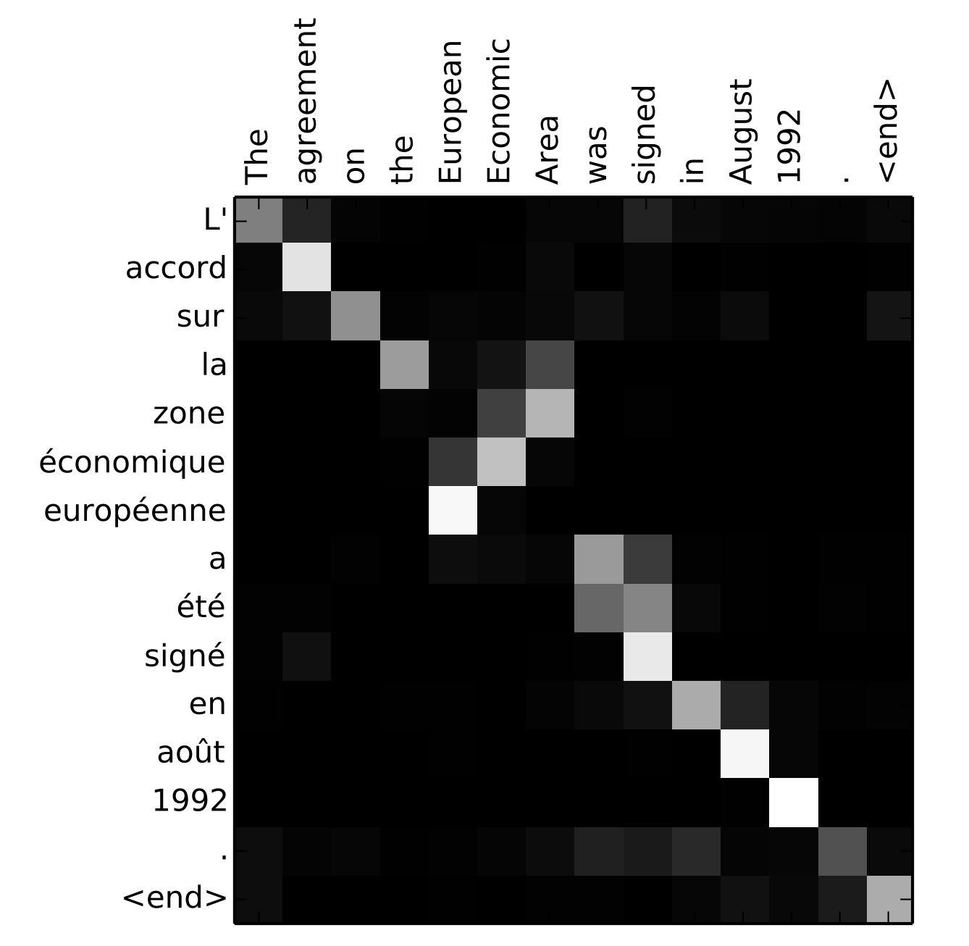
Let’s look at the Attention weights

Slide 82
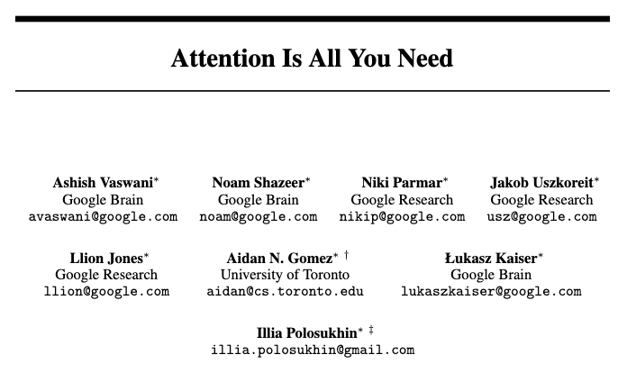
Transformers: Attention is All You Need

Slide 83
Questions?

