Slide 1
Deep Learning for Vision & Language
Natural Language Processing I: Transformers II

Slide 2
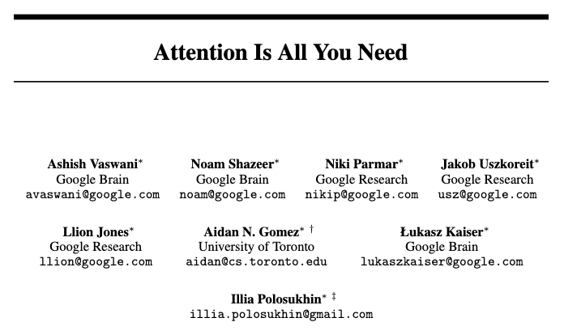
Transformers: Attention is All You Need

Slide 3
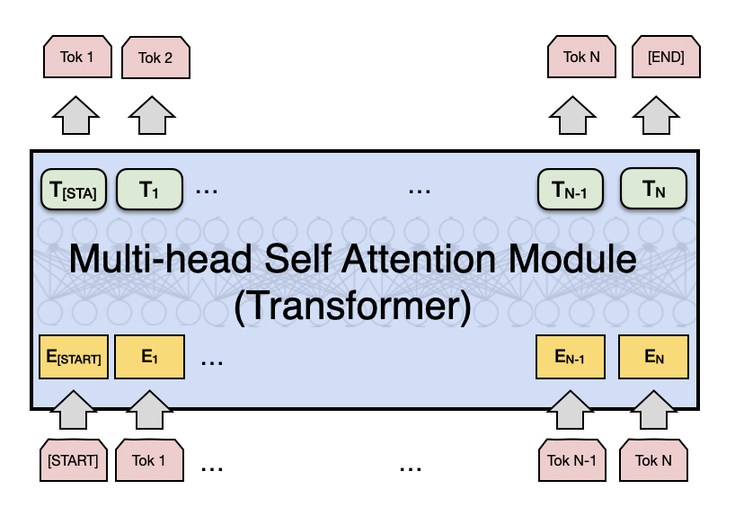
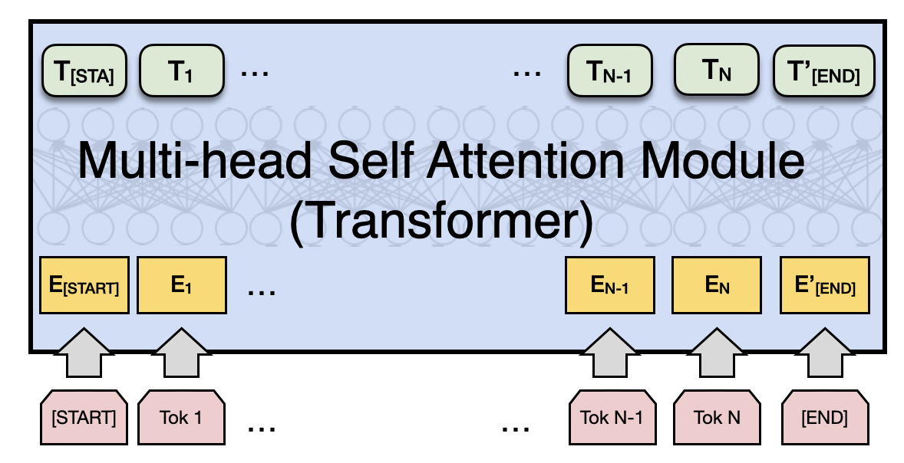
Attention is All you Need (no RNNs)
Vaswani et al. Attention is all you need
https://arxiv.org/abs/1706.03762
Decoder
Encoder
Fixed number of input tokens
[but hey! we can always define a large enough length and add mask tokens]

Slide 4
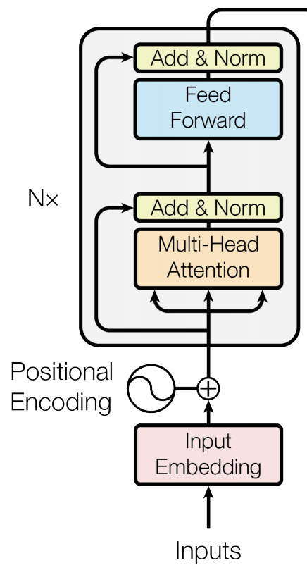
Attention is All you Need (no RNNs)
Vaswani et al. Attention is all you need
https://arxiv.org/abs/1706.03762
Decoder
Encoder
Fixed number of input tokens
[but hey! we can always define a large enough length and add mask tokens]

Slide 5
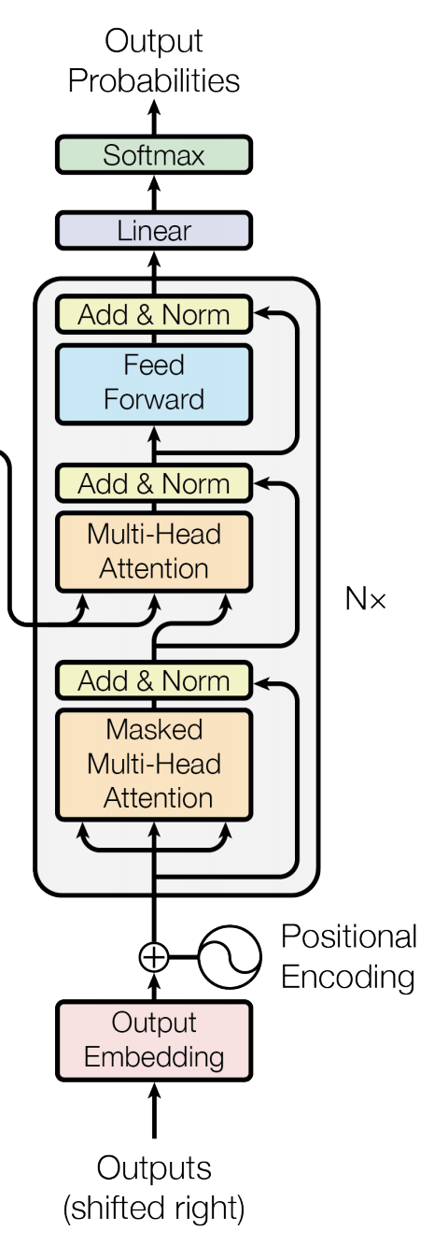
Attention is All you Need (no RNNs)
Vaswani et al. Attention is all you need
https://arxiv.org/abs/1706.03762
Decoder
Encoder
Fixed number of input tokens
[but hey! we can always define a large enough length and add mask tokens]

Slide 6
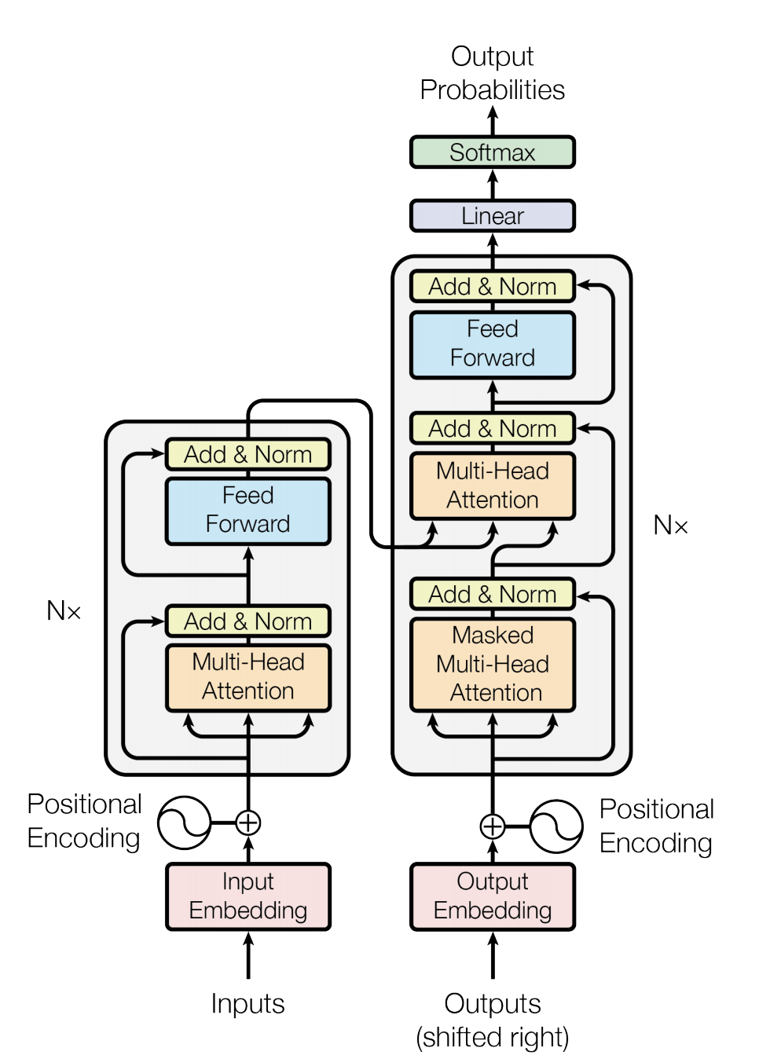
We can also draw this as in the paper:
Vaswani et al. Attention is all you need
https://arxiv.org/abs/1706.03762

Slide 7
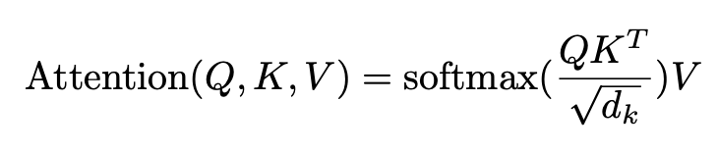
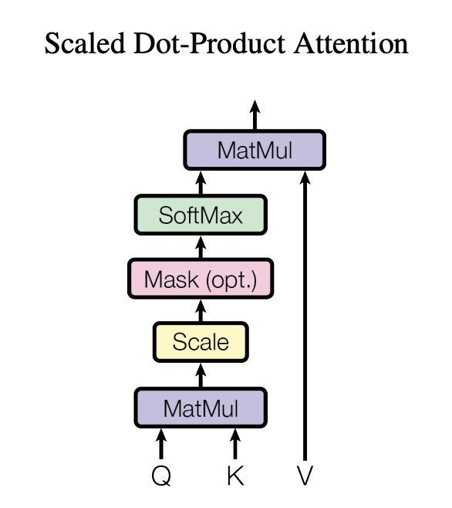
Regular Attention: + Scaling factor
Vaswani et al. Attention is all you need
https://arxiv.org/abs/1706.03762

Slide 8







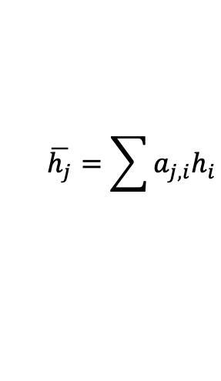









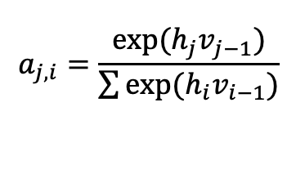

This is not unlike what we already used before
Only showing the third time step encoder-decoder connection
The
world
is
not
enough
<END>
V: those are h’s here
Q: those are h’s here
K: those are v’s here
$$y_{1}$$
$$y_{2}$$
$$y_{3}$$
$$y_{4}$$
$$y_{5}$$
$$y_{6}$$
$$h_{1}$$
$$h_{2}$$
$$h_{3}$$
$$h_{4}$$
$$h_{5}$$
$$h_{6}$$
$$v_{0}$$
RNN
$$v_{1}$$
RNN
$$v_{2}$$
RNN
$$v_{3}$$
RNN
$$v_{4}$$
RNN
$$v_{5}$$
RNN
$$x_{1}$$
$$x_{2}$$
$$x_{3}$$
$$x_{4}$$
$$x_{5}$$
$$x_{6}$$
The
world
is
not
enough
$$\overline{h}$$
$$h_{1}$$
$$h_{2}$$
$$h_{3}$$
$$h_{4}$$
$$h_{5}$$
$$h_{6}$$
$$\overline{h_{j}}=\sum{a_{j,i}h_{i}}$$
RNN
RNN
RNN
RNN
RNN
RNN
such that:
$$h_{0}$$
$$h_{1}$$
$$h_{2}$$
$$h_{3}$$
$$h_{4}$$
$$h_{5}$$
$$a_{j,i}=\frac{exp⁡(h_{j}v_{j−1})}{\sum{exp⁡(h_{i}v_{i−1})}}$$
$$x_{1}$$
$$x_{2}$$
$$x_{3}$$
$$x_{4}$$
$$x_{5}$$
$$x_{6}$$
<START>
El
mundo
no
es
suficiente

Slide 9
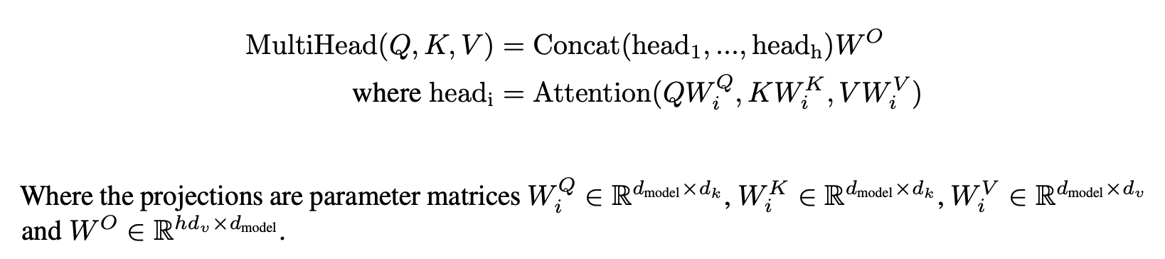
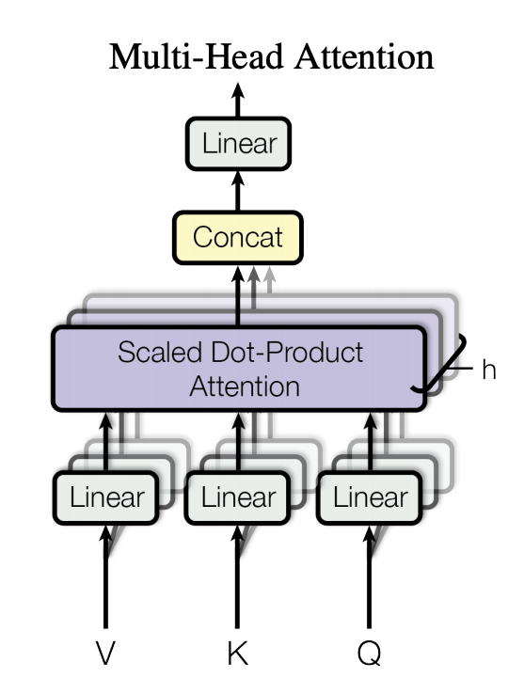
Multi-head Attention: Do not settle for just one set of attention weights.
Vaswani et al. Attention is all you need
https://arxiv.org/abs/1706.03762

Slide 10
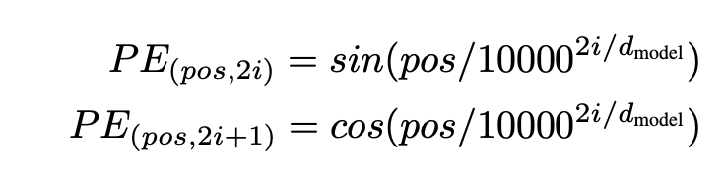
We can lose track of position since we are aggregating across all locations
Vaswani et al. Attention is all you need
https://arxiv.org/abs/1706.03762

Slide 11
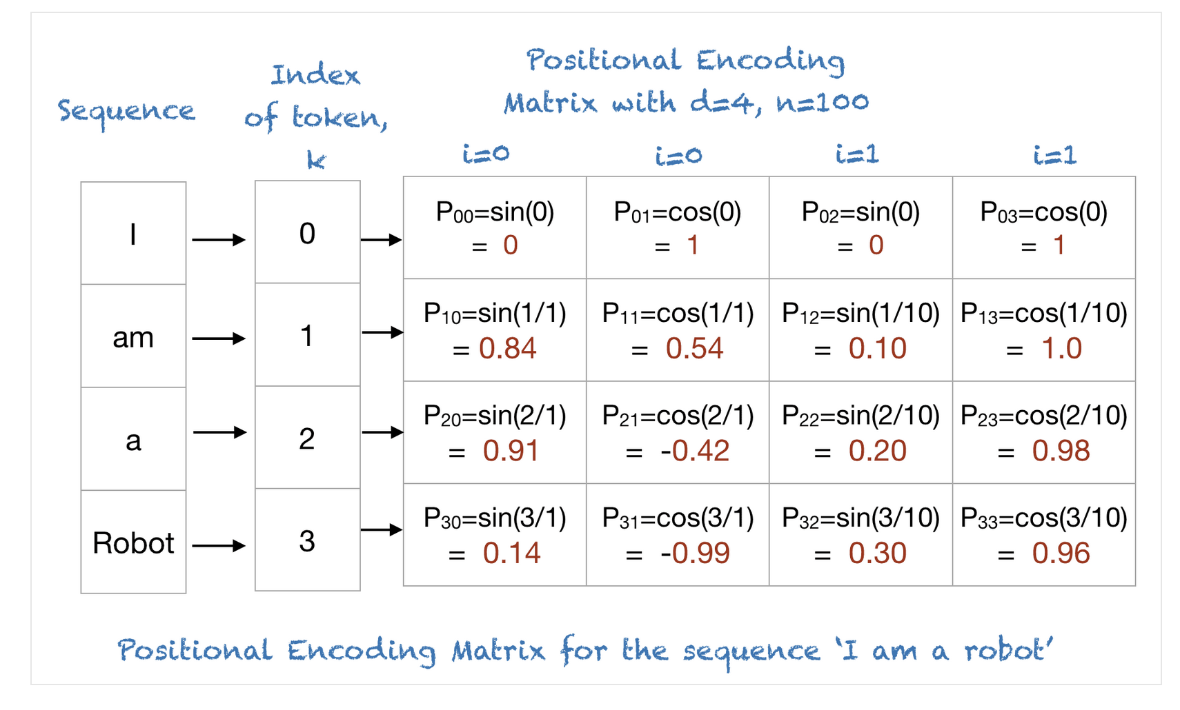
Positional Encodings
https://machinelearningmastery.com/a-gentle-introduction-to-positional-encoding-in-transformer-models-part-1/
By Mehreen Saeed

Slide 12
Other Positional Encodings
Learnable Absolute Positional Encodings: Initialize them with random weights and learn them. However fixed for each position. BERT Models use this.
Relative Positional Encodings: Encode distances between tokens instead of absolute positions. Used in moderns such as T5 from Google.
RoPE: Rotationary Positional Encodings: Position information is encoded through rotation in multidimensional space. Models such as LlaMA use this.
NoPE? No Positional Encodings? Let’s hope the model learns through attention weights?

Slide 13
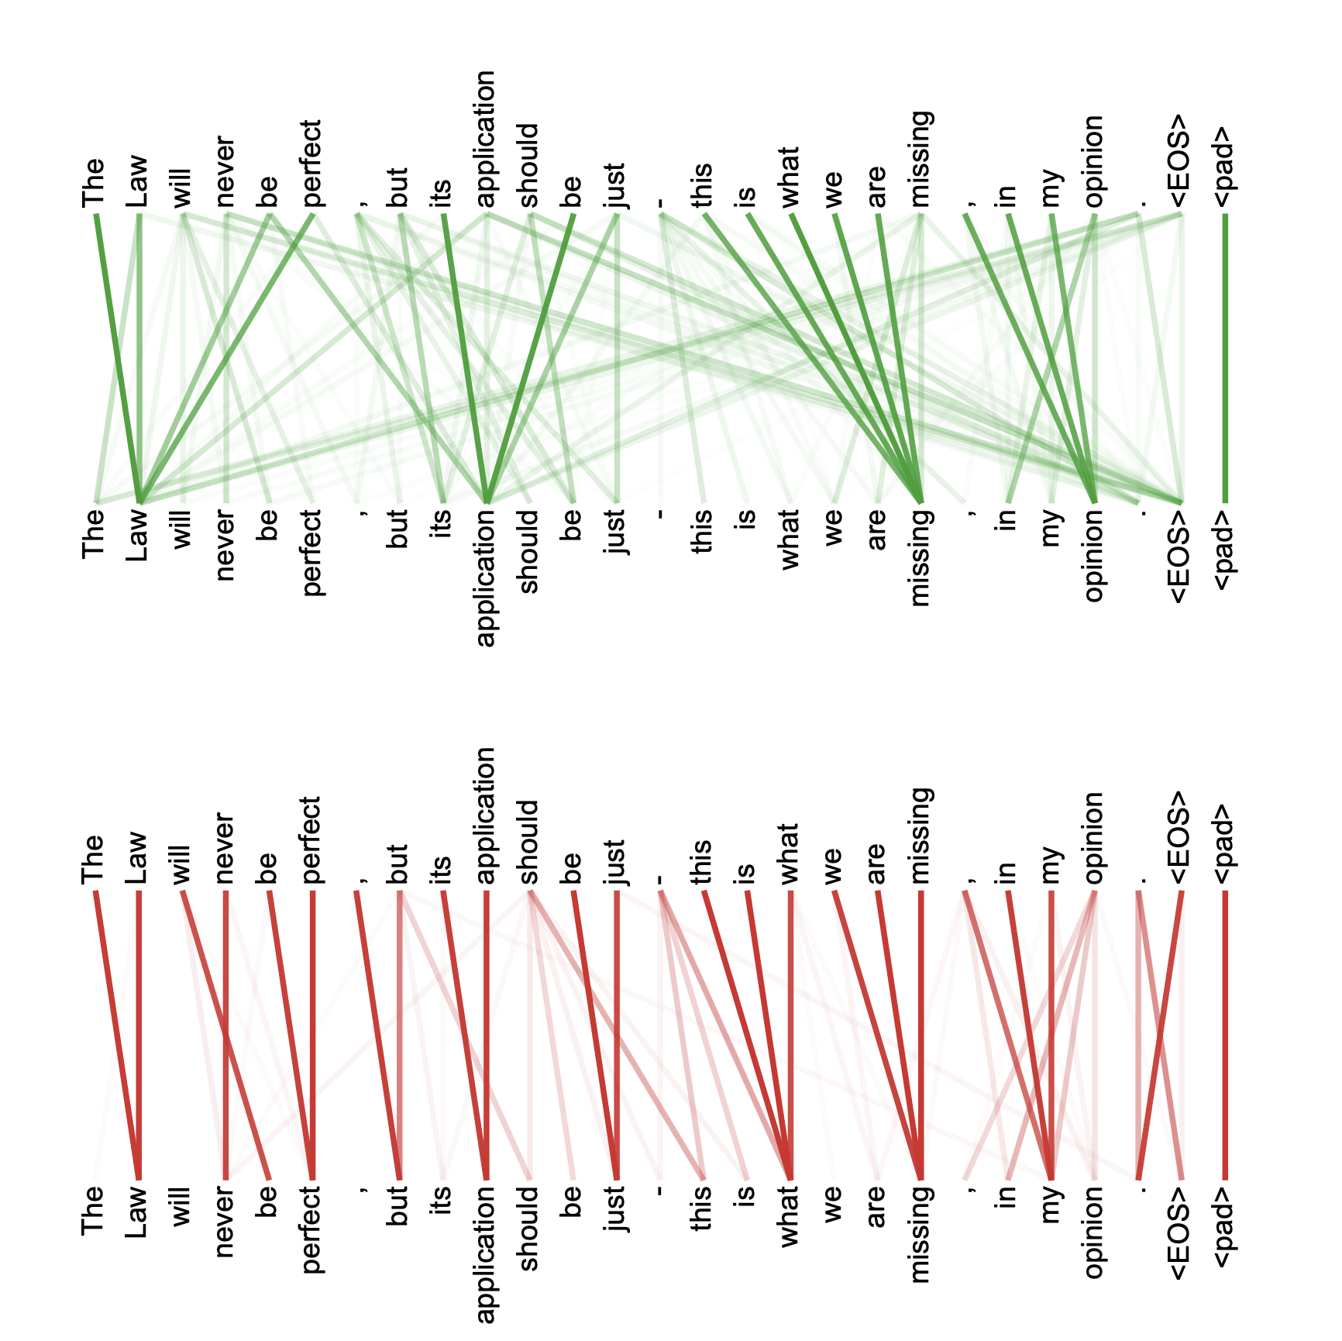
Multi-headed attention weights are harder to interpret obviously

Slide 14
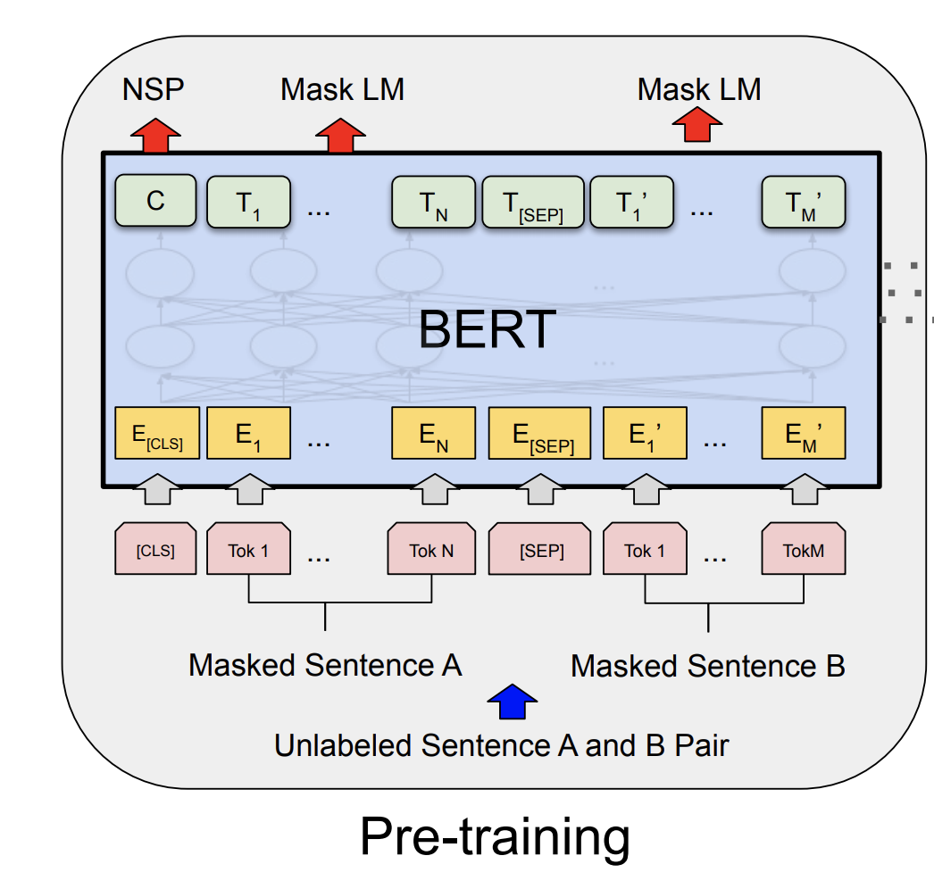
The BERT Encoder Model (October, 2018)
Devlin et al. BERT: Pre-training of Deep Bidirectional Transformers for Language Understanding . https://arxiv.org/abs/1810.04805
Important things to know
No decoder
Train the model to fill-in-the-blank by masking some of the input tokens and trying to recover the full sentence.
The input is not one sentence but two sentences separated by a [SEP] token.
Also try to predict whether these two input sentences are consecutive or not.

Slide 15
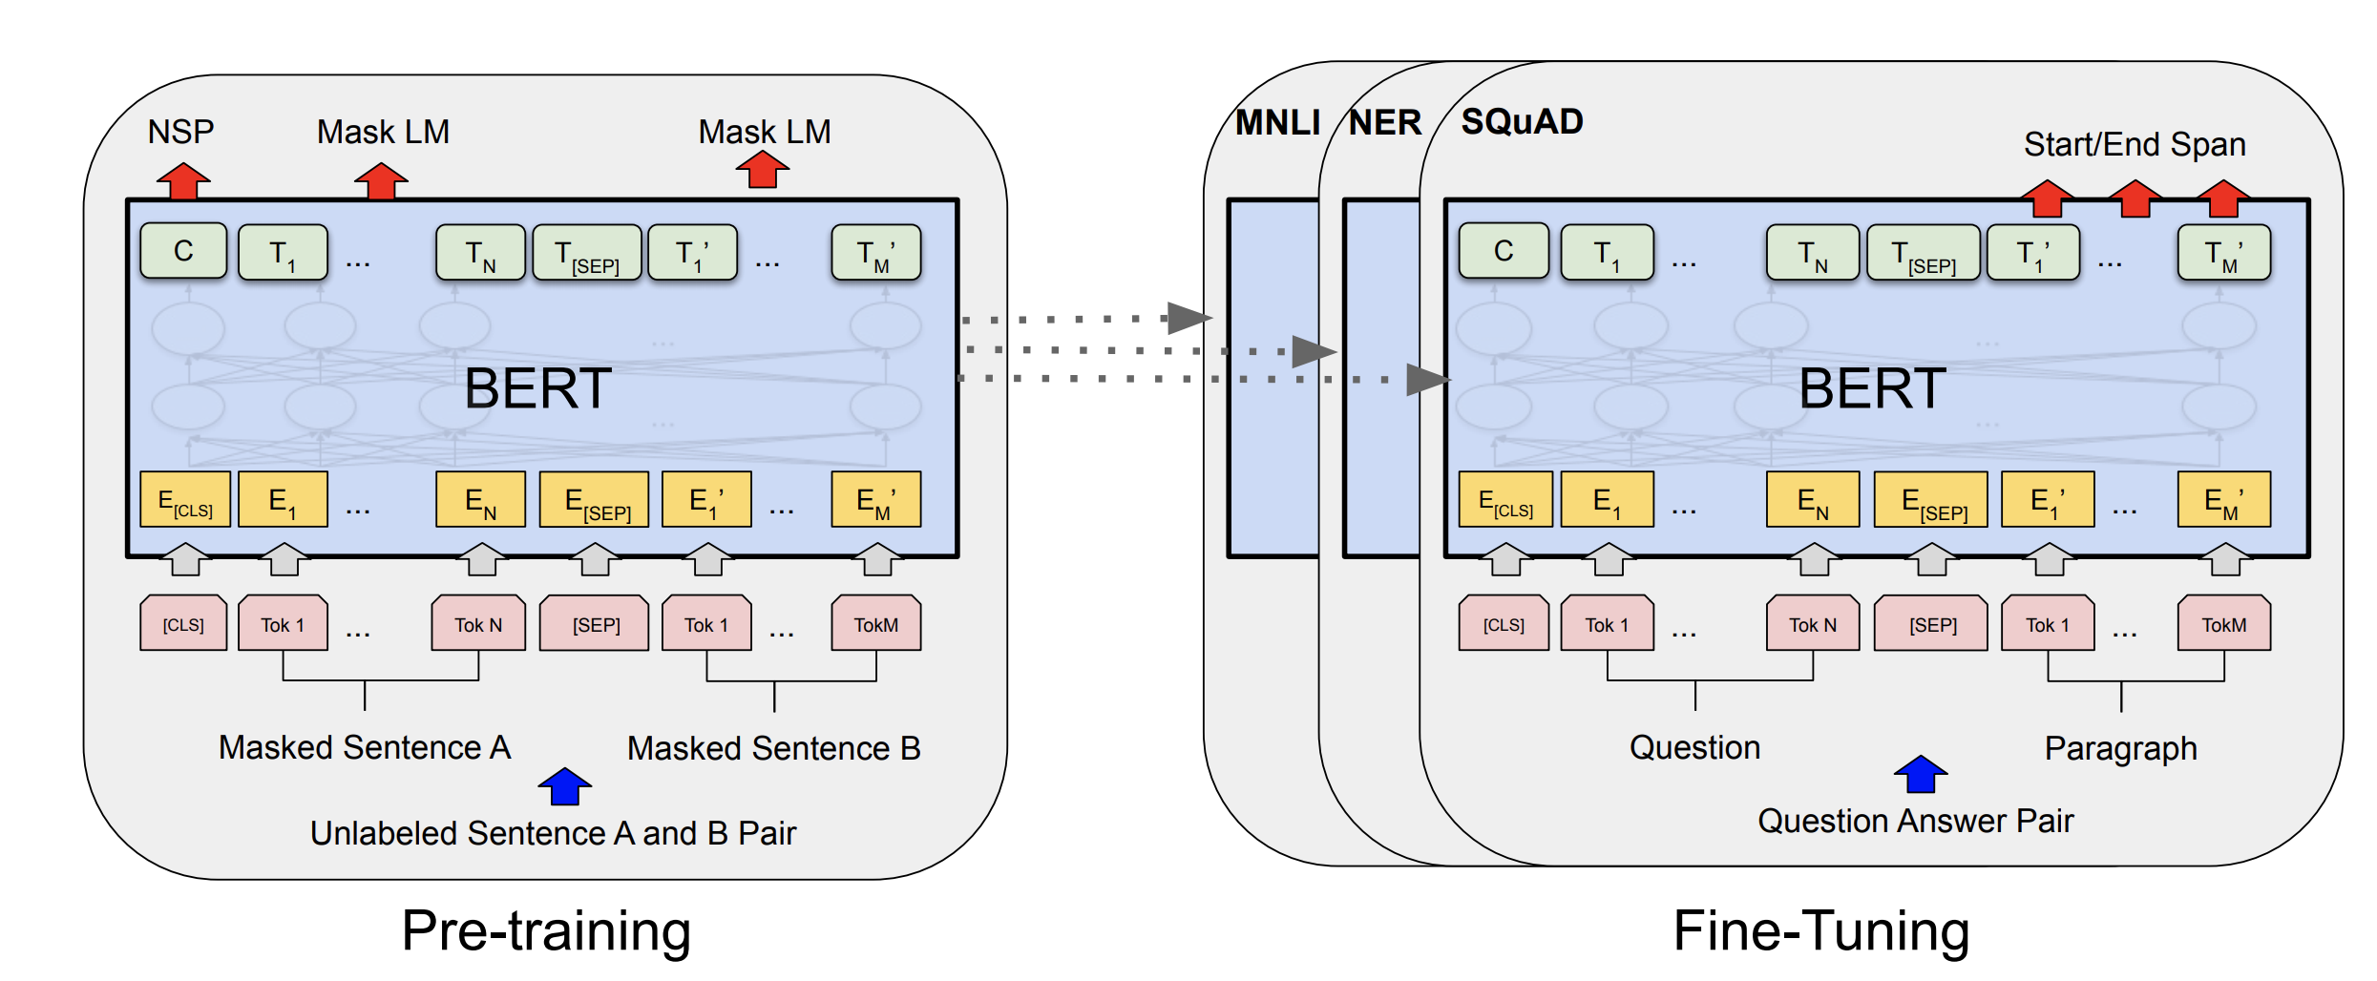
The BERT Encoder Model
Devlin et al. BERT: Pre-training of Deep Bidirectional Transformers for Language Understanding . https://arxiv.org/abs/1810.04805

Slide 16
The BERT Encoder-only Model
Devlin et al. BERT: Pre-training of Deep Bidirectional Transformers for Language Understanding . https://arxiv.org/abs/1810.04805

Slide 17
The T5 Encoder-Decoder Model
Decoder
Encoder

Slide 18
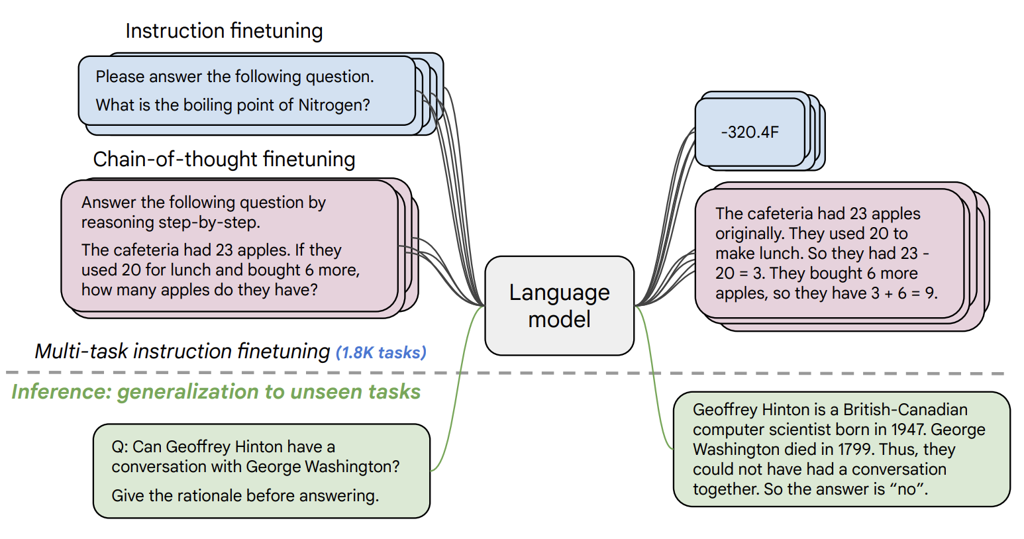
Instruction Tuning (FLAN-T5 by Google)
https://arxiv.org/pdf/2210.11416.pdf

Slide 19
The GPT-2, GPT-3 Decoder-only Model
Decoder

Slide 20
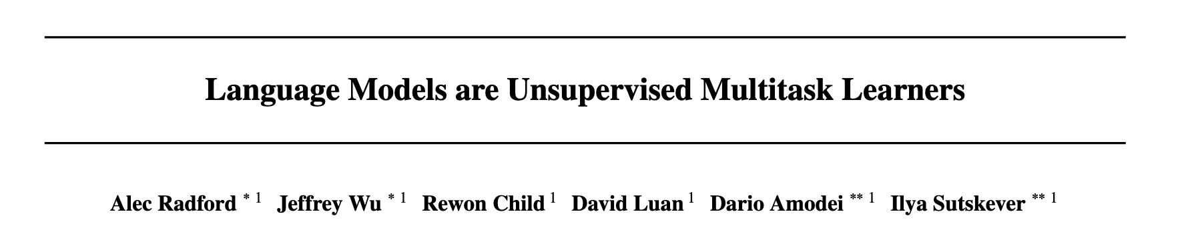
The GPT-2 Model (Feb, 2019)
https://openai.com/blog/better-language-models/

Slide 21
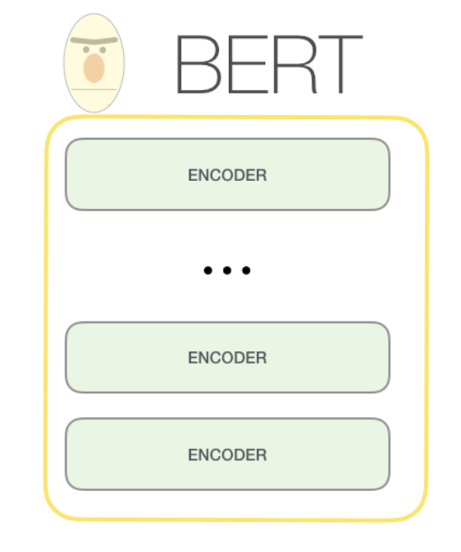
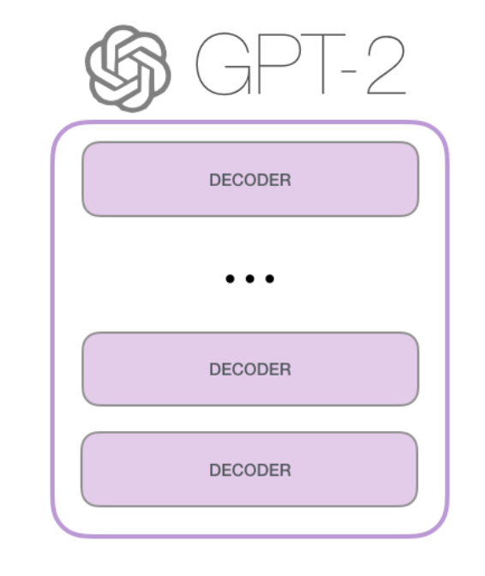
The GPT-2 Model
https://jalammar.github.io/illustrated-gpt2/

Slide 22
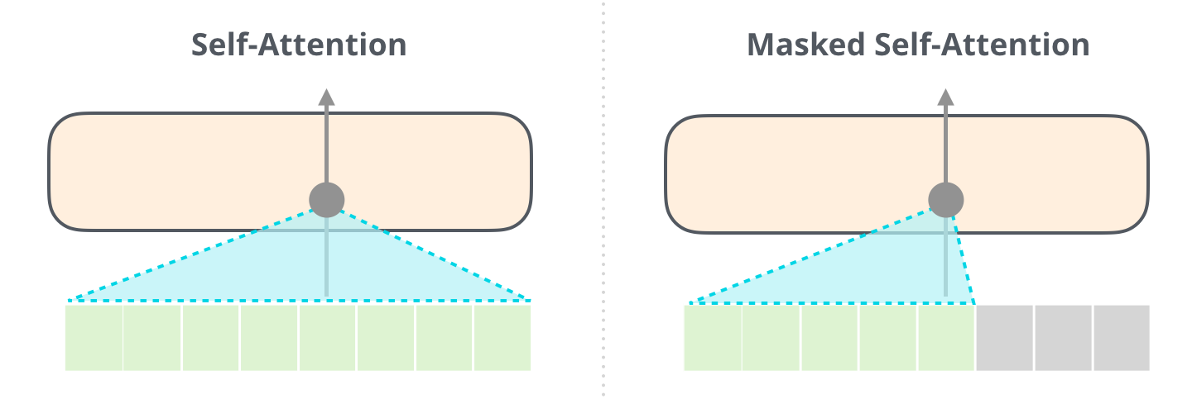
The GPT-2 Model
BERT
GPT
https://jalammar.github.io/illustrated-gpt2/

Slide 23
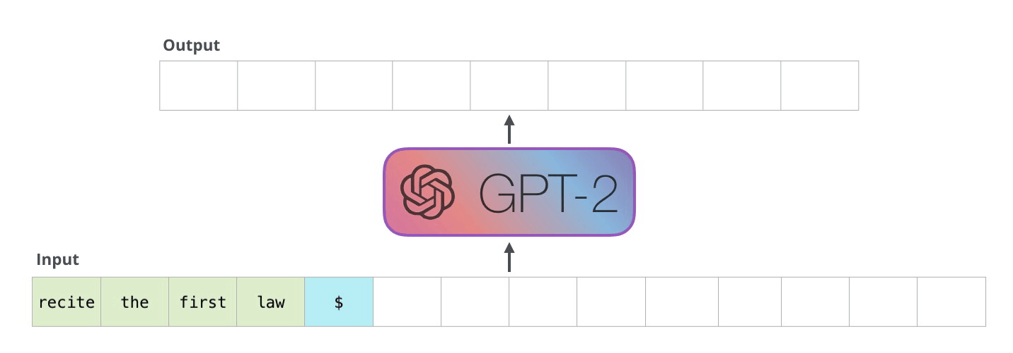
The GPT-2 Model
https://jalammar.github.io/illustrated-gpt2/

Slide 24
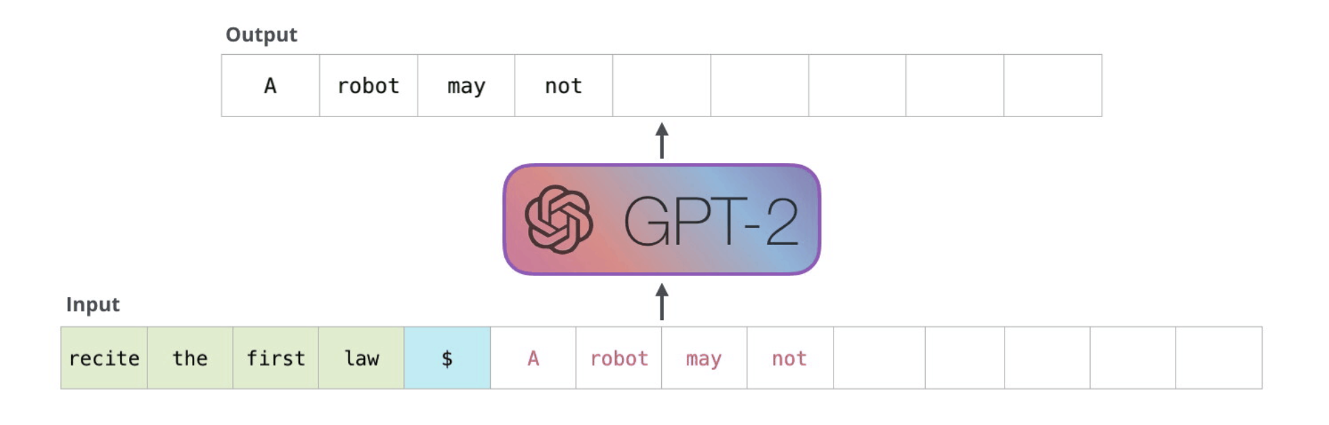
The GPT-2 Model
https://jalammar.github.io/illustrated-gpt2/

Slide 25
The GPT-2 Model
https://jalammar.github.io/illustrated-gpt2/

Slide 26
GPT-1 vs GPT-2 vs GPT-3
 | GPT-1 | GPT-2 | GPT-3
Parameters | 117 Million | 1.5 Billion | 175 Billion
Decoder Layers | 12 | 48 | 96
Context Token Size | 512 | 1024 | 2048
Hidden Layer | 768 | 1600 | 12288
Batch Size | 64 | 512 | 3.2M
https://360digitmg.com/blog/types-of-gpt-in-artificial-intelligence

Slide 27
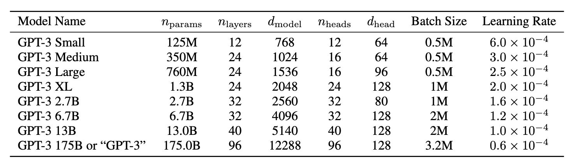
GPT-3 (July, 2020)
https://arxiv.org/abs/2005.14165

Slide 28
GPT family keeps growing
GPT-3.5
GPT-3.5-turbo
GPT-4
GPT-4-turbo
GPT-4o
o1, o3, o3-pro
Gemini family (Gemini Pro) (Google)
Mistral 7xMoE (Open Source by Mistral.ai)
Llama-2, Llama-3(Open Source by Meta AI)
DeepSeek, DeepSeek-R1 (Open Source by DeepSeek Team)
Claude3.5 Sonnet, Haiku, etc (Anthropic)
Grok3 (Twitter/xAI)
Competitors

Slide 29
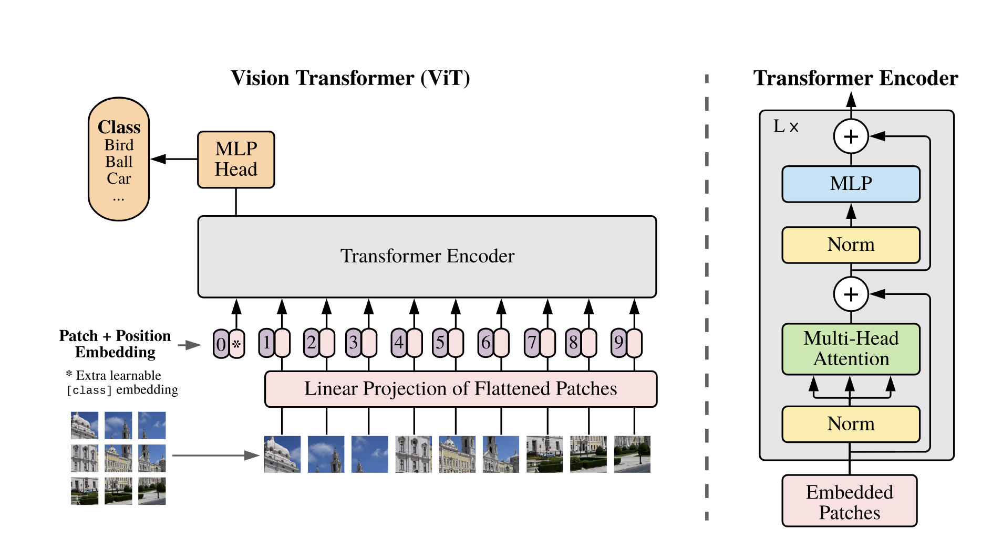
Vision Transformers
https://arxiv.org/abs/2010.11929
An Image is Worth 16x16 Words: Transformers for Image Recognition at Scale
Alexey Dosovitskiy, Lucas Beyer, Alexander Kolesnikov, Dirk Weissenborn, Xiaohua Zhai, Thomas Unterthiner, Mostafa Dehghani, Matthias Minderer, Georg Heigold, Sylvain Gelly, Jakob Uszkoreit, Neil Houlsby

Slide 30
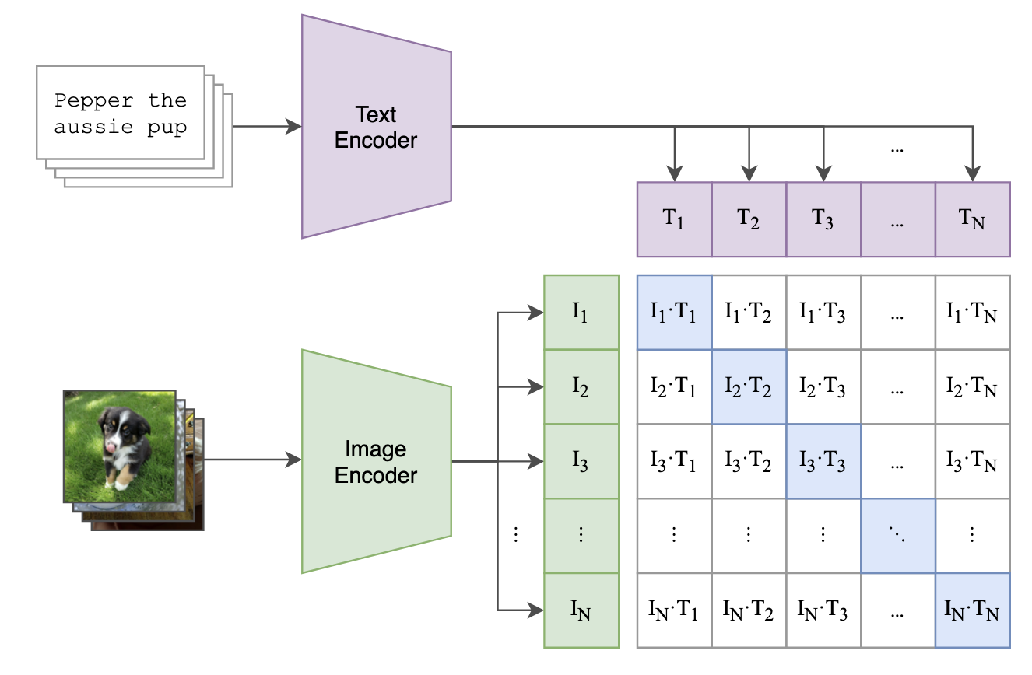
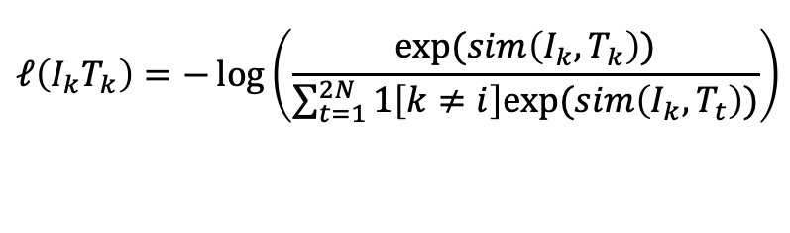
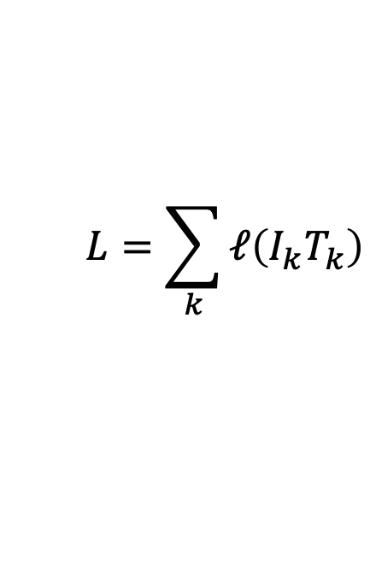
The CLIP Model
$$L=\sum_{k}{ℓ\left(I_{k}T_{k}\right)}$$
$$ℓ\left(I_{k}T_{k}\right)=−\log\left(\frac{exp⁡(sim\left(I_{k}, T_{k}\right))}{\sum_{t=1}^{2N}{1\left[k≠i\right]exp⁡(sim\left(I_{k}, T_{t}\right))}}\right)$$
https://arxiv.org/abs/2103.00020
Learning Transferable Visual Models From Natural Language Supervision
Alec Radford, Jong Wook Kim, Chris Hallacy, Aditya Ramesh, Gabriel Goh, Sandhini Agarwal, Girish Sastry, Amanda Askell, Pamela Mishkin, Jack Clark, Gretchen Krueger, Ilya Sutskever

Slide 31
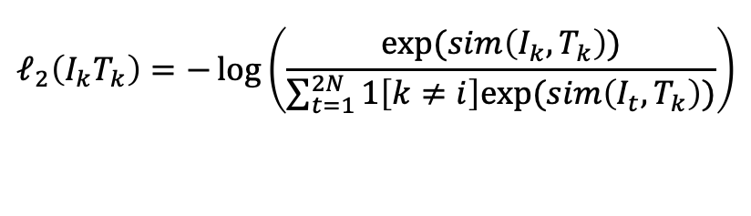
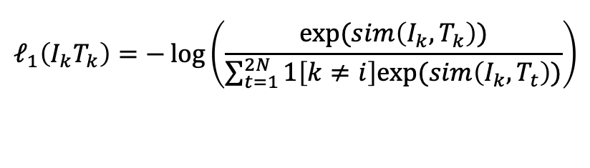
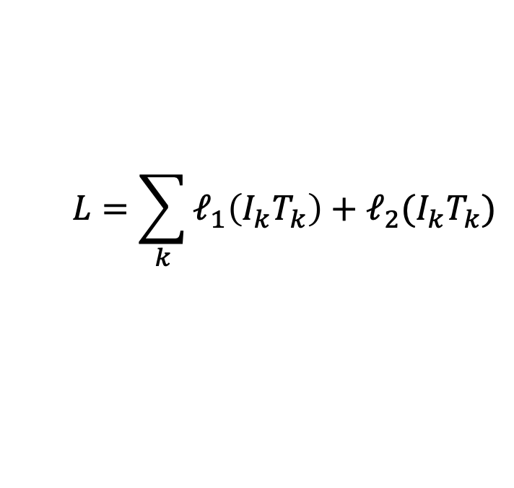
The CLIP Model
$$L=\sum_{k}{ℓ_{1}\left(I_{k}T_{k}\right)+ℓ_{2}(I_{k}T_{k})}$$
$$ℓ_{1}\left(I_{k}T_{k}\right)=−\log\left(\frac{exp⁡(sim\left(I_{k}, T_{k}\right))}{\sum_{t=1}^{2N}{1\left[k≠i\right]exp⁡(sim\left(I_{k}, T_{t}\right))}}\right)$$
$$ℓ_{2}\left(I_{k}T_{k}\right)=−\log\left(\frac{exp⁡(sim\left(I_{k}, T_{k}\right))}{\sum_{t=1}^{2N}{1\left[k≠i\right]exp⁡(sim\left(I_{t}, T_{k}\right))}}\right)$$
https://arxiv.org/abs/2103.00020
Learning Transferable Visual Models From Natural Language Supervision
Alec Radford, Jong Wook Kim, Chris Hallacy, Aditya Ramesh, Gabriel Goh, Sandhini Agarwal, Girish Sastry, Amanda Askell, Pamela Mishkin, Jack Clark, Gretchen Krueger, Ilya Sutskever

Slide 32
Next Work Prediction is limited
Predicting the next word can lead to intelligent behavior such as the one exemplified earlier however this still limited
What makes some of the new LLMs special? ChatGPT (GPT-3.5, 3.5 Turbo, 4, 4-turbo), FLAN-T5, OPT-IML
SFT: Supervised Finetuning (Curated Input/Output Instruction Sets)
DPO: Direct Preference Optimization
PPO: Proximal Policy Optimization (Reinforcement Learning with Human Feedback)
GRPO: Group-relative Policy Optimization (DeepSeek)

Slide 33
Instruction Tuning (e.g. FLAN-T5 by Google)
https://arxiv.org/pdf/2210.11416.pdf

Slide 34
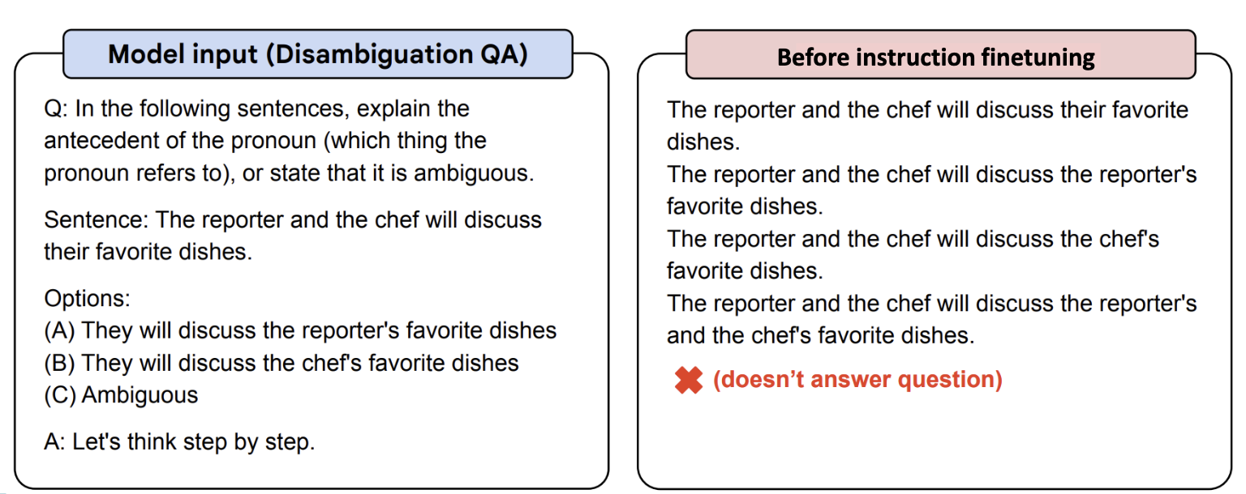
FLAN-T5

Slide 35
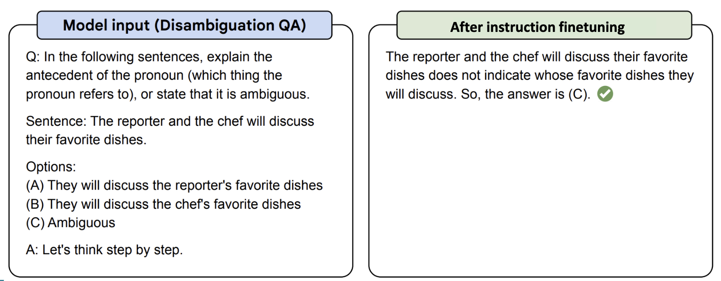
FLAN-T5

Slide 36
Questions?

