Slide 1
Deep Learning for Vision & Language
Segmentation, AutoEncoders, Variational AutoEncoders, Introduction to Diffusion Models

Slide 2
Final Project
I am still giving feedback on the project proposal. There’s no grade for the project proposal. There’s also no grade for class attendance. See course syllabus. I won’t change course syllabus in the middle of the course. I aim to send feedback to everyone before Spring Break.
I will provide you an opportunity to provide a Project Progress Report so you have an idea of my expectations and grade and avoid “surprises”.
Final project deliverables is worth 60% of the class divided as follows:
Originality: 10pts
Technical accuracy: 10pts
Presentation: 10pts
Results: 10pts

Slide 3
Final Project
Originality: Is the idea of the project original itself? Is the original idea of the project standard but is any of the experiments original? [10pts]
Technical accuracy: Is your final project report accurate? Are all the terms used appropriately and are the mathematical expressions used to explain your model/loss/optimization accurate?
Presentation: Is your final report publication-ready? Could your final project report be published as a technical report? I don’t want to see unprofessional practices that you would not see on a technical paper. Common mistakes: Pixelated images, axis on output figures that don’t warrant axes, etc.
Results: Are your results good? I can judge this by using metrics such as accuracy, BLEU, retrieval@K, human surveys, and I can also judge by looking at any input-output results that you include. I want to SEE you did well.

Slide 4
Semantic Segmentation / Image Parsing
deer
cat
trees
grass

Slide 5
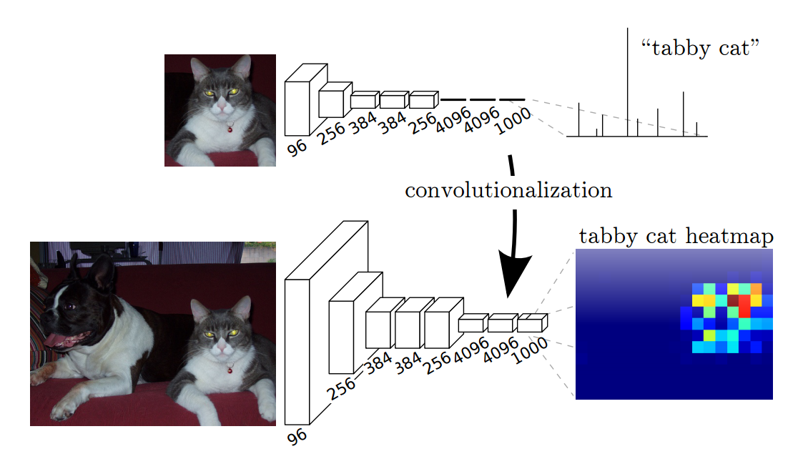
Idea 1: Convolutionalization
However resolution of the segmentation map is low.
https://people.eecs.berkeley.edu/~jonlong/long_shelhamer_fcn.pdf

Slide 6
Alexnet
https://www.saagie.com/fr/blog/object-detection-part1

Slide 7

Idea 1: Convolutionalization
nn.Linear(4096, 1000) == nn.Conv2D(4096, 1000, kernel_size = 1, stride = 1)
$$≡$$

Slide 8
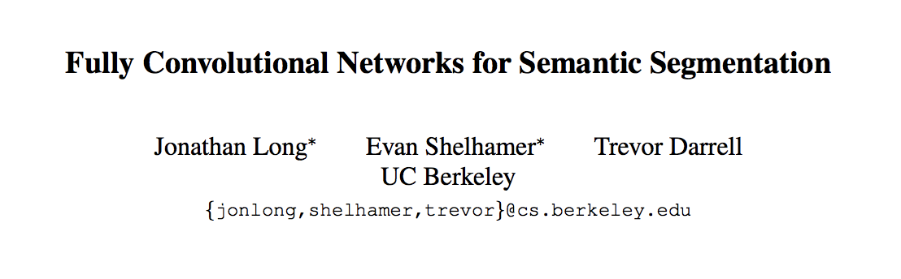
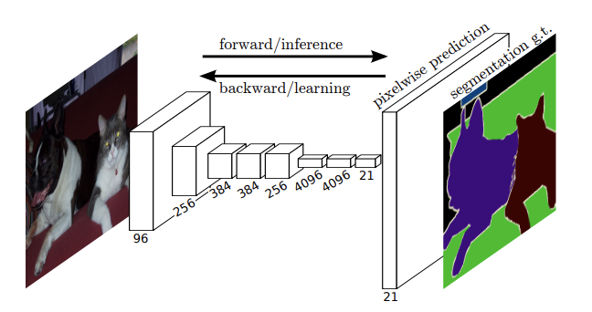
Fully Convolutional Networks (CVPR 2015)

Slide 9
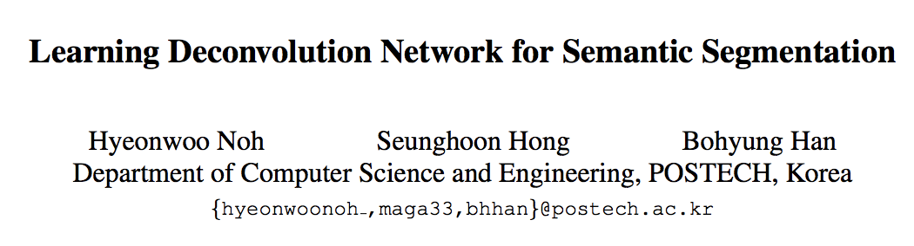
Idea 2: Up-sampling Convolutions or ”Deconvolutions” or Transposed Convolutions
http://cvlab.postech.ac.kr/research/deconvnet/

Slide 10
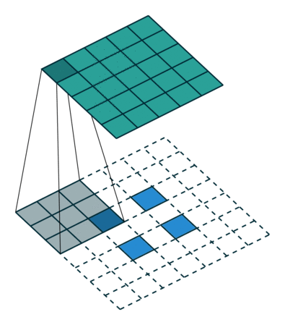
Idea 2: Up-sampling Convolutions or ”Deconvolutions” or Transposed Convolutions
https://github.com/vdumoulin/conv_arithmetic

Slide 11
Idea 2: Up-sampling Convolutions or ”Deconvolutions”
Deconvolutional Layers
Upconvolutional Layers
Backwards Strided Convolutional Layers
Fractionally Strided Convolutional Layers
Transposed Convolutional Layers
Spatial Full Convolutional Layers

Slide 12
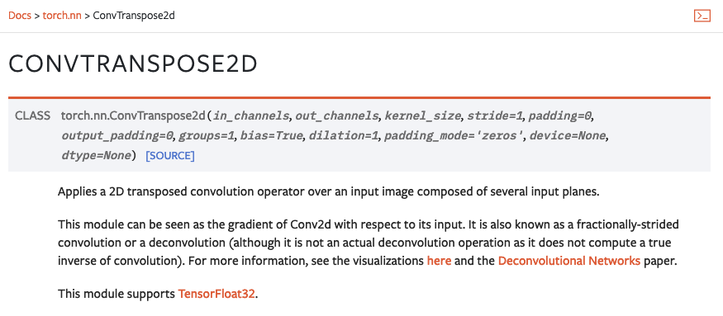
Pytorch

Slide 13
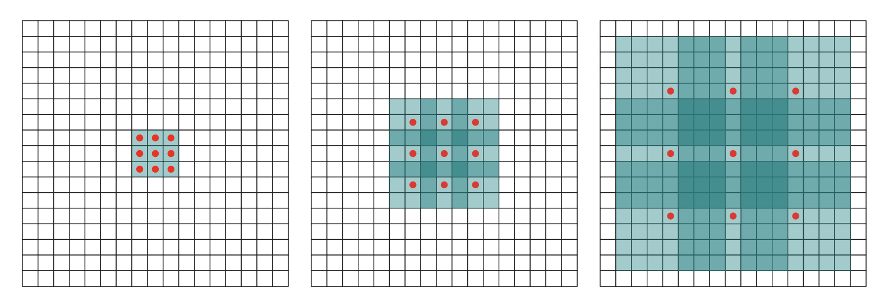
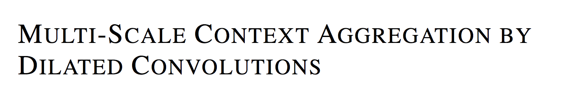
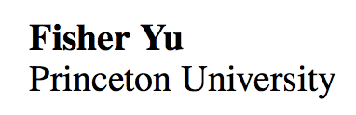
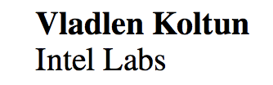
Idea 3: Dilated Convolutions
ICLR 2016

Slide 14
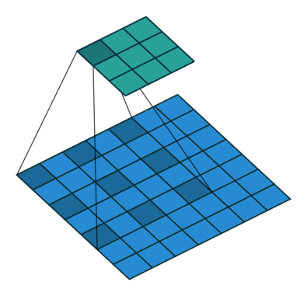
Idea 3: Dilated Convolutions
ICLR 2016

Slide 15
Convolutional Layer in pytorch
kernel_size
Input
out_channels x
Output
kernel_size
in_channels
out_channels (equals the number of convolutional filters for this layer)
in_channels (e.g. 3 for RGB inputs)

Slide 16
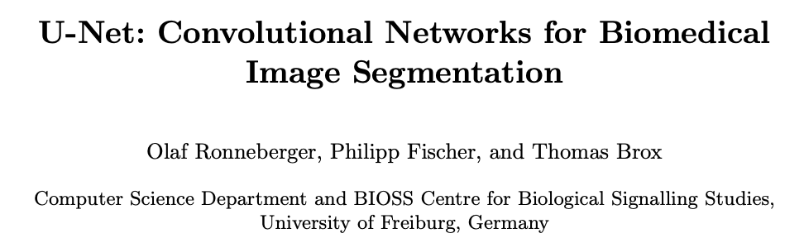
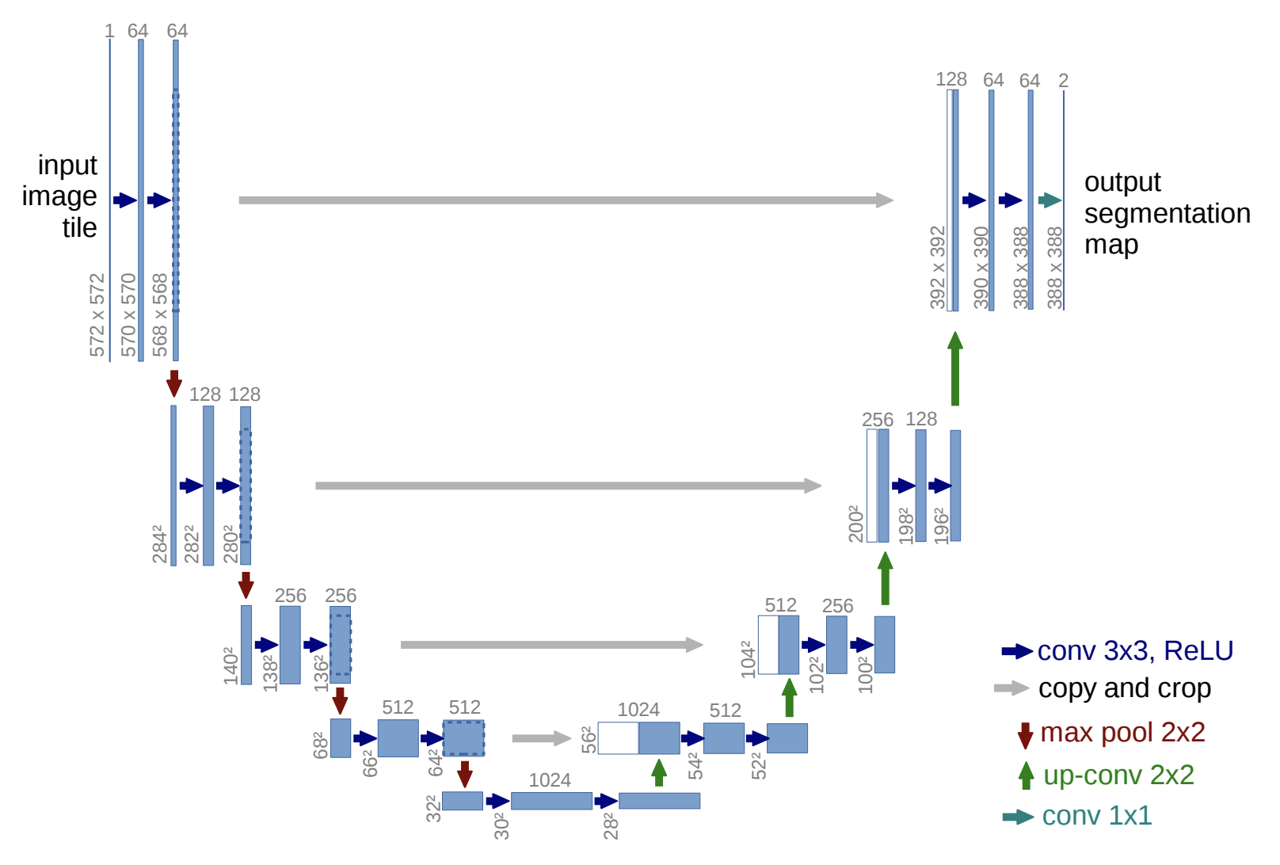
https://arxiv.org/abs/1505.04597
https://github.com/milesial/Pytorch-UNet
https://github.com/usuyama/pytorch-unet

Slide 17
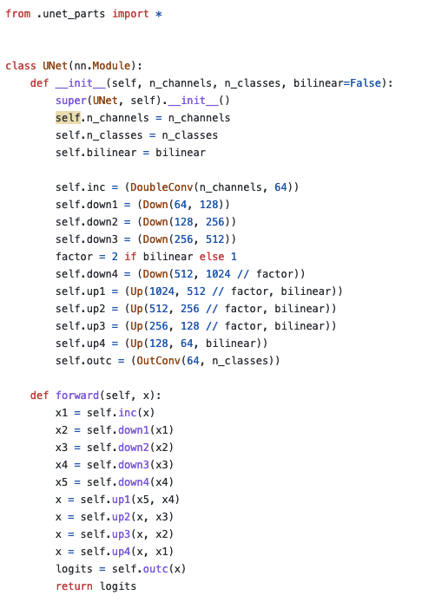
UNet in Pytorch
https://github.com/milesial/Pytorch-UNet/blob/master/unet/unet_model.py

Slide 18
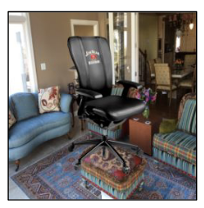

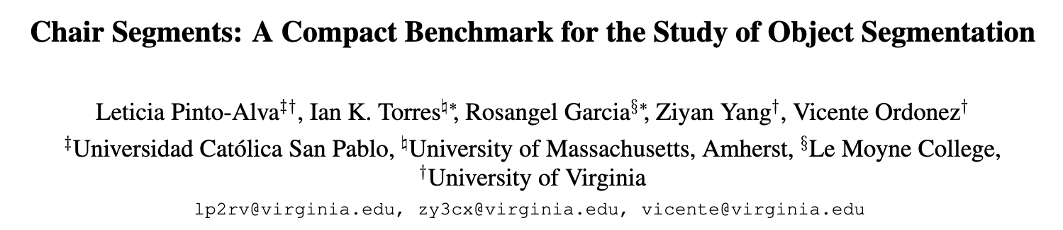
Chair segmentation - Training

Slide 19
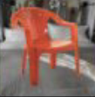

Chair segmentation - Prediction

Slide 20
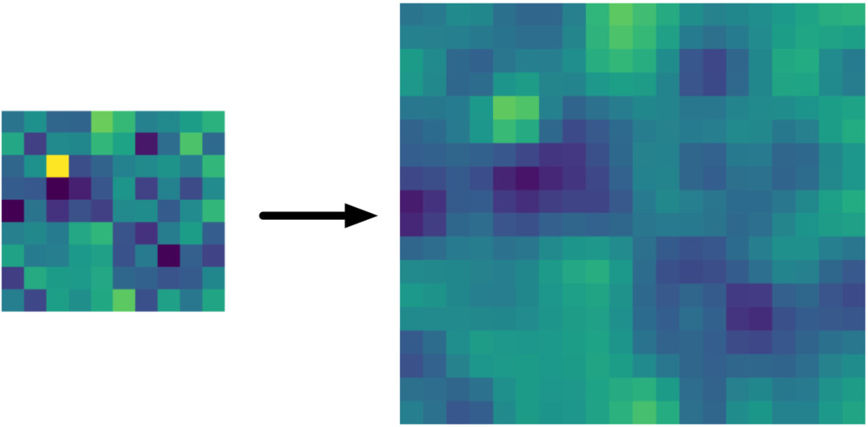
Bilinear Upsampling Layer
https://machinethink.net/blog/coreml-upsampling/

Slide 21
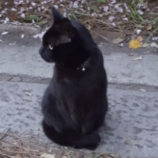
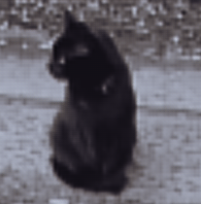
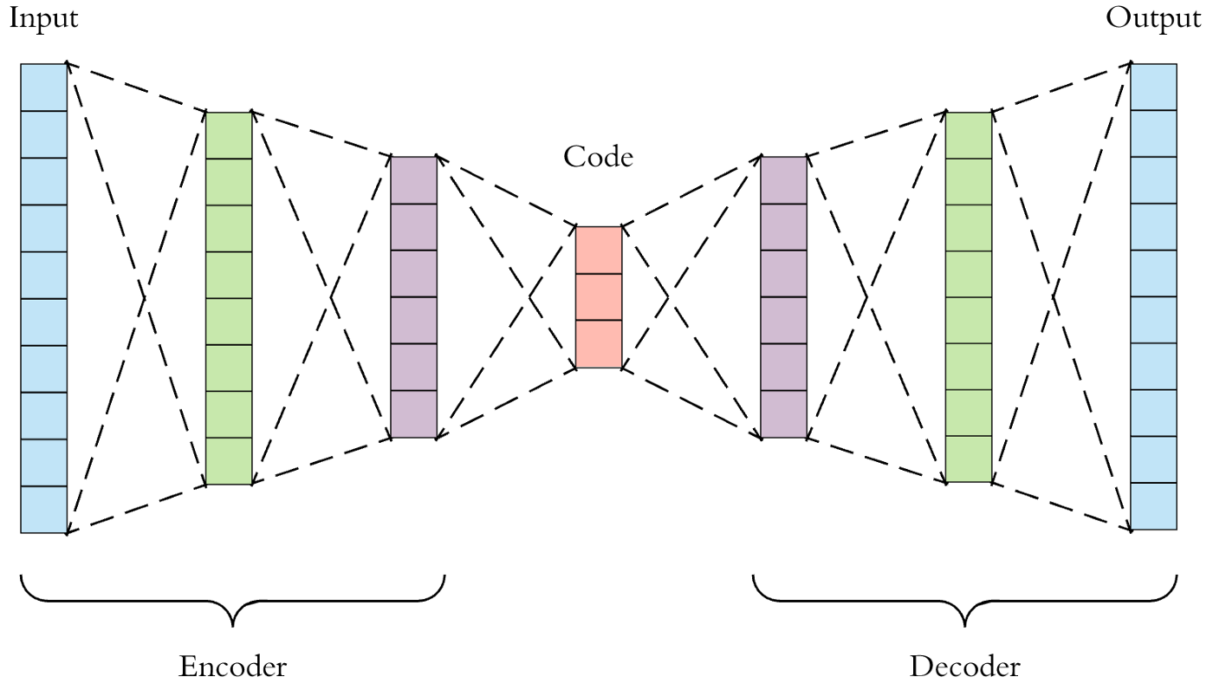
AutoEncoder Models (Downsample, Upsample)

Slide 22
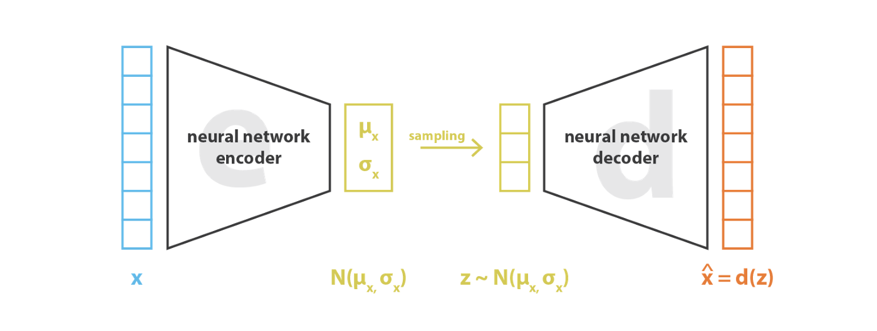

Variational AutoEncoders (VAE)
https://pytorch.org/docs/stable/generated/torch.normal.html
https://ai.stackexchange.com/questions/30176/are-mean-and-standard-deviation-in-variational-autoencoders-unique

Slide 23

Reparameterization “trick”
https://pytorch.org/docs/stable/generated/torch.normal.html
https://ai.stackexchange.com/questions/30176/are-mean-and-standard-deviation-in-variational-autoencoders-unique

Slide 24
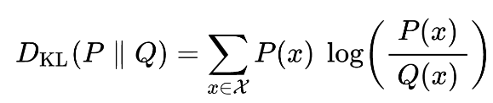
Kullback-Leibler Divergence

Slide 25
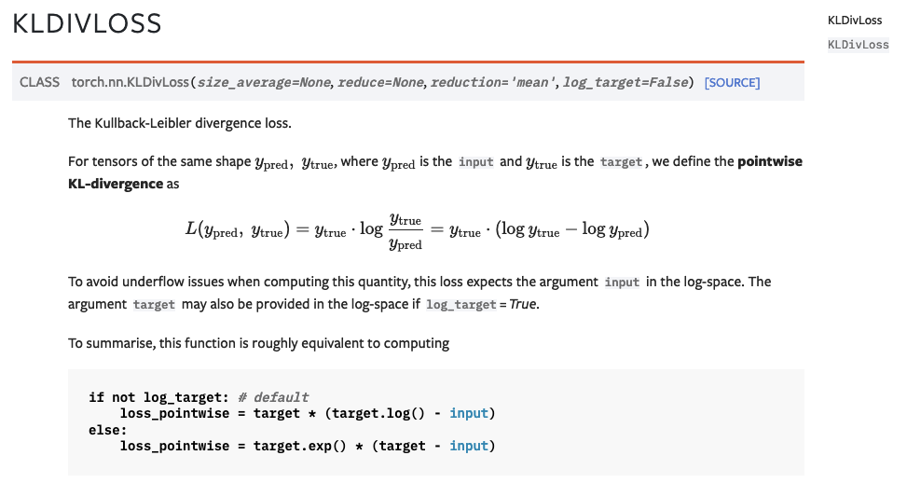

Slide 26
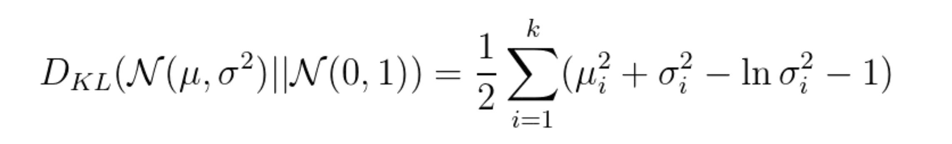
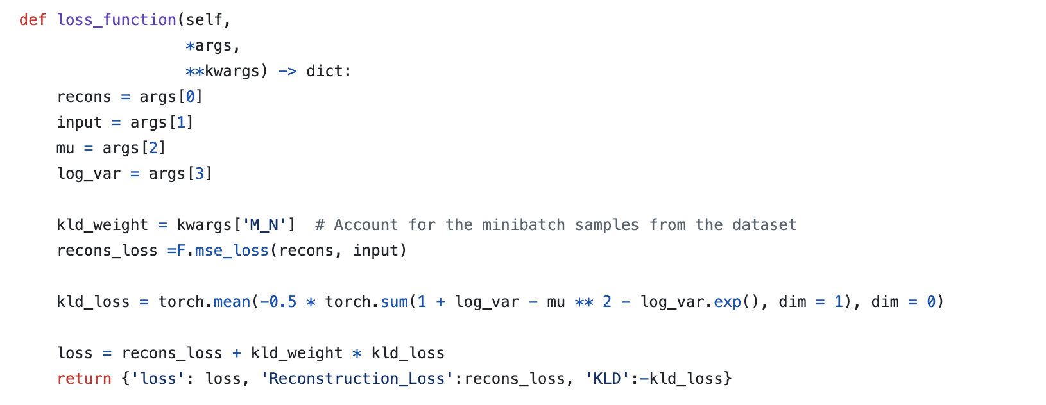
For Gaussian Probabilities KL Divergence even simpler
https://github.com/AntixK/PyTorch-VAE/blob/master/models/cvae.py

Slide 27
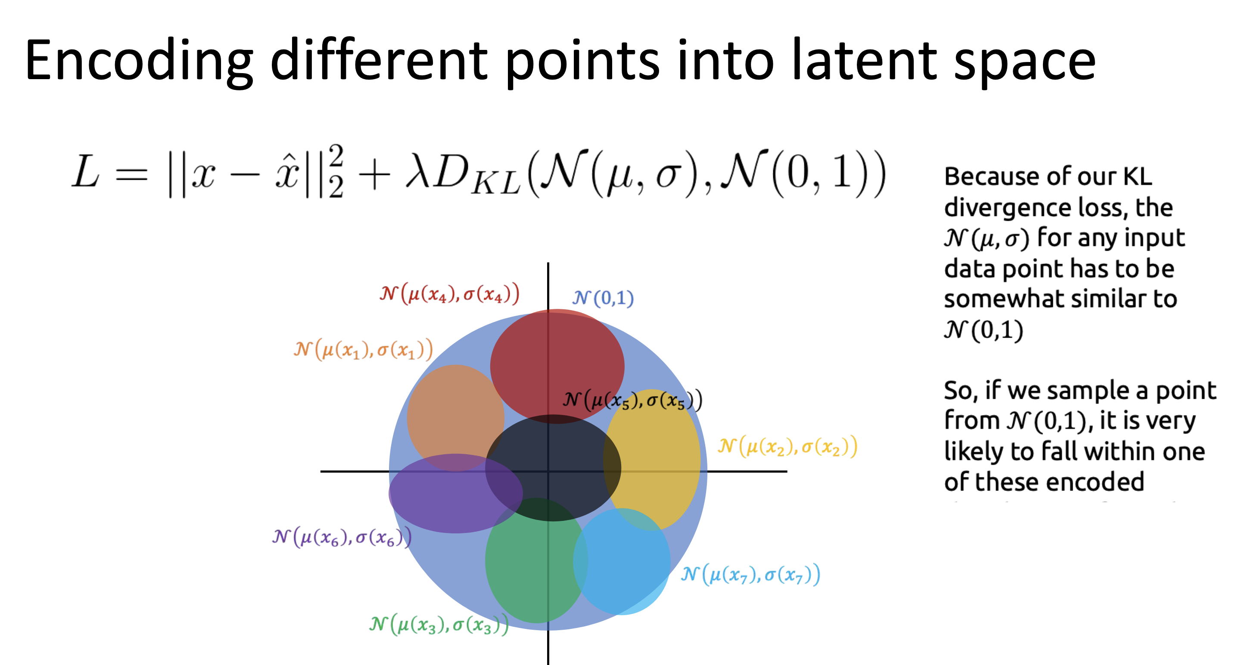
Slide from Ritambara Singh’s Deep Learning class at Brown
https://brown-deep-learning.github.io/dl-website-s23/slides/lecture27.pdf

Slide 28
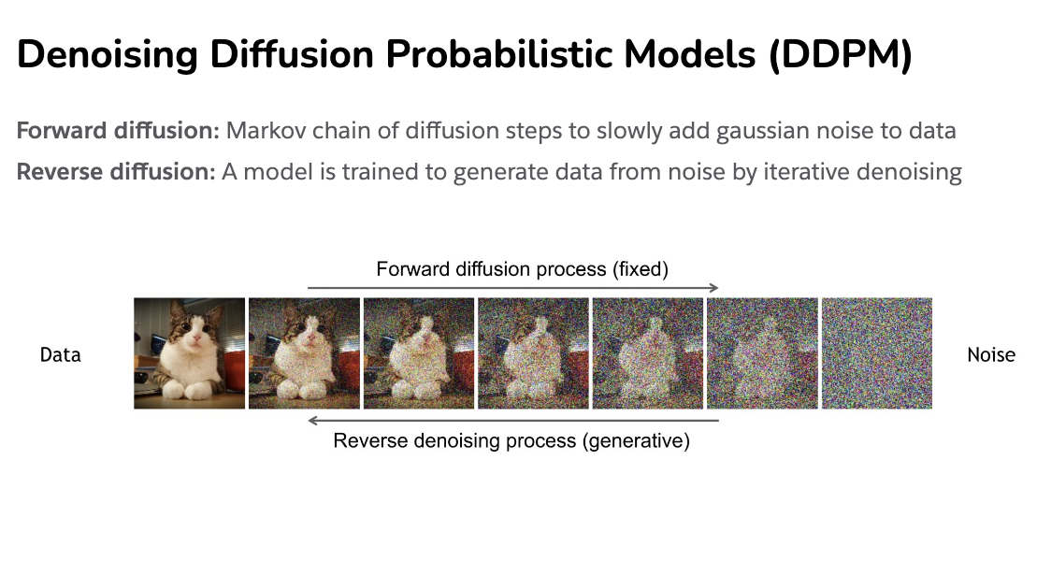
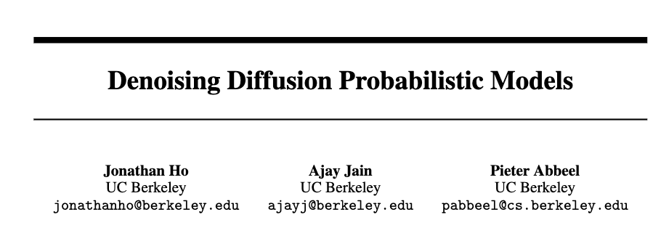
Diffusion Process
https://cvpr2022-tutorial-diffusion-models.github.io/
Slides compiled by my student Aman Shrivastava

Slide 29
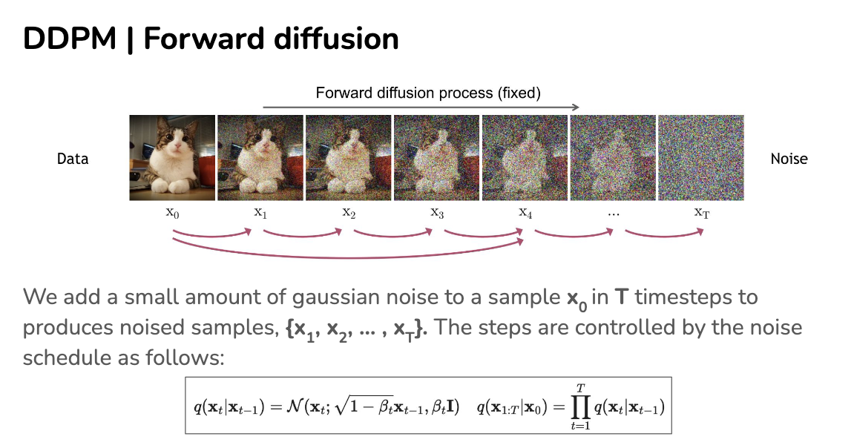
https://cvpr2022-tutorial-diffusion-models.github.io/

Slide 30
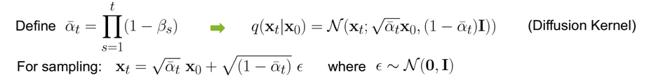

Slide 31
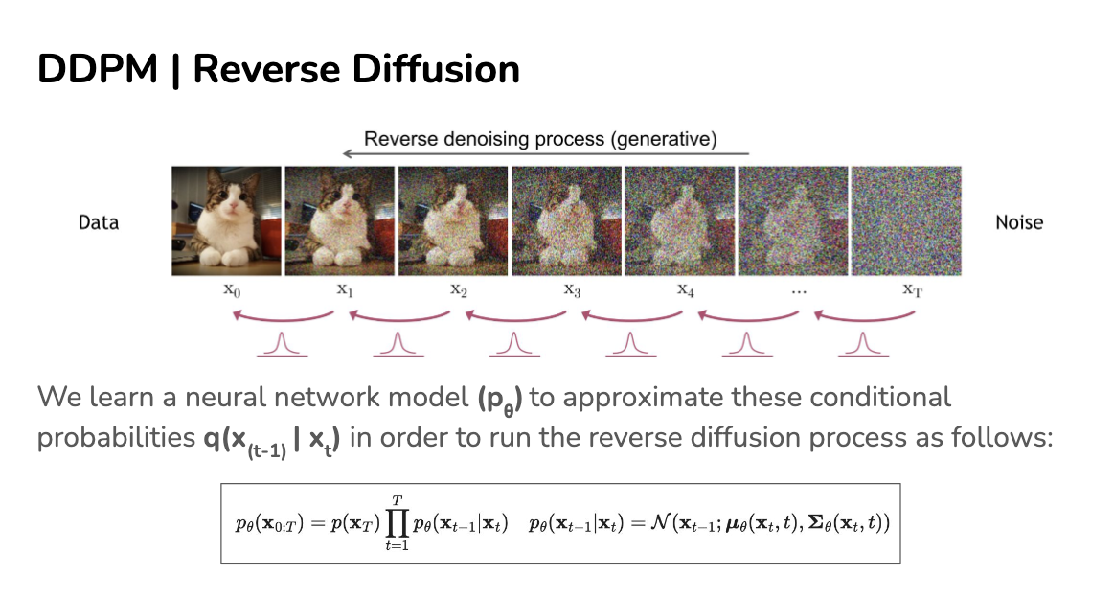
https://cvpr2022-tutorial-diffusion-models.github.io/

Slide 32
https://cvpr2022-tutorial-diffusion-models.github.io/

Slide 33
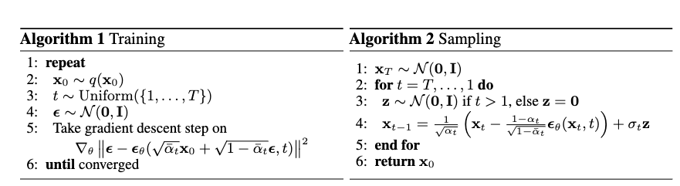
How do we train?
https://cvpr2022-tutorial-diffusion-models.github.io/

Slide 34
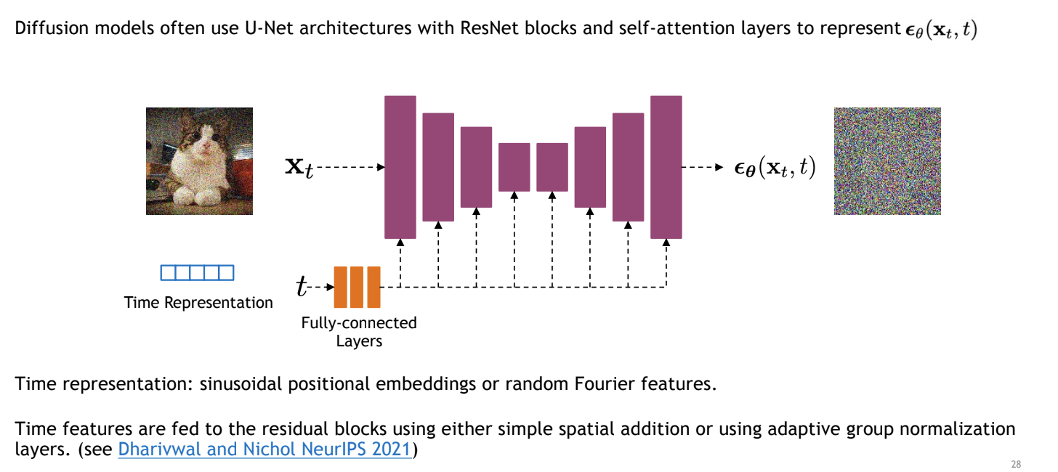
Unet to model transition
https://cvpr2022-tutorial-diffusion-models.github.io/

Slide 35
How do we train?
https://cvpr2022-tutorial-diffusion-models.github.io/

Slide 36
How do we train?
https://cvpr2022-tutorial-diffusion-models.github.io/

Slide 37
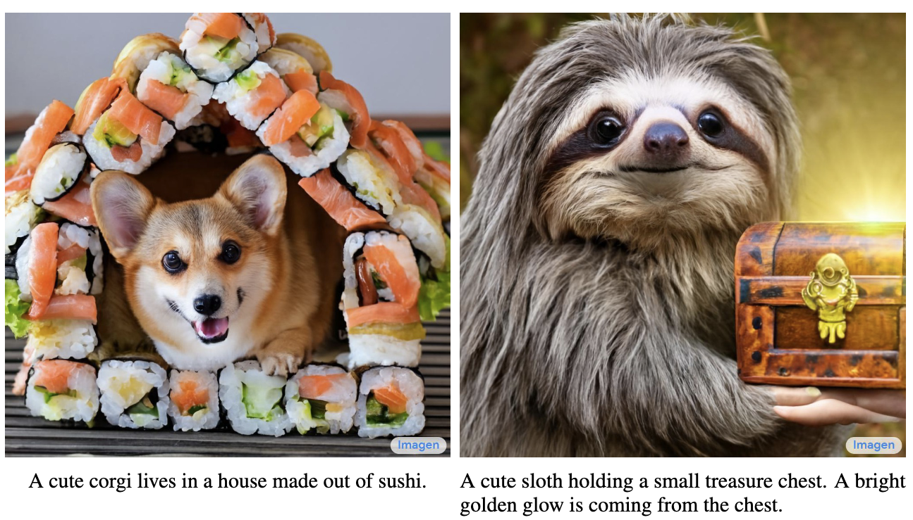
Imagen by Google

Slide 38
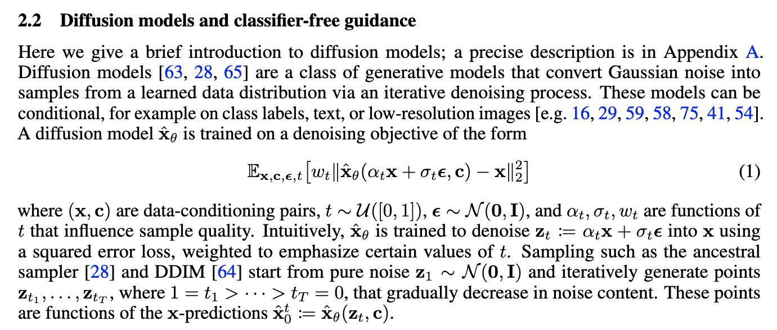
Imagen by Google
https://arxiv.org/pdf/2205.11487.pdf

Slide 39
Questions

