Slide 1
Deep Learning for Vision & Language
Segmentation, AutoEncoders, Variational AutoEncoders, Introduction to Diffusion Models

Slide 2
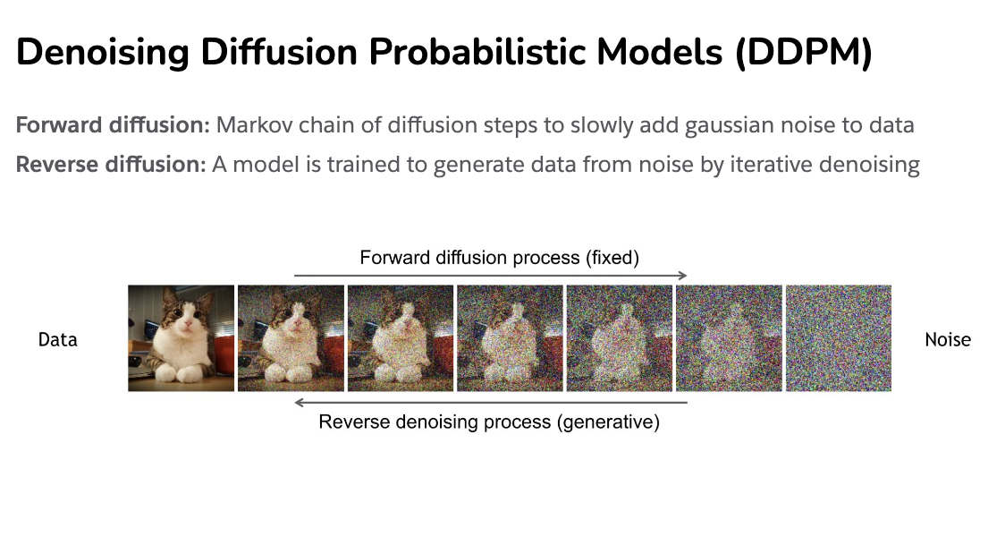
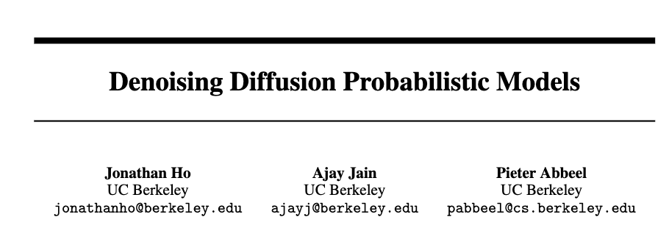
Diffusion Process
https://cvpr2022-tutorial-diffusion-models.github.io/
Slides compiled by my student Aman Shrivastava

Slide 3
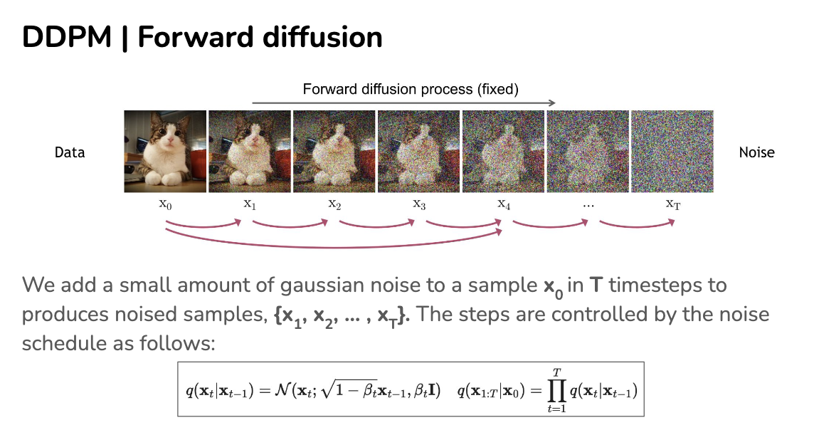
https://cvpr2022-tutorial-diffusion-models.github.io/

Slide 4
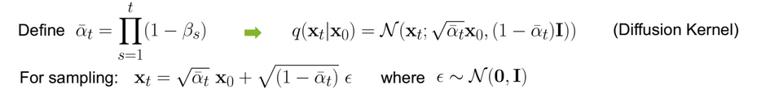

Slide 5
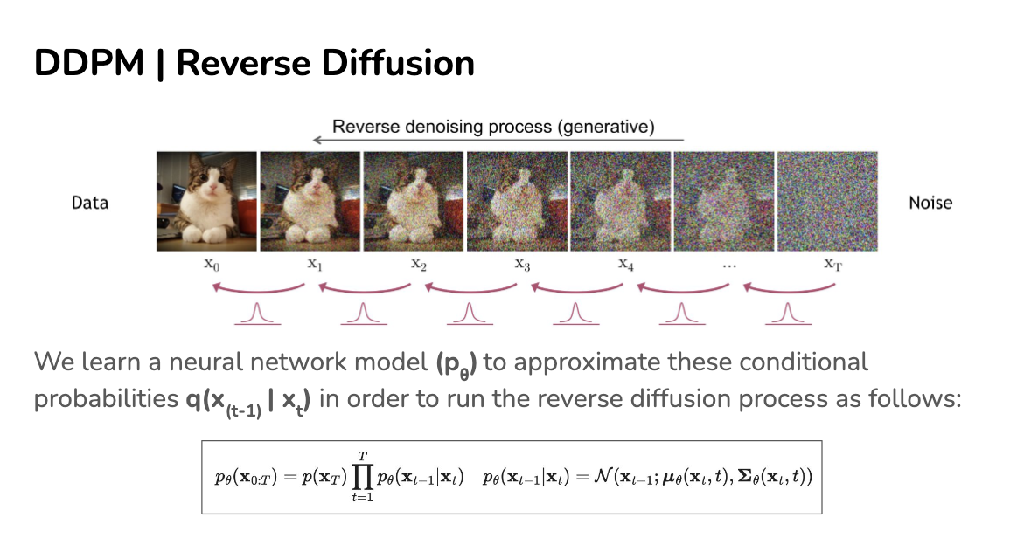
https://cvpr2022-tutorial-diffusion-models.github.io/

Slide 6
https://cvpr2022-tutorial-diffusion-models.github.io/

Slide 7
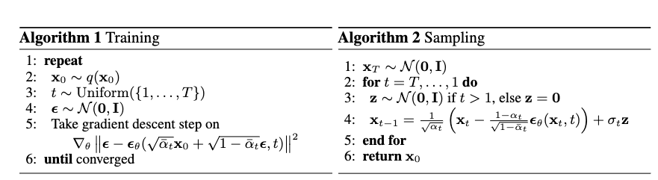
How do we train?
https://cvpr2022-tutorial-diffusion-models.github.io/

Slide 8
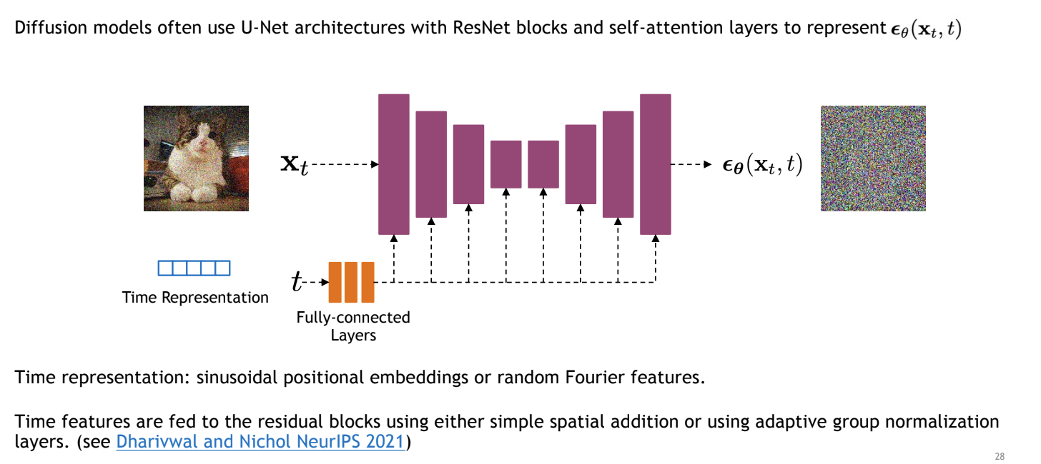
Unet to model transition
https://cvpr2022-tutorial-diffusion-models.github.io/

Slide 9
How do we train?
https://cvpr2022-tutorial-diffusion-models.github.io/

Slide 10
How do we train?
https://cvpr2022-tutorial-diffusion-models.github.io/

Slide 11
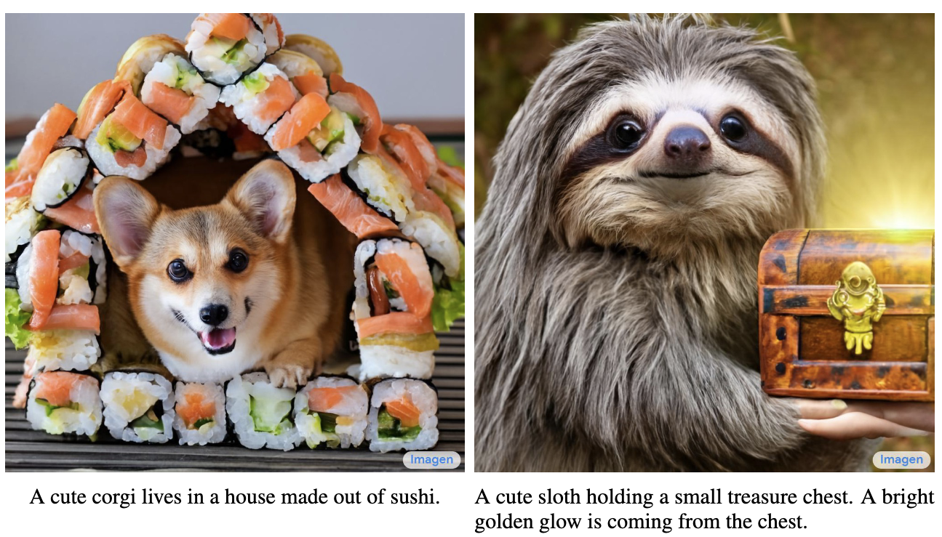
Imagen by Google

Slide 12
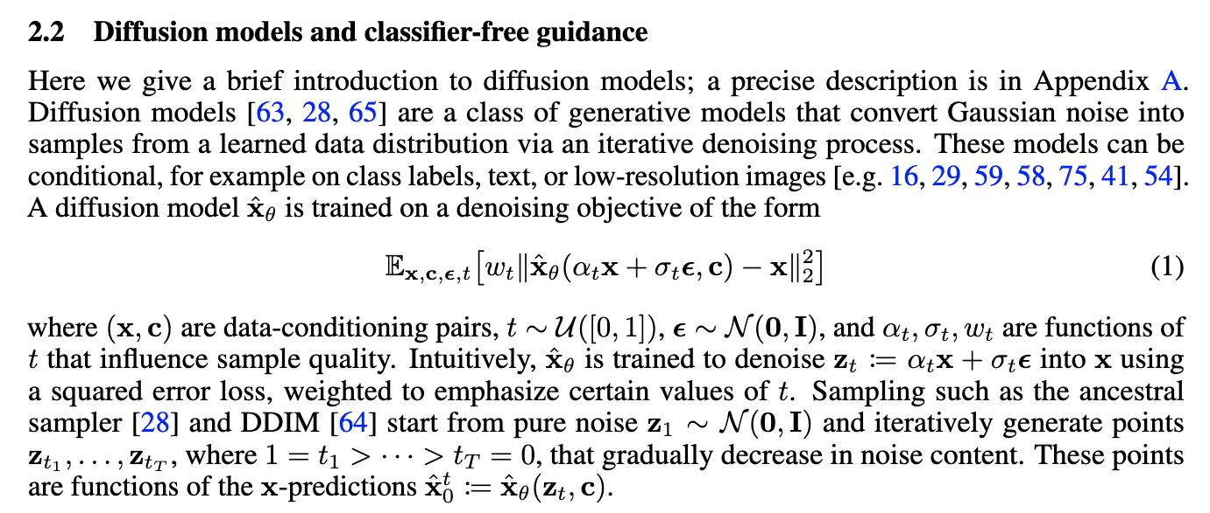
Imagen by Google
https://arxiv.org/pdf/2205.11487.pdf

Slide 13
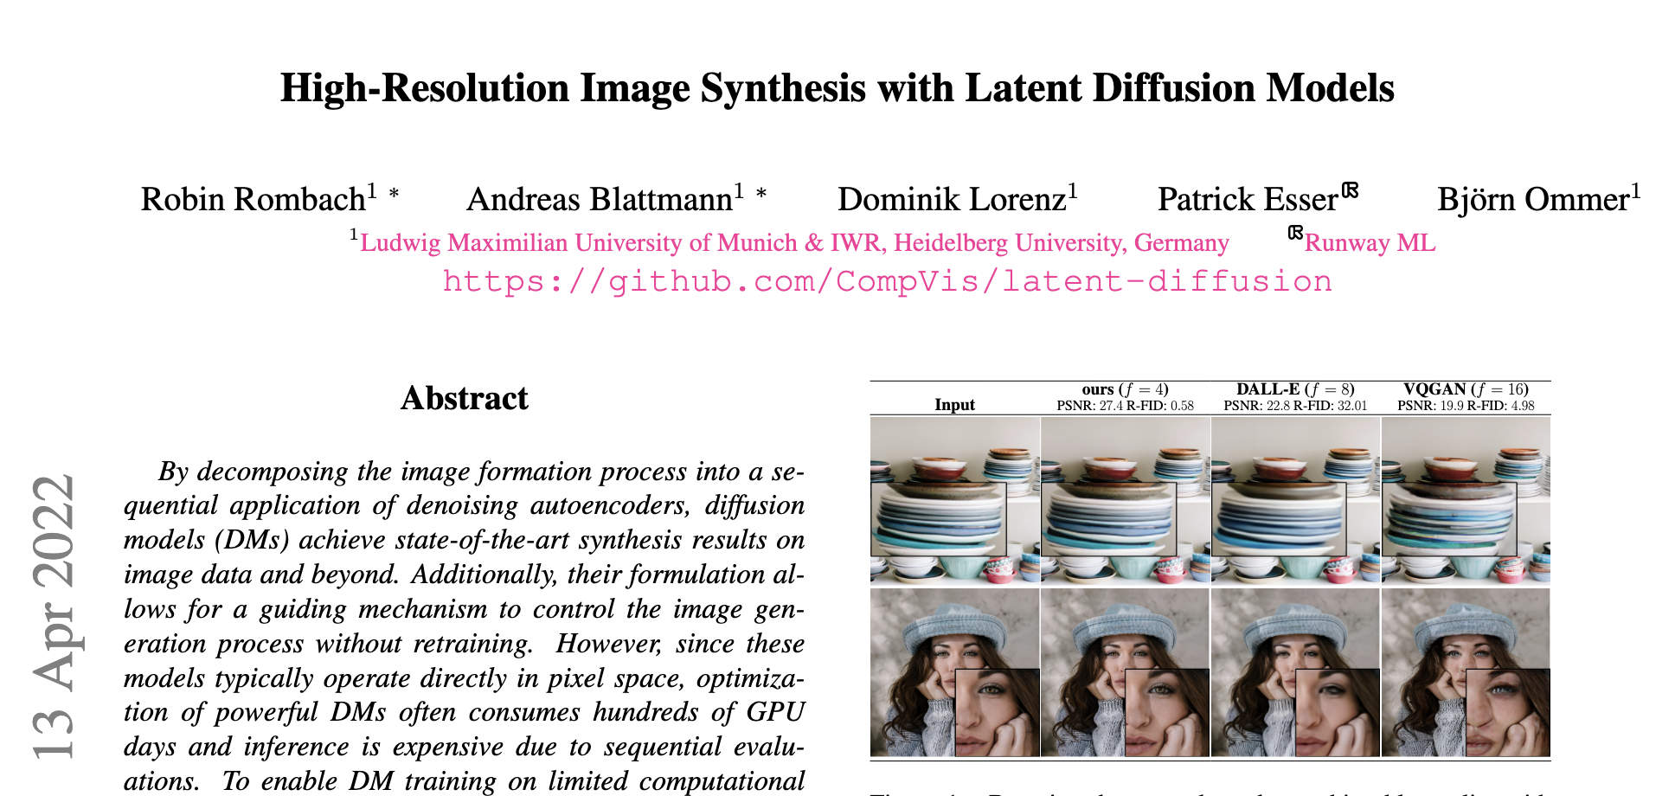
Latent Diffusion Models (Stable Diffusion)

Slide 14
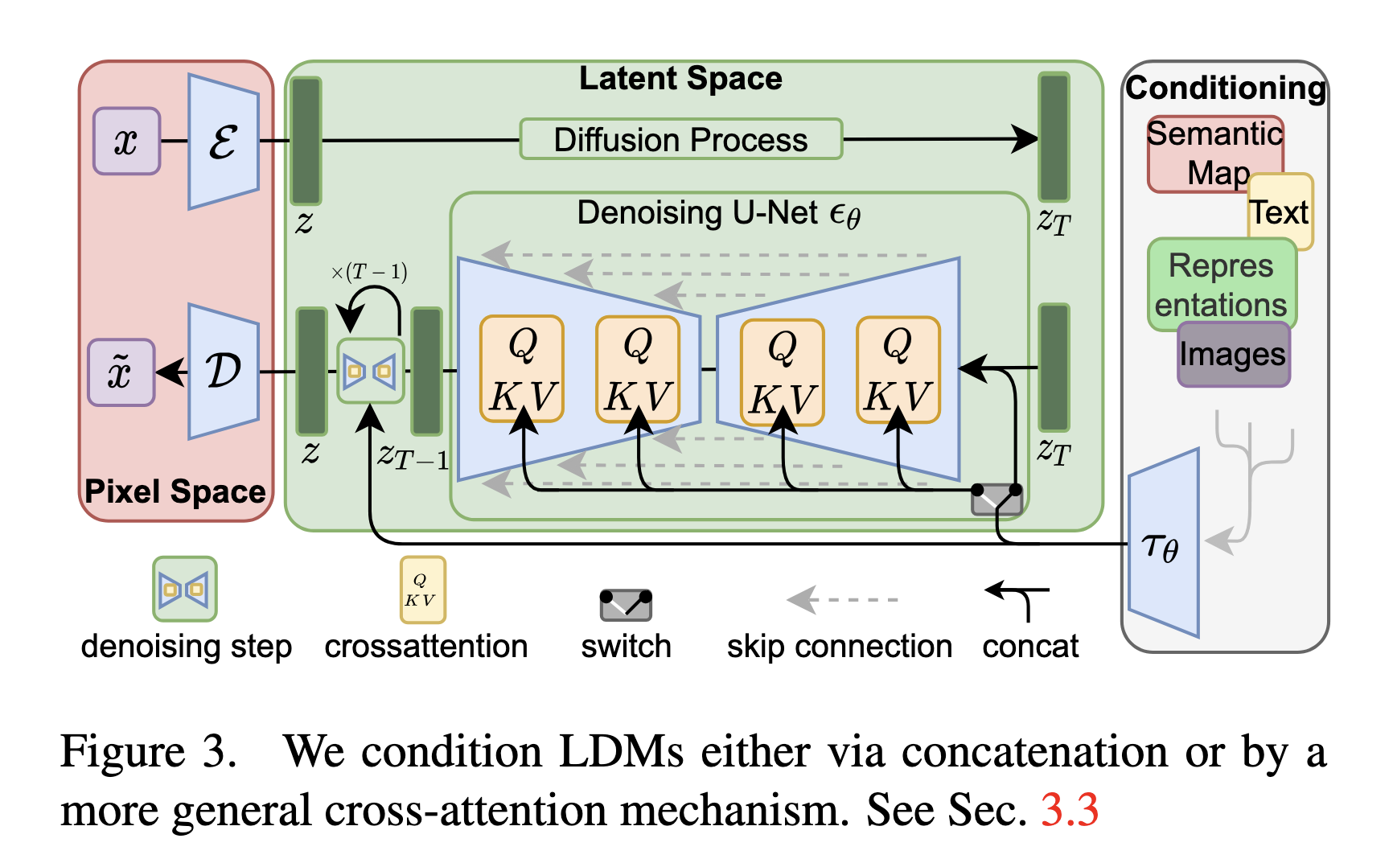
Latent Diffusion Models

Slide 15
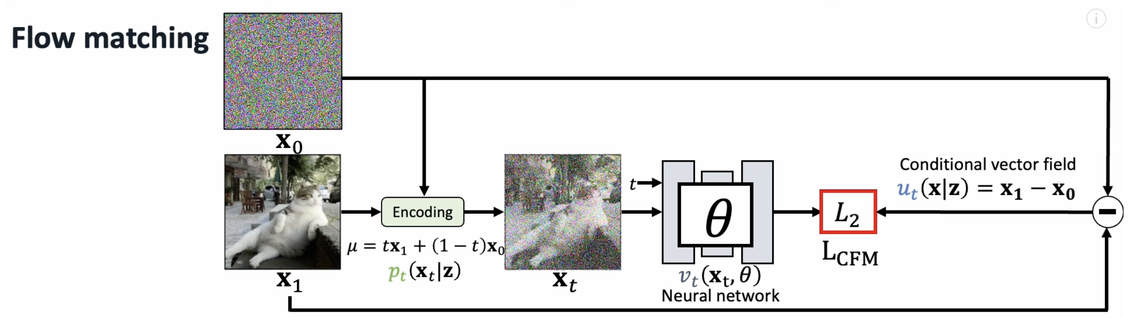
Another More Recent Improvement: Flow Matching
See video by Jia-bin Huang (U of Maryland)
https://www.youtube.com/watch?v=DDq_pIfHqLs

Slide 16
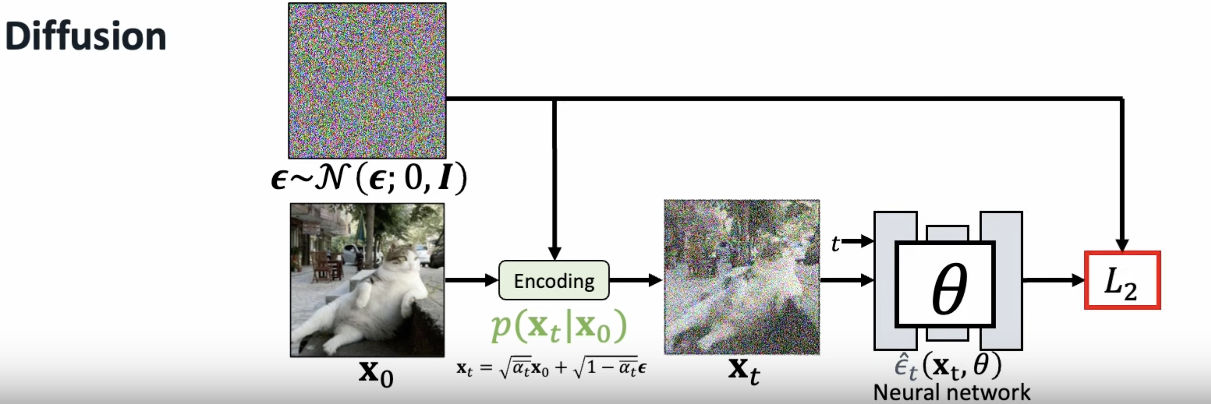

Slide 17
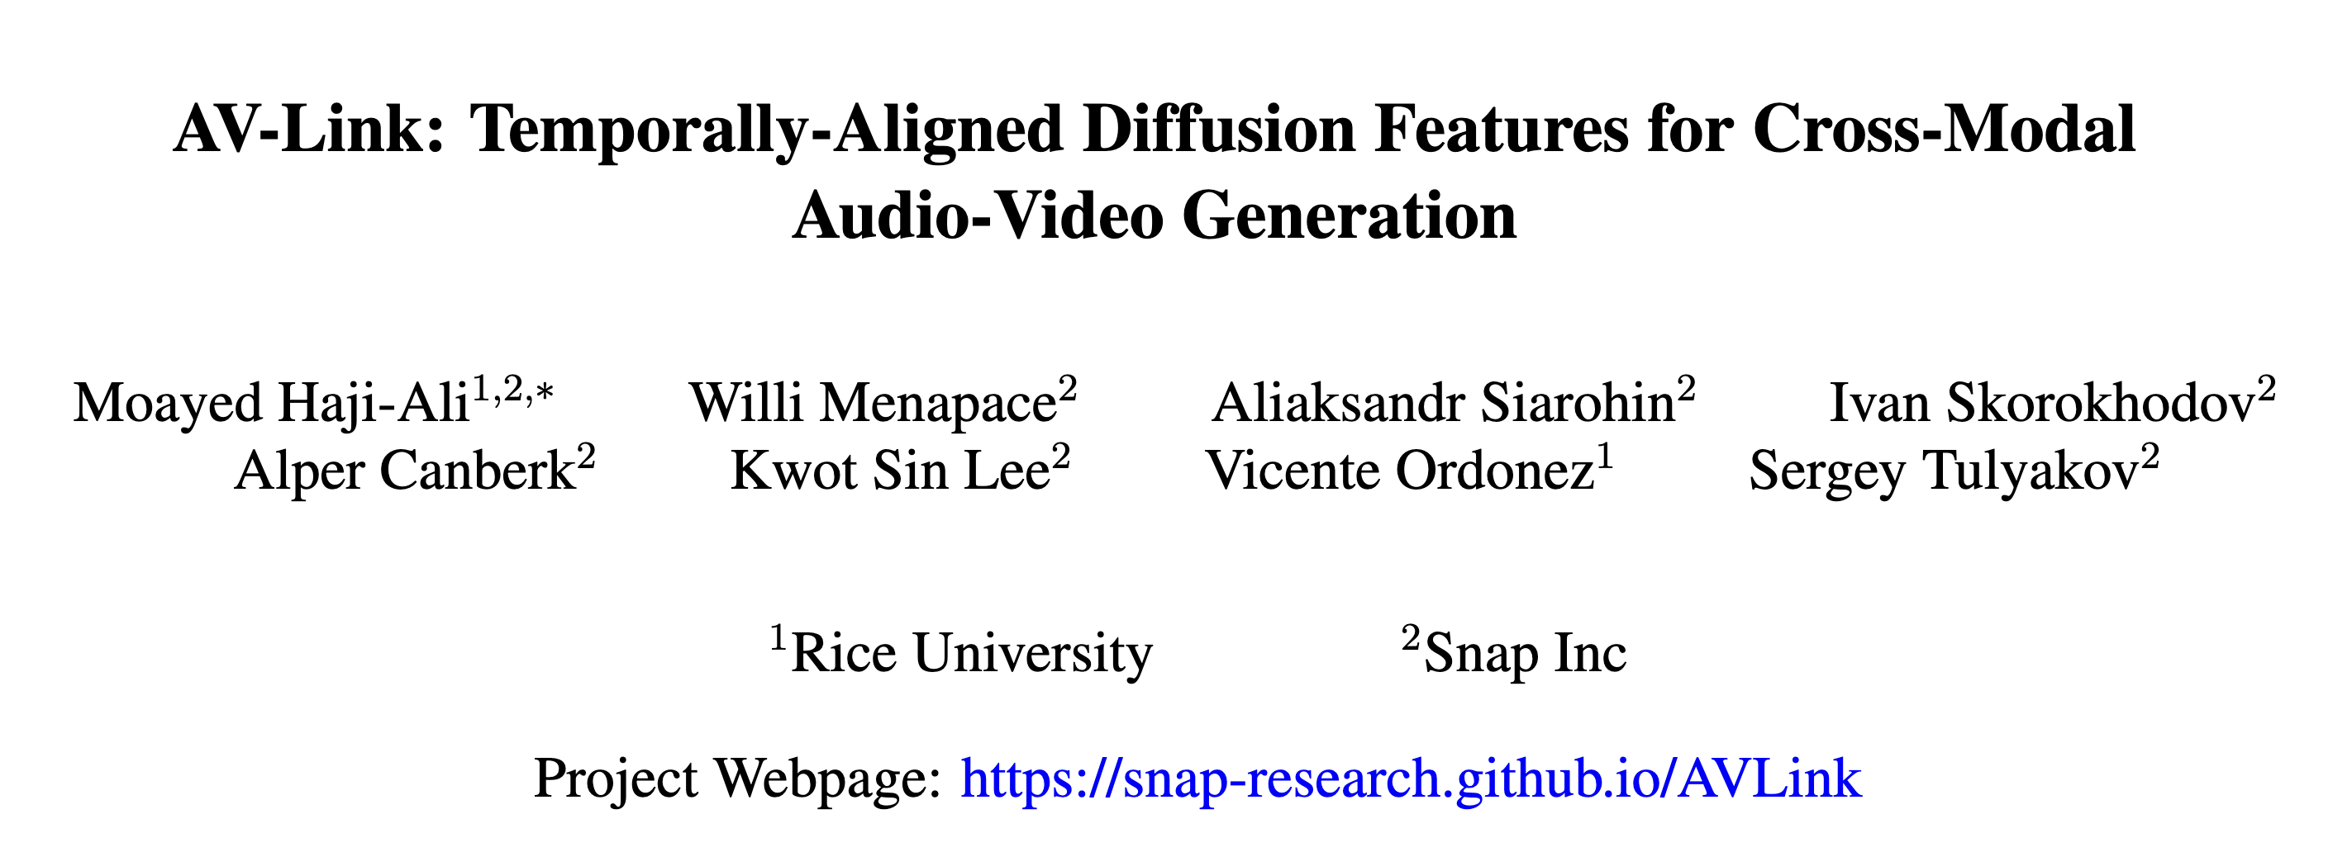
https://arxiv.org/pdf/2412.15191

Slide 18
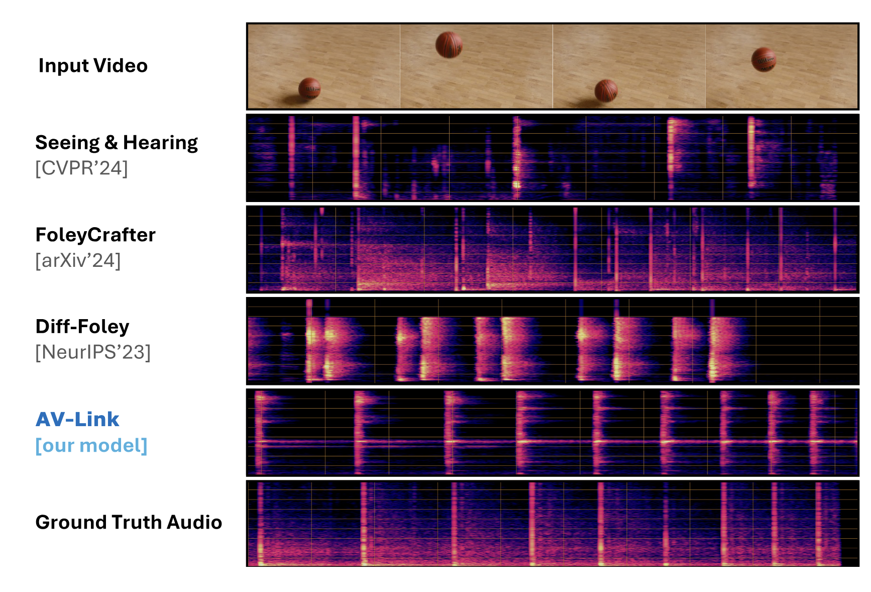

Slide 19
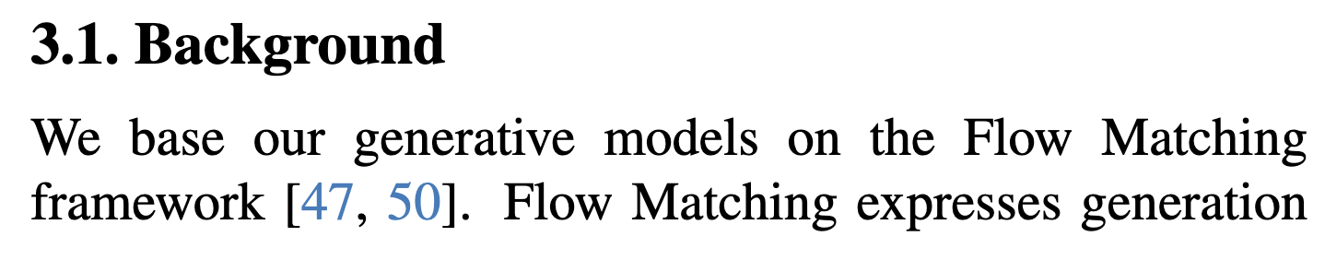
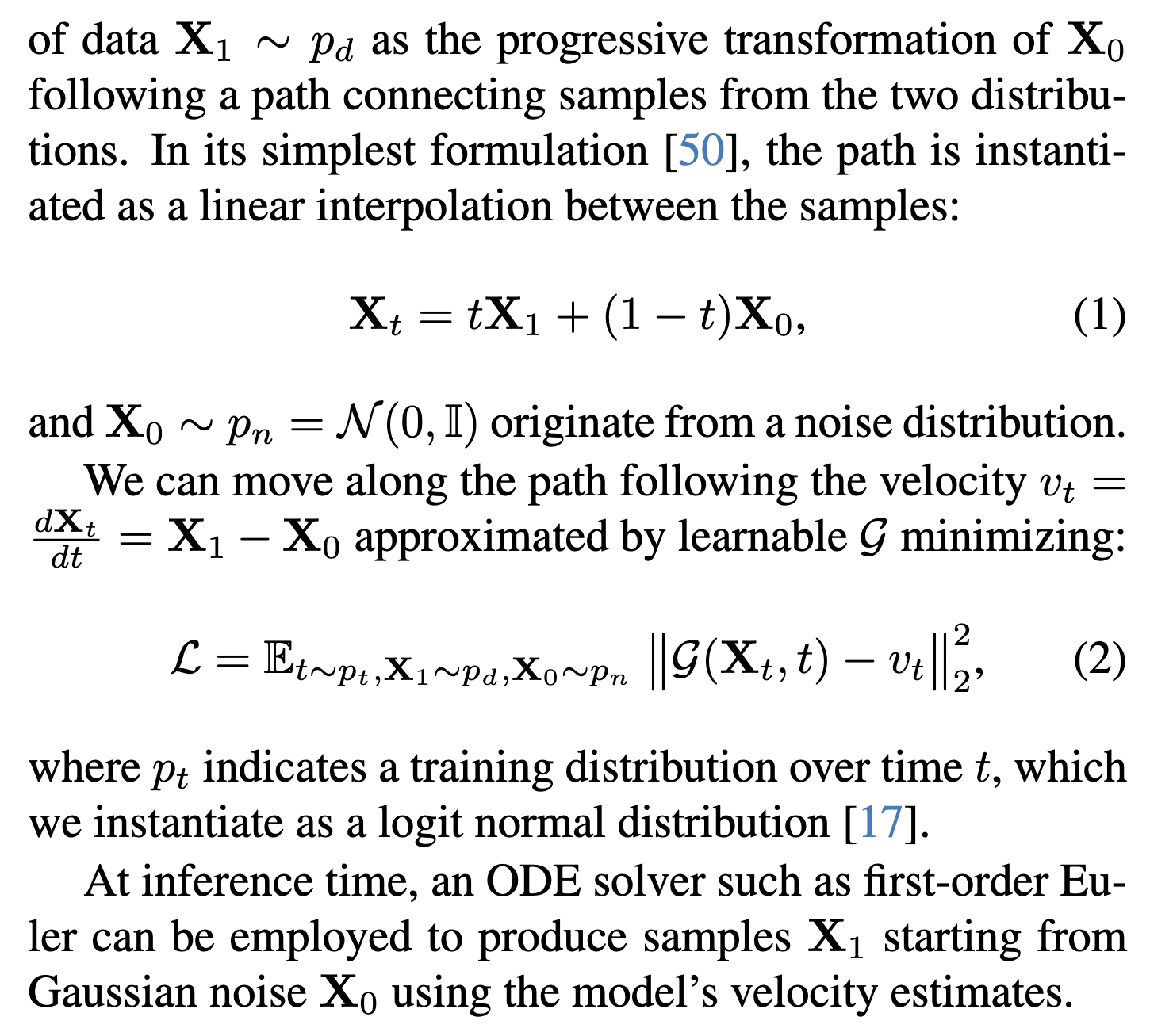

Slide 20
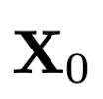
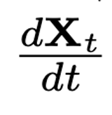
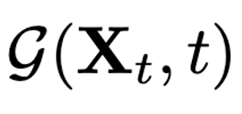

Assume we have the following:
and
=
How do we find ?

Slide 21
Assume we have the following:
and
=
How do we find ?

Slide 22
Also check this material to know more
Entire class on Flow Matching and Diffusion Models: https://diffusion.csail.mit.edu/

Slide 23
Alternative Methods to Diffusion
Auto-Regressive models (LLMs to Generate Images!)

Slide 26
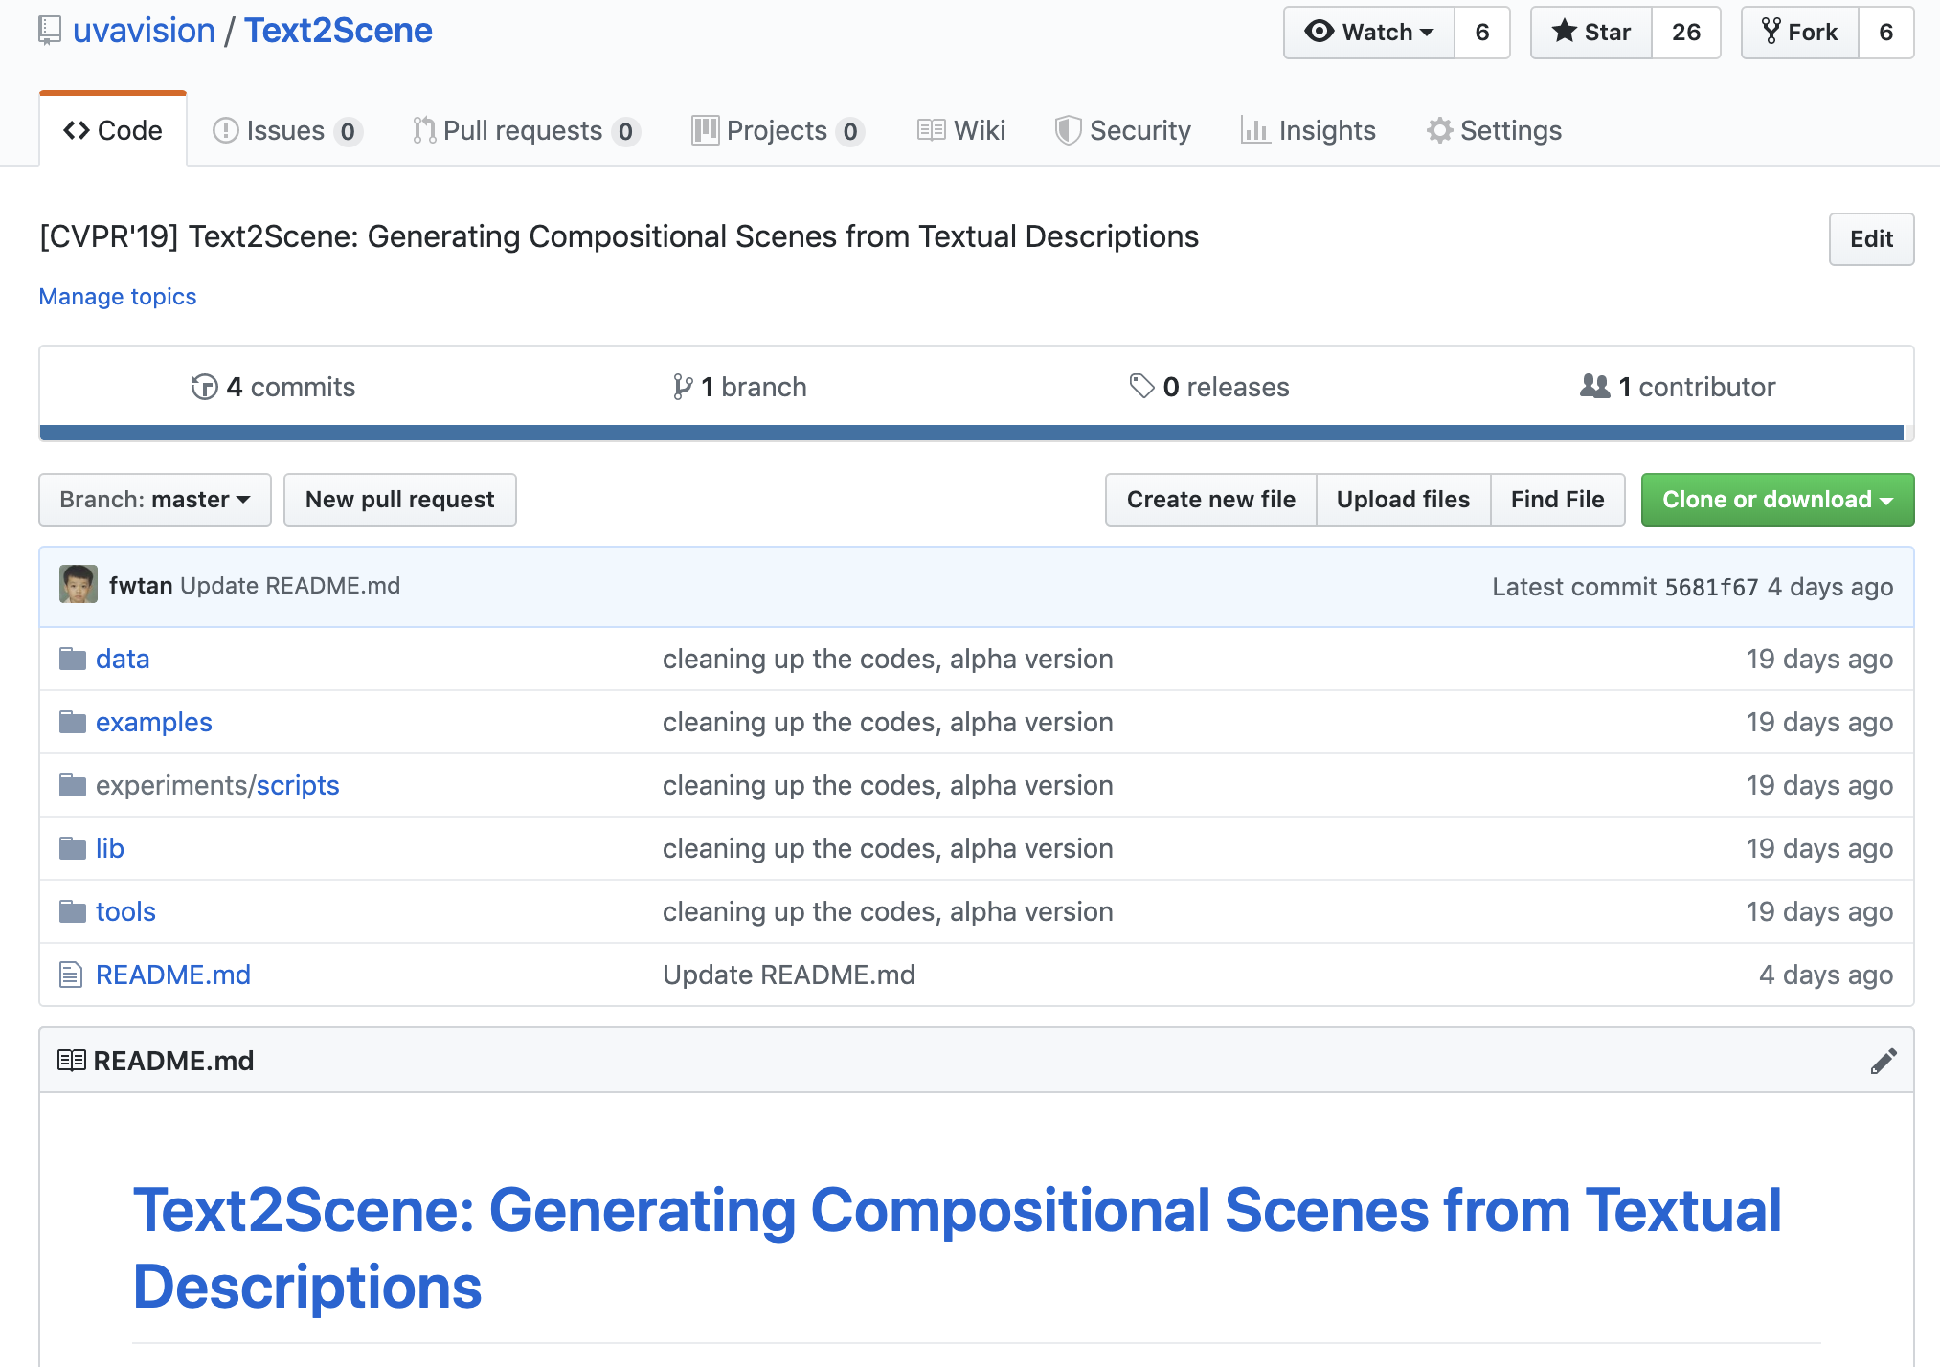
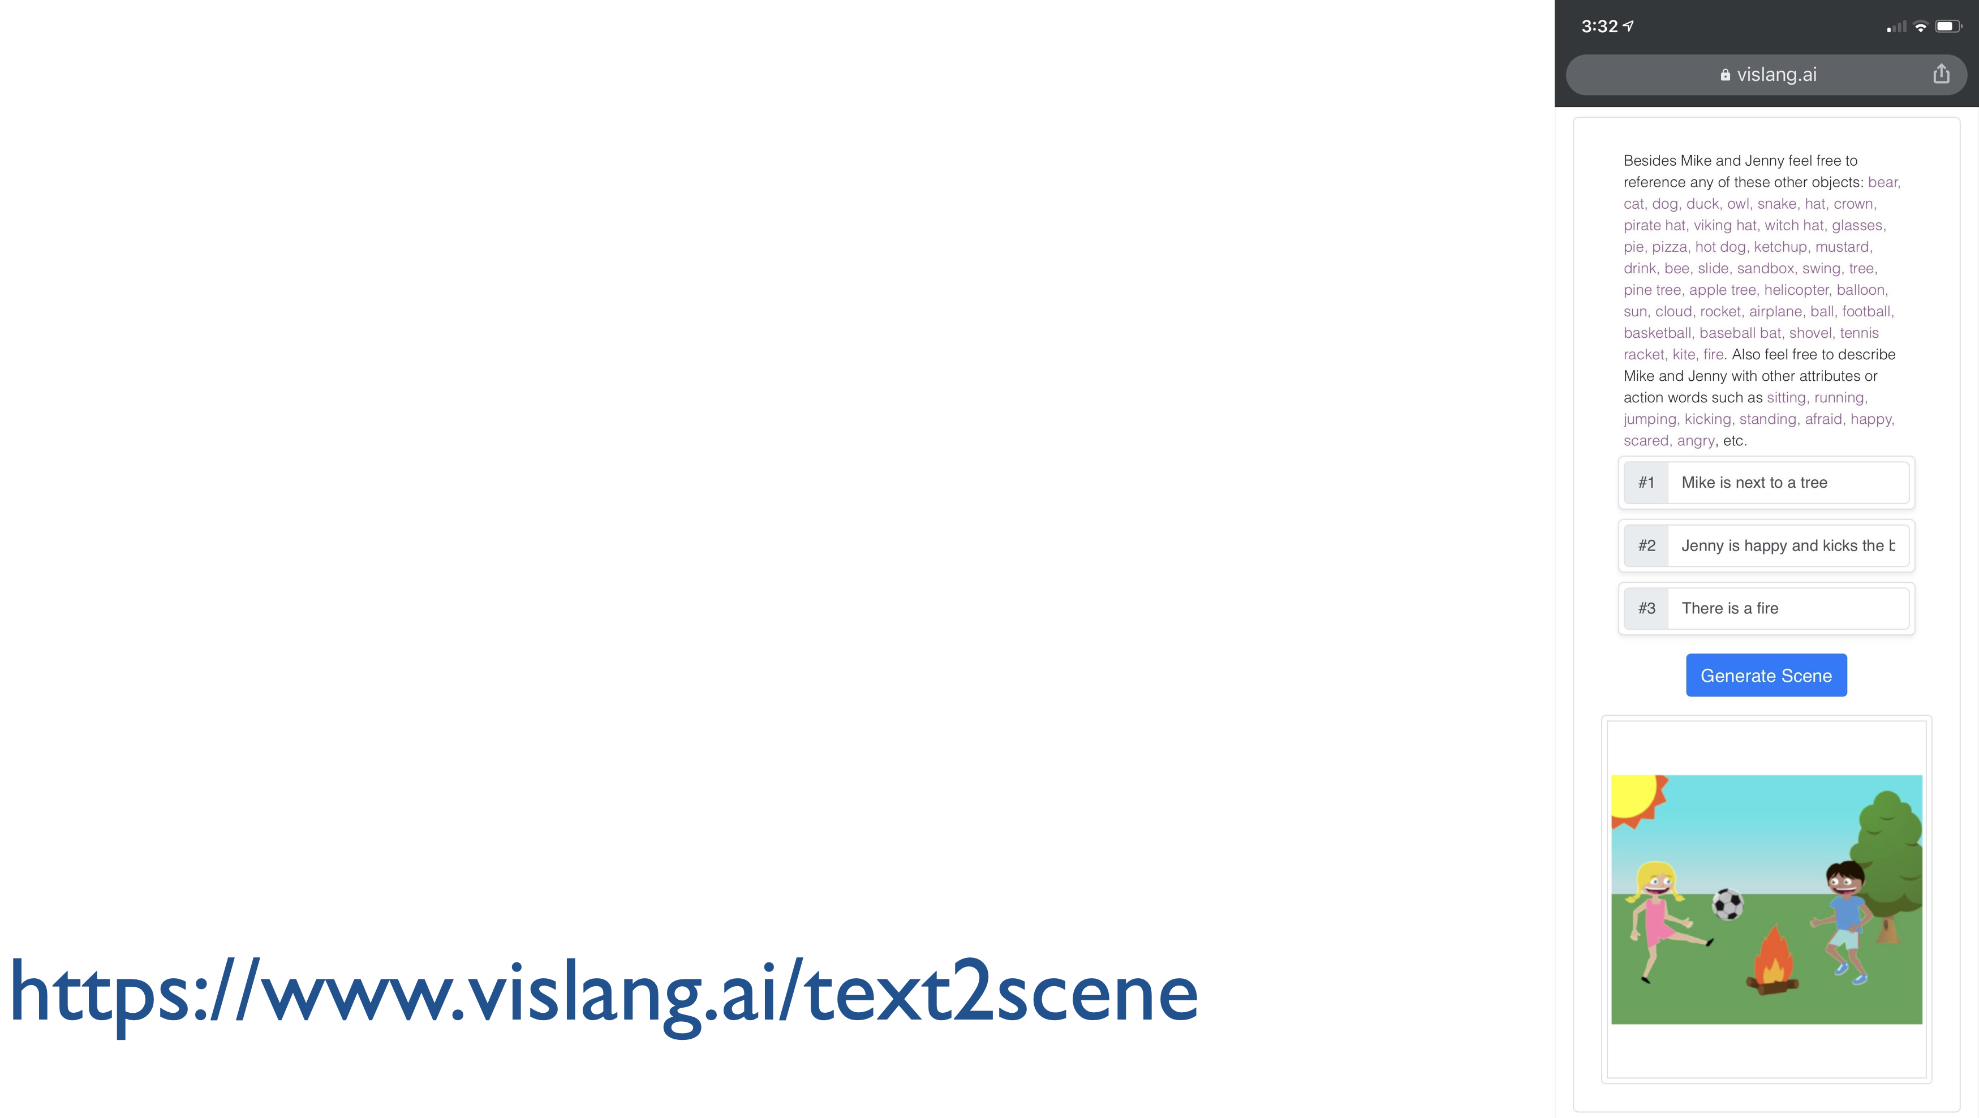

Slide 29
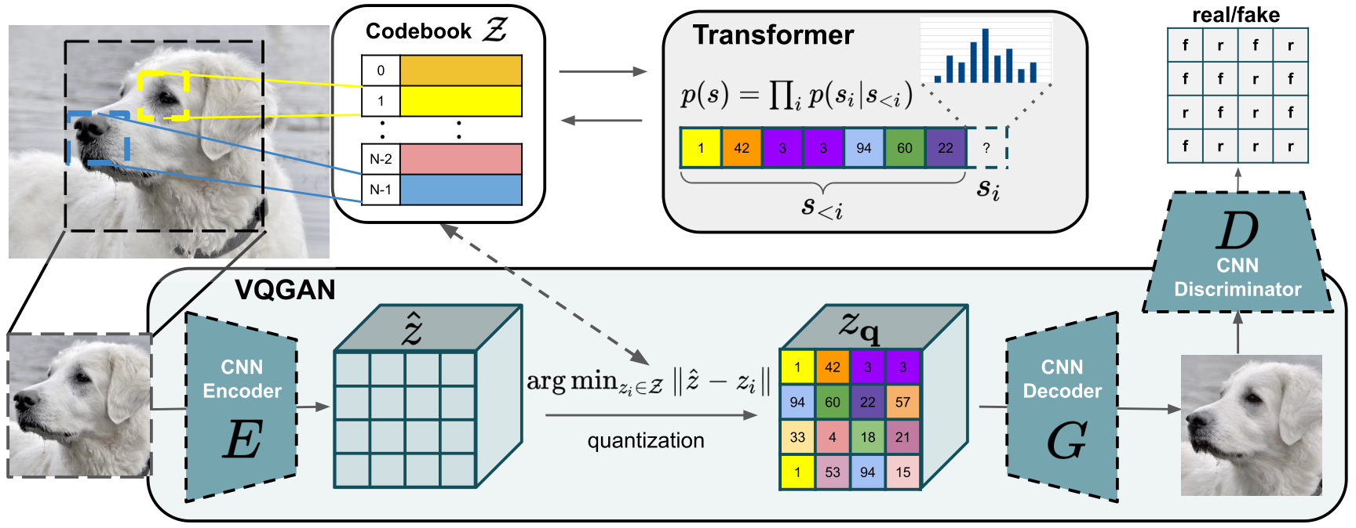
Vector Quantized - GAN
https://arxiv.org/abs/2012.09841
https://arxiv.org/pdf/2110.04627.pdf

Slide 30
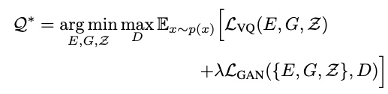

Vector Quantized GAN (VQGAN)
https://arxiv.org/abs/2012.09841
https://arxiv.org/pdf/2110.04627.pdf

Slide 31
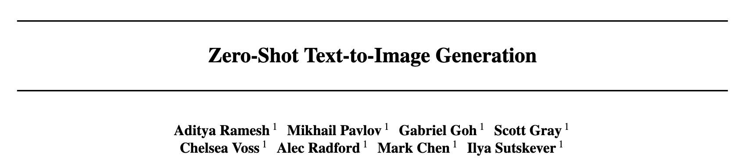
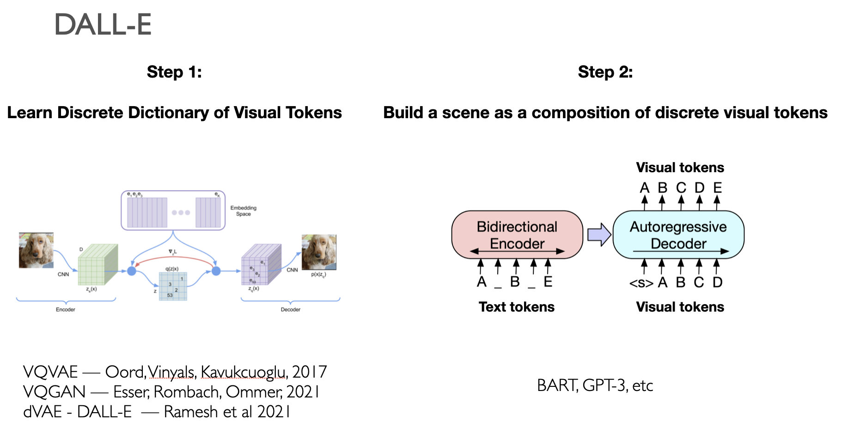
DALL-E (v1)
OpenAI Feb 2021

Slide 32
DALL-E (v1)

Slide 33
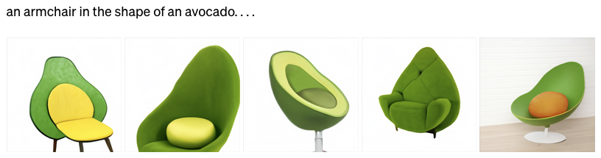

Slide 34
Questions

