Slide 1
Deep Learning for Vision & Language
Convolutional Neural Networks for Object Detection

Slide 2
Object Detection
deer
cat

Slide 3
Object Detection as Classification
deer?
CNN
cat?
background?

Slide 4
Object Detection as Classification
deer?
CNN
cat?
background?

Slide 5
Object Detection as Classification
deer?
CNN
cat?
background?

Slide 6
Object Detection as Classification with Sliding Window
deer?
CNN
cat?
background?

Slide 7
Object Detection as Classification with Box Proposals

Slide 8
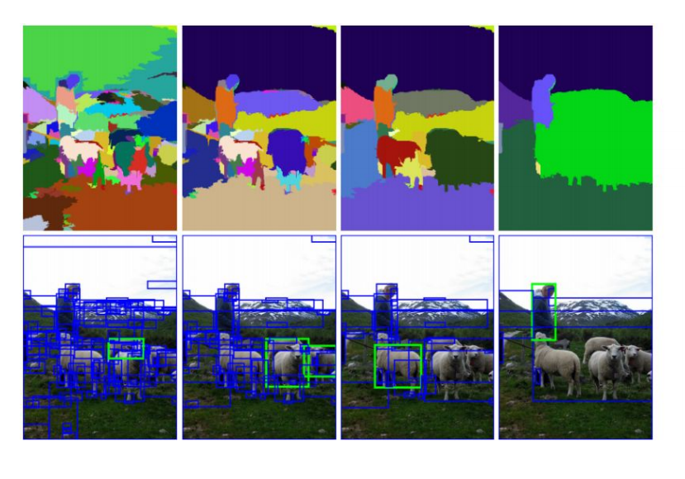
Box Proposal Method – SS: Selective Search
Segmentation As Selective Search for Object Recognition. van de Sande et al. ICCV 2011

Slide 9
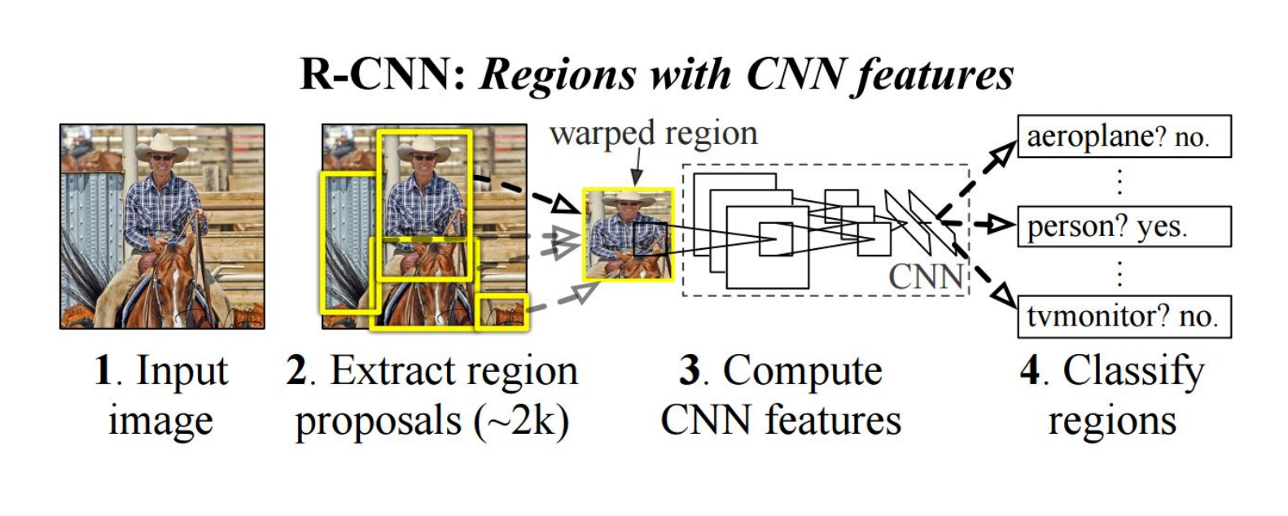
RCNN
https://people.eecs.berkeley.edu/~rbg/papers/r-cnn-cvpr.pdf
Rich feature hierarchies for accurate object detection and semantic segmentation. Girshick et al. CVPR 2014.

Slide 10
Fast-RCNN
Idea: No need to recompute features for every box independently, Regress refined bounding box coordinates.
https://arxiv.org/abs/1504.08083
Fast R-CNN. Girshick. ICCV 2015.
https://github.com/sunshineatnoon/Paper-Collection/blob/master/Fast-RCNN.md

Slide 11
Faster-RCNN
Idea: Integrate the Bounding Box Proposals as part of the CNN predictions
https://arxiv.org/abs/1506.01497
Ren et al. NIPS 2015.

Slide 12
Single-shot Object Detectors
No two-steps of box proposals + Classification
Anchor Points for predicting boxes

Slide 13
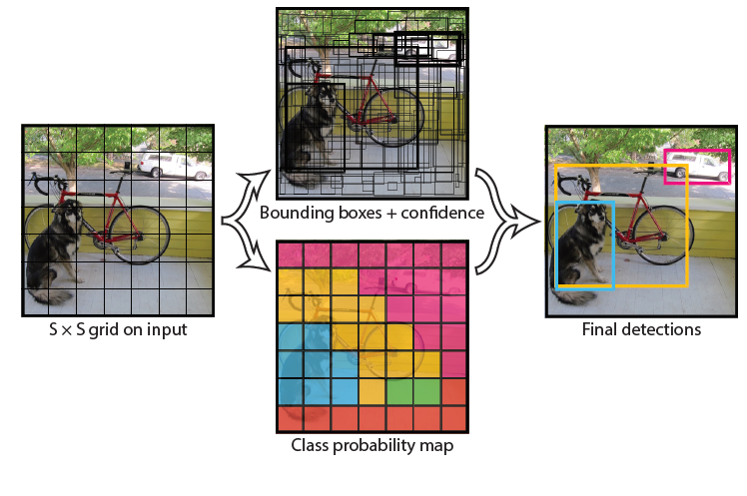
YOLO- You Only Look Once
Idea: No bounding box proposals. Predict a class and a
box for every location
in a grid.
https://arxiv.org/abs/1506.02640
Redmon et al. CVPR 2016.

Slide 14
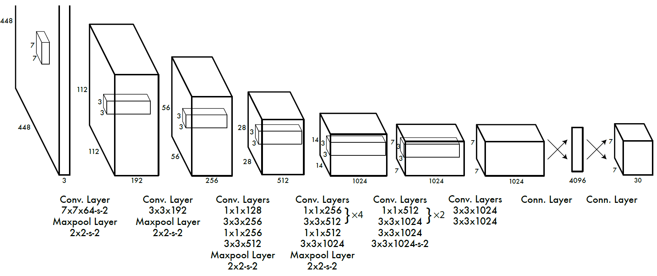
YOLO- You Only Look Once
Divide the image into 7x7 cells.
Each cell trains a detector.
The detector needs to predict the object’s class distributions.
The detector has 2 bounding-box predictors to predict
bounding-boxes and confidence scores.
https://arxiv.org/abs/1506.02640
Redmon et al. CVPR 2016.

Slide 15
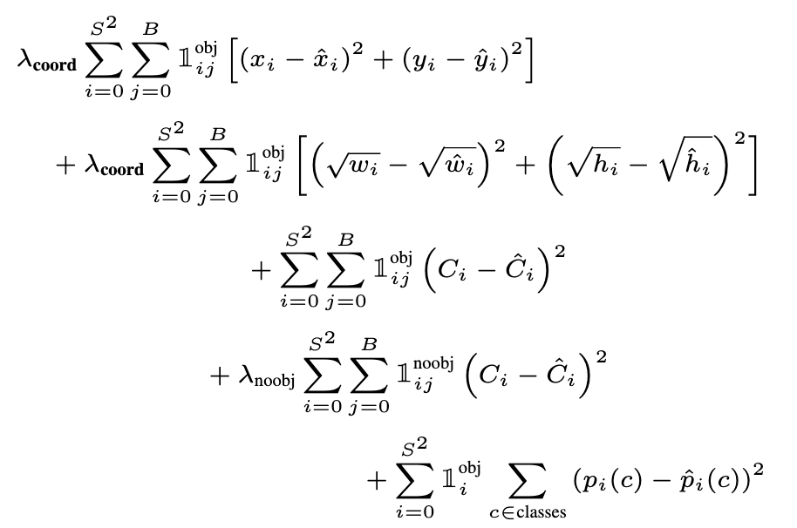
YOLO - Loss Function

Slide 16
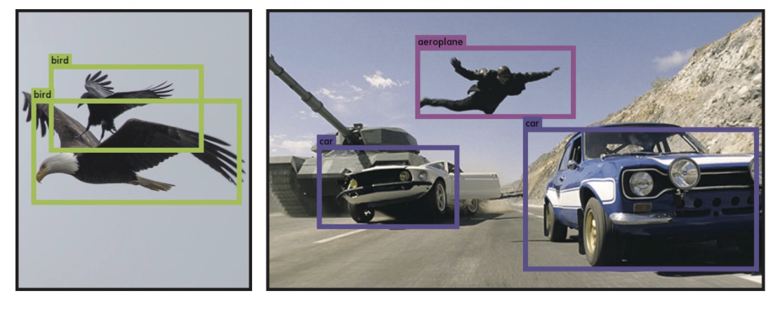
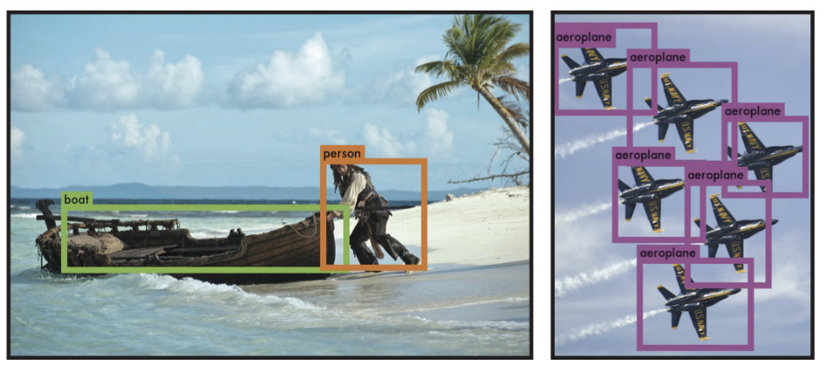

Slide 17
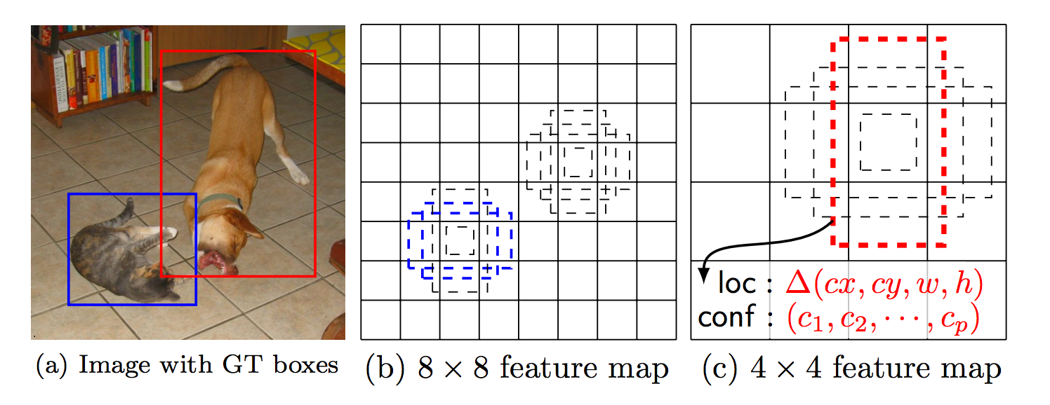
SSD: Single Shot Detector
Idea: Similar to YOLO, but denser grid map, multiscale grid maps. + Data augmentation + Hard negative mining + Other design choices in the network.
Liu et al. ECCV 2016.

Slide 18
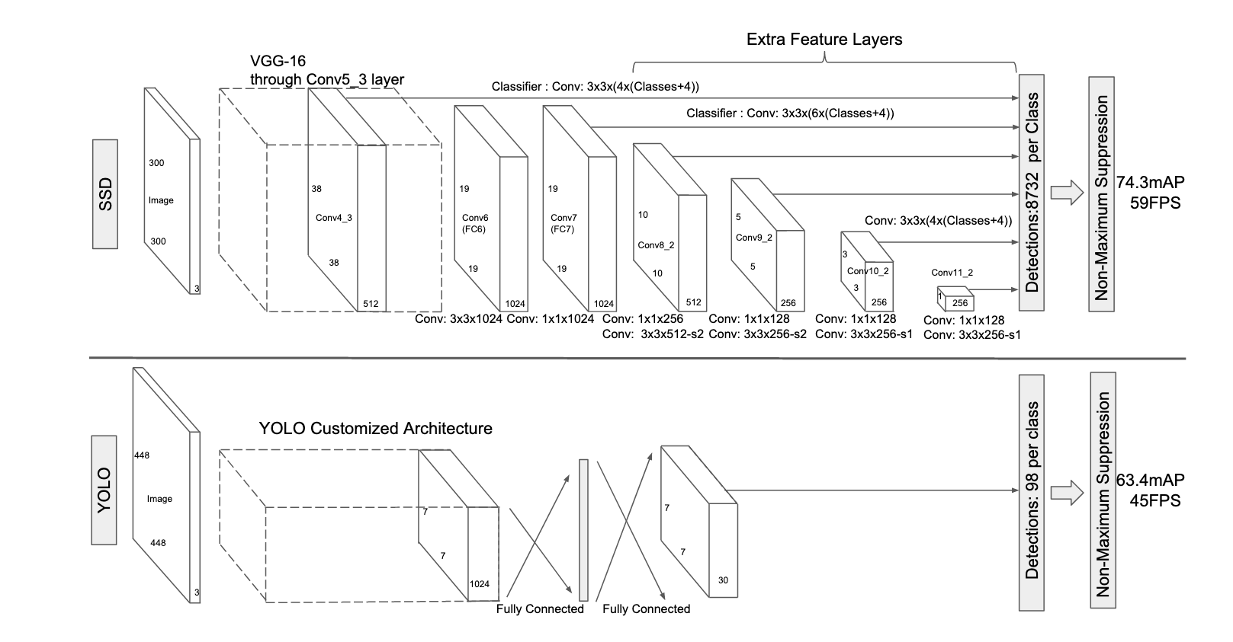
SSD vs YOLO

Slide 19
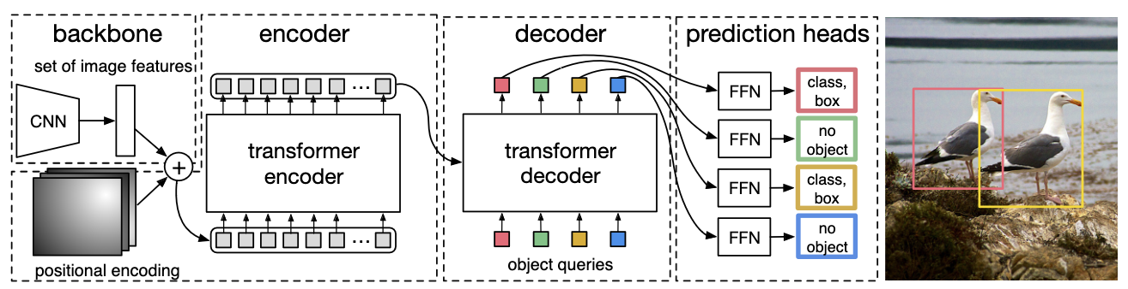
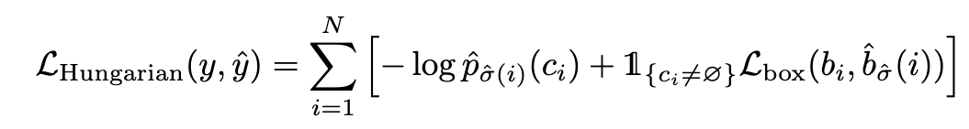
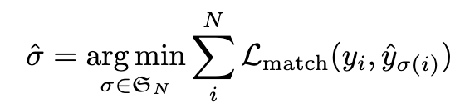
Object Detection with Transfromers (DETR) (2020)
where
https://arxiv.org/abs/2005.12872
https://github.com/facebookresearch/detr

Slide 20
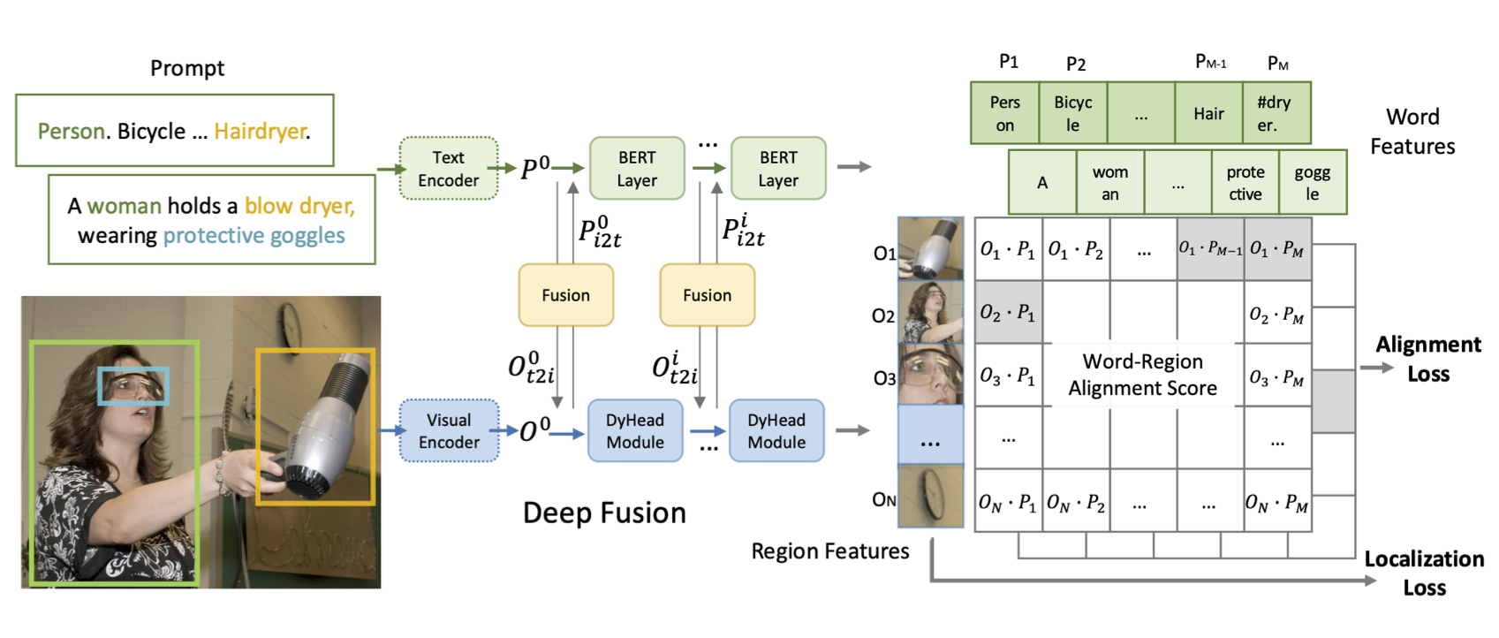
GLIP: CLIP but also outputs boxes (2021)
https://arxiv.org/abs/2112.03857
https://github.com/microsoft/GLIP

Slide 21
More recent Object Detectors
OwL-ViT (2022): https://arxiv.org/abs/2205.06230
GLIP-v2 (2022): https://arxiv.org/abs/2206.05836
DetCLIP (2022): https://arxiv.org/abs/2209.09407
YOLO-World (2024): https://github.com/AILab-CVC/YOLO-World

Slide 22
Questions

