Slide 1
Deep Learning for Vision & Language
Self-supervised Models for Computer Vision

Slide 2
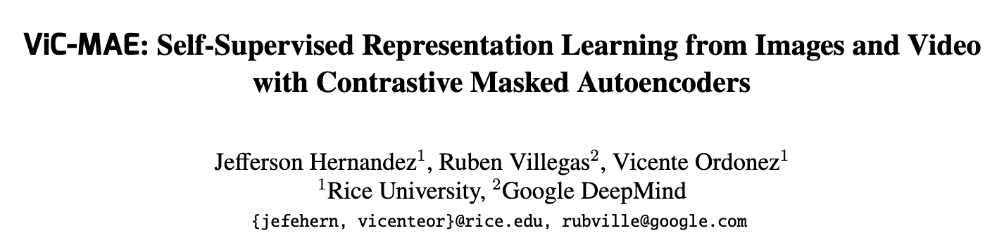

Slide 3
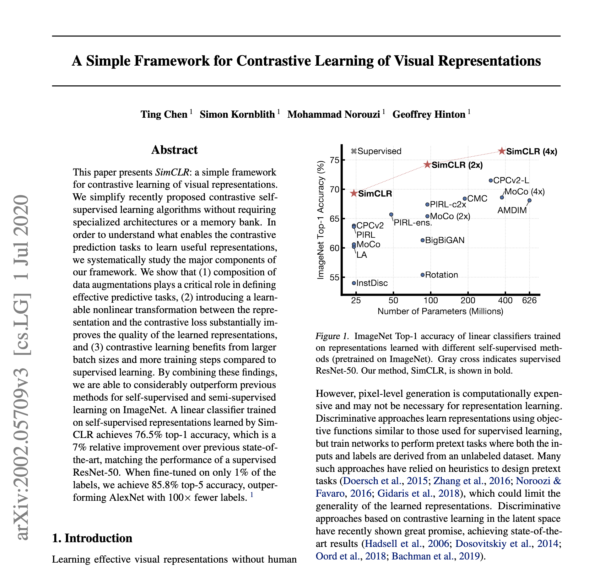

Slide 4
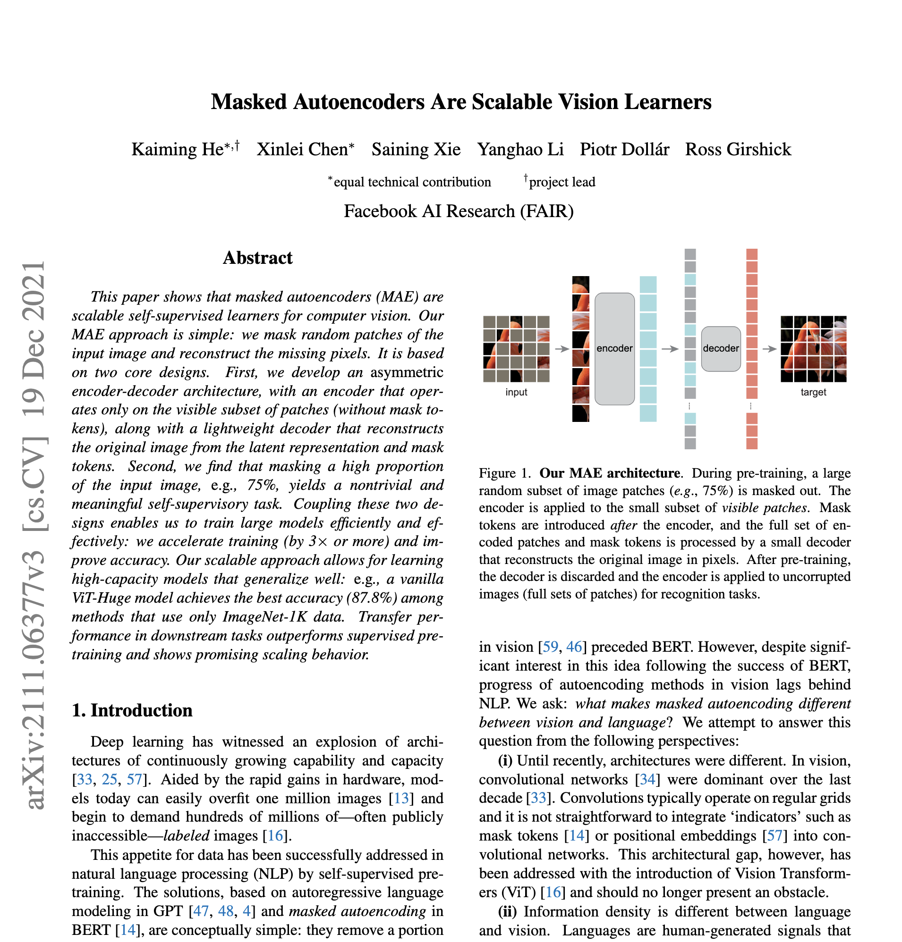

Slide 5
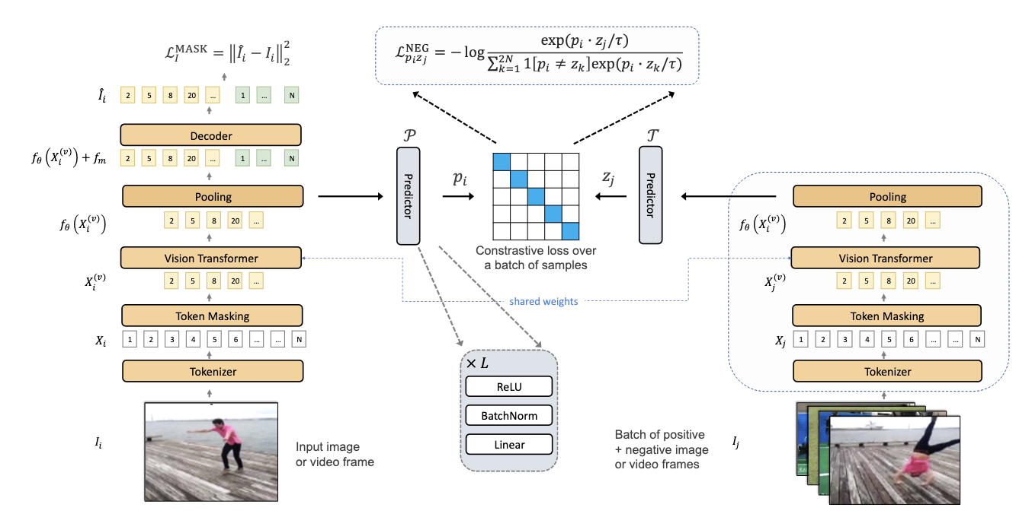
ViC-MAE

Slide 6
Self-Supervision for Visual Model Learning
Lots of data but no labels
Labeling data is expensive

Slide 7
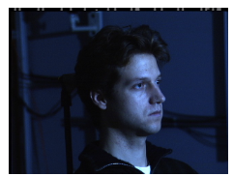
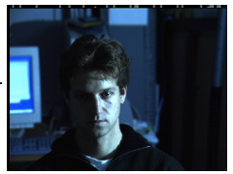
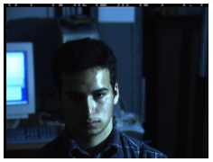




Similarity Learning: Triplet Loss (Supervised)
$$x_{i}^{a}$$
$$x_{i}^{p}$$
$$x_{i}^{n}$$
https://www.cv-foundation.org/openaccess/content_cvpr_2015/html/Schroff_FaceNet_A_Unified_2015_CVPR_paper.html

Slide 8
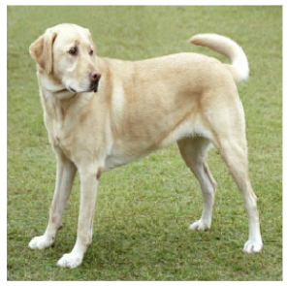
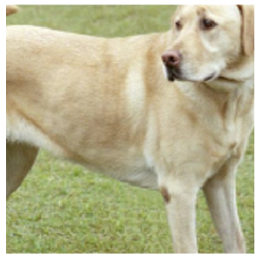
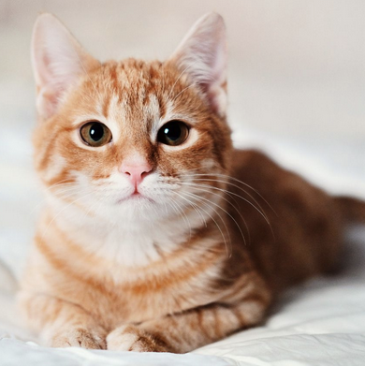
Similarity Learning: Triplet Loss (Self Supervised)
$$x_{i}^{a}$$
$$x_{i}^{p}$$
$$x_{i}^{n}$$
https://www.cv-foundation.org/openaccess/content_cvpr_2015/html/Schroff_FaceNet_A_Unified_2015_CVPR_paper.html

Slide 9
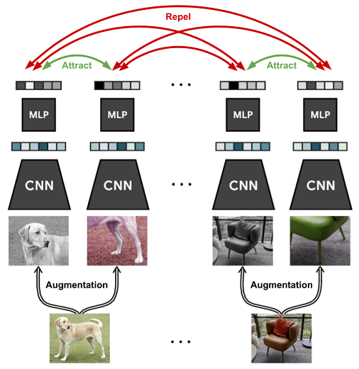
SimCLR: Contrastive Learning
https://arxiv.org/abs/2002.05709

Slide 10

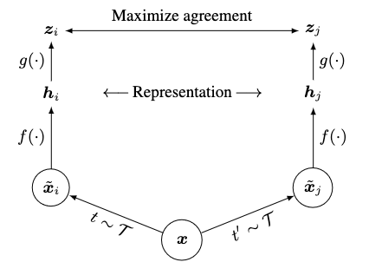

Contrastive Learning
Positive pair
Negative pairs
https://arxiv.org/abs/2002.05709

Slide 11
Issue with Contrastive Learning
Large number of negative examples in the denominator are needed
In practice this is approximated through batches – all other elements in the batch are negatives.
Random negative examples are easy
Large number of negative examples means larger batch sizes which occupy more memory
GPU memory is expensive (What is the max memory a GPU has these days vs your PC?)

Slide 12
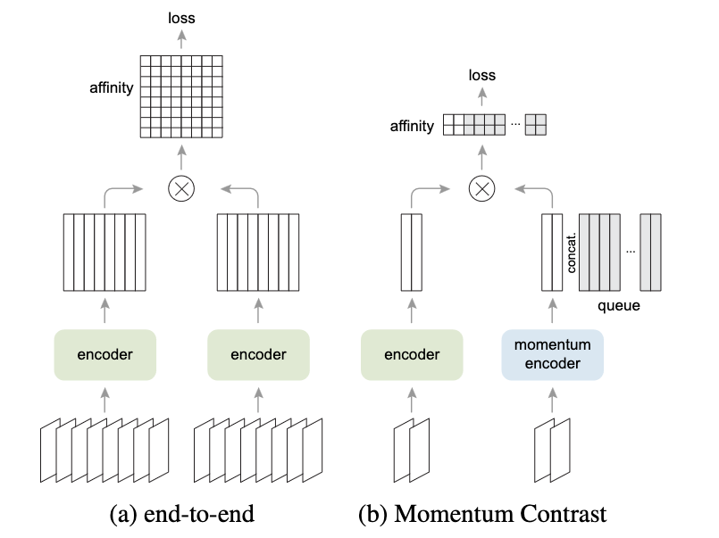
Momentum Contrastive Learning (MoCo)
https://arxiv.org/abs/2003.04297
https://arxiv.org/abs/1911.05722

Slide 13
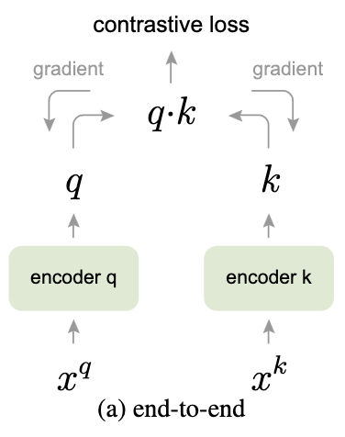
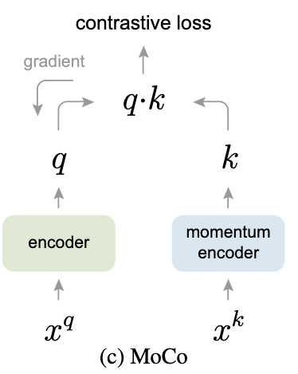

Momentum Contrastive Learning (MoCo)
https://arxiv.org/abs/2003.04297
https://arxiv.org/abs/1911.05722

Slide 14
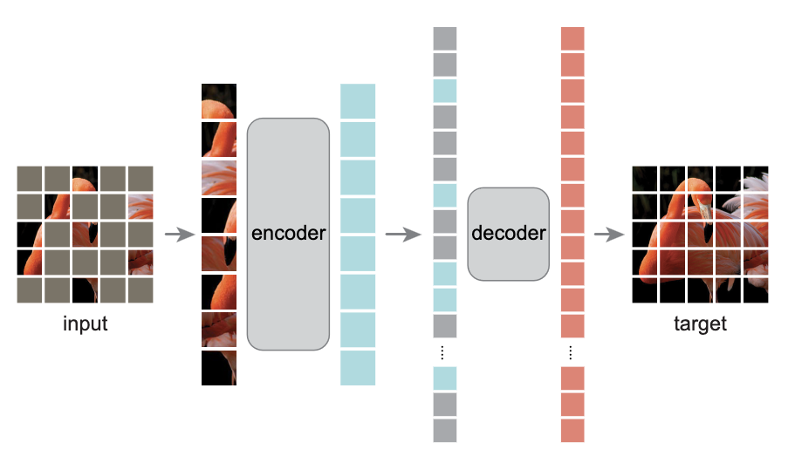
Alternative: Masked AutoEncoders (MAE)
https://arxiv.org/abs/2111.06377

Slide 15
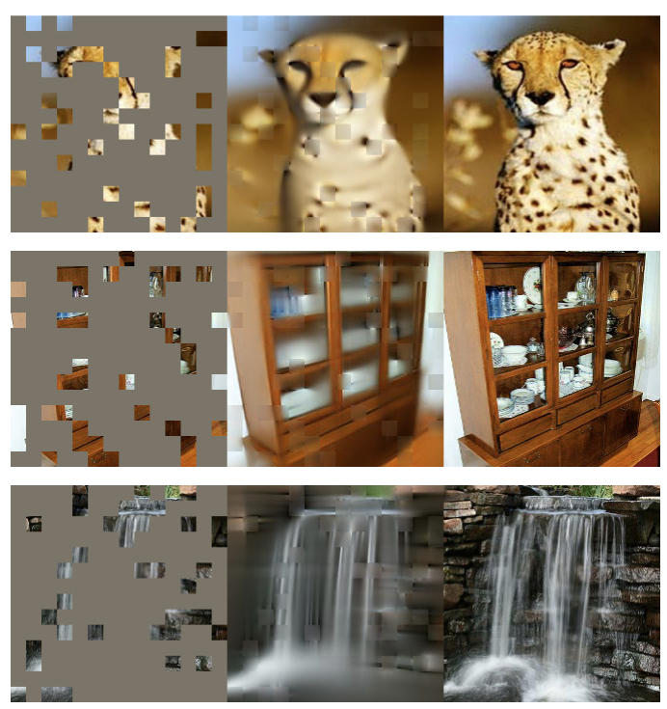
Examples
After training, the model learns to fill-in-the-blanks for images.
Similar to text masked image modeling
The model can be finetuned for any other task.

Slide 16
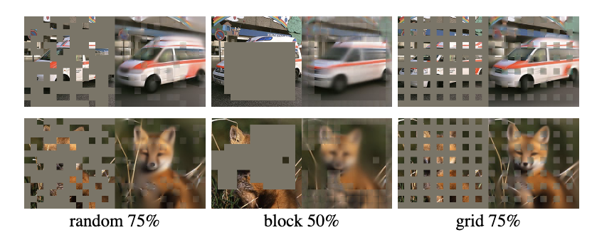
Several Analysis in the Paper

Slide 17
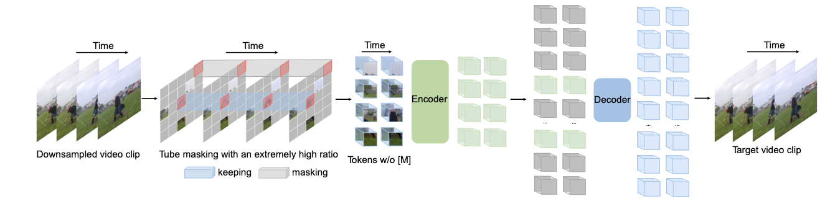

Video MAE
https://arxiv.org/abs/2203.12602

Slide 18
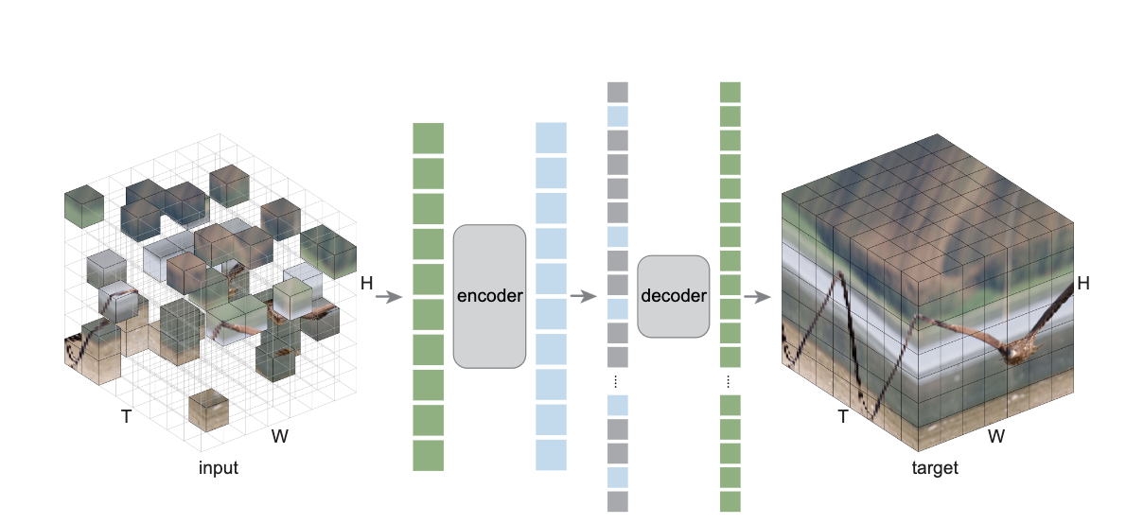
ST MAE
https://arxiv.org/abs/2205.09113

Slide 19
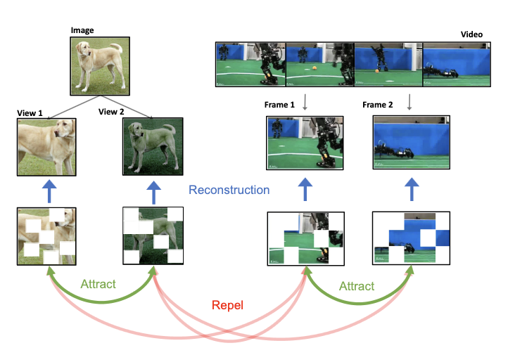
ViC-MAE
https://arxiv.org/abs/2303.12001

Slide 20
ViC-MAE

Slide 21
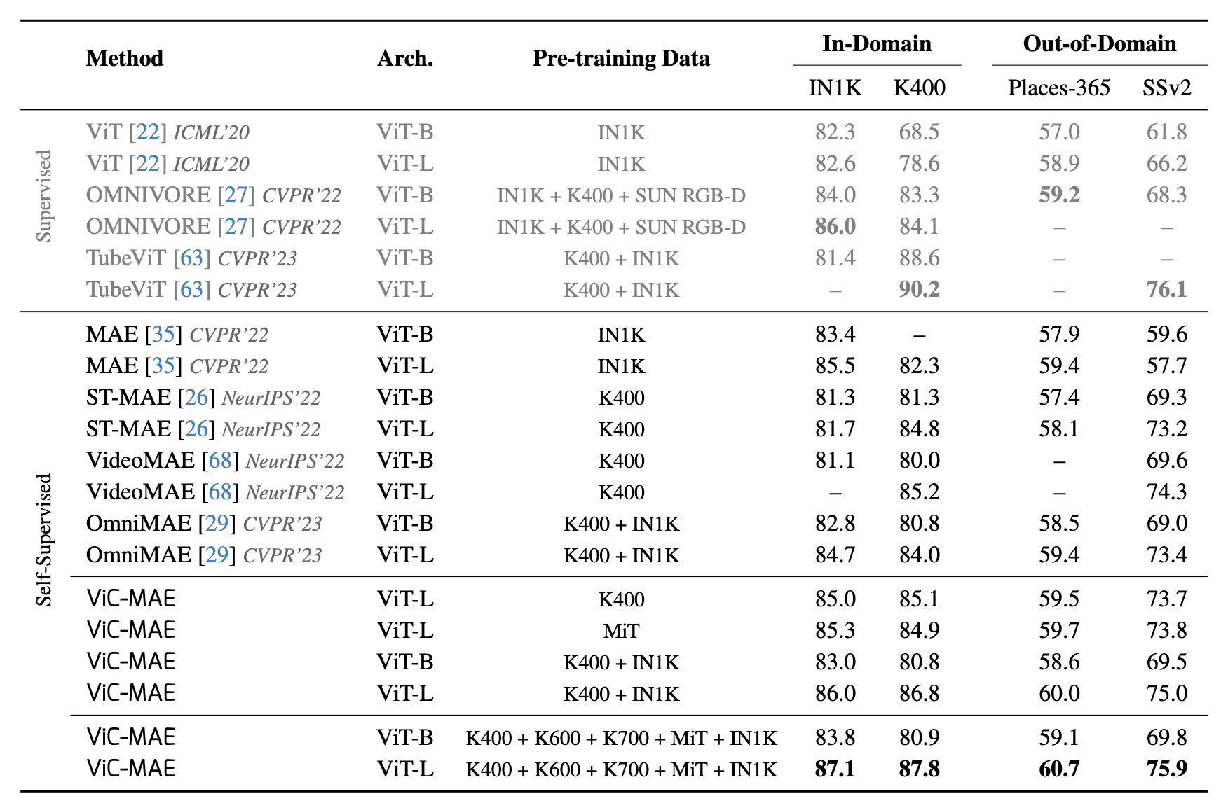
Results

Slide 22
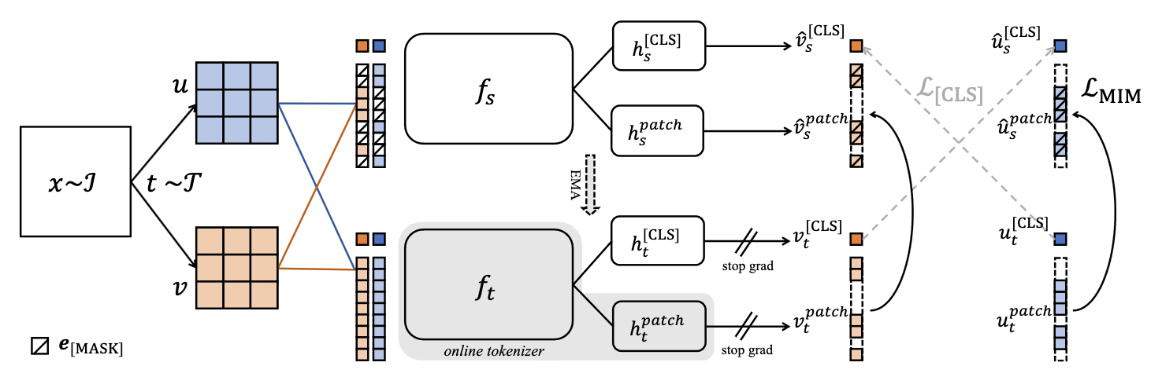
Also take a look at iBOT
https://arxiv.org/abs/2111.07832

Slide 23
iBOT
Masked Image Modeling
Plus…
Student – Teacher Learning (with Exponential Moving Average)
Online Tokenizer

Slide 24
Questions

