Slide 1
Deep Learning for Vision & Language
Transformers for NLP and Beyond

Slide 2
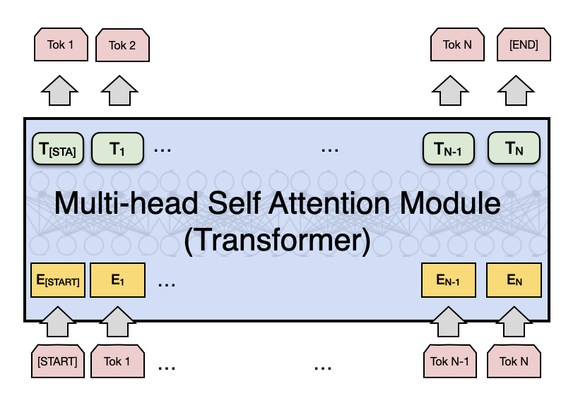
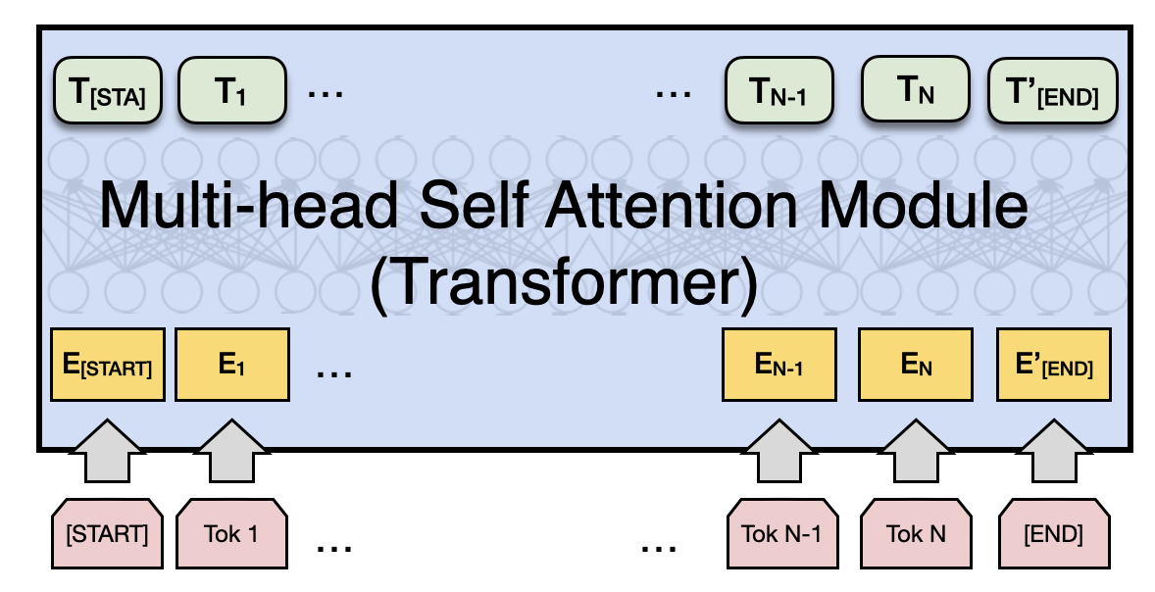
Attention is All you Need (no RNNs)
Vaswani et al. Attention is all you need
https://arxiv.org/abs/1706.03762
Decoder
Encoder
Fixed number of input tokens
[but hey! we can always define a large enough length and add mask tokens]

Slide 3
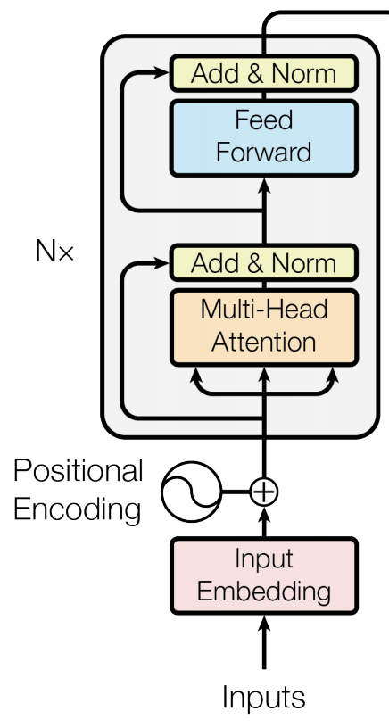
Attention is All you Need (no RNNs)
Vaswani et al. Attention is all you need
https://arxiv.org/abs/1706.03762
Decoder
Encoder
Fixed number of input tokens
[but hey! we can always define a large enough length and add mask tokens]

Slide 4
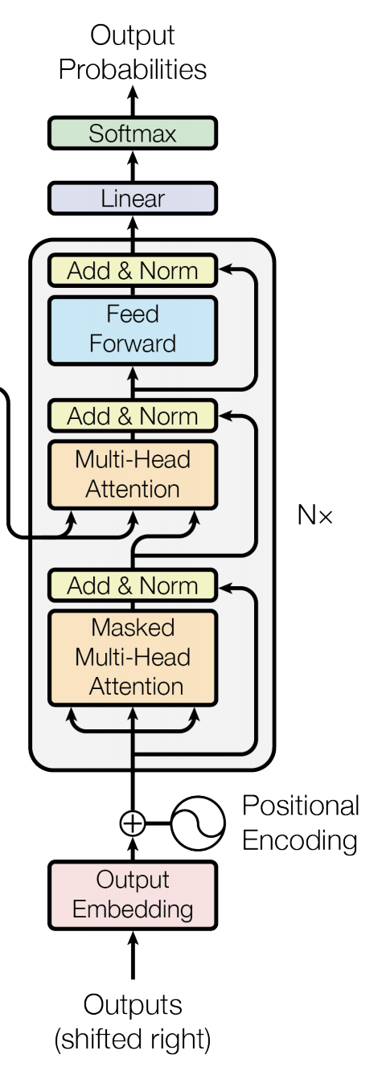
Attention is All you Need (no RNNs)
Vaswani et al. Attention is all you need
https://arxiv.org/abs/1706.03762
Decoder
Encoder
Fixed number of input tokens
[but hey! we can always define a large enough length and add mask tokens]

Slide 5
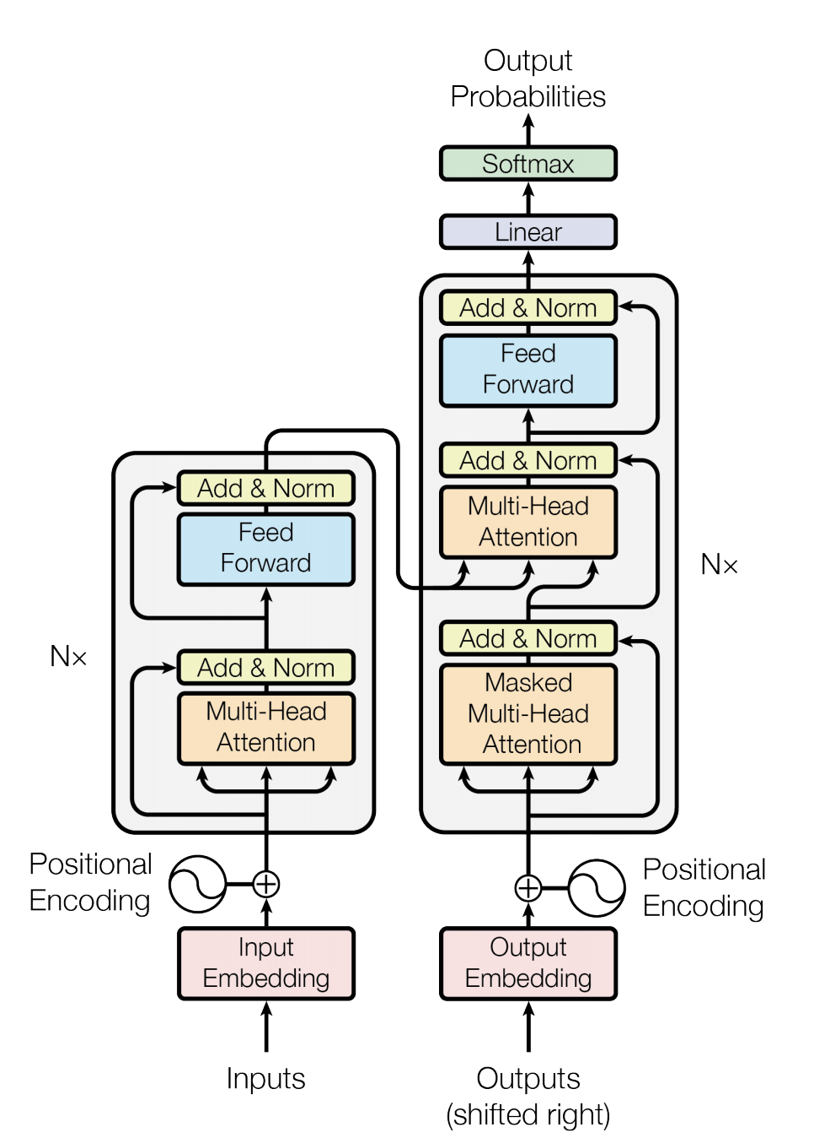
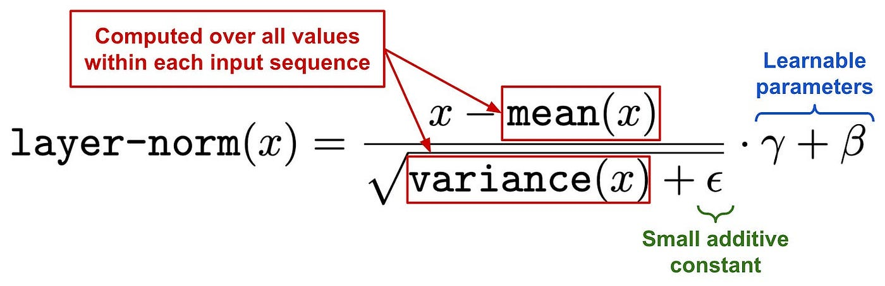
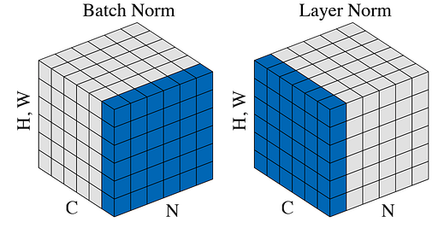
We can also draw this as in the paper:
Vaswani et al. Attention is all you need
https://arxiv.org/abs/1706.03762
across different samples
across different hidden dimensions
Notes:
Vicente’s message: I explained at length Single-Head Self-Attention and Multi-Head Self-Attention in the previous lecture and I will include these in the quiz.
However I did not have time to cover what is in a Transformer Block. In slide 4 (attached) you can skip the issue of explaining Multi-Head Attention and treat it as a black box but you have to explain what is "Add&Norm", what is "Feed Forward", what are "Positional Encoding" and what is "Masked Multi-Head Attention". I also have slides later that develop the concept of Positional Encodings -- I also mention why they are needed and what are other alternatives to cosine-sine embeddings (without going into detail for each one).

Slide 6
We can also draw this as in the paper:
Vaswani et al. Attention is all you need
https://arxiv.org/abs/1706.03762
FFN(x) = W2 * ReLU(W1 * x + b1) + b2

Slide 7
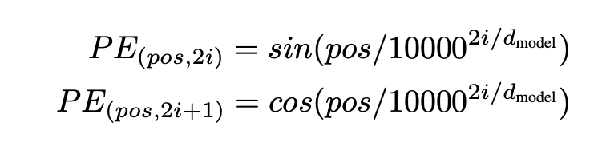
We can lose track of position since we are aggregating across all locations
Vaswani et al. Attention is all you need
https://arxiv.org/abs/1706.03762
"The cat sat on the mat."
“mat sat on the cat."

Slide 8
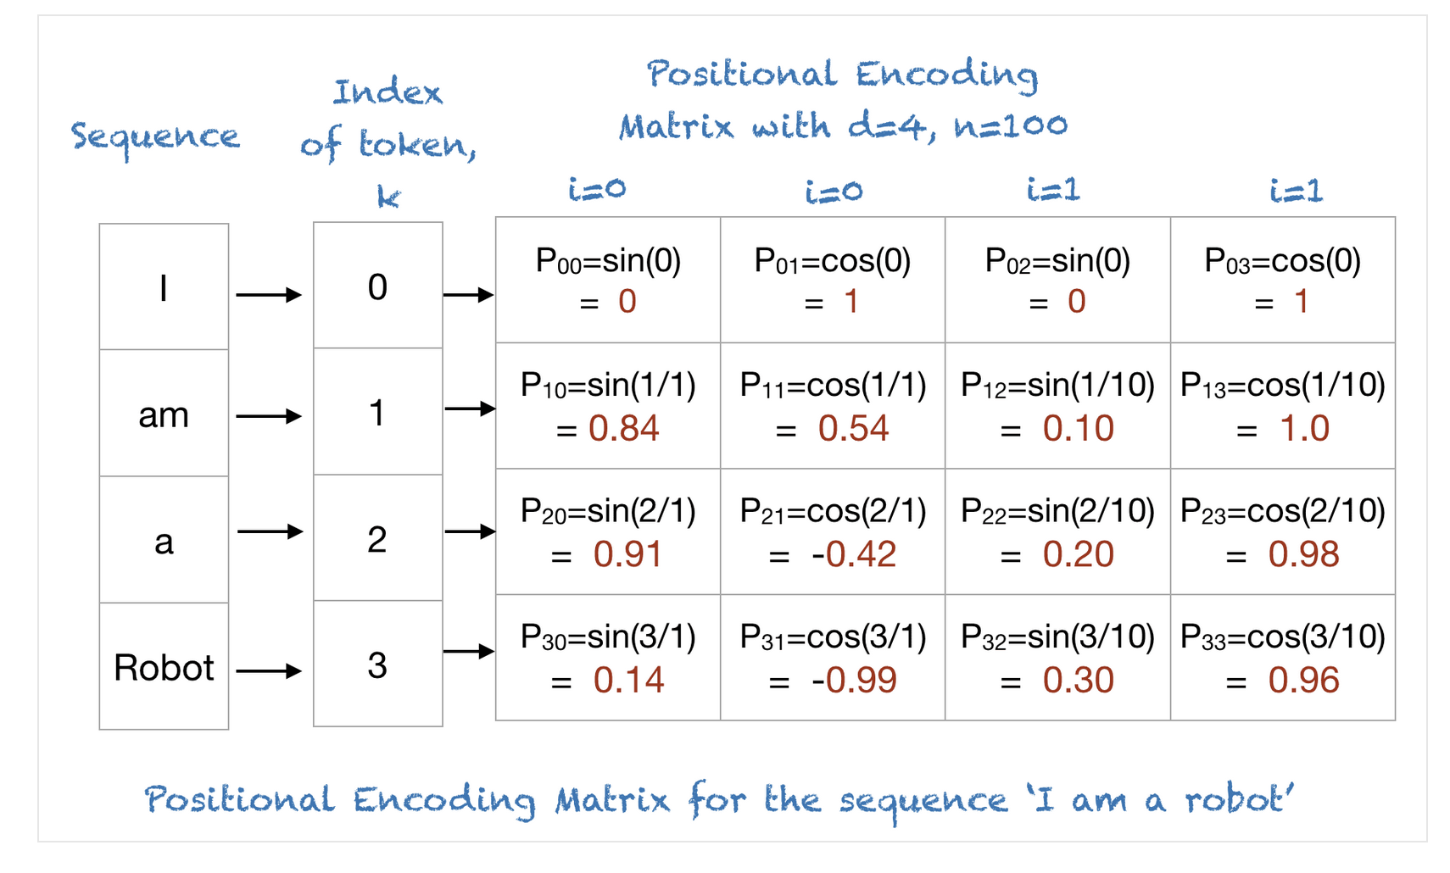
Positional Encodings
https://machinelearningmastery.com/a-gentle-introduction-to-positional-encoding-in-transformer-models-part-1/
By Mehreen Saeed

Slide 9
Other Positional Encodings
Learnable Absolute Positional Encodings: Initialize them with random weights and learn them. However fixed for each position. BERT Models use this.
Relative Positional Encodings: Encode distances between tokens instead of absolute positions. Used in moderns such as T5 from Google.
RoPE: Rotationary Positional Encodings: Position information is encoded through rotation in multidimensional space. Models such as LlaMA use this.
NoPE? No Positional Encodings? Let’s hope the model learns through attention weights?

Slide 10
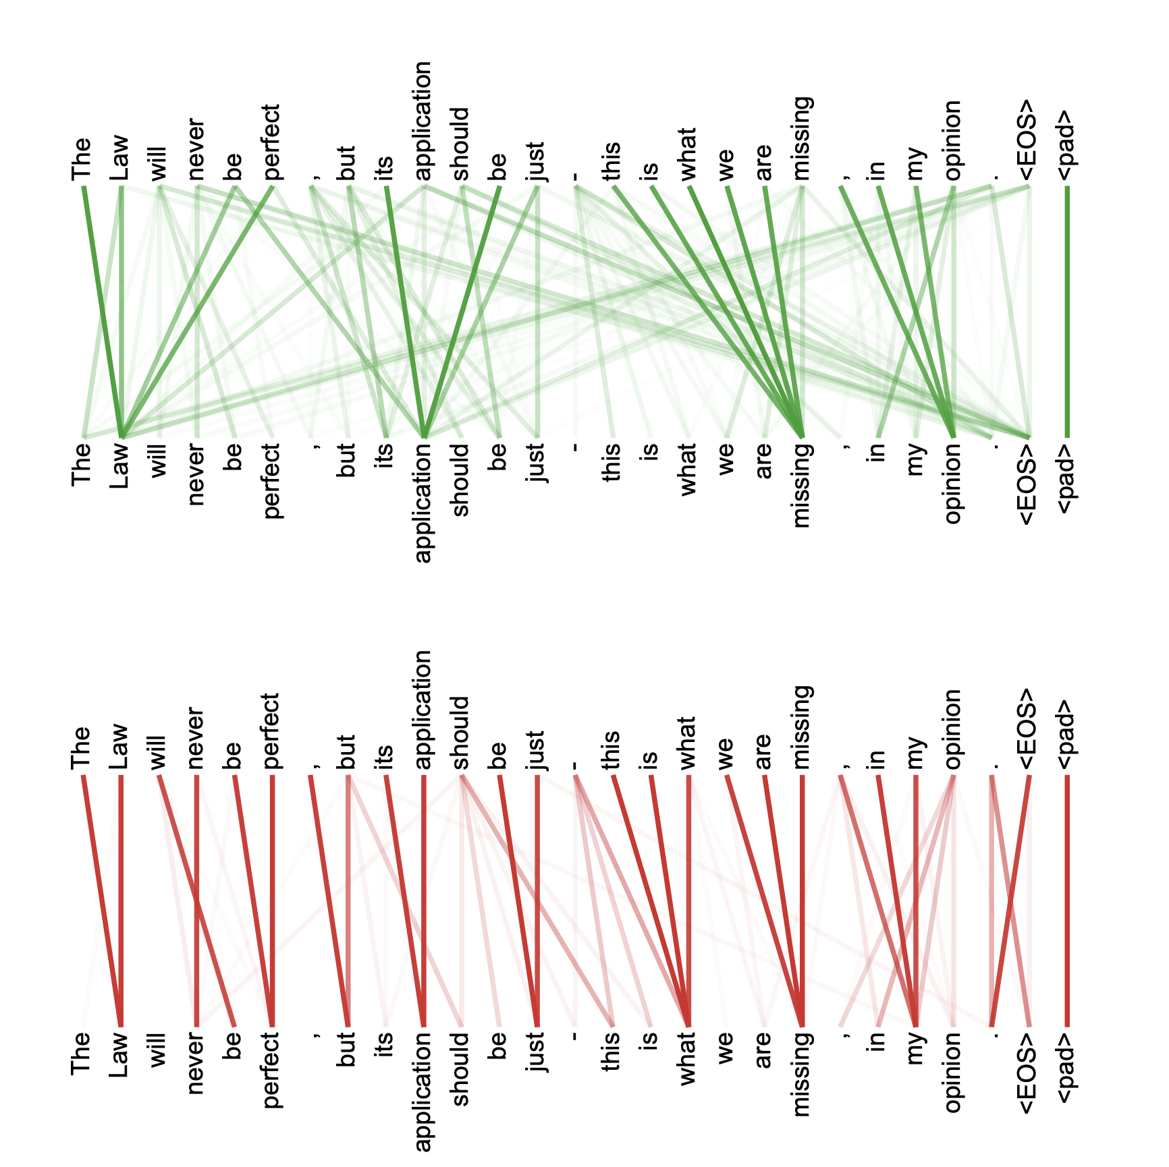
Multi-headed attention weights are harder to interpret obviously

Slide 11
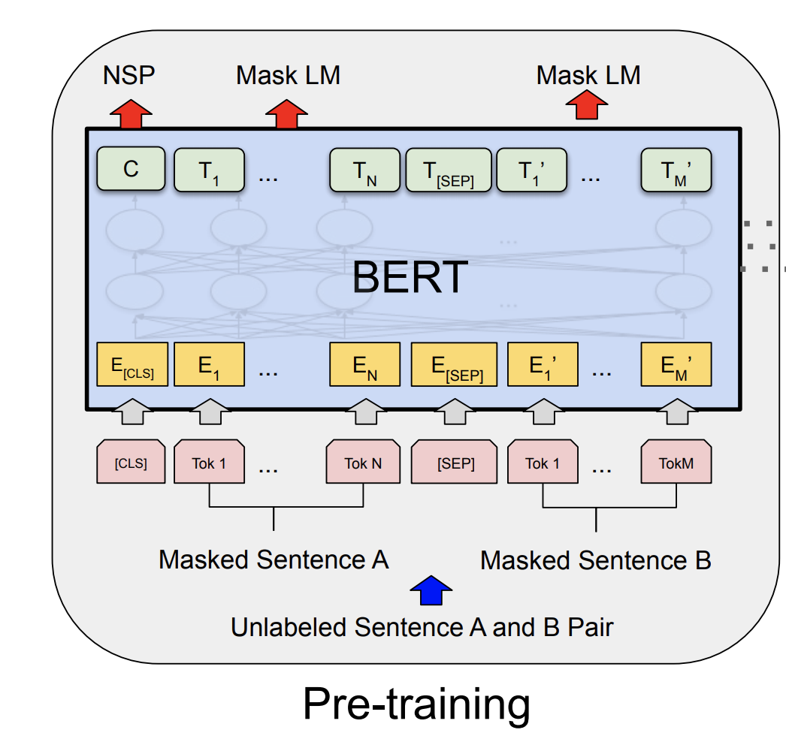
The BERT Encoder Model (October, 2018)
Devlin et al. BERT: Pre-training of Deep Bidirectional Transformers for Language Understanding . https://arxiv.org/abs/1810.04805
Important things to know
No decoder
Train the model to fill-in-the-blank by masking some of the input tokens and trying to recover the full sentence.
The input is not one sentence but two sentences separated by a [SEP] token.
Also try to predict whether these two input sentences are consecutive or not.

Slide 12
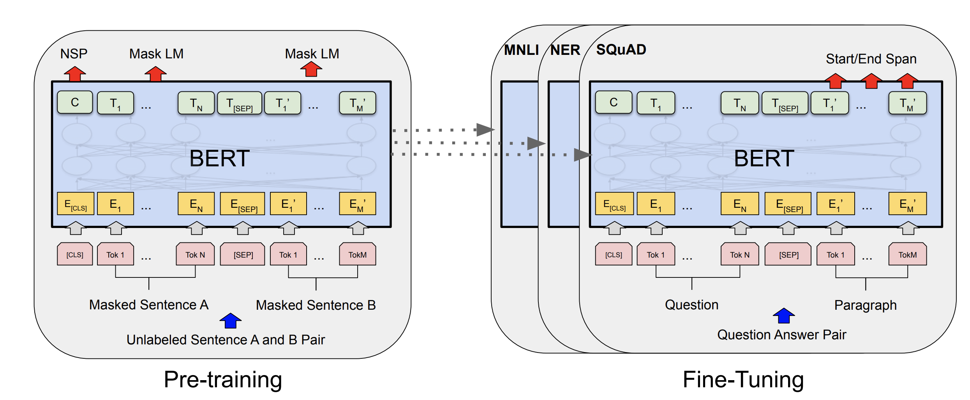
The BERT Encoder Model
Devlin et al. BERT: Pre-training of Deep Bidirectional Transformers for Language Understanding . https://arxiv.org/abs/1810.04805

Slide 13
The BERT Encoder-only Model
Devlin et al. BERT: Pre-training of Deep Bidirectional Transformers for Language Understanding . https://arxiv.org/abs/1810.04805

Slide 14
The T5 Encoder-Decoder Model
Decoder
Encoder

Slide 15
The GPT-2, GPT-3 Decoder-only Model
Decoder

Slide 16
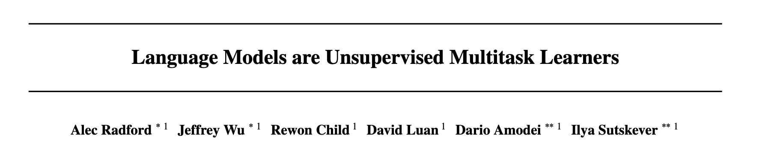
The GPT-2 Model (Feb, 2019)
https://openai.com/blog/better-language-models/

Slide 17
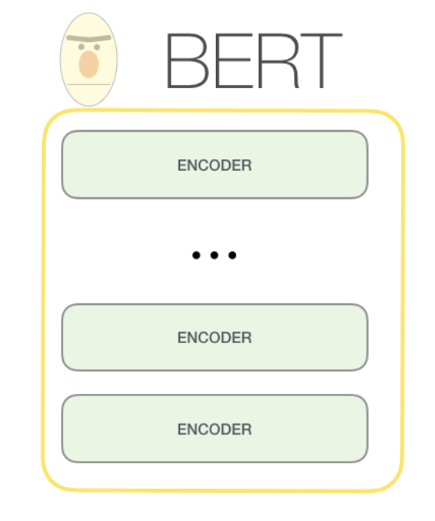
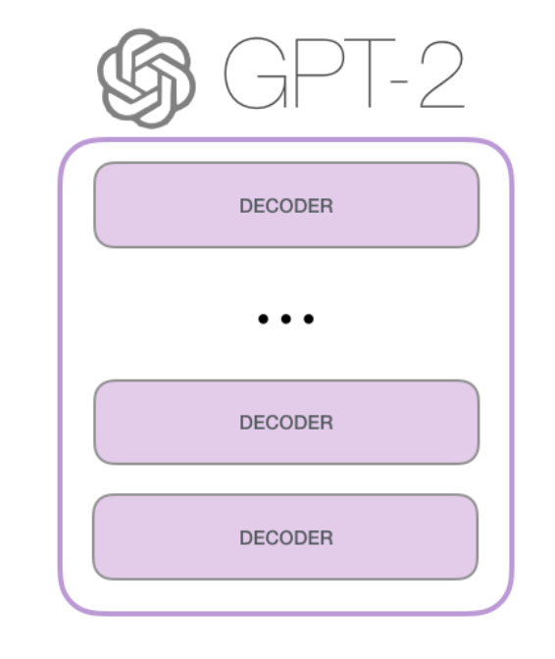
The GPT-2 Model
https://jalammar.github.io/illustrated-gpt2/

Slide 18
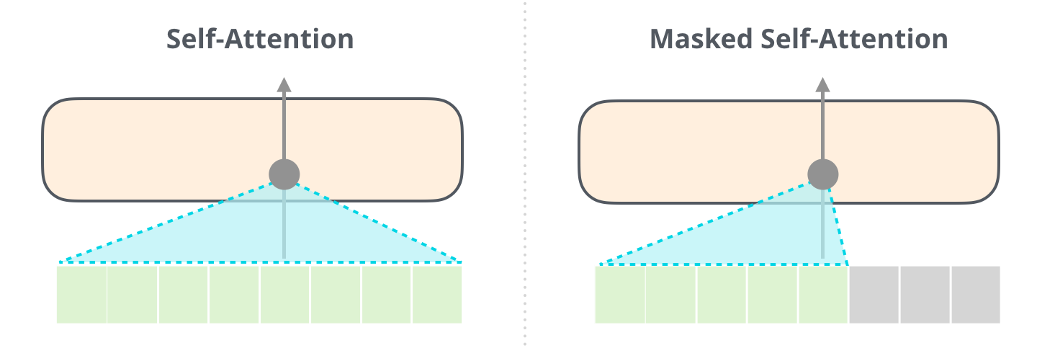
The GPT-2 Model
BERT
GPT
https://jalammar.github.io/illustrated-gpt2/

Slide 19
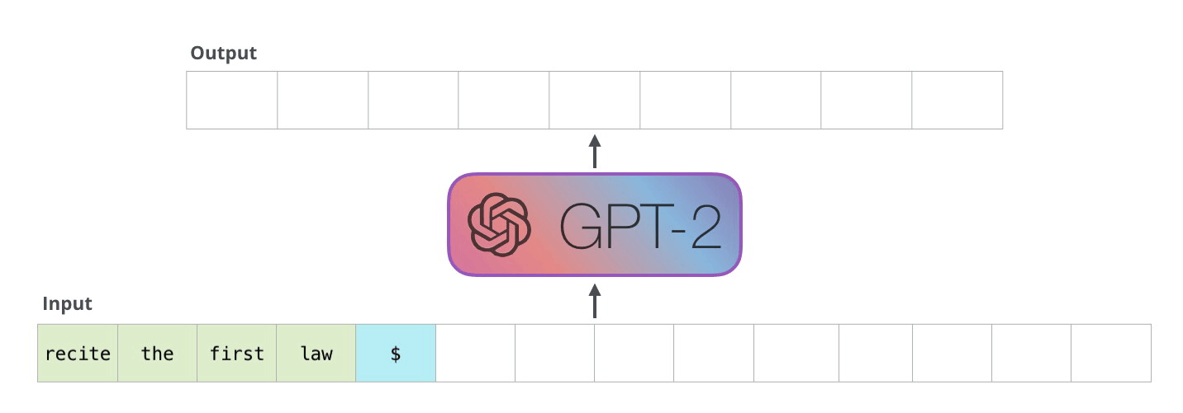
The GPT-2 Model
https://jalammar.github.io/illustrated-gpt2/

Slide 20
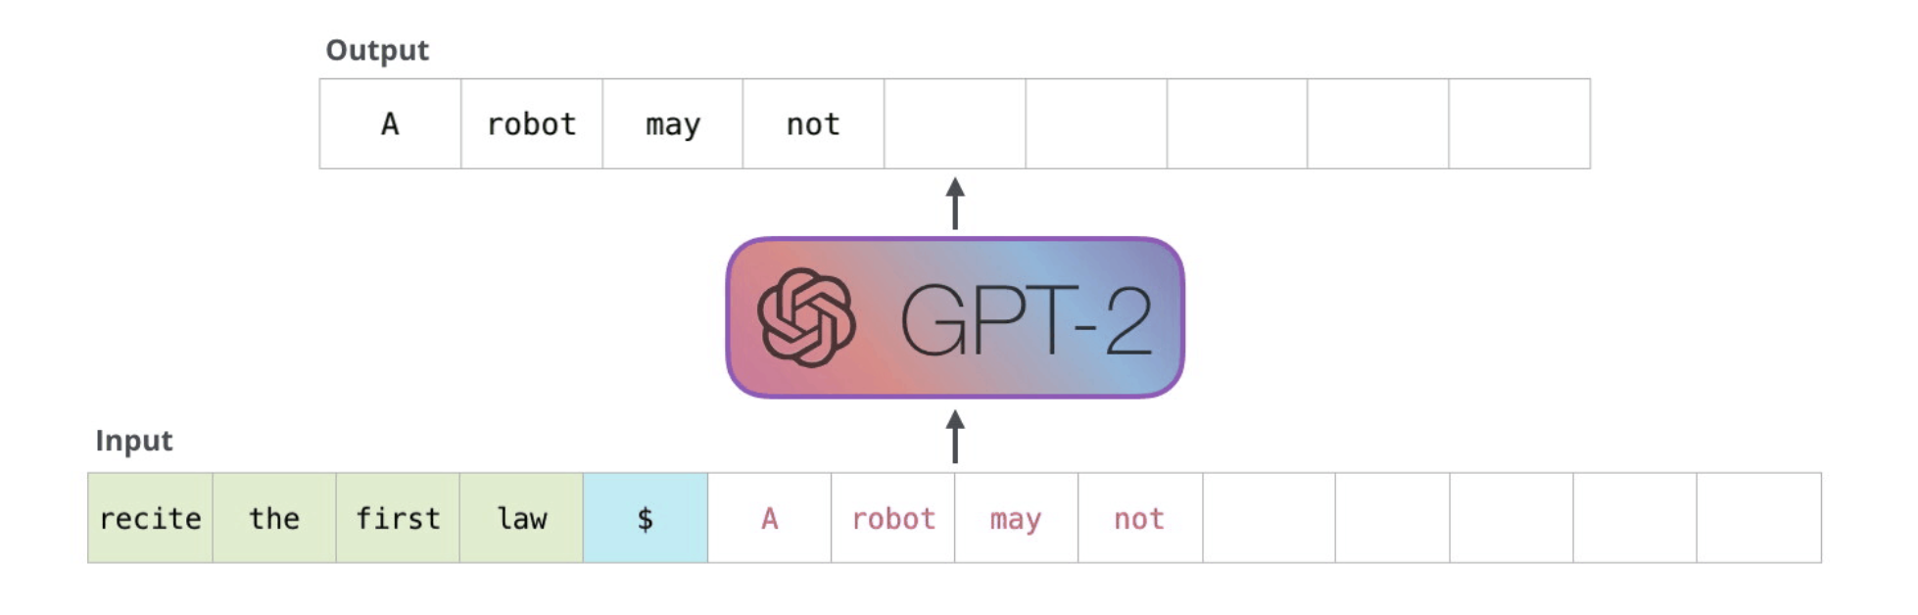
The GPT-2 Model
https://jalammar.github.io/illustrated-gpt2/

Slide 21
The GPT-2 Model
https://jalammar.github.io/illustrated-gpt2/

Slide 22
GPT-1 vs GPT-2 vs GPT-3
 | GPT-1 | GPT-2 | GPT-3
Parameters | 117 Million | 1.5 Billion | 175 Billion
Decoder Layers | 12 | 48 | 96
Context Token Size | 512 | 1024 | 2048
Hidden Layer | 768 | 1600 | 12288
Batch Size | 64 | 512 | 3.2M
https://360digitmg.com/blog/types-of-gpt-in-artificial-intelligence

Slide 23
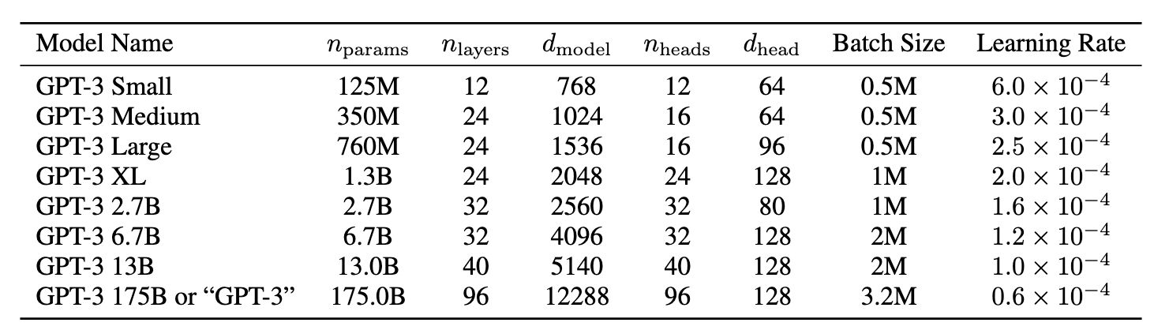
GPT-3 (July, 2020)
https://arxiv.org/abs/2005.14165

Slide 24
GPT family keeps growing
GPT-3.5
GPT-3.5-turbo
GPT-4, GPT 4.1
GPT-4-turbo
GPT-4o
o1, o3, o3-pro
GPT-5.2 (Thinking)
Gemini family (Gemini Pro) (Google) (Gemini Pro 3.0, Gemini Pro 3.1, Gemini-Flash)
Mistral 7xMoE (Open Source by Mistral.ai)
Llama-2, Llama-3(Open Source by Meta AI), Llama-4
Qwen3.5, Qwen3, Qwen2.5 (Alibaba)
DeepSeekV3, DeepSeek, DeepSeek-R1 (Open Source by DeepSeek Team)
Claude Opus 4.6 (Extended), Claude3.5 Sonnet, Haiku, etc (Anthropic)
Grok3, Grok4 (Twitter/xAI)
Competitors

Slide 25
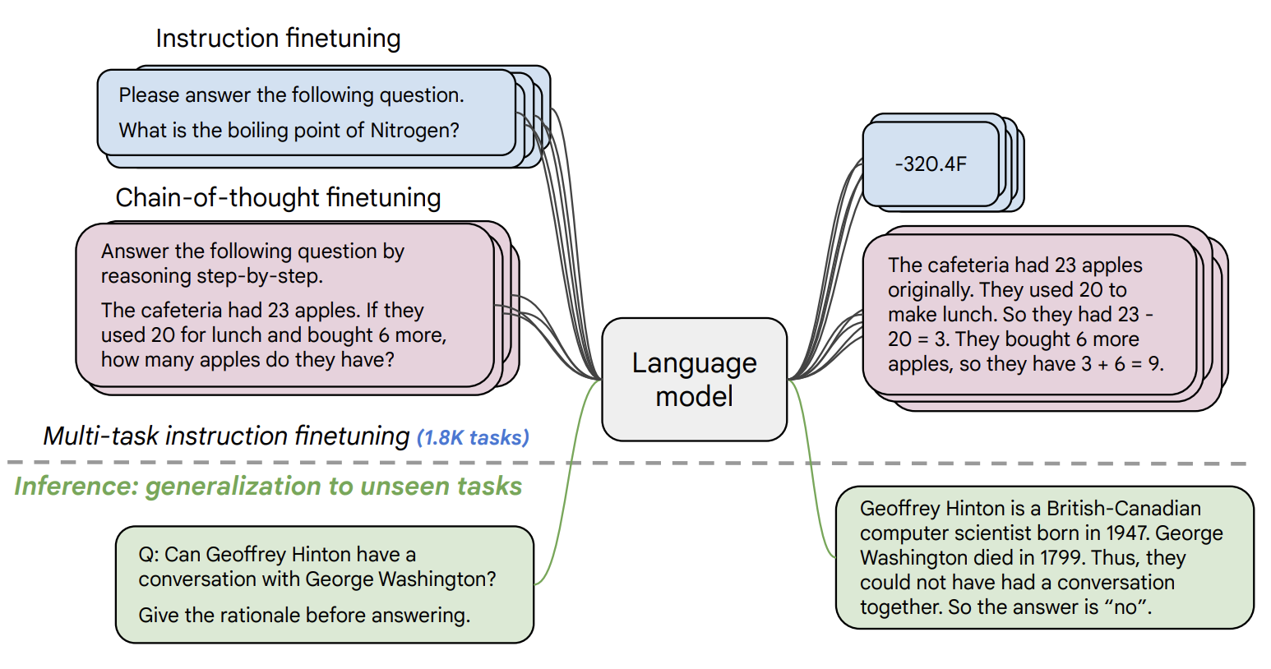
Instruction Tuning (FLAN-T5 by Google)
https://arxiv.org/pdf/2210.11416.pdf
Notes:
This diagram shows instruction finetuning, from the Flan paper. This is a preview of the Supervised Finetuning concept that makes modern LLMs special.
The idea: take a pre-trained language model and fine-tune it on a large collection of tasks framed as instructions. The Flan paper uses 1.8K tasks for multi-task instruction finetuning.
There are two types of finetuning data shown here: regular instruction finetuning with simple input-output pairs, and chain-of-thought finetuning where the model learns to show its reasoning steps before giving the answer.
Below the dashed line is inference on unseen tasks. The key insight: by training on many diverse instruction-following tasks, the model learns to generalize to completely new tasks it has never seen. This is zero-shot generalization.
This is part of what transforms a basic language model into something like ChatGPT. It is not just next-word prediction — instruction finetuning teaches the model to follow user instructions. We will discuss SFT and other alignment techniques on a later slide.

Slide 26
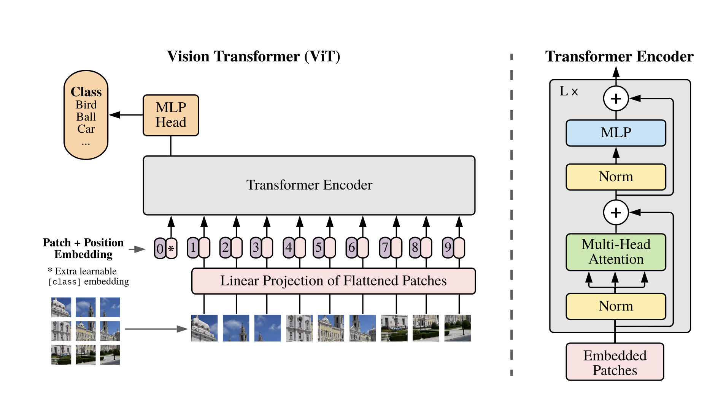
Vision Transformers
https://arxiv.org/abs/2010.11929
An Image is Worth 16x16 Words: Transformers for Image Recognition at Scale
Alexey Dosovitskiy, Lucas Beyer, Alexander Kolesnikov, Dirk Weissenborn, Xiaohua Zhai, Thomas Unterthiner, Mostafa Dehghani, Matthias Minderer, Georg Heigold, Sylvain Gelly, Jakob Uszkoreit, Neil Houlsby

Slide 27
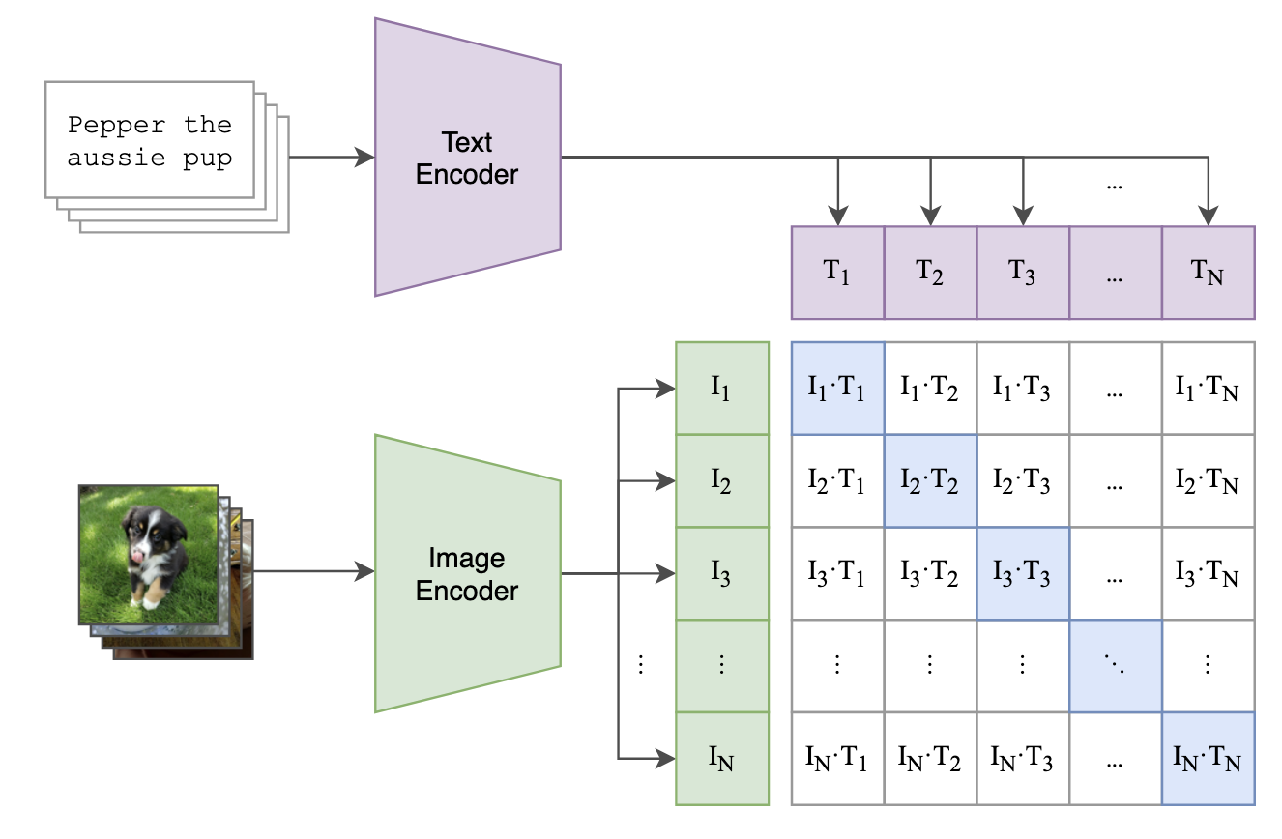
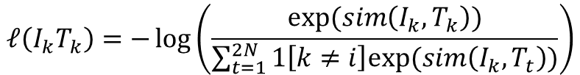
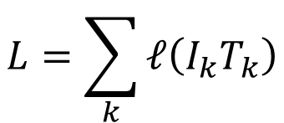
The CLIP Model
$$L=\sum_{k}{ℓ\left(I_{k}T_{k}\right)}$$
$$ℓ\left(I_{k}T_{k}\right)=−\log\left(\frac{exp⁡(sim\left(I_{k}, T_{k}\right))}{\sum_{t=1}^{2N}{1\left[k≠i\right]exp⁡(sim\left(I_{k}, T_{t}\right))}}\right)$$
https://arxiv.org/abs/2103.00020
Learning Transferable Visual Models From Natural Language Supervision
Alec Radford, Jong Wook Kim, Chris Hallacy, Aditya Ramesh, Gabriel Goh, Sandhini Agarwal, Girish Sastry, Amanda Askell, Pamela Mishkin, Jack Clark, Gretchen Krueger, Ilya Sutskever

Slide 28
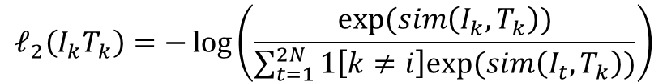
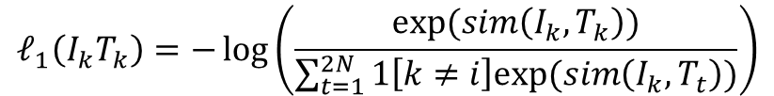
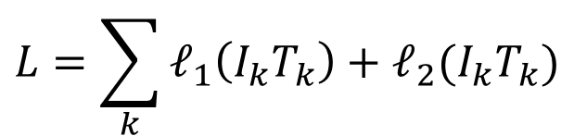
The CLIP Model
$$L=\sum_{k}{ℓ_{1}\left(I_{k}T_{k}\right)+ℓ_{2}(I_{k}T_{k})}$$
$$ℓ_{1}\left(I_{k}T_{k}\right)=−\log\left(\frac{exp⁡(sim\left(I_{k}, T_{k}\right))}{\sum_{t=1}^{2N}{1\left[k≠i\right]exp⁡(sim\left(I_{k}, T_{t}\right))}}\right)$$
$$ℓ_{2}\left(I_{k}T_{k}\right)=−\log\left(\frac{exp⁡(sim\left(I_{k}, T_{k}\right))}{\sum_{t=1}^{2N}{1\left[k≠i\right]exp⁡(sim\left(I_{t}, T_{k}\right))}}\right)$$
https://arxiv.org/abs/2103.00020
Learning Transferable Visual Models From Natural Language Supervision
Alec Radford, Jong Wook Kim, Chris Hallacy, Aditya Ramesh, Gabriel Goh, Sandhini Agarwal, Girish Sastry, Amanda Askell, Pamela Mishkin, Jack Clark, Gretchen Krueger, Ilya Sutskever

Slide 29
Next Word Prediction is limited
Predicting the next word can lead to intelligent behavior such as the one exemplified earlier however this still limited
What makes some of the new LLMs special? ChatGPT (GPT-3.5, 3.5 Turbo, 4, 4-turbo), FLAN-T5, OPT-IML
  SFT: Supervised Finetuning (Curated Input/Output Instruction Sets)
  DPO: Direct Preference Optimization
  PPO: Proximal Policy Optimization (Reinforcement Learning with Human Feedback)
  GRPO: Group-relative Policy Optimization (DeepSeek)

Slide 30
Instruction Tuning (e.g. FLAN-T5 by Google)
https://arxiv.org/pdf/2210.11416.pdf

Slide 31
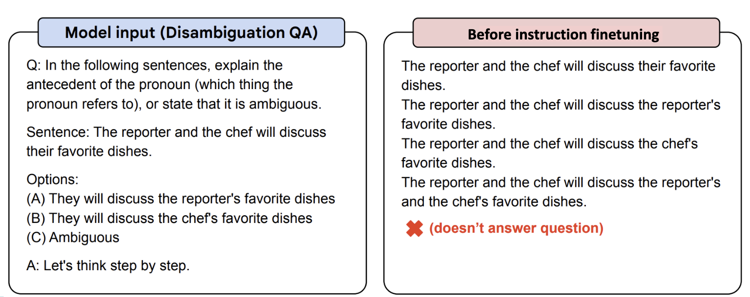
FLAN-T5

Slide 32
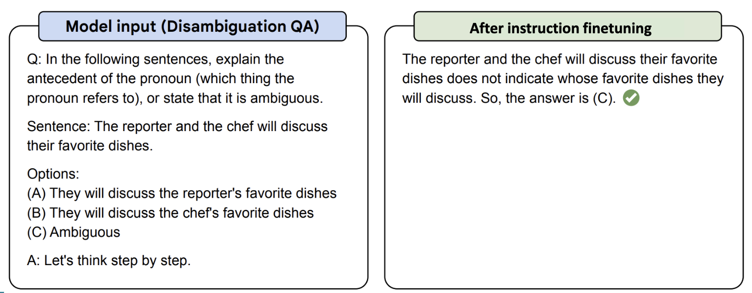
FLAN-T5

Slide 33

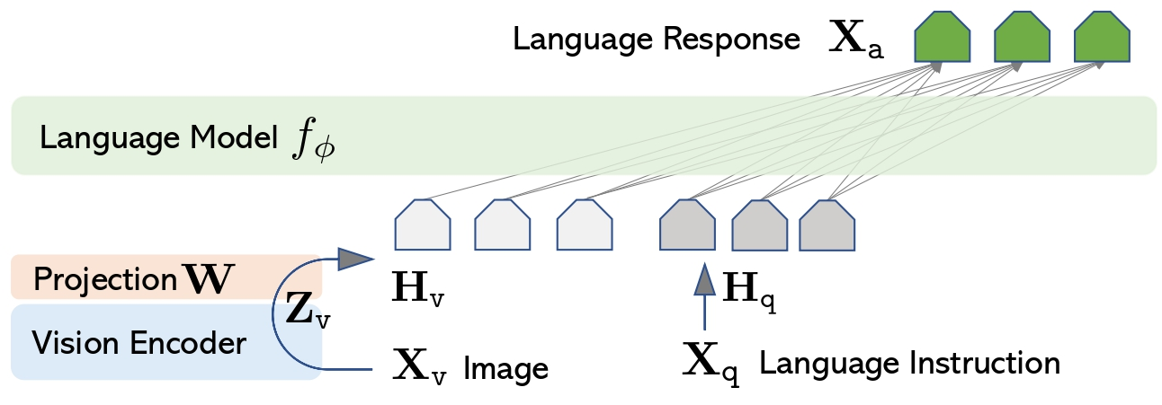
Three Core Components of Llava-style Vision-Language Models
Image Input
Vision Encoder
(e.g. CLIP ViT)
Connector
(Projector/Adapter)
LLM Decoder
(Vicuna/Qwen)
Text
Response
Frozen pretrained
visual features
Bridges modality gap
(trainable)
Generates text
(fine-tuned)
Source: [Liu et al. 2023]
Notes:
Llava-1.0

Slide 34

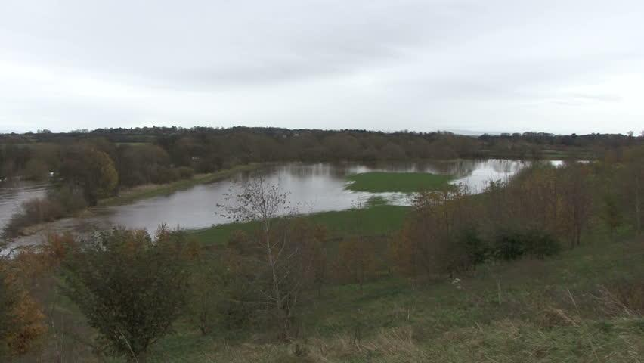
Three Core Components of Llava-style Vision-Language Models
Training Stage 1 / 2
  large-scale image-text pretraining with the LLM and Visual Encoder Frozen
  Data: 600K filtered CC3M
a river has burst it 's banks and has spread out onto arable farmland alongside

Slide 35
Three Core Components of Llava-style Vision-Language Models
Training Stage 2 / 2
  visual instruction tuning stage: use 150K GPT-generated multimodal instruction-following data

Slide 36
Three Core Components of Llava-style Vision-Language Models
LLaVA-1.5 Update
  Projection Layer: Linear Projection -> MLP
  Visual Encoder: CLIP ViT-L/14 -> CLIP-ViT-L-336px
  Data Mix: Stage 1 - 558K LAION-CC-SBU; Stage 2: 150K + 515K VQA data from academic-oriented tasks

Slide 37
The Bottleneck of LLaVA: Fixed Visual Tokens for Every Image
The limitation of early VLMs (LLaVA 1.5 and before)
  Each image gets resized to 224x224 and processed by a CLIP ViT.
  224x224 with patch size:14 ->256 patches per image
  Details are not preserved at all.

Slide 38
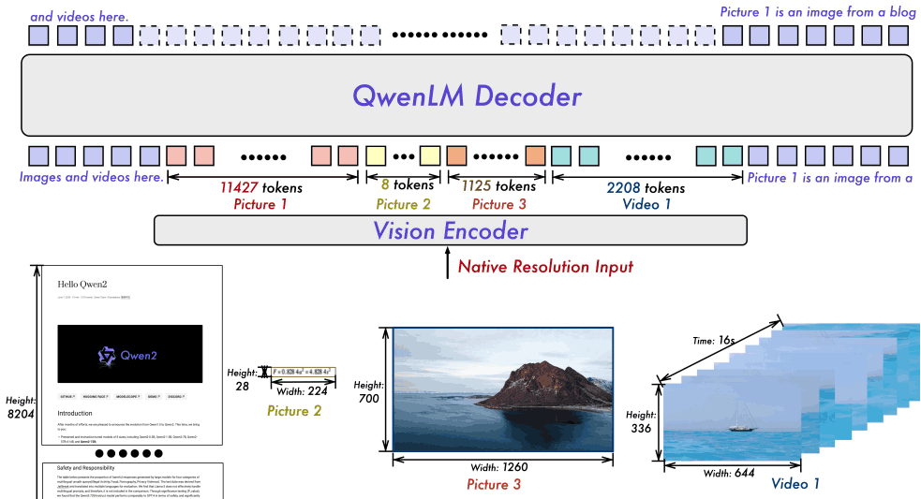
Solution: Vision-Language Models with Dynamic Resolution
The Number of Visual Tokens
Varies with the Complexity of the Visual Input!

Slide 39
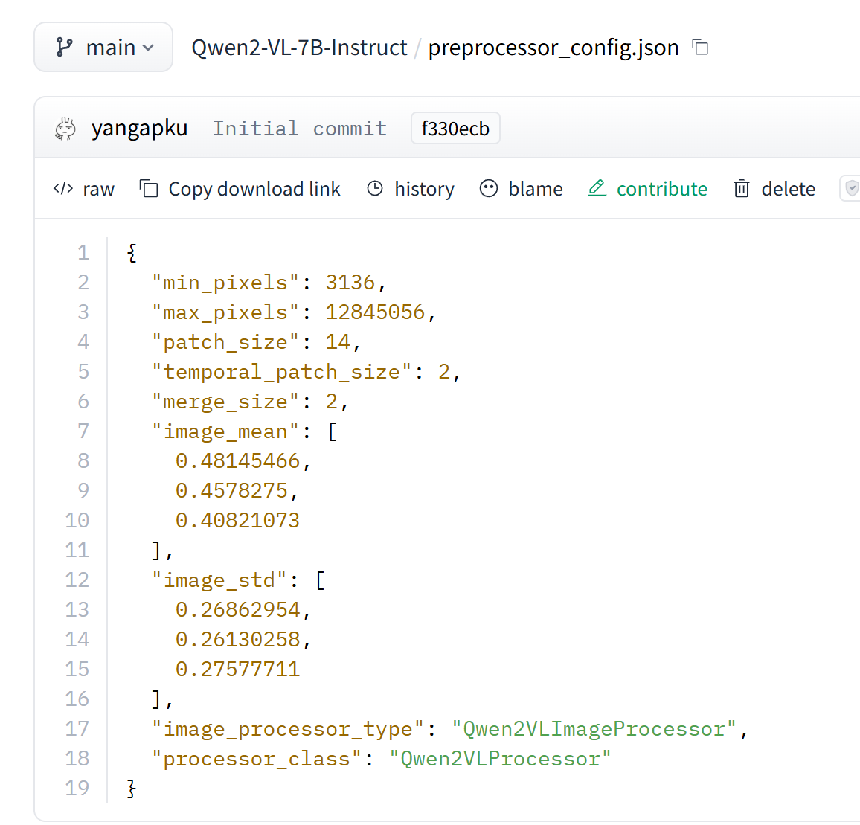
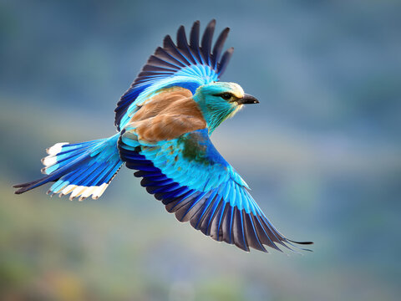
Solution: Vision-Language Models with Dynamic Resolution
Step 1: Resize but keep aspect ratio
  If an image is too small, it can be upscaled to exceed min_pixels.
  If it’s too large, it can be downscaled to stay under max_pixels.
Resize
Resize w/ aspect ratio

Slide 40
Solution: Vision-Language Models with Dynamic Resolution
Step 2: Patchify
  If resized to 3584×3584: 3584/14 = 256 → 256×256 = 65,536 patch tokens
  If resized to 56×56: 56/14 = 4 → 4×4 = 16 patch tokens
The number of patches is no longer a fixed number.

Slide 41
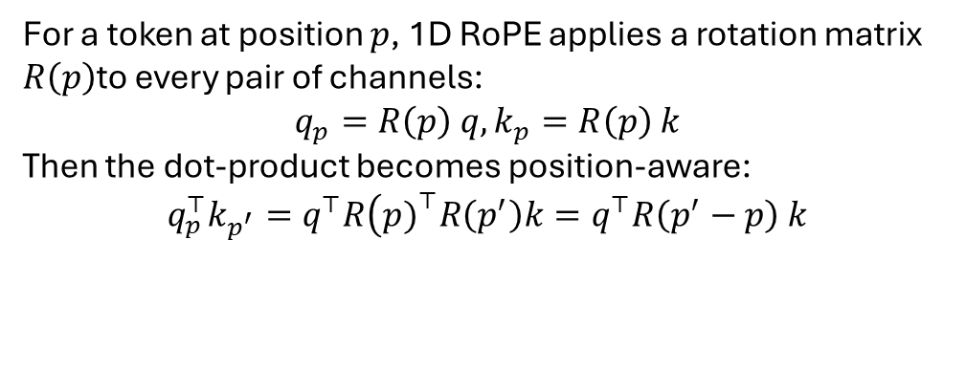
Solution: Vision-Language Models with Dynamic Resolution
Step 3: Use 2D-RoPE Position Embedding
  Instead of fixed absolute position embeddings in classic ViT, Qwen2-VL uses 2D Rotary Position Embedding (2D-RoPE) so positions are encoded in a way that generalizes across different H×W grids.
For a token at position $p$, 1D RoPE applies a rotation matrix $R\left(p\right)$to every pair of channels:
$$q_{p}=R\left(p\right) q, k_{p}=R\left(p\right) k$$
Then the dot-product becomes position-aware:
$$q_{p}^{⊤}k_{p^{′}}=q^{⊤}R\left(p{\left.)\right.}^{⊤}R\left(p^{′}\right)k=q^{⊤}R\left(p^{′}−p\right) k\right.$$
Attention naturally depends on relative distance $\left(p^{′}−p\right)$.

Slide 42
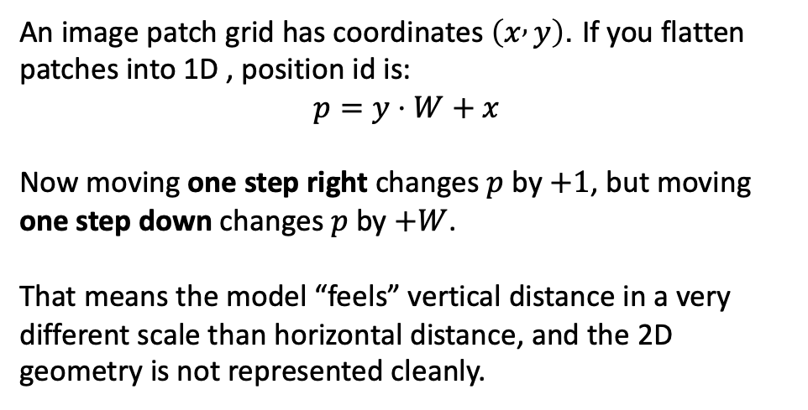
Solution: Vision-Language Models with Dynamic Resolution
Step 3: Use 2D-RoPE Position Embedding
  Instead of fixed absolute position embeddings in classic ViT, Qwen2-VL uses 2D Rotary Position Embedding (2D-RoPE) so positions are encoded in a way that generalizes across different H×W grids.
An image patch grid has coordinates $\left(x , y\right)$. If you flatten patches into 1D , position id is:
$$p=y⋅W+x$$
Now moving one step right changes $p$by $+1$, but moving one step down changes $p$by $+W$.
That means the model “feels” vertical distance in a very different scale than horizontal distance, and the 2D geometry is not represented cleanly.

Slide 43
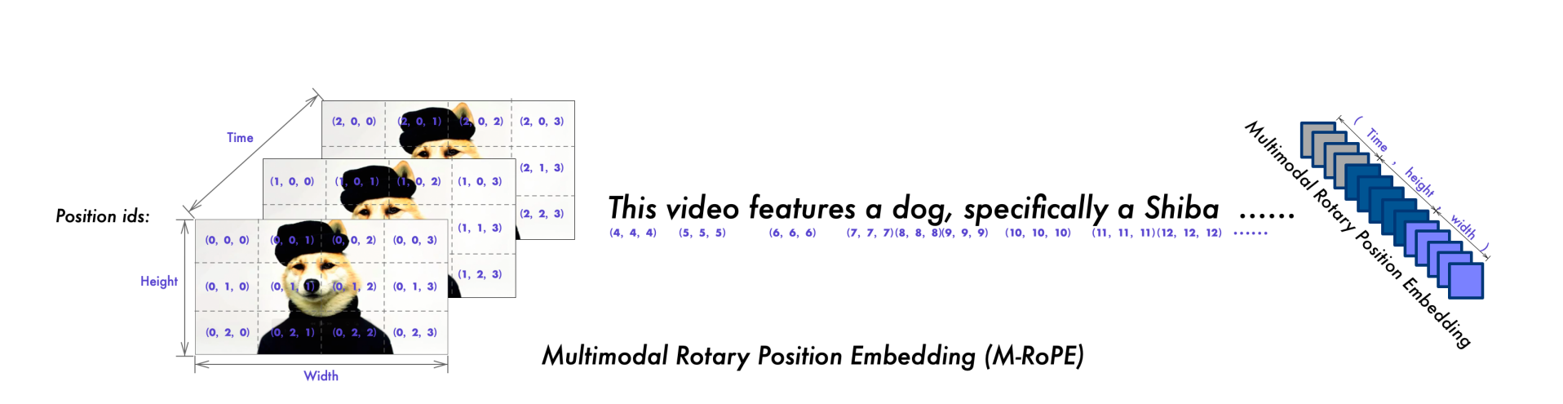
Solution: Vision-Language Models with Dynamic Resolution
Step 3: Use 3D-RoPE Position Embedding
  Instead of fixed absolute position embeddings in classic ViT, Qwen2-VL uses 3D Rotary Position Embedding (3D-RoPE) so positions are encoded in a way that generalizes across different H×W grids and timesteps.
Source: [Wang et al. 2024]

Slide 44
Solution: Vision-Language Models with Dynamic Resolution
Step 3: Token compression
  Qwen2-VL applies a simple MLP “compression” that merges adjacent tokens in token space so the LLM doesn’t get overwhelmed by huge grids.
  Indicated by “merge_size” in the config.
  if 48 patch tokens -> 12 visual tokens in the LLM input

Slide 45
Questions?
Notes:
That wraps up today's lecture. Let me quickly recap what we covered:
1. Transformer Block Components: Add and Norm (residual connections + layer normalization), Feed Forward (position-wise FFN with two linear layers), Positional Encodings (why they are needed and the sinusoidal approach), and Masked Multi-Head Attention (causal attention for autoregressive generation).
2. Positional Encoding alternatives: Learned absolute (BERT), Relative (T5), RoPE (LLaMA), and NoPE.
3. BERT vs GPT: Encoder-only with bidirectional attention for understanding (BERT) vs Decoder-only with causal attention for generation (GPT). This is the single most important architectural distinction.
4. GPT-2 to GPT-3: Same architecture, just massively scaled up — more layers, wider hidden dimensions, more heads, more data. The scaling laws insight.
5. Vision Transformers: Treating images as sequences of patches and processing them with a standard Transformer encoder.
6. CLIP: Contrastive learning to align images and text in a shared embedding space, enabling zero-shot transfer.
7. SFT and alignment: Why next-word prediction alone is not enough, and how instruction finetuning, DPO, PPO, and GRPO transform a language model into an assistant.
For the quiz, make sure you understand: the components of a Transformer block, why positional encodings are needed, the difference between bidirectional and causal attention, and why BERT and GPT use different types. Any questions?

