Slide 1
Deep Learning for Vision & Language
Post-Training for LLMs and VLMs: Thinking/Reasoning Models

Slide 2
Last Class
Efficient Finetuning: LoRA
Instruction Finetuning (IFT)
Supervised Finetuning
Learning from Human Preferences
Reinforcement Learning from Human Feedback (RLHF)
Direct Preference Optimization (DPO)

Slide 3
Today
Chain-of-Thought Reasoning
Thinking/Reasoning Models
Reinforcement Learning with Verifiable Rewards (RLVR)
Group Reward Preference Optimization (GRPO)
DeepSeek-R1
Paper Discussion: Budget Forcing

Slide 4
Pretrained: LLM or VLM: Next Token Prediction
Because these are two different constants and numerically …
Multi-layer Self-Attention Causal Transformer Model
Why is e > pi?

Slide 5
Next Word Prediction is limited
Predicting the next word can lead to intelligent behavior however this still limited when trying to get answers out of LLMs.
What makes some of the new LLMs special? ChatGPT (GPT-3.5, 3.5 Turbo, 4, 4-turbo), FLAN-T5, OPT-IML
Instruction Tuning:
SFT: Supervised Finetuning (Curated Input/Output Instruction Sets)
Preference Tuning:
DPO: Direct Preference Optimization
PPO: Proximal Policy Optimization (Reinforcement Learning with Human Feedback)
Reinforcement Tuning for Reasoning:
GRPO: Group-relative Policy Optimization (DeepSeek)

Slide 6
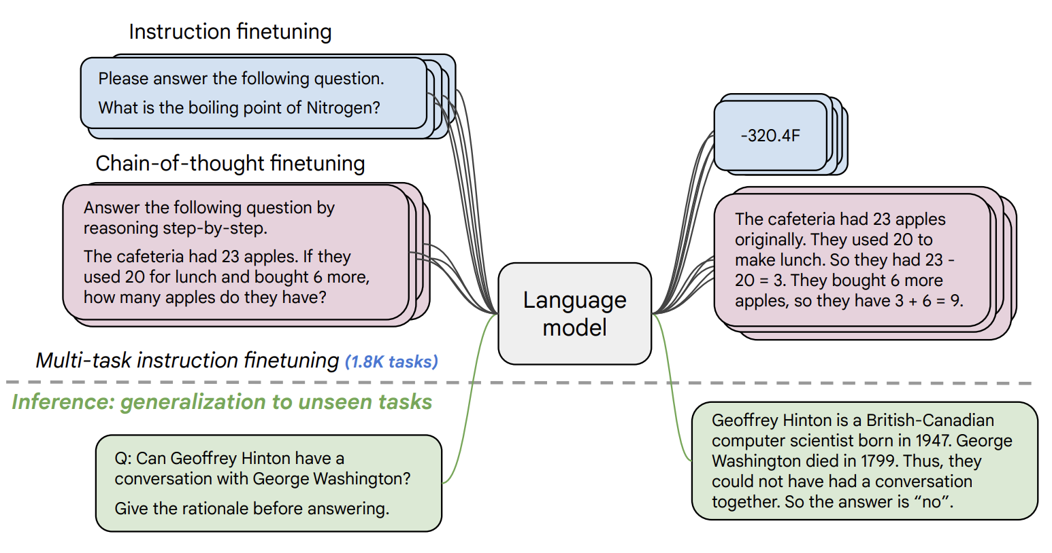
Instruction Tuning (e.g. FLAN-T5 by Google)
https://arxiv.org/pdf/2210.11416.pdf

Slide 7
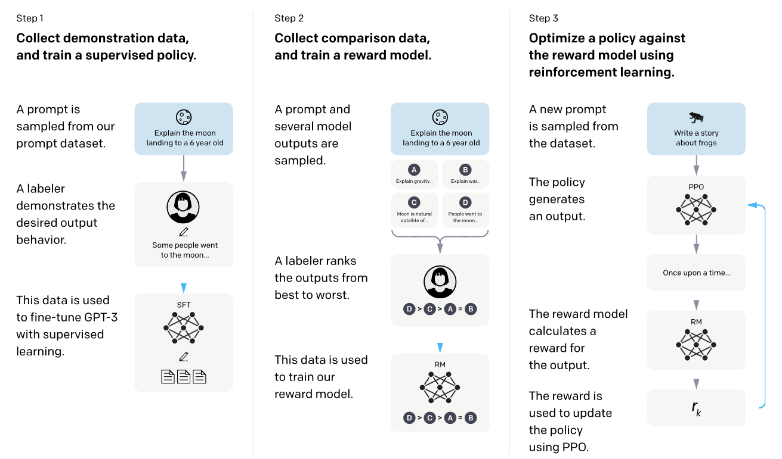
InstructGPT (ChatGPT) SFT (IFT) + Reinforcement Learning with Human Feedback (RLHF)
https://arxiv.org/abs/2203.02155

Slide 8
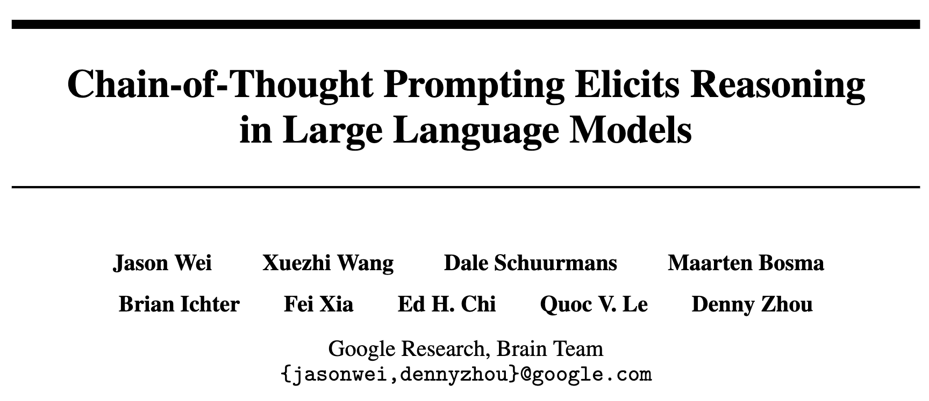
Chain-of-Thought Prompting
January 2023

Slide 9
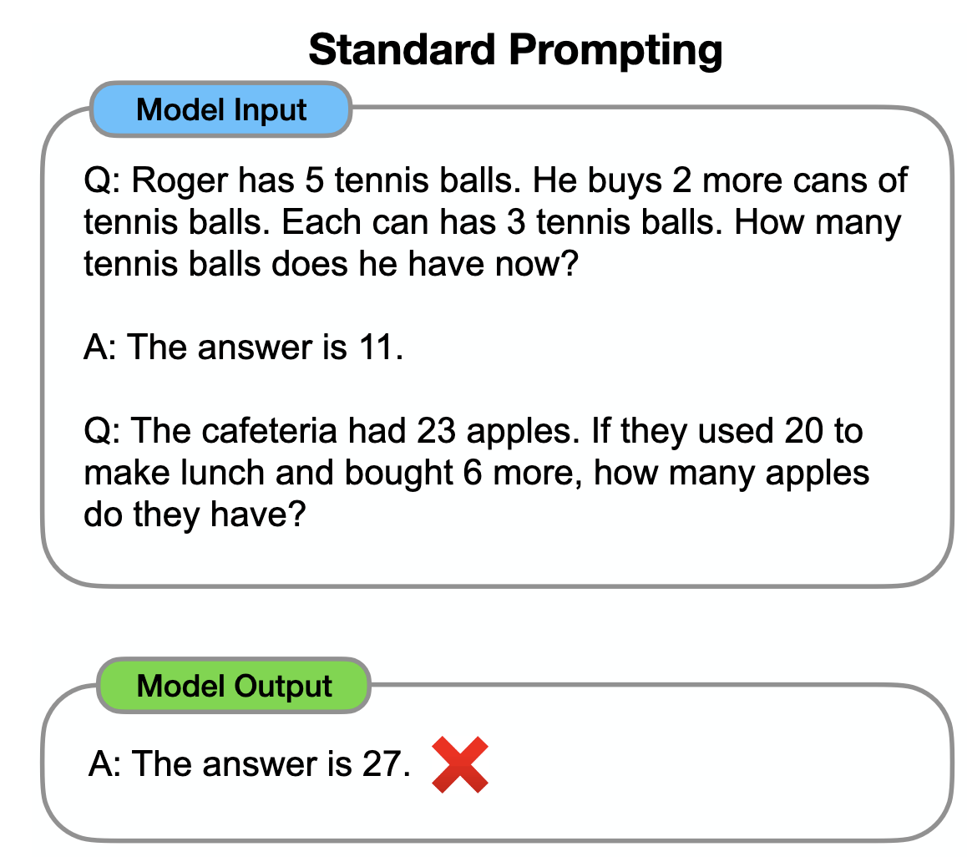
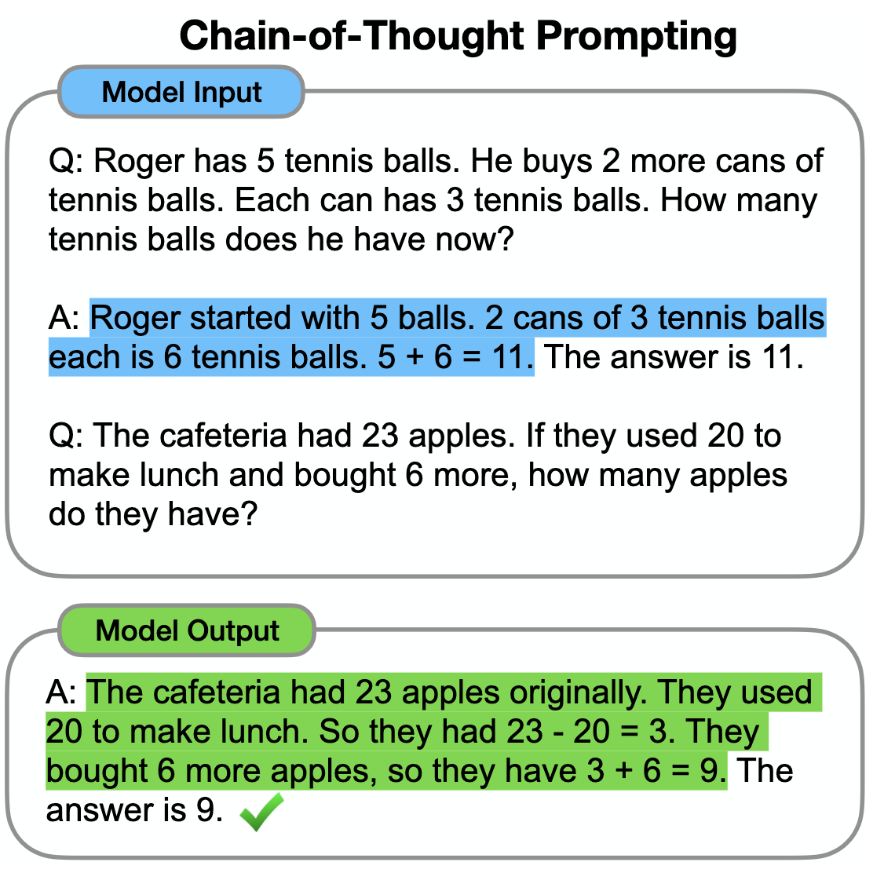
Chain-of-Thought Prompting

Slide 10
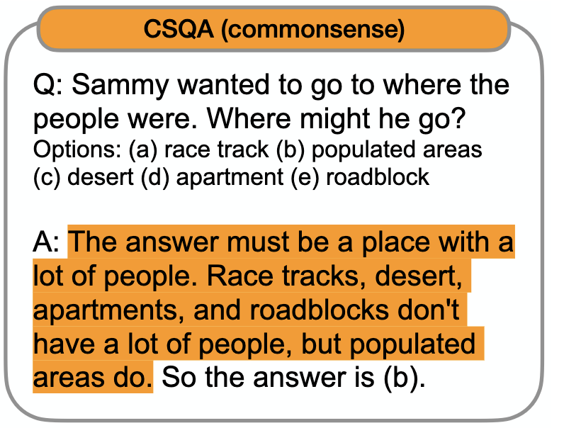
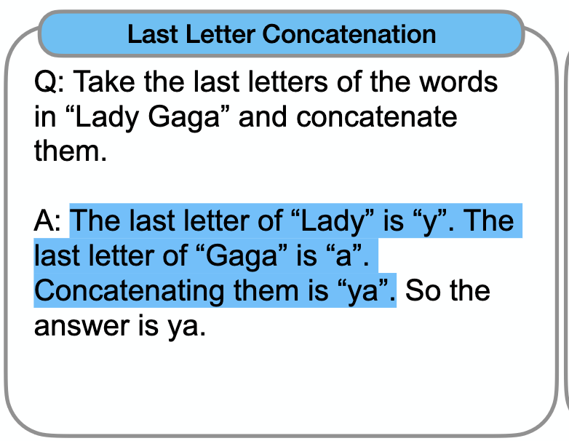

Slide 11
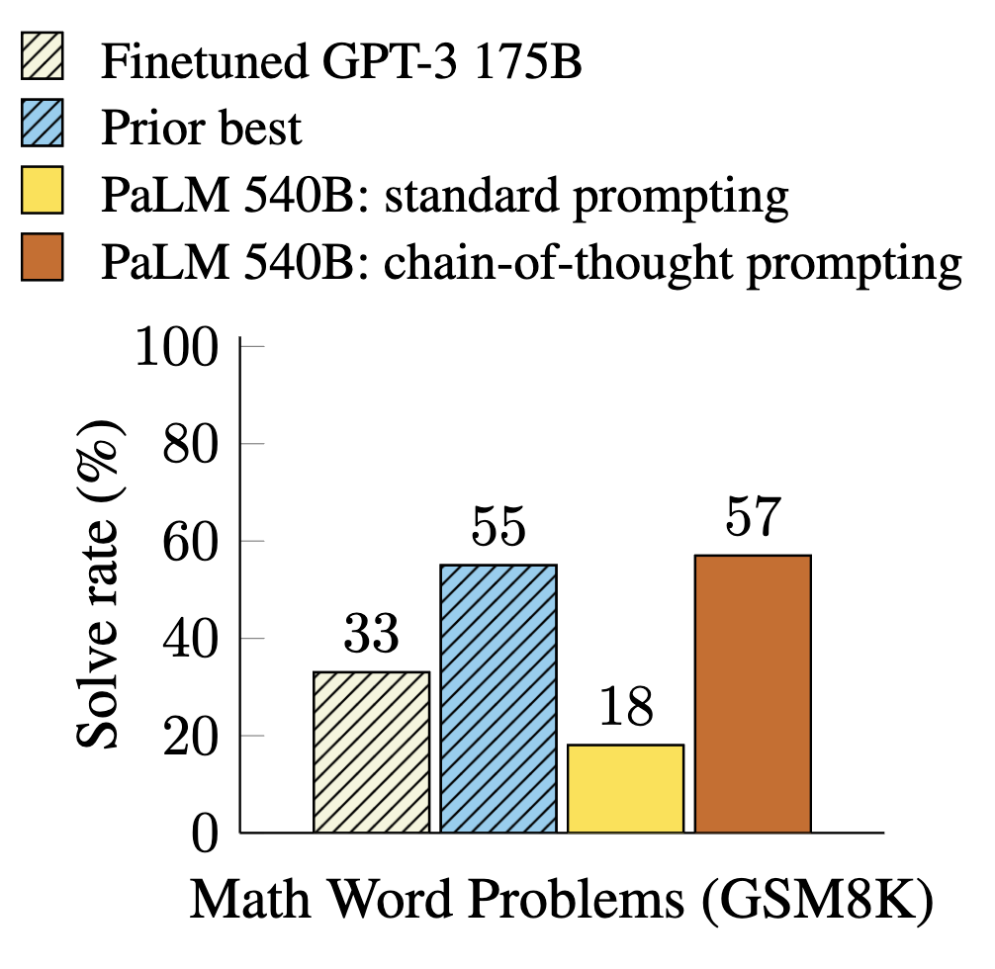
Chain-of-Thought Prompting
Weng earns $12 an hour for babysitting. Yesterday, she just did 50 minutes of babysitting. How much did she earn?
Albert is wondering how much pizza he can eat in one day. He buys 2 large pizzas and 2 small pizzas. A large pizza has 16 slices and a small pizza has 8 slices. If he eats it all, how many pieces does he eat that day?
It takes Roque two hours to walk to work and one hour to ride his bike to work. Roque walks to and from work three times a week and rides his bike to and from work twice a week. How many hours in total does he take to get to and from work a week with walking and biking?

Slide 12
Reasoning Models
<think> Let us analyze each constant e = …. </think> <answer> The question is incorrect …
Multi-layer Self-Attention Causal Transformer Model
Why is e > pi?

Slide 13
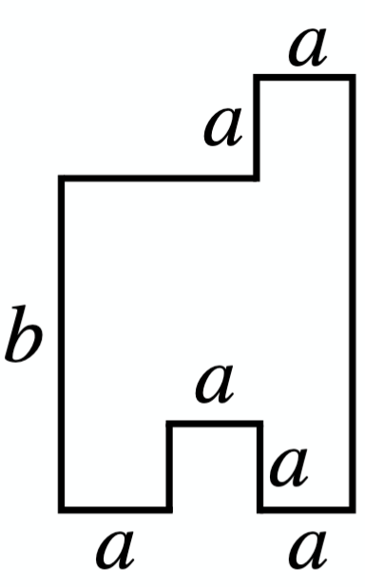
Reasoning + (Visual) Grounding Models
<think> Let us first divide …. </think> <answer> The shape can be computed as...
Multi-layer Self-Attention Causal Transformer Model
What is the area of the room?

Slide 14


Reinforcement Tuning (Rollouts!)
<T> Let us first divide …. </T> <A> The shape can be computed as 2ab + a (b – a)
Multi-layer Self-Attention Causal Transformer Model
<T> Let us first divide …. </T> <A> The shape can be computed as 3a(a + b) – a^2
<T> Let us first divide …. </T> <A> The shape can be computed as 3ab
What is the area of the room?
…
<T> Let us first divide …. </T> <A> The shape can be computed as 3a^2b + a^2

Slide 15
Reinforcement Learning with Verifiable Rewards (RLVR)
<T> Let us first divide …. </T> <A> The shape can be computed as 2ab + a (b – a)
Multi-layer Self-Attention Causal Transformer Model
<T> Let us first divide …. </T> <A> The shape can be computed as 3a(a + b) – a^2
<T> Let us first divide …. </T> <A> The shape can be computed as 3ab
What is the area of the room?
…
<T> Let us first divide …. </T> <A> The shape can be computed as 3a^2b + a^2

Slide 16
What problems have verifiable rewards?
When can it be applied?
What types of problems?

Slide 17
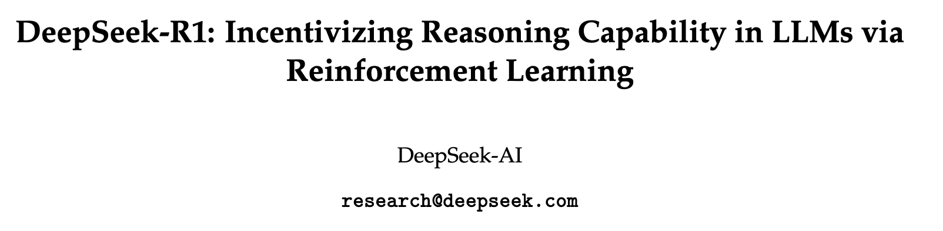
How does it work?
January 2025

Slide 18
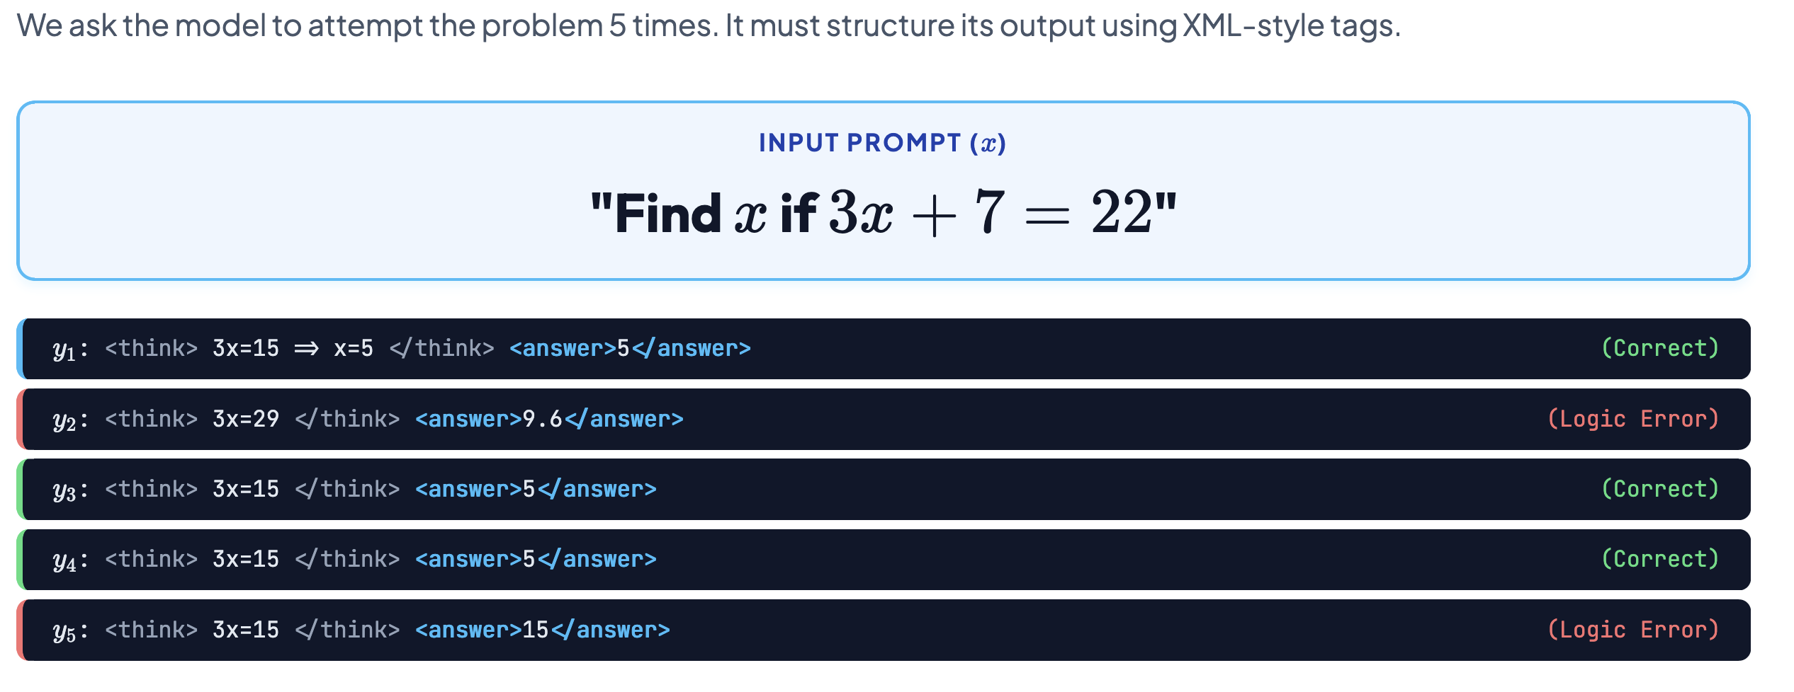
Group Relative Policy Optimization (GRPO)

Slide 19
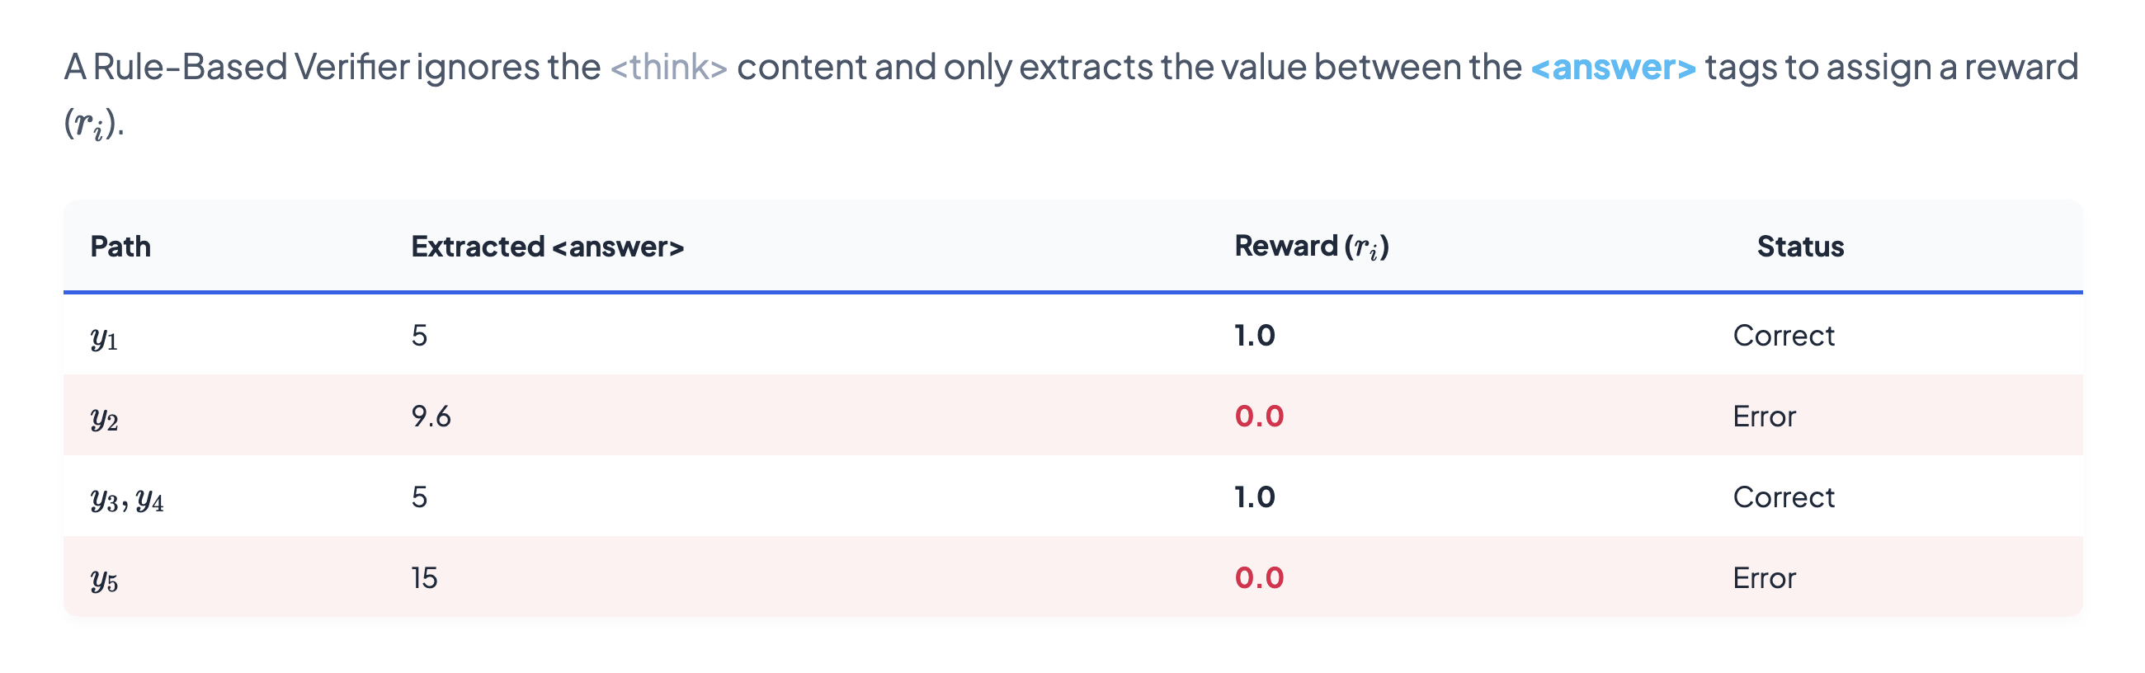
GRPO – Reward Computation

Slide 20
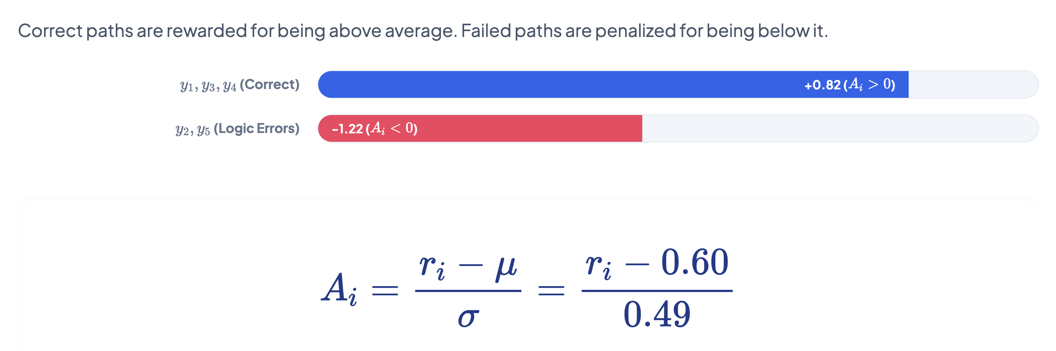
GRPO – Relative Group Advantage Computation

Slide 21
Reinforcement Tuning (Rollouts!)
<T> Let us first divide …. </T> <A> The shape can be computed as 2ab + a (b – a)
Multi-layer Self-Attention Causal Transformer Model
<T> Let us first divide …. </T> <A> The shape can be computed as 3a(a + b) – a^2
<T> Let us first divide …. </T> <A> The shape can be computed as 3ab
What is the area of the room?
…
<T> Let us first divide …. </T> <A> The shape can be computed as 3a^2b + a^2

Slide 22
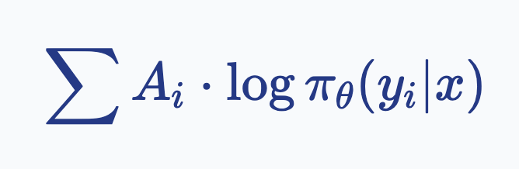
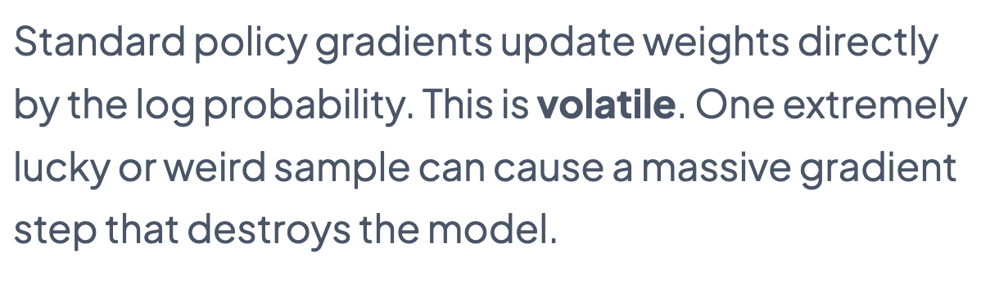
Simplest Loss Function to Use (REINFORCE)

Slide 23
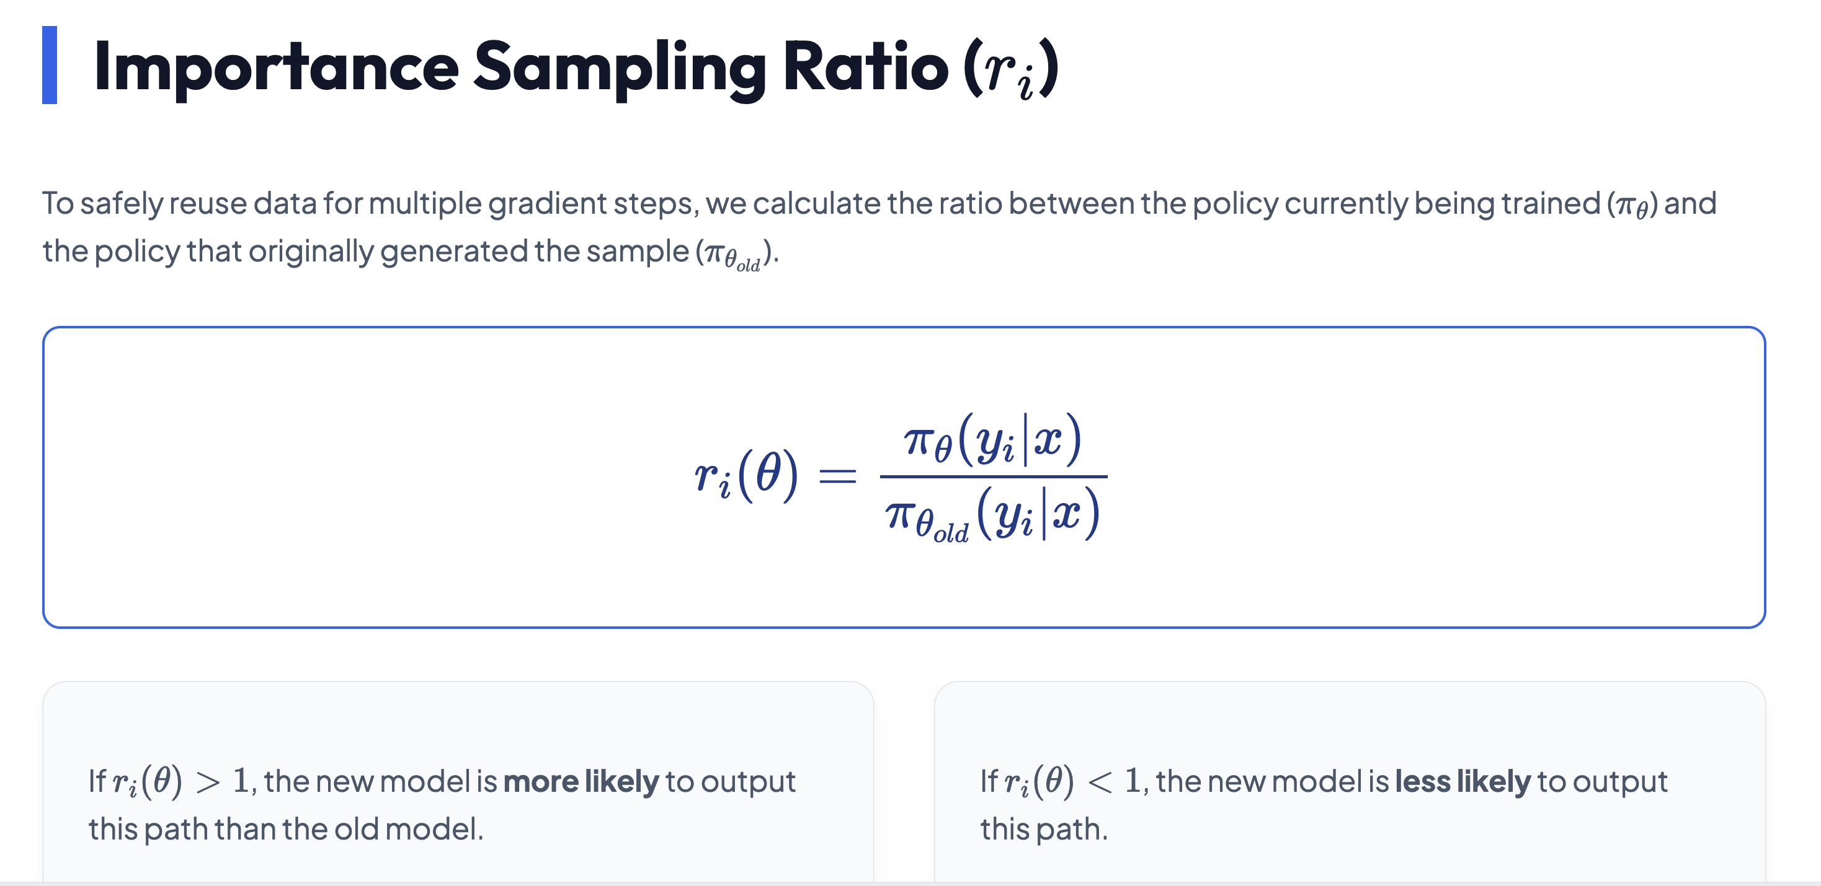

Slide 24
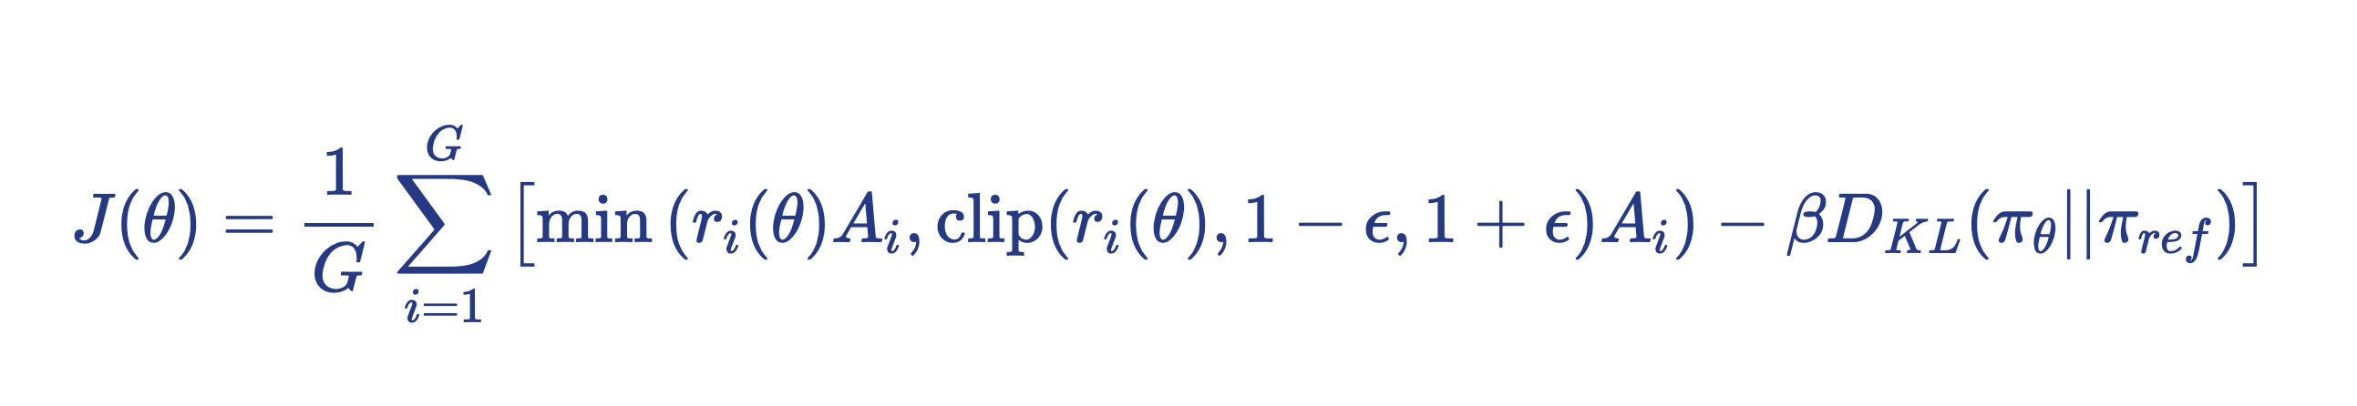
The GRPO Objective Function

Slide 25
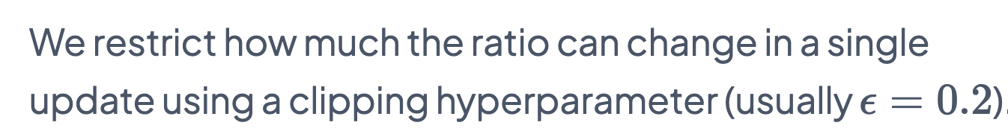
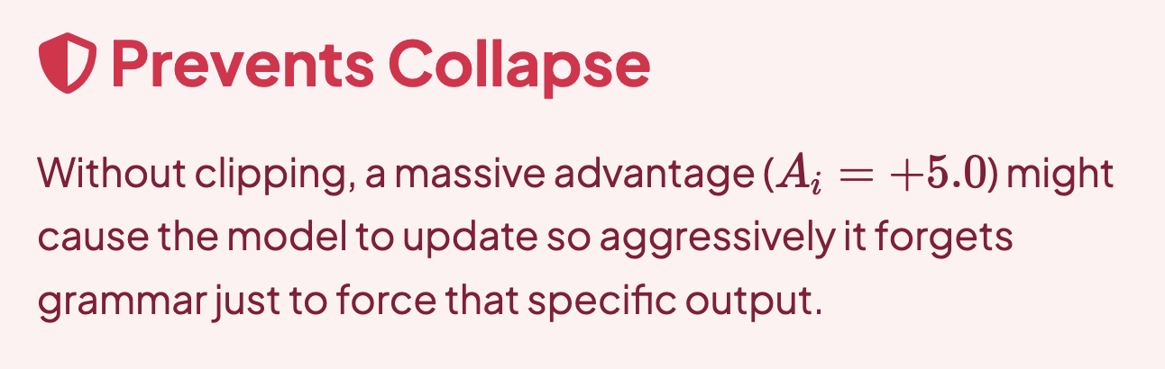
The GRPO Objective Function

Slide 26
The GRPO Objective Function
Same as PPO. We want to further prevent the model from deviating too much from the base “reference” model. We still want coherent language to be generated.

Slide 27

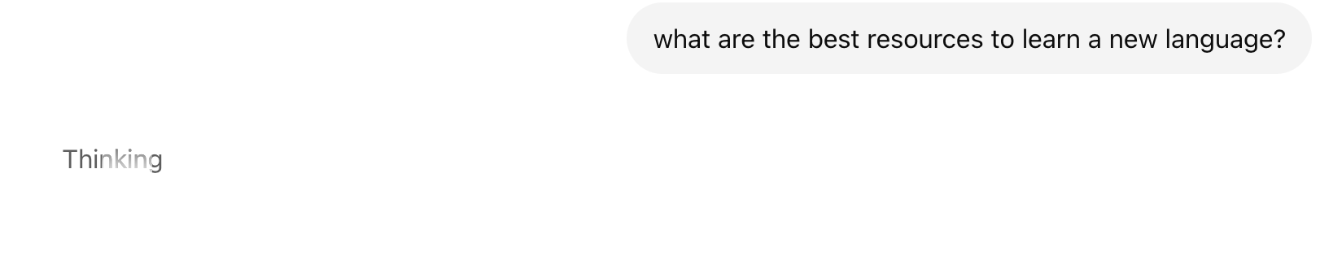
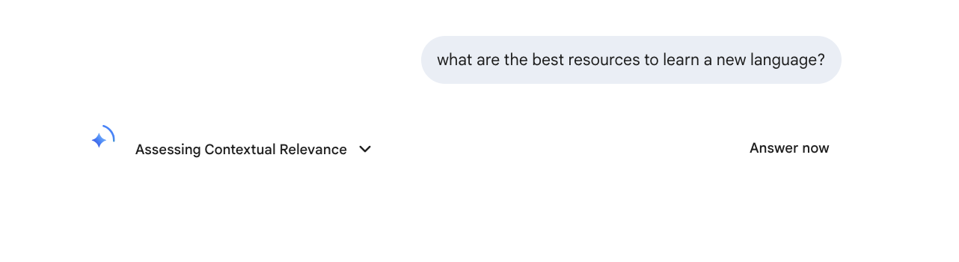


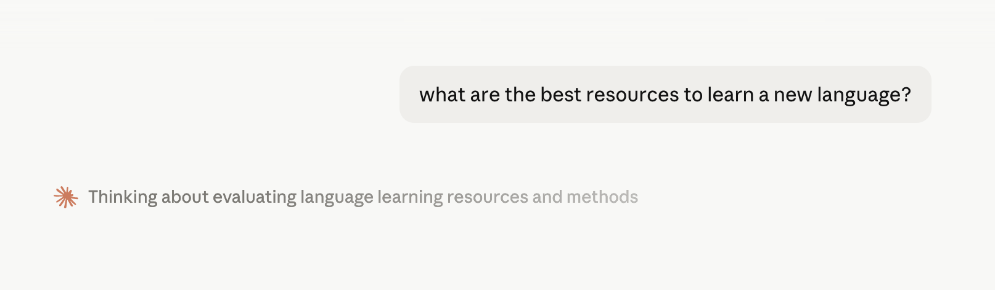

Slide 28
Reasoning Models
<think> Let us analyze each constant e = …. </think> <answer> The question is incorrect …
Multi-layer Self-Attention Causal Transformer Model
Why is e > pi?

Slide 29
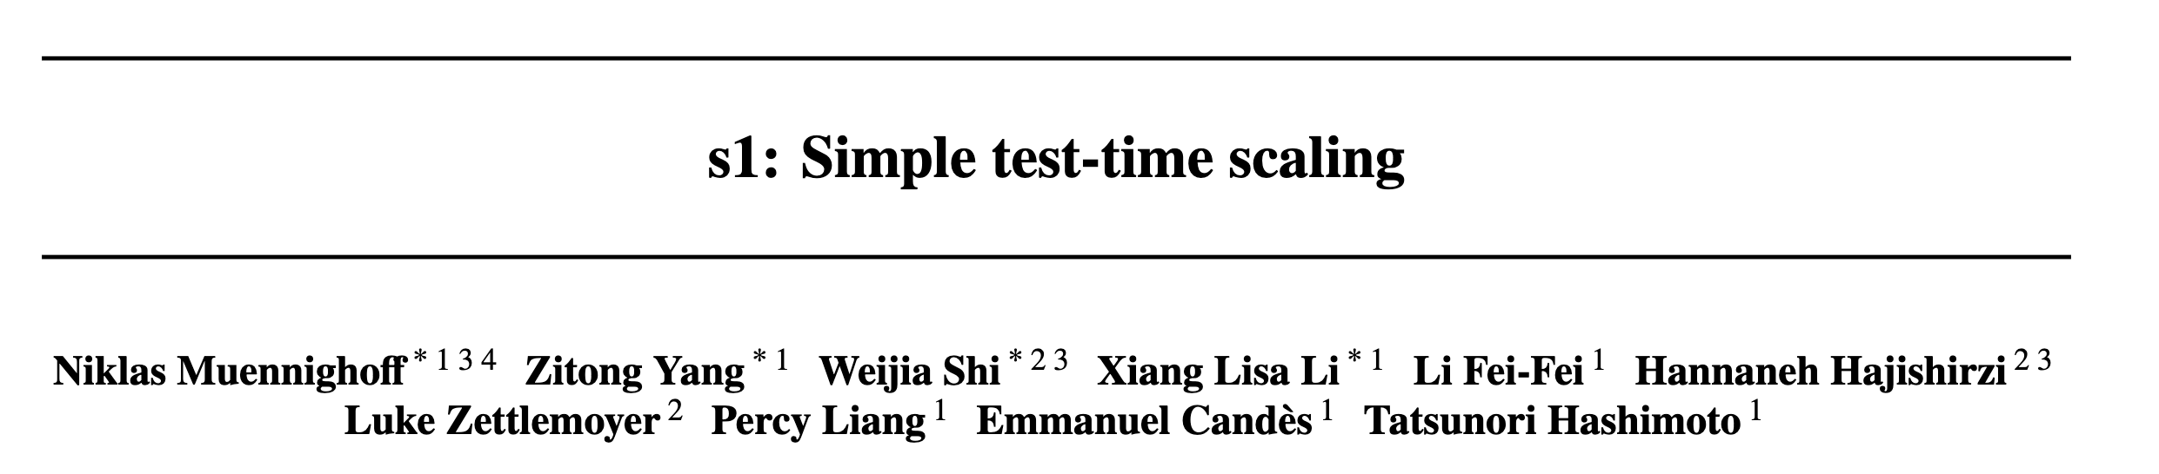
Paper Discussion

Slide 30
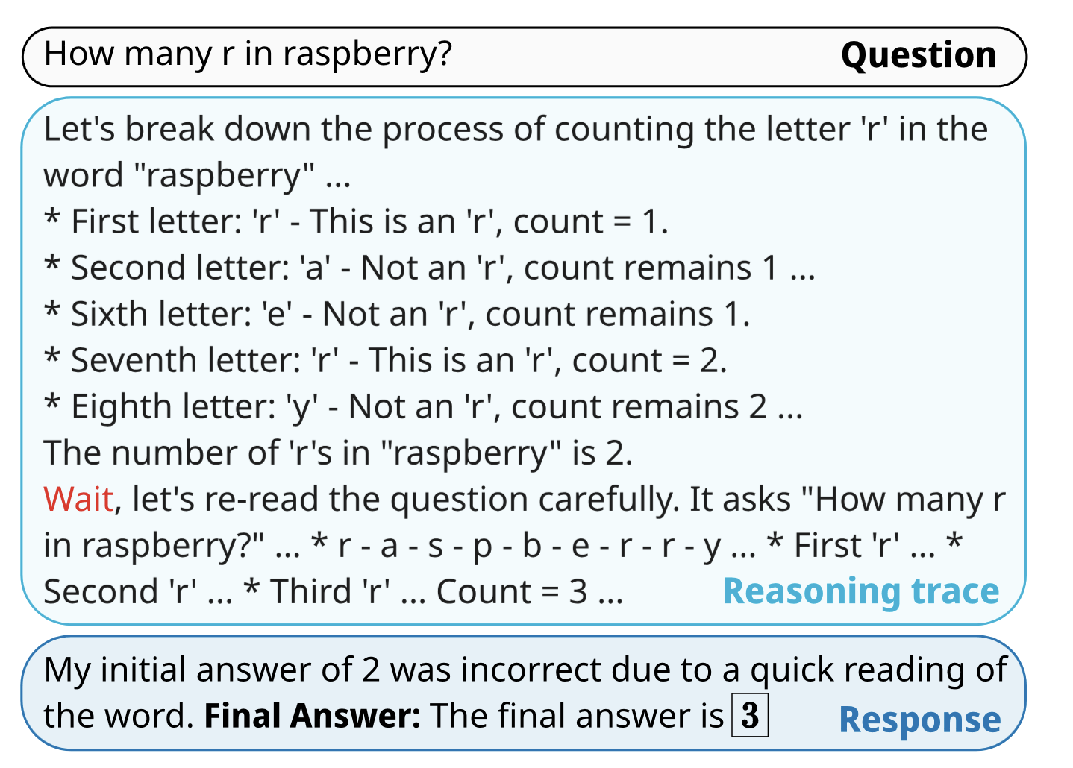
Can someone explain this figure?

Slide 31

Paper Discussion

Slide 32
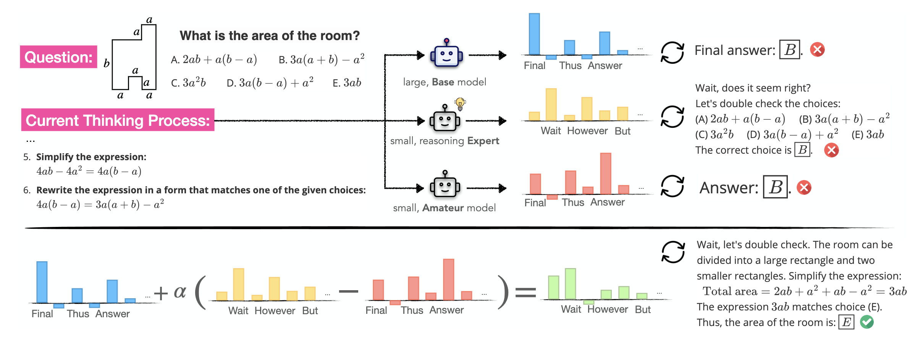
Can someone explain this Figure?

Slide 33
Questions?

