Slide 1
Adversarial Examples, Generative Adversarial Networks, Deep Dream, Style Transfer, etc

Slide 2
Convnets (optimize weights to predict bus)
bus

Slide 3
Convnets (optimize input to predict ostrich)
ostrich
Work on Adversarial examples by Goodfellow et al. , Szegedy et. al., etc.

Slide 5
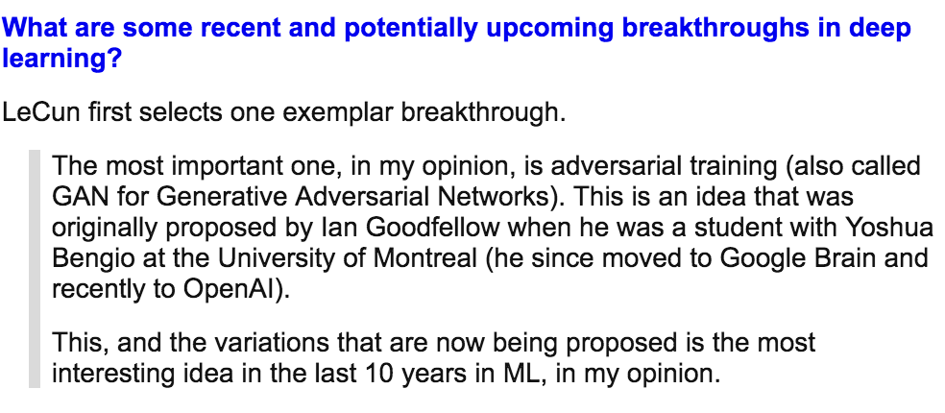
Generative Adversarial Networks (GAN) [Goodfellow et al.]

Slide 6
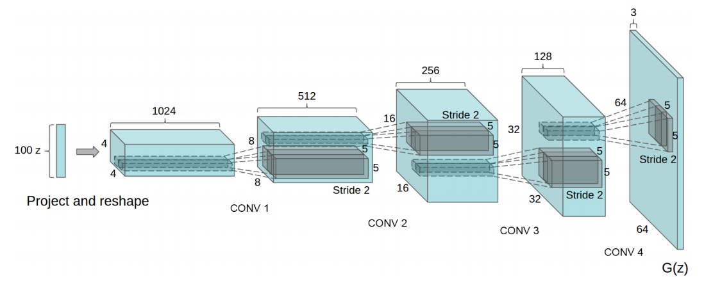
Generative Network (closer look)
Deconvolutional Layers
Upconvolutional Layers
Backwards Strided Convolutional Layers
Fractionally Strided Convolutional Layers
Transposed Convolutional Layers
Spatial Full Convolutional Layers
Radford et. al. Unsupervised Representation Learning with Deep Convolutional Generative Adversarial Networks. ICLR 2016

Slide 7
Gatys et. al. Image Style Transfer Using Convolutional Neural Networks. CVPR 2016

Slide 8
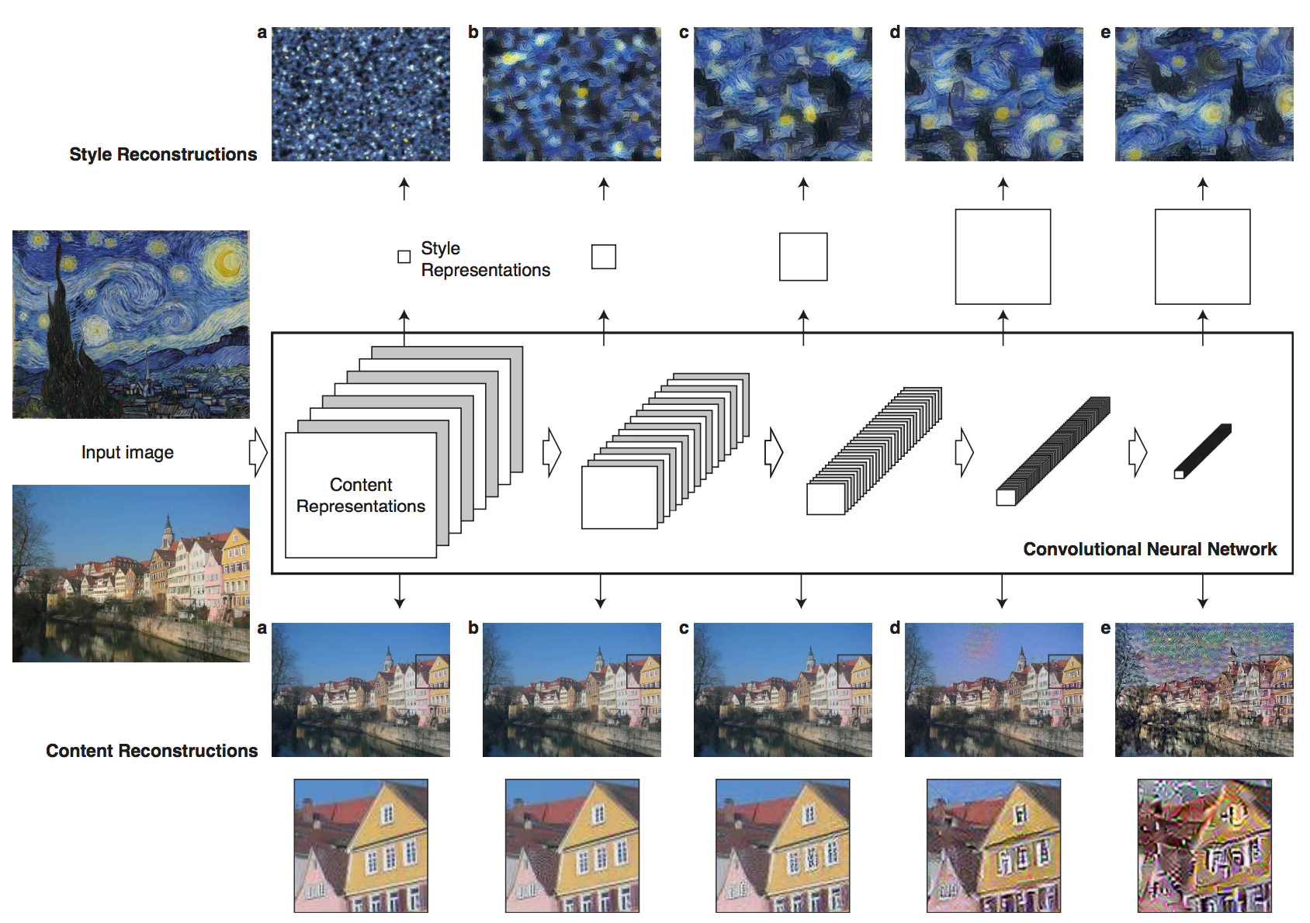

Slide 10
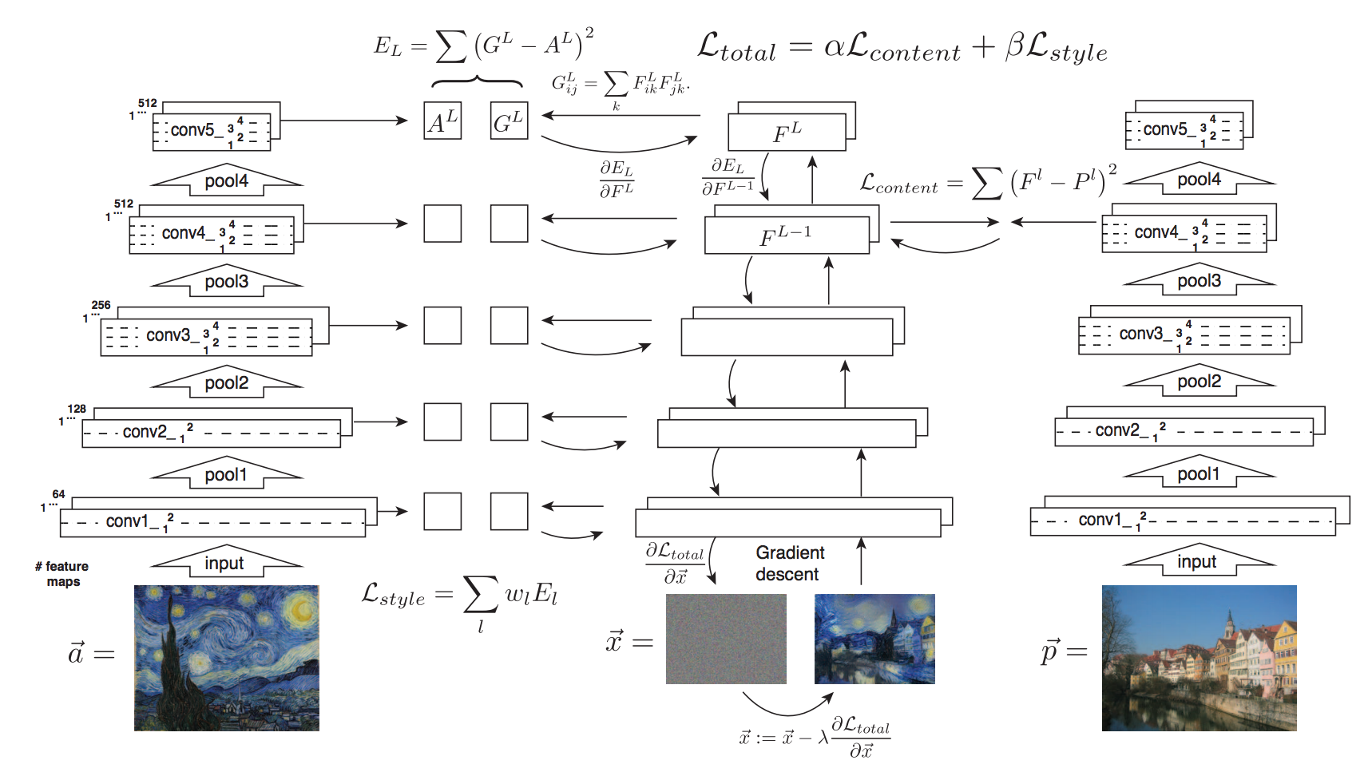

Slide 11
Johnson et. al. Perceptual Losses for Real-Time Style Transfer and Super-Resolution. ECCV 2016

Slide 12
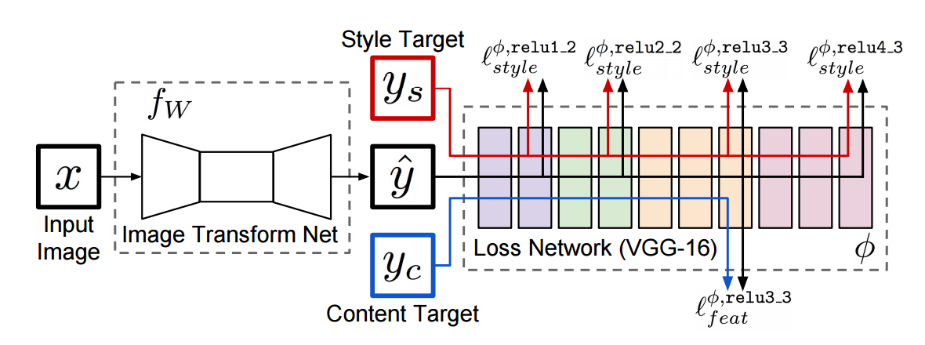

Slide 13
