Slide 1
LEARNING VISUAL GROUPS FROM CO-OCCURRENCES IN SPACE AND TIME
CS 6501-003: Computational Visual Recognition
Journal Presentation, 10/24/2016
Di Fang, Jeff Xing
Phillip Isola, Daniel Zoran, Dilip Krishnan, Edward H. Adelson (Submitted on 21 Nov 2015). https://arxiv.org/abs/1511.06811v1

Slide 2
1. Introduction

Slide 3
Introduction
“Self-Supervised” learning
Space, Time
Object proposals
Movie segmentation
Geospatial grouping

Slide 4
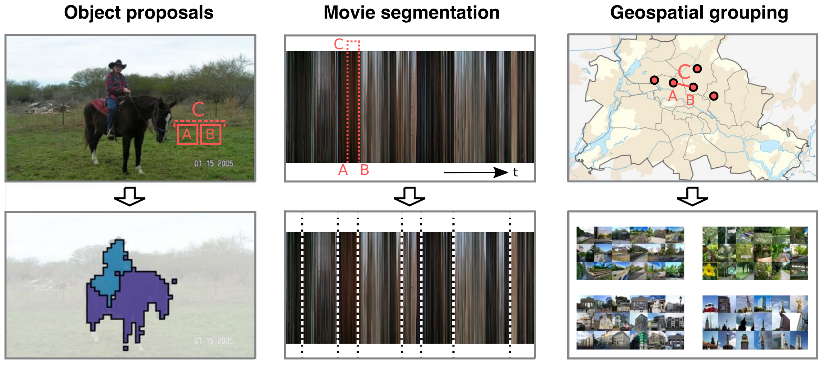
Notes:
Figure 1: We model statistical dependences in the visual world by learning to predict which visual primitives – patches, frames, or photos – will be likely to co-occur within the same spatial or temporal context. Above, the primitives are labeled A and B, and the context is labeled C. By clustering primitives that predictably co-occur, we can uncover groupings such as objects (a group of patches; left), movie scenes (a group of frames; middle), and place categories (a group of photos; right)

Slide 5
2. Related Work

Slide 6
3. Modeling Visual Affinities by Predicting Co-Occurence

Slide 7
Model
Primitives - A,B
Supervised Classifier – Q
predict indicator variable Q {0,1}
Space and Time Classifier – C
classifiers to predict spatial or temporal proximity, denoted by C {0,1}
w(A,B)
5. Bayes’ rule

Slide 8
C: similarity proxy
Task 1 (patches): C=1, if immediately adjacent patches
Task 2 (movie): C=1, if 2 frames between 3-10 seconds apart
Task 3 (photos): C=1, if 2 photos within 11 meters (GPS coord.)
C=0 otherwise
Hence, C can be usually computed without human-annotated labels!

Slide 9
Predicting Co-Occurrences with a CNN
Loss Function in this paper:
i=
N – number of training examples
Sigma – logistic function
f – neural net
Theta – net parameters
Stochastic gradient descent

Slide 10
Loss Function in this paper:
i=
Cross Entropy Loss Function:

Slide 11
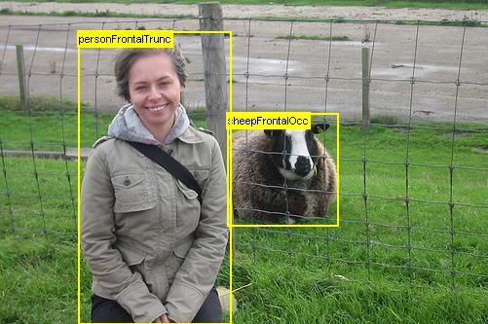
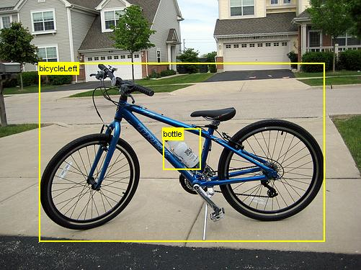
Patch dataset: VOC2012

Slide 12
Frames dataset: IMDB top 100

Slide 13
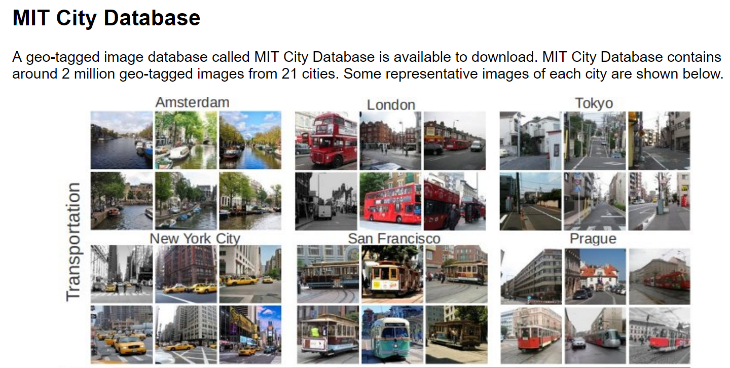
Photos dataset: MIT Cities dataset
http://cityimage.csail.mit.edu/

Slide 14
Patches
Many to many
Find similarity
Pascal VOC 2012
Notes:
Figure 2: Overview of our approach to learning to group patches. We train a classifier to that takes two isolated patches, A and B, and predicts C: whether or not they were taken from nearby locations in an image. We use the output of the classifier, P(C = 1|A, B), as an affinity measure for grouping. The rightmost panel shows our grouping strategy. We setup a graph in which nodes are image patches, and all nearby nodes are connected with an edge, weighted by the learned affinity (for clarity, only a subset of nodes and edges are shown). We then apply spectral clustering to partition this graph and thereby segment the image. The result on this image is shown in Figure 5.

Slide 15
Learned Affinities vs Related Techniques
Notes:
Table 1: Average precision scores of our method (labeled “Co-occurrence classifier”) compared to baselines at predicting C (spatial or temporal adjacency) and Q (semantic sameness) for three domains: image patches, video frames, and geospatial photos.

Slide 16
Robustness of Learned Affinities
Patches | 0.001 | 0.001 | 0 | 0.437 | 0.296
Frames | 0.023 | 0.045 | 0.004 | 0.553 | 0.209
Photos | 0.062 | 0.051 | 0.004 | 0.03 | 0.034
Notes:
Table 2: Probing the learned affinities by transforming B while leaving A unmodified. Each number reports the mean output, w(A, B), from each network after the specified transformation has been applied. Transformations applied to one example patch are shown at the top of each column. Comparison should be made with respect to the unmodified input, given in the left-most column.

Slide 17
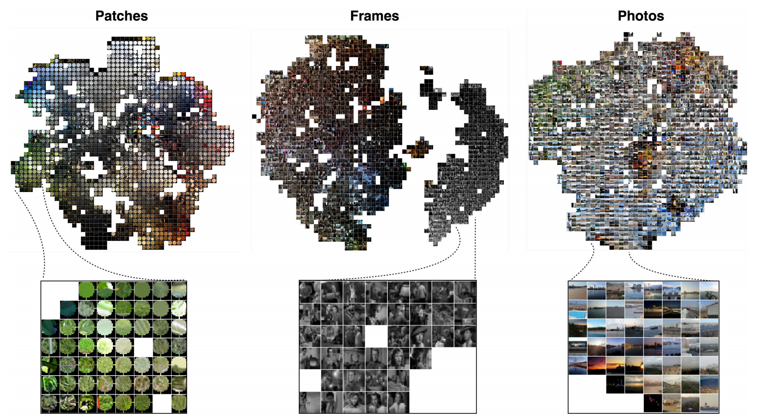
Visualizing Learned Affinities
t-SNE: van der Maaten & Hinton (2009)
Notes:
Figure 3: t-SNE visualizations of the learned affinities in each domain. We construct an affinity matrix between 3000 randomly sampled primitives to create each visualization, using w(A, B) as the affinity measure. We then apply t-SNE on this matrix (van der Maaten & Hinton (2009)). To avoid clutter, we visualize the embedded primitives snapped to the nearest point on a grid. The learned affinities pick up on different kinds of similarity in each domain. Patches are arranged largely according to color, while the geo-photo affinities are less dependent on color, as can be seen in the inset where day and night waterfronts map to nearby points in the t-SNE embedding

Slide 18
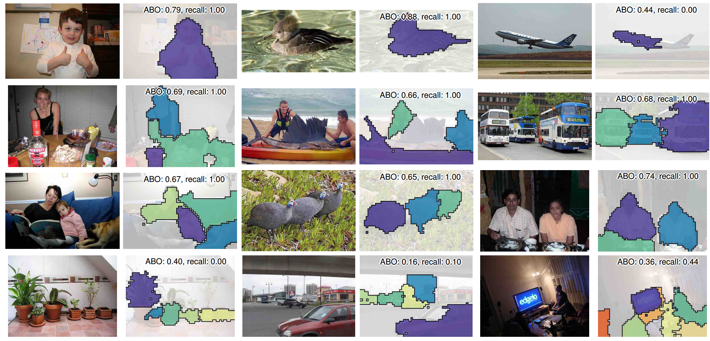
Notes:
Figure 4: Example object proposals. Out of 100 proposals per image, we show those that best overlap the ground truth object masks. Average best overlap (defined in Krahenbuhl & Koltun (2014)) and recall at a Jaccard index of 0.5 are superimposed over each result.

Slide 19
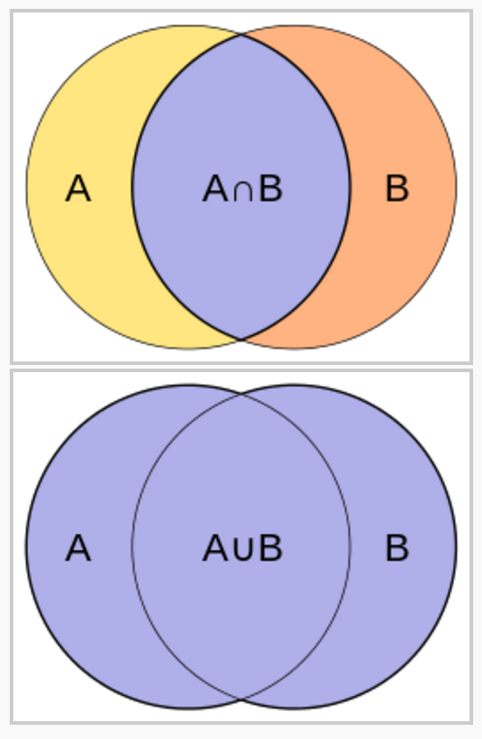
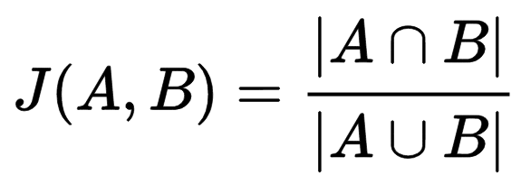
Jacard index (jaccard similarty coefficient)
Notes:
Jaccard index, also known as the Jaccard similarity coefficient

Slide 20
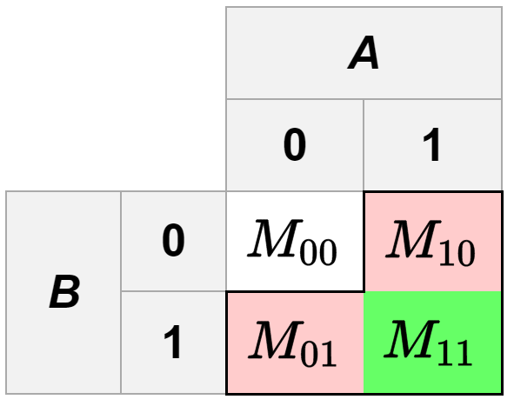
Jacard index: binary features
Notes:
Why is Jaccard index used over Simple Matching Coefficient? When you don’t want to say that two objects are similar just because they both DON’T have something.

Slide 21
4. From Predicting Co-Occurrence to Forming Visual Groups

Slide 22
How to extract groupings?

Slide 23
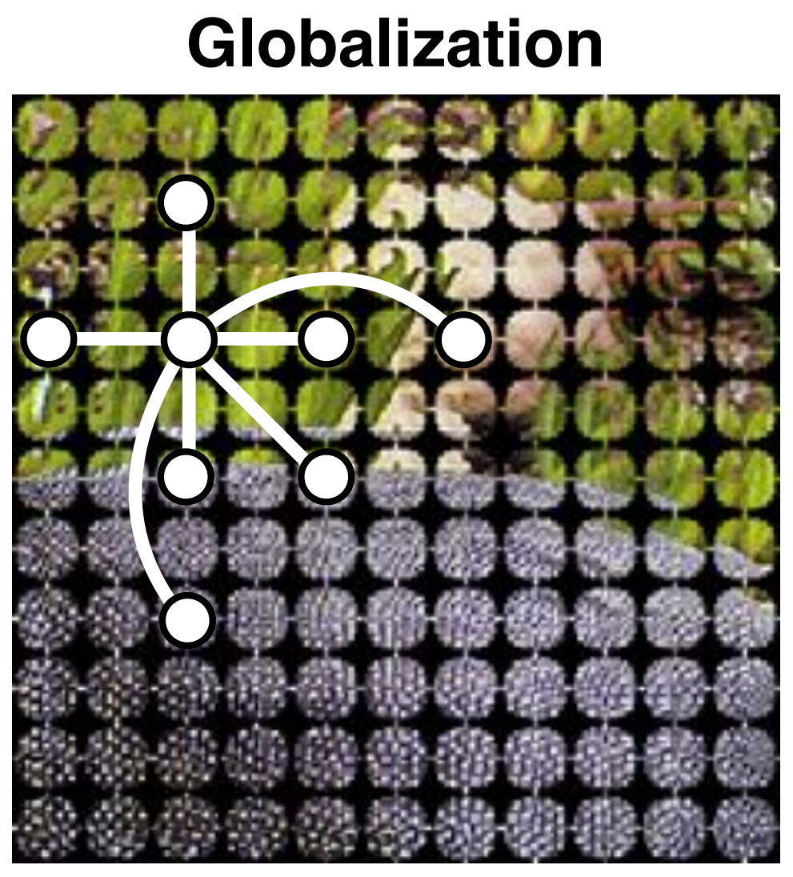
a representative subset of the network graph

Slide 24
4 seconds per image on a 2015 Macbook Pro

Slide 25
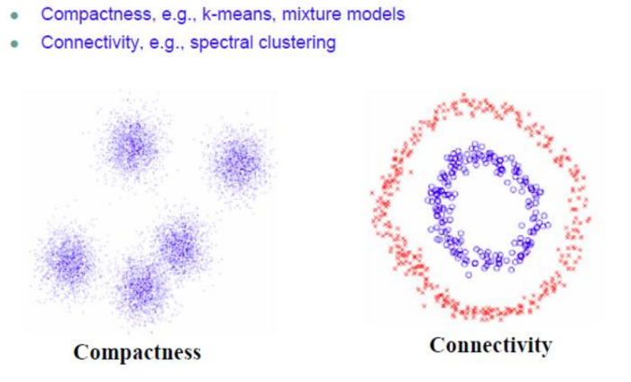
Spectral clustering
https://charlesmartin14.wordpress.com/2012/10/09/spectral-clustering/
Notes:
https://charlesmartin14.wordpress.com/2012/10/09/spectral-clustering/
cluster data that is connected but not lnecessarily compact

Slide 26
Results: Object proposal
Notes:
Figure 5:
Object proposal results, evaluated on bounding boxes.
Our unsupervised method (labeled “Co-occurrence”) is competitive with recent supervised algorithms at proposing up to around 100 objects.
ABO is the average best overlap metric from (Krahenbuhl & Koltun (2014)),
J is Jaccard index.
The papers compared to are:
BING (Cheng et al. (2014)),
EdgeBoxes (Zitnick & Dollar (2014),
LPO (Krahnenbuhl & Koltun (2015)),
Objectness (Alexe et al. (2012)),
GOP (Krahenbuhl & Koltun (2014)),
Randomized Prim (Manen et al. (2013)),
Sel. Search (Uijlings et al. (2013)).

Slide 27
Movie Barcode
http://moviebarcode.tumblr.com/post/4773062134/the-lord-of-the-rings-the-two-towers-2002
Notes:
Original algorithm not published, but some possibilities include:
http://arcanesanctum.net/2011/03/15/movie-barcode-generator/ or https://bitbucket.org/yaurthek/moviebarcodegenerator/src
http://wordpress.mrreid.org/moviebarcode/
http://forum.doom9.org/showthread.php?p=1480852#post1480852
http://projects.metafilter.com/2996/Make-your-own-Movie-Barcodes
Algorithm:
- Extract (subsample?) images/frames from movie
- Resize (e.g. resize or crop in ImageMagick) each image to 1 pixel
- Montage/concatenate into a row
- Expand to desired vertical height like a real-world “barcode”

Slide 28
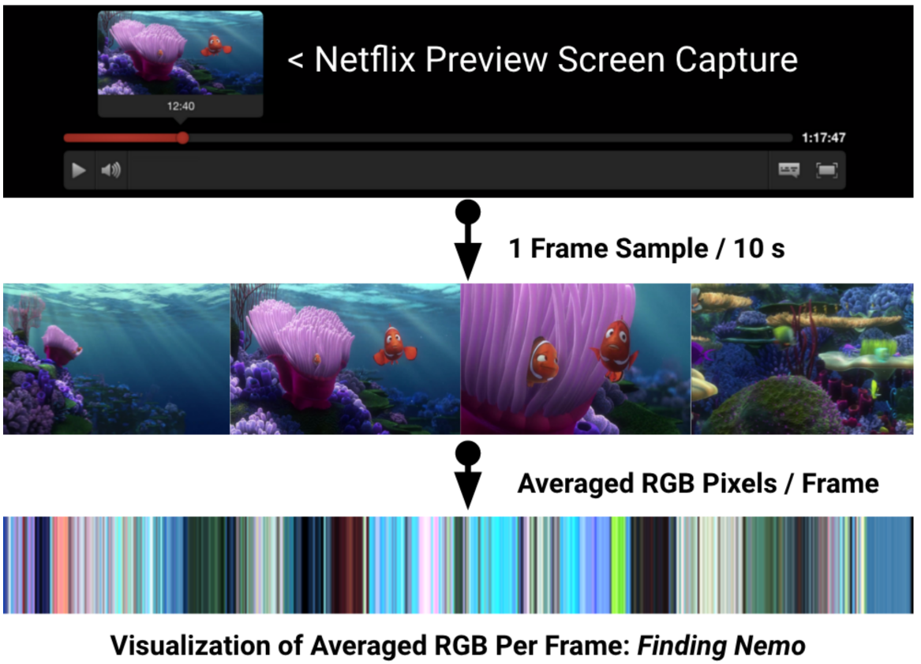
http://cs229.stanford.edu/proj2015/181_report.pdf

Slide 29
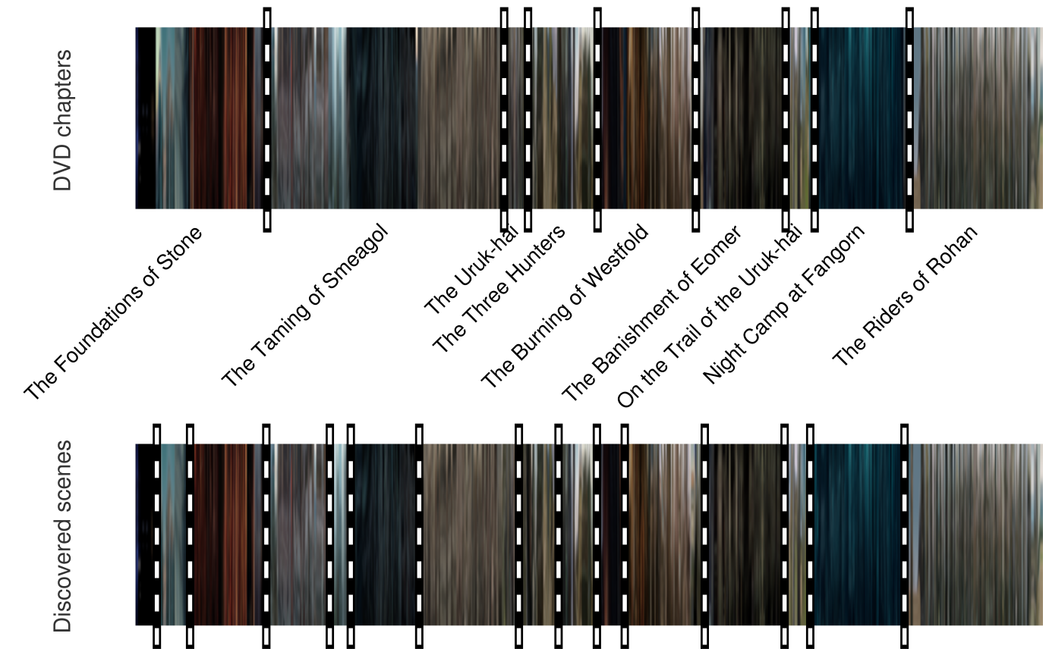
Notes:
Figure 6: Left:
“movie barcode” for The Two Towers, in which each frame of the movie is resized into a signal column of the visualization;
the top shows the DVD chapters and the bottom our recovered scene segmentation.
Notice that some DVD chapters contain multiple different scenes.
Our method tends to detect these sub-chapter scenes, resulting in an over-segmentation compared to the chapters.

Slide 30
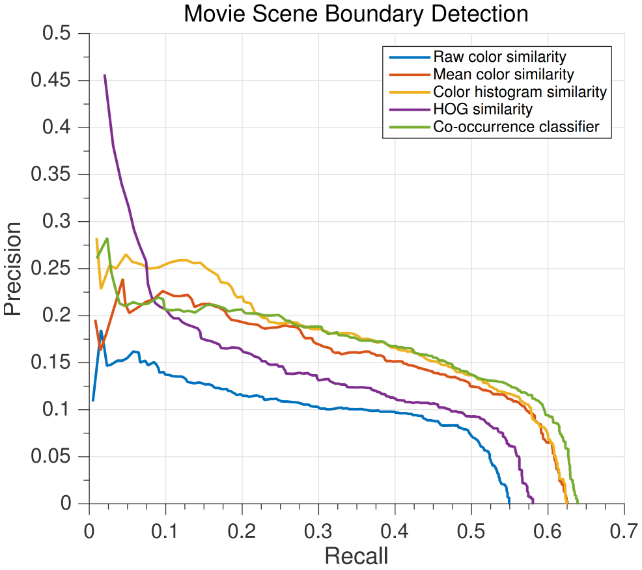
Notes:
Figure 6: Right:
we quantify our performance on this scene segmentation task; see text for details.

Slide 31
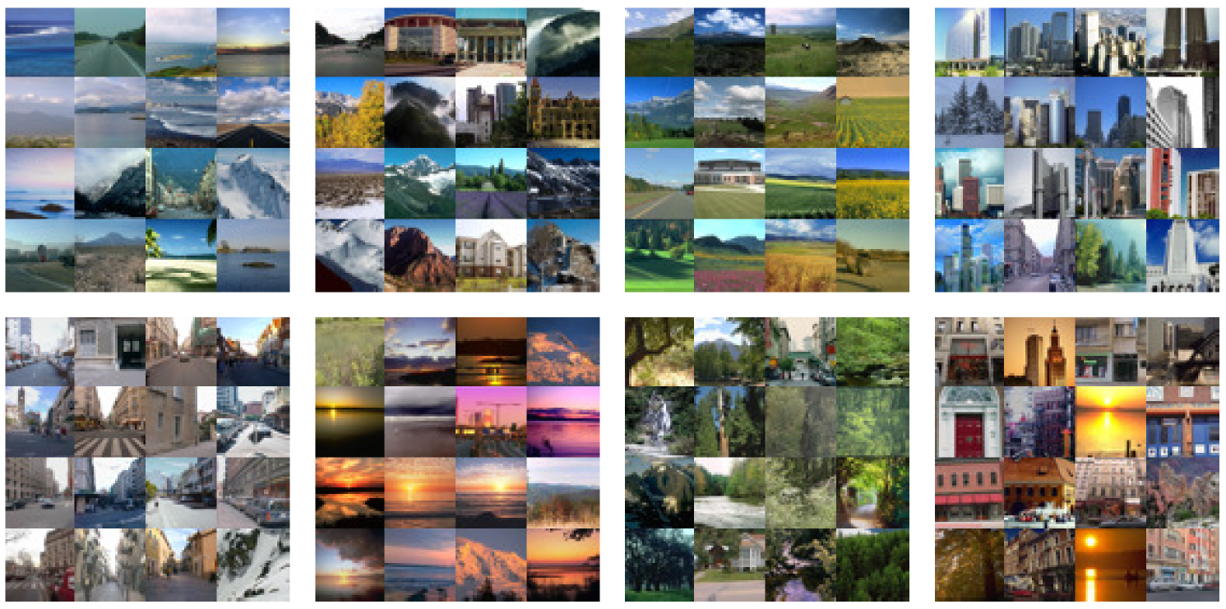
Notes:
Figure 7: Left:
Clustering the LabelMe Outdoor dataset (Liu et al. (2009)) into 8 groups using our learned affinities.
Random sample images are shown from each group.

Slide 32
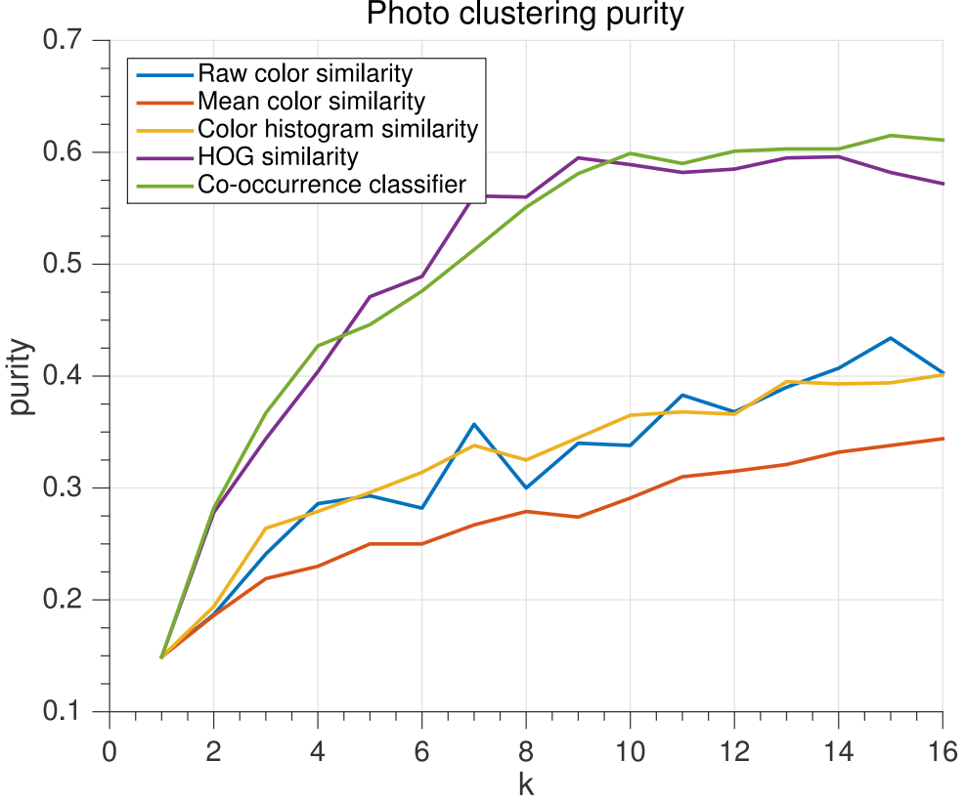
Notes:
Figure 7: Right:
Photo cluster purity versus number of clusters k.
Note that we trained our model on an independent dataset, the MIT City dataset (Zhou et al. (2014)).

Slide 33
5. Conclusions

Slide 34
Summary
A simple & general approach to visual grouping:
No pre-defined labels required!
Uses co-occurrence in space or time
Competitive results
object proposal
movie scene segmentation
semantic place category

Slide 35
Questions?

