Slide 1
The Open World of Micro-Videos
Yujia Li & Sharon Han

Slide 2
Micro-videos
Contain significantly more diversity and narrative structure
Contain specialized viewpoints:
Third-person:https://www.instagram.com/p/BK2Ljf6DUDv/?taken-by=myluvming
Egocentric: https://www.instagram.com/p/BBAvs0rmheW/
Self-facing: https://www.instagram.com/p/BLBYMzdBrNC/?taken-by=foodmento
Contain interesting open-world dynamics
264,327 micro-videos labeled with 58, 243 tags

Slide 3
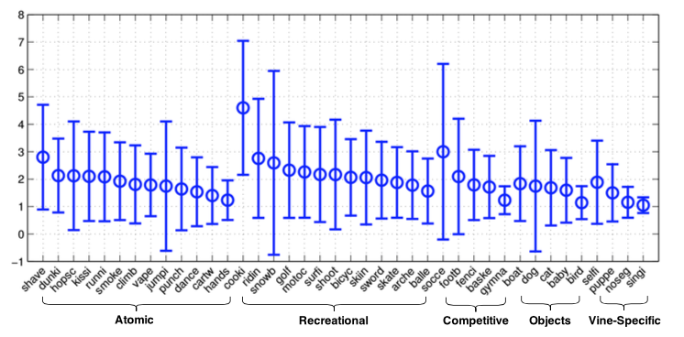
Dataset: distinct from existing video benchmarks
Streaming dataset collection (figure: overall distribution of tags)
Curation
Long-tail distributions
Temporal dynamics
Short statistics
Viewpoint

Slide 4
Methods: tag prediction
Appearance features(Ka): CNN
Final video pipeline 15x slower and 2x larger than standard single-frame CNN
6144-dimensional multi-scale features across
multiple layers
VGG-16
Max-pooling
One frame
A video
15 equally-spaced
frames
6144-dimensional multi-scale features across
multiple layers
One frame
Resulting features of 15 frames
...
...

Slide 5
Methods: tag prediction
Motion features(Km): Improved Dense Track(IDT)
“Interest-track” framework: short-term tracks are found from tracking interest points across frames
Extracts various features aligned to these temporal tracks, including oriented gradient histograms and optical flow
Quantize these descriptors based on established guidelines for constructing a codebook using K = 4000

Slide 6
Methods: tag prediction
Cue-combination: using Appearance features(Ka) and Motion features(Km) for tag prediction
Similarity between two video clips
Appearance similarity between two video clips
Motion similarity between two video clips
Training vocabulary of K tags, using LIBSVM to train K binary kernelized SVMs

Slide 7
Methods: viewpoint classification
Viewpoint mixtures
Third-person
Each tag
Self-facing
Tag prediction with maximum score
Egocentric

Slide 8
Methods: dynamics
Temporally-adapted models
Evaluate models trained with videos sampled over different temporal windows
Assume that tag priors very smoothly over time
Use a weighted estimate of recent tags’ popularity

Slide 9
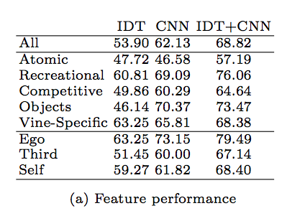
Experiments: diagnostic evaluations
Feature comparisons
CNN outperforms IDT in most category groups
IDT+CNN outperforms both CNN and IDT in all category groups
Notes:
Dataset: MV-40 (hand-curated dataset containing only videos with direct visual evidence for a subset of 40 tags selected to span both common and rare tags)

Slide 10
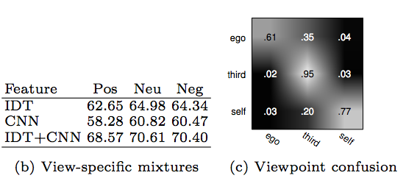
Experiments: diagnostic evaluations
View-specific mixtures
IDT+CNN outperforms both CNN and IDT in all Pos, Neu and Neg training examples
Viewpoint prediction
Egocentric view are often confused with third-person

Slide 11
Experiments: comparison to existing benchmarks
The average accuracy on vine-15 is lower than HMDB: data is more challenging
Temporally iconic videos: Temporally iconic depiction
“Even though third-person and temporal iconic-ness accounts for much of the difference between HMDB and our dataset, our micro-videos can still generalize better.”
Qualitative differences
“It is surprisingly hard to collect diverse video clips.”
“Micro-video dataset is inherently diverse by construction due to its dynamic and pre-trimmed nature.”

Slide 12
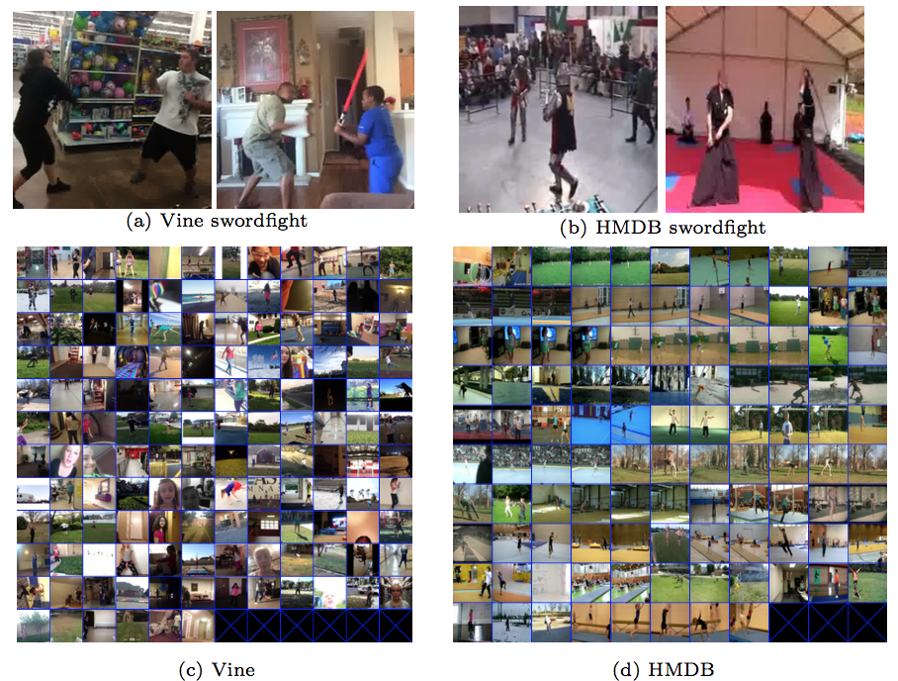
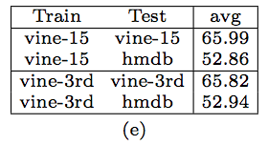
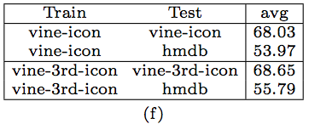
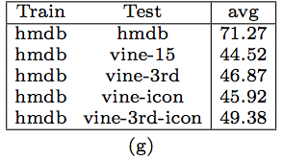
Experiments: comparison to existing benchmarks

Slide 13
Experiments: open-world dynamics
Properties of open-world MV-58K dataset
Score criteria: mAPT and mAPI
Curated vs raw data
Closed vs open vocabularies
Temporal dynamics

Slide 14
Conclusion
Open-world dataset of micro-videos: easy capture, storage, and processing
Can be used a live testbed for open-world evaluation of video understanding systems: naturally diverse, pre-trimmed, user-annotated
Distribute a benchmark script that evaluates models on live open-world micro-videos

Slide 15
Questions?

