Slide 1
Robust Image Sentiment Analysis Using Progressively Trained and Domain Transferred Deep Networks
Quanzeng You, Jiebo Luo, Hailin Jin and Jianchao Yang
Presented by Abhimanyu Banerjee

Slide 2
Sentiment Analysis
Definition: Aims to determine the attitude of a speaker or a writer with respect to some topic or the overall contextual polarity of a document
Sentiment Analysis Tasks
Polarity - a basic task; classifies whether the expressed opinion is positive, negative or neutral
Emotion states - an advanced task; Plutchik’s wheel of emotion
Subjective vs Objective - very difficult:
Subjective sentences in objective documents
Definition of subjectiveness depends on context
Source: https://en.wikipedia.org/wiki/Sentiment_analysis
Notes:
e.g., a news article quoting people's opinions

Slide 3
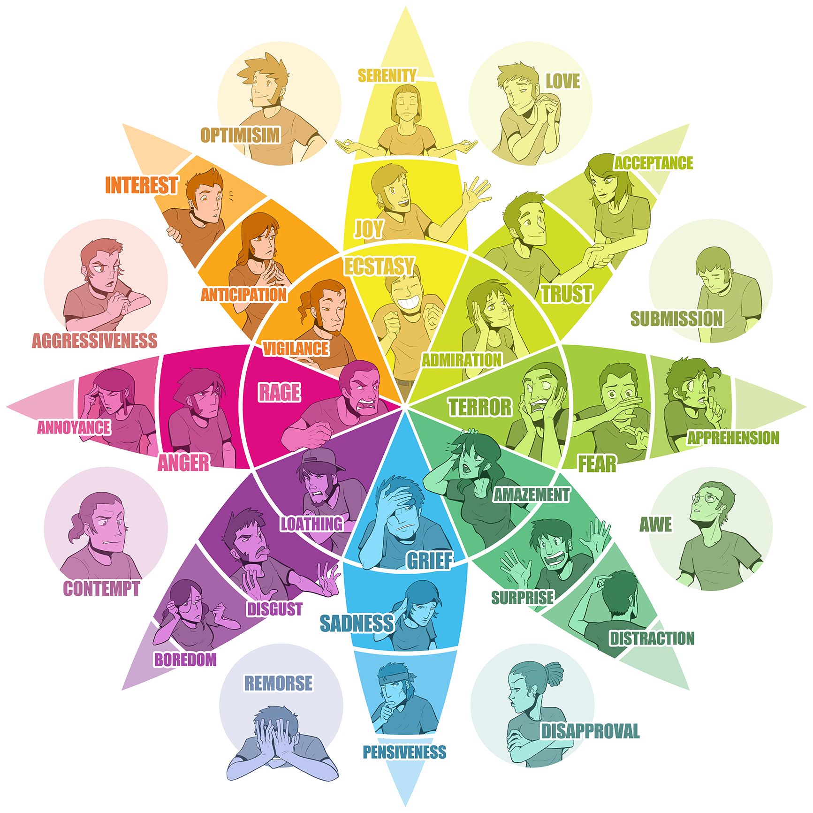
Plutchik’s wheel of emotion
Eight basic emotions with eight derivative emotions each composed of two basic ones.
Each emotion has three levels of intensity with intensity decreasing as we move away from the center.
It is theorized that there are twenty-four human emotions, each composed out of two of Plutchik’s basic emotions
Source: https://en.wikipedia.org/wiki/Sentiment_analysis, Plutchik's wheel

Slide 4
Challenges of Visual Sentiment Analysis
Text is highly structured and easy to parse semantically while image is unstructured and noisy.
Requires a much higher level of abstraction and subjectivity
Involves a wide variety of image recognition task - object, scene, event, etc
Creation of large datasets requires extensive image annotation
Learning schemes must have high level of generalizability to cover various domains
Notes:
2) high level abstraction may require viewer’s knowledge beyond the image content itself.
4) images in the same class of ImageNet mainly contain the same type of object. In sentiment analysis, each class contains much more diverse images.

Slide 5
Contributions
Develop a deep convolutional network architecture that can effectively learn features in the images themselves that are indicative of sentiment
Attempt to alleviate the noisy nature (weakly labelled) nature of visual sentiment datasets by using progressive training
Build a large hand-annotated dataset for visual sentiment using Amazon Mechanical Turk
Create a highly generalizable model by inducing domain transfer

Slide 6
Related Work
Sentibank: large-scale ontology and classifiers for detecting sentiment and emotions in visual content ~ Borth et al.
Analyzing and predicting sentiment of images on the social web ~ Siersdorfer
Sentribute: image sentiment analysis from a mid-level perspective ~ Yuan et al.
From Pixels to Sentiment: Fine-tuning CNNs for Visual Sentiment Prediction ~ Victor Campos
Source: Quanzeng et al

Slide 7
Sentibank
1200 Adjective-Noun Pairs (ANP)
ANPs used to query and crawled Flickr
The features of the images in each ANP group used to form 1200 ANP detectors
Responses of these detectors considered as mid level features
Source: Sentibank: Visual Sentiment Ontology

Slide 8
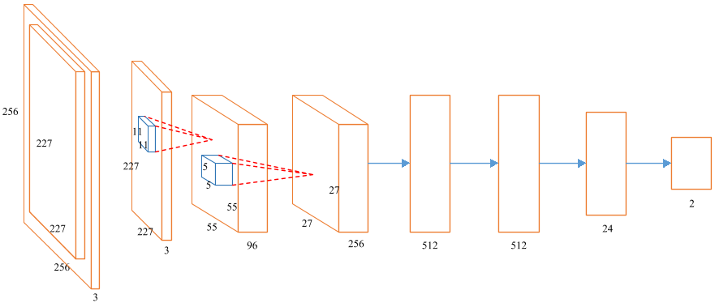
The Architecture
Source: Quanzeng et al

Slide 9
The Architecture [continued]
Each image is resized to 256x256 (center crop if needed)
Two convolutional layers -
Layer 1 has 96 kernels of size 11x11x3 with stride of 4
Layer 2 has 256 kernels of size 5x5 with stride of 2
Four fully connected layers, with the second to last layer having 24 units (inspired by Plutchik’s wheel of emotions)
Source: Quanzeng et al
Notes:
help the network to learn the 24 emotions from a given image and then classify each image into positive or negative class according to the responses of these 24 emotions.

Slide 10
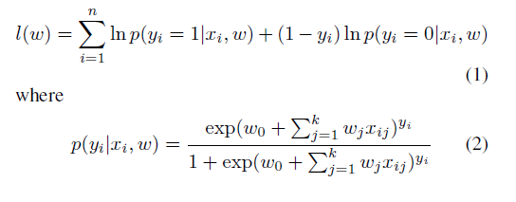
Loss/Cost Function
Source: Quanzeng et al

Slide 11
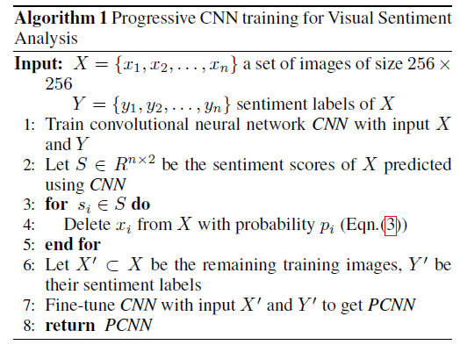
Progressive Training
Images are weakly labelled; can get stuck at local optimum
Model is able to correctly classify a large proportion of the training instances.
Progressively select a subset of training samples to reduce the impact of noisy training instances
Source: Quanzeng et al

Slide 12
Progressive Training Pipeline
Source: Quanzeng et al

Slide 13
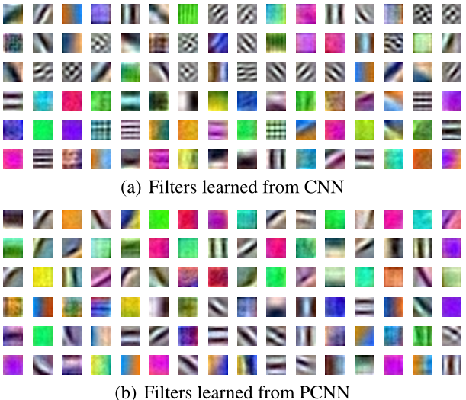
Progressive Training Visualized
Source: Quanzeng et al

Slide 14
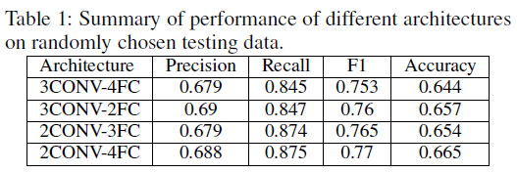
Results
Source: Quanzeng et al

Slide 15
Twitter Data
A total of 1269 image tweets used as candidate images
Used Amazon Mechanical Turk for generating sentiment labels in the following fashion -
Each image assigned to 5 AMT workers.
Each worker assigns the image a polarity - positive, negative, neutral
Only small proportion of the images had significant disagreement among the workers regarding its polarity
Source: Quanzeng et al

Slide 16
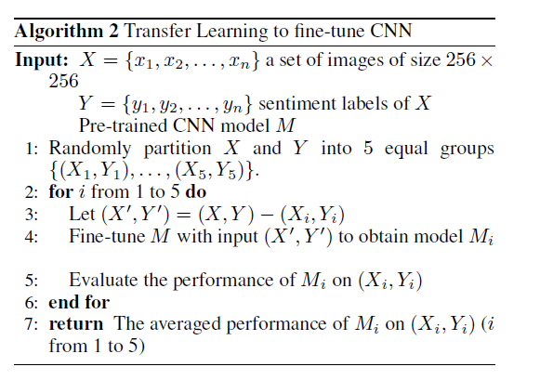
Transfer Learning
The users of Flickr are more likely to take high quality pictures, while most of the Twitter images are casually taken snapshots
Randomly divide the Twitter images into 5 equal partitions; use 4 of the 5 partitions to fine-tune the model, evaluate on the remaining
Used 5 fold cross-validation [ following Borth et al]
Source: Quanzeng et al

Slide 17
Domain Transfer Results
Source: Quanzeng et al

Slide 18
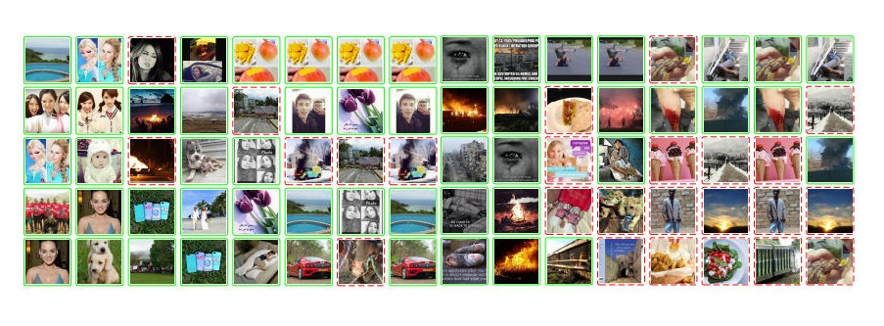
Source: Quanzeng et al

Slide 19
Thank You. Any Questions?

