Slide 1
mengye ren, ryan kiros, richard s. zemel
Exploring models and data for image question answering

Slide 2
Overview
1. Address the problem of image-based question-answering with new models and dataset
2. Assume that THE ANSWERS CONSIST OF ONLY A SINGLE WORD. TREAT THE PROBLEM AS A CLASSIFICATION PROBLEM
3. A GENERIC END-TO-END QA MODEL
4. AN AUTOMATIC QUESTION GENERATION ALGORITHM THAT CONVERTS DESCRIPTION SENTENCES INTO QUESTIONS
5. A new dataset(coco-qa) generated by the above algorithm
6. comparisons to other models and baselines

Slide 3
DATASETS
datasets
Previous dataset(DAQUAR): Malinowski and Fritz released a dataset with images and question-answer pairs, the DAtaset for Question Answering on Real-world images(DAQUAR), containing about 1500 images. All images are indoor scenes. Most questions in this dataset can be divided into three types: object type, object color, and number of objects. All these types of questions can be answered with on word.
COCO-QA: Containing about 78736 train images and 38948 test images.
Difference: The dataset they generated has more images and more even distributed,

Slide 4
how to get the dataset
datasets
Using Stanford parser to obtain the syntactic structure of the original image description
Compound sentences to simple sentences
Indefinite determiners “a(n)” to definite determiners “the”
Wh-movement constrains
example: A man is riding a horse. -> What is the man riding?
Question Generation: Object Questions; Number Questions; Color Questions; Location Questions

Slide 5
how to get the dataset
datasets
Post-Processing:
Answers that appear less than a frequency threshold are discarded.
Enroll a QA pair one at a time. The probability of enrolling the next QA pair(q,a) is:
K <= K2, K = 100 and K2 = 200 in this paper

Slide 6
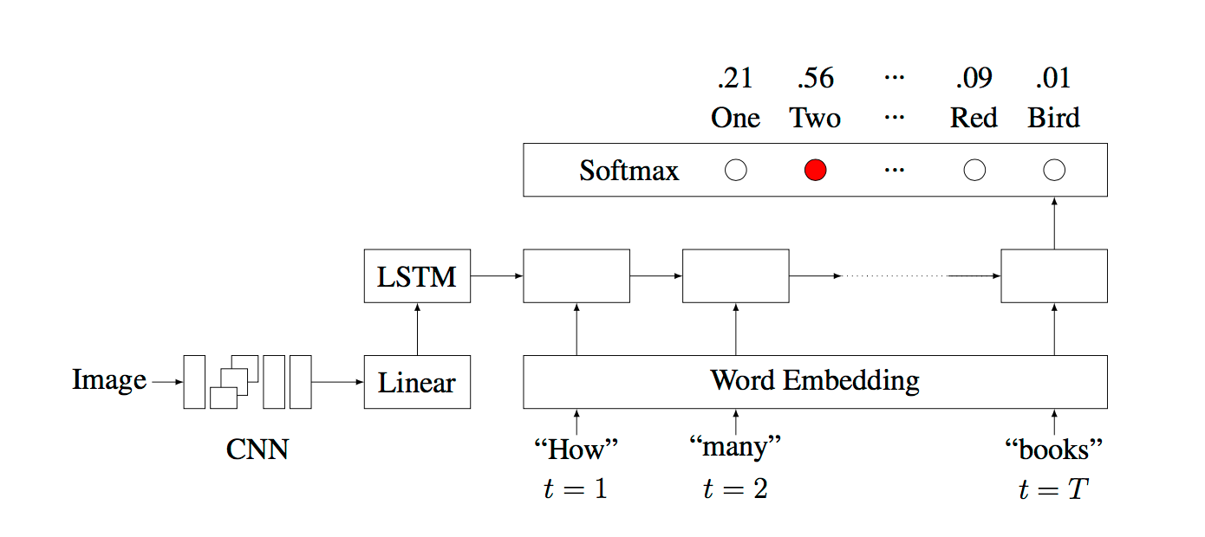
vis+lstm model
models
Use the last hidden layer of the 19-layer Oxford VGG Conv Net trained on ImageNet 2014 Challenge as visual embeddings
Skip-gram Word Embedding
Treat the image as one word of the question
The LSTM(s) outputs are fed into a softmax layer at the last step to generate answers

Slide 7
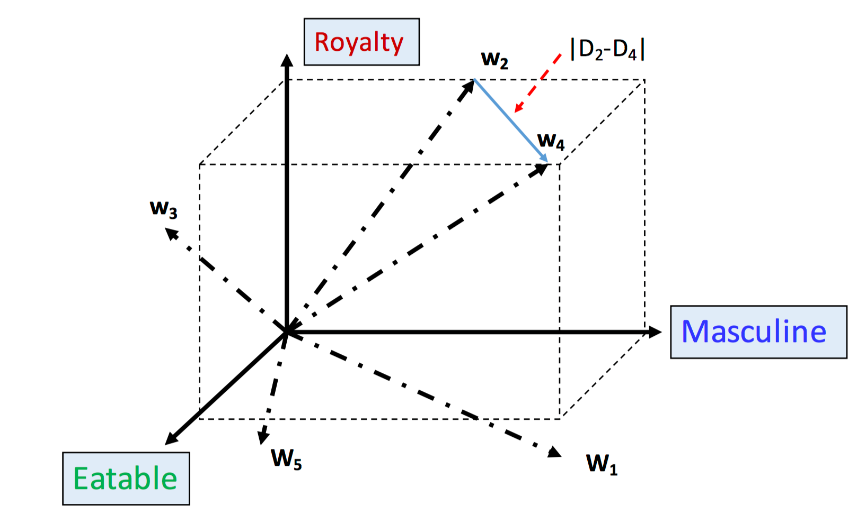
skip-gram word embedding
word embeddings
Represent a word: Vector Representation
Dimension: 300-500 dimension, each dimension may represent certain feature of a word

Slide 8
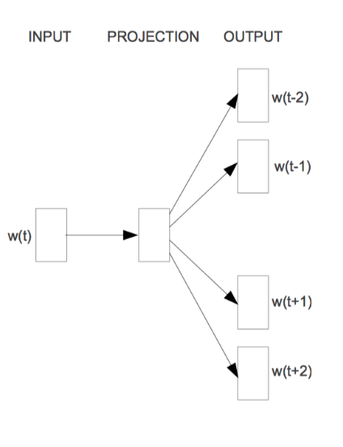
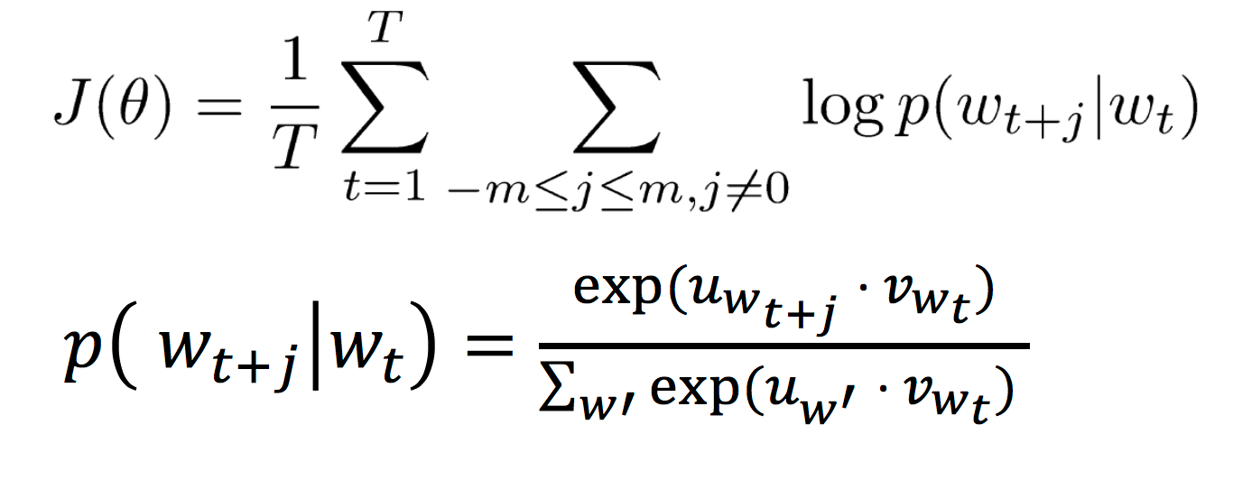
skip-gram word embedding
word embeddings

Slide 9
RNNS(recurrent neural networks) AND LSTM(long short-term memory)
models
Problems: I grew up in France… I speak fluent French.
Bengio, et al. (1994)
http://colah.github.io/posts/2015-08-Understanding-LSTMs/

Slide 10
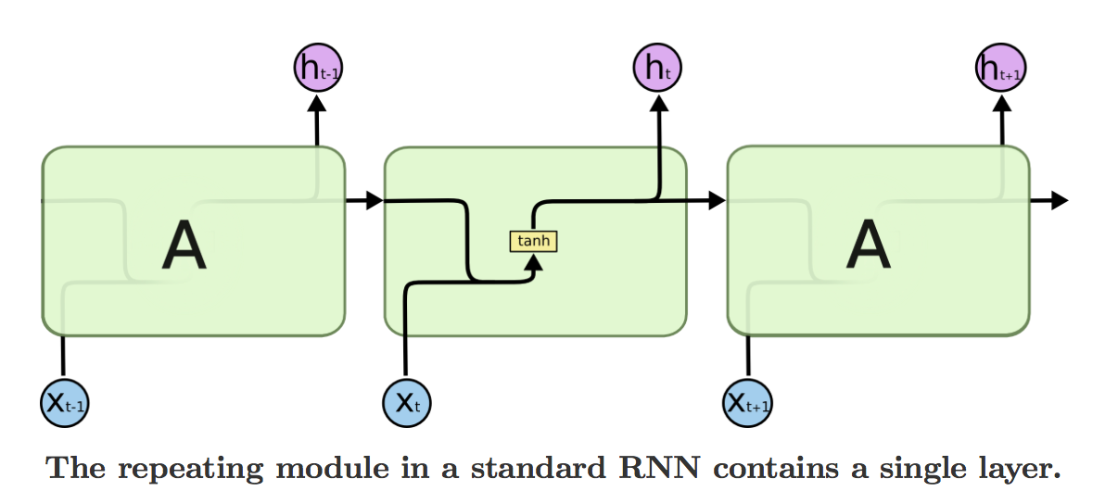
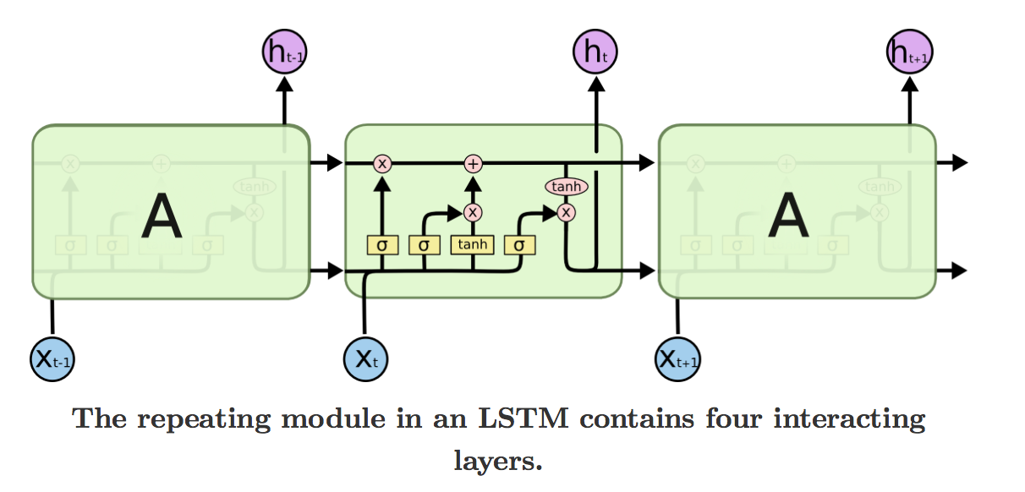
RNNS(recurrent neural networks) AND LSTM(long short-term memory)
models
http://colah.github.io/posts/2015-08-Understanding-LSTMs/

Slide 11
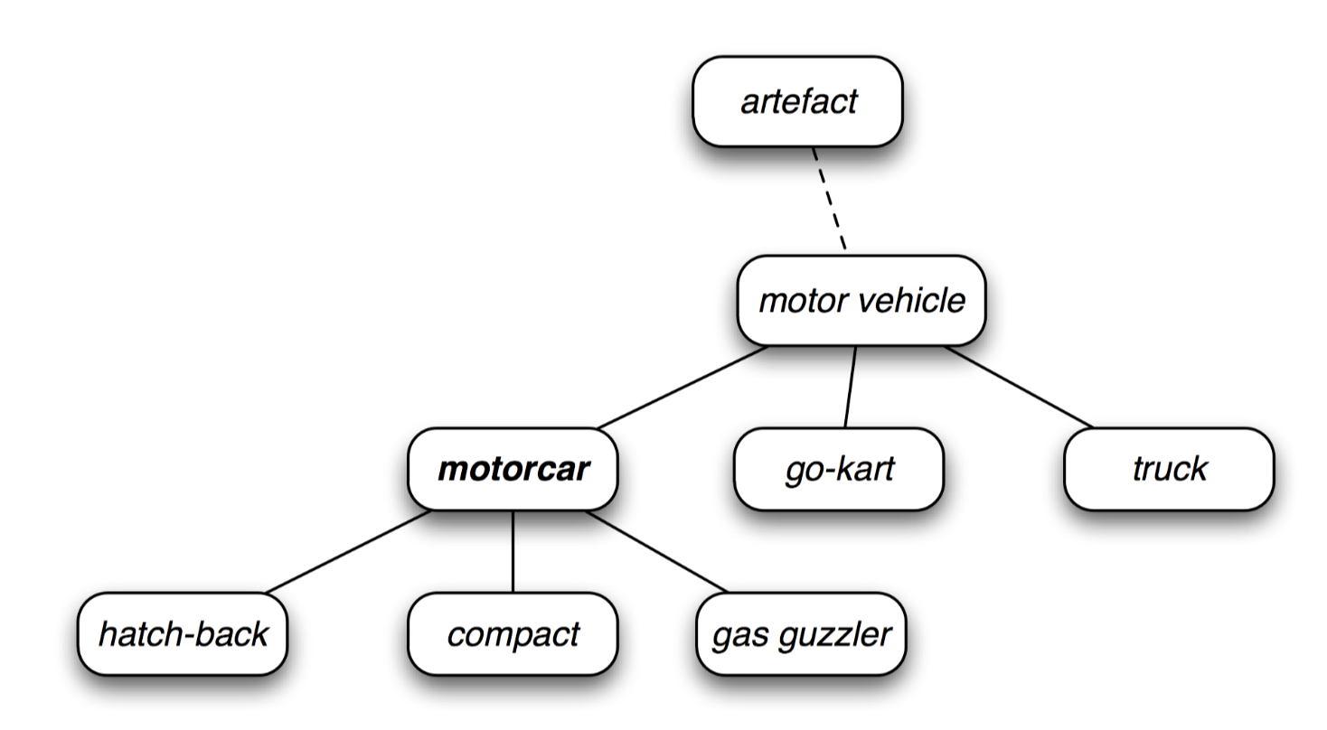
experimental results
comparisons
Performance Metrics: Plain answer accuracy as well as Wu-Palmer similarity measure
WUPS:
Example: hatch-back and compact vs hatch-back and truck

Slide 12
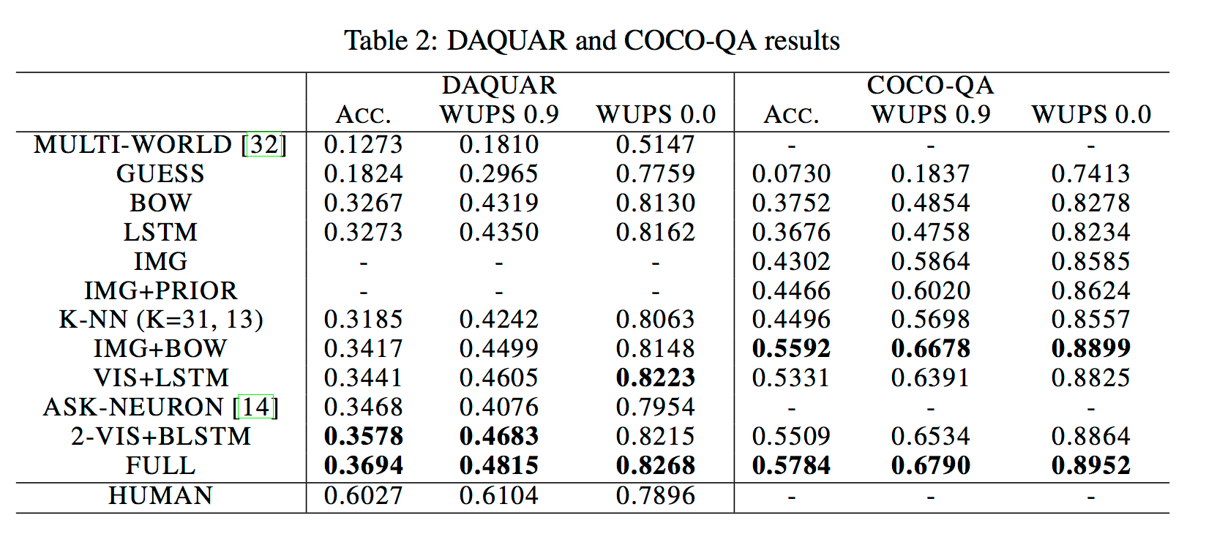
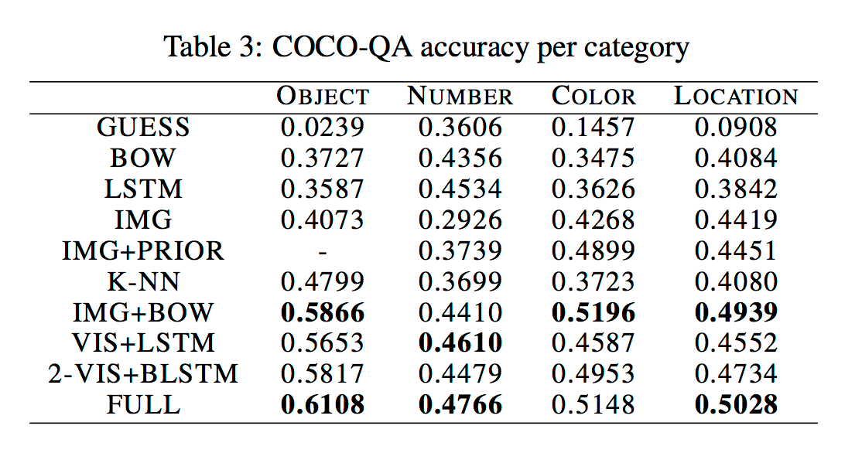
experimental results
comparisons

Slide 13
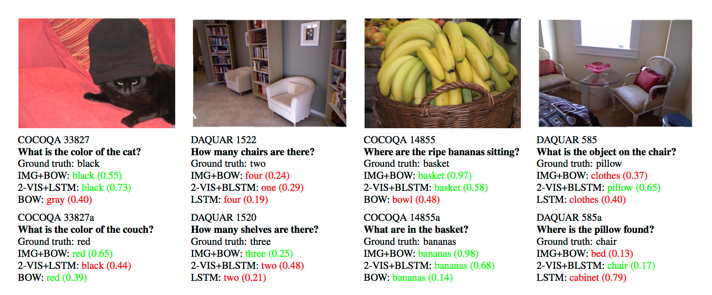
limitations
Limitations
The answers only have one word.
Types of questions.
Accuracy.

Slide 14
Questions
Weiqiang Jin

