Slide 1
Final Day

Slide 2
Outline for Today
Recurrent Neural Networks Lab Recap
Course Recap
Ethics and Scholarship in AI / Vision

Slide 3




Recurrent Neural Network Cell
$$h_{0}$$
$$RNN$$
$$h_{1}$$
$$x_{1}$$

Slide 4
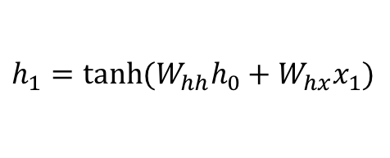
Recurrent Neural Network Cell
$$h_{1}=tanh⁡(W_{hh}h_{0}+W_{hx}x_{1})$$
$$h_{0}$$
$$RNN$$
$$h_{1}$$
$$x_{1}$$

Slide 5

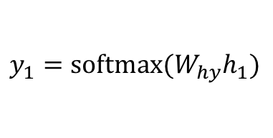
Recurrent Neural Network Cell
$$y_{1}$$
$$h_{1}$$
$$h_{0}$$
$$RNN$$
$$h_{1}$$
$$h_{1}=tanh⁡(W_{hh}h_{0}+W_{hx}x_{1})$$
$$x_{1}$$
$$y_{1}=softmax⁡(W_{hy}h_{1})$$

Slide 6
Recurrent Neural Network Cell
$$y_{1}$$
$$h_{1}$$
$$h_{0}$$
$$RNN$$
$$h_{1}$$
$$x_{1}$$

Slide 7
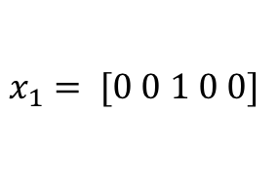
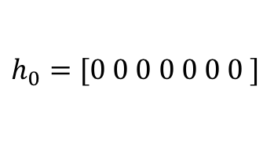

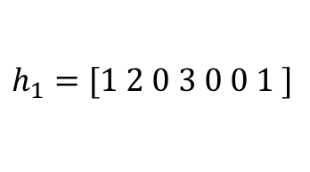
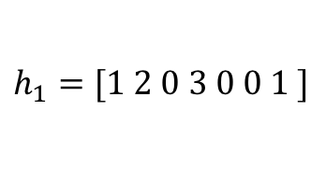
Recurrent Neural Network Cell
$$y_{1}=[0.1, 0.05, 0.05, 0.1, 0.7]$$
e (0.7)
$$h_{1}=[1 2 0 3 0 0 1 ]$$
$$h_{0}=[0 0 0 0 0 0 0 ]$$
$$RNN$$
$$h_{1}=[1 2 0 3 0 0 1 ]$$
$$x_{1}= [0 0 1 0 0]$$
c
a b c d e

Slide 8
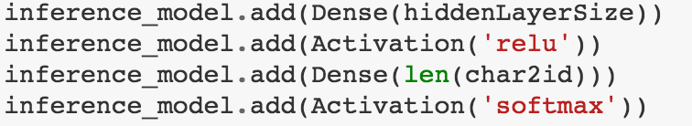
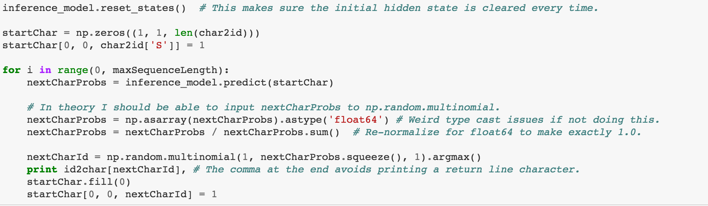
Generating Samples from the Recurrent Neural Network Cell

Slide 9



LSTM Cell (Long Short-Term Memory)
$$h_{0}$$
$$h_{1}$$
$$LSTM$$
$$c_{0}$$
$$c_{1}$$
$$x_{1}$$

Slide 10
How do we train the network?
We don’t do it character by character.

Slide 11
Recurrent Neural Network Cell
$$y_{1}$$
$$h_{1}$$
$$h_{0}$$
$$RNN$$
$$h_{1}$$
$$x_{1}$$

Slide 12
Recurrent Neural Network Cell
$$h_{1}$$
$$h_{0}$$
$$RNN$$
$$h_{1}$$
$$x_{1}$$

Slide 13










(Unrolled) Recurrent Neural Network
a
t
<<space>>
$$y_{1}$$
$$y_{1}$$
$$y_{1}$$
$$h_{1}$$
$$h_{2}$$
$$h_{3}$$
$$h_{0}$$
$$RNN$$
$$h_{1}$$
$$h_{2}$$
$$h_{3}$$
$$RNN$$
$$RNN$$
$$x_{1}$$
$$x_{2}$$
$$x_{3}$$
c
a
t

Slide 14
(Unrolled) Recurrent Neural Network
cat
likes
eating
$$y_{1}$$
$$y_{1}$$
$$y_{1}$$
$$h_{1}$$
$$h_{2}$$
$$h_{3}$$
$$h_{0}$$
$$RNN$$
$$h_{1}$$
$$h_{2}$$
$$h_{3}$$
$$RNN$$
$$RNN$$
$$x_{1}$$
$$x_{1}$$
$$x_{1}$$
the
cat
likes

Slide 15
(Unrolled) Recurrent Neural Network
positive / negative sentiment rating
$$y_{1}$$
$$h_{3}$$
$$h_{0}$$
$$RNN$$
$$h_{1}$$
$$h_{2}$$
$$h_{3}$$
$$RNN$$
$$RNN$$
$$x_{1}$$
$$x_{1}$$
$$x_{1}$$
the
cat
likes

Slide 16












(Unrolled) Recurrent Neural Network
a
t
<<space>>
$$y_{1}$$
$$y_{1}$$
$$y_{1}$$
$$h_{1}$$
$$h_{2}$$
$$h_{3}$$
$$h_{0}$$
$$RNN$$
$$h_{1}$$
$$RNN$$
$$h_{2}$$
$$RNN$$
$$h_{3}$$
$$x_{1}$$
$$x_{1}$$
$$x_{1}$$
c
a
t

Slide 17
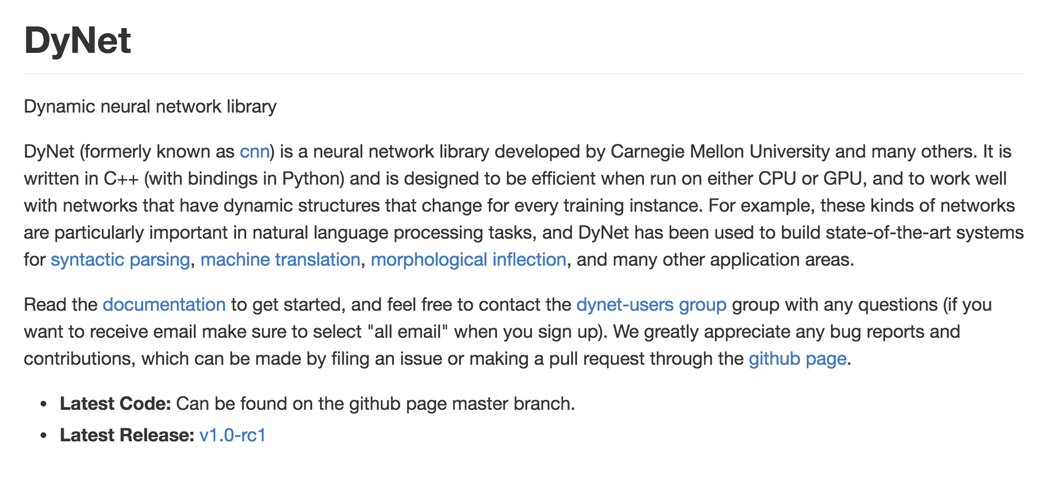

Slide 18












Bidirectional Recurrent Neural Network
gato
quiere
comer
$$y_{1}$$
$$y_{1}$$
$$y_{1}$$
$$h_{1}$$
$$h_{2}$$
$$h_{3}$$
$$h_{0}$$
$$BRNN$$
$$h_{1}$$
$$BRNN$$
$$h_{2}$$
$$BRNN$$
$$h_{3}$$
$$x_{1}$$
$$x_{1}$$
$$x_{1}$$
the
cat
wants

Slide 19







Stacked Recurrent Neural Network
$$y_{1}$$
$$y_{1}$$
$$y_{1}$$
$$h_{1}$$
$$h_{2}$$
$$h_{3}$$
$$h_{0}$$
$$RNN$$
$$h_{1}$$
$$RNN$$
$$h_{2}$$
$$RNN$$
$$h_{3}$$
$$h_{1}$$
$$h_{2}$$
$$h_{3}$$
$$h_{0}$$
$$RNN$$
$$h_{1}$$
$$RNN$$
$$h_{2}$$
$$RNN$$
$$h_{3}$$
$$x_{1}$$
$$x_{1}$$
$$x_{1}$$
c
a
t

Slide 20
Bidirectional Stacked Recurrent Neural Network
$$y_{1}$$
$$y_{1}$$
$$y_{1}$$
$$h_{1}$$
$$h_{2}$$
$$h_{3}$$
$$h_{0}$$
$$RNN$$
$$h_{1}$$
$$RNN$$
$$h_{2}$$
$$RNN$$
$$h_{3}$$
$$h_{1}$$
$$h_{2}$$
$$h_{3}$$
$$h_{0}$$
$$RNN$$
$$h_{1}$$
$$RNN$$
$$h_{2}$$
$$RNN$$
$$h_{3}$$
$$x_{1}$$
$$x_{1}$$
$$x_{1}$$
c
a
t

Slide 21
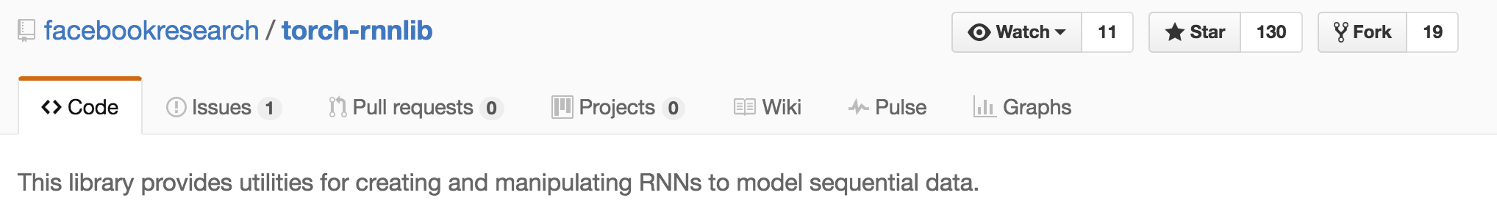
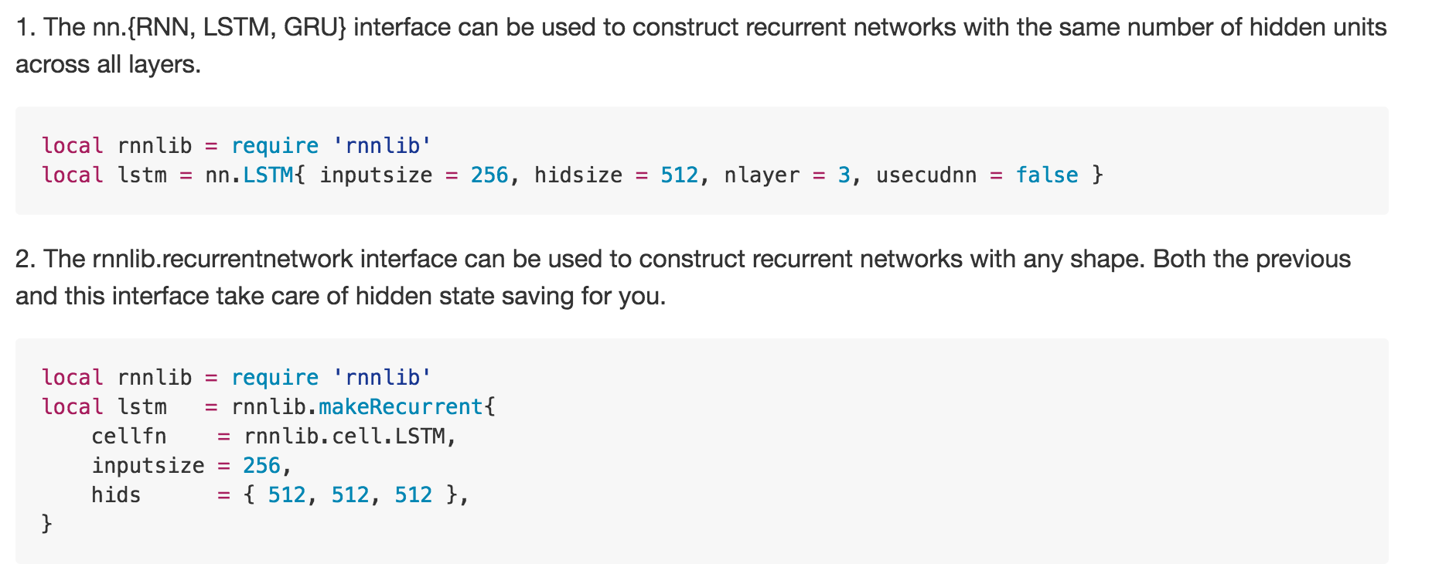

Slide 22
Course Recap (1)
Convolutions / Filtering Images / Blur / Edges / etc
Color Spaces HSV / Saturation Enhancement
Linear Classifier (Softmax)
Softmax Loss / Gradient Computation
Training / Validation / Test
Stochastic Gradient Descent

Slide 23
Course Recap (2)
Convolutional Neural Networks / Backpropagation
AlexNet, VGG, GoogLenet
CIFAR-10 Dataset (Obtained 80% Accuracy, and some of you 90%)
Use a pretrained Convnet to obtain Features.
Repurpose a pretrained Convnet for another task.

Slide 24
Course Recap (3)
Object Detection (RCNN, FastRCNN, YOLO)
Image Segmentation (Fully Convolutional Networks)
Object Proposals (Box Proposals, Segment Proposals)
Generative Adversarial Networks (GAN) / Deep Dream
Siamese Networks (For Comparing Images / Patches)
Visual Recognition for Videos
Place / Scene / Location Recognition

Slide 25
Course Recap (4)
Inception Network / Residual Network
How to make networks faster? XNORNet, EIE.
Principles of Categorization / Intuitions from Psychology
Recurrent Neural Networks (Image Captioning, Text Generation)
And finally, you hopefully are proficient now with either Torch (Facebook fans) or
Keras/Tensorflow (Google fans).

Slide 26
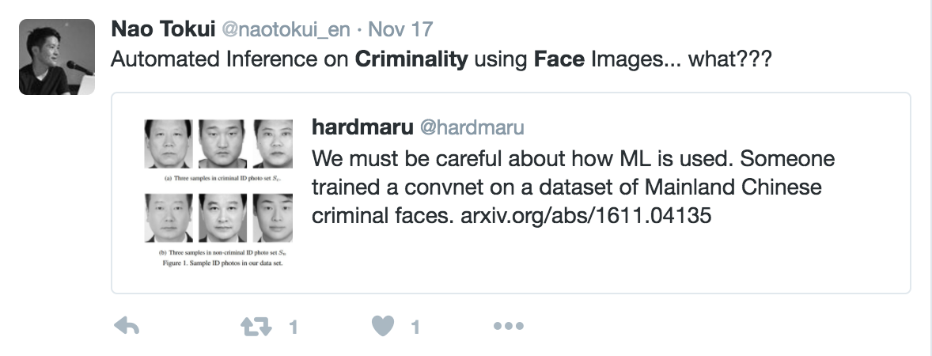
Scholarship and Ethics (What not to do)
[In class discussion]

Slide 27
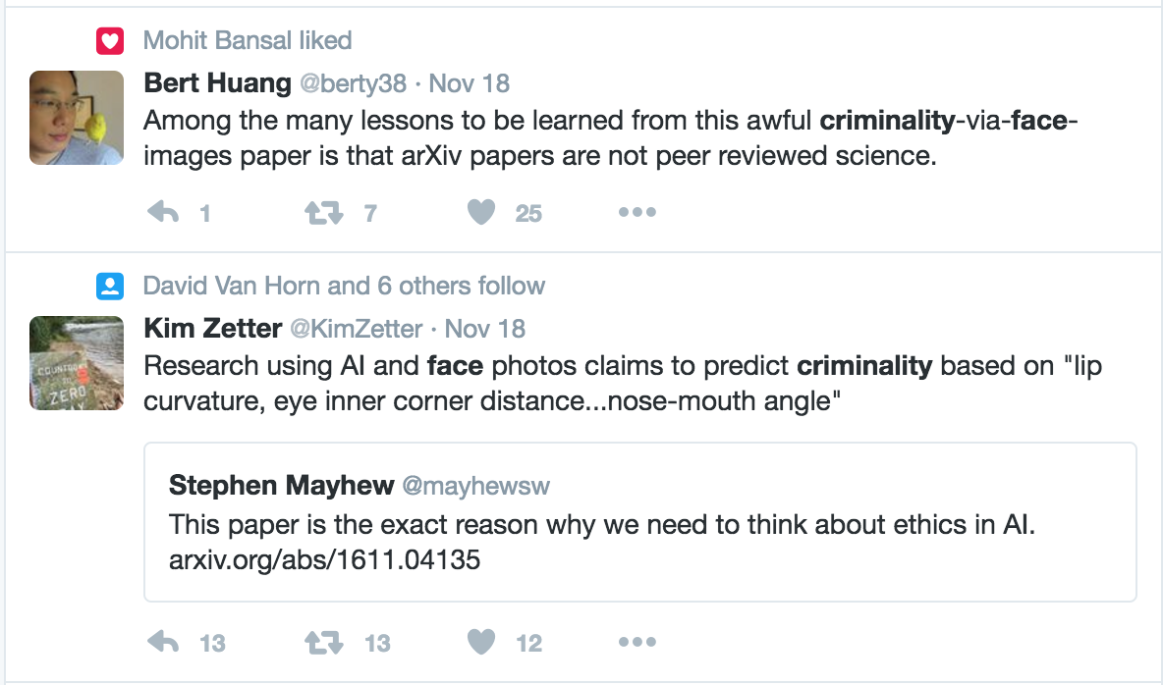
Scholarship and Ethics (What not to do)
[In class discussion]

Slide 28
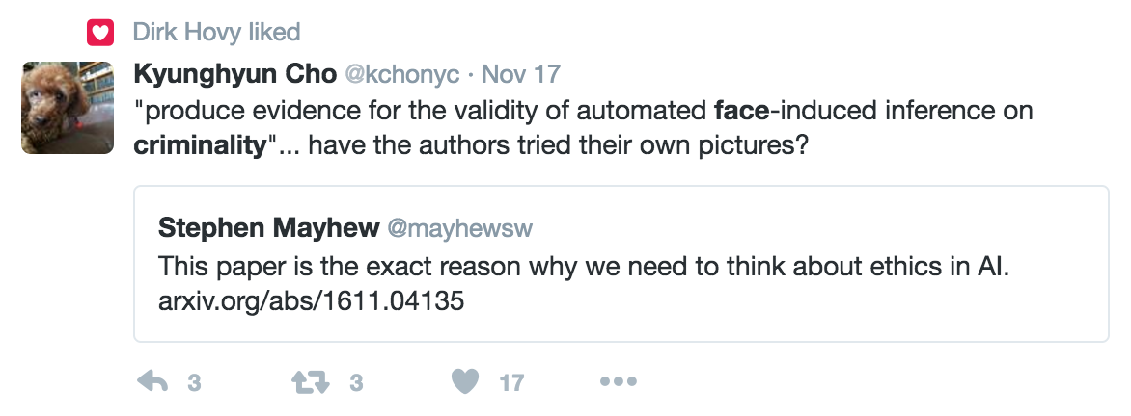
Scholarship and Ethics (What not to do)
[In class discussion]

Slide 29
Reminder about your Projects
Presentations are 10 minutes total.
* Project report is due on December 5th for everyone.
* Use inspirations from the papers we have read during class to elaborate your final report.
* Make sure you include an introduction motivating your problem (probably similar to what you already wrote in your proposal and progress report)
* Make sure you also include a clear description of your method, including figures of the model if necessary, a clear description of your algorithm and parameter choices, and discussion of your choices in the method.
* Make sure you include figures, and plots, and tables and numbers of your experiments.
* IMPORTANT: Make sure you include actual outputs of your method. For instance actual input images and outputs/predictions of your algorithm, including cases where it worked well, and cases where it might have failed. Include discussions of why it might have failed and what you could have done to improve those cases, etc. Trust your judgment for this part but again. take inspiration on the papers we have read this semester.
Best luck to all!

Slide 30
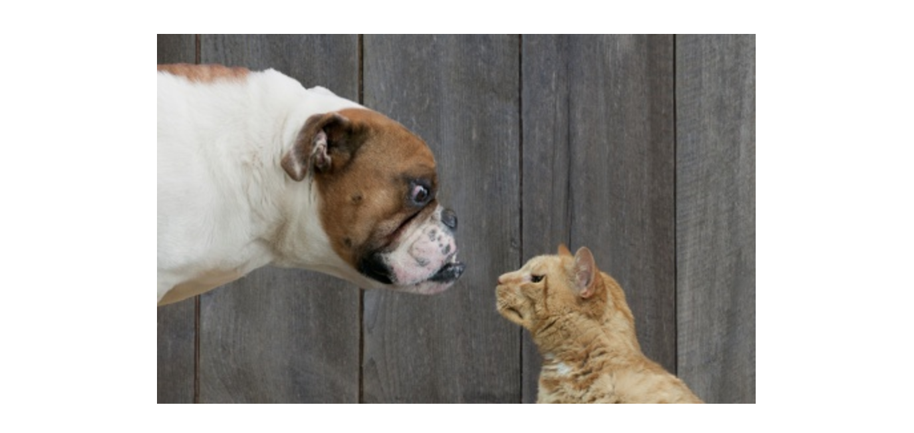
Hope you enjoyed the Class. Thanks!

