Slide 1
Machine Learning I & II

Slide 2
About the Course
CS6501: Computational Visual Recognition
Instructor: Vicente Ordonez
Email: vicente@virginia.edu
Office Hour: 310 Rice Hall, Tuesday 3pm to 4pm.
Only for Today: 5 to 6pm
Website: http://www.cs.virginia.edu/~vicente/recognition
Class Location: Olsson Hall, 005
Class Times: Tuesday-Thursday 11:00am – 12:15pm
Piazza: http://piazza.com/virginia/fall2017/cs6501009/home

Slide 3
Teaching Assistants
Tianlu Wang
PhD Student
Office Hours: Wednesdays 5 to 6pm.
Location: Rice 430, desk 12
Siva Sitaraman
MSc Student
Office Hours: Fridays 3 to 4pm.
Location: Rice 304
Piazza: http://piazza.com/virginia/fall2017/cs6501009/home

Slide 4
Grading
Labs: 30% (4 labs [5%, 5%, 10%, 10%])
Paper presentation + Paper summaries: 10%
Quiz: 20%
Final project: 40%
  No Late Assignments / Honor Code Reminder

Slide 5
Objectives for Today
Machine Learning Overview
Supervised vs Unsupervised Learning
Machine Learning as an Optimization Problem
Softmax Classifier
Stochastic Gradient Descent (SGD)

Slide 6
Machine Learning
Machine learning is the subfield of computer science that gives "computers the ability to learn without being explicitly programmed.”
- term coined by Arthur Samuel 1959 while at IBM
The study of algorithms that can learn from data.
In contrast to previous Artificial Intelligence systems based on Logic, e.g. ”Expert Systems”

Slide 7
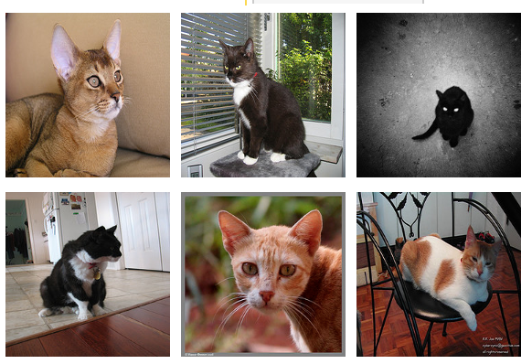
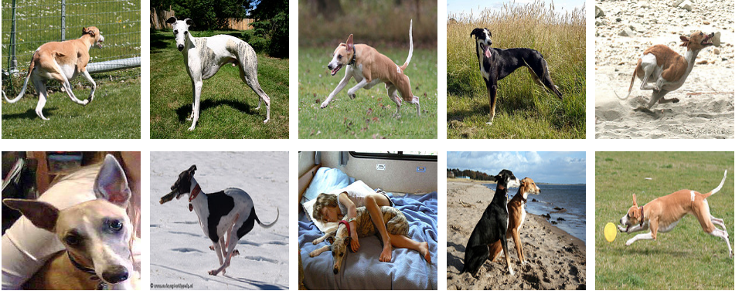
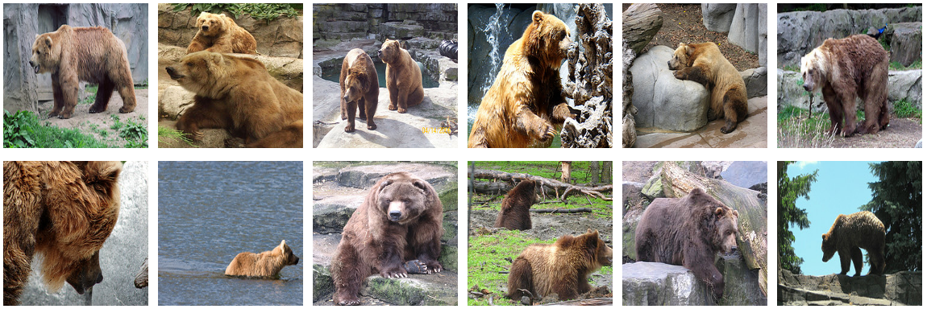
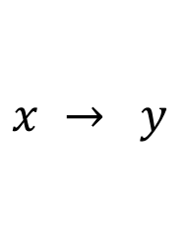

Supervised Learning vs Unsupervised Learning
$$x → y$$
$$x$$
cat
dog
bear
dog
bear
dog
cat
cat
bear

Slide 8
Supervised Learning vs Unsupervised Learning
$$x → y$$
$$x$$
cat
dog
bear
dog
bear
dog
cat
cat
bear

Slide 9
Supervised Learning vs Unsupervised Learning
$$x → y$$
$$x$$
cat
dog
bear
Classification
dog
Clustering
bear
dog
cat
cat
bear

Slide 10
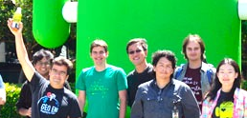
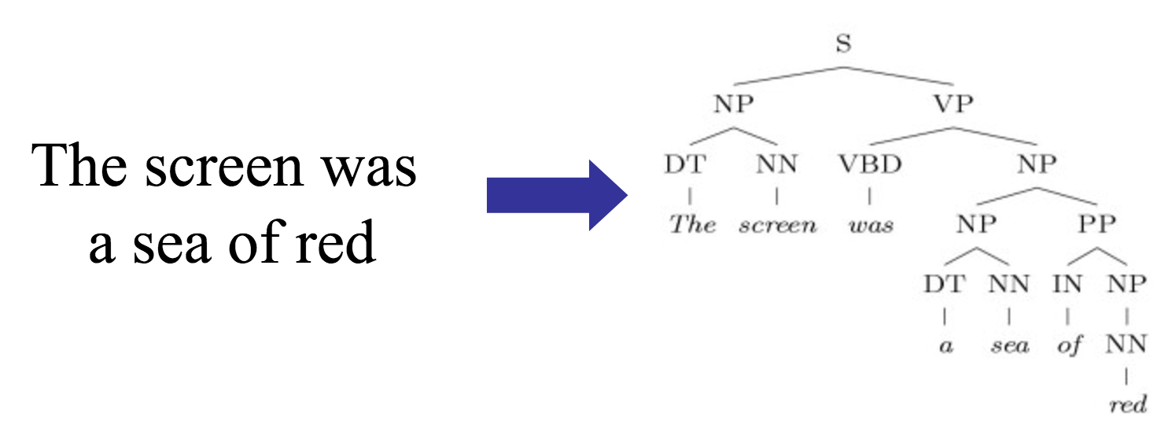
Supervised Learning Examples
Classification
cat
Face Detection
Language Parsing
Structured Prediction

Slide 11
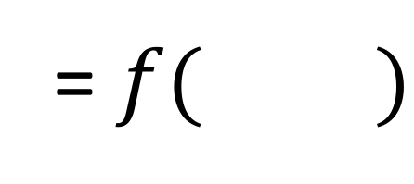
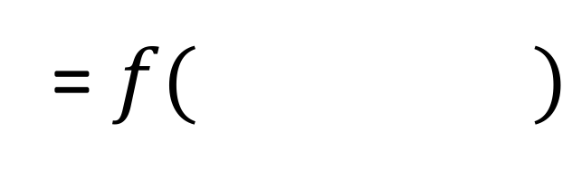
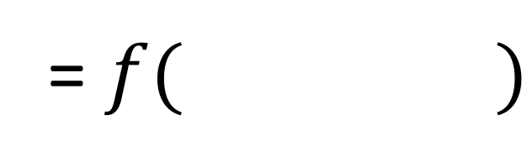
Supervised Learning Examples
= $f( )$
cat
= $f( )$
= $f( )$

Slide 12
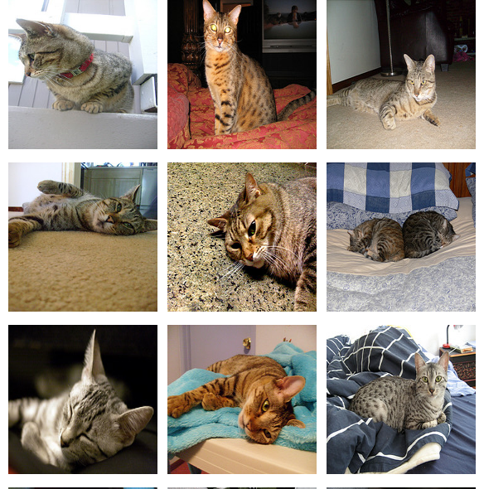
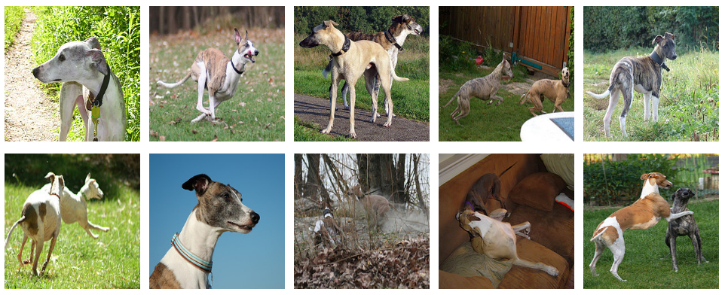
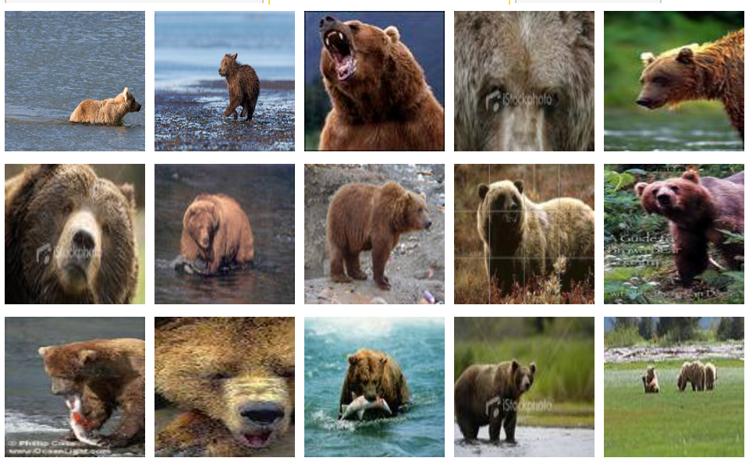
Supervised Learning – k-Nearest Neighbors
cat
dog
bear
k=3
cat, cat, dog
cat
cat
dog
bear
dog
bear

Slide 13
Supervised Learning – k-Nearest Neighbors
cat
dog
bear
k=3
cat
cat
bear, dog, dog
dog
bear
dog
bear

Slide 14
Supervised Learning – k-Nearest Neighbors
How do we choose the right K?
How do we choose the right features?
How do we choose the right distance metric?

Slide 15
Supervised Learning – k-Nearest Neighbors
How do we choose the right K?
How do we choose the right features?
How do we choose the right distance metric?
Answer: Just choose the one combination that works best!
BUT not on the test data.
Instead split the training data into a ”Training set” and
a ”Validation set” (also called ”Development set”)

Slide 16
Unsupervised Learning – k-means clustering
k = 3
1. Initially assign all images to a
random cluster

Slide 17
Unsupervised Learning – k-means clustering
k = 3
2. Compute the
mean image (in
feature space) for
each cluster

Slide 18
Unsupervised Learning – k-means clustering
k = 3
3. Reassign images
to clusters
based on similarity to
cluster means

Slide 19
Unsupervised Learning – k-means clustering
k = 3
4. Keep repeating
this process
until convergence

Slide 20
Unsupervised Learning – k-Means clustering
How do we choose the right K?
How do we choose the right features?
How do we choose the right distance metric?
How sensitive is this method with respect to the random assignment of clusters?
Answer: Just choose the one combination that works best!
BUT not on the test data.
Instead split the training data into a ”Training set” and
a ”Validation set” (also called ”Development set”)

Slide 21
Supervised Learning - Classification
Training Data
Test Data
dog
bear
cat
cat
dog
bear
cat
dog
bear

Slide 22
Supervised Learning - Classification
Training Data
Test Data
cat
dog
cat
.
.
.
.
.
.
bear

Slide 23
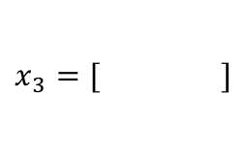
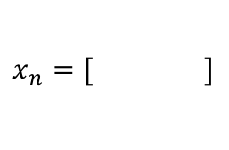
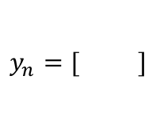
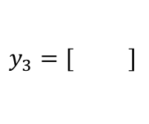
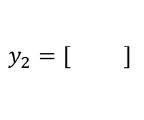
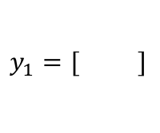
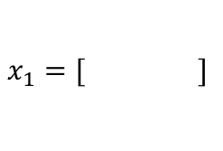
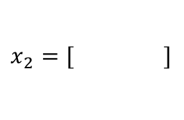
Supervised Learning - Classification
Training Data
cat
$$x_{1}=[ ]$$
$$y_{1}=[ ]$$
dog
$$x_{2}=[ ]$$
$$y_{2}=[ ]$$
cat
$$x_{3}=[ ]$$
$$y_{3}=[ ]$$
.
.
.
bear
$$x_{n}=[ ]$$
$$y_{n}=[ ]$$

Slide 24
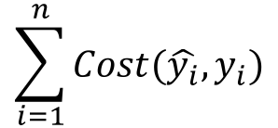








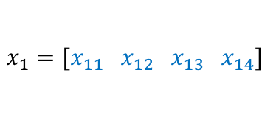
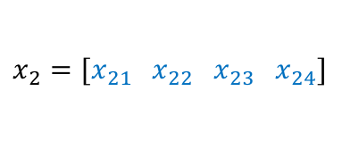
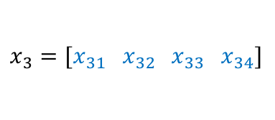
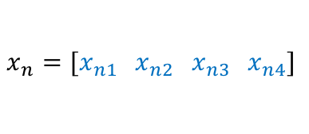

Supervised Learning - Classification
Training Data
targets /
labels /
ground truth
We need to find a function that
maps x and y for any of them.
inputs
predictions
$$x_{1}=[x_{11} { x}_{12} x_{13} { x}_{14}]$$
$$y_{1}=$$
1
$${\hat{y}}_{1}=$$
1
$$\hat{y_{i}}=f(x_{i};θ)$$
$$x_{2}=[x_{21} { x}_{22} x_{23} { x}_{24}]$$
$$y_{2}=$$
2
$${\hat{y}}_{2}=$$
2
$$x_{3}=[x_{31} { x}_{32} x_{33} { x}_{34}]$$
$$y_{3}=$$
1
$${\hat{y}}_{3}=$$
2
How do we ”learn” the parameters
of this function?
.
.
.
We choose ones that makes the
following quantity small:
$$\sum_{i=1}^{n}{Cost(\hat{y_{i}}, y_{i})}$$
$$x_{n}=[x_{n1} { x}_{n2} x_{n3} { x}_{n4}]$$
$$y_{n}=$$
3
$${\hat{y}}_{n}=$$
1

Slide 25
Supervised Learning – Linear Softmax
Training Data
targets /
labels /
ground truth
inputs
$$x_{1}=[x_{11} { x}_{12} x_{13} { x}_{14}]$$
$$y_{1}=$$
1
$$x_{2}=[x_{21} { x}_{22} x_{23} { x}_{24}]$$
$$y_{2}=$$
2
$$x_{3}=[x_{31} { x}_{32} x_{33} { x}_{34}]$$
$$y_{3}=$$
1
.
.
.
$$x_{n}=[x_{n1} { x}_{n2} x_{n3} { x}_{n4}]$$
$$y_{n}=$$
3

Slide 26




Supervised Learning – Linear Softmax
Training Data
targets /
labels /
ground truth
inputs
predictions
$$x_{1}=[x_{11} { x}_{12} x_{13} { x}_{14}]$$
$$y_{1}=$$
[1 0 0]
$${\hat{y}}_{1}=$$
[0.85 0.10 0.05]
$$x_{2}=[x_{21} { x}_{22} x_{23} { x}_{24}]$$
$$y_{2}=$$
[0 1 0]
$${\hat{y}}_{2}=$$
[0.20 0.70 0.10]
$$x_{3}=[x_{31} { x}_{32} x_{33} { x}_{34}]$$
$$y_{3}=$$
[1 0 0]
$${\hat{y}}_{3}=$$
[0.40 0.45 0.05]
.
.
.
$$x_{n}=[x_{n1} { x}_{n2} x_{n3} { x}_{n4}]$$
$$y_{n}=$$
[0 0 1]
$${\hat{y}}_{n}=$$
[0.40 0.25 0.35]

Slide 27
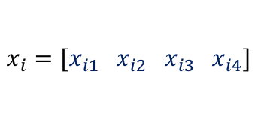
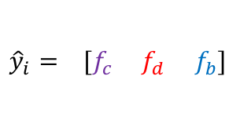




Supervised Learning – Linear Softmax
$$x_{i}=[x_{i1} { x}_{i2} x_{i3} { x}_{i4}]$$
$$y_{i}=$$
[1 0 0]
$${\hat{y}}_{i}= [f_{c} f_{d} f_{b}]$$
$$g_{c}=w_{c1}x_{i1}+w_{c2}x_{i2}+w_{c3}x_{i3}+w_{c4}x_{i4}+b_{c}$$
$$g_{d}=w_{d1}x_{i1}+w_{d2}x_{i2}+w_{d3}x_{i3}+w_{d4}x_{i4}+b_{d}$$
$$g_{b}=w_{b1}x_{i1}+w_{b2}x_{i2}+w_{b3}x_{i3}+w_{b4}x_{i4}+b_{b}$$
$$f_{c}=e^{g_{c}}/{(e}^{g_{c}}+e^{g_{d}}+e^{g_{b}})$$
$$f_{d}=e^{g_{d}}/{(e}^{g_{c}}+e^{g_{d}}+e^{g_{b}})$$
$$f_{b}=e^{g_{b}}/{(e}^{g_{c}}+e^{g_{d}}+e^{g_{b}})$$

Slide 28
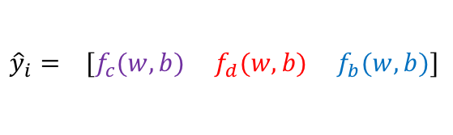
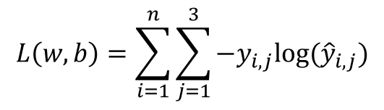
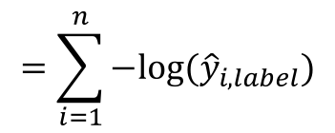
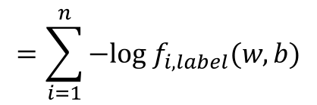
How do we find a good w and b?
$$x_{i}=[x_{i1} { x}_{i2} x_{i3} { x}_{i4}]$$
$$y_{i}=$$
[1 0 0]
$${\hat{y}}_{i}= [f_{c}(w,b) f_{d}(w,b) f_{b}(w,b)]$$
We need to find w, and b that minimize the following:
$$L\left(w,b\right)=\sum_{i=1}^{n}{\sum_{j=1}^{3}{−y_{i,j}log⁡({\hat{y}}_{i,j})}}$$
$$=\sum_{i=1}^{n}{−log⁡({\hat{y}}_{i,label})}$$
$$=\sum_{i=1}^{n}{−log f_{i,label}(w,b)}$$
Why?

Slide 29



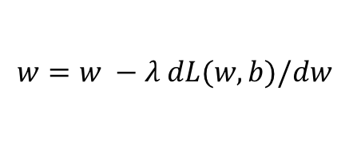
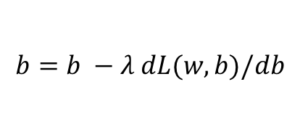

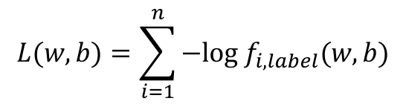
Gradient Descent (GD)
expensive
$$λ=0.01$$
$$L(w,b)=\sum_{i=1}^{n}{−log f_{i,label}(w,b)}$$
Initialize w and b randomly
for e = 0, num_epochs do
Compute:
$$dL(w,b)/dw$$
and
$$dL(w,b)/db$$
Update w:
$$w=w −λ dL(w,b)/dw$$
Update b:
$$b=b −λ dL(w,b)/db$$
Print:
$$L(w,b)$$
// Useful to see if this is becoming smaller or not.
end

Slide 30


Gradient Descent (GD) (idea)
1. Start with a random value
of w (e.g. w = 12)
$$L\left(w\right)$$
2. Compute the gradient
(derivative) of L(w) at point
w = 12. (e.g. dL/dw = 6)
3. Recompute w as:
w = w – lambda * (dL / dw)
w=12
$$w$$

Slide 31
Gradient Descent (GD) (idea)
$$L\left(w\right)$$
2. Compute the gradient
(derivative) of L(w) at point
w = 12. (e.g. dL/dw = 6)
3. Recompute w as:
w = w – lambda * (dL / dw)
w=10
$$w$$

Slide 32


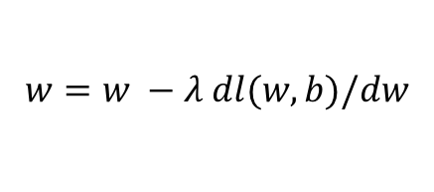
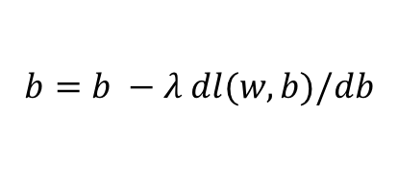

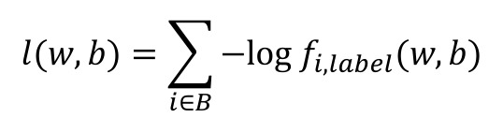
(mini-batch) Stochastic Gradient Descent (SGD)
$$λ=0.01$$
$$l(w,b)=\sum_{i∈B}{−log f_{i,label}(w,b)}$$
Initialize w and b randomly
for e = 0, num_epochs do
for b = 0, num_batches do
Compute:
$$dl(w,b)/dw$$
and
$$dl(w,b)/db$$
Update w:
$$w=w −λ dl(w,b)/dw$$
Update b:
$$b=b −λ dl(w,b)/db$$
Print:
$$l(w,b)$$
// Useful to see if this is becoming smaller or not.
end
end

Slide 33
Source: Andrew Ng

Slide 34
Three more things
What is the form of the gradient
Regularization
Momentum updates

Slide 35
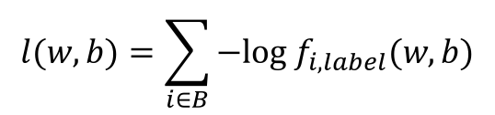
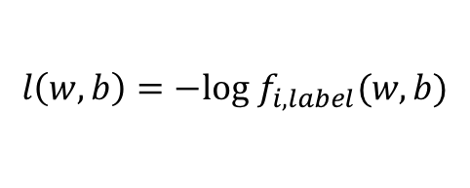
What is the form of the gradient?
$$l(w,b)=\sum_{i∈B}{−log f_{i,label}(w,b)}$$
Let’s assume |B| = 1, then we are interested in the following:
$$l\left(w,b\right)=−log f_{i,label}(w,b)$$

Slide 36
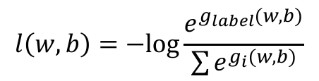
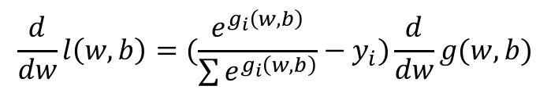
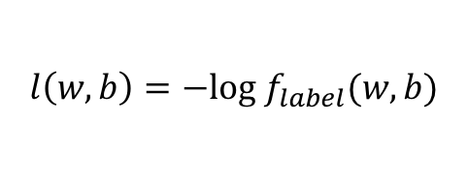
What is the form of the gradient?
$$l\left(w,b\right)=−log f_{label}(w,b)$$
$$l\left(w,b\right)=−log\frac{e^{g_{label}(w,b)}}{\sum{e^{g_{i}(w,b)}}}$$
$$\frac{d}{dw}l\left(w,b\right)=(\frac{e^{g_{i}\left(w,b\right)}}{\sum{e^{g_{i}\left(w,b\right)}}}−y_{i})\frac{d}{dw}g(w, b)$$

Slide 37


Regularization
$$l(w,b)=\sum_{i∈B}{l\left(w,b\right)}$$
$$+ \frac{1}{2}{\left\|w\right\|}^{2}$$

Slide 38
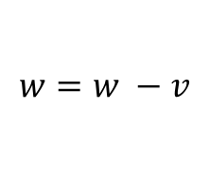
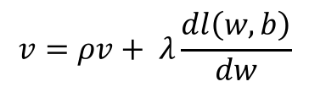
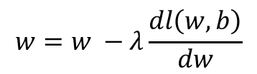
Momentum updates
$$w=w −λ\frac{dl\left(w,b\right)}{dw}$$
instead of this
$$v=ρv+ λ\frac{dl\left(w,b\right)}{dw}$$
we use this with
rho typically 0.8-0.9
$$w=w −v$$
See also: https://github.com/karpathy/neuraltalk2/blob/master/misc/optim_updates.lua
38

