Slide 1
Deep CNNs for Detection
and Segmentation

Slide 2
About the Course
CS6501: Computational Visual Recognition
Instructor: Vicente Ordonez
Email: vicente@virginia.edu
Office Hour: 310 Rice Hall, Tuesday 3pm to 4pm.
Website: http://www.cs.virginia.edu/~vicente/recognition
Class Location: Olsson Hall, 005
Class Times: Tuesday-Thursday 11:00am – 12:15pm
Piazza: http://piazza.com/virginia/fall2017/cs6501009/home

Slide 3
Teaching Assistants
Tianlu Wang
PhD Student
Office Hours: Wednesdays 5 to 6pm.
Location: Rice 430, desk 12
Siva Sitaraman
MSc Student
Office Hours: Fridays 3 to 4pm.
Location: Rice 204
Piazza: http://piazza.com/virginia/fall2017/cs6501009/home

Slide 4
Outline for Today
CNNs for Object Detection
CNNs for Segmentation
De-convolutional Layers!

Slide 5
Object Detection
deer
cat

Slide 6
Object Detection as Classification
deer?
CNN
cat?
background?

Slide 7
Object Detection as Classification
deer?
CNN
cat?
background?

Slide 8
Object Detection as Classification
deer?
CNN
cat?
background?

Slide 9
Object Detection as Classification with Sliding Window
deer?
CNN
cat?
background?

Slide 10
Object Detection as Classification with Box Proposals

Slide 11
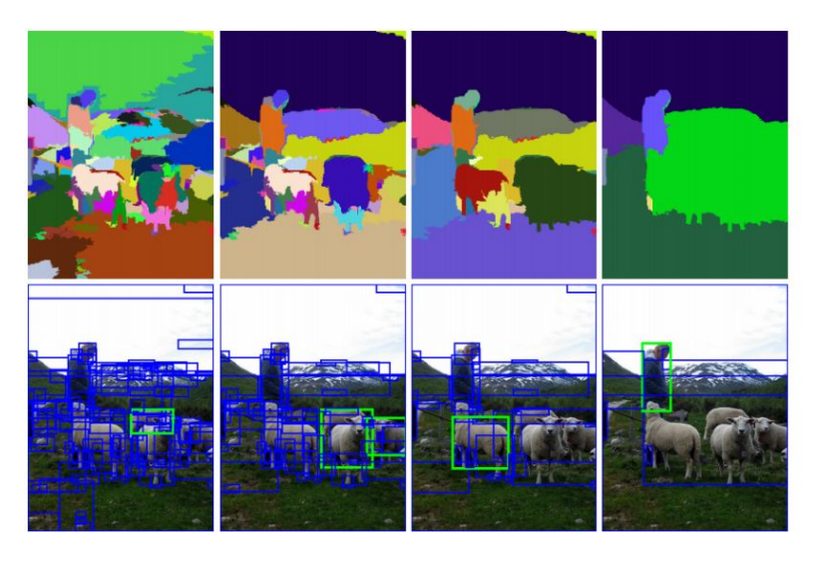
Box Proposal Method – SS: Selective Search
Segmentation As Selective Search for Object Recognition. van de Sande et al. ICCV 2011

Slide 12
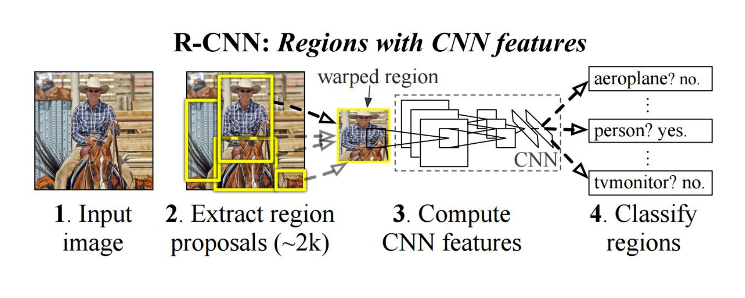
RCNN
https://people.eecs.berkeley.edu/~rbg/papers/r-cnn-cvpr.pdf
Rich feature hierarchies for accurate object detection and semantic segmentation. Girshick et al. CVPR 2014.

Slide 13
Fast-RCNN
Idea: No need to recompute features for every box independently,
Regress refined bounding box coordinates.
https://arxiv.org/abs/1504.08083
Fast R-CNN. Girshick. ICCV 2015.
https://github.com/sunshineatnoon/Paper-Collection/blob/master/Fast-RCNN.md

Slide 14
Faster-RCNN
Idea: Integrate the Bounding Box Proposals as part of the CNN predictions
https://arxiv.org/abs/1506.01497
Ren et al. NIPS 2015.

Slide 15
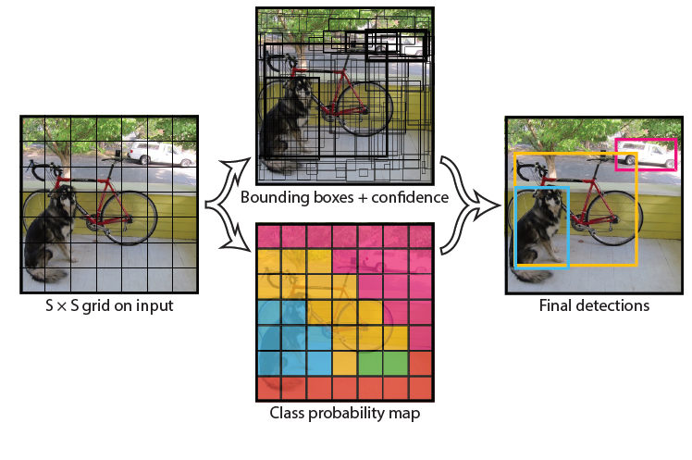
YOLO- You Only Look Once
Idea: No bounding
box proposals.
Predict a class and a
box for every location
in a grid.
https://arxiv.org/abs/1506.02640
Redmon et al. CVPR 2016.

Slide 16
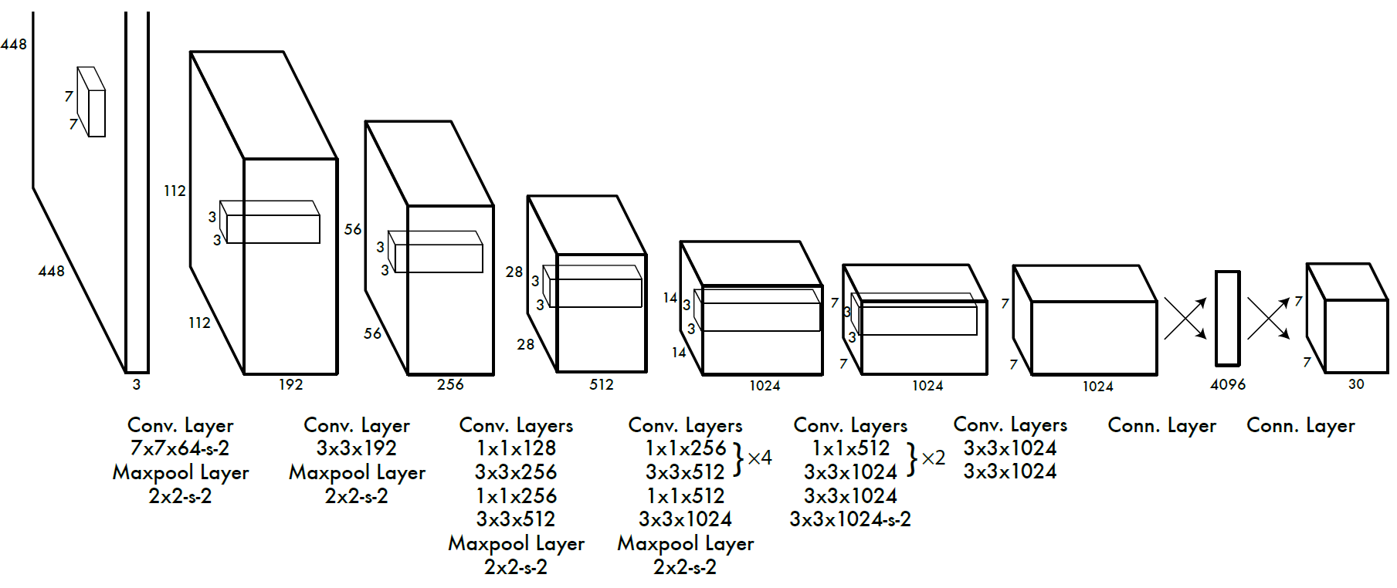
YOLO- You Only Look Once
Divide the image into 7x7 cells.
Each cell trains a detector.
The detector needs to predict the object’s class distributions.
The detector has 2 bounding-box predictors to predict
bounding-boxes and confidence scores.
https://arxiv.org/abs/1506.02640
Redmon et al. CVPR 2016.

Slide 17
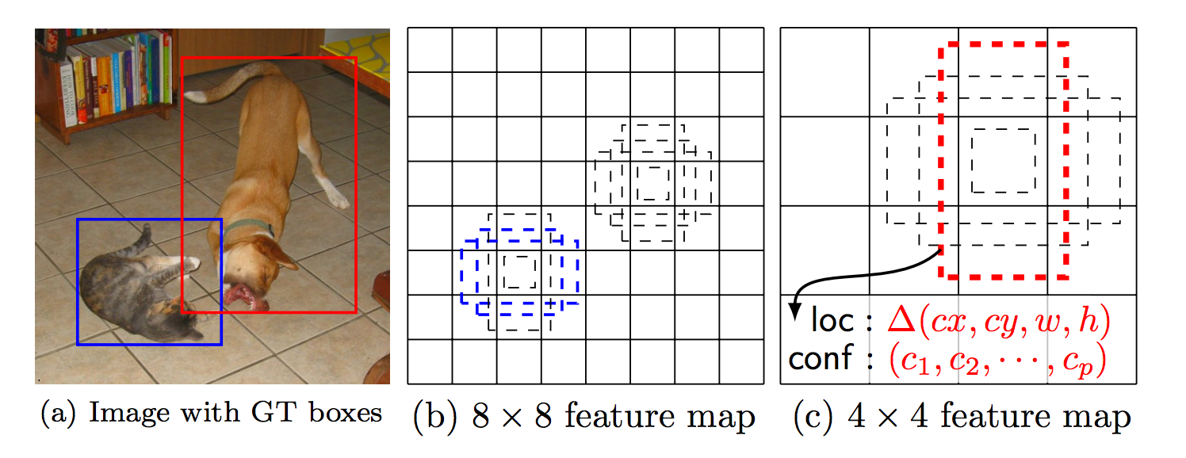
SSD: Single Shot Detector
Idea: Similar to YOLO, but denser grid map, multiscale grid maps. + Data augmentation + Hard negative mining + Other design choices in the network.
Liu et al. ECCV 2016.

Slide 18
Semantic Segmentation / Image Parsing
deer
cat
trees
grass

Slide 19
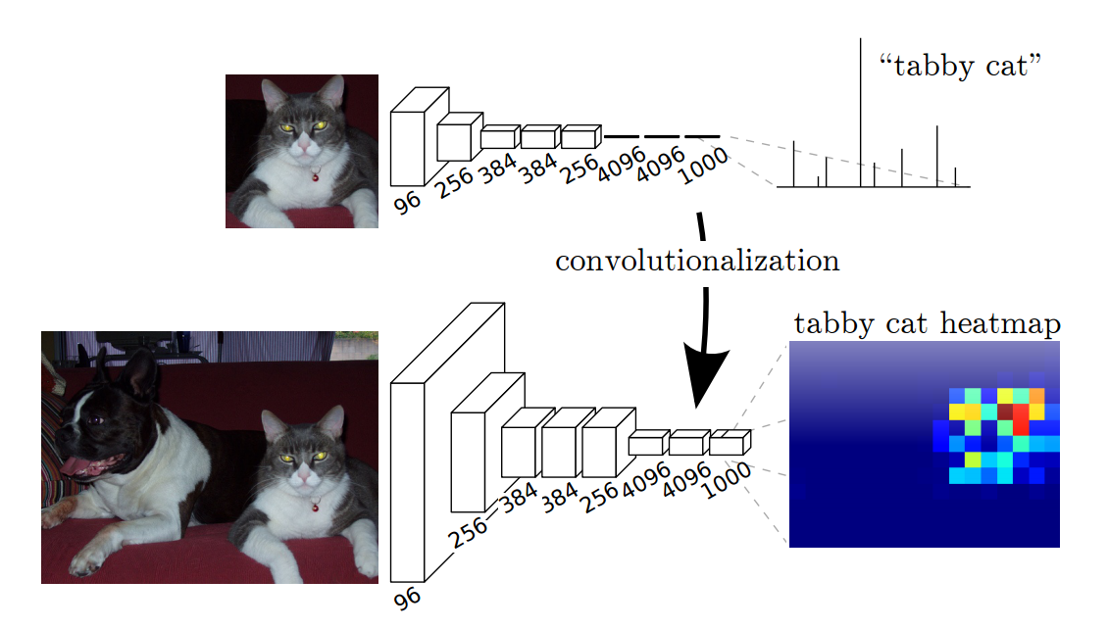
Idea 1: Convolutionalization
However resolution of the segmentation map is low.
https://people.eecs.berkeley.edu/~jonlong/long_shelhamer_fcn.pdf

Slide 20

Idea 1: Convolutionalization
$$≡$$

Slide 21
Idea 2: Up-sampling Convolutions or ”Deconvolutions”
http://cvlab.postech.ac.kr/research/deconvnet/

Slide 22
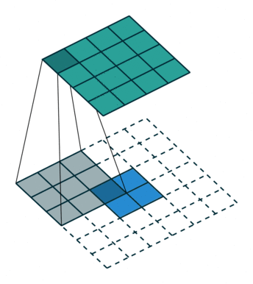
Idea 2: Up-sampling Convolutions or ”Deconvolutions”
https://github.com/vdumoulin/conv_arithmetic

Slide 23
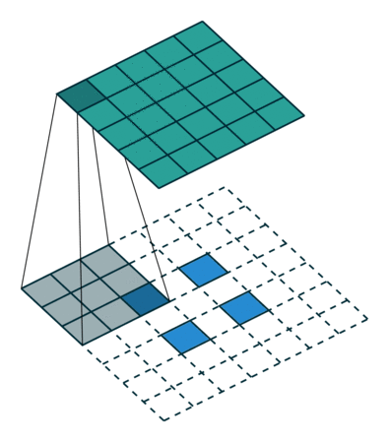
Idea 2: Up-sampling Convolutions or ”Deconvolutions”
https://github.com/vdumoulin/conv_arithmetic

Slide 24
Idea 2: Up-sampling Convolutions or ”Deconvolutions”
Deconvolutional Layers
Upconvolutional Layers
Backwards Strided Convolutional Layers
Fractionally Strided Convolutional Layers
Transposed Convolutional Layers
Spatial Full Convolutional Layers

