Slide 1
Recurrent Neural Networks

Slide 2
Today
Recurrent Neural Network Cell
Recurrent Neural Networks (unenrolled)
RNN, Bidirectional-RNN, Stacked Bidirectional-RNNs
LSTM, Bidirectional-LSTM, Stacked Bidirectional-LSTMs

Slide 3




Recurrent Neural Network Cell
$$h_{0}$$
$$RNN$$
$$h_{1}$$
$$x_{1}$$

Slide 4
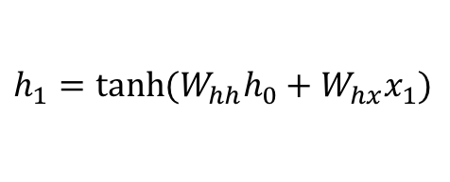
Recurrent Neural Network Cell
$$h_{1}=tanh⁡(W_{hh}h_{0}+W_{hx}x_{1})$$
$$h_{0}$$
$$RNN$$
$$h_{1}$$
$$x_{1}$$

Slide 5

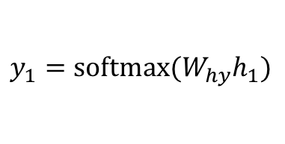
Recurrent Neural Network Cell
$$y_{1}$$
$$h_{1}$$
$$h_{0}$$
$$RNN$$
$$h_{1}$$
$$h_{1}=tanh⁡(W_{hh}h_{0}+W_{hx}x_{1})$$
$$x_{1}$$
$$y_{1}=softmax⁡(W_{hy}h_{1})$$

Slide 6
Recurrent Neural Network Cell
$$y_{1}$$
$$h_{1}$$
$$h_{0}$$
$$RNN$$
$$h_{1}$$
$$x_{1}$$

Slide 7
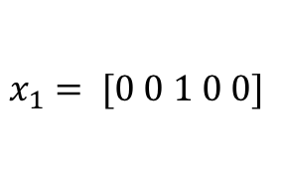
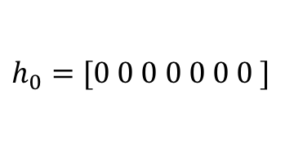

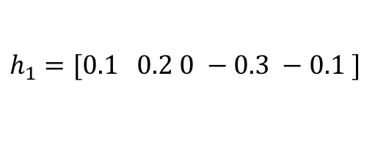
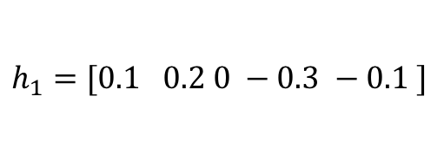
Recurrent Neural Network Cell
$$y_{1}=[0.1, 0.05, 0.05, 0.1, 0.7]$$
e (0.7)
$$h_{1}=[0.1 0.2 0 −0.3 −0.1 ]$$
$$h_{0}=[0 0 0 0 0 0 0 ]$$
$$RNN$$
$$h_{1}=[0.1 0.2 0 −0.3 −0.1 ]$$
$$x_{1}= [0 0 1 0 0]$$
c
a b c d e

Slide 8
Recurrent Neural Network Cell
$$y_{1}$$
$$h_{1}$$
$$h_{0}$$
$$RNN$$
$$h_{1}$$
$$x_{1}$$

Slide 9
Recurrent Neural Network Cell
$$h_{1}$$
$$h_{0}$$
$$RNN$$
$$h_{1}$$
$$x_{1}$$

Slide 10











(Unrolled) Recurrent Neural Network
a
t
<<space>>
$$y_{1}$$
$$y_{2}$$
$$y_{3}$$
$$h_{1}$$
$$h_{2}$$
$$h_{3}$$
$$h_{0}$$
$$RNN$$
$$h_{1}$$
$$h_{2}$$
$$h_{3}$$
$$RNN$$
$$RNN$$
$$x_{1}$$
$$x_{2}$$
$$x_{3}$$
c
a
t

Slide 11
(Unrolled) Recurrent Neural Network
cat
likes
eating
$$y_{1}$$
$$y_{2}$$
$$y_{3}$$
$$h_{1}$$
$$h_{2}$$
$$h_{3}$$
$$h_{0}$$
$$RNN$$
$$h_{1}$$
$$h_{2}$$
$$h_{3}$$
$$RNN$$
$$RNN$$
$$x_{1}$$
$$x_{2}$$
$$x_{3}$$
the
cat
likes

Slide 12


(Unrolled) Recurrent Neural Network
positive / negative sentiment rating
$$y_{}$$
$$h_{3}$$
$$h_{0}$$
$$RNN$$
$$h_{1}$$
$$h_{2}$$
$$h_{3}$$
$$RNN$$
$$RNN$$
$$x_{1}$$
$$x_{2}$$
$$x_{3}$$
the
cat
likes

Slide 13














Bidirectional Recurrent Neural Network
gato
quiere
comer
$$y_{1}$$
$$y_{2}$$
$$y_{3}$$
$$h_{1}$$
$$h_{2}$$
$$h_{3}$$
$$h_{0}$$
$$BRNN$$
$$h_{1}$$
$$BRNN$$
$$h_{2}$$
$$BRNN$$
$$h_{3}$$
$$x_{1}$$
$$x_{2}$$
$$x_{3}$$
the
cat
wants

Slide 14






















Stacked Recurrent Neural Network
$$y_{1}$$
$$y_{2}$$
$$y_{3}$$
$$h_{1}$$
$$h_{2}$$
$$h_{3}$$
$$h_{0}$$
$$RNN$$
$$h_{1}$$
$$RNN$$
$$h_{2}$$
$$RNN$$
$$h_{3}$$
$${\check{h}}_{1}$$
$${\check{h}}_{2}$$
$${\check{h}}_{3}$$
$${\check{h}}_{0}$$
$$RNN$$
$${\check{h}}_{1}$$
$$RNN$$
$${\check{h}}_{2}$$
$$RNN$$
$${\check{h}}_{3}$$
$$x_{1}$$
$$x_{2}$$
$$x_{3}$$
c
a
t

Slide 15
Stacked Bidirectional Recurrent Neural Network
$$y_{1}$$
$$y_{2}$$
$$y_{3}$$
$$h_{1}$$
$$h_{2}$$
$$h_{3}$$
$$h_{0}$$
$$RNN$$
$$h_{1}$$
$$RNN$$
$$h_{2}$$
$$RNN$$
$$h_{3}$$
$${\check{h}}_{1}$$
$${\check{h}}_{2}$$
$${\check{h}}_{3}$$
$${\check{h}}_{0}$$
$$RNN$$
$${\check{h}}_{1}$$
$$RNN$$
$${\check{h}}_{2}$$
$$RNN$$
$${\check{h}}_{3}$$
$$x_{1}$$
$$x_{2}$$
$$x_{3}$$
c
a
t

Slide 16
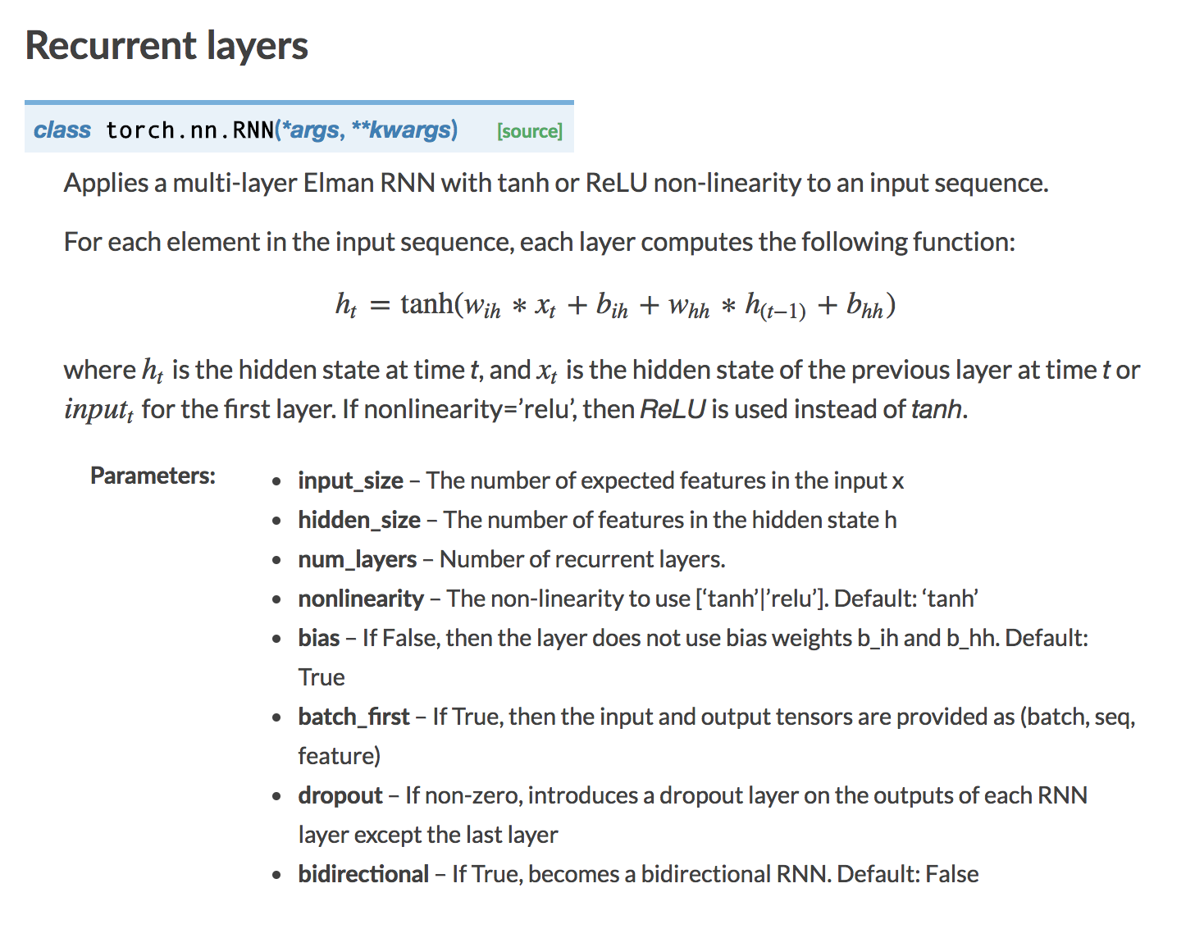
RNN in Pytorch

Slide 17



LSTM Cell (Long Short-Term Memory)
$$h_{0}$$
$$h_{1}$$
$$LSTM$$
$$c_{0}$$
$$c_{1}$$
$$x_{1}$$

Slide 18
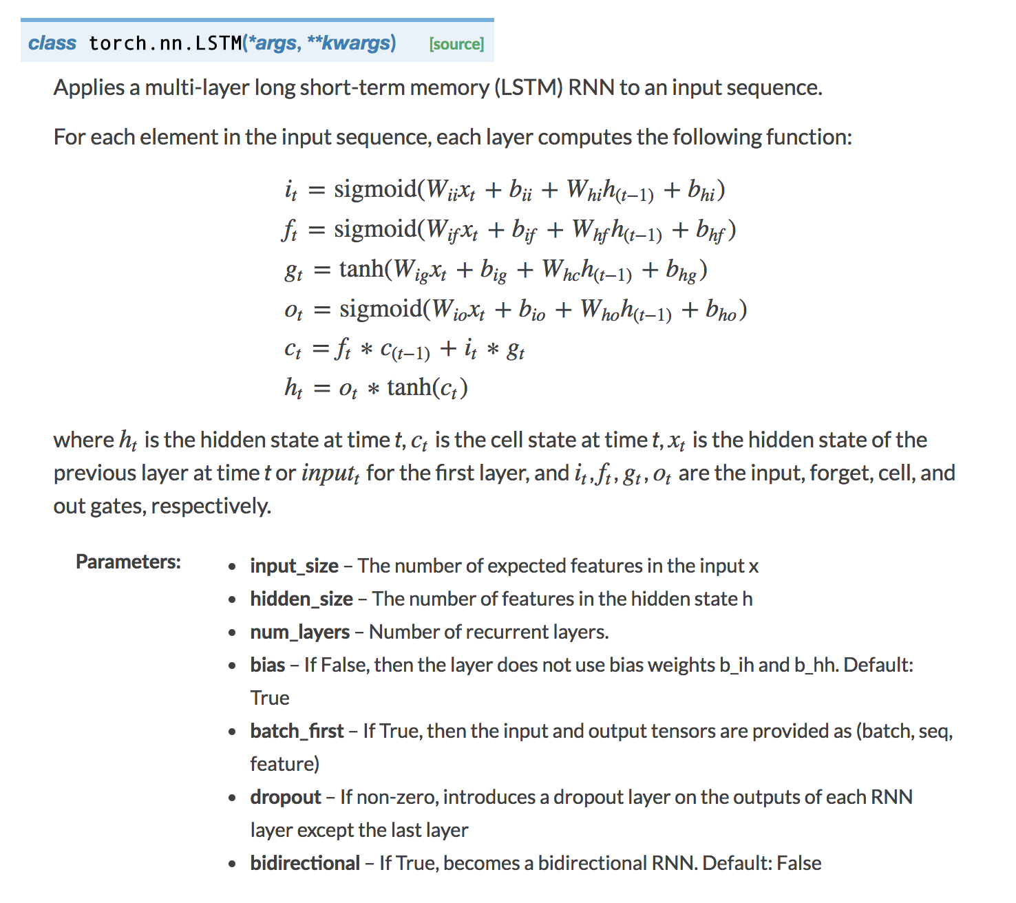
LSTM in Pytorch

Slide 19
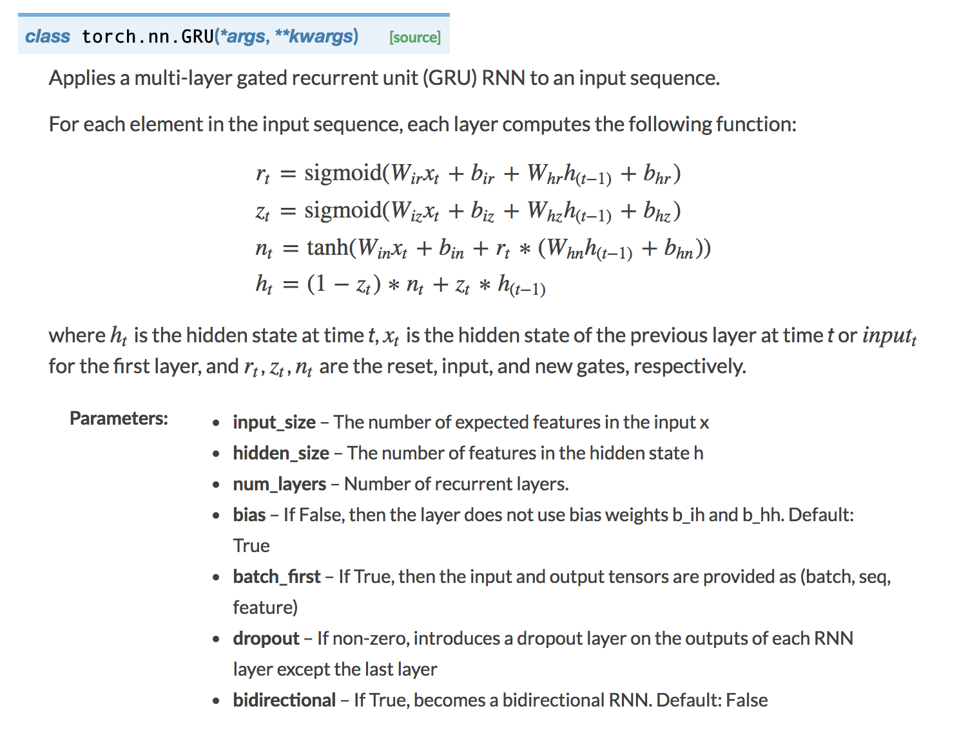
GRU in Pytorch

Slide 20
Questions?

