Slide 1
Convolutional Networks

Slide 2
Today
Convolutional Operator Recap
Convolutional Layers
Alexnet, VGG, GoogLenet, ResNet

Slide 3
Convolution operator
$$k(x, y)$$
$$g\left(x, y\right)=\sum_{v}{\sum_{u}{k\left(u,v\right)f(x −u, y−v) }}$$
Image Credit: http://what-when-how.com/introduction-to-video-and-image-processing/neighborhood-processing-introduction-to-video-and-image-processing-part-1/

Slide 4
(filter, kernel)
http://www.cs.virginia.edu/~vicente/recognition/animation.gif

Slide 5
Convolutional Layer

Slide 6
Convolutional Layer
Weights

Slide 7
Convolutional Layer
Weights
4

Slide 8
Convolutional Layer
Weights
4
1

Slide 9
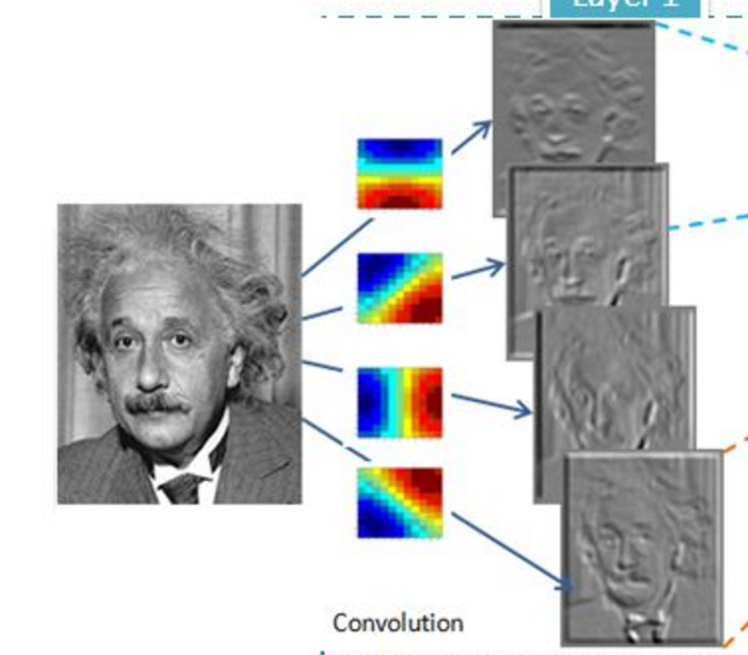
Convolutional Layer (with 4 filters)
weights: 4x1x9x9
Input: 1x224x224
Output: 4x224x224
if zero padding,
and stride = 1

Slide 10
Convolutional Layer (with 4 filters)
weights: 4x1x9x9
Input: 1x224x224
Output: 4x112x112
if zero padding,
but stride = 2

Slide 11
Convolutional Layer in Torch
kW
Input
nOutputPlane x
Output
kH
nInputPlane
nOutputPlane (equals the number of convolutional filters for this layer)
nInputPlane (e.g. 3 for RGB inputs)

Slide 12
Convolutional Layer in Keras
Convolution2D(nOutputPlane, kW, kH, input_shape = (3, 224, 224), subsample = 2, border_mode = valid)
kW
Input
nOutputPlane x
Output
kH
nInputPlane
nOutputPlane (equals the number of convolutional filters for this layer)
nInputPlane (e.g. 3 for RGB inputs)

Slide 13
Convolutional Layers as Matrix Multiplication
https://petewarden.com/2015/04/20/why-gemm-is-at-the-heart-of-deep-learning/

Slide 14
Convolutional Layers as Matrix Multiplication
https://petewarden.com/2015/04/20/why-gemm-is-at-the-heart-of-deep-learning/

Slide 15
Convolutional Layers as Matrix Multiplication
Pros?
Cons?
https://petewarden.com/2015/04/20/why-gemm-is-at-the-heart-of-deep-learning/

Slide 16
Convolutional Network: LeNet

Slide 17
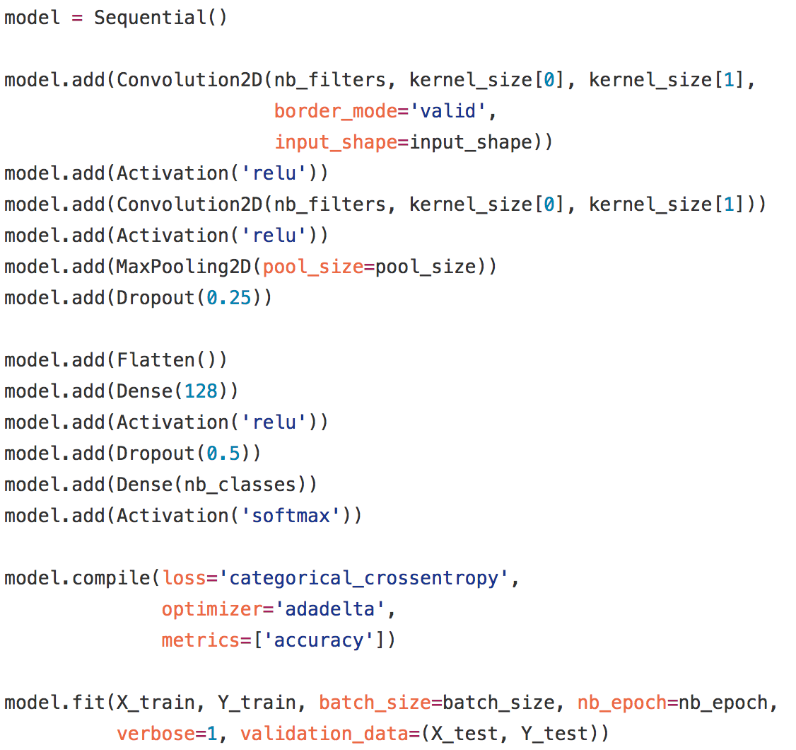
LeNet in Keras

Slide 18
SpatialMaxPooling Layer
take the max in this neighborhood
8
8
8
8
8

Slide 19
Alexnet

Slide 20
The Problem: Classification
Classify an image into 1000 possible classes: e.g. Abyssinian cat, Bulldog, French Terrier, Cormorant, Chickadee,
red fox, banjo, barbell, hourglass, knot, maze, viaduct, etc.
cat, tabby cat (0.71) Egyptian cat (0.22)
red fox (0.11)
…..

Slide 21
The Data: ILSVRC
Imagenet Large Scale Visual Recognition Challenge (ILSVRC): Annual Competition
1000 Categories
~1000 training images per Category
~1 million images in total for training
~50k images for validation
Only images released for the test set but no annotations, evaluation is performed centrally by the organizers (max 2 per week)

Slide 22
The Evaluation Metric: Top K-error
Top-1 error: 1.0
Top-1 accuracy: 0.0
Top-2 error: 1.0
Top-2 accuracy: 0.0
True label: Abyssinian cat
Top-3 error: 1.0
Top-3 accuracy: 0.0
Top-4 error: 0.0
Top-4 accuracy: 1.0
Top-5 error: 0.0
Top-5 accuracy: 1.0
cat, tabby cat (0.61) Egyptian cat (0.22)
red fox (0.11)
Abyssinian cat (0.10)
French terrier (0.03)
…..

Slide 23
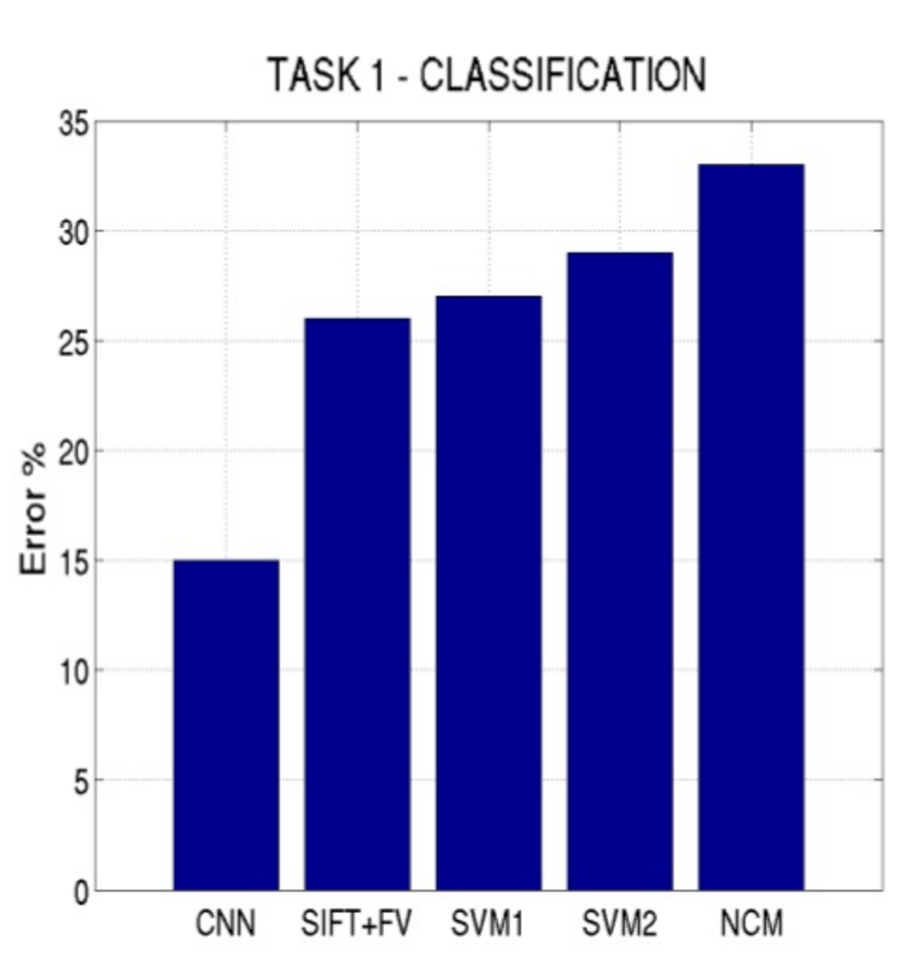
Top-5 error on this competition (2012)

Slide 24
Alexnet
https://www.saagie.com/fr/blog/object-detection-part1

Slide 25
What is happening?
https://www.saagie.com/fr/blog/object-detection-part1

Slide 26
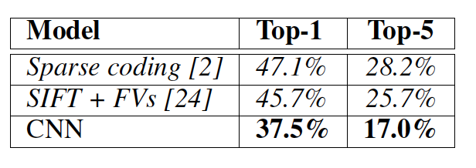
Other Important Aspects
Using ReLUs instead of Sigmoid or Tanh
Momentum + Weight Decay
Dropout (Randomly sets Unit outputs to zero during training)
GPU Computation!

Slide 27
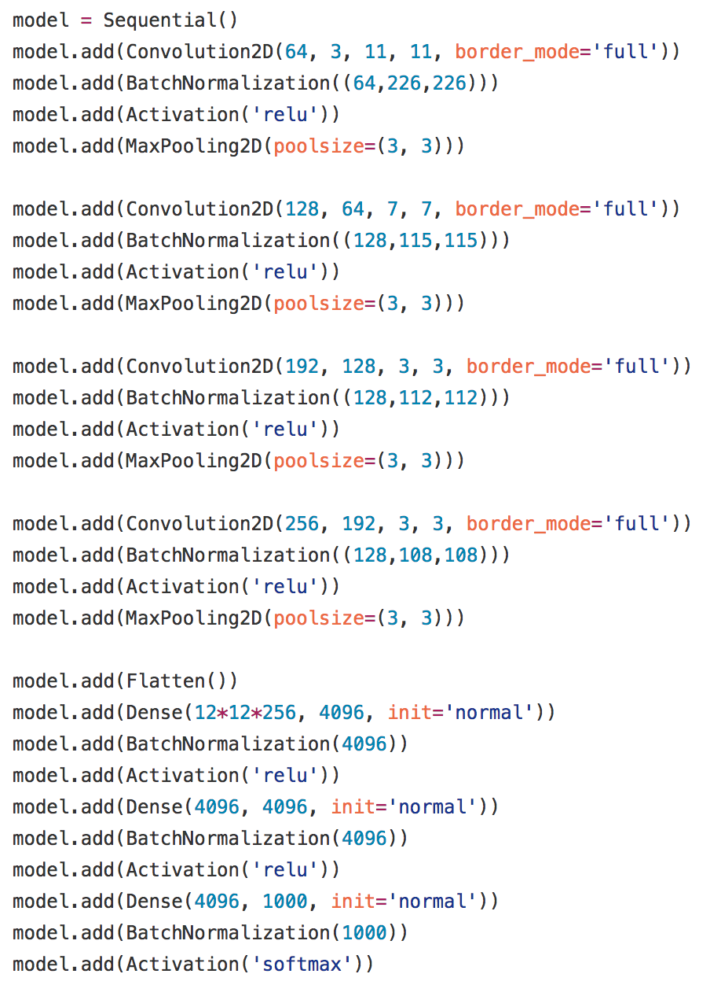
Alexnet in Keras

Slide 28
BatchNormalization Layer

Slide 29
VGG Network
Top-5:
Keras: https://gist.github.com/baraldilorenzo/07d7802847aaad0a35d3
Simonyan and Zisserman, 2014.

Slide 30
GoogLeNet
Keras: https://gist.github.com/joelouismarino/a2ede9ab3928f999575423b9887abd14
Szegedy et al. 2014

Slide 31
ResNet
Sorry, does not fit in slide.
http://felixlaumon.github.io/assets/kaggle-right-whale/resnet.png
Keras: https://github.com/raghakot/keras-resnet/blob/master/resnet.py

Slide 32
Slide by Mohammad Rastegari

Slide 33
Questions?

